Slide 1

The past, present and future of the Proteomics Research Group: DIA, beer and glycoproteomics
  ABRF Proteomics Research Group
  https://www.abrf.org/proteomics-prg-
Identification of certain commercial equipment, instruments, software or materials does not imply recommendation or endorsement by the National Institute of Standards and Technology, nor does it imply that the products identified are necessarily the best available for the purpose.

Slide 2
The Proteomics Research Group
Through the promotion of broad participation and scientific excellence, the PRG aims to raise awareness, knowledge and education about modern methods of protein analysis.
Current members:
Joanna Kirkpatrick (Co-Chair) The Francis Crick Institute
Benjamin Neely (Co-chair) National Institute of Standards and Technology
Laura Herring University of North Carolina at Chapel Hill
LeRoy Martin III Waters Corporation
Mukul Midha Institute for Systems Biology
Brett Phinney University of California Davis
Baozhen (Paul) Shan Bioinformatics Solutions, Inc.
Paul Stemmer Wayne State University
Yan Wang NIH/NIDCR
Hua Ding The Children’s Hospital of Philadelphia
Vikas Kumar University of Nebraska Medical Center
Daniel A. Polasky University of Michigan Medical School
Ben Schulz The University of Queensland
Magnus Palmblad (EB-liaison) Leiden University Medical Center
Notes:
Pratik has moved on, and we have four new members, the last two are very new.

Slide 3
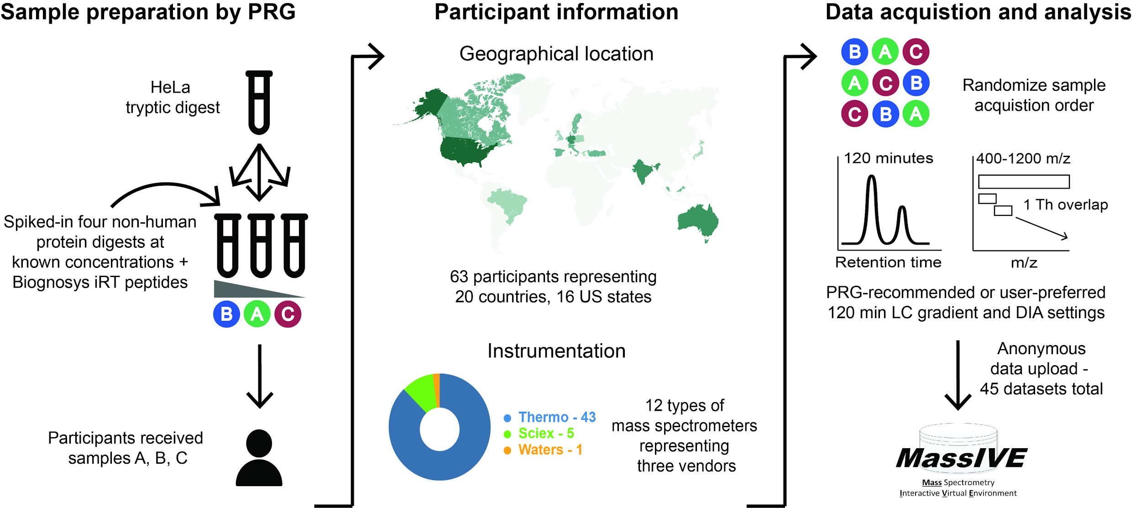
2019 DIA Study - data available
45 labs
936 files
1.72 TB

Slide 4
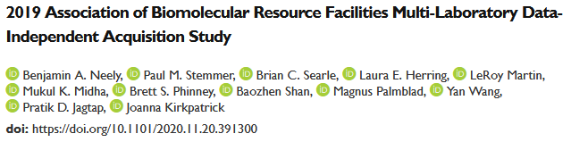
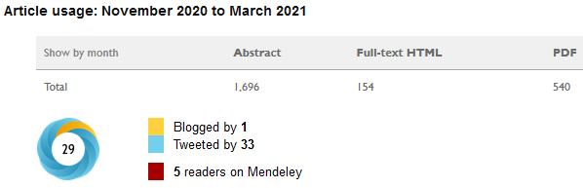

2019 DIA Study - preprint available, and in submission
Submission and review
Ongoing promotion to developers and users

Slide 5
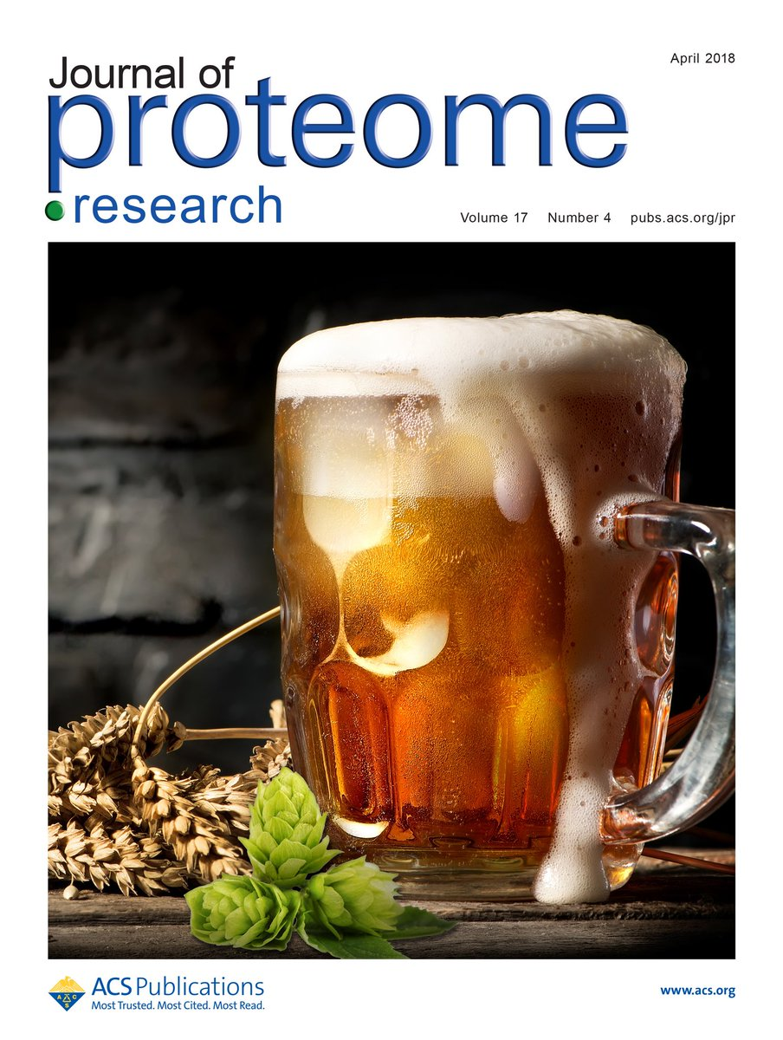
2020 “Bridge” Study: Processing and analyzing a mixed, fermented yeast-plant proteome… The Beer Study.
Evaluate consistency of experimentally acquired proteome profiles
Compare beer proteomes
Provide data for the community and to other ABRF research groups
Engage with others in the community over a beer or three

Slide 6
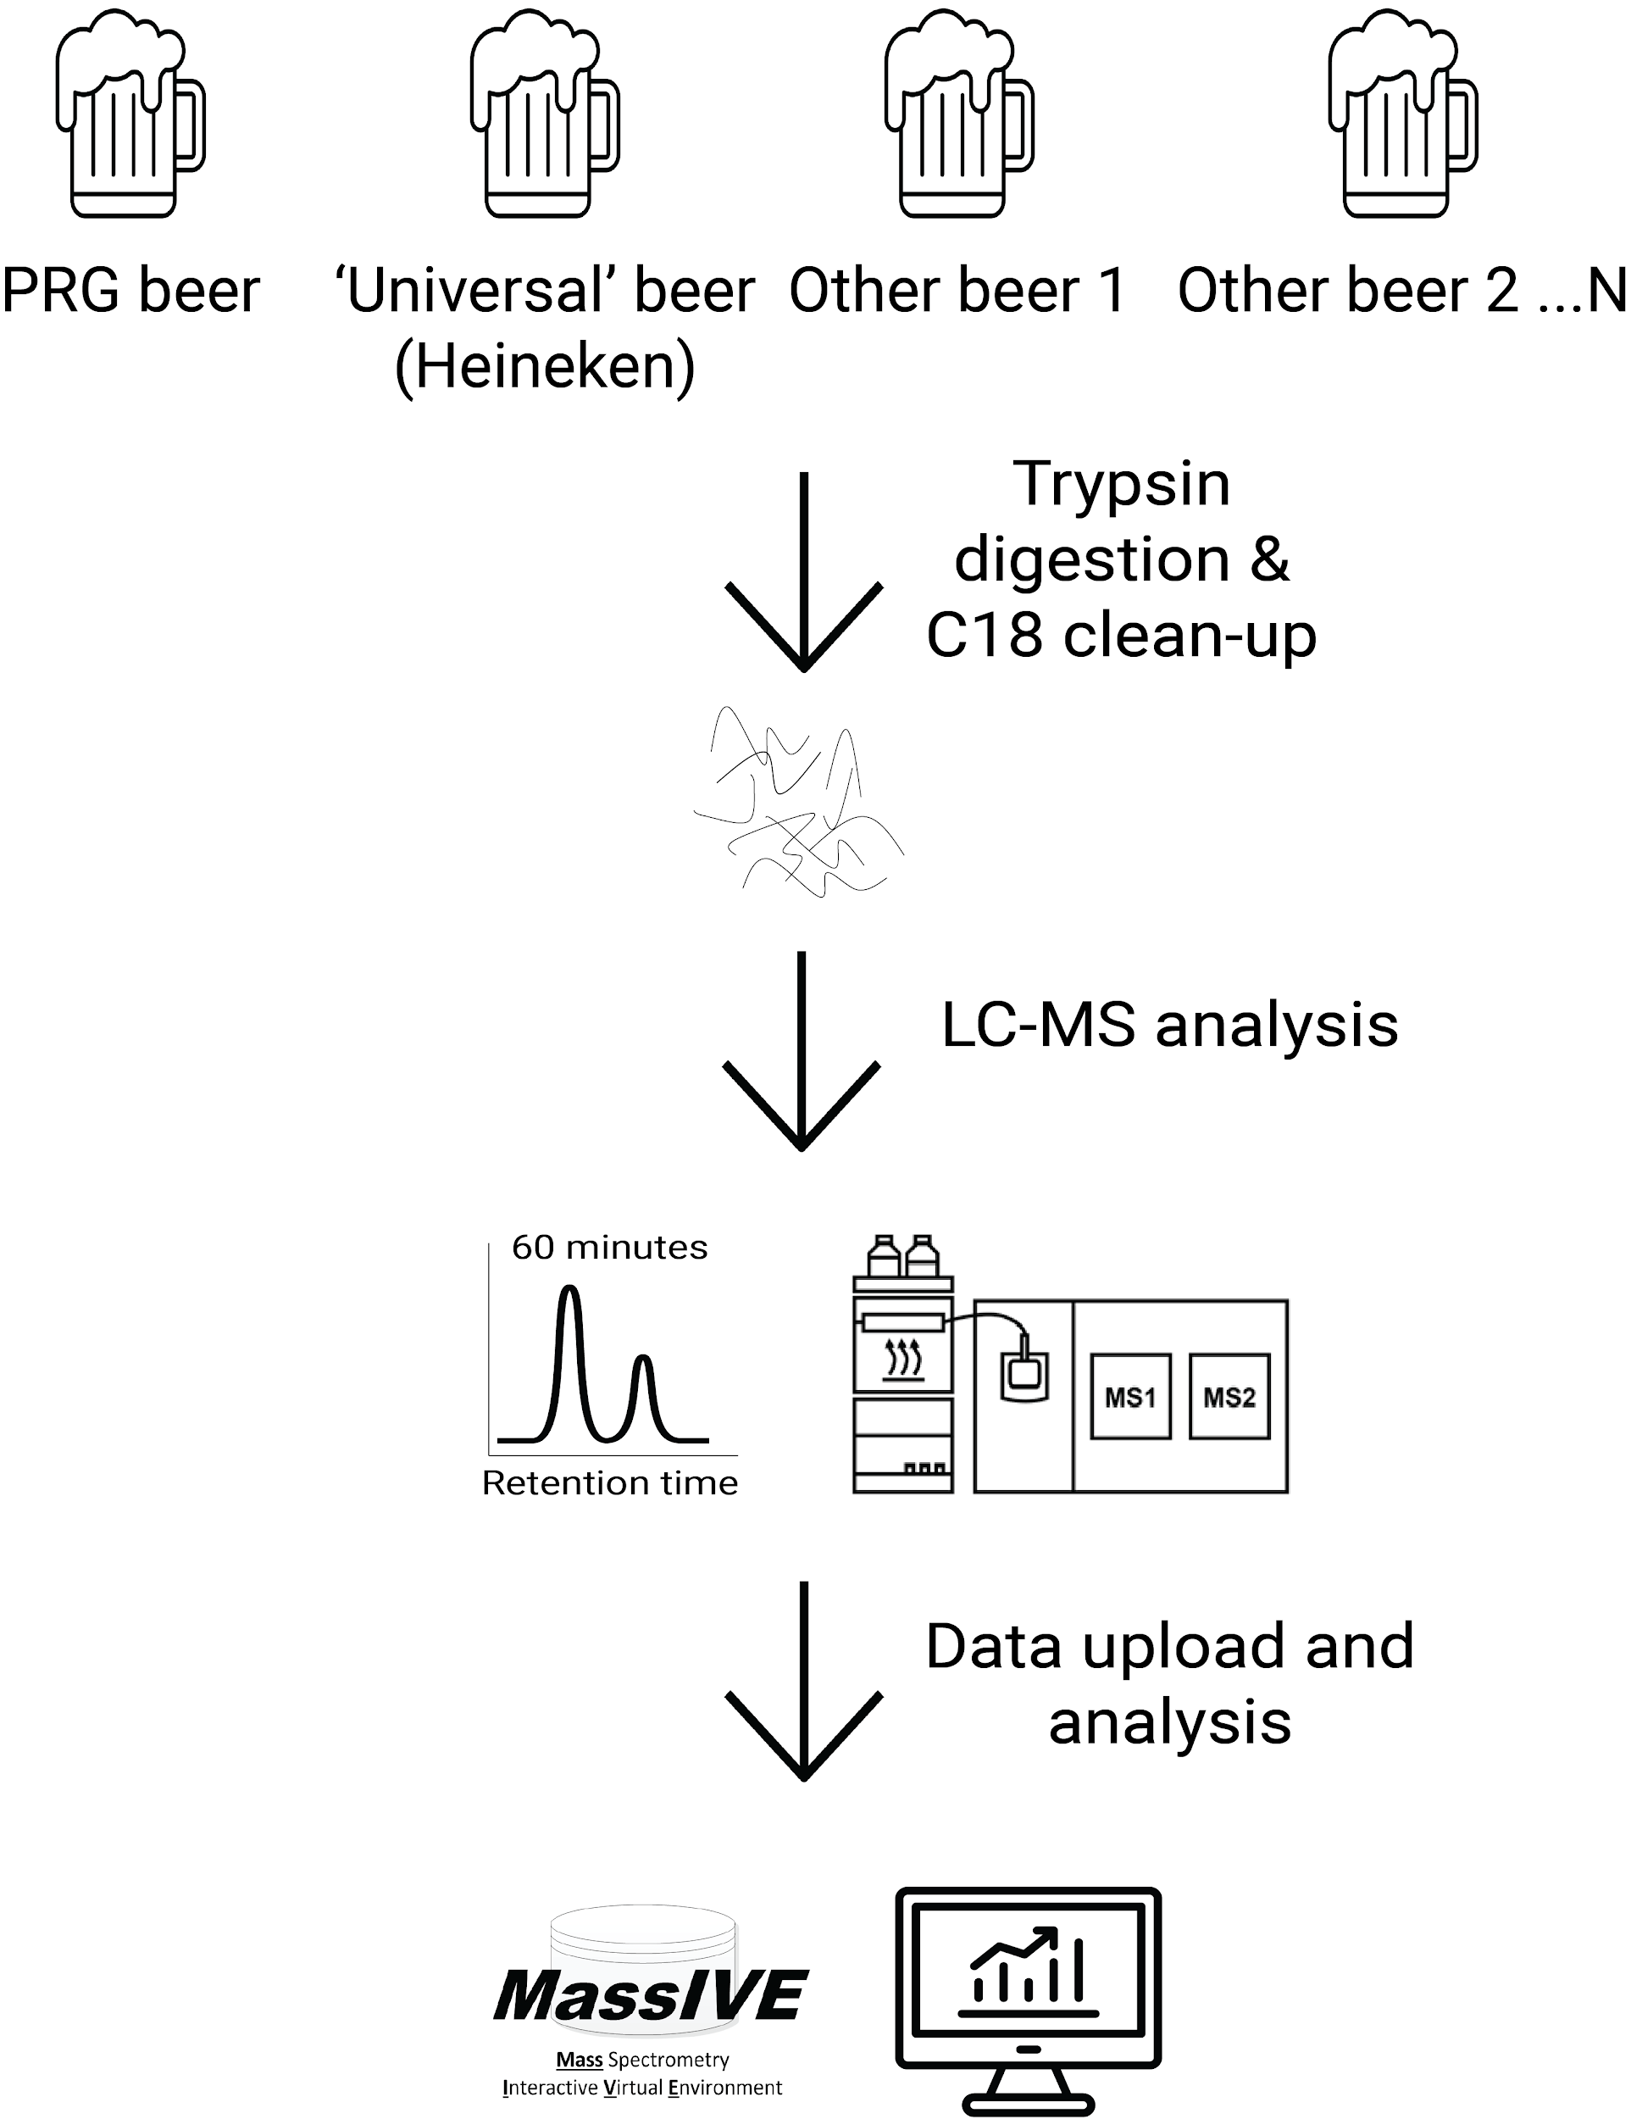
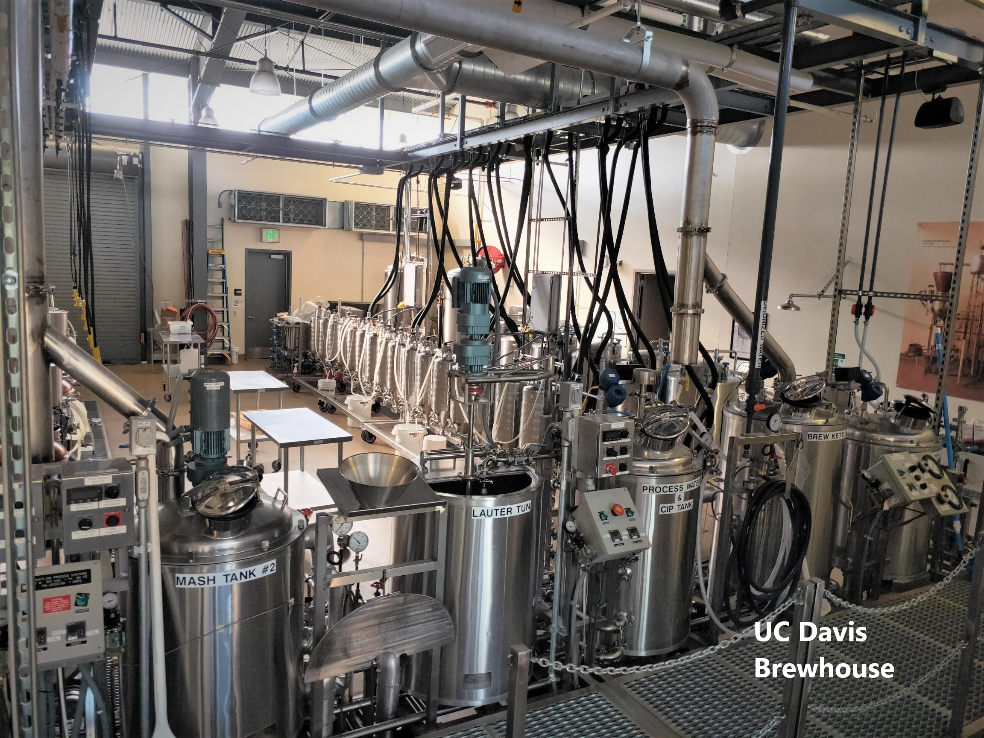

2020 Beer Study: Design

Slide 7
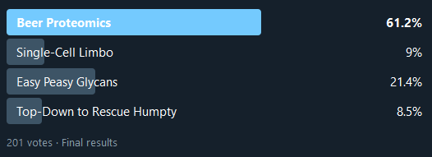
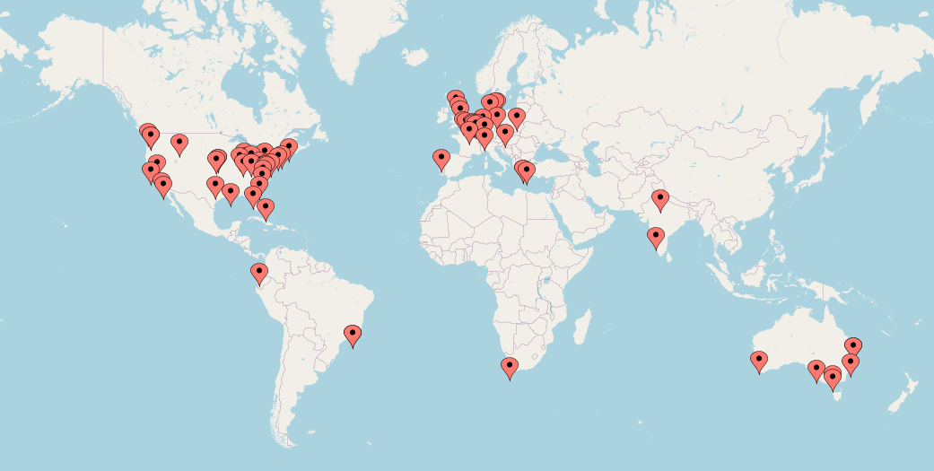
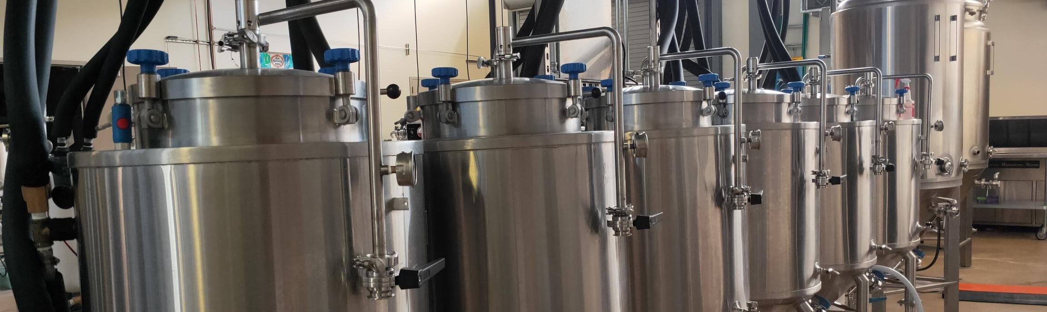
Timeline so far
July 2020: Glen Fox and Kelly Scott (UC Davis) brewed and bottled the PRG beer
  Pale Ale brewed at UC Davis
  All materials and yeast are known
August 2020: staged a twitter poll followed by signup
  68 signed up, 32 non-US
Notes:
Mention all the beer people and pics of brett and Glen.

Slide 8
Timeline so far
September 2020: Brett Phinney sent out 52 PRG Beer samples
  32 non-US participants
Data returned end of January 2021
  33 returned data
  30 analyzed PRG Beer, 16 Heineken (13 did both)
  25 analyzed another beer (max was 10 other beers)
326 injections

Slide 9
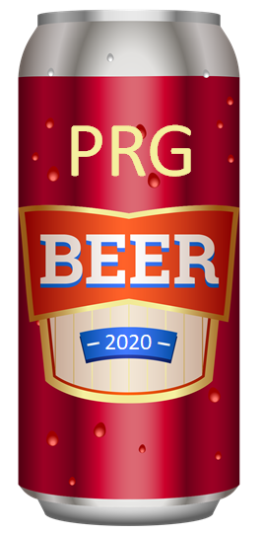
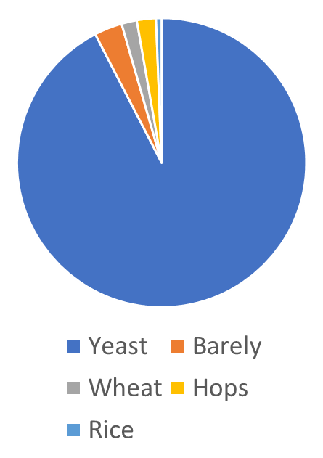
Ex. ID-based analysis of a single participant
raw -> mgf -> Mascot (vanilla search settings)
1813 protein groups
(1924 proteins)
1778 (of 1924) proteins were yeast
Notes:
Most abundant protein was Thioredoxin-2 (yeast)

Slide 10
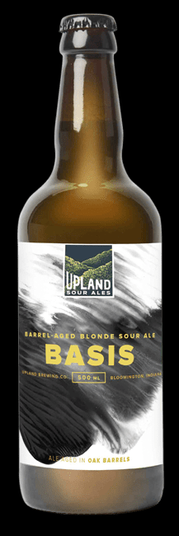
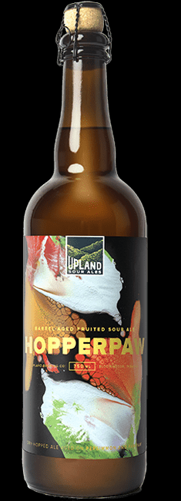
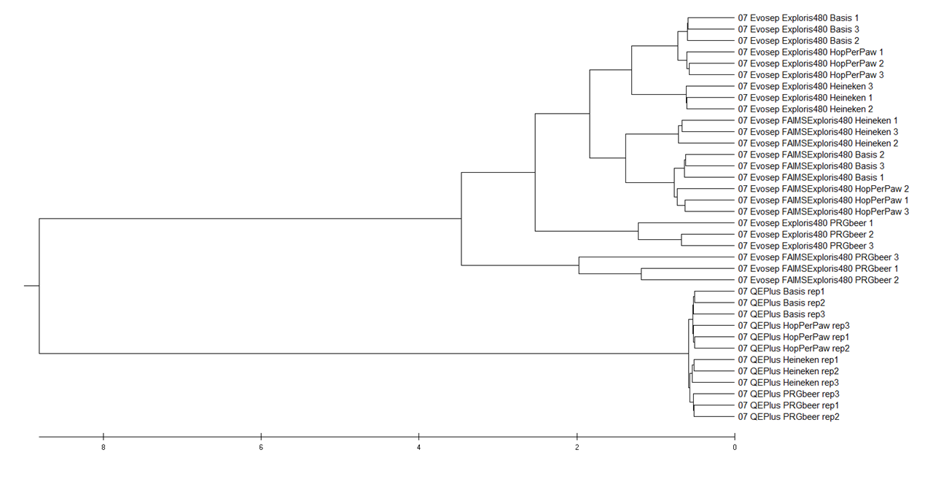
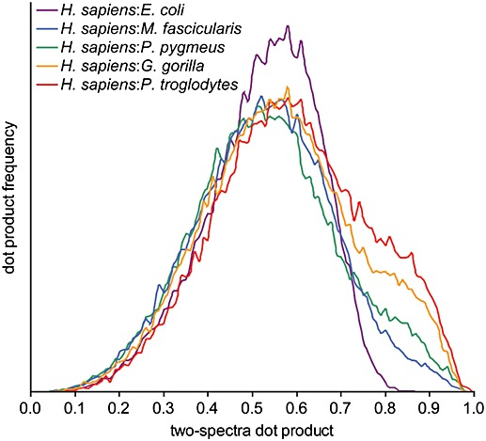
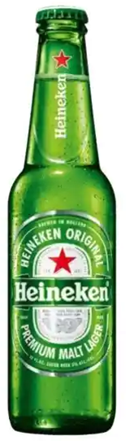
Ex. ID-free analysis of a single participant
raw -> mgf -> compareMS2
no FAIMS
FAIMS
Exploris 480
no FAIMS
FAIMS
QE Plus
Palmblad and Deelder, 2012. doi: 10.1002/rcm.6162
Notes:
Both Basis and HopPerPaw are sour ales from Upland Brewery, and these are more similar to each other than they are to Heineken and the PRG Brew. These are also more dissimilar than the Upland beers. All as expected!
The Exploris data is deeper, and the MGFs contain almost twice as many MS2s (46,000-56,000, most around 52,000) than the QE ones (around 33,000 tandem mass spectra). In the analysis I used the top 20,000 MS2s from each dataset, to make the comparisons as fair as possible. I think the tree is topologically identical to the one constructed using the top-5000 spectra.
The major split is between the QE and Exploris data, even when allowing very large differences in RT (basically anything is allowed to match) and m/z (2.05 m/z units). The PRG brew also stands out. Each beer is clearly separated within each instrument. For the QE data, the first and second replicates are a bit more similar to each other than they are to the third dataset.

Slide 11
Ongoing work
“Vanilla” search results into experiment-wide results matrix
Comparison of PRG beer processed across the world
Publish and make data available
  encourage further analyses with public (i.e., glycoproteomics)

Slide 12
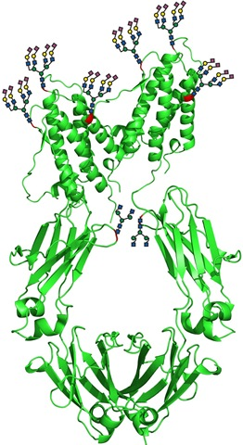
2021/2022 Glycoproteomic Study
Brought on two glycoproteomic experts (Ben Schulz and Dan Polasky)
  focus on N-glycans and glycopeptides
Developing parallel internal PRG studies
  Single-glycoprotein
  Glycoprotein mixture (enriched or native)
Complete internal by summer, results and 2022 Study announcement for ABRF 2022 Palm Springs
image source: https://biotop.boku.ac.at/Projects/2015/Joint6.html

Slide 13
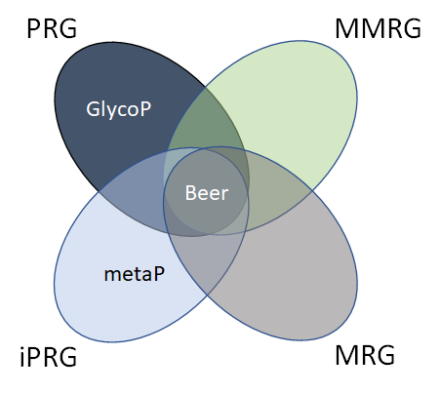
Bigger Picture - Integrating with other RGs
Integrating with other proteomic RGs
ex. iPRG with both Beer Study and Glycoproteomic Study
Reaching out to sequencing and metabolomic RGs when applicable
ex. sequencing yeast strain in beer study could create an interesting SAAV project

Slide 14
Thank you to all past and present participants!

