Slide 1
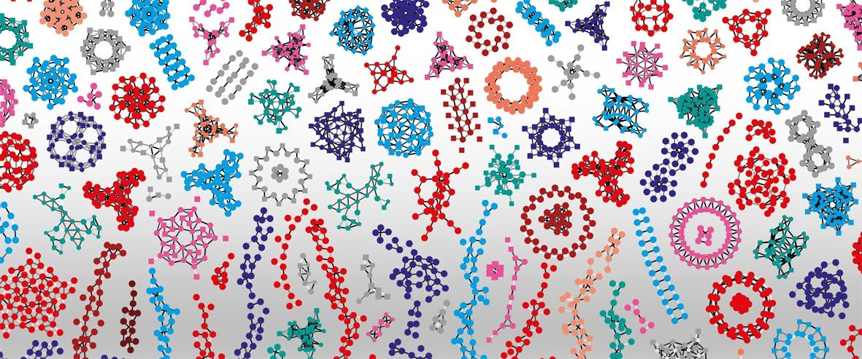

Open and FAIR in bioinformatics and training
Patricia M. Palagi - Training Lead, SIB Swiss Institute of Bioinformatics
Open Science Zurich - 4 March 2021

Slide 2


Overview
Open resources
SIB Training
Open and FAIR

Slide 3

Federating researchers and resources in bioinformatics

Slide 4

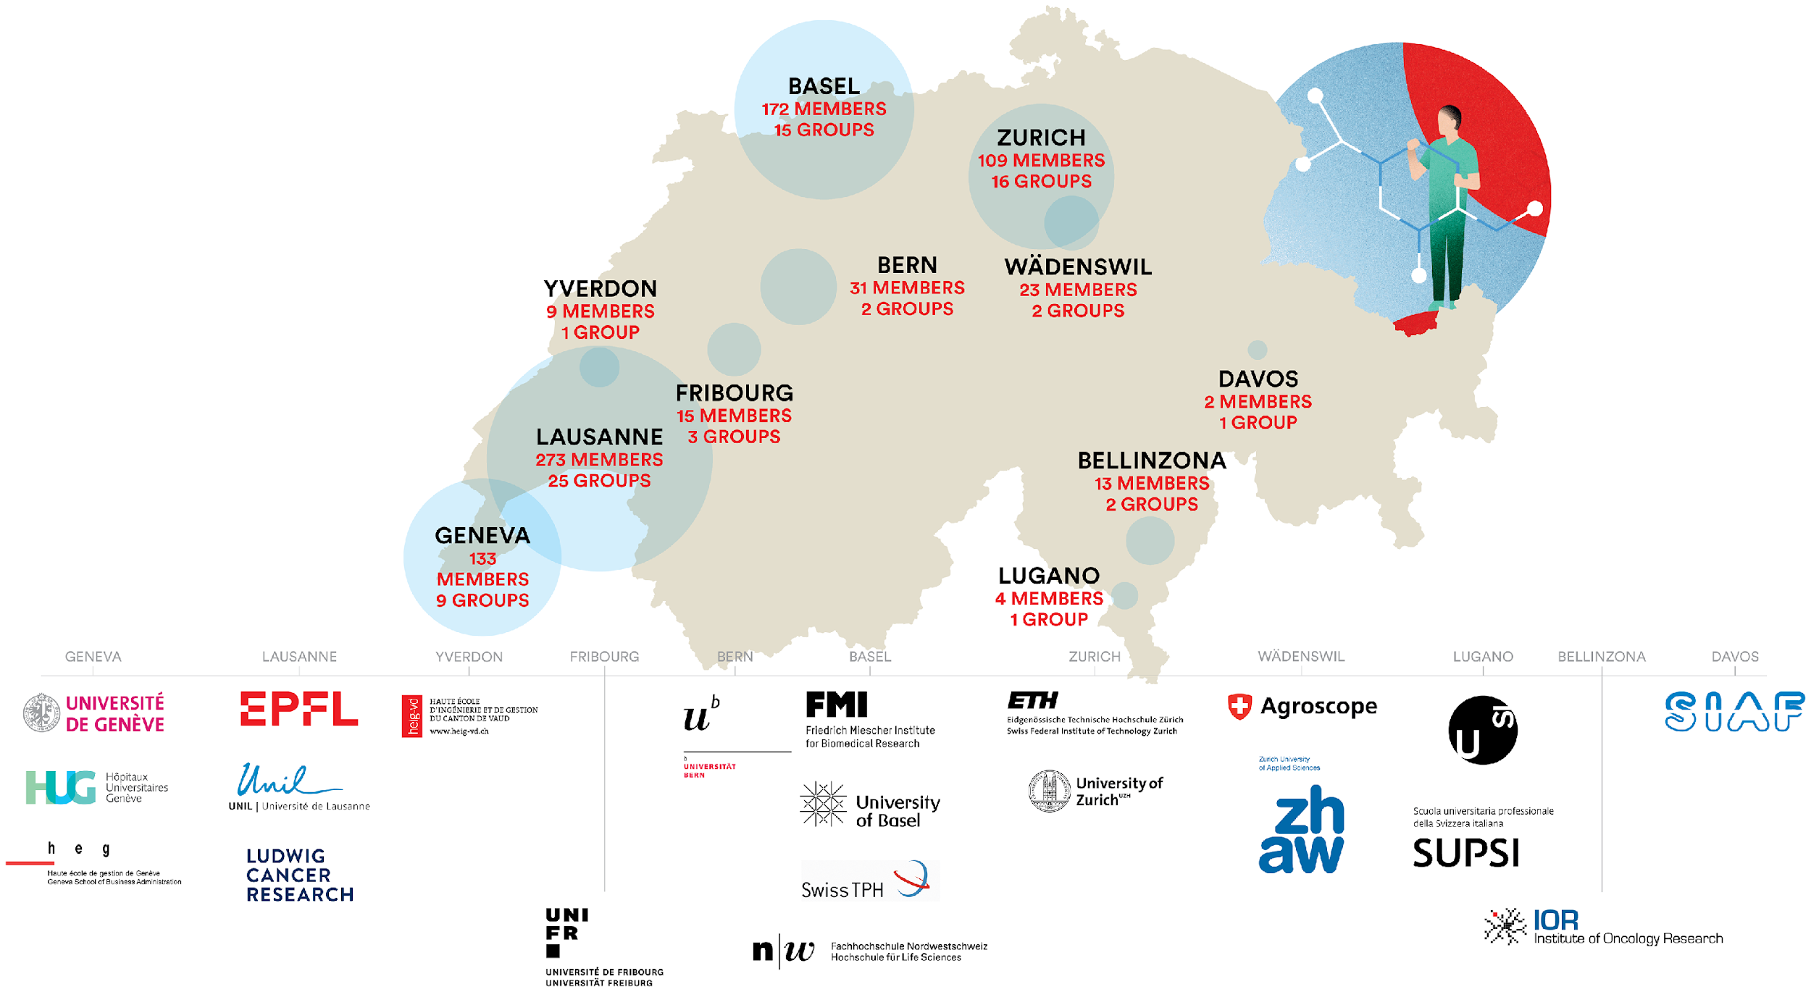
21 institutional partners
all over Switzerland
Notes:
800 scientists
80 groups

Slide 5
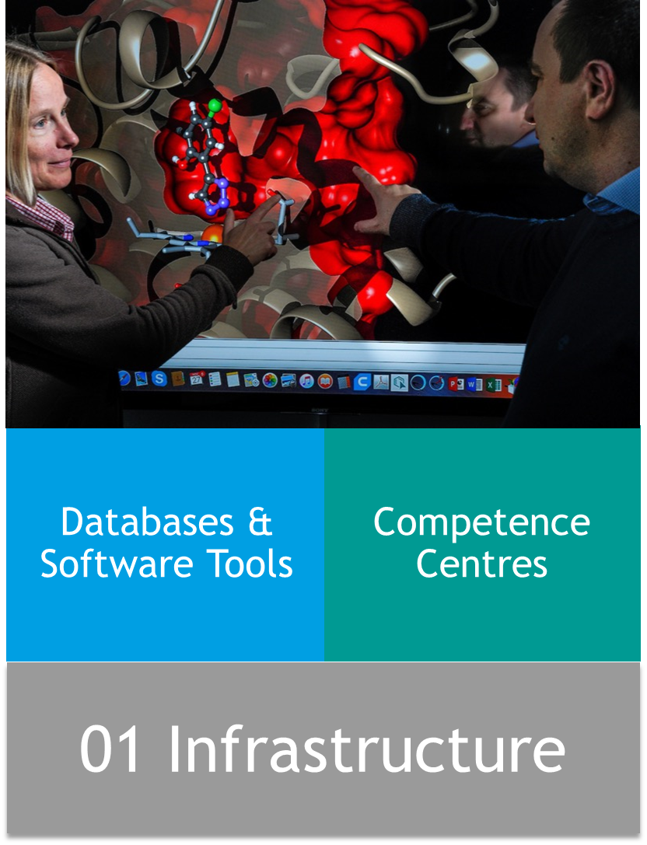
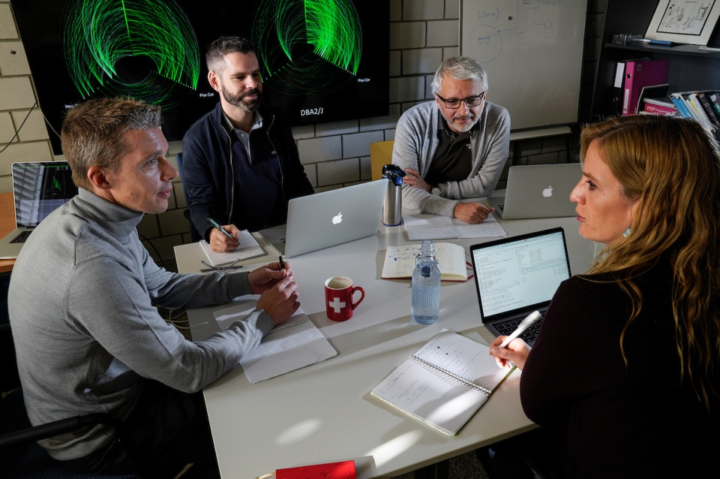
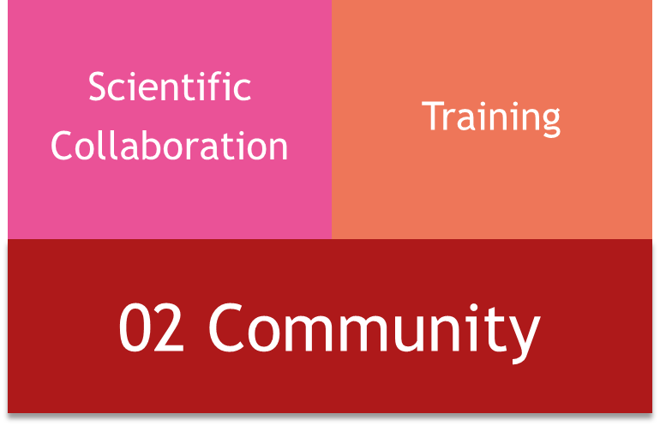
The four pillars of SIB’s activities

Slide 6









SIB Resources - UniProtKB/Swiss-Prot
Protein sequences and functional annotation
Genome annotation
Enzymes and reactions
Lipids and biology
Viral biology
Notes:
Information related to a protein’s function, structure and subcellular location, sequence features such as active sites or post-translational modifications, the protein’s interactions with other proteins
High-quality Automated and Manual Annotation of Proteins

Slide 7

UniProtKB/Swiss-Prot
>570,000
expert curated
protein sequences

Slide 8
UniProtKB/Swiss-Prot
>950,000 users
per month
Search, browse, download, API, SPARQL

Slide 9
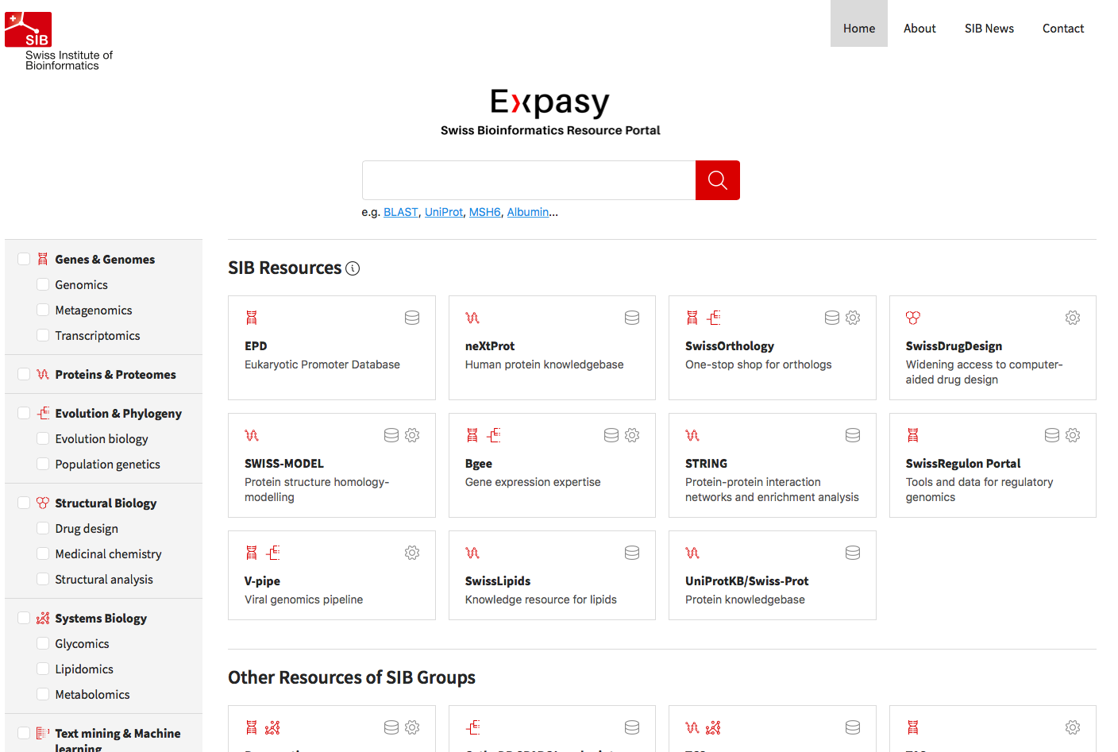
Notes:
160 databases and software tools on Expasy

Slide 10
Training for life and health scientists

Slide 11
SIB Training
TO WHOM
WHAT FORMAT
  1 to 5-day courses
Face-to-face or streamed
  Emphasis on practical learning
  Few asynchronous e-learning modules
  PhD
  Postdocs
  PI
  Staff
  Academia and Industry

Slide 12
SIB Training – examples of domains taught
  Statistics
  Programming
  Data visualization, integration & analysis
  Data life cycle management
  Machine learning
  NGS, RNA-seq, single-cell, proteomics

Slide 13
SIB Training in figures - annual average
54
block courses
99
days
of course
1,265
trainees
89
experts & trainers
Notes:
Just to give you an idea at which scale SIB training is working, this slide shows some figures computed over three years (2017-2019):
-On average 54 block courses have been given per year.
- which correspond to 99 days of course
- covering over 1200 trainees
- and involving 22 SIB groups

Slide 14
Overview
Open resources
SIB Training

Slide 15
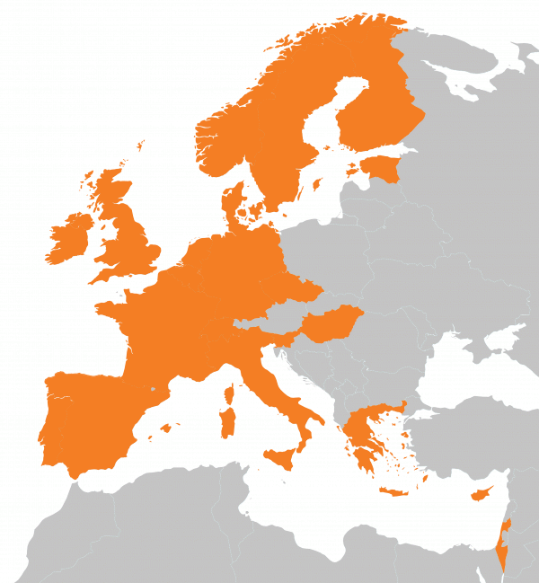
is the Swiss Node of ELIXIR
Data infrastructure for Europe’s life-science research
www.elixir-europe.org

Slide 16
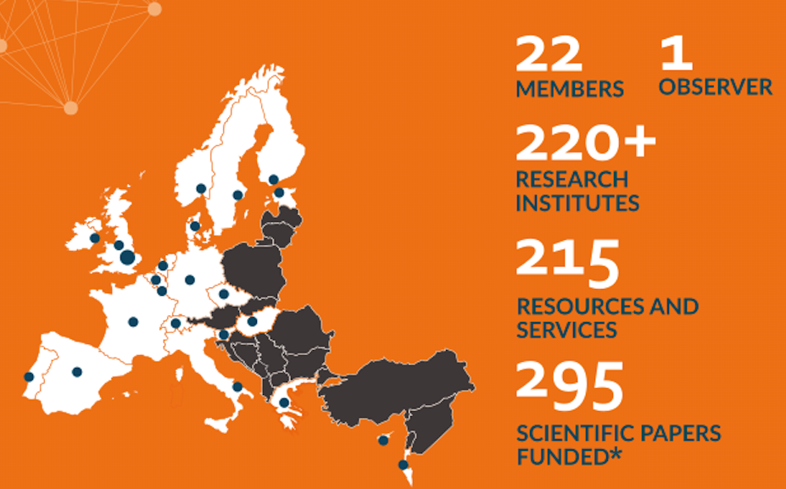
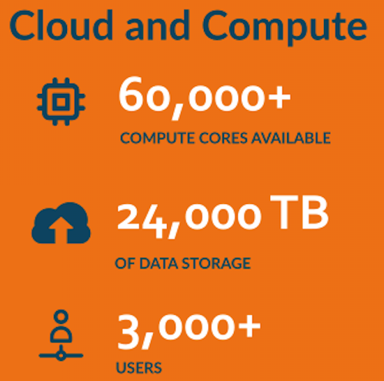
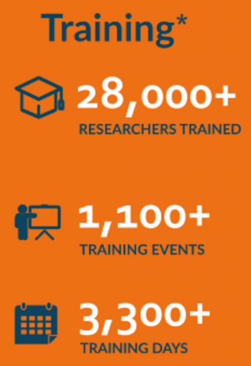
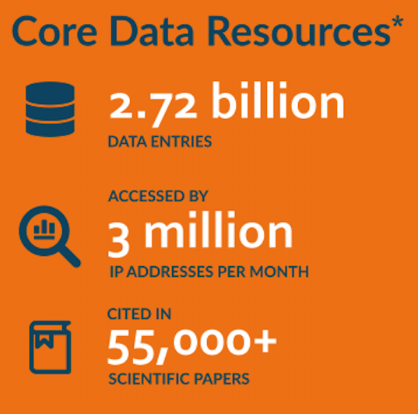
Data infrastructure for Europe’s life-science research
www.elixir-europe.org
*2015-2020

Slide 17
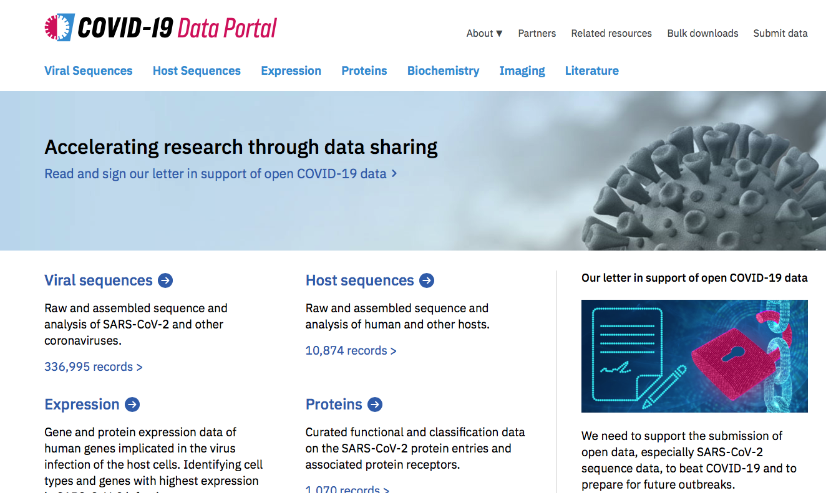

Slide 18
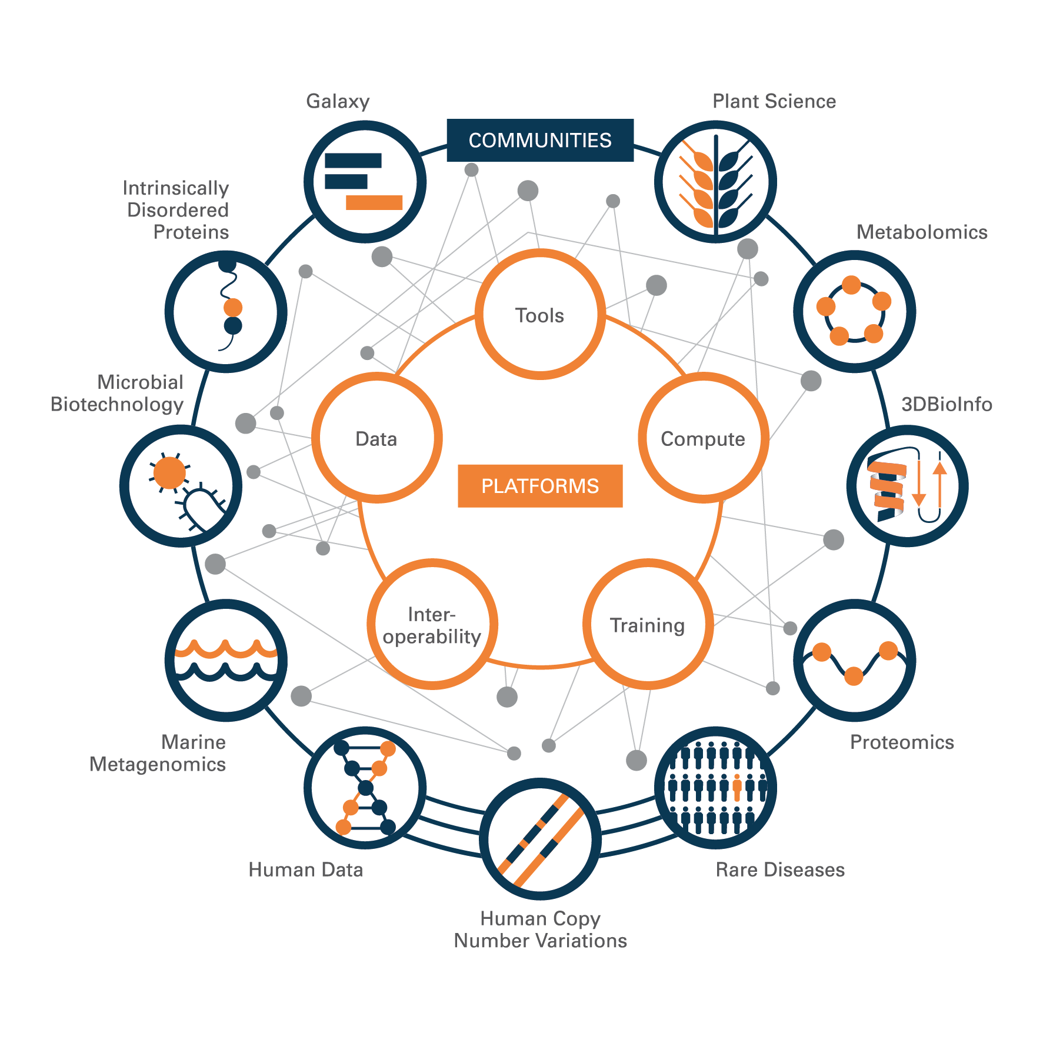
ELIXIR’s structure
Five Platforms: Data, Tools, Compute, Interoperability and Training
Bioinformatics service development is driven by eleven Communities (or ‘Use Cases’)

Slide 19
Overview
Open resources
SIB Training
Open and FAIR

Slide 20

FAIR principles
Data, software, workflows are:
Findable - can be searched for by the community after publication
Accessible - can be read/downloaded by other researchers
Interoperable - can be understood clearly in the context of the original experiment
Re-usable - can be used by other researchers

Slide 21
ELIXIR FAIR Training - Working Group
Aims
Teach researchers about FAIR principles and how to apply them
Make FAIR training materials

Slide 22
Why FAIR training materials
Training materials are also digital objects
FAIRness - training materials work together with data, software, workflows → the full picture is useful for science
FAIR needs community agreements

Slide 23
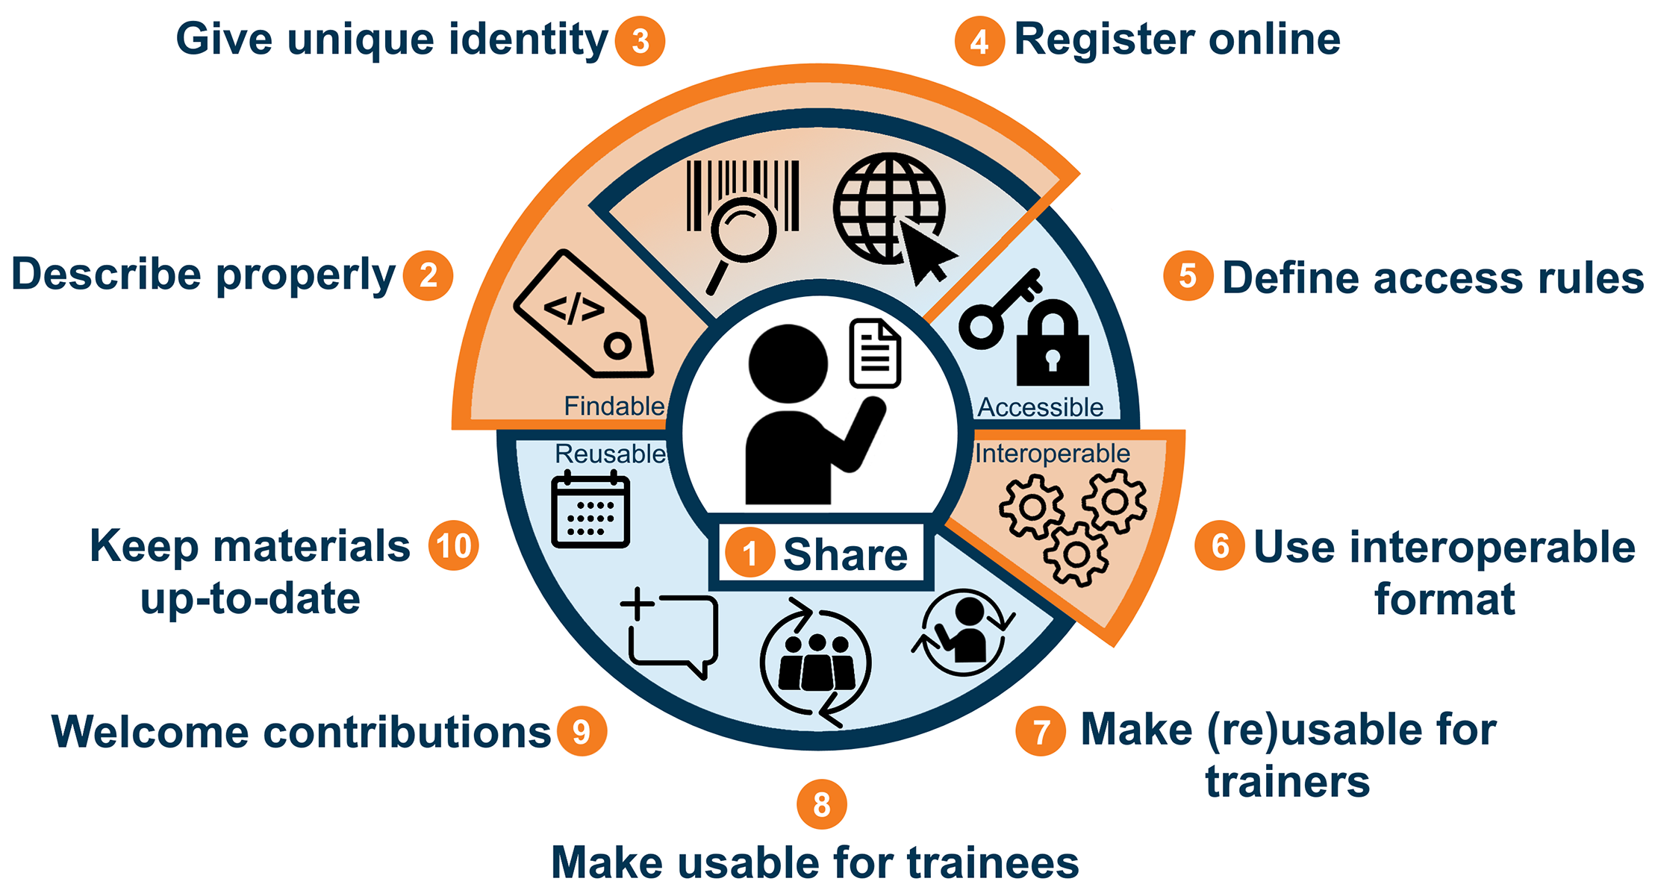
Ten simple rules to make training materials FAIR
  Garcia L, Batut B, Burke ML, Kuzak M, Psomopoulos F, Arcila R, et al. (2020) Ten simple rules for making training materials FAIR. PLoS Comput Biol 16(5): e1007854. https://doi.org/10.1371/journal.pcbi.1007854
Illustration from Luc Wiegers and Celia van Gelder: https://doi.org/10.5281/zenodo.3593257.

Slide 24

Rule 1 - Share
Good of science
Recognition
Record
Identify gaps
Inspire
Train

Slide 25



Rule 2 – Describe properly (with metadata)
Appropriate and standardized Metadata
Data types
Properties
Course
Course instance
Training material
Describing & annotating: keywords from controlled vocabularies, taxonomies, thesauri or ontologies
https://bioschemas.org/profiles/

Slide 26




Rule 3 – Unique identity
URL

Slide 27



Rule 4 – Register online
ELIXIR Training Portal

Slide 28

Rule 5 – Define access rules
Open
Membership
Domain
Restricted
Paid
If you collect usage data - say it
data-protection information

Slide 29

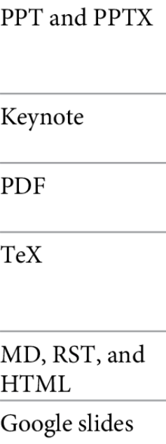
Rule 6 – Use an interoperable format

Slide 30

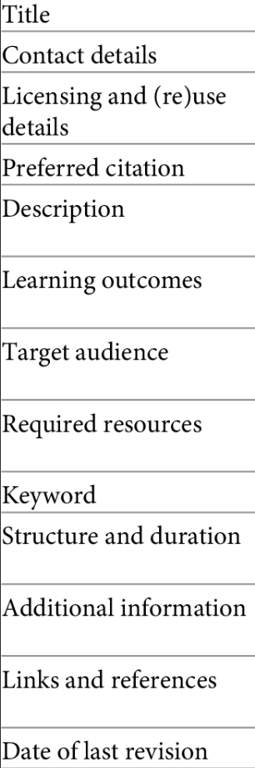

Rule 7 – Make your training materials (re)usable for trainers
License: - give authors and users appropriate rights of (re)use
Metadata
context

Slide 31


Rule 8 – Make your training materials (re)usable for trainees
?
?
?
Metadata
context

Slide 32


Rule 9 – Welcome contributions
Errors
Examples
Feedback
Alternative explanations
Stating
Rules for contribution
  Expectations
  Recognition

Slide 33

Rule 10 – Keep them up-to-date
Training materials evolve and adapt to changes
Changelog
Timestamped
Version
control
New PID
Archive

Slide 34
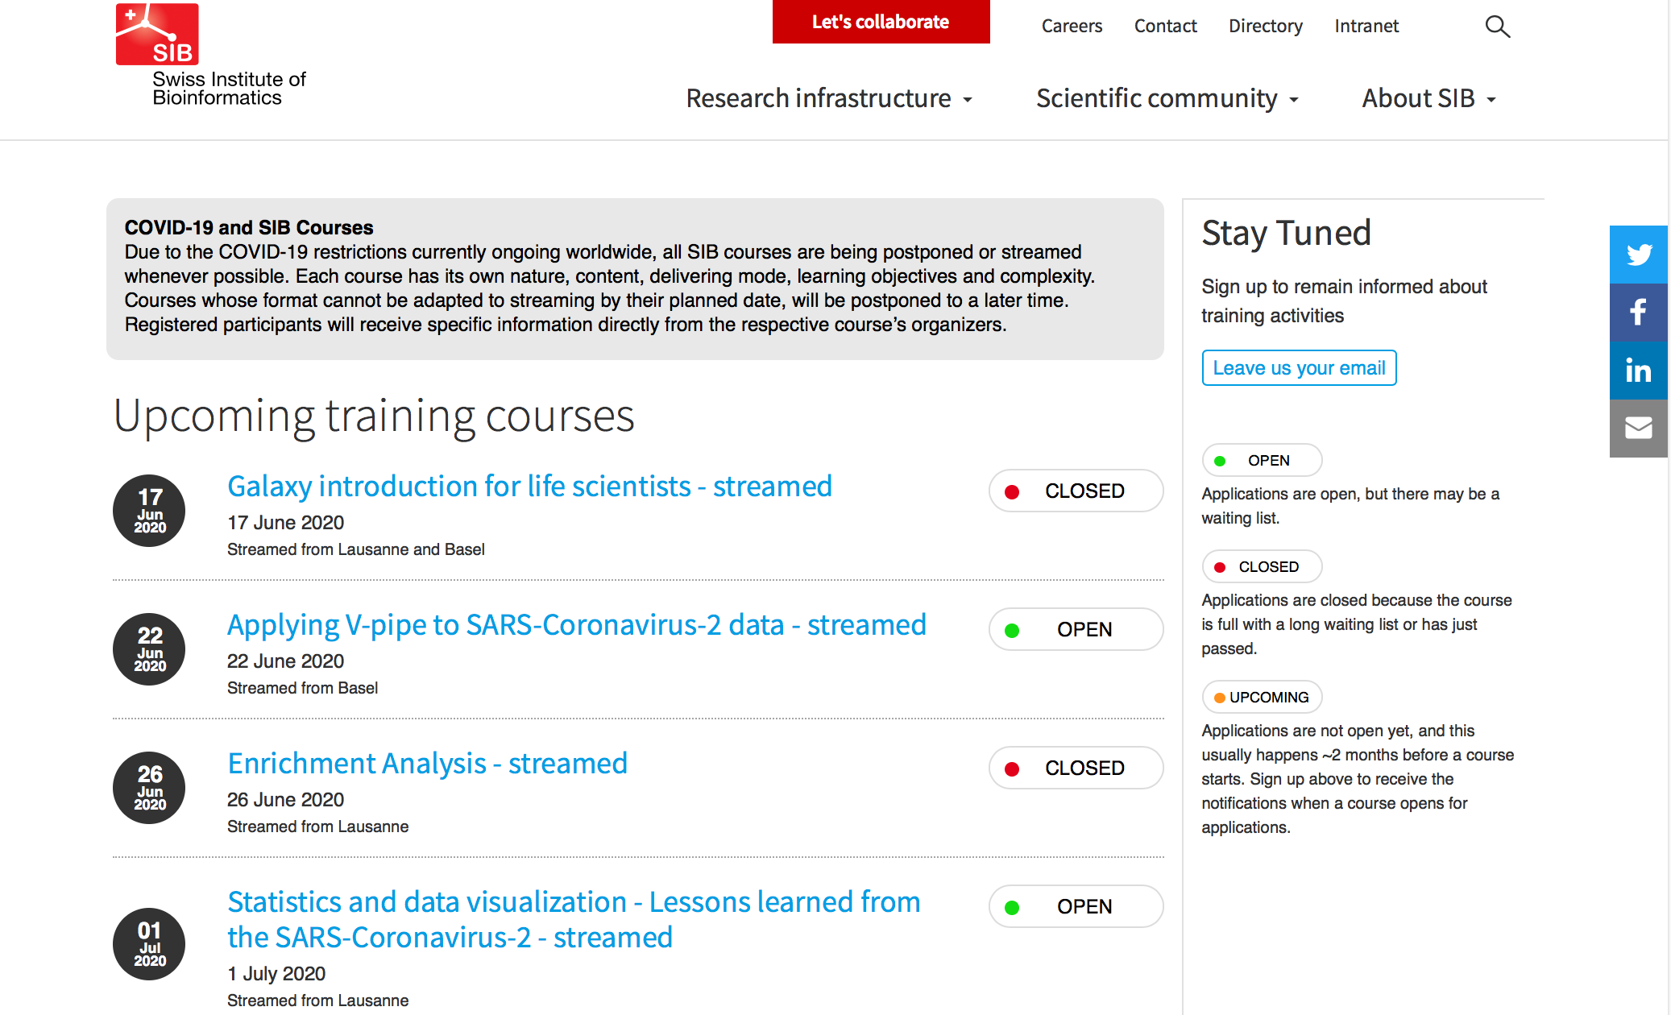
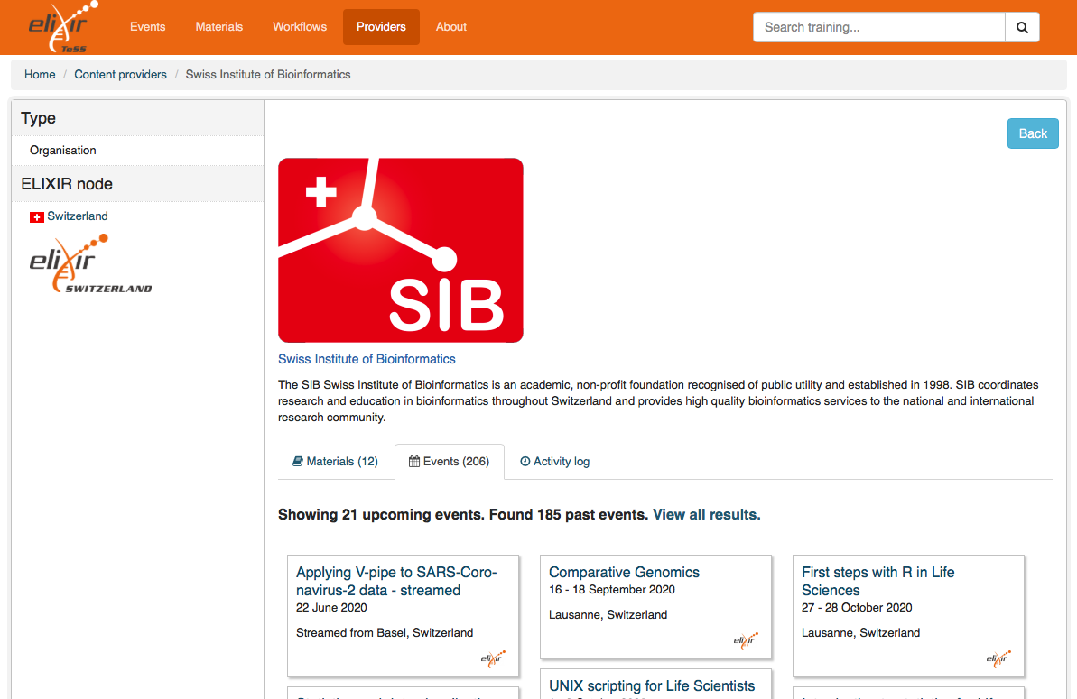
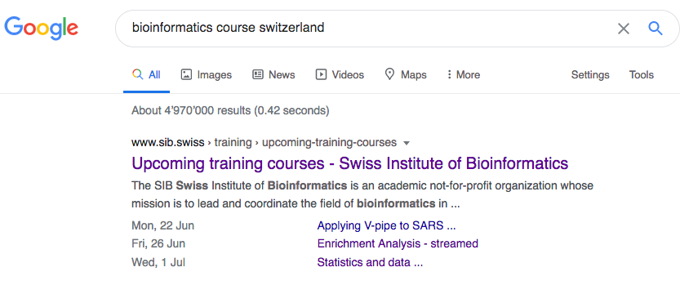
SIB Courses are (F)indable
https://www.sib.swiss/training
https://tess.elixir-europe.org

Slide 35



SIB Training materials - FAIRness today
FAIRness of this sample: https://sib-swiss.github.io/NGS-introduction-training/

Slide 36
Open and FAIR experience
Life/Success is a journey, not a destination
  Open and FAIR is a journey and a destination
Learning with and from a community
Change in mindset: from authorship to contributorship (*)
(*) 0. Kowalczyk et al (2020) What senior academics can do to support reproducible and open research: a short, three-step guide.

Slide 37

Swiss Reproducibility Network (SwissRN)
Working groups
Preregistration and Registered Reports
Research Assessment and Incentives
Replication Studies
Research Methodology
Training

Slide 38


Data scientists for life

Slide 39
Acknowledgments
  SIB Training group: Valeria di Cola, Alessia di Pietro, Wandrille Duchemin, Isabelle Dupanloup, Geert van Geest, Diana Marek, Grégoire Rossier, Frédéric Schütz, Monique Zahn
  SIB Training Advisory Committee: Marc Robinson-Rechavi, Rémy Bruggmann, Christine Durinx, Pierre Farmer, Christoph Handschin, Mark Ibberson, Mark Robinson, Thierry Sengstag, Florian Steiner
  Our partners @ ELIXIR: Allegra Via, Jessica Lindvall, Celia van Gelder, Fotis Psomopoulus, Leyla Garcia and our colleagues from the FAIR Training Working Group and the Training Platform

Slide 40
Thank you
https://www.sib.swiss/training

