Slide 1
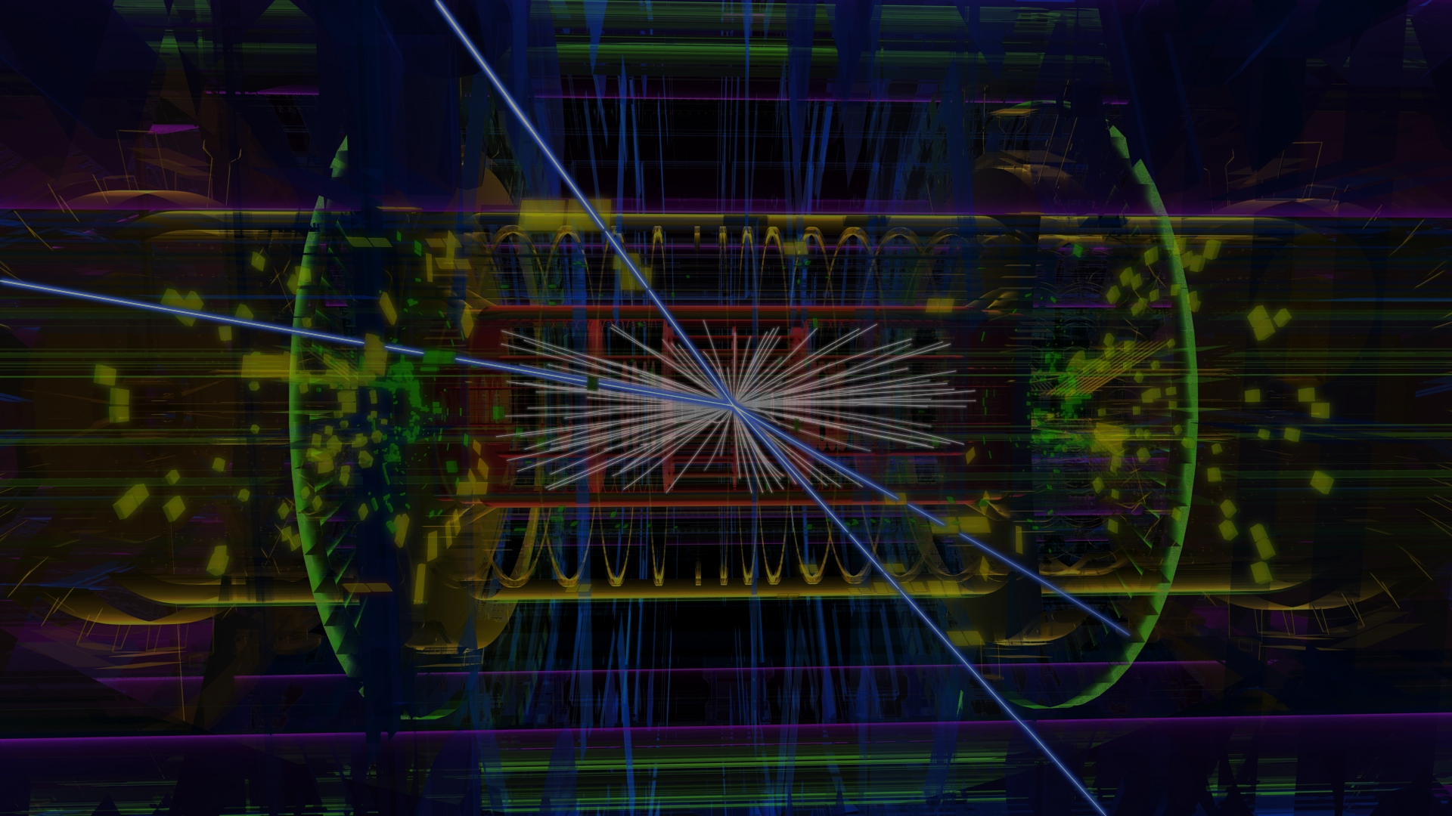





Computing And Particle Physics
G. Watts
2021-02-25

Slide 2
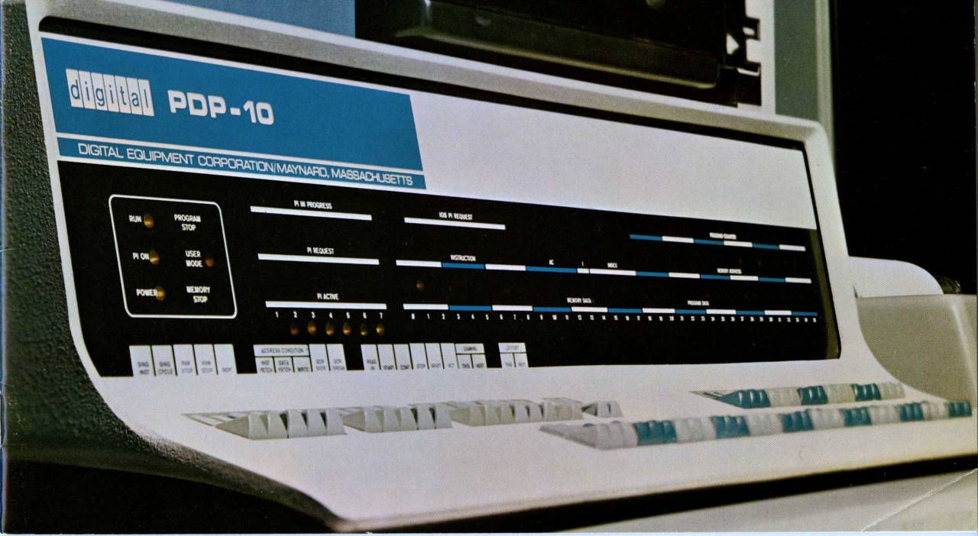
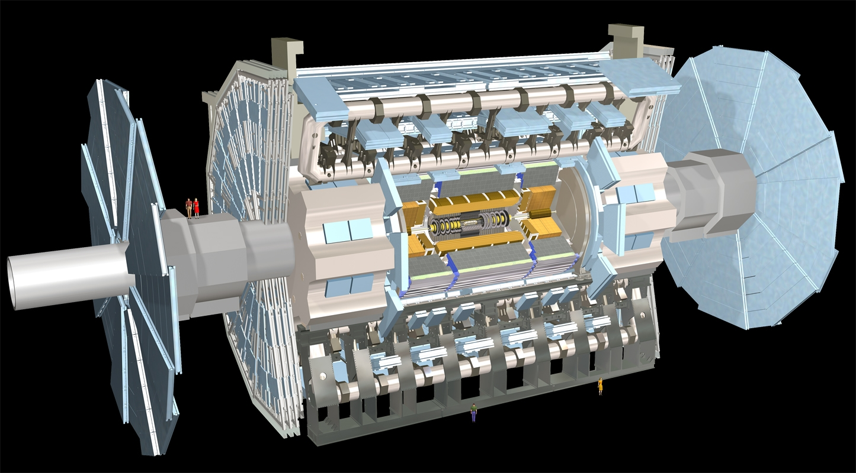
Physics
Theory
Experiment

Slide 3
Why Now?
And why in connection with Experimental Particle Physics?
Notes:
Large experiments – of any kind – have always depended on software – and we’ve long seen that investments in this area can be equated to hardware upgrades, allowing us to extract more and more physics

Slide 4
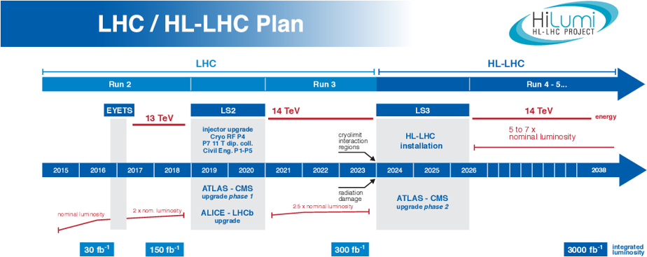
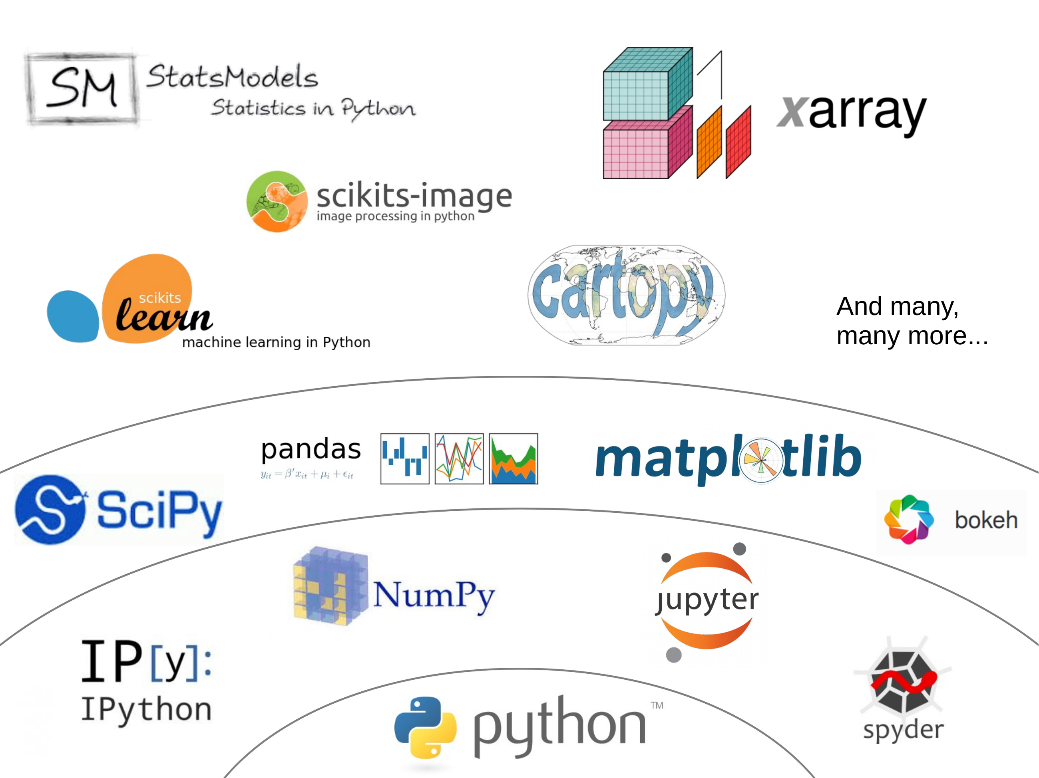
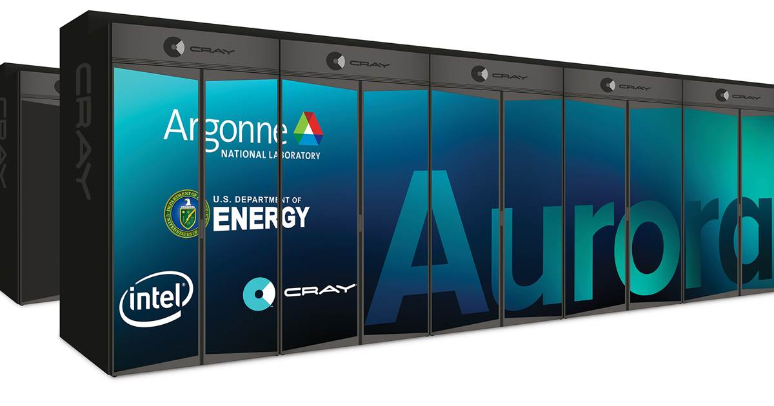
Notes:
1 is under physics control, 2 and 3 are motivated by external trends and technology. For us, as scientists, #1 is the real motivator for why we are thinking about computing.

Slide 5
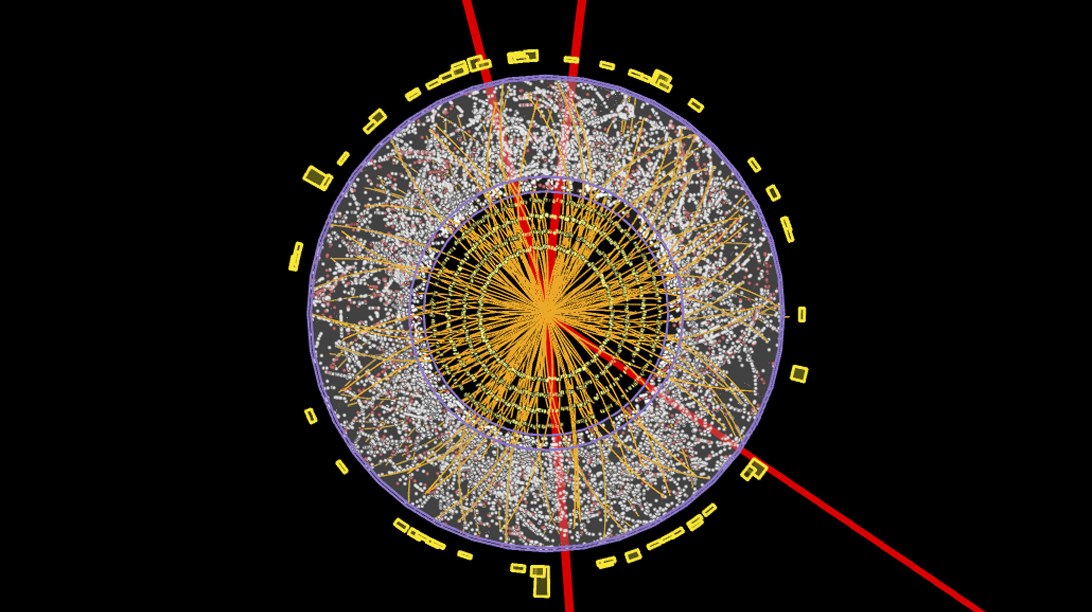
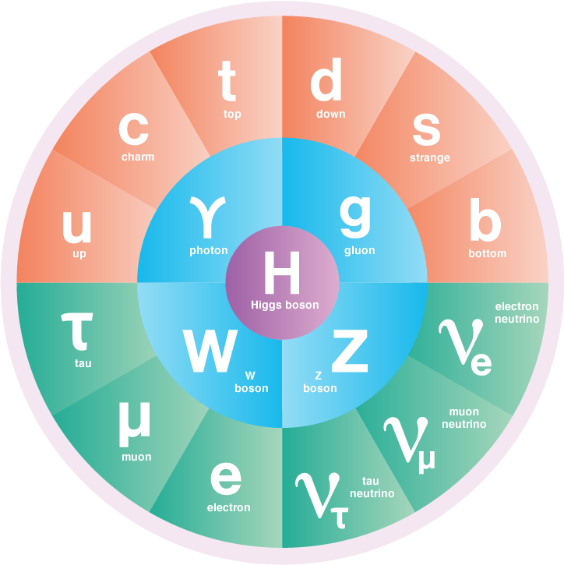
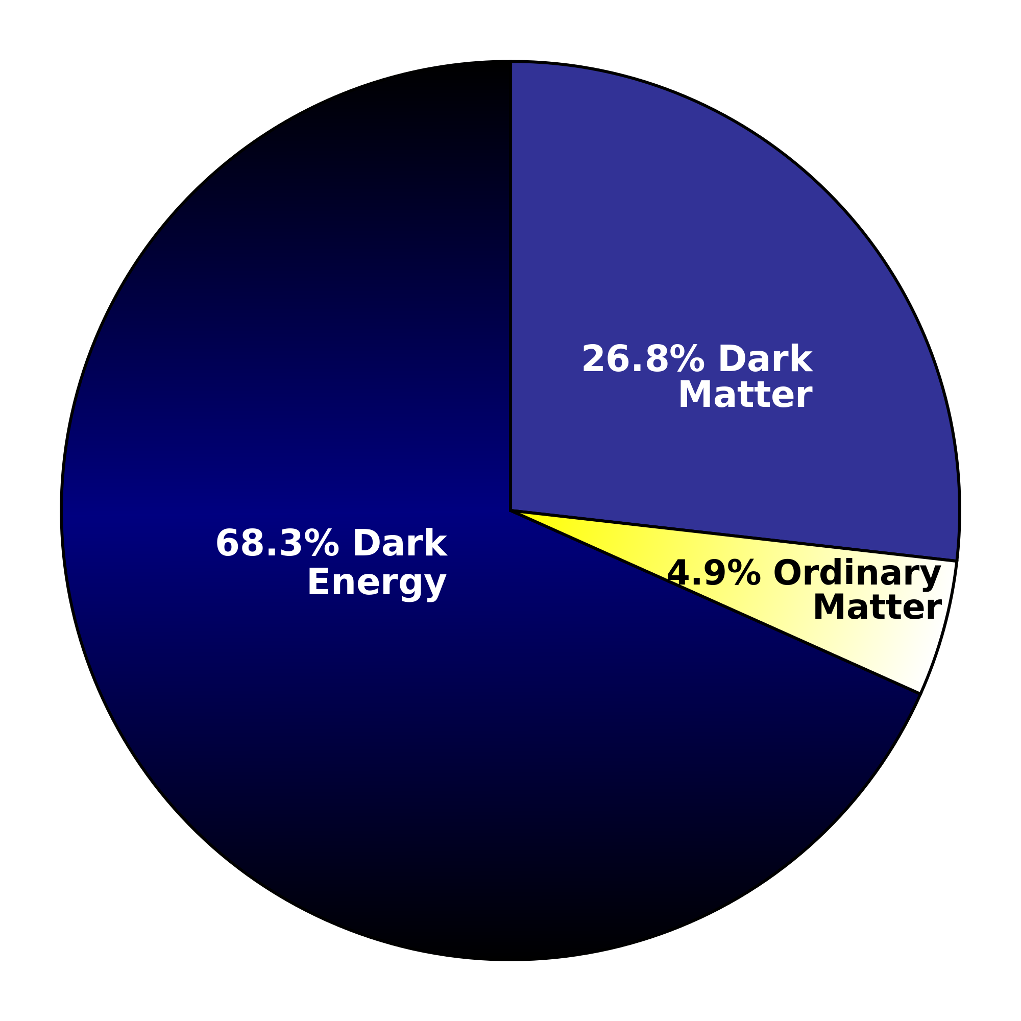
Completing The Story
Notes:
We have a theory – and despite how well it has held up – it has holes.

Slide 6
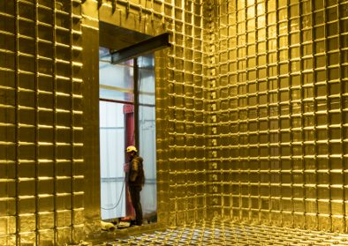
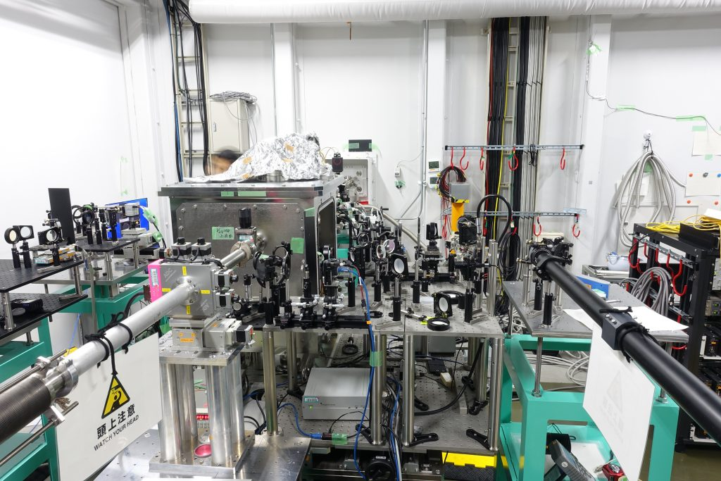
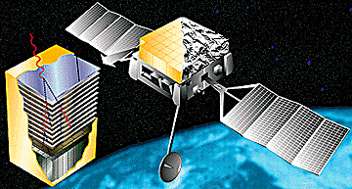
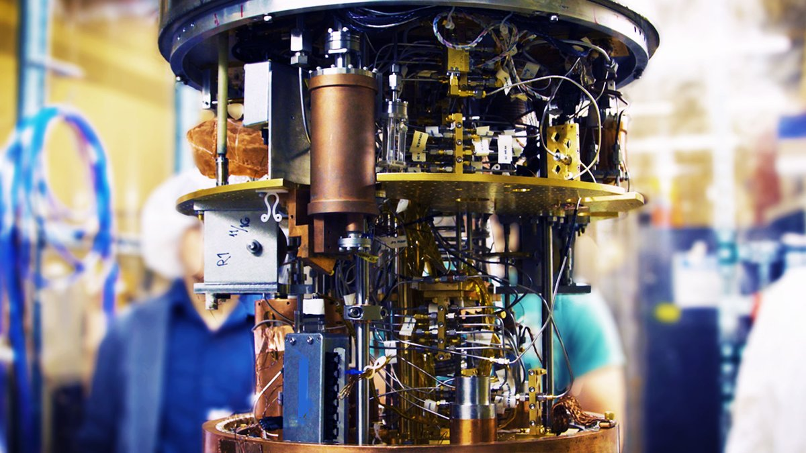
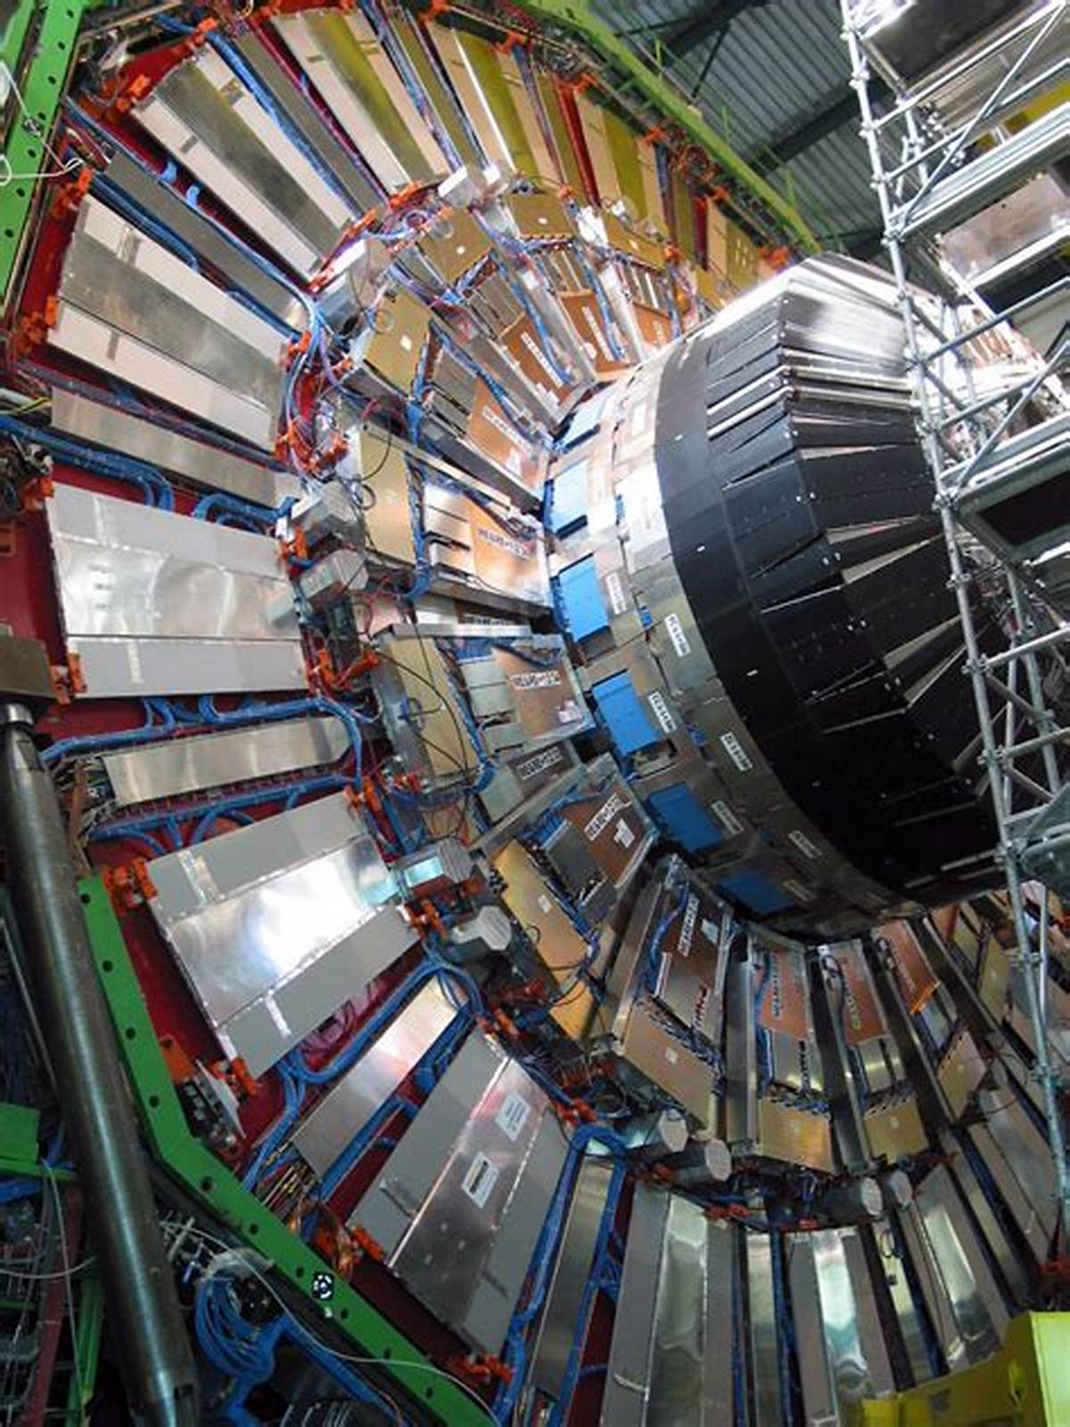

Challenging the Theory
Nuclear Physics
Tabletop Experiments
Astro
Nuclear Physics
(Fermi/GLAST)
(ADMX)
(DUNE)
($γγ$ scattering @ XFEL)
Particle Physics
(CMS @ LHC)

Slide 7
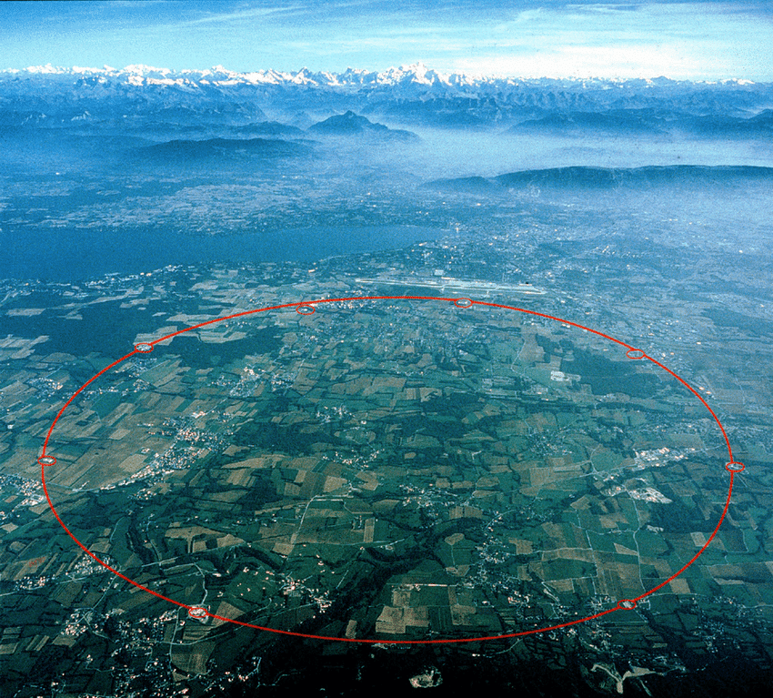
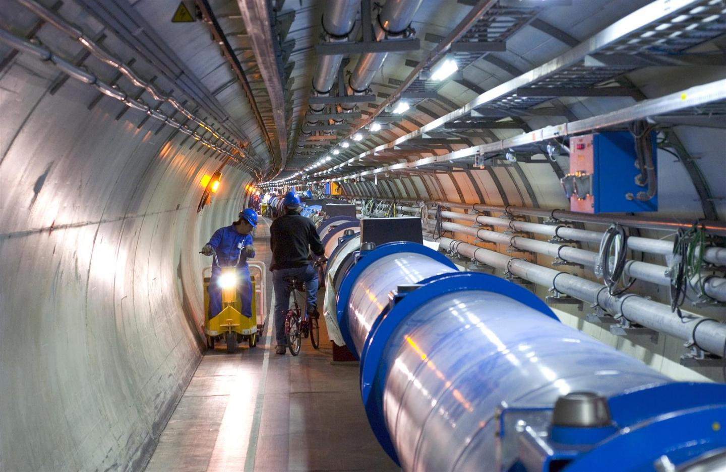

Particle Physics
Mt. Blanc
Geneva, Switzerland
$\sqrt{s}=13$ TeV
Notes:
Studying Particle Physics at the Energy Frontier means CERN and the LHC. The highest possible energies give us access to as much new physics as possible.

Slide 8


$$ℒ$$
$$\sqrt{s}$$
Luminosity
Collision Energy
Needs a new collider

Slide 9

$$ℒ$$
Access to rare decays
Access to production of rare states or new states
Precision Measurements of Model Parameters
Luminosity

Slide 10
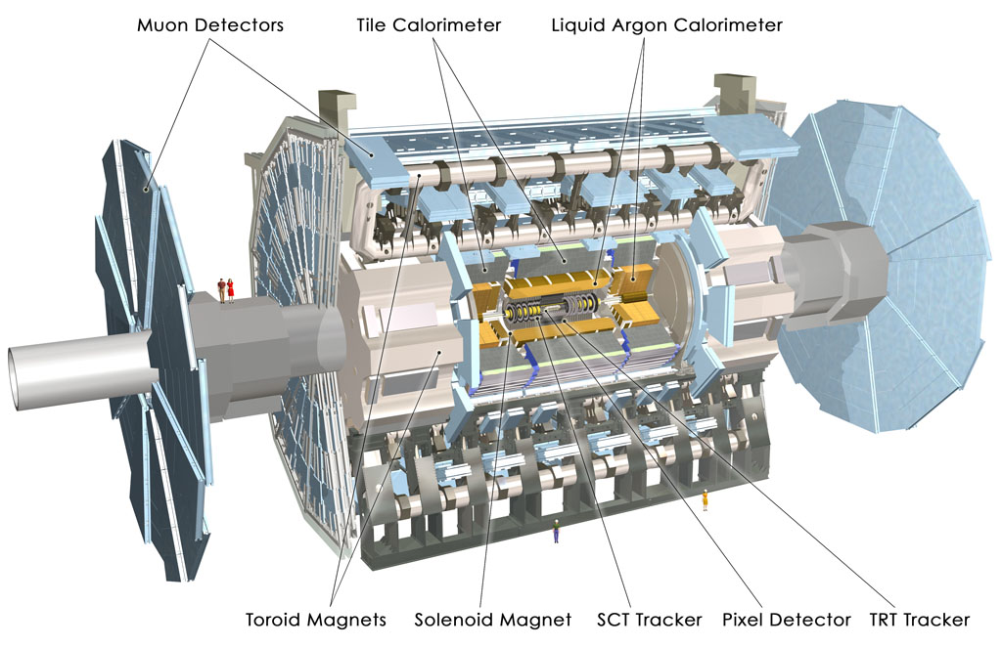
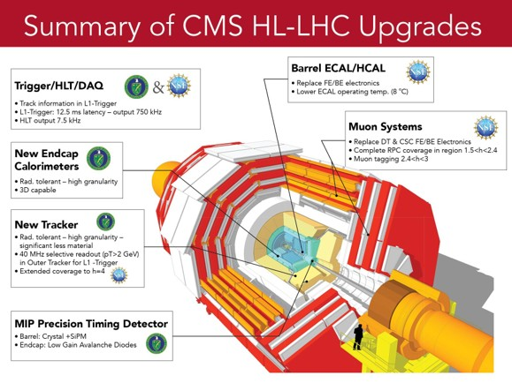
Plans for Run 4 – Upgrade the Detectors

Slide 11
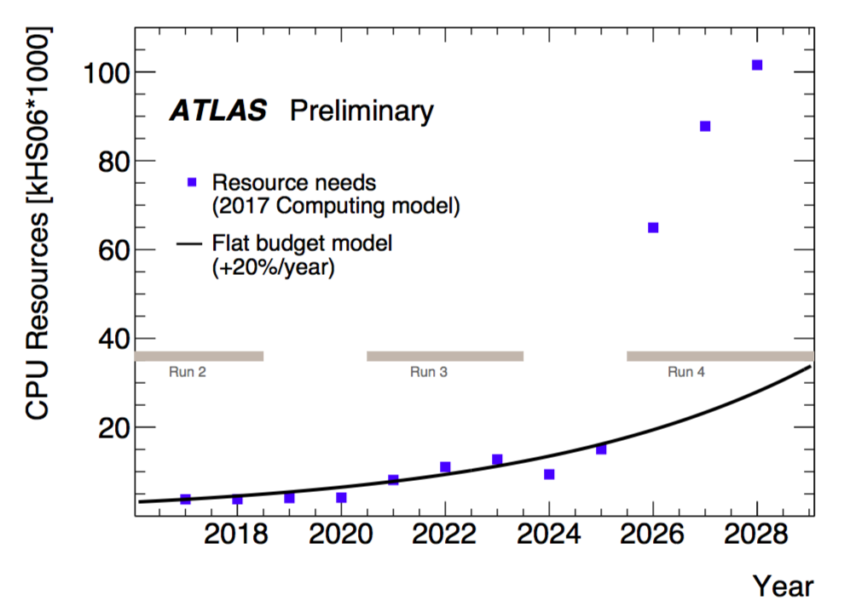
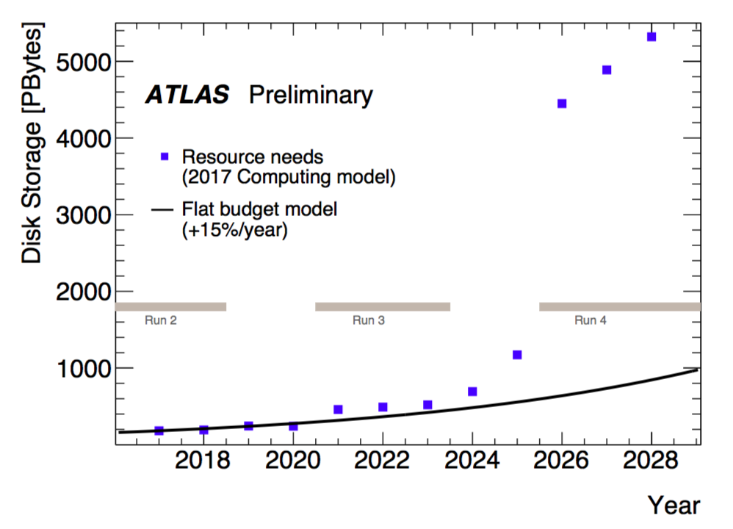
Plans for Run 4 – Computing

Slide 12
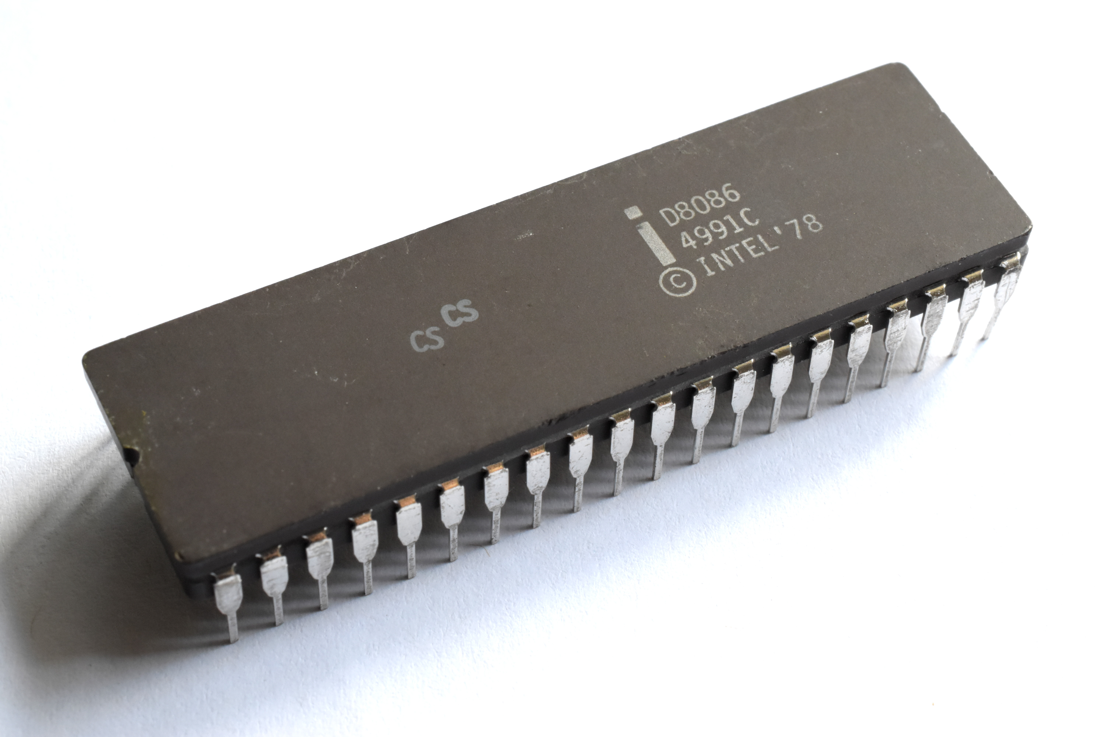

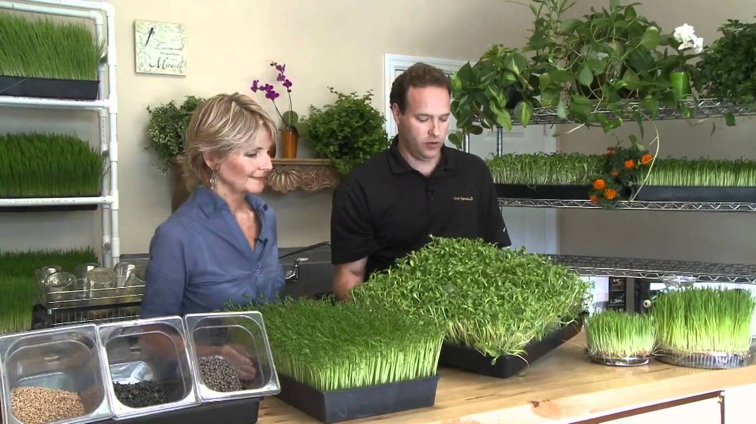


The World Is Changing
$$≠$$

Slide 13
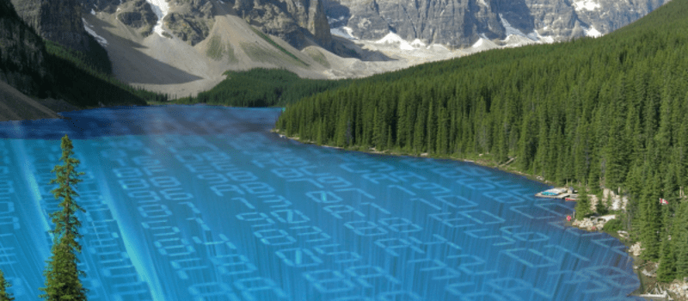
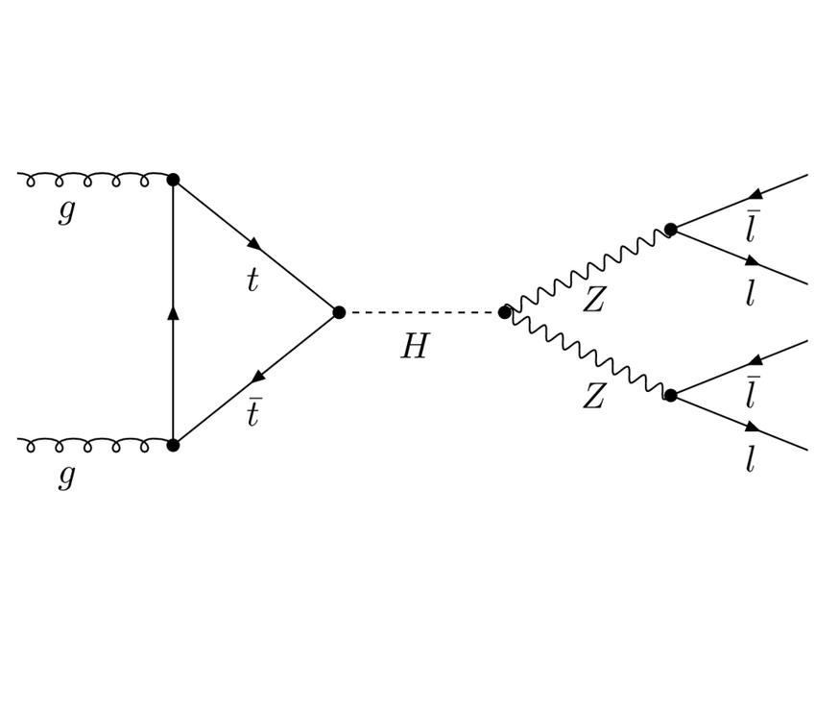
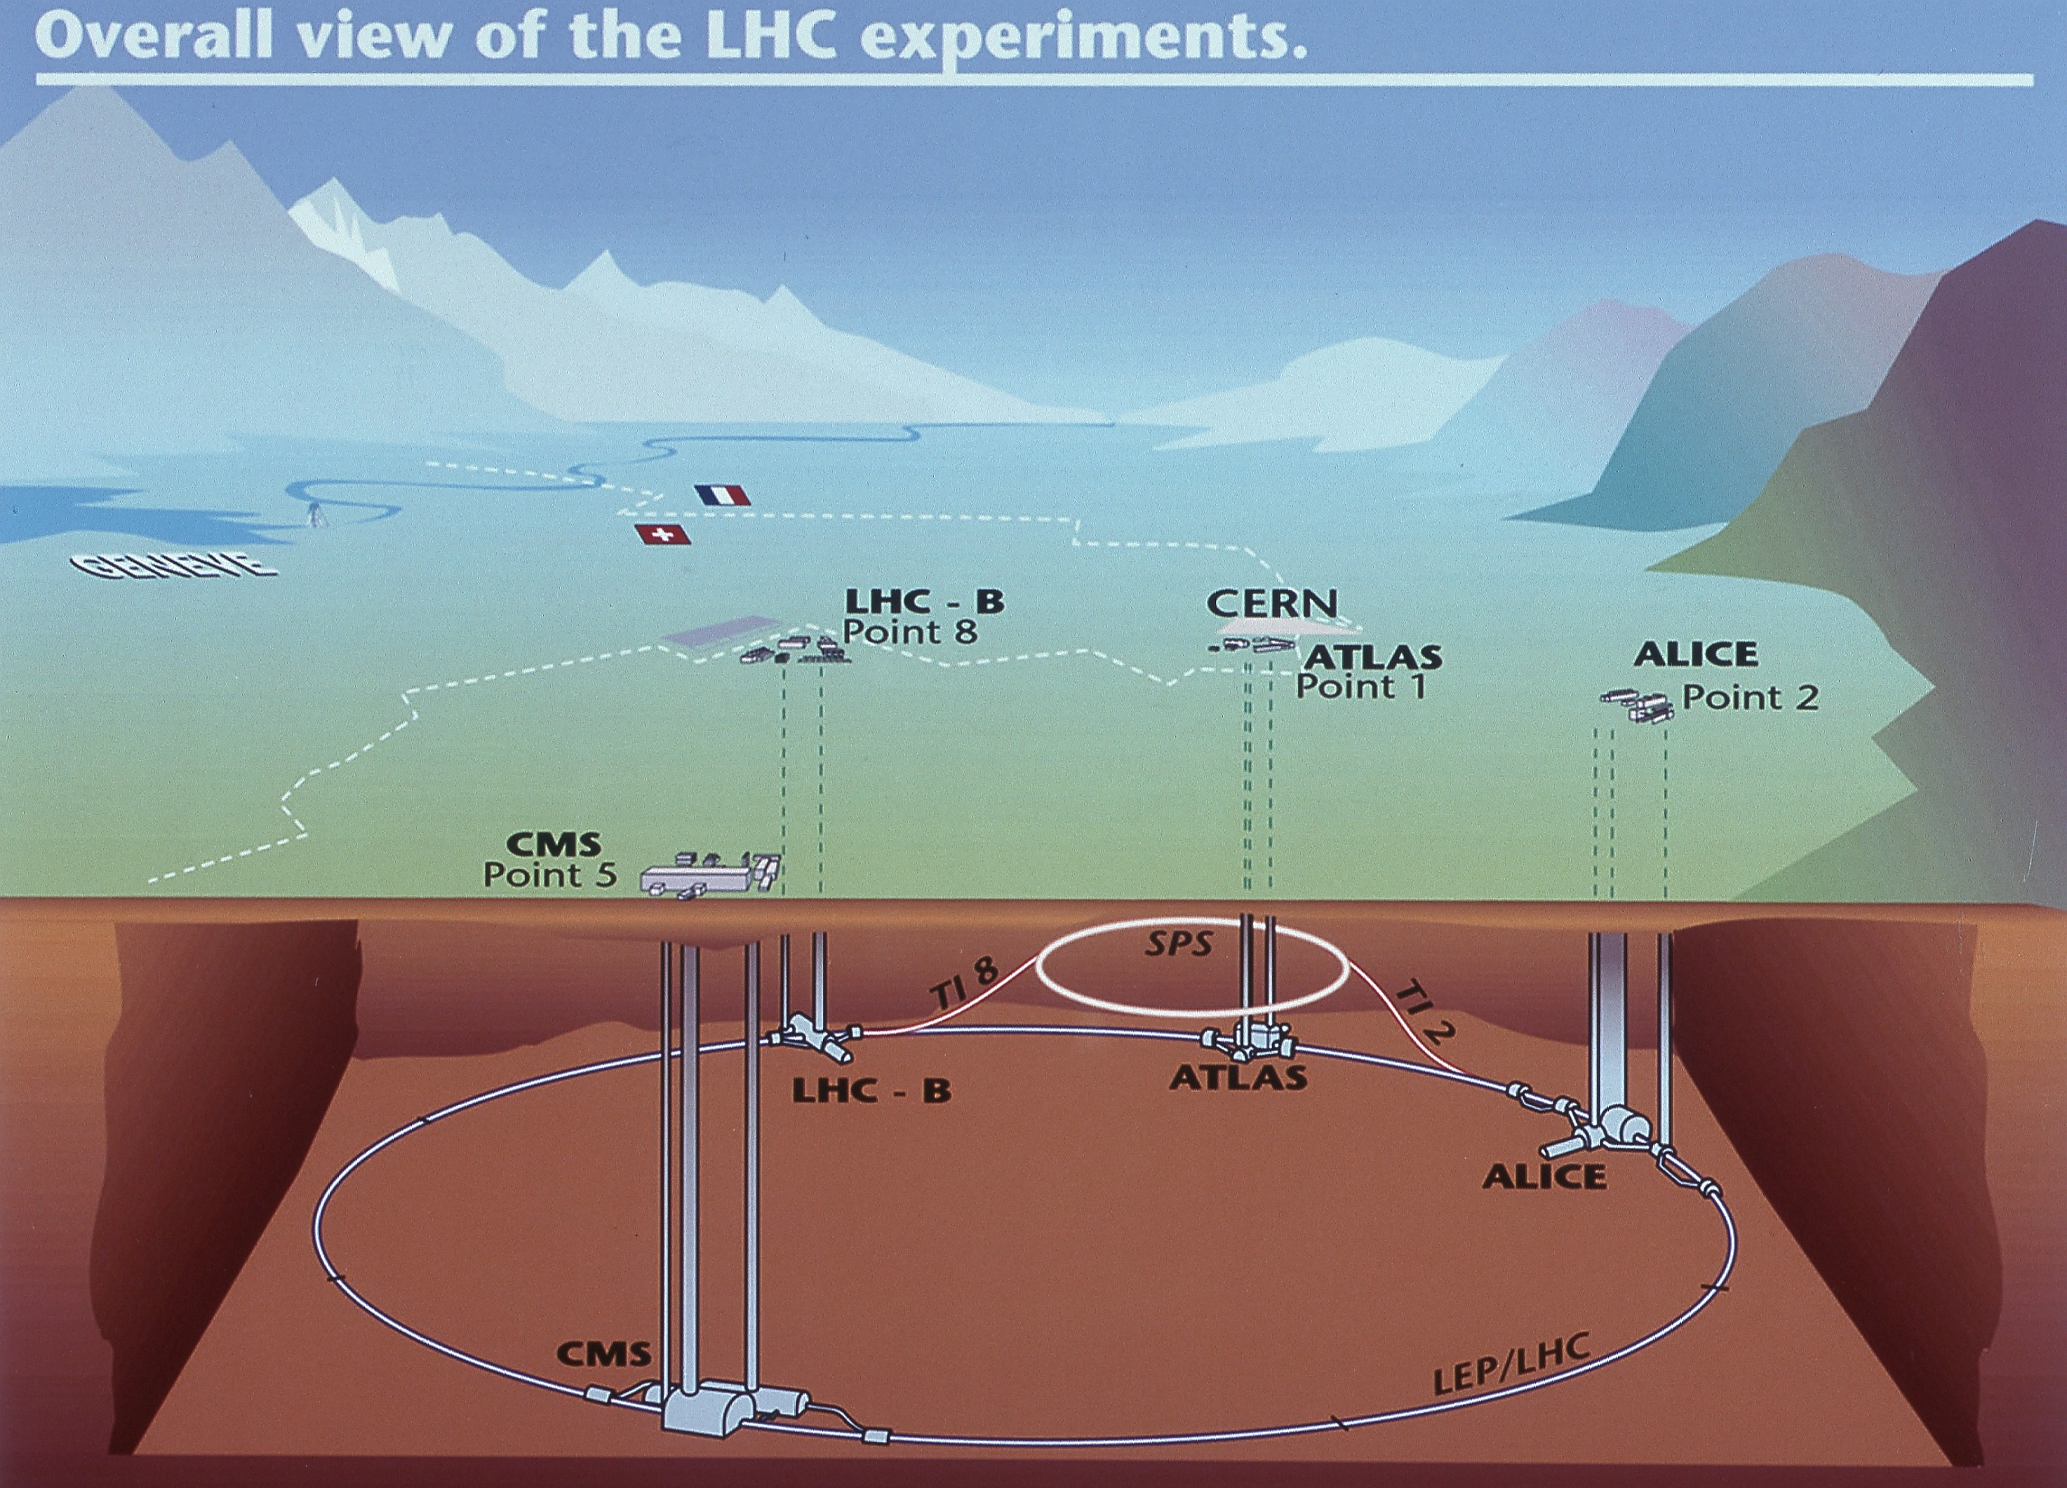
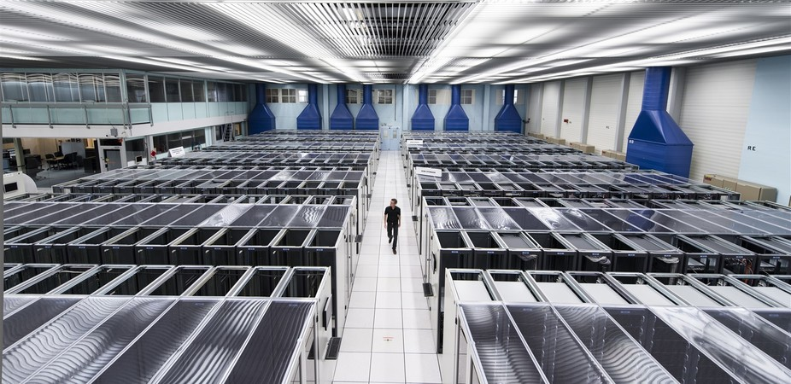
Computing @ LHC
4
Analysis Reconstructs the underlying physics
Data Lake
1
Reconstructs hits into objects (electrons, etc.)
2
Measures
3

Slide 14
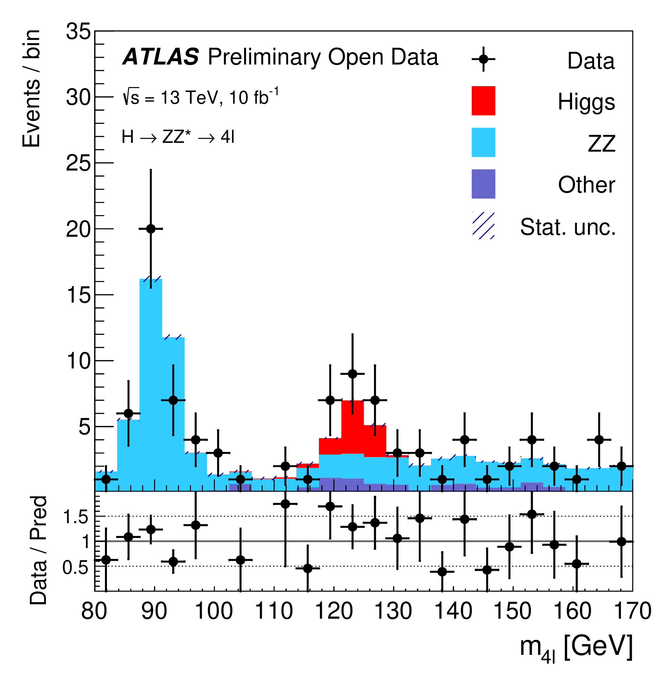
Computing @ LHC
4
Analysis Reconstructs the underlying physics
Data Lake
MonteCarlo & Data
Reconstructs hits into objects (electrons, etc.)
Measures
3
1
2
Madgraph5
Detector Simulation
(The Standard Model)

Slide 15
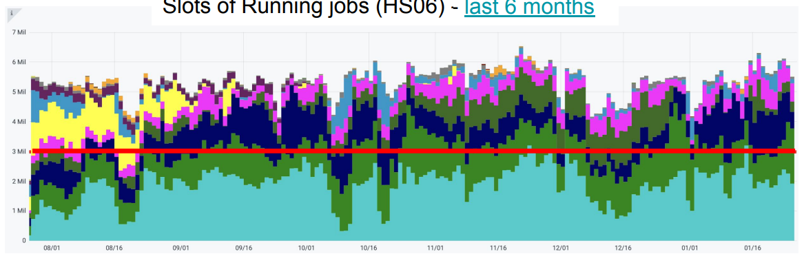
~10K 40-core boxes continuously around the world…
(this is current)
>15 million per month in the commercial cloud!
~4 million lines of (open source) code
~10 PB/year of reconstructed data during Run 4
Notes:
1 million is about 2000 modern 40-core machines
Just to give a scale…

Slide 16
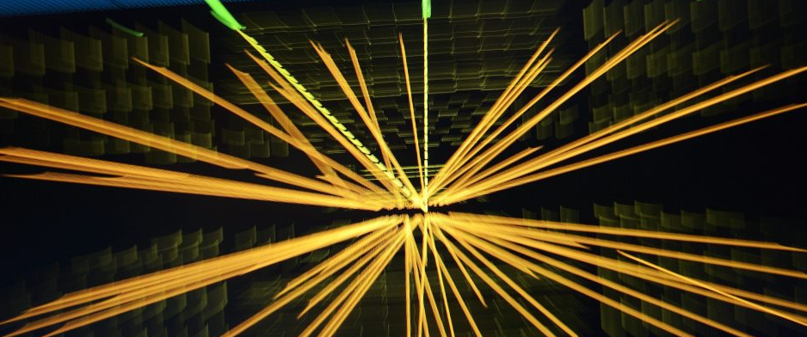
Software And Particle Physics
IRIS-HEP: 17 institute, ~30 FTE NSF software institute.
Data Management
Algorithms
Analysis
Facilities
The NSF
Physics Division
Office of Advanced Cyberinfrastructure
HEP-CCE: DOE software institute
GPU Porting of Algorithms and Generators
I/O and data formats and disk usage

Slide 17
Machine Learning

Slide 18
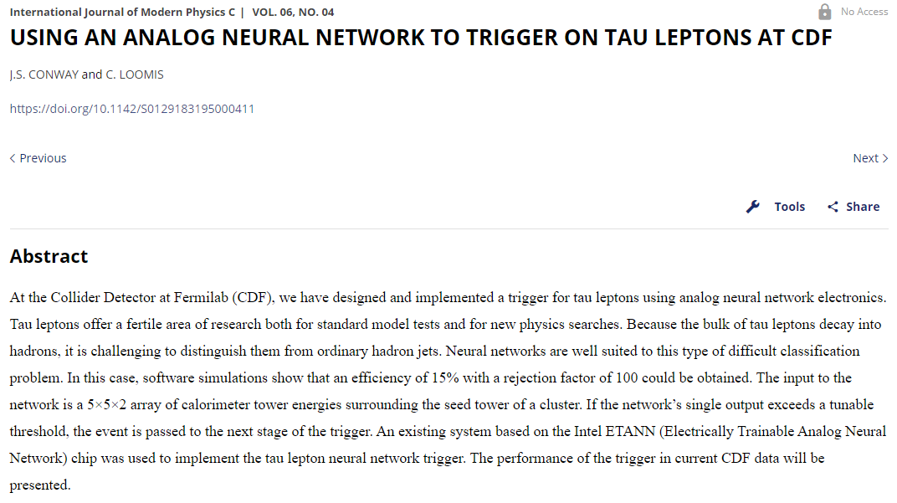

ML Has Been Around…
We learned how to calculate the gradient exactly…
1995
Deep Learning: function has millions of parameters
A function fit, or minimization problem
Notes:
ML is a cheat…?

Slide 19
Generation of Monte Carlo
Simulation of complex detector elements
Calibration
Separating signal and background

Slide 20

We can “calculate” this
$$f(x)$$
Result
Notes:
Everyone would rather calculate something exactly – ML is a cheat.

Slide 21
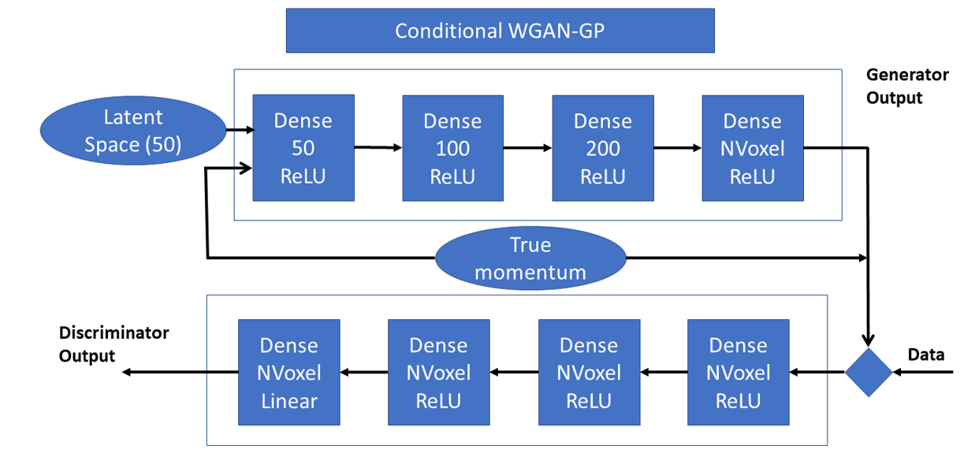
In Simulation
Photon Simulation
Random Numbers
Simulated Detector Data
G4 Simulation (training goal)
Trained to look for difference between G4 and Simulated Detector Data

Slide 22
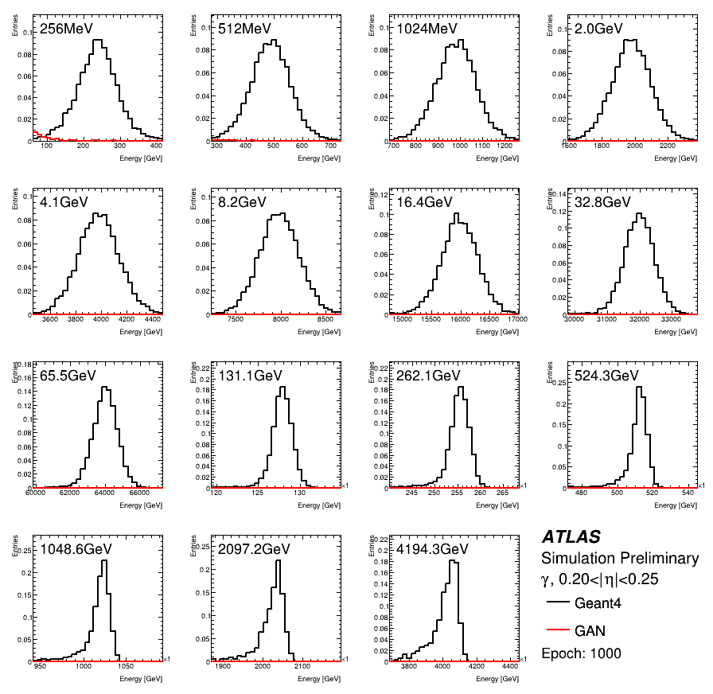
In Simulation
Photons – Geant4 vs GAN

Slide 23
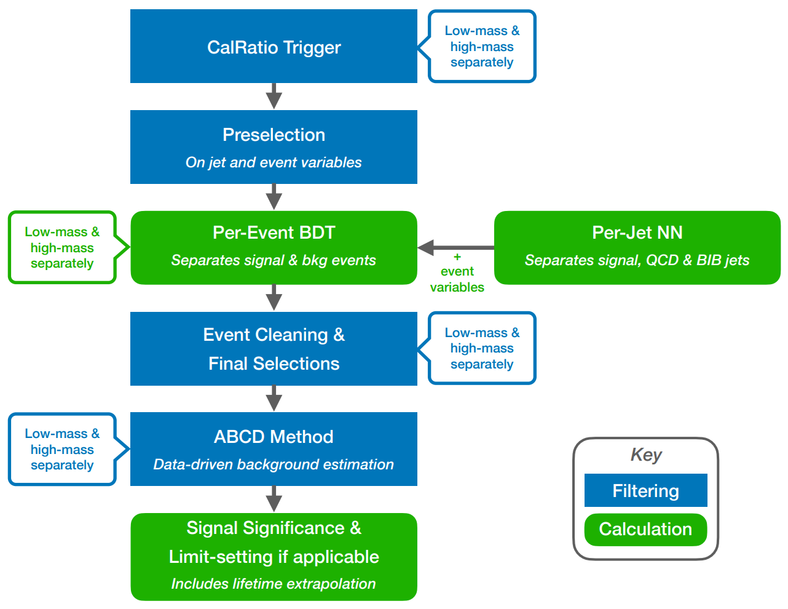
In Analysis
Grab decay from CMS or ATLAS detector picture
Make sure to save to LLP PR plots
20-30% Gain in Sensitivity

Slide 24


Differentiable Programming
Black Box (NN)
Traditional NN Approach
Traditional Approach
Select 4 muons
Selection cuts on muons
Combine into Z bosons
Selection cuts on Z’s
Combine into $4l$ object
Plot $m_{4l}$
Lepton Information
Environment Information
Black Box (NN)
$$m_{4l}$$

Slide 25
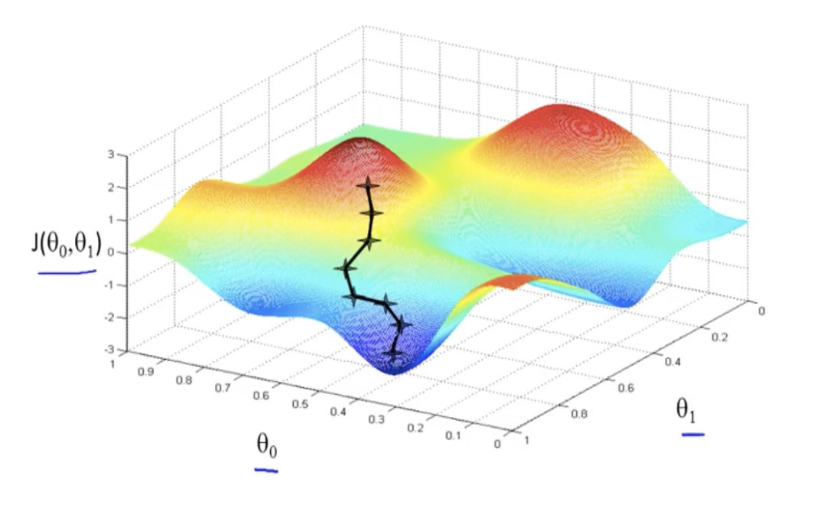

Differentiable Programming
Combine the Approaches
Select 4 muons
Selection cuts on muons
Combine into Z bosons
Selection cuts on Z’s
Combine into $4l$ object
Plot $m_{4l}$
Use ML techniques to optimize selection!
Based on figure of merit: expected sensitivity
Differentiable Programming allows you to do gradient decent through loops, if statements, etc.
Differentiable Programming allows you to do gradient decent through loops, if statements, etc.
Take into account systematic errors!

Slide 26
Coprocessors

Slide 27
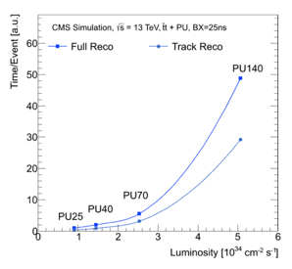
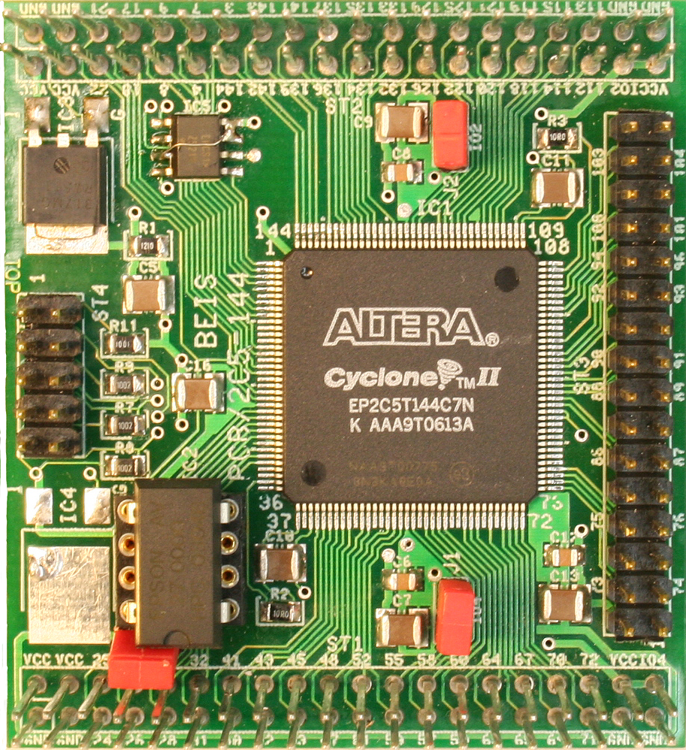

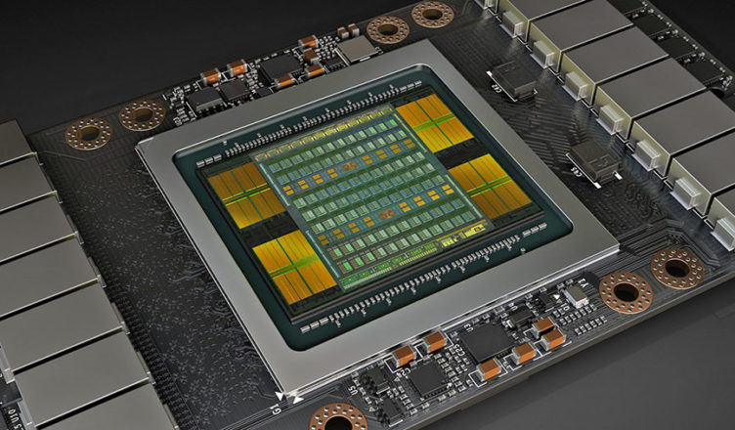
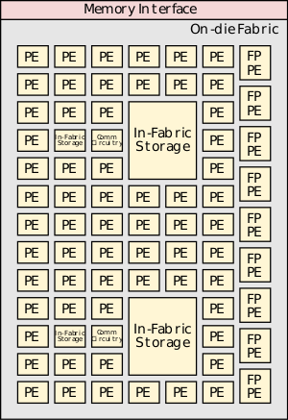
Why Are Coprocessors Interesting?
A Co-Processor does a specific calculation much more efficiently than a general-purpose CPU
FPGA’s
Configurable Spatial Accelerator (CSA)
ASIC
GPU

Slide 28
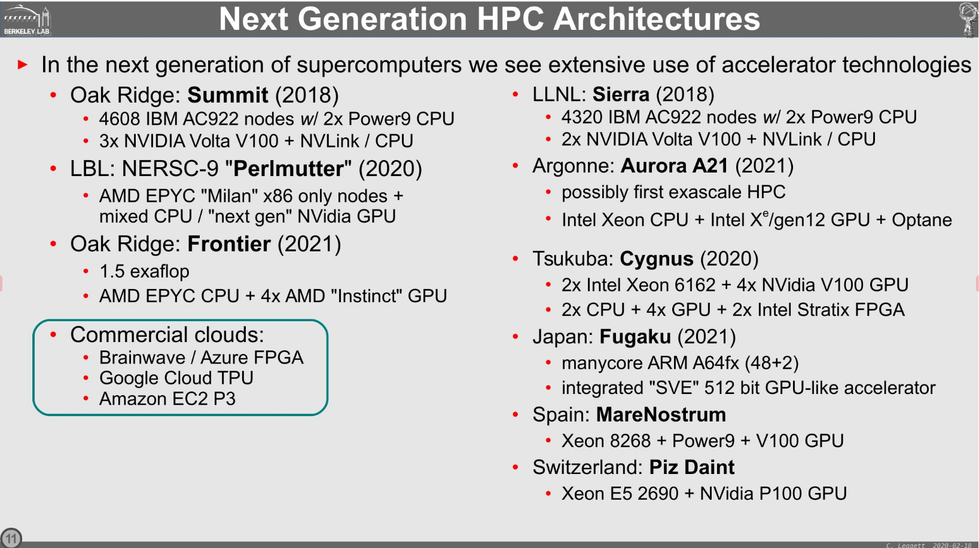
Sources of FLOPS…
What is viable?
GPU’s – for general purpose applications
FPGA – for tailor-made applications

Slide 29
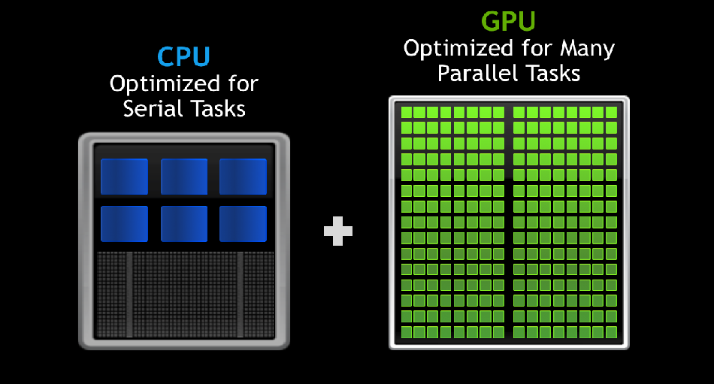
The GPU is optimized for the same parallel task

Slide 30
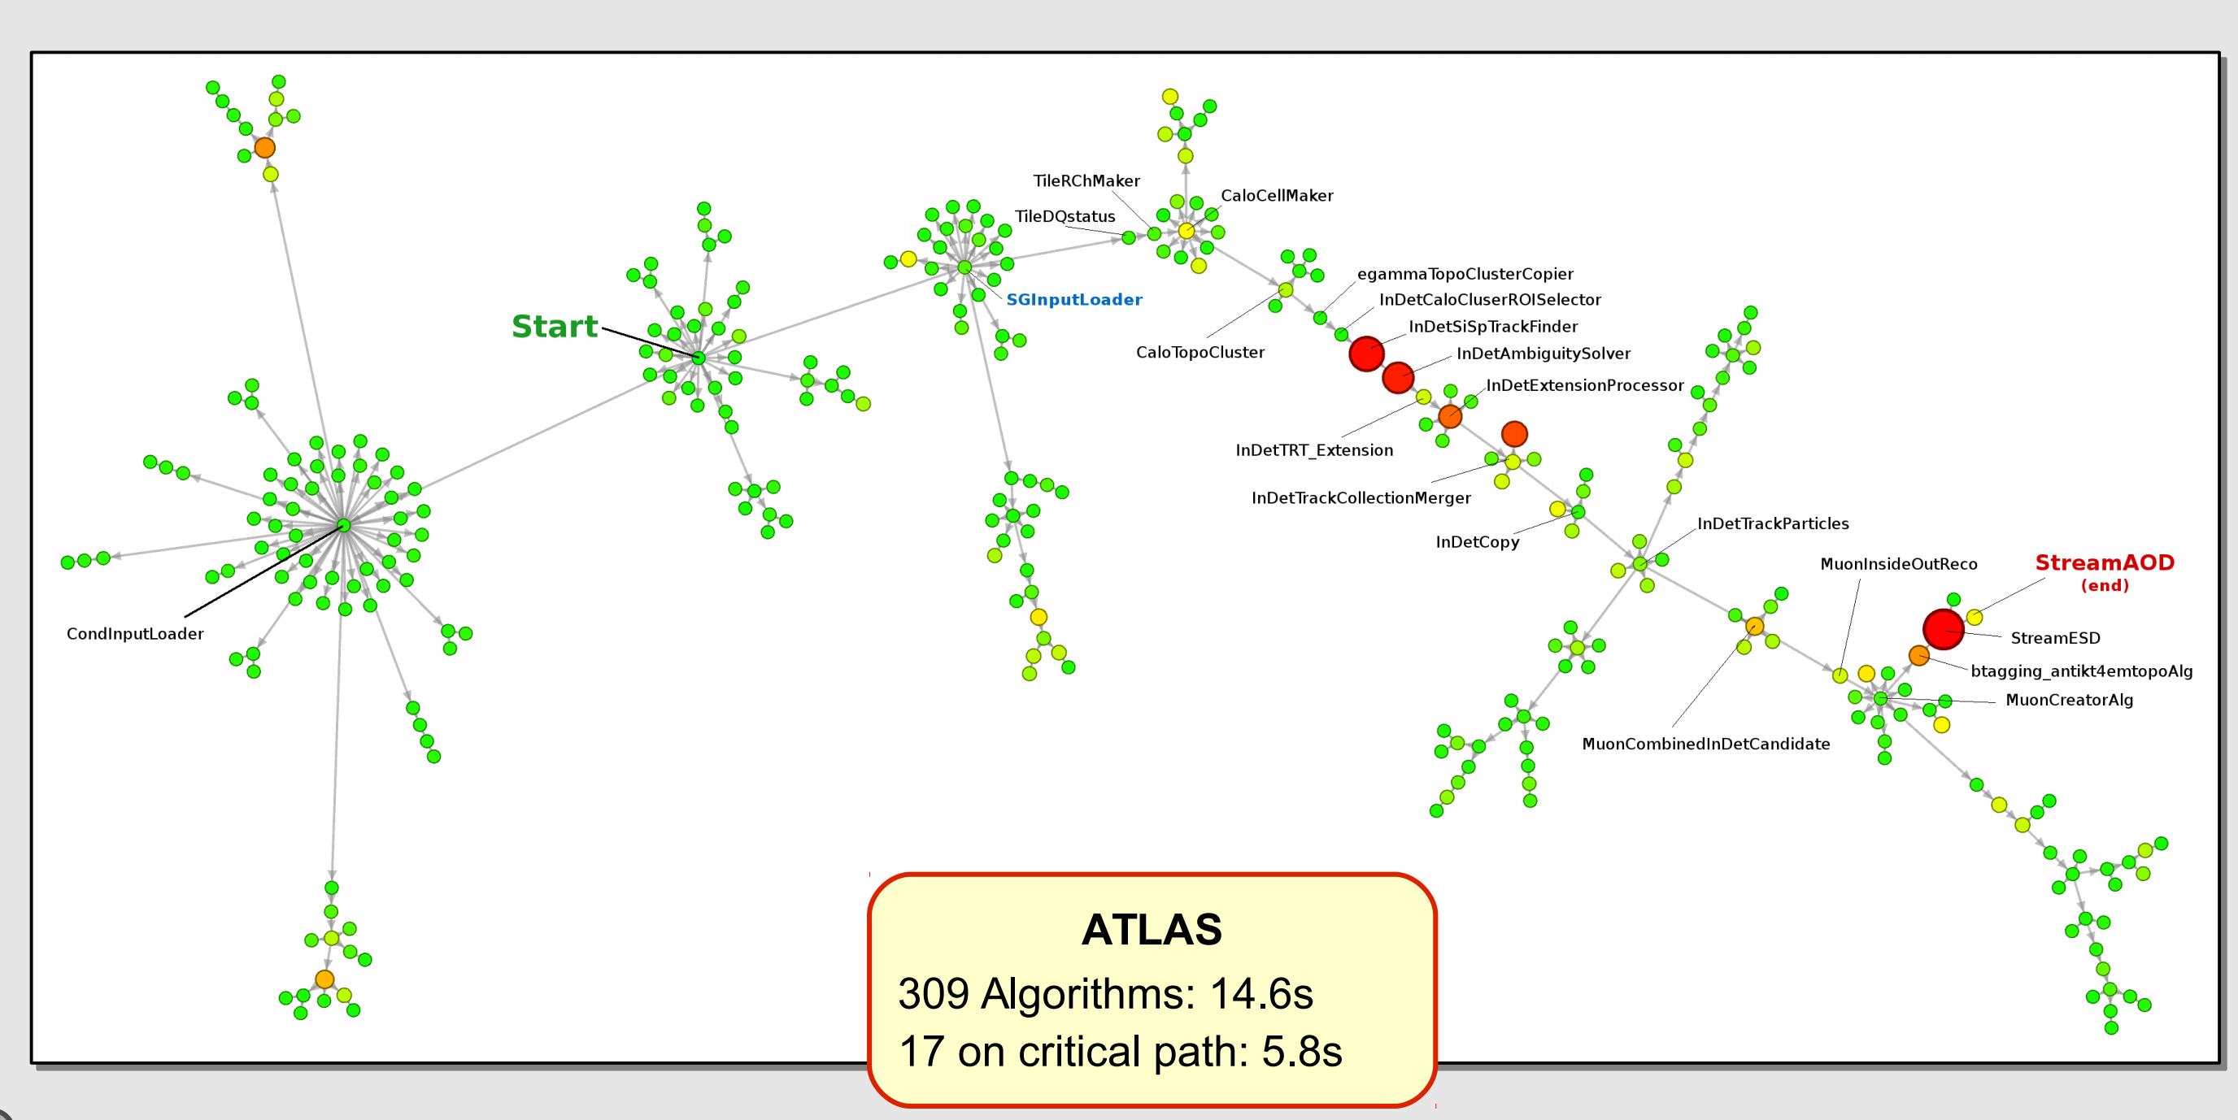

Slide 31
GPU’s are very good at Linear Algebra
GPU’s are very bad at if statements
Threads operate in lock-step
There is no i86 instruction set!
Porting algorithms is difficult or nearly impossible

Slide 32
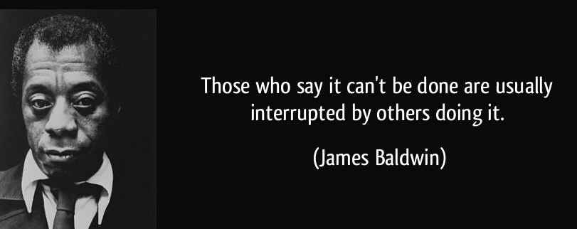


Slide 33
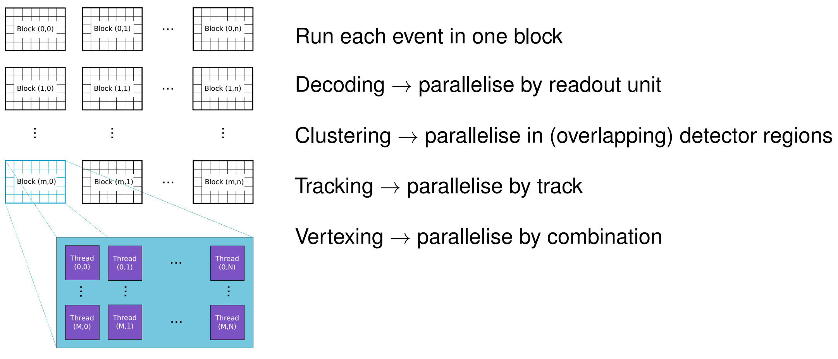
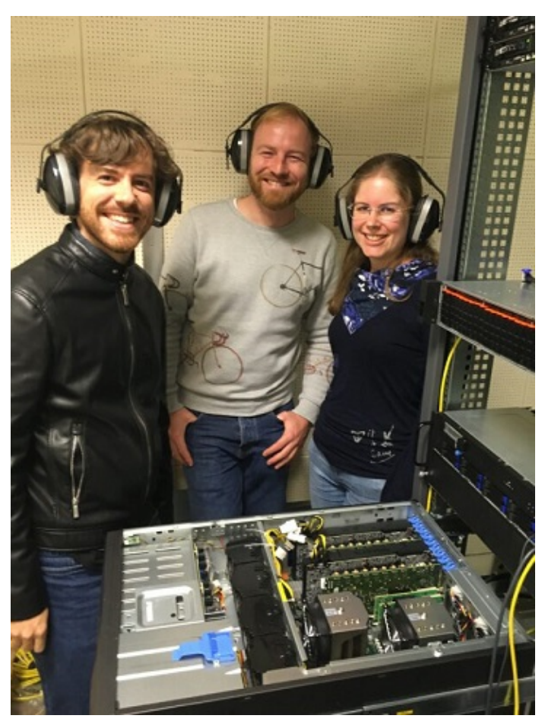
Daniel C´ampora (Maastricht)
Roel Aaij (Nikhef)
Dorothea vom Bruch (CPPM)

Slide 34
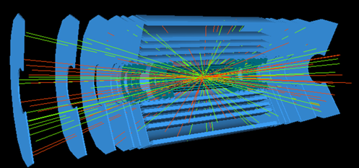
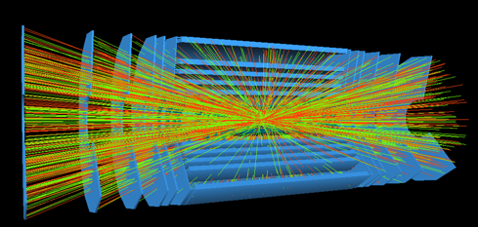
Is LHCb the exception? Or the Rule?
Two of the most expensive operations:
Tracking
Jet reconstruction
Run 2
Run 4
Let's hope it is the rule…

Slide 35
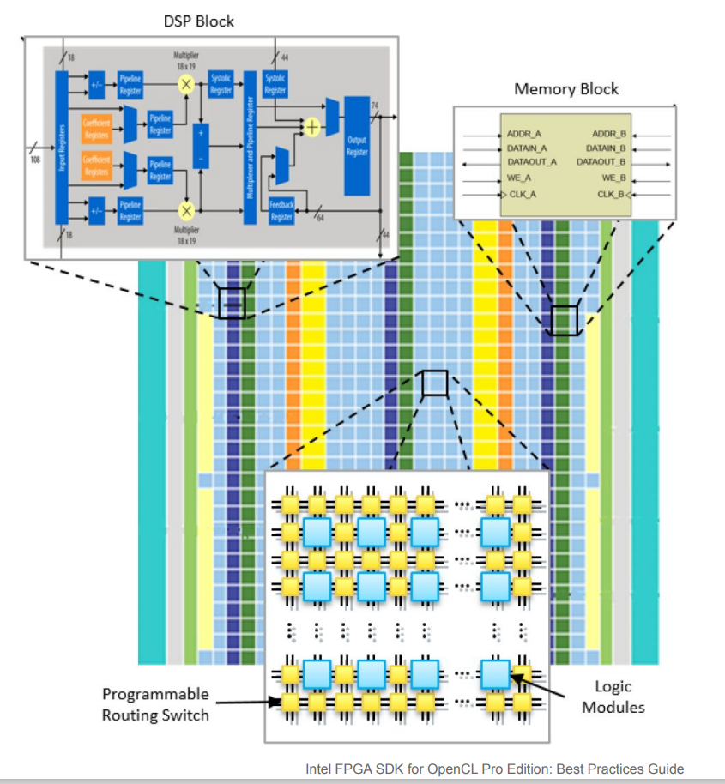
Field Programmable Gate Arrays
A Reconfigurable Integrated Circuit
Organize and route data between building blocks
Very energy efficient, very fast
Better than GPU’s in some cases
Particle physics has used them for years
Real-time applications
Low-Level Trigger
Speed and Flexability
They are starting to show up as co-processors on PCIe

Slide 36

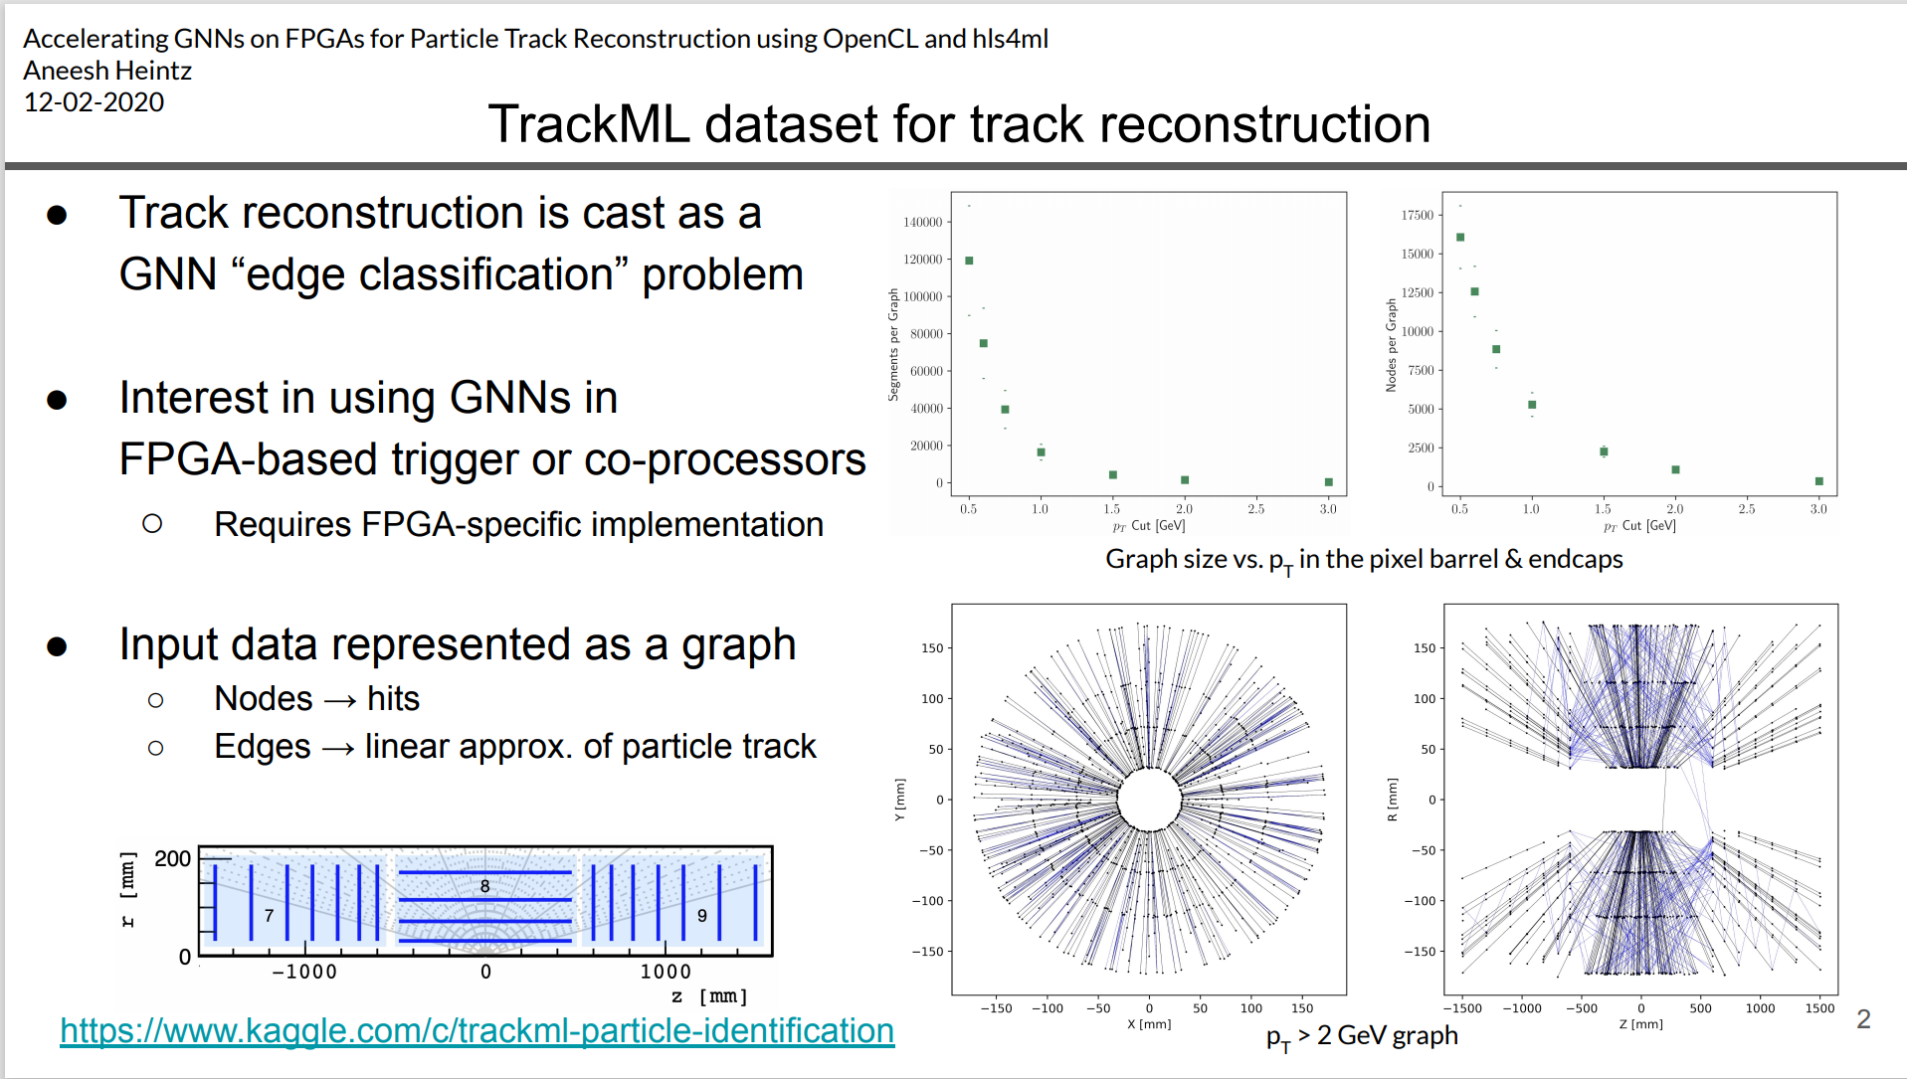
Mostly Arbitrary NN’s
FPGA Code
Graph Neural Network to search for tracks in an FPGA
Faster than Kalman filter!
Tracking results availible sooner
Can make decision more quickly – save bandwidth

Slide 37
Analysis

Slide 38


More Flexability
Less Flexability
The Wild West
Notes:
It is ok when you run on your laptop…

Slide 39
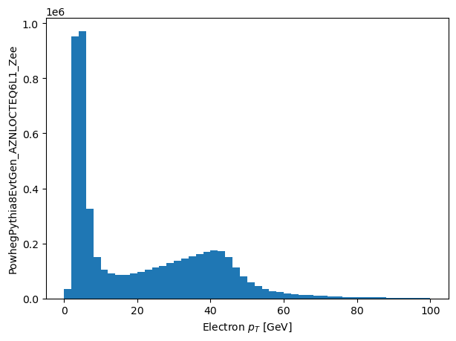
Refers to 200 TB of ATLAS binary data
ds = data_set(‘my_analysis_data’)
eles = ds.electrons
good_eles = eles[abs(eles.eta)<2.4]
plot (good_eles.pt, 50, 0.0, 100.0)
Marshalls 100’s of cores on high-speed networked machine for 60 seconds…
Aggregates the result to produce this

Slide 40
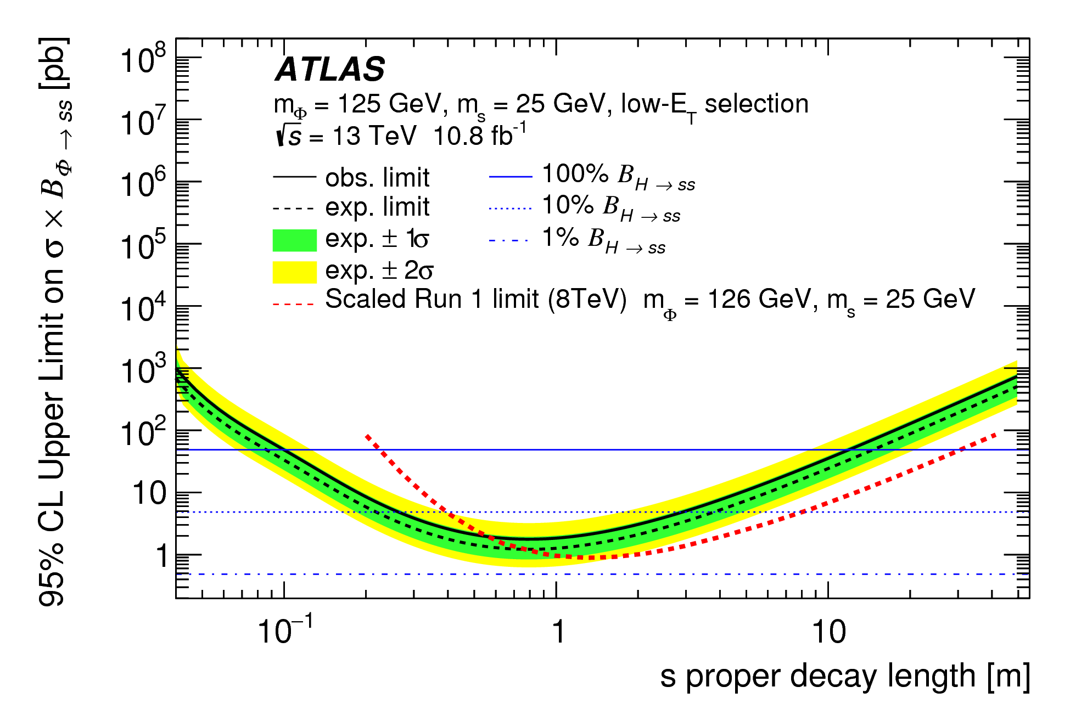
Optimize the “expected” limit
Take the gradient of the whole analysis…

Slide 41

Optimize the “expected” limit
Take the gradient of the whole analysis…

Slide 42

Particle Physics Software Eco-System
ROOT
Python
The computational backbone of particle physics for the last 25 years
Used by industry to analyze data similar to HEP data
Maintained by the community and a core of ~10 developers at CERN and Fermilab.
C++ (even in a command line)
A framework
I/O, data analysis, histogram filling, fitting, etc., all carefully put together
Designed by and for particle physics
Limited use outside
Ecosystem of many packages maintained by industry and open-source developers
Uses C/C++ for speed, python for productive interface
A collection of libraries that communicate via standards
I/O, data analysis, histogram filling, fitting, etc., all availible
Needs additional libraries to satisfy all of science’s needs
Growing use by particle physicists
Notes:
About 800 people attend the scientific python conference each year

Slide 43


Slide 44
Declarative “Analysis”
ds = data_set(‘my_analysis_data’)
eles = ds.electrons
good_eles = eles[abs(eles.eta)<2.4]
plot (good_eles.pt, 50, 0.0, 100.0)
SQL
Structured Query Language
SELECT CustomerName, City FROM Customers
The data you want to start from
What parts of the data you want
Write C++ code to access experiment Data Format
Locate Data in Data Lake
Submit jobs to run on world-wide GRID of computers on many files
Download & combine data locally
Make plots/look at data
Get Name of Data in Data Lake
Write “simple” query
Make plots/look at data

Slide 45

Extreme Parallelism
Industry Solution: Columnar Calculations
Don’t loop over events
Loop over objects/numbers/arrays
Calculate the mean energy of all jets in an event
Event 1
Load electron energies into memory for all events
Scan all at the same time, calculating the mean
Event 2
No loops, no if statements: very GPU friendly!
What if your data is too large to fit in memory?
Complex operations generate unneeded temporaries

Slide 46



Rectilinear Data
Particle Physics Data is Jagged
Gaps!
Each Event does not look the same!
(numpy ecosystem in Python)
Build out and Extend the numpy ecosystem

Slide 47
Data Access
ServiceX
ROOT
Python Ecosystem
Columnar or Awkward data
Give it a simple data query: grab only the data you want
Transmits the data in a compact format to the world
Built with open-source distributed tools (RabbitMQ, Kubernetes, etc.)

Slide 48
OpenData and Reuse

Slide 49



OpenData and Particle Physics
“The replication crisis”
Publicly Availible Data Has Benefits Too
Non-collaboration members can produce science
New models can be tested
Tool authors have realistic datasets to experiment on
Easy to link in other communities for tooling
Funding agencies
Laboratories
The Community

Slide 50


High Level Results for published papers
Computer readable
No more overlaying transparencies!

Slide 51



CERN Has an OpenData Policy!
What it means…
Can you imagine anyone running over 1 PB of data?

Slide 52




Defines the analysis
  Background Model
  All Errors
Defines sample set of signals
Analysis is freeze-dried
New set of signals
Uses reana resources

Slide 53
Last Thoughts

Slide 54
The Community Outside of HEP
All branches of science are taking advantage of the recent advances in computing
“Can a physicist get a Ph.D. without at least understanding Machine Learning?”
Astrophysics
Particle Physics
Nuclear Physics (Jefferson Lab’s efforts)
Interacting with the non-Physics Community
Pulling techniques and software from industry into the community
Designing our own software and putting out into industry
Physics
Science & Industry
Communicator

Slide 55
Conclusions
$100M is being spent on LHC upgrades
  We must extract as much physics from this and past investments as possible
  This requires a major change in our field’s approach to computing
Machine Learning
  We are still learning the places it might be applicable
  Proved itself for signal/background separation
Coprocessors
  Cheap, energy efficient access to FLOPs for specific applications
  Field is working on the general case
Analysis
  Making the last mile more uniform
  Flexability possible means bold ideas can be tried
  Data delivery to reduce time to insight by using industry tools
Open Data & Reuse
  From plots to full analyses
  Useful for both physicists inside and outside collaborations
Physics is not an island
  Industry and others have many mature and useful tools
  We have years of experience to give back
Software and Computing is a huge subject
  Quantum Computing
  Major advances in computing facilities
  Data management & Access
  Machine Learning Details would require several talks all on its own
The community is vibrant
  And not at all limited to just Particle Physics

Slide 56

Backup

Slide 57


Community White Paper
Many of our collaborators and colleagues at U.S. CMS universities and laboratories have contributed to the CWP process and papers

Slide 58
Mathusla
We can still do it on one computer

Slide 59



How Did I End Up Here?
My physics (current) passion is searches for Long Lived Particles
I got into (particle) physics because I’ve the intersection of physics, computers, and hardware fascinated me.
As I became a professor… I had less and less time… How could I keep doing physics (e.g. making plots)!?
Got involved with others looking to make analysis easy and ended up being deputy executive director of IRIS-HEP.
Notes:
Find a picture of me as a grad student

Slide 60

Notes:
There is a second aspect: it isn’t just large energy, we also need statistics. This is because of the way the SM works. Especially us experimentalists prefer to think of this in terms of feynman diagrams. Here we have gg -> ZZ -> llll, one of the Higgs discovery channels. Using the SM Lagrangian we can calculate how often when two gluons, with appropriate energy, interact and produce this Higgs. The answer: not often – it wasn’t until we had the LHC running in Run 1 that we had enough raw interactions to convincingly see this particular decay channel.

Slide 61


Now
HL-LHC Projections

Slide 62

$$ℒ$$
$$ℒ_{nature}=ℒ_{SM}⊕ℒ_{BSM}$$
Luminosity

Slide 63
Run 4

Slide 64
The Frontiers of Computing Evolution
Machine Learning
Coprocessors (GPU)
Analysis
OpenData/Reuse

Slide 65

Industry Has Tackled This
e.g.
Given a query against a registered dataset, automates all aspects and returns your requested data. Tested against PB of data.
Many tools
Kafka, Hive, Fink, Storm, etc.
Many tools are mature… why not take advantage of them?
There are many working prototypes
Independent collider collisions: extreme parallelism
Rectilinear Data Model
Data Lake Interfaces

Slide 66
ROOT Tools
Particle physics lives and dies by the size of its on-disk data
PB’s of data
SSD’s are very expensive – but fastest way to access data
RNTuple
New data format tied to ROOT
  ~25% smaller than current file formats
  2-5 times faster read times
Should be favorable compared with industry formats!

Slide 67




Statistics
Fundamentally, calculating the sensitivity, limit, and discovery of a signal is fitting
Expected Background
Systematic and Statistical Errors on background
Data
How Compatible?

