Slide 1





Little Minions in Archaeology
An open space for RSE software and small scripts in digital archaeology
Florian Thiery
Ronald Visser
Moritz Mennenga
SORSE | 2021
3rd March 2021
© by CAA International
Illustriouss by fiverr

Slide 2
We are the Little Minions - small self-made scripts, home-grown small applications and small hardware devices - which help archaeologists in their daily work.
© by CAA International
Illustriouss by fiverr

Slide 3
We often reduce the workload or optimise workflows, but we are not often presented to the outside world and the research community.
© by CAA International
Illustriouss by fiverr

Slide 4
Researchers generally focus on presenting the results of research and silently use Little Minions to generate these, without not even pointing to them.
© by CAA International
Illustriouss by fiverr

Slide 5
We see, that in archaeology, research software is underrepresented in conference talks as well as in research publications.
© by CAA International
Illustriouss by fiverr

Slide 6
Let us promote us as Little Minions in the RSE and domain specific research communities to make us visible!
© by CAA International
Illustriouss by fiverr

Slide 7
The Little Minions were created as “Working Group” at the Computer Applications & Quantitative Methods in Archaeology (CAA).
© by CAA International
Illustriouss by fiverr

Slide 8
Human helpers organise a session that focus on us Little Minions and invite researchers to share their little helpers, so that the scientific community may benefit.
© by CAA International
Illustriouss by fiverr

Slide 9
In such a “Minion Session” we are focussing on lightning talks - aka “Minion Talks” - where a wide range of tools are shared.
© by CAA International
Illustriouss by fiverr

Slide 10
Each “Minion Talk” explains the innovative character and mode of operation of the digital tool.
© by CAA International
Illustriouss by fiverr

Slide 11
We love Open Science and Open Source Software!
© by CAA International
Illustriouss by fiverr

Slide 12
Our aim is that all Little Minions are non-proprietary as well as open and freely available on e.g. GitHub, GitLab.
© by CAA International
Illustriouss by fiverr

Slide 13

This are some cool Little Minions from the last CAA conferences. The next CAA conference will be held virtual on 14-18 June 2021.
https://2021.caaconference.org
Illustriouss by fiverr

Slide 14
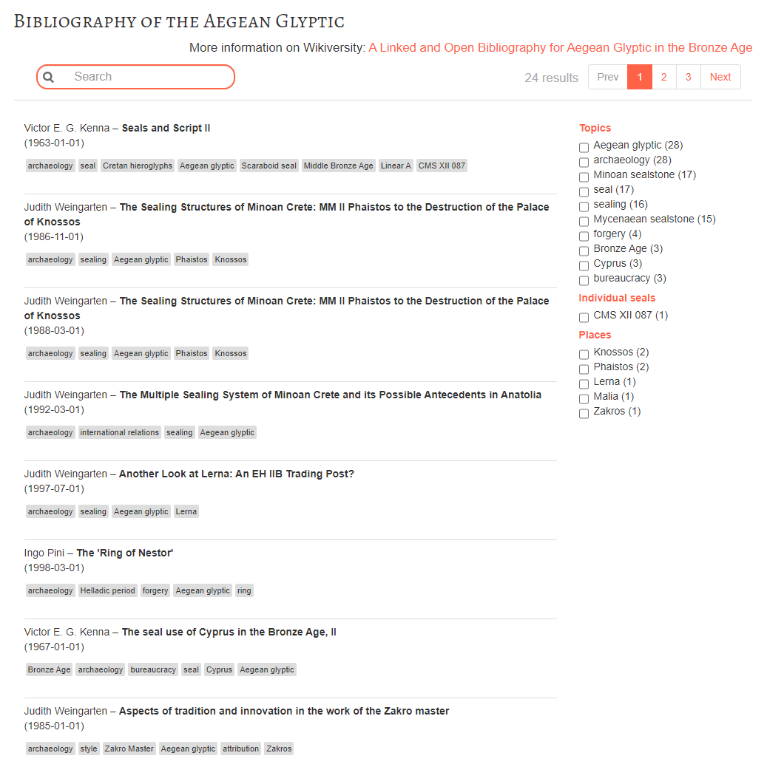
© by CAA International
Illustriouss by fiverr
A Linked and Open Bibliography for Aegean Glyptic in the Bronze Age
Martina Trognitz (CAA 2019)
https://youtu.be/ywsRcnlQ198
https://bellerophons-pegasus.github.io/lobib/

Slide 15
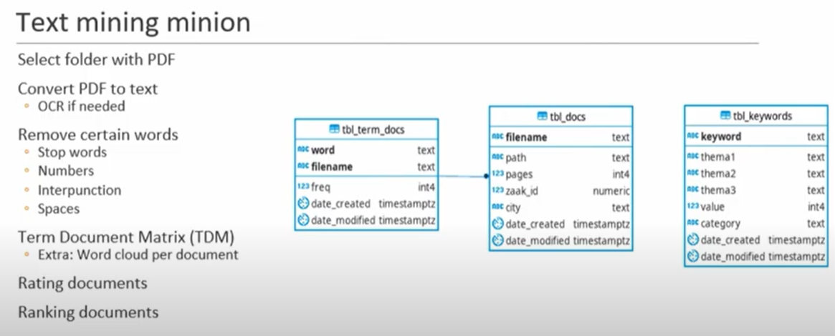
© by CAA International
Illustriouss by fiverr
My little text mining minion
Ronald Visser (CAA 2019)
https://youtu.be/KIyWEFHaG5A

Slide 16
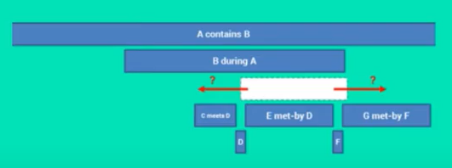
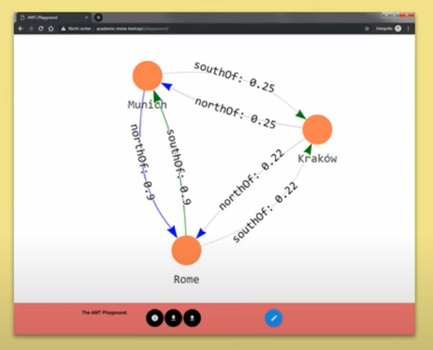
© by CAA International
Illustriouss by fiverr
Taming Time Tools: Alligator and Academic Meta Tool
Florian Thiery, Allard Mees (CAA 2019)
https://youtu.be/X7mwRToJZbA
https://github.com/RGZM/alligator
http://academic-meta-tool.xyz

Slide 17
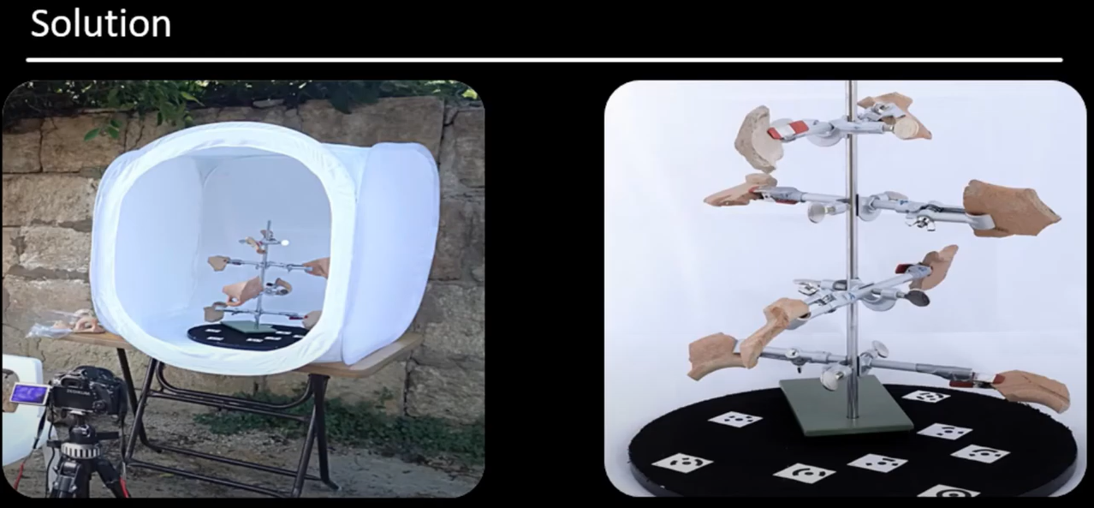
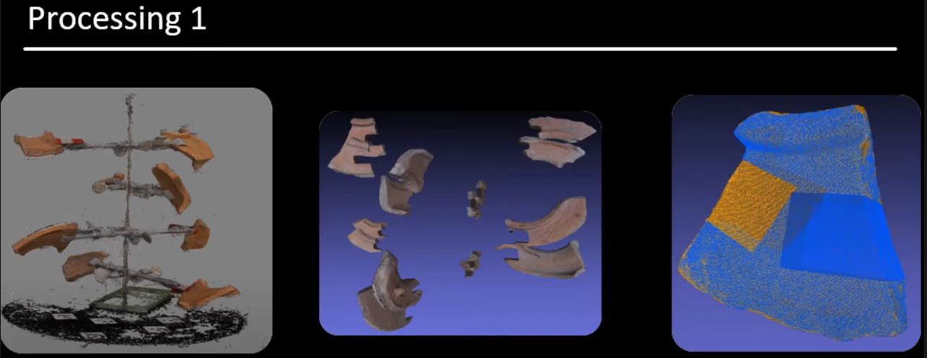
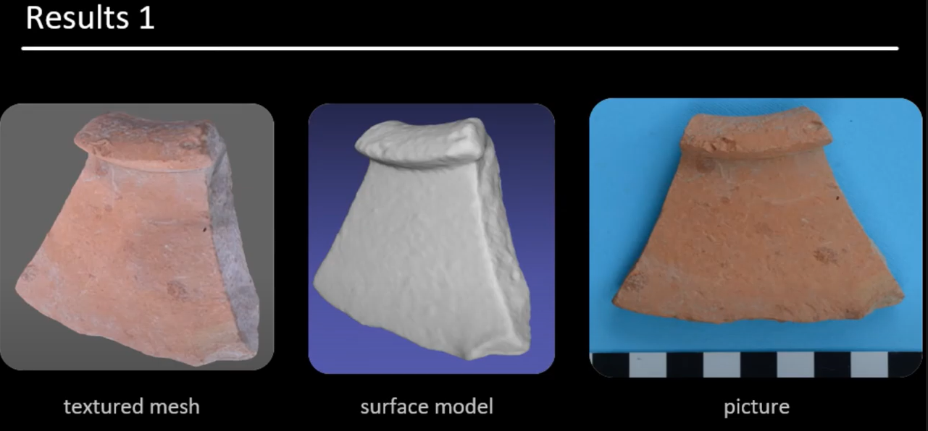
© by CAA International
Illustriouss by fiverr
Serial, fast and low cost 3D pottery
on site documentation
Fanet Göttlich (CAA 2019)
https://youtu.be/zhD2bI3K66A

Slide 18
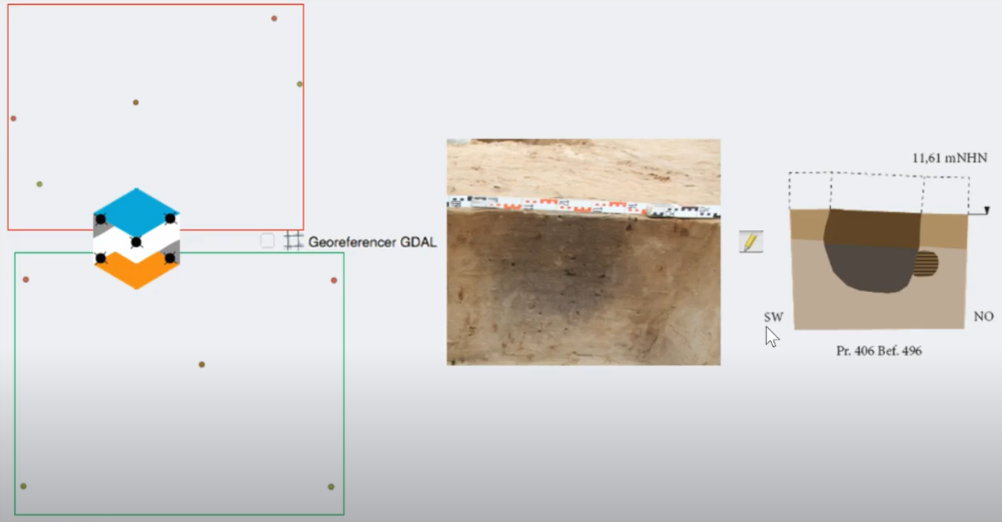
© by CAA International
Illustriouss by fiverr
profileAAR – a small tool helping to
rectify archaeological profiles in QGIS
Moritz Mennenga (CAA 2018/2019)
https://youtu.be/SgVIP3lF7m8
https://github.com/ISAAKiel/profileAAR
https://plugins.qgis.org/plugins/profileAAR/

Slide 19
What have we learned?
What can you do?
© by CAA International
Illustriouss by fiverr

Slide 20
Presenting RSE work is important to increase the understanding for digital processes in archaeological research as well as the approvement of RSEs works as scientific research.
© by CAA International
Illustriouss by fiverr

Slide 21
Short lightning talks in combination with “spontaneous stand up minions” create a dynamic and casual atmosphere.
© by CAA International
Illustriouss by fiverr

Slide 22
What can you do? Create your own “Little Minions” Session on domain specific scientific conferences!
© by CAA International
Illustriouss by fiverr

Slide 23
Thx!
Any questions?
Florian Thiery
Ronald Visser
Moritz Mennenga
Little Minions in Archaeology - an open space for RSE software and small scripts in digital archaeology
© by CAA International
Illustriouss by fiverr
Notes:
Thank you. Any Questions?

Slide 24
Credits
title image by Wikimedia Foundation, Inc.
presentation template by SlidesCarnival
photos not referenced by Pixabay
or F. Thiery / R. Visser / M. Mennenga [CC BY 4.0]

Slide 25
License
Except where otherwise noted, content on this presentation "Little Minions in Archaeology - an open space for RSE software and small scripts in digital archaeology" is licensed under a Creative Commons Attribution 4.0 International license.

