Slide 1



FAIR principles and Open Data
Emma Lazzeri
ORCID iD: https://orcid.org/0000-0003-0506-046X
Istituto di Scienza e Tecnologie dell’Informazione
Consiglio Nazionale delle Ricerche

Slide 2
Practicalities
During the course, we will use different tools and services to
Share
Collaborate
Interact

Slide 3

Virtual Research Environment
We set up a Virtual Research Environment (VRE) for this course. By entering the VRE you will find:
  A dedicated forum (social networking) where you can ask questions after the lessons, discuss, share experiences. Trainers will use the forum to share important information about the course.
  A dedicated workspace where trainers will share course material and other useful documentation
To join the VRE, you can use your institutional, google or LinkedIn account:
https://eosc-pillar.d4science.org/group/eosc-pillar-gateway/explore?siteId=273133421

Slide 4
Interactive Zoom buttons
CHAT
RAISE HAND
Q&A
Use the Chat for technical/ practical messages. Useful links will be shared here during the lessons
If you wish to speak during the discussion sections, please raise your hand
Please use the Q&A button to pose questions anytime during the course. Questions will be answered in the discussion sessions, after the presentations.

Slide 5

Mentimeter
Mentimeter allows for a quick interaction with the audience.
You will be able to post anonimous comments
You will be asked to answer questions anonimously
Results of the interactions will be available live
You can access mentimeter from any device (mobile pc, tablet…)
  Go to www.menti.com and enter code: 17 62 71
  Click on the direct link: https://www.menti.com/663okc6efu
  Scan the QR code

Slide 6
What we will learn today
FAIR refers to principles, not to standards: no one size fits all!
We will see how to generally apply FAIR principles to your data
We will learn how you can apply FAIR principles in a structured community (institutional or disciplinary)
We will learn a good recipe for Data Management Plans

Slide 7
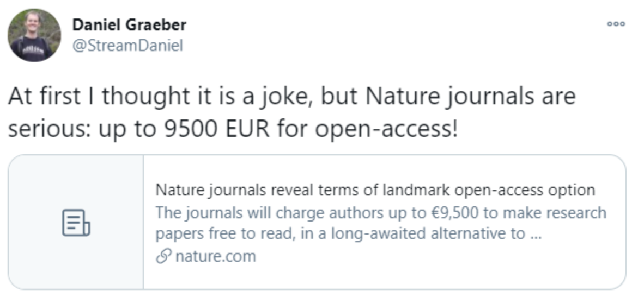
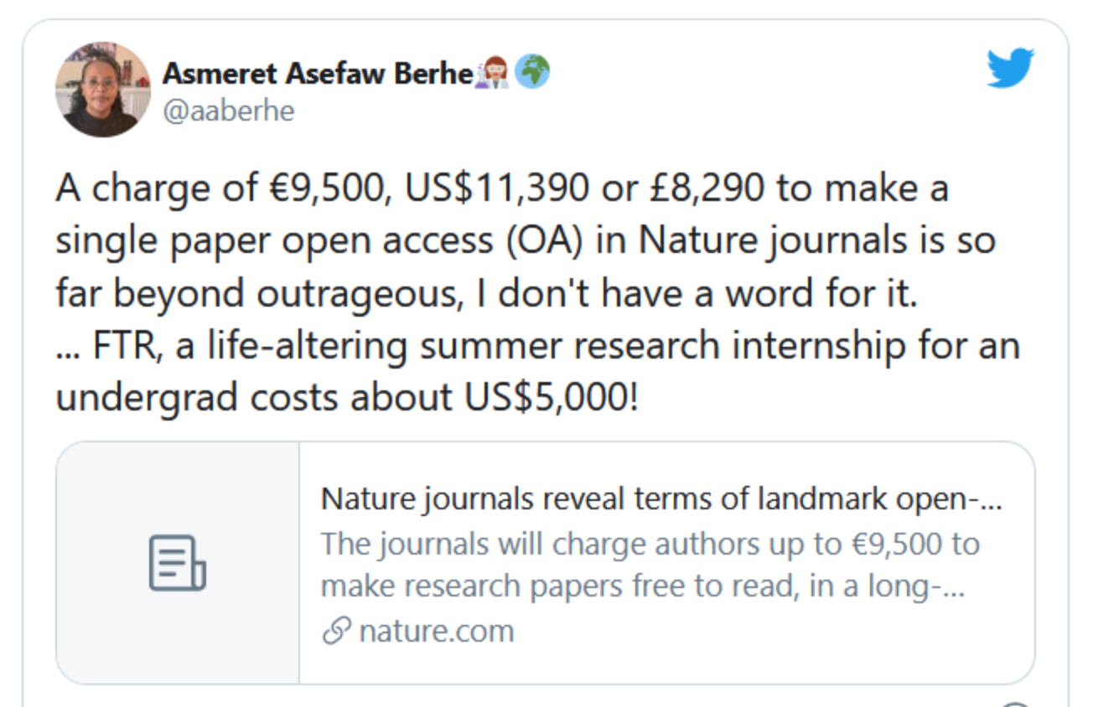
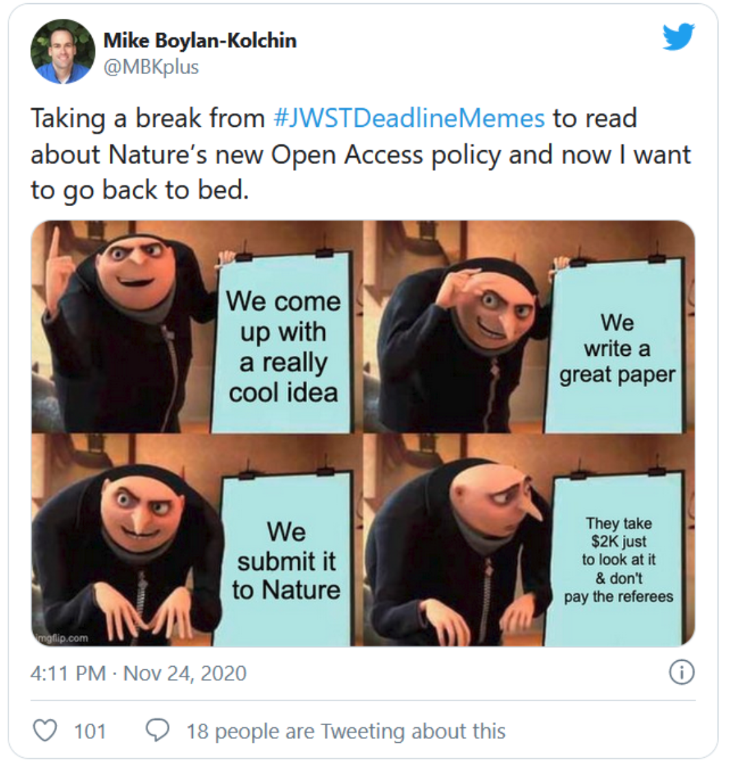
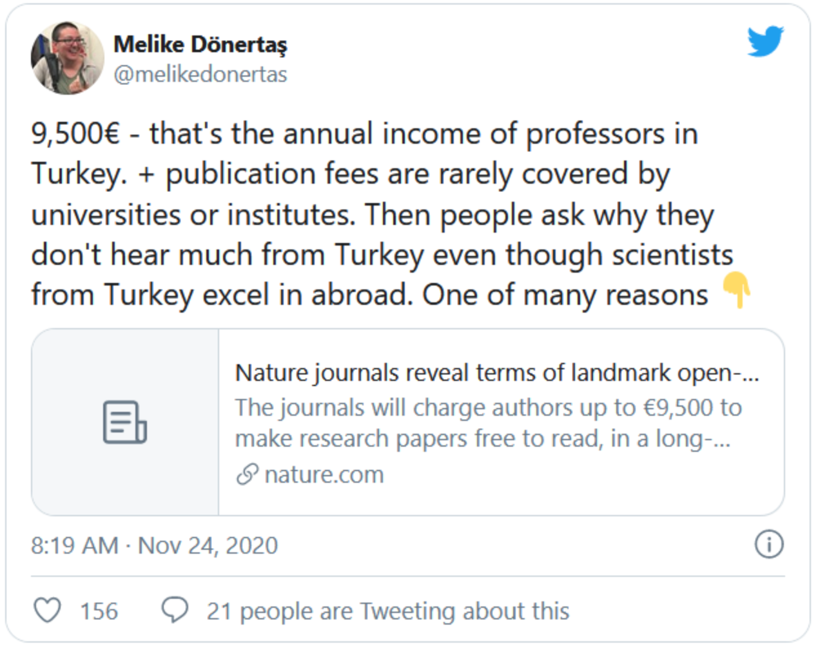
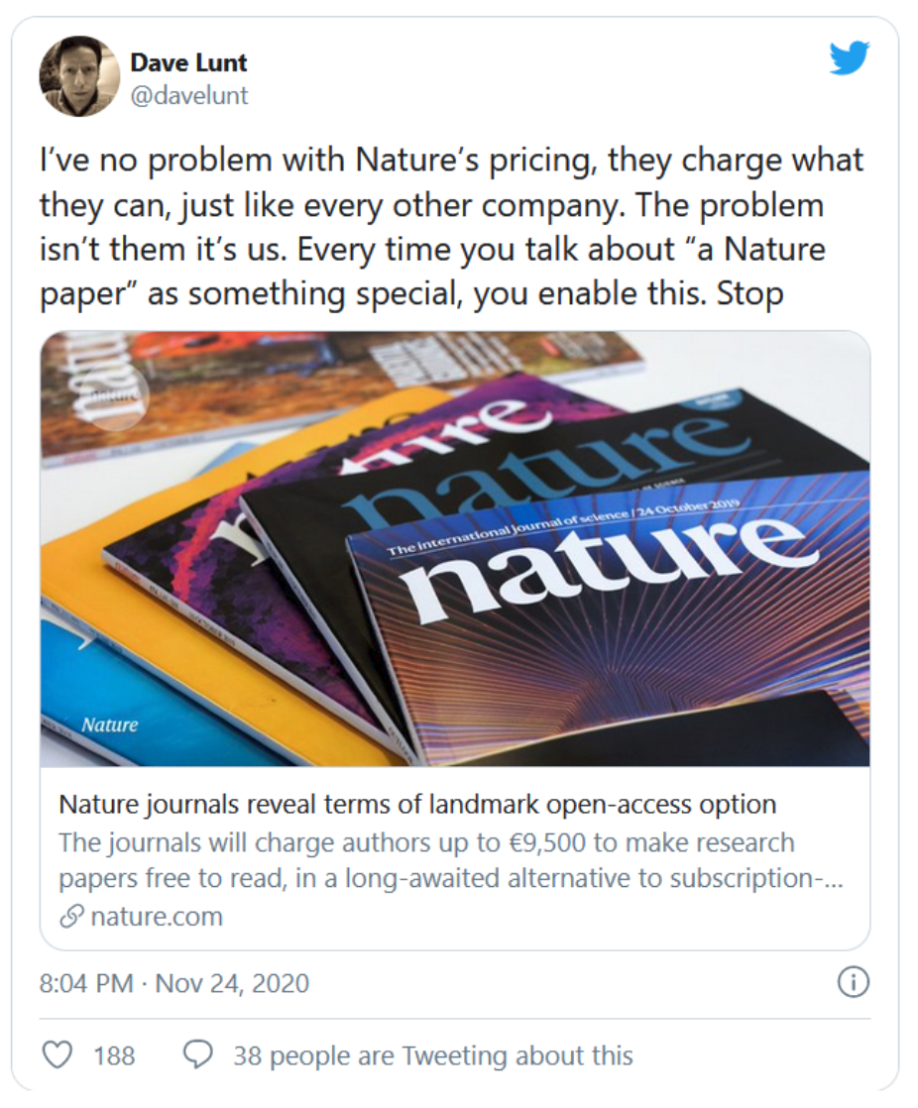
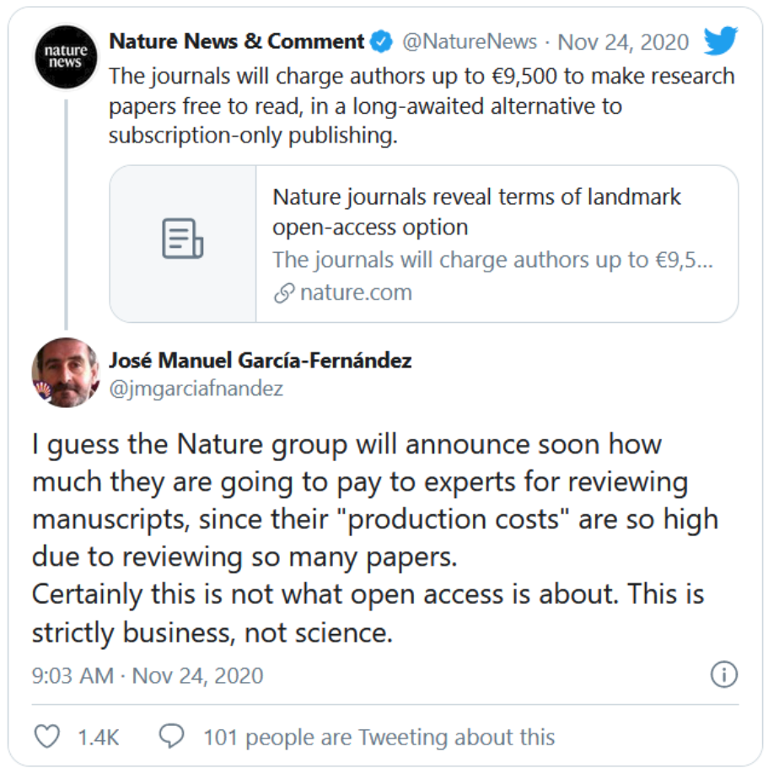
Some news from the publishers’ side…
http://bjoern.brembs.net/2020/11/are-natures-apcs-outrageous-or-very-attractive/

Slide 8
Definitions we will need in todays lecture

Slide 9
Payload
In the context of this course: it is referred to any research result in its digital form that can be uploaded (and eventually openly shared) in a repository.
Examples: articles, dataset, software, images, videos, reports, conference poster or presentations, lectures, etc

Slide 10
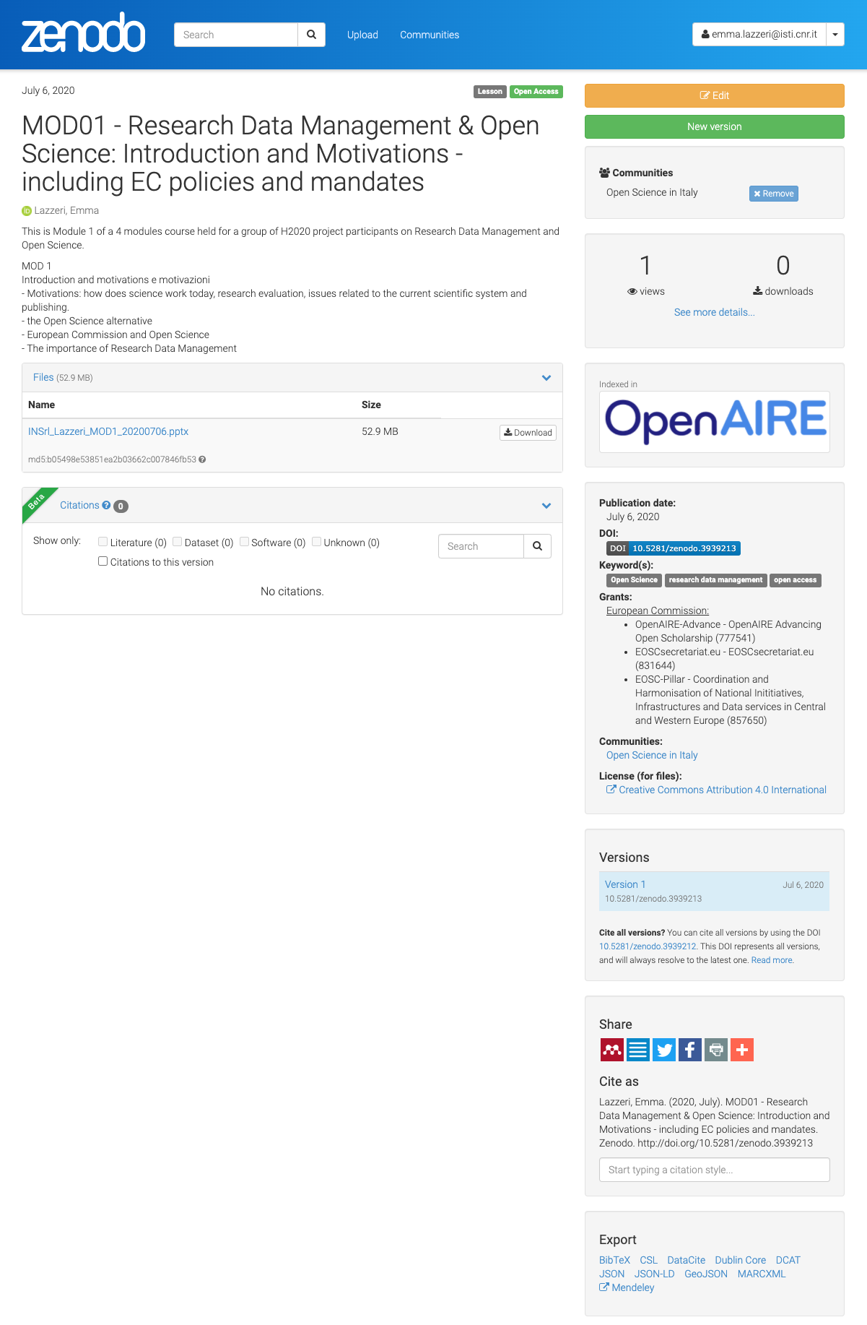
A Record deposited in a Repository
Metadata
Payload
A set of data describing the digital object(s) you are depositing
The digital object(s) you are uploading to be stored (and eventually shared). Payload includes attached files such as the file containing the data and the accompaning material(s), readmefile, etc

Slide 11
FAIR
Principles
These slides summarise the contents of Martínez-Lavanchy, P.M., Hüser, F.J., Buss, M.C.H., Andersen, J.J., Begtrup, J.W. (2019). ‘FAIR Principles’. In: Holmstrand, K.F., den Boer, S.P.A., Vlachos, E., Martínez-Lavanchy, P.M., Hansen, K.K. (Eds.), Research Data Management (eLearning course). doi: 10.11581/dtu:00000049
Find the video to this link: https://vidensportal.deic.dk/RDMelearn

Slide 12
FAIR Principles
FAIR indicate a list of principles that can help you in making your data ready for Open Science
They are principles, not standards!
They were designed to enable optimal use of research data and methods
A group of different experts designed the FAIR principles between 2014 and 2016
They identified a set of 15 principles

Slide 13



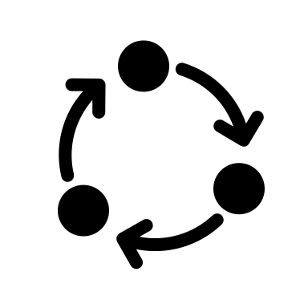
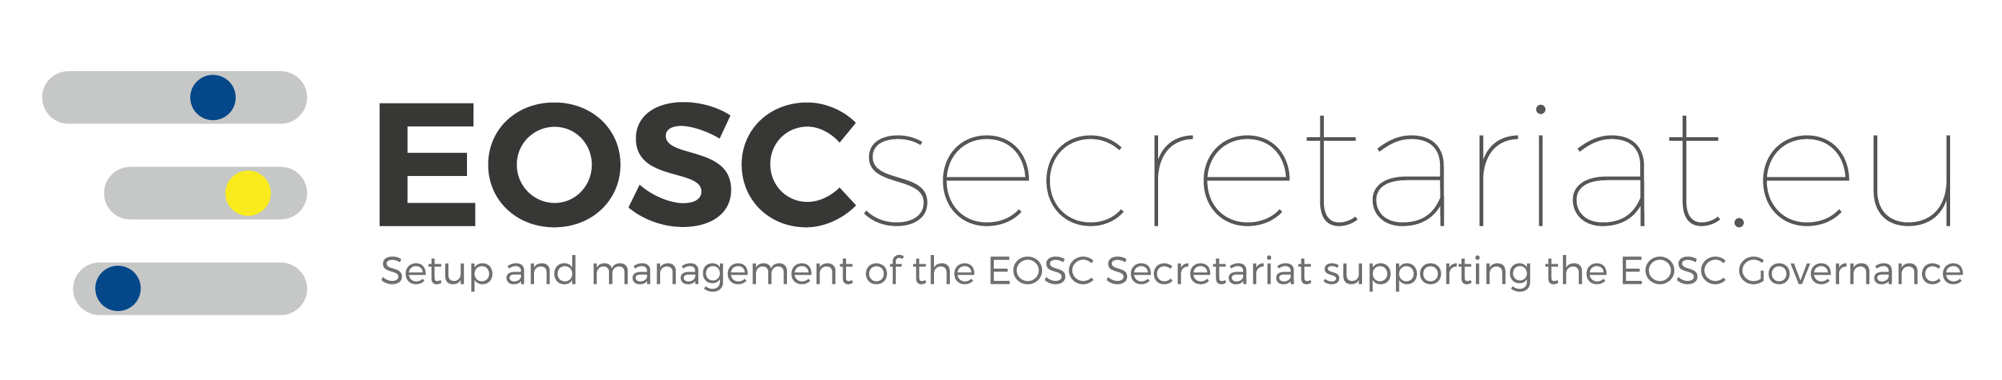
FAIR: What does it mean?
Findable
Accessible
Interoperable
Reusable
Other can find your data
Your data is accessible to others
Your data can be integrated with other data and/or they can be easily used and read by machines.
Your data can be reused by others in new research

Slide 14
FAIR principles
Plan
FAIR principles apply to the entire research data lifecycle.
They are strongly interconnected.
Reuse
Collect Create
Preserve
Process Analyse
Publish
Share

Slide 15
FAIR principles
Plan
Please note:
Apply FAIR principles
does not mean
to openly share
research data
Reuse
Collect Create
Preserve
Process Analyse
Publish
Share

Slide 16

FAIR Data
Open Data
$$≠$$

Slide 17
Open Data
Data can be freely used, shared, enriched by anyone, anywhere for any purpose.
FAIR Data
Data follow a series of good practices to allow data access, still respecting any ethical, legal and contractual restriction.

Slide 18
Your research data could
Contain personal information (privacy e GDPR)
Fall under copyright (in the case of a database with creative structure)
Fall under the Sui Generis right (database obtained thanks to a substantial investment)
Be protected by patent or industrial secret
Data sharing needs to respect the specific law.
Data needs to be protected against non authorised access.

Slide 19
How can you adhere to FAIR principles if your data cannot be opened?
Create and share a description of your data
  This way other researchers may ask for permission to access your data for reuse purposes, by giving a specific aim and following the rules defined by the law.
  Restrict access to the record payload (attachment, files,…)

Slide 20
Good practices to make your data
FAIR

Slide 21
By applying FAIR principles
You will produce high quality data
You will maximise the impact of your research
You will improve the recognition within and behind your research community

Slide 22
The application of FAIR principles strongly depends on the specific discipline and on the way the single researcher works
No one size fits all

Slide 23
Why should I apply FAIR principles?

Slide 24
Why do we need FAIR principles?
The ultimate goal of FAIR principles is to make your research data (or object) reusable and safe
You should always keep this goal in mind when trying to apply the FAIR principles to your results
Are my results reusable by someone
that was not involved in its collection/creation?

Slide 25
So how can you make your data FAIR?

Slide 26
FAIRification basics
Documentation
  Gives the context to make your data understandable by others
Metadata
  Make your data easy to find
Data formats
  Make your data simple to combine to other data and machine readable.
Access to data
  It meas to decide who will have access to your data and how
Persistent identifiers
  Persistent links to data that allows other to find and cite (give credit to) your data.
Licenses
  Are used to tell others how they can reuse your data.

Slide 27
Documentation
Specifies the context that led to the creation/collection of your data to make them understandable
At the beginning of a new (project) activity, you need to clearly define with your collegues the strategy to structure and document your data.
Document every detail of data collection/generation:
  Methods
  Tools
  Software
  Processes (who worked with the data? What did he/she did with the data? What are the relation to other data and/or publications?)
  Metadata

Slide 28
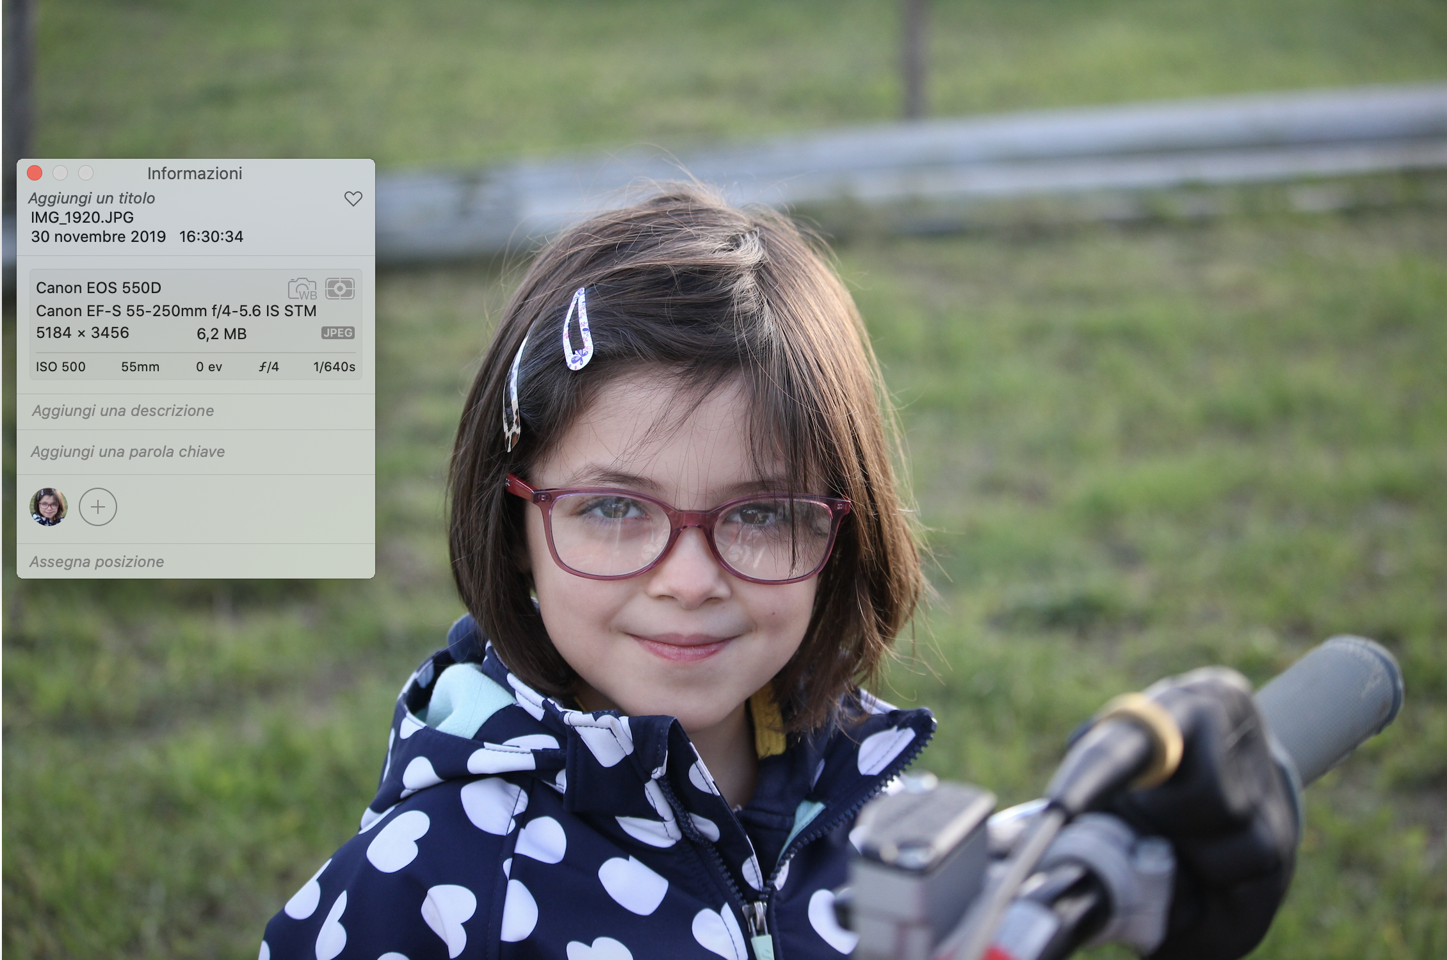
Metadata
Data describing data
Very important for:
  Access
  Comprehension
  Process
Use your discipline specific standards: you will spend less time curating and interpreting data and more time to actually make science!

Slide 29
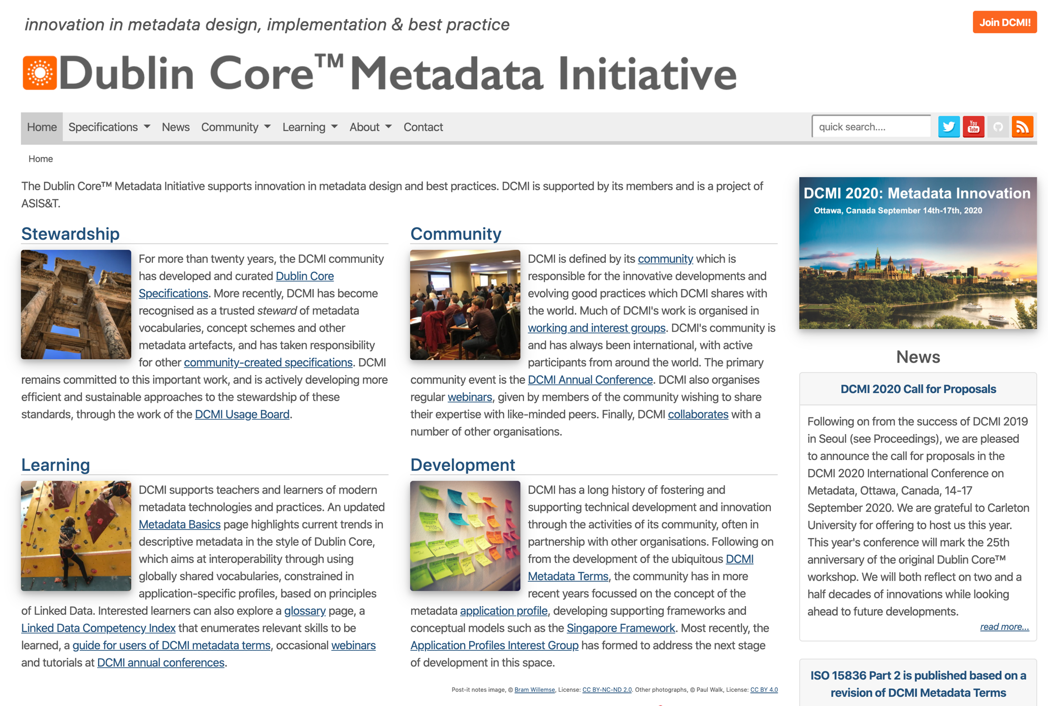


Metadata help making your data
Findable
Interoperable
Reusable
Generic!
Title
Authors
Subject
…
Social Science and Humanities

Slide 30
Accessibility
Can I make my data accessible to others?
Who will be granted access?
How?

Slide 31
Findable

Slide 32
Findable
The first step in (re)using data is to find them.
Metadata and data should be easy to find for both humans and computers.
Machine-readable metadata are essential for automatic discovery of datasets and services, so this is an essential component of the FAIRification process.

Slide 33
Some definitions

Slide 34

Persistent Identifiers
A persistent identifier (PI or PID) is a long-lasting reference to a document, file, web page, or other object.
The term persistent identifier is usually used in the context of digital objects that are accessible over the Internet.
Typically, such an identifier is not only persistent but actionable: you can plug it into a web browser and be taken to the identified source.
It is like the bar code used on products…

Slide 35
Some examples in the Open Science Context

Slide 36
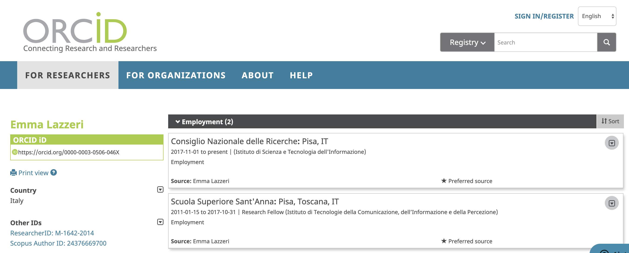
Orcid
The Open Researcher and Contributor ID (ORCID)
is a nonproprietary alphanumeric code to uniquely identify scientific and other academic authors and contributors
Do you have one? You should…

Slide 37
DOI – Digital Object Identifier
In computing, a digital object identifier (DOI) is a persistent identifier or handle used to identify objects uniquely, standardized by the International Organization for Standardization (ISO).
A DOI aims to be resolvable, usually to some form of access to the information object to which the DOI refers.
This is achieved by binding the DOI to metadata about the object, such as a URL, indicating where the object can be found
a DOI differs from identifiers such as ISBNs and ISRCs which aim only to identify their referents uniquely

Slide 38
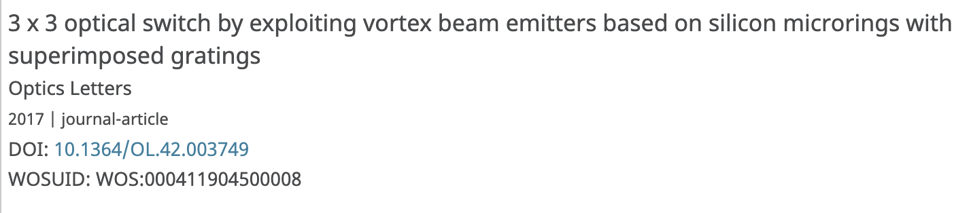
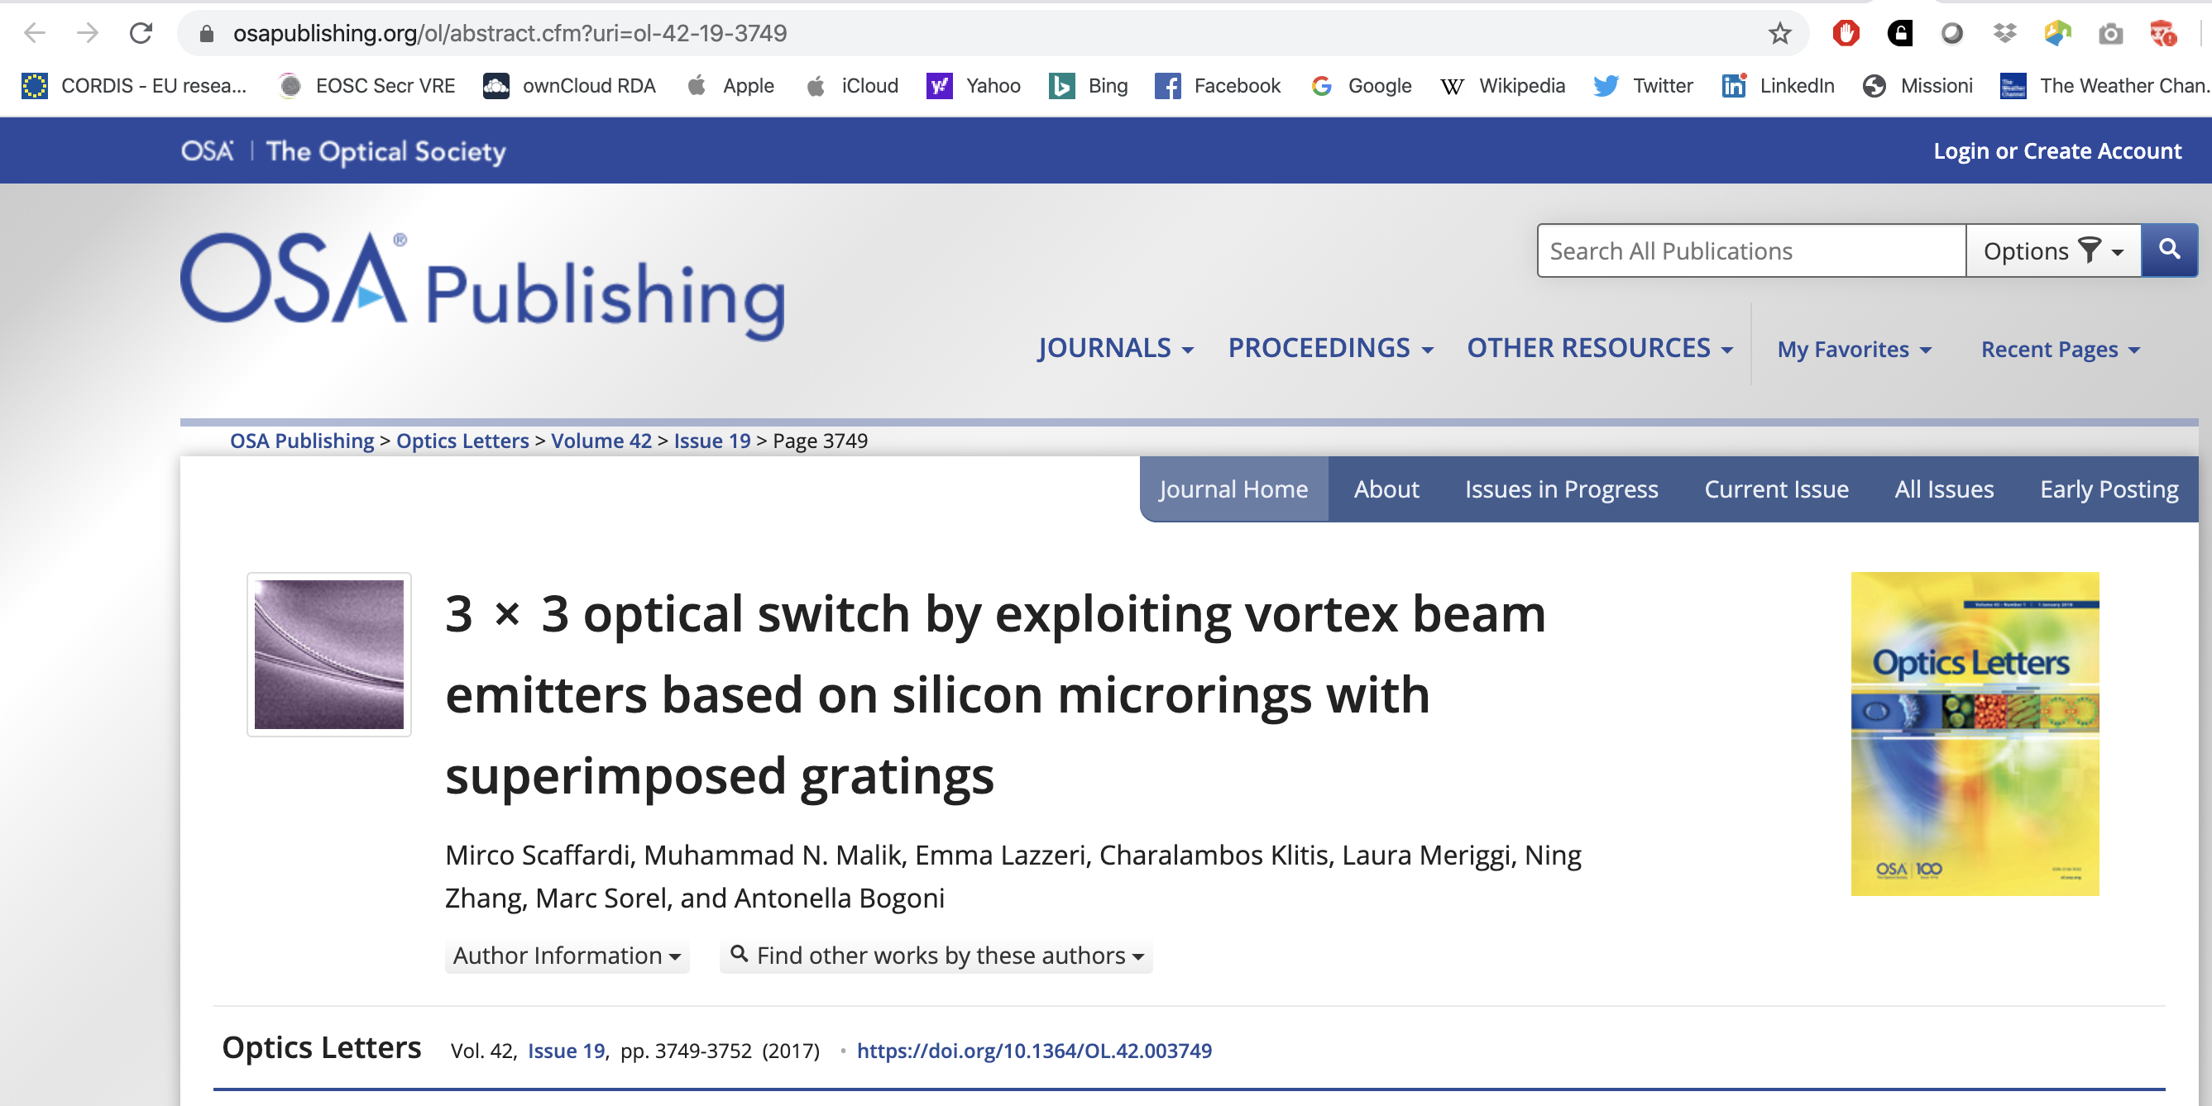
An example
A tip for you: create a citation record from DOI with https://citation.crosscite.org/

Slide 39
Persistent identifiers make your data:
Findable
Accessible

Slide 40
How can you assign a Persistent Identifier to your digital object?
Persistent identifiers need to be assigned by an entity that can ensure the persistency of the link to the object
Zenodo assigns DOIs to digital objects that do not already have one
Your repository will probabily assign a persistent identifier to your digital object!

Slide 41
Accessible

Slide 42
Accessible
Once the user finds the required data, she/he needs to know how can they be accessed, possibly including authentication and authorisation.

Slide 43
How do you give access to your data?
Through a Repository

Slide 44
Open Access Respositories
Thematic or disciplinary repositories
Designed for specific contents, curated by specific communities: ArXiv, bioarXiv, PMC…
http://oad.simmons.edu/oadwiki/Disciplinary_repositories
Institutional or national repositories
Maintained and curated by single institutions/countries. Typically only authors based in the specific institution/country can deposit, everyone can access
Literature Repositories
Reserved to text deposit (articles, reports, books, …). Metadata reflect the repository contents.
https://v2.sherpa.ac.uk/opendoar/
Data repositories
Designed to deposit data. They often are disciplinary and have specific metadata to describe the type of data they preserve. https://www.re3data.org/
Catch-all repositories
All research products can be deposited (data, literature, presentations, poster, images, software, …). Example: Zenodo
Who does curate/deposit in the repository?
What are the
repository contents?

Slide 45
An important difference
Deposit: upload a digital object (data, articles, …) on a platform that allows to correctly describe the object through medatada and that implements long-term preservation.
Give access: once the object has been deposited, the authors can choose the type of access that can be granted (open, restricted, closed, embargoed,…) and assigns a licence to reuse the contents (Creative Commons)

Slide 46
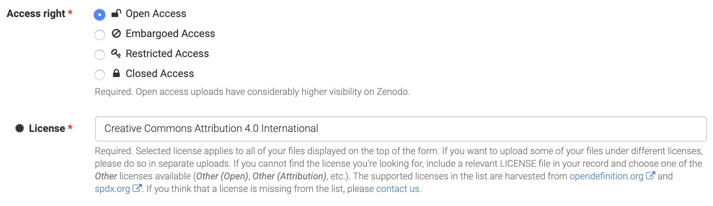
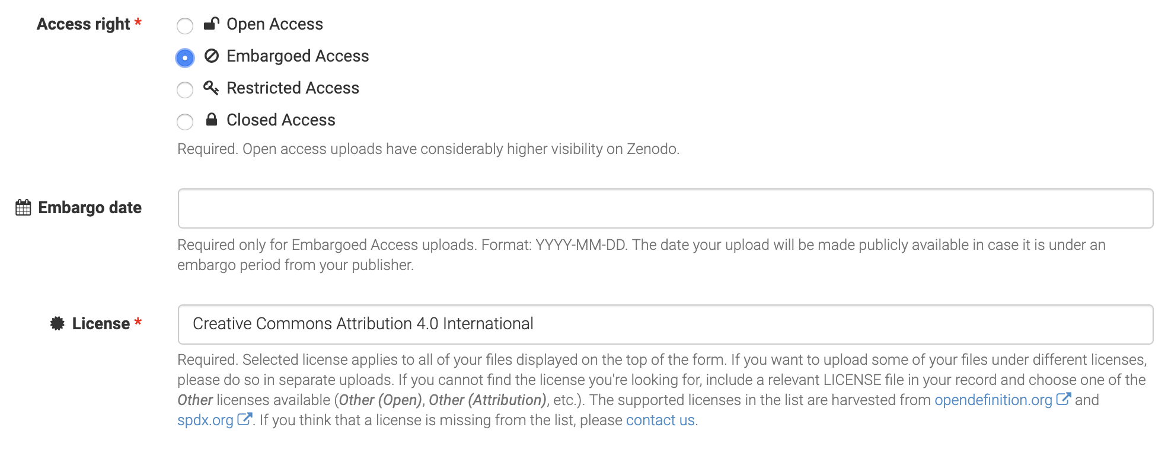
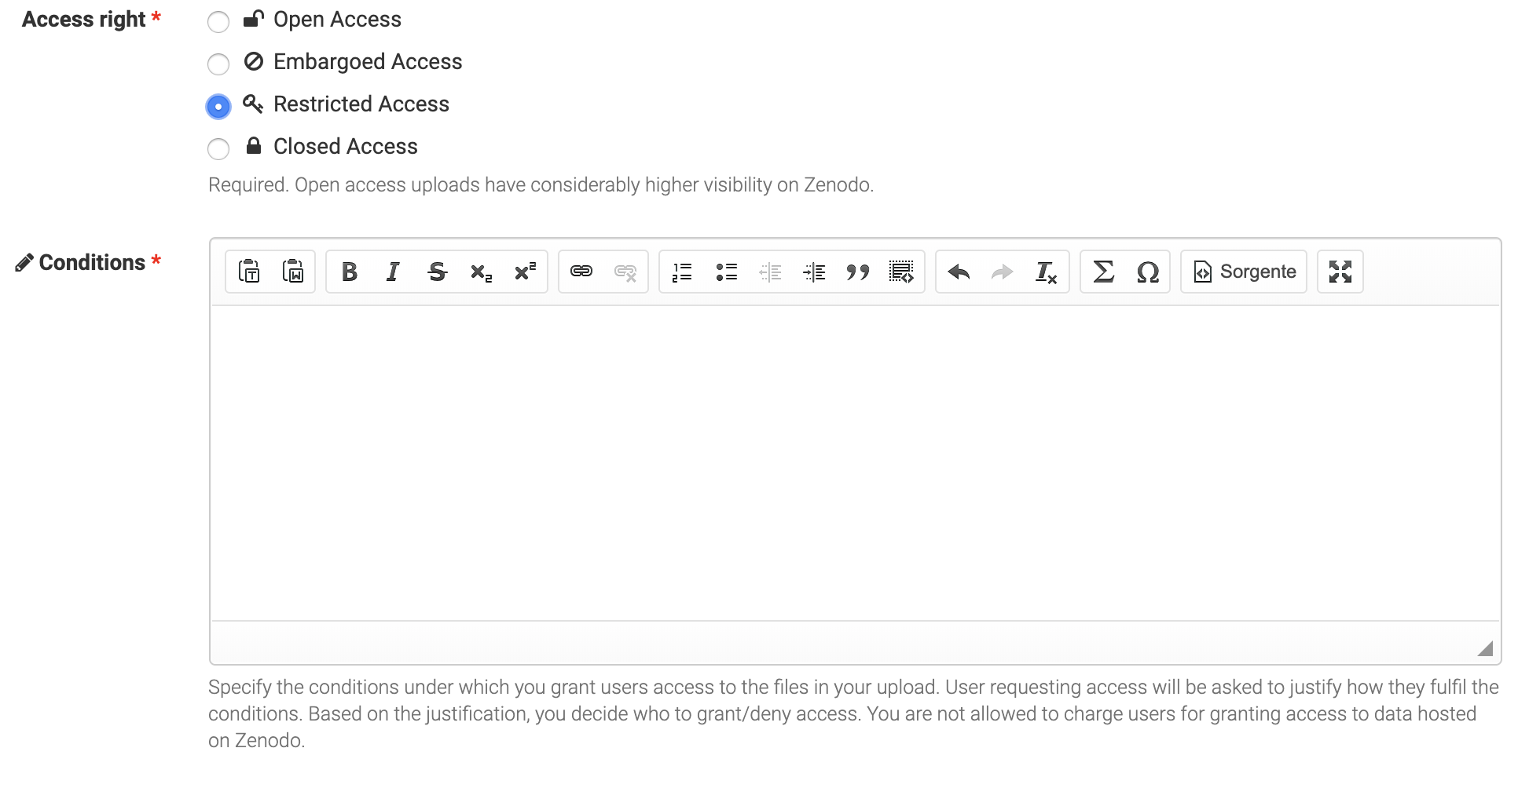
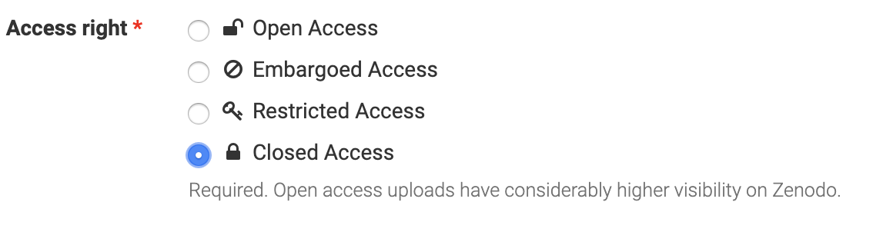
Access Rights in Zenodo

Slide 47
Warning!
Attaching your data to the article you published does not mean you are depositing the data.
Journals do not guarantee long term preservation and curation of the data.

Slide 48
Interoperable

Slide 49
Interoperable
The data usually need to be integrated with other data. In addition, the data need to interoperate with applications or workflows for analysis, storage, and processing.
Use community standard or best practice!

Slide 50
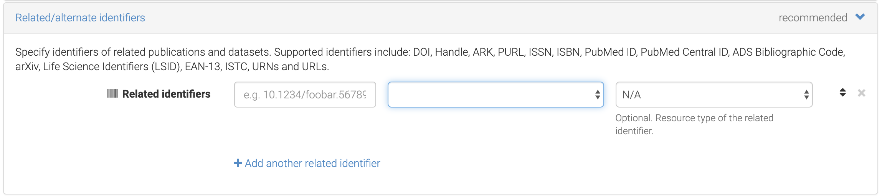
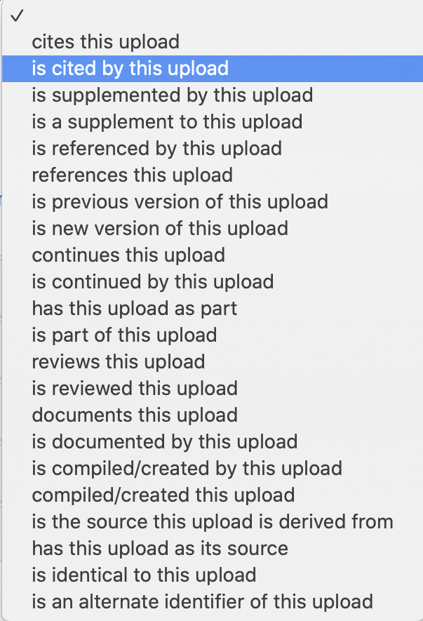
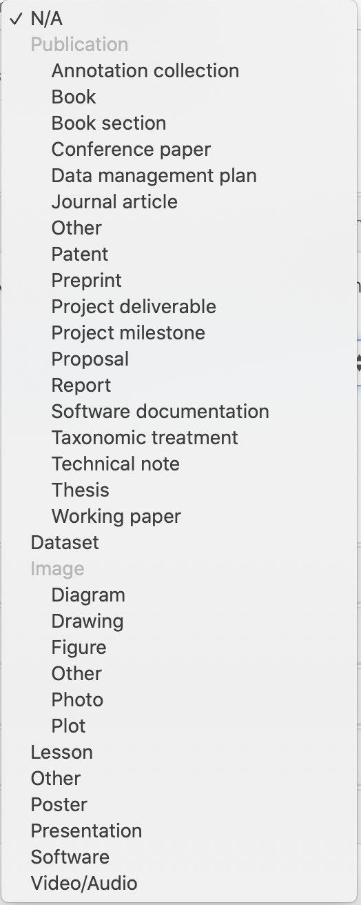
Linking Objects in Zenodo

Slide 51
Reusable

Slide 52
Reusable
The ultimate goal of FAIR is to optimise the reuse of data. To achieve this, metadata and data should be well-described so that they can be replicated and/or combined in different settings

Slide 53
Licenses
Tell others how they can reuse your data!
Where is your data coming from?
Provenance

Slide 54
Research data may be:
Automatically protected by the law;
Regulated by contract;
Subject to community norms such as academic best practices.

Slide 55
Some consideration on data protection
Copyright is a property right in certain types of original literary, artistic and scientific works.
Copyright does not protect ideas.
Confidentiality protects confidential information. This might be imposed by a contract or if the information is marked confidential. Use of confidential information might give rise to a claim for compensation if confidentiality is breached.
Data Subject Rights arise in information that identifies individuals and are recognised by data protection laws in the EU.
Patents are registered rights in novel inventions of products or processes.
Some research data may not benefit from any legal protection, although moral and ethical considerations may apply.

Slide 56
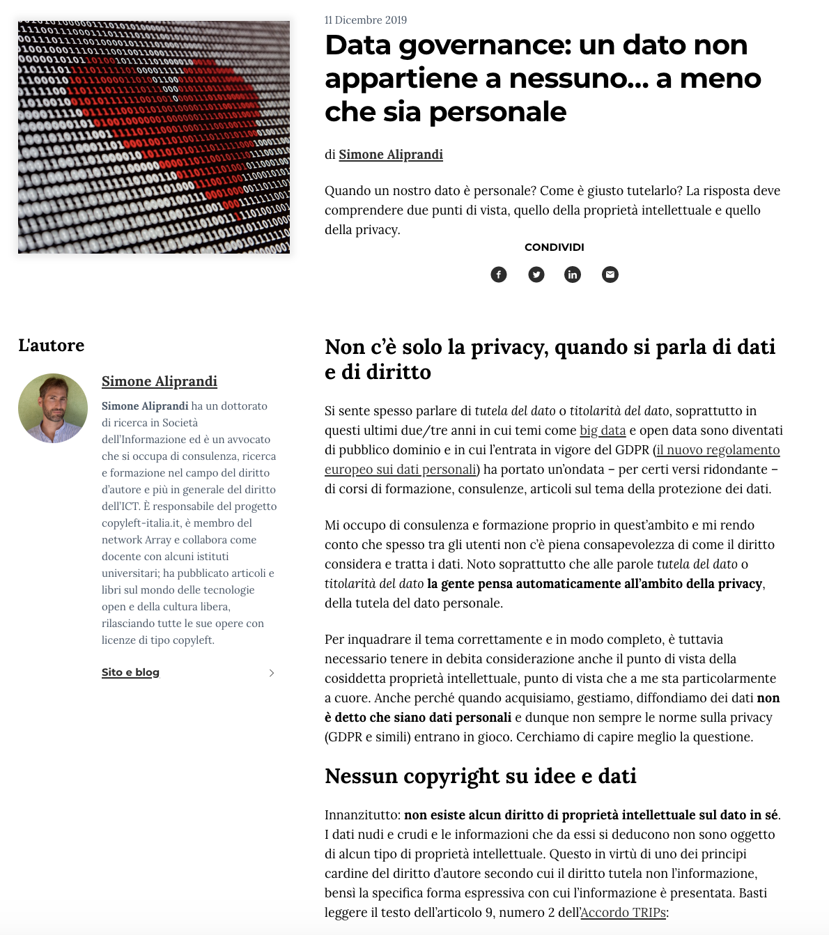
Data is not yours!
Data is not intellectual work, no copyright applies!
Copyright protection covers expressions and not ideas, procedures, operating methods or mathematical concepts as such.
Protection is on databases and not on data. The data are protected only and especially when they are collected and organized in a database.
The sui generis database right (only in Europe) covers not only the reproduction and dissemination of the database, but also the extraction and reuse of substantial parts of the database.
Read complete article here.
A similar content article in English here.
OpenAIRE Guidelines on data protection: available here

Slide 57
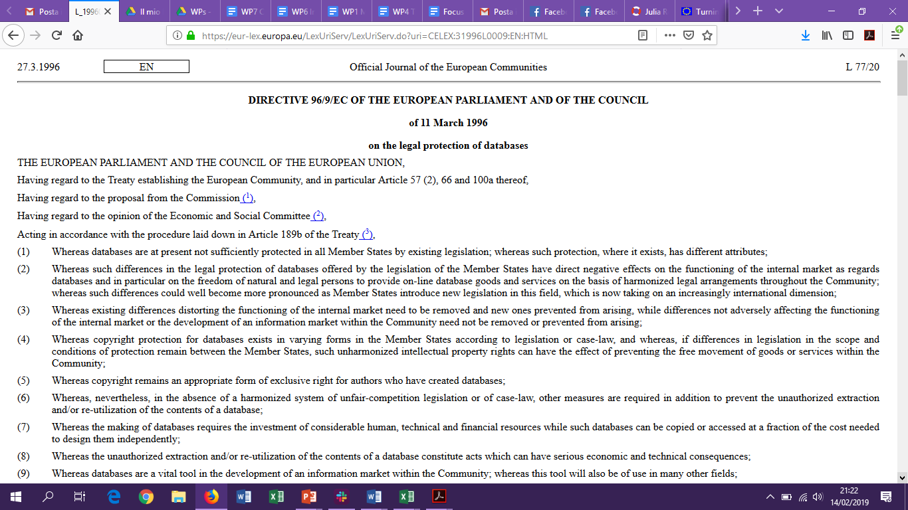
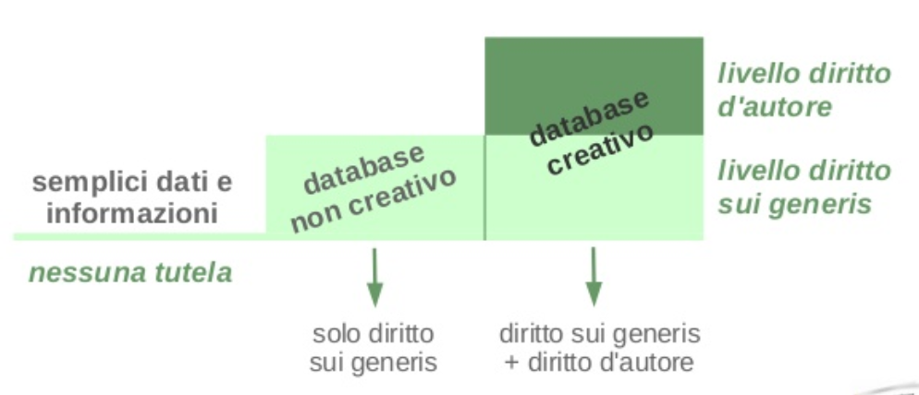
Data and law protection
Raw data are not protected by copyright
Database is defined as a collection of independent works, data or other materials arranged in a systematic or methodical way
Copyright protects the structure, selection or arrangement of the database contents, not the data
Sui generis database right: protects the substantial effort in obtaining data (not creating)
  Note: the right owner is often the institution.
copyright
creative database
raw data
non creative database
sui generis
NO copyright
sui generis
sui generis+ copyright

Slide 58
Authors and rights owners
Are you the author of the data you collected?
  Yes, in case you can proove it (deposit with clear date, DOI, … use a data repository!)
Do you own any rights on the raw data you collected?
  No, data is facts/information and none can own rights on it!

Slide 59
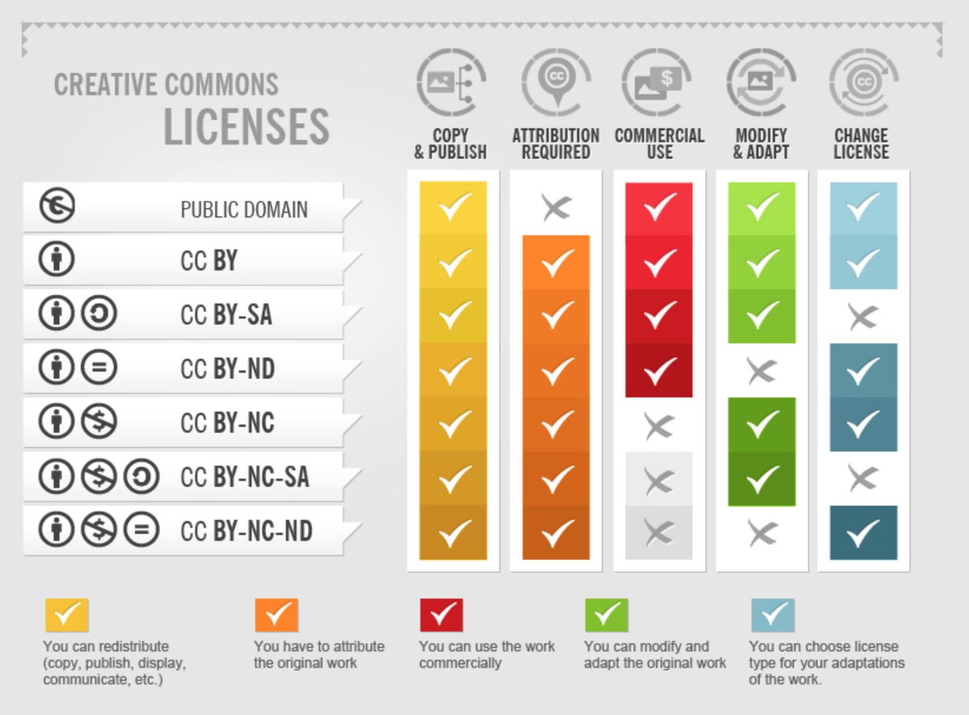
Creative Commons
Not all of us are legal experts capable of writing proper liceses
Creative Commons and Public Domain create legal certainty for everyone, who wants to use works, that are licensed respectively.
It is important to follow and understand the different meanings of the licenses and follow the rules for using them.
CC-Infographic by Foter under CC-BY-SA 3.0 license.

Slide 60
Creative Commons
Public Domain
Works are not covered by copyright
CC-0 (no rights reserved)
Allows creators to give up their copyright and put their works into the worldwide public domain
CC-BY (Attribution)
This license allows reusers to distribute, remix, adapt, and build upon the material in any medium or format, so long as attribution is given to the creator
CC-BY-SA (Attribution – ShareAlike)
This license allows reusers to distribute, remix, adapt, and build upon the material in any medium or format, so long as attribution is given to the creator. The license allows for commercial use. If you remix, adapt, or build upon the material, you must license the modified material under identical terms.
CC-BY-ND (Attribution – NonDerivative)
This license allows reusers to copy and distribute the material in any medium or format in unadapted form only, and only so long as attribution is given to the creator. The license allows for commercial use.
CC-BY-NC (Attribution – NonCommercial)
This license allows reusers to distribute, remix, adapt, and build upon the material in any medium or format for noncommercial purposes only, and only so long as attribution is given to the creator.
CC-Infographic by Foter under CC-BY-SA 3.0 license.

Slide 61
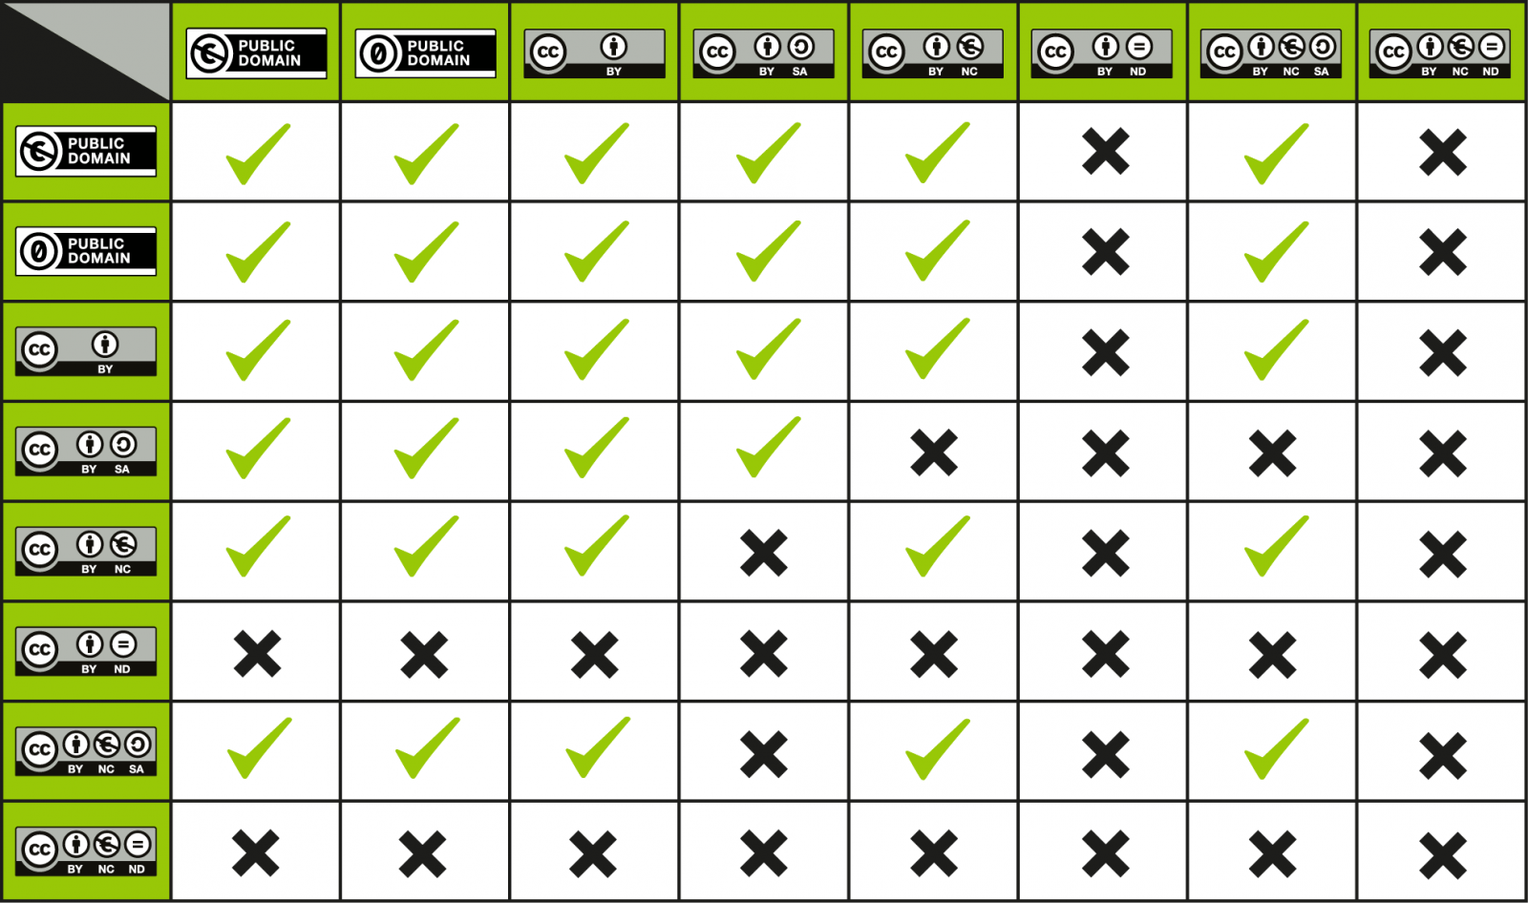
Clear licenses help you also in combining your data:

Slide 62
Warning!
Attaching your data to the article you published does not mean you are depositing the data.
Journals do not guarantee long term preservation and curation of the data.

Slide 63
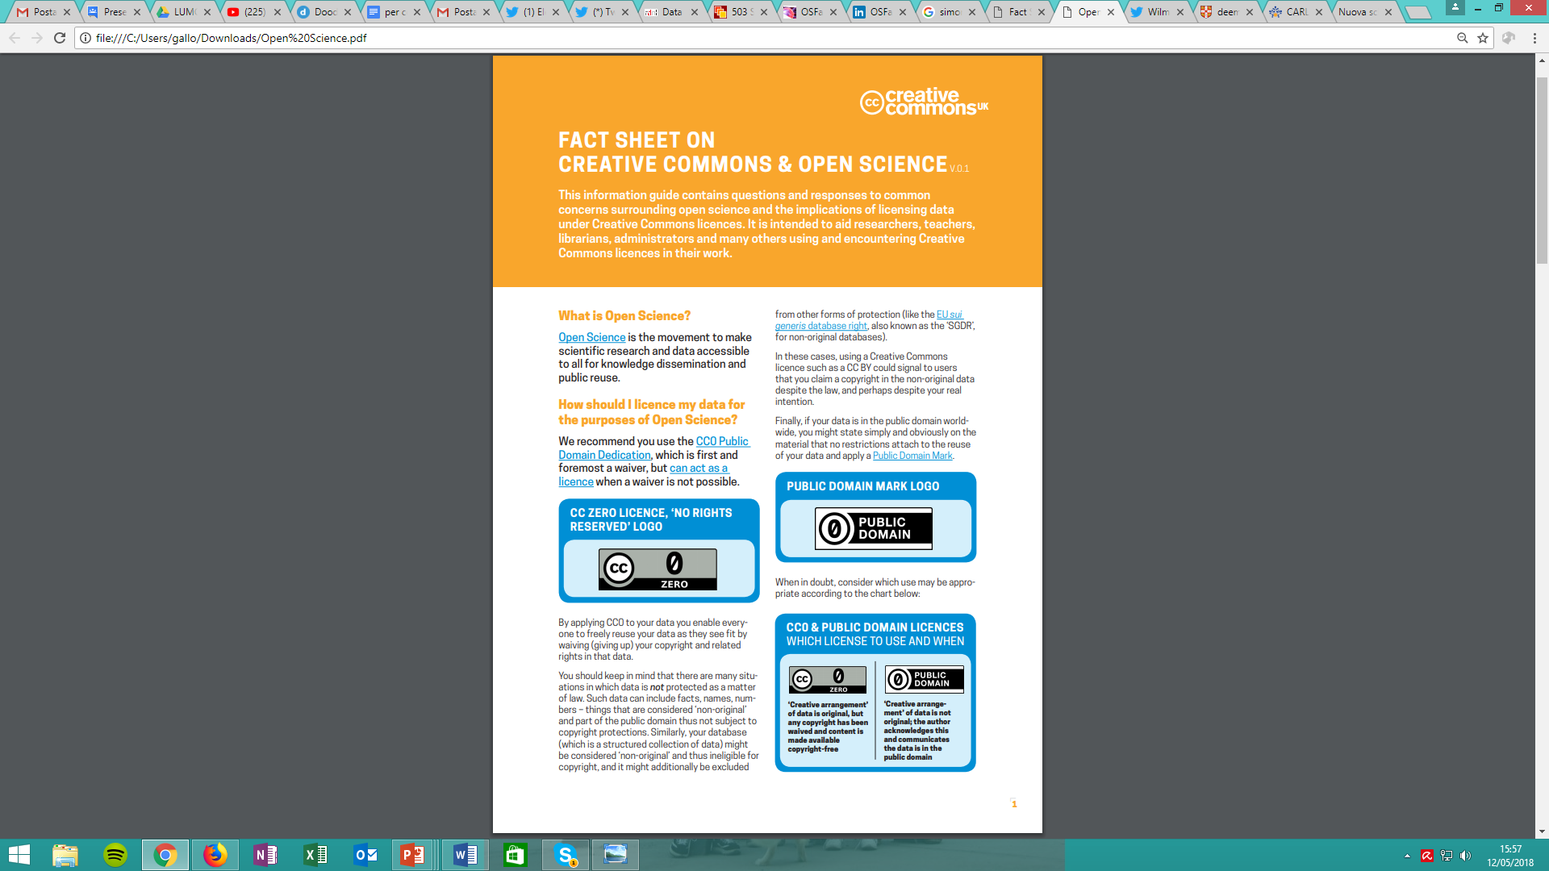
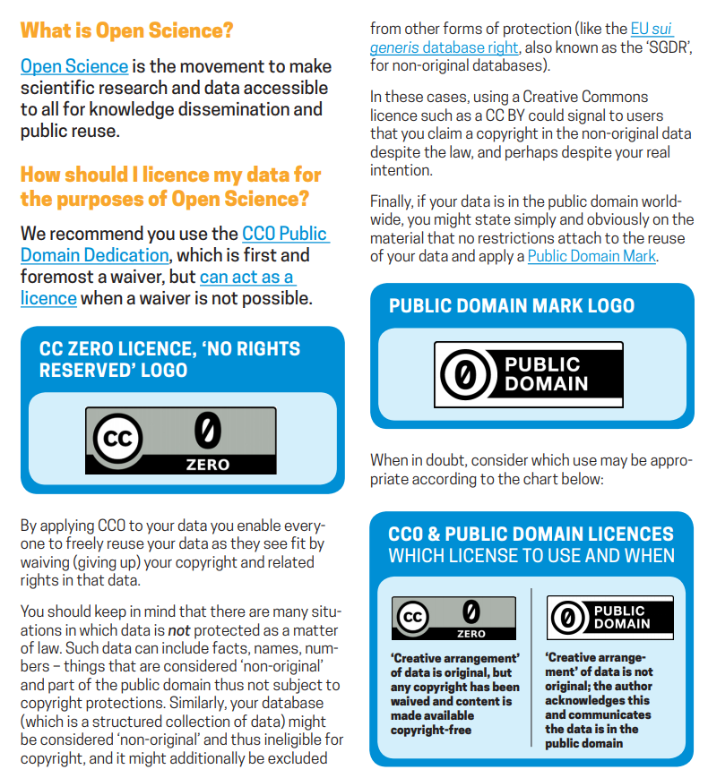
Licensing your data: Creative Commons
Creative Commons e Open Science
https://doi.org/10.5281/zenodo.840651

Slide 64
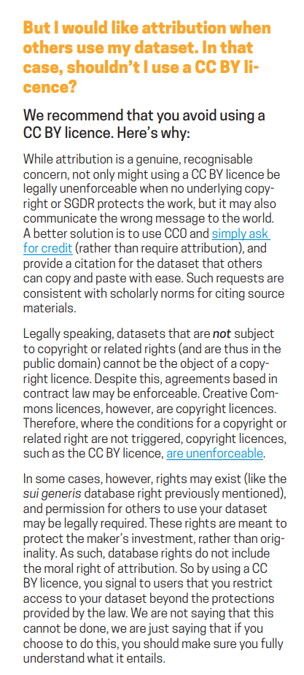
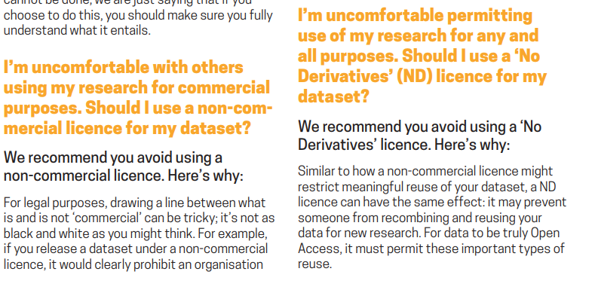
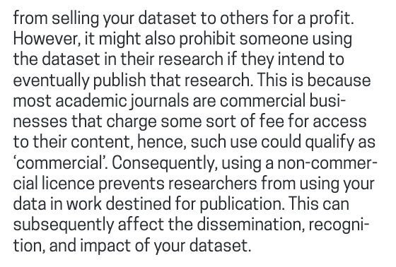
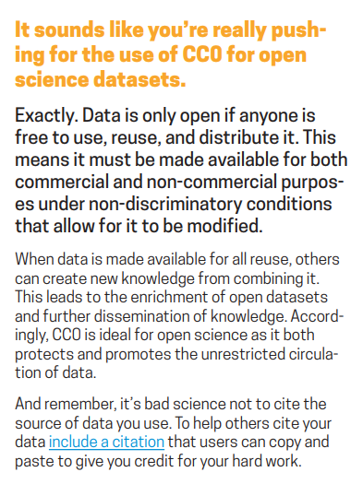
Licensing your data: Creative Commons
Use a CC0 or public domain
Then ask for credit
Provide a citation that researchers using your data can simply copy and paste to give you credit for your work
Bear in mind it’s bad science not to cite the source
CC0 does not mean academic unpoliteness
https://doi.org/10.5281/zenodo.840651

Slide 65
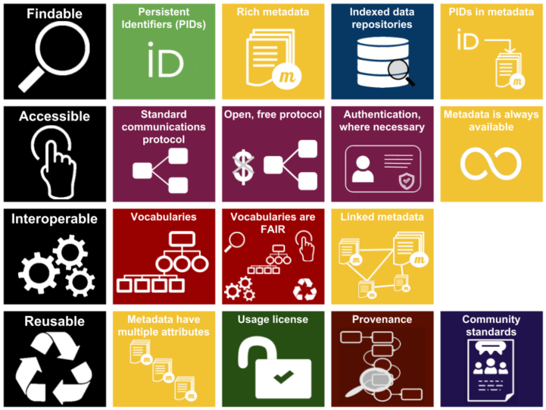
To summarise…

Slide 66
Once your data is FAIR, decide to go Open!

Slide 67
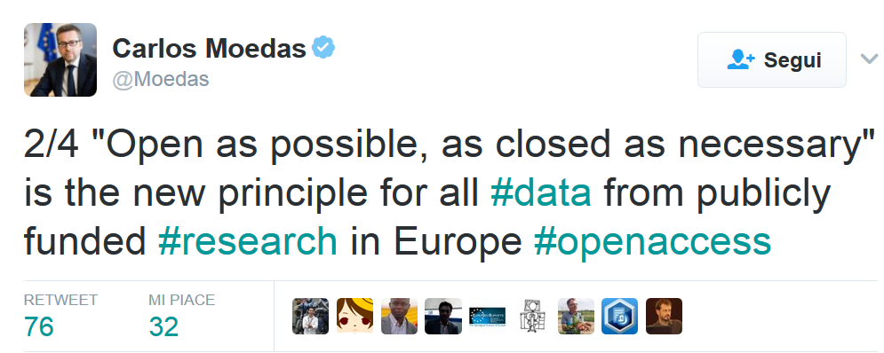
From 2014 until 2019, Moedas served as European Commissioner covering the portfolio of Research, Science and Innovation under the leadership of President Jean-Claude Juncker

Slide 68
Open your data in practice

Slide 69
How about Reliability?
Is FAIR = Reliable
No, it is not

Slide 70
Emma Lazzeri
emma.lazzeri@isti.cnr.it
This work was partially supported by European Union's Horizon 2020 under projects grant Agreement numbers 831644, 857650, and 777541

