Slide 1



Introduction and Motivations:
Open Science and
Access to Research Data
Emma Lazzeri
ORCID iD: https://orcid.org/0000-0003-0506-046X
Istituto di Scienza e Tecnologie dell’Informazione
Consiglio Nazionale delle Ricerche

Slide 2
Course outline
Nov
24
Nov
26
Dec
1
Dec
3
Introduction and motivations: access to research data
Federated approaches to data and service integration: experiences from EPOS research infrastructure
Research Data Management: Open Data, FAIR Data and Data Management Plan
Demo session: Open Science Tools and Services

Slide 3
Practicalities
During the course, we will use different tools and services to
Share
Collaborate
Interact

Slide 4

Virtual Research Environment
We set up a Virtual Research Environment (VRE) for this course. By entering the VRE you will find:
  A dedicated forum (social networking) where you can ask questions after the lessons, discuss, share experiences. Trainers will use the forum to share important information about the course.
  A dedicated workspace where trainers will share course material and other useful documentation
To join the VRE, you can use your institutional, google or LinkedIn account:
https://eosc-pillar.d4science.org/group/eosc-pillar-gateway/explore?siteId=273133421

Slide 5
Interactive Zoom buttons
CHAT
RAISE HAND
Q&A
Use the Chat for technical/ practical messages. Useful links will be shared here during the lessons
If you wish to speak during the discussion sections, please raise your hand
Please use the Q&A button to pose questions anytime during the course. Questions will be answered in the discussion sessions, after the presentations.

Slide 6

Mentimeter
Mentimeter allows for a quick interaction with the audience.
You will be able to post anonimous comments
You will be asked to answer questions anonimously
Results of the interactions will be available live
You can access mentimeter from any device (mobile pc, tablet…)
  Go to www.menti.com and enter code: 17 62 71
  Click on the direct link: https://www.menti.com/663okc6efu
  Scan the QR code

Slide 7
Let’s start!

Slide 8
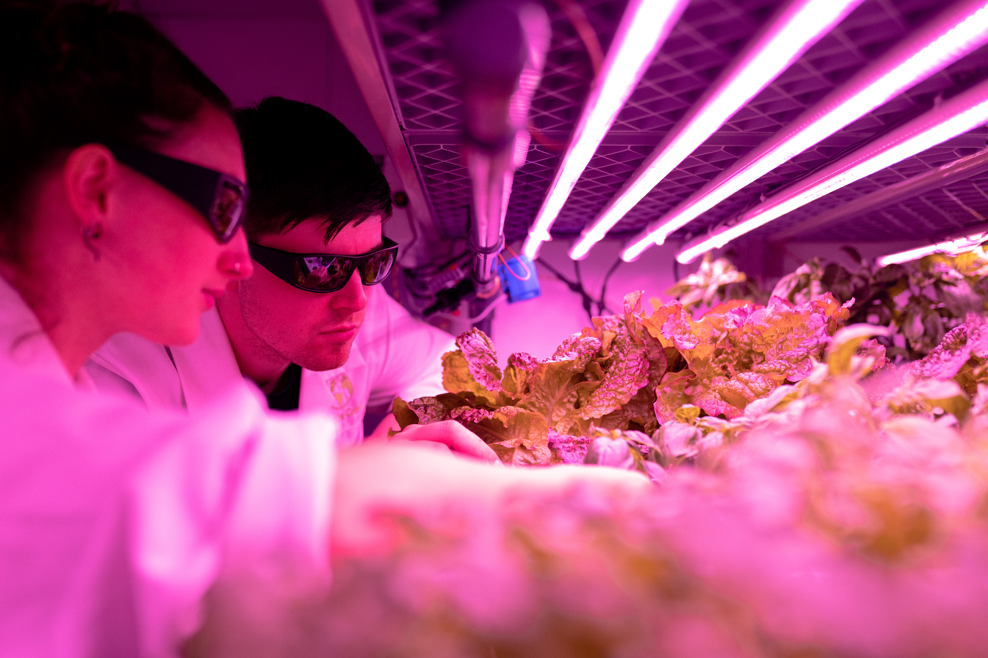
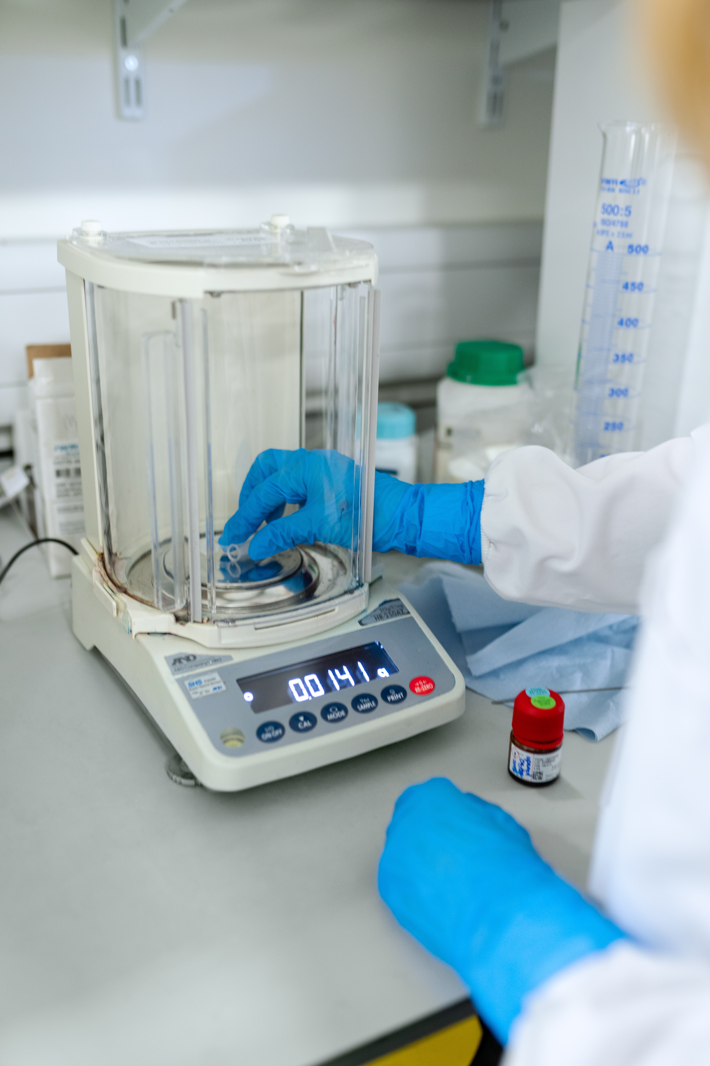
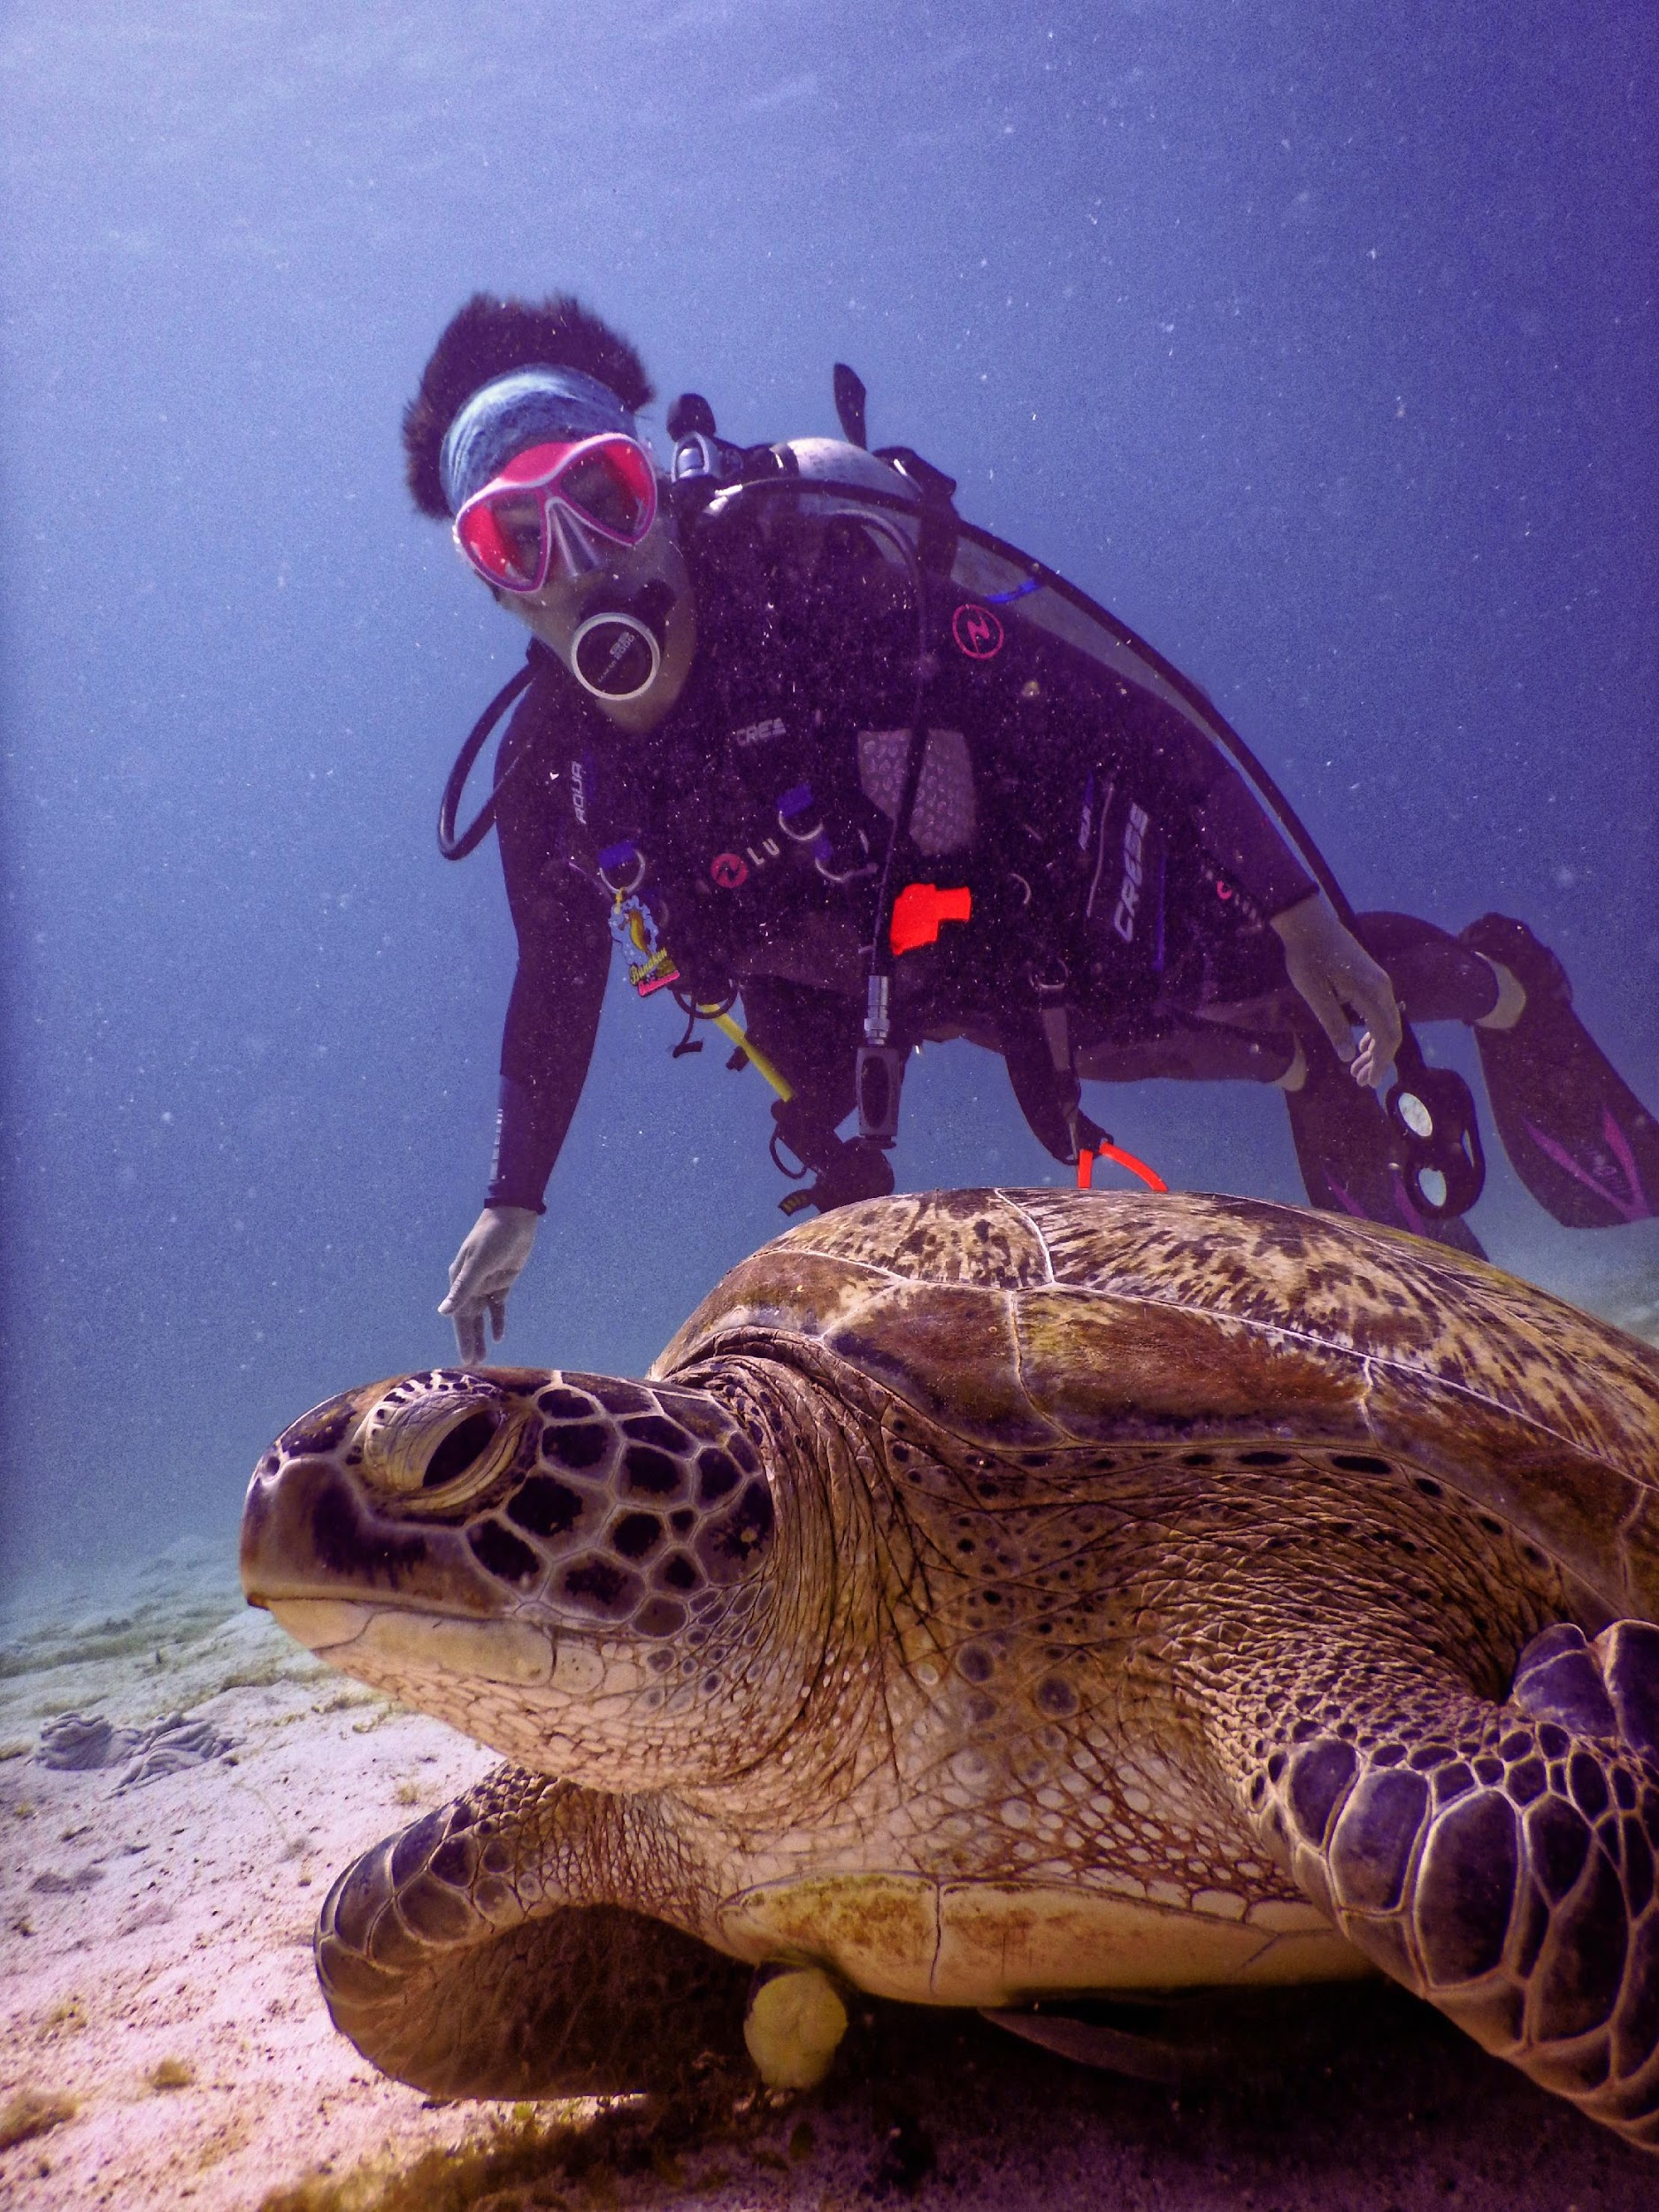

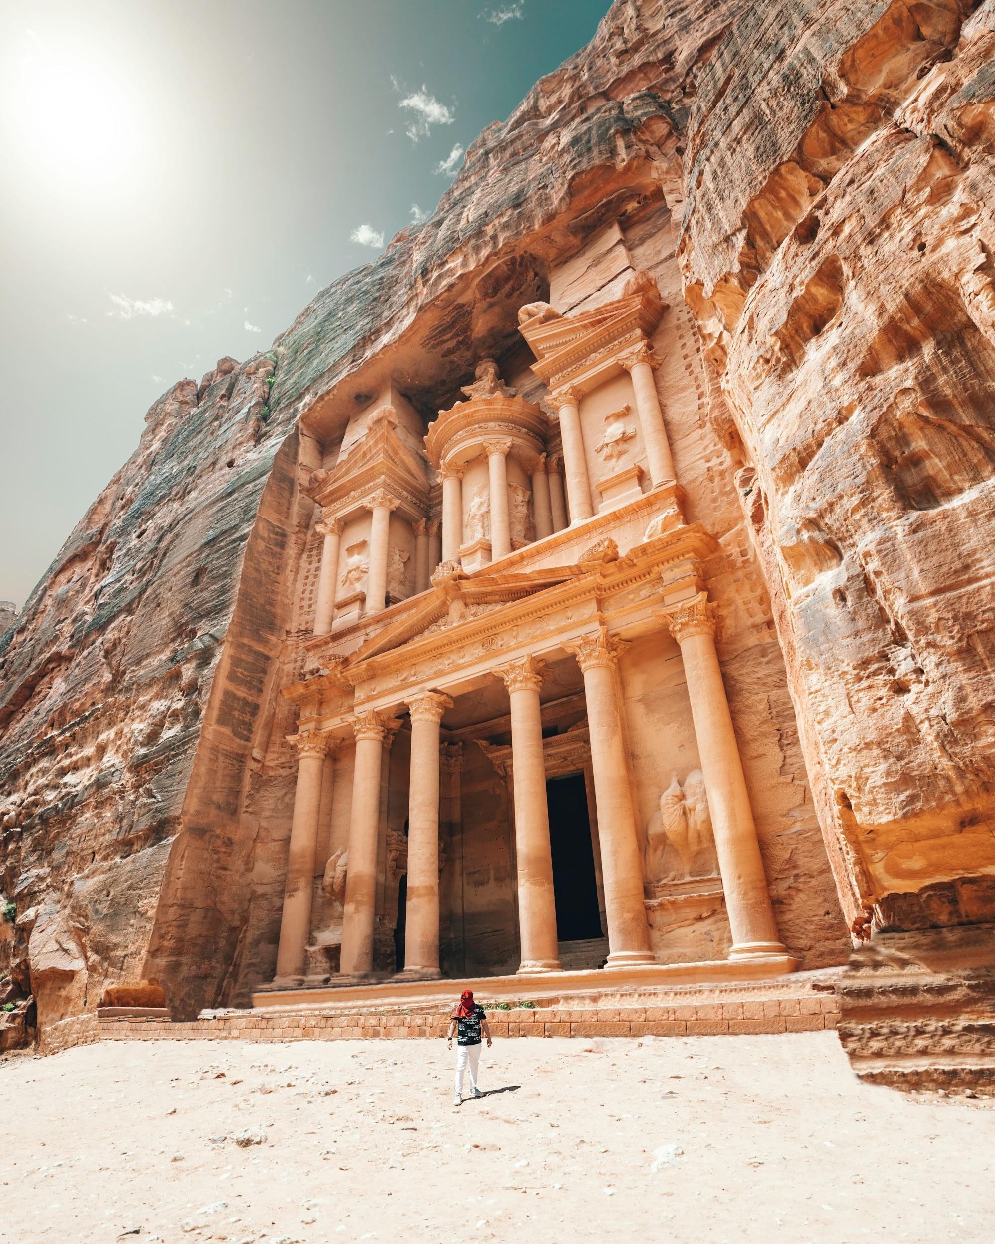

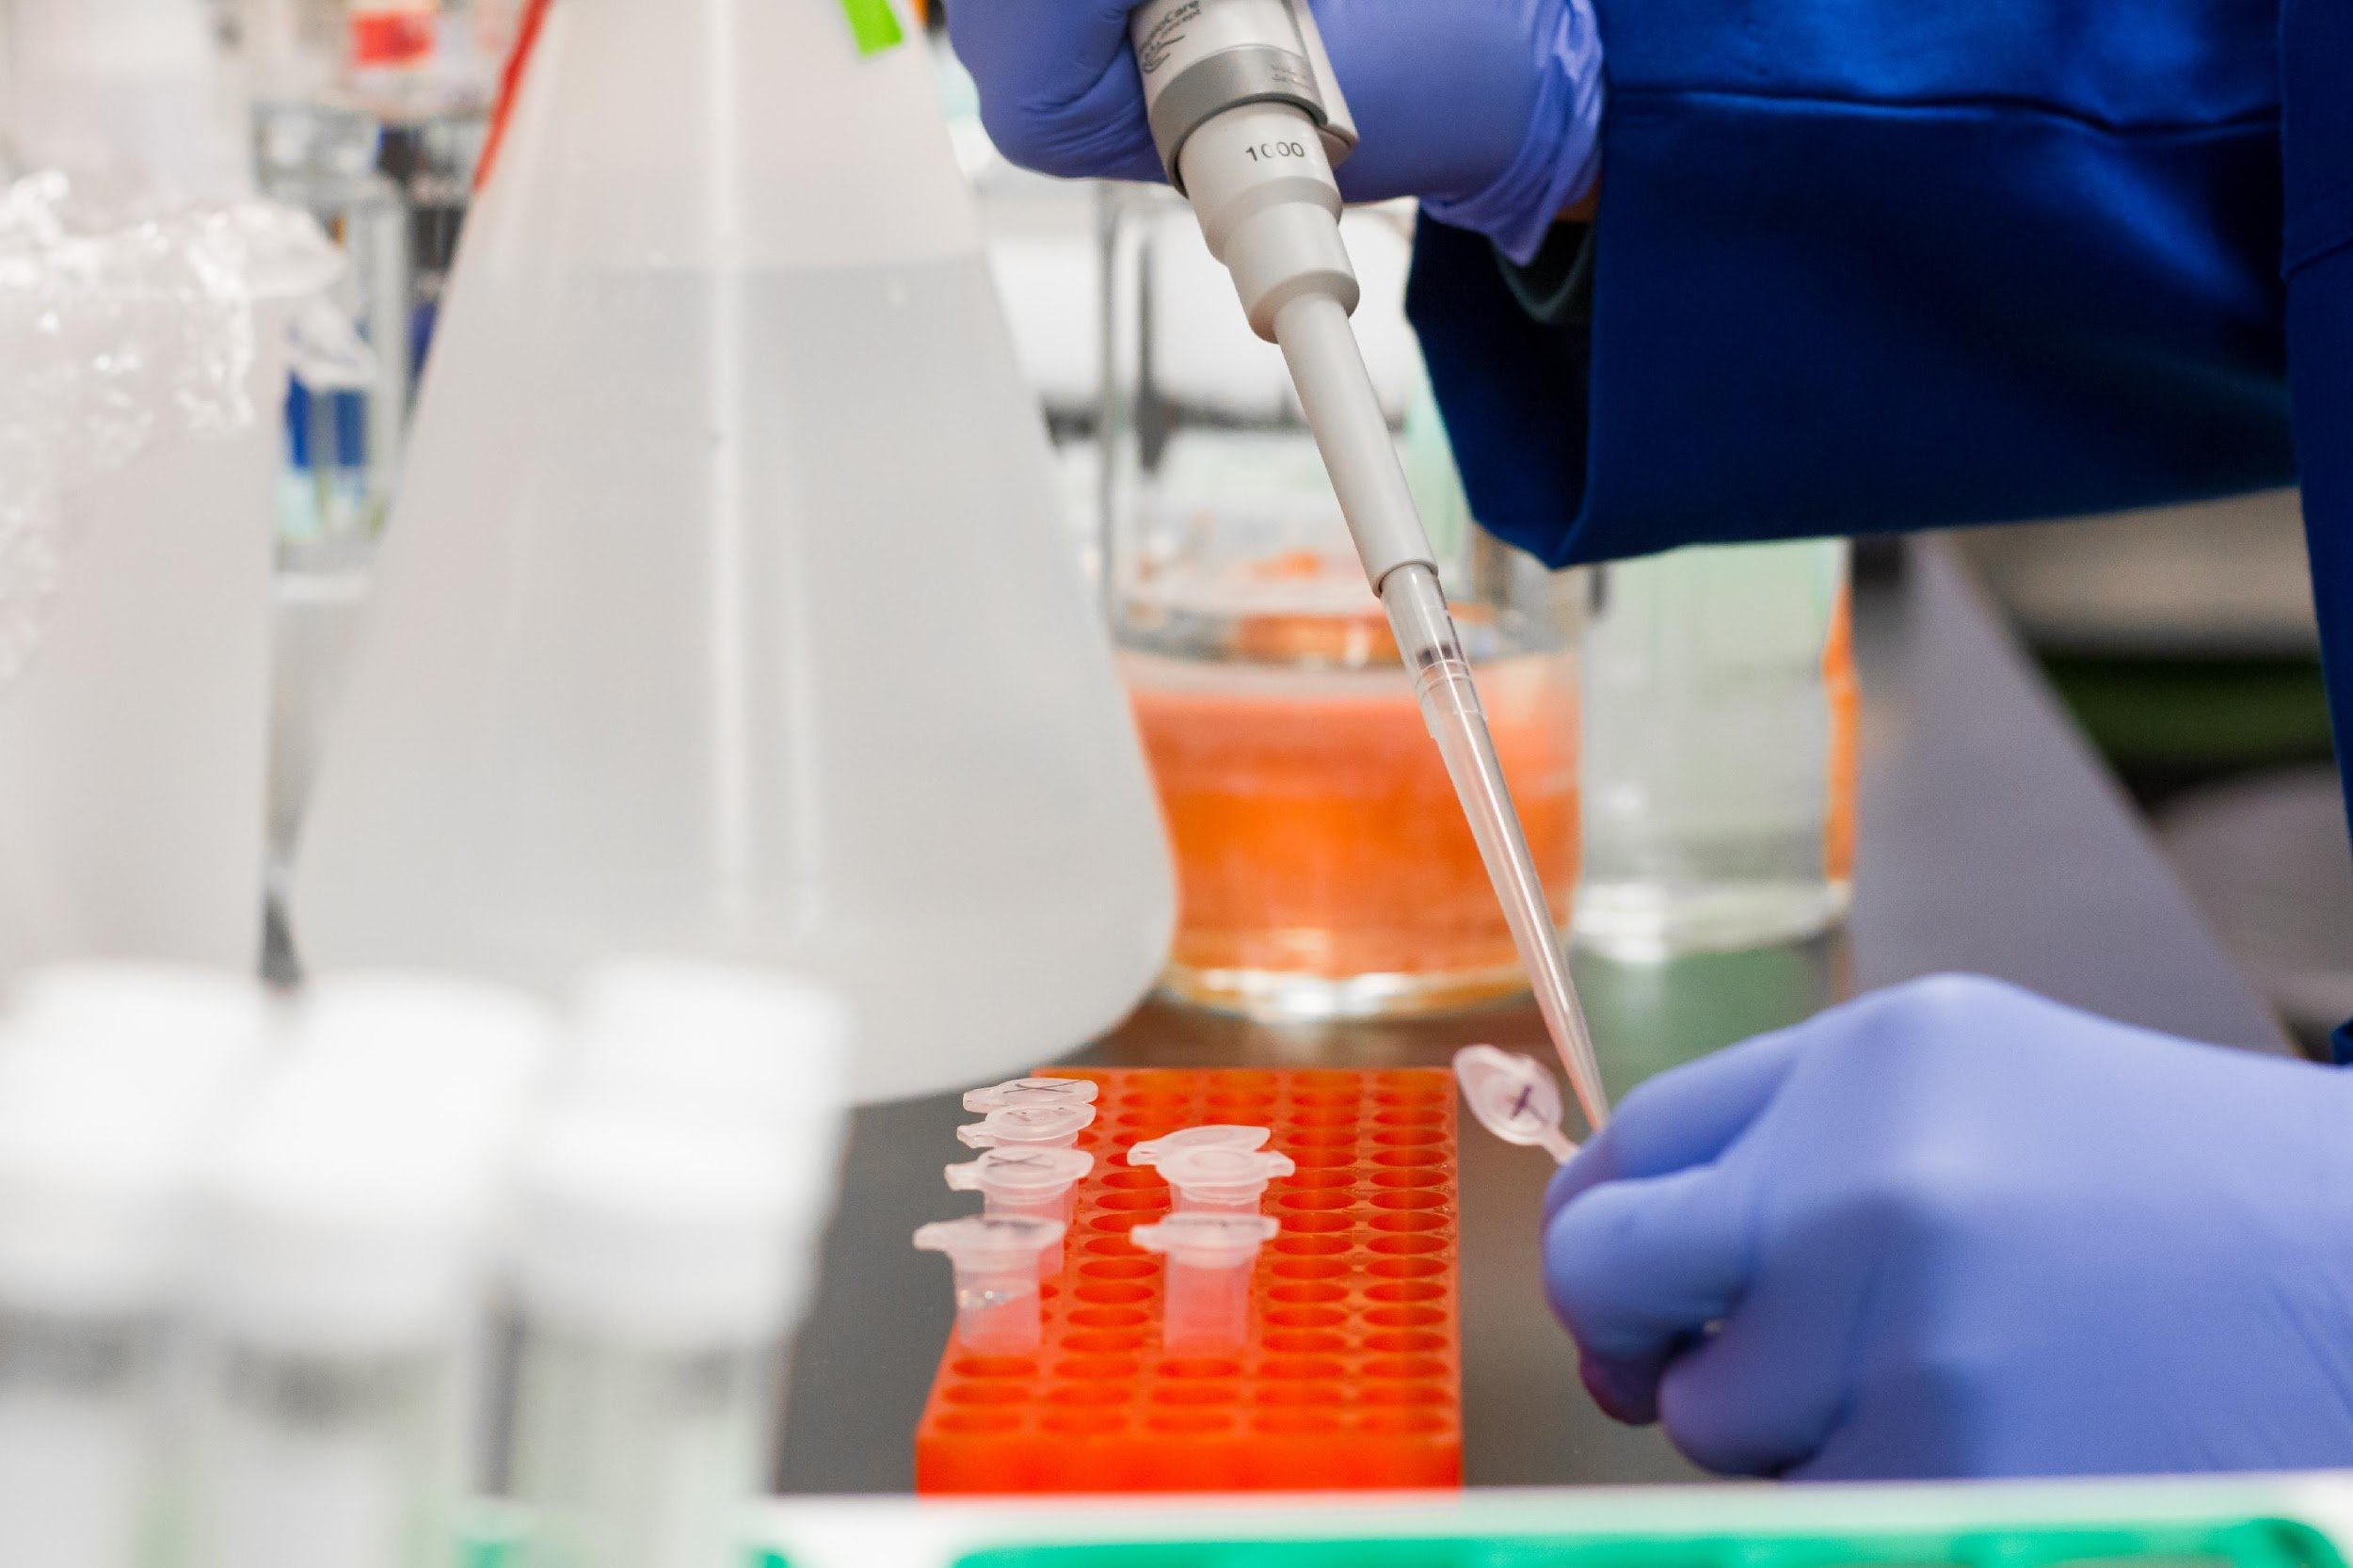

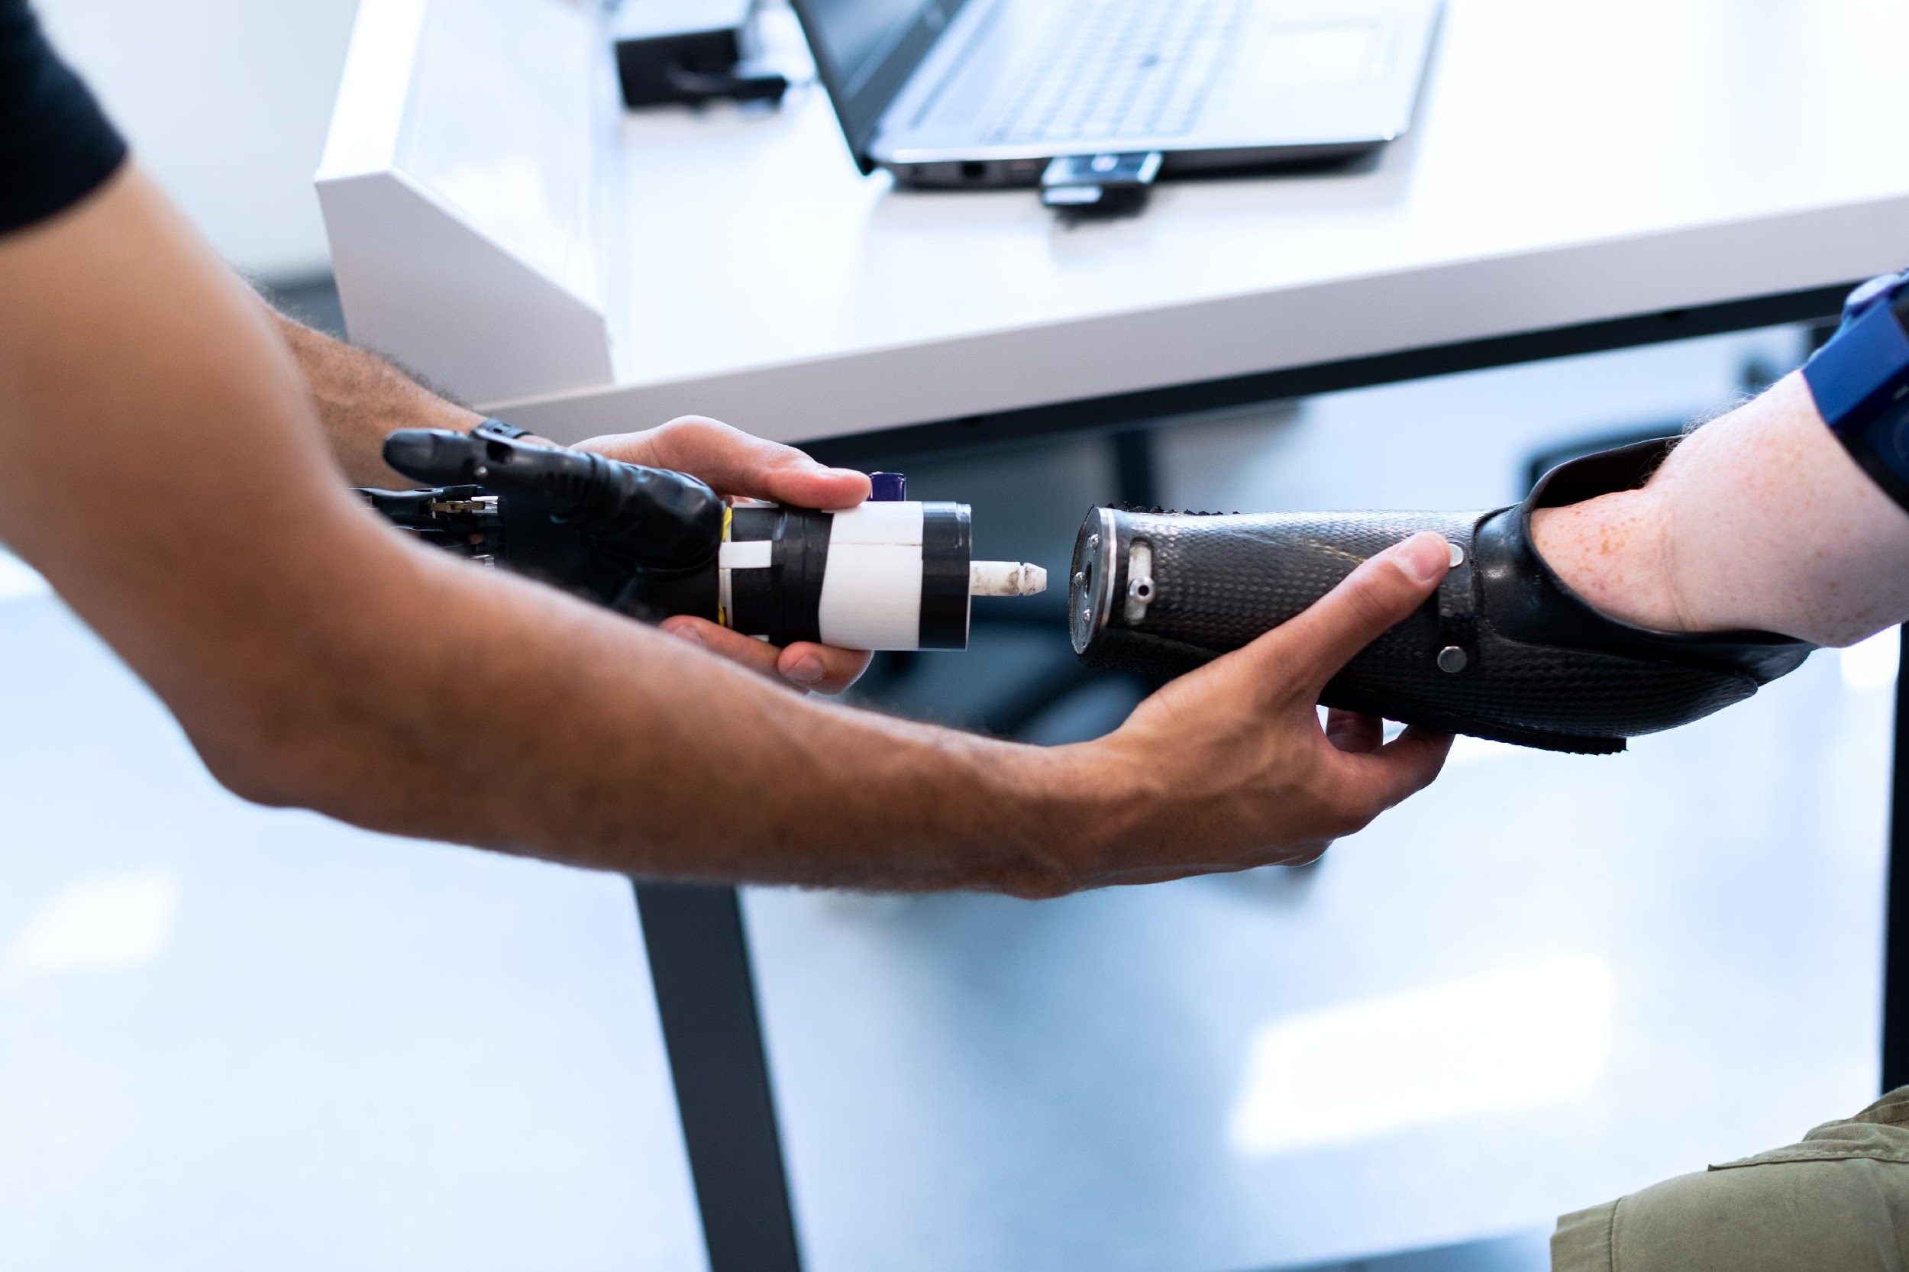
How I imagined my life as a researcher

Slide 9
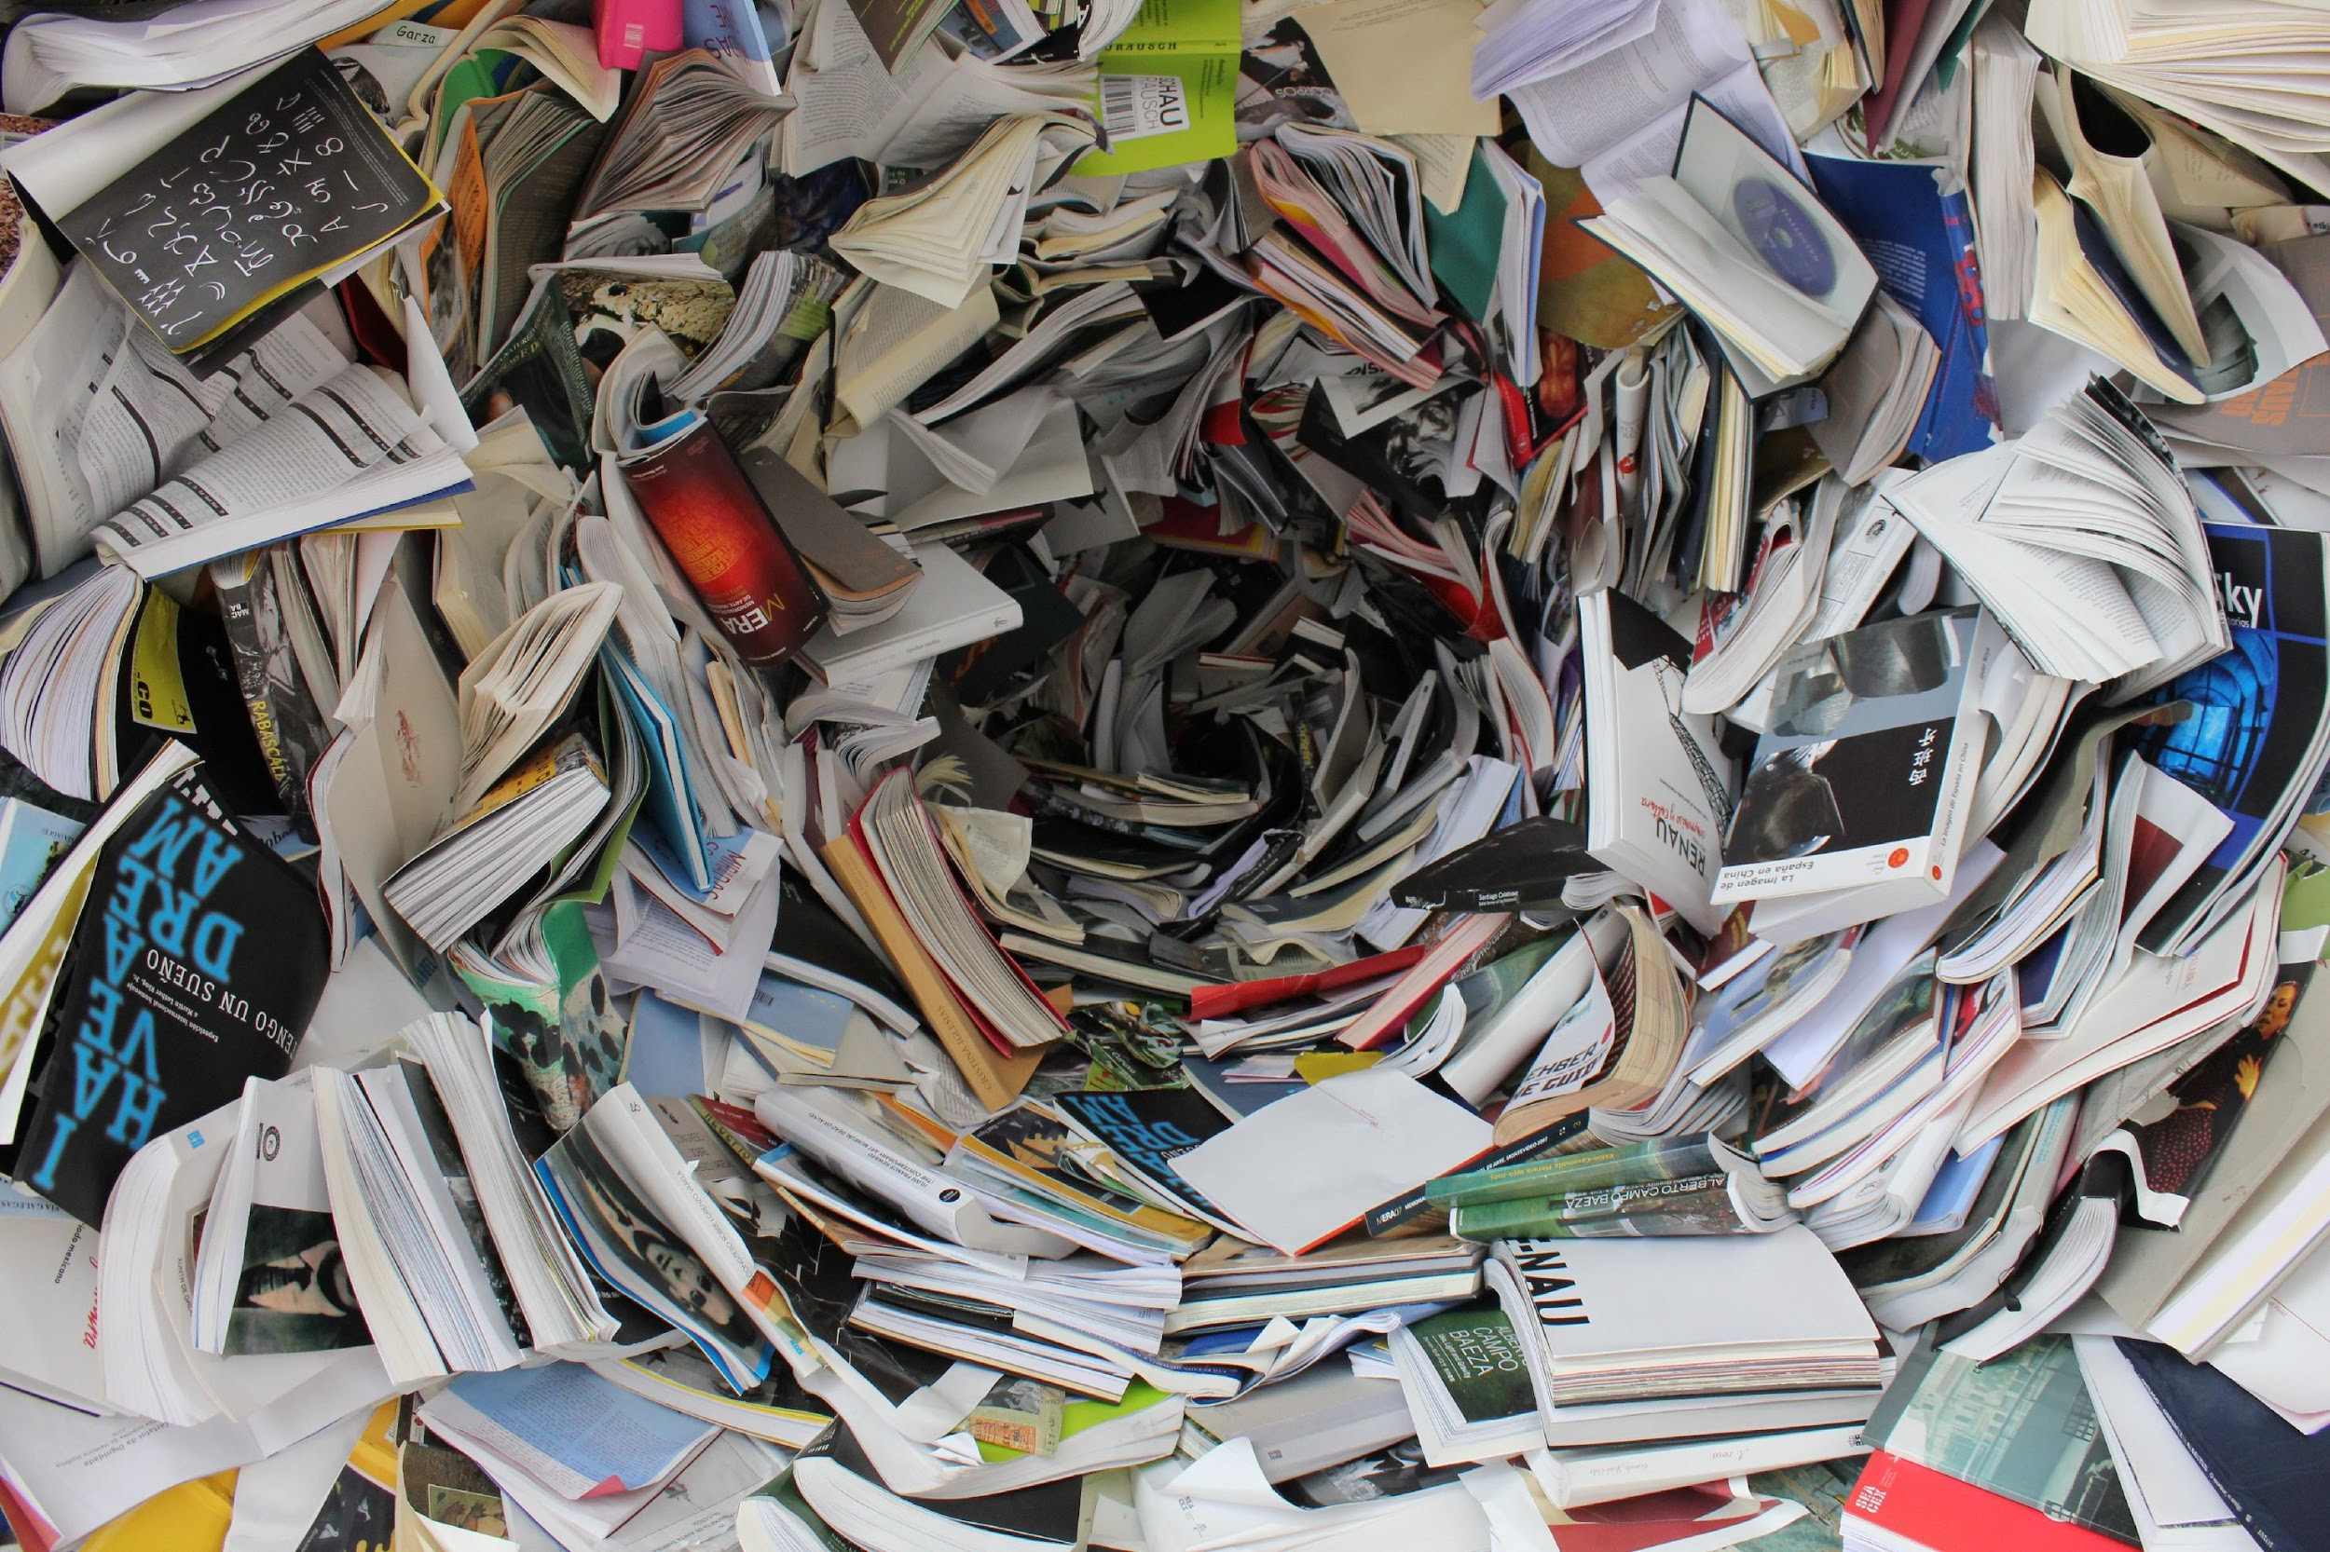
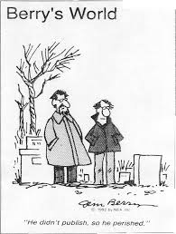


Reality: what do I need to do to advance my career?
I need to publish in high Impact Journals!
I need to be cited!

Slide 10
Access to
Scientific Literature

Slide 11
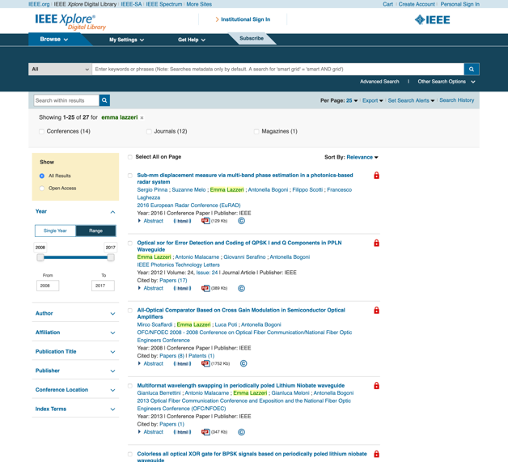
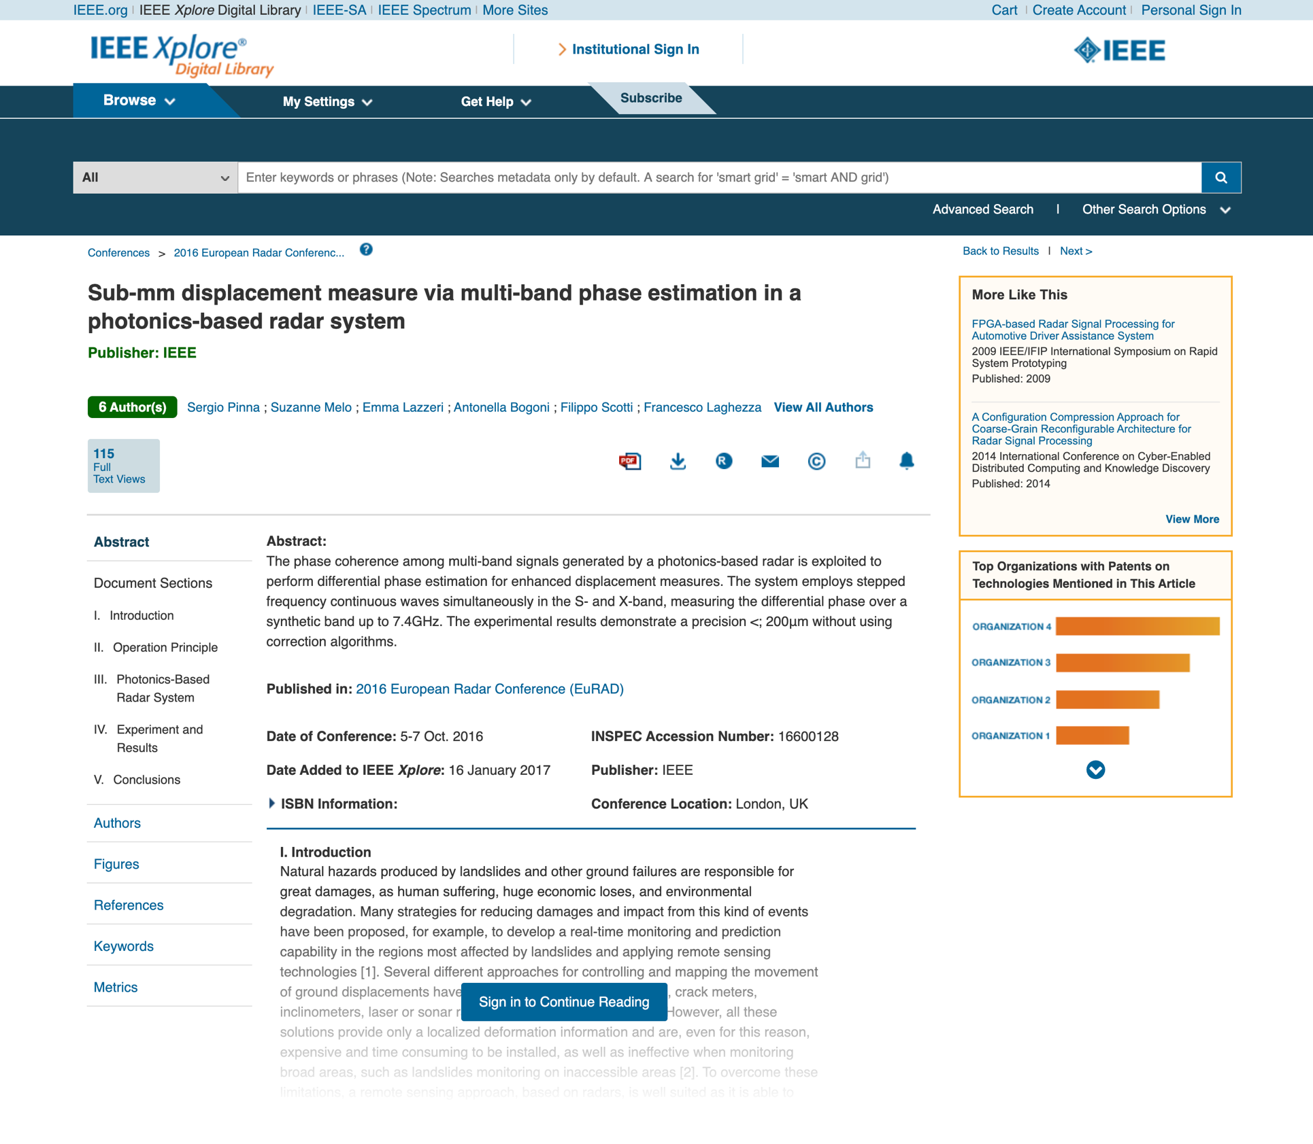
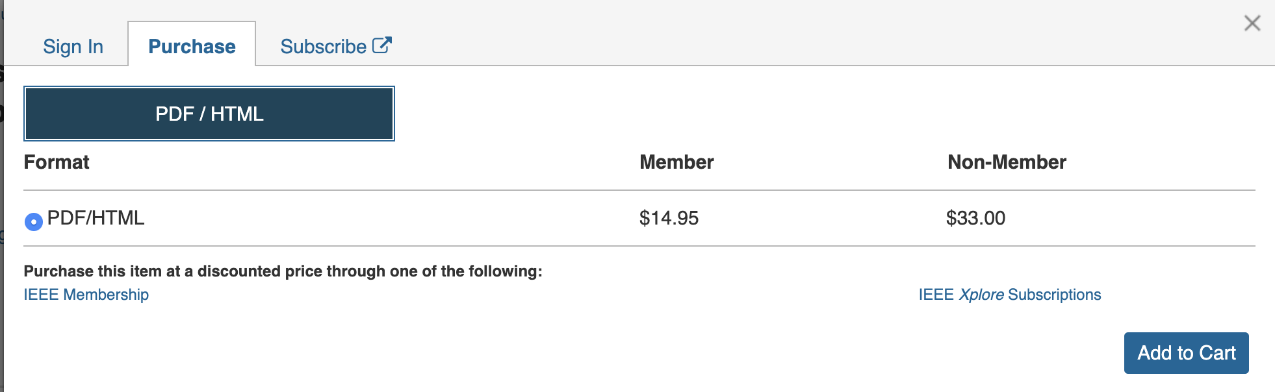
Did you know?
Reading your own article outside the Institutional network is not free.
If you try to access from your home, you will hit a paywall
Paywall

Slide 12
Scientific Journals are based on Subscriptions: your Institution pays, you can access and read the contents
Your Institutions pays
What you get is access, not ownership!
Your institution owns nothig!!!
You get access

Slide 13

Costs of scientific literature: business models
Traditional subscription based
Research Institutions pay annual fees to give access to the Journal contents to their researchers (not to own the literature!)
Gold Open Access
Articles published in Gold Open Access Journals are accessible to anyone starting from the very moment of the publication. Sometimes the author pays an APC (Article Processing Charge) to give access to the public to his/her publication
Hybrid Model
The Journal is a traditional subscription based one, but the editor charges the authors an APC to open access their specific paper to the World.
1-3 Millions
euros
100-6000
euros
100-3000
euros
Double dipping

Slide 14
Schimmer, R., Geschuhn, K. K., & Vogler, A. (2015). Disrupting the subscription journals’ business model for the necessary large-scale transformation to open access. doi:10.17617/1.3.
Estimation:10 Billions Dollars used for journal subscriptions
That is the money Institutions pay to re-buy the article their own researchers write!

Slide 15
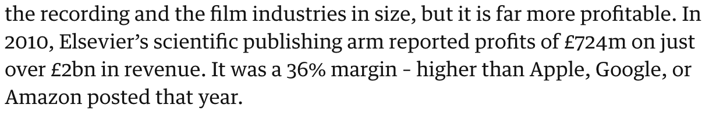




What is the problem?
Big deals with editors are not transparent
Research can be accessed by few with long delays
Authors are giving away their copyrights thinking they have no choice
Subscription costs are rising every year (by 1-2%)
APC costs are not tracked
Authors, reviewers and editors are not paid but are giving for free the raw material to scientific publishers who make great profit out of it:
https://www.theguardian.com/science/2017/jun/27/profitable-business-scientific-publishing-bad-for-science

Slide 16
Why do we spend public money to close the research results behind limited access subscriptions scientific journals?

Slide 17
Research Evaluation

Slide 18
Based on bibliometric indexes or, for non-bibliometric sectors, on selected «fascia A» list of journals

Slide 19
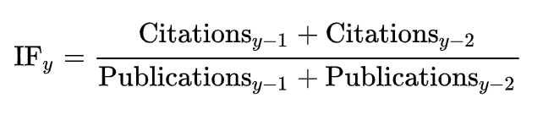
For a researcher: the maximum value of h such that the given author has published h papers that have each been cited at least h times
H-index
For a given year y, the specific journal Impact Factor is:
Impact Factor

Slide 20
Citation based indexes criticism
Early career researchers are penalised
The citation context is not considered (eg. Negative citation)
They are influenced by the limitation of the citational databases (which are all owned by big scientific publishers)
It can be manipulated by both authors and reviewers (self and cross citations)
It does not take into account the number of authors in a paper and their contribution given
It does not take into account research multidisciplinarity
It does not facilitate science freedom.
DORA, 2013, https://sfdora.org/read/
McKiernan, et al, 2019. https://elifesciences.org/articles/47338
Niles, et al, 2019. https://www.biorxiv.org/content/10.1101/706622v1
Alder, et al, 2008. https://www.mathunion.org/fileadmin/IMU/Report/CitationStatistics.pdf

Slide 21
What are we evaluating?

Slide 22
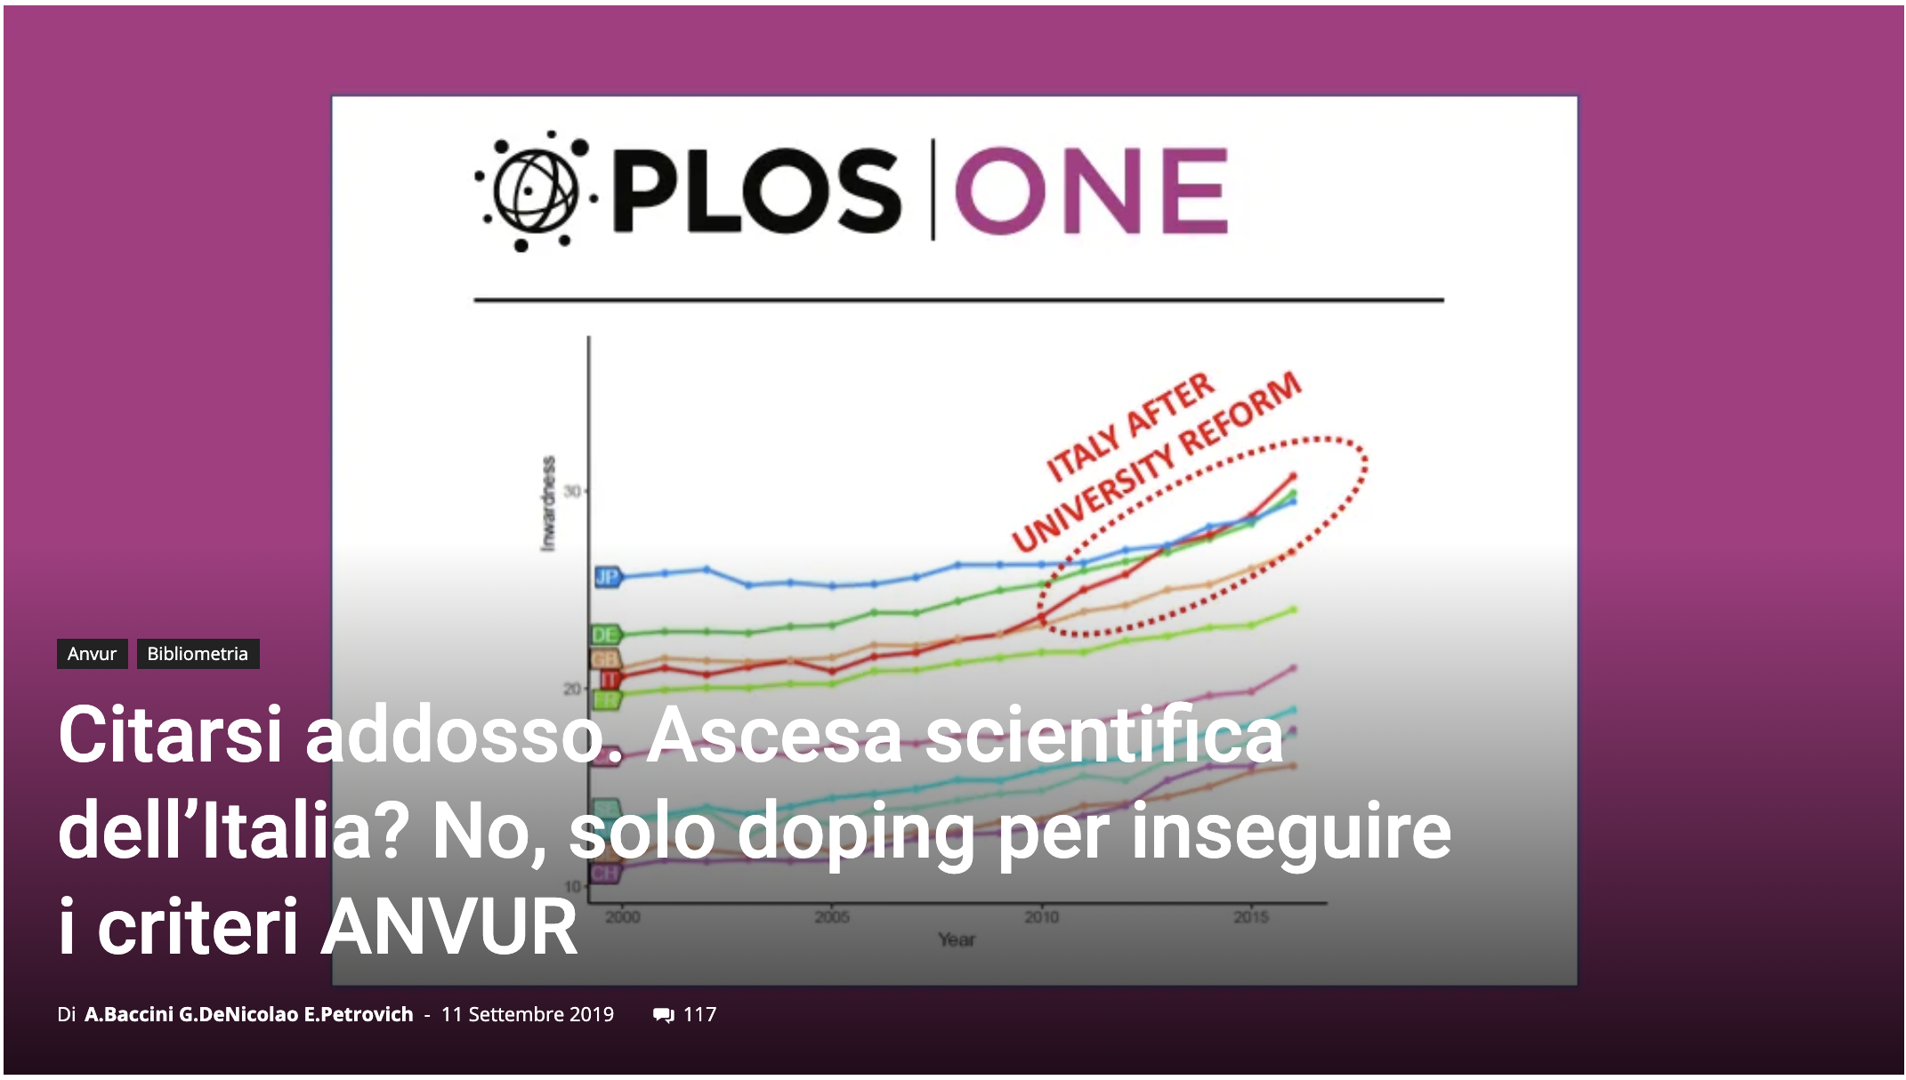
https://www.roars.it/online/citarsi-addosso-ascesa-scientifica-dellitalia-no-solo-doping-per-inseguire-i-criteri-anvur/#

Slide 23
Scientific Journals

Slide 24
















Journal Editor
Reviewers
Journal Editor
copyright
Pre-print
Editorial Version
Author
Post-print
Scientific Community

Slide 25
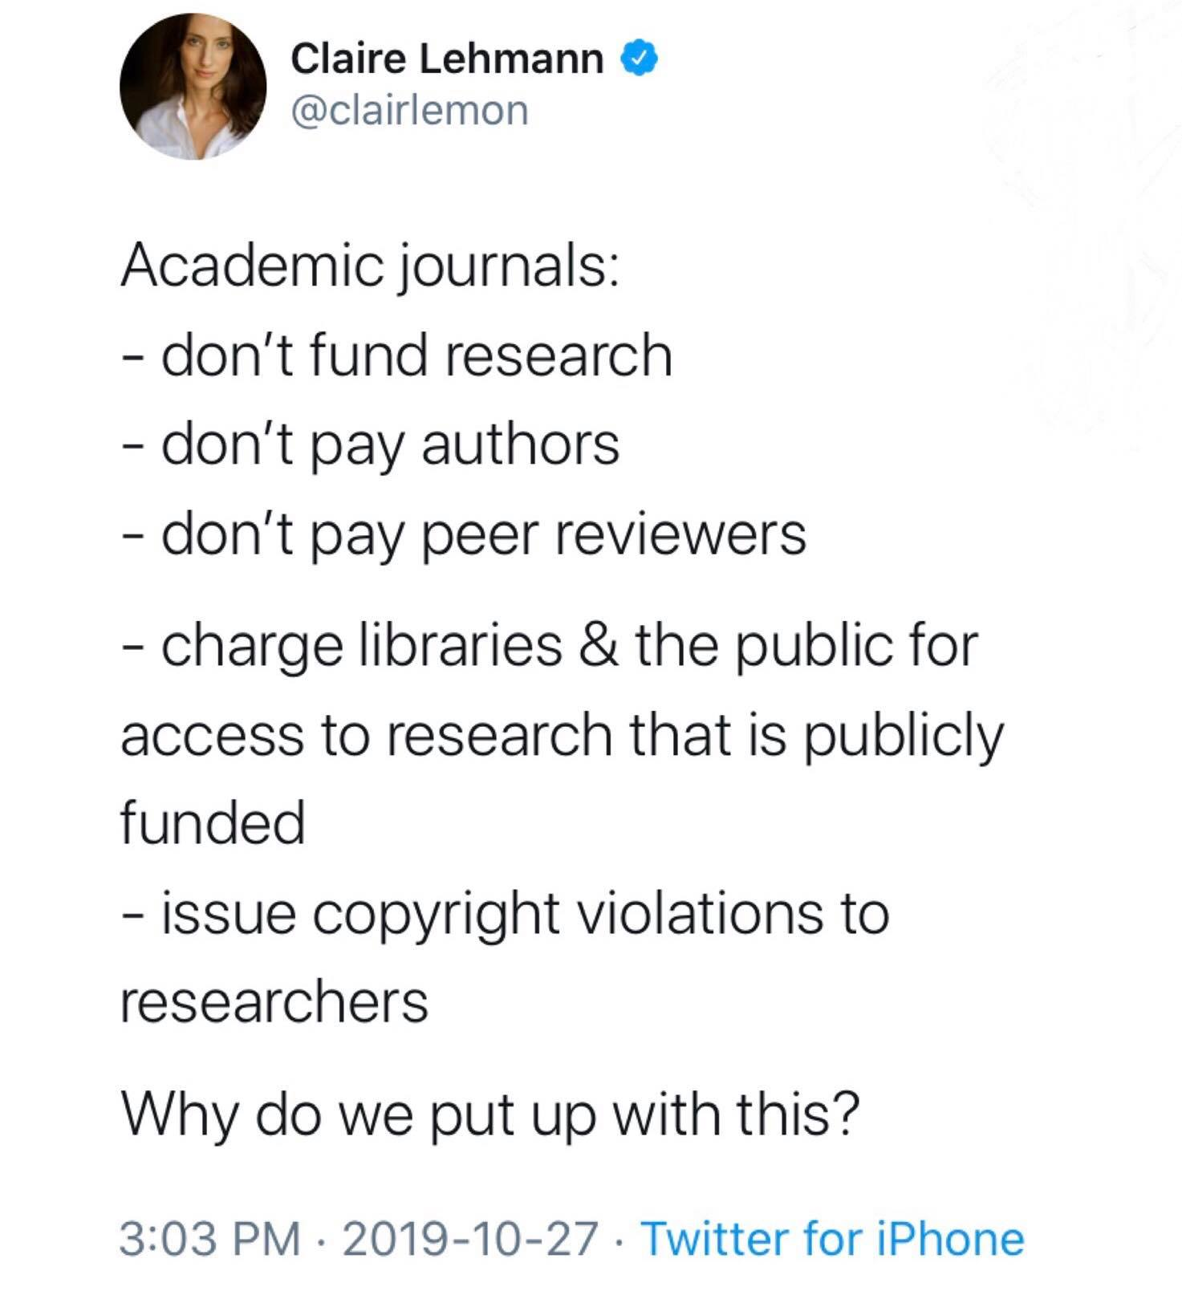

Slide 26
Alternatives to APC-based Open Access Publishing
Community driven effort
  High energy physics: SCOAP3 initiative
Institutional publishing
  Università di Milano: riviste.unimi.it
Funder sponsored
  Wellcome Trust: Wellcome Open Research
  Bill and Melinda Gates Foundation: Gates Open Research
  European Commission: Open Research Europe (we’ll see this in details in a moment!)

Slide 27
How about the rest?
Science is more than publishing papers in commercial platforms!

Slide 28
What are we missing in research evaluation?
Negative results
Data
Algorithms
Processes
Software
Methodologies
Educational Resources
Peer-review
Grey Literature
Project proposals
Leadeship skills
Product development
…

Slide 29
Publishing research without data is simply advertising, not science
Graham Steel

Slide 30
Why do we need to share Data?

Slide 31
An experiment is reproducible until another laboratory tries to repeat it
Alexander Kohn

Slide 32
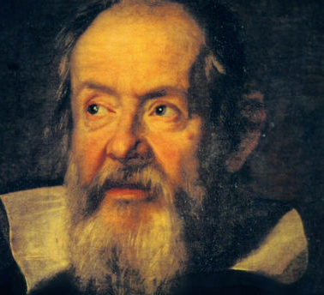
Reproducibility
Is (still) a principle of the Scientific Method!
Data is the proof of your papers: how can others trust your research without accessing the data?

Slide 33
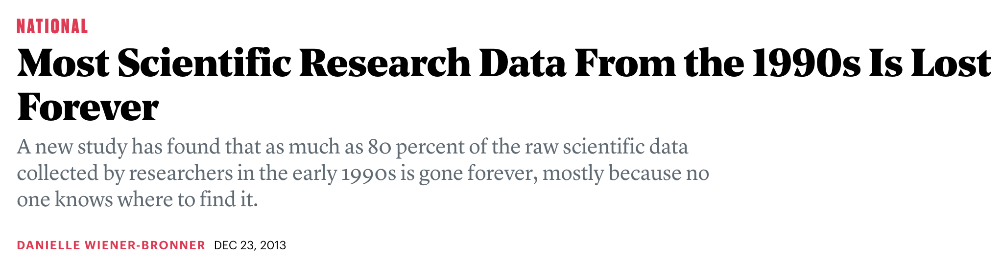
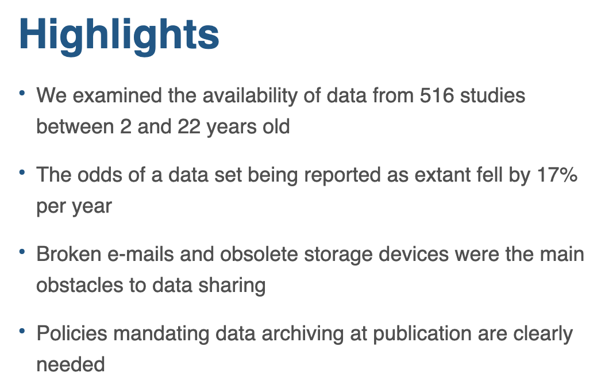
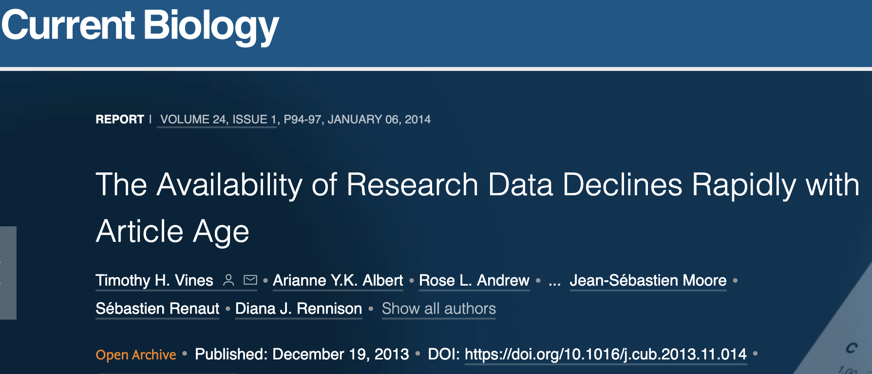
https://www.cell.com/current-biology/fulltext/S0960-9822(13)01400-0

Slide 34
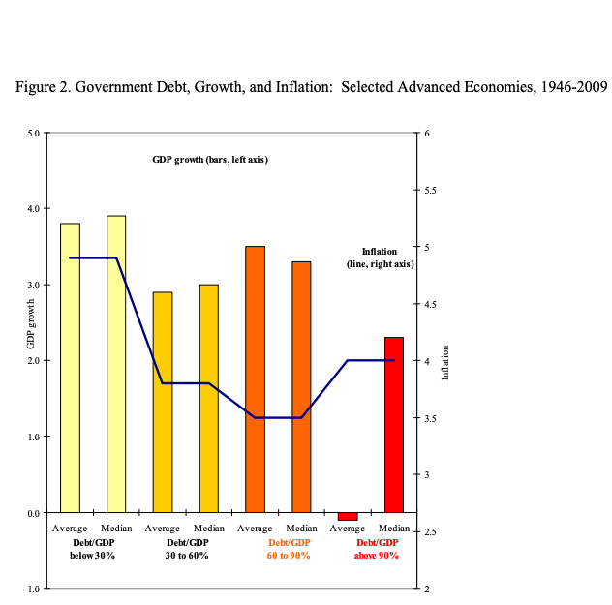
Austerity theory
Thesis presented: A Country economic growth is strongly affected (and decreased) whenever the amount of debt exceeds 90% of the Gross Domestic Product.
The results shown in the paper have been used to support public austerity policies during the recent economic crisis.
But some considerations were based on incorrect calculations.
A PhD student who fails to replicate the results finds out when asking the authors for the original dataset.

Slide 35
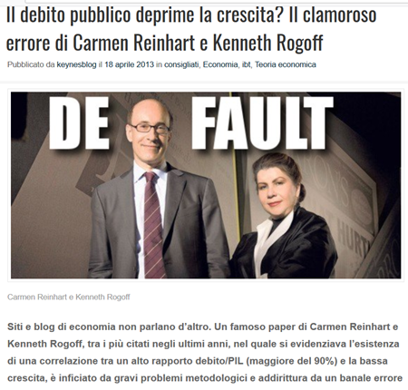
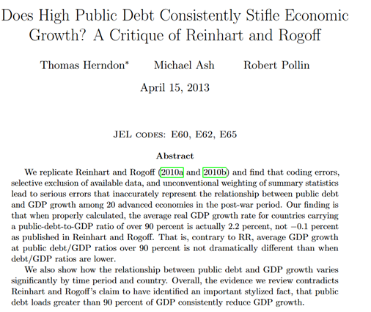
2013
Herndon, 2013

Slide 36
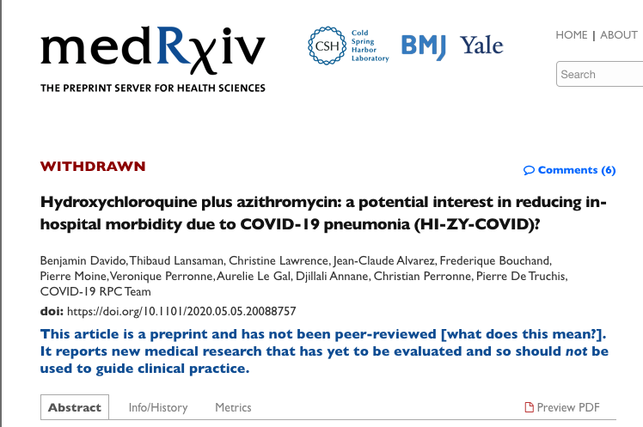
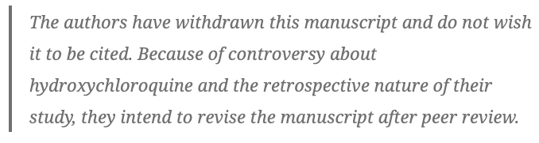
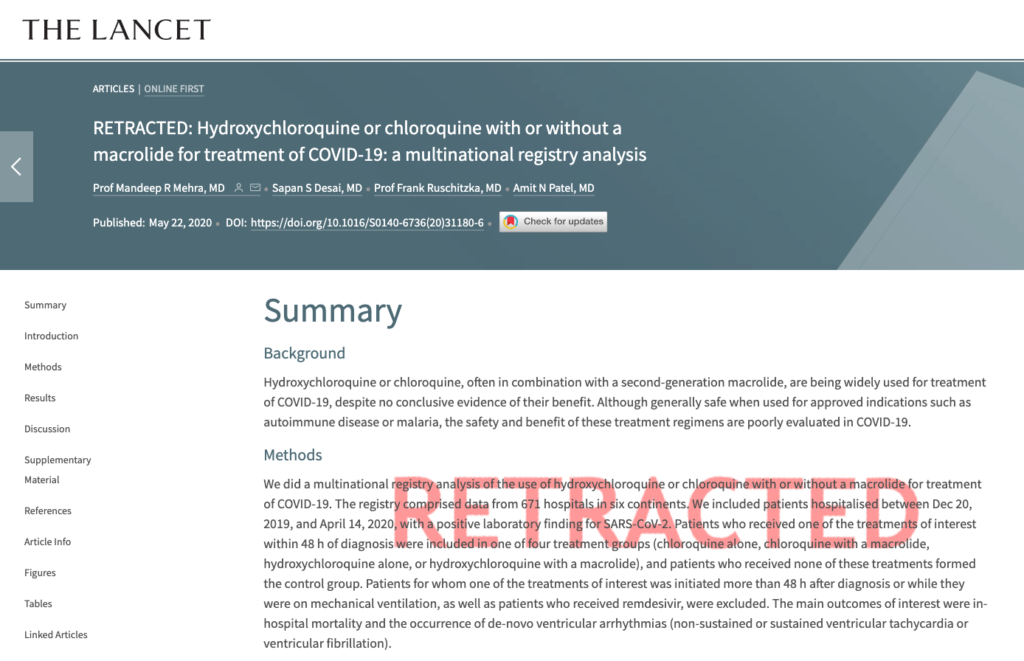
Covid-19 and preprint and article retraction
Preprints allow for a wider and open discussion in science
Discussion does not end with the review process!
Retraction is actually good for science:
it means that the community
checks results even outside of
the official review process
https://www.valigiablu.it/approfondimenti/ricercatori-lancet-idrossiclorochina/
https://www.sciencemag.org/news/2020/06/two-elite-medical-journals-retract-coronavirus-papers-over-data-integrity-questions?utm_campaign=SciMag&utm_source=JHubbard&utm_medium=Facebook
https://retractionwatch.com/retracted-coronavirus-covid-19-papers/

Slide 37
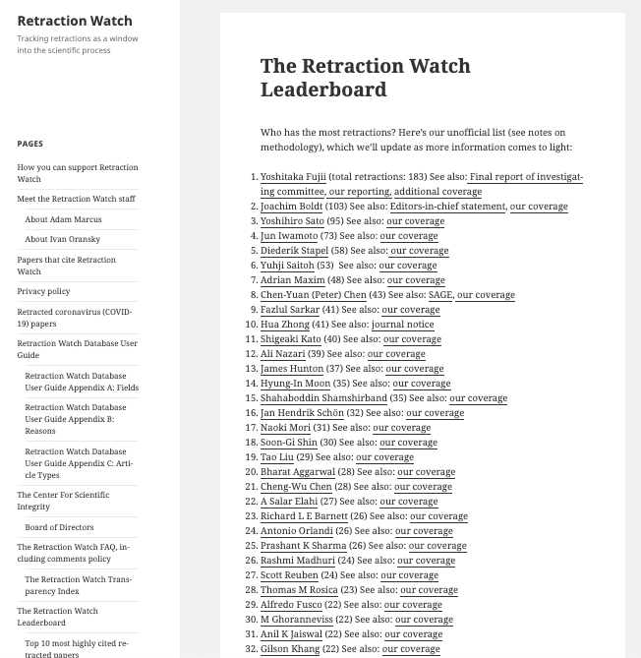
Retraction Watch Blog
Top 10 most highly cited retracted papers
Article | Year of retraction | Citing Articles before retraction | Citing Articles after retraction | Total cites (journals indexed by Web of Science)
Primary Prevention of Cardiovascular Disease with a Mediterranean Diet. N Engl J Med April 4, 2013 Estruch R, Ros E, Salas-Salvado J, Covas MI, Corella, D, Aros F, Gomez-Gracia E, Ruiz-Gutiérrez V, Fiol M, Lapetra J, Lamuela-Raventos RM, Serra-Majem L, Pinto X, Basora J, Munoz MA, Sorli JV, Martinez JA, Martinez-Gonzalez MA, et al., for the PREDIMED Study Investigators | 2018 | 1895 | 371 | 2266
2. Visfatin: A protein secreted by visceral fat that mimics the effects of insulin. SCIENCE, JAN 21 2005 Fukuhara A, Matsuda M, Nishizawa M, Segawa K, Tanaka M, Kishimoto K, Matsuki Y, Murakami M, Ichisaka T, Murakami H, Watanabe E, Takagi T, Akiyoshi M, Ohtsubo T, Kihara S, Yamashita S, Makishima M, Funahashi T, Yamanaka S, Hiramatsu R, Matsuzawa Y, Shimomura I. | 2007 | 228 | 1096 | 1324
3. Ileal-lymphoid-nodular hyperplasia, non-specific colitis, and pervasive developmental disorder in children. LANCET, FEB 28 1998 Wakefield AJ, Murch SH, Anthony A, Linnell J, Casson DM, Malik M, Berelowitz M, Dhillon AP, Thomson MA, Harvey P, Valentine A, Davies SE, Walker-Smith JA | 2010 | 633 | 669 | 1302
4. An enhanced transient expression system in plants based on suppression of gene silencing by the p19 protein of tomato bushy stunt virus. PLANT JOURNAL, MAR 2003 Voinnet O, Rivas S, Mestre P, Baulcombe D. | 2015 | 895 | 271 | 1166
5. Cardiac stem cells in patients with ischaemic cardiomyopathy (SCIPIO): initial results of a randomised phase 1 trial. LANCET, NOV 2011 Bolli, Roberto; Chugh, Atul R.; D’Amario, Domenico; et al. | 2019 | 904 | 22 | 926
7. TREEFINDER: a powerful graphical analysis environment for molecular phylogenetics. BMC EVOLUTIONARY BIOLOGY, JUN 28 2004 Jobb G, von Haeseler A, Strimmer K. | 2015 | 772 | 132 | 904
6. Purification and ex vivo expansion of postnatal human marrow mesodermal progenitor cells. BLOOD, NOV 1 2001 Reyes M, Lund T, Lenvik T, Aguiar D, Koodie L, Verfaillie CM. | 2009 | 600 | 292 | 892
8. Viral pathogenicity determinants are suppressors of transgene silencing in Nicotiana benthamiana. EMBO JOURNAL, NOV 16 1998 Brigneti G, Voinnet O, Li WX, Ji LH, Ding SW, Baulcombe DC | 2015 | 773 | 54 | 827
9. Spontaneous human adult stem cell transformation. CANCER RESEARCH, APR 15 2005 Rubio D, Garcia-Castro J, Martín MC, de la Fuente R, Cigudosa JC, Lloyd AC, Bernad A. | 2010 | 326 | 429 | 755
10. Combination treatment of angiotensin-II receptor blocker and angiotensin-converting-enzyme inhibitor in non-diabetic renal disease (COOPERATE): a randomised controlled trial. LANCET, JAN 11 2003 Nakao N, Yoshimura A, Morita H, Takada M, Kayano T, Ideura T. | 2009 | 583 | 148 | 731

Slide 38
BUT!
This is all about to change…

Slide 39

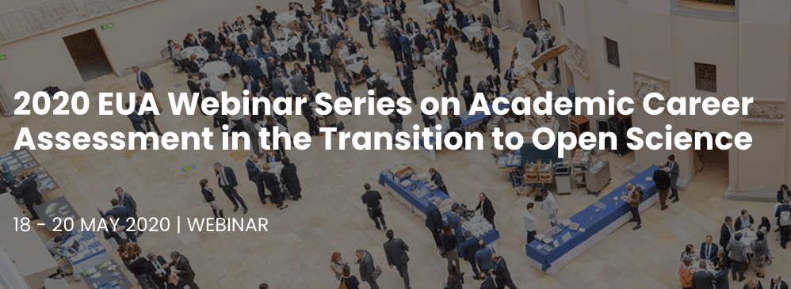
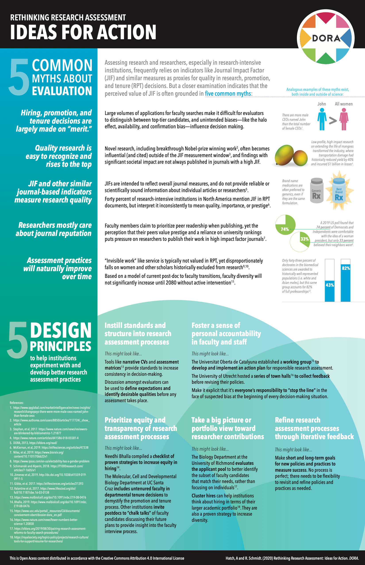
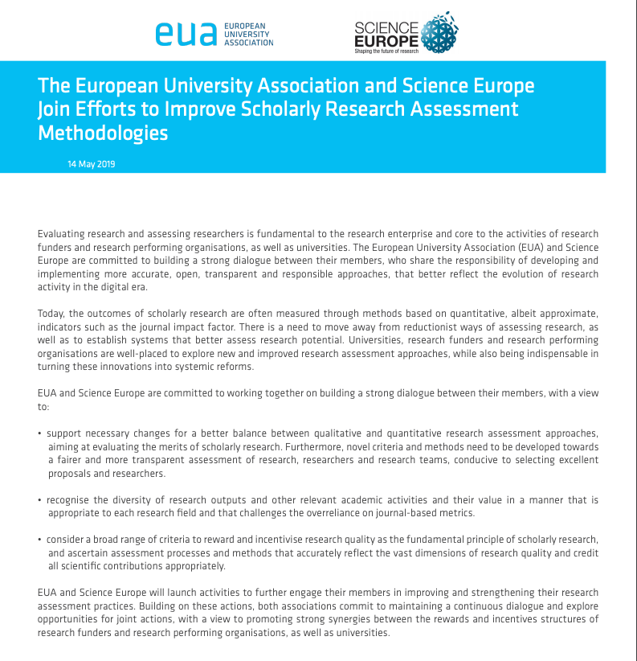
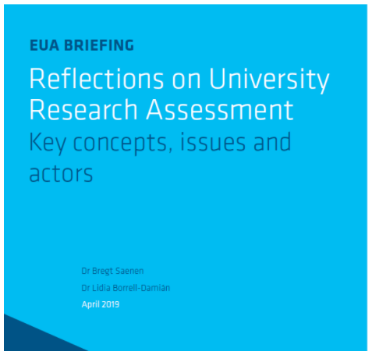
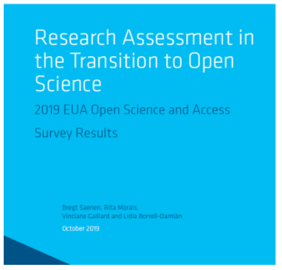
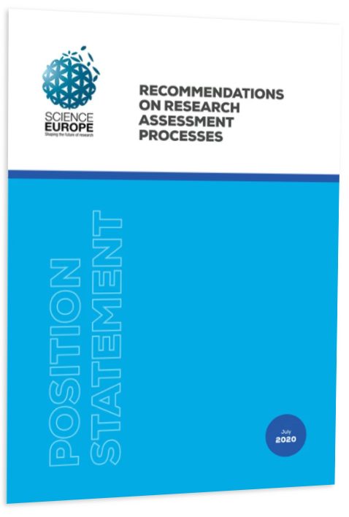

Position Statement and Recommendations on Research Assessment Processes
Worldwide …

Slide 40

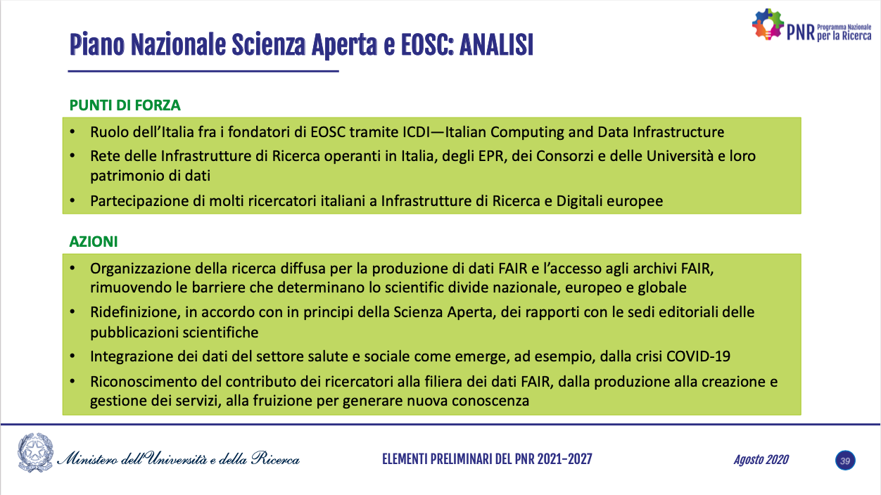
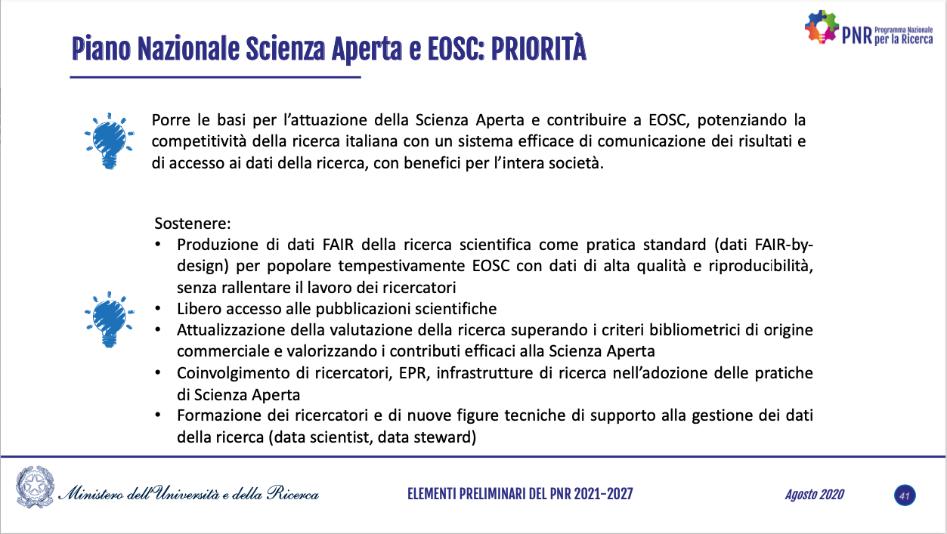
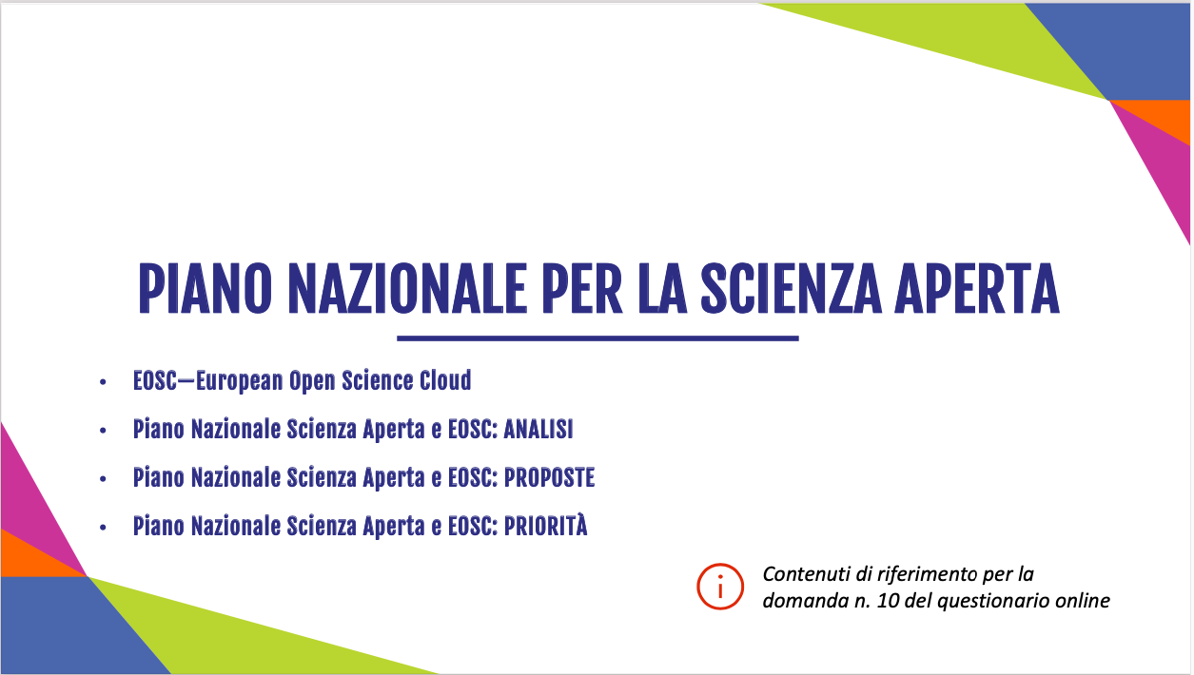


… in Italy
https://www.ui.torino.it/servizio/direzione/notizia/83057/e-on-line-e-accessibile-la-consultazione-pubblica/#ToolManager

Slide 41
Open Science

Slide 42
The opposite of Open Science is not Closed Science. It is Bad Science
Jon Tennants

Slide 43
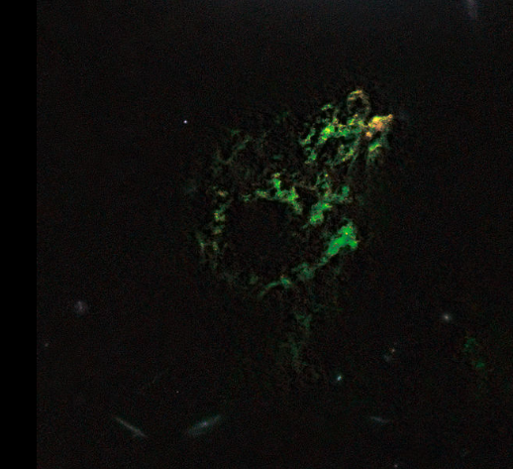
Hanny’s Voorwerp
It is a new galaxy that was detects thanks to the collaborative project Galaxy Zoo, that open the universe observation data to the citisens. The name derives from the Dutch teacher who first discovered it.

Slide 44
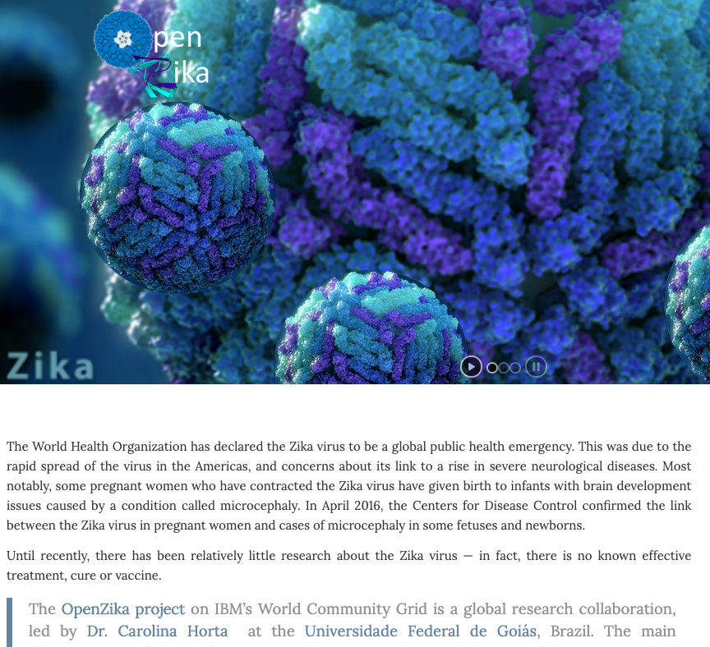
Open Zika
Open Science based collaborative project on Zika virus:
http://openzika.ufg.br/

Slide 45
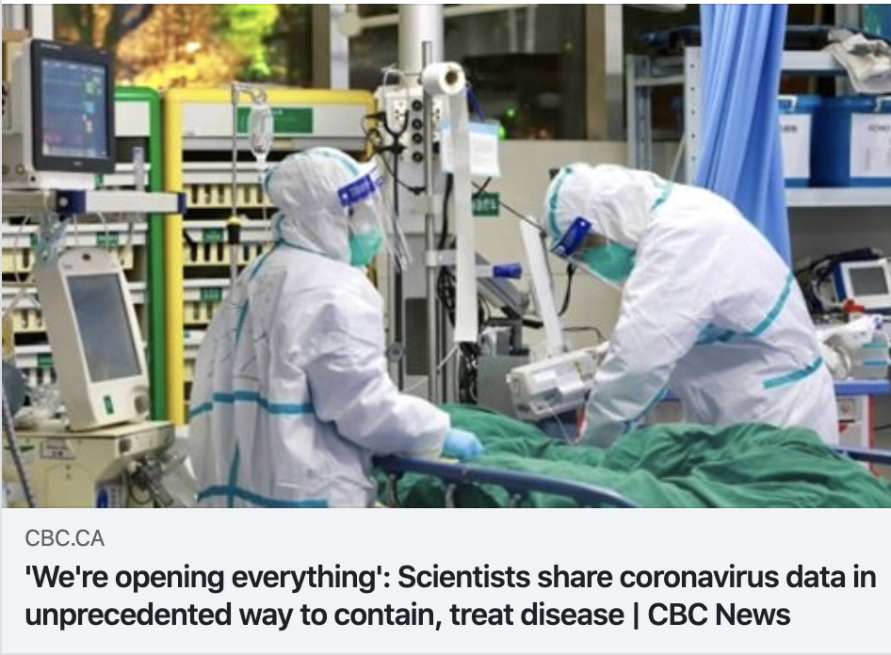
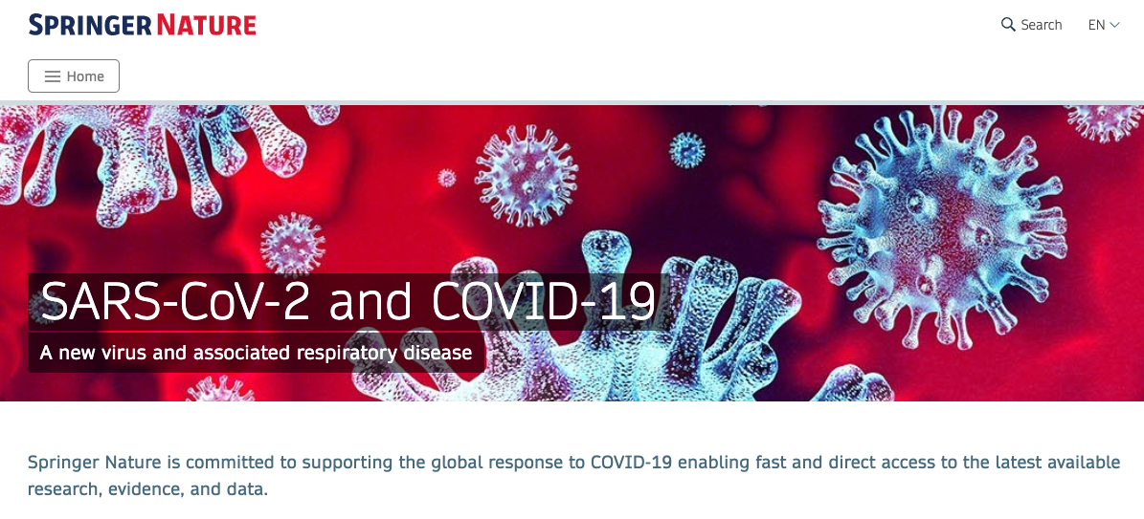
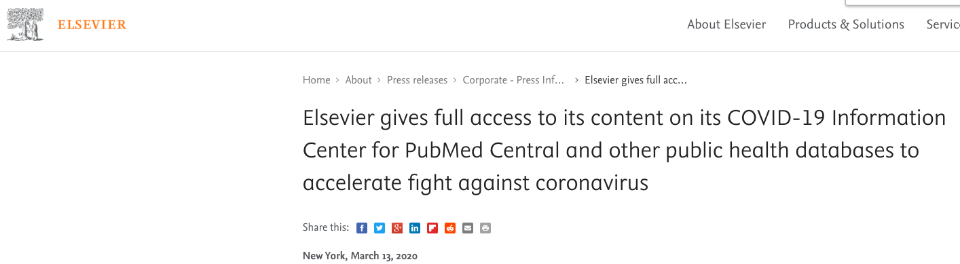
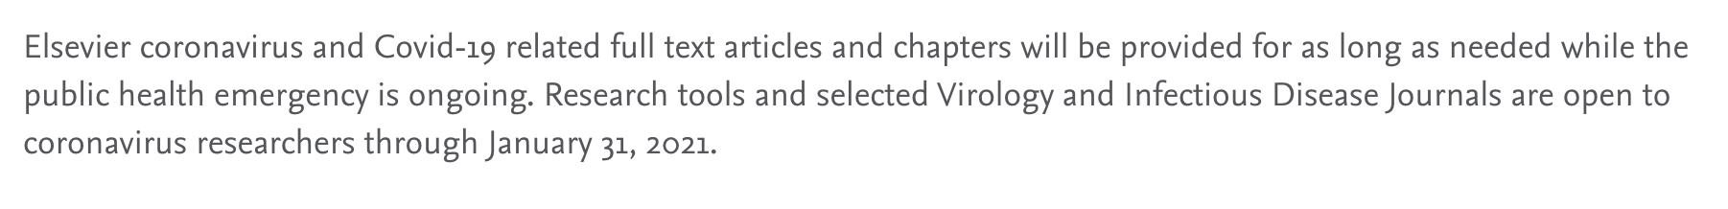
Collaboration
«It is imperative to leverage scientific innovations and support principles of openness and inclusiveness in processes that generate solutions to the severe health menace that is likely to bring significant hardships to humanity.»
UNESCO - Open access to facilitate research and information on COVID-19

Slide 46
Why Open Science?
Currently, the scientific communication system is regulated by market interests of big commercial publishers and outdated research assessment criteria. Studies and publications are not accessible because enclosed behind expensive paywalls (usually thousands of dollars) that nobody can afford (doctors, professionals, SMEs…)
Every institution pays four times for research: salaries, research funds, subscriptions to “buyback” the researches, rights to reuse
All this with public funds; every year single institutions spend millions of euros for subscriptions to journals (instead of on research)
Without forgetting that neither authors nor reviewers are paid!

Slide 47
Schimmer, R., Geschuhn, K. K., & Vogler, A. (2015). Disrupting the subscription journals’ business model for the necessary large-scale transformation to open access. doi:10.17617/1.3.
Estimation:10 Billions Dollars used for journal subscriptions
That is the money Institutions pay to re-buy the article their own researchers write!

Slide 48
This is not about saving money, it is about spending public money in a better way!

Slide 49
Open Science: Science the correct way!
Open Science means: open each step of the research cycle.
Open Science principles are: transparency, reproducibility, collaboration, inclusiveness, accessibility, accuracy, re-use
Open Science steps from the concept that the reseach that is funded with public money has to be made immediately available to the community: «every EU citizen has the right to access and benefit from knowledge produced using public funds» [Neelie Kroes, European Commission]
The European Commission and a long list of International Funders made a clear choice towards Open Science

Slide 50
Open Science
Open Science means a broader access to publicly funded research results and therefore helps to:
build on previous research results (improved quality of results)
encourage collaboration and avoid duplication of effort (greater efficiency)
speed up innovation (faster progress to market means faster growth)
involve citizens and society (improved transparency of the scientific process).

Slide 51

Research
Infrastructures
Open Science
Research
Integrity
Open
Software
Open Access Publications
Open Metodologies
Open Access Data
Evaluation:Altmetrics
Open Workflows/Protocols
Open Education
Citizen
Science
Open Peer-Review

Slide 52
Open Access
The main pillar of
Open Science is
to publications
and research data

Slide 53
Open Access
Open Access is «free and unrestricted online access to research outputs (texts and data)»

Slide 54
Beware!
Open Access doesn’t mean paying for publishing!

Slide 55
How do you give access to your production?
Through a Repository

Slide 56
Open Access Repository
A repository stores Open Access digital objects and makes them available and downloadable. It’s accessible and interoperable through a OAI-PMH protocol and it deploys a long-term archiving policy
Institutional
Thematic/Disciplinary
Literature
How to chose your repository
Literature repository: Open Access Repository Directory
www.opendoar.org
Data repository: Registry of Research Data Repository
https://www.re3data.org/
Data
Catch All

Slide 57
Why do you need to deposit in a Repository?
Repositories are managed by institutions, countries, transnational infrastructures or solid scientific communities that implement long-term curation and preservation of content
Preserve
A repository provides a public interface that allows anyone to access the metadata of digital objects. The author can assign different access rights for attachments (open, restricted, closed, embargoed, ...)
Share

Slide 58
Open Access to Scientific Literature
There are two ways to implement Open Access to scientific literature :
    Green Open Acces: when the Open Access version of papers, wherever they have been published, is deposited in open archives (repositories), in compliance with copyright regulations; editors that may retain the rights can require an embargo period (months in which the deposited paper remains closed).
    Gold Open Access: the publication in Open Access Journals, which are journals witouth subscription for readers, with transparent peer review and which leaves the rights to the authors; in 26% of cases they apply APC – Article Processing Charges – to support editorial costs.
To guarantee the reuse, authors should choose open licenses (ie. Creative Commons, which have 4 criteria: BY, SA, NC, ND)

Slide 59
Deposit in literature Repository
The possible versions are:
  PRE-PRINT: your final draft, as submitted to the journal (does not have reviewers comments yet)
  POST-PRINT or ACCEPTED MANUSCRIPT: the final version, with reviewers comments, identical to the published one except for the editorial layout
  EDITORIAL PDF or PUBLISHED VERSION: the exact version published in the journal, with layout and graphic
To know which version you can deposit and the eventual period of embargo, you can check SHERPA-RoMEO database
To find an Open Access Journal and and find out if charges APC (Article Processing Charges), you can check DOAJ, Directory of Open Access Journals

Slide 60
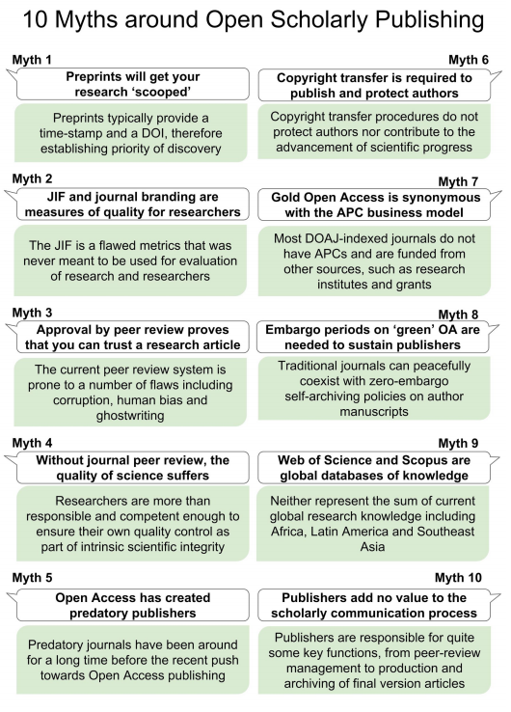
10 Myths around open scholarly publishing
Tennant JP, Crane H, Crick T, Davila J, Enkhbayar A, Havemann J, Kramer B, Martin R, Masuzzo P, Nobes A, Rice C, Rivera-López BS, Ross-Hellauer T, Sattler S, Thacker P, Vanholsbeeck M. 2019. Ten myths around open scholarly publishing. PeerJ Preprints 7:e27580v1 https://doi.org/10.7287/peerj.preprints.27580v1

Slide 61

European Commission and Open Science

Slide 62
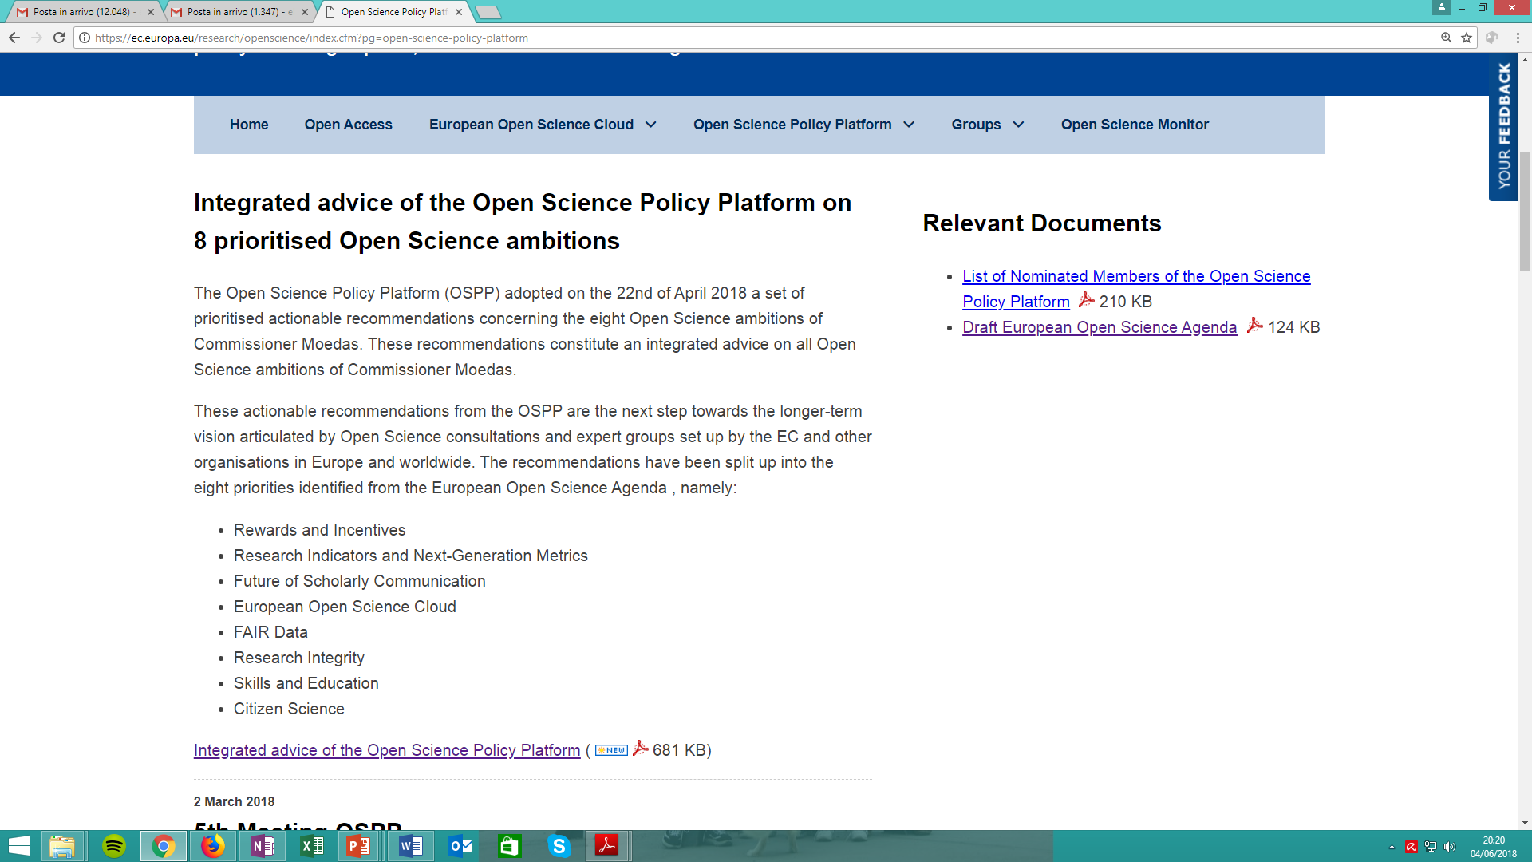
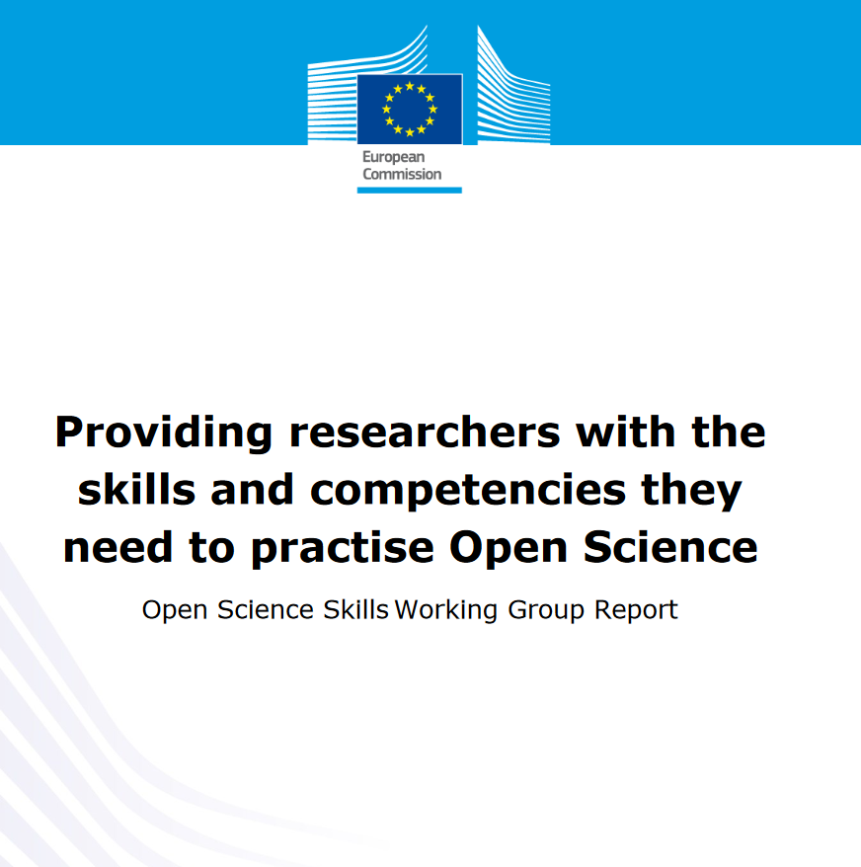
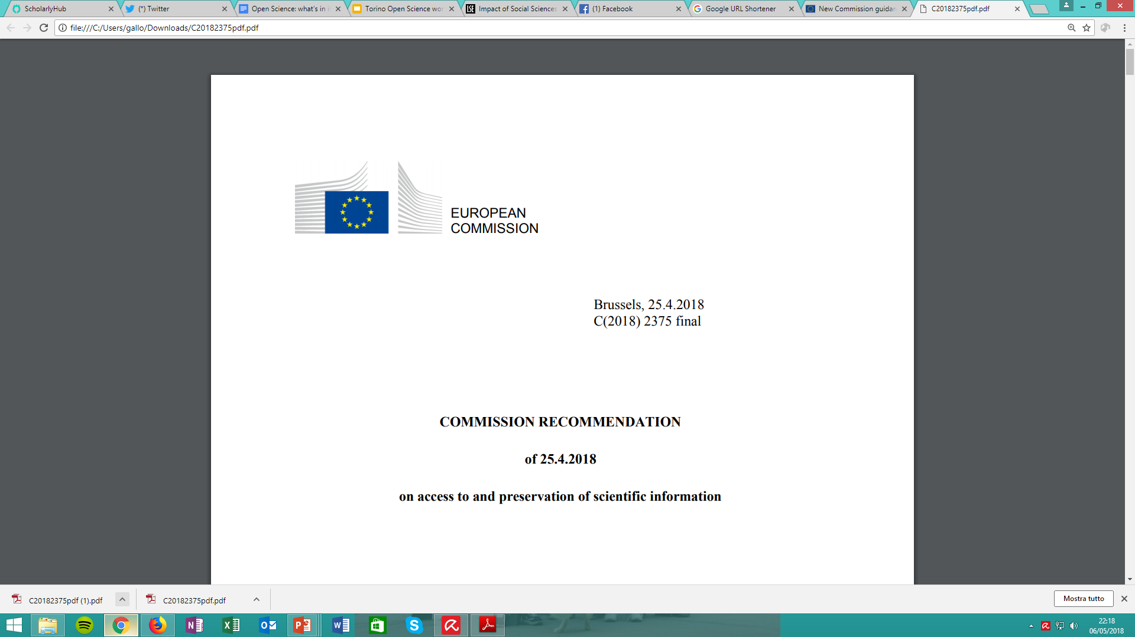
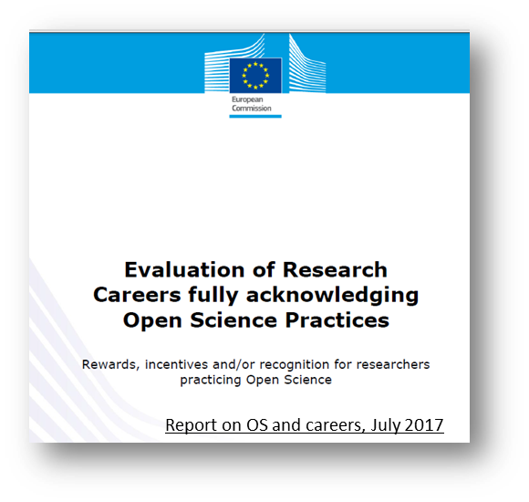
Open Science in Europe
May 29, 2018
25 Apr. 2018
Report, Sept.2017
Politiche nazionali e di ogni ateneo su Open Access e Open Data

Slide 63
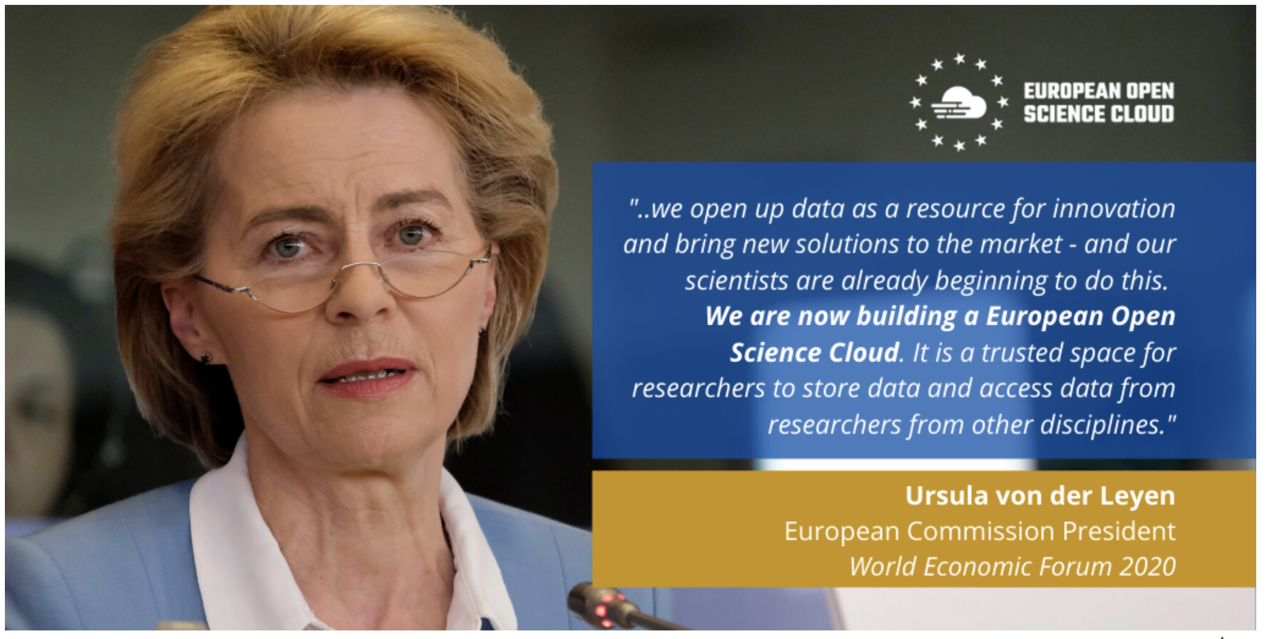
European Open Science Cloud - EOSC
EOSC aims at creating a virtual research environment to access and interoperate research data and other research outputs in Europe across the different disciplines.
Più informazioni su
https://ec.europa.eu/research/openscience/index.cfm?pg=open-science-cloud
www.eoscsecretariat.eu
https://www.eosc-portal.eu/

Slide 64
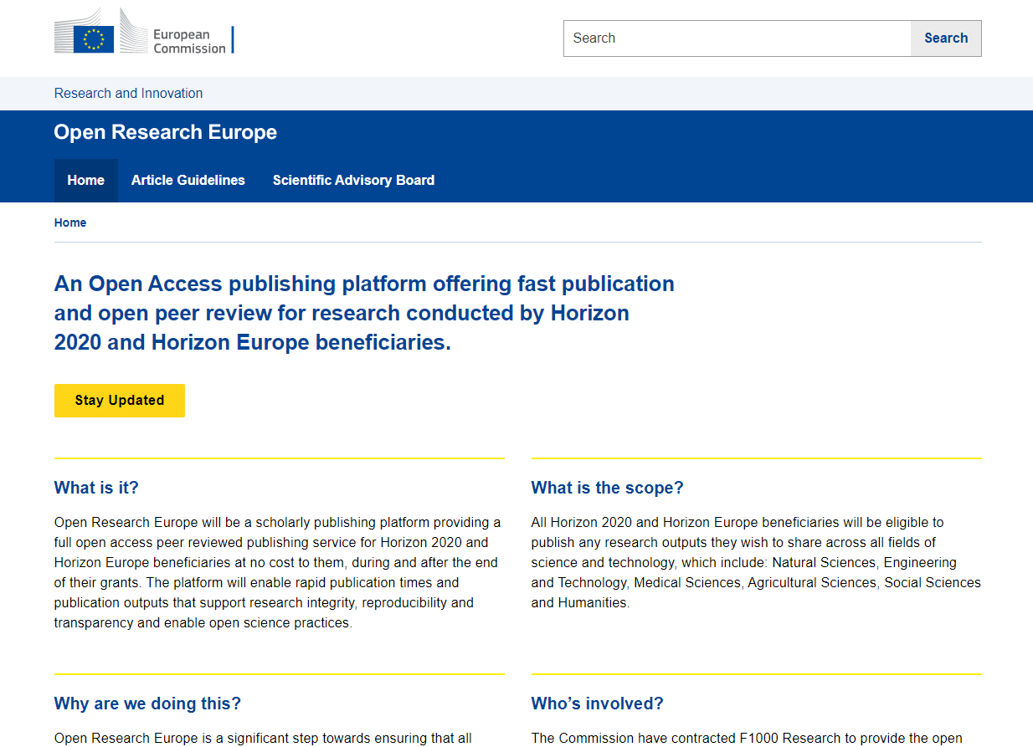
European Commission
Open Research Publishing Platform
Launching in 2021
Research publication platform for scientific papers – service dedicated to EC funding beneficiaries
The platform will manage all the publication, post-publication, curation and preservation process
Open peer-review
Pre-prints and final versions of papers will be open to the end users free of charge (also non-scientists), and licensed for re-use
Full support of underlying data that meets the FAIR (Findable, Accessible, Interoperable and Reusable) principles to enable reanalysis, replication and reuse, and thus improving reproducibility and increasing impact.
Now accepting submissions!
https://open-research-europe.ec.europa.eu

Slide 65
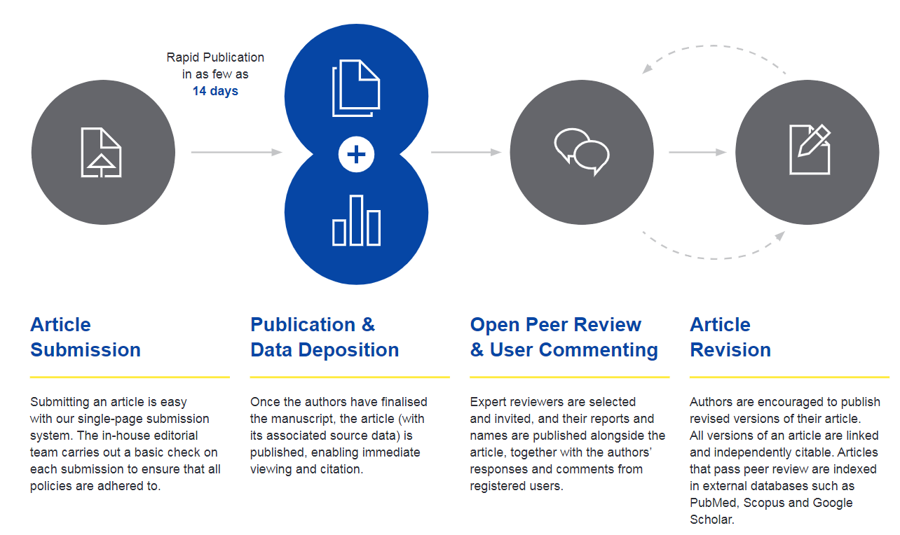
ORE Publishing Model

Slide 66
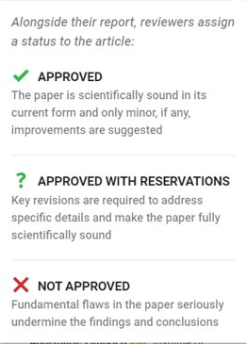

ORE: Open Peer Review Example
Visibility & credit for reviewers:
Co-reviewing
ORCID ids
DOIs for reports

Slide 67

Plan-S
Plan S is an initiative for Open Access publishing that was launched in September 2018. The plan is supported by cOAlition S, an international consortium of research funders. Plan S requires that, from 2021, scientific publications that result from research funded by public grants must be published in compliant Open Access journals or platforms.

Slide 68

cOAlition S
Funders that have endorsed Plan S and are jointly working on its implementation

Slide 69





Consequences of Plan-S
Transformative agreements:
Large Institutions or Countries contracted different publishing models to allow their researchers to publish in OA all their works
Publish and Read contracts
Transparency on the contracts contents
Complete list at: https://esac-initiative.org/about/transformative-agreements/agreement-registry/

Slide 70
Transformative agreements in Italy
CRUI: agreements with a group of publishers already in place (Springer, ACS, Cambridge UP, emerald, De Gruyter, Wiley, Elsevier), others are under development.
  Reactions from the Open Science community: AISA - Associazione Italiana per la promozione della Scienza Aperta, University of Milan.
CNR: Read&Publish agreements signed with AIP, IEEE, and RSC. CNR team estimated the number of articles published, and the overall cost for both subscriptions and APC for each publisher in the last 3 years.

Slide 71



H2020: guides and legal basis
Art. 29.2 e 29.3 of the Model Grant Agreement
Guidelines to the Rules on Open Access to Scientific Publications and Open Access to Research Data in Horizon 2020
H2020 Programme Guidelines on FAIR Data Management in Horizon 2020

Slide 72

H2020 beneficiaries
Must decide whether to patent or publish
Guidelines to the Rules on Open Access to Scientific Publications and
Open Access to Research Data in Horizon 2020

Slide 73

EC Open Access Mandate to Scientific
Publications
    Open by mandate: each beneficiary must ensure open
    access to all peer-reviewed scientific publications relating to its results.
    Embargo period: at most 6 months (12 months for publications in the social sciences and humanities).
    What to deposit?
      Post Print or Editorial Version (machine-readable electronic copy)
      Metadata must contain project coordination (name of the
      action, acronym and grant number)
    Where to deposit?
      A repository that is compliant to OpenAIRE guidelines
Open by mandate

Slide 74
EC mandate on Open Access to research data
Open by default (“Opt Out” always possible)
What to deposit
    Data produced by funded research that led to a scientific publication, but in general all types of data
    Metadata with reference to the project
Where to deposit
A repository that is compliant to OpenAIRE guidelines
What to produce
    Data Management Plan
As Open As Possible
As Closed As Necessary

Slide 75





«Opt Out» option of Open Data Pilot (ODP)
Industrial or commercial exploitation
Achievement of project objectives
Participation in the ODP is incompatible with the duty to protect results that can be reasonnably exploited commercially or industrially
Participation in the ODP is incompatible with the achievement of project targets
Security
No Data Produced/Gathered
Participation in the ODP is incompatible with the need for confidentiality related to security issues
The project doesn’t require creating or gathering the data of the research
Personal Data Protection
Other Legitimate Reasons
Participation in the ODP is incompatible with the rules on personal data protection
There are other legitimate reasons (to motivate in the proposal or in the Data Management Plan)

Slide 76

Research Data Management
European Commission policies aims to spread correct aspects of research data management
A Data Management Plan is required (mandatory deliverable within
month 6)
You need to make your data compliant with the FAIR principles even if you will not assign Open Access rights to it.

Slide 77
Data must be FAIR
Accessible
Findable
For at least 10 years! It does not mean that data is open, but it must be clear who and how can access the data.
it should be clear where data are located and can be cited!
Interoperable
Reusable
Data should be easily integrated with other data, machine readeable, and linked to other research results
usable for re-analysis or new research (transparency, integrity)
FAIR does not mean Open

Slide 78

Once your data is FAIR, open it!
From 2014 until 2019, Moedas served as European Commissioner covering the portfolio of Research, Science and Innovation under the leadership of President Jean-Claude Juncker

Slide 79
Be aware of possible Sanctions!
Grant reduction or payment suspension
[Art. 43 of the Grant Agreement]

Slide 80







OpenAIRE collects data coming from 17.000 data providers, and builds a graph connecting reserch results, projects, insitutions, funders,…

Slide 81
Content Providers 17.000
Publications 40.000.000
Projects 3.000.000
Datasets 10.000.000
Software 230.000
Funders 21

Slide 82




Different perspectives of the OpenAIRE Graph
Institution
Repository
Project
Product

Slide 83




Information is sent directly to the participant portal for
scientific and financial reporting

Slide 84

National Open Access Desks (NOADs)
Facts
Research is global, support is local
Diversity in culture & maturity of national/local infras
Not one size fits all in OA and open science
Our pan-European network
⇢ 34 countries
Key national organizations
⇢ 4 area coordinators
Courtesy of Natalia Manola, OpenAIRE

Slide 85



OpenAIRE NOAD in Italy
Elena Giglia
Unità di progetto Open Access
Direzione Ricerca e Terza Missione
Universita' degli Studi di Torino
noad-it@openaire.eu
Emma Lazzeri, Gina Pavone
CNR – Istituto di Scienze e
Tecnologie dell’Informazione
Pisa
Please contact us for any information or clarification

Slide 86
And now…the floor is yours

Slide 87
Mentimeter
You can access mentimeter from any device (mobile pc, tablet…)
  Go to www.menti.com and enter code: 17 62 71
  Click on the direct link: https://www.menti.com/663okc6efu
  Scan the QR code

Slide 88
Emma Lazzeri
emma.lazzeri@isti.cnr.it
This work was partially supported by European Union's Horizon 2020 under projects grant Agreement numbers 857650, and 777541 , and by ICDI (Italian Computing and Data Infrastructure)

