Slide 1



/01020304
A First Introduction
to Open Science

Slide 2



/01020304
A FIRST INTRO TO OPEN SCIENCE
A first introduction to open science
01/ Open Science or Open Scholarship; the basics
02/ Different definitions
03/ Benefits of going open
04/ Who can help me?

Slide 3
/01020304
A FIRST INTRO TO OPEN SCIENCE
Open Science or Open Scholarship; the basics
/01

Slide 4



/01020304
A FIRST INTRO TO OPEN SCIENCE
‘Open Science’ or ‘Open Scholarship’ stands for the transition to a new, more open and participatory way of conducting, publishing and evaluating scholarly research.
Central to this concept is the goal of increasing cooperation and transparency in all research stages. This is achieved, among other ways, by sharing research data, publications, tools and results as early and open as possible.
The idea is that Open Science leads to more robust scientific results, to more efficient research and (faster) access to scientific results for everyone.
Open Science is the most used term for this concept: others use Open Scholarship to more explicitly include all areas of research.

Slide 5
/01020304
A FIRST INTRO TO OPEN SCIENCE
New digital possibilities
Open Science stems, among other things, from the growing digitisation of science. Never before was it possible to share and digitally analyse such large quantities of research data as it is today. Online collaboration among researchers from around the world is becoming a normal way of working. Moreover, the ability to directly publish research results and data oneself is an important driver for change.
Culture change
For many, Open Science is more than the sharing of research data, publications and tools. It is also seen as a transition to a new, inclusive and equitable way of working collectively. Through Open Science, the focus shifts to working in (interdisciplinary) teams and making results also more accessible to non-scientists.
It is crucial to connect this with the research assessment protocols and recognition and rewards structures of the universities: the idea is that the necessary cultural change needs a new, widely-accepted incentive and reward system for researchers in order to become the ‘new normal’.

Slide 6
/01020304
A FIRST INTRO TO OPEN SCIENCE
‘Open Science does not mean everything has to be open’
Opening up your research does not mean everything has to be open per se. There may be legitimate reasons to shield outputs and data and services generated with public funding from public access. These include personal privacy, national security, and competitiveness.
For instance, the Dutch funder NWO states that research data that emerges from NWO-funded research should be as accessible and reusable, as FAIR as possible. NWO expects all researchers to carefully manage and store all research data that they collect or generate during their project, but this is based on the motto ‘As open as possible, as closed as necessary.’
For more info about FAIR data, see the slide deck:
Answers to five questions about FAIR data

Slide 7
/01020304
A FIRST INTRO TO OPEN SCIENCE
‘Engaging in open science need not require a long-term commitment or intensive effort. ’
Open Science is not about being a 100% open or closed, it is about taking the steps towards openness that you are comfortable with.
The specific step(s) can vary depending on your particular domain and project.
Various disciplines have already done a great deal of work on developing standards, tools and training. Other domains do not traditionally use large quantities of research data and are at an earlier stage.
“There are a number of practices and resolutions that researchers can adopt with very little effort that can help advance the overall open science cause while simultaneously benefiting the individual researcher.”
Erin C McKiernan et al. 2016, How open science helps researchers succeed
https://doi.org/10.7554/eLife.16800.001
Notes:
Benefits to researchers, as listed on the cited paper, include: citations, media attention, potential collaborators, job opportunities, funding opportunities.

Slide 8
/01020304
Different definitions
/02

Slide 9

/01020304
A FIRST INTRO TO OPEN SCIENCE
“Open Science is the practice of science in such a way that others can collaborate and contribute, where research data, lab notes and other research processes are freely available, under terms that enable reuse, redistribution and reproduction of the research and its underlying data and methods.”
FOSTER Open Science Project

Slide 10
/01020304
A FIRST INTRO TO OPEN SCIENCE
As Friesike and Fecher already identified in 2013, Open Science is an umbrella term.
They identified five Open Science schools of thought:
1 The infrastructure school
concerned with the technological architecture;
2 The public school
concerned with the accessibility of knowledge creation;
3 The measurement school
concerned with alternative impact measurement;
4 The democratic school
concerned with access to knowledge;
5 The pragmatic school
concerned with collaborative research.
Fecher B., Friesike S. (2014) Open Science: One Term, Five Schools of Thought. In: Bartling S., Friesike S. (eds) Opening Science. Springer, Cham. https://doi.org/10.1007/978-3-319-00026-8_2

Slide 11
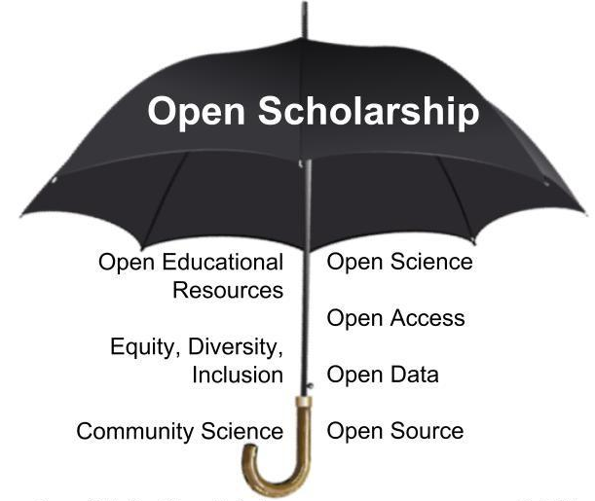

/01020304
A FIRST INTRO TO OPEN SCIENCE
R. Champieux, D. Robinson
Next to the five different schools of thought, different terms are put under the ‘umbrella’ of open science by different initiatives over the years.
In order to get to a global understanding of the meaning, opportunities and challenges of Open Science, the 193 Members States tasked UNESCO with the development of an international standard-setting instrument on Open Science in the form of a UNESCO Recommendation on Open Science. The Second draft of the Recommendation, on the basis of the received comments, will be shared by the end of March 2021.

Slide 12


/01020304
A FIRST INTRO TO OPEN SCIENCE
Recommended links
You can find more info about Open Science here:
FOSTER Open Science
UNESCO recommendations
NWO and Open Science
Open Science MOOC
Knowledge Exchange: an approach to Open Scholarship

Slide 13
/01020304
A FIRST INTRO TO OPEN SCIENCE
Benefits of going open
/03

Slide 14
/01020304
A FIRST INTRO TO OPEN SCIENCE
According to the FOSTER project, the overall arguments for supporting Open Science can be summarised in the following factors (OECD, 2015:18):
Efficiency: greater access to scientific inputs and outputs improves the effectiveness and productivity of the research system;
Quality and integrity: open access to scientific outputs, data and other assets that support the research process offer the opportunity of a wider evaluation and scrutiny by the scientific community, thus allowing a greater and more accurate replication and validation of research results;
Economic benefits: increased access to research results can foster spillovers not only to scientific systems but also innovation systems more broadly, as well as increase awareness and conscious choices among consumers;
Innovation and knowledge transfer: Open Science can reduce delays in the re-use of the results of scientific research including articles and data sets by firms and individuals, and promote a swift path from research to innovation to produce new products and services;
Public disclosure and engagement: science should be open for the whole society, so it may promote awareness among citizens;
Global benefits: Open Science can promote collaborative efforts and faster knowledge transfer for a better understanding of challenges that require coordinated international actions, such as climate change or the ageing population, and could help identify solutions more effectively.

Slide 15
/01020304
A FIRST INTRO TO OPEN SCIENCE
Recommended links
There are different use cases describing the benefits of using open practices and collaboration. These often vary depending on the specific domain.
Over the recent years, different research papers have described the benefits of different open practices, such as data sharing, open access publishing, open peer review et cetera.
Moreover, there are different blogs and interviews describing the benefits (and difficulties) of open working to be found at local universities.
A Collection of Open Science Use Cases
Profiles in Open and a list of Scholarly research on the benefits of Open
Openaccess.nl
RDM stories UU
Open working TUDelft

Slide 16
/01020304
A FIRST INTRO TO OPEN SCIENCE
Who can help me?
/04

Slide 17
/01020304
A FIRST INTRO TO OPEN SCIENCE
‘More and more universities have an Open Science Programme’
Next to local Open Science Programmes, there are local help desks for, for instance, Research Data Management.
Data stewards can help researchers with practical questions.
Depending on your local institution your can often find them located at faculties or centrally at the library.

Slide 18
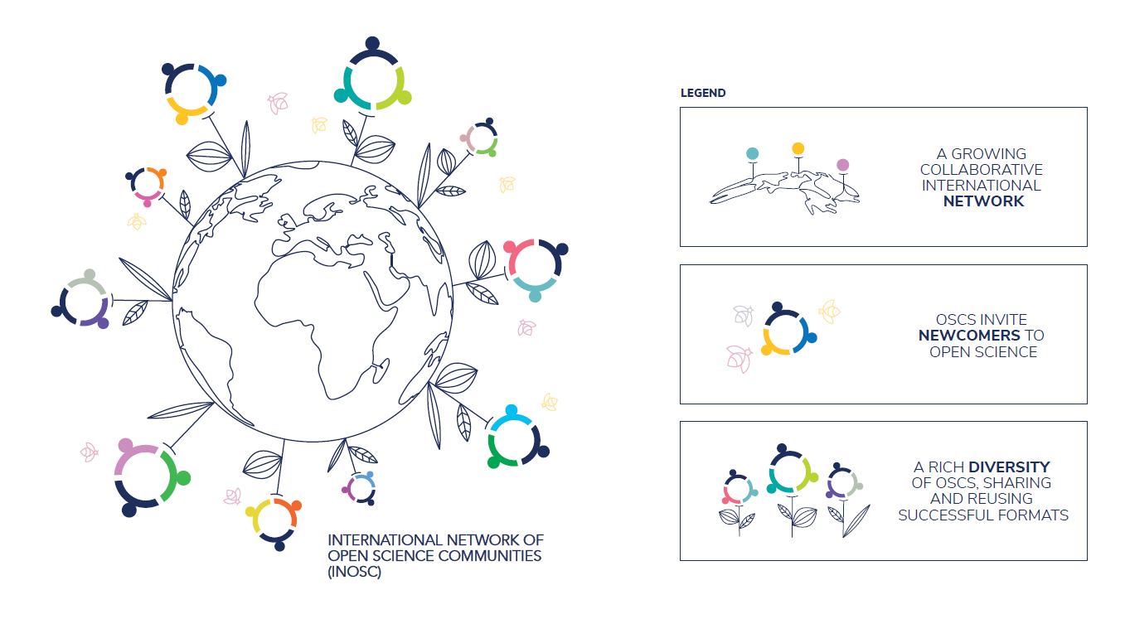
/01020304
A FIRST INTRO TO OPEN SCIENCE
Next to that, almost all universities in the Netherlands als have an Open Science Community: a local, bottom-up learning community comprising members of various scientific disciplines and career stages.
See the International Network of Open Science Communities for your local OSC.

Slide 19
More info
This slide deck is part of the outputs of the Accelerate Open Science project, a project within the scope of the National Programme Open Science. Aim of this project is to foster initiatives that promote Open Science in the Netherlands.
This is done, for instance, by sharing good practices for researchers undertaking Open Science and clear guidance on topics such as Open Access, FAIR data, Recognition & Rewards and Plan S. The project connects and fosters local initiatives, such as the new Open Science Communities at different universities. Moreover, it organises the first Netherlands National Open Science Festival, which provides researchers the opportunity to learn about the benefits of various Open Science practices and to meet peers that are already working openly.
DOI https://doi.org/10.5281/zenodo.4529129
All content in this slide deck is available under a license NPOS Accelerate Open Science
except where otherwise noted.

