Slide 1


Assessing the climate response to regional sea ice change across all Arctic regions
EGU General Assembly 2020
Online Session CL4.15
May 8th, 2020
Xavier J. Levine
Ivana Cvijanovic, Pablo Ortega, Markus Donat
Notes:
Structure of the talk: (1) motivation, (2) goals, (3) setup, (4) results, (5) key explanation, (6) summary & planned follow up
(a) sea ice loss as consequence and driver of Arctic warming, (b) effect of sea ice on seasonal and intraseasonal anomalies, (c) multiple mechanisms of sea ice loss’ impact on climate have been proposed, but which one(s) is(are) most relevant to climate change likely depends on the spatial pattern of sea ice change and climate models used across studies, (d) impact of sea ice loss may be non-additive, and if so we would like to understand, (e) Fall sea ice may have a dominant impact on climate variability [2 slides].
(a) to do a systematic study of regional sea ice loss, and assess degree of additivity of the response, (b) assess the importance of Fall sea ice loss in the Central Arctic for the winter climate response and the role played by the stratosphere, (c) propose a mechanism of action for the influence of sea ice on the winter climate. [1 slides]
(a) AMIP experiments, 150 members run 1 year, sea ice loss mask; 9 experiments, including a control, a future pan-Arctic (don’t mention yet the 2 last experiments) [1-2 slides]
Geopotential height at 500hPa: stationary, zonal-mean.

Slide 2
Motivations
Sea ice cover has dramatically shrunk in the past 3 decades (e.g. Stroeve et al., 2012).
Sea ice cover is expected to shrink further in the coming decades, but intermodel agreement in regional pattern of sea ice loss is poor (Collins et al. 2013).
Sea ice loss, whether regional or global, has a noticeable impact on the Winter climate (Vihma, 2014; Cohen et al., 2014), but its influence seems to depend on pattern of sea ice loss (Petoukhov and Semenov, 2010; Semenov and Latif, 2015; Chen et al., 2016; Screen, 2017).
How does the Northern Hemisphere Winter climate respond to regional sea ice loss in the Arctic?

Slide 3
Goals
Describe the climate response to regional sea ice loss in a set of atmosphere-only experiments (“AMIP”) run with EC-EARTH.
Assess the degree of linearity of the climate response to regional sea ice loss.
3. Propose a mechanism explaining qualitatively the similarities and discrepancies in the climate response to regional and pan-Arctic sea ice loss.

Slide 4
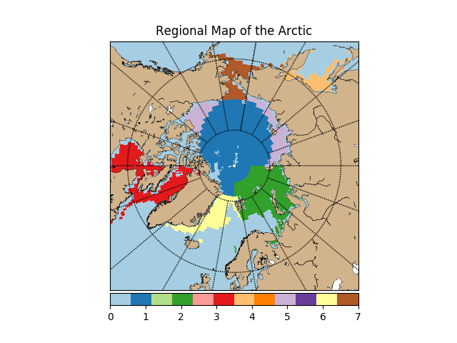
Protocol
Model: EC-Earth v3.3 (CMIP6 production): atmosphere IFS T255, 91 vertical levels.
Configuration: atmosphere-only 1-year simulations* (150 members)
Setup: Combining the present-day (pdSST-pdSIC) and projected future Arctic SIC and SST masks (pdSST-futArcSIC), we define new masks by setting SIC and SST to its present-day state everywhere except over specific regions, where the projected future Arctic state is chosen instead.
Experiments are run for each sea ice loss regions:
Central Arctic (pdSST-futCentArcSIC)
Barents-Kara (pdSST-futBKSeasSIC)
Hudson-Baffin-Labrador (pdSST-futHudBafLabSIC)
Okhotsk (pdSST-futOkhotskSIC)
Beaufort-East Siberian-Laptev (pdSST-futBeaufSibSIC)
Irminger-Nordic Seas (pdSST-futIrminNorSIC)
Bering-Chukchi (pdSST-futBerChukSIC)
Note: pdSST-pdSIC and pdSST-futArcSIC masks are provided by the PAMIP consortium

Slide 5
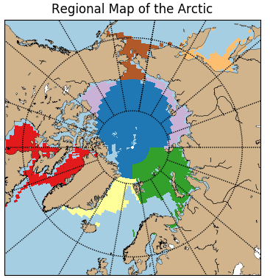
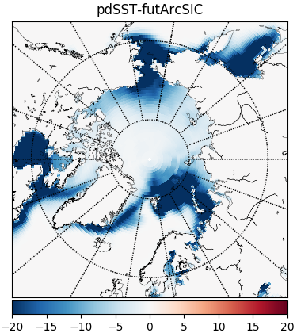
Surface forcing pattern:
(Left) predefined regions (Right) prescribed sea ice loss pattern in Winter
Winter sea ice loss predicted to be largest over marginal areas of the Arctic:
Hudson-Baffin Bays, Nordic-Irminger, Barents-Kara, Okhotsk and Bering-Chukchi seas.
Note relative invariance over Central Arctic

Slide 6
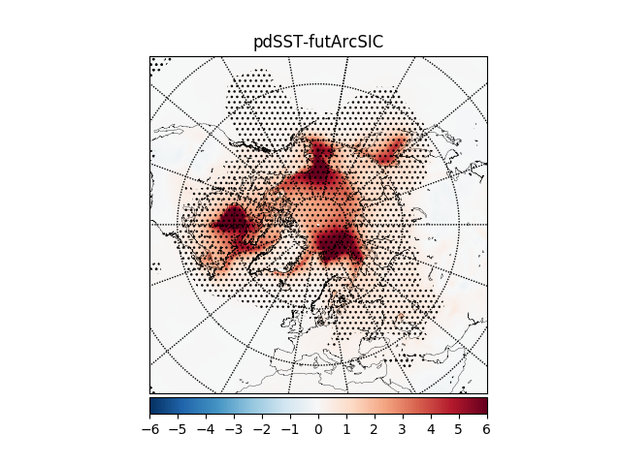
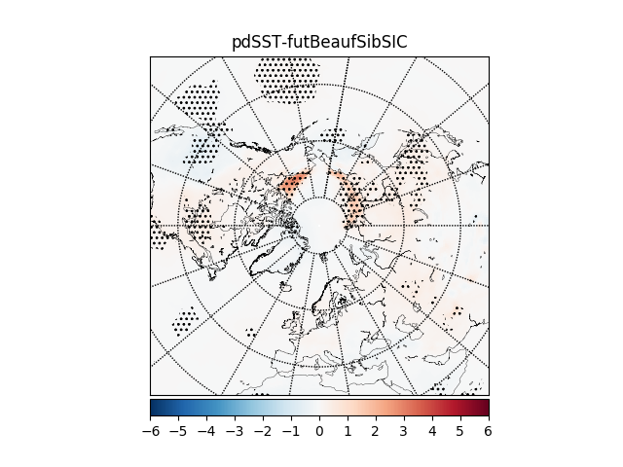
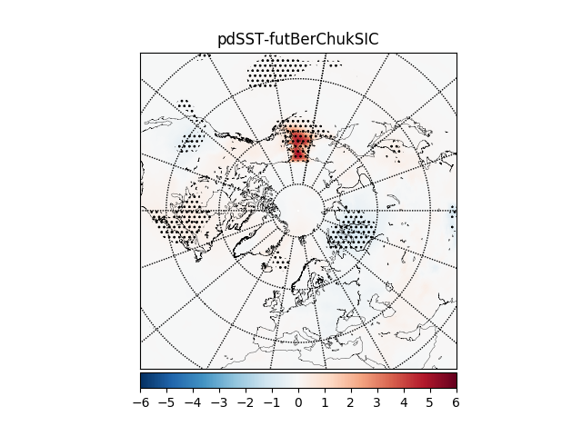
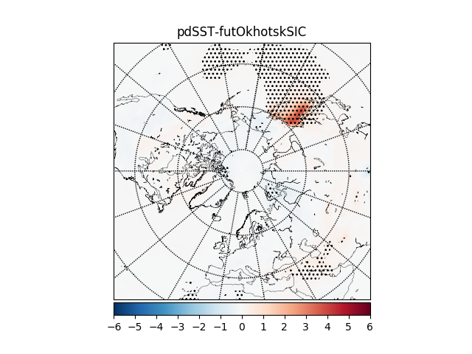
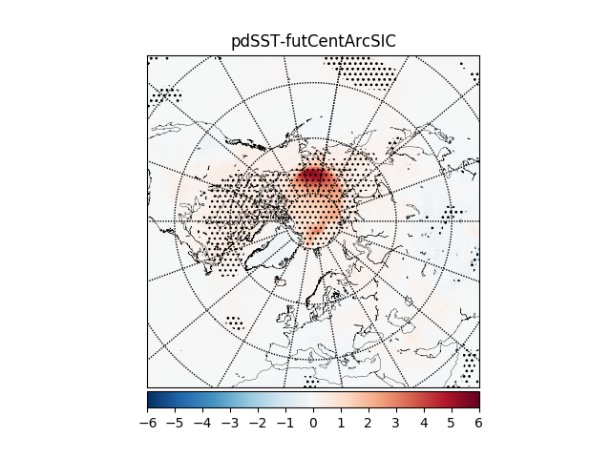
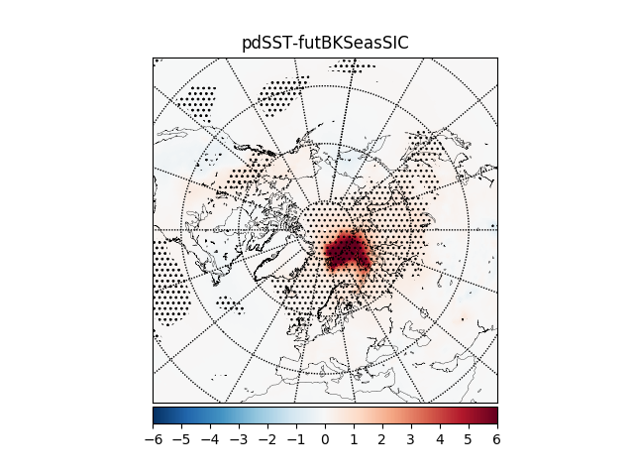
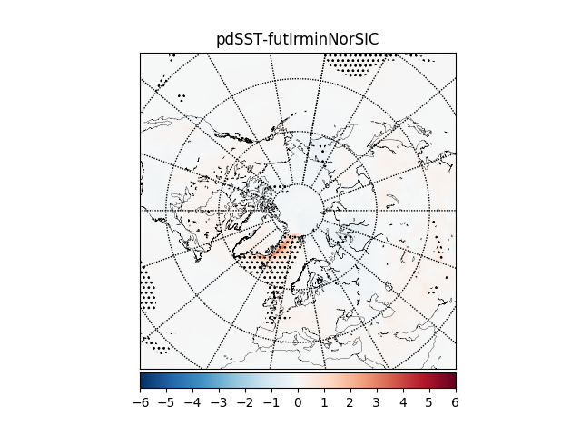
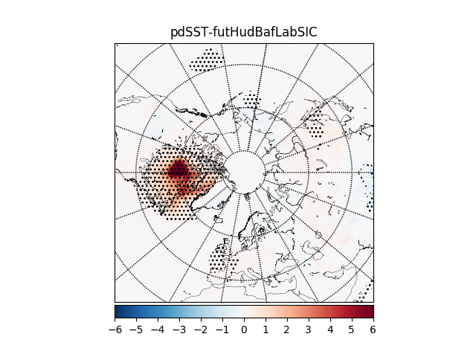
2-m air temperature anomalies in Winter (DJF)
Near-surface warming is confined to areas of sea ice loss
Notes:
Surface (LH+SH) fluxes

Slide 7
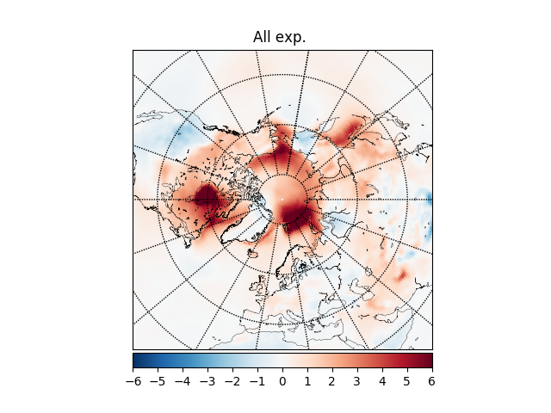
2-m air temperature changes:
(left) in pan-Arctic, and (right) sum of all regional experiments.
Near-surface warming is qualitatively additive when comparing the added climate response to sea ice loss in regional experiments with the pan-Arctic experiment.

Slide 8
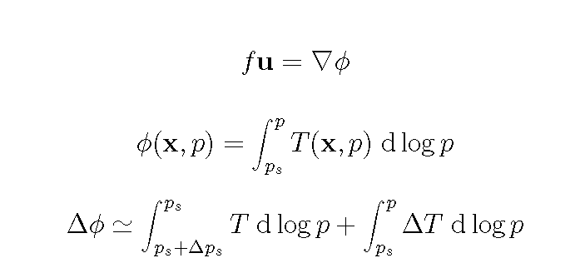
Let’s investigate impact of regional sea ice loss on the tropospheric circulation
Due to its dominant role in driving the large-scale circulation (e.g. geostrophy), we focus on the geopotential height response to sea ice loss.
Here, we focus on the mid-tropospheric (500 hPa) anomalies.

Slide 9
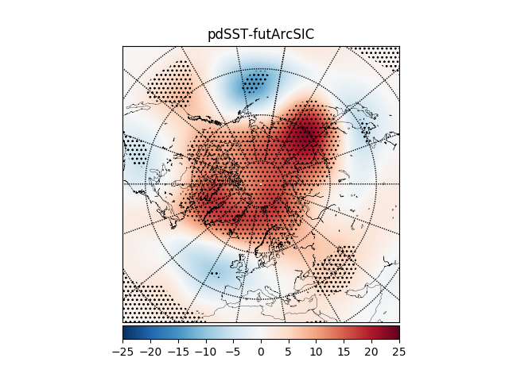
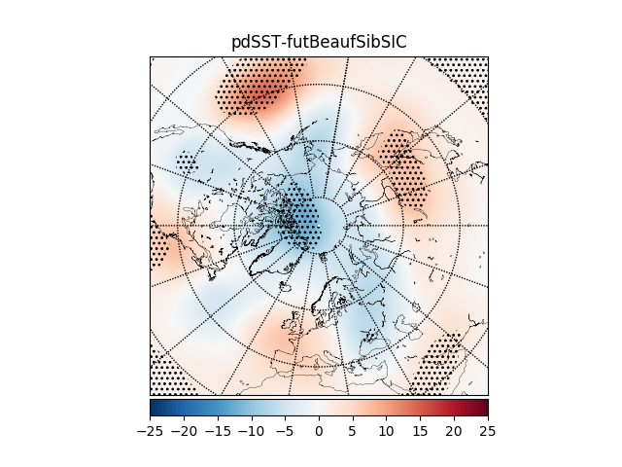
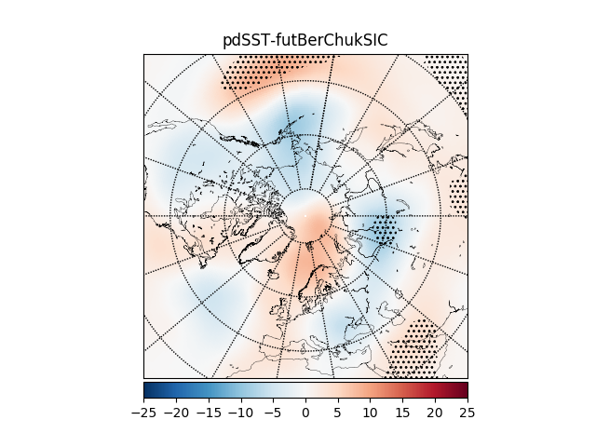
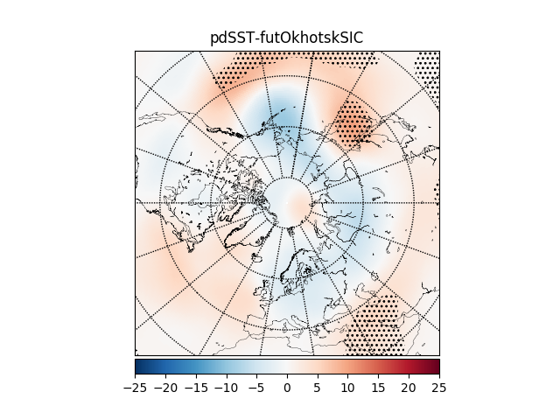
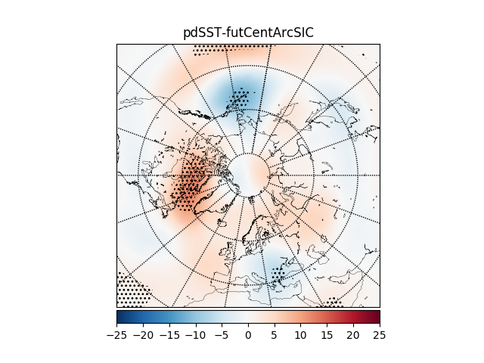
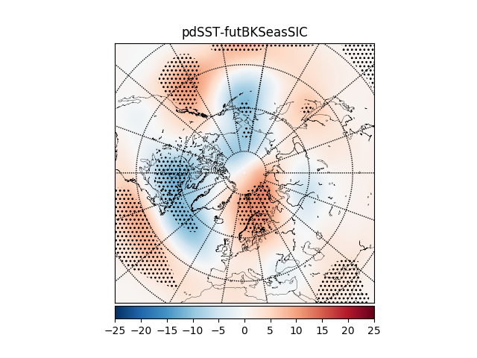
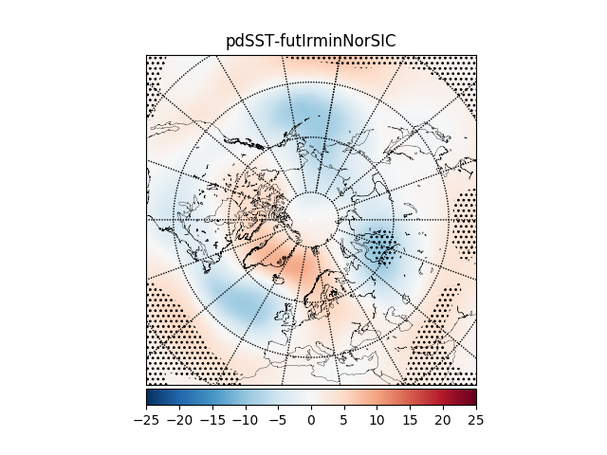
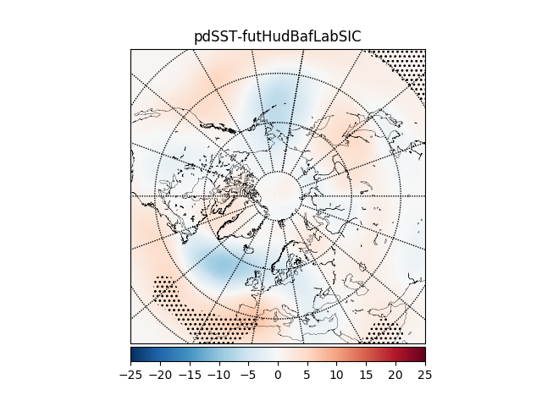
Geopotential height anomalies at 500hPa in Winter
Thermal High in Pan-Arctic experiment not found in other (regional) experiments!

Slide 10
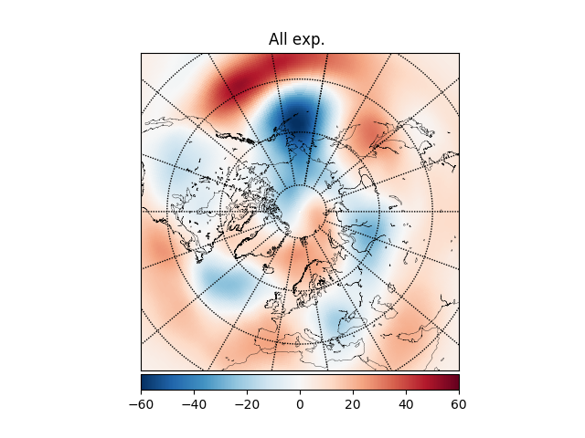
Geopotential height changes at 500hPa
(left) in pan-Arctic, and (right) sum of all regional experiments.
Tropospheric circulation changes from regional sea ice loss are not linearly additive

Slide 11
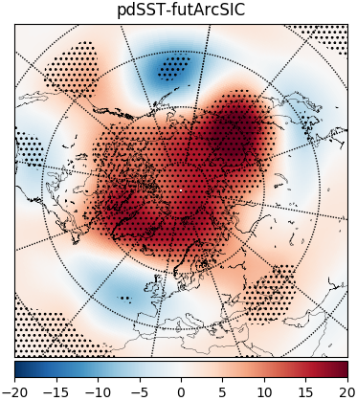
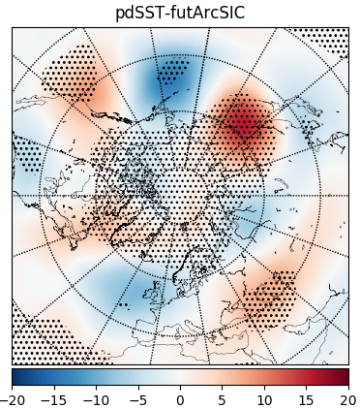
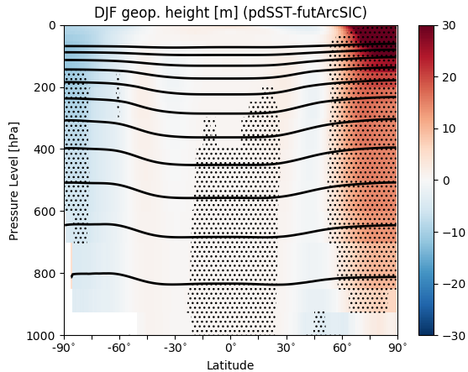
Pan-Arctic sea ice experiment:
(left) total, (middle) stationary, (right) zonal-mean components
Arctic High projects mostly on its zonal-mean component

Slide 12
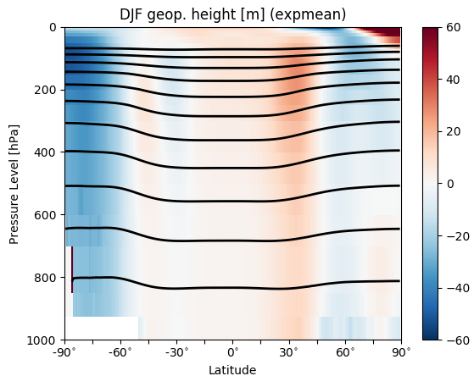
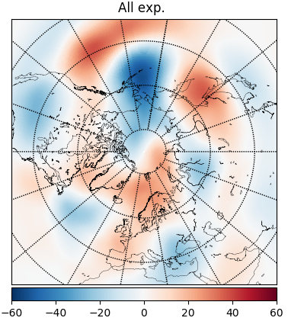
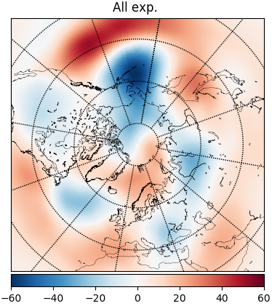
Zonal-mean vs. stationary components
PAN-ARCTIC
PAN-ARCTIC
PAN-ARCTIC
REGIONAL ADD
REGIONAL ADD
REGIONAL ADD
Non-additivity of climate response to regional sea ice loss derives from the zonal-mean atmospheric circulation response.

Slide 13
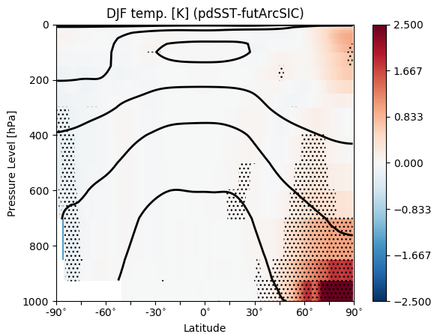
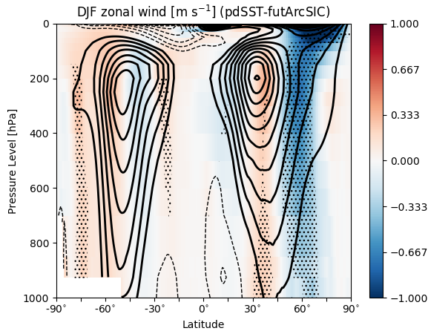
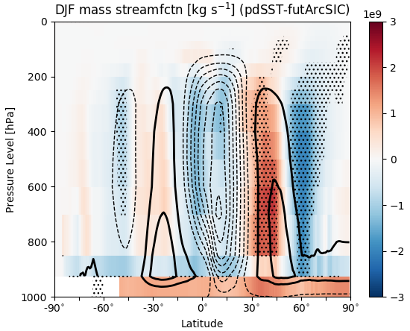
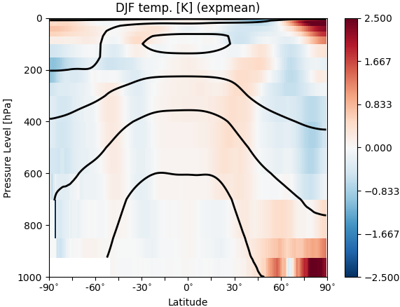
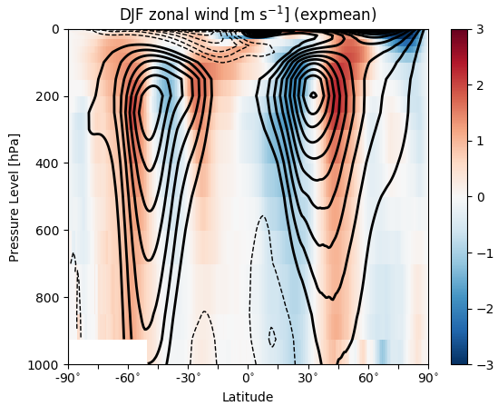
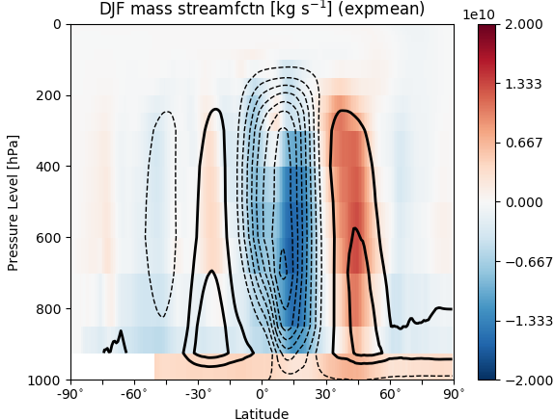
Zonal-mean anomalies in temperature, zonal wind, streamfunction
PAN-ARCTIC
PAN-ARCTIC
PAN-ARCTIC
REGIONAL ADD
REGIONAL ADD
REGIONAL ADD
Zonal-mean fields are non-additive, esp. the zonal-mean jet
Notes:
(top row): zonal-mean zg, ua, psi for future pan-arctic
(bottom row): zonal-mean zg, ua, psi for additivity

Slide 14
How does sea ice loss impact the zonal-mean flow?
Why is its influence seemingly non-additive?

Slide 15
Proposed mechanism of sea ice loss impact on zonal-mean climate
Regional or pan-Arctic Sea ice loss....
…. warms the atmospheric boundary layer in the Arctic,...
… leading to a reduction of near-surface baroclinicity at the polar front.
This drives an anomalous polar cell,...
… which enhances subsidence over the Arctic,….
… leading to adiabatic warming of the tropospheric column,….
This weakens the tropospheric meridional temperature gradient.
=> zonal-mean tropospheric subpolar jet weakens.
This mechanism is expected to be found in all experiments,
However, stationary waves activity in Winter or preceding Fall will also be playing a role

Slide 16
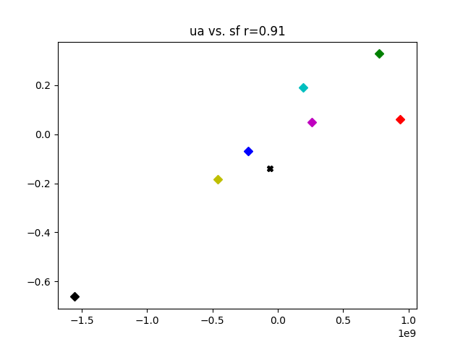
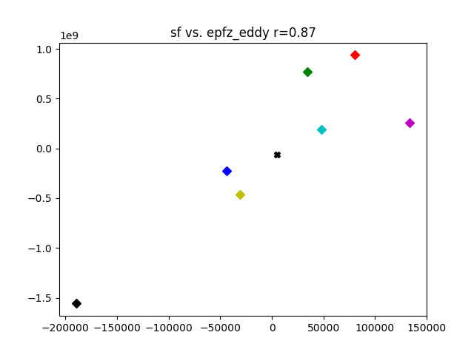
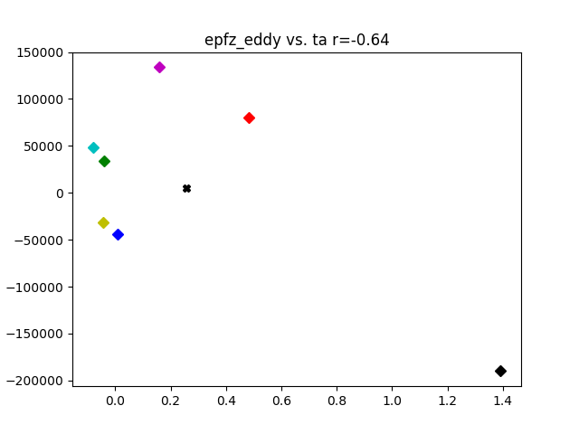
Pathway between sea ice loss between tropospheric jet weakening
Mean zonal wind [m s-1]
Mean overturning mass flux [10^9 kg s-1]
Mean upward wave activity [s-1]
Mean overturning mass flux [10^9 kg s-1]
Mean upward wave activity [s-1]
Mean near-surface temperature [K]
Pan Arctic (diamond), Central Arctic (cross), Okhotsk, Bering-Chukchi, Beaufort-East Siberian-Laptev, Hudson-Baffin, Irminger-Nordic Seas, Barents-Kara
(3) Stronger polar cell leads to weaker tropospheric subpolar jet
(increased adiabatic warming)
(2) Weaker baroclinic wave activity leads to a stronger polar cell at subpolar front
(reduced upward wave activity)
(1) Near-surface Arctic warming weakens baroclinic wave activity at subpolar front
(reduced baroclinicity)
Subpolar jet weakening and polar cell strengthening can be related to upward wave activity from surface
Upward wave activity is only qualitatively related to the near-surface baroclinicity

Slide 17
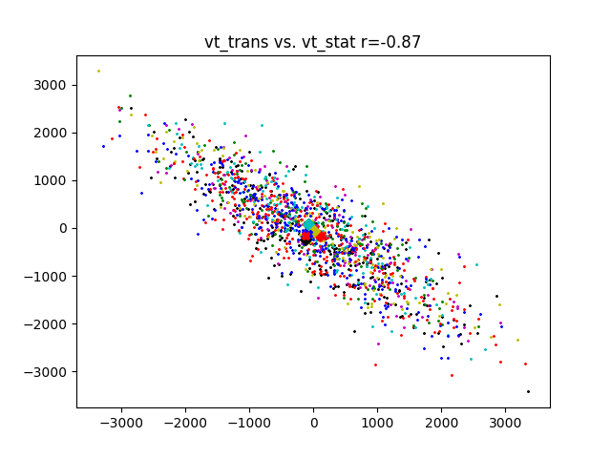
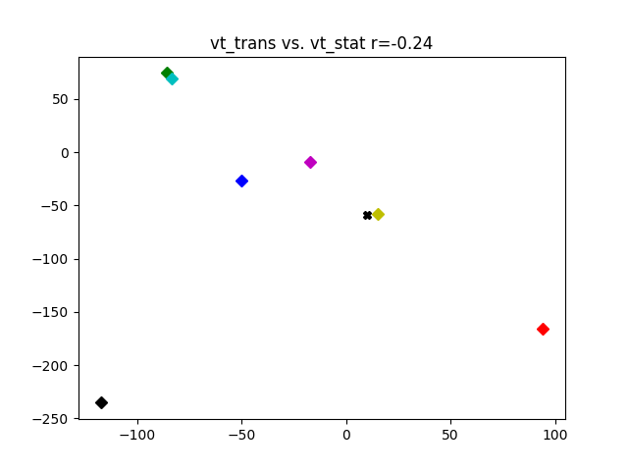
Stationary and transient waves changes generally cancel each other …..
… except in the pan-Arctic experiment
Transient vs. Stationary EPFz
Pan Arctic (diamond), Central Arctic (cross), Okhotsk, Bering-Chukchi, Beaufort-East Siberian-Laptev, Hudson-Baffin, Irminger-Nordic Seas, Barents-Kara
In natural variability, stationary and transient eddy activity changes cancel one another.
This cancellation holds when comparing the ensemble-mean of the regional experiments
=> cancellation of wave activity, lack of strong response in subpolar jet or polar cell strength
In the pan-Arctic experiment, however, the decrease in transient eddy activity is not compensated by a 1-to-1 increase in stationary wave activity
=> strong decrease in wave activity strengthens polar cell and weakens subpolar jet.
Notes:
Delete red and blue cross experiments (not regional experiments)

Slide 18
Cartoon
Sea ice loss
Weakening of tropospheric jet at polar front
Arctic boundary layer warms
Adiabatic warming of troposphere in the Arctic
Near-surface baroclinicity reduced at polar front
Stationary waves
Increased air subsidence over Arctic
Baroclinic wave activity is weakened at polar front
Ferrel cell shifts equatorward
Ferrel and Polar cells strengthen

Slide 19
Summary
We ran 7 regional Arctic sea ice loss experiments, and compared their climate anomalies with the future pan-Arctic sea ice loss experiment)
Zonal-mean tropospheric circulation response to sea ice loss is non-additive:
  In regional experiments, stationary wave and baroclinic eddy activity nearly cancel one another, leading to a small response of the zonal-mean climate.
  In Pan-Arctic experiments, baroclinic eddy activity weakens but without compensation from stationary waves, leading to strong weakening of the polar jet and strengthening of the polar cell.
What controls the compensation between transient and stationary eddies is key for understanding the nonlinearity of the tropospheric response to sea ice loss.

Slide 20

THANK YOU! Questions?
This project has received funding from the European Union’s Horizon 2020 research and innovation programme under the Marie Skłodowska-Curie grant agreement H2020-MSCA-COFUND-2016-754433

Slide 21
Appendix

Slide 22
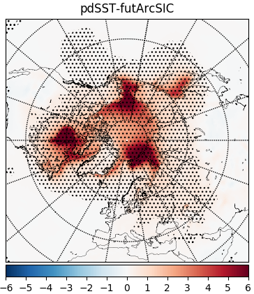
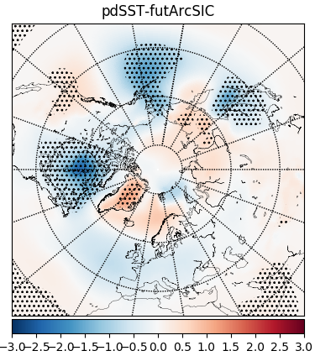
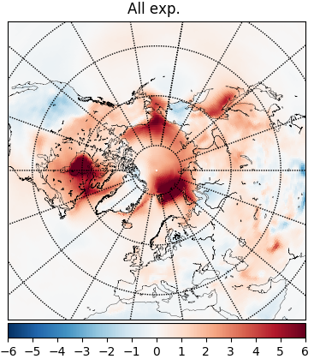
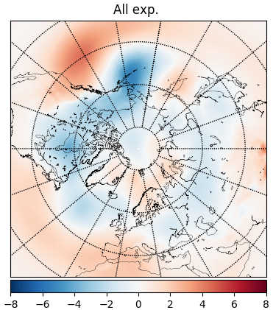
Surface climate anomalies
Near-surface warming is qualitatively additive when comparing the added climate response to sea ice loss in regional experiments with the pan-Arctic experiment.

Slide 23
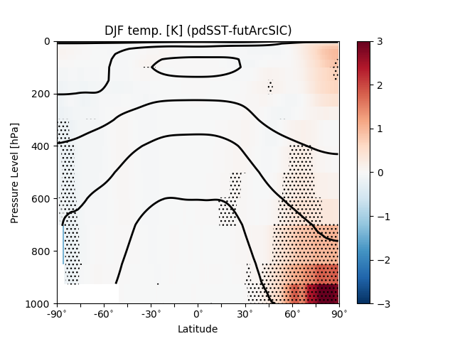
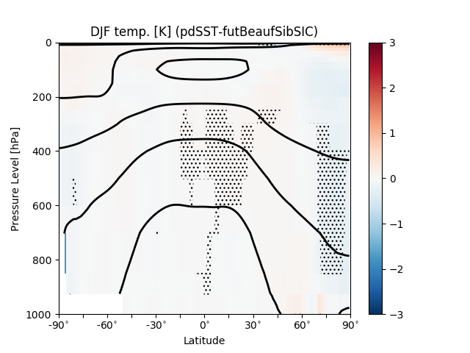
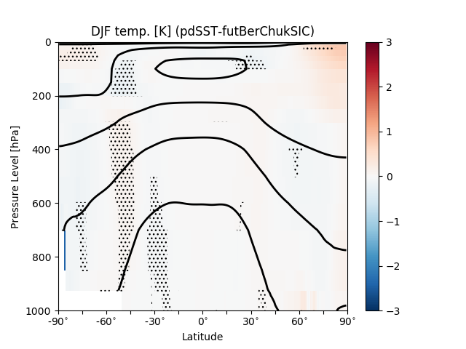
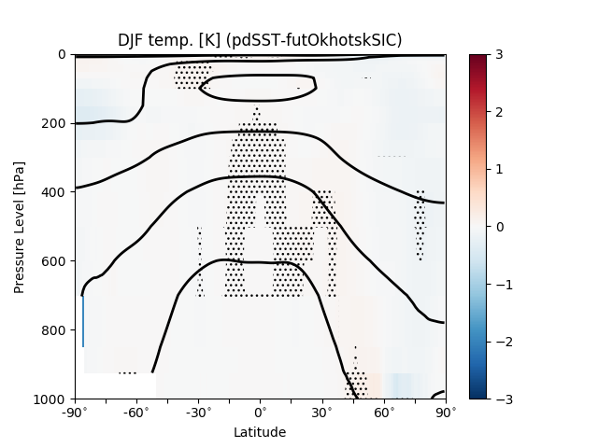
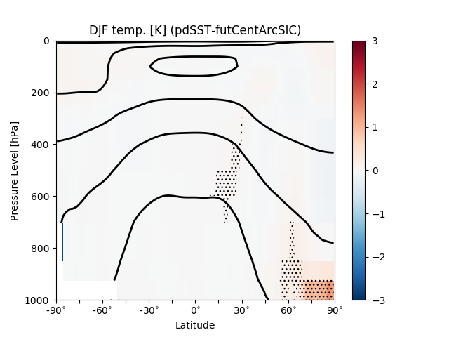
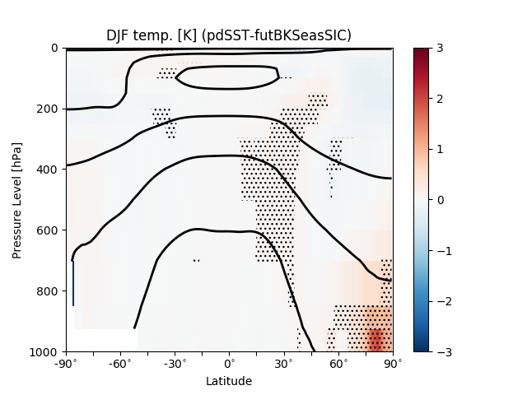
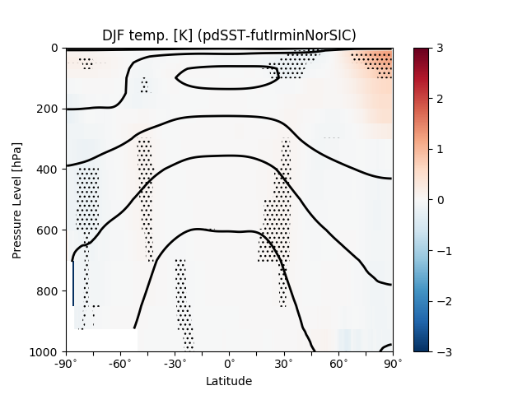

Zonal-mean temperature anomalies

Slide 24








Zonal-mean changes in Geopotential Height

Slide 25








Zonal-mean changes in the Zonal Wind
None of the regional expt shows a robust weakening of the tropospheric subpolar jet

Slide 26








Precipitation in DJF

