Slide 1


AICTE Sponsered
International Conference on Management & IT
National Values
Community Values
Organizational Values
Individual or Work Values
Societal Values
World Values
Track 1 :Innovations in Business Management for Sustainability
Business Ethics in Sustainable Development
HIGHER EDUCATION EFFECTIVENESS
THROUGH Instrumental & terminal VALUES IN STUDENTS

Slide 2
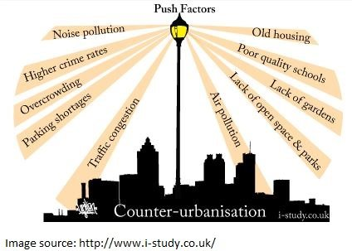
Threats to sustainability

Slide 3
THE PROBLEM – MISSING VALUES IN EMPLOYEES
Figure 1 Percentage of Organizations which are victims of fraud in last 24 months (PwC, 2018)
Figure 2 Reported Economic Crime across the territories in last 2 years (PwC, 2018)

Slide 4
ECONOMIC TIMES DATED Jan 8,2012
Frauds are more in IT and BFSI SECTOR

Slide 5
Social INDICATORS
Figure 5 Types of Crime in number in Rajasthan State (Network, 2019)

Slide 6
Kpmg fraud survey 2012

Slide 7

Threats to sustainability
Result In
Non-sustainable growth in business
Depletion of values in individuals
Solution is in

Slide 8
ALIGNMENT OF CONFERENCE AND RESEARCH PAPER OBJECTIVES
CONFERENCE OBJECTIVES
INNOVATION IN BUSINESS PROCESSES , COMPUTATIONAL METHODS AND TECHNIQUES
NOVEL AND CREATIVE IDEAS
HOLISTIC PROBLEM SOLVING AND DECISION MAKING
INNOVATIVE SOLUTIONS FOR ENHANCING SUSTAINABILITY
VALUE DEVELOPMENT & SUSTENANCE
SKILLS NEEDED FOR EMPLOYABILITY
PLACEMENT STRATEGY
TAPPING IMPLICIT REQUIREMENTS OF EMPLOYERS
EMPLOYER VALUES , VISION & MISSION
INCREASING FRAUD AND CYBER CRIME
FAILURE OF INSTILLED VALUES DUE TO POOR SYSTEMS OF SOCIETY,ORGANIZATIONS
VALUE INCULCATION AS A PART OF PLACEMENT PREPARATION
STUDENT FITNESS AS AN EMPLOYEE
BEHVIOURAL MODELIING
STRENGTH OF ORGANIZATIONAL CULTURE
LEARNING
BEST WORK ENVIRONMENT/ ATTRITION

Slide 9
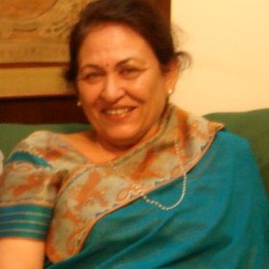
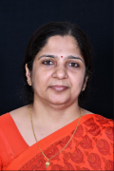
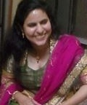
TEAM OF AUTHORS
Dr.Rashmi Chaturvedi (3rd Author )
Director ( Kanodia College )
More than 35 years of experience in Teaching and Administration
Dr. Mahima Rai ( Supervisor and 2nd Author )
Associate.Professor (IIS University –Dept. of Mgmt.-HRM and IB )
HOD Mgmt.Department (Apex Institute of Mgmt.and Science)
Joohi Chaturvedi (Corresponding Author )
M.S Quality Management + B.E Mechanical
Experience ( 4 .5 years at Bosch and Whirlpool + 5.5 years in Education Sector at IIM Indore , JECRC and Abhinav Arts NATA Academy )
Pursuing Ph.D from IIS University

Slide 10
ORGANIZATIONAL CULTURE
SURFACE ASPECTS OF ORGANISATIONAL CULTURE
Technology
Office Arrangement
Language/Slogans
Sworn in Ceremony
Interiors
Uniform
Mementos
Technology
Level 3 : Organizational Culture
Level 2 : Perceived Attributes (Climate )
Level 1 : Values
BASIC ASSUMPTIONS (how to perceive)
Levels described by Dr.Sushma Khanna
Schein Model

Slide 11


TERMINAL VALUES (DESIRED END STATES OF EXISTENCE )
INSTRUMENTAL VALUES (CHOICE OF BEHAVIOUR IN REACHING THE END STATES )

Slide 12
ROKEACH FRAMEWORK
Rokeach Framework
Terminal Values | Instrumental Values
A comfortable life | Ambition
An exciting life | Broad minded
Equality | Capable
Family security | Self controlled
Freedom | Clean
Health | Courageous
Inner harmony | Forgiving
Mature love | Helpful
National security | Honest
Pleasure | Imaginative
Salvation | Independent
Self respect | Intellectual
A sense of accomplishment | Logical
Social recognition | Loving
True friendship | Loyal
Wisdom | Obedient
A world at peace | Polite
A world of beauty | Responsible

Slide 13
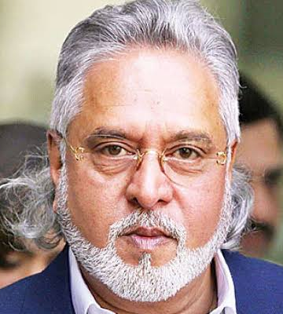
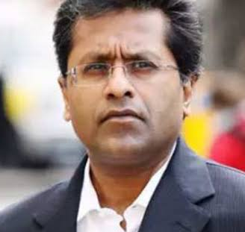
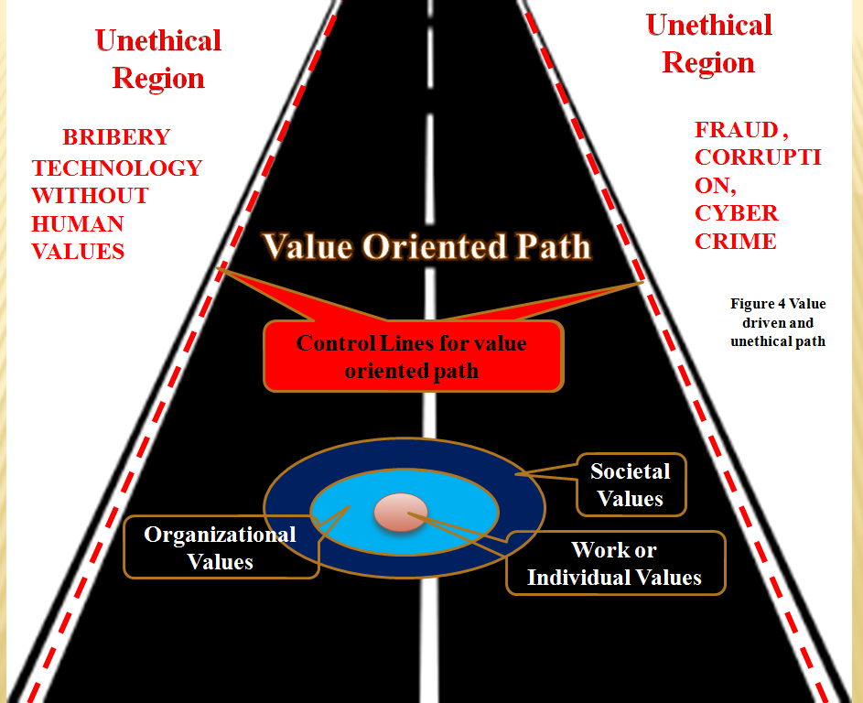

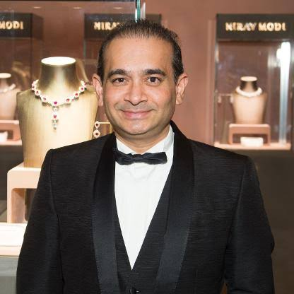
HAVE THEY MADE PROGRESS ?

Slide 14












OBJECTIVES OF THE RESEARCH
12TH STUDENTS
OC 1
OC 2
OC 3
OC 2
OC 1
OC 4
OBJECTIVE 4A &4B-DIFF IV & TV (MBA INSTITUTES & EMPLOYERS)
OBJECTIVE 3B-DIFF. IV & TV (EMPLOYERS)
OC 3
OC 4
ORGANISATIONAL CULTURE
VALUES
INTSTRUMENTAL
TERMINAL
PERCEIVED ATTRIBUTES
SURFACE ASPECTS OF OC
OC 5
OBJECTIVE 1-MAX IV & TV (MBA INSTITUTES)
ORGANISATIONAL CULTURE
VALUES
INTSTRUMENTAL
TERMINAL
PERCEIVED ATTRIBUTES
SURFACE ASPECTS OF OC
OBJECTIVE 2-MAX IV & TV (EMPLOYERS)
OBJECTIVE 3A-DIFF. IV & TV (MBA INSTITUTES)
IMPLICIT & EXPLICIT NEEDS

Slide 15
RESEARCH METHODOLOGY
RESEARCH DESIGN
EXPLORATORY AS SECONDARY DATA IS COLLECTED FROM WEBSITES
RESEARCH TYPE
DESCRIPTIVE (DESCRIBES DIFFERENT TYPES OF VALUES)
SAMPLING TYPE
RANDOM SAMPLING AS ALL EMPLOYERS/EDUCATIONAL INSTITUTIONS HAVE EQUAL CHANCE OF SELECTION
SAMPLE SIZE
33 EMPLOYERS
33 UNIVERSITIES
DATA TYPE
SECONDARY DATA
CATEGORICAL DATA
QUALITATIVE DATA
DATA COLLECTED ON
ORGANISATIONAL VALUES ( INSTRUMENTAL AND TERMINAL)
SAMPLING FRAME
UNIVERSITIES : RAJASTHAN
EMPLOYERS ACROSS THE GLOBE

Slide 16
SOURCES OF DATA - WEBSITES
Figure 8 Number of Employers from different sectors
Figure 9 Type Wise Number of Universities

Slide 17
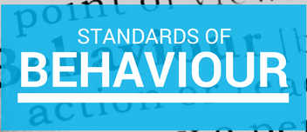
Findings based on data analysis
Students
Not aware as customers and are not demanding
Employers
Very aware as customers of talent, skills of employees and do not compromise on Value driven work
VALUES ARE

Slide 18
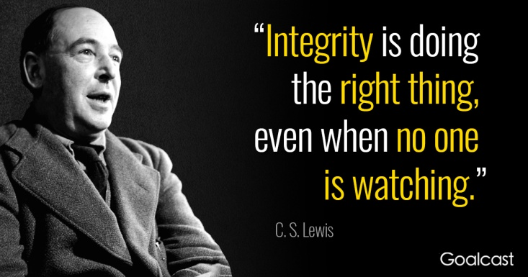
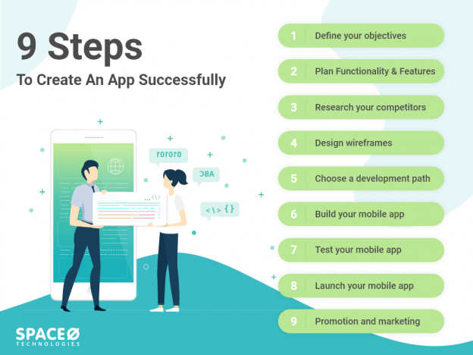


FINDINGS BASED ON DATA ANALYSIS
Goodness
Honesty
Fairness
Integrity
VARIATION IN DEFINITIONS
MEANING OF WORD
DEPENDS ON USAGE
CREATE (VERB)VALUE
CREATIVE (ADJ)
TAUTOLOGY- FAULT IN WRITING STYLE
positive regard and respect for each other.
High opinion and respect

Slide 19




FINDINGS BASED ON DATA ANALYSIS
VARIATION IN UNDERSTANDING FROM THAT FOUND IN LITERATURE REVIEW
VALUES
Highest priority to customer needs ,high standards of public conduct and transparency in operations
CULTURE
caring ,initiatives and innovation and integrity , trustworthiness and reliability
 | Terminal values are achieved | Terminal values are not achieved
Value Oriented Path is adhered (Instrumental Values are practiced)
Value Oriented Path is not adhered (Instrumental Values are not practiced)

Slide 20





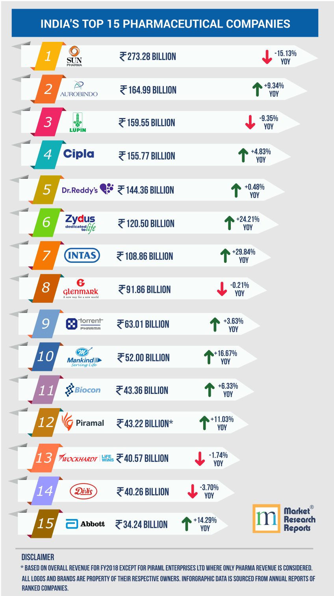
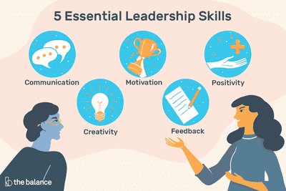
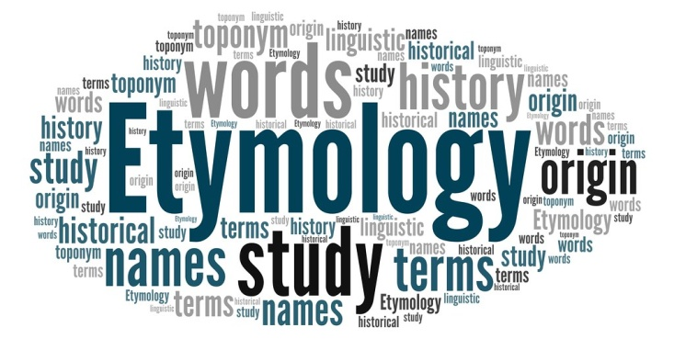
FINDINGS BASED ON DATA ANALYSIS
INSTRUMENTAL
TERMINAL
NEW PREMISE- SOME VALUES ARE INSTRUMENTAL AS WELL AS TERMINAL

Slide 21
FINDINGS- SOME VALUE ARE BOTH INSTRUMENTAL AND TERMINAL
Instrumental | Terminal | Instrumental & Terminal
Empathy | Efficiency ((output/input)/Efficient ( timely completion of a task/less wastage of money and effort ) | Customer/Stakeholder/People/ Client/Society Focus /Customer first (first priority)
Integrity (goodness ,fairness, honesty ) | Effectiveness (Actual /Ideal output ) | Responsibility (Social),(Environmental)
Honesty | Excellence/Academic Excellence (very good /outstanding ) | Trust (Earning trust/trusting others )
Fairness | Growth/Community Growth/Growth in all areas/Profitable Growth | Respect (Earning respect /respecting others )
Creative/Imaginative | Create | Transparency (not hiding anything )/Open /Openness (freedom of expression and thoughts , open to new ideas )
Ethical/Principled/High standards of public conduct/Corporate citizenship behavior | Innovation | Creating standards / Adhering standards

Slide 22
FINDINGS – SOME VALUES ARE BOTH INSTRUMENTAL AND TERMINAL
Teamwork/Cooperation/Collaboration | Maintain | Commitment (giving your time /energy & keeping promises )
Team spirit (keeping organizational/team/group goals ahead of individual goals ) | Professionalism (Having the desired competency attained through a formal training to do a task ) /Skilled | Safety/Security (Following safe practices is a behavioral trait /Safety is also a desired state of existence /Security (protection from danger or threat )is a broader term where threats from competition are also considered)
Discipline | Reliability(to serve intended function over the expected life time )/becoming trustworthy (believable) | Sustainability (avoiding using up natural resources is a strategy and is an example of environmental consciousness ),Synonym-Endure (being able to last long in pain and difficult times )
 | Development(Product /Relationships ) | Leadership (a combination of qualities defined differently by different people /Situational Leadership
 | Process Approach | Quality
 | Improvement (Continuous , Constant , Continual )
 | Success/Student success
 | Co-prosperity/prosper

Slide 23
FINDINGS BASED ON DATA ANALYSIS
Employees
Vendors
Customers
Management
Society
Employees
Vendors
Customers
Customers
FOCUS ON STAKEHOLDERS (BROAD TO NARROW)
INSTRUMENTAL AS WELL TERMINAL
achieving results related to the concerned stakeholder hence terminal
incorporating activities in daily work which are stakeholder oriented and hence instrumental .

Slide 24


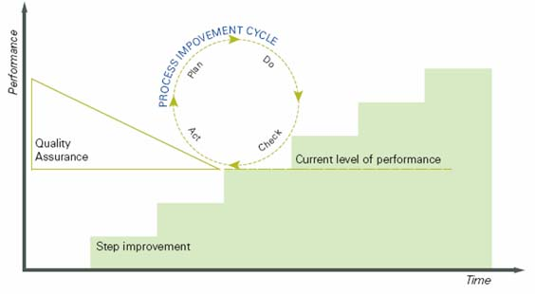
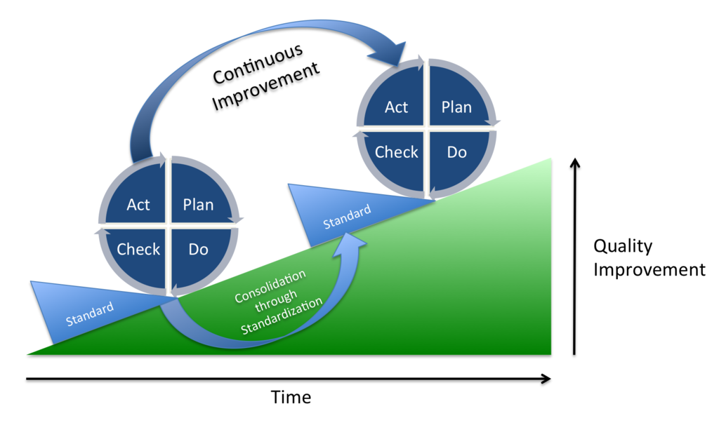
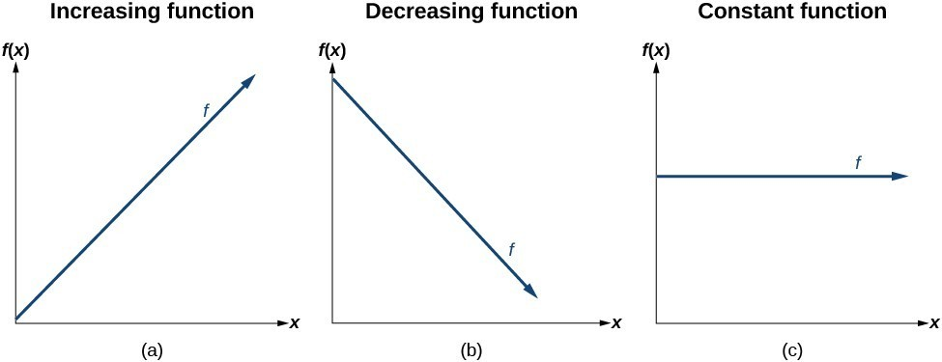

FINDINGS BASED ON DATA ANALYSIS
Objective
PRODUCT
IMPROVEMENT
SERVICE IMPROVEMENT
ORGANIZATIONAL & TEAM IMPROVEMENT
Constant Annual Savings – 700 million euros
CONSTANT IMPROVEMENT
CONTINUAL IMPROVEMENT NEEDS STABILIZATON
CONTINUOUS IMPROVEMENT IS A MYTH,
VERY SLOW ,SMALL IMPROVEMENTS
Engagement
Pride
Commitment
Satisfaction
Praise
Exceed Expectations and innovate
Going beyond the call of duty
OWNERSHIP
INNOVATION
Employee Engagement
Customer Delight
Respects the different opinion of people

Slide 25










FINDINGS BASED ON DATA ANALYSIS
System
Improvement
Process Improvement
Process Approach
Customer focus
Internal Customer concept
Flatter Organizations
Ethical standard
1
ISO 9001:2000 (STANDARD)
2
Vision statement , Quality Policy , Organizational Quality Objectives , QMS Manual , Process relationship diagrams
3
QMS Procedures
4
Instructions for planning ,operation and control of , work , inspection , maintenance , calibration ,plans ,schedules , specifications , drawings , lists etc.
5
Records , forms , formats , labels , tags , tally sheets etc.
Business standards
Quality standard
Performance & Excellence
Do it right standard
Figure 13 5levels of documents linked to ISO 9001 :2000 (Mathur, 2009)

Slide 26
Hypothesis, STATISTICAL TESTS, results
Z | Z value from table | Null Hypothesis (Accepted /Rejected)
-0.738 | 1.96 | Accepted
-1.537 | 1.96 | Accepted
14.736 | 1.96 | Rejected
15.416 | 1.96 | Rejected
H1 & Ha1 : Test of proportion applied
H2 & Ha2 : Test of proportion applied
H3 & Ha3 :Test of proportion applied
H4 & Ha4:Test of proportion applied
H1: No significant difference between instrumental and terminal values of universities of Rajasthan teaching MBA Course .
Ha1: Significant difference is there “”
H2: No significant difference is there between instrumental and terminal values of employers .
Ha2 : Significant difference is there “”
H3 : No significant difference is there between instrumental values of MBA student employers and Universities teaching MBA students .
Ha3 : Significant difference is there “”
H4 :No significant difference is there between terminal values of MBA student employers and Universities teaching MBA students .
Ha4 : Significant difference is there “”

Slide 27
CONCLUSION –top 5 instrumental and terminal values of employers and universities
S.No | Instrumental Values in Universities | Terminal Values in Universities | Instrumental Values in Employing Organizations | Terminal Values in Employing Organizations
1 | Integrity | Excellence | Customer Focus | Customer Focus
2 | Quality | Quality | Trust | Innovation
3 | Transparency Responsibility Respect Ethics/Ethical Behaviour Customer Focus (Student/Patient) | Transparency | Respect/ Regard | Trust/Faith
4 | Teamwork Environmental Consciousness Character Trust Success/flourish Inclusion | Responsibility | Ethical/Principled Transparency Efforts/Actions/Pursuit/will | Excellence
5 |  | Trust /Accountability/Lifelong Learning/Continuous Improvement/Customer Focus/Environmental Consciousness/Inclusion/Longterm(Lifelong) | Commitment Standards (Business/Ethical/Quality/Do it Right/Performance & Excellence) Passion/Enthusiasm | Respect
6 |  |  | Integrity | Transparency/(Execute or Do)

Slide 28

CONCLUSION
Implicit requirements of an employer in a probable employee
Instrumental Values
Behavioural requirements
NLP can be used
Terminal Values
Competency requirements
Implicit knowledge requirements
S.No | Value | Topics student should be aware of
1 | Quality | TQM Concepts, ISO 9001
2 | Environmental Consciousness | ISO 14001
3 | Improvement (Constant, Continuous,Continual) | Kaizen , Breakthrough Improvement
4 | Innovation | Corrective Action and Preventive Action , Failure Mode Effect Analysis , Lifecycle Assessment
5 | Excellence | PDCA (Plan do Check Act ),RADAR
6 | Sustainability | Reduce , Reuse , Recycle
Instrumental and Terminal Values
Input for Placement Strategy
Output will be Training Calendar for Placement Preparation

Slide 29
Limitations
Study is limited to
Chosen Samples because of
Economic Considerations
Resource Availability

Slide 30
FUTURE PROSPECTS IN RESEARCH
Alignment
Terminal Values
Desired end goals
Vision
Aspirations for future
Mission
Purpose of it’s very existence
Alignment
Internal mechanisms to deal with non-compliance to code of conduct
Instrumental Values
Behavioral Requirements
Code of Conduct
Customers
Vendors
Employees
Differences in code of conduct with respect to different stakeholders
Alignment
Exploring how universities and institutes are preparing students on behavioural and knowledge oriented aspects and how students internalize these .
If University values are same as Employer Values
Student is a fit as an employee
Impact on attrition rate of employer

Slide 31


CONCLUSION – SOME POSSIBILITIES
Culture 1 and Culture 2 are different in terms of values
Culture 1 and Culture 2 are similar in terms of values
Without Industry Academia Linkage
No awareness on Value inculcation importance and methods
Difficult to adapt
Attrition may be a problem
Possibility of More Frauds
Industry Academia Linkage
Awareness on Value inculcation importance and methods is there
Easy to adapt
Chances of attrition are reduced
Possibility of Less Frauds

Slide 32
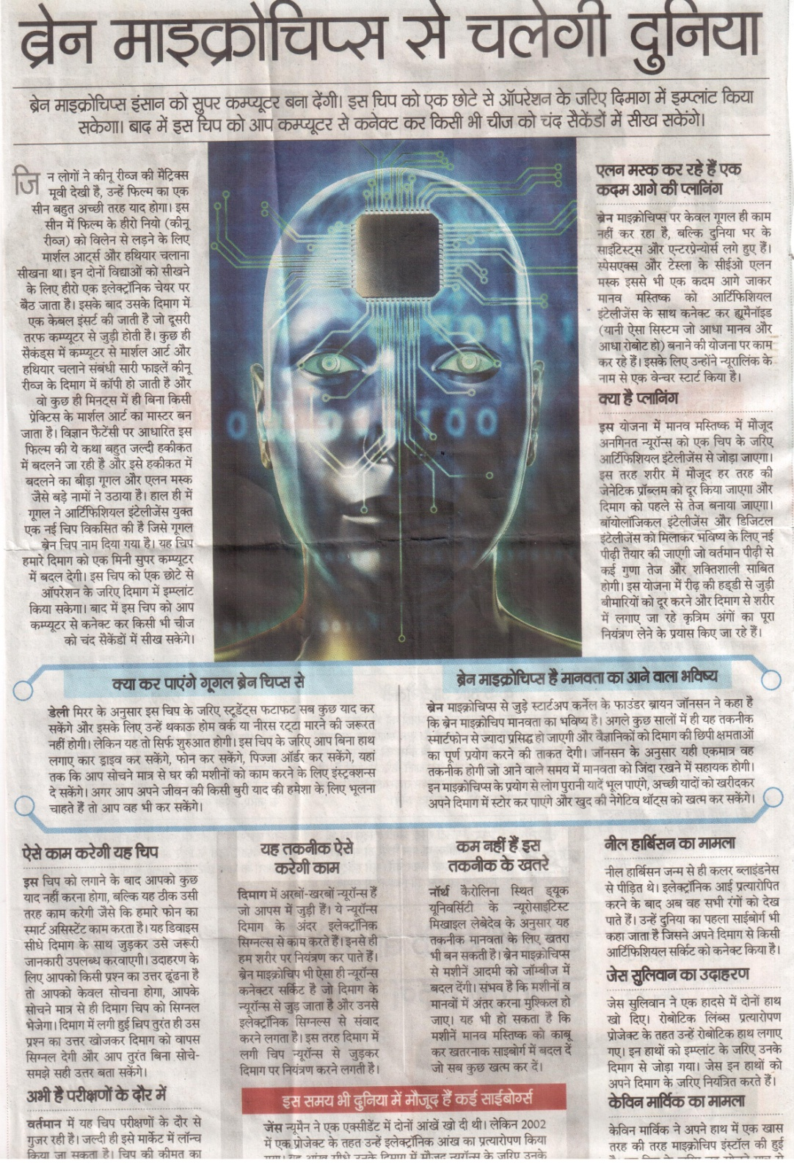
Brain Microchips usage for behavioural modelling

Slide 33
references
(n.d.). Retrieved from mahindrrise.com.
(n.d.). Retrieved from hdfclife.com: https://www.hdfclife.com/about-us/vision-values
(n.d.). Retrieved from sbi.co.in: https://www.sbi.co.in/portal/web/about-us/mission-vision-values
(n.d.). Retrieved from infosys.com: https://www.infosys.com/careers/discover/culture/
(n.d.). Retrieved from bosch.in: https://www.bosch.in/our-company/our-responsibility/
(n.d.). Retrieved from dcmshriram.com: https://www.dcmshriram.com/our-values
(n.d.). Retrieved from bajajfinserv.in: https://www.bajajfinserv.in/about-us-our-brand-identity
(n.d.). Retrieved from bajajconsumercare.com: https://bajajconsumercare.com/our_values.aspx
(n.d.). Retrieved from newindia.co.in: https://www.newindia.co.in/portal/aboutUs/Profile
(n.d.). Retrieved from tata.com: https://www.tata.com/about-us/tata-values-purpose
(n.d.). Retrieved from galpinvolkswagen.com: https://www.galpinvolkswagen.com/mission-statement-core-values/
(n.d.). Retrieved from metrohospitals.com: https://www.metrohospitals.com/about/vision-mission
(n.d.). Retrieved from stryker.com: https://www.stryker.com/us/en/about.html
(n.d.). Retrieved from bankofbaroda.in: https://www.bankofbaroda.in/human-resources.htm
(n.d.). Retrieved from vlccwellness.com: https://www.vlccwellness.com/Nepal/about-us/core-values/
(n.d.). Retrieved from snggroupindia.com: http://www.snggroupindia.com/vision-mission.html
(n.d.). Retrieved from http://www.actionshoes.com/
(n.d.). Retrieved from actionshoes.com: http://www.actionshoes.com/
(n.d.). Retrieved from srisriravishankar.org: https://www.srisriravishankar.org/work/service-social-programs/international-association-for-human-values/
(n.d.). Retrieved from samsunglife.com: http://www.samsunglife.com/companyeng/overview/comp/ethical/overviewEthicsRule.html
(n.d.). Retrieved from delltechnologies.com: https://www.delltechnologies.com/content/dam/delltechnologies/assets/whoweare/resources/Dell%20Technologies%20Code%20of%20Conduct%20-%20English.pdf
(n.d.). Retrieved from sunpharma.com: https://www.sunpharma.com/vision-and-values
(n.d.). Retrieved from omlogistics.co.in: http://omlogistics.co.in/vision-mission-our-values/
(n.d.). Retrieved from godrejsecure.com: http://www.godrejsecure.com/SecuritySolutions/aboutsecuritysolutions.aspx?id=25&menuid=211
(n.d.). Retrieved from eurekaforbes.com: https://www.eurekaforbes.com/career-with-us/values
(n.d.). Retrieved from nddb.coop: https://www.nddb.coop/about/values
(n.d.). Retrieved from inditex.com: https://www.inditex.com/about-us/our-brands/zara
(n.d.). Retrieved from sutlejtextiles.com: http://sutlejtextiles.com/sutlej-overview.html

Slide 34
references
(n.d.). Retrieved from centurytextind.com: https://www.centurytextind.com/about-us.html
(n.d.). Retrieved from geetanjalihospital.co.in: https://www.geetanjalihospital.co.in/mission-vision-values
(n.d.). Retrieved from jktyre.com/codeofconduct.aspx: https://www.jktyre.com/codeofconduct.aspx
(n.d.). Retrieved from jaipur.manipal.edu: https://jaipur.manipal.edu/muj/about-us/vision-mission.html
(n.d.). Retrieved from uniraj.ac.in: https://www.uniraj.ac.in/index.php?mid=1102
(n.d.). Retrieved from nimsuniversity.org: https://nimsuniversity.org/vision-mission-core-values/
(n.d.). Retrieved from dknmu.org: http://www.dknmu.org/page/Vision
(n.d.). Retrieved from rtu.ac.in: http://www.rtu.ac.in/RTU/mission
(n.d.). Retrieved from iisuniv.ac.in: https://www.iisuniv.ac.in/about-IIS/The-University/vision
(n.d.). Retrieved from lordsuni.edu.in: http://www.lordsuni.edu.in/vision-and-mission/
(n.d.). Retrieved from cpur.in: http://www.cpur.in/aboutus/Mission-Vision-Values.php
(n.d.). Retrieved from jecrcuniversity.edu.in: https://jecrcuniversity.edu.in/files/naac/The%20Core%20Values%20of%20JECRC%20University.pdf
(n.d.). Retrieved from gyanvihar.org: https://www.gyanvihar.org/school/education/about-school/
(n.d.). Retrieved from jnujaipur.ac.in: https://www.jnujaipur.ac.in/vision-mission/
(n.d.). Retrieved from mnit.ac.in: http://www.mnit.ac.in/about_us/mandv.php
(n.d.). Retrieved from iimu.ac.in: https://www.iimu.ac.in/about/our-mission-core-values-and-culture

Slide 35
references
n.d.). Retrieved from vgu.ac.in: https://www.vgu.ac.in/principles&objectives.php
(n.d.). Retrieved from uok.ac.in: https://www.uok.ac.in/vision-mission
(n.d.). Retrieved from spsu.ac.in: https://www.spsu.ac.in/vision-mission.php
(n.d.). Retrieved from shyamuniversity.in: https://shyamuniversity.in/about-us/vision/
(n.d.). Retrieved from skduniversity.com: https://skduniversity.com/about-us/
(n.d.). Retrieved from shridharuniversity.ac.in: https://shridharuniversity.ac.in/about/vision-mission
(n.d.). Retrieved from cet-gov.ac.in: http://cet-gov.ac.in/web/about?ref=header
(n.d.). Retrieved from ggtu.ac.in: https://www.ggtu.ac.in/vision-mission
(n.d.). Retrieved from mpuat.ac.in: https://www.mpuat.ac.in/singlePage.php?id=24&type=SP
(n.d.). Retrieved from msbrijuniversity.ac.in: http://msbrijuniversity.ac.in/home/show_page/ORUzjiIl
(n.d.). Retrieved from mlsu.ac.in: https://www.mlsu.ac.in/vision-mission
(n.d.). Retrieved from nlujodhpur.ac.in: http://www.nlujodhpur.ac.in/about.php?mn=vision
(n.d.). Retrieved from raubikaner.org: http://raubikaner.org/PDF/2_Teachers_&_Officers_service_&_conduct_rules.pdf
(n.d.). Retrieved from universityoftechnology.edu.in: https://www.universityoftechnology.edu.in/about-us/mission-vision/
(n.d.). Retrieved from vmou.ac.in: https://www.vmou.ac.in/content/5
(n.d.). Retrieved from iihmr.edu.in: https://www.iihmr.edu.in/profile
(n.d.). Retrieved from jrnrvu.edu.in: http://www.jrnrvu.edu.in/aboutus.php
(n.d.). Retrieved from curaj.ac.in: https://curaj.ac.in/vision-and-mission
(n.d.). Retrieved from apexuniversity.co.in: https://www.apexuniversity.co.in/vision.php

Slide 36
references
(Bajaj Finserv. (n.d.). Retrieved from bajajfinserv.in: https://www.bajajfinserv.in/about-us-our-brand-identity
Board, M. o. (2014, August 12). Code of Conduct. Retrieved from jktyre.com: https://www.jktyre.com/codeofconduct.aspx
Cain, A. (2016, September 19). 11 leadership skills that can take you to the top. Retrieved from economictimes.indiatimes.com: https://economictimes.indiatimes.com/work-career/11-leadership-skills-that-can-take-you-to-the-top/ability-to-manage-expectations/slideshow/54407842.cms
Chaturvedi Joohi, C. A. (2015). Skill Development in Educational Institutions. Asian Network for Quality. Taipei.
Craig, W. (2019, January 31). 8 Must-Have Transformational Leadership Qualities. Retrieved from forbes.com: https://www.forbes.com/sites/williamcraig/2019/01/31/8-must-have-transformational-leadership-qualities/#67c0be5f1117
Entrepreneurship, M. o. (2015). National Policy for Skill Development and Entrepreneurship. Ministry of Skill Development and Entrepreneurship.
EY. (2018). "Integrity in the Spotlight " 15th Global Fraud Survey. Retrieved from ey.com/fraudsurveys
Fortis Escorts. (n.d.). Retrieved from fortisescorts.in: http://www.fortisescorts.in/our-values
Fries, K. (2018, February 8). 8 Essential Qualities That Define Great Leadership. Retrieved from forbes.com: https://www.forbes.com/sites/kimberlyfries/2018/02/08/8-essential-qualities-that-define-great-leadership/#2ddc5f603b63

Slide 37
references
Hasan, S. (2017, February 13). Top 10 Leadership Qualities That Make Good Leaders. Retrieved from blog.taskque.com: https://blog.taskque.com/characteristics-good-leaders/
Hawker, S. (2014). Little Oxford English Dictionary. Oxford University Press. Retrieved 2013
Health Management and Social Care. (n.d.). Retrieved from http://www.hkwmacsl.edu.hk: http://www.hkwmacsl.edu.hk/system/tool/webpage/index.php?charset=iso-8859-1&netroom_id=9277&tool_id=202225&channel=&tool_admin=0
I.Levin, R., S.Rubin, D., Rastogi, S., & Siddiqui, M. H. (2012). Statistics for Management. Pearson.
ICICI Prudential Life. (n.d.). Retrieved from www.iciciprulife.com: https://www.iciciprulife.com/about-us/company-overview.html
K.Malhotra, N., & Dash, S. (n.d.). Marketing Research An Applied Orientation. Pearson.
Khanna, S. (2017). Udai Pareek's Understanding Organizational Behaviour. Oxford University Press.
LTD, J. T. (2014). Core Values. Retrieved from jktyre.com: https://www.jktyre.com/corevalues.aspx
M.Mahajan. (n.d.). Statistical Quality Control. Delhi: Dhanpat Rai and Co.(P)Ltd .
Mathur, P. K. (2009). Implementing ISO 9001 : 2000. Noida: Vikas Publishing house pvt.ltd.
Oxford. (2019, September 8). British & World English> tautology. Retrieved from lexico.com: https://www.lexico.com/en/definition/tautology
PwC. (2018). "Pulling Fraud out of the Shadows"Global Economic Crime and Fraud Survey 2018. Retrieved from http://www.pwc.com/fraudsurvey

Slide 38
references
Ravishankar, S. S. (February 2013). Management Mantras-Keys to Effective Management and Leadership (1st ed.). Bangalore-560004: Elegant Printing Works. Retrieved from wisdom.srisriravishankar.org: https://wisdom.srisriravishankar.org/attributes-great-leader/
sdmh. (n.d.). Retrieved from sdmh.in: http://www.sdmh.in/about
Systems, B. D. (n.d.). Diesel Systems Procedure on Quality Assurance Matrix. Bosch Diesel Systems.
Technical Committee ISO/TC 176, Q. m. (2015). ISO 9001:2015 Quality Management System Requirements. Retrieved from http://www.iso.org.: https://www.iso.org/obp/ui/#iso:std:iso:9001:ed-5:v1:en
Textiles, C. (n.d.). Century Textiles and Industries Limited>About Century Textiles and Industries Limited. Retrieved from centurytextind.com: https://www.centurytextind.com/about-us.html#century-textiles
The Little Oxford Dictionary. (n.d.).

Slide 39
Presentation References
https://www.google.com/url?sa=i&source=images&cd=&ved=2ahUKEwich6GjrdnkAhVFfH0KHfnJDQYQjRx6BAgBEAQ&url=http%3A%2F%2Fwww.bbc.com%2Fearth%2Fstory%2F20170116-the-tree-that-shaped-human-history&psig=AOvVaw1ZXuLbNnV6bkOi6YmqDWDW&ust=1568860585655165

Slide 40

THANKYOU

