Slide 1


National PID Infrastructure Strategy for Open Research:
The view from Down Under
PIDapalooza 2021
Adrian Burton & Natasha Simons

Slide 2
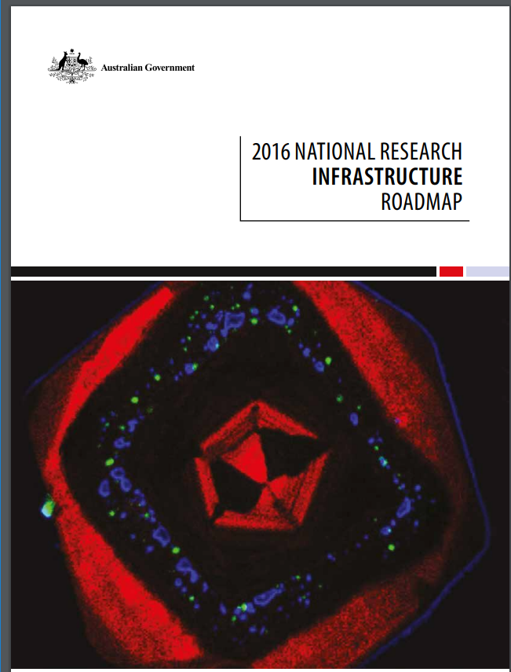
Australian National Research Infrastructure Roadmap
“...nationally significant assets, facilities and services to support leading edge research...”
https://docs.education.gov.au/node/43736
Notes:
The 2016 National Research Infrastructure Roadmap (2016 Roadmap), developed by an Expert Working Group led by Australia’s Chief Scientist outlines national research infrastructure required over the coming decade so that Australia's world class research system continues to improve productivity, create jobs, lift economic growth and support a healthy environment.
Definition of National Research Infrastructure National research infrastructure comprises the nationally significant assets, facilities and services to support leading-edge research and innovation. It is accessible to publicly and privately funded users across Australia, and internationally.
The 2016 Roadmap identifies nine focus areas that require ongoing support to ensure that Australia will be able to maintain its position as an emerging or established global leader

Slide 3









Notes:
National Research Infrastructure – optimises the use of scarce resources to create scale predominantly from geographically distributed and highly networked facilities. This drives efficiency by reducing duplication of facilities, equipment and skills across institutions by focusing on national research infrastructure that is highly collaborative, cross disciplinary, supported by the best highly skilled technical workforce and representing national best practice.
The Roadmap includes Government commitment to ongoing operational funding for the NCRIS program. NCRIS is a national network of world-class research infrastructure projects that support high-quality research that will drive greater innovation in the Australian research sector and the economy more broadly. Projects support strategically important research through which Australian researchers and their international partners can address key national and global challenges. NCRIS is a significant financial investment from the Australian federal government and supports approximately 40,000 domestic and international users each year

Slide 4


Australian Research Data Commons
...transforming digital infrastructure to support leading edge research and innovation....
Notes:
ARDC is one of the NCRIS facilities. (ARDC) is a transformational initiative that enables Australian research community and industry access to nationally significant, leading edge data intensive eInfrastructure, platforms, skills and collections of high-quality data. Primary focus is on data and building supporting infrastructure for data analysis and discovery. We do this by partnering with other stakeholders in the Australian research sector. For example, through a series of open calls we invite partners to co-invest with us in the development of critical data infrastructure, software, platforms and collections.

Slide 5
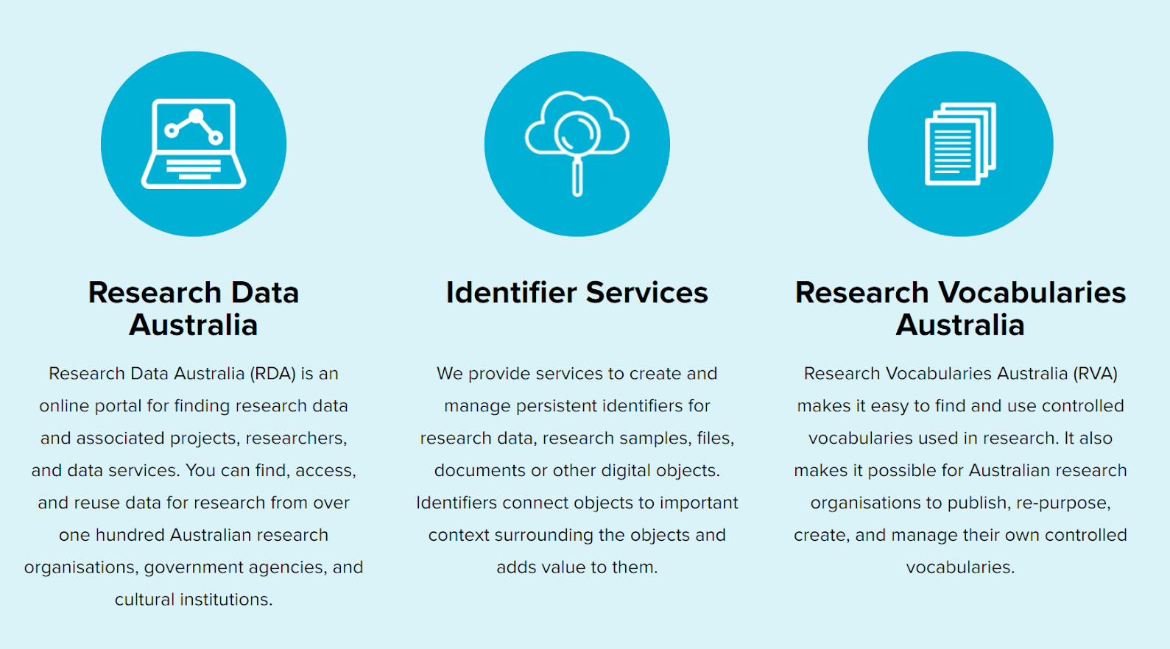
ARDC National Information Infrastructure

Slide 6
Persistent Identifiers as National Infrastructure
national adoption and coverage
efficient national provision
strategic national direction
Notes:
ORCID Consortium
DataCite Consortium

Slide 7
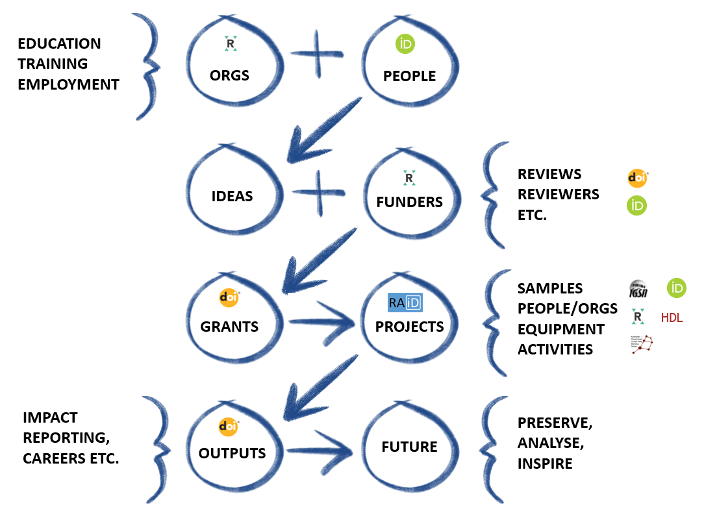

Josh and Natasha made this graphic. Ta!

Slide 8
PID Service Portfolio Considerations
coverage of key elements of research: eg people, publications, data, samples, projects, etc
spectrum of PID technical approaches: eg Handle, DOI, Linked data
operation and facilitation
attributes of “good” PID systems (more on that in below in Policy)

Slide 9


New in 2020
ARDC PID Policy
ARDC PID Roadmap
Notes:
ORCID Consortium
DataCite Consortium

Slide 10
ARDC PID Policy - Highlights
Research impact….research integrity….research innovation and efficiency...
PIDs...core component of national.. and global infrastructure
ARDC PID services are offered in partnership with international service providers..
..a condition of ARDC investment…
... greatest value at global scale...
https://ardc.edu.au/wp-content/uploads/2020/06/ARDC_Persistent_Identifiers_Policy.pdf
Notes:
“Selection of PIDs in the ARDC services suite is based on an assessment of the attributes of good PID systems such as fitness for purpose, effective technical infrastructure, good governance, broad community adoption, cost effectiveness, and sustainability.”

Slide 11
ARDC PID Services Roadmap

Slide 12
 |  | Keep | Chuck | Change | Add
1 | Grant ID |  | Discontinue PURL |  | ARDC investment IDs (CrossRef Grant ID)
2 | DataCite DOI | Funding consortium access | Discontinue ARDC local systems | Long term consortium model | Outcome and impact tracking
3 | RAID | Support of Australian uptake |  | 3 year transition to international organisation | 3 year establishment investment
4 | Handle | Stable operation |  | Join global consortium
5 | IGSN | Support for Australian uptake | Existing system | New system with int. collaborators | “IGSN 2040” architecture
6 | AGLDWG |  |  |  | ARDC operation of AGLDWG service

Slide 13
 |  | Keep | Chuck | Change | Add
7 | ORCID | Support for Australian uptake |  |  | Outcome and impact tracking
8 | ROR | Support for Australian uptake |  |  | Integrate into ARDC systems
9 | Instruments | Support for Australian uptake |  |  | Support the establishment of global initiative

Slide 14
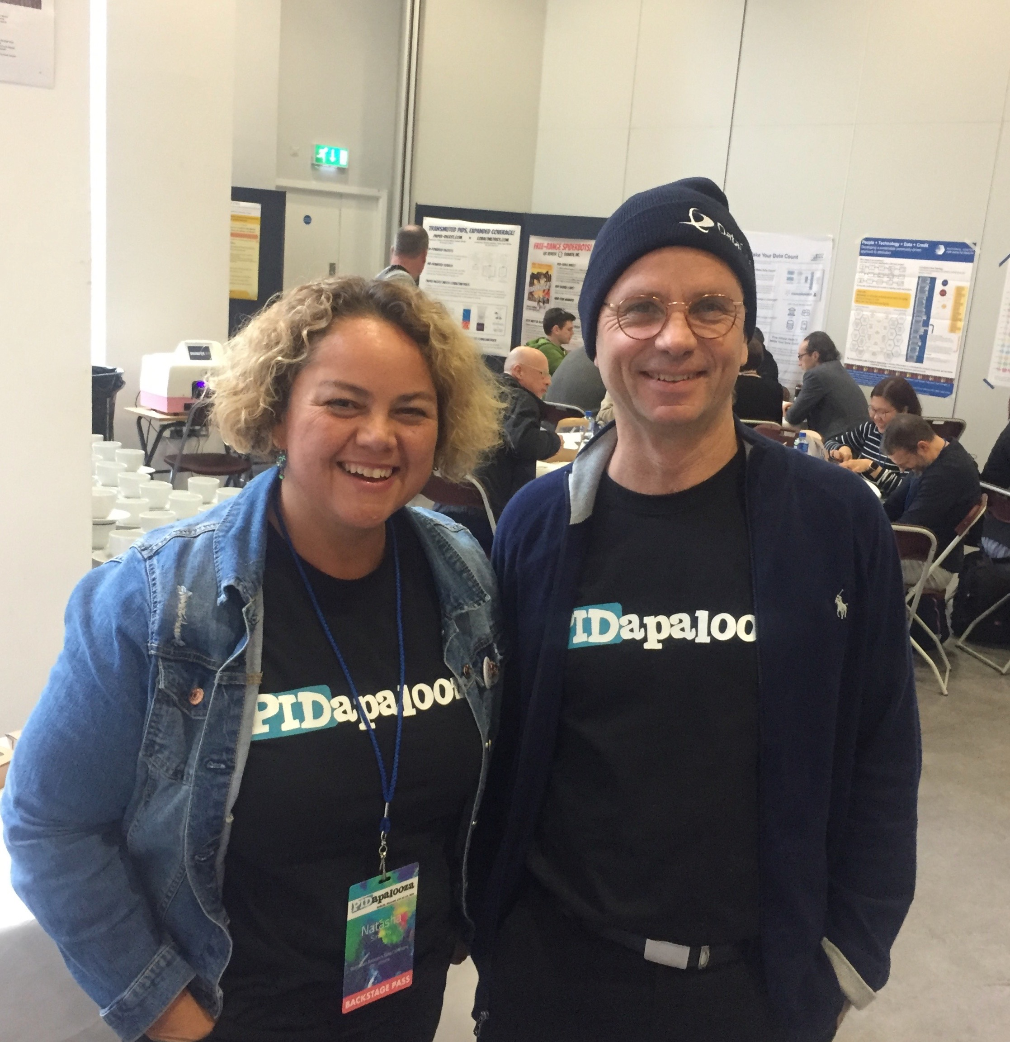
Adrian Burton Natasha Simons
Director, Data Policy and Services Associate Director, Data and Services
ARDC Canberra ARDC Brisbane
adrian.burton@ardc.edu.au natasha.simons@ardc.edu.au
PIDapalooza Dublin 2019

