Slide 1






Machine learning for weather predictions
Peter Dueben
Royal Society University Research Fellow & ECMWF’s Coordinator for Machine Learning and AI Activities
The ESIWACE2 project has received funding from the European Union’s Horizon 2020 research and innovation programme under grant agreement No 823988.
The strength of a common goal
This research used resources of the Oak Ridge Leadership Computing Facility (OLCF), which is a DOE Office of Science User Facility supported under Contract DE-AC05-00OR22725.

Slide 2

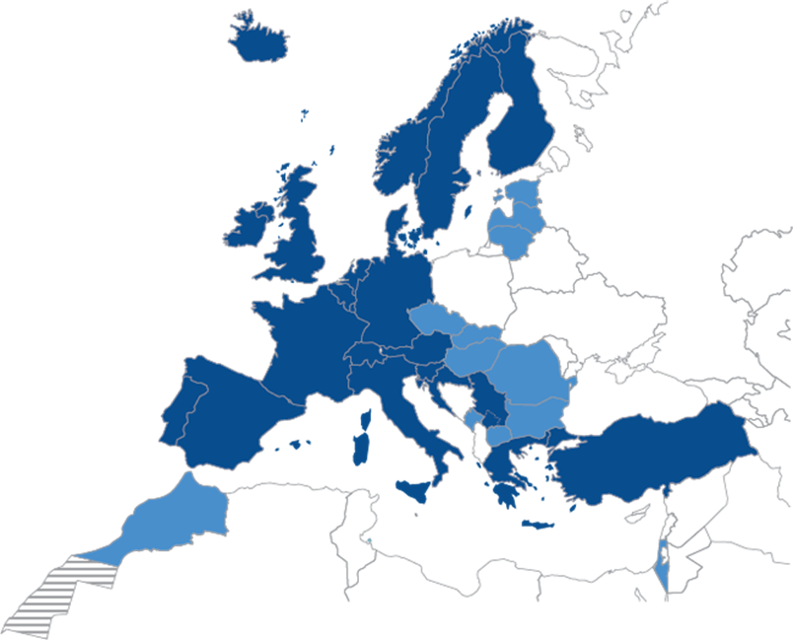
European Centre for Medium-Range Weather Forecasts (ECMWF)
www.ecmwf.int
Research institute and 24/7 operational weather service for medium-range,
monthly and seasonal forecasts.
Independent, intergovernmental organisation supported by 34 states.
Based in Reading in the UK; ≈350 member of staff.
Home of two supercomputers.
Home of the Integrated Forecast System (IFS).

Slide 3
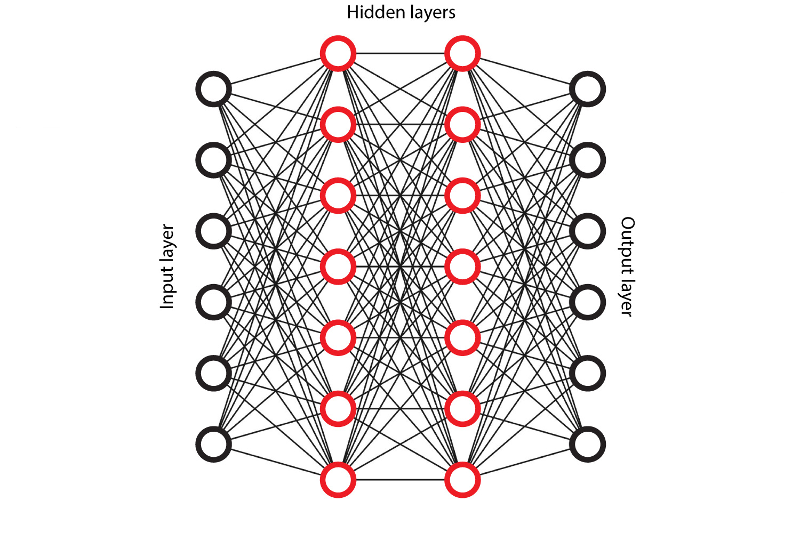
Deep learning and artificial neural networks as one example of machine learning
The concept:
Take input and output samples from a large data set
Learn to predict outputs from inputs
Predict the output for unseen inputs
The key:
Neural networks can learn a complex task as a “black box”
No previous knowledge about the system is required
More data will allow for better networks
What’s new:
HPC developments allow networks to be very complex
The number of options for different networks has exploded
The number of applications is increasing by day:
Image recognition
Speech recognition
Healthcare
Gaming
Finance
Music composition and art
…
And weather?

Slide 4
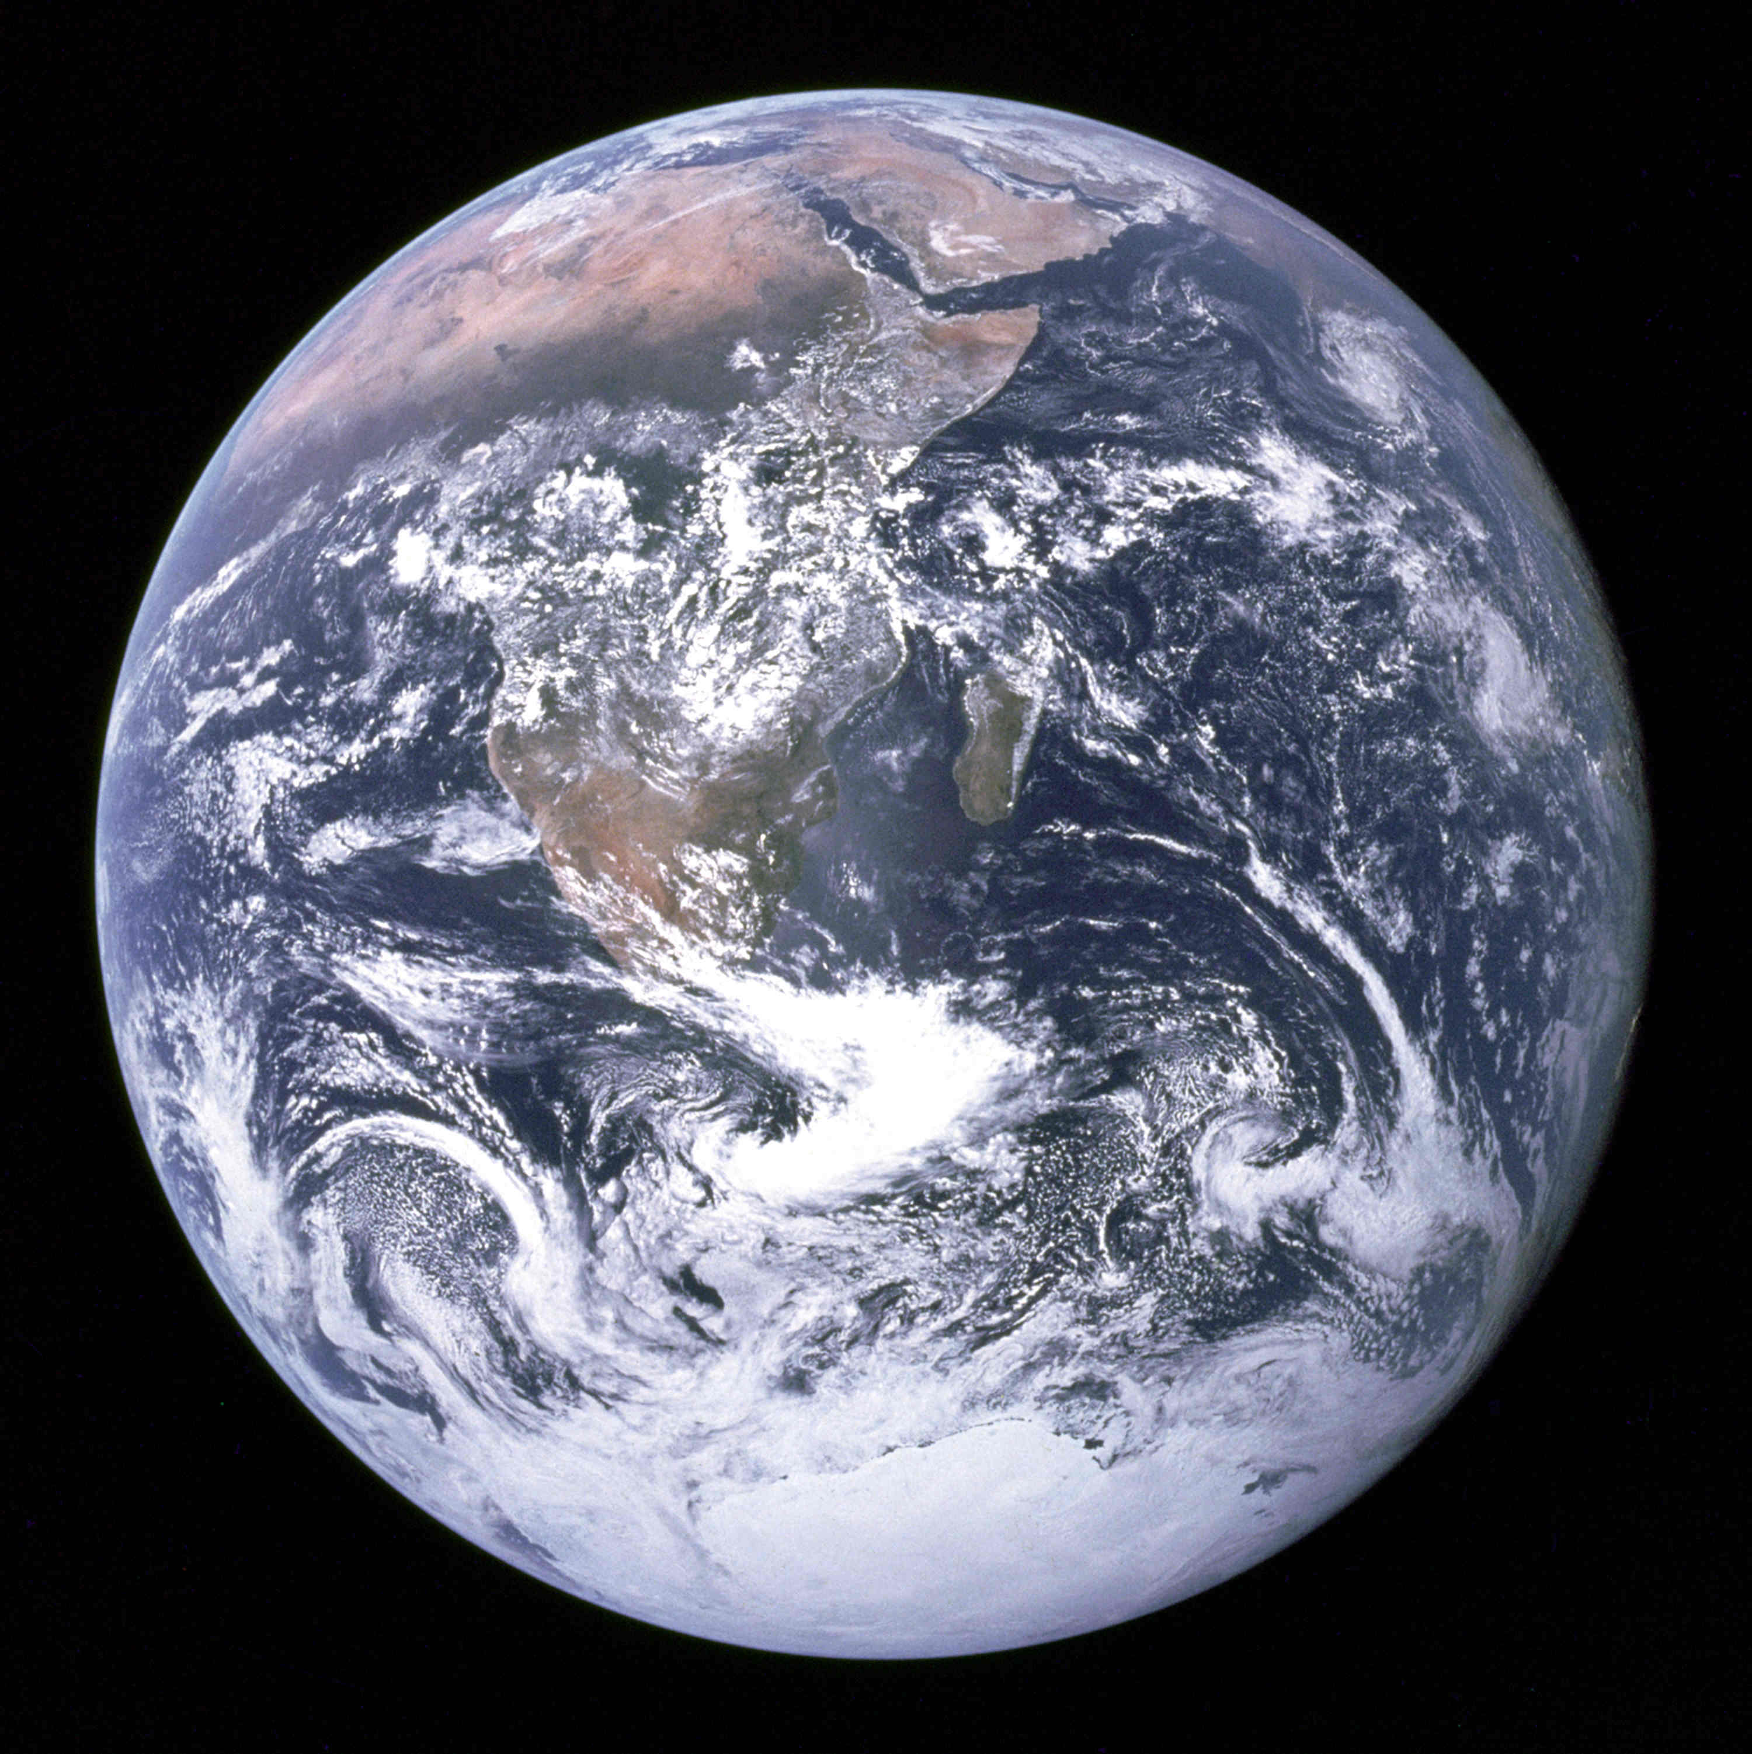
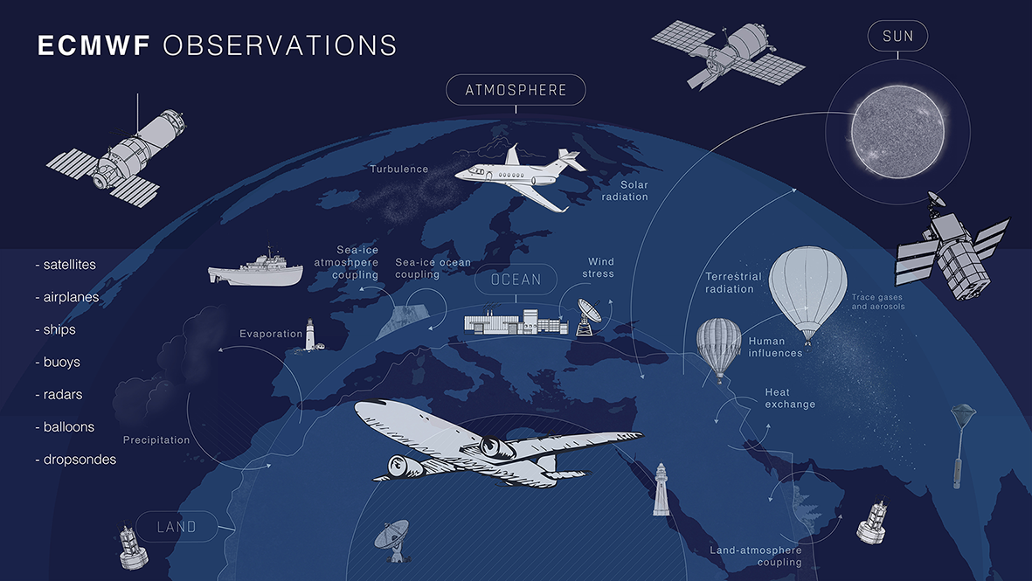
Why would machine learning help in weather predictions?
Predictions of weather and climate are difficult:
The Earth is huge, resolution is limited and we cannot represent all important processes within model simulations
The Earth System shows “chaotic” dynamics which makes it difficult to predict the future based on equations
Some of the processes involved are not well understood
All Earth System components (atmosphere, ocean, land surface, cloud physics,…) are connected in a non-trivial way
However, we have a huge number of observations and Earth System data
There are many application areas for machine learning in numerical weather predictions
Machine learning also provides a number of
opportunities for high performance computing

Slide 5
What will machine learning for numerical weather predictions
look like in 10 years from now?
Machine learning will have
no long-term effect
Machine learning will replace
conventional models
Simple post-processing
applications
Feature detection in
model output
Observation screening
Emulation of
parametrisation schemes
Bias correction in 4DVar
Learn model components
from observations
Learn equations of motion
The uncertainty range is still very large...

Slide 6
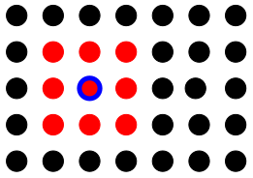
Can we replace conventional weather forecast systems by deep learning?
We could base the entire model on neural networks and trash the conventional models.?
There are limitations for existing models and ECMWF provides access to 210 petabyte of data
A simple test configuration:
We retrieve historical data (ERA5) for geopotential at 500 hPa (Z500) for the last decades
(>65,000 global data sets)
We map the global data to a coarse two-dimensional grid (60x31)
We learn to predict the update of the field from one hour to the next using deep learning
Once we have learned the update, we can perform predictions into the future
No physical understanding is required!
Dueben and Bauer GMD 2018

Slide 7
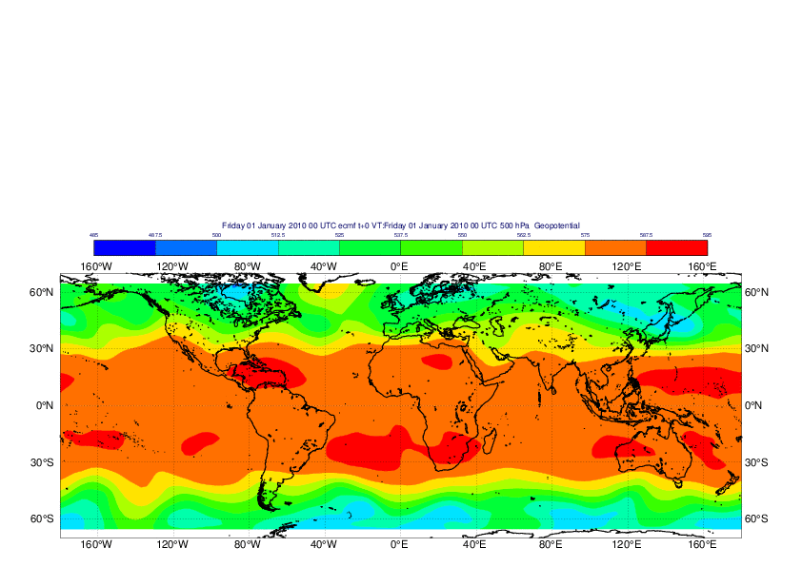
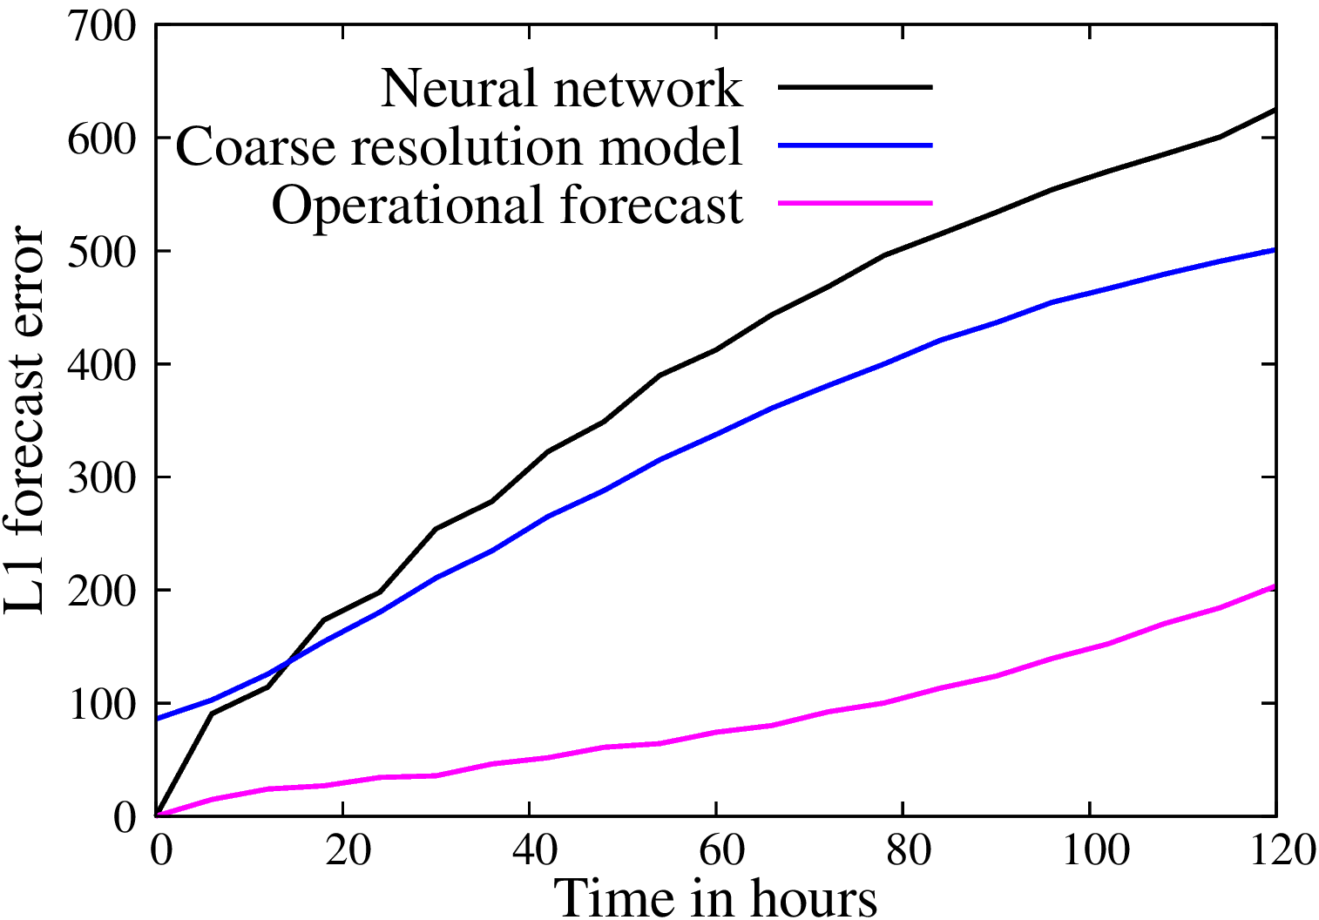
Can we replace conventional weather forecast systems by deep learning?
Time evolution of Z500 for historic data and a neural network prediction.
Can you tell which one is the neural network?
The neural network is picking up the dynamics nicely.
Forecast errors are comparable if we compare like with like.
Is this the future?
Unlikely…
The simulations are unstable and it is unclear how to fix conservation properties.
It is unknown how to increase complexity and how to fix feature interactions.
There are only ~40 years of data available.
However, there is a lot of progress at the moment:
Scher and Messori GMD 2019; Weyn, Durran, and Caruana JAMES 2019; …
Dueben and Bauer GMD 2018

Slide 8
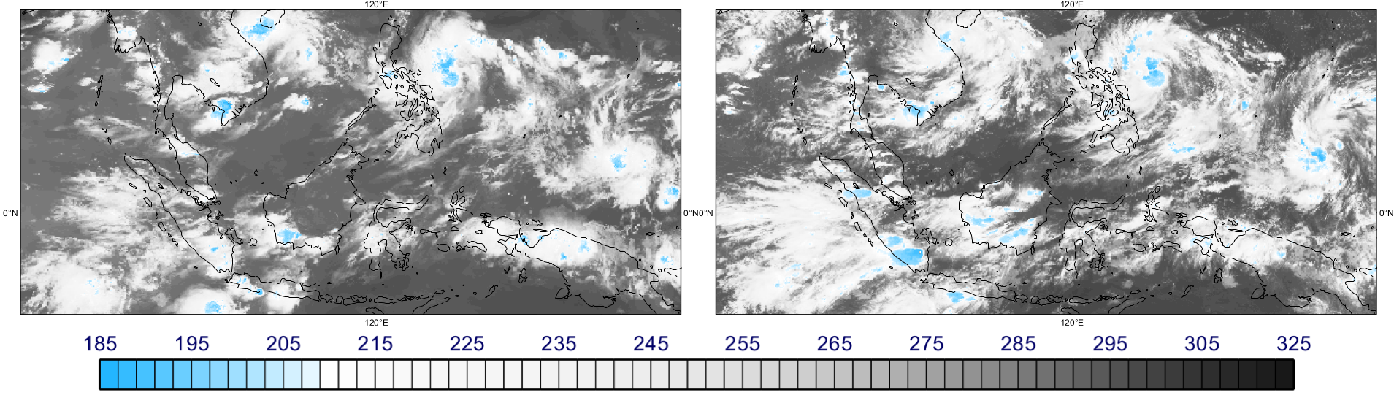
Why is it hard to beat conventional weather forecast systems?
Top-of-the-atmosphere cloud brightness temperature [K] for satellite observations and a simulation of the atmosphere with 1.45 km resolution.
Dueben, Wedi, Saarinen and Zeman JSMJ 2020
Today, global weather forecast simulations have O(1,000,000,000) degrees-of-freedom, can represent many details of the Earth System, and show a breath-taking level of complexity.
They are based on decades of model developments and process understanding.

Slide 9
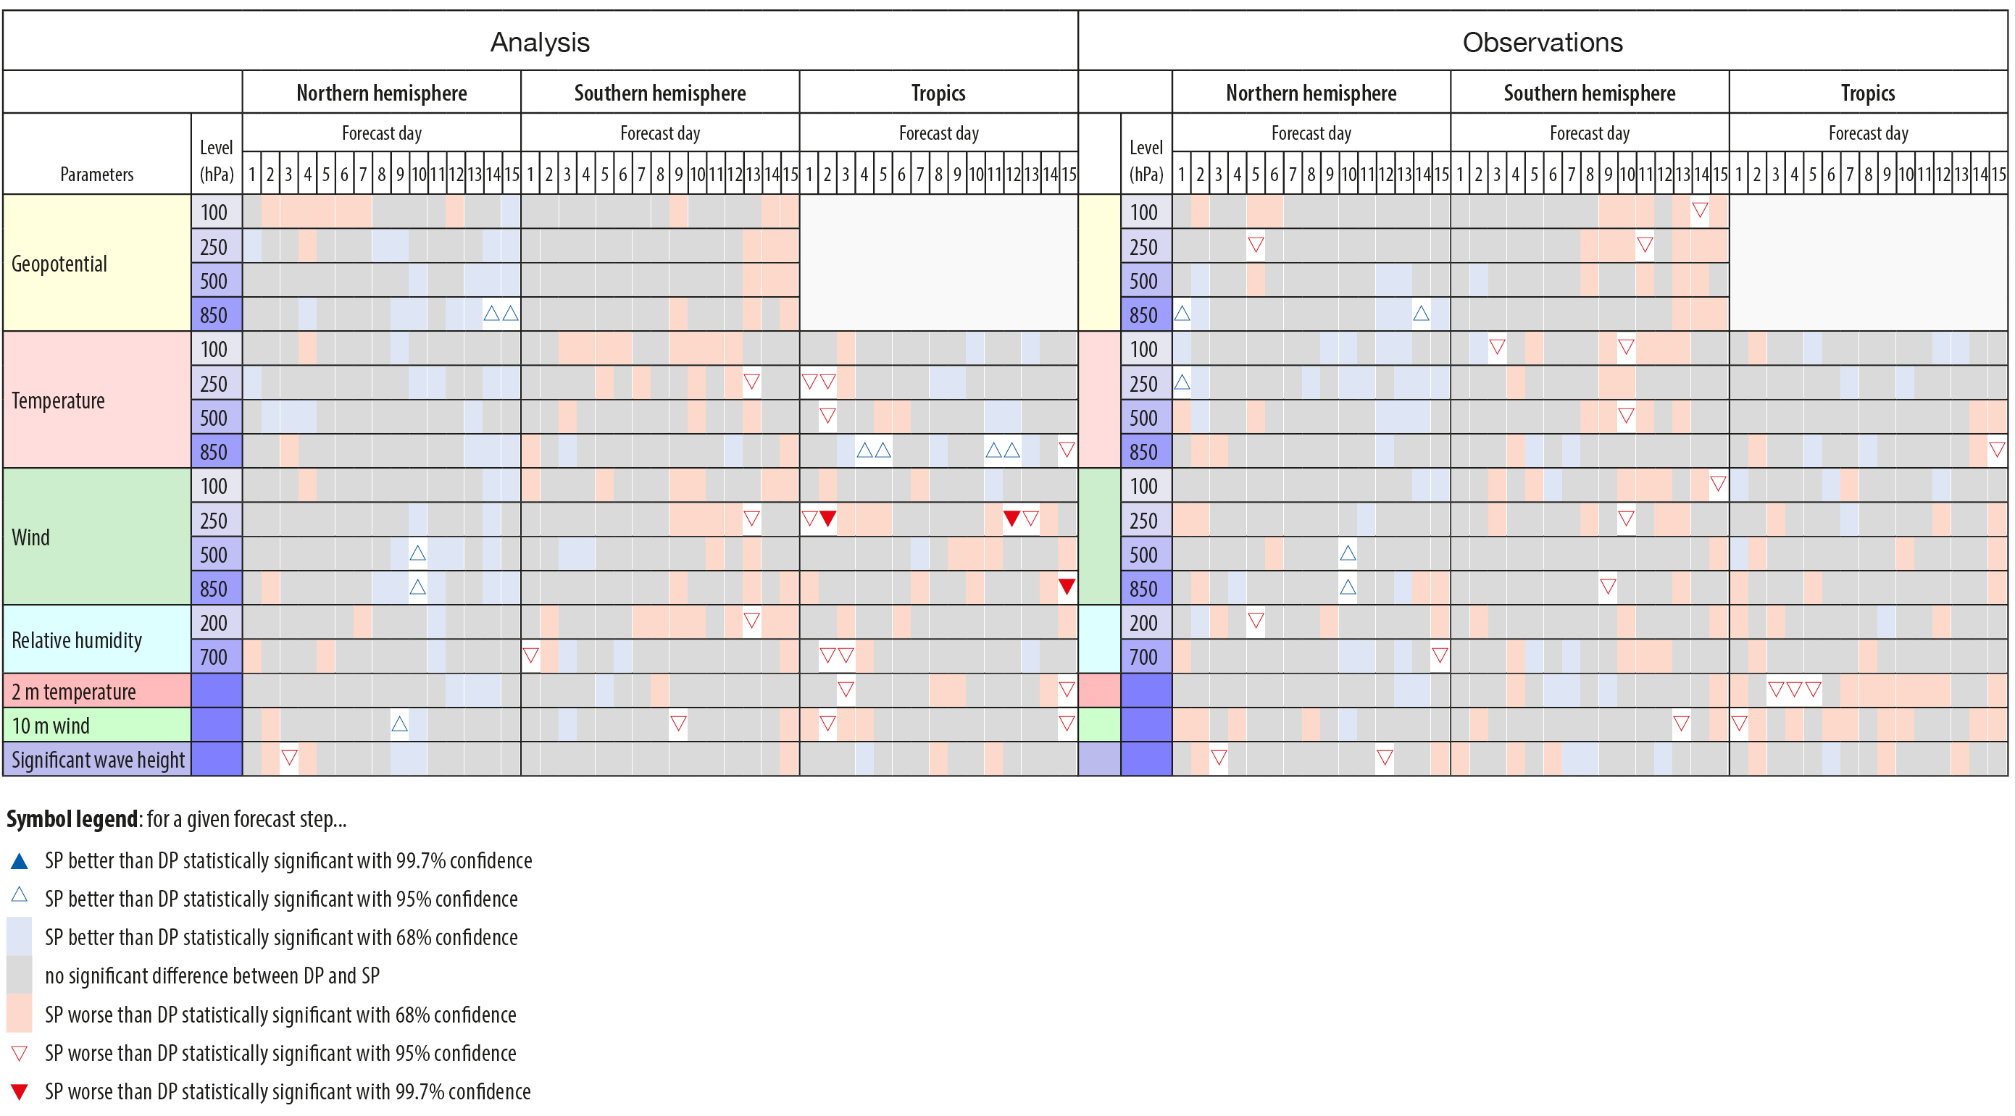
Why is it hard to beat conventional weather forecast systems?
So…using machine learning for weather predictions is useless then?
No!
Dueben, Diamantakis, Lang, Saarinen, Sandu, Wedi, Wilhelmsson ECMWF Newsletter 2018

Slide 10
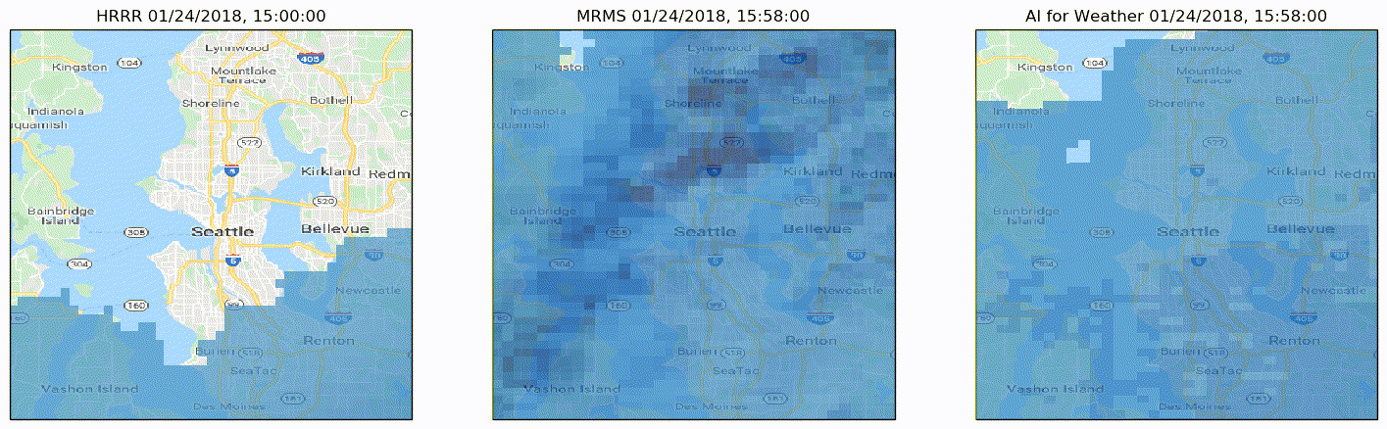
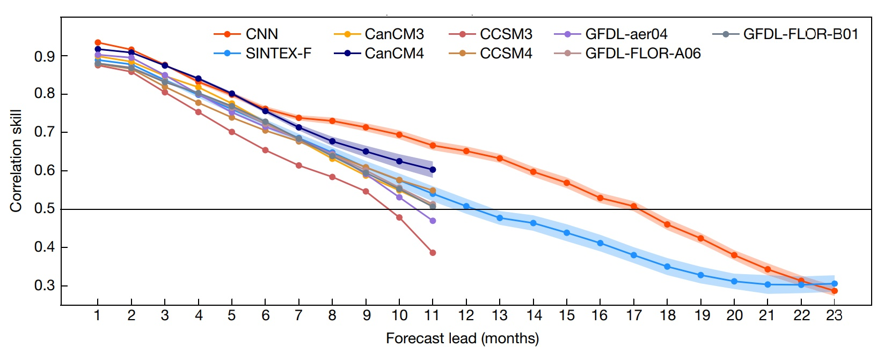
Can we replace conventional Earth System models by deep learning?
1-hour precipitation predictions by Google: Agrawal, Barrington, Bromberg, Burge, Gazen, Hickey arXiv:1912.12132
NOAA forecast Ground truth Machine learning:
Deep learning for multi-year ENSO forecasts: Ham, Kim, Luo Nature 2019

Slide 11
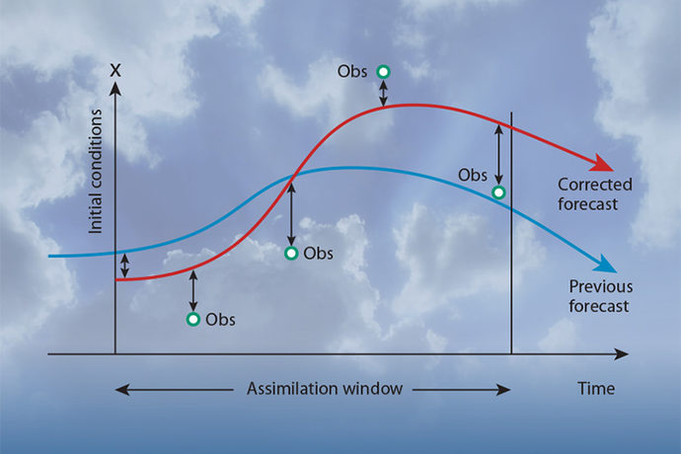
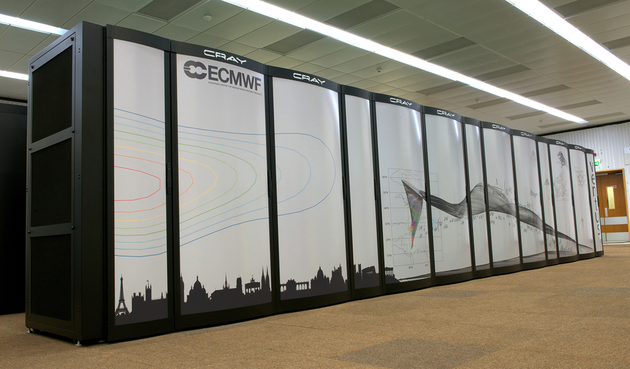

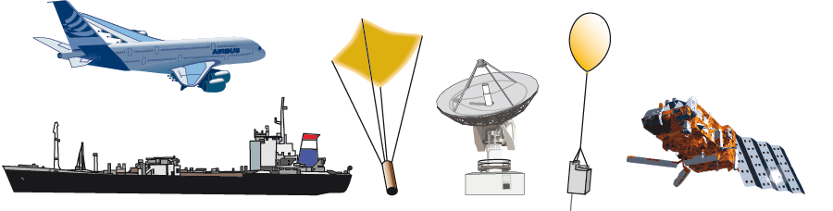
Machine learning applications across the numerical weather prediction workflow
Observations
Data-assimilation
Numerical weather forecasts
Post-processing and dissemination
Application areas for machine learning are spread over the entire workflow:
weather data monitoring, real-time quality control for observational data, anomaly interpretation, guided quality assignment and decision making, data fusion from different sources, correction of observation error,
learn governing differential equations, non-linear bias correction, bias predictors, learn operational operators, define optical properties of hydrometeors and aerosols, emulate conventional tools improve efficiency,
emulate model components, develop improved parametrisation schemes, build better error models, learn the underlying equations of motion, generate tangent linear or adjoint code from machine learning emulators,
real-time adjustments of forecast products, feature detection, uncertainty quantification, error corrections for seasonal predictions, development of low-complexity models, bespoke products for business opportunities,
and many more…

Slide 12
State-of-play and outline of the talk
There are many interesting application areas for machine learning to improve weather and climate predictions
We are only at the beginning to explore the potential of machine learning in the different areas
I will present a couple of example applications of machine learning at ECMWF in the following
I will name the main challenges that we are facing when using machine learning today

Slide 13
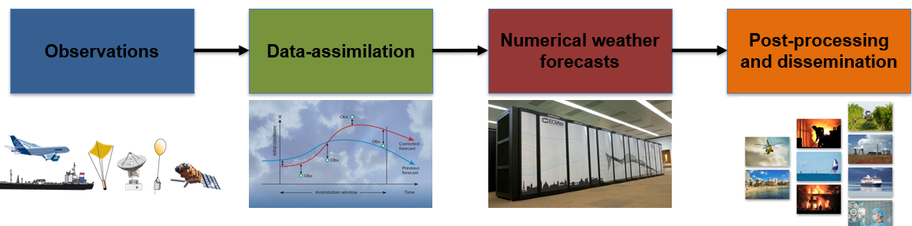
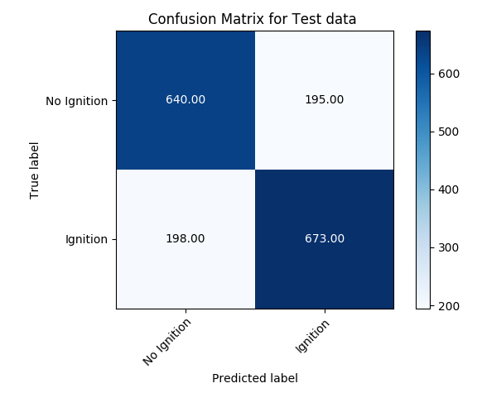
Observations:
Detect the risk for the ignition of wild fires by lightnings
Observations for 15 variables are used as inputs including soil moisture, 2m temperature, soil type, vegetation cover, relative humidity, and precipitation
The rate of radiant heat output from the Global Fire Assimilation System (GFAS) was used to generate a “truth”
12,000 data points were used for training
Different machine learning tools (decision trees, random forest and Ada Boost​) are used to classify the cases into
“ignition” and “no-ignition”
The best classifier has an accuracy of 77 %
Ruth Coughlan, Francesca Di Giuseppe, Claudia Vitolo and the SMOS-E project

Slide 14
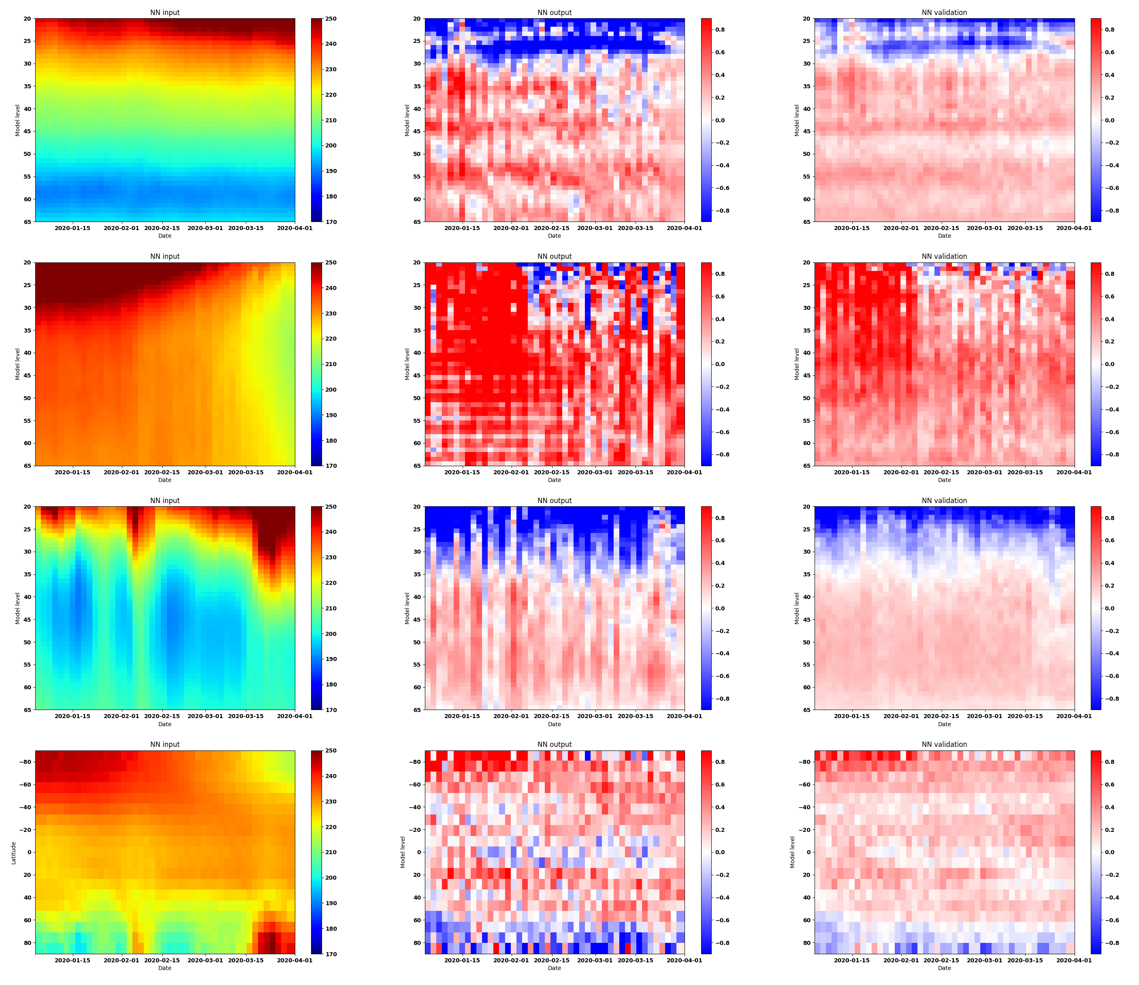
Data assimilation: Bias-correct the forecast model in 4DVar data assimilation
Data-assimilation blends observations and the forecast model to generate initial conditions for weather predictions
During data-assimilation the model trajectory is “synchronised” with observations for the same weather regimes
It is possible to learn model error when comparing the model with (trustworthy) observations
Two approaches:
Learn model error within the 4DVar data-assimilation framework for so-called “weak-constraint 4D-Var”
Learn model error from a direct comparison of the model trajectory to observations or analysis increments using deep learning.
Benefit:
When the bias is learned, it can be used to:
Correct for the bias during data-assimilation to improve initial conditions
Correct for the bias in forecast simulations to improve predictions
(discussed controversially)
Understand model deficiencies
Laloyaux, Bonavita and Dueben @ ECMWF + Kurth and Hall @ NVIDIA

Slide 15
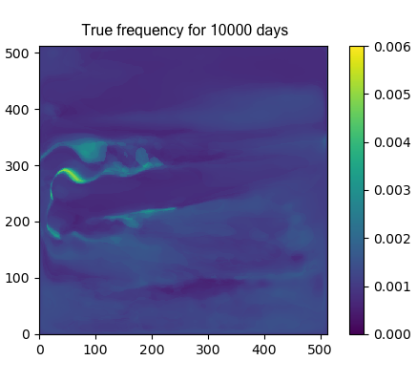
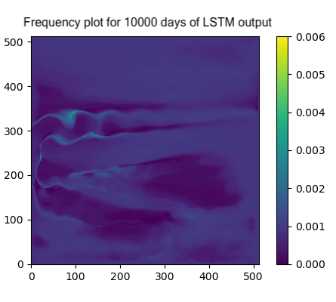
Numerical weather forecasts: Low dimensional ocean models
Motivation: We would like to build a low-dimensional ocean model for medium-range weather forecasts.
Testbed: 3-layer double gyre quasi-geostrophic model in rectangular domain.
Data: 40 year time series for the coefficients of the first eight Principle Components of the surface layer (daily data).
Approach: Use neural networks to learn the equations of motion.
Neural Network setup: LSTM with 2 hidden layers, 50 neurons/layer, Sigmoid activation and Adam optimizer.
Please note that “conventional machine learning” with linear regression + red-noise performs even better.
Agarwal, Dueben, Berloff, Ryzhov, Kondrashov

Slide 16
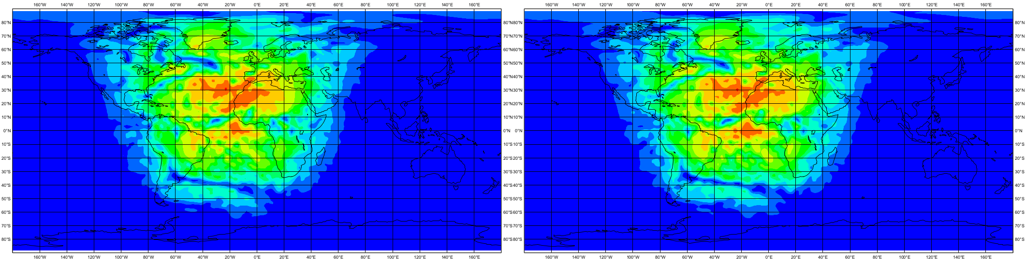
Numerical weather forecasts: To emulate the radiation scheme
Store input/output data pairs of the radiation schemes
Use this data to train a neural network
Replace the radiation scheme by the neural network within the model
Why would you do this?
Neural networks are likely to be much more efficient and portable to heterogenous hardware
Surface downward solar radiation for the original scheme and the neural network emulator (based on a ResNet).
The approach is working and the neural network is ~10 times faster than the original scheme.
However, model results are still degraded.
This is a very active area of research:
Rasp, Pritchard, Gentine PNAS 2018
Brenowitz and Bretherton GRL 2018
…
Dueben, Hogan, Bauer @ECMWF and Progsch, Angerer @NVIDIA

Slide 17
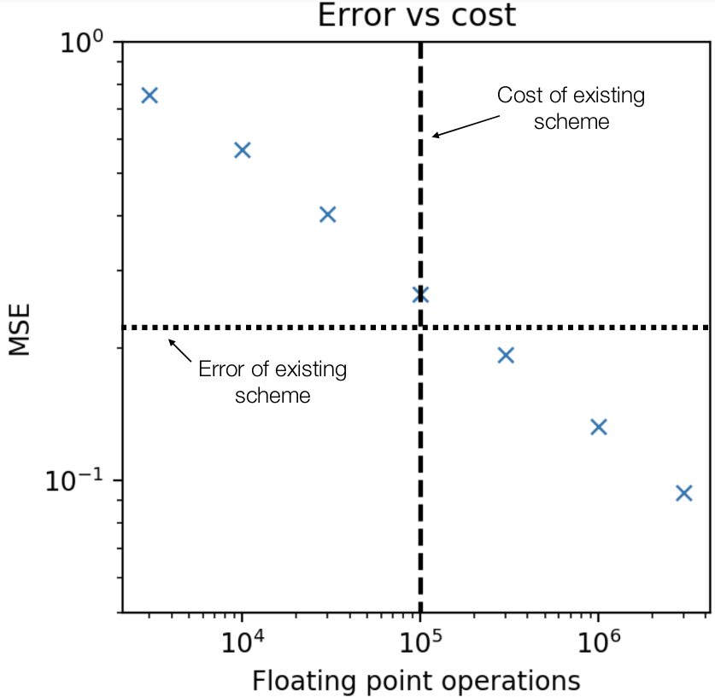
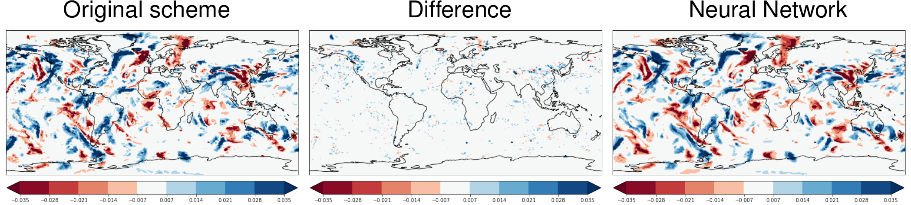
Numerical weather forecasts: To emulate gravity wave drag
Repeat the same approach for the gravity wave drag scheme of IFS
Start with non-orographic and continue with orographic wave drag
Results for the non-orographic gravity wave drag are promising.
There is also a nice relation between network size and accuracy.
However, it is still questionable whether computational performance of the Neural Nets is better when compared to the conventional scheme.
Results are not as good for the orographic gravity wave drag scheme.
Chantry, Dueben, Palmer

Slide 18
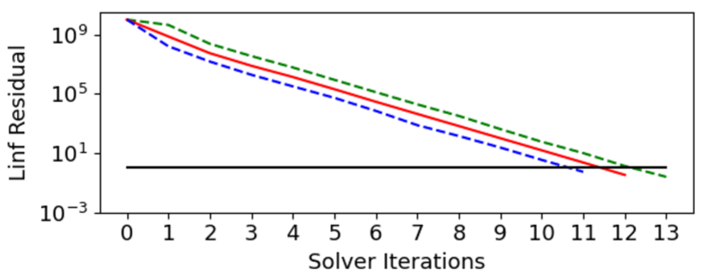
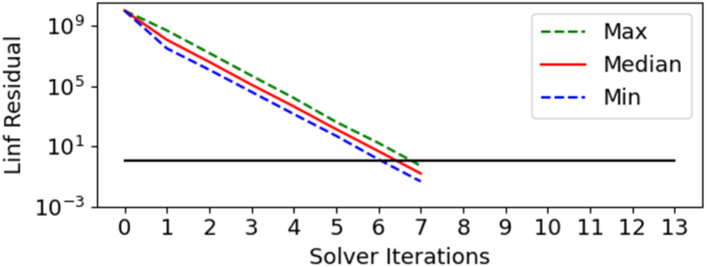
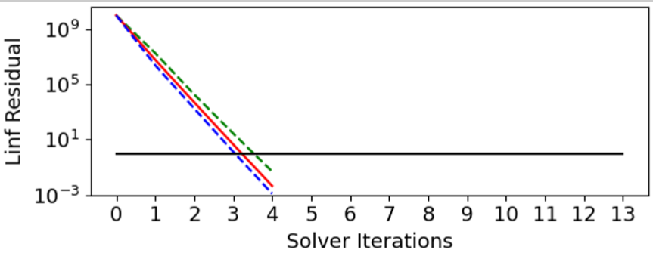
Numerical weather forecasts: To precondition the linear solver
Linear solvers are important to build efficient semi-implicit time-stepping schemes for atmosphere and ocean models.
However, the solvers are expensive.
The solver efficiency depends critically on the preconditioner that is approximating the inverse of a large matrix.
Can we use machine learning for preconditioning, predict the inverse of the matrix and reduce the number of iterations that are required for the solver?
Testbed: A global shallow water model at 5 degree resolution but with real-world topography.
Method: Neural networks that are trained from the model state and the tendencies of full timesteps.
No preconditioner: Machine learning preconditioner: Implicit Richardson preconditioner:
It turns out that the approach (1) is working and cheap, (2) interpretable and (3) easy to implement
even if no preconditioner is present.
Ackmann, Dueben, Smolarkieicz and Palmer

Slide 19
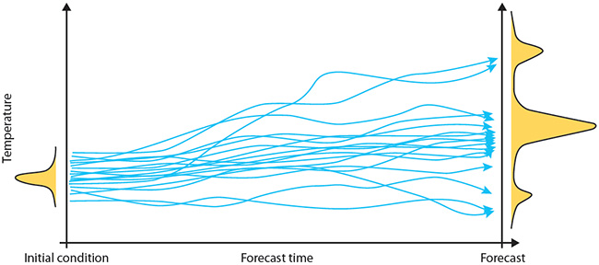
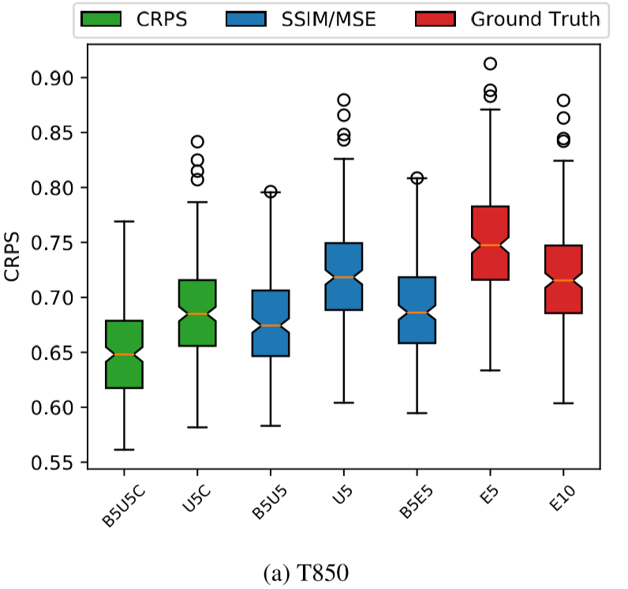
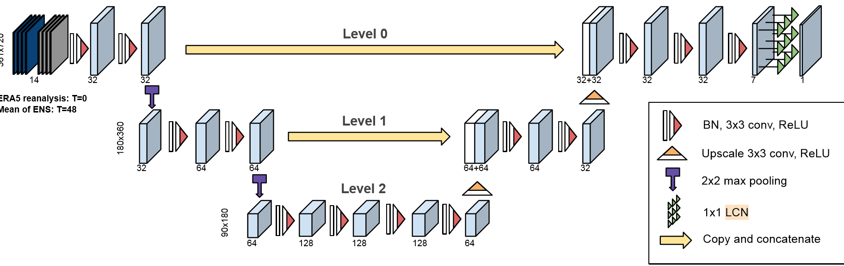
Post-processing and dissemination: Improve ensemble predictions
Ensemble predictions are important but expensive.
Can we improve ensemble skill scores from a small number of ensemble members via deep learning?
Use global fields of five ensemble members as inputs.
Correct the ensemble scores of temperature at 850 hPa and Z500 hPa for a 2-day forecast towards a full 10 member ensemble forecast.
Grönquist, Yao, Ben-Nun, Dryden, Dueben, Lavarini, Li, Hoefler https://arxiv.org/abs/2005.08748

Slide 20
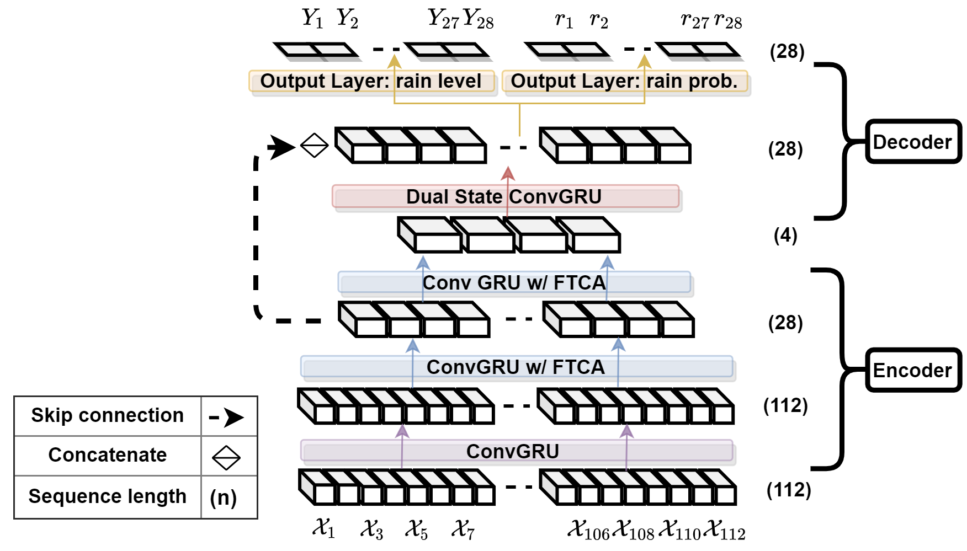
Post-processing and dissemination: Precipitation down-scaling
Problem: Learn to map precipitation predictions from ERA5 reanalysis data at ~50 km resolution to E-OBS local precipitation observations at ~10 km resolution over the UK.
Use case: Eventually, apply the tool to climate predictions to understand changes of local precipitation pattern due to climate change.
Method: Use Tru-NET with a mixture of ConvGru layers to represent spatial-temporal scale interactions and a novel Fused Temporal Cross Attention mechanism to improve time dependencies.
Model | RMSE
IFS within ERA5 | 3.627
Tru-Net | 3.005
Adewoyin, Dueben, Watson, He, Dutta http://arxiv.org/abs/2008.09090

Slide 21
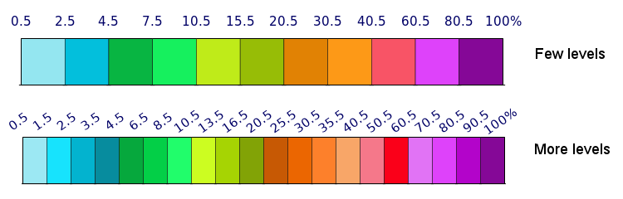
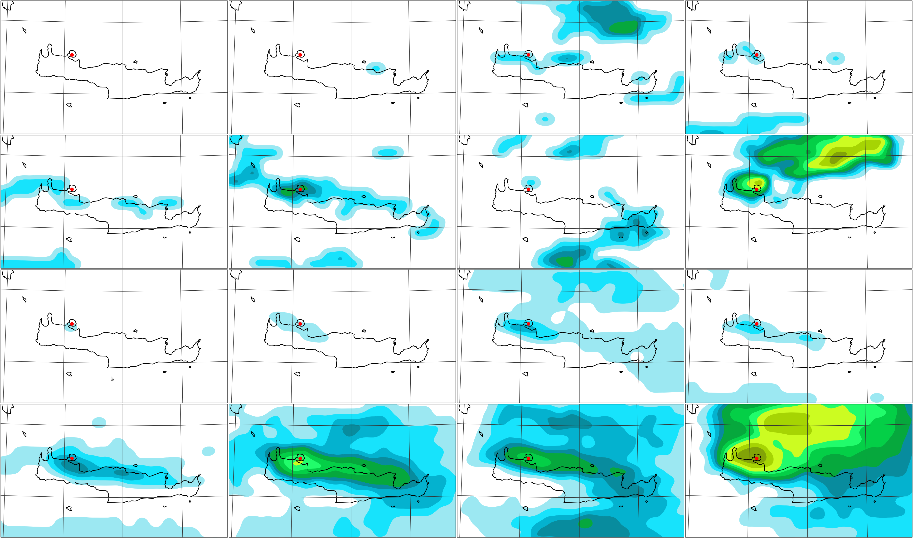
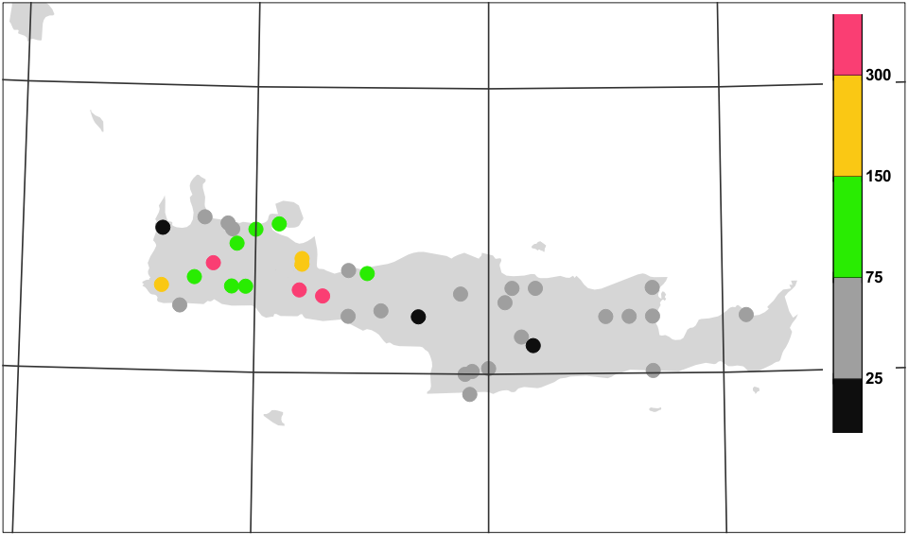

Post-processing and dissemination: ecPoint to post-process rainfall predictions
Use forecast data as inputs
Train against worldwide rainfall observations
Improve local rainfall predictions by accounting
for sub-grid variability and weather-dependent biases
Use decision trees as machine learning tool
Example: Devastating floods in Crete on 25 February 2019
Benefits: Earlier and more consistent signal with higher probabilities
Probability (%) > 50mm /12h
RAW ENSEMBLE
D4
D3
D2
D1
POINT RAINFALL (post-processed)
D4
D3
D2
D1
24h rain
Timothy Hewson and Fatima Pillosu

Slide 22
Scientific challenges for machine learning in numerical weather predictions
There is no fundamental reason not to use a black box within weather and climate models but there are unanswered questions.
Can we use our knowledge about the Earth System to improve machine learning tools?
Can we diagnose physical knowledge from the machine learning tools?
Can we remove errors from neural networks and secure conservation laws?
Can we guarantee reproducibility?
Can we find the optimal hyper-parameters?
Can we efficiently scale machine learning tools to high performance computing applications?
Can we interface machine learning tools with conventional models?
Can we design good training data (short time steps and high resolution, labelled datasets)?
Can we explore the full phase space (all weather regimes) during training?
Many scientists are working on these challenges as we speak.

Slide 23
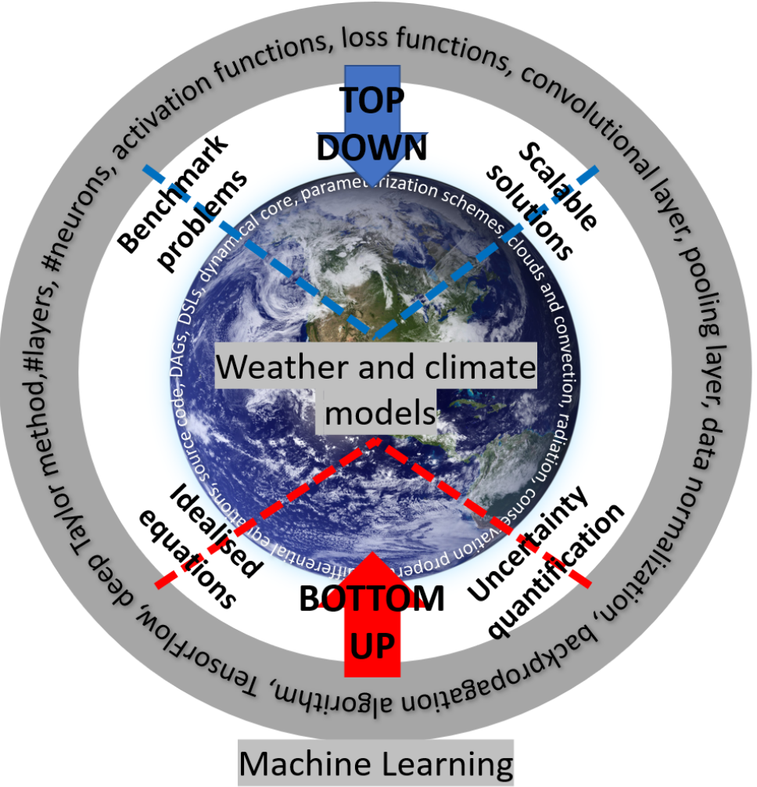
My personal vision of the way forward...
Idealised equations: To study known differential equations to learn how to derive blueprints for neural network architectures.
Uncertainty quantification: To study the representation of variability and the correction of systematic errors.
Scalable solutions: To learn how to scale neural networks to millions of inputs for 3D fields on the sphere.
Benchmark problems: To build benchmark problems similar to ImageNet (see WeatherBench in Rasp, Dueben, Scher, Weyn, Mouatadid and Thureey 2020)
To focus on useful tools that can serve as beacons.
This will require machine learning solutions that are customised to weather and climate science.

Slide 24
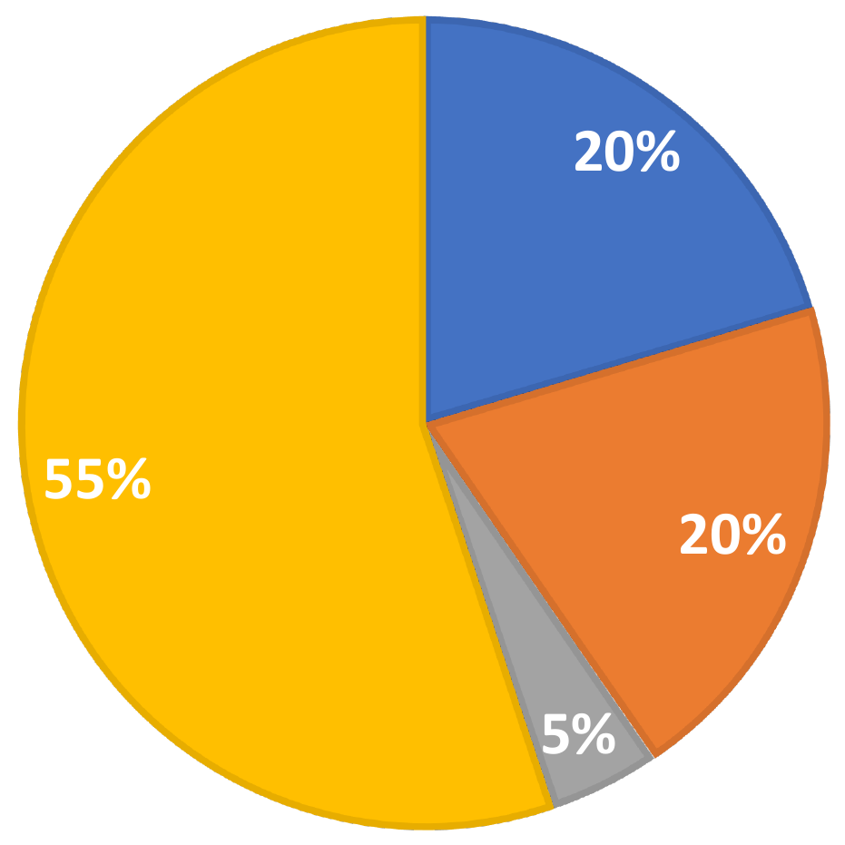
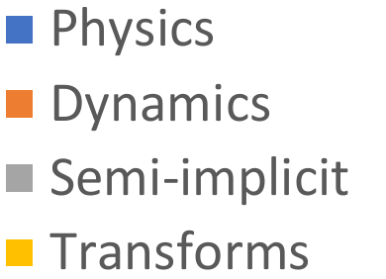
Can we use deep learning hardware for conventional models?
Machine learning accelerators are focussing on low numerical precision and high floprats.
Example: TensorCores on NVIDIA Volta GPUs are optimised for half-precision matrix-matrix calculations with single precision output.
→ 7.8 TFlops for double precision vs. 125 TFlops for half precision
Can we use TensorCores within our models?
Relative cost for model components for a non-hydrostatic model at 1.45 km resolution:
The Legendre transform is the most expensive kernel. It consists of a large number of standard matrix-matrix multiplications.
If we can re-scale the input and output ﬁelds, we can use half precision arithmetic.

Slide 25
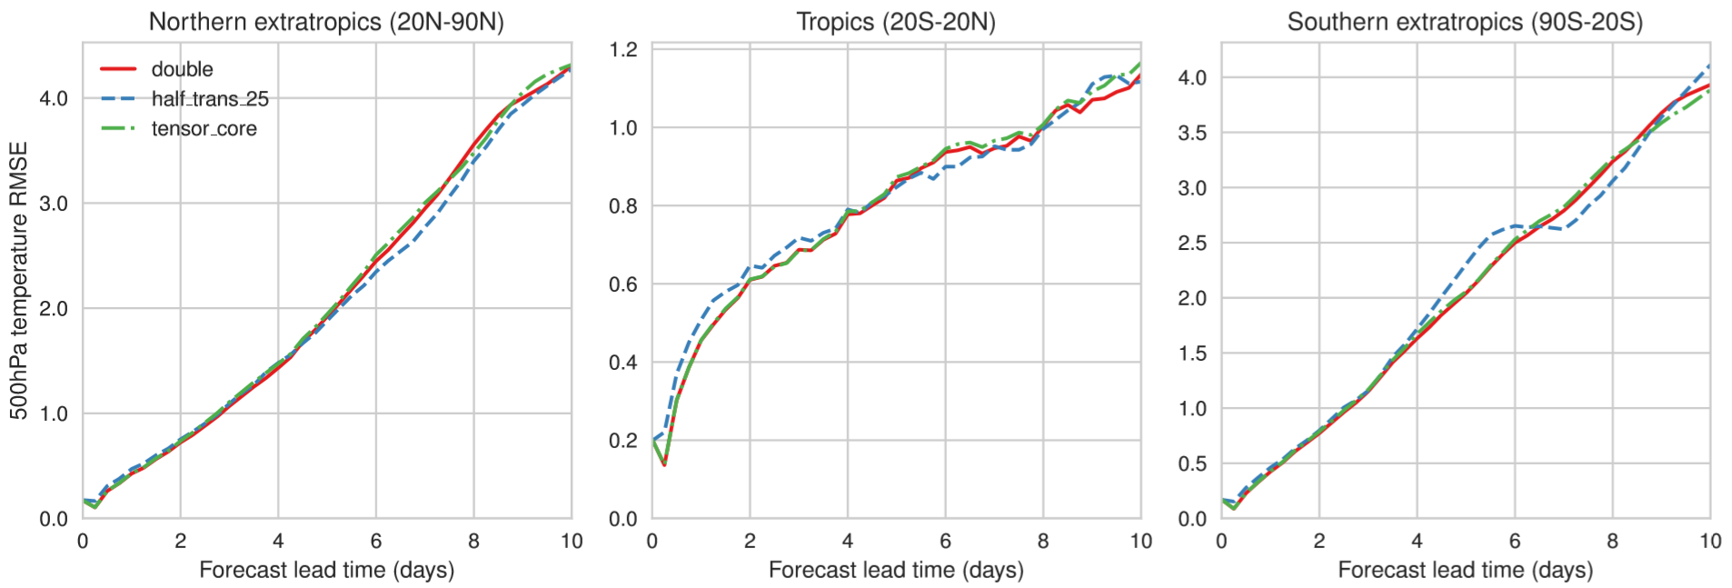
Half precision Legendre Transformations
Root-mean-square error for geopotential height at 500 hPa at 9 km resolution averaged over multiple start dates. Hatﬁeld, Chantry, Dueben, Palmer Best Paper Award PASC2019
The simulations are using an emulator to reduce precision (Dawson and Dueben GMD 2017) and more thorough diagnostics are needed.

Slide 26



Some room for interactions with machine learning efforts at ECMWF
ECMWF-ESA Workshop on Machine Learning for Earth System Observation and Prediction at ECMWF 5-8 October 2020. More information is here.
We have also started a special seminar series on Machine Learning that is broadcasted.
ECMWF is developing the European Weather Cloud in collaboration with EUMETSAT.
Our MAELSTROM EuroHPC proposal was successful which will allow us to develop
customised machine learning solutions for weather and climate models.
We are hiring soon.

Slide 27
Conclusions
There are a large number of application areas throughout the prediction workflow in weather and climate modelling for which machine learning could really make a difference.
The weather and climate community is still only at the beginning to explore the potential of machine learning (and in particular deep learning).
Machine learning could not only be used to improve models, it could also be used to make them more efficient on future supercomputers.
Machine learning accelerators may be useful to speed-up components of weather and climate models.
However, there are limitations for the application of black-box solutions within weather and climate models and challenges that need to be addressed.
Many thanks! Peter.Dueben@ecmwf.int @PDueben

Slide 28

The strength of a common goal

