Slide 1






Machine learning for weather and climate predictions
Peter Dueben
Royal Society University Research Fellow & ECMWF’s Coordinator for Machine Learning and AI Activities
This research used resources of the Oak Ridge Leadership Computing Facility (OLCF), which is a DOE Office of Science User Facility supported under Contract DE-AC05-00OR22725.
The ESIWACE2 project has received funding from the European Union’s Horizon 2020 research and innovation programme under grant agreement No 823988.
The strength of a common goal
Notes:
The headlines for the period have been:
The tender and selection process to procure our new supercomputer has come to an end and we have been in a position to present our recommendation to committees, and a bit later today to you
Having made this choice, even if not endorsed by Council has allowed us to also plan the science that this choice could help us develop
The implementation of the Council decision that the President and I should investigate the way to meet the EU funding policies requirements which has led us to contact all of you through a letter advocating the move of some of our EU-funded activities to an EU country
The future accommodation project developed with the UK Government having reached a stage where it can be paused without too much risk is helping us go through this analysis of the action we need to take to mitigate the impact of Brexit on ECMWF
We are making progress on understanding the role we believe artificial intelligence could be playing in numerical weather prediction, and we have appointed one of our staff as coordinator of all activities across the organisation falling into this category
Of course, and I will start with that the period has also seen the excellent results that we are now getting from Aeolus

Slide 2

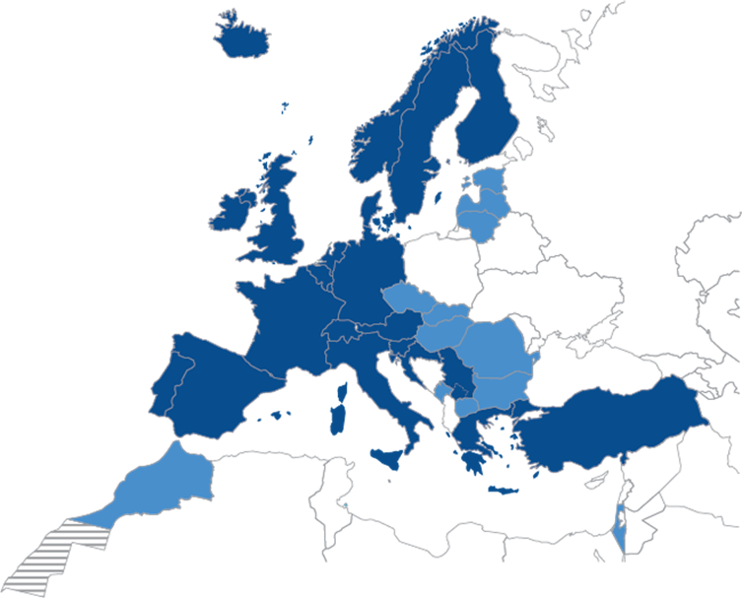
European Centre for Medium-Range Weather Forecasts (ECMWF)
www.ecmwf.int
Research institute.
24/7 operational weather service for medium-range, monthly and seasonal forecasts.
Independent, intergovernmental organisation supported by 34 states.
Based in Reading in the UK; ≈350 member of staff.
Home of two supercomputers.
Home of the Integrated Forecast System (IFS).

Slide 3
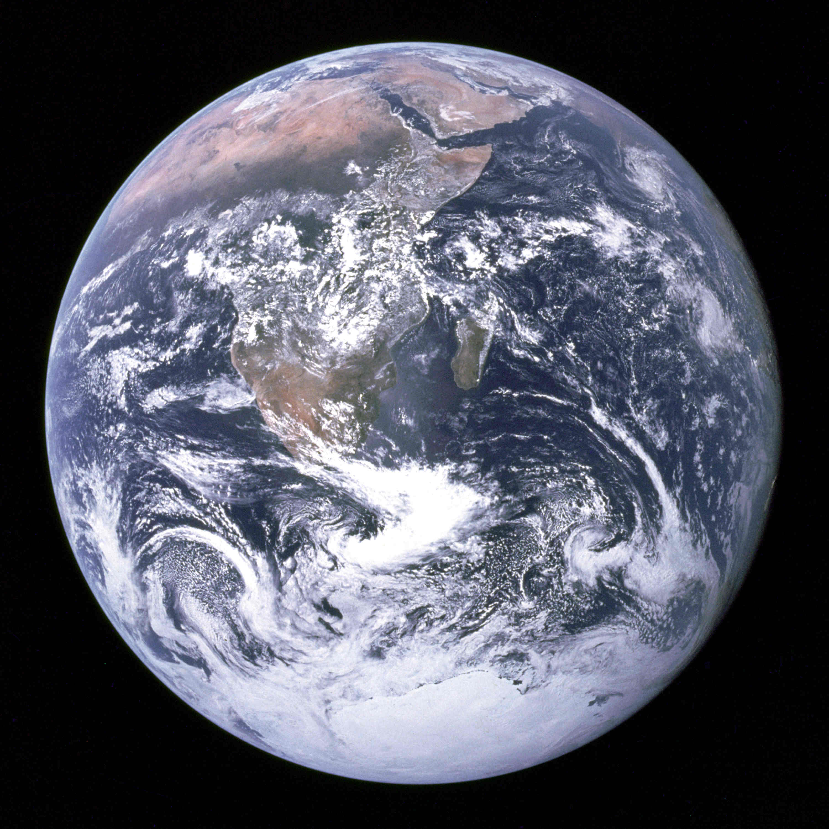
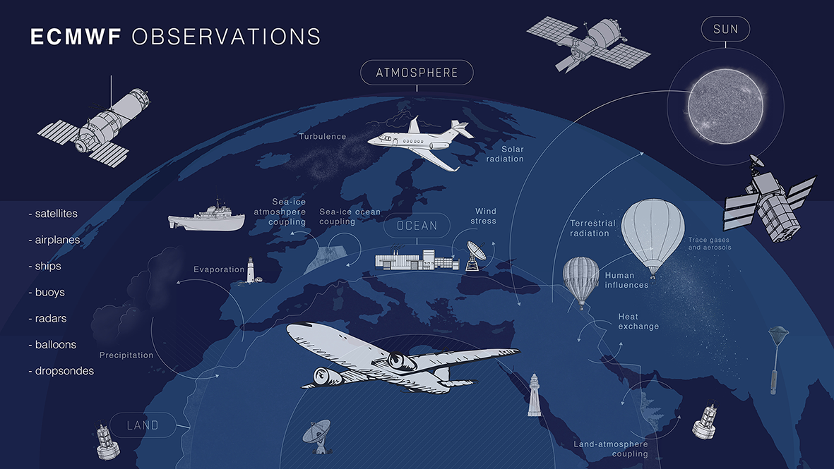
Why would machine learning help in weather and climate predictions?
Predictions of weather and climate are difficult:
The Earth is huge, resolution is limited and we cannot represent all important processes within model simulations
The Earth System shows “chaotic” dynamics which makes it difficult to predict the future based on equations
All Earth System components (atmosphere, ocean, land surface, cloud physics,…) are connected in a non-trivial way
Some of the processes involved are not well understood
However, we have a huge number of observations and Earth System data
There are many application areas for machine learning in numerical weather predictions
Machine learning also provides a number of
opportunities for high performance computing

Slide 4
Some views on Machine Learning for numerical weather and climate predictions
Two years into the “boom” of machine learning…
Conservative domain scientist:
Machine learning is a wave passing by and many of the “new” methods are not really new.
Please consider machine learning as an amazing expansion to your toolbox.
Proactive domain scientist:
Machine learning can only be useful if it’s embracing process understanding and if it turns into a grey box.
Please have a look at developments in other domains.
High Performance Computing scientist:
Think in petabytes and exaflop. Sooner or later machine learning will replace all conventional tools.
Please consider decades of process understanding and model development, and the complexity of the problem.

Slide 5
What will machine learning for numerical weather and climate predictions
look like in 10 years from now?
Machine learning will have
no long-term effect
Machine learning will replace
conventional models
Simple post-processing
applications
Feature detection in
model output
Bias correction in
data assimilation
Observation screening
Emulation of
parametrisation schemes
Learn model components
from observations
Learn equations of motion
The uncertainty range is still very large...

Slide 6
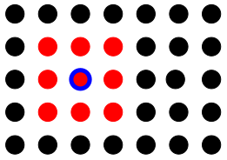
Can we replace conventional weather forecast systems by deep learning?
We could base the entire model on neural networks and trash the conventional models.?
There are limitations for existing models and ECMWF provides access to hundreds of petabytes of data
A simple test configuration:
We retrieve historical data (ERA5) for geopotential at 500 hPa (Z500) for the last decades
(>65,000 global data sets)
We map the global data to a coarse two-dimensional grid (60x31)
We learn to predict the update of the field from one hour to the next using deep learning
Once we have learned the update, we can perform predictions into the future
No physical understanding is required!
Dueben and Bauer GMD 2018

Slide 7
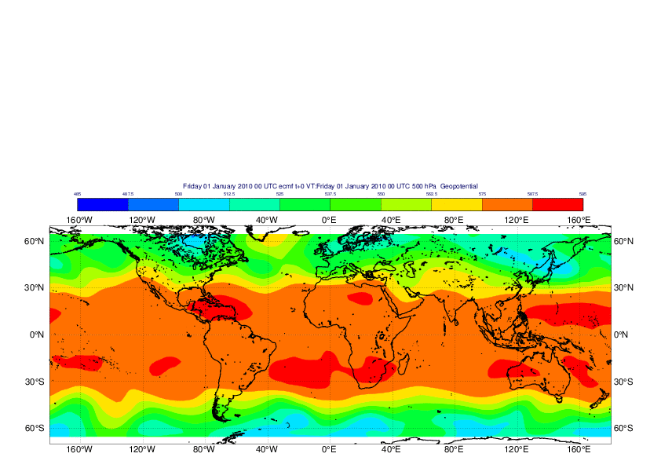
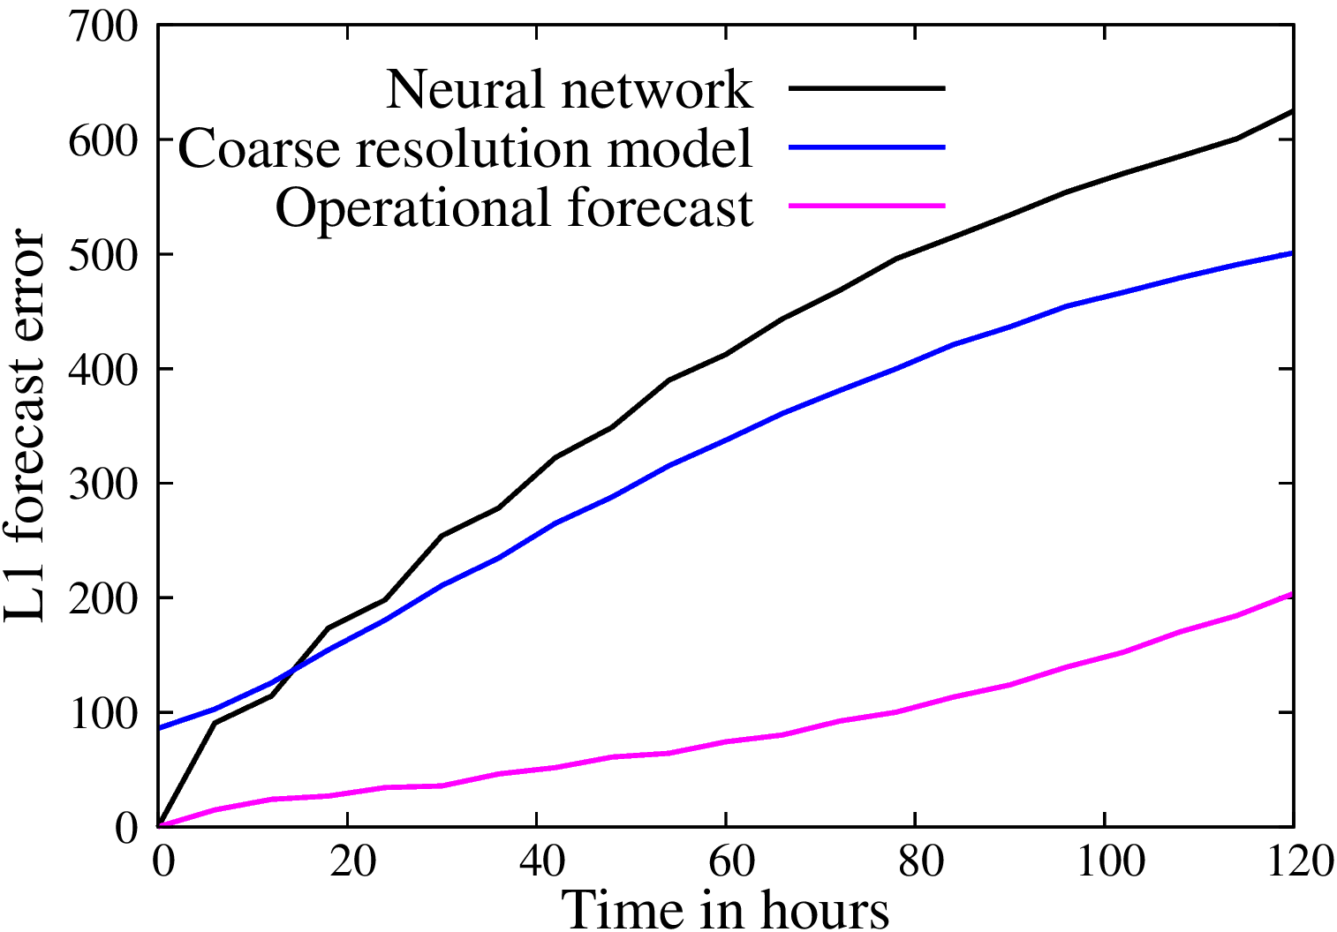
Can we replace conventional weather forecast systems by deep learning?
Time evolution of Z500 for historic data and a neural network prediction.
Can you tell which one is the neural network?
The neural network is picking up the dynamics nicely.
Forecast errors are comparable if we compare like with like.
There is a lot of progress at the moment.
Scher and Messori GMD 2019; Weyn, Durran, and Caruana JAMES 2019; Rasp and Thuerey 2020…
Is this the future for medium-range weather predictions?
Unlikely…
The simulations change dynamics in long integrations and it is unclear how
to fix conservation properties.
It is unknown how to increase complexity and how to fix feature interactions.
There are only ~40 years of data available.
Dueben and Bauer GMD 2018

Slide 8
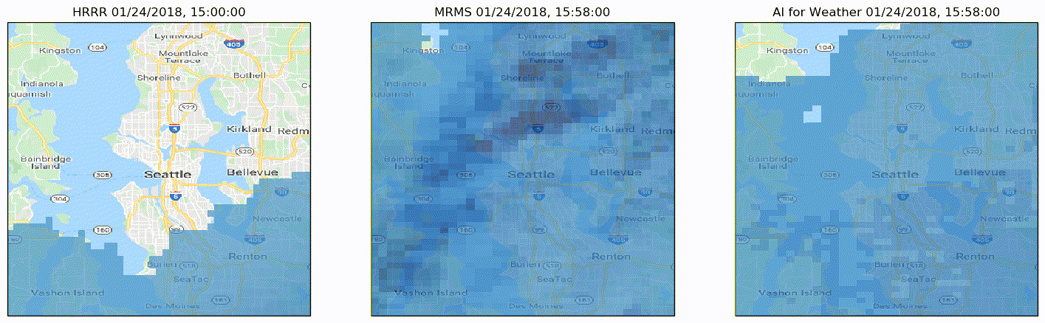
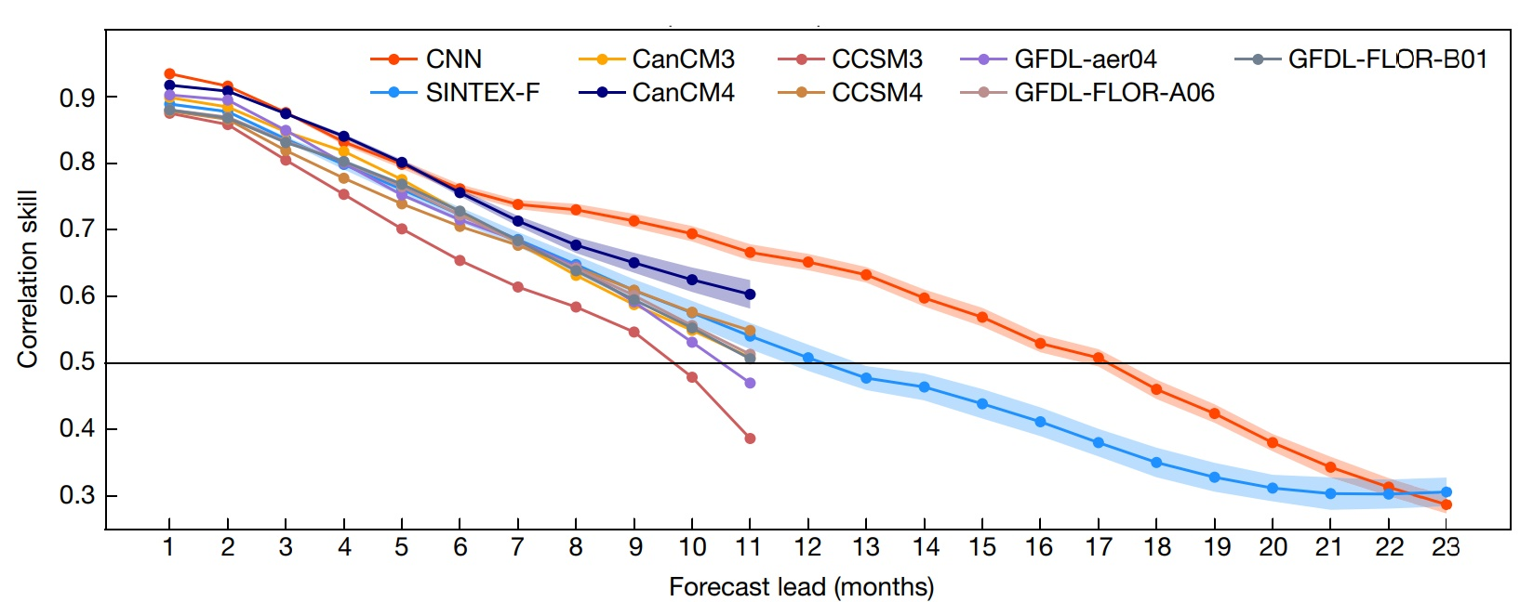
Can we replace conventional Earth System models by deep learning?
1-hour MetNET precipitation predictions by Google:
Agrawal, Barrington, Bromberg, Burge, Gazen, Hickey arXiv:1912.12132
NOAA forecast Ground truth Machine learning:
Deep learning for multi-year ENSO forecasts: Ham, Kim, Luo Nature 2019
And climate?

Slide 9
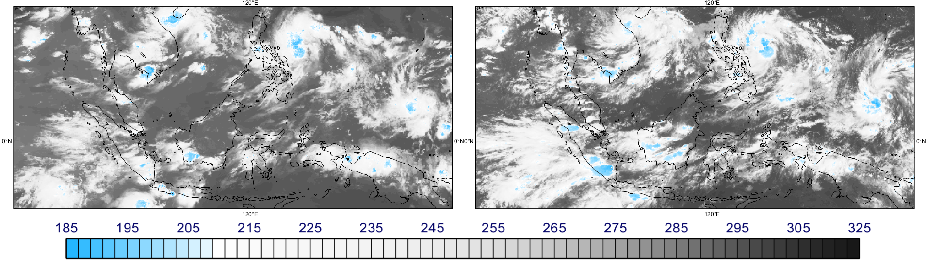
Why is it hard to beat conventional forecast systems in the medium range?
Top-of-the-atmosphere cloud brightness temperature [K] for satellite observations and a simulation of the atmosphere with 1.45 km resolution.
Dueben, Wedi, Saarinen and Zeman JSMJ 2020
Today, global weather forecast simulations have O(1,000,000,000) degrees-of-freedom, can represent many details of the Earth System, and show a breath-taking level of complexity.
They are based on decades of model developments and process understanding.
Readers’ Choice Award for the “Best Use of HPC in Physical Science” by HPCwire in 2020.

Slide 10
Machine learning applications at ECMWF
Hydrology models and identification of human influence
Gravity wave drag emulation
ecPoint precipitation post-processing
Automated quality
control of analysis
Clustering and categorisation for predictability and model errors
Hybrid ML/conventional
land-surface models
Pollution anomaly detection
and pollution downscaling
Post-processing for extreme
predictions in Copernicus
Anomaly detection
Radiation emulation
ML preconditioning
Learn forecasts from observations
Feature detection (TC and AR)
High-performance computing and data processing infrastructure
Observations
Data-assimilation
Numerical weather forecasts
Post-processing and dissemination
ML preconditioning for 4DVar
Bias correction and model learning
Optimise data access
CliMetLab
Precipitation downscaling
Use land surface observations
and data assimilation
Bias correction and gap filling
for aerosol observations
Anomaly detection and workflow
for IT infrastructure
Fuse observations and
predictions for sea ice products
Mapping of non-Gaussian to Gaussian distributions for data assimilation
Optimise chillers for HPC
Ensemble post-processing
I will provide detail on some of these boxes in the following.
Notes:
Please add your own field here:

Slide 11
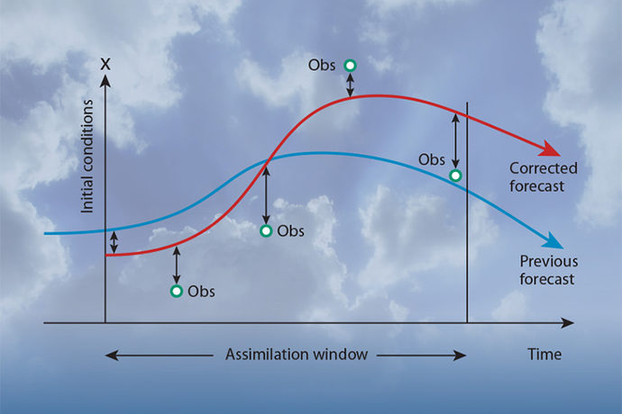
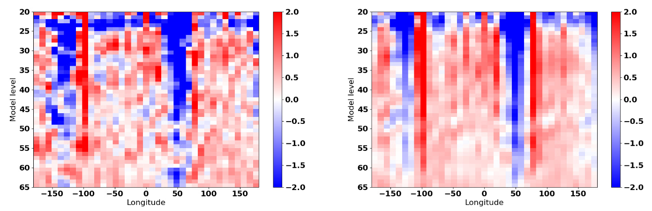
Data assimilation: Bias-correct the forecast model in 4DVar data assimilation
Data-assimilation blends observations and the forecast model to generate initial conditions for weather predictions
During data-assimilation the model trajectory is “synchronised” with observations for the same weather regimes
It is possible to learn model error when comparing the model with (trustworthy) observations
Two approaches:
Learn model error within the 4DVar data-assimilation framework for “weak-constraint 4D-Var”
Learn model error from a direct comparison of the model trajectory to observations or analysis increments using deep learning
(column-based or three-dimensional)
Benefit:
When the bias is learned, it can be used to:
Correct for the bias during data-assimilation
to improve initial conditions
Correct for the bias in forecast simulations
to improve predictions (discussed controversially)
Understand model deficiencies
Background departure
Estimation from Neural Network
Patrick Laloyaux, Massimo Bonavita and Peter Dueben @ ECMWF + Thorsten Kurth and David Matthew Hall @ NVIDIA

Slide 12
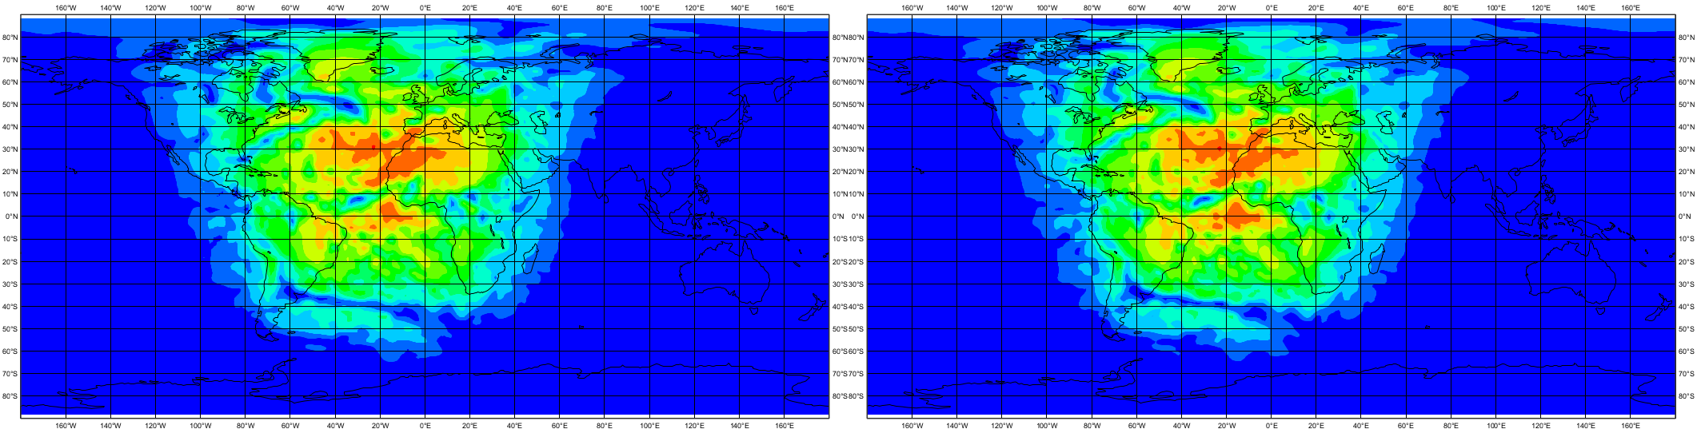
Numerical weather forecasts: To emulate the radiation scheme
This is a very active area of research:
Rasp, Pritchard, Gentine PNAS 2018
Brenowitz and Bretherton GRL 2018
…
Store input/output data pairs of the radiation schemes
Use this data to train a neural network
Replace the radiation scheme by the neural network within the model
Why would you do this?
Neural networks are likely to be much more efficient and portable to heterogenous hardware
Surface downward solar radiation for the original scheme and the neural network emulator (based on a ResNet).
The approach is working and the neural network is ~10 times faster than the original scheme.
However, model results are still degraded.
Dueben, Hogan, Bauer @ECMWF and Progsch, Angerer @NVIDIA

Slide 13
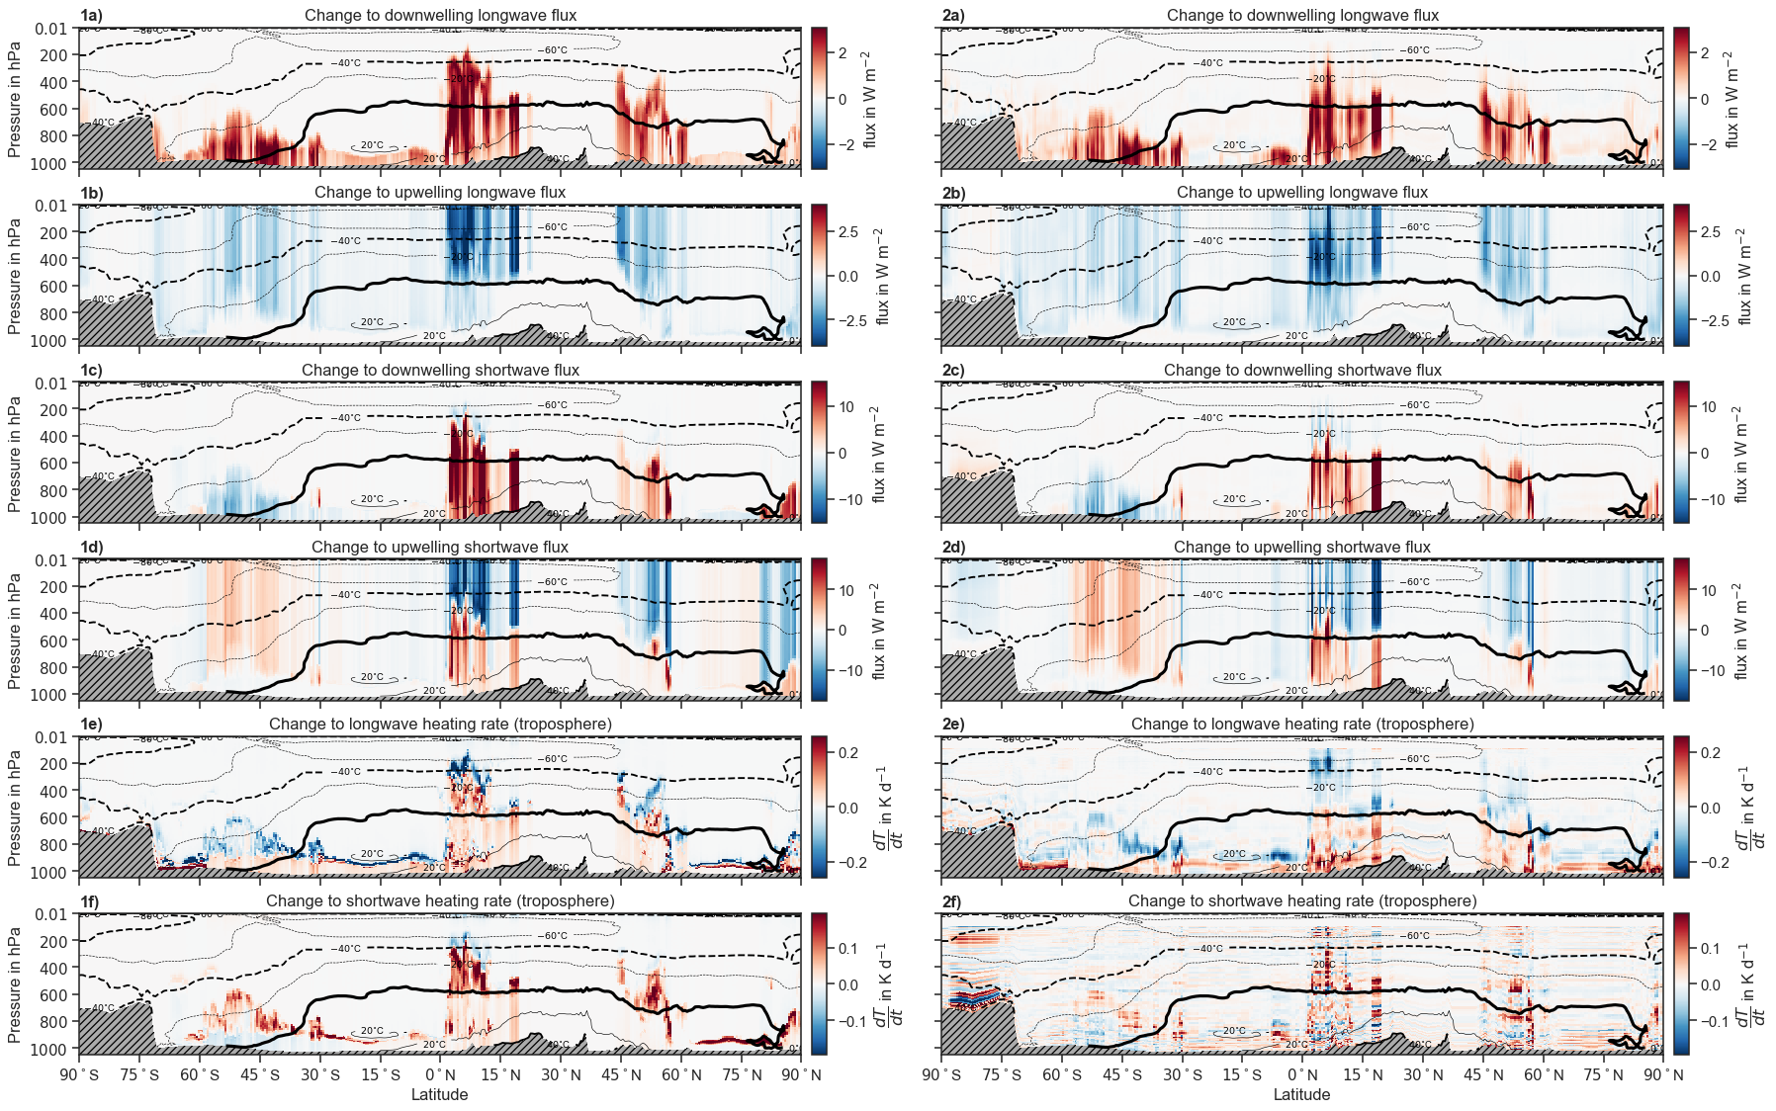
Numerical weather forecasts: To emulate the 3D cloud effects in radiation
To represent 3D cloud effects for radiation (SPARTACUS) within simulations of the Integrated Forecast Model is four time slower than the standard radiation scheme (ecRad)
Can we emulate the difference between ecRad and SPARTACUS using neural networks?
Preliminary results look good.
Relative Compute Cost | ecRad | SPARTACUS | Neural Network | ecRad + Neural Network
CPU single-threaded | 1.0 | 4.4 | 0.003 | 1.003
Meyer, Hogan, Dueben

Slide 14
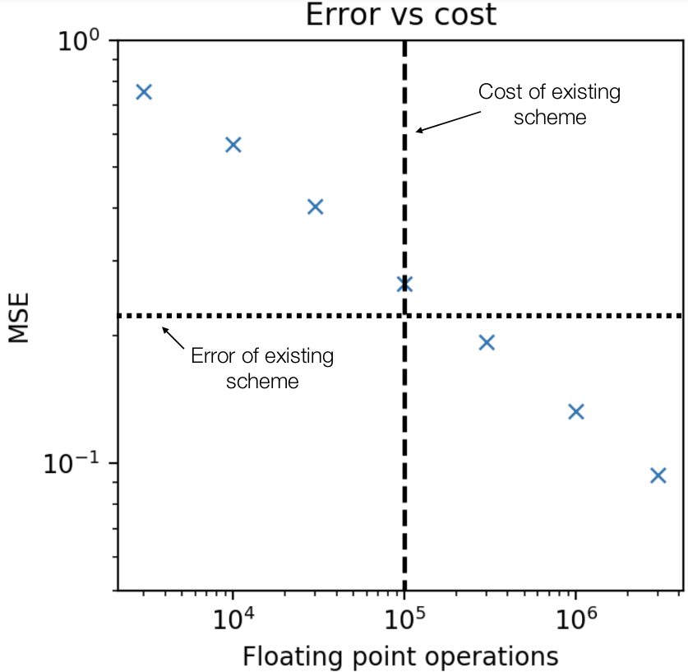
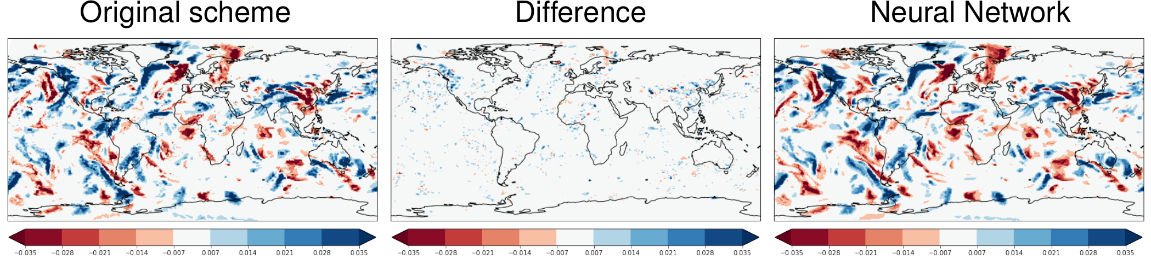
Numerical weather forecasts: To emulate gravity wave drag
Repeat the same approach for the gravity wave drag scheme of IFS
Start with non-orographic and continue with orographic wave drag
Results for the non-orographic gravity wave drag are promising.
There is also a nice relation between network size and accuracy.
However, it is still questionable whether computational performance of the Neural Nets is better when compared to the conventional scheme.
Results are not as good for the orographic gravity wave drag scheme.
The emulator was used successfully to generate tangent linear and adjoint code within data assimilation.
Chantry, Dueben, Palmer

Slide 15
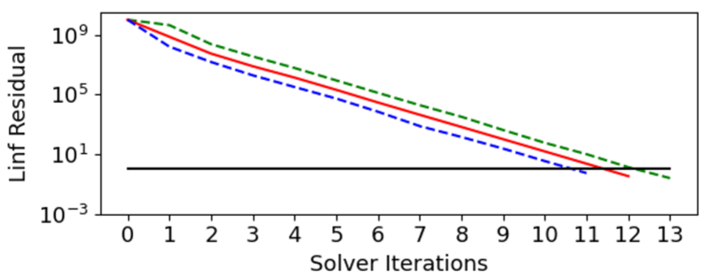
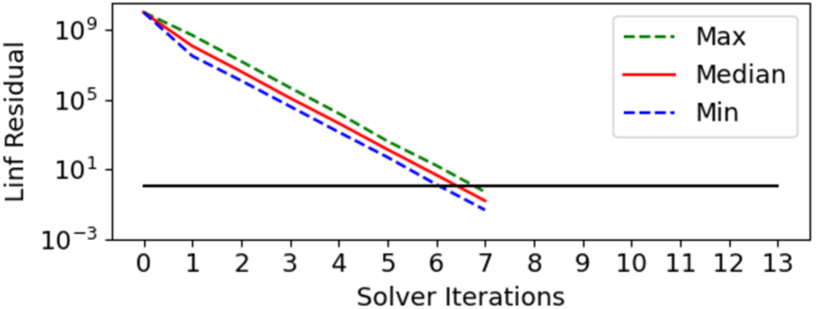
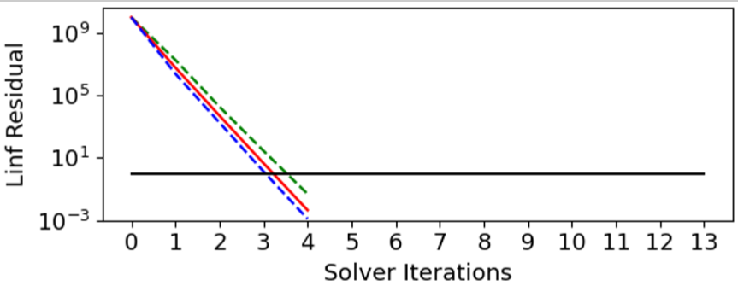
Numerical weather forecasts: To precondition the linear solver
Linear solvers are important to build efficient semi-implicit time-stepping schemes for atmosphere and ocean models.
However, the solvers are expensive.
The solver efficiency depends critically on the preconditioner that is approximating the inverse of a large matrix.
Can we use machine learning for preconditioning, predict the inverse of the matrix and reduce the number of iterations that are required for the solver?
Testbed: A global shallow water model at 5 degree resolution but with real-world topography.
Method: Neural networks that are trained from the model state and the tendencies of full timesteps.
No preconditioner: Machine learning preconditioner: Implicit Richardson preconditioner:
It turns out that the approach (1) is working and cheap, (2) interpretable and (3) easy to implement
even if no preconditioner is present.
Ackmann, Dueben, Smolarkieicz and Palmer https://arxiv.org/abs/2010.02866

Slide 16
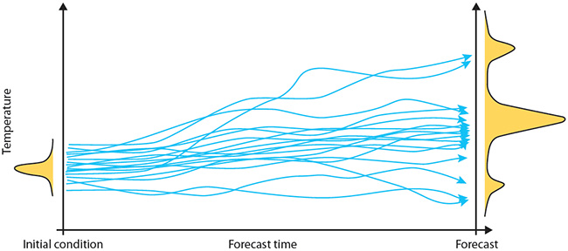
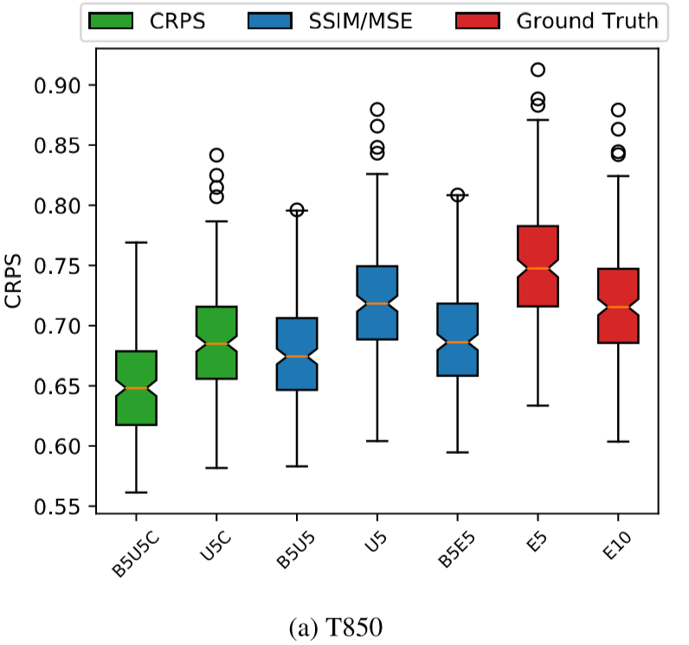
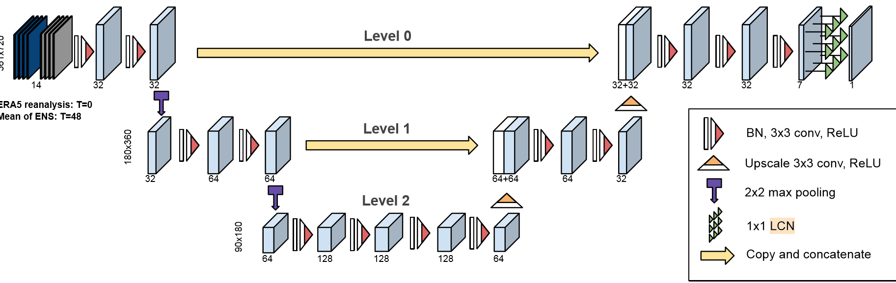
Post-processing and dissemination: Improve ensemble predictions
Ensemble predictions are important but expensive.
Can we improve ensemble skill scores from a small number of ensemble members via deep learning?
Use global fields of five ensemble members as inputs.
Correct the ensemble scores of temperature at 850 hPa and Z500 hPa for a 2-day forecast towards a full 10 member ensemble forecast.
Grönquist, Yao, Ben-Nun, Dryden, Dueben, Lavarini, Li, Hoefler https://arxiv.org/abs/2005.08748

Slide 17
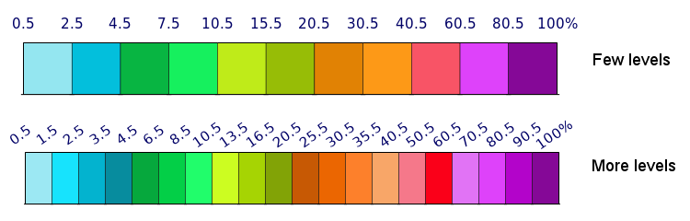
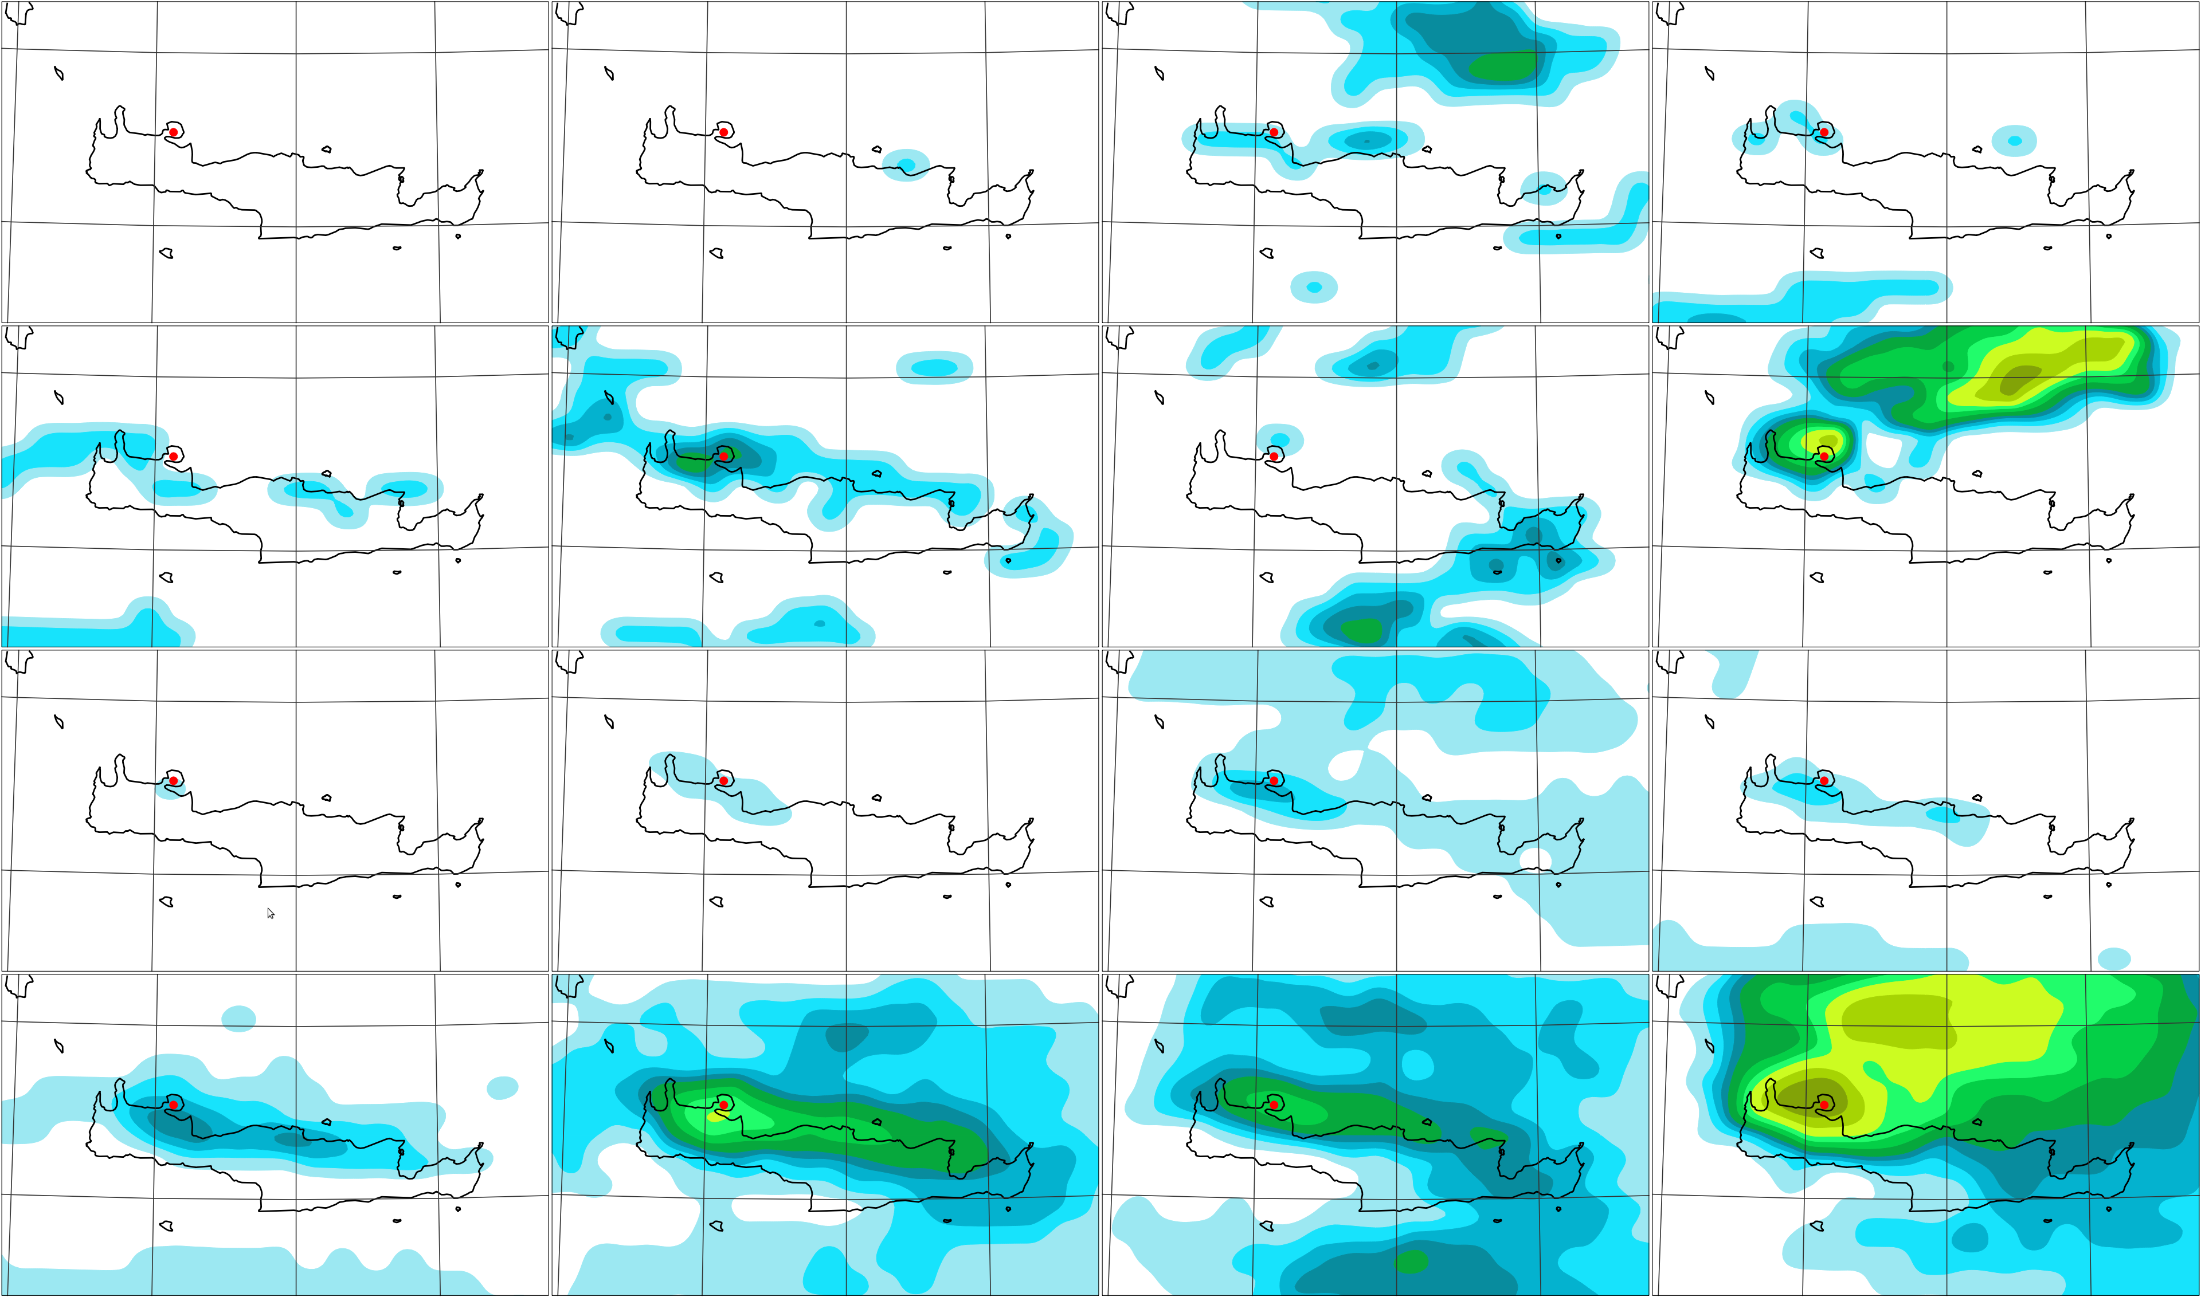
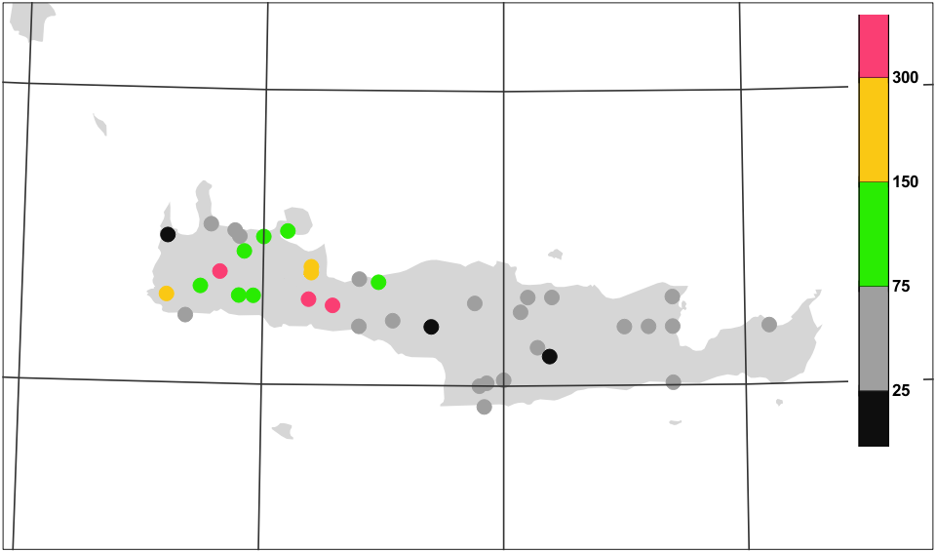

Post-processing and dissemination: ecPoint to post-process rainfall predictions
Use forecast data as inputs
Train against worldwide rainfall observations
Improve local rainfall predictions by accounting
for sub-grid variability and weather-dependent biases
Use decision trees as machine learning tool
Example: Devastating floods in Crete on 25 February 2019
Benefits: Earlier and more consistent signal with higher probabilities
Probability (%) > 50mm /12h
RAW ENSEMBLE
D4
D3
D2
D1
POINT RAINFALL (post-processed)
D4
D3
D2
D1
24h rain
Timothy Hewson and Fatima Pillosu

Slide 18
Some challenges for machine learning for weather and climate predictions
Machine learning and Earth Science domain scientists often follow a different philosophy.
Foster close collaborations / explainable AI / trustworthy AI
Different set of hardware/software tools required for conventional and machine learning developments
Make it easy to get up to speed with the software and provide access to the hardware
Difficult to learn from observations.
Blend data assimilation and machine learning
Data volume and data needs
Understand data needs and develop standard and benchmark datasets (WeatherBench)
Many machine learning applications will require customised machine learning solutions.
Develop customised solutions that are generic / benchmark datasets

Slide 19
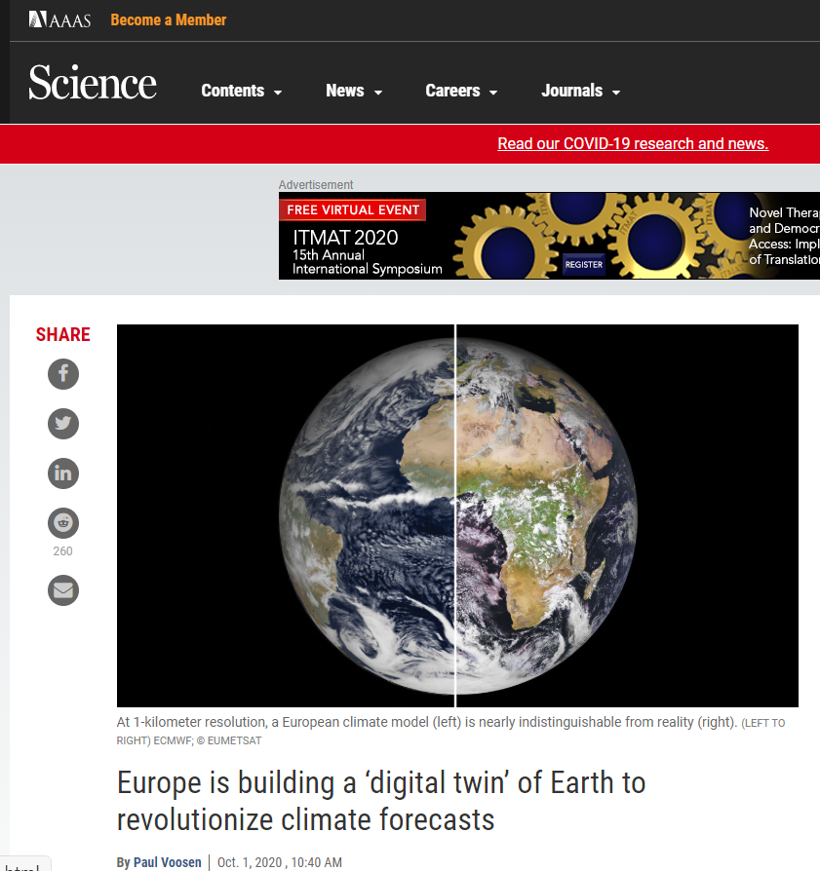

Future of Machine Learning at ECMWF
1. New Center of Excellence in Weather & Climate Modelling between ATOS and ECMWF
+ AMD, Mellanox, Nvidia and DDN
2. ECMWF is developing the European Weather Cloud in collaboration with EUMETSAT.
3. Significant GPU power on the new ECMWF high performance computer via A100 GPUs.
4. Opening of the data archive at ECMWF.
5. Seminar series on Machine Learning in weather and climate science.
6. Destination Earth.

Slide 20

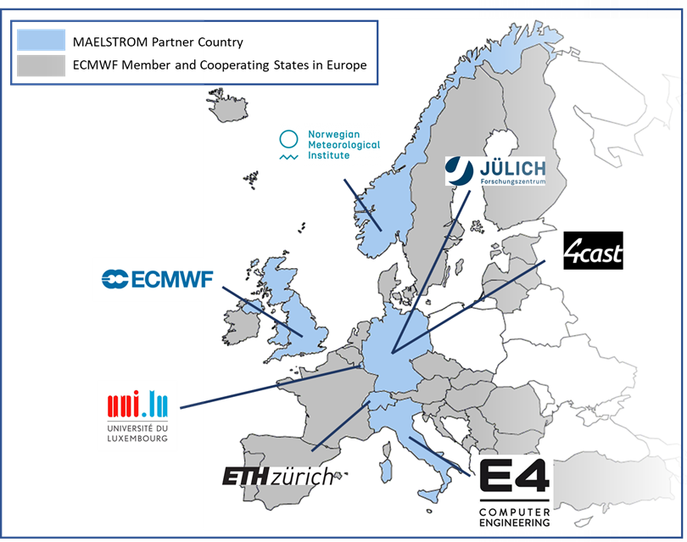
The MAELSTROM Euro HPC JU project to start in April 2021
4m€ project coordinated by ECMWF
7 fantastic partners across Europe
A co-design cycle at its core to optimise high performance computing
for machine learning applications in weather and climate modelling
Compute
system designs
Benchmark
datasets and ML solutions
ML workflow
tools
W&C applications and ML
solution development
Hardware benchmarking
and bespoke system design
Co-design
cycle
ML workflow
and software benchmarking

Slide 21
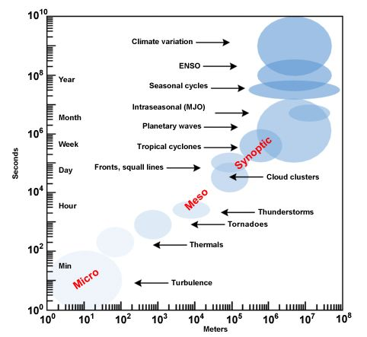
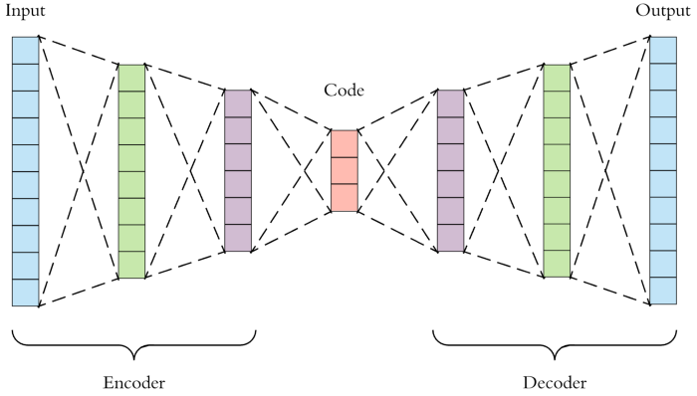
1st domain specific problem: Scale interactions
Weather and climate modelling:
Tools need to allow for scale interactions
Machine learning:
Neural network tools allow for encoding/decoding structures
Source: https://towardsdatascience.com
Source: UCAR
Can we use encoder/decoder networks to represent scale interactions?

Slide 22
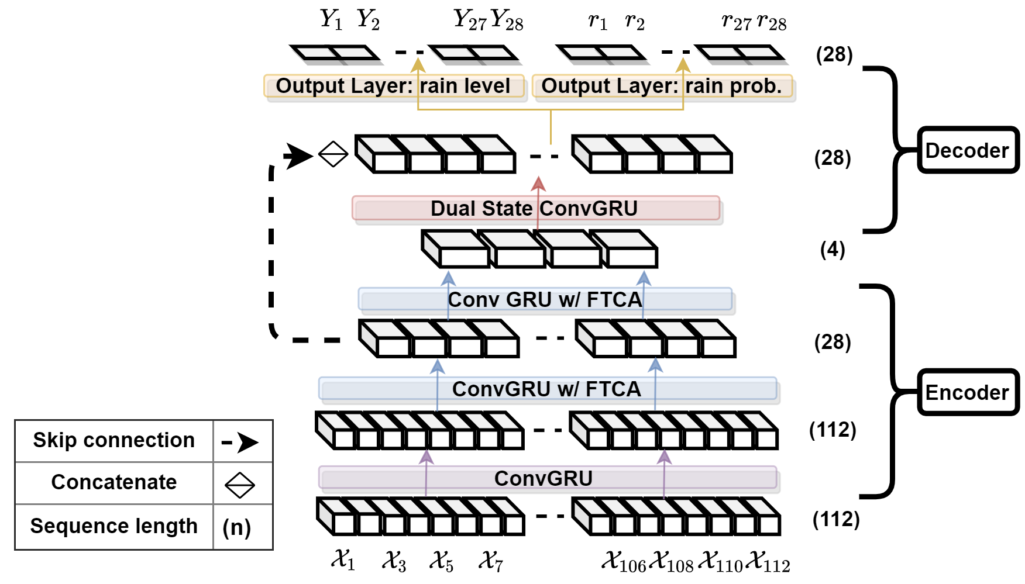
Post-processing and dissemination: Precipitation down-scaling
Problem: Learn to map precipitation predictions from ERA5 reanalysis data at ~50 km resolution to E-OBS local precipitation observations at ~10 km resolution over the UK.
Use case: Eventually, apply the tool to climate predictions to understand changes of local precipitation pattern due to climate change.
Method: Use Tru-NET with a mixture of ConvGru layers to represent spatial-temporal scale interactions and a novel Fused Temporal Cross Attention mechanism to improve time dependencies.
Model | RMSE
IFS within ERA5 | 3.627
Hierarchical Convolutional GRU | 3.266
Tru-Net | 3.081
Adewoyin, Dueben, Watson, He, Dutta http://arxiv.org/abs/2008.09090

Slide 23
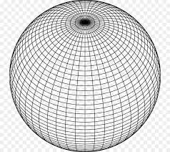
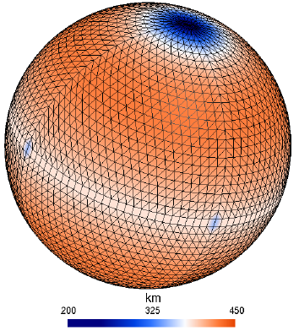
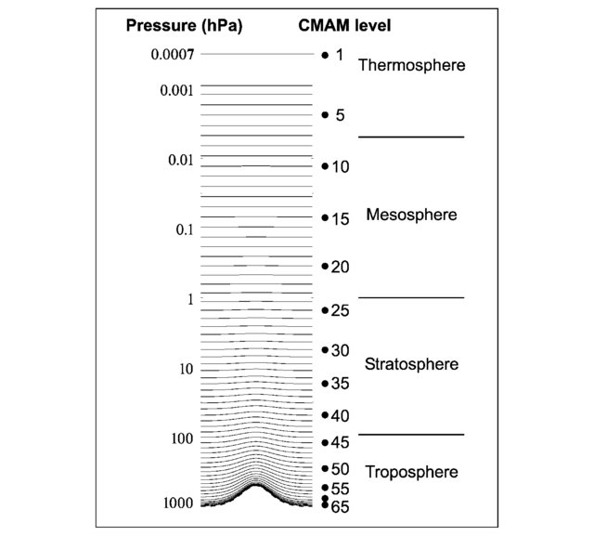
2nd domain specific problem: Multi-scale modelling on unstructured grids
Source: Willem Deconinck
Source: Polavarapu et al. 2005
Longitude/latitude vs. reduced Gaussian cubic octahedral grid
Problem: Find a three-dimensional machine learning solution that work on unstructured grids.
Solution: Maybe Geometric deep learning and Graph Neural Networks,
see Master Thesis of Icíar Lloréns Jover @ EPFL (https://infoscience.epfl.ch/record/278138)

Slide 24
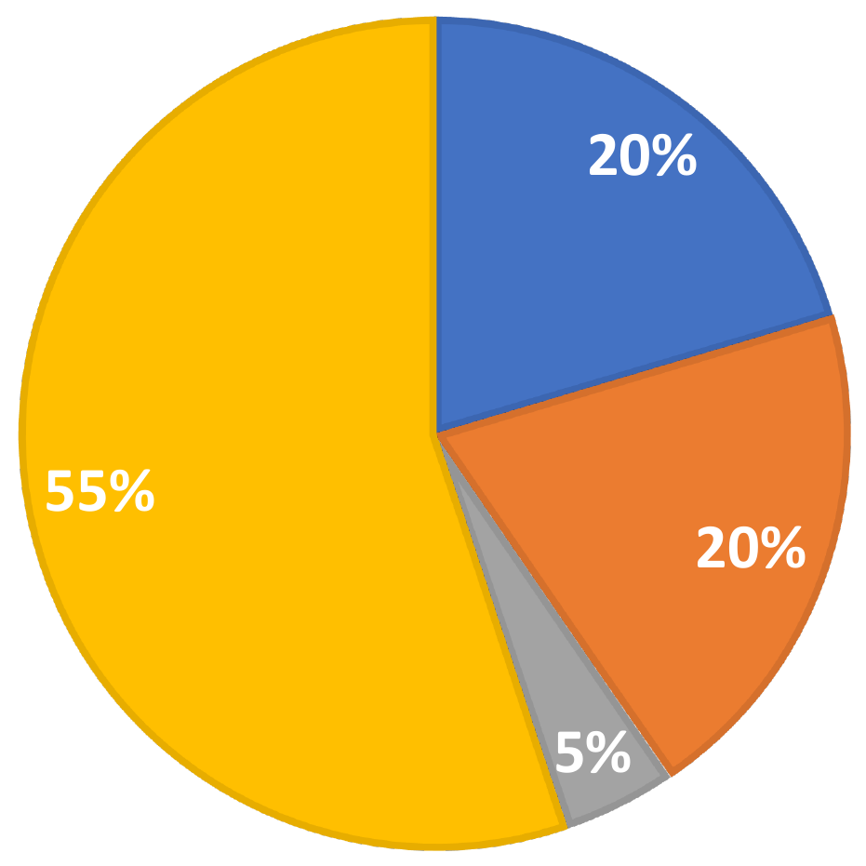
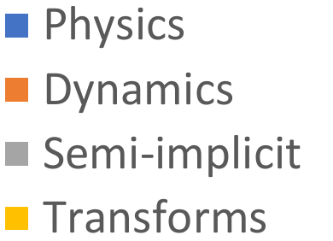
3rd domain specific problem: Use of deep learning hardware for conventional models
Machine learning accelerators are focussing on low numerical precision and high floprats.
Example: TensorCores on NVIDIA Volta GPUs are optimised for half-precision matrix-matrix calculations with single precision output.
→ 7.8 TFlops for double precision vs. 125 TFlops for half precision
Can we use TensorCores within our models?
Relative cost for model components for a non-hydrostatic model at 1.45 km resolution:
The Legendre transform is the most expensive kernel. It consists of a large number of standard matrix-matrix multiplications.
If we can re-scale the input and output ﬁelds, we can use half precision arithmetic.

Slide 25
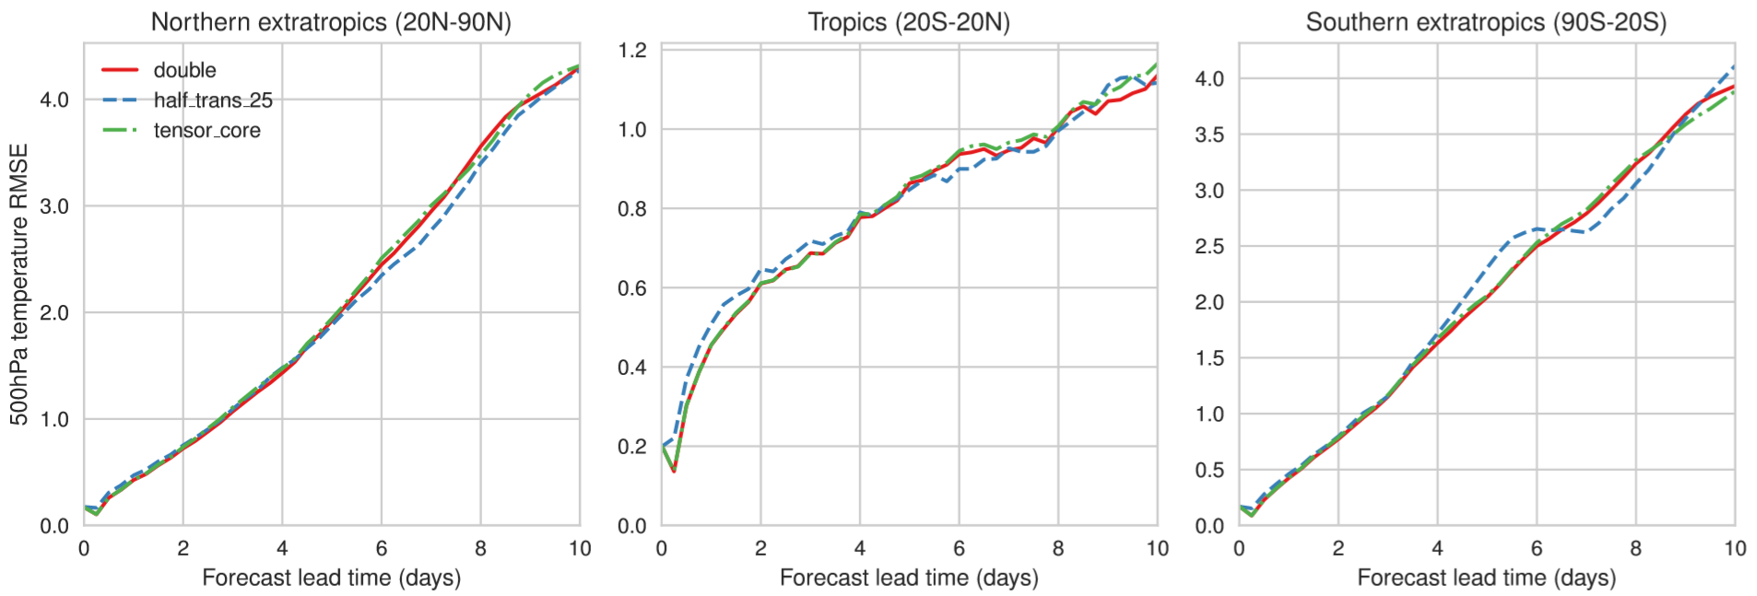
Half precision Legendre Transformations
Root-mean-square error for geopotential height at 500 hPa at 9 km resolution averaged over multiple start dates. Hatﬁeld, Chantry, Dueben, Palmer Best Paper Award PASC2019
The simulations are using an emulator to reduce precision (Dawson and Dueben GMD 2017) and more thorough diagnostics are needed.

Slide 26
Conclusions
There are a large number of application areas throughout the prediction workflow in weather and climate modelling for which machine learning could really make a difference.
The weather and climate community is still only at the beginning to explore the potential of machine learning (and in particular deep learning).
Machine learning could not only be used to improve models, it could also be used to make them more efficient on future supercomputers.
Many thanks! Peter.Dueben@ecmwf.int @PDueben

Slide 27

The strength of a common goal

