Slide 1
OWA Wake Modelling Challenge
Javier Sanz Rodrigo¹, Fernando Borbón Guillén¹, Pedro M. Fernandes Correia¹, Bibiana García Hevia¹, Wolfgang Schlez², Sascha Schmidt², Sukanta Basu³, Bowen Li³, Per Nielsen⁴, Marie Cathelain⁵, Cédric Dall’Ozzo⁶, Laure Grignon⁷, David Pullinger⁷
¹CENER, ²ProPlanEn, ³TU-Delft, ⁴EMD International, ⁵IFP Energies Nouvelles, EDF Renewables, ⁷Lloyd’s Register
IEA Task 31 Wakebench meeting, 17 June 2020
Notes:
1

Slide 2



Open-Source Repositories
Sanz Rodrigo J, Borbón Guillén F, Fernandes Correia P M, García Hevia B, Schlez W, Schmidt S, Basu S, Li B, Nielsen P, Cathelain M, Dall’Ozzo C, Grignon L, Pullinger D (2020) Validation of Meso-Wake Models for Array Efficiency Prediction Using Operational Data from Five Offshore Wind Farms. J. Phys.: Conf. Ser., under review
Sanz Rodrigo, Javier, Borbón Guillén, Fernando, Fernandes Correia, Pedro M., García Hevia, Bibiana, Schlez, Wolfgang, Schmidt, Sascha, … Pullinger, David. (2020). OWA Wake Modelling Challenge Dataset (Version 1.0) http://doi.org/10.5281/zenodo.3715198
Sanz Rodrigo, Javier, Gancarski, Pawel, & Fernandes Correia, Pedro Miguel. (2020, April 28). OWA Wake Modelling Challenge Scripts (Version v2.0.1).
http://doi.org/10.5281/zenodo.3773129
https://github.com/CENER-EPR/OWAbench
Notes:
2

Slide 3

The OWA Wake Modelling Challenge: Objectives
Evaluate wake modelling and power prediction methods and validate the results with measured data.
Examine the accuracy of specific models, quantify uncertainty bands and highlight modelling trends.
Define an open-access model evaluation methodology that can systematically improve consistency and traceability in the assessment of state-of-the-art wake models for power prediction as more datasets are added.
  → Integrate with IEA-Wind Task 31 V&V Framework
https://www.carbontrust.com/offshore-wind/owa/wakes/
Notes:
3

Slide 4
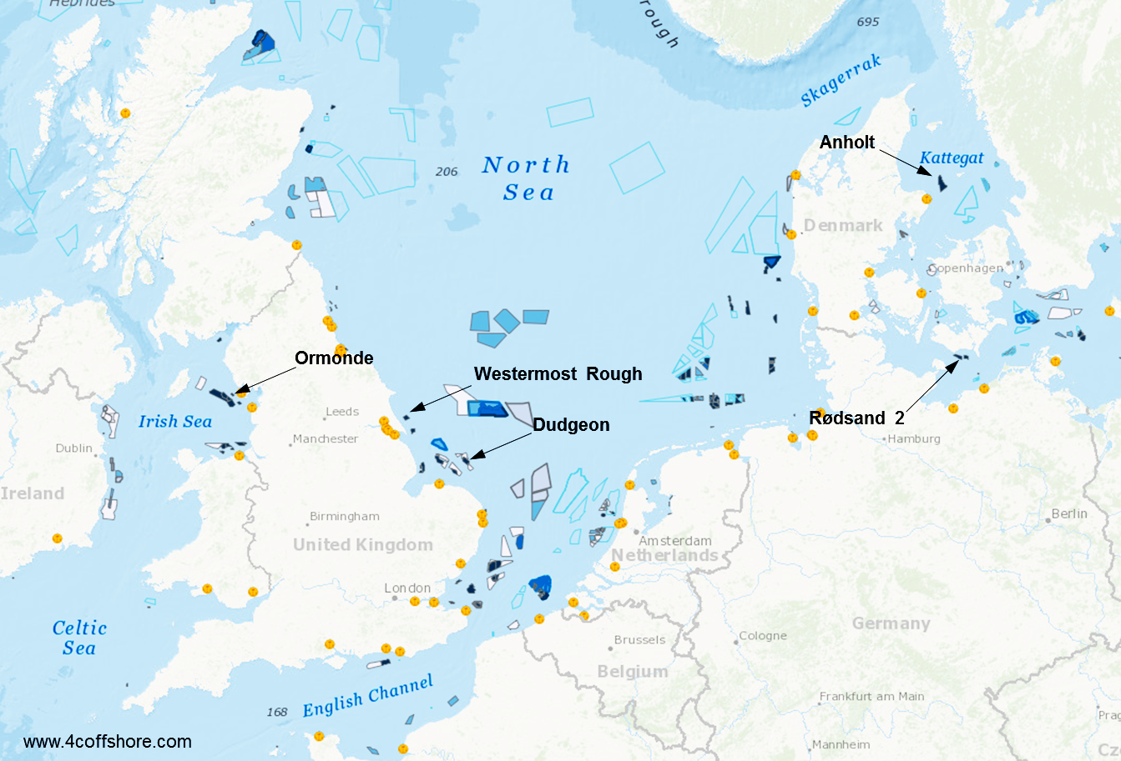
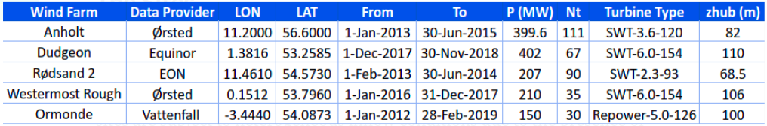
Validation Priorities and Site Selection
Large wind turbines (up to 6 MW) and large offshore wind farm arrays.
Multiple-site evaluation to map performance across diverse wind climates and layout characteristics.
Targeted validation focus on heterogeneous inflow and stability.
Notes:
4

Slide 5
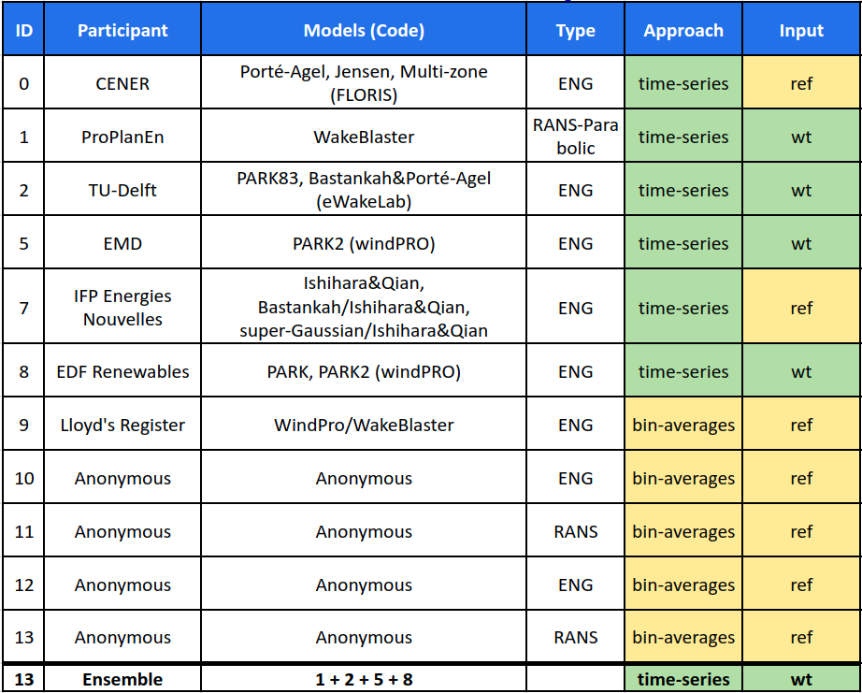
Challenge Participants
Input
ref: homogeneous
wt: heterogeneous
Ensemble = Mean of wt-models
(benchmark to compute bias/mae in the blind test)
Some submissions include several parameterizations of wake models
(40+ simulations/site)
We’ll focus on the results of participants 0 – 8 that submitted all the simulations and follow a time-series approach (which avoids potential errors in the bin-averaging process) and are not anonymous
These participants (0-8) have agreed to include their data in the open-access benchmark repository

Slide 6
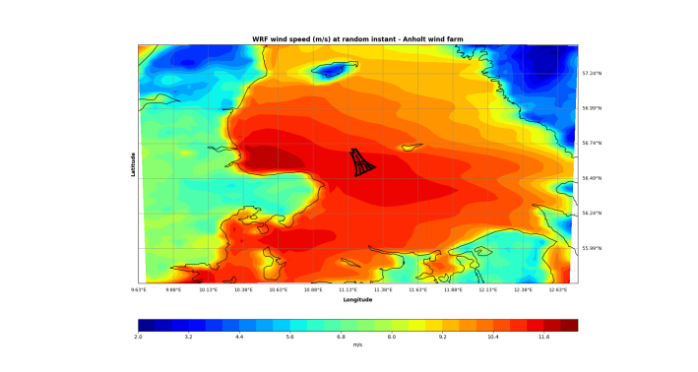
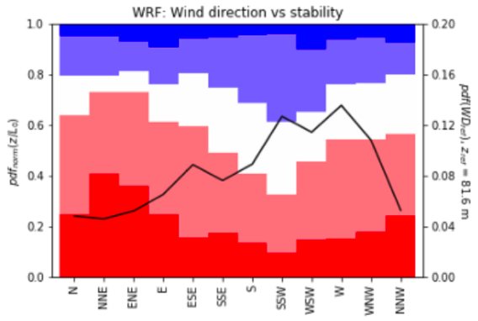

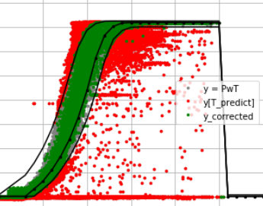

Model Evaluation Methodology
Input data for each turbine from mesoscale simulations following the NEWA WRF set-up (ERA5, MY-NN, 27>9>3 km) + Fitch wind farm parameterization.
Wind conditions classified based on a reference site at the wind farm centroid.
  WD_{ref} in 30º bins (12 sectors)
  8 m/s < S_{ref} < 10 m/s
  Unstable (u): -0.2 < z/L_{ref} < -0.02
  Neutral (n): -0.02 < z/L_{ref} < 0.02
  Stable (s): 0.02 < z/L_{ref} <0.2
Machine-learning based gap-filling to correct observed power data from turbines that are working in non-nominal conditions, i.e. abnormally large deviations from power curve (less than 10% corrected data).
Open-source evaluation script available during the benchmarking process for transparency and collaboration.
https://github.com/CENER-EPR/OWAbench
Notes:
6

Slide 7
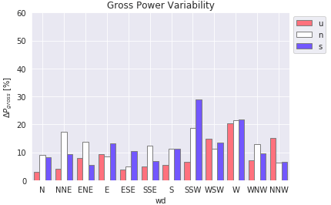
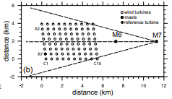
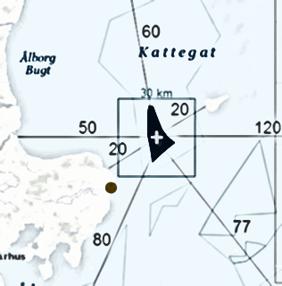
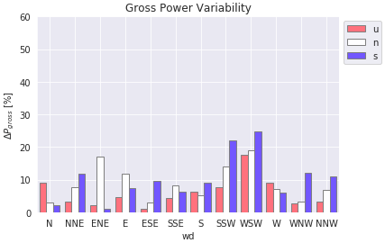
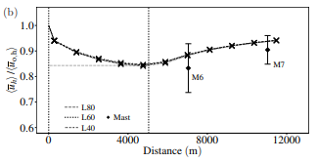
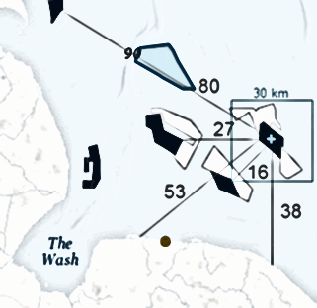
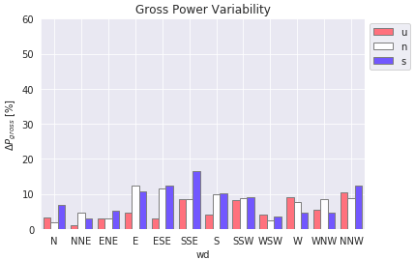
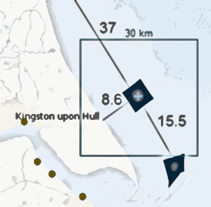
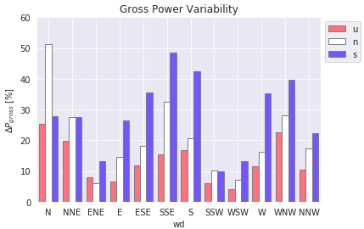
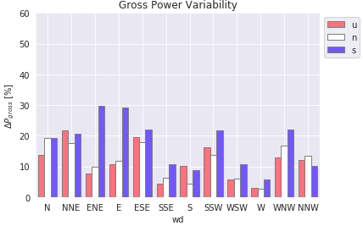
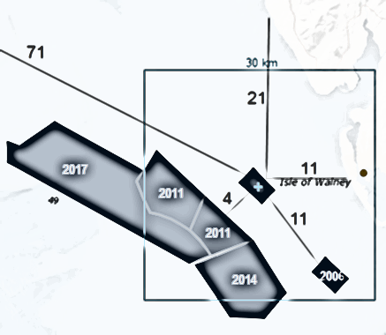
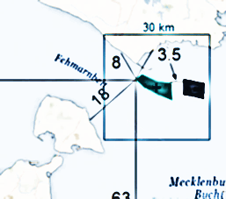
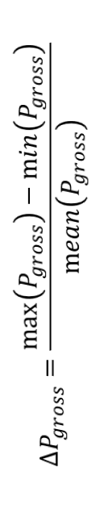
Horizontal Wind Resource Gradients
Large values, of similar magnitude than wake losses
Ormonde and Rødsand 2 gradients questionable being in the near-wake region of upstream wind farms where largest gradients take place
Larger gradients in stable conditions
Anholt
Dudgeon
Westermost Rough
Volker et al (2015)
$$∆P_{gross}=\frac{\max\left(P_{gross}\right)−\min\left(P_{gross}\right)}{\operatorname{mean}\left(P_{gross}\right)}$$
Ormonde
Rødsand 2
Notes:
7

Slide 8
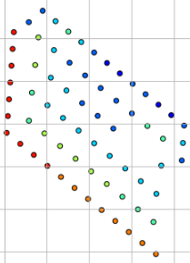
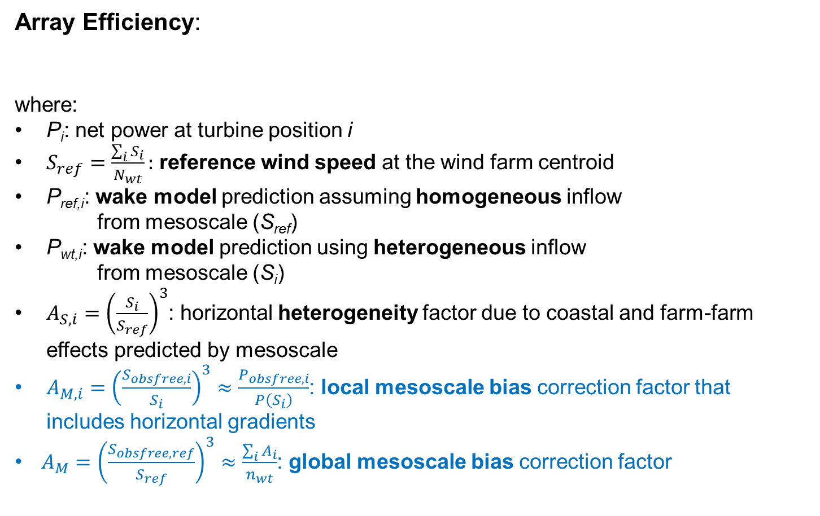
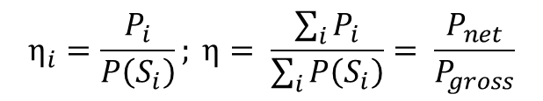

Meso-Wake Framework for Array Efficiency Prediction
$$η_{i}=\frac{P_{i}}{P\left(S_{i}\right)}; η= \frac{\sum_{i}{P_{i}}}{\sum_{i}{P\left(S_{i}\right)}}= \frac{P_{net}}{P_{gross}}$$
Array Efficiency:
where:
P_{i}: net power at turbine position i
$S_{ref}=\frac{\sum_{i}{S_{i}}}{N_{wt}}:$ reference wind speed at the wind farm centroid
P_{ref,i}: wake model prediction assuming homogeneous inflow
from mesoscale (S_{ref})
P_{wt,i}: wake model prediction using heterogeneous inflow
from mesoscale (S_{i})
$A_{S,i}={\left(\frac{S_{i}}{S_{ref}}\right)}^{3}$: horizontal heterogeneity factor due to coastal and farm-farm effects predicted by mesoscale
$A_{M,i}={\left(\frac{S_{obsfree,i}}{S_{i}}\right)}^{3}≈\frac{P_{obsfree,i}}{P\left(S_{i}\right)}$: local mesoscale bias correction factor that includes horizontal gradients
$A_{M}={\left(\frac{S_{obsfree,ref}}{S_{ref}}\right)}^{3}≈\frac{\sum_{i}{A_{i}}}{n_{wt}}$: global mesoscale bias correction factor
{WD,S,I}_{i}
$$P_{i}=P_{ref,i}A_{S,i}A_{M,i}=P_{wt,i}A_{M,i}$$
ref
+
Notes:
8

Slide 9
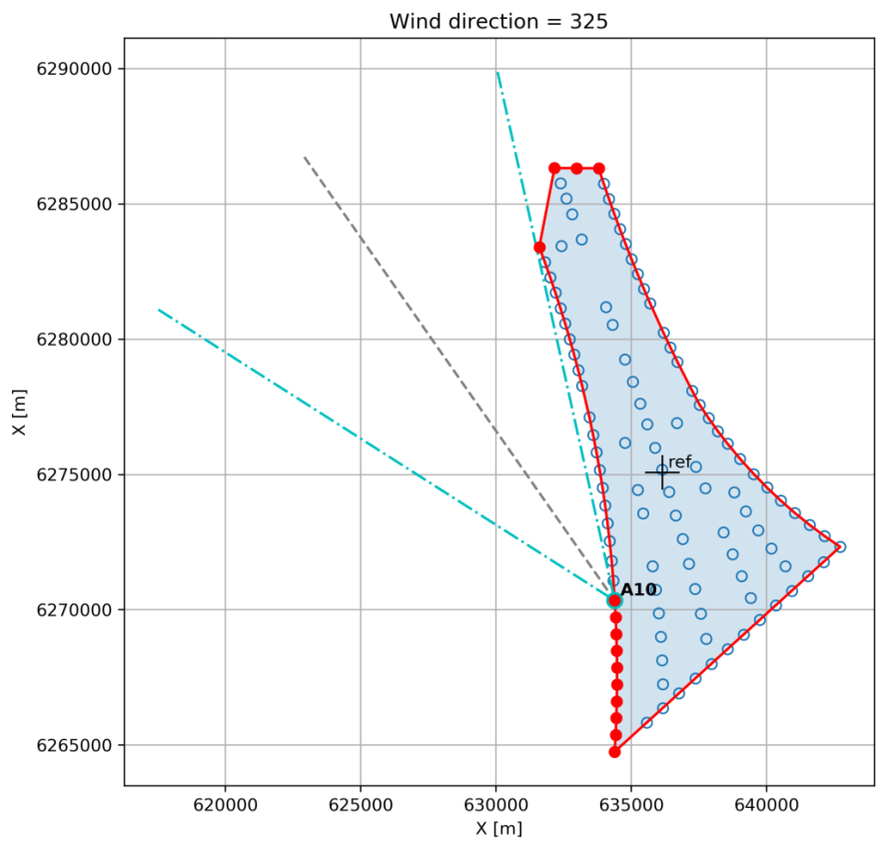
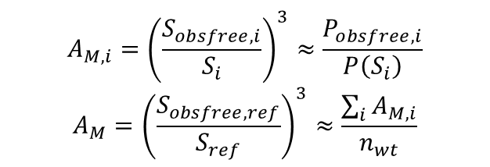
Defining “Free-Stream” Gross Power
Since we don’t have undisturbed measurements of the wind resource (S_{obs}), we obtain the gross power from the freestream turbines (P_{obsfree})
The gross power is derived from the net power and, therefore, is affected by turbine performance, induction effects and potential global blockage effects
Since these effects are present in both the gross and the net power, we can limit their impact in array efficiency and allow a fairer assessment of engineering wake models that, in principle, do not account for these effects
Ray casting algorithm: identifies free-stream turbines depending on wind direction and transfer the gross power to interior turbines through nearest neighbor interpolation
Gross power is converted into “free-stream” wind speed, through the inverse of the theoretical power curve, to derive mesoscale correction factors
$$A_{M,i}={\left(\frac{S_{obsfree,i}}{S_{i}}\right)}^{3}≈\frac{P_{obsfree,i}}{P\left(S_{i}\right)}$$
$$A_{M}={\left(\frac{S_{obsfree,ref}}{S_{ref}}\right)}^{3}≈\frac{\sum_{i}{A_{M,i}}}{n_{wt}}$$
Notes:
9

Slide 10
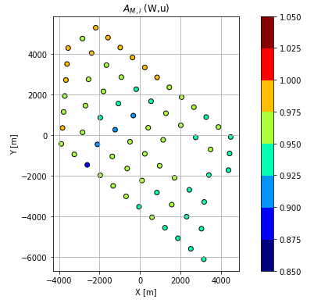
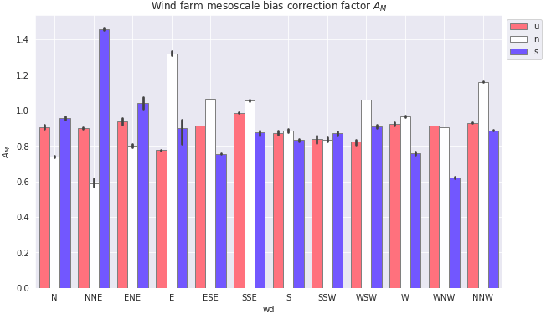
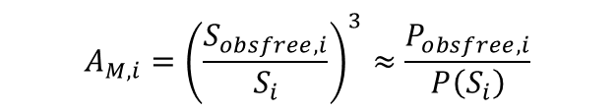
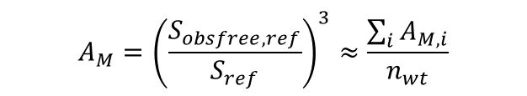
FreeStream Mesoscale Correction Factors (corr input)
$$A_{M,i}={\left(\frac{S_{obsfree,i}}{S_{i}}\right)}^{3}≈\frac{P_{obsfree,i}}{P\left(S_{i}\right)}$$
$$A_{M}={\left(\frac{S_{obsfree,ref}}{S_{ref}}\right)}^{3}≈\frac{\sum_{i}{A_{M,i}}}{n_{wt}}$$
Dudgeon global mesoscale correction = 0.892
Similarly for Anholt (0.971), Ormonde (1.043),
Rødsand 2 (0.885), Westermost Rough (0.991)
These long-term bin-averaged correction factors are used to calibrate the mesoscale wind resource (“corr” input)
These are “climatology” linear corrections so they do not compensate the hour-to-hour bias like scada input does.
TU-Delft could use time series of scada-derived wind resource (S_{obsfree}) to run simulations with the least influence on mesoscale bias (“scada” input)
Notes:
10

Slide 11
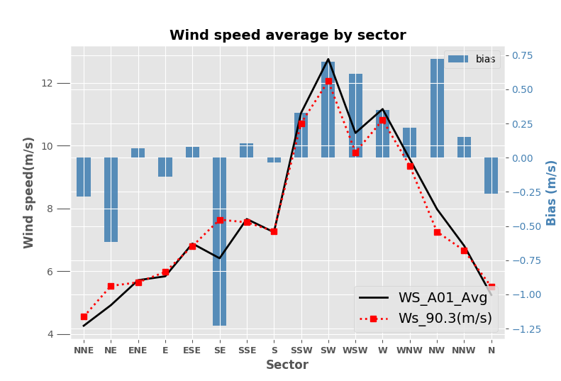
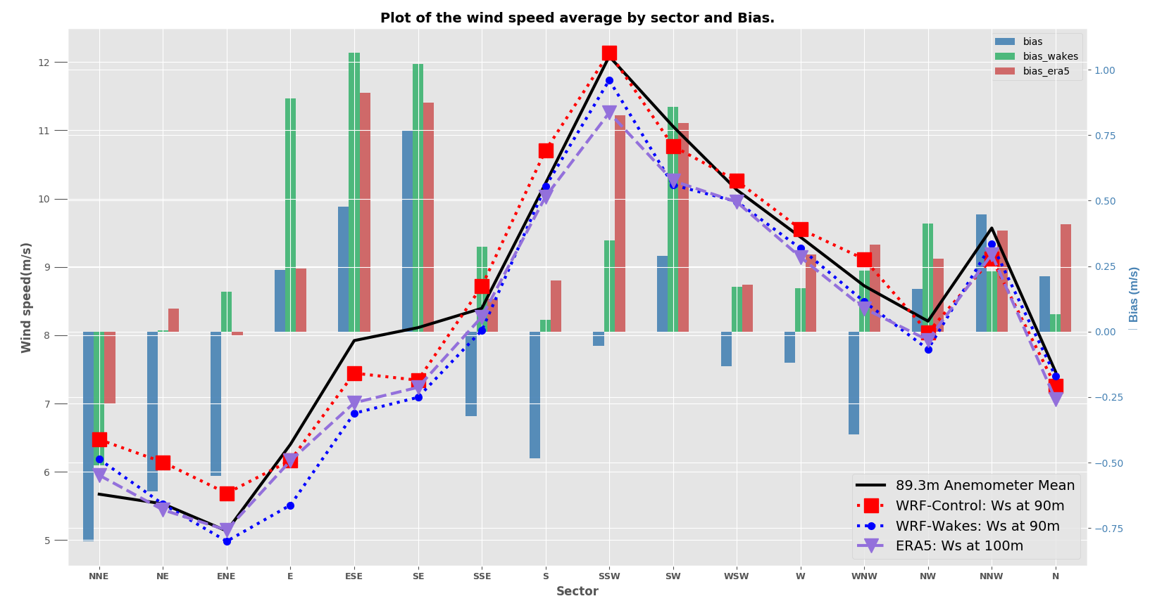
Validation of Mesoscale Winds
Mast measurements from http://www.marinedataexchange.co.uk/
  →They come quality-checked
West Duddon Sands (Data from 2014-2015)
  Near to Ormonde
  90-m mast with wind farm already in operation
  Wake effects from the North
  Assessment of WRF-Wakes, SSE-NW sector:
    Bias = 0,3 m/s, A_{M} = 1,1
    From Ormonde SCADA: A_{M} = 1.095
Race Bank (Data from 2006-2008)
  Near to Dudgeon
  90-m mast pre-construction
  Only wake effects from neighbor wind farms
  Assessment of WRF-Wakes
    Bias = 0,39 m/s, A_{M} = 0.885
    From Dudgeon SCADA: A_{M} = 0.892
+
WDS
Wake-free
+
Notes:
11

Slide 12
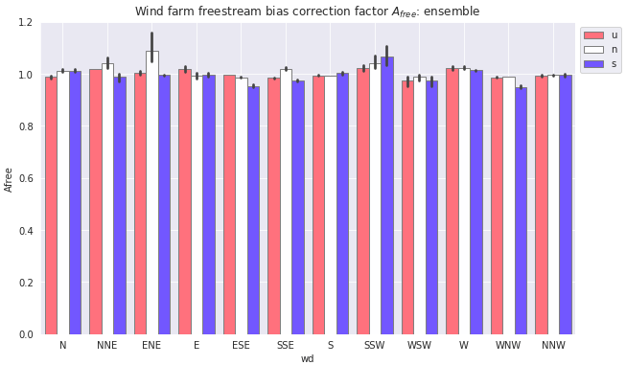
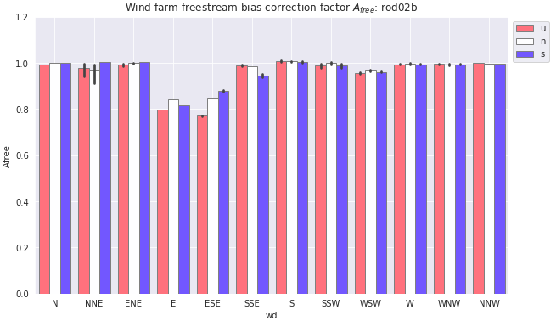
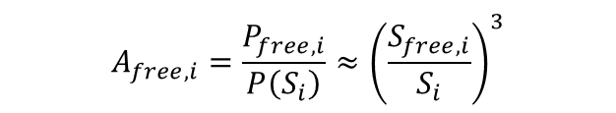
Free-stream Bias in the Gross Power
Using simulation data, we can compare the gross power obtained from the ray-casting method, P_{free}, with the real gross power based on the background wind resource P(S_{i}):
Similarly for Anholt (0.99), Ormonde (1.006) and Westermost Rough (0.991)
$$A_{free,i}=\frac{P_{free,i}}{P\left(S_{i}\right)}{≈\left(\frac{S_{free,i}}{S_{i}}\right)}^{3}$$
Dudgeon: A_{free} = 0.995
Rødsand 2: A_{free} = 0.943
Notes:
12

Slide 13
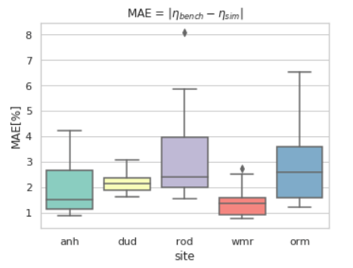
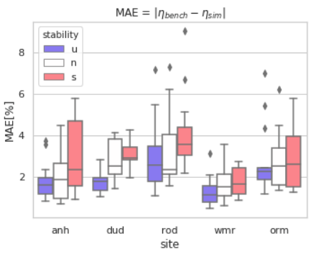
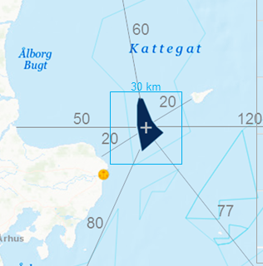
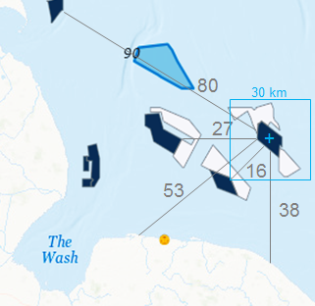
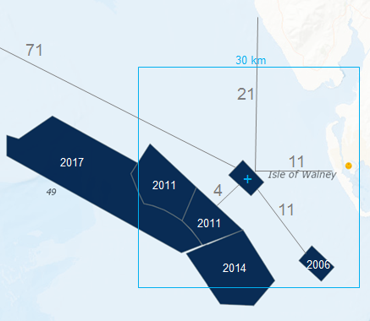
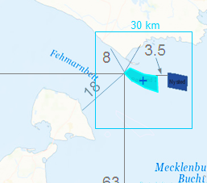
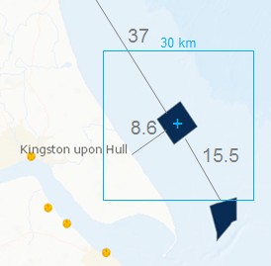
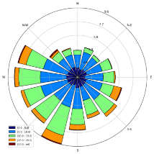
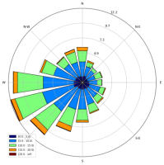
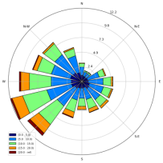
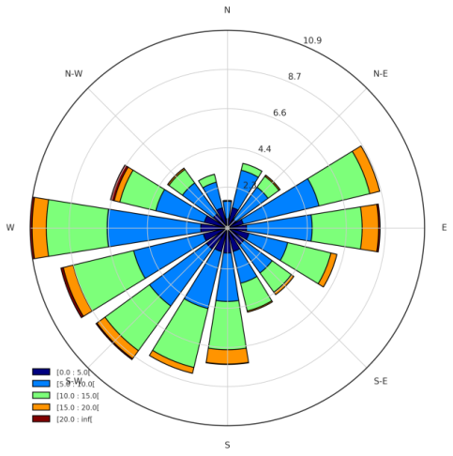

Blind Test Results vs Ensemble: Are models consistent?
Reasonably good consistency between models
Larger spread in sites with farm-farm effects (rod, orm) and large wind farms (anh, rod)
  Challenge: horizontal gradients
Better agreement when there is more mixing (unstable)
  → Challenge: stable conditions
ensemble
Anholt (anh)
Dudgeon (dud)
Ormonde (orm)
Rødsand 2 (rod)
Westermost Rough (wmr)

Slide 14
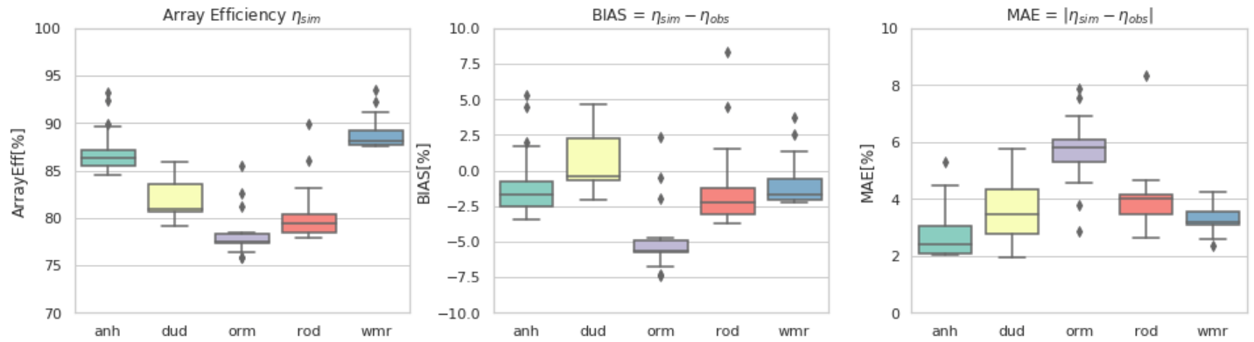
Overall Validation Results: Negative Bias
Tendency towards underestimation of array efficiency. Possible reasons for this are:
  Underestimation of turbulence intensity in mesoscale simulations
  Streamwise gradients in the gross power not captured by the free-stream method and not resolved well by the mesoscale model
  Turbine performance and local interaction effects not captured well by models
Largest deviations in Ormonde where the mesoscale model is not detailed enough to solve farm-farm effects
Anholt (anh)
Dudgeon (dud)
Ormonde (orm)
Rødsand 2 (rod)
Westermost Rough (wmr)

Slide 15
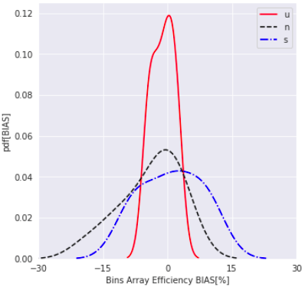
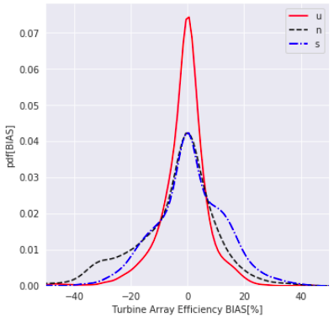
Overall Validation Results: Error Compensation
Compensation of errors between bins and between turbines
Large errors, especially in neutral and stable conditions, limit the capacity of using engineering wake models in wind farm design optimization
Note that, by definition, we impose zero bias at the freestream turbines
Distribution of errors at Dudgeon with the ensemble model

Slide 16
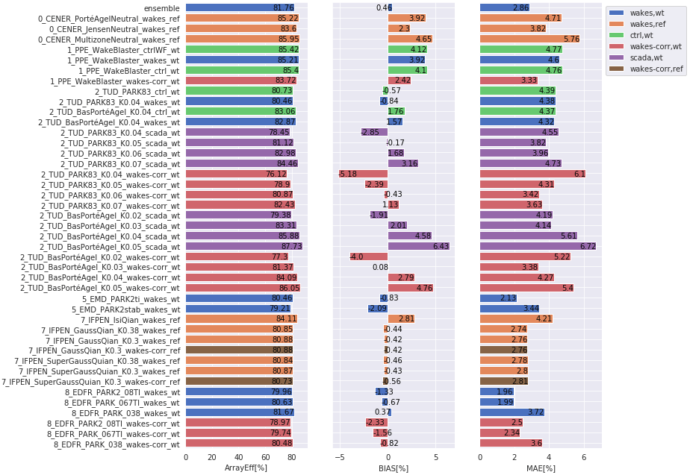
Dudgeon: Overall Metrics
Mesoscale bias correction does not affect ref models array efficiciency prediction but its performance seems to be model-dependent for wt models.
Comparing TUD results scada and wakes-corr we can see that it is around 2% off
- Calibration through the wake decay coefficient.
- BP model more sensitive than PARK model
- Two users of the same code come up with differences of up to 2% depending on how the input is interpreted (WDC dependency on turbulence intensity). Sign of robustness in the model
Dudgeon (dud)
Notes:
16

Slide 17
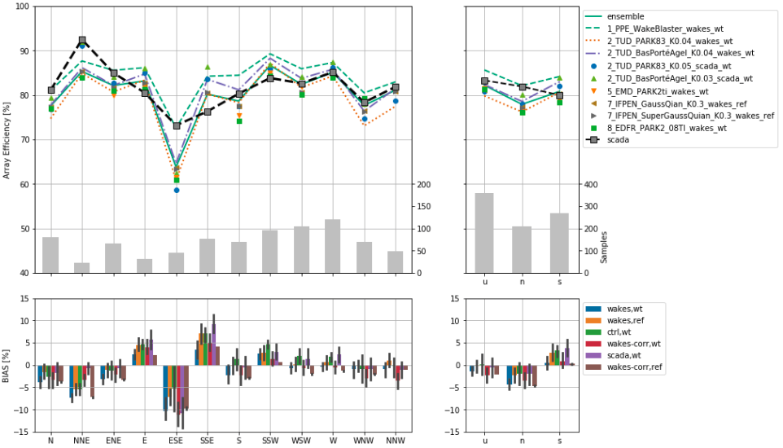
Dudgeon: Metrics by Wind Direction and Stability
Low quality validation bins in the NNE-ESE sectors
Weak dependency on stability not camptured by models
Notes:
17

Slide 18
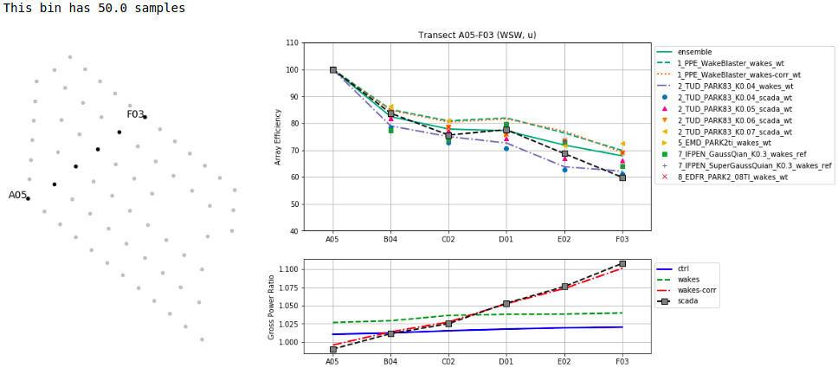



Dudgeon: WSW Transect
We can see how, eventhough the 10% power increase along the transect, array efficiency is not depending on the input and we can then focus on the wake loss effect
Notice the effect of increasing the wake decay coefficient in TUD_PARK83
Little dependency on stability
$$η_{i}=\frac{P_{i}}{P_{gross,i}}$$
$${GPR}_{i}=\frac{P_{gross,i}}{P_{gross,ref}}$$
Notes:
18

Slide 19

Anholt: Overall Metrics
Negative bias apparent
As in Dudgeon, corr input is neutral for IFPEN, positive for PPE and negative for TUD or EDPR models
Notes:
19

Slide 20

Anholt: Metrics by Wind Direction and Stability
Good performance in general
Good agreement between the results of EMD and EDFR with PARK2
Good results of FLORIS/Jensen eventhough no stability is considered
Notes:
20

Slide 21




Anholt: WSW Transect
Good match in the gross power
Reasonably good results
Spike at F25 captured by Wakeblaster
Not that much dependency on stability, except for F27-F26 that show lower array efficiency which is not captured by models
$$η_{i}=\frac{P_{i}}{P_{gross,i}}$$
$${GPR}_{i}=\frac{P_{gross,i}}{P_{gross,ref}}$$
Notes:
21

Slide 22

Westermost Rough: Overall Metrics
Good results with low scatter between models
Wakeblaster tends to provide positive bias while the others cluster more towards negative bias
Notes:
22

Slide 23

Westermost Rough: Metrics by Wind Direction and Stability
Wakeblaster shows better directional performance
Low variability in observed array efficiency indicative of well mixed conditions, which is not well reproduced by the engineering models
Notes:
23

Slide 24



Westermost Rough: WSW Transect
Good performance by Wakeblaster in stratified conditions and by the other models in neutral conditions
Fully-alighned transect results in underestimation of array efficiency. Maybe the models are not representing well the smoothing effect on the power deficit due to mixing by turbulent wind direction variability (meandering, yaw missalignment effects, etc)
Small variation due to stability
$$η_{i}=\frac{P_{i}}{P_{gross,i}}$$
$${GPR}_{i}=\frac{P_{gross,i}}{P_{gross,ref}}$$
Notes:
24

Slide 25



Westermost Rough: ENE Transect
Best performance and smalest scatter in neutral conditions
Large drop in the second turbine (E03) in stable conditions well captured by the models but then they tend to underpredict (too low mixing?)
Mind the low sample count in unstable and stable conditions
$$η_{i}=\frac{P_{i}}{P_{gross,i}}$$
$${GPR}_{i}=\frac{P_{gross,i}}{P_{gross,ref}}$$
Notes:
25

Slide 26

Rødsand 2: Overall Metrics
Better results when Rødsand 2 and Nysted are both simulated at microscale (ctrlNysted) with PARK-type models whyle Wakeblaster does a bit better by simulating Rødsand 2 alone at microscale (wakes)
The mesoscale correction is clearly introducing a bias
Notes:
26

Slide 27

Rødsand 2: Metrics by Wind Direction and Stability
Wakeblaster shows a systematic overprediction
Coastal and farm-farm sectors problematic (large gradients), otherwise relatively good results
Notes:
27

Slide 28



Rødsand 2: W Transect
Large scatter
Best performance in neutral conditions
Observations show more apparent deep array effects towards stable conditions (constant array efficiency in the last turbines) while models a show monotonic decrease.
$$η_{i}=\frac{P_{i}}{P_{gross,i}}$$
$${GPR}_{i}=\frac{P_{gross,i}}{P_{gross,ref}}$$
Notes:
28

Slide 29

Ormonde: Overall Metrics
Better results with Wakeblaster with similar results when simulating all the cluster at microscale or just simulating Ormonde
Large bias otherwise, even using scada data as input
TUD calibration points to higher K values than in Dudgeon. Maybe not realistic
Notes:
29

Slide 30

Ormonde: Metrics by Wind Direction and Stability
Slightly better results with Wakeblaster simulating the whole cluster at microscale
Otherwise, systematic underprediction
Notes:
30

Slide 31



Ormonde: WSW Transect
Very uncertain inflow conditions
  wakes simulation shows first two rows in the near-wake of large cluster
  Streamwise gradients not captured in the scada/wakes-corr gross power
Low dependency on stability
Small differences in Wakeblaster between simulating the cluster at microscale or at mesoscale
$$η_{i}=\frac{P_{i}}{P_{gross,i}}$$
$${GPR}_{i}=\frac{P_{gross,i}}{P_{gross,ref}}$$
Notes:
31

Slide 32


Multi-Site Assessment
Simulations without mesoscale correction (input = ctrl for anh, wakes for the rest)
Aggregated errors show tendency towards negative bias
  Wakeblaster shows positive bias while PARK or Gaussian models show negative bias
Ensemble (PPE+TUD+EMD+EDFR) showing the lowest MAE
Notes:
32

Slide 33
Conclusions
Validation of array efficiency (wake losses) requires good assessment of the gross power, otherwise the assessment can be “contaminated” by the presence of wind resource gradients which can be as large as the wake losses themselves
By defining the gross power from the freestream turbines we limit the influence of induction and transversal wind resource gradients.
Tendency towards underestimation of array efficiency (except for Wakeblaster). Possible reasons for this are:
  Underestimation of turbulence intensity in mesoscale simulations
  Streamwise gradients in the gross power not captured by the free-stream method and not resolved well by the mesoscale model
  Turbine performance and local interaction effects not captured well by models
Largest deviations in Ormonde where the mesoscale model is not detailed enough to solve farm-farm effects. This brings high uncertainty to the assessment of array efficiency
Error compensation at bin and turbine levels is large, where errors larger than 20% are frequent. This limits the capacity of using engineering models in wind farm optimization
Mesoscale calibration useful to reduce net power bias but requires further iterations with the wake model to remove the influence on array efficiency.
Sensitivity analysis with TUD models shows how the wake decay coefficient remains the main parameter to tune engineering wake models. Calibration is model-specific of course.
Notes:
33

Slide 34

www.cener.com
Notes:
34
34

