Slide 1


igraph
@igraph2
The network analysis package
Szabolcs Horvát, Tamás Nepusz, Vincent Traag, Fabio Zanini, Gábor Csárdi

Slide 2
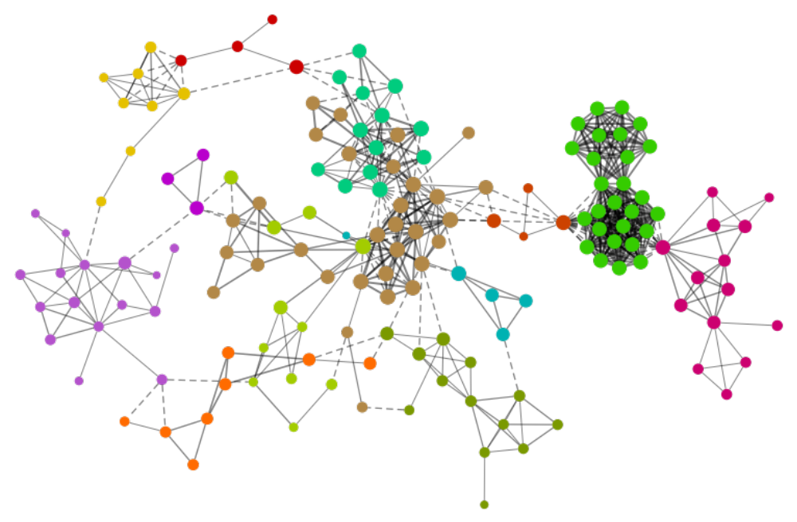
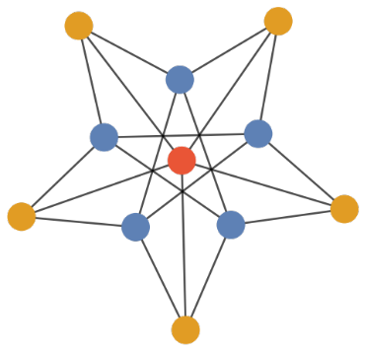
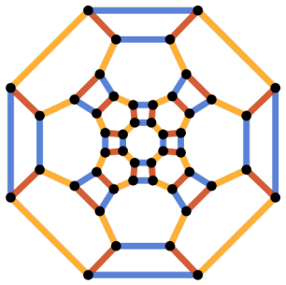
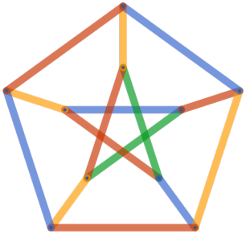
What is igraph? — igraph.org
A general purpose software package for:
Network science
Graph theory
Notes:
high performance

Slide 3
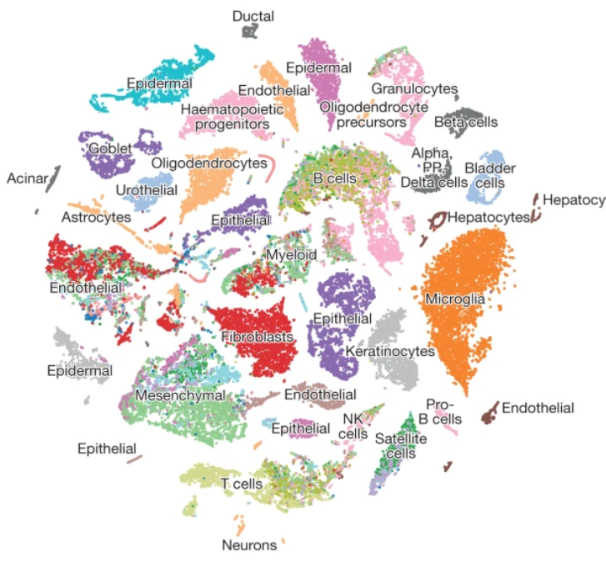
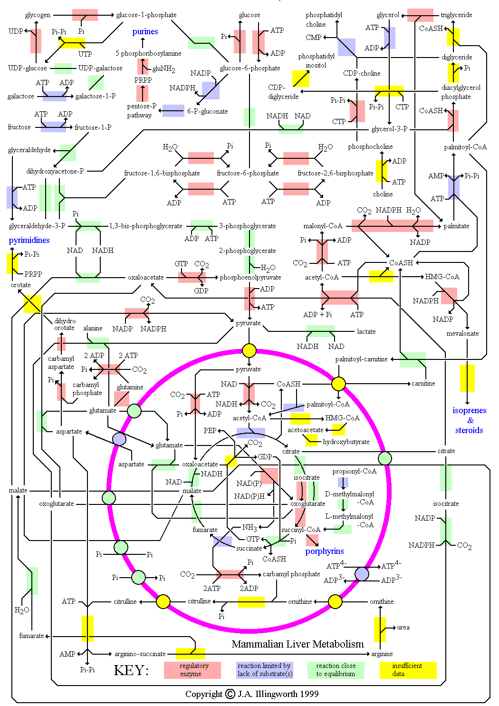
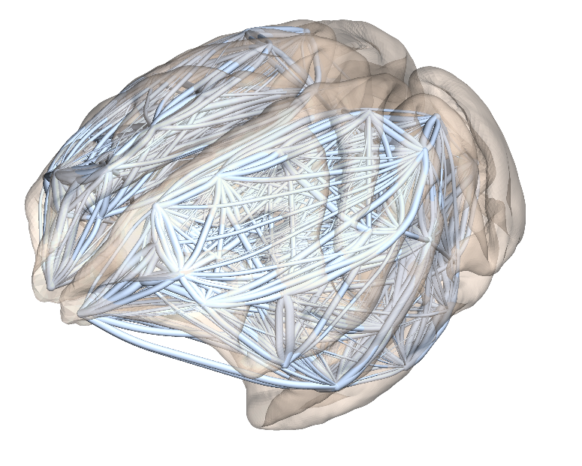
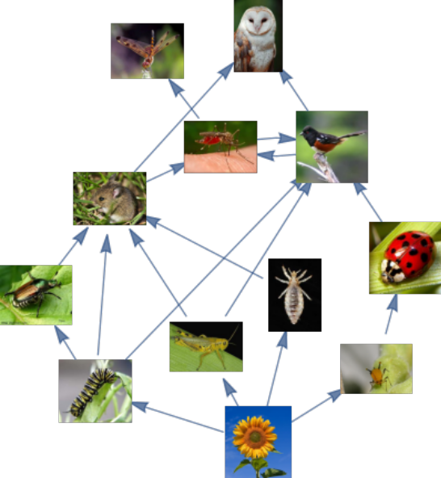
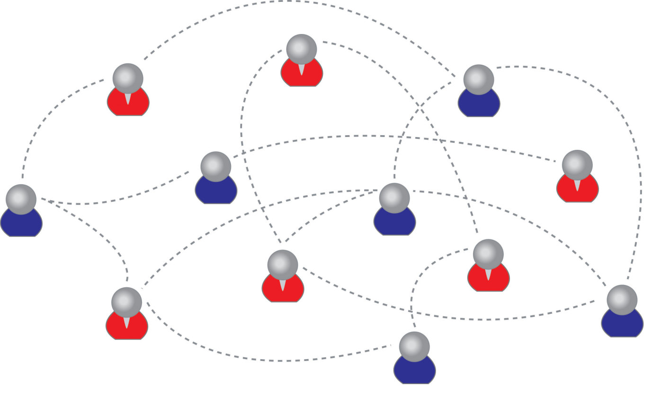
metabolic network
gene expression
similarities
neural connections
food web
social contacts
vascular network

Slide 4
Who uses igraph?
7033 citations on Google Scholar (1430 in 2020)
python-igraph: 141 dependents on GitHub
R igraph: 825 dependents on CRAN
CZI EOSS: Seurat, ScanPy

Slide 5



igraph architecture
works on all major platforms (Mac/Linux/Win)
graph representation | core API
algorithms | C language API
IGraph/M
(for Mathematica)
igraph
R package
python-igraph

Slide 6
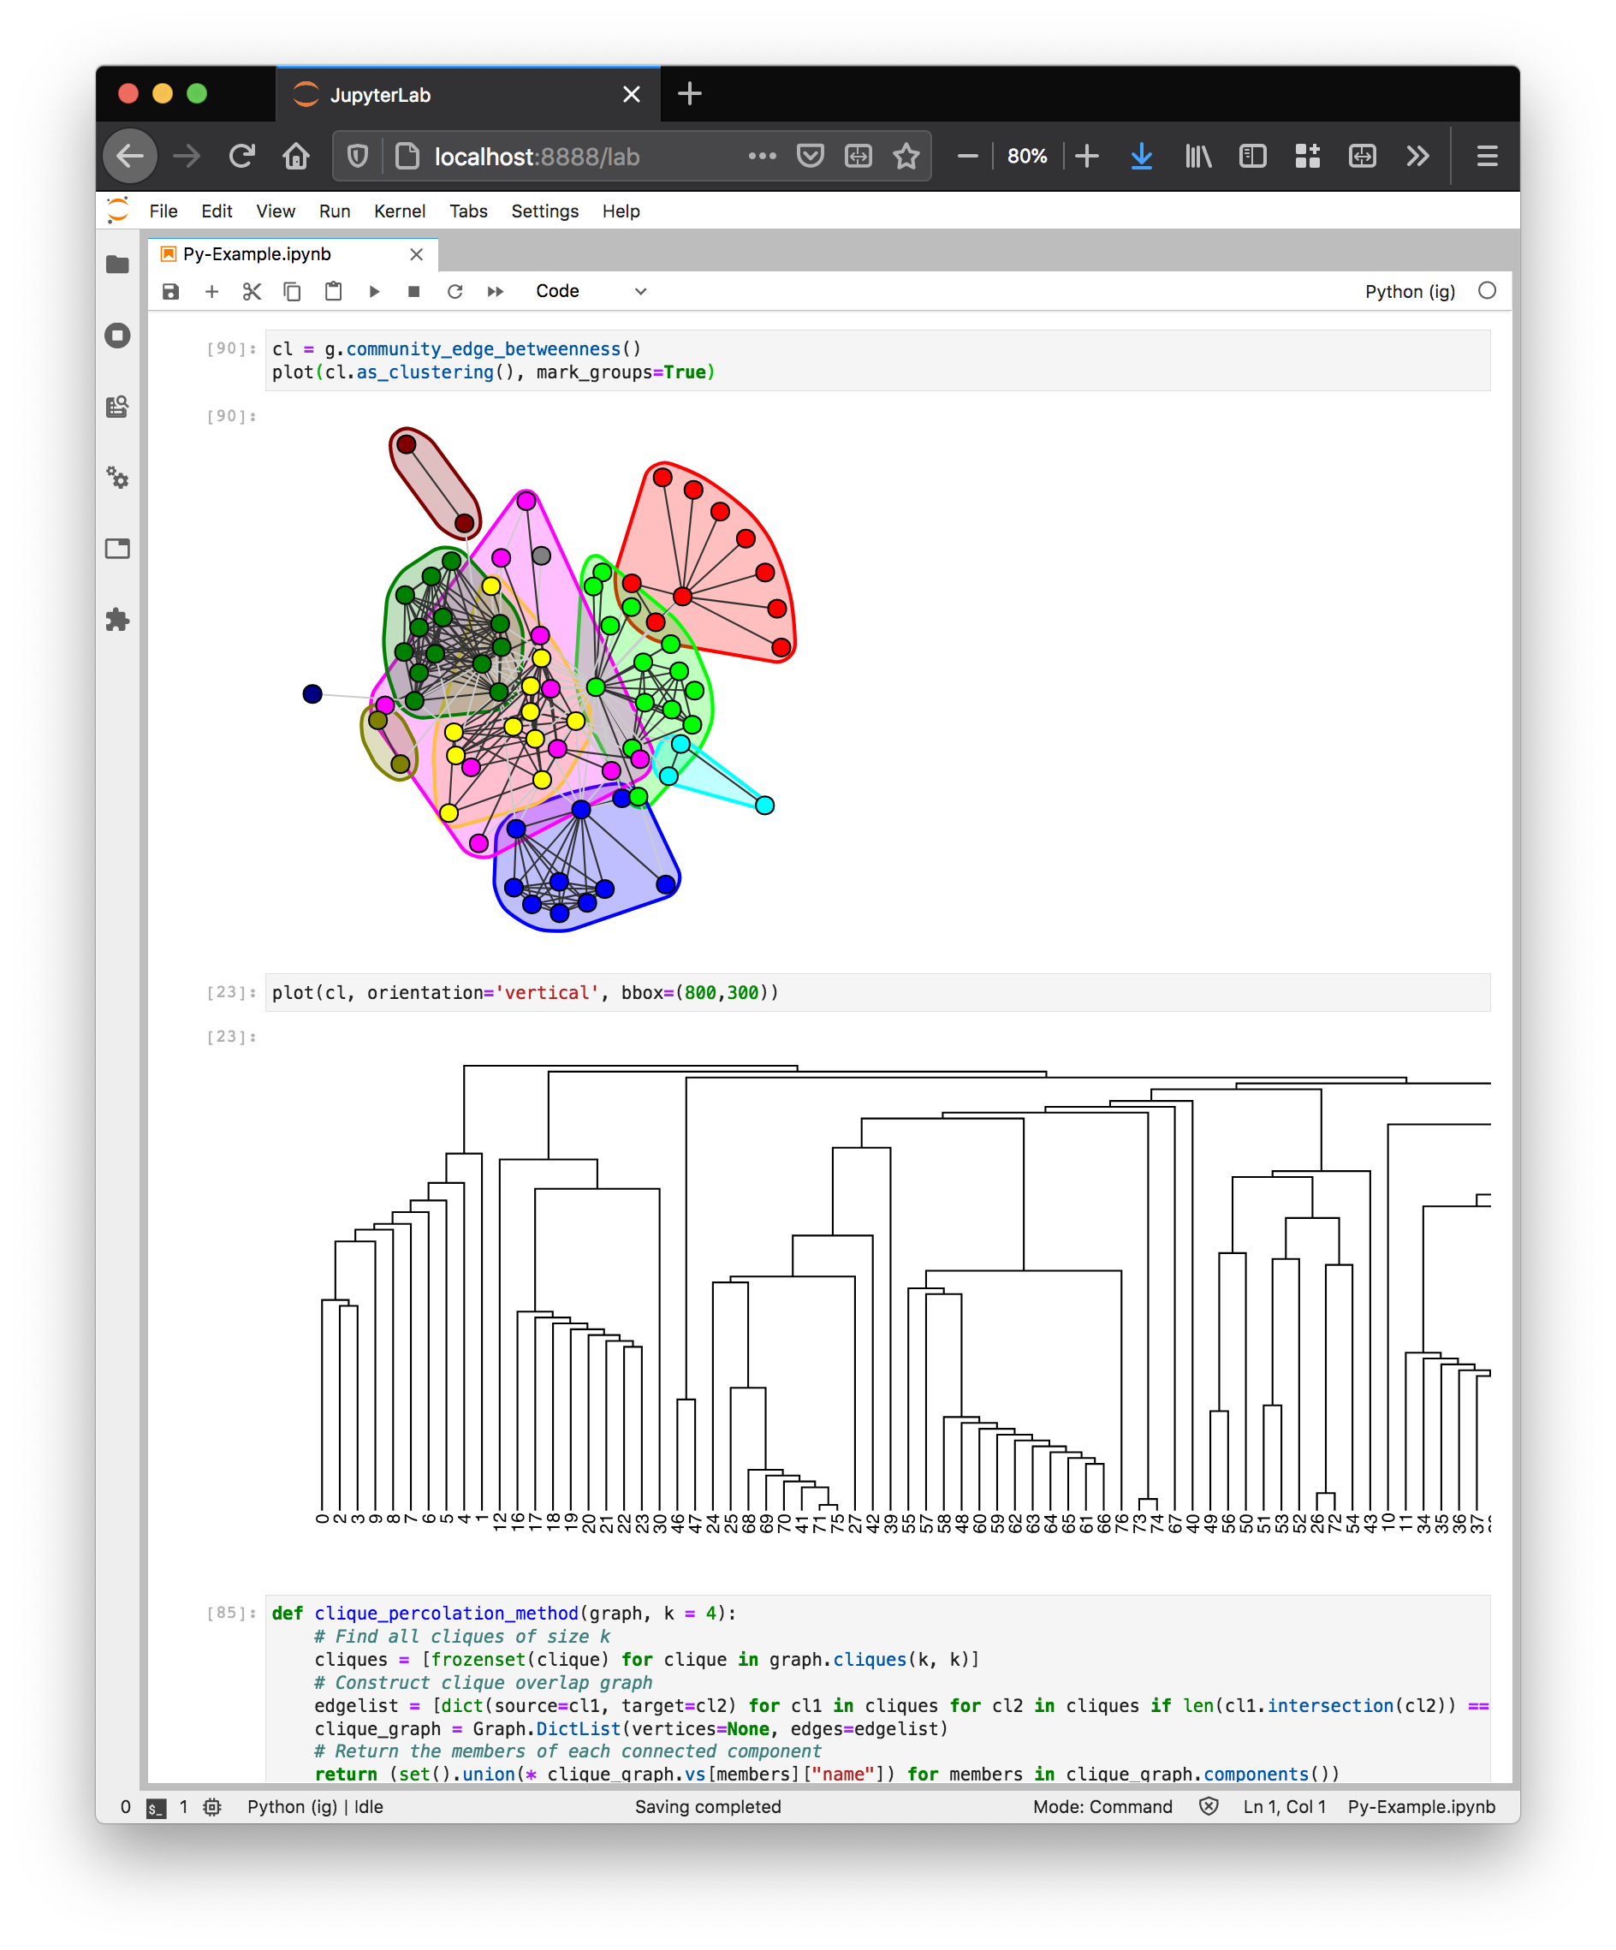
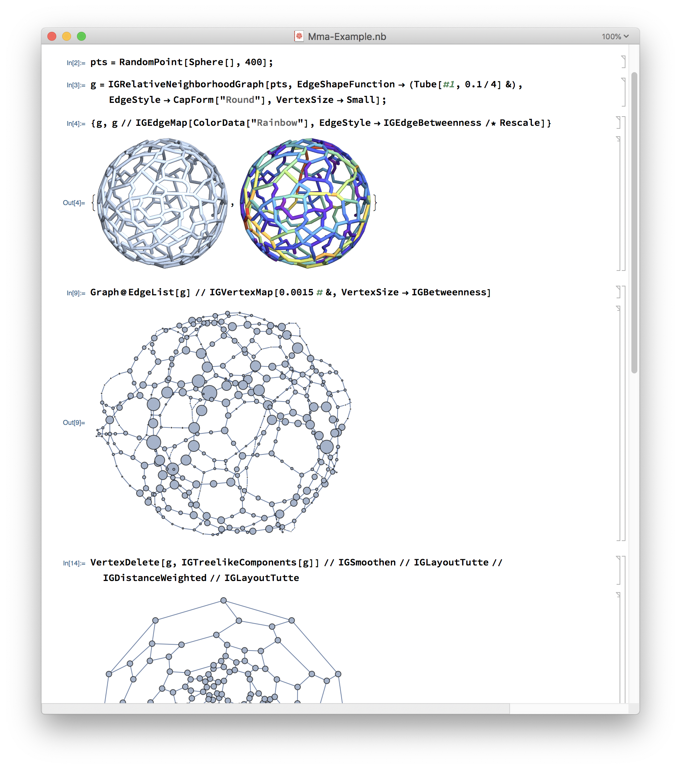

Slide 7
Designed for high-level languages
& interactive use
Interruptible
  Does not lock up your session
Integrates with the supplied RNG
  Just use the native seed() function
Hooks for error and warning reporting
  E.g. errors are mapped to Python exceptions
Flexible vertex and edge attributes
  Use any Python/R object
Progress reporting (e.g. for GUIs)

Slide 8
Demos

Slide 9
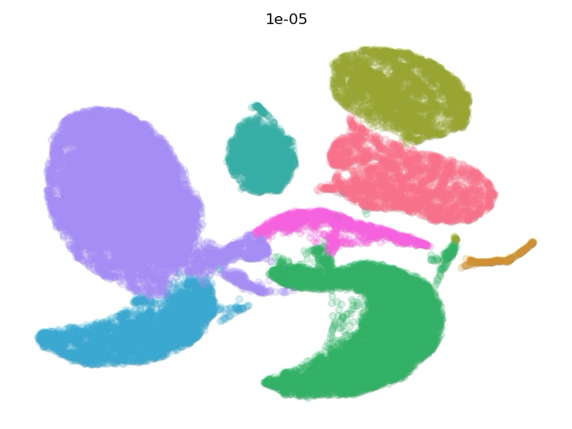
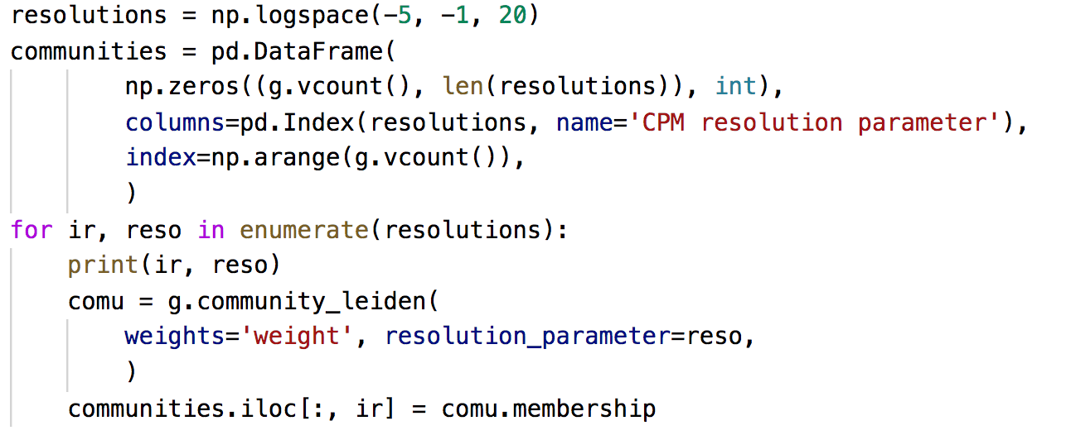
https://tabula-muris-senis.ds.czbiohub.org/limb-muscle/droplet/

Slide 10



Slide 11
Revitalizing igraph: Recent progress
C/igraph 0.8 release (first release in 5 years! — now at 0.8.5)
python-igraph: binary wheels on PyPI
New user forum: https://igraph.discourse.org/
Transitioned to CMake build system from autotools
  Faster builds, easier maintenance, better cross-platform support
New functionality, many bug fixes, etc.

Slide 12
Revitalizing igraph: Future plans
Release new R package! — help is welcome
Internal restructuring, improved maintainability
Ease of use, accessibility, documentation
New graph representation for efficient modification
igraph 1.0 with stable API
A network package is never complete … (lots of new feature ideas)

Slide 13
Collaboration
We are looking for R developers!
Coordinate with other network packages
  Users should have a seamless experience — e.g. networkx <-> igraph conversion
  Sharing of expertise
  Ways to reduce duplication of effort
Novel network method? → Contribute it to igraph.
Downstream tools (Seurat, ScanPy, etc.): talk to us!

Slide 14
