Slide 1

OpenAIRE - Advance
University approaches to Citizen Science in the transition to Open Science - Institutional strategies for creating an open and inclusive environment for research
December 10, 2020

Slide 2
OpenAIRE
Citizen Science
Activities
Notes:
Eugenia-what is T7.4

Slide 3



Activities
Schools Seismograph Network
Open Schools Journal for Open Science
Bringing
Nobel Prize Physics
to Classroom
Seismic Data
Open Science Journal
Access Research Data
Notes:
delete?

Slide 4
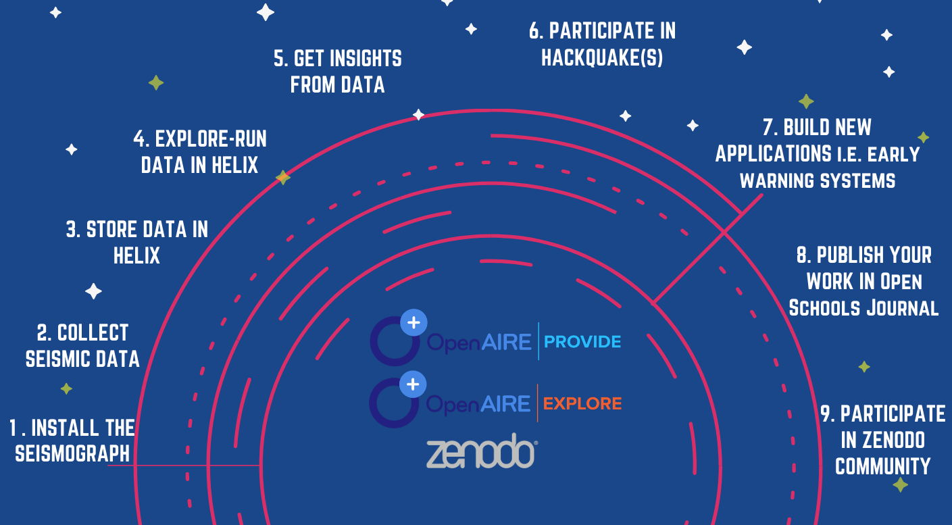

Journal Articles
Assigned DOI
Indexed on OpenAIRE through PROVIDE
Complete metadata collection on Graph
Available on Zenodo, EXPLORE
Findability
Accessibility
Interoperability
Reusage
Integration with OpenAIRE Services
Notes:
@androniki

Slide 5
Activities in Schools-
The seismic data Journey
Notes:
@eugenia

Slide 6
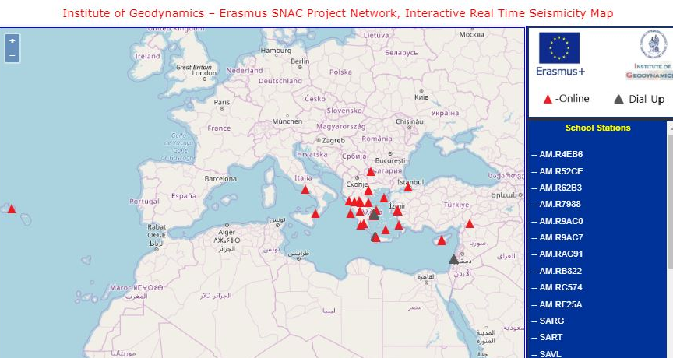
Schools network map
https://snac.gein.noa.gr/schools-list/
Notes:
@eugenia

Slide 7





The installation
Notes:
@eugenia

Slide 8
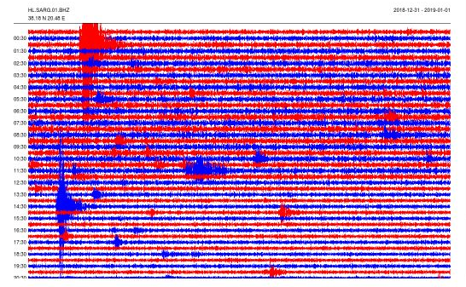
Visualization
Notes:
@eugenia

Slide 9
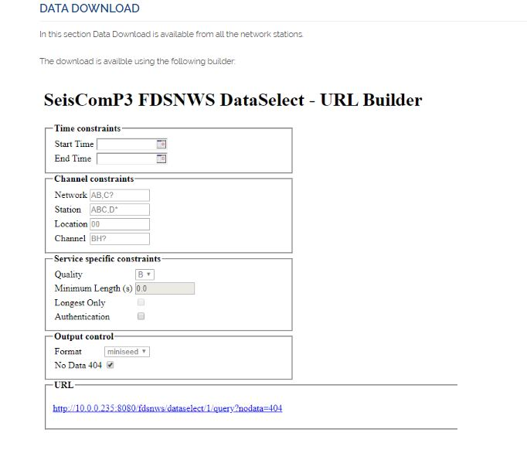
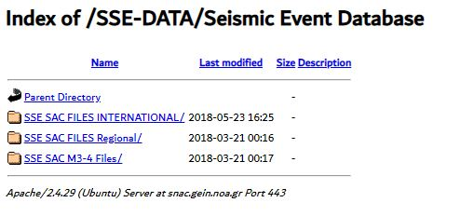
Raw data
Notes:
@eugenia

Slide 10
Seismic data on National Infrastructure
Notes:
@androniki

Slide 11
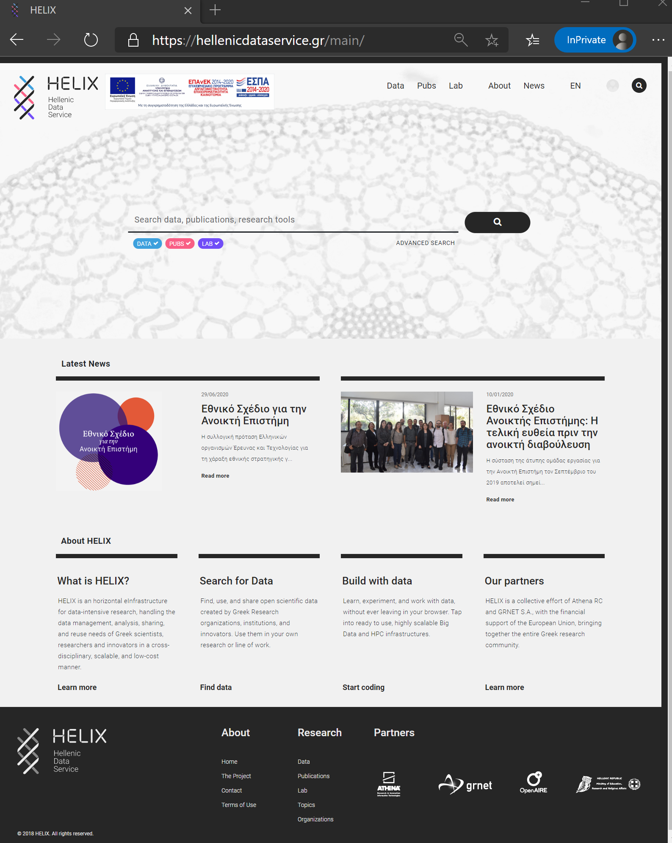
HELIX the Hellenic Data Service, is the national e-Infrastructure in support of data-intensive research, handling the data management, analysis, sharing, and reuse needs of Greek scientists, researchers and innovators in a cross-disciplinary, scalable, and low-cost manner.
https://hellenicdataservice.gr/main/
What is Helix
Notes:
@androniki

Slide 12
Step by Step process
Special Raspberry TC1 installed in schools
SAC files
Create an account, email for approval
Start Server in
HELIX LAB
DATA collection from schools
DATA stored in repository
DATA uploaded on HELIX Data
RUN Jupyter notebook on HELIX Lab
GET Insights and Graphs
EU extended from Israel to Azores
On demand availability
Upload Python script
Open Jupyter notebook and RUN it
View graphs of seismic activity
Schools
HELIX
Jupyter
ZENODO
OpenAIRE
Notes:
@androniki

Slide 13

October 2019
Notes:
@eugenia

Slide 14
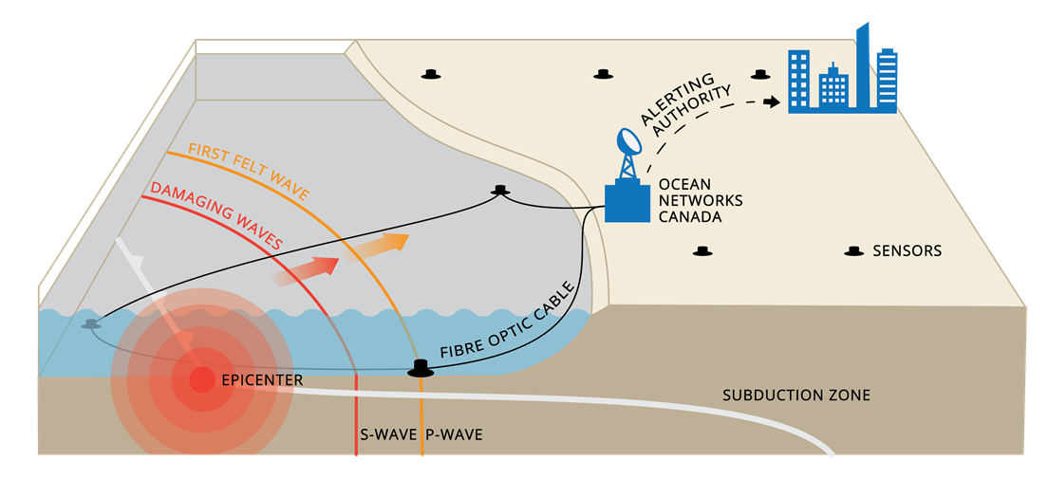
Early warning systems

Slide 15
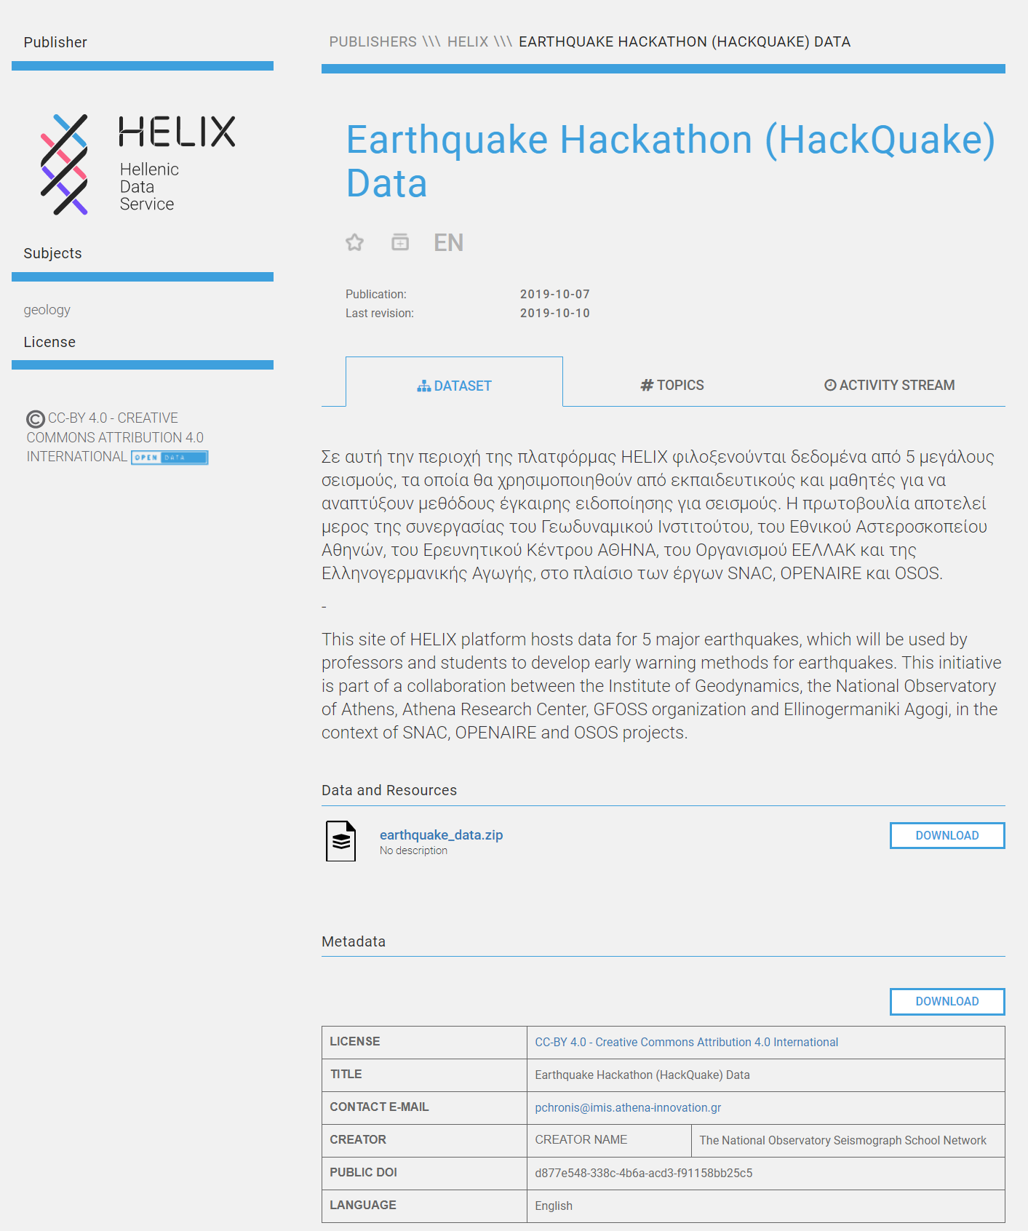
Publicly available via HELIX
https://data.hellenicdataservice.gr/en/dataset/f4dfd3fc-42ee-4a60-91a6-3e32af449654
Hackquake data

Slide 16
Publishing
students research
Notes:
@eugenia

Slide 17

An international scientific Journal from students to students
https://ejournals.epublishing.ekt.gr/index.php/openschoolsjournal/index
The Journal
Notes:
@eugenia

Slide 18
Journal in numbers
241
244
Users
Published articles & posters
141
Authors
13
Issues
100
Reviewers
Notes:
@eugenia

Slide 19
OSJ on Zenodo
Notes:
@eugenia

Slide 20
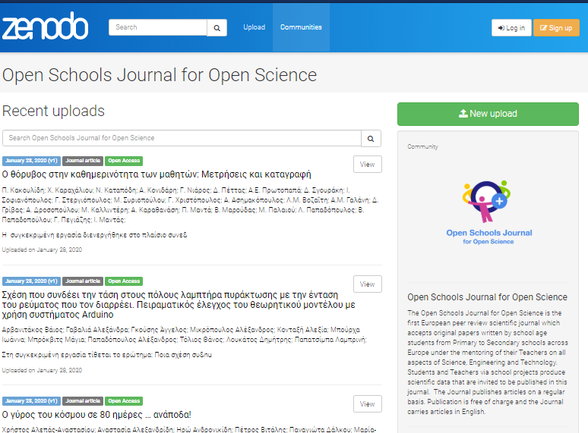
Zenodo Community

Slide 21
Nobel Prize Physics
on Zenodo
Notes:
@eugenia

Slide 22
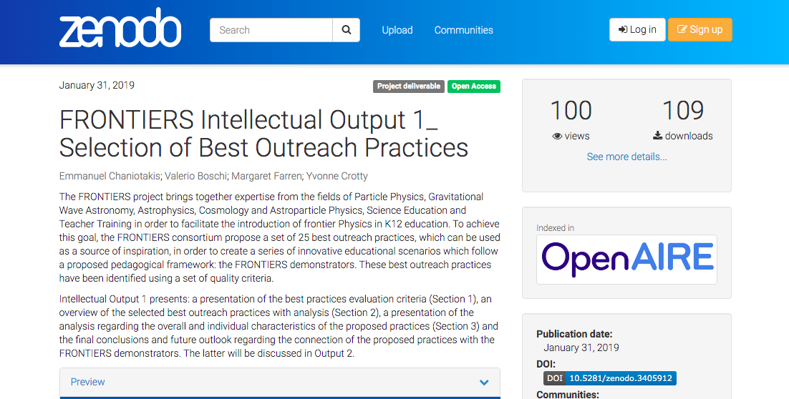

Slide 23
Good practice example
Notes:
@eugenia

Slide 24
New discovery of an exoplanet!
Title: Exoplanet hunting
Authors (1): Andreas Vatistas, Thanasis Vassilainas, Emmelia Voutierou, Fotini-Maria Dravilla, George Kalpaxis, Renia Menegou, Panagiotis Michalinas, Iasonas Pavlopoulos, Dimitra Pina, Thomas Pitsargiotis, George Tsakiris, Stelios Fragoudakis, Authors (2): Dr. Sotirios Tsantilas
(1) Zanneio Experimental High School Piraeus, Attica, Greece
(2) Mathematician, Astrophysicist, Zanneio Experimental High School Piraeus, Attica, Greece
Since 2009, Kepler Space Telescope has been recording small reductions (eclipses) in the light of distant stars due to the transit of planets in front of them. Our goal is to detect planets in orbit around distant stars from Kepler's mission data, following the Reading Method using two programs written by our team in programme language C. If the readings are detected and confirmed, we proceed to their analysis. characteristics of the planet: Ray, inclination, distance from the star, and especially if it is in the so-called "habitable zone" which will make it possible to maintain life.
However, we have already identified such an exoplanet in orbit around the star KIC 1432789, the characteristics of which our team analyzed for the first time.
DOI: https://doi.org/10.12681/osj.22398
https://ejournals.epublishing.ekt.gr/index.php/openschoolsjournal/article/view/22398

Slide 25
Take away
Notes:
@eugenia

Slide 26
Citizen Science in education helps...
students to get familiarised with Science and Open Science FAIR principles, rules & procedures
mapping the university and research environment into school environments
the use of the tools and the language of Science by students
students’ engaging in scientific reasoning
sparking students’ interest, excitement & understanding of
scientific content & knowledge

Slide 27
Eugenia Kypriotis,
ekypriotis@ea.gr, Ellinogermaniki Agogi
Androniki Pavlidou,
niki.pavlidou@athenarc.gr, Athena Research Center
Notes:
add androniki

Slide 28
Any questions?
Notes:
add androniki

Slide 29
Additional material
Notes:
@androniki

Slide 30
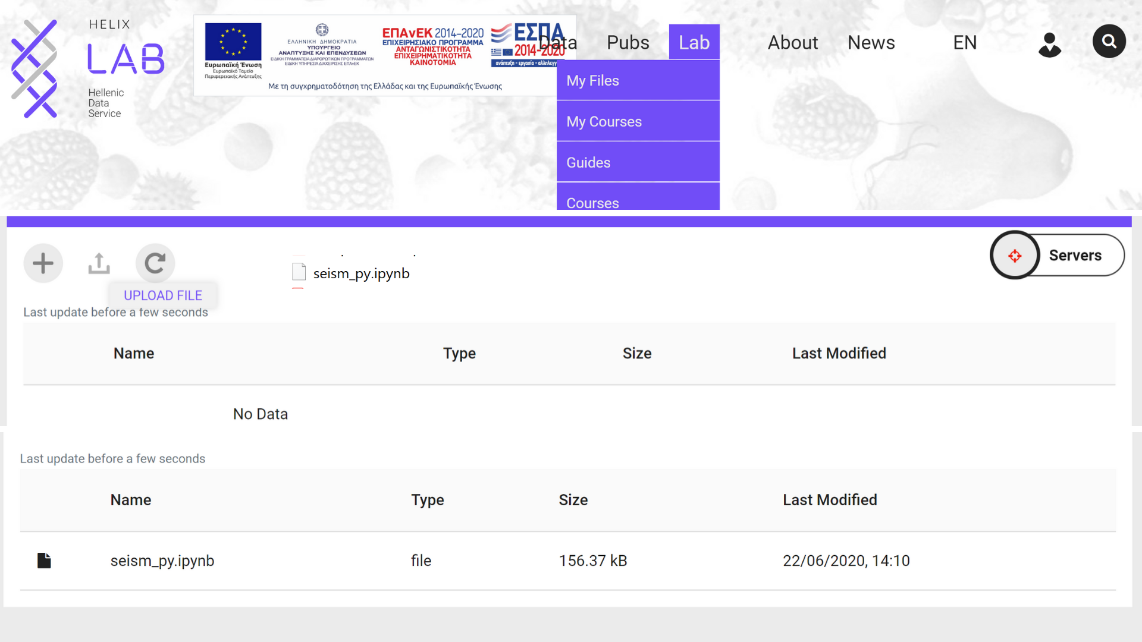
Notes:
@androniki

Slide 31
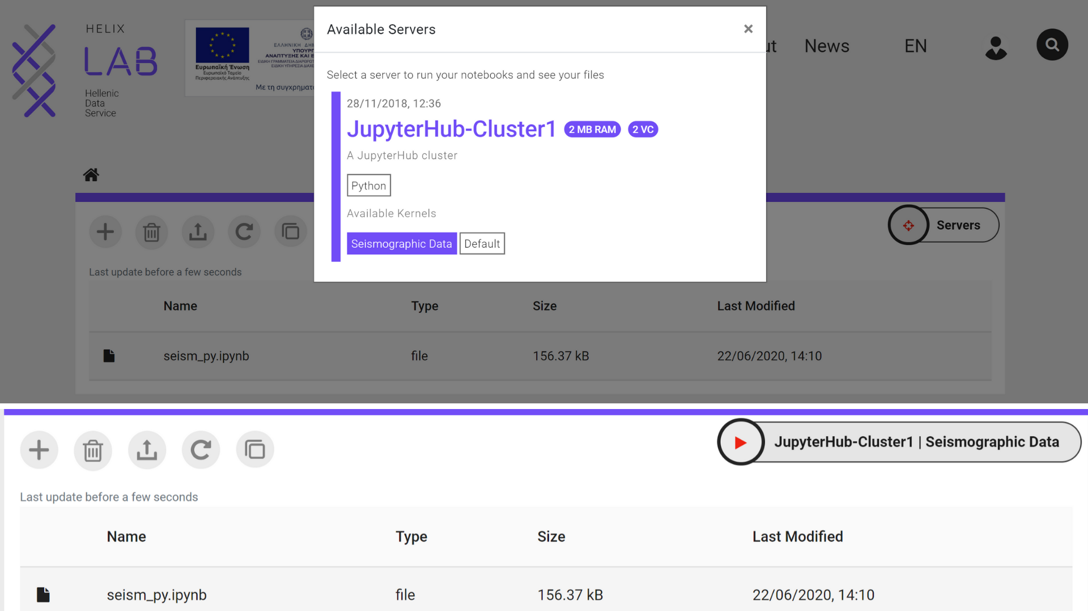
Notes:
@androniki

Slide 32
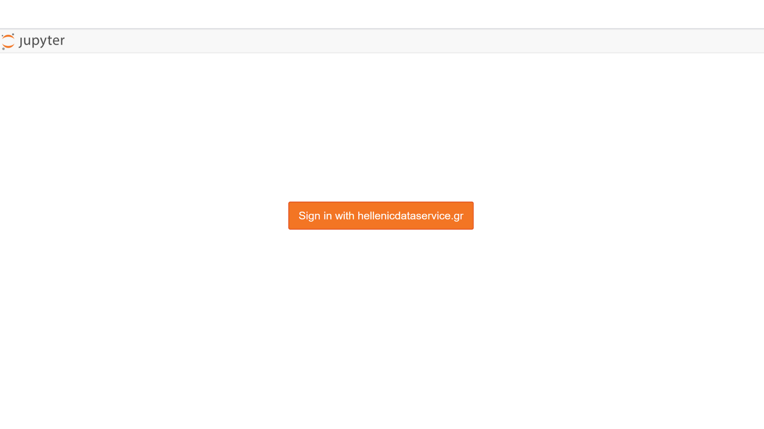
Access Jupyter notebook
Notes:
@androniki

Slide 33
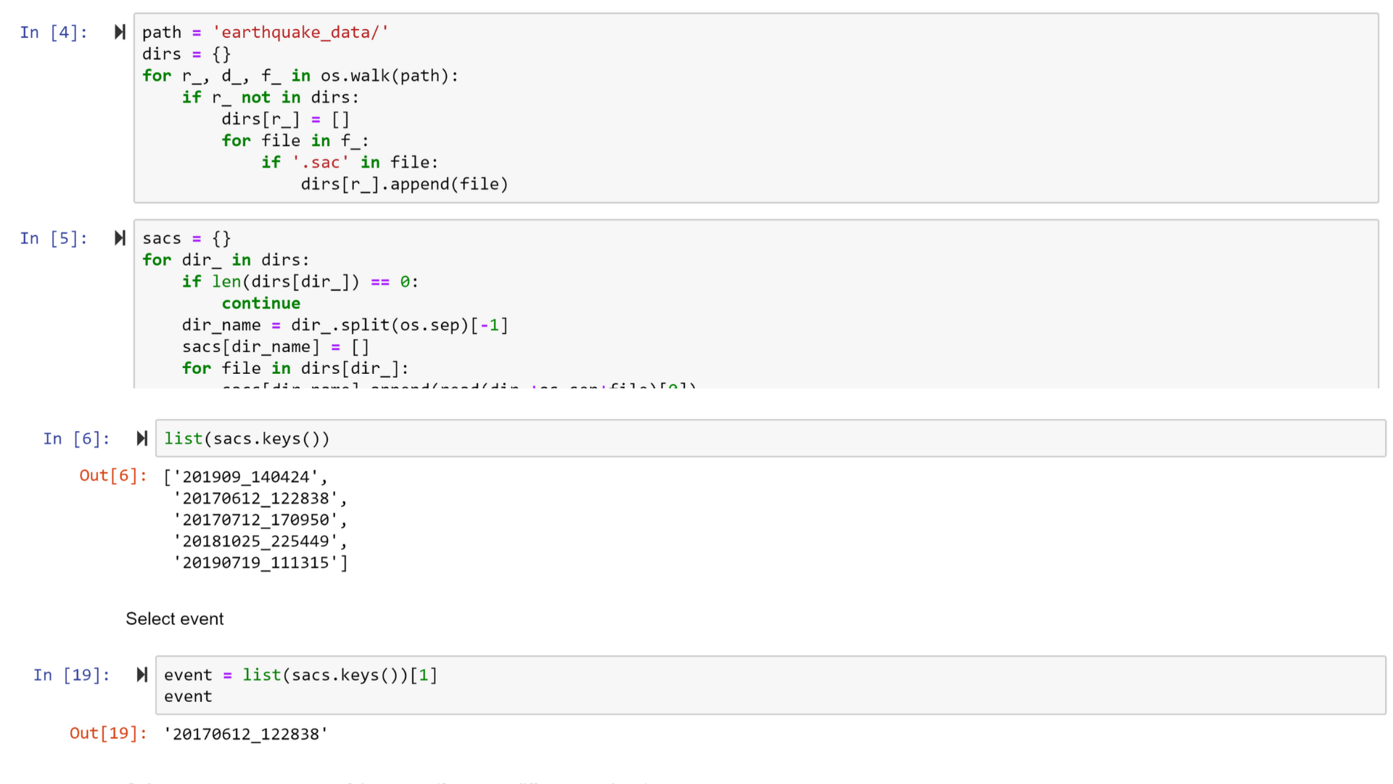
Run seismic data script on Jupyter
Notes:
@androniki

Slide 34
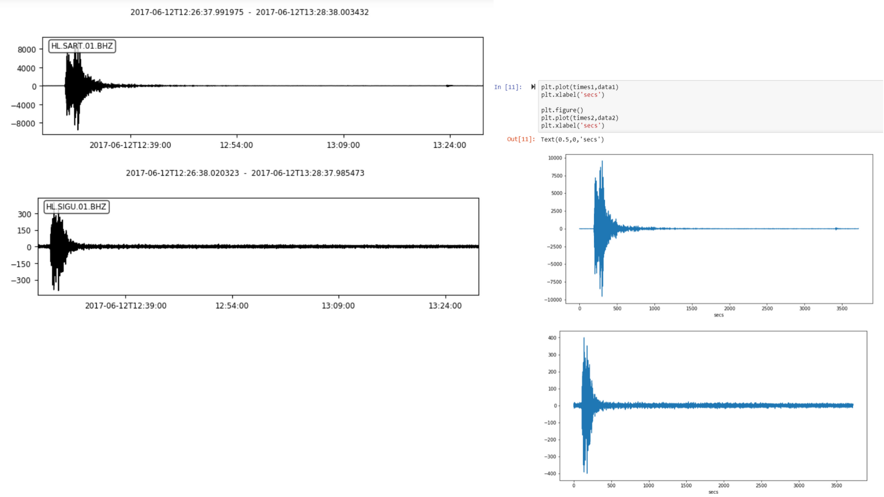
Visualization of seismic data on Jupyter
Gymnasium Agnanta Arta, Greece
3rd Gymnasium Igoumenitsa, Greece
Distance of two cities: 107 Km

