Slide 1
The OpenAIRE COVID-19 gateway: discovering coronavirus research results at the time of the
COVID-19 emergency
Notes:
Cover

Slide 2







OpenAIRE COVID-19 Gateway
- Single access point for discovery and navigation of research results and resources on the Coronavirus disease and SARS-CoV-2.
- Not only publications but also data, software, protocols and more.
- Open Science activities to help researchers fight the pandemic and understand its aftermath.
- Discoverability
- Synchronize efforts and collaboration
Fast sharing –> Zenodo community
Data management –>
RDA guidelines on COVID-19
data sharing
+100k publications; 5,5k research data; 440 software,
6k other research outputs, 130 projects dedicated to the pandemic
https://covid-19.openaire.eu/
Involvement of
domain experts
Building of the thematic gateway(s)
Notes:
POSTER

Slide 3

OpenAIRE COVID-19 Gateway
Fast sharing, synchronization of efforts and collaboration
- Single access point for discovery and navigation of research results and resources on the Coronavirus disease and SARS-CoV-2.
- Not only publications but also data, software, protocols and more.
- Open Science activities to help researchers fight the pandemic and understand its aftermath.
https://covid-19.openaire.eu/
Notes:
Slide 1

Slide 4
OpenAIRE COVID-19 Gateway - Building of the gateway
A (thematic) open metadata research graph
All COVID-19 related research results are linked to people, organizations, projects and fundings.
Relevant products in OpenAIRE research graph
Other and authoritative sources worldwide
Public up-to-date list of data sources
research products COVID-19 related and uploaded in the Zenodo community
Authenticated users linking scientific products to the "COVID-19" community (moderated)
Information available via a target set the OpenAIRE APIs (LOD, REST) or via periodic dumps in Zenodo.
https://covid-19.openaire.eu/
Notes:
Slide 2

Slide 5
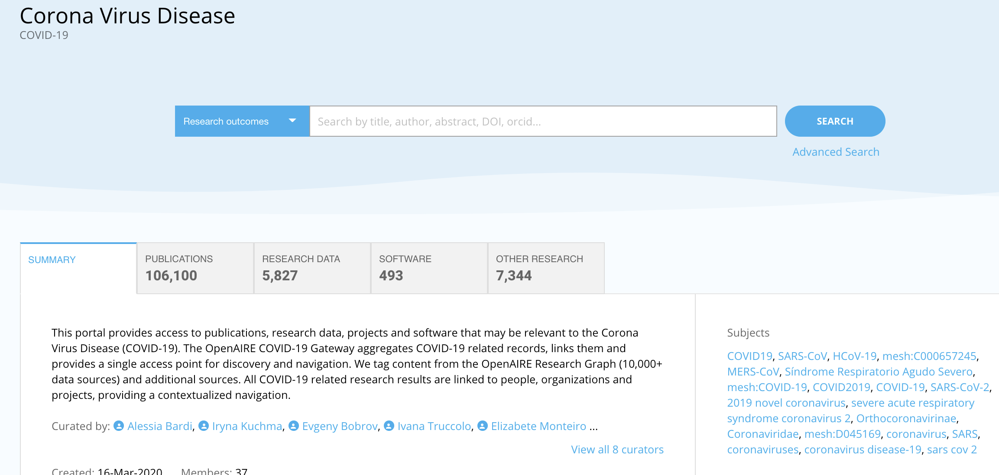
OpenAIRE COVID-19 Gateway – Building of the thematic gateway
Set up of different processes to identify research outcomes
Single entry point
  Extensive set of keywords
  (free text and from subject classification schemes)
  Full-text mining
  Analysis of the OpenAIRE Research Graph and exploiting the links between publications, datasets, and funding projects
  Manual addition of research outcomes (with a DOI)
https://covid-19.openaire.eu/
Notes:
Slide 3

Slide 6
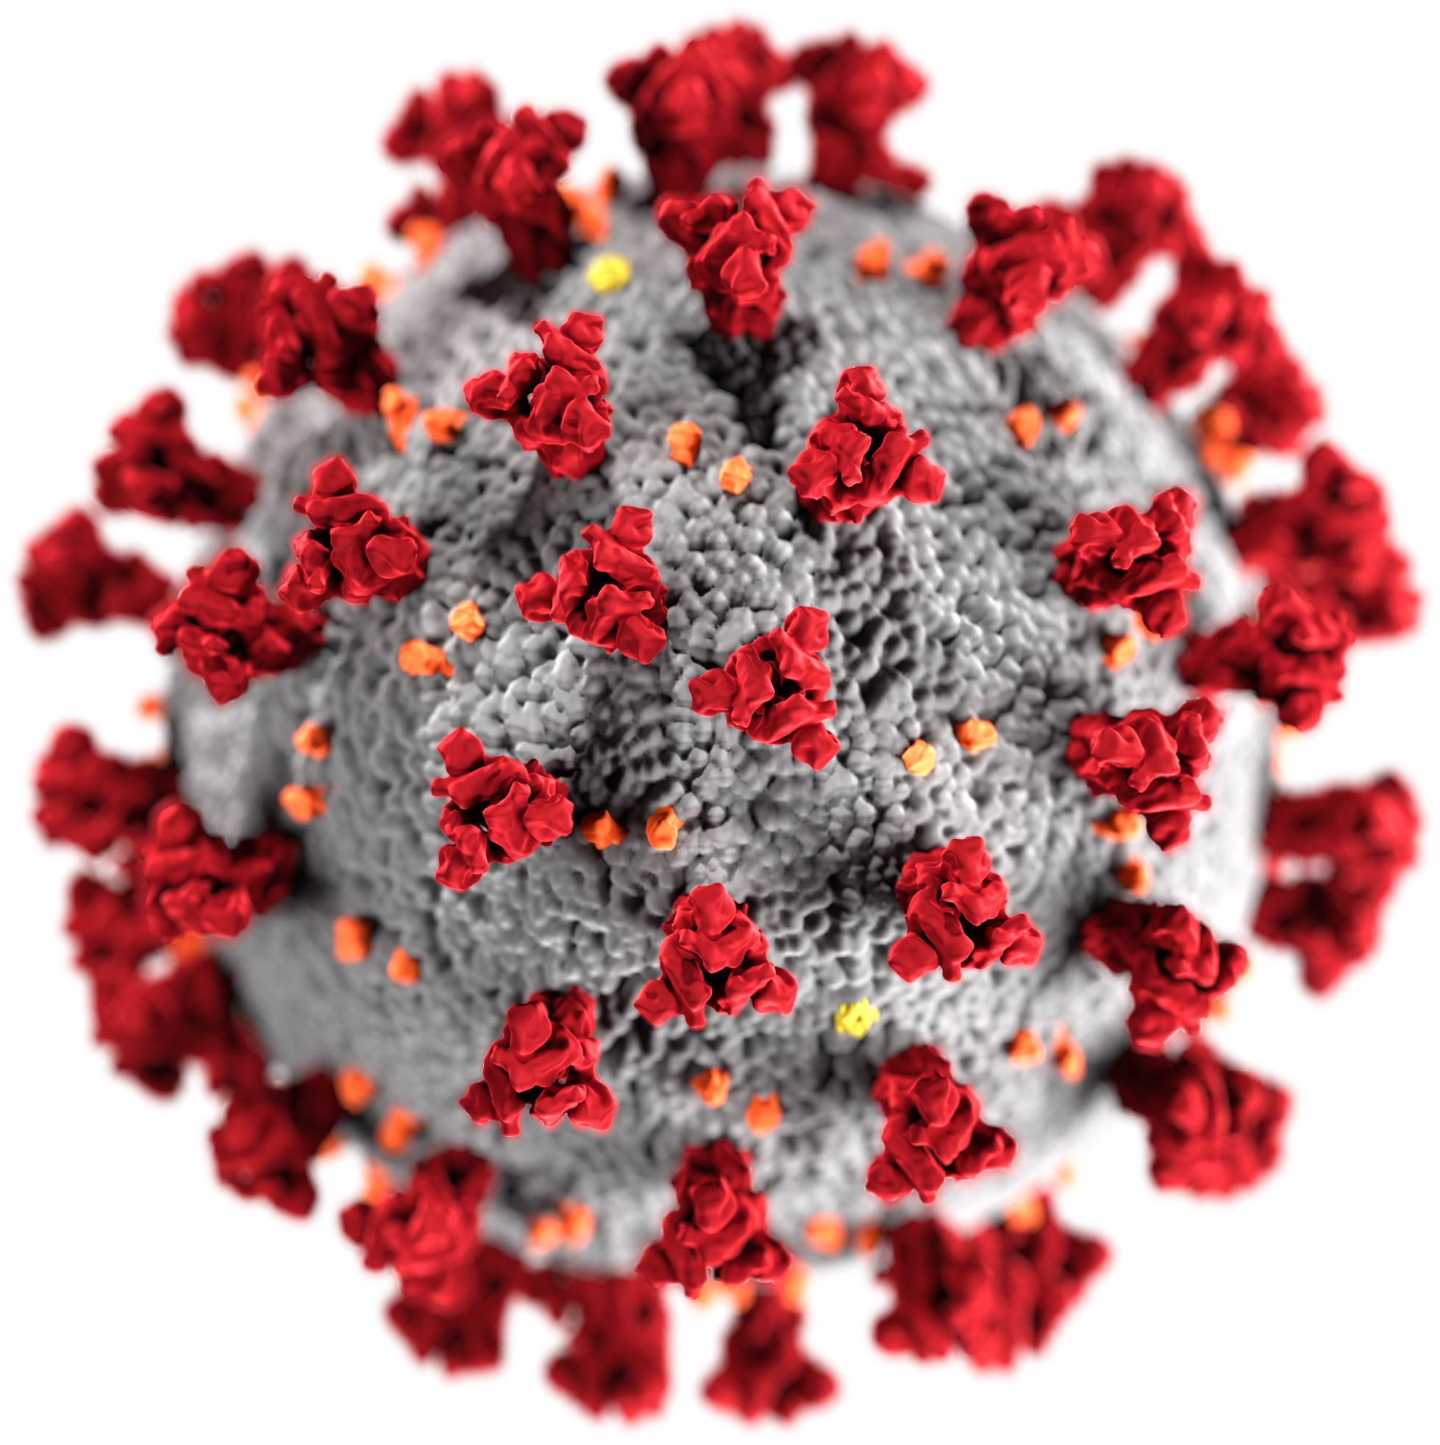

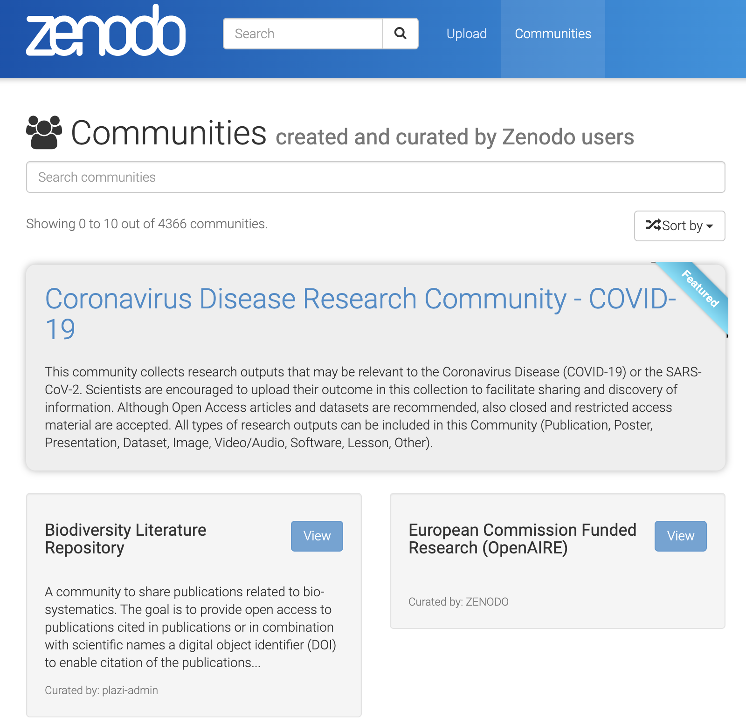




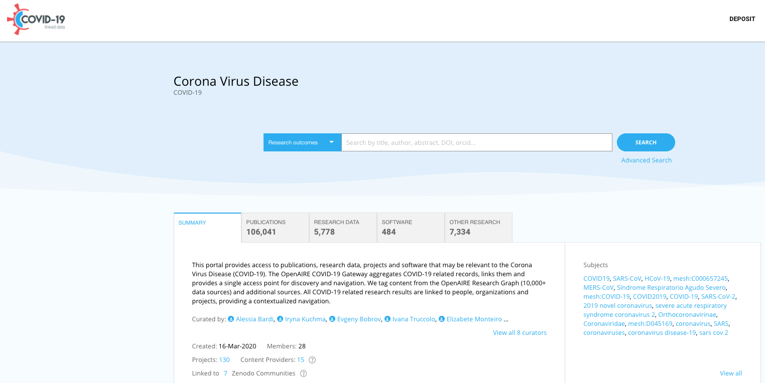

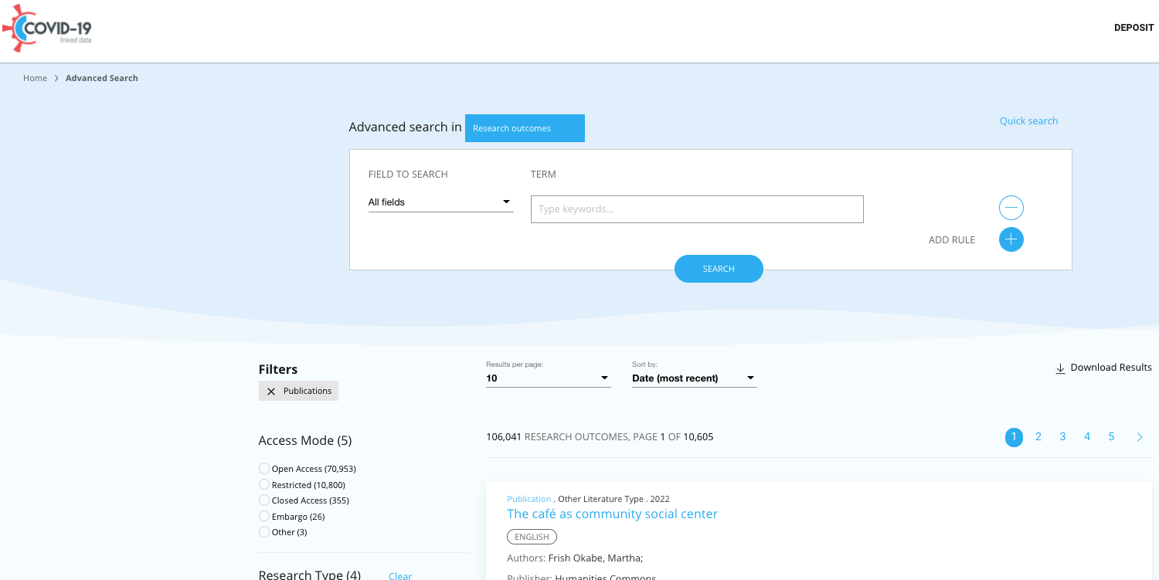




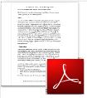



















2
Zenodo COVID-19 community
Deposit COVID-19 datasets, publications
Multidisciplinary
1
10,000 OpenAIRE
validated sources
4
Mining for COVID-19
OpenAIRE COVID-19 Gateway
Discover, navigate, link
5
3
APIs
REST, Zenodo dump,
CSV downloads
Additional global COVID-19 sources
Notes:
Slide 4
How does OpenAIRE materializes the graph?
Collection records (dedup)
Collection full-texts for OA publications
Mining full-texts of publications to find links to data, software, other product, projects, research communities and infrastructures and enhance metadata with affiliation information, subjects/keywords: article-data and data-data links are around 120 Mi, article-article similarity links are around 300Mi

Slide 7
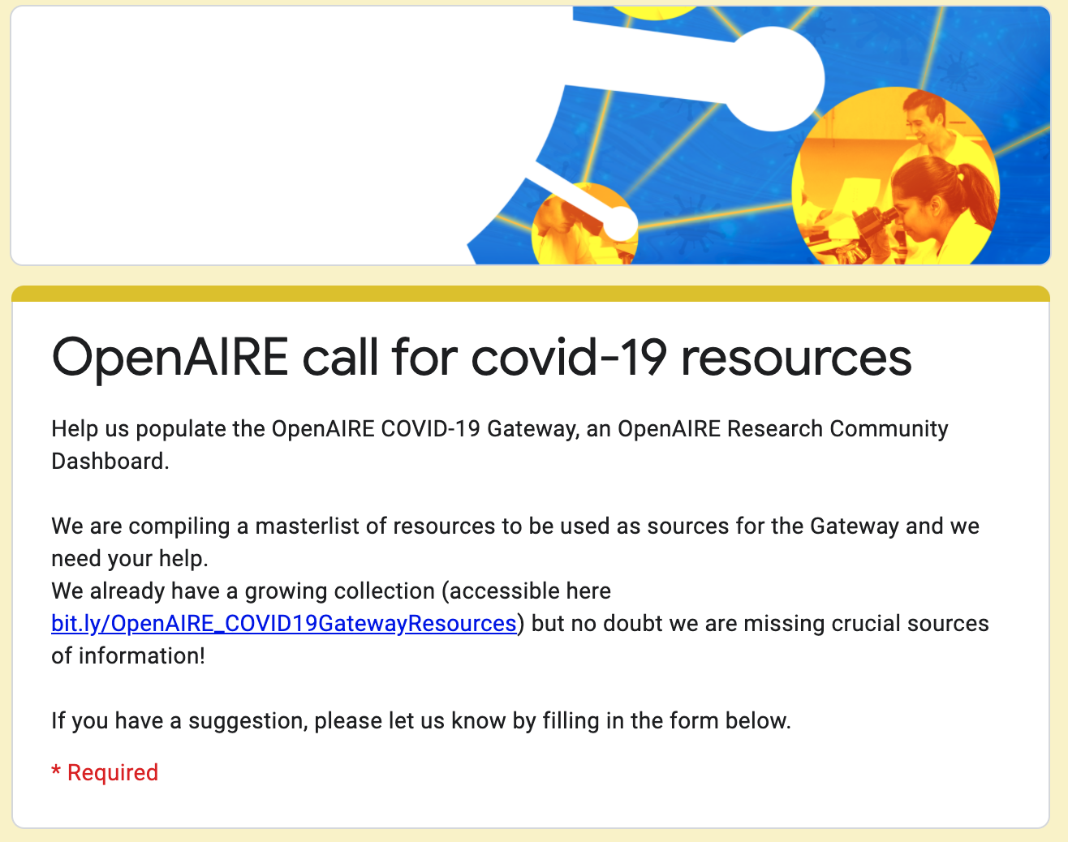
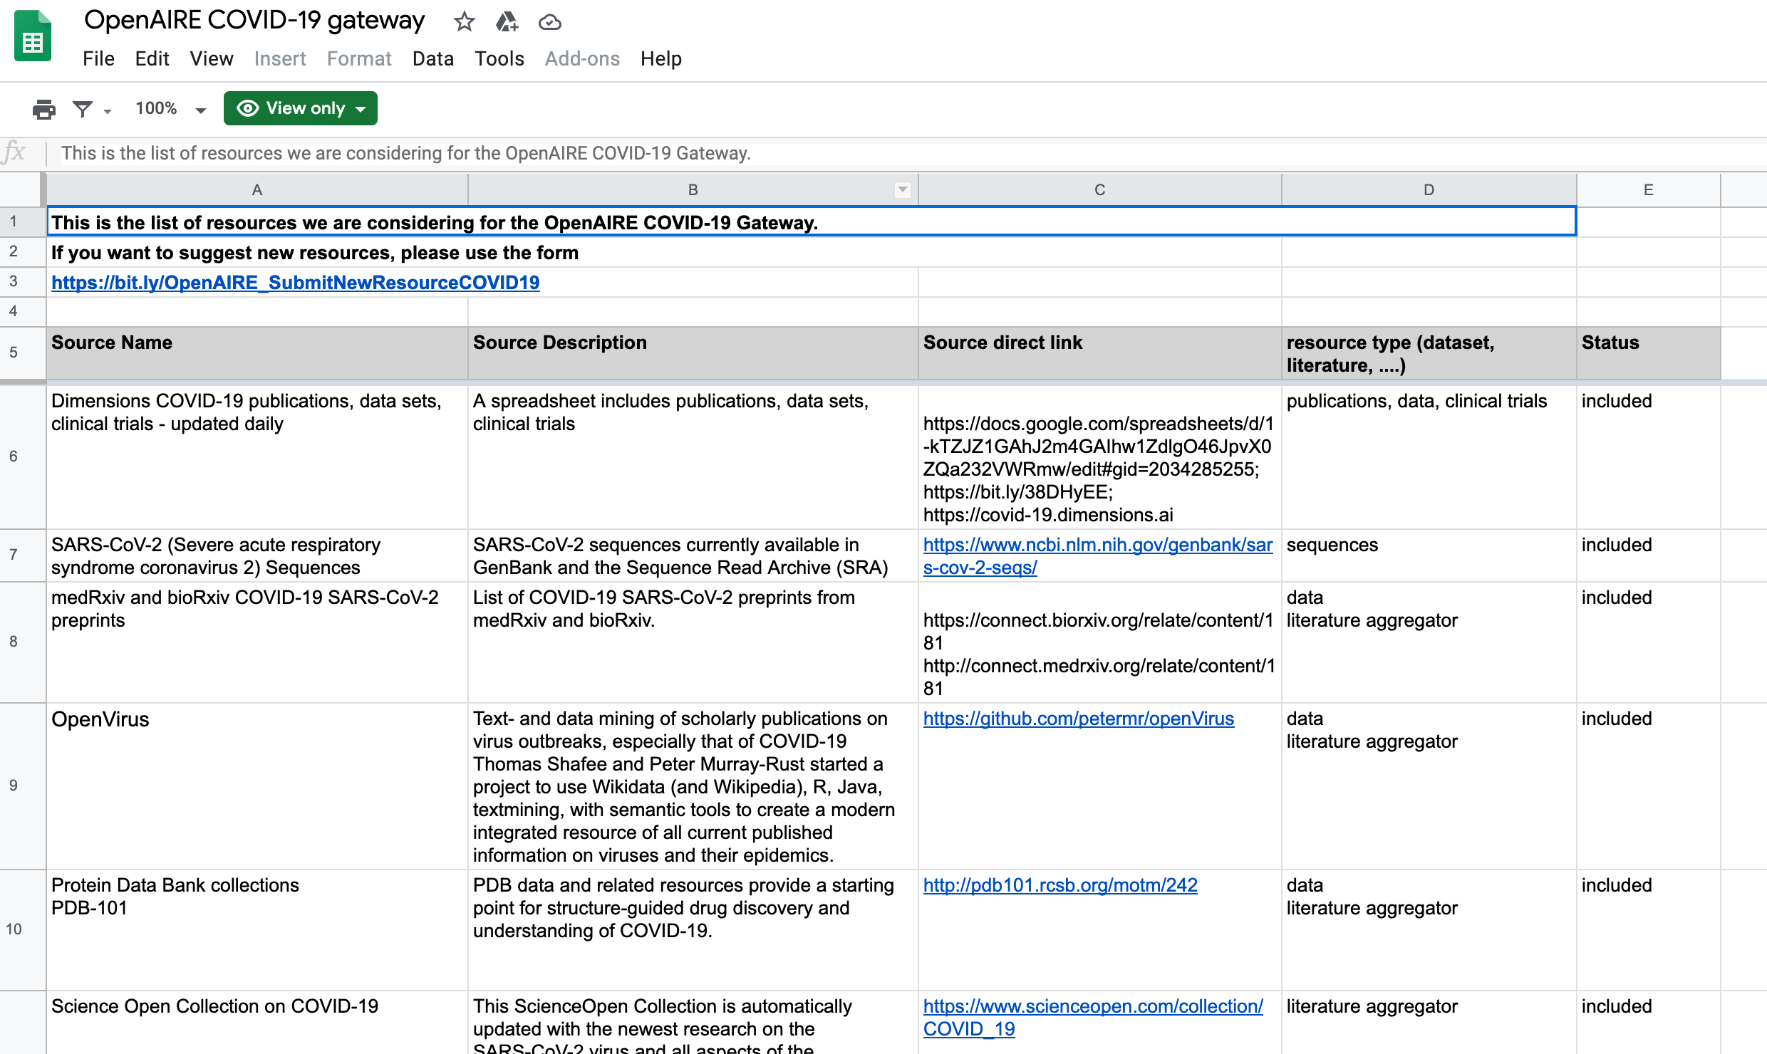
OpenAIRE COVID-19 Gateway
Involvement of domain experts:
Various call for experts:
Call for experts among researchers, librarians, research managers
Creation of public list of ”data sources”, updated thanks to community suggestions via a dedicated form
Call for curators of the Zenodo community
https://covid-19.openaire.eu/
Notes:
Slide 5

Slide 8

OpenAIRE COVID-19 Gateway - Zenodo community
Fast sharing
Deposit research products related to the pandemic https://zenodo.org/communities/covid-19/
FAIRness and reusability of research results
All types of research outputs can be included in this Community
(Publication, Poster, Presentation, Dataset, Image, Video/Audio, Software, Lesson, Other)
The contents of the community automatically feed the graph (covid-19 gateway)
Curated by a team of experts
Open Access records are recommended, but also closed and restricted access material are accepted
Link per upload: https://zenodo.org/deposit/new?c=covid-19
https://covid-19.openaire.eu/
Notes:
Slide 6

Slide 9
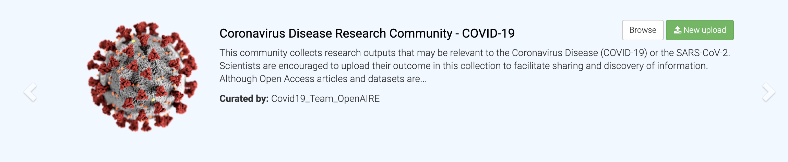
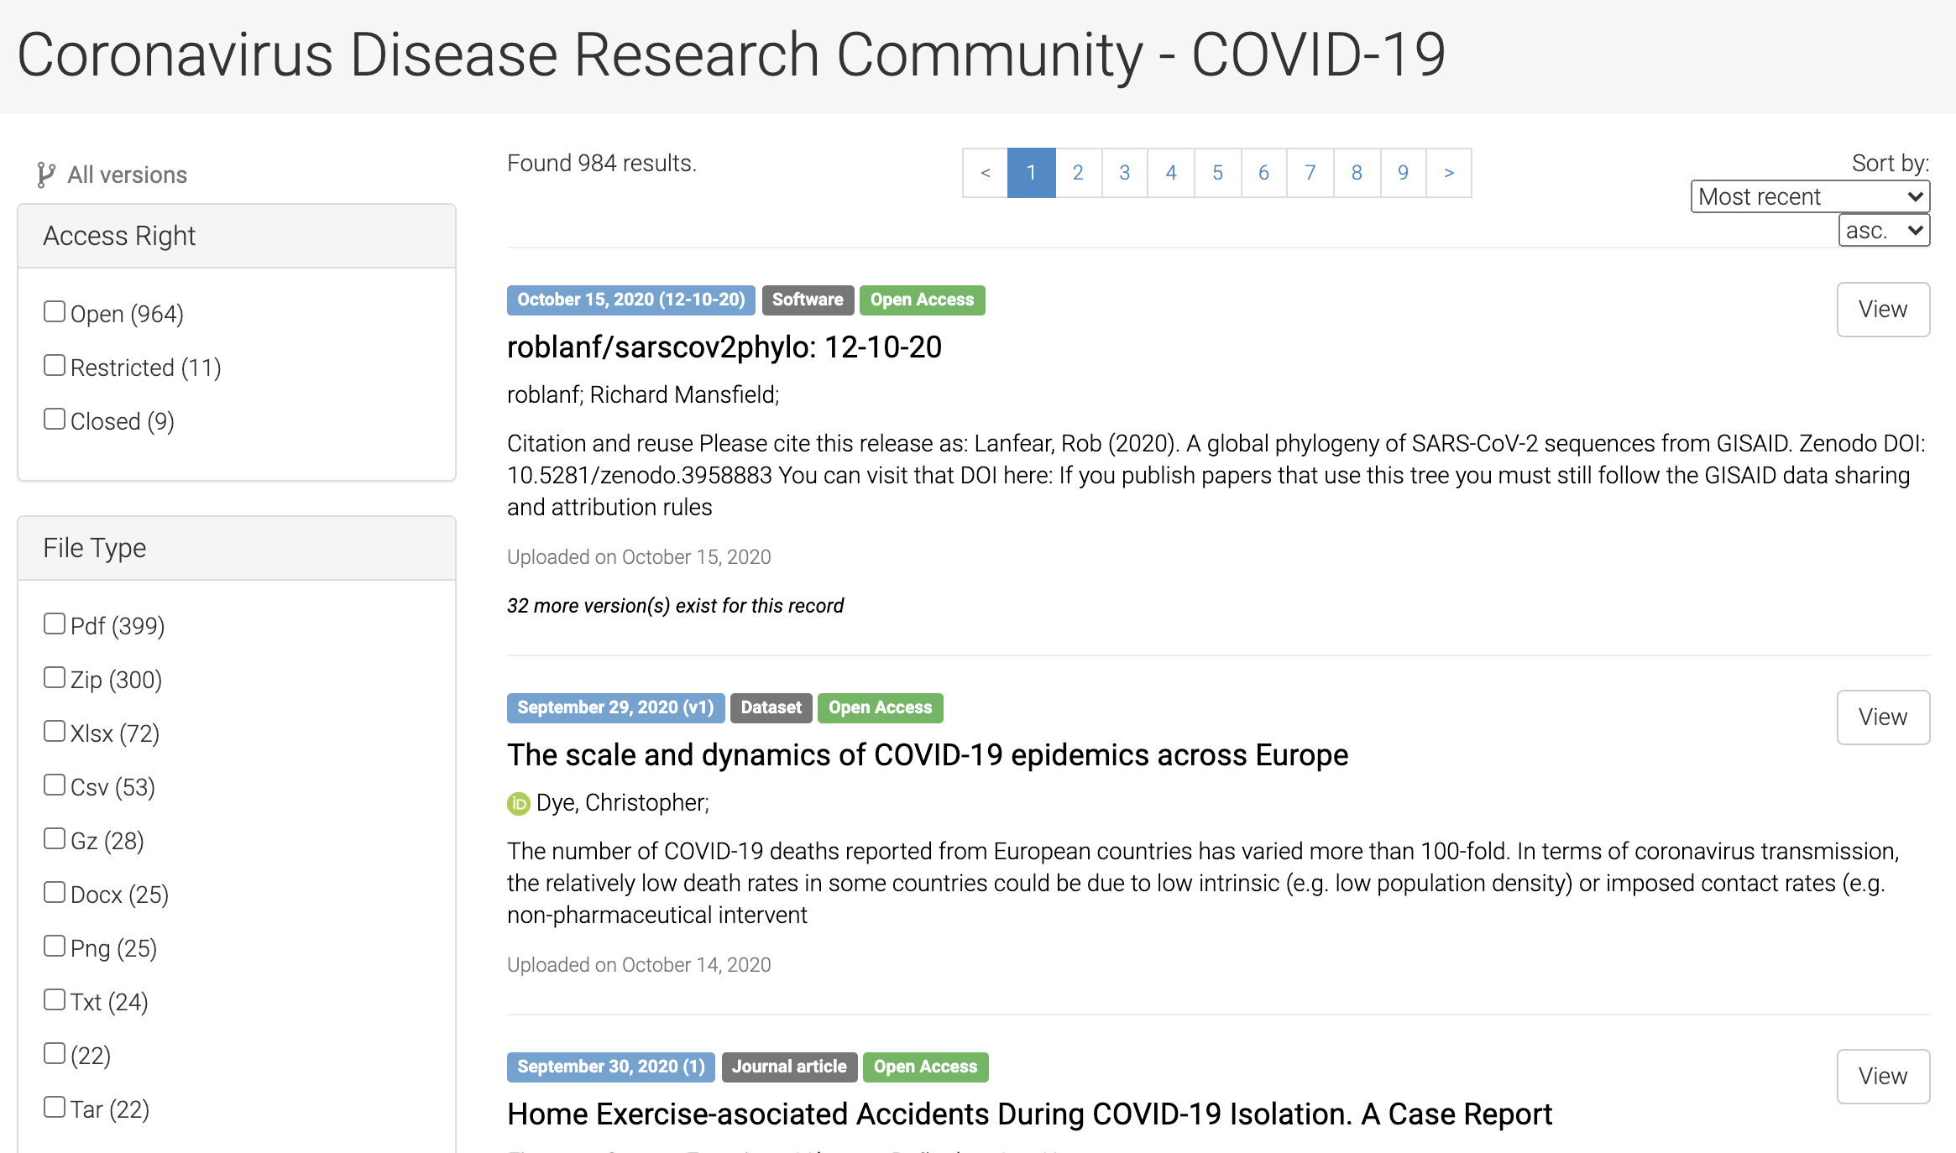
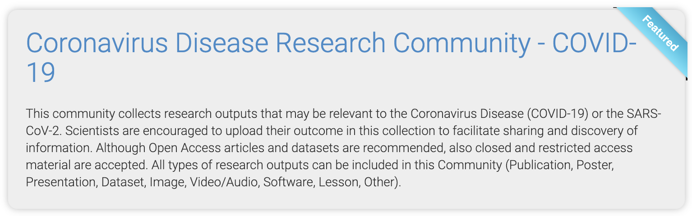
https://zenodo.org/communities/covid-19
Notes:
Slide 7

Slide 10
OpenAIRE COVID-19 Gateway – RDA guidelines on COVID-19 data sharing
Good data sharing
RDA: The Research Data Alliance (RDA) builds the social and technical bridges to enable the open sharing and re-use of data.
Grass-roots, cross-discipline, inclusive approach covering all data lifecycle stages, engaging data producers, users and stewards, addressing data exchange, processing, and storage.
RDA for COVID-19: Guidelines and reccomentations to help researchers follow best practices to maximize the efficiency of their work (ie. Balancing timeliness and precision; encouraging researchers to publish data alongside their papers etc)
4 research areas (clinical, omics, epidemiology, social science) + 4 cross-cutting areas (community participation in data sharing, indigenous data, legal & ethical, research software).
RDA COVID-19 Working Group. Recommendations and Guidelines on data sharing. Research Data Alliance, 2020. DOI: https://doi.org/10.15497/rda00052.
https://covid-19.openaire.eu/
Notes:
Slide 8

Slide 11
OpenAIRE COVID-19 Gateway – RDA guidelines on COVID-19 data sharing
Overaching consideretions
Coordinated, cross-jurisdictional efforts to foster global Open Science
Infrastructure Investment & Economies of Scale
FAIR and Timely outputs
Early & frequently updated Data Management Planning
Metadata essential for cross-disciplinary access
Documentation of methodologies
Use of Trusted Data Repositories (TDRs)
Expedited Publications / Data Publications
Ethical and legal considerations
Legal frameworks
RDA COVID-19 Working Group. Recommendations and Guidelines on data sharing. Research Data Alliance, 2020. DOI: https://doi.org/10.15497/rda00052.
https://covid-19.openaire.eu/
Notes:
Slide 9

Slide 12
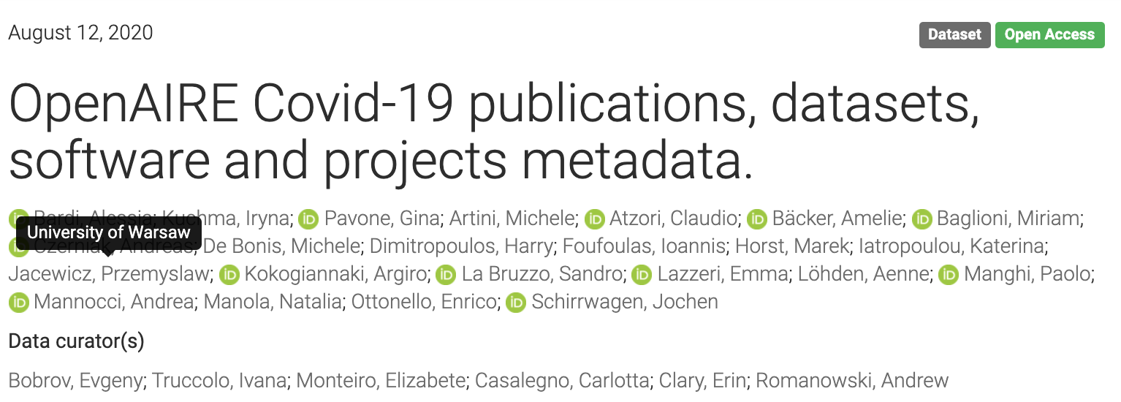
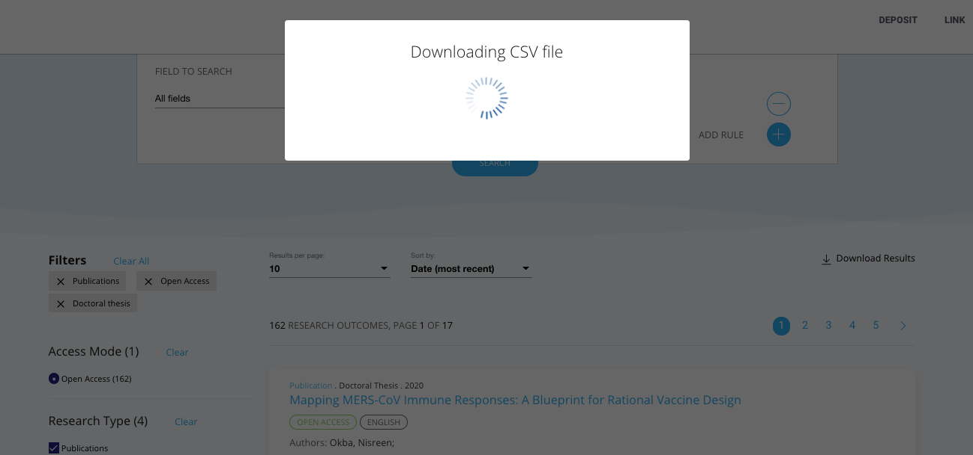

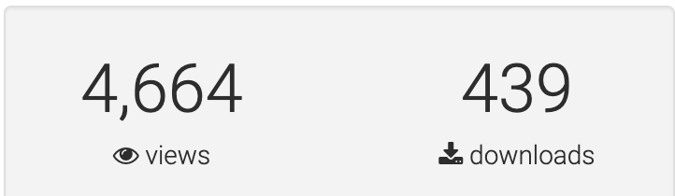
OpenAIRE COVID-19 Gateway - APIs
CSV downloads
Json dumps on Zenodo
HTTP API
https://doi.org/10.5281/zenodo.3980490
CSV file with:
Type, Specific type, Title, Authors, Publication Year, DOI, Download from, Access Rights, Funder | Project Name (GA Number), Journal
http://api.openaire.eu/search/publications?community=covid-19
XML or json format
Notes:
Slide 10

Slide 13
OpenAIRE COVID-19 Gateway – RDA guidelines on data sharing
Useful links
Everything about OpenAIRE for COVID-19: https://www.openaire.eu/openaire-activities-for-covid-19
The OpenAIRE COVID-19 Gateway: https://covid-19.openaire.eu
The COVID-19 Zenodo community: https://zenodo.org/communities/covid-19
Everything about the OpenAIRE Research Graph https://graph.openaire.eu
Notes:
Slide 11

