Slide 1
EOSC-hub: selected KERs, governance and sustainability strategies
Tiziana Ferrari
EOSC-hub Project Coordinator
EGI Foundation Director

Slide 2
Outline
Overview of EOSC-hub KERs
Examples of sustainability and governance for selected KERs
  EOSC Core
    EOSC Marketplace
    Service Management System
  EOSC Exchange
    Horizontal services
    Thematic services
Conclusions

Slide 3

Mission
The EOSC-hub project mobilises providers of pan-European relevance offering services, software and data for advanced data-driven research and innovation.
These resources are offered via the Hub – the integration and management system of the European Open Science Cloud, acting as
a European-level entry point for all stakeholders.
Tot budget: €33,287,542
EC Grant 30 000 000
Coordinator
EGI Foundation
Consortium
100 partners, 53 countries
Duration
36 Months
Jan 2018 – 31 Mar 2021

Slide 4









Key Exploitable Results
Enterprise: Boost innovation
EOSC-hub
Key Exploitable Results
Digital Innovation Hub:
Platform for industrial collaborations with EOSC
EOSC
Portal
and
Marketplace
EOSC Core Operators: implement components of the EOSC Core
Service Providers:
Provide services for
Researchers
Educate, inform and support my team and community
Rules of Participation
Internal services in the Hub portfolio
Service Management System
Business and sustainability models for services and the Hub
Training courses and Materials
Researchers and research communities:
Empower my research
Interoperability & Integration Guidelines
Services in the EOSC Service Portfolio

Slide 5









1. EOSC Portal and Marketplace
Enterprise
Educate, inform and support
EOSC Portal
and
Marketplace
EOSC-hub Operators
Service
Providers
Researchers and research communities

Slide 6
EOSC Portal and Marketplace - Overview
EOSC Portal is the result of EOSC Portal collaboration
  Agreement between EOSC-hub, OpenAIRE-Advance and EOSC Enhance (previously eInfraCentral)
  Registry of EOSC Exchange services
  Providers and resources onboard via the EOSC Provider Portal while users explore, compare, access and order them via the Marketplace (connect the demand and supply side)
  Platform being expanded to cover data and other research products under EOSC Enhance
A delivery channel connecting the demand-side and the supply-side which showcases the potential of integrated and coordinated access to European services, data and other scientific outputs
For more information, visit: eosc-hub.eu/eosc-hub-key-exploitable-results#KER1

Slide 7
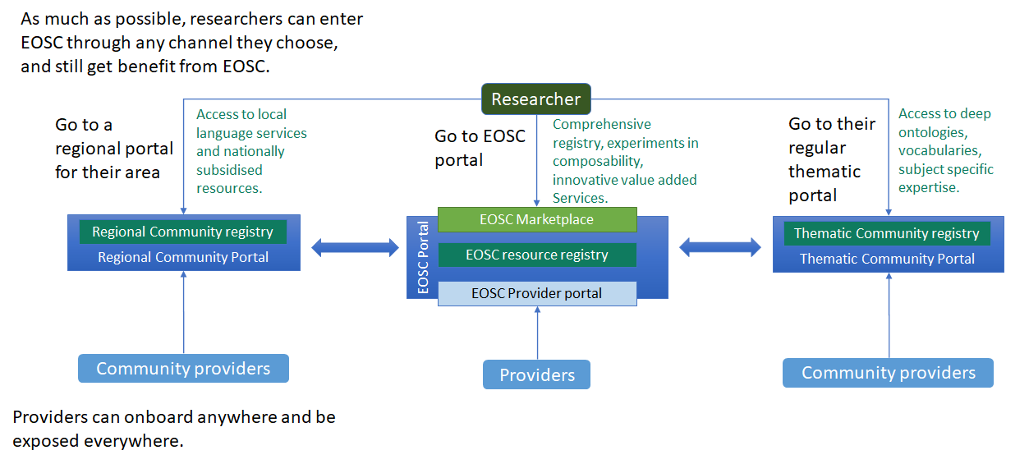
Marketplace and portal ecosystem

Slide 8
Marketplace: Governance and Sustainability Strategies
Running service
  Service provisioning: Service provisioning by the EGI Federation governed by a Service Level Agreement
  Software: Technical developments by consortium members of EOSC-hub and EOSC Future ⇒ Source code licenses: different OSI licenses
  Brand: Use of EOSC brand
Continuity of support and development in EOSC-Future
The long term vision is that the service will be part of the EOSC Core

Slide 9


2. EOSC Service Management System
Enterprise
Educate, inform and support
EOSC-hub Operators
Service
Providers
Service Management System
Researchers and research communities

Slide 10
Service Management System (SMS) - Overview
EOSC-hub defined and implemented the EOSC IT service management system (ITSM): plan, deliver, operate and control services offered to customers
  Directed by policies and are structured and organised by processes and procedures
  Maintain customer focus while
  sharing the load and responsibilities
  dynamically across providers
  Shared awareness across
  organisations – e.g. coordinate updates,
  Manage personal data in a GDPR Compliant manner, EOSC trust and identity framework, etc.
People
Responsibilities
Skills
Awareness
Technology
Support people
In their roles
Increase process effectiveness and efficiency
Processes
Defined activities
Effectiveness and repeatability

Slide 11
SMS: Governance and Sustainability Strategies
Governance
  Intellectual Property of SMS specifications (processes/procedures/policies)
    IP co-owned by specific organizations/authors of EOSC-hub
    Access rights will ensure re-use and evolution in the context of follow-up projects. Default project license: Creative Commons Attribution 4.0 International
Sustainability
  Follow-on projects, EOSC AISBL

Slide 12
EOSC-hub contributions to the EOSC Exchange
Enterprise
Educate, inform and support
EOSC-hub Operators
Service Providers
Researchers and
research communities
Services in the EOSC
Service Portfolio

Slide 13
Value proposition
These services and solutions are “onboarded” to EOSC Portal and Marketplace and also often integrated with each other ⇒ Contribution to the EOSC Exchange portfolio
  Research outputs including services have different application areas and sustainability models.
  They speed up the research process and enable cross-disciplinary collaboration and reuse of tools and results.
  EOSC Service Portfolio will support them by making the discovery of
  the services easier and reducing the effort needed to adopt them.
More information: https://www.eosc-hub.eu/eosc-hub-key-exploitable-results#KER5

Slide 14
EOSC Exchange: Horizontal services
DATA DISCOVERY AND ACCESS
Providing a common data discovery and access layer for EOSC
Off-the-shelf services to support FAIR data
FEDERATED COMPUTE
Provide a multi purpose, federated compute environment
Cloud Compute
Container compute
High Throughput Compute
PROCESSING AND ORCHESTRATION
Provide orchestration services to provision & configure virtual infrastructures across multiple cloud sites, and support deployment onto EOSC compute resources as well as commercial providers (AWS, Azure...)
DATA AND METADATA MANAGEMENT
FAIR data resources with seamless access from EOSC-hub computational resources
DATA
PRESERVATION
Provide a Certified Trusted Digital Repository.
Fully integrated with EOSC FAIR data service
SENSITIVE DATA SERVICES
Off the shelf sensitive data services.
EOSC Integration: Exposing sensitive data services via EOSC FAIR data services.
‹#›

Slide 15
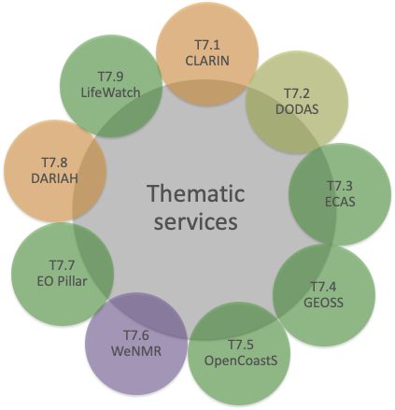
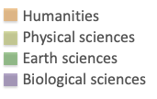
EOSC Exchange: Thematic services

Slide 16
Governance and sustainability of thematic services of the EOSC Exchange
Sustainability/Technical integration
  Currently: Incremental improvement to existing software code for integration and interoperability merged back in the related software package
  After EOSC-hub: bilateral agreements between the provider of the thematic service provider and the providers of horizontal services/solutions
Governance/Access policies
  EOSC-hub: transnational access with EC funded support
  After EOSC-hub: to be defined by each thematic service provider according to their specific business model

Slide 17
Conclusions
Different paths for governance and sustainability depending on the result and its role in the EOSC implementation
Proper licensing of project foreground is key for exploitation in EOSC beyond the project lifetime
Intellectual property ownership important for proper attribution of results
EOSC-Hub choice wrt branding
  EOSC brand for candidate EOSC Core components
  For other results the owners retain their brand

Slide 19
EOSC SMS scope
SMS aims to structure, plan, implement, monitor and continually improve all service management processes that support the services within the EOSC.
Act
Plan
The Hub service portfolio: internal services
  Services enabling EOSC (the Hub) and supporting EOSC SMS.
    E.g. accounting, monitoring, helpdesk, AAI, order management tool
  Scope: all service management processes, high expectations and close control.
EOSC service portfolio: external services
  EOSC services promoted and delivered to the research communities, that can be found and ordered via EOSC portal.
    E.g. storage, compute, processing, data management
  Scope: Portfolio management (Rules of Participation), Service level management, Order management, Customer Relationship Management
    Possible limited interaction with Incident management,
    change management etc.
Continuous Improvement
Check
Do

Slide 20
EOSC SMS key benefits
Robust and resilient service delivery within the hub to the EOSC federated infrastructure;
Facilitate communication between customer and providers by introducing single point of contact (helpdesk, marketplace etc.);
Shares service delivery best practices among providers;
Aligns service management activities of all of the service providers,
supporting different integration levels with the centralised services;
Integrates services provided by the different providers into the common marketplace and monitoring frameworks in a way that provides value for EOSC.

