Slide 1

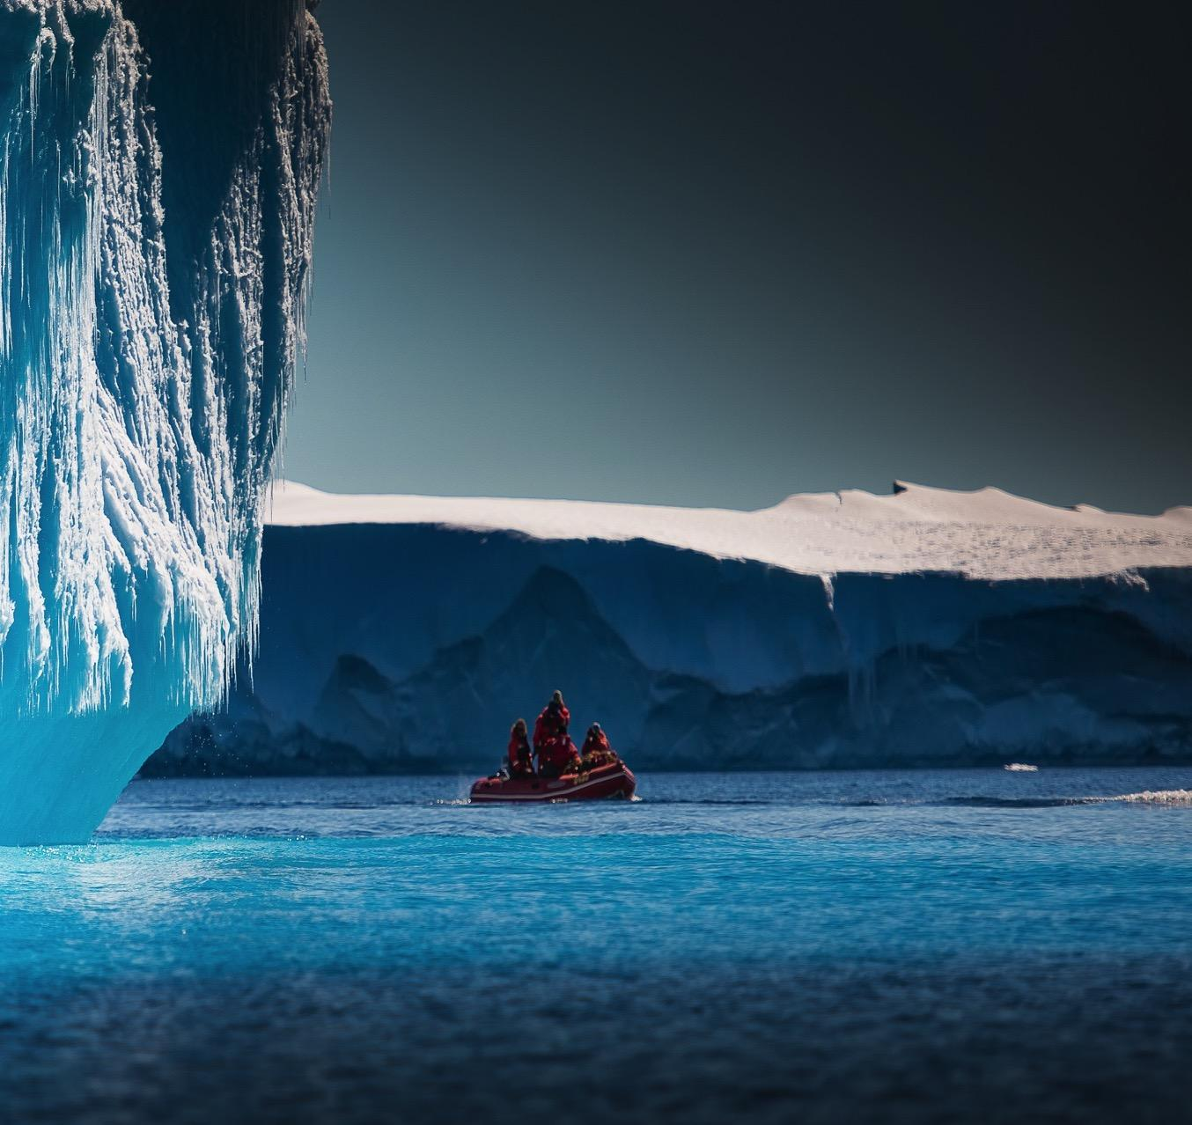


Cover image
Please select the cover image you require from the following selection:
5 x Discovery stories (SN)
5 X Transformer images (SN)
Once you have chosen the cover image move the associated Thank you page to the end of the presentation and delete all the other cover and thank you pages.
Printing
When printing the deck you can reduce ink use by selecting:
Ctrl p (print)
Change the option to greyscale
Societal Impact Workshop
Leandra Koetsier
https://orcid.org/0000-0002-3183-0651
Health Sciences
  15 October 2020
Antarctica meltdown could double sea level rise
DOI: 10.5281/zenodo.4304403
Workshop leader: Stefan de Jong
Host: VU Amsterdam
Local coach: Sandy Broere-Lee (Grants Office),
Diane Schöller (IXA Valorisation Office)
Maurice Vanderfeesten (Library)

Slide 2
Agenda table
1 | Session A – Creating a spark!
2 | Session B – Shining a light on your impact
3 | Session C – Passing on the torch

Slide 3

Session A – Creating a spark!
Section breaks
Section breaks are available in each palette colour and in a neutral blue grey.
In most cases one section break colour should be used consistently throughout the deck – ideally following the colour of the Advancing Discovery bookmark on the cover page.
1.0

Slide 4
Motivation
1. Creating societal impact with my project is important to translate the study results into tools for policy and practice in order to facilitate local implementation.
2. Societal impact might be a way to inform collaboration partners, to be visible and to increase and maintain commitment of the partners involved.

Slide 5
Inspiration: three examples
1. Project Care for Obesity- tools for policy and practice
2. Pharos, low literacy, language barrier
3. The Groentefroetels

Slide 6
Session B – Shining a light on your impact
Section breaks
Section breaks are available in each palette colour and in a neutral blue grey.
In most cases one section break colour should be used consistently throughout the deck – ideally following the colour of the Advancing Discovery bookmark on the cover page.
2.0

Slide 7
Impact strategy
Goal
I will develop an assessment tool (paper version) for children with obesity as earlier research shows that the current assessment tool need to be improved (especially the structure of the assessment tool, psychosocial factors that need to be more elaborated and a version for teenagers with additional relevant themes). The developed assessment tool will facilitate professionals in performing their work-related activities as part of the care for childhood obesity. The assessment tool includes themes that gives insights into the causes of obesity and the factors that maintains obesity, which will provide input for the health care plan.
  I will provide tips that belong to the use of the assessment (for instance attitude of the professional)
  I will provide an instruction (how to use the assessment; e.g. use it as a guidance, not as a checklist)
I will provide a recommendation about how to use the assessment tool for children with obesity in combination with other/existing assessment tools in practice (in the Netherlands)
Notes:
What type of results do you expect from your project? Think about conclusions, but consider new methodologies and technologies as well, for example.
I will develop an assessment tool (paper version) for children with obesity as earlier research shows that the current assessment tool need to be improved (especially the structure of the assessment tool, psychosocial factors that need to be more elaborated and a version for teenagers with additional relevant themes). The developed assessment tool will facilitate professionals in performing their work related activities as part of the care for childhood obesity. The assessment tool includes themes that gives insights into the causes of obesity and the factors that maintains obesity, which will provide input for the health care plan.
I will provide tips that belong to the use of the assessment (for instance attitude of the professional)
I will provide an instruction (how to use the assessment; e.g. use it as a guidance, not as a checklist)
I will provide a recommendation about how to use the assessment tool for children with obesity in combination with other/existing assessment tools in practice (in the Netherlands )
What challenge in society could you address using these results?
Facilitating professionals of 35 municipalities in the Netherlands in performing their work related activities as part of the care for childhood obesity as research shows that the current assessment tool needs to be improved, e.g:
How to assess important factors that play a role in the maintenance of childhood obesity
How to make a health care plan for childhood obesity
With the aim to improve the care for children with obesity!
What is the final audience that should adopt your results to address this challenge? Do you need partners, such as companies or the media, to reach them?
Coordinating professionals (mostly youth health care professionals) as tey are the end-users (these professionals participate in the study, which will make them become more familiar with the solution and be able to easily adopt it and disseminate it to their colleagues).
To reach them, I need coalition colleagues as they are acting ‘closer to practice’ and spread the knowledge.
Coalitie Kind naar Gezonder Gewicht (JOGG, Nederlands Jeugdinstituut (NJI), Nederlands Centrum Jeugdgezondheid (NCJ), Vrije Universiteit Amsterdam - Care for Obesity (VU/C4O) en Rijksinstituut voor Volksgezondheid en Milieu (RIVM)
The knowledge need to be incorporated in the post-academic education for these professionals (coordinated by some of these coalition colleagues).
Educators of the post-academic education (Anja en Madeline)
Children and parents as they are the potential audience
How will you interact with your audiences and partners?
Coalition colleagues
I will let them be study participants; what are their ideas by the further development of the broad assessment? This will 1) help me to better align the tool to uses and needs in practice 2) inform my audiences about what to expect and 3) create a feeling of ownership, which will supports actual use
I will present the interim results to test ideas that my research team developed in an existing work-session with all the interested coalition colleagues
I will provide an academic article (English) of the study findings that will be published in an international academic journal.
I will provide a Dutch summary of the study findings that will be disseminated published on the website of the coalition.
Professionals
I will let them be study participants: what are their ideas by the further development of the broad assessment? This will 1) help me to better align the tool to uses and needs in practice 2) inform my audiences about what to expect and 3) create a feeling of ownership, which will supports actual use
I will provide an academic article (English) of the study findings that will be published in an international academic journal.
I will provide a Dutch summary of the study findings that will be disseminated published on the website of the coalition.

Slide 8
Impact strategy
Societal challenges
Facilitating professionals of 35 municipalities in the Netherlands in performing their work related activities as part of the care for childhood obesity as research shows that the current assessment tool needs to be improved, e.g.:
  How to assess important factors that play a role in the maintenance of childhood obesity
  How to make a health care plan for childhood obesity
→ With the aim to improve the care for children with obesity!
Notes:
What type of results do you expect from your project? Think about conclusions, but consider new methodologies and technologies as well, for example.
I will develop an assessment tool (paper version) for children with obesity as earlier research shows that the current assessment tool need to be improved (especially the structure of the assessment tool, psychosocial factors that need to be more elaborated and a version for teenagers with additional relevant themes). The developed assessment tool will facilitate professionals in performing their work related activities as part of the care for childhood obesity. The assessment tool includes themes that gives insights into the causes of obesity and the factors that maintains obesity, which will provide input for the health care plan.
I will provide tips that belong to the use of the assessment (for instance attitude of the professional)
I will provide an instruction (how to use the assessment; e.g. use it as a guidance, not as a checklist)
I will provide a recommendation about how to use the assessment tool for children with obesity in combination with other/existing assessment tools in practice (in the Netherlands )
What challenge in society could you address using these results?
Facilitating professionals of 35 municipalities in the Netherlands in performing their work related activities as part of the care for childhood obesity as research shows that the current assessment tool needs to be improved, e.g:
How to assess important factors that play a role in the maintenance of childhood obesity
How to make a health care plan for childhood obesity
With the aim to improve the care for children with obesity!
What is the final audience that should adopt your results to address this challenge? Do you need partners, such as companies or the media, to reach them?
Coordinating professionals (mostly youth health care professionals) as tey are the end-users (these professionals participate in the study, which will make them become more familiar with the solution and be able to easily adopt it and disseminate it to their colleagues).
To reach them, I need coalition colleagues as they are acting ‘closer to practice’ and spread the knowledge.
Coalitie Kind naar Gezonder Gewicht (JOGG, Nederlands Jeugdinstituut (NJI), Nederlands Centrum Jeugdgezondheid (NCJ), Vrije Universiteit Amsterdam - Care for Obesity (VU/C4O) en Rijksinstituut voor Volksgezondheid en Milieu (RIVM)
The knowledge need to be incorporated in the post-academic education for these professionals (coordinated by some of these coalition colleagues).
Educators of the post-academic education (Anja en Madeline)
Children and parents as they are the potential audience
How will you interact with your audiences and partners?
Coalition colleagues
I will let them be study participants; what are their ideas by the further development of the broad assessment? This will 1) help me to better align the tool to uses and needs in practice 2) inform my audiences about what to expect and 3) create a feeling of ownership, which will supports actual use
I will present the interim results to test ideas that my research team developed in an existing work-session with all the interested coalition colleagues
I will provide an academic article (English) of the study findings that will be published in an international academic journal.
I will provide a Dutch summary of the study findings that will be disseminated published on the website of the coalition.
Professionals
I will let them be study participants: what are their ideas by the further development of the broad assessment? This will 1) help me to better align the tool to uses and needs in practice 2) inform my audiences about what to expect and 3) create a feeling of ownership, which will supports actual use
I will provide an academic article (English) of the study findings that will be published in an international academic journal.
I will provide a Dutch summary of the study findings that will be disseminated published on the website of the coalition.

Slide 9
Impact strategy
Audience
Coordinating professionals (mostly youth health care professionals) as tey are the end-users (these professionals participate in the study, which will make them become more familiar with the solution and be able to easily adopt it and disseminate it to their colleagues).
To reach them, I need coalition colleagues as they are acting ‘closer to practice’ and spread the knowledge.
  Coalitie Kind naar Gezonder Gewicht (JOGG, Nederlands Jeugdinstituut (NJI), Nederlands Centrum Jeugdgezondheid (NCJ), Vrije Universiteit Amsterdam - Care for Obesity (VU/C4O) en Rijksinstituut voor Volksgezondheid en Milieu (RIVM)
The knowledge need to be incorporated in the post-academic education for these professionals (coordinated by some of these coalition colleagues).
  Educators of the post-academic education (Anja en Madeline)
Children and parents as they are the potential audience
Notes:
What type of results do you expect from your project? Think about conclusions, but consider new methodologies and technologies as well, for example.
I will develop an assessment tool (paper version) for children with obesity as earlier research shows that the current assessment tool need to be improved (especially the structure of the assessment tool, psychosocial factors that need to be more elaborated and a version for teenagers with additional relevant themes). The developed assessment tool will facilitate professionals in performing their work related activities as part of the care for childhood obesity. The assessment tool includes themes that gives insights into the causes of obesity and the factors that maintains obesity, which will provide input for the health care plan.
I will provide tips that belong to the use of the assessment (for instance attitude of the professional)
I will provide an instruction (how to use the assessment; e.g. use it as a guidance, not as a checklist)
I will provide a recommendation about how to use the assessment tool for children with obesity in combination with other/existing assessment tools in practice (in the Netherlands )
What challenge in society could you address using these results?
Facilitating professionals of 35 municipalities in the Netherlands in performing their work related activities as part of the care for childhood obesity as research shows that the current assessment tool needs to be improved, e.g:
How to assess important factors that play a role in the maintenance of childhood obesity
How to make a health care plan for childhood obesity
With the aim to improve the care for children with obesity!
What is the final audience that should adopt your results to address this challenge? Do you need partners, such as companies or the media, to reach them?
Coordinating professionals (mostly youth health care professionals) as tey are the end-users (these professionals participate in the study, which will make them become more familiar with the solution and be able to easily adopt it and disseminate it to their colleagues).
To reach them, I need coalition colleagues as they are acting ‘closer to practice’ and spread the knowledge.
Coalitie Kind naar Gezonder Gewicht (JOGG, Nederlands Jeugdinstituut (NJI), Nederlands Centrum Jeugdgezondheid (NCJ), Vrije Universiteit Amsterdam - Care for Obesity (VU/C4O) en Rijksinstituut voor Volksgezondheid en Milieu (RIVM)
The knowledge need to be incorporated in the post-academic education for these professionals (coordinated by some of these coalition colleagues).
Educators of the post-academic education (Anja en Madeline)
Children and parents as they are the potential audience
How will you interact with your audiences and partners?
Coalition colleagues
I will let them be study participants; what are their ideas by the further development of the broad assessment? This will 1) help me to better align the tool to uses and needs in practice 2) inform my audiences about what to expect and 3) create a feeling of ownership, which will supports actual use
I will present the interim results to test ideas that my research team developed in an existing work-session with all the interested coalition colleagues
I will provide an academic article (English) of the study findings that will be published in an international academic journal.
I will provide a Dutch summary of the study findings that will be disseminated published on the website of the coalition.
Professionals
I will let them be study participants: what are their ideas by the further development of the broad assessment? This will 1) help me to better align the tool to uses and needs in practice 2) inform my audiences about what to expect and 3) create a feeling of ownership, which will supports actual use
I will provide an academic article (English) of the study findings that will be published in an international academic journal.
I will provide a Dutch summary of the study findings that will be disseminated published on the website of the coalition.

Slide 10
Impact strategy
Interaction with audience (1)
Coalition colleagues
  I will let them be study participants; what are their ideas by the further development of the broad assessment? This will 1) help me to better align the tool to uses and needs in practice 2) inform my audiences about what to expect and 3) create a feeling of ownership, which will support actual use
  I will present the interim results to test ideas that my research team developed in an existing work-session with all the interested coalition colleagues
  will provide an academic article (English) of the study findings that will be published in an international academic journal.
  I will provide a Dutch summary of the study findings that will be disseminated published on the website of the coalition.
Notes:
What type of results do you expect from your project? Think about conclusions, but consider new methodologies and technologies as well, for example.
I will develop an assessment tool (paper version) for children with obesity as earlier research shows that the current assessment tool need to be improved (especially the structure of the assessment tool, psychosocial factors that need to be more elaborated and a version for teenagers with additional relevant themes). The developed assessment tool will facilitate professionals in performing their work related activities as part of the care for childhood obesity. The assessment tool includes themes that gives insights into the causes of obesity and the factors that maintains obesity, which will provide input for the health care plan.
I will provide tips that belong to the use of the assessment (for instance attitude of the professional)
I will provide an instruction (how to use the assessment; e.g. use it as a guidance, not as a checklist)
I will provide a recommendation about how to use the assessment tool for children with obesity in combination with other/existing assessment tools in practice (in the Netherlands )
What challenge in society could you address using these results?
Facilitating professionals of 35 municipalities in the Netherlands in performing their work related activities as part of the care for childhood obesity as research shows that the current assessment tool needs to be improved, e.g:
How to assess important factors that play a role in the maintenance of childhood obesity
How to make a health care plan for childhood obesity
With the aim to improve the care for children with obesity!
What is the final audience that should adopt your results to address this challenge? Do you need partners, such as companies or the media, to reach them?
Coordinating professionals (mostly youth health care professionals) as tey are the end-users (these professionals participate in the study, which will make them become more familiar with the solution and be able to easily adopt it and disseminate it to their colleagues).
To reach them, I need coalition colleagues as they are acting ‘closer to practice’ and spread the knowledge.
Coalitie Kind naar Gezonder Gewicht (JOGG, Nederlands Jeugdinstituut (NJI), Nederlands Centrum Jeugdgezondheid (NCJ), Vrije Universiteit Amsterdam - Care for Obesity (VU/C4O) en Rijksinstituut voor Volksgezondheid en Milieu (RIVM)
The knowledge need to be incorporated in the post-academic education for these professionals (coordinated by some of these coalition colleagues).
Educators of the post-academic education (Anja en Madeline)
Children and parents as they are the potential audience
How will you interact with your audiences and partners?
Coalition colleagues
I will let them be study participants; what are their ideas by the further development of the broad assessment? This will 1) help me to better align the tool to uses and needs in practice 2) inform my audiences about what to expect and 3) create a feeling of ownership, which will supports actual use
I will present the interim results to test ideas that my research team developed in an existing work-session with all the interested coalition colleagues
I will provide an academic article (English) of the study findings that will be published in an international academic journal.
I will provide a Dutch summary of the study findings that will be disseminated published on the website of the coalition.
Professionals
I will let them be study participants: what are their ideas by the further development of the broad assessment? This will 1) help me to better align the tool to uses and needs in practice 2) inform my audiences about what to expect and 3) create a feeling of ownership, which will supports actual use
I will provide an academic article (English) of the study findings that will be published in an international academic journal.
I will provide a Dutch summary of the study findings that will be disseminated published on the website of the coalition.

Slide 11
Impact strategy
Interaction with audience (2)
Professionals
  I will let them be study participants: what are their ideas by the further development of the broad assessment? This will 1) help me to better align the tool to uses and needs in practice 2) inform my audiences about what to expect and 3) create a feeling of ownership, which will supports actual use
  I will provide an academic article (English) of the study findings that will be published in an international academic journal.
  I will provide a Dutch summary of the study findings that will be disseminated published on the website of the coalition.
My research contributes to SDG: Goal 3: Ensure healthy lives and promote well-being for all at all ages.
Notes:
What type of results do you expect from your project? Think about conclusions, but consider new methodologies and technologies as well, for example.
I will develop an assessment tool (paper version) for children with obesity as earlier research shows that the current assessment tool need to be improved (especially the structure of the assessment tool, psychosocial factors that need to be more elaborated and a version for teenagers with additional relevant themes). The developed assessment tool will facilitate professionals in performing their work related activities as part of the care for childhood obesity. The assessment tool includes themes that gives insights into the causes of obesity and the factors that maintains obesity, which will provide input for the health care plan.
I will provide tips that belong to the use of the assessment (for instance attitude of the professional)
I will provide an instruction (how to use the assessment; e.g. use it as a guidance, not as a checklist)
I will provide a recommendation about how to use the assessment tool for children with obesity in combination with other/existing assessment tools in practice (in the Netherlands )
What challenge in society could you address using these results?
Facilitating professionals of 35 municipalities in the Netherlands in performing their work related activities as part of the care for childhood obesity as research shows that the current assessment tool needs to be improved, e.g:
How to assess important factors that play a role in the maintenance of childhood obesity
How to make a health care plan for childhood obesity
With the aim to improve the care for children with obesity!
What is the final audience that should adopt your results to address this challenge? Do you need partners, such as companies or the media, to reach them?
Coordinating professionals (mostly youth health care professionals) as tey are the end-users (these professionals participate in the study, which will make them become more familiar with the solution and be able to easily adopt it and disseminate it to their colleagues).
To reach them, I need coalition colleagues as they are acting ‘closer to practice’ and spread the knowledge.
Coalitie Kind naar Gezonder Gewicht (JOGG, Nederlands Jeugdinstituut (NJI), Nederlands Centrum Jeugdgezondheid (NCJ), Vrije Universiteit Amsterdam - Care for Obesity (VU/C4O) en Rijksinstituut voor Volksgezondheid en Milieu (RIVM)
The knowledge need to be incorporated in the post-academic education for these professionals (coordinated by some of these coalition colleagues).
Educators of the post-academic education (Anja en Madeline)
Children and parents as they are the potential audience
How will you interact with your audiences and partners?
Coalition colleagues
I will let them be study participants; what are their ideas by the further development of the broad assessment? This will 1) help me to better align the tool to uses and needs in practice 2) inform my audiences about what to expect and 3) create a feeling of ownership, which will supports actual use
I will present the interim results to test ideas that my research team developed in an existing work-session with all the interested coalition colleagues
I will provide an academic article (English) of the study findings that will be published in an international academic journal.
I will provide a Dutch summary of the study findings that will be disseminated published on the website of the coalition.
Professionals
I will let them be study participants: what are their ideas by the further development of the broad assessment? This will 1) help me to better align the tool to uses and needs in practice 2) inform my audiences about what to expect and 3) create a feeling of ownership, which will supports actual use
I will provide an academic article (English) of the study findings that will be published in an international academic journal.
I will provide a Dutch summary of the study findings that will be disseminated published on the website of the coalition.

Slide 12
Impact strategy: tips & tricks
Be more concrete! Specify aim and medium of the tool, and be more specific about which partners need to be involved
Join already existing initiatives
Add quantitative data to your impact plan to show the urgency of your idea/project
Explain why the current strategy is not good enough
Already think about the implementation part

Slide 13
Session C – Passing on the torch
Section breaks
Section breaks are available in each palette colour and in a neutral blue grey.
In most cases one section break colour should be used consistently throughout the deck – ideally following the colour of the Advancing Discovery bookmark on the cover page.
3.0

Slide 14
Impact support: top recommendations
Use ORCID to increase visibility of your work
Visit the impact support website regularly! It is motivating to see what support is available
Dare to contact people!
Notes:
Before contacting any impact support, you should reflect first in which domain your skills are least developed. For example, if you are very good in presenting and networking with others, but not so good in writing, then you should think about visting an academic writing course first.
When preparing a meeting with a support officer, break down your research into the easiest explanation possible. The officer is most likely not familiar with your research field, so it is important to explain your research to him/her in a clear manner. This will make it easier for him/her, to think about the possible impact.
Before the meeting with a support officer, write down all domains in which you need support, but also prioritize them, so that if there is not enough time to discuss everything, you make sure that you covered the most important aspects for which you need support.

Slide 15
Stakeholder interaction: best practices
Create a win-win situation to make the stakeholders willing to make time. ‘what’s in it for them’?
Prepare! What is the aim of this interaction? Decide when you are satisfied and what you want to achieve with the interaction (for instance input on your plan, or commit someone to your project
Make sure that you can communicate about conditions and resources (e.g. planning or budget if applicable). What exactly do you need from someone? And is that feasible?

Slide 16
Lessons learned & achievements
Very nice and valuable to have input from experts
Good to be forced to think about societal impact and especially to work it out and make an impact plan
Understanding of societal impact, strategies and actions to optimize impact is very relevant to my (further) career ☺

Slide 17
Thank you
Thank you page
Make sure you have the thank you page associated with the cover image you have chosen and move this slide to the end of your presentation
Updating the footer
To update the footer:
Go the slide master via View
Scroll to the first page
Change text in the footer
Close slide master
Supporting information/contacts

