Slide 1


DDI Cross Domain Integration (DDI-CDI)
An introduction to the draft specification
Hilde Orten , Norwegian Centre for Research Data - NSD
Arofan Gregory , Consultant
EDDI20 : 12th Annual European DDI User Conference 30 Nov-2 Dec 2020 Online (France)
License: Creative Commons Attribution 4.0 International (CC BY 4.0)

Slide 2
Outline
Introduction and Background
Example Constructs from the Model
  Foundational Metadata
  Data Description
  Exercises
  Process and Provenance
Summary

Slide 3
Introduction and Background

Slide 4
DDI-CDI and FAIR
Many people talk about Findability and Access
  Not so much about Interoperability and Reuse
DDI-CDI focuses on these aspects of FAIR data
  It is also quite useful for data discovery
Interoperability and reuse of data are metadata-intensive
Historically, these aspects of data management are expensive and have not been fully incentivized by research funders
Today’s focus on FAIR data demands that we do more!

Slide 5
DDI – CDI as a New Type of Work Product
DDI Codebook and DDI Lifecycle are metadata specifications for the Social, Behavioral, and Economic (SBE) Sciences
  They are generic enough to be used in similar domains (official statistics, public health)
  They still use terms and models familiar to SBE sciences
DDI – CDI is different: it is intended to be used across a wider range of domains
  Different types of data and models
  More abstract/general terminology
DDI – CDI is a new type of specification, meant to be used with many other standards, in SBE and outside it

Slide 6
History: MRT and DDI Developments
In the margins of the 2018 European DDI User Conference (Berlin) it was agreed that a “core” of the next-generation/model based DDI work should be brought to market
A 1-year timeframe was proposed
The Modelling, Representation and Testing (MRT) group was formed in early 2019
The working process was to base models on implementations, tested against real-world use cases
  ALPHA Network
  DDI R Libraries (references: 1, 2)
  Others (U.S. Bureau of Labor Statistics for time series, etc.)

Slide 7
Group and Events
Small group (9 members) meeting weekly (and more) for over a year
No turn-over – members have been extremely focused and disciplined
Ottawa Sprint in margins of NADDI 2019
Dagstuhl Sprint in October 2019
Public Review Release April 2020
MRT has done 7 webinars to reach out to users in different areas (250+ people)
  In collaboration with CODATA
  More are planned
Communications with management, technical committee work, marketing, and training groups within the DDI Alliance have been emphasized

Slide 8
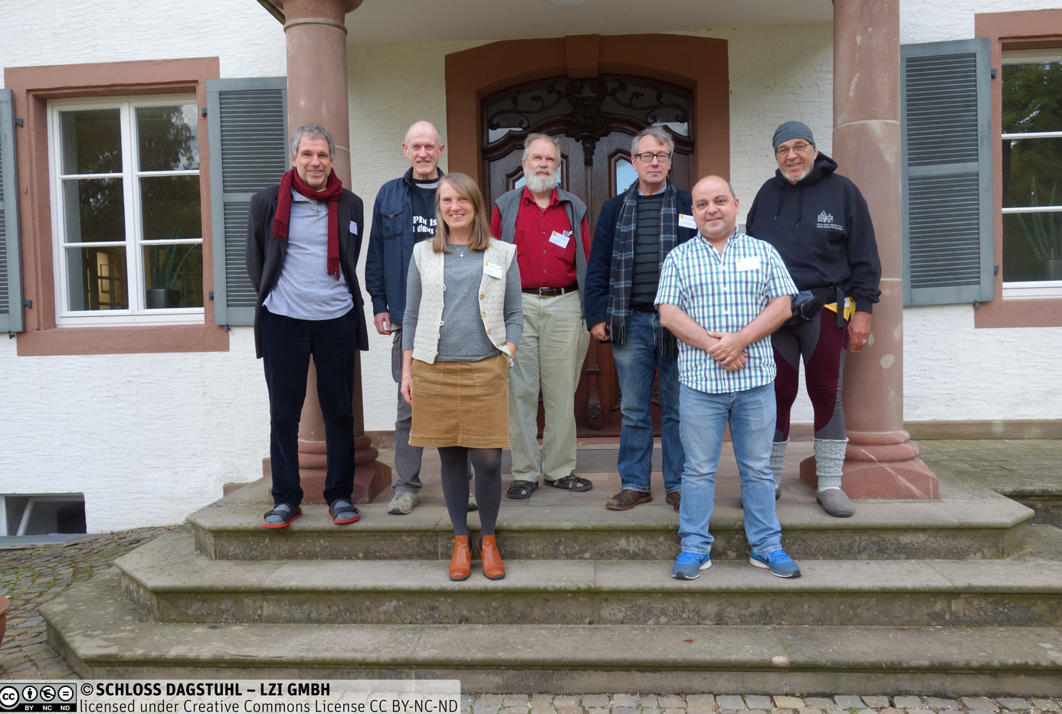
MRT Members
Back row, from left: Joachim Wackerow Dan Gillman
Larry Hoyle
Arofan Gregory
Jay Greenfield
Front row, from left: Hilde Orten
Flavio Rizzolo
Not in picture:
Oliver Hopt
Wendy Thomas
https://ddi-alliance.atlassian.net/wiki/spaces/DDI4/pages/707624961/Dagstuhl+Sprint+October+2019
Notes:
Back row, from left: Joachim Wackerow, Dan Gillman, Larry Hoyle, Arofan Gregory, Jay Greenfield
In front, from left: Hilde Orten, Flavio Rizzolo
Not on the picture: Oliver Hopt, Wendy Thomas

Slide 9
Evolution in Purpose
DDI-CDI was expected to be the “core” of a model-driven DDI
  A “next generation” after DDI-Lifecycle
Implementation cases showed that something else was needed: a focus on data provenance and data integration
DDI-CDI has emerged as a companion to DDI-Codebook and DDI-Lifecycle, not a replacement for them
The Social, Behavioral, and Economic (SBE) community needs better data integration tools
  So do other domains!

Slide 10
Real-World Trends and Requirements
Several changes have taken place in recent years which impact the requirements for DDI-CDI
  Larger research projects using data sometimes coming from external domains
  More data, coming from a wider range of sources
  Increased ability to compute with data (Machine Learning, etc.)
These changes result in requirements for data/metadata management
  More complete, machine-actionable metadata is needed
  Improved “context” for data is needed (provenance, semantics)
  New data formats/structures must be described and integrated
  A broader range of technology platforms require support

Slide 11
DDI-CDI within the Product Suite
DDI-CDI does not replace DDI-Codebook or DDI-Lifecycle
  It can and will be used in combination with other DDI specifications
It adds support for describing new types of data
It expands the ability to describe process/provenance
It provides a detailed description of integration between disparate types of data
Extends the applicability of the DDI to new domains/disciplines
  As an integration tool
  As a data management tool

Slide 12
DDI-CDI Goals and Purpose
Design goal: Create a useful, implementable product based on real use cases
Developed with modern systems in mind
  That employs a variety of models
  That complies with a range of specifications, related to data description and provenance
Fills in information that other standards do not capture (align rather than replace)
For data: Description of a single data point – a Datum – that can play different roles in different data structures and formats
For process/provenance: Packaging of machine level processes into a structure that relates to business processes described at a level understood by users.

Slide 13
DDI-CDI Domain-Independence
Designed to be used by any domain
Focus on structure and generic aspects of the things it describes
Generic elements like variables and classifications
Do not cover domain specific aspects like semantics or lifecycles (provided by domains)
Complementary to domain specific models, for example DDI-Lifecycle
Well suited to combining data from more than one domain or system (cross domain)

Slide 14
The Model is the Main Thing!
A formal UML class model
Based on a subset of UML features
Expressed as Canonical XMI
  XMI is an XML language for describing/exchanging UML models
  Canonical XMI is well-supported by a broad range of UML tools
Representations in specific tools/syntaxes can be generated automatically from the UML
An XML representation is provided, others may be in future
UML “future-proofs” the standards
  Against changes in technology tools
  By being extensible

Slide 15
DDI – CDI Scope
“Microdata”/Unit Record Data
Aggregate Data/ Data “Cube”
Raw Data
Indicators
DDI – CDI describes the data at each stage, indicating the roles played by each atomic bit of data (“datum”)
This includes describing classifications, variables, concepts, etc. (“Foundational Metadata”)
New types of data can be described
DDI – CDI tracks the processing between each stage (implements PROV), reflecting the relationships between atomic datums (uses other standards for describing specific processes - SDTL)

Slide 16
Example Constructs from the Model
Features of DDI-CDI to Illustrate its Potential Utility

Slide 17
Foundational Metadata
Concepts and Concept Systems
Variables (of many types!)
Classifications, Codelists, Categories (etc.)
  Includes classification management
Populations, Units, and Universes

Slide 18
Foundational Metadata: The Variable Cascade
Understanding the roles played by variables is critical in integration of data
Variables do many, many different things
Not all variables are the same!
We have three levels of variables in our model:
  Conceptual Variables
  Represented Variables
  Instance Variables
Notes:
The Variable Cascade was developed as part of the DDI-CDI (DDI4) development. It is also taken on board in DDI-Lifecycle

Slide 19
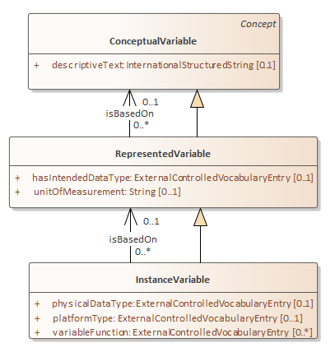
Variable Cascade – Conceptual Variable
Variable descriptions at a high level. Early in designing data collection, broad searches. Broadly reusable.
Notes:
The ConceptualVariable holds information at a very general level.

Slide 20
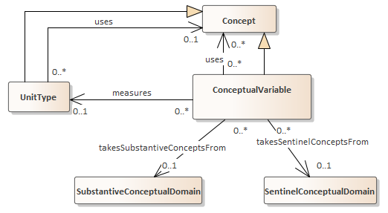
ConceptualVariable
What we want to collect
measures on
Notes:
In addition to a text description, the model can describe Concepts associated with the
ConceptualVariable. It can also describe what units we want to collect measures on.
It can also describe substantive and sentinel conceptual domains.
The substantive categories would describe data you would like to include in your analyses. The sentinel categories could typically be missing values like “don’t know” and “unanswered”.
No codes for categories are specified at this level. Those are specified at the RepresentedVariable level. This allows tying together any RepresentedVariables that use different codes for the same categories.

Slide 21
Variable Cascade - RepresentedVariable
More specificity about value domain, units of measurement. Still reusable.
Notes:
RepresentedVariable: A ConceptualVariable with a substantive value domain specified.

Slide 22
Variable Cascade - InstanceVariable
Describing collected data. Physical datatype and platform. Invariant role of the variable (e.g. a weight)
Notes:
InstanceVariables are for collected data. Represents the use of a RepresentedVariable within a data set.
The InstanceVariable class inherits all of the properties and relationships of the RepresentedVariable class and, in turn, the ConceptualVariable class.
This means that an InstanceVariable can be completely populated without the need to create an associated RepresentedVariable or ConceptualVariable.

Slide 23
Application: Documenting Comparability among Variables (Simple Example)
Legalmaritalstatus
(conceptual variable)
Conceptual variable
Common variable specification without a representation
1 | Married
2 | Separated
3 | Divorced
4 | Widowed
5 | Never married
MARITAL
(represented variable)
MARITALB
(represented variable)
Represented variable
Common variable specification with a code representation
1 | Legally married
2 | In a legally registered civil union
3 | Legally separated
4 | Legally divorced/civil union dissolved
5 | Widowed/civil partner died
6 | None of these (NEVER married or in legally registered civil union)
MARITAL
2004
(variable)
MARITALB
2008
(variable)
MARITALB
2018
(variable)
Variable
Variable specification within a dataset context
Notes:
The example, European Social Survey 2004, 2008 and 2018:
Three Different (distinct) sets of data with a different variables all measuring legal marriage status.
Represented variables link variables which are directly comparable and have the same representation of the value domain. It doesn’t care about the question asked- only the value domain.
The represented variable is a way to measure marriage and so links to the marriage conceptual variable.
(Value domain = Variable representation in DDI-Lifecycle)

Slide 24
Application: Recognizing Similar variables in Difficult Cases
Two variables in different data sets might:
  Measure the same concept differently
  Measure the same concept in the same way with different physical representations
  Exist identically in two data sets, but with no formal link
In all of these cases, understanding the variables at each level (conceptual, representational, and actual) provides a strong basis for programmatically identifying them as potential points for joining data sets

Slide 25
DDI-CDI and External Vocabularies, Ontologies, or Thesauri
DDI-CDI allows for the use of any concept system
  It does not model the semantics of any specific domain
  Rich model for classifications, codelists, and controlled vocabularies
  Mechanism for referencing domain ontologies
Formal use of concepts is specified
  Concepts can be variables, categories, population, units, etc.
  Concept systems are modelled generically, but can be external
Semantic mapping is not provided
  Semantic mapping has its own standards/mechanisms
  DDI-CDI provides a framework where semantic mapping becomes more meaningful

Slide 26
Data Structures
DDI-CDI currently can describe four different data structures
  Wide – as with unit records
  Long - as with event or stream data
  Key value – as in a key-value store
  Dimensional - as with aggregate data
We’ll now show some examples of data and their representations in the different structure types.
Notes:
Wide Data
Traditional rectangular unit record data sets. Each record has a unit identifier and a set of measures for the same unit
Long Data
Each record has a unit identifier and a set of measures but there may be multiple records for any given unit. The structure is used for many different data types, for example event data and spell data
Multi-Dimensional Data
Data in which observations are identified using a set of dimensions. Examples are multi-dimensional cubes and time series
Key-Value Data
Set of measures, each paired with an identifier

Slide 27
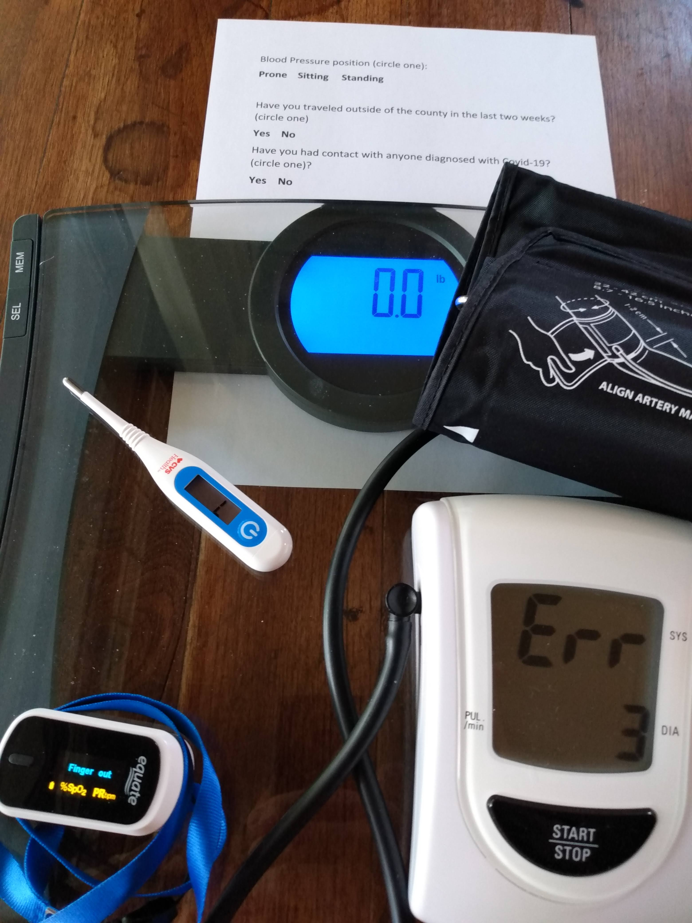
Example:
COVID Related Information at Building Doors
Imagine that a program (Python?) collects Covid related information at building doors:
Blood Pressure( Systolic, diastolic)
Position for BP
weight
temperature
pctO2
pulse
beenToFloridaEtc?
exposed?
Position (prone, sitting, standing)
beenToFloridaEtc ,Exposed (yes, no)
Notes:
COVID example: In this example we’ll use a set of sample data that might be collected in the screenings that are common now for the COVID19 pandemic. These include biometric and survey type data. This photo shows some of the instruments that might be used to collect the data in a home setting.

Slide 28
Wide Example
Prone
Sitting
Standing
As a spreadsheet table
Blood pressure in mmHg
entry | datetime | systolic | diastolic | position | weight | temp | pctO2 | pulse | away | exposed
101 | 2020-07-14T13:54 | 114 | 70 | 2 | 83914.6 | 36.44 | 98 | 70 | n | n
132 | 2020-07-14T14:03 | 125 | 86 | 3 | 68038.9 | 37.5 | 85 | 92 | y | n
As tab delimited text lines
entry datetime systolic diastolic position weight temp pctO2 pulse away exposed
101 2020-07-14T13:54 114 70 2 83,914.6 36.44 98 70 n n
132 2020-07-14T14:03 125 86 3 68,038.9 37.50 85 92 y n
Notes:
Wide Data: Traditional rectangular unit record data sets. Each record has a unit identifier and a set of measures for the same unit
COVID example: Here are two rows from our example data in a wide structure.
At the top the data are displayed as in a spreadsheet. Below they are displayed as tab delimited text.
Each row represents one observed unit (a person represented by the entry number) and each column contains values for one variable, for example the person’s temperature in degrees Celsius .

Slide 29
Long Example
Entry | DateTime | Measure | Position | Value
101 | 2020-07-14T13:54 | systolic | 2 | 114
101 | 2020-07-14T13:54 | diastolic | 2 | 70
101 | 2020-07-14T13:54 | weight | 2 | 83914.60
101 | 2020-07-14T13:54 | temp | 2 | 36.44
101 | 2020-07-14T13:54 | pctO2 | 2 | 98
101 | 2020-07-14T13:54 | pulse | 2 | 70
101 | 2020-07-14T13:54 | away | 2 | n
101 | 2020-07-14T13:54 | exposed | 2 | n
132 | 2020-07-14T14:03 | systolic | 3 | 125
132 | 2020-07-14T14:03 | diastolic | 3 | 86
132 | 2020-07-14T14:03 | weight | 3 | 68038.90
132 | 2020-07-14T14:03 | temp | 3 | 37.5
132 | 2020-07-14T14:03 | pctO2 | 3 | 85
132 | 2020-07-14T14:03 | pulse | 3 | 92
132 | 2020-07-14T14:03 | away | 3 | y
132 | 2020-07-14T14:03 | exposed | 3 | n
Notes:
Long Data: Each record has one or more unit identifier and a set of measures but there may be multiple records for any given unit. The structure is used for many different data types, for example event data and spell data
COVID example: Here are the same data in a long structure, The columns Entry and DateTime are identifiers and Position is an attribute. These are repeated from their respective row in the wide structure. The column labeled Value has the other values from both wide rows.

Slide 30
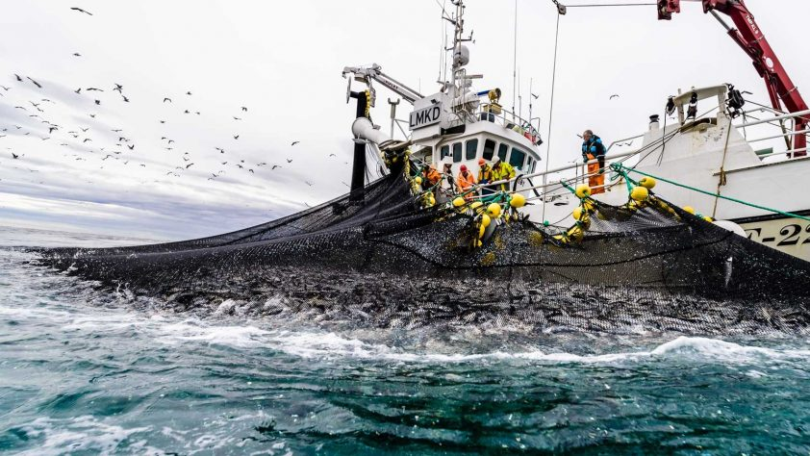
Example: Fisheries statistics - Norway
Data for each ‘landing’ of catches are recorded
Boat
Nationality of boat
Fishing equipment
Species
Round weight in ton
Landing time
and lots of other information
Notes:
Fisheries statistics example: Fisheries statistics in Norway collected when catches are delivered or ‘landed’ on shore based fish receptions.

Slide 31
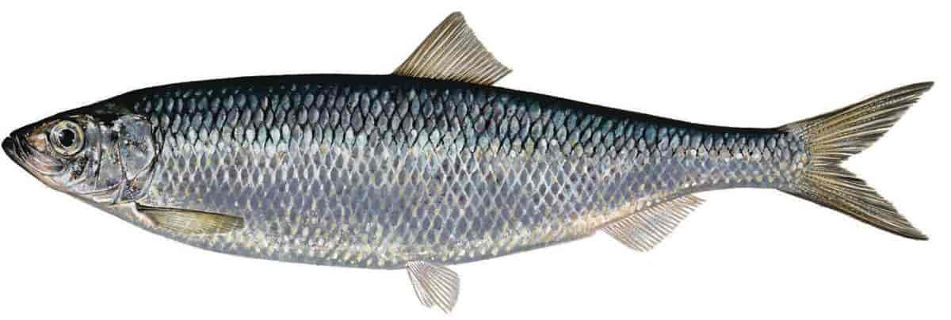
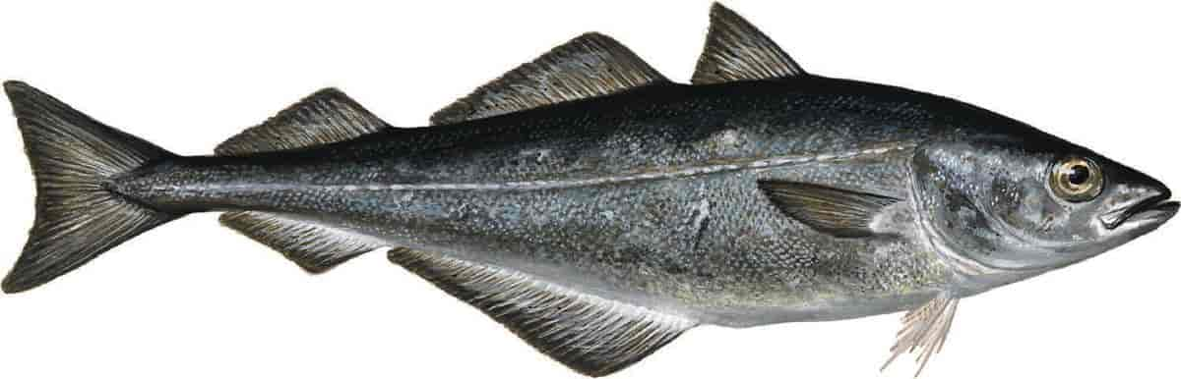
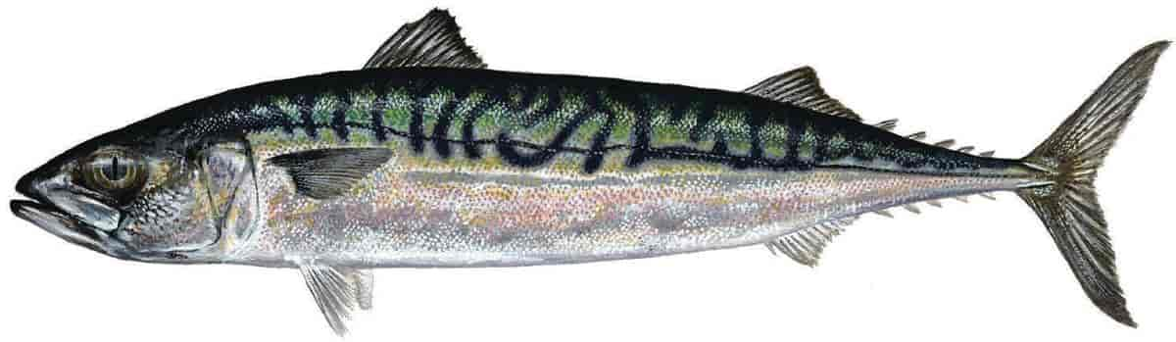
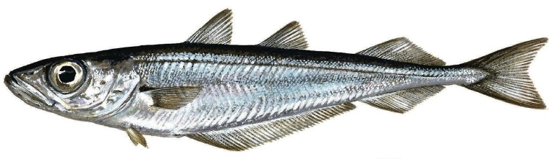
Long Example
Samples from Fisheries Statistics
Boat name | Nationality of boat | Landing date | Spieces | Round weight in ton | Fishing equipment
Lønningen | NO | 07.04.2019 | Blue whiting | 2917,75 | Trawl
Ligrunn | NO | 29.08.2019 | Herring | 23034,41 | Trawl
Ligrunn | NO | 29.08.2019 | Pollock | 307,1 | Trawl
Ligrunn | NO | 25.09.2019 | Mackerel | 1621,68 | Seine net
Vikingbank | NO | 05.11.2019 | Norwegian spring – spawning herring | 2932,16 | Seine net
Blue whiting
Mackerel
Pollock
Herring
Notes:
Again a long example. A selection of landing data for the boats Lønningen, Ligrunn and Vikingbank in 2019 are selected for this example.
Sample statistics adapted from sources:
https://fiskeriportalen.no/fiskebater/lonningen-h-0030b
https://fiskeriportalen.no/fiskebater/ligrunn-h-0002f
https://fiskeriportalen.no/fiskebater/vikingbank-r-0003k

Slide 32

Much shorter example: Fish catching boats!

Slide 33
Dimensional Example
Aggregate fisheries statistics, Year 2019 – Norwegian boats – Round weight in ton
 | Fishing equipment, main group
Species, main group | Purse seine | Conventional | Trawl | Other
Pelagic fish | 587465 | 1371 | 712873 | 359
Cod and cod species | 33554 | 397254 | 237496 | 11
etc.
Long table from the former slide
Boat name | Nationality of boat | Landing date | Spieces | Round weight in ton | Fishing equipment
Lønningen | NO | 07.04.2019 | Blue whiting | 2917,75 | Trawl
Ligrunn | NO | 29.08.2019 | Herring | 23034,41 | Trawl
Ligrunn | NO | 29.08.2019 | Pollock | 307,1 | Trawl
Ligrunn | NO | 25.09.2019 | Mackerel | 1621,68 | Seine net
Vikingbank | NO | 05.11.2019 | Norwegian spring breeding herring | 2932,16 | Net equipment
Notes:
Adapted from source: https://www.fiskeridir.no/Yrkesfiske/Tall-og-analyse/Fangst-og-kvoter/Fangst/Fangst-fordelt-paa-art

Slide 34
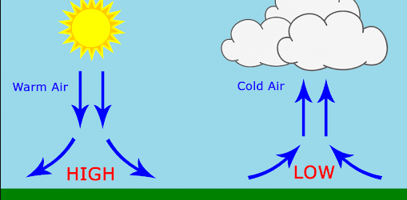
Example - Streaming Data, Barometric Pressure
Streaming data may involve a flexible set of measures arriving at unpredictable times.
An example sensor observation from the W3C Semantic Sensor Network Ontology (SSN) (https://www.w3.org/TR/vocab-ssn/#iphone_barometer-sosa) is of a barometric pressure taken by an iPhone.
Barometric pressure is pressure caused by the weight of the air above us

Slide 35
Key-Value example
Semantic Sensor Network Ontology (SSN) example
Wide
SensorID | Property | Time | ResultingValue
sensor/35-207306-844818-0/BMP282 | atmosphericPressurehPa | 2017-06-06T12:36:12Z | 1021.45
Key-Value
Key | Time | ResultingValue
sensor/35-207306-844818-0/BMP28/atmosphericPressurehPa | 2017-06-06T12:36:12Z | 1021.45
Notes:
Streaming data may involve a flexible set of measures arriving at unpredictable times. Structures that may be useful for streaming data include the long structure (like for event data) or a key value store.
With a long structure measure variables, may be associated with identifier variables (such as a sensor identifier) and attribute variables (such as time of measurement, time of receipt, location of measurement).
An example sensor observation from the W3C Semantic Sensor Network Ontology (SSN) (https://www.w3.org/TR/vocab-ssn/#iphone_barometer-sosa) is of a barometric pressure taken by an iPhone.
Upper table: Long format:
The value atmosphericPressurehPa is a code that points to a variable that links to the Concept “earthAtmosphere” in units of hectoPascal (hPa).
Lower table: Key Value Store format:
The SensorID and Property are concatenated into a single Key. The Key could be decomposed into the SensorID and Property components as needed.
Measures may involve datatypes not currently described in DDI (images, sound recording, etc.) but envisioned for future updates such as for Qualitative data.

Slide 36
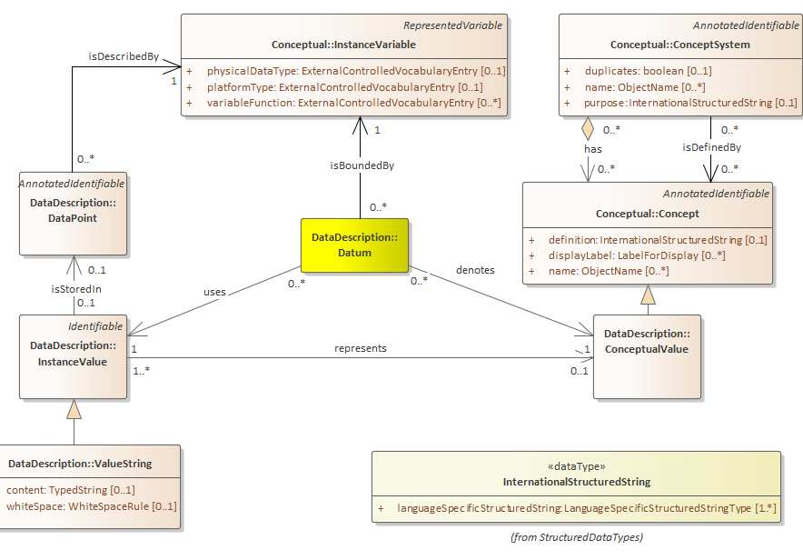

Metadata close up on the ‘observation’: The Datum approach
Described
by exactly one
Instance Variable
Notes:
All of the preceding structures are built up as sets of DataPoints. These are ‘containers’ for an instance value in a structure and exist independently of them.
An example is a cell in a data cube or a table. Data points are reusable across structures.
NB: It’s not unknown, anymore to have metadata at the cell (DataPoint) level. Excel, for example has built-in styles for cells allowing them to be labeled with standard or custom styles.
DDI-CDI allows for a package of metadata to be attached to an individual DataPoint. There have been suggestions that this package (the Annotation class) be structured differently but the ability to attach that set of information at the DataPoint level should not change.
The ‘instance value’ is the representation of the measured value. If the Conceptual Value is the same the measured value is the same too.
The Datum ties together the InstanceVariable, the InstanceValue and the ConceptualValue.
Contained in a DataPoint, the InstanceValue is the physical representation of the measurement.
There could be many InstanceValues representing the same ConceptualValue.

Slide 37
Tracking across structures
Entry | DateTime | Position | Measure | Value
101 | 2020-07-14T13:54 | 2 | systolic | 114
101 | 2020-07-14T13:54 | 2 | diastolic | 70
101 | 2020-07-14T13:54 | 2 | weight | 83914.60
101 | 2020-07-14T13:54 | 2 | temp | 36.44
101 | 2020-07-14T13:54 | 2 | pctO2 | 98
101 | 2020-07-14T13:54 | 2 | pulse | 70
101 | 2020-07-14T13:54 | 2 | away | n
101 | 2020-07-14T13:54 | 2 | exposed | n
132 | 2020-07-14T14:03 | 3 | systolic | 125
132 | 2020-07-14T14:03 | 3 | diastolic | 86
132 | 2020-07-14T14:03 | 3 | weight | 68038.90
132 | 2020-07-14T14:03 | 3 | temp | 37.5
132 | 2020-07-14T14:03 | 3 | pctO2 | 85
132 | 2020-07-14T14:03 | 3 | pulse | 92
132 | 2020-07-14T14:03 | 3 | away | y
132 | 2020-07-14T14:03 | 3 | exposed | n
The example contains three Instance Values relating to the same ConceptualValue
DDI-CDI can tie all three together!
And through the use of keys map the transformations between the long structure at right and the wide structures below.
For Europe
entry datetime systolic diastolic position weight temp pctO2 pulse away exposed
101 2020-07-14T13:54 114 70 2 83.914,6 36,44 98 70 n n
132 2020-07-14T14:03 125 86 3 68.038,9 37,50 85 92 y n
For US
entry datetime systolic diastolic position weight temp pctO2 pulse away exposed
101 2020-07-14T13:54 114 70 2 83,914.6 36.44 98 70 n n
132 2020-07-14T14:03 125 86 3 68,038.9 37.50 85 92 y n
Notes:
Previous versions of DDI would have difficulty in documenting these three representations (Instance values) of the weight of entry 101 at 2020-07-14T13:54 as representing the same thing.
DDI-CDI allows for identifying DataPoints through the use of keys.

Slide 38
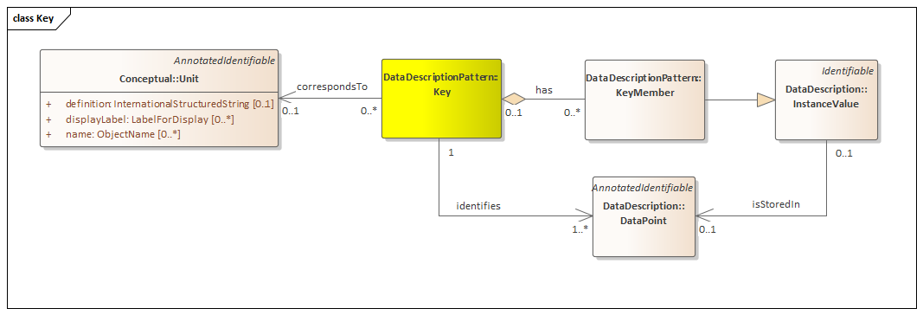
Keys
Notes:
DDI-CDI uses keys to place DataPoints in a structure.
In the model Keys work as identifiers that ty things together. They identify a DataPoint and links it to a unit or a or population
An InstanceValue is linked to a Unit via a Key that identifies the DataPoint where the InstanceValue is stored.
If the key has a physical representation (an InstanceKey), that is one or more InstanceValue too.

Slide 39
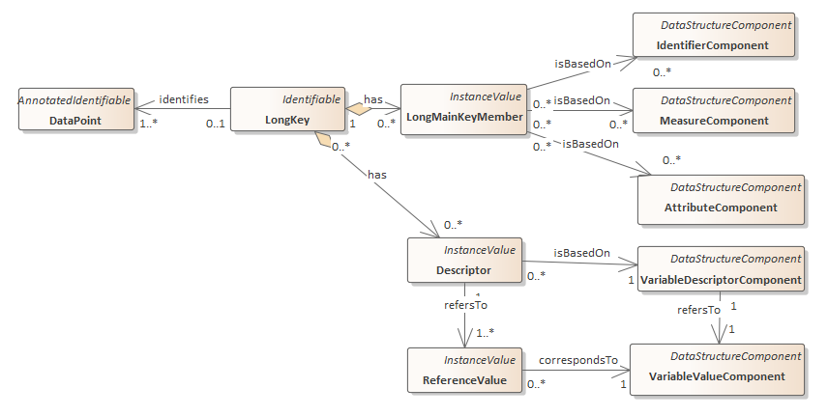
Roles for Data Points – Long Structure Extract

Slide 40
Roles: The COVID example- Long structure
VariableDescriptorComponent
AttributeComponent
VariableValueComponent
Identifiers
Entry | DateTime | Position | Measure | Value
101 | 2020-07-14T13:54 | 2 | systolic | 114
101 | 2020-07-14T13:54 | 2 | diastolic | 70
101 | 2020-07-14T13:54 | 2 | weight | 83914.60
101 | 2020-07-14T13:54 | 2 | temp | 36.44
101 | 2020-07-14T13:54 | 2 | pctO2 | 98
101 | 2020-07-14T13:54 | 2 | pulse | 70
101 | 2020-07-14T13:54 | 2 | away | n
101 | 2020-07-14T13:54 | 2 | exposed | n
132 | 2020-07-14T14:03 | 3 | systolic | 125
132 | 2020-07-14T14:03 | 3 | diastolic | 86
132 | 2020-07-14T14:03 | 3 | weight | 68038.90
132 | 2020-07-14T14:03 | 3 | temp | 37.5
132 | 2020-07-14T14:03 | 3 | pctO2 | 85
132 | 2020-07-14T14:03 | 3 | pulse | 92
132 | 2020-07-14T14:03 | 3 | away | y
132 | 2020-07-14T14:03 | 3 | exposed | n
The Variable Descriptor Component has values
taken from the list of non-Unit Identifiers
in the wide data set.
(This can be programmatically known.)
The “key” for each value is composed from
the identifiers plus the Variable Descriptor.
Notes:
COVID example: DDI-CDI builds up compound keys from components. For Long structures there are identifier, measure and attribute components.
Here Position is intended as an attribute of the blood pressure measurement. More on that in the next slide. A long structure has a column that is problematic for describing this as a traditional record. The
Value column does not have a single concept or datatype, instead there is another column that has a code that indicates what the measure is. This is a common type of structure for event or stream data. Here, the value column is associated with a VariableValueComponent and the Measure column is associated with the VariableDescriptorComponent.
* IdentifierComponent – one of possibly several components that together identify the Unit associated with the measures and attributes.
* AttributeComponent – an attribute that annotates the associated measure values.
* VariableDescriptorComponent – an indicator of the InstanceVariable in each associated VariableValueComponent.
* VariableValueComponent – defines a column that has a value associated with the value in the VariableDescriptorComponent. A character datatype for the associated RepresentedVariable would be required.
NB: In many statistical platforms there are tools to reshape data between wide and long format. Many have restrictions that would force all of the measure values to have the same datatype (e.g. all numeric).
* MeasureComponent (not in the example) – a measure just like in the wide layout. This allows a hybrid wide-tall layout. There is no such column in the example above.

Slide 41
Roles: The COVID example- Wide structure
(Unit)
Identifier
Component
Measure
Component
Attribute
Component
entry | datetime | systolic | diastolic | position | weight | temp | pctO2 | pulse | away | exposed
101 | 2020-07-14T13:54 | 114 | 70 | 2 | 83914.6 | 36.44 | 98 | 70 | n | n
132 | 2020-07-14T14:03 | 125 | 86 | 3 | 68038.9 | 37.5 | 85 | 92 | y | n

Slide 42
Application: Automating Data Integration
If I understand the role played by any given data point in its data set of origin, I can predict what role it must play in the data set I need to transform it into for integration purposes
The DDI-CDI model shows us how these relate, and can avoid manual intervention in performing the needed structural transformations
Reduces the (up to 80%) resource burden on projects for preparing data for analysis

Slide 43
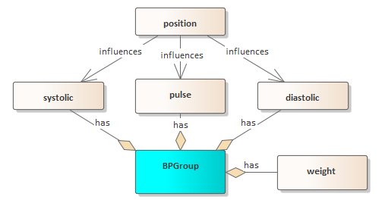
Paradata as Attributes in DDI-CDI
Entry | DateTime | Measure | Position | Value
101 | 2020-07-14T13:54 | systolic | 2 | 114
101 | 2020-07-14T13:54 | diastolic | 2 | 70
101 | 2020-07-14T13:54 | weight |  | 83914.60
101 | 2020-07-14T13:54 | temp |  | 36.44
101 | 2020-07-14T13:54 | pctO2 |  | 98
101 | 2020-07-14T13:54 | pulse | 2 | 70
101 | 2020-07-14T13:54 | away |  | n
101 | 2020-07-14T13:54 | exposed |  | n
132 | 2020-07-14T14:03 | systolic | 3 | 125
132 | 2020-07-14T14:03 | diastolic | 3 | 86
132 | 2020-07-14T14:03 | weight |  | 68038.90
132 | 2020-07-14T14:03 | temp |  | 37.5
132 | 2020-07-14T14:03 | pctO2 |  | 85
132 | 2020-07-14T14:03 | pulse | 3 | 92
132 | 2020-07-14T14:03 | away |  | y
132 | 2020-07-14T14:03 | exposed |  | n
The COVID example:
Systolic, diastolic and position could be defined as a variable collection with a structure indicating that
entry datetime systolic diastolic position weight temp pctO2 pulse away exposed
101 2020-07-14T13:54 114 70 2 83.914,6 36,44 98 70 n n
132 2020-07-14T14:03 125 86 3 68.038,9 37,50 85 92 y n
Notes:
The Covid example: Here Position is intended as an attribute of the blood pressure measurement. In the tall structure that can be made clear by only having it in the relevant rows. In the wide structure that is not possible.
VariableCollection could be useful for the wide structure to indicate that position is an attribute of the blood pressure measures.

Slide 44
A "hands on-line" Exercise!
http://palachelandtrust.org/EDDI_Exercise.htm

Slide 45
The DDI-CDI Process Model
Describes the use of individual processes, and how they fit together
Supports standard descriptions (SDTL, VTL) and specific languages (SQL, R, STAT, SPSS, Python, SAS, etc.)
Three “modes”:
  Procedural: Step-wise, with decision points
  Declarative: “Black box” multi-threaded, uses a “playbook” and configurations
  Hybrid approaches of the two

Slide 46
Simple Diagram
Parameters
Process
Engine
Playbook
(Functions)
Activity
Control Logic
Step
Inputs
Outputs
Inputs
DECLARATIVE PROCESS
Outputs
Sub-Step
PROCEDURAL PROCESS

Slide 47
Process Example: Data Cleaning Activity
Step 1: Inspect data and generate a report with:
  Impossible cases (e.g., 3-year-olds giving birth; people marrying themselves)
  Improbable cases (e.g., 12-year-olds with an earned income of 250,000 EUR per annum)
Step 2: Evaluate quality
  Accept: Data has low percentage of impossible/improbable cases - continue
  Reject: Data has high percentage of impossible/improbable cases – exit process with errors
Step 3: Produce cleaned data set
  Trim out impossible/improbable cases

Slide 48
Procedural Process
Input
Data
INSPECT DATA
Report of Errors
PRODUCE
CLEAN DATA
Cleaned
Data
Input
Metadata
EVALUATE DATA
Cleaned
Metadata
ACCEPT
PROCESS CONTROL (FLOW LOGIC)
REJECT

Slide 49
Declarative Process
Input
Data
Cleaned
Data
PROCESS “BLACK BOX”
Input
Metadata
OR
Cleaned
Metadata
Completion Criteria
PROCESS CONTROL
Playbook (Functions)

Slide 50
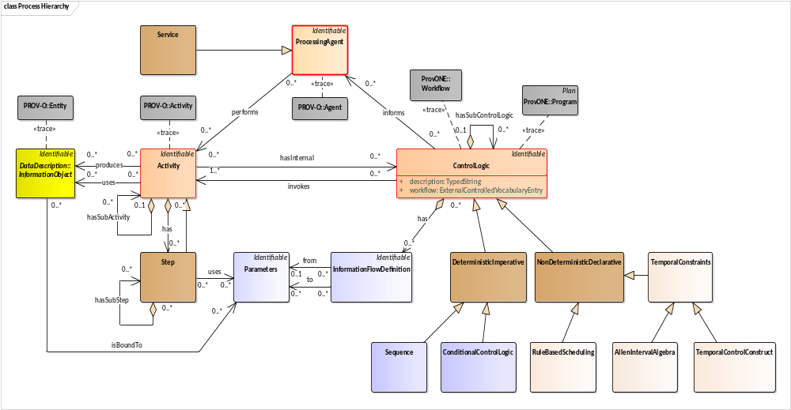
Process Model (High Level)

Slide 51
Application: A Provenance Browser
One question researchers often ask is: “Where did this number come from? What is it really?”
Typically, the answer is unsatisfying and/or non-existent.
The following examples are drawn from an application being developed using the DDI-CDI model to bring together processes and data sets, and the metadata attached to them, to give researchers a useful way to look at any portion of the provenance chain, and to answer this question.

Slide 52
Application: A Provenance Browser (cont.)
This is an application was one of the test cases for DDI-CDI specification development
Provenance metadata (the processes) are mined programmatically from the ETL platform, Pentaho
  These are often “chains” which leverage STATA scripts to perform the processing itself
Variable descriptions are taken from DDI Codebook XML
Human-readable “Purpose” statements are added manually
The “browser” brings this together in an easy-to-use form, from the viewpoint of a specific process step or data set

Slide 53
[NAME OF PROCESS]
JOB: [NAME OF JOB]
[TASK]
[TASK]
[TASK]
JOB: [NAME OF JOB]
[TASK]
[TASK]
[TASK]
DATASETS
[DATASET NAME]
[DATASET NAME]
[DATASET NAME]
[INPUT DATASET]
[OUTPUT DATASET]
[NAME OF JOB]
Overview
Purpose
Algorithm
[INPUT DATASET]
[OUTPUT DATASET]

Slide 54
[NAME OF PROCESS]
JOB: [NAME OF JOB]
[TASK]
[TASK]
[TASK]
JOB: [NAME OF JOB]
[TASK]
[TASK]
[TASK]
DATASETS
[DATASET NAME]
[DATASET NAME]
[DATASET NAME]
[CONSUMING
JOB]
[NAME OF DATASET]
Overview
Purpose
Algorithm
[CREATINGJOB]
[CONSUMING
JOB]

Slide 55
[NAME OF PROCESS]
JOB: [NAME OF JOB]
[TASK]
[TASK]
[TASK]
JOB: [NAME OF JOB]
[TASK]
[TASK]
[TASK]
DATASETS
[DATASET NAME]
[DATASET NAME]
[DATASET NAME]
[NAME OF TASK FILE]
use hsb2, clear
* get values for boxplot
summarize write, d
gen f=43 /* set value a little larger than bin with highest frequency */
gen pmin=r(min)
gen p25=r(p25)
gen p50=r(p50)
gen p75=r(p75)
gen pmax=r(max)
gen pmean=r(mean)
* graph histogram and boxplot on same axes
two (histogram write, start(30) width(5) freq) ///
(rcap pmin pmax f in 1, hor bcolor(dknavy)) ///
(rbar p25 p75 f in 1, hor bcolor(dknavy)) ///
(rcap p50 p50 f in 1, hor bcolor(white)) ///
(rcapsym pmean pmean f in 1, hor msym(plus) mcolor(white)), ///
legend(off) xtitle("Writing Score") ytitle("Frequency")
* drop variables created for boxplot values
drop f-pmean

Slide 56
EXAMPLE: Data Quality Metrics (“Job”)
ALPHA Data Pipeline Spec. 6.1
Business Processes:
[02] Core ETL for Raw Input
Overview
Purpose
Steps:
[2.1] Generate Anonymized IDs
[2.2] Map original IDs to
Anonymized IDs
[2.3] Store ID Mapping
[2.4] Create 6.1 Data from Raw
Data
[03] 6.1 Data Quality Metrics
Overview
Purpose
Steps:
[3.1] Compile Quality Metrics
[3.2] Compile Residency Starting
Events
[3.3] Compile Residency Ending
Events
[3.4] Compile Legal and Illegal
Starting Events
OUTPUT DS
[2] DoB Quality Metrics
INPUT DS
[03]
6.1 Data Quality
Metrics
[1] Raw 6.1 Event Format
OUTPUT DS
[3] Illegal Transitions

Slide 57
Example: Descriptive Metadata about a Job
ALPHA Data Pipeline Spec. 6.1
Business Processes:
[02] Core ETL for Raw Input
Overview
Purpose
Steps:
[2.1] Generate Anonymized IDs
[2.2] Map original IDs to
Anonymized IDs
[2.3] Store ID Mapping
[2.4] Create 6.1 Data from Raw
Data
[03] 6.1 Data Quality Metrics
Overview
Purpose
Steps:
[3.1] Compile Quality Metrics
[3.2] Compile Residency Starting
Events
[3.3] Compile Residency Ending
Events
[3.4] Compile Legal and Illegal
Starting Events
02 Core ETL for Raw Input - Purpose
Creates staging tables from member-centre-specific data. The staging tables are then transformed further to create the ALPHA specification 6.1.

Slide 58
Example: Conceptual Metadata about a Data Set
ALPHA Data Pipeline Spec. 6.1
Business Processes:
[02] Core ETL for Raw Input
Overview
Purpose
Steps:
[2.1] Generate Anonymized IDs
[2.2] Map original IDs to
Anonymized IDs
[2.3] Store ID Mapping
[2.4] Create 6.1 Data from Raw
Data
[03] 6.1 Data Quality Metrics
Overview
Purpose
Steps:
[3.1] Compile Quality Metrics
[3.2] Compile Residency Starting
Events
[3.3] Compile Residency Ending
Events
[3.4] Compile Legal and Illegal
Starting Events
[3.2] Compile Residency Starting Events
Description:
Identify in the data, events that start a residency episode (birth, external-immigration, enumeration, becoming eligible for a study, found after being lost to follow-up).
Concepts:
This algorithm step references the following study concepts: residency
birth
migration
The change of residence by a registered individual or social group (e.g., a household). There are two types of migration that occur among the registered population. These are internal and external migration.

Slide 59
Example: Structural/Codebook Metadata about a Data Set
ALPHA Data Pipeline Spec. 6.1
Business Processes:
[03] 6.1 Data Quality Metrics
Overview
Purpose
Steps:
[3.1] Compile Quality Metrics
[3.2] Compile Residency Starting
Events
[3.3] Compile Residency Ending
Events
[3.4] Compile Legal and Illegal
Starting Events
Data Sets:
[1] Raw 6.1 Event Format
[2] DoB Quality Metrics
[3] Illegal Transitions
recnr [INT]
study_name [VARCHAR(15)]
idno [VARCHAR(32)]
hhold_id [VARCHAR(32)]
hhold_id_extra [VARCHAR(32)]
sex [INT]
dob [DATETIME]
residence [VARCHAR(5)]
eventnr [INT]
event [INT]
event_date [DATETIME]
type_of_date [INT]
obs_date [DATETIME]
obs_round [VARCHAR(2)]
CONSUMING PROCESS
CREATING PROCESS
[03] 6.1 Data Quality Metrics
[1]
Raw 6.1 Event Format
[01] Site-Specific ETL
CONSUMING PROCESS
[04] Clean 6.1 Data
View Dataset Structure

Slide 60
Application: Transparency - Replication/Reproduction of Findings
With rich provenance metadata, it is much easier for humans to reproduce findings
With a complete machine-actionable record of data provenance, reproducibility of findings can be performed by machines – ‘computational replication’
Transparency requires this ability, but…
Problems of scale will demand that these processes be more efficient!

Slide 61
Summary
Status and Feedback/Comment

Slide 62
Where Are We?
Engagement with external domains and reviewers has been high
  Webinars on specific topics/domains
  EOSC Project to Recommend Applications of DDI-CDI
  International FAIR Convergence Symposium/GO FAIR/CODATA
Release of final specification in Q2 of 2021

Slide 63
DDI-CDI under public review
Your feedback is appreciated!
See our review page at https://ddi-alliance.atlassian.net/wiki/x/IQBPMw
The Intro document (for a brief summary):
https://ddi-alliance.atlassian.net/wiki/download/
attachments/860815393/Part_1_DDI-CDI_Intro_PR_1.pdf

Slide 64
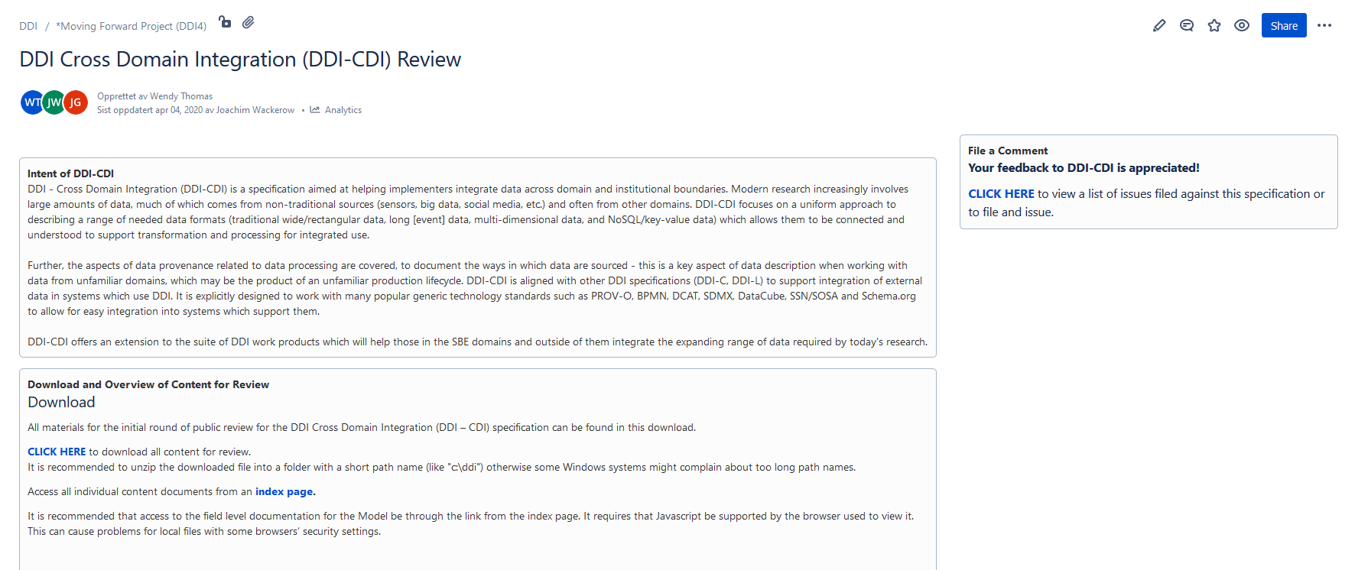
DDI-CDI Review page at https://ddi-alliance.atlassian.net/wiki/x/IQBPMw
Post comment
Download package
Access package content from index page

Slide 65
Your comments to the DDI-CDI are appreciated ☺
Review page: https://ddi-alliance.atlassian.net/wiki/x/IQBPMw
Contact: ddi-cdi@googlegroups.com joachim.wackerow@gesis.org

Slide 66
Thank you very much for your attention ☺
Attribution to Larry Hoyle’s work ‘DataDescription with the DDI Cross Domain Integration (DDI-CDI)’ https://codata.org/wp-content/uploads/2020/08/DataDescriptionInDDI-CDI3a.pptx. Examples from the model as well as the COVID use case are from this presentation.

