Slide 1
Generating
DDI - Cross-Domain Integration
(DDI-CDI) in the Language of your Choice
Model Driven Architecture for Metadata Standards in Practice
Tutorial at EDDI20, the 12th Annual European DDI User Conference
November 30, 2020 (virtual)
Joachim Wackerow, GESIS – Leibniz Institute for the Social Sciences
License Creative Commons Attribution 4.0 International (CC BY 4.0), Web page of the tutorial

Slide 2
Overview
Part I
  Overview
  DDI-CDI - Features
  Model-Driven Approach
  Model-Driven Approach for DDI-CDI
  UML Subset for DDI-CDI
  Generation of Specific Representations XSD, OWL, R, reST, and DOT
  Generation of Any Syntax Representation
Part II
  Eclipse Environment
    Papyrus - UML Tool
    QVTo - Model to Model
    Acceleo - Model to Text
  UML Class Diagram Primer
  Exercises
  Credits, Community, and Contact
Warning: work in progress
DDI-CDI model can change prior to publication
This approach using Eclipse tools is explorative
Multiple approaches for code generating currently used for DDI-CDI

Slide 3
DDI-CDI - Features
Part I
  Overview
  DDI-CDI - Features
  Model-Driven Approach
  Model-Driven Approach for DDI-CDI
  UML Subset for DDI-CDI
  Generation of Specific Representations XSD, OWL, R, reST, and DOT
  Generation of Any Syntax Representation
Part II
  Eclipse Environment
    Papyrus - UML Tool
    QVTo - Model to Model
    Acceleo - Model to Text
  UML Class Diagram Primer
  Exercises
  Credits, Community, and Contact

Slide 4
DDI Cross-Domain Integration
DDI-CDI
Designed to be used by any domain
Model for describing data across a wide range of domains/structures
  Sensor and event data, key-value data, rectangular data, multi-dimensional data
Model for describing processing of data from one form into another
Model for showing how individual Datums are used across the entire chain
Complement to traditional metadata/documentation standards

Slide 5
DDI-CDI Datum-Oriented
Data Description
Based on atomic components – individual Datums (or cells)
Datums can play different roles in different formatting of the same (or different) dataset(s), depending on how it has been transformed or processed (Identifier, Descriptor, Measure, etc.)
Each Datum’s use can be described across a series of processes as it plays different roles in different structures

Slide 6
DDI-CDI Basic Data Structure Types
Wide Data
  Traditional rectangular unit record data sets. Each record has a unit identifier and a set of measures for the same unit
Long Data
  Each record has a unit identifier and a set of measures but there may be multiple records for any given unit. The structure is used for many different data types, for example event data
Multi-Dimensional Data
  Data in which observations are identified using a set of dimensions. Examples are multi-dimensional cubes and time series
Key-Value Data
  Set of measures, each paired with an identifier (“big data”)

Slide 7
DDI-CDI: Process Model
Supports three main uses which are of growing importance in research, especially as increased emphasis is placed on transparency.
The first is a description of provenance at the level of the systems which manage data;
the second is reproducibility (e.g., does the information exist to reproduce findings?), and
the third is computational reproducibility (can the reproducibility be performed by computers?).
All three uses require a similar set of information, of increasing detail.
Based on W3C PROV (provenance) and
parts of BPMN (Business Process Model and Notation)

Slide 8
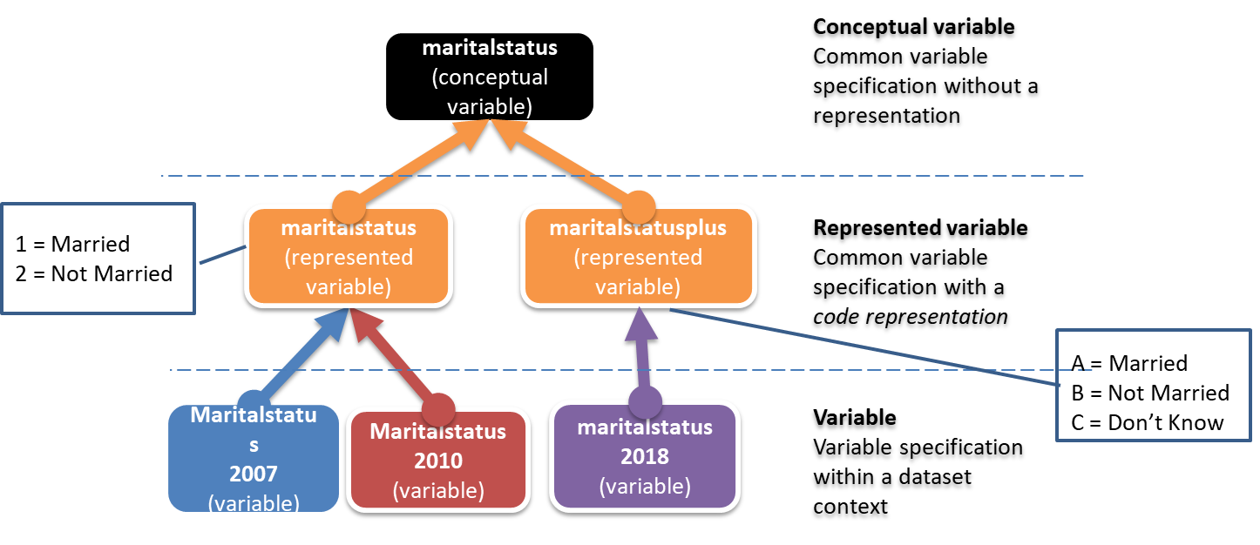
DDI-CDI Foundational Metadata
Core elements to be modeled – based on DDI-CDI work
Statistical concepts and their various usages
Includes categories and variables and much more
Important feature: The variable cascade
  How different types of variables relate to each other
  How they describe data creation, processing and use

Slide 9
Variable Cascade
Detail
Concept
  The concept layer provides an overarching concept from which a variable is defined. Examples include gender, income, occupation, and wages.
Conceptual Variable
  The conceptual variable includes the concept as the meaning of the variable, the associated unit type, and the categories the variable may assign. Note, these categories might be enumerated or described by a set of rules. The categories include processing or sentinel categories. These include reasons why data might be missing or incomplete.
Represented Variable
  The represented variable includes everything already specified for the conceptual variable plus the way the categories are represented, the intended datatype, a unit of measure if applicable, and any precision (e.g., number of decimal places) if applicable.
Instance Variable
  The instance variable includes everything already specified for the represented variable plus the representations for any sentinel (processing) categories.
Value Mapping
  The value mapping provides the means to find and retrieve data corresponding to the instance variable defined above out of a record in a file. It includes the specification of a physical datatype.
Each of the upper four layers may be reused to help specify layers underneath.
From concept to data value

Slide 10
Alignment with Other Standards
Detail
DDI-CDI attempts to align with a number of other standards
For process description:
  PROV-O (and PROV-ONE) . Directly implements these
  SDTL/VTL – provides for combined use
  BPMN – formal alignment
For discovery:
  Schema.org
  DCAT (in progress)
For data description:
  DDI Codebook, DDI Lifecycle
  GSIM
  SDMX/Data Cube
Others (see documentation)

Slide 11
What’s in the Specification?
DDI-CDI is a formal UML class model (as Canonical XMI)
UML can be easily implemented across technology platforms
  Generation of syntax bindings
  Familiar to many developers
UML “future-proofs” the specification
  Emerging technology platforms can be supported
  Content of model is extensible
An XML Schema representation is provided
  Other representations (e.g., RDF, JSON) are being considered
Documentation of model and schemas
Architecture and design documentation
Examples of use
Final Release in 2021 Q2

Slide 12
DDI-CDI Download Package
Contents
DDI-CDI_Public_Review_1
DDI-CDI_Credits_and_Licensing.pdf
DDI-CDI_Futures_Open_Issues.pdf
DDI-CDI_Package_Overview_PR_1.pdf
index - Copy.html
index.html
1_Specification_Documents
Part_1_DDI-CDI_Intro_PR_1.pdf
Part_2_DDI-CDI_Detailed_Model_PR_1.pdf
Part_3_DDI-CDI_Architecture_PR_1.pdf
Part_4_DDI-CDI_Examples_PR_1.pdf
1_Specification_Documents/Supporting_Documents
UML_Class_Diagram_-_Practitioner's_Subset_for_Data_Modeling_0-9.pdf
UML_Class_Diagram_-_Practitioner’s_Subset_for_Data_Modeling_-_Detailed_List_of_Items_0-9.html
2_Model
00ReadMe.txt
DDI-CDI_PublicReviewRelease_1-0.eap
DDI-CDI_PublicReviewRelease_1-0.xmi
DDI-CDI_PublicReviewRelease_1-0_UniqueAssociationNames.xmi
2_Model/Field-Level_Documentation
index.html
2_Model/Supporting_Documents
DDI-CDI_PublicReviewRelease_1-0_UMLDiagrams.pdf
3_Syntax_Representation/XSD
DDI-CDI_PublicReviewRelease_1-0.xsd
xml.xsd
3_Syntax_Representation/XSD/Examples
00ReadMe.txt
hdss_event_history_data_description_example.xml
metadata_workflow_example.xml
the_hdss_event_history_data_workflow_example.xml
3_Syntax_Representation/XSD/XSDDoc
index.html
4_Examples
00ReadMe.txt

Slide 13
DDI-CDI Resources
Recommended
Introduction (5 pages summary)
Public review page
Complete download package
Announcement at DDI Alliance website
Presentations and recordings of introduction webinars

Slide 14
Model-Driven Approach
Part I
  Overview
  DDI-CDI - Features
  Model-Driven Approach
  Model-Driven Approach for DDI-CDI
  UML Subset for DDI-CDI
  Generation of Specific Representations XSD, OWL, R, reST, and DOT
  Generation of Any Syntax Representation
Part II
  Eclipse Environment
    Papyrus - UML Tool
    QVTo - Model to Model
    Acceleo - Model to Text
  UML Class Diagram Primer
  Exercises
  Credits, Community, and Contact

Slide 15

Model Driven Architecture - MDA
Model Driven Architecture® (MDA®) is an approach to software design, development and implementation spearheaded by the OMG
  The Object Management Group (OMG) is a computer industry standards consortium.

Slide 16
OMG‘s Description of MDA
Software development in the MDA starts with a Platform-Independent Model (PIM) of an application's business functionality and behavior
  constructed using a modeling language based on OMG's Meta Object Facility (MOF).
This model remains stable as technology evolves, extending and thereby maximizing software ROI (return on investment).
MDA development tools, available now from many vendors, convert the PIM first to a Platform-Specific Model (PSM) and then to a working implementation on virtually any middleware platform.
Web Services, XML/SOAP, EJB, C#/.Net, OMG's own CORBA, or others.
Portability and interoperability are built into the architecture.
OMG's industry-standard modeling specifications support the MDA: The MOF; UML; the Common Warehouse Metamodel (CWM); and XML Metadata Interchange (XMI).

Slide 17
Purpose of Model-Driven Approach
High quality
Consistency
Code generation on basis of the model
Changes in the model will automatically be reflected the next time the code is generated
Life cycle development is faster
Information living in the model not in documents
Models (graphical representation) are good for sharing information with both „business people“ and „technical people“
Model is center of „truth“

Slide 18
PIM, PSM, and Code
Platform-independent model (PIM)
  „A model that is independent of implementation technology that is also at a high level of complexity.“
Platform-specific model (PSM)
  „A model created by transforming a PIM tailored to specify your system in terms of implementation constructs available in one specific technology.“
Code
  „Code is generated by the transformation of PSMs.“
Citations from: The Object Primer. Agile Model-Driven Development with UML 2.0. Scott W. Ambler.

Slide 19
Code Generation
Why to Use Code Generation
  Productivity: write the generator once
  Simplification: generate your code from some abstract description
  Portability: target a different language or framework
  Consistency: get always the code you expect
Why Not to Use Code Generation
  Maintenance: dependency on tools
  Complexity: tend to be more complex than code written by hand
Source: A Guide to Code Generation, May 9, 2018/in Code processing, Domain specific languages, Model driven development, Software Engineering /by Gabriele Tomassetti

Slide 20
Model-Driven Approach
Other Metadata Standards
Detail
ISO 19136-1 Geography Markup Language (GML)
  Uses UML in Enterprise Architect
  Representation in XSD
  Example documentation
  Best practices for modelling
Fast Healthcare Interoperability Resources (FHIR)
  Uses own modeling language
  Representations in UML diagrams, XML, JSON, Turtle
Statistical Data and Metadata eXchange (SDMX)
  Uses UML in a PDF document
  Representations in XSD, JSON, CSV
Generic Statistical Information Model (GSIM), reference model
  Uses UML in Enterprise Architect
United Nations Centre for Trade Facilitation and Electronic Business (UN/CEFACT)
  Uses own modeling language UMM
  Representation in XSD

Slide 21
Model-Driven Approach for DDI-CDI
Part I
  Overview
  DDI-CDI - Features
  Model-Driven Approach
  Model-Driven Approach for DDI-CDI
  UML Subset for DDI-CDI
  Generation of Specific Representations XSD, OWL, R, reST, and DOT
  Generation of Any Syntax Representation
Part II
  Eclipse Environment
    Papyrus - UML Tool
    QVTo - Model to Model
    Acceleo - Model to Text
  UML Class Diagram Primer
  Exercises
  Credits, Community, and Contact

Slide 22
Enterprise Architect Model
DDI-CDI is realized in the commercial UML software Enterprise Architect
  Available as Enterprise Architect file
  Can be viewed in the free Enterprise Architect Viewer, read-only 'Lite' Edition: description, download
Exported to Enterprise Architect XMI flavor and transformed by custom XSLT to Canonical XMI

Slide 23
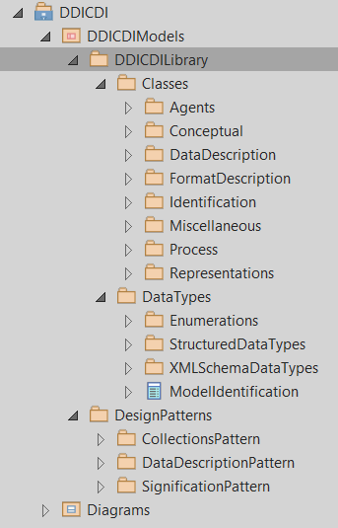
Structure of the
Enterprise Architect Model
Detail

Slide 24
Model-Driven Approach
Representation
Encoding
PIM as XMI
PSM as XMI
Instance
DDICDILibrary for XSD
XML Schema
XML
DDICDILibrary
DDICDILibrary for OWL
OWL/RDF-S
RDF
DDICDILibrary for
Java …
Java Library
Java Program
DDICDILibrary for
‚future‘ language

Slide 25
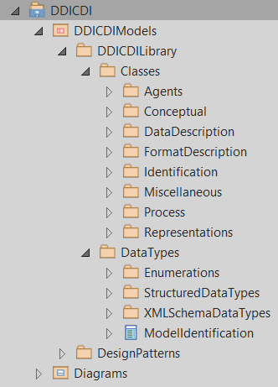
Levels of DDI-CDI MDA
Description | Format | Purpose
Complete UML model (DDICDILibrary) with design patterns and diagrams | UML as Enterprise Architect format (EAP) | Development, can be understood as PIM
Class diagram (DDICDILibrary) | UML as Canonical XMI | „Canonical“ form (official representation) of the model, can be understood as PIM
XML Schema | PSM as UML, XSD | Formal definition of implementation level as PSM and specific syntax
OWL vocabulary | PSM as UML, OWL/RDF-S | Formal definition of implementation level as PSM and specific syntax
Other target representations | PSM as UML, specific type | PSM and specific syntax
XML instance | XML | Metadata in structured and standardized form
RDF instance | RDF | Metadata in structured and standardized form
Instances in other syntaxes | … | Metadata in structured and standardized form

Slide 26
DDI-CDI Production and Exploration
DDICDILibrary as EAP
DDICDILibrary
as EAP XMI
XSLT
Canonical XMI (CX)
XSLT
XSLT
Model to text
Acceleo
Documentation
as restructeredText and dot
Javascript
XML Schema
as UML CX and XSD
Ontology
as UML CX and OWL/RDF-S
Other target
representations

Slide 27
Modeling, Representation, Testing
DDI-CDI can change up to the publication date
DDI-CDI extensions will be added later to DDI-CDI
Model-driven generation of syntax representations / encodings can immediately reflect the changes
Can be represented in future encodings
Unit tests for validation
High-quality development

Slide 28
Vision: Round Trip of Metadata in
Multiple Representations
Some requirements:
Consistency of model and syntax representations are crucial
Simple subset of UML class diagram features enables the mapping to multiple syntax representations even if the concepts of the representations might be different

Slide 29
Canonical XMI
The XML Metadata Interchange (XMI) is an OMG standard for exchanging metadata information via XML
  Issue: flexibility of XMI causes many interoperability limitations, many tool-specific flavors are common
Canonical XMI is a portable XMI flavor with strict rules which can be imported in many UML tools
  Details described in XMI 2.5.1 specification,
  appendix B
  Tools can often import Canonical XMI, but usually don’t export it
 Canonical XMI enables interoperability

Slide 30
Using a UML Model as Canonical XMI
Tested Tools
Further processing in UML tools
  Sample purposes: simplification, combining with other models, and generation of program code
  Commercial tools: Enterprise Architect, IBM Rhapsody (successor of Rational Rose), Visual Paradigm, Altova Umodel, MagicDraw (seems to be most standards compliant)
Programmatic processing
  Specialized programs as with: XSLT, Javascript
  XMI parser like SDMetrics Open Core
  Eclipse modeling tools (i.e. Papyrus, QVTo, Acceleo, Modelio standalone)

Slide 31
Comparison of Processing Approaches of Model/XMI
Kind of approach | Pro | Con
Commercial UML tools | Mature modeling tools | Often limited approaches of code generation Model hard to export for other tools, no Canonical XMI export Risk of dependency Cost
Own programs | Total control | XMI parser must be developed Development and maintenance effort
Own programs with existing XMI parser | Use of existing free XMI parser Total control | Development and maintenance effort
Eclipse tools (Acceleo) | Standards-based modeling tools Integrated development environment for processing/querying the model Small scripts and no cost | Initial learning curve

Slide 32
UML Subset for DDI-CDI
Part I
  Overview
  DDI-CDI - Features
  Model-Driven Approach
  Model-Driven Approach for DDI-CDI
  UML Subset for DDI-CDI
  Generation of Specific Representations XSD, OWL, R, reST, and DOT
  Generation of Any Syntax Representation
Part II
  Eclipse Environment
    Papyrus - UML Tool
    QVTo - Model to Model
    Acceleo - Model to Text
  UML Class Diagram Primer
  Exercises
  Credits, Community, and Contact

Slide 33
Advantages of the Used
UML Class Diagram Subset
The focus on few popular UML class diagram items results in …
  Simpler modeling
  Easier understanding
  Portability to many UML tools
  Many mapping options to target languages
Powerful enough for modeling purposes regarding DDI-CDI
Information on „UML Class Diagram Practitioner's Subset for Data Modeling “: document, spreadsheet

Slide 34
Subset of UML Class Diagram Items for DDI-CDI
Packaging
  Model – only one model
  Package – multiple packages, can be nested
Class definition
  Class – template for creating objects, each related object can be identified by a DDI URN (persistent identifier)
  Property – used for attributes and association ends, have multiplicity definition
Relationships
  Association – only binary, directed associations, with association name (DDI-CDI usage violates currently the requirement of unique names in a package), without association end (role) names, both ends have multiplicity definitions
  Generalization – inherits all attributes and associations of the whole inheritance tree, only single inheritance
Data types
  DataType – structured data types, attribute type definitions could relate to primitive data types or other structured data types
  Enumeration – set of named values
  EnumerationLiteral – used in Enumeration
  LiteralInteger – used in multiplicity definition
  LiteralUnlimitedNatural – used in multiplicity definition
  PrimitiveType
    Boolean
    Integer
    Real
    String
    UnlimitedNatural
Documentation
  Comment – can be attached to any item
The UML items are used in the XMI representation with the prefix „uml:“ like „uml:Class“.
Links of items go to pages of XMI validator of NIST.
Useful UML documentation: UML Diagrams by Kirill Fakhroutdinov

Slide 35
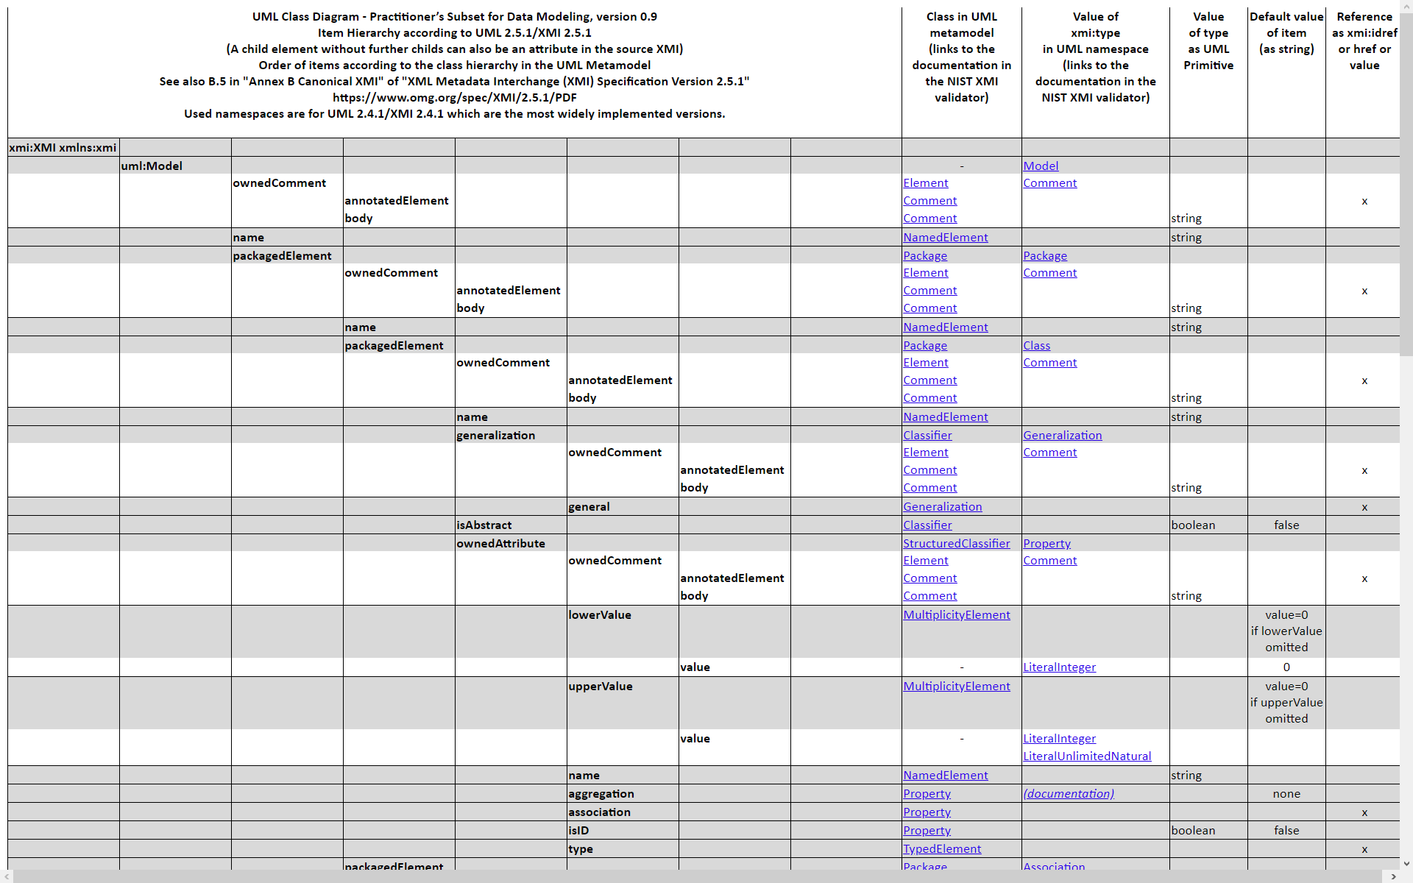
Subset of UML Class Diagram Items: Details

Slide 36
Generation of Specific Representations XSD, OWL, R, reST, and DOT
Current Status
Part I
  Overview
  DDI-CDI - Features
  Model-Driven Approach
  Model-Driven Approach for DDI-CDI
  UML Subset for DDI-CDI
  Generation of Specific Representations XSD, OWL, R, reST, and DOT
  Generation of Any Syntax Representation
Part II
  Eclipse Environment
    Papyrus - UML Tool
    QVTo - Model to Model
    Acceleo - Model to Text
  UML Class Diagram Primer
  Exercises
  Credits, Community, and Contact

Slide 37
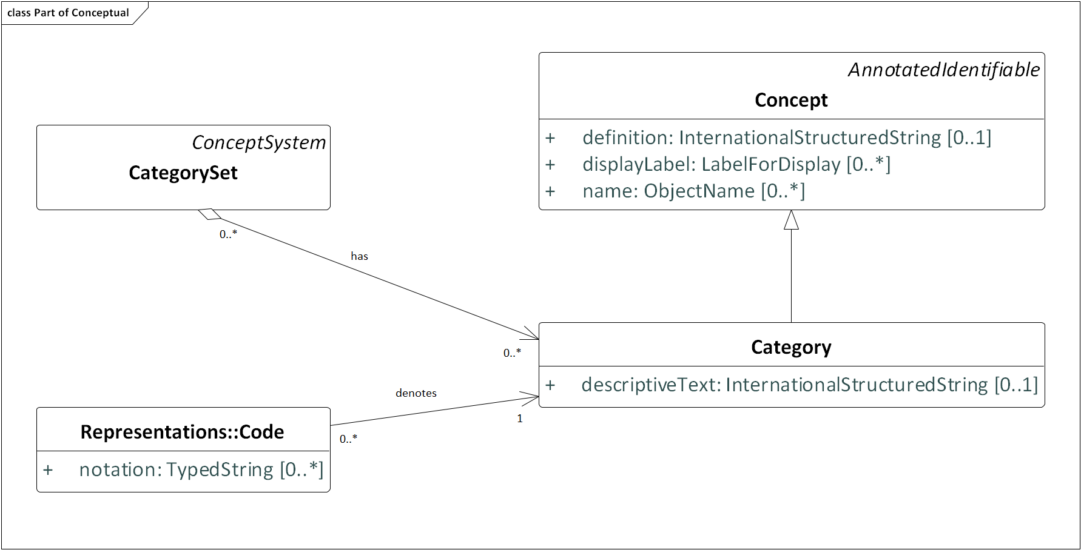
DDI-CDI Example – Class Diagramm

Slide 38
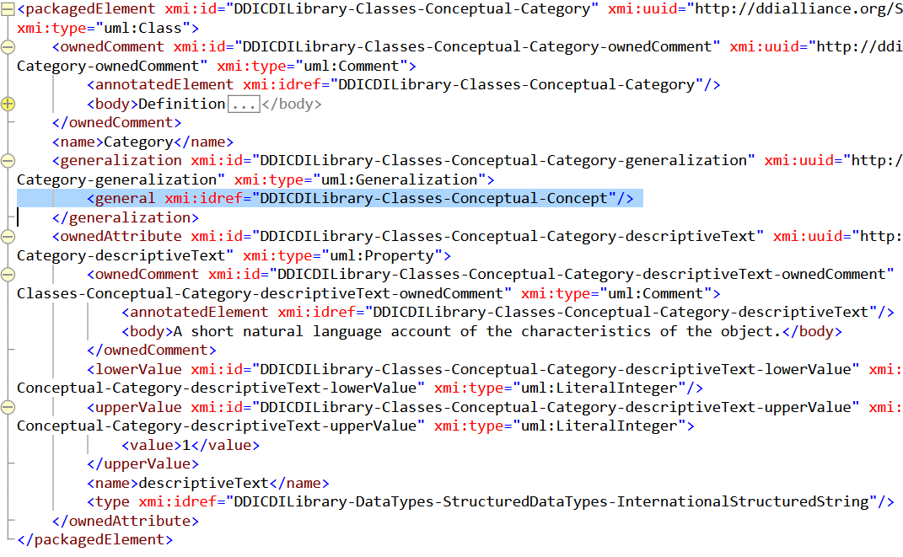
DDI-CDI „Category“ – Canonical XMI
Superclass

Slide 39
XML Schema (XSD) for XML instances
Purpose: preservation and exchange
Document on mapping rules
XSLT stylesheet for transformation
  Repository: xmi2xmi4xsd.xsl, xmi2xsd.xsl

Slide 40
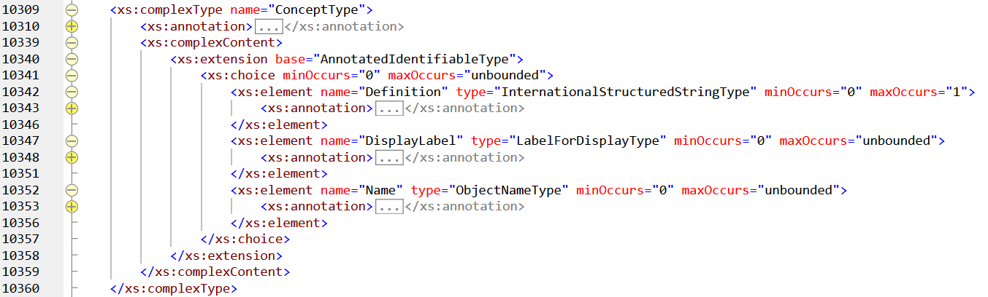
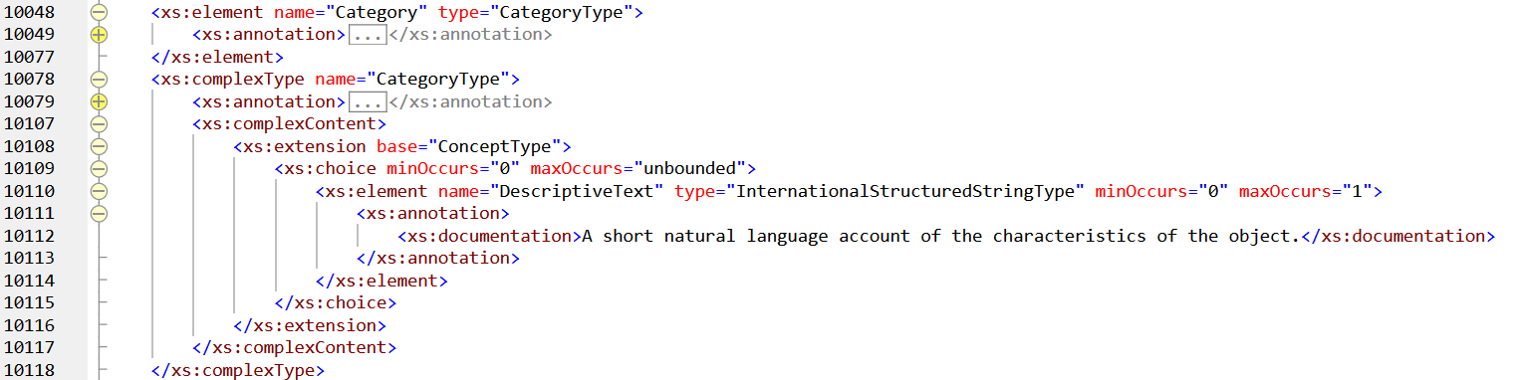
Class/Superclass Relationship in
XML Schema
Detail

Slide 41
OWL Vocabulary for RDF Instances
Purpose: discovery in the Linked Data web
Draft, doesn’t use other RDF vocabularies
Document on mapping rules
Generator in Javascript
Generates OWL and ShEx (RDF validation)

Slide 42
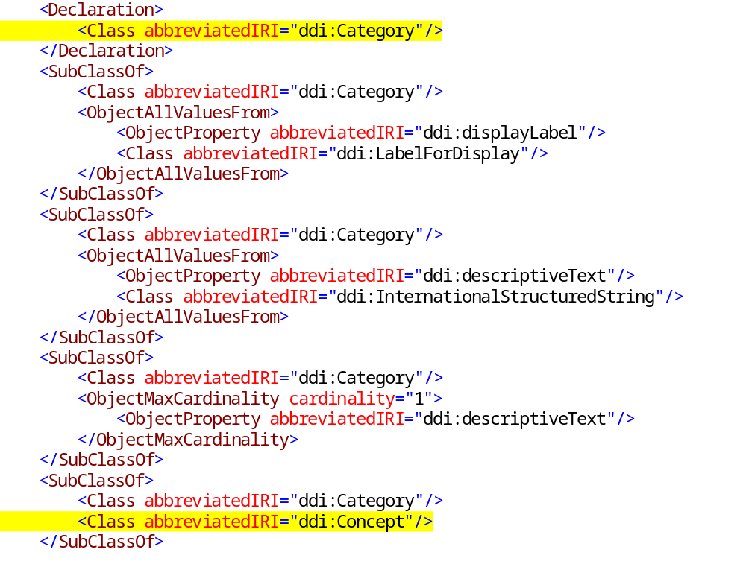
OWL
Detail

Slide 43
Library for the R Language for Statistical Computing
Python generator program
  Parser for XMI
  Generation part
R6 classes in R follow object-oriented rules
Repository

Slide 44
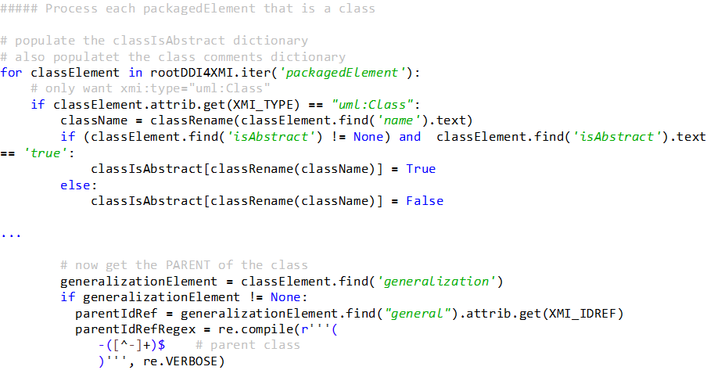
Python Program for Parsing of XMI and Generation of R
Parser only approx. 1400 code lines.

Slide 45
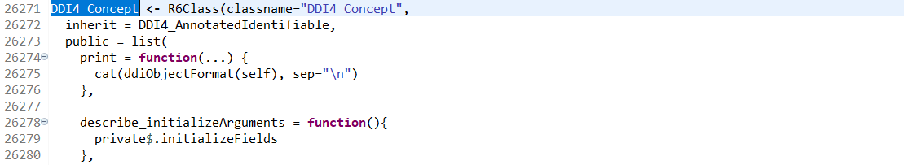
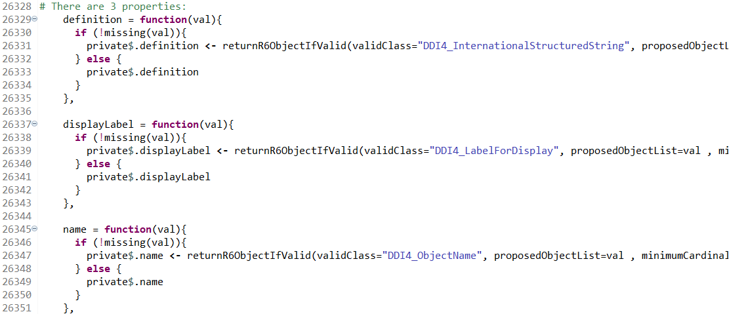
R: Item „Concept“
Detail
R6Class and housekeeping functions

Slide 46
Generation of reStructuredText (reST) and Graphviz (DOT)
Both together are used as documentation system for DDI-CDI
reST is part of Python's Sphinx documentation generation system
reST is related to Markdown
DOT (graph description language) is usually processed by Graphviz (Graph Visualization Software)
Repository of XSLT stylesheets (approx. 1000 lines of code)

Slide 47
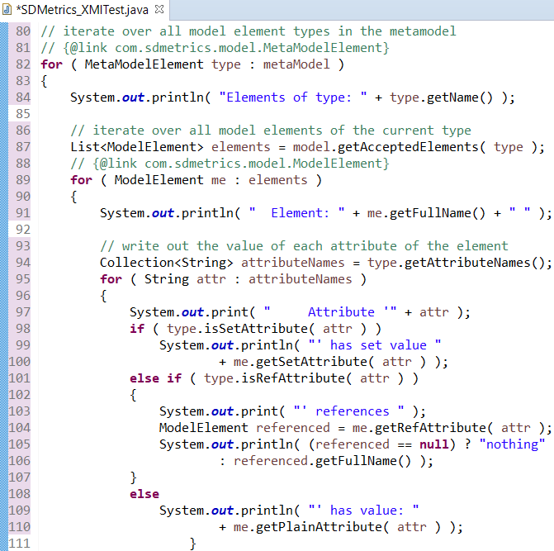
XMI Parser in Java
SDMetrics Open Core
Can parse Canonical XMI and other XMI flavors
Free part of commercial software SDMetrics
SDMetrics is an object-oriented design quality measurement tool for UML
Example in download in SDMetricsOpenCore/src/com/
sdmetrics/model/package.html

Slide 48
Generation of
Any Syntax Representation
Part I
  Overview
  DDI-CDI - Features
  Model-Driven Approach
  Model-Driven Approach for DDI-CDI
  UML Subset for DDI-CDI
  Generation of Specific Representations XSD, OWL, R, reST, and DOT
  Generation of Any Syntax Representation
Part II
  Eclipse Environment
    Papyrus - UML Tool
    QVTo - Model to Model
    Acceleo - Model to Text
  UML Class Diagram Primer
  Exercises
  Credits, Community, and Contact

Slide 49
OMG Standards
UML 2.4.1 (most common in tools) with documentation of 2.5.1 (better than 2.4*)
XMI 2.4.1 (most common in tools) with documentation of 2.5.1 (better than 2.4*)
QVT - Meta Object Facility (MOF) 2.0 Query, View, and Transformation specification (model to model)
MOFM2T - MOF Model to Text Transformation Language
OCL - Object Constraint Language

Slide 50
Model to Text
MOF Model to Text Transformation Language (Mof2Text or MOFM2T) is an Object Management Group (OMG) specification for a model transformation language
Specifically, it can be used to express transformations which transform a model into text (M2T), for example a platform-specific model into source code or documentation
MOFM2T is one part of OMG's Model-driven architecture (MDA) and reuses many concepts of MOF, OMG's metamodeling architecture
Whereas MOFM2T is used for expressing M2T transformations, OMG's QVT is used for expressing M2M transformations.
From wikipedia

Slide 51
DDI-CDI Factory – Possible Setup Based on OMG Standards and Eclipse Tools
EMF Ecore /
Canonical XMI
PIM
Including design patterns etc.
PIM
Library
PSM per Representation
Library
Representation / Encoding
Library
Model
Model transformation to reduce complexity
UML Tool
for creation, validation, and export
OMG QVT Operational
Model to Model
OMG MOFM2T
Model to Text
Method
Eclipse Modeling Tools
Papyrus (Epsilon),
commercial tools
Eclipse QVT Operational
Eclipse Acceleo
Tool

Slide 52
Example Acceleo Application
Detailed documentation of the model
  Purpose: exploring possibilities of Acceleo, needs further development for mature DDI-CDI documentation.
  Status: development
  File DDICDI_Documentation.mtl, currently less than 300 code lines
Generates file hierarchy corresponding to the package/class hierarchy in the model
Generates restructuredText code for further processing with Sphinx (documentation generator)
Generates also Plantuml code embedded in the restructuredText code
  PlantUML creates UML diagrams from a plain text language; it uses Graphviz (graph visualization) software to lay out its diagrams
Application generates complete documentation for all packages (18), classes (160), and data types (38) with detailed information
Result in Sphinx/_build/html/index.html

Slide 53
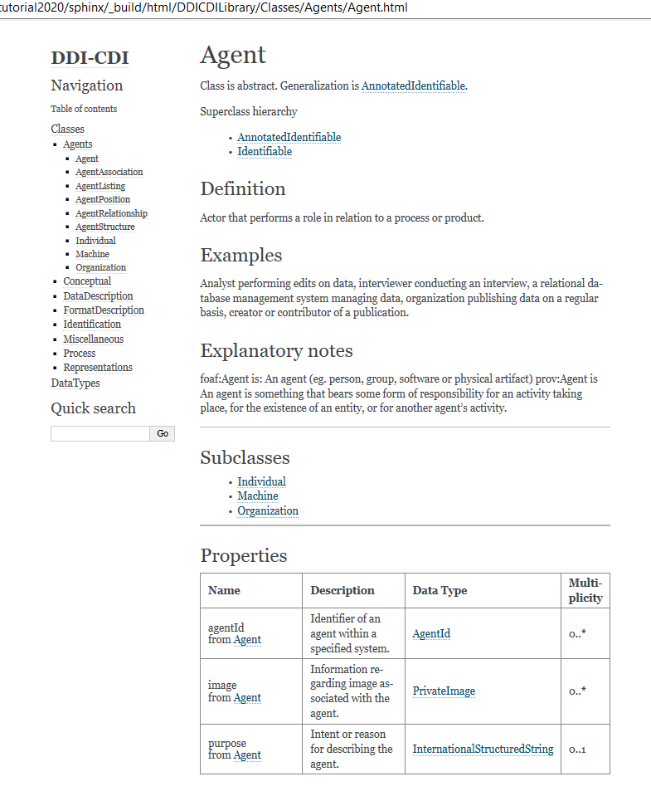
Generated Documentation

Slide 54
Eclipse Environment
Part I
  Overview
  DDI-CDI - Features
  Model-Driven Approach
  Model-Driven Approach for DDI-CDI
  UML Subset for DDI-CDI
  Generation of Specific Representations XSD, OWL, R, reST, and DOT
  Generation of Any Syntax Representation
Part II
  Eclipse Environment
    Papyrus - UML Tool
    QVTo - Model to Model
    Acceleo - Model to Text
  UML Class Diagram Primer
  Exercises
  Credits, Community, and Contact

Slide 55
Eclipse IDE
Integrated development environment used in programming
  Using IDE will cost you less time and effort
  Auto completion - one of the best features, you don’t have to remember all
  Error debugging is easy , you can easily navigate to Error line
  All files can be viewed and managed at same screen
  Downloading requires packages at ease
It is free and open source
Industrial level of development
It supports many languages

Slide 56
Eclipse Tools
Papyrus – UML editor
QVTo – Implementation of the OMG specification MOF Query, View, and Transformation (QVT), part Operational Mappings
Acceleo – Implementation of the OMG specification MOF to Text Template Language (Mof2Text)

Slide 57
Papyrus
UML editor
  Creating UML class diagrams and other
    Formal definition
    Visualizing diagrams
  Validation of UML definition
Integrated in Eclipse modeling tools
Expects XMI files with extension .uml

Slide 58
QVTo – Model to Model
Operates with UML models
Uses OCL for model navigation
Main goal - model modification and transformation
Includes an example from UML to relational database

Slide 59
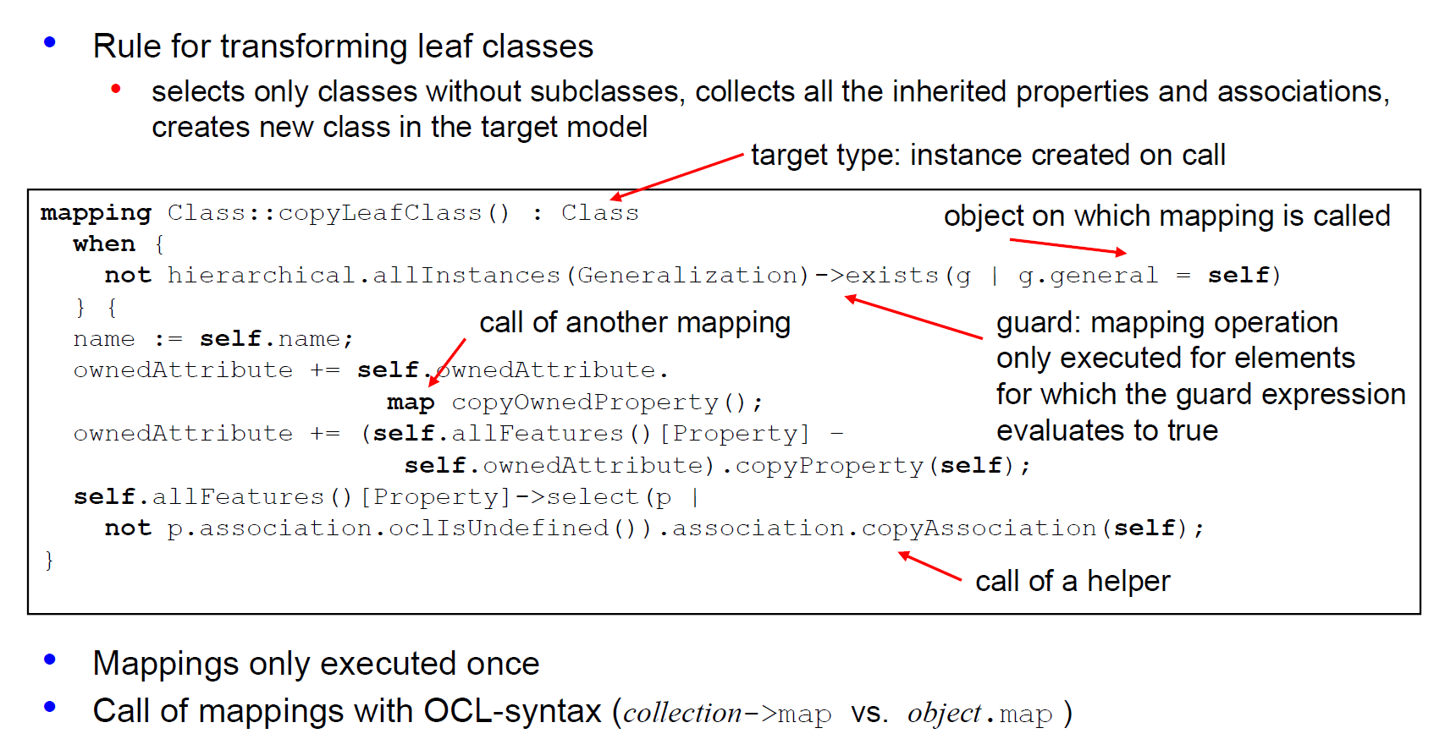
QVTo Example
Flattening Class Hierarchies
Source: Course Modelling with UML, with Semantics, Till Mossakowski, slide 13

Slide 60
QVTo Resources
Wiki
Project
Videos
  Introduction to QVTO on the Eclipse Modeling Tools
  QVTO and Query Operations
Slides
  Rubby Casallas
  Radomil Dvorak
  Sergey Boyko et al.

Slide 61
Acceleo – Model to Text
Embedded in Eclipse
Can be used standalone
Implementation of Model to Text Transformation language (MOFM2T, OMG specification)
First stable release in 2006
Kind of high-level programming language
  Powerful and small scripts
  Initial learning curve
More powerful than approaches with Java, Python, XSLT
  Operates on the model structure
  Code is written in templates
    Easier to develop, easier to debug

Slide 62
Acceleo Environment - Features
Syntax highlighting
Smart completion
Documentation on hover
Context assistant (ctrl+space)
Outline view
Code folding
Search references of objects (ctrl+shift+g)
Dynamic error detection while editing

Slide 63
Acceleo Resources
Website
Installation instructions (from the Eclipse marketplace)
Getting Started
User Guide
FAQ
Best Practices
In Eclipse 2020-09 documentation
References
  Operations
  OCL Operations
Videos
  Automatic Code Generation, Shaun Lindsey (18 min)
  Code generation using Acceleo, Marco Di Natale (87 min)
User forums
  Eclipse community forum M2T (model-to-text transformation)
  Stack Overflow - Questions tagged [acceleo]
Standalone usage, Ant (limited support), Maven
Query and navigate in EMF models

Slide 64
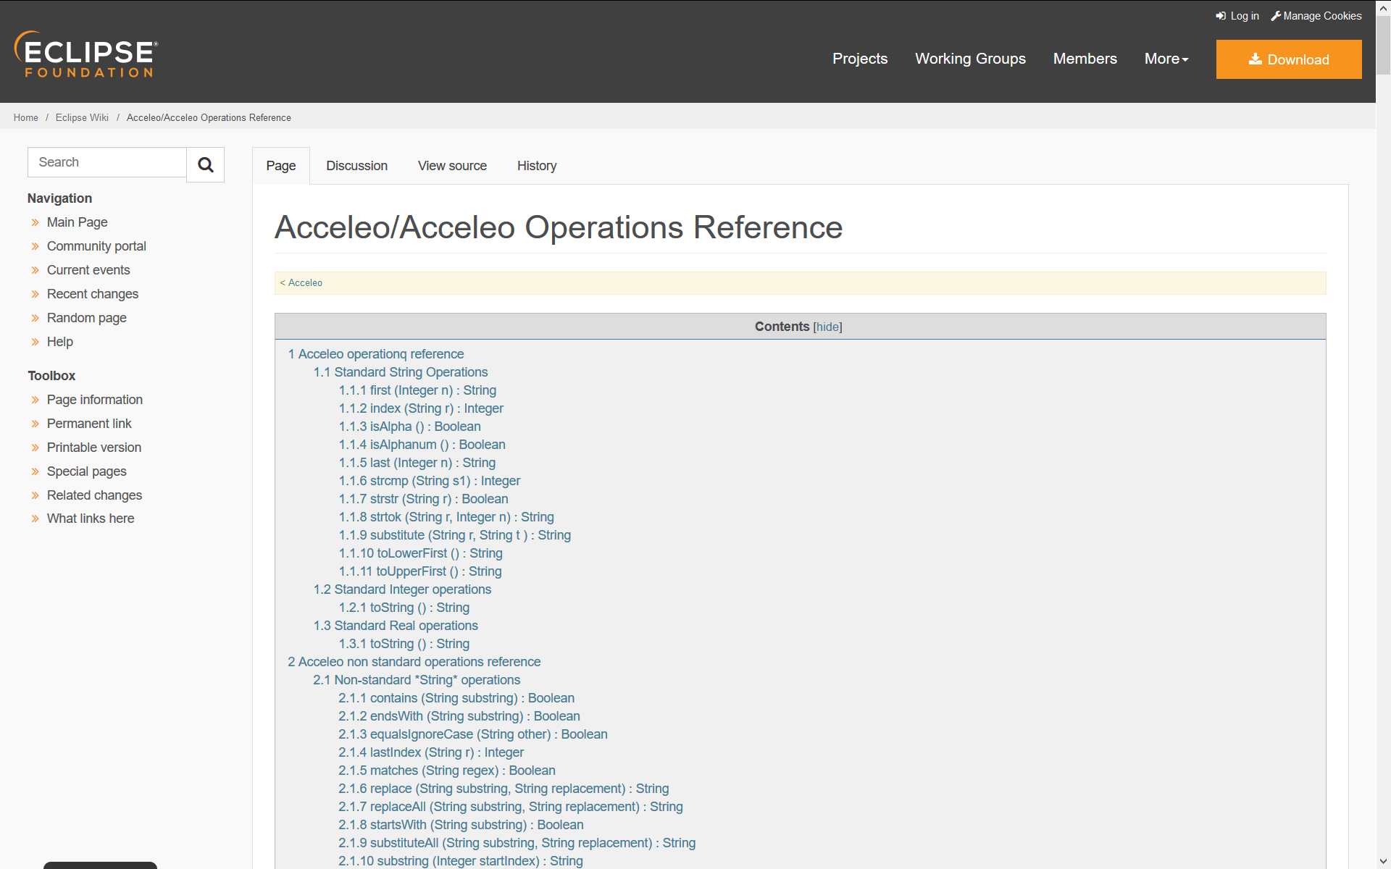
Acceleo Operations Reference
Detail

Slide 65
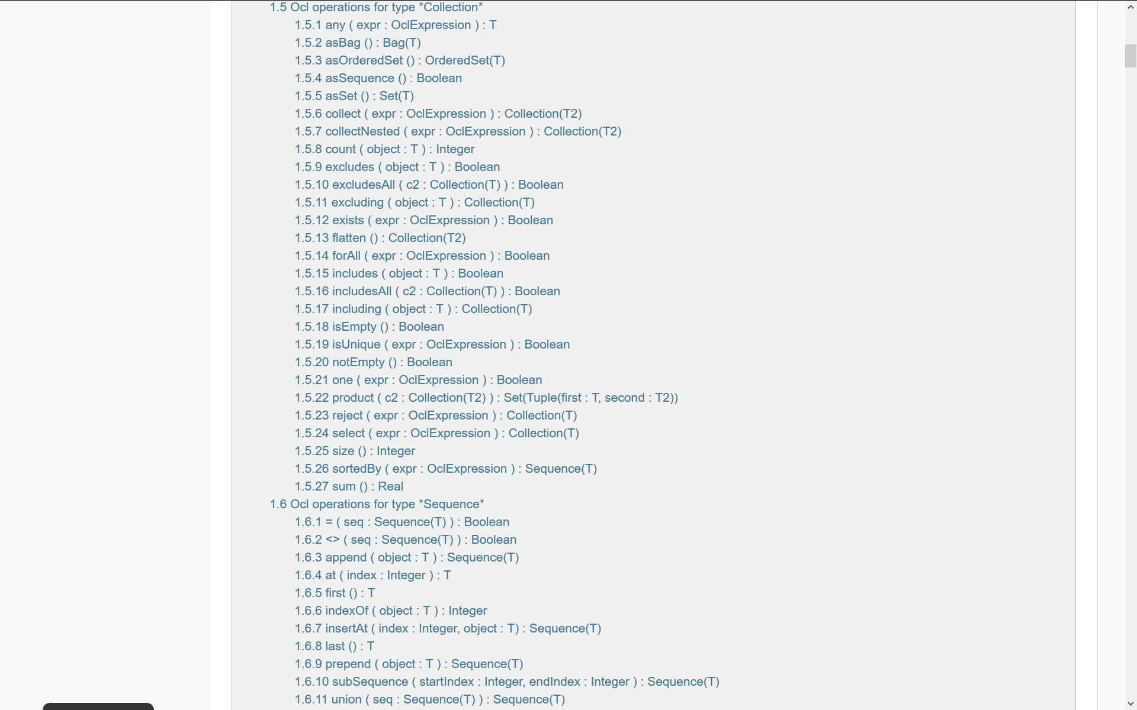
Acceleo/OCL Operations Reference
Detail

Slide 66
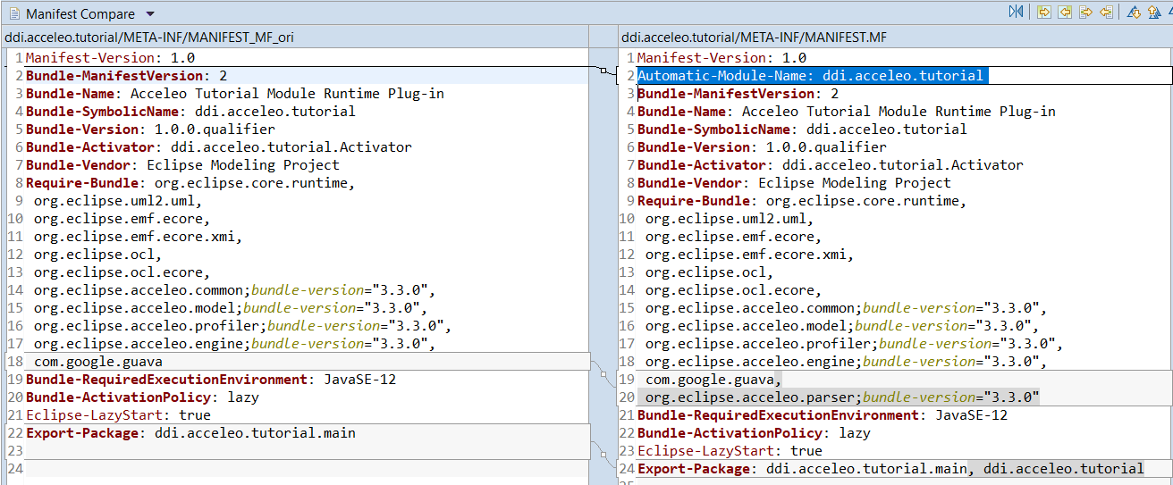
MANIFEST.MF - Changes
Detail
Additions

Slide 67
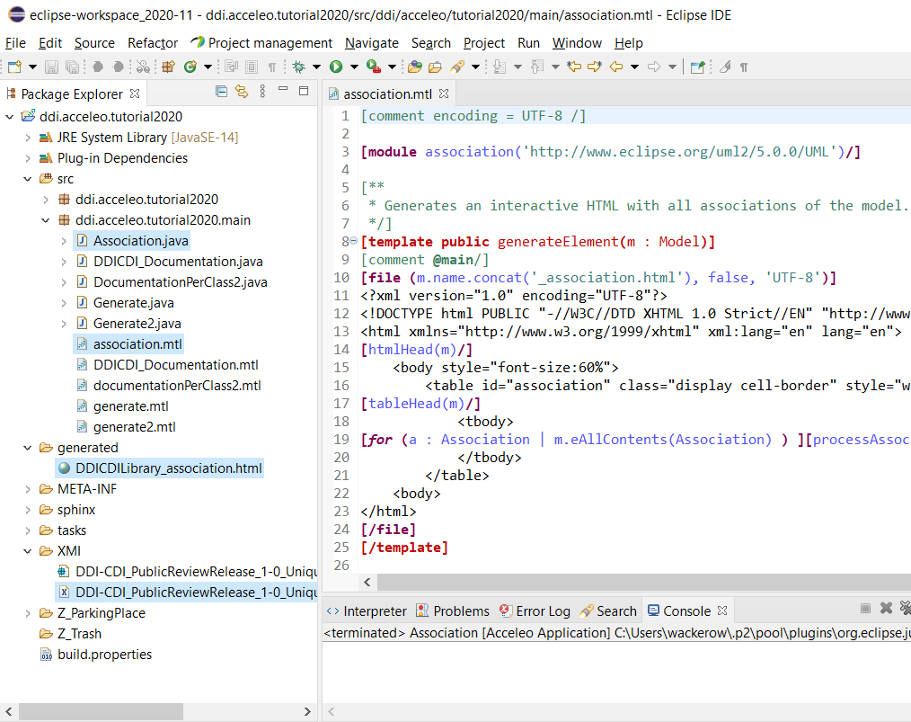
Acceleo Perspective in Eclipse
Editor
3. Generated Java code
2. Acceleo code file
4. Generated output
1. Input model as XMI
Console

Slide 68
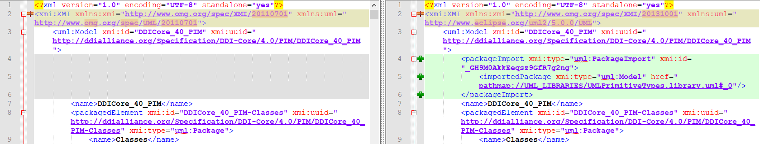
XMI Import: Workaround for
Mapping Namespaces
Detail
Change XMI and UML namespaces
Add package import for UML primitives in Eclipse
Change URI for UML primitives
❶
❷
❸

Slide 69
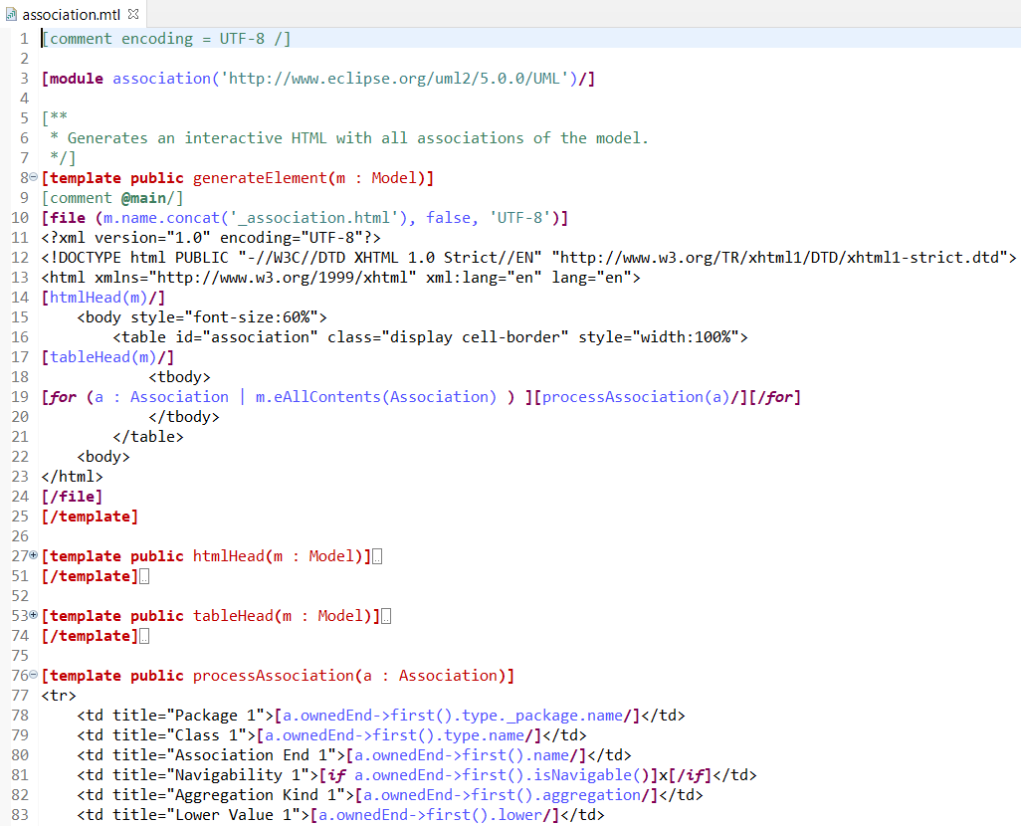
Example: List All Associations

Slide 70
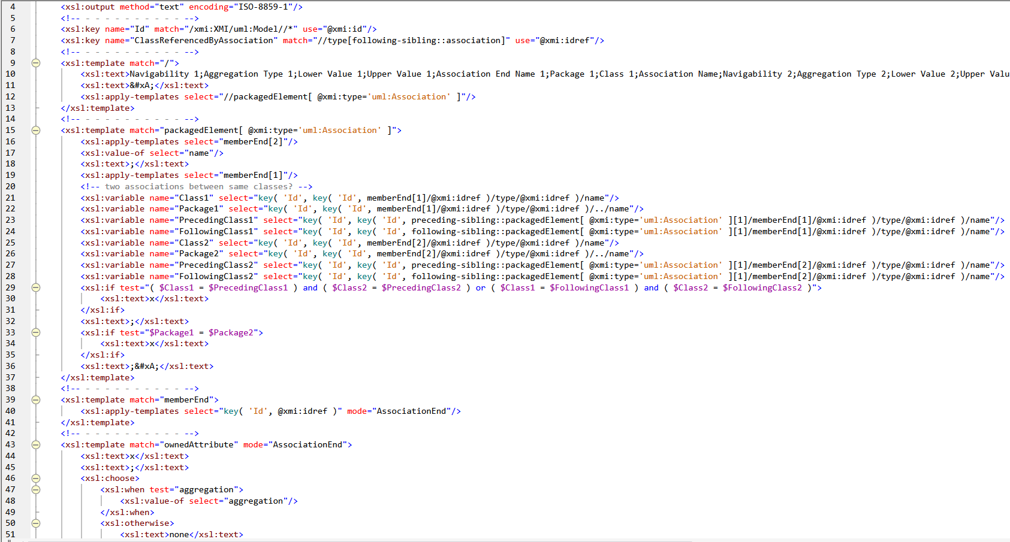
Example: List All Associations – XSLT
(only for comparison)
Detail

Slide 71
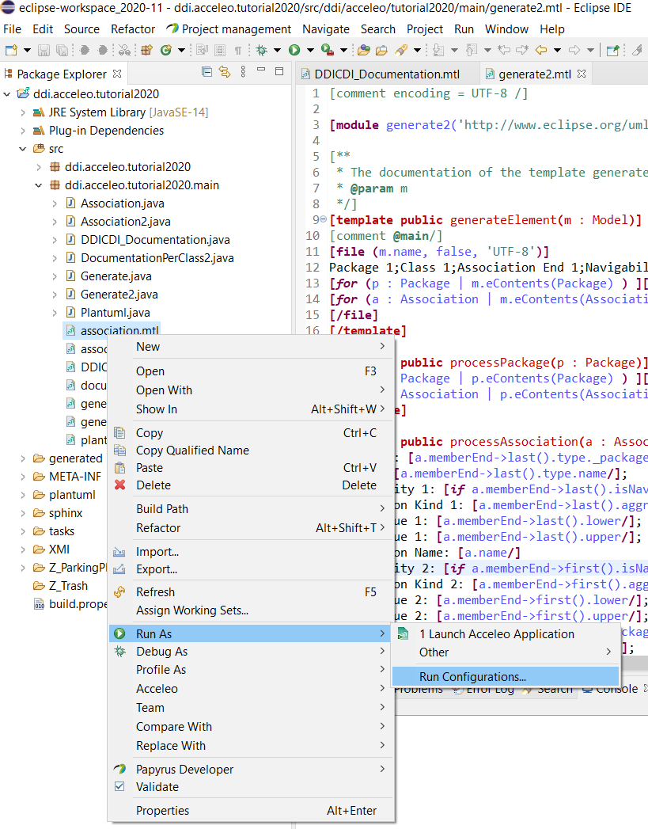
Acceleo: Configure Application I

Slide 72
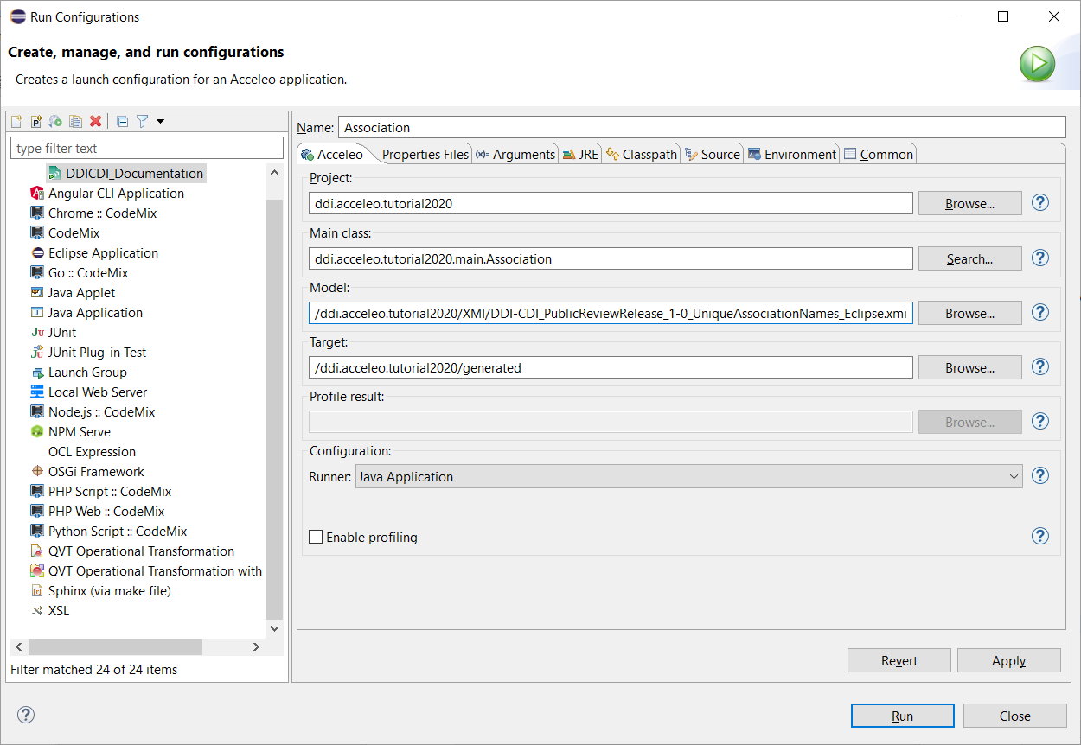
Acceleo: Configure Application II

Slide 73
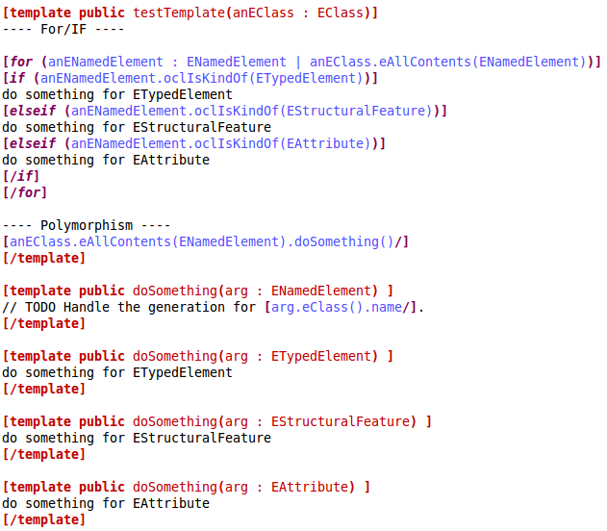
Polymorphism
Detail
for/if is quick but dirty
Use polymorphism instead, i.e. a single interface to entities of different types
Source: Acceleo Best Practices from Obeo

Slide 74
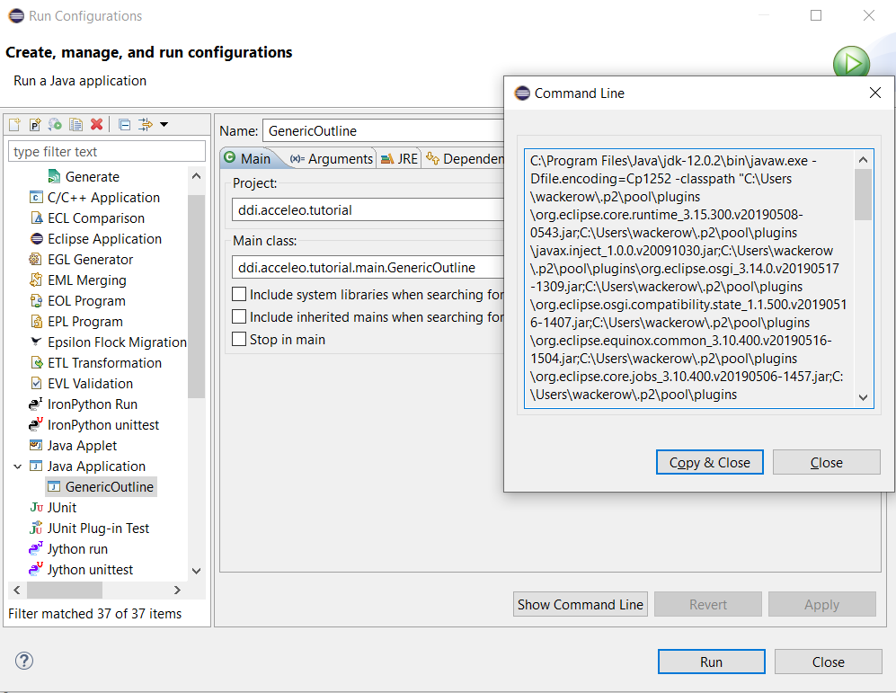
Standalone
Detail

Slide 75
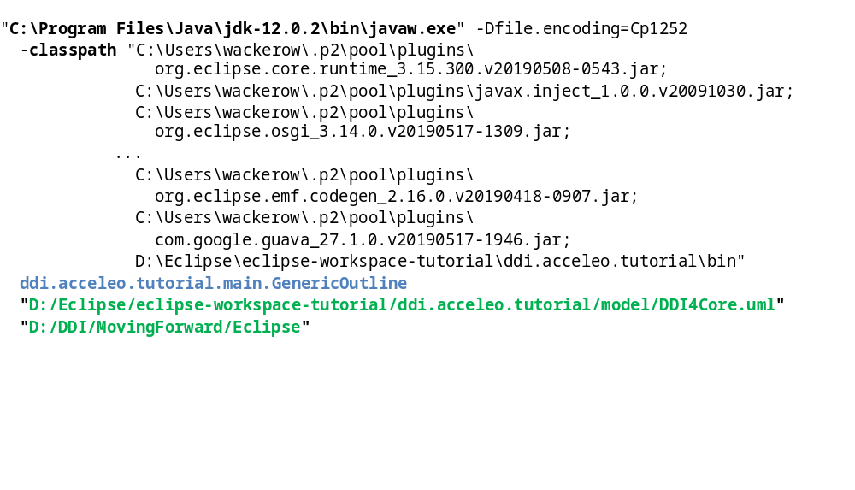
Build Automation: Command Line
Detail
Model-to-text application
Output folder
Input model

Slide 76
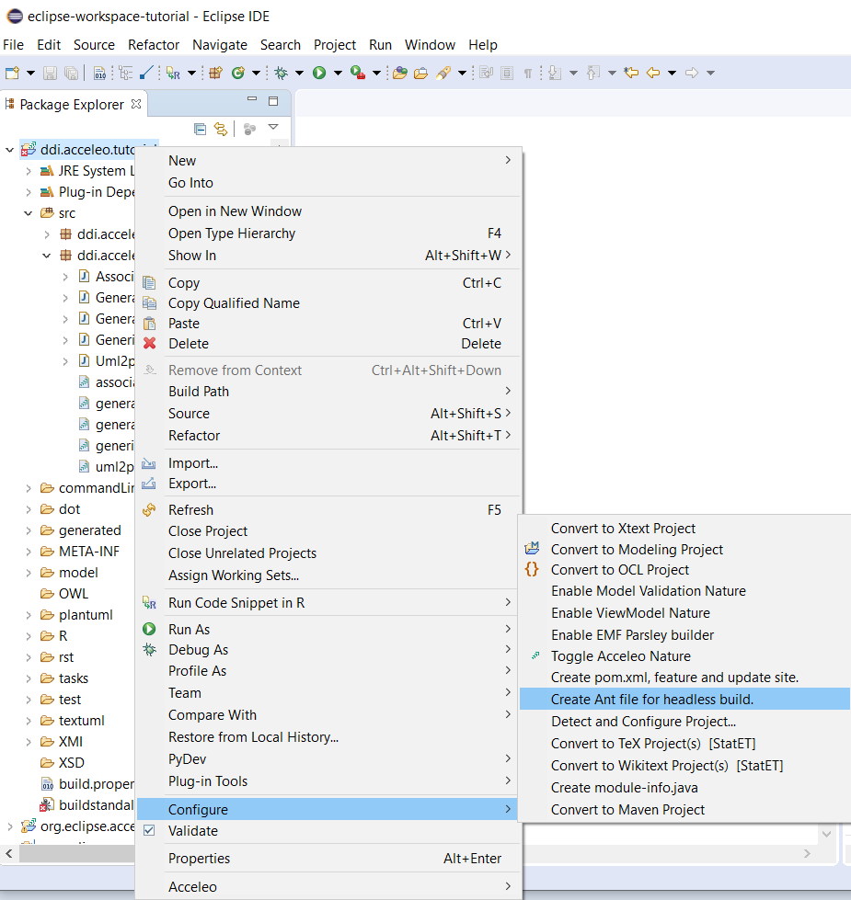
Build Automation: Ant - 1
Detail

Slide 77
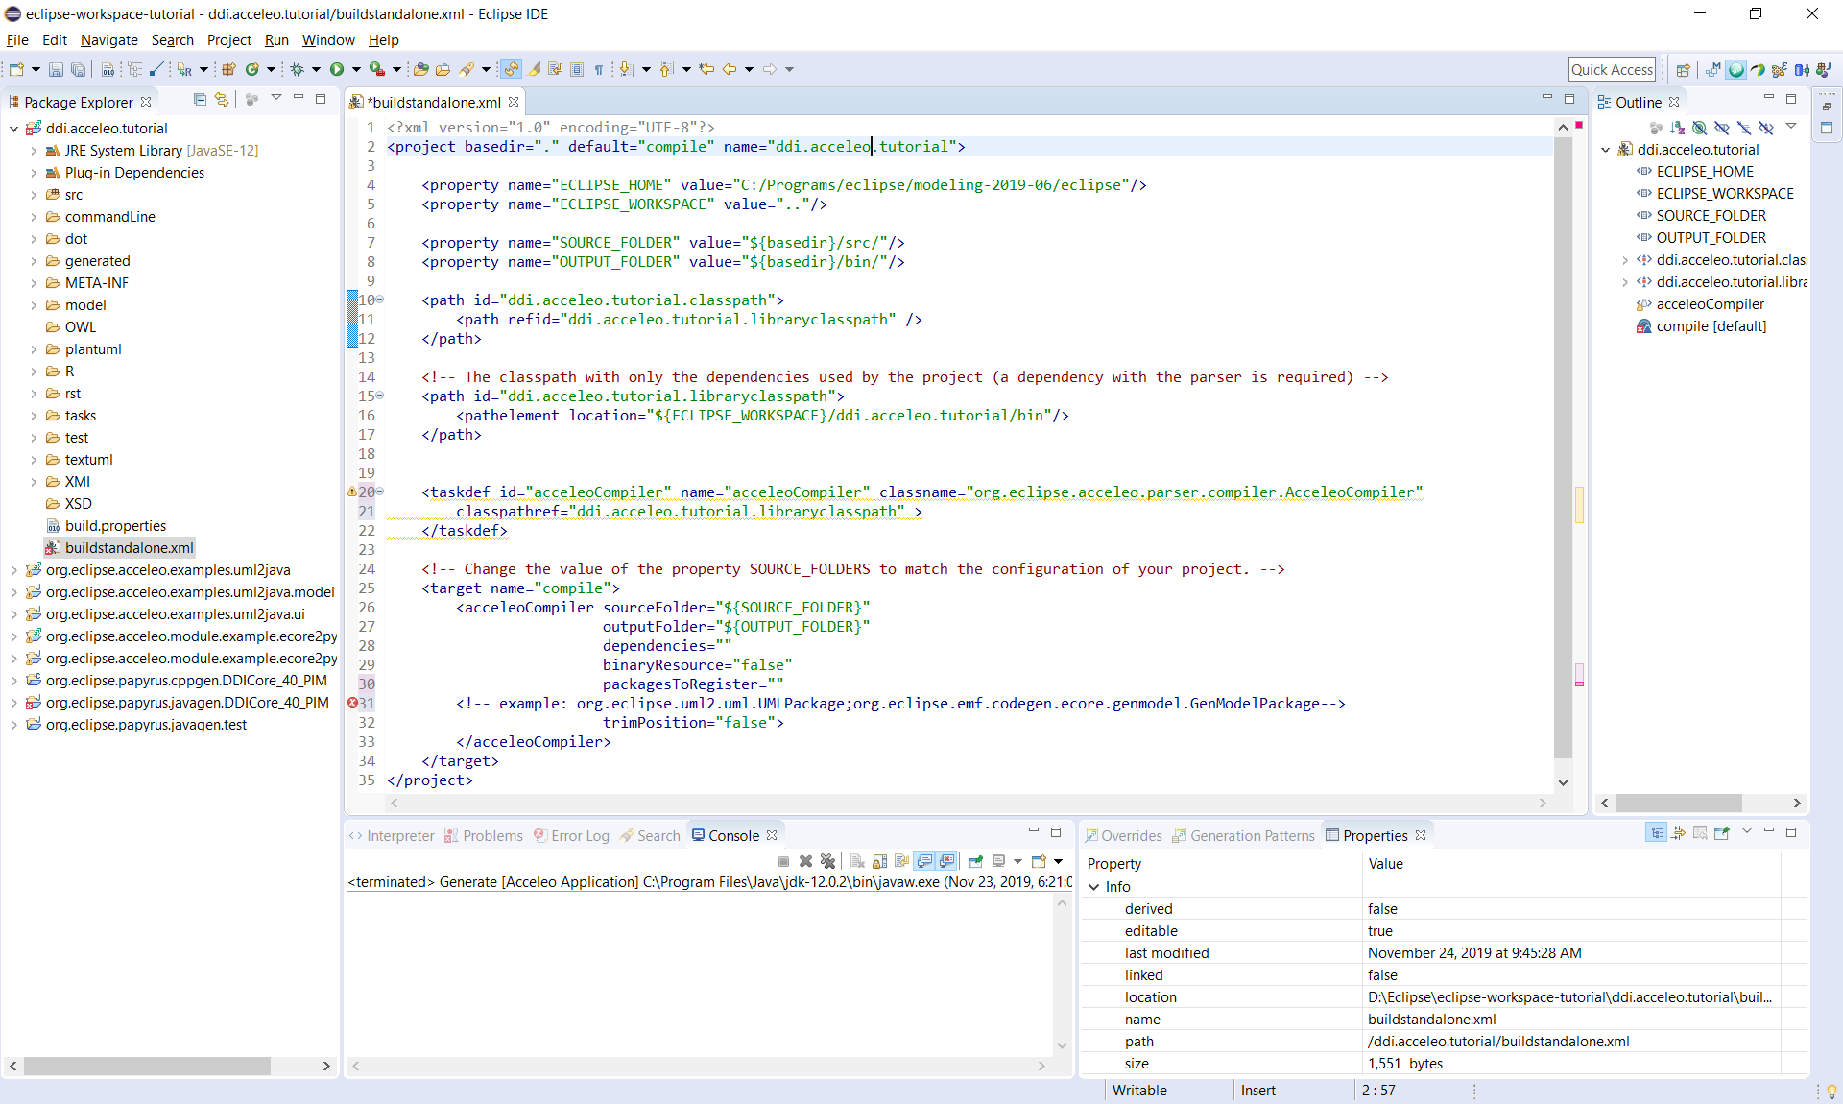
Build Automation: Ant - 2
Detail

Slide 78
UML Class Diagram Primer
Part I
  Overview
  DDI-CDI - Features
  Model-Driven Approach
  Model-Driven Approach for DDI-CDI
  UML Subset for DDI-CDI
  Generation of Specific Representations XSD, OWL, R, reST, and DOT
  Generation of Any Syntax Representation
Part II
  Eclipse Environment
    Papyrus - UML Tool
    QVTo - Model to Model
    Acceleo - Model to Text
  UML Class Diagram Primer
  Exercises
  Credits, Community, and Contact

Slide 79
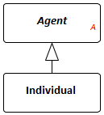



UML Class Diagram Primer
And Some Specific DDI-CDI Rules
Multiplicity is formally defined as a lower and upper bound. Simply put: a multiplicity is made up of a lower and an upper cardinality. A cardinality is how many elements are in a set.
Class
  Name is unique in the model
  Attribute (has a multiplicity definition)
  Can inherit properties and associations
  from a superclass, using single inheritance
Association
  Has a name (unique in one version)
  Has multiplicity definitions
  Only binary and directed associations
  Shared aggregation, has only documentary meaning
  Composite aggregation
Datatypes
  Primitives
  Enumerations
  Structured data types
Resources
  UML Diagram website and related index
  OMG specification UML 2.5.1

Slide 80
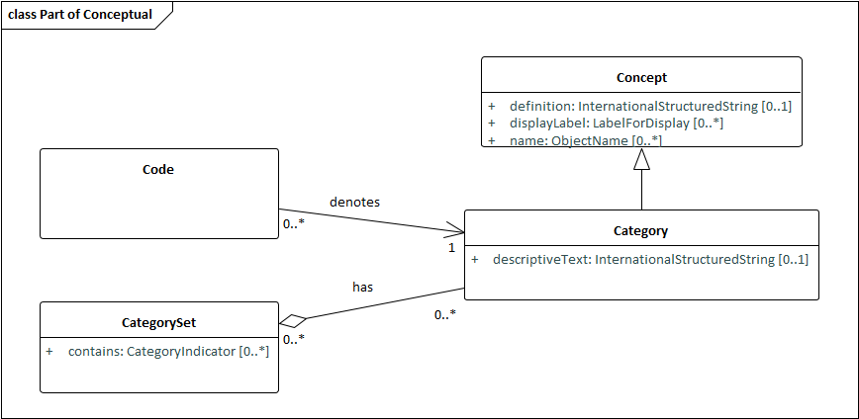
DDI-CDI Example – Class Diagramm
Attribute
Attribute data type
Class name
Association name
Generalization
Aggregation
Multiplicity

Slide 81
Navigability / Multiplicity
Detail
Navigability
  Can be understood as a recommendation for
  efficient direction
Multiplicity
  “A specification of the range of allowable cardinality values - the size - that a set may assume.”
  Source: The Unified Modeling Language Reference Manual

Slide 82
Exercises
Part I
  Overview
  DDI-CDI - Features
  Model-Driven Approach
  Model-Driven Approach for DDI-CDI
  UML Subset for DDI-CDI
  Generation of Specific Representations XSD, OWL, R, reST, and DOT
  Generation of Any Syntax Representation
Part II
  Eclipse Environment
    Papyrus - UML Tool
    QVTo - Model to Model
    Acceleo - Model to Text
  UML Class Diagram Primer
  Exercises
  Credits, Community, and Contact

Slide 83
Exercise Steps
Focus on Acceleo (model to text)
  Create a mapping table (based on the template) for a specific language
  Use the model in the UML Model Editor to get familiar with the model structure
  Make a copy of genericOutline.mtl or objectOrientedTemplate.mtl in
  ddi.acceleo.tutorial2020/src/ddi.acceleo.tutorial2020.main
    Object oriented template has a filter for only one package („Agents“) which can be removed if the application should be run for all packages.
  Change module name according to the file name
  Use it as basis for adding specific language fragments to it

Slide 84
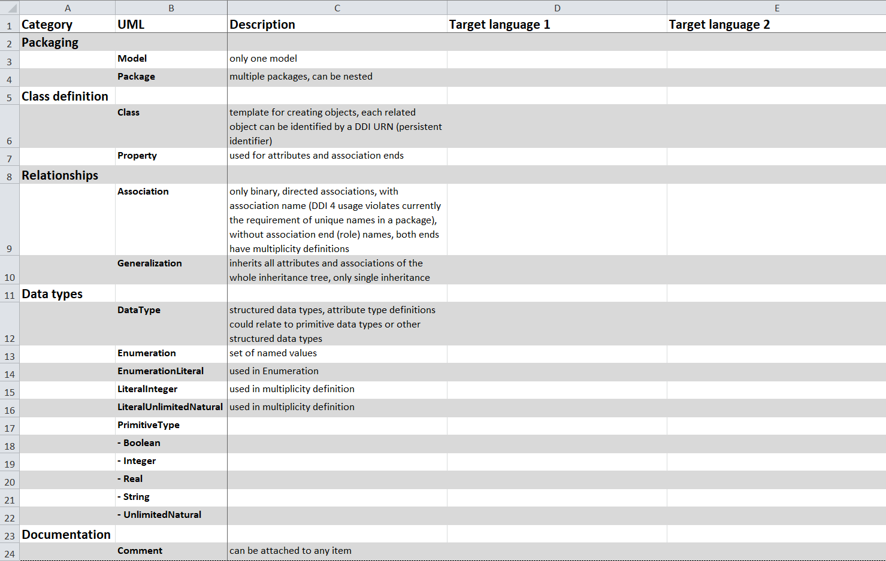
Exercises – Mapping Table

Slide 85
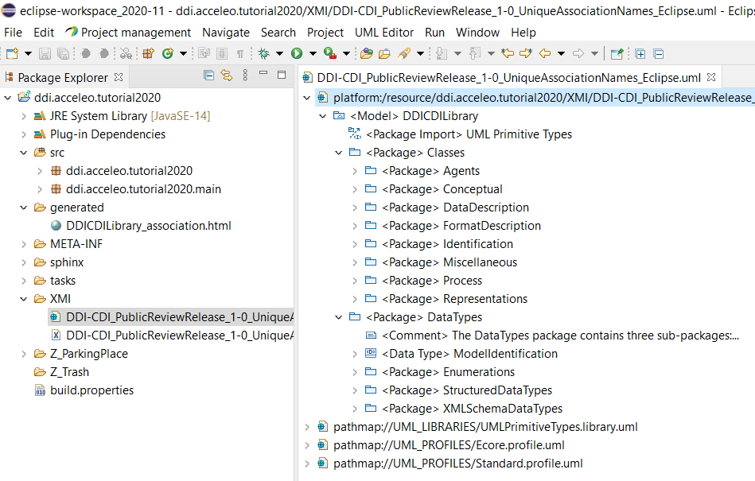
DDI-CDI in UML Model Editor

Slide 86
Subset of UML Class Diagram Items for DDI-CDI
Packaging
  Model – only one model
  Package – multiple packages, can be nested
Class definition
  Class – template for creating objects, each related object can be identified by a DDI URN (persistent identifier)
  Property – used for attributes and association ends, have multiplicity definition
Relationships
  Association – only binary, directed associations, with association name (DDI-CDI usage violates currently the requirement of unique names in a package), without association end (role) names, both ends have multiplicity definitions
  Generalization – inherits all attributes and associations of the whole inheritance tree, only single inheritance
Data types
  DataType – structured data types, attribute type definitions could relate to primitive data types or other structured data types
  Enumeration – set of named values
  EnumerationLiteral – used in Enumeration
  LiteralInteger – used in multiplicity definition
  LiteralUnlimitedNatural – used in multiplicity definition
  PrimitiveType
    Boolean
    Integer
    Real
    String
    UnlimitedNatural
Documentation
  Comment – can be attached to any item
The UML items are used in the XMI representation with the prefix „uml:“ like „uml:Class“.
Links of items go to pages of XMI validator of NIST.
Useful UML documentation: UML Diagrams by Kirill Fakhroutdinov

Slide 87
Subset of UML Class Diagram Items: Details

Slide 88
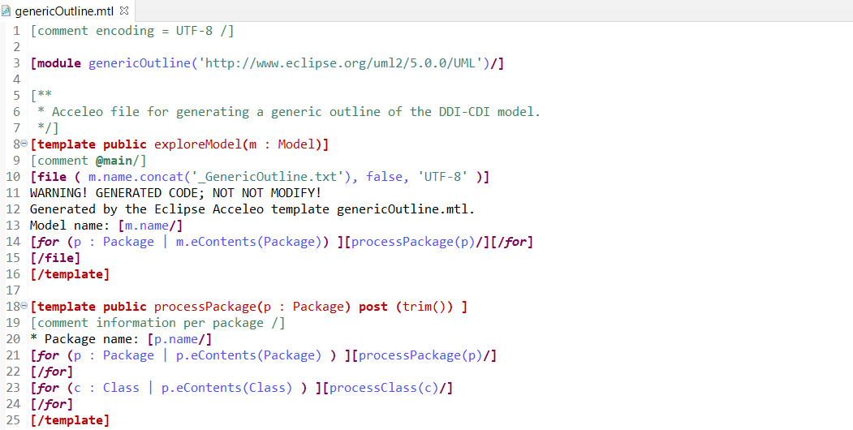
Generic Outline – part 1 genericOutline.mtl

Slide 89
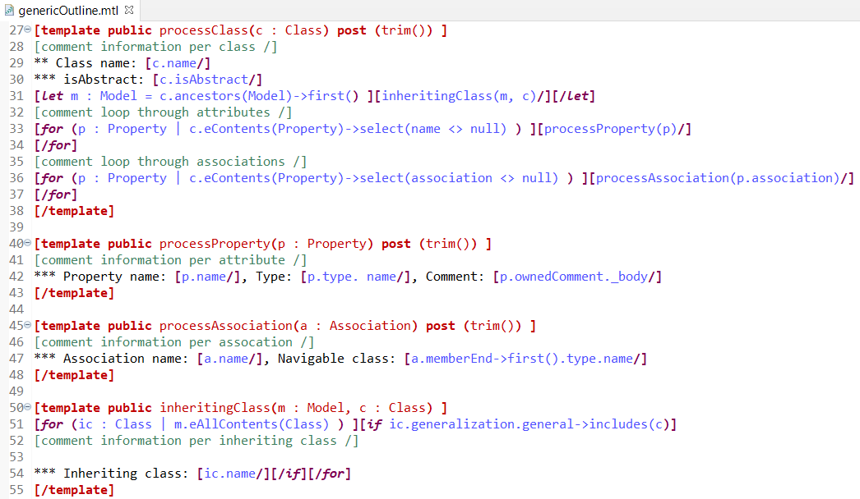
Generic Outline – part 2 genericOutline.mtl

Slide 90
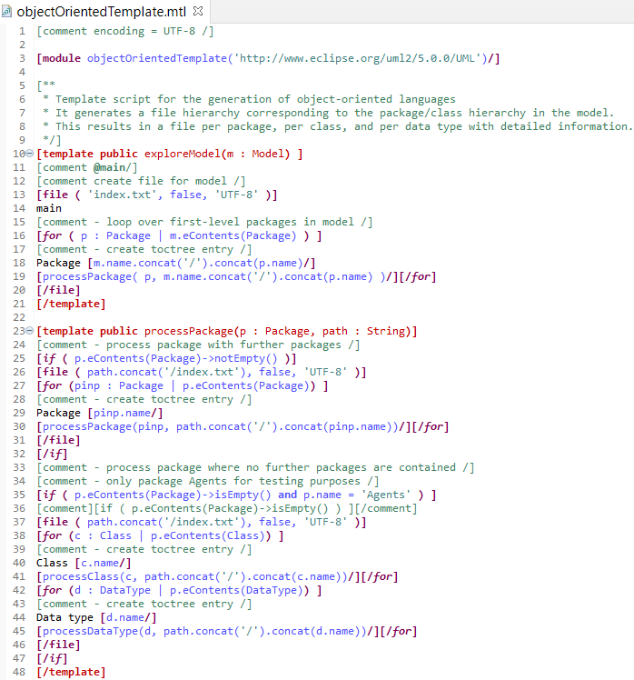
Object Oriented Template

Slide 91
Credits, Community, and Contact
Thanks to …
  Participants of DDI-CDI working groups and sprints, especially to the DDI-CDI development group
Feed back to the community
  Mature approaches of code generation based on the DDI-CDI model could be published on a „marketplace“
Please contact me if you are working on code generation of DDI-CDI: joachim.wackerow@gesis.org
Web page of this tutorial

