Slide 1

A Study of Work Engagement among Employees of Large Retail Enterprises in Region XII, Philippines
NORAIDA C. ALI, PhD

Slide 2
Statement of the Problem
This study determined the best fit model on work engagement among employees of large retail enterprises in Region XII.
Specifically, the following objectives were achieved in this study.
1. Assessed the level of transformational leadership among managers in large retail enterprises in terms of:
  inspirational motivation;
  individualized consideration;
  idealized influence; and
  intellectual stimulation.
2. Ascertained the level of motivation among managers in large retail enterprises in terms of:
  rewards;
  achievement and recognition; and
  performance feedback.

Slide 3
Statement of the Problem
3. Evaluated the level of human resource management practices among employees in large retail enterprises in terms of:
  planning and recruitment;
  training program;
  compensation; and
  performance appraisal.
4. Measured the level of work engagement among employees in large retail enterprises in terms of:
  vigor;
  dedication; and
  Absorption.
5. Determined the relationship between
  transformational leadership and work engagement;
  motivation and work engagement; and
  human resource management practices and work engagement.
6. Determined the best fit model that predicts work engagement.

Slide 4
Method
Research Design
Quantitative Research Method
Descriptive Correlation
Structural Equation Modeling
Research Instrument
Survey Questionnaire
Statistical Tool
Mean
Pearson Product Moment Correlation
Structural Equation Modelng
Research Locale
Nine (9) large retail enterprises in Region XII, mainly in Cotabato City, Isulan, Sultan Kudarat, Tacurong City and Koronadal City.

Slide 5
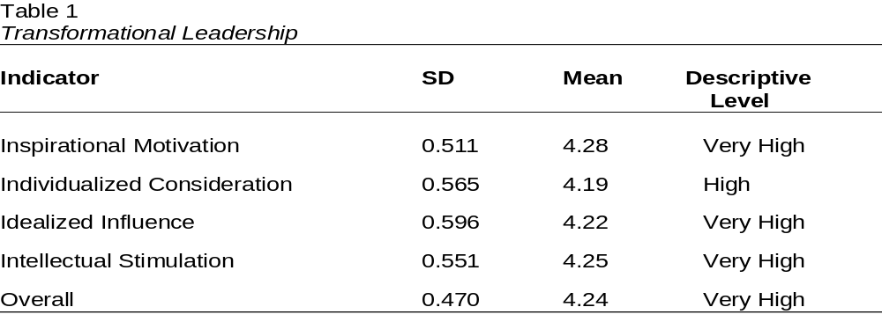
Result

Slide 6
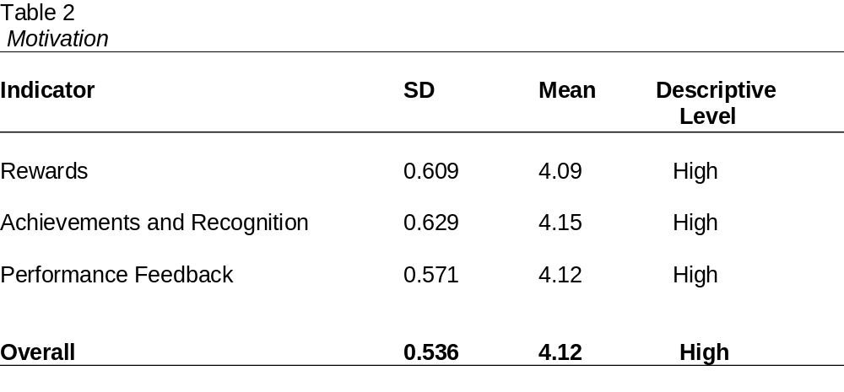

Slide 7
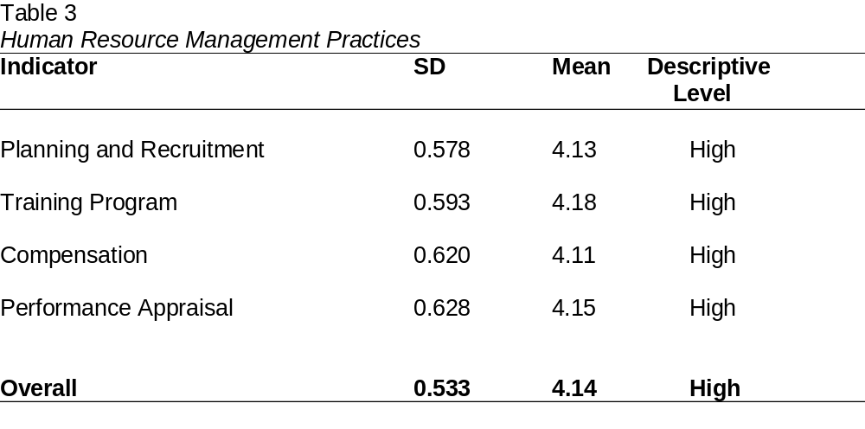

Slide 8
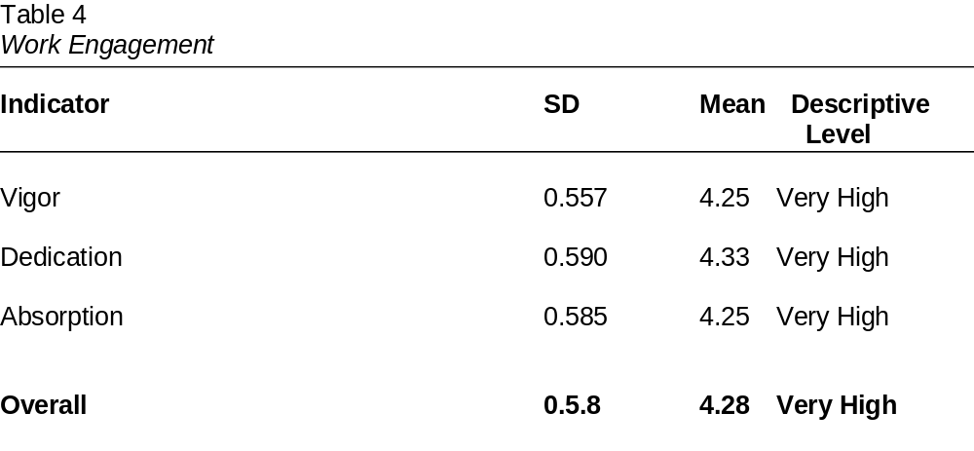

Slide 9
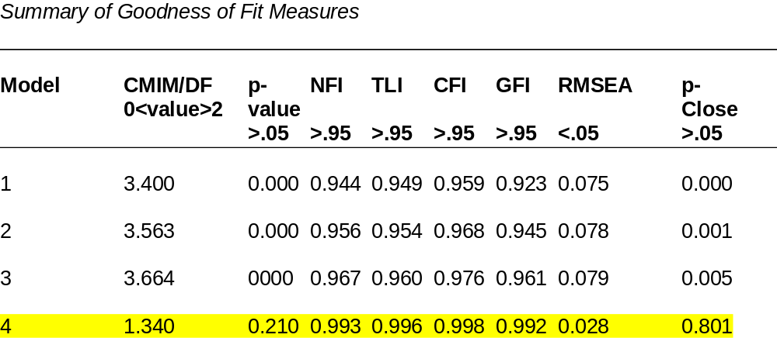

Slide 10
Thank You for Listening

