Slide 1
Community building with the EOSC Portal
Gergely Sipos
Stakeholder Engagement Coordinator
Dissemination level: Public
Realising the European Open Science Cloud, 16-18 Nov, 2020.

Slide 2
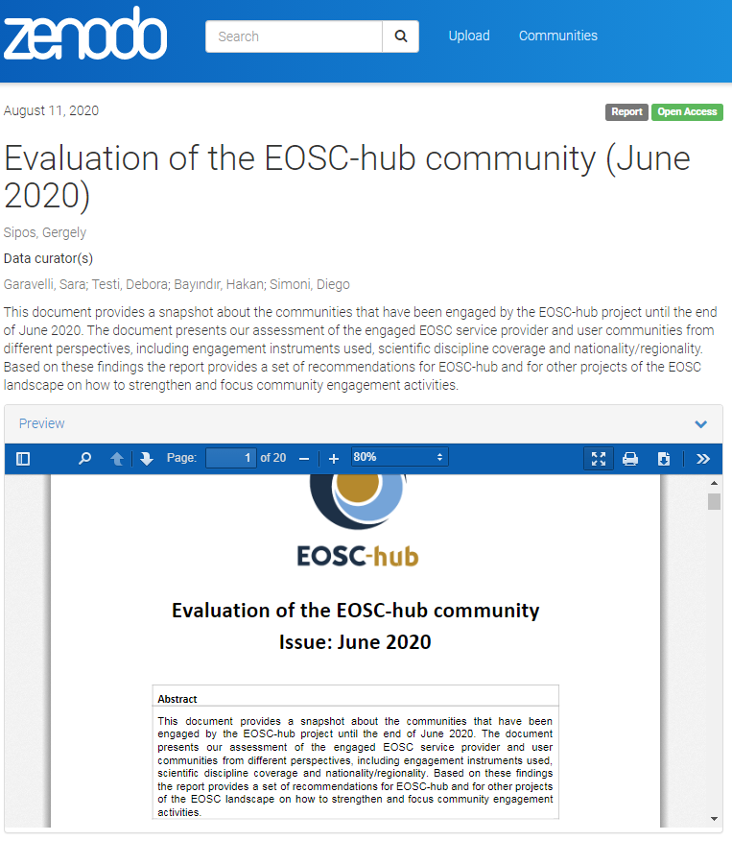
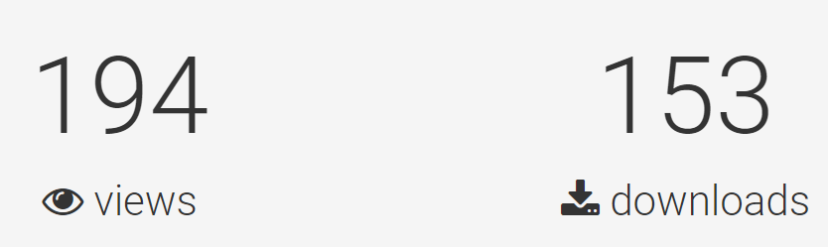
Community engagement by EOSC-hub
Published in June 2020:
https://zenodo.org/record/3979112#.X7O_-shKiUk
Competence centres - 10
Thematic services - 9
Services onboarded - 90/250+
Service users served - 331 (+10k visits)
Early Adopter Programme Pilots - 13
Event engagement - 30 (+...)
Consortium
Portal
Call
Events

Slide 3

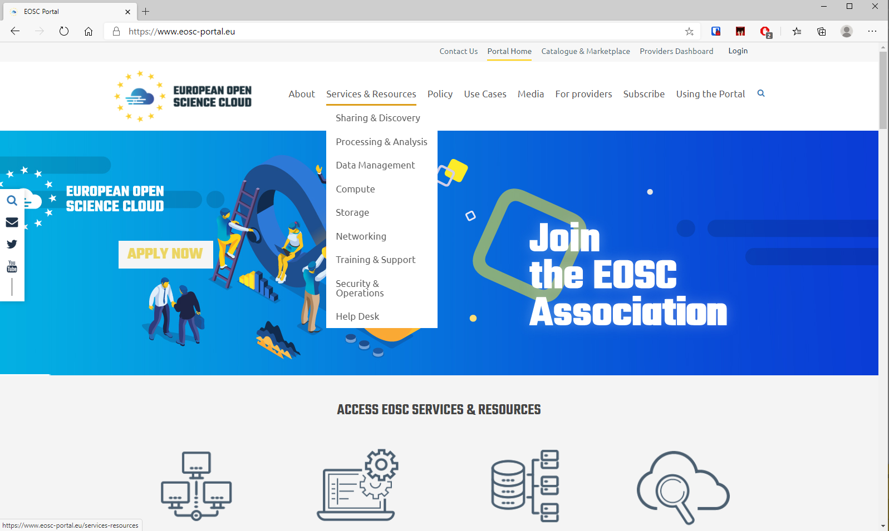
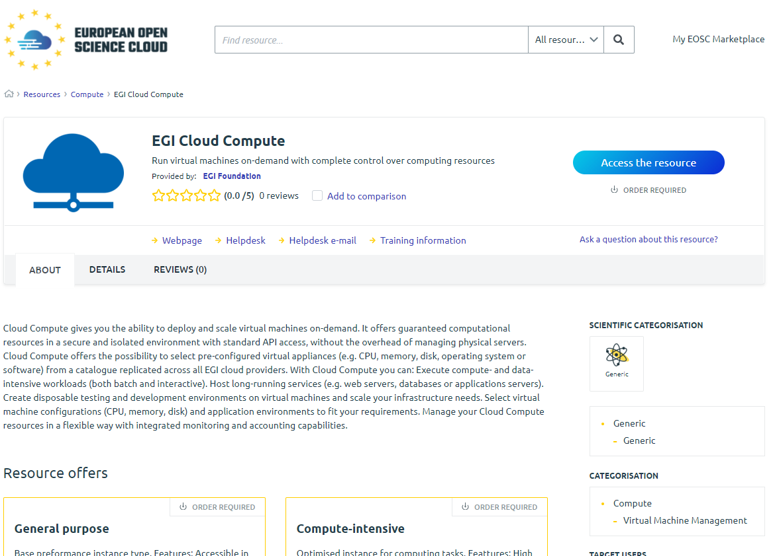
EOSC Portal - since November 2018.
New resource
registrations
(by providers)
250+ services, ~90 through the website
Visits on open access services - ~10,000
Service access (by users)
Access requests for controlled services - 331
Notes:
Opened in Nov 2018
Operation by EOSC-hub
Operational processes run by EOSc-hub
Registering new providers
Dispatching user access requests

Slide 4
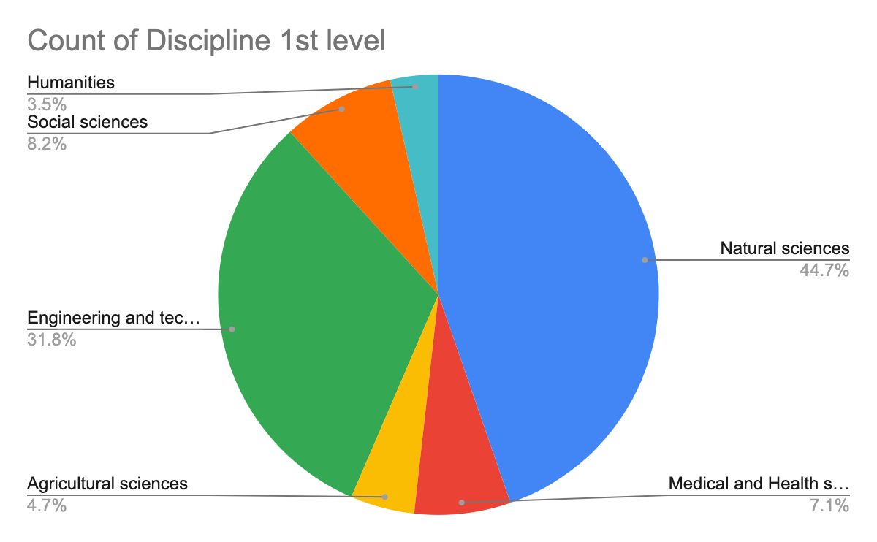
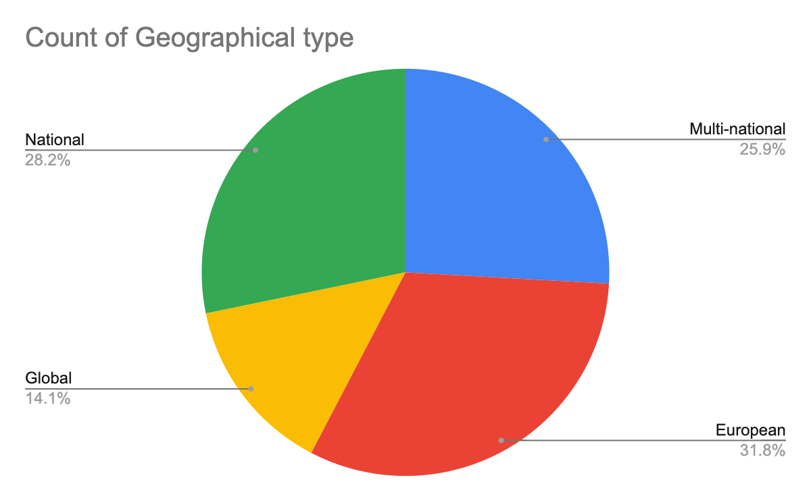
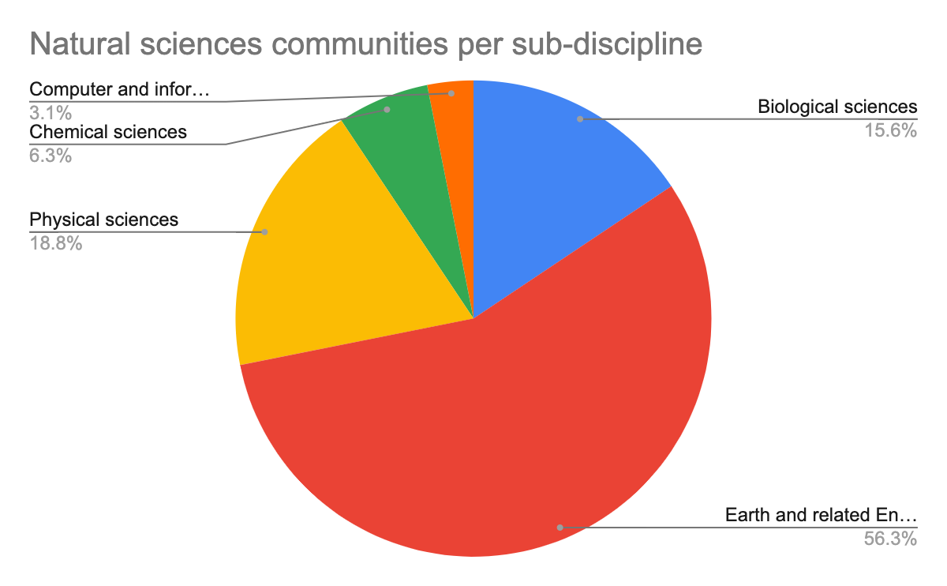
Provider analysis (Providers + CCs, TSs, EaPs)
Based on the Frascati schema
Typically European projects
Generic IT services (cloud, storage)
Typically RIs
Typically multinational companies

Slide 5
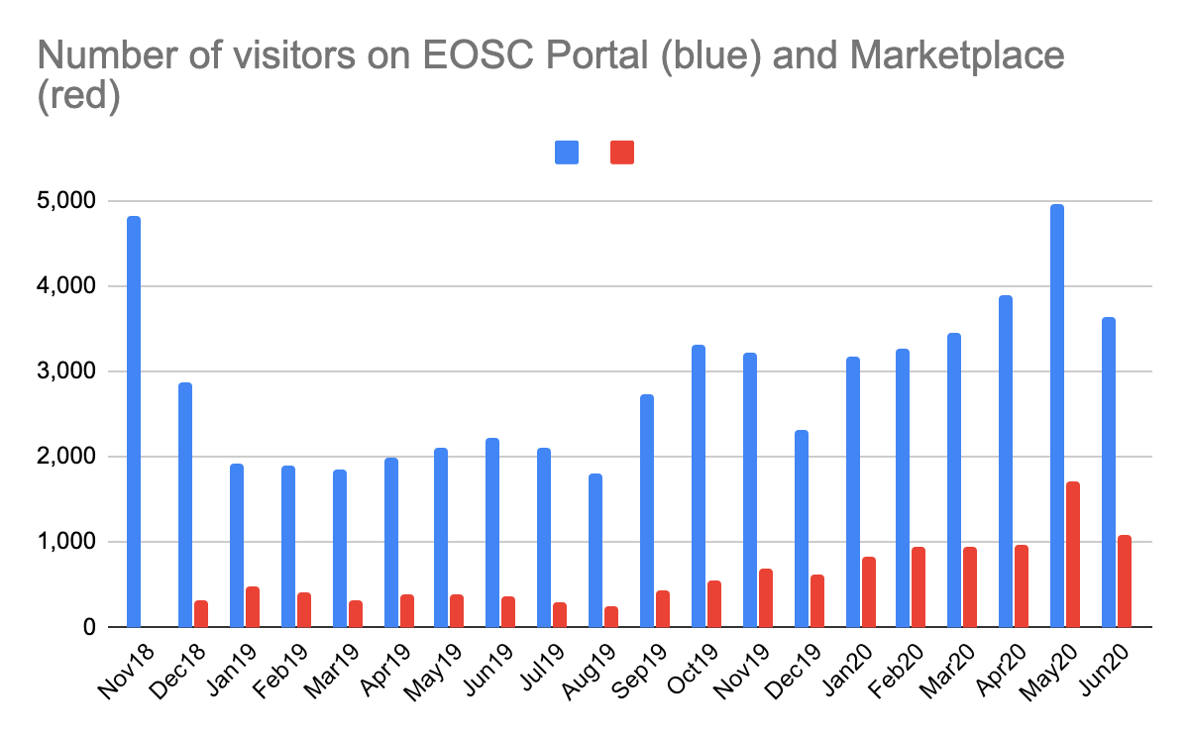
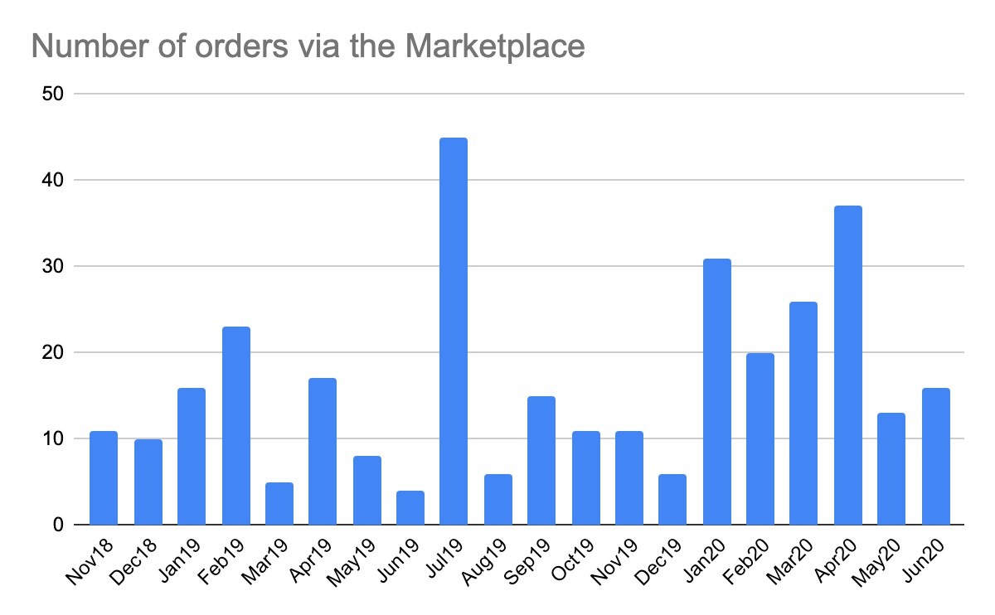
User analysis
~60,000 in total
A confused user
~10,000 in total
Early Adopter Pilots
331 in total

Slide 6
Order analysis
Country | Population (in million) | Number of orders received from that country | Expected number of orders based on the European average
Albania | 2,8 | 2 | 0,6
Austria | 8,8 | 5 | 2
Belgium | 11 | 1 | 2,49
Czech Republic | 10,69 | 1 | 2,54
Denmark | 5,8 | 4 | 1,38
Finland | 5,5 | 3 | 1,3
France | 66 | 28 | 16
Germany | 83 | 43 | 20
Greece | 10,72 | 2 | 2,55
Hungary | 9,77 | 3 | 2,27
Italy | 60,36 | 11 | 14,37
Netherlands | 17,28 | 5 | 4,11
Poland | 37,97 | 14 | 9,04
Portugal | 10,28 | 1 | 2,44
Slovenia | 2 | 2 | 0,47
Spain | 46,94 | 7 | 11,18
Sweden | 10,23 | 7 | 2,43
Switzerland | 8,57 | 8 | 2,04
Ukraine | 41,98 | 6 | 9,995
United Kingdom | 66,65 | 19 | 15,87
User's country | Total orders | Unique users
Albania | 2 | 1
Armenia | 2 | 1
Australia | 2 | 2
Austria | 5 | 4
Belgium | 1 | 1
Brazil | 1 | 1
Czech Republic | 1 | 1
Denmark | 4 | 2
EU projects | 10 | 6
Finland | 3 | 3
France | 28 | 9
Germany | 43 | 28
Greece | 2 | 2
Hungary | 3 | 3
Italy | 11 | 7
Korea | 52 | 2
Netherlands | 5 | 3
Poland | 14 | 8
Portugal | 1 | 1
Slovenia | 2 | 1
Spain | 7 | 5
Sweden | 7 | 5
Switzerland | 8 | 3
Ukraine | 6 | 1
United Kingdom | 19 | 10
TOTAL FROM KNOWN COUNTRIES | 239 | 110
176 European order
741 mill population
1 order / 4.2 mill
+92 from unnamed location

Slide 7
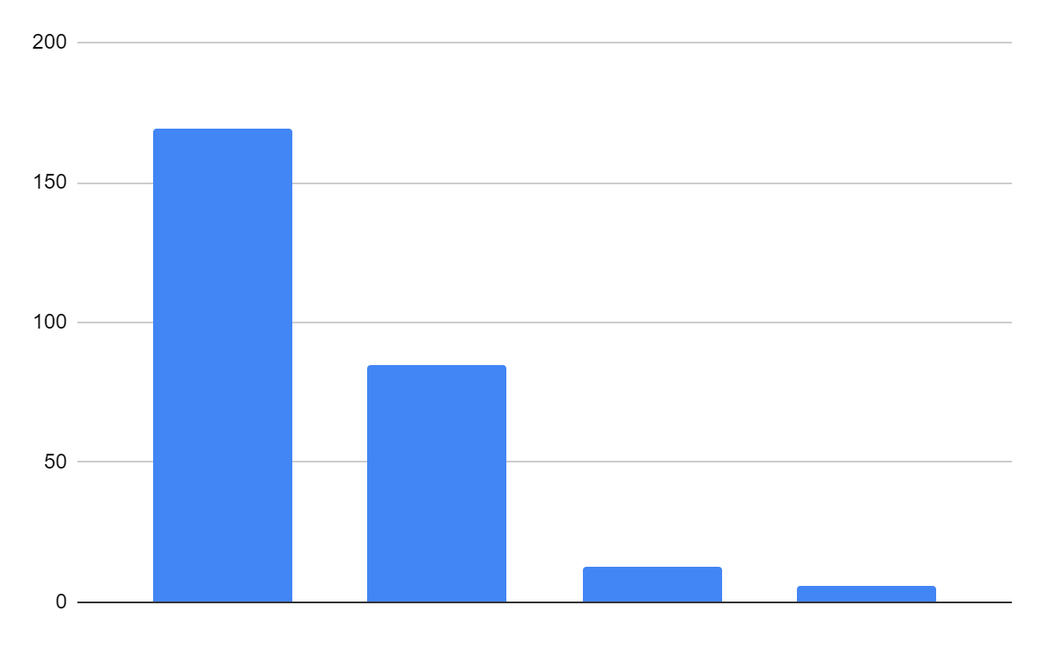
Order analysis (331)
(57 services are orderable, 204 service are Open Access)
Top 10 ordered services:
egi-cloud-compute | Infrastructure as a Service cloud
deepaas-training-facility | Model training for Machine Learning
egi-notebooks | Interactive data analysis environment
B2DROP | File storage
B2safe | Long term data storage
egi-online-storage | File/object storage
B2handle | Persistent Identifier Service
egi-check-in | Authentication-Authorisation service
elastic-cloud-compute-cluster-ec3 | Platform as a Service cloud
B2find | Metadata catalogue/search
Number of services with … orders:
169
Some of the open access services also require ordering - For traceability reason
85
All generic capabilities
13
6
0 order
1-5 orders
6-10 orders
11+ orders

Slide 8
Conclusions & Last steps
KPIs: The project is on track - but EOSC Portal wasn’t planned
Service onboarding: Demand for Catalogue onboarding (in design)
User access: Consultancy & support should be integrated across projects
Last steps:
Analysis and findings were sent to EOSC regional / thematic projects
  Updated analysis to be done in early 2021
Webinar programme launched: https://www.eosc-hub.eu/webinar-programme
Handover to EOSC-Enhance and EOSC Association/EOSC Future in Feb/Mar

Slide 9
gergely.sipos@egi.eu

