Slide 1

Measuring and Harmonising Education with Education Coding Tools
Verena Ortmanns & Silke Schneider

Slide 2
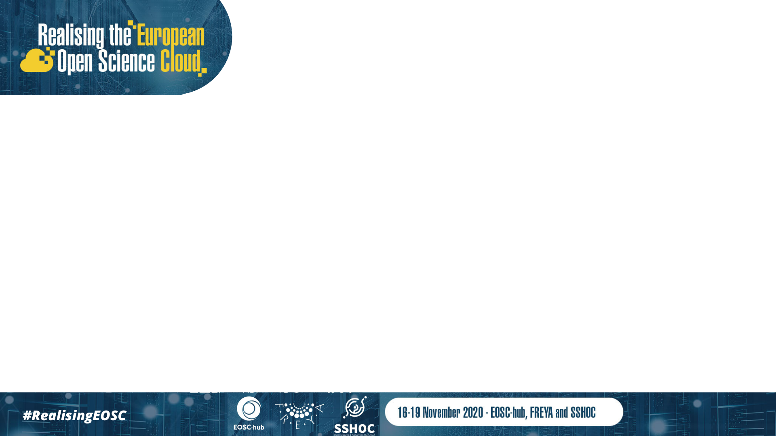
Outline
Background
Tool for fields of education and training
Tool for levels of education and training
Outlook

Slide 3
Background

Slide 4
Education…
usually means “educational attainment”: the highest formal education program completed
is the most central background variable in surveys of individuals, next to age and sex
is a key predictor/control for many outcomes
Measuring education in surveys is challenging, esp. in cross-national surveys

Slide 5
Levels and fields of education
Levels of education -> hierarchical differentiation
“What is your highest educational qualification?”
Difficult to measure in cross-cultural surveys since qualifications and levels of education are country-specific (no translation possible) – ex-ante output harmonisation is needed
Fields of education -> horizontal differentiation
"What is the main subject area of your highest qualification?”
Difficult to measure because of the large number of fields and difficulty of self-classification into broad fields

Slide 6
Education tools surveycodings.org
Tools were developed within the CAMCES project (Computer-Assisted Measurement and Coding of Education in Surveys) and within SERISS WP8 “A coding module for socio-economic survey questions”
Tool for level of education covers 100 countries
Tool for fields of education covers 35 languages
Extension of this work within SSHOC

Slide 7
Components of the tools
Question module:
  Identify relevant education system
  Ask about highest educational qualification obtained (educational attainment) or about the main field education
Survey interfaces:
  Combination Box (CB), including algorithm for textstring matching
  Search Tree (ST)
Database:
  One database per concept which defines universe, provides international codes (such as ISCED), and structures interfaces (esp. search tree)

Slide 8
Tool for fields of education and training

Slide 9
Database
Unit: fields of education and training as defined in International Standard Classification of Education for Fields of Education and Training (ISCED-F) 2013
3 level classification:
  1st level: 11 broad fields (0-10, i.e. 4 digits)
  2nd level: 29 narrow fields
  3rd level: about 80 detailed fields
Same entries for different countries – fields of education can be translated

Slide 10
Broad fields (1st level) of ISCED-F
00 Generic programmes and qualifications
01 Education
02 Arts and humanities
03 Social sciences, journalism and information
04 Business, administration and law
05 Natural sciences, mathematics and statistics
06 Information and Communication Technologies (ICTs)
07 Engineering, manufacturing and construction
08 Agriculture, forestry, fisheries and veterinary
09 Health and welfare
10 Services

Slide 11
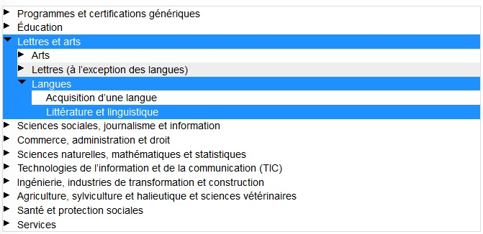
Search Tree for fields of education - France
https://www.surveycodings.org/fields-education/database-live-search

Slide 12
Tool for levels of education and training

Slide 13
Database
Unit: educational qualifications (and levels without qualifications)
Different entries for different countries to reflect specificity of education systems – no translation
Each entry connected with international classification code
Use International Standard Classification of Education (ISCED) 1997 and 2011, and edulvlb

Slide 14
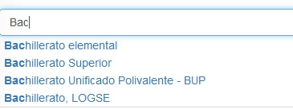
Combination Box - Spain
https://www.surveycodings.org/education/live-search-database-educational-qualifications

Slide 15
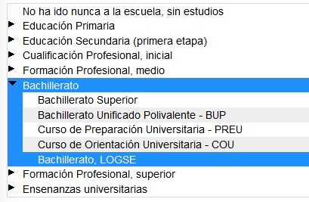
Search Tree - Spain
https://www.surveycodings.org/education/live-search-database-educational-qualifications

Slide 16
Validation of the CAMCES tool
  Compare predictive power of 3 instruments for measuring migrants‘ homeland education in the SOEP migration and refugee samples:
  Years of schooling directly asked
  SOEP instrument: generic descriptions of educational levels (e.g. compulsory school)
  CAMCES instrument: country-specific list of educational qualifications

Slide 17
Predictive power (in %) when predicting German language skills

Slide 18
Outlook

Slide 19
Future work within SSHOC
Update databases for fields of education and levels of education (e.g. consider changes in education systems)
Extend database for levels of education by adding some more countries, e.g. China, Colombia, South Africa
Add background information on the tools and other material (like videos)

Slide 20

Contact:
Verena.Ortmanns@gesis.org
Sike.Schneider@gesis.org

