Slide 1




State of WikiCite 2020
(Version 3)
Daniel Mietchen - 26 October 2020 - DOI: 10.5281/zenodo.4121846 - Q&A: https://w.wiki/iGK

Slide 2
Backchannels for questions & comments
Please put questions and comments into the Etherpad at
https://w.wiki/iGK
For issues requiring a deeper discussion, consider joining the WikiCite group on Telegram.
Daniel Mietchen - 26 October 2020 - DOI: 10.5281/zenodo.4121846 - Q&A: https://w.wiki/iGK

Slide 3
Structure of the talk
Hello WikiCite!
Previous versions of State of WikiCite 2020
Overview of WikiCite
WikiCite developments since the 2018 meeting in Berkeley
  Content
  Infrastructure, tools and workflows
  Grants & fellowships
  Events, including WikiCite 2020 sessions and talks
Getting involved
Q & A
Daniel Mietchen - 26 October 2020 - DOI: 10.5281/zenodo.4121846 - Q&A: https://w.wiki/iGK

Slide 4

Hello WikiCite!
I am
  Daniel Mietchen (User:Daniel Mietchen)
  thankful to organizers of WikiCite activities
  a member of the WikiCite Steering Committee
  a biophysicist by training
  a data scientist at the University of Virginia’s School of Data Science
  @EvoMRI on Twitter
  looking forward to questions and comments
Daniel Mietchen - 26 October 2020 - DOI: 10.5281/zenodo.4121846 - Q&A: https://w.wiki/iGK

Slide 5
State of WikiCite 2020
Previous versions
Source: https://meta.wikimedia.org/wiki/WikiCite/administration
Daniel Mietchen - 26 October 2020 - DOI: 10.5281/zenodo.4121846 - Q&A: https://w.wiki/iGK

Slide 6
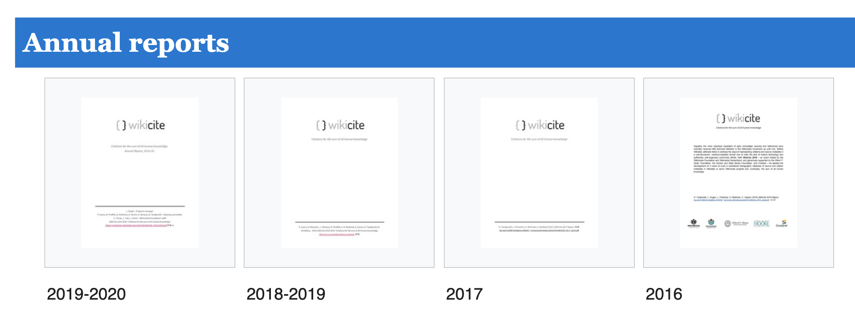
State of WikiCite 2020 - version 1
Source: https://meta.wikimedia.org/wiki/WikiCite/administration
Daniel Mietchen - 26 October 2020 - DOI: 10.5281/zenodo.4121846 - Q&A: https://w.wiki/iGK

Slide 7
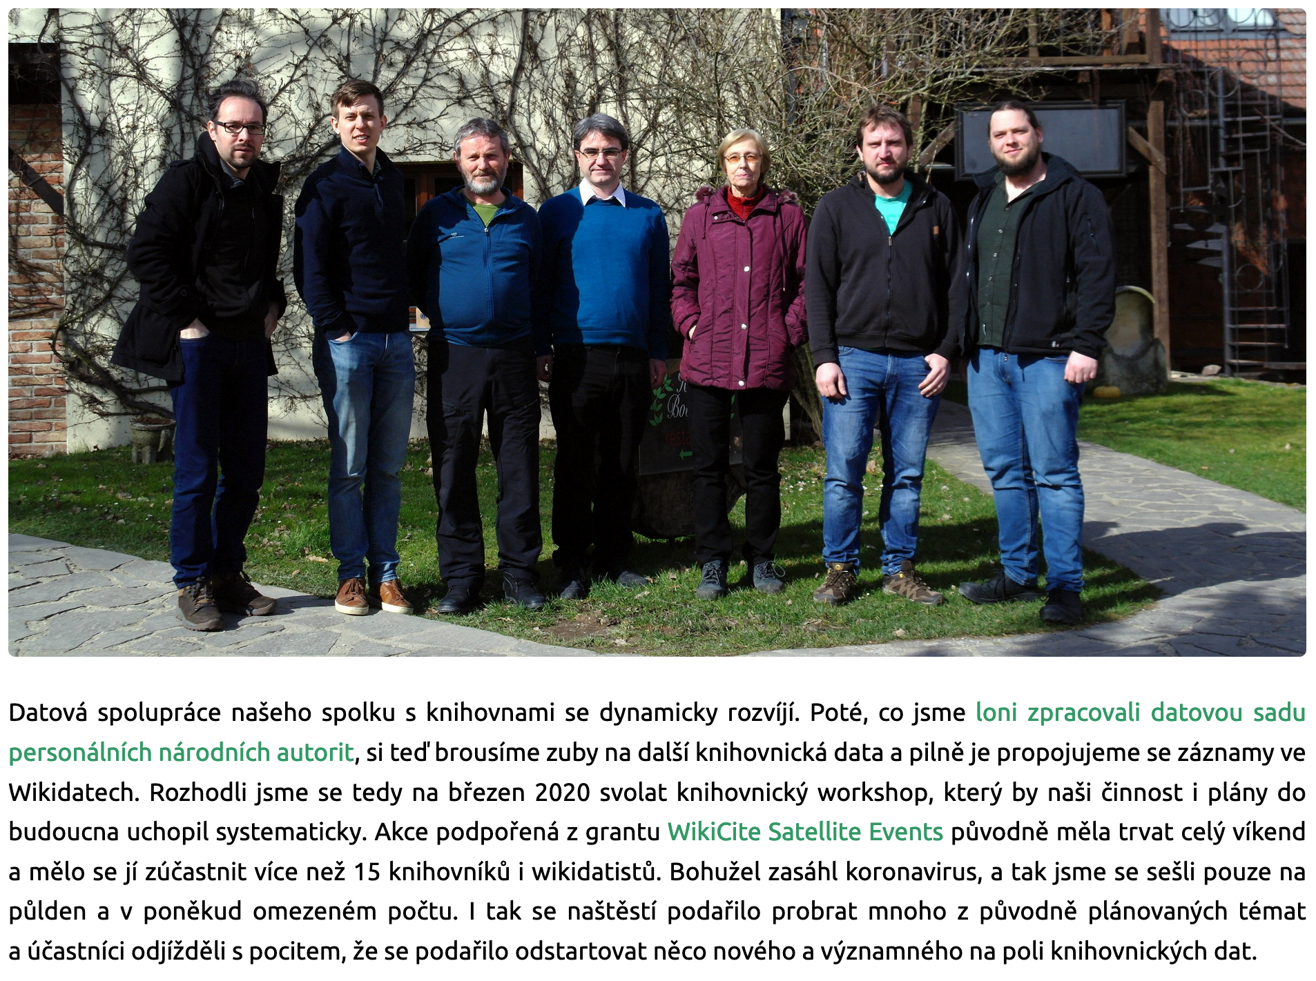
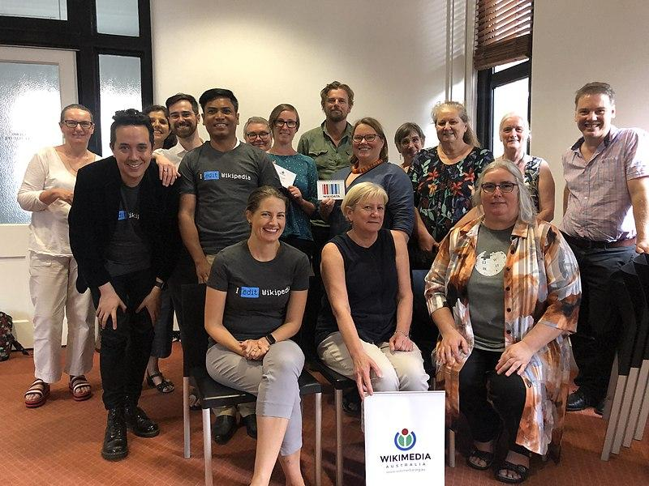
Key takeaways from the annual report
The event series goes decentral & multilingual
  Australia
  Czechia
  …
The COVID-19 pandemic
  Modified activities planned in Czechia, Ireland, Finland
  Canceled events in Ghana, Germany, India
  Postponed events in Haiti, Ghana
  Triggered WikiProject COVID-19, with lots of WikiCite in it
The ecosystem around WikiCite is evolving
Daniel Mietchen - 26 October 2020 - DOI: 10.5281/zenodo.4121846 - Q&A: https://w.wiki/iGK

Slide 8
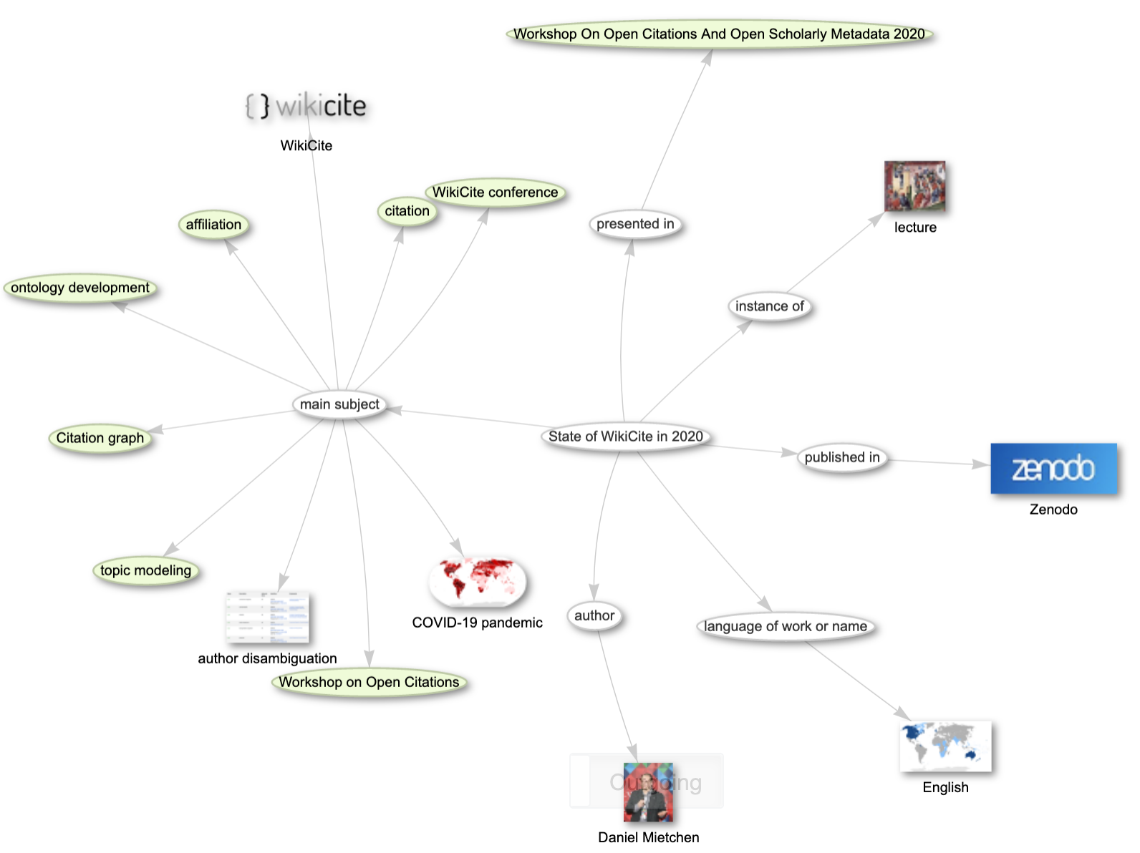
State of WikiCite 2020 - version 2
A talk at the Workshop On Open Citations And Open Scholarly Metadata 2020
Key takeaways:
  Despite the pandemic, WikiCite is moving forward, though not sure about the citation part
Source: https://scholia.toolforge.org/topic/Q99196756
Daniel Mietchen - 26 October 2020 - DOI: 10.5281/zenodo.4121846 - Q&A: https://w.wiki/iGK

Slide 9
State of WikiCite 2020
So now on to version 3
Daniel Mietchen - 26 October 2020 - DOI: 10.5281/zenodo.4121846 - Q&A: https://w.wiki/iGK

Slide 10
Overview of WikiCite (i)
A community
A sociotechnical platform
An ecosystem of projects, tools and other activities
A collection of datasets
A series of events
...
Daniel Mietchen - 26 October 2020 - DOI: 10.5281/zenodo.4121846 - Q&A: https://w.wiki/iGK

Slide 11
Overview of WikiCite (ii)
Community with
  The (2016) vision
    [to curate] “the sum of all human citations, as linked open data”
  the mission
    “to develop open citations and linked bibliographic data to serve free knowledge” using Wikimedia platforms, especially Wikidata
Daniel Mietchen - 26 October 2020 - DOI: 10.5281/zenodo.4121846 - Q&A: https://w.wiki/iGK

Slide 12
Overview of WikiCite (iii)
Community with
  The goals to
    Lay the foundations for building a repository of all Wikimedia references as structured data in Wikidata
    Design data models and technology to improve the coverage, quality, standards-compliance and machine-readability of citations and source metadata in Wikipedia, Wikidata and other Wikimedia projects
Daniel Mietchen - 26 October 2020 - DOI: 10.5281/zenodo.4121846 - Q&A: https://w.wiki/iGK

Slide 13
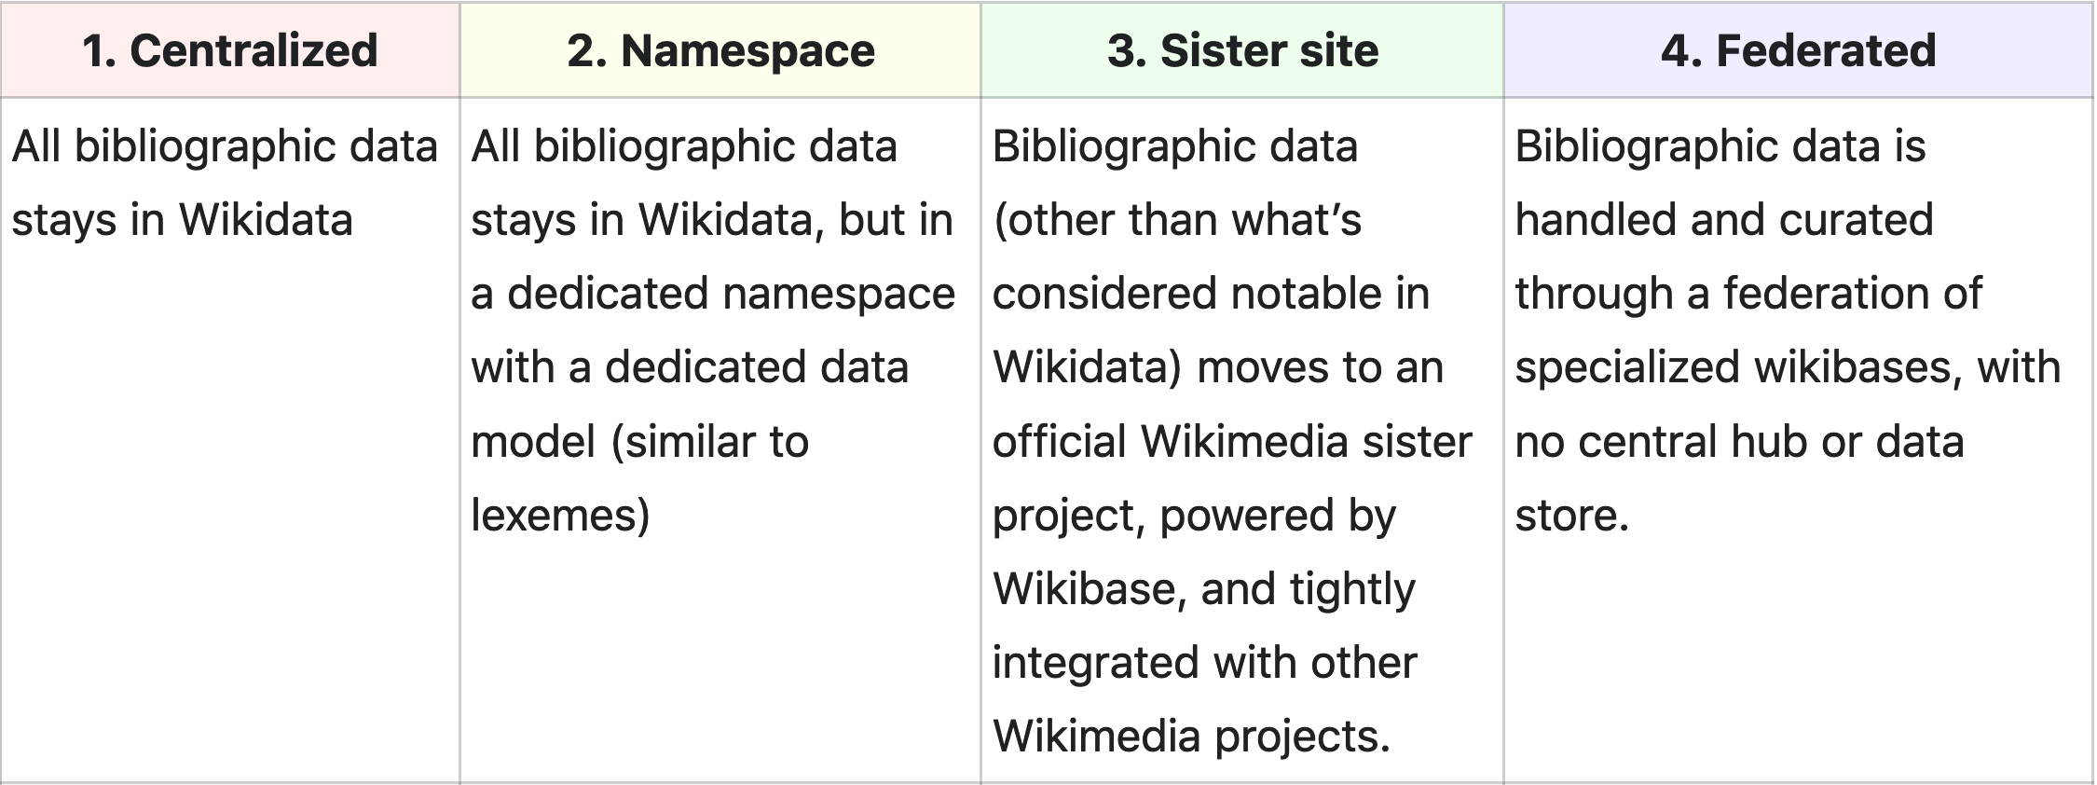
Overview of WikiCite (iv)
Community with
  A (2018) roadmap that is rarely used
Daniel Mietchen - 26 October 2020 - DOI: 10.5281/zenodo.4121846 - Q&A: https://w.wiki/iGK

Slide 14
Overview of WikiCite (v)
Homebase
  on (Wikimedia) Meta: WikiCite
  on Wikidata: WikiProject Source Metadata
    Oversees about ⅓ of Wikidata
Series of events
  2016 Berlin, 2017 Vienna, 2018 Berkeley, 2020 decentral
Daniel Mietchen - 26 October 2020 - DOI: 10.5281/zenodo.4121846 - Q&A: https://w.wiki/iGK

Slide 15
What is Wikidata?
Daniel Mietchen - 26 October 2020 - DOI: 10.5281/zenodo.4121846 - Q&A: https://w.wiki/iGK

Slide 16
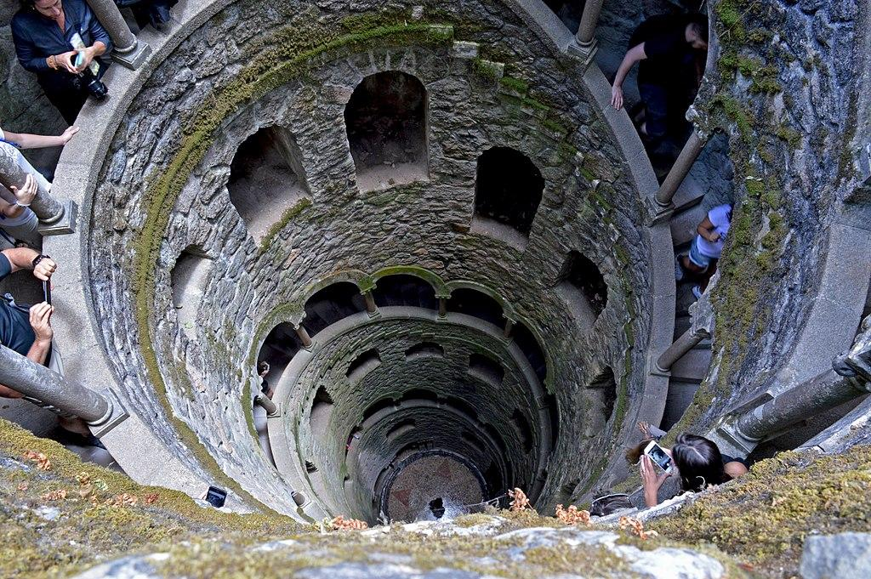

The free knowledge base that anyone can use and edit.
Image by Alex Lehner, CC BY 2.0
Notes:
Image: https://commons.wikimedia.org/wiki/File:Down_the_rabbit_hole_(35422356720).jpg

Slide 17
Sorry,
what is
Wikidata?
Try this
7-minute
intro
Daniel Mietchen - 26 October 2020 - DOI: 10.5281/zenodo.4121846 - Q&A: https://w.wiki/iGK

Slide 18
Wikidata in WikiCite numbers (i)
Description
Triples
Citations
Scholarly articles
Items with a DOI
ORCIDs
Source: Scholia homepage
Count
11,636,281,340
174,483,508
36,635,929
26,201,937
1,651,914
Daniel Mietchen - 26 October 2020 - DOI: 10.5281/zenodo.4121846 - Q&A: https://w.wiki/iGK

Slide 19
Wikidata in WikiCite numbers (ii)
Description
works to topics
works to people
people to education
people to employer
Count
12,216,602
19,576,747
1,486,667
1,077,272
Daniel Mietchen - 26 October 2020 - DOI: 10.5281/zenodo.4121846 - Q&A: https://w.wiki/iGK

Slide 20
WikiCite curation workflows
topic tagging
  e.g., "all the papers about SARS-COV-2"
author disambiguation
  e.g., "all papers by a given author"
ontology development
  e.g., "all papers about math education", incl. subtopics
subject affiliation
  e.g., "all papers from people at a given institution"
Daniel Mietchen - 26 October 2020 - DOI: 10.5281/zenodo.4121846 - Q&A: https://w.wiki/iGK

Slide 21
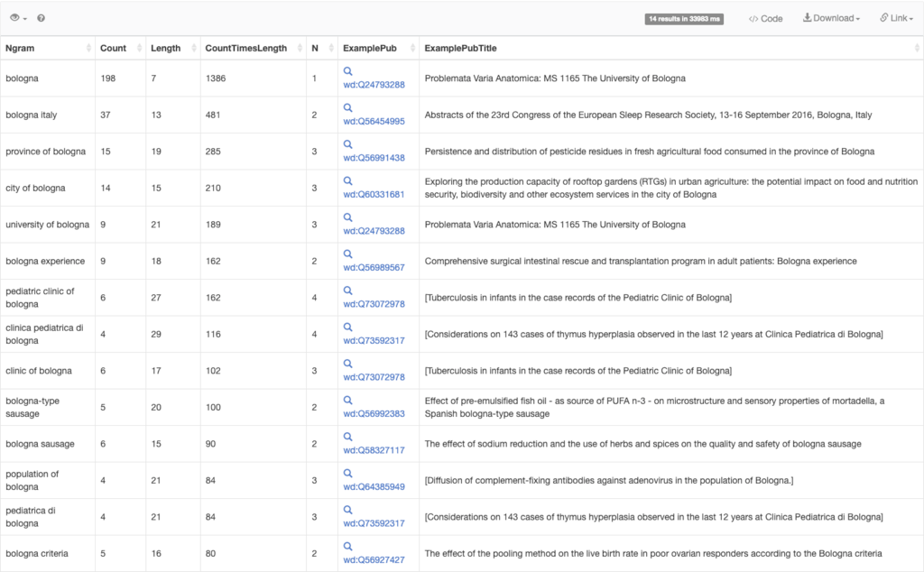
Topic
tagging
Source:
https://w.wiki/bfh
Daniel Mietchen - 26 October 2020 - DOI: 10.5281/zenodo.4121846 - Q&A: https://w.wiki/iGK

Slide 22
Most popular topic tags, August 2020
schizophrenia
teenager
asthma
patient
tuberculosis
obesity
India
endothelium
chemotherapy
colorectal cancer
nanoparticle
statistics
Daniel Mietchen - 26 October 2020 - DOI: 10.5281/zenodo.4121846 - Q&A: https://w.wiki/iGK

Slide 23
Zika virus infection
features -
model for disaster response
relatively complete for a pathogen
data model enriched as epidemic progresses
triggered tool development
re-used for technical tests and education
See also -
WikiProject Zika Corpus
COVID-19
WikiProject Humanitarian metadata
Daniel Mietchen - 26 October 2020 - DOI: 10.5281/zenodo.4121846 - Q&A: https://w.wiki/iGK

Slide 24
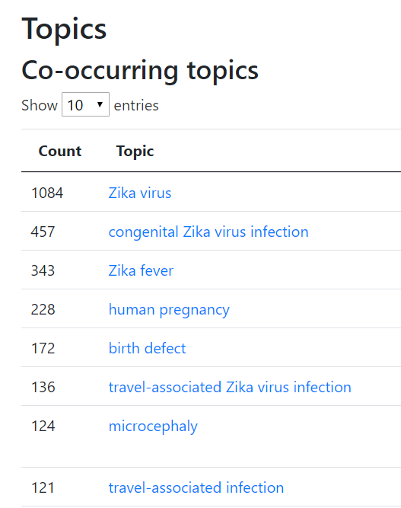
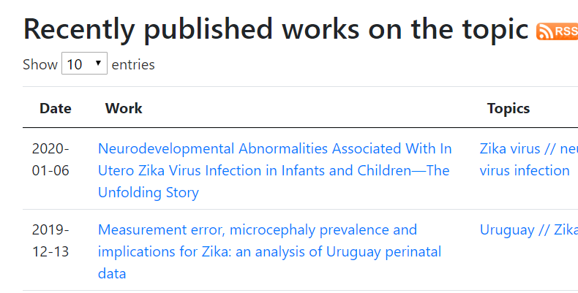

Daniel Mietchen - 26 October 2020 - DOI: 10.5281/zenodo.4121846 - Q&A: https://w.wiki/iGK

Slide 25
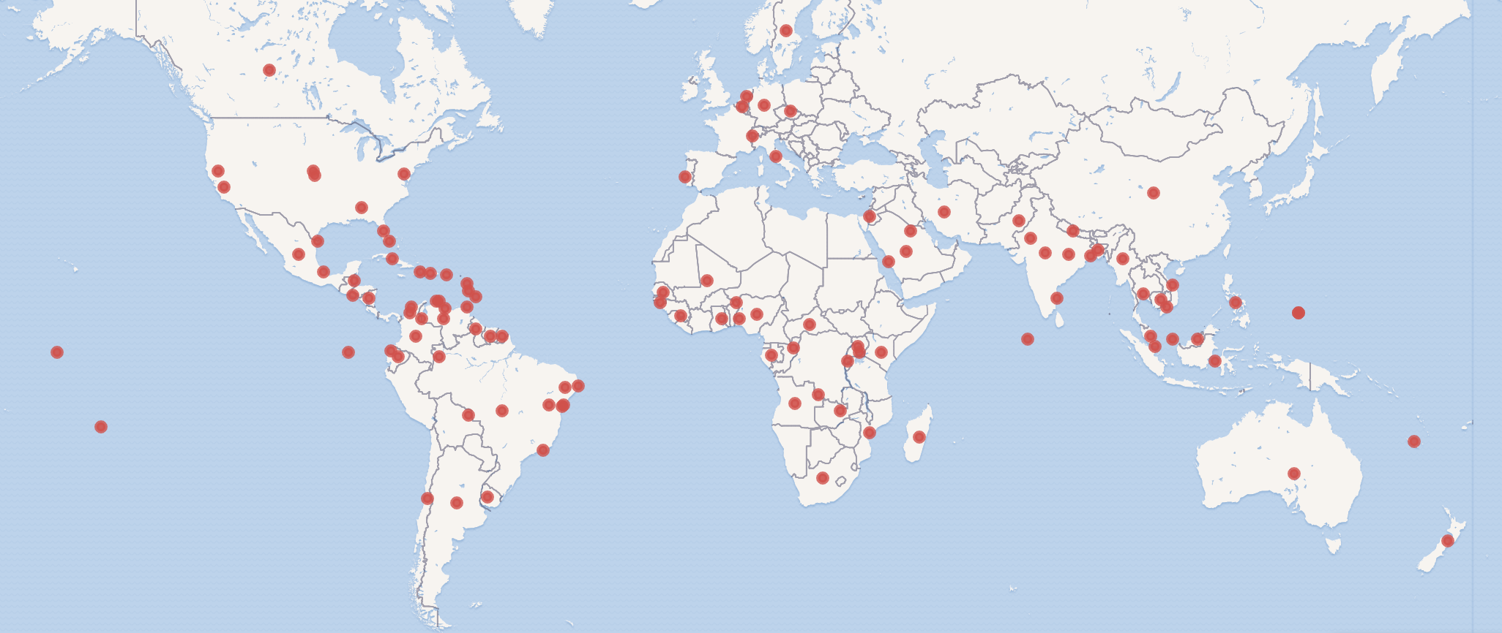
Zika virus infection
locations discussed in papers
Daniel Mietchen - 26 October 2020 - DOI: 10.5281/zenodo.4121846 - Q&A: https://w.wiki/iGK

Slide 26
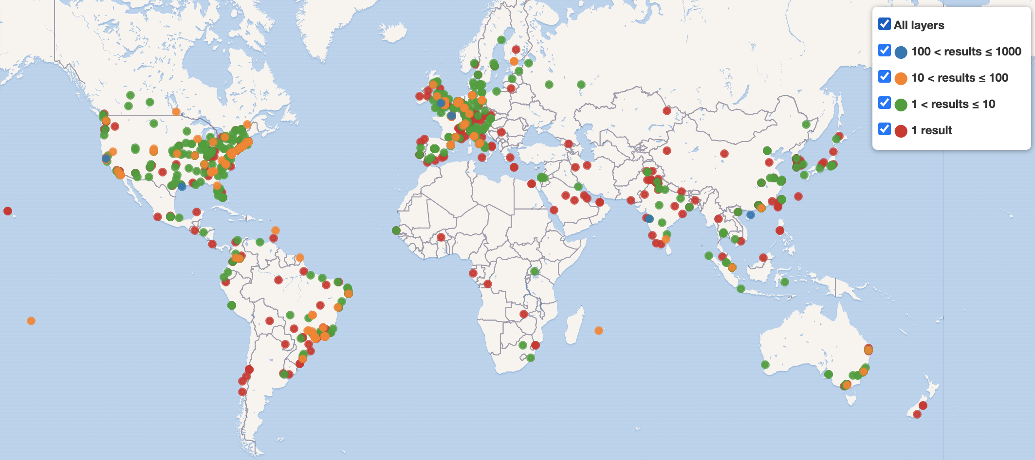
Zika virus infection
Locations of authors of papers on the topic
Daniel Mietchen - 9 September 2020 - DOI: 10.5281/zenodo.4019954 - Q&A: https://w.wiki/be4

Slide 27
Author disambiguation
strategy
use ORCID if/ when possible
anyone can disambiguate as they see fit
various mechanisms for quality control
tool support available
institutions can disambiguate their people
avoiding thinking about how big the challenge is
Daniel Mietchen - 26 October 2020 - DOI: 10.5281/zenodo.4121846 - Q&A: https://w.wiki/iGK

Slide 28
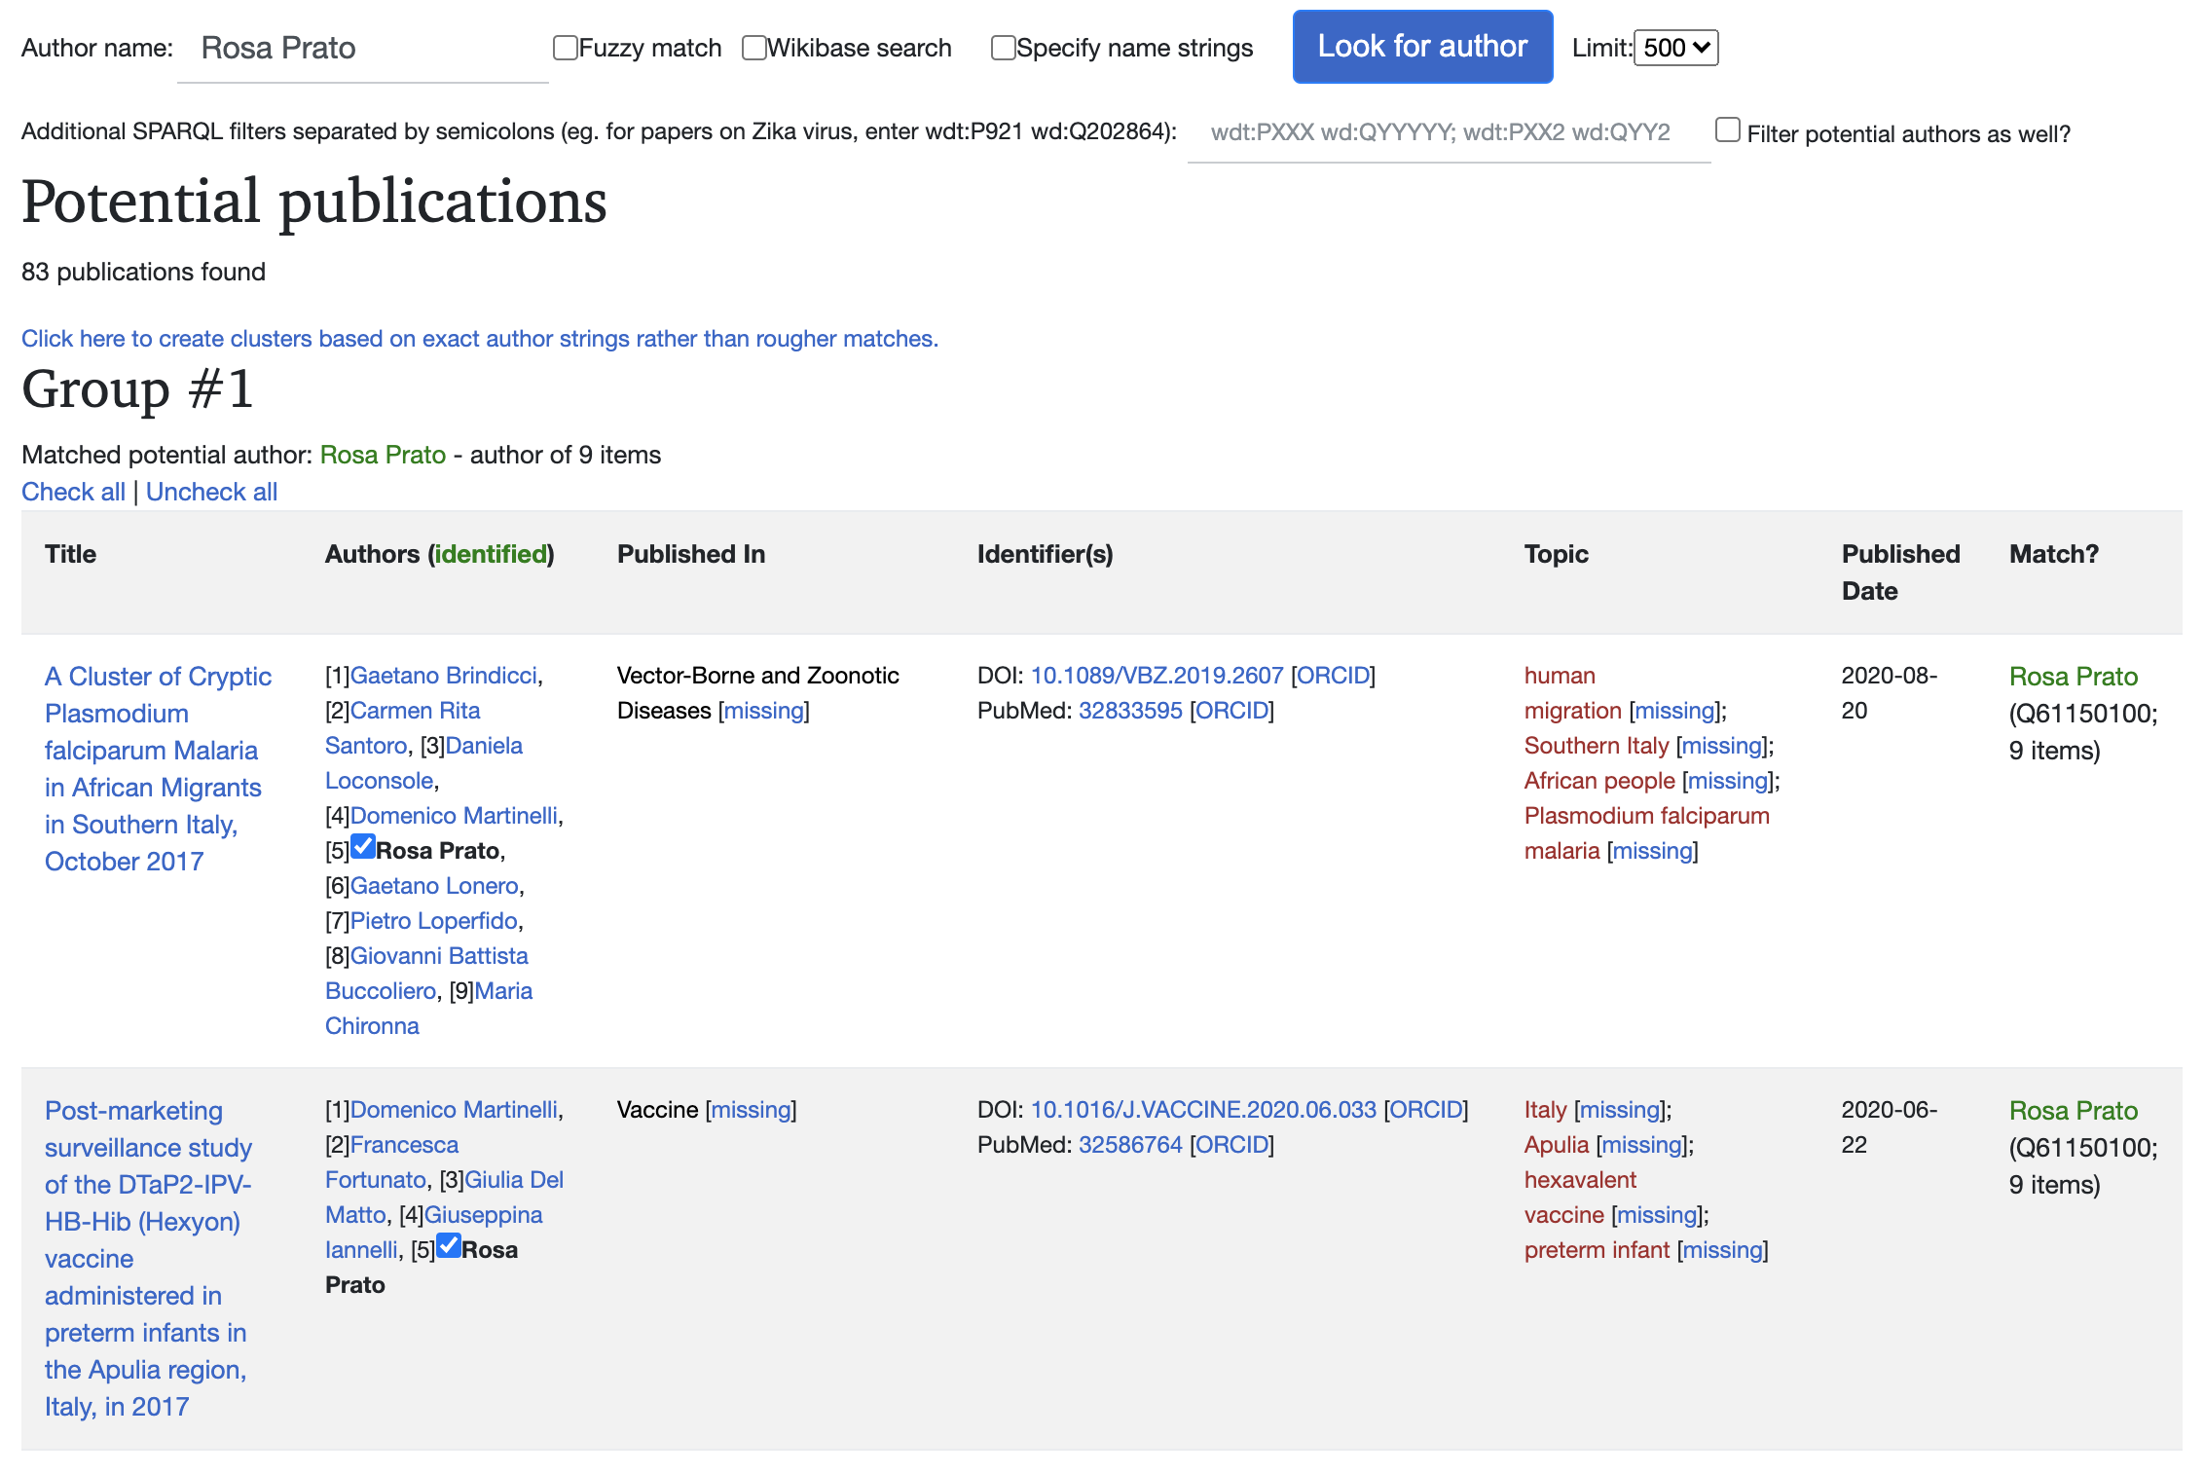
Author disambiguation
Source:
https://w.wiki/bg6
Daniel Mietchen - 26 October 2020 - DOI: 10.5281/zenodo.4121846 - Q&A: https://w.wiki/iGK

Slide 29
Subject affiliation
With affiliations, we can search by university or organization and get other info
faculty and their papers
research sites and clinical trials
events, such as conferences and location
Daniel Mietchen - 26 October 2020 - DOI: 10.5281/zenodo.4121846 - Q&A: https://w.wiki/iGK

Slide 30
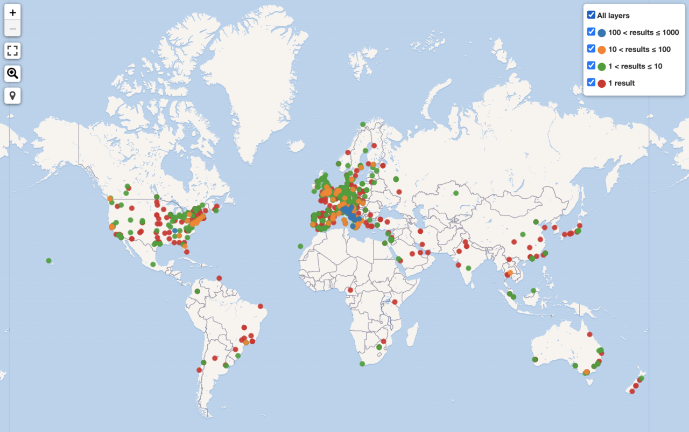
Affiliation tagging
Source:
https://w.wiki/bgC
Daniel Mietchen - 9 September 2020 - DOI: 10.5281/zenodo.4019954 - Q&A: https://w.wiki/be4

Slide 31
Vanderbilt University
Features -
model for how any university can benefit
loaded all faculty into Wikidata
Working on linking them with their works
see also -
Librarians @ Vandy
Vanderbot
Indiana
Canary Islands
Netherlands
Daniel Mietchen - 26 October 2020 - DOI: 10.5281/zenodo.4121846 - Q&A: https://w.wiki/iGK

Slide 32
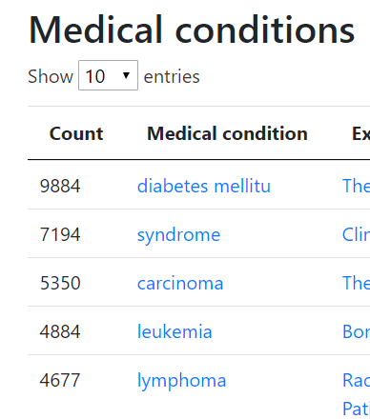
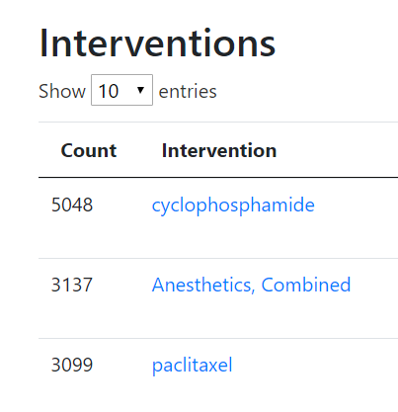
Clinical trials
Daniel Mietchen - 9 September 2020 - DOI: 10.5281/zenodo.4019954 - Q&A: https://w.wiki/be4

Slide 33



Tools in the Wikidata Ecosystem
Bot icon by Robot by Creaticca Creative Agency from the Noun Project (CC BY 3.0)
User icon by Font Awesome (CC BY 4.0)
Tools icon by Verdy_p(CC0)
QuickStatements Mix’N’Match
W
Scholia
R
M
Wiki, API
Wiki
API, SPARQL endpoint
ReCoin
Histropedia
Wikibase
Wikimedia Stats
Dashboard
Daniel Mietchen - 26 October 2020 - DOI: 10.5281/zenodo.4121846 - Q&A: https://w.wiki/iGK
Notes:
Mention scripts and standalone tools deployed in the wm server

Slide 34
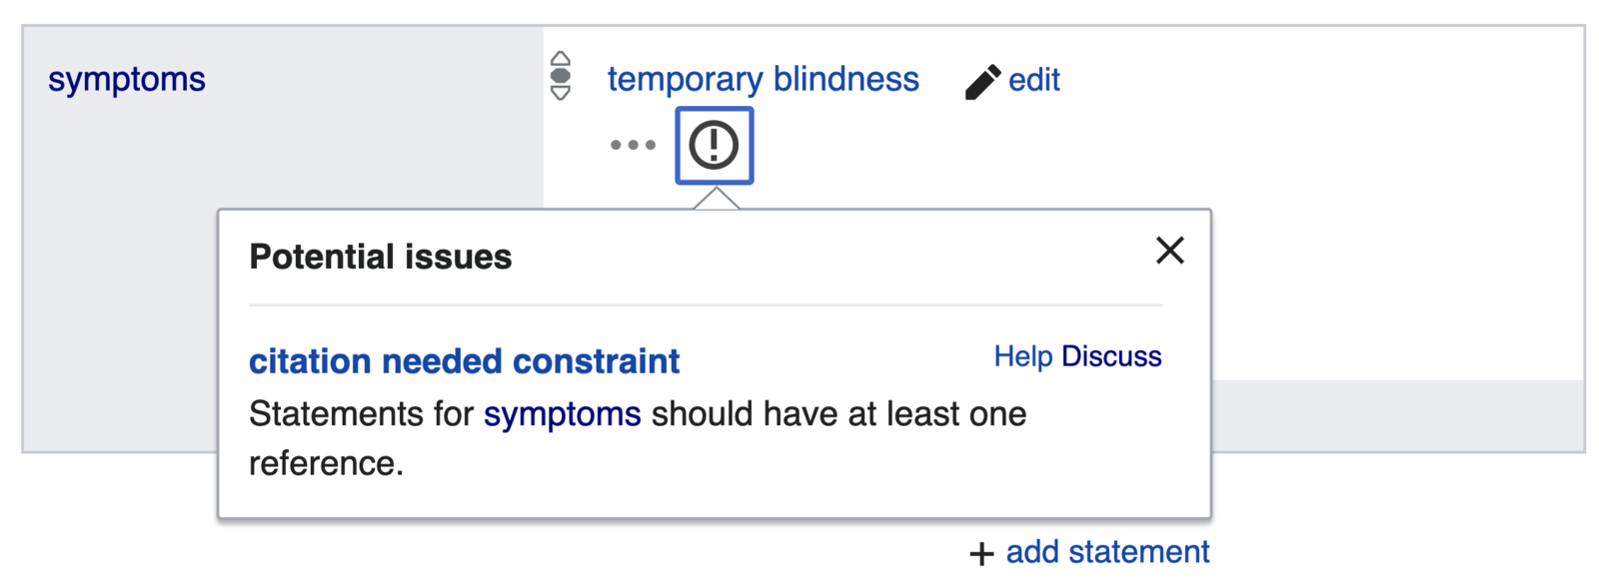
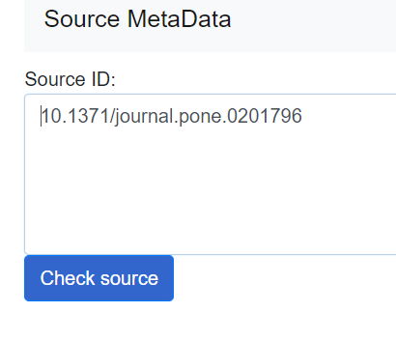
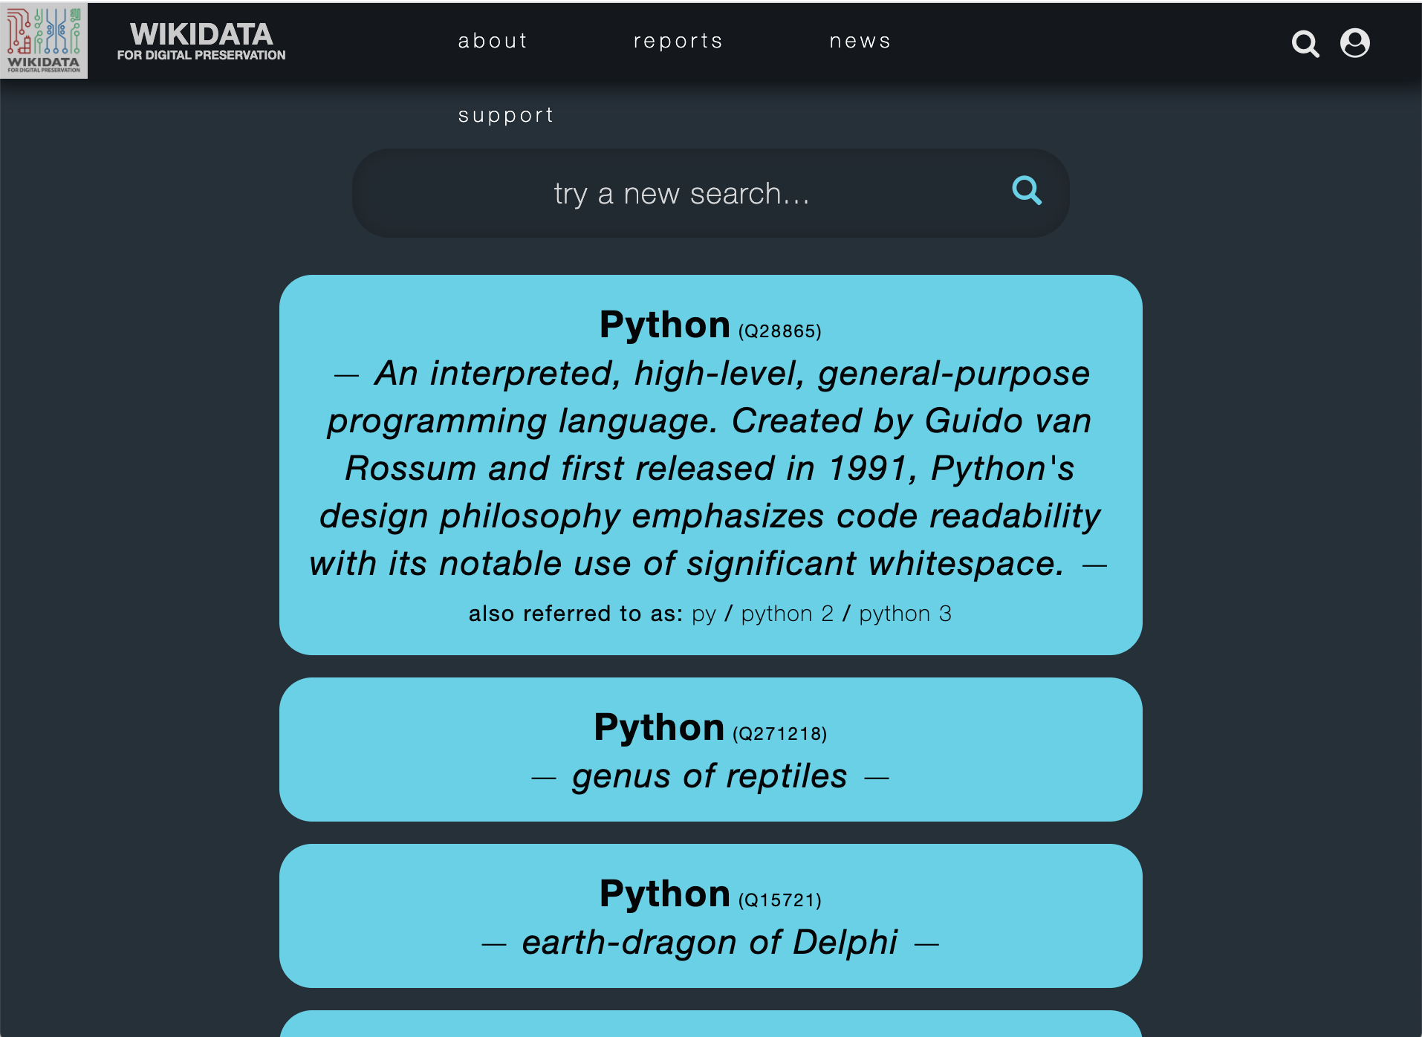
Overview of Wikidata tools
https://www.wikidata.org/wiki/Wikidata:Tools
CHECK
EDIT
BROWSE
Daniel Mietchen - 26 October 2020 - DOI: 10.5281/zenodo.4121846 - Q&A: https://w.wiki/iGK

Slide 35
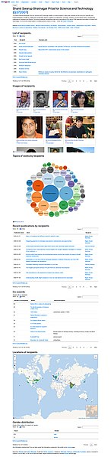
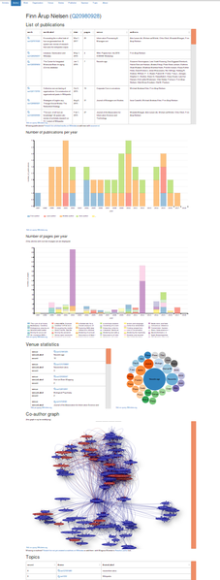
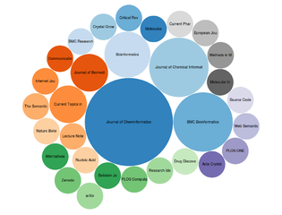
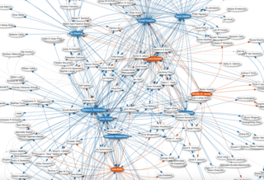
https://commons.wikimedia.org/wiki/Category:Scholia
Daniel Mietchen - 26 October 2020 - DOI: 10.5281/zenodo.4121846 - Q&A: https://w.wiki/iGK

Slide 36
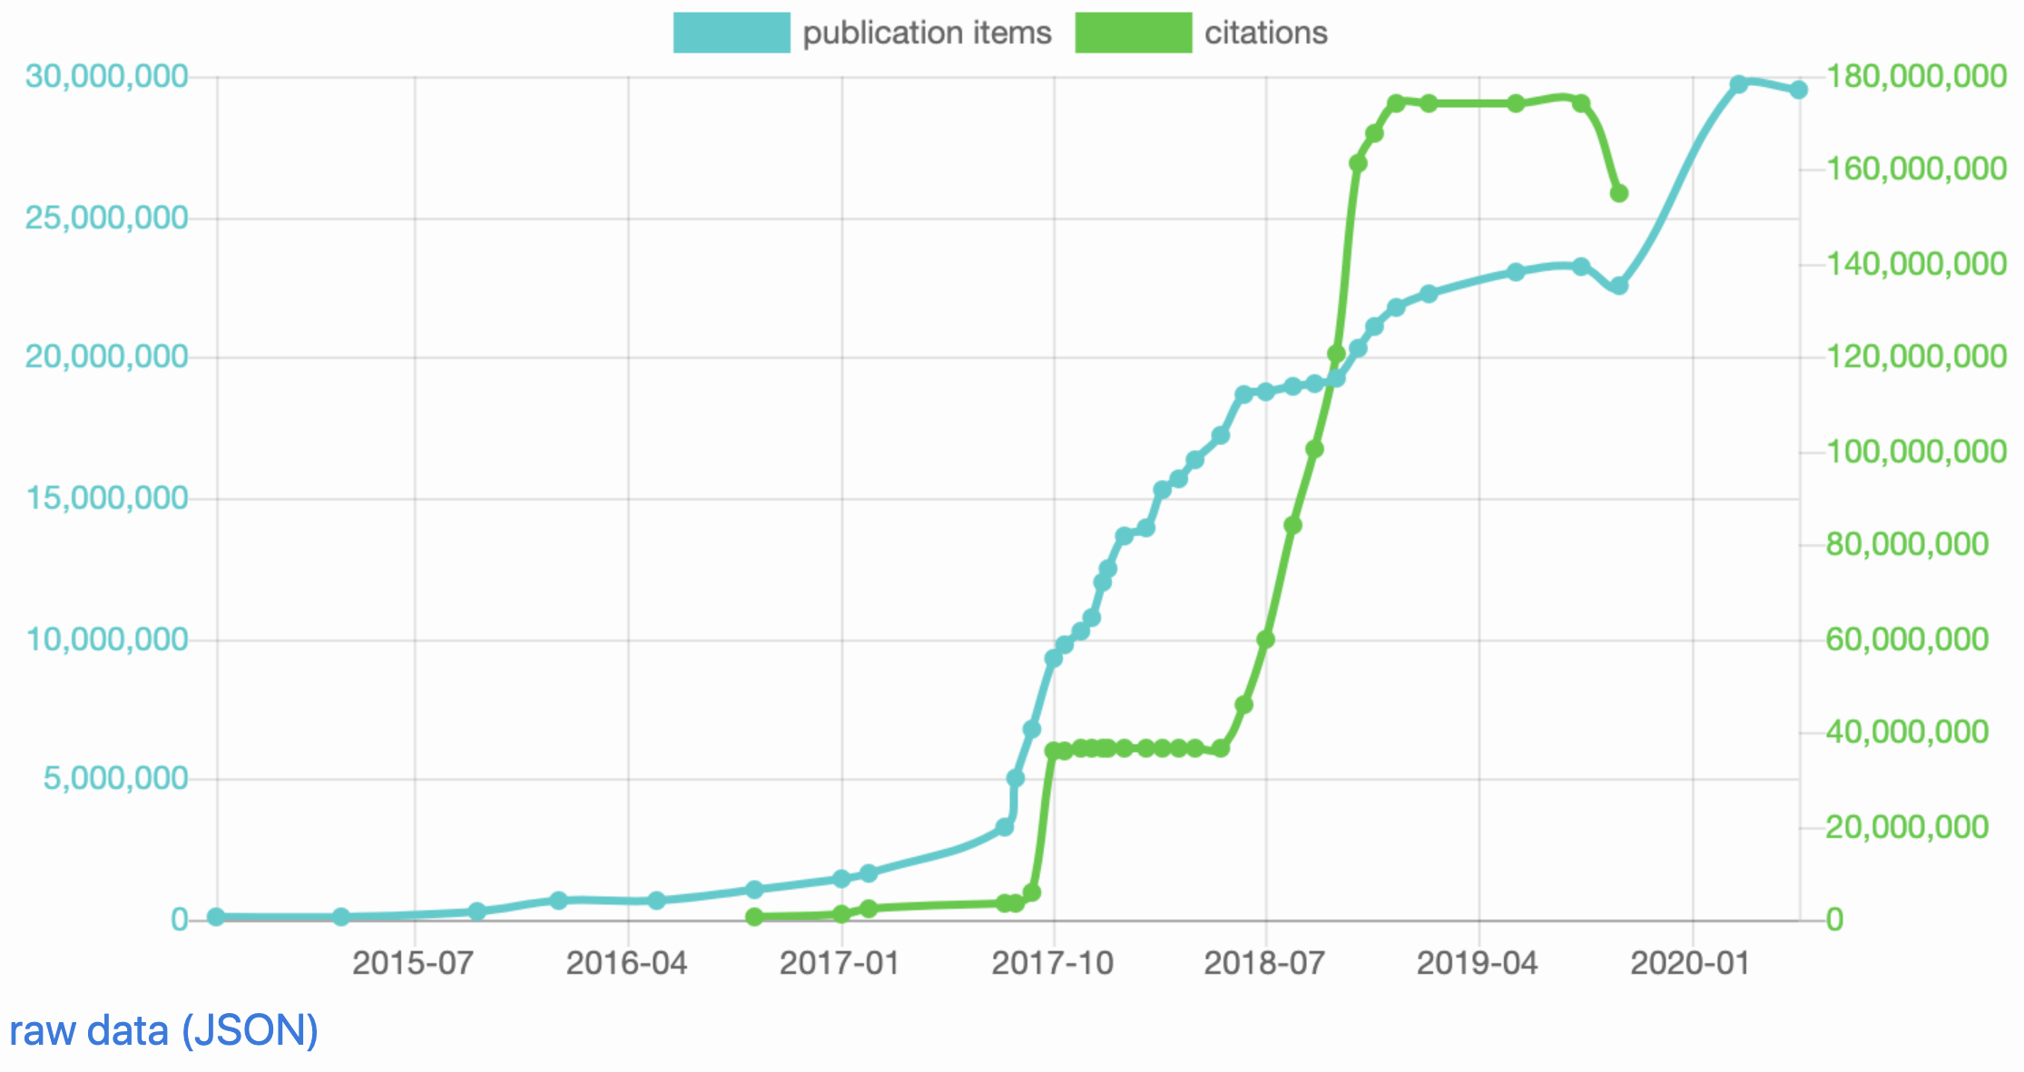
What about open citations?
Source:
http://wikicite.org/statistics.html
Daniel Mietchen - 26 October 2020 - DOI: 10.5281/zenodo.4121846 - Q&A: https://w.wiki/iGK

Slide 37
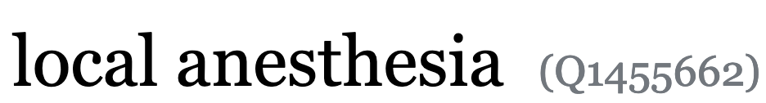
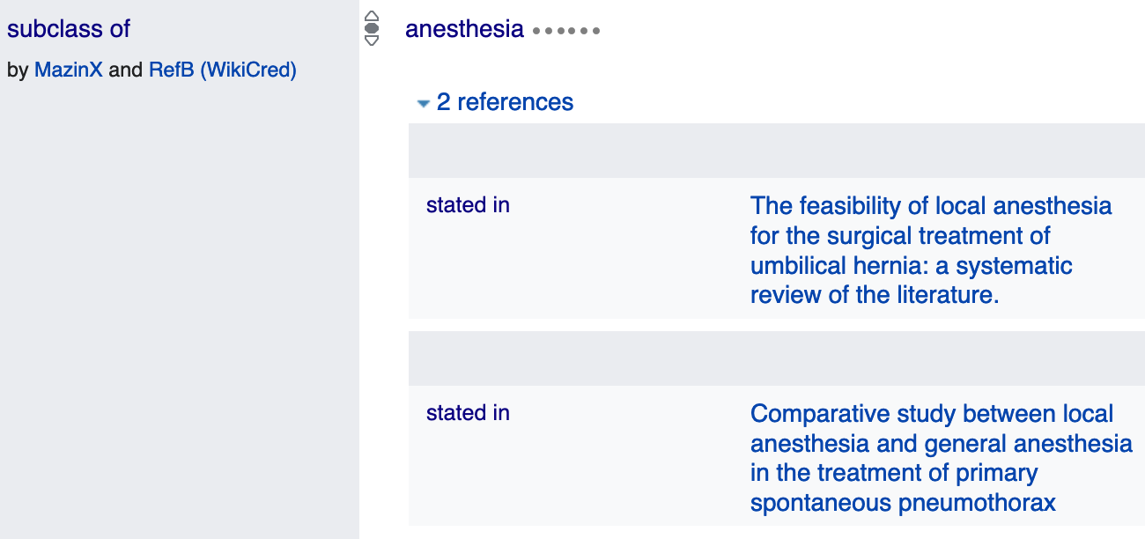
Bots
VanderBot
  Curates Vanderbilt data
LargeDataSetBot
  Curates publication items
RefB
  Adds references to Wikidata statements
OpenCitations_Bot (pending)
  To work on the open citation graph
...
Daniel Mietchen - 26 October 2020 - DOI: 10.5281/zenodo.4121846 - Q&A: https://w.wiki/iGK

Slide 38
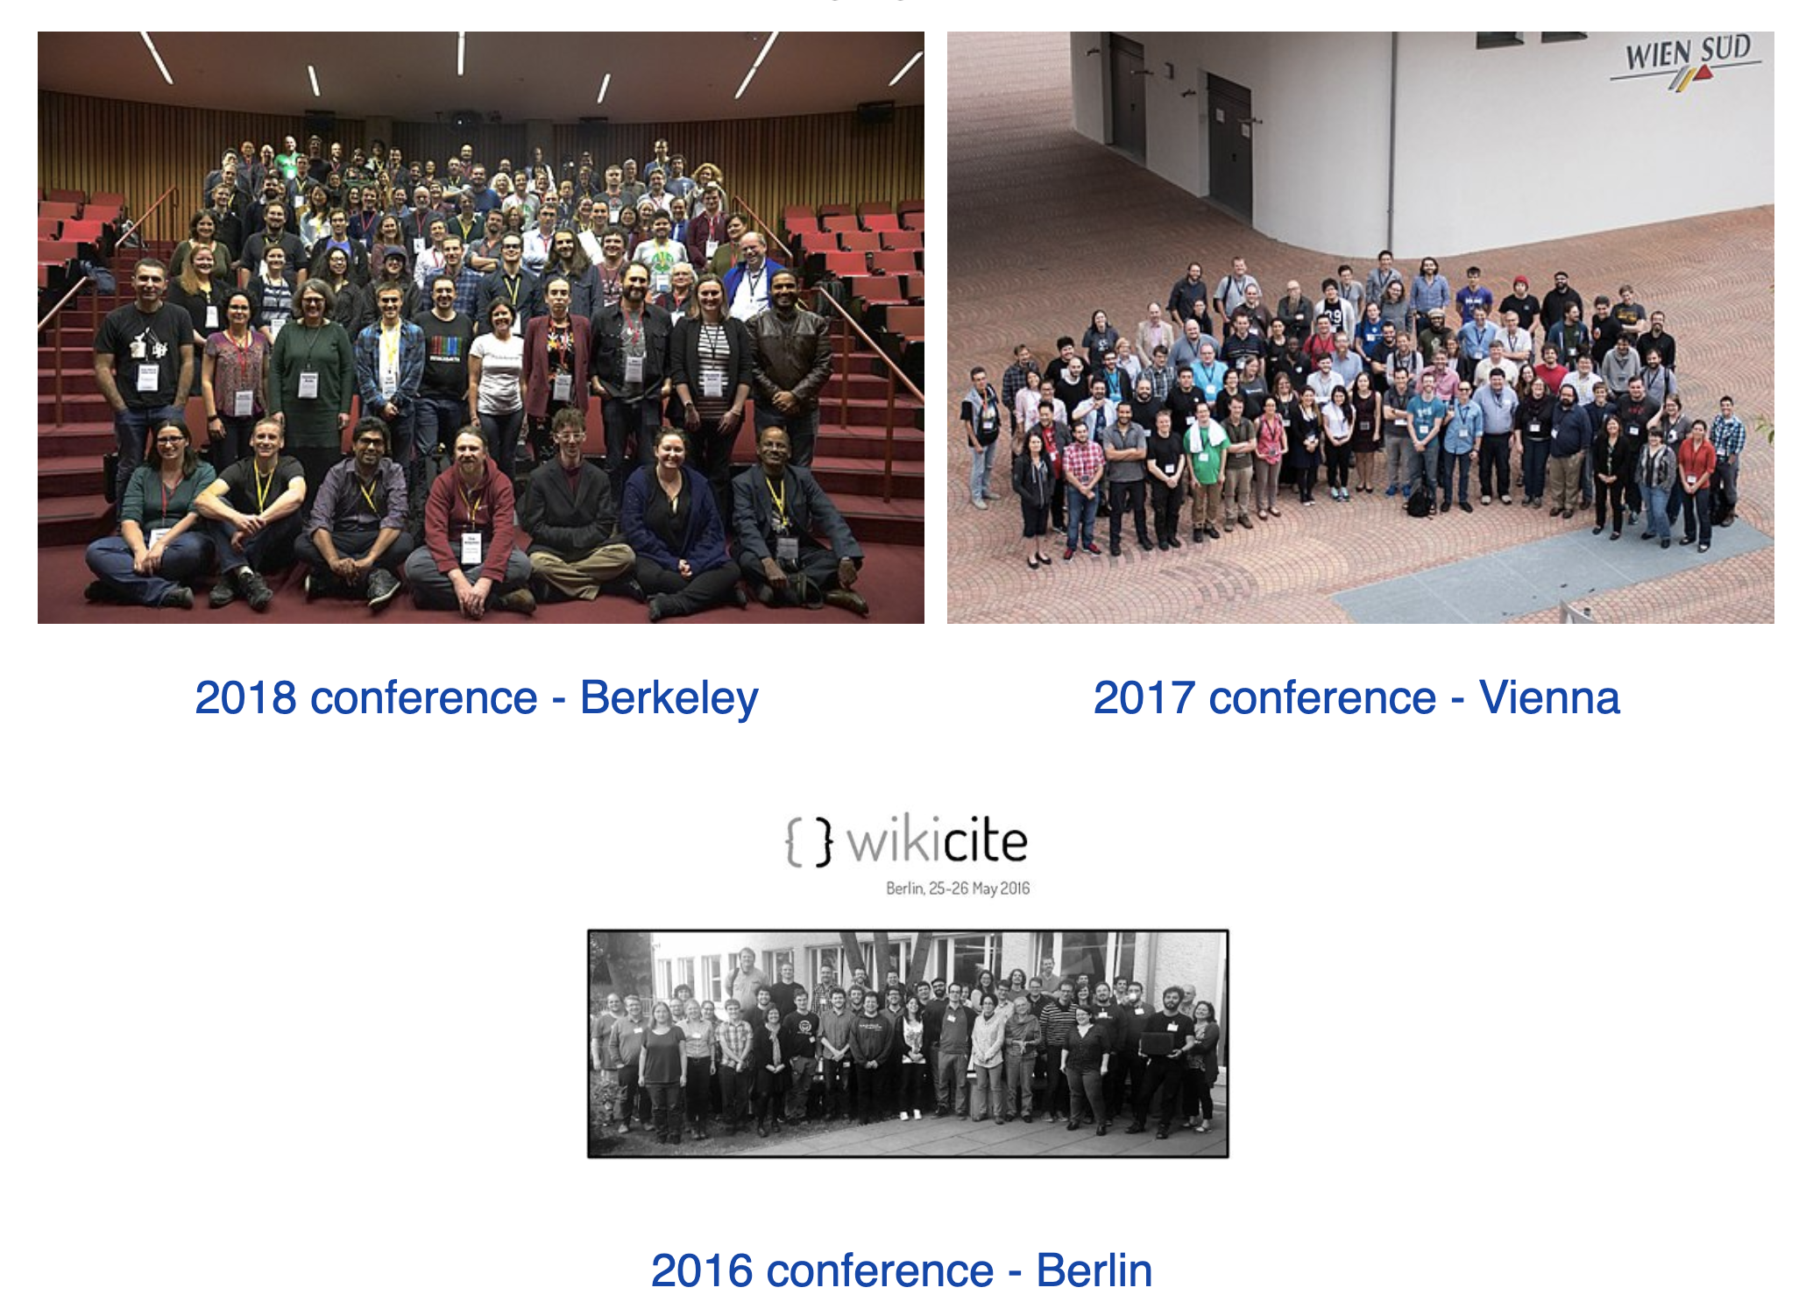
WikiCite events - history
Daniel Mietchen - 26 October 2020 - DOI: 10.5281/zenodo.4121846 - Q&A: https://w.wiki/iGK

Slide 39
Events - this week’s
WikiCite 2020 virtualconference
https://www.wikidata.org/wiki/Q100741900
- not very detailed yet
- same problem with WikiCite 2016
Daniel Mietchen - 26 October 2020 - DOI: 10.5281/zenodo.4121846 - Q&A: https://w.wiki/iGK

Slide 40
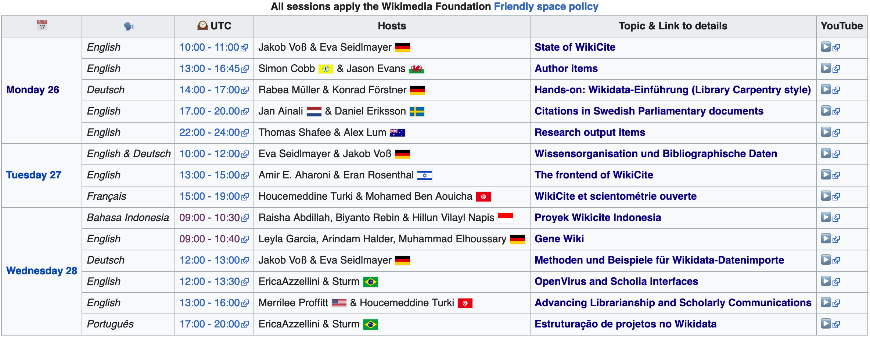
Overview of WikiCite 2020 events
Source: https://meta.wikimedia.org/wiki/WikiCite/2020_Virtual_conference
Daniel Mietchen - 26 October 2020 - DOI: 10.5281/zenodo.4121846 - Q&A: https://w.wiki/iGK

Slide 41

Other activities
Source:
https://w.wiki/ipi
Daniel Mietchen - 26 October 2020 - DOI: 10.5281/zenodo.4121846 - Q&A: https://w.wiki/iGK

Slide 42
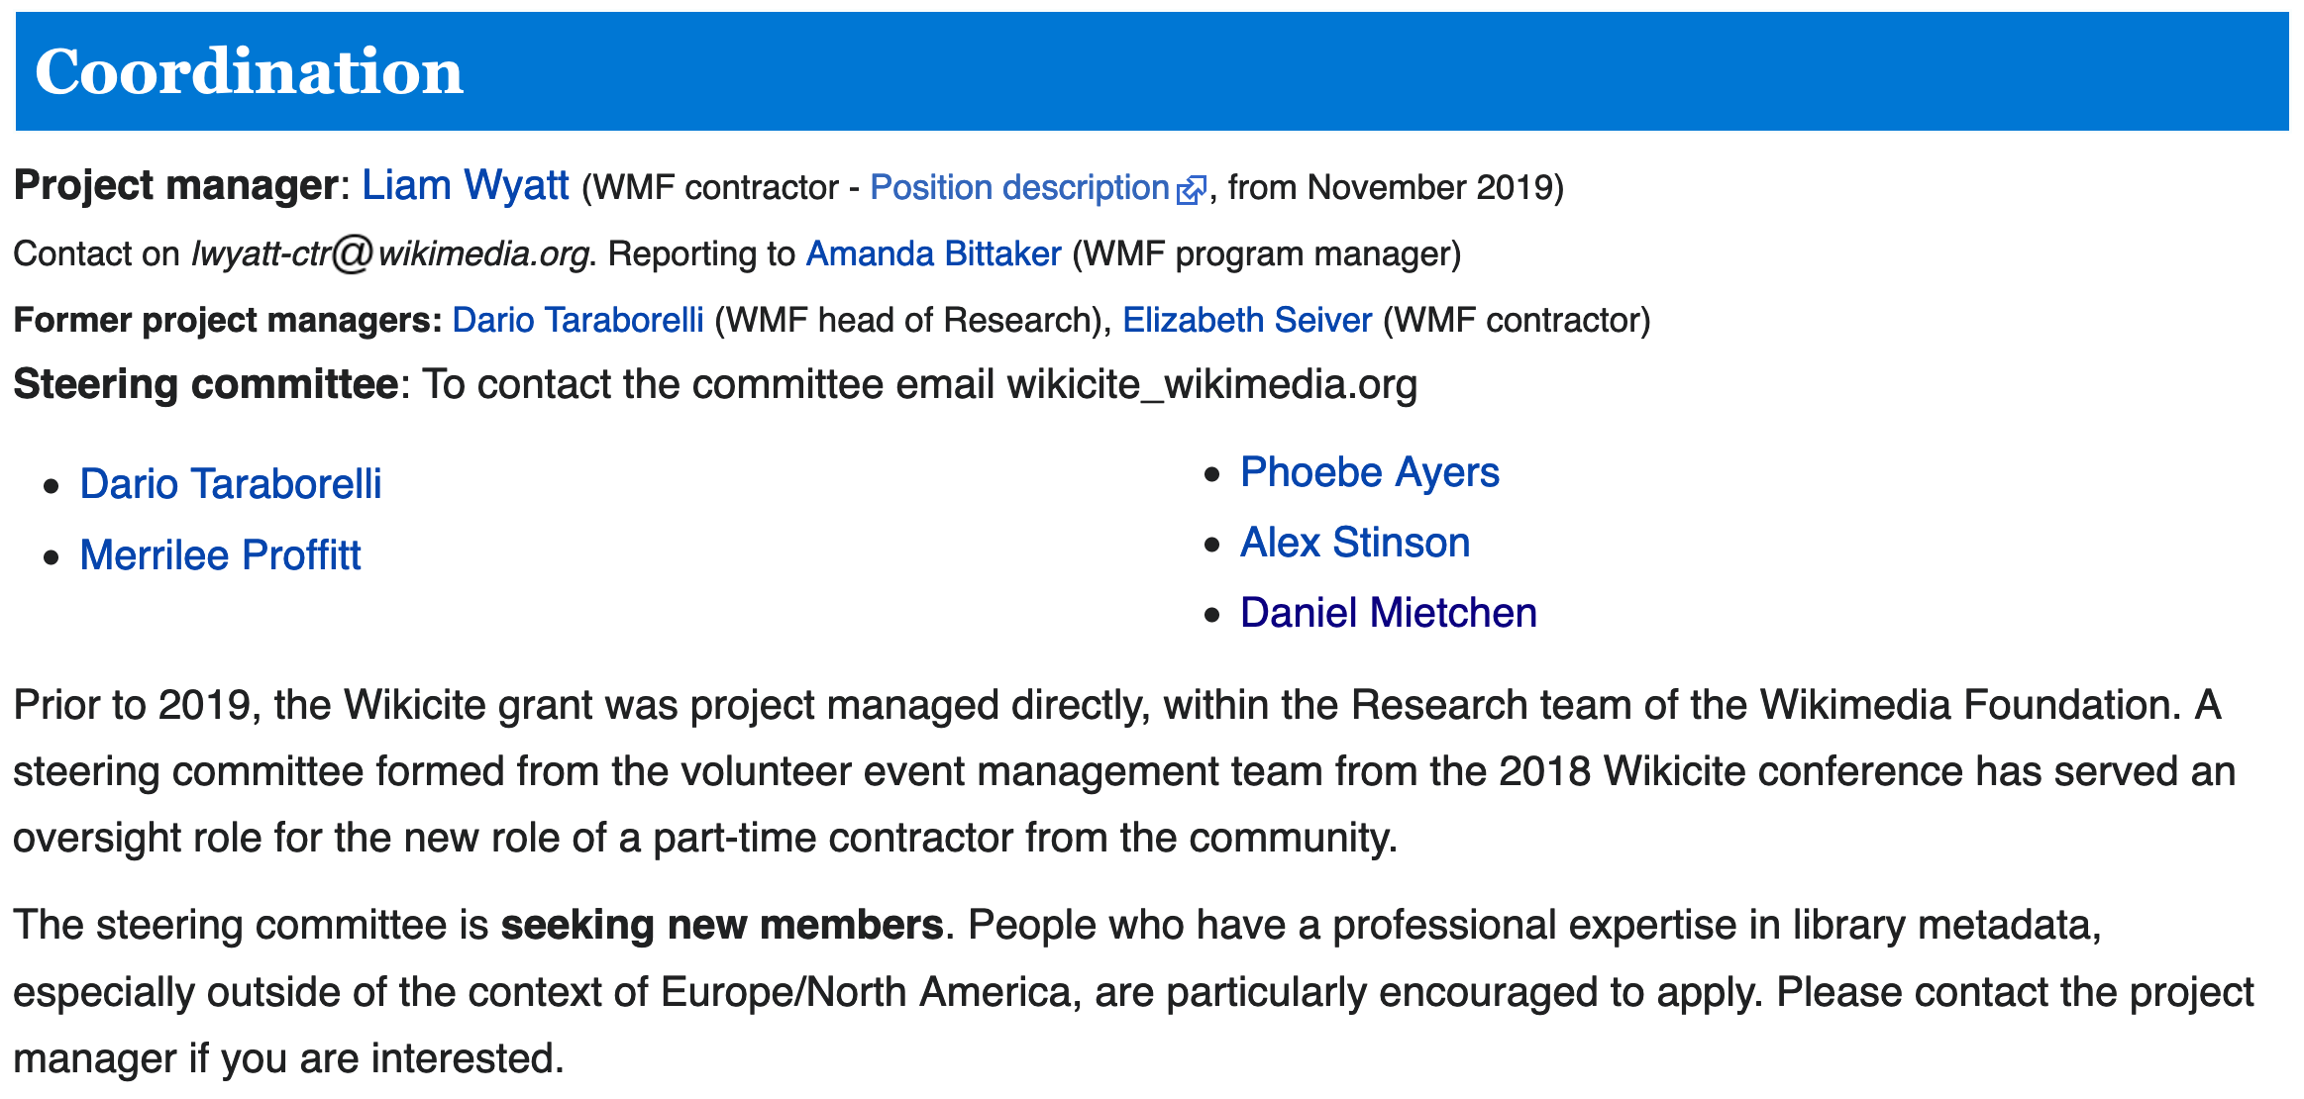
WikiCite coordination
Know someone who would be a great addition to the team? Perhaps even you?
Let us know!
Source: https://meta.wikimedia.org/wiki/WikiCite/administration
Daniel Mietchen - 26 October 2020 - DOI: 10.5281/zenodo.4121846 - Q&A: https://w.wiki/iGK

Slide 43
Thanks!
Providers of open infrastructure
Presentation template by SlidesCarnival, under CC BY 4.0
Wikimedia/ Wikidata/ WikiCite community
Scholia team: Finn Nielsen, Egon WIllighagen, Lane Rasberry
Alfred P. Sloan Foundation
Organizers of WikiCite events
YOU
Daniel Mietchen - 26 October 2020 - DOI: 10.5281/zenodo.4121846 - Q&A: https://w.wiki/iGK

Slide 44


Your turn!
Any questions or comments?
You can find me at:
User:Daniel Mietchen
@EvoMRI
dm7gn@virginia.edu
Daniel Mietchen - 26 October 2020 - DOI: 10.5281/zenodo.4121846 - Q&A: https://w.wiki/iGK

Slide 45
Backchannels for questions & comments
Please put questions and comments into the Etherpad at
https://w.wiki/iGK
For issues requiring a deeper discussion, consider joining the WikiCite group on Telegram.
Daniel Mietchen - 26 October 2020 - DOI: 10.5281/zenodo.4121846 - Q&A: https://w.wiki/iGK

