Slide 1
THE EFFECT OF “ALPHABET” GAME ON STUDENTS’ VOCABULARY MASTERY ON DESCRIPTIVE TEXT OF THE SEVENTH GRADE OF MTsN 2 KOTA PALANGKA RAYA
Nidia Najati, Misrita, Bahing

Slide 2
INTRODUCTION
Research Background
Vocabulary is central to language and critical importance to typical language learner. Without a sufficient vocabulary, people cannot communicate effectively or express his ideas in both oral and written form.
Having limited vocabulary is also a barrier that precludes learner from learning a foreign language. Vocabulary itself consists of several parts; they are noun, verb, adjective, and adverb. From those kinds of vocabulary, the first that students need to know is noun.

Slide 3
Vocabulary appears in every skill of language such as listening, speaking, reading and writing skill. Many people realize that their vocabulary is limited so they have difficulties in expressing their idea.

Slide 4
  Research Delimitation
This study only focused on the result of students’ vocabulary mastery by using alphabet game, especially vocabulary of using nouns of the seventh grade students of MTsN 2 Kota Palangka Raya.
Research Objective
To find out the effect of using alphabet game on the vocabulary mastery of the seventh grade students of MTsN 2 Kota Palangka Raya.

Slide 5
RESEARCH METHOD
Research Design
In this research, the researcher used pre-experimental method.
Population and Sample Research
Population and sample from all of the seventh grade students of MTsN 2 Kota Palangka Raya.
Research Instruments
  Instrument Development
The researcher developed instrument pretest-posttest to measure students’ vocabulary mastery of the seventh grade of MTsN Kota Palangka Raya.

Slide 6

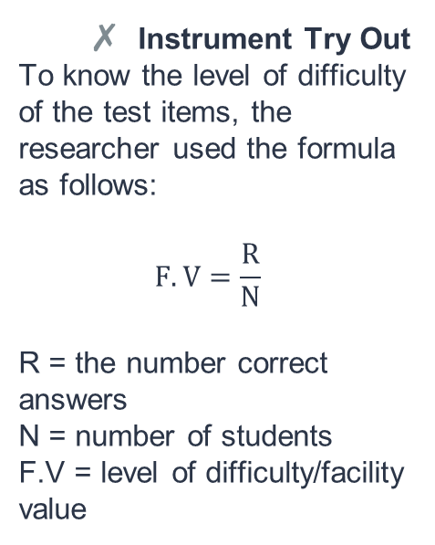
  Instrument Try Out
To know the level of difficulty of the test items, the researcher used the formula as follows:
$$F.V=\frac{R}{N}$$
R = the number correct answers
N = number of students
F.V = level of difficulty/facility value

Slide 7

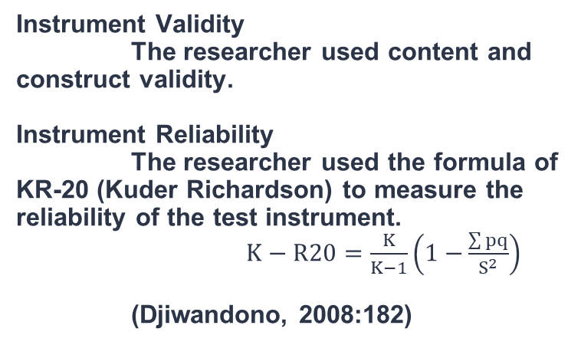
  Instrument Validity
  The researcher used content and construct validity.
  Instrument Reliability
  The researcher used the formula of KR-20 (Kuder Richardson) to measure the reliability of the test instrument.
  $K−R20=\frac{K}{K−1}\left(1−{\frac{\sum{pq}}{S^{2}}}\right)$
  (Djiwandono, 2008:182)

Slide 8
Techniques of Data Analysis
1. Editing
2. Coding
3. Scoring

Slide 9
DISCUSSIONS
The researcher gave pre-test to the students, and then the researcher evaluated the result of the pre-test. After evaluated the result of pre-test, the researcher gave treatment to them about two times. Then the researcher gave post-test to the students, and then the researcher evaluated the result of post-test. The last, the researcher compared the result of pre-test and post-test by using t-test.

Slide 10
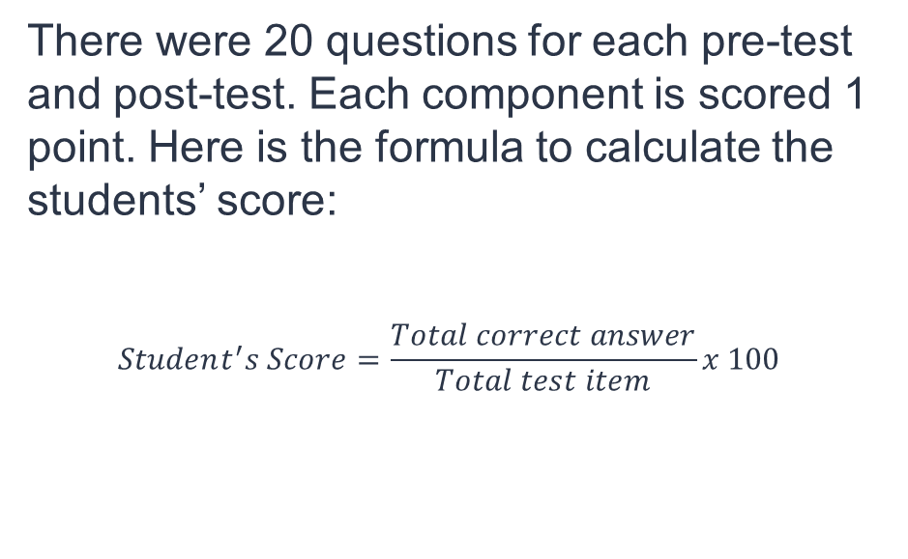
There were 20 questions for each pre-test and post-test. Each component is scored 1 point. Here is the formula to calculate the students’ score:
$$Student^{′}s Score=\frac{Total correct answer}{Total test item}x 100$$

Slide 11
Test of Hypotheses
To calculate and analyze the data of pre-test and post-test, the researcher used parametric statistics which was the dependent sample t-test.
The critical value for one-tailed test was, tα with df = n-1 = 37-1 = 36. Table critical value for the students’ distribution showed that df = 36. t 0.05 {36} = 1.690. Because, t* ˂ tα {36} = 0.979 ˂ 1.690. The test result were statistically significant at the 5% level.

Slide 12
At the 5% significant level, the data provided significant evidence. To conclude that, on average, the students’ score of post-test improved from the students’ score of pre-test. It means that Ho was rejected and Hα was supported. In other words, there was an effect of using alphabet game on students’ vocabulary mastery of descriptive test on the seventh grade of MTsN 2 Kota Palangka Raya.

Slide 13
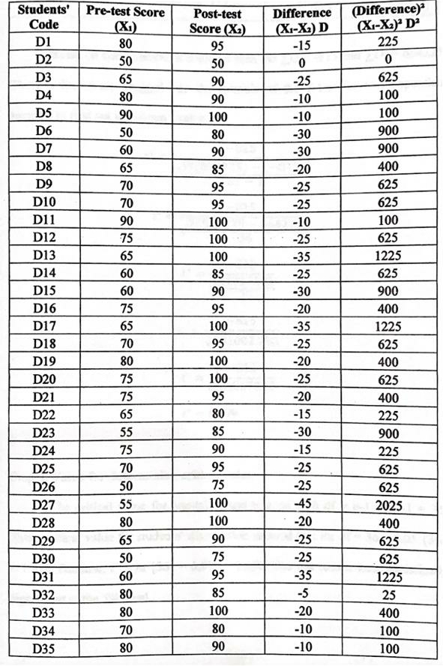
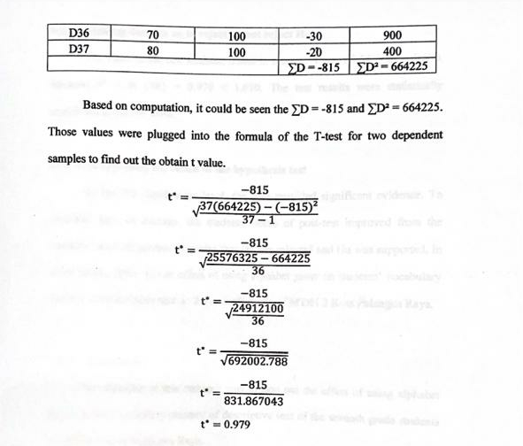

Slide 14
CONCLUSION AND SUGGESTIONS
CONCLUSION
Based on the result of the study and its discussion above, there were some points to be concluded:
The calculation of t-test score 0.979 was smaller than t-table 1.690 since t* ˂ tα {36} = 0.979 ˂ 1.690. It means null hypothesis was rejected and alternative hypothesis was supported.
There was significant difference between the students’ score in pre-test and post-test. It means there was some effect after the researcher gave a treatment.

Slide 15
Thank you.

