Slide 1
Legal and Policy Task Force
Led by Thomas Margoni (UGlasgow), Prodromos Tsiavos (ARC) and Marina Angelaki (EKT)
Aimed at Researchers and Legal Support staff

Slide 2
GOAL
support RPOs & RFOs in the adoption of OS policies (with the main elements, the legal aspects and potential support from the NOADs)
MEMBERS
25 (15 NOADs)

Slide 3
Main Outcomes of the Task Force
Toolkit
Toolkit
Webinars
for Researchers on
Legal Issues (Deliverable) https://doi.org/10.5281/zenodo.2574619
for Policy Makers on Open Science and Open Access (Deliverable) https://doi.org/10.5281/zenodo.2573797
2 webinars (29/04, 3/05) focusing on research data regulation
https://www.openaire.eu/item/openaire-legal-policy-webinars
Blog
Guides
Toolkit
Blog Post / Report on Legal Policy Webinars https://www.openaire.eu/blogs/report-openaire-legal-policy-webinars
Supporting materials on legal issues https://www.openaire.eu/guides
for Policy Makers on Open Science and Open Access
(Portal)
https://www.openaire.eu/toolkit-for-policy-makers-on-open-science-and-open-access

Slide 4
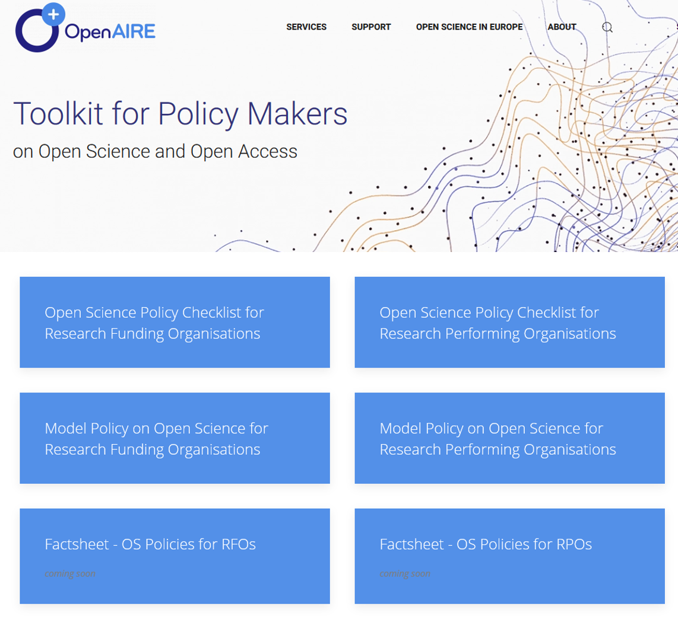
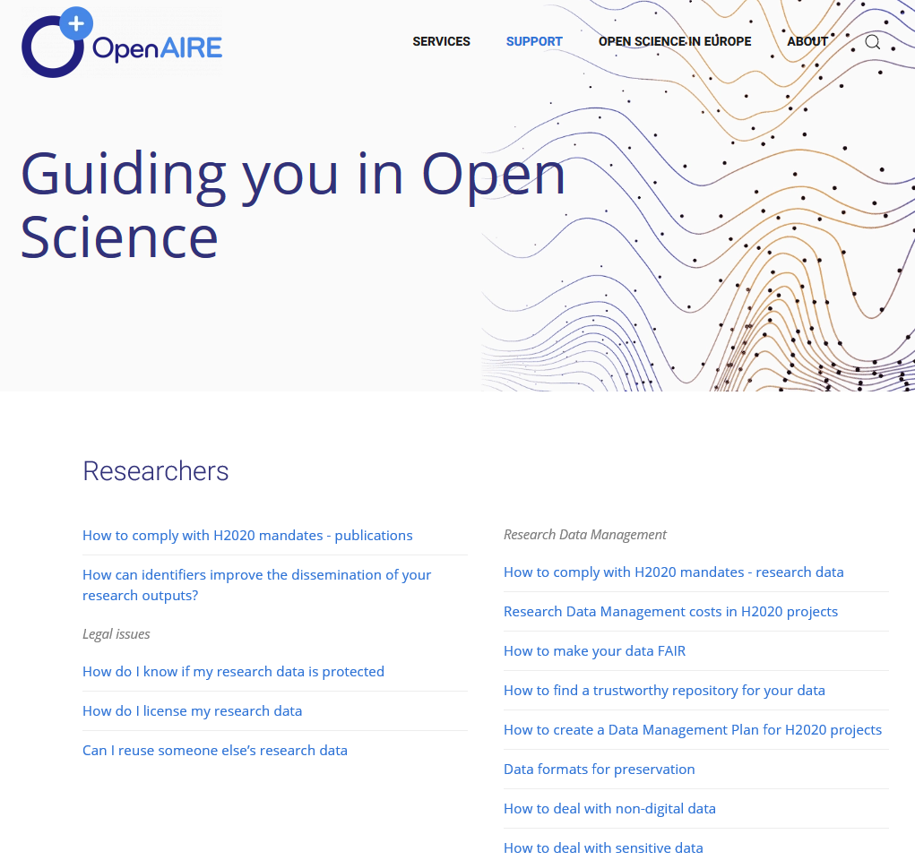
Legal Issues: Support materials
https://www.openaire.eu/toolkit-for-policy-makers-on-open-science-and-open-access
https://www.openaire.eu/guides

Slide 5
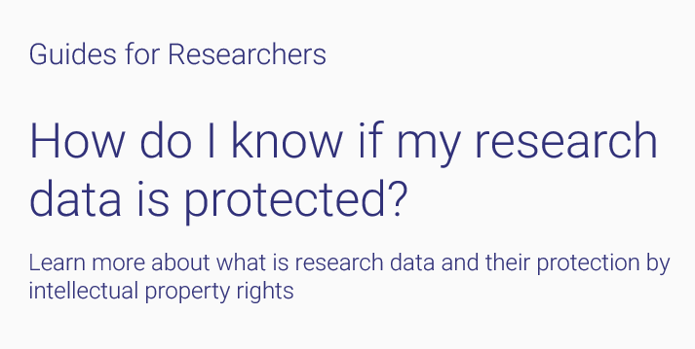
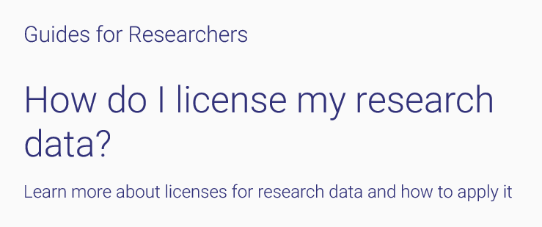
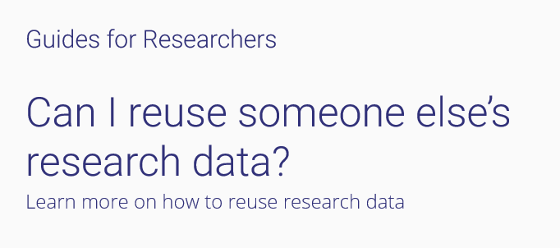
OpenAIRE guides on Legal Issues
https://www.openaire.eu/how-do-i-know-if-my-research-data-is-protected
https://www.openaire.eu/how-do-i-license-my-research-data
See more guides!
https://www.openaire.eu/guides
https://www.openaire.eu/can-i-reuse-someone-else-research-data

Slide 6
additional support (materials or webinars) on the basis of NOAD needs/requests
synergies with other
organisations and initiatives
Next steps

