Slide 1

SSHOC Workshop
Sharing Datasets of Pathological Speech

Slide 2
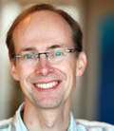
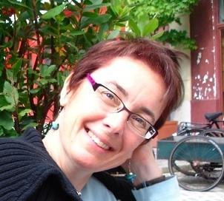
SPEAKERS
Henk van den Heuvel
CLST, Radboud University, Nijmegen, The Netherlands
Researcher
Director of the Centre for Language and Speech Technology
Head of the Humanities Lab and research data officer at the Faculty of Arts
Coordinating member of the CLARIN Knowledge Centre for Atypical Communication
DELAD Committee Member
Nicola Bessell
Department of Speech and Hearing Sciences, University College Cork, Cork, Ireland
Lecturer in Speech and Hearing Sciences
Research in typical and atypical phonetics and phonology, dialectology, language change
Active in collection of language corpora for typical and atypical speech
UCC Social Research Ethics Committee member
DELAD Committee Member

Slide 3
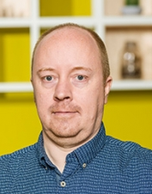
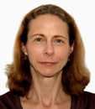
SPEAKERS
Paul Trilsbeek
The Language Archive, Max Planck Institute for Psycholinguistics, Nijmegen, The Netherlands
Archivist
Head of The Language Archive
Member of the CoreTrustSeal Boardcv
Libby Bishop
GESIS-Leibniz Institute for Social Sciences, Cologne, Germany
Coordinator for International Data Infrastructures
Manages relationships between GESIS and international data infrastructures
Social Sciences and Humanities Open Science Cloud Project – Leader on Task 5.4 Remote Access to Secure Data
CAVA: Human Communication: an Audio-Visual Archive–UCL–Advisory Group (c. 2009)

Slide 4
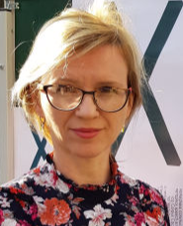
SPEAKERS
Katarzyna Klessa
Adam Mickiewicz University in Poznan, Poland
Researcher
Member of the Programme Board of CLARIN-PL
Head of the project: Infant-directed and adult-directed speech: preliminary investigation with Carstens AG501 Articulograph (Polish National Science Center)
Visiting scholar at the University of Texas at Austin, USA within the COLING project (Minority Languages, Major Opportunities. Collaborative Research, Community Engagement and Innovative Educational Tools; EU Horizon 2020 )
Participant of the project MuMoStance: Multimodal Stancetaking: Expressive Movement and Affective Stance. Political Debates in German Bundestag and Polish Sejm

Slide 5
NOTES
  This webinar is being recorded. All participants will receive a link to the recording later.
  Slides are available: See the chat box for the link.
  Questions? Put them in the chat box. We’ll put questions to the speakers at the end of the webinar.

Slide 6









Project:
Type of action & funding:
Research and Innovation action
(INFRAEOSC-04-2018)
Partners: 45
(20 beneficiaries + 25 LTPs)
SSH ESFRI Landmarks and Projects
& international SSH data infrastructures
Project budget:
€ 14,455,594.08
Project website: www.SSHopencloud.eu
Duration: 40 months
(January 2019 – 30 April 2022)
Objectives:
creating the social sciences and humanities (SSH) part of European Open Science Cloud (EOSC)
maximising re-use through Open Science and FAIR principles (standards, common catalogue, access control, semantic techniques, training)
interconnecting existing and new infrastructures (clustered cloud infrastructure)
establishing appropriate governance model for SSH-EOSC

Slide 7
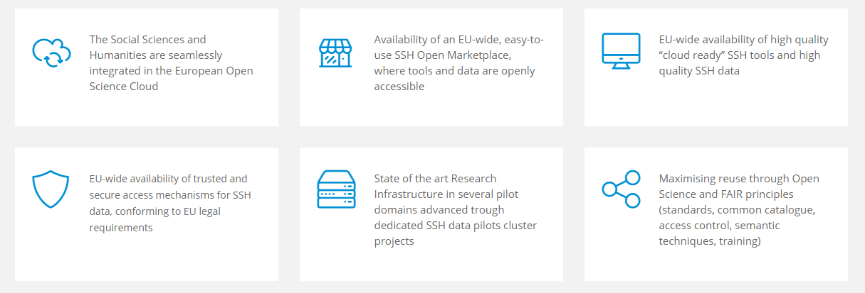
EXPECTED IMPACT

Slide 8
Programme for this webinar
Henk van den Heuvel: The DELAD initiative for sharing corpora of speech disorders
Nicola Bessell: GDPR & Ethics of special category data
Paul Trilsbeek: Storing and sharing CSD at the The Language Archive
Libby Bishop: Remote Access to sensitive data
Libby Bishop: The CAVA project
Katarzyna Klessa: the case of the Polish Cued Speech Corpus of Hearing-Impaired Children

Slide 9

DELAD initiative
Initiative to collect and share corpora of speech with disorders (CSD):
http://delad.net/
Partners are a mix of researchers, infrastructure specialists, legal experts
DELAD organises annual workshops since 2015 where these groups convene
Since 2017 under CLARIN header and support
Topics addressed:
Examples of CSD
Guidelines for collecting and sharing CSD
Ethics and legal aspects
Levels of anonymisation
Layered access of data
Integration of CSD in the CLARIN infrastructure
Formats
Relevant metadata

Slide 10
CLARIN in six bullets
CLARIN is the Common Language Resources and Technology Infrastructure
ESFRI ERIC status since 2012, Landmark since 2016
that provides easy and sustainable access for scholars in the humanities and social sciences and beyond
to digital language data (in written, spoken, video or multimodal form)
and advanced tools to discover, explore, exploit, annotate, analyse or combine them, wherever they are located
through a single sign-on online environment

Slide 11
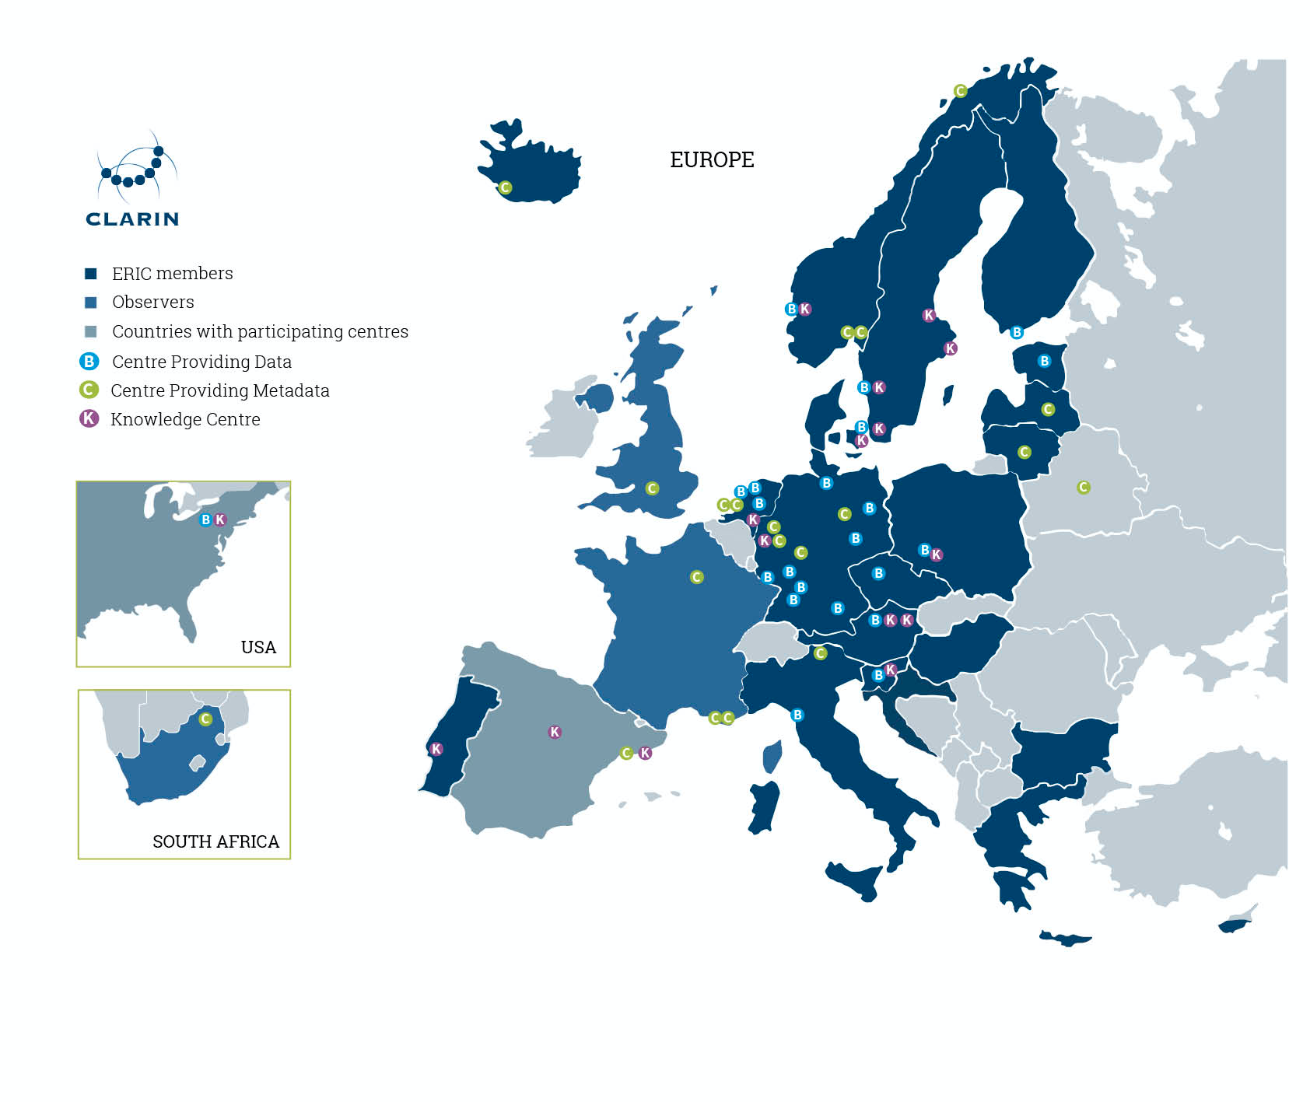
CLARIN Centres
24+3 countries
24 B-centres
K-centres
increased coverage of topics
inclusion in Tour de CLARIN
Website as channel for
multiple audiences.
www.clarin.eu/covid-19

Slide 12
DELAD initiative
Collaboration with CLARIN Knowledge Centre for Atypical Communication Expertise (ACE)
For data storage hosting and sharing DELAD cooperates with ACE:
  The Language Archive at MPI Nijmegen: https://archive.mpi.nl/tla/
  Talkbank at CMU: https://talkbank.org/
Use case: https://phonbank.talkbank.org/access/Clinical/PCSC.html
Next DELAD workshop: 25-29 January 2021, online
  Access options for CSD
  Space for researchers to present their datasets and solutions/wishes for sharing them
  GDPR-issues & DPIA for selected cases, role play
  Contact person: Henk van den Heuvel, h.vandenheuvel@let.ru.nl

Slide 13
Ethics and GDPR considerations when collecting for corpora of speech disorders
Nicola Bessell
Department of Speech and Hearing Sciences
University College Cork
Ireland

Slide 14
GDPR applies to processing of personal data, which is
  Data about living persons from which they can be identified including
    Personal identifiers
    Audio recordings
    Video recordings
Lawful basis (Article 6) is:
‘… performance of a task in the public interest.’

Slide 15
What about health-related data?
Article 9
Recital35
…all data pertaining to the health status of a data subject…any information on disease, disability, medical history…independent of its source…
Additional rationale required for processing health-related data. Must be
  necessary for research purposes
  archiving purposes must be in the public interest

Slide 16
Processing health data requires safeguards
Research ethics
Data minimization: collect only the personal data that’s necessary for the research purpose
Anonymize or pseudonymize where possible
Ensure security of data handling and storage

Slide 17
Process to ensure participant control of data
Transparency requires clear language and includes
  Informed consent
  Information about the organization, research unit and members
  Specifics of project
  Specifics of use of data (present and potential)
  Details of sharing of data
  Details of storage of data
Fairness
  Right to refuse
  Right to withdraw

Slide 18
Consent forms must address
Use of data
  Seek explicit consent for current purposes and purposes of any reuse of data
  Outline how confidentiality protected
Dissemination or sharing of data
  On what terms
  Include any future use by research teams
Archiving of data (Article 89)
  Archival period can be specified

Slide 19
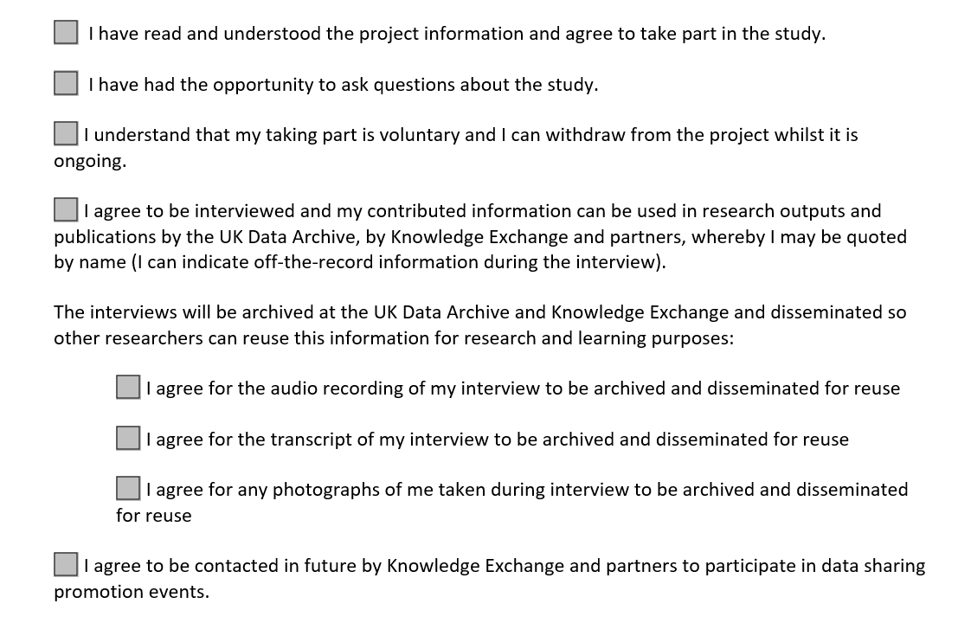
Example from https://ukdataservice.ac.uk/manage-data/legal-ethical/consent-data-sharing/audio-visual.aspx

Slide 20
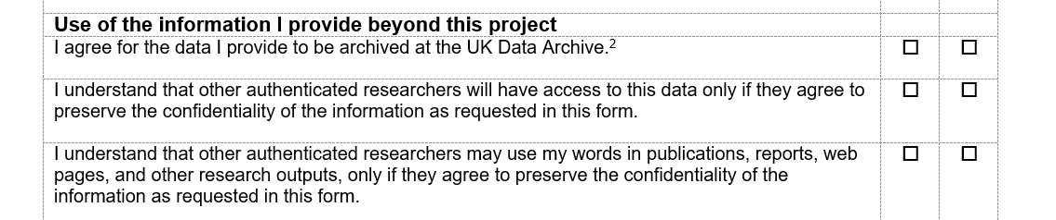
Example from https://ukdataservice.ac.uk/manage-data/legal-ethical/consent-data-sharing/audio-visual.aspx

Slide 21
Local or national oganisations and national laws
National/public health services
Private health services
Charity run services
Associations and advocacy groups
National Data Protection Guidelines
National Health Research Regulations

Slide 22
Covid 19
Benefits of research (in the public interest) must outweigh risks to individual
Use collection methods other than face-to-face
Institution specific restrictions may apply:
research with vulnerable populations may require an amendment request to existing ethics
Contact Data Protection Officer

Slide 23
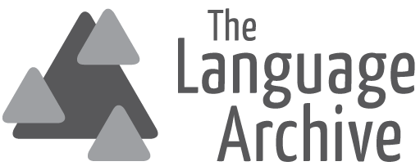
Storing and sharing corpora
of speech disorders at
The Language Archive
Paul Trilsbeek
The Language Archive
Max Planck Institute for psycholinguistics

Slide 24
THE LANGUAGE ARCHIVE – Max Planck Institute for Psycholinguistics
The Language Archive
Exists since the late 90’s, repository that contains data collections resulting from various language-related research disciplines, such as language acquisition, psychology of language, documentary linguistics
Currently holds more than 350 collections covering over 250 different languages from around the world
CLARIN B-Type centre, holds CoreTrustSeal certification
Contains the “DOBES Archive”, resulting from the DOBES Documentation of Endangered Languages funding programme
64 TLA collections added to the UNESCO Memory of the World register in 2015
Research data repository and archive of cultural heritage at the same time

Slide 25
THE LANGUAGE ARCHIVE – Max Planck Institute for Psycholinguistics
Archiving and sharing of (clinical) speech data
Anonymisation not possible without invalidating the data for many research purposes -> no transformations of people’s voices -> GDPR applies
GDPR has explicit provisions for “processing” personal data for research purposes (archiving is seen as “processing”)
Several legal grounds for archiving: informed consent, “public interest”, “legitimate interest” (justification required)
Agreements needed for archiving and sharing:
  Deposit / Processing agreement
  Data use agreement / License (note that many existing licenses are “perpetual” and may therefore be in conflict with the GDPR under certain conditions)

Slide 26
THE LANGUAGE ARCHIVE – Max Planck Institute for Psycholinguistics
Appropriate technical solution
“Data protection by design and by default”:
  Up-to-date systems and software
  Secure transport of data (HTTPS)
  Elaborate system of access policies and authorisation
All archived copies reside within the EU (Netherlands, Germany) at trusted data centres within the Max Planck Society
Encryption: No strict requirement in the GDPR but mentioned as an appropriate protection measure
  Conflict: significant risk with respect to long-term preservation, reduces possibilities for working with data in the archive
  Audio-visual data in TLA is not encrypted “at rest” at the moment
  Trying to develop a solution that allows us to use encryption while mitigating the issues above

Slide 27
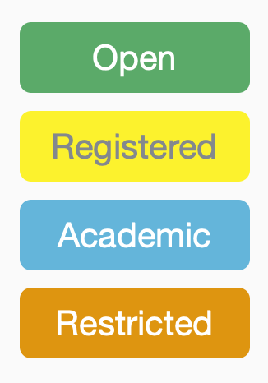
THE LANGUAGE ARCHIVE – Max Planck Institute for Psycholinguistics
Access policies
Access levels:
  Open: Completely public, no registration required
  Registered: Accessible to any registered user
  Academic: Accessible to any academic user
  Restricted: Access permission needs to be requested on an individual basis, depositor typically decides
Depositor determines appropriate access level
Different access policies can be defined for different files within a collection, if necessary
  E.g. anonymous transcriptions could be “open” and audio recordings “restricted”

Slide 28
THE LANGUAGE ARCHIVE – Max Planck Institute for Psycholinguistics
Authorisation
  Account registration: validity of a new user is manually verified by archive staff, optionally their academic status as well
  Login via own academic account (“Shibboleth” federated login): account is active immediately and academic status is automatically assigned
  Access to specific restricted materials is granted to individual users once a request is approved
  Access request: Users needs to specify intended usage of the resources

Slide 29
THE LANGUAGE ARCHIVE – Max Planck Institute for Psycholinguistics
TalkBank exchange
Arrangement with TalkBank at Carnegy Mellon University in Pittsburgh, U.S.A. for sharing non-sensitive (anonymous/anonymised) parts of collections of “atypical” speech
Anonymous metadata and transcriptions/annotations are made publicly available in the appropriate part of the TalkBank system
Both non-sensitive and sensitive files (audio, video) are stored at The Language Archive
Links to the collections at TLA are provided on the TalkBank collection overview pages

Slide 30
THE LANGUAGE ARCHIVE – Max Planck Institute for Psycholinguistics
General GDPR considerations
As with any complex law, there’s room for different interpretations. No case law yet for the GDPR in relation to academic data
Different local implementations make things even more complex in an international setting
Different approaches:
  Better safe than sorry: stop sharing. Clearly in conflict with current views on proper scientific conduct (“FAIR” principles)
  Comply to the best of our ability, knowing that there’s a chance that we may not always be 100% compliant, in particular with older pre-GDPR collections
The incentive for the EC to create the GDPR was not to make it hard or impossible for the scientific community to collect, share and preserve personal data for research purposes

Slide 31
Paul.Trilsbeek@mpi.nl
archive.mpi.nl

Slide 32
From the CAVA to the Cloud?
The quest for remote access to (sensitive) data
Libby Bishop, PhD
SSHOC Webinar: Sharing Datasets of Pathological Speech
14 Sep 2020
virtual

Slide 33



CAVA
Human Communication Audio-Visual Archive
Co-funded by UCL and the JISC (Joint Information Systems Committee)
April 2009 – March 2010
Martin Moyle, UCL Library Services
Merle Mahon, Developmental Science, UCL
Suzanne Beeke, Language and Communication, UCL

Slide 34
CAVA project aims
establish a digital video repository for human communication sciences, populated with an existing body of rights-cleared content (naturally occurring speech) owned by UCL researchers
house this within the UCL Library Services Digital Collections service which uses the Ex Libris DigiTool repository platform
catalogue each video to a discipline-specific descriptive standard, IMDI
deposit transcripts and other supporting material wherever available
develop procedures and processes for managing access (restricted to bona fide researchers)
look at options for long-term digital preservation of the master files, with help of UK Data Archive

Slide 35
Data from past projects | Hours
Deaf children & teachers UCL/ Mahon/Department of Health | 45
Deaf children & parents UCL/Mahon/ESRC | 6
Children with language disorder & teachers Institute of Education/Radford/PhD | 14
Persons with autism-teacher interaction Roehampton/Rae, Dickerson & Stribling/ESRC | 16
Typically developing toddlers & parent UCL/Corrin/PhD | 60
Typically developing toddlers & parent Canterbury/Forrester/ESRC | 12
Children using AAC &peer UCL/Clarke/PhD | 4
People with MND & spouse UCL/Bloch/PhD | 6
Data expected from ongoing projects
Aphasia therapy UCL/Beeke/Stroke Association | 13
Adults with neurological disease UCL/ S.Bloch/NHS HIHR/PI | 45
British Sign Language Corpus project UCL/Schembri/ESRC | 360
Deaf children UCL Mahon/British Academy | 7

Slide 36
The CAVA repository
Will use UCL’s DigiTool repository platform
  http://digital-collections.lib.ucl.ac.uk
Metadata is openly searchable; video resources will have access restrictions
Built-in technical metadata extraction (using JHOVE), checksums, change history metadata; access control capabilities (IP and/or username)
Front-end: quick overview…

Slide 37
Consent and technical issues
Consent
  Retrospective
  Prospective
    guidelines for depositors based on recent successful approval via UCL Research Ethics Committee/NHS multi-site ethics process
  renewed consent at 18 years old
Access controls (item-specific) - Application, authorisation and authentication
What technical work is needed to underpin access and rights management procedures?
Long-term preservation
The ideal would be to retain the uncompressed master files in a managed environment, but these exceed current storage capacity.

Slide 38
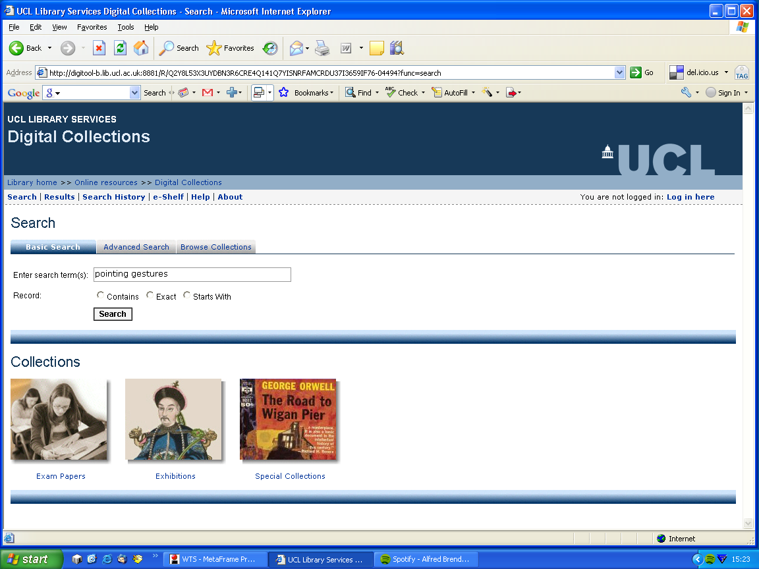
Keyword search…
“CAVA” link will also appear here.
This will allow browse navigation.

Slide 39
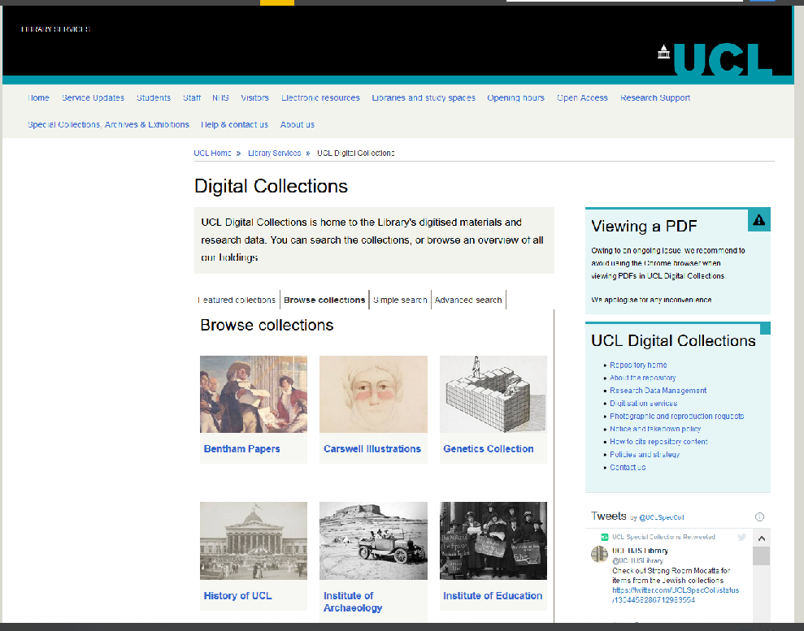
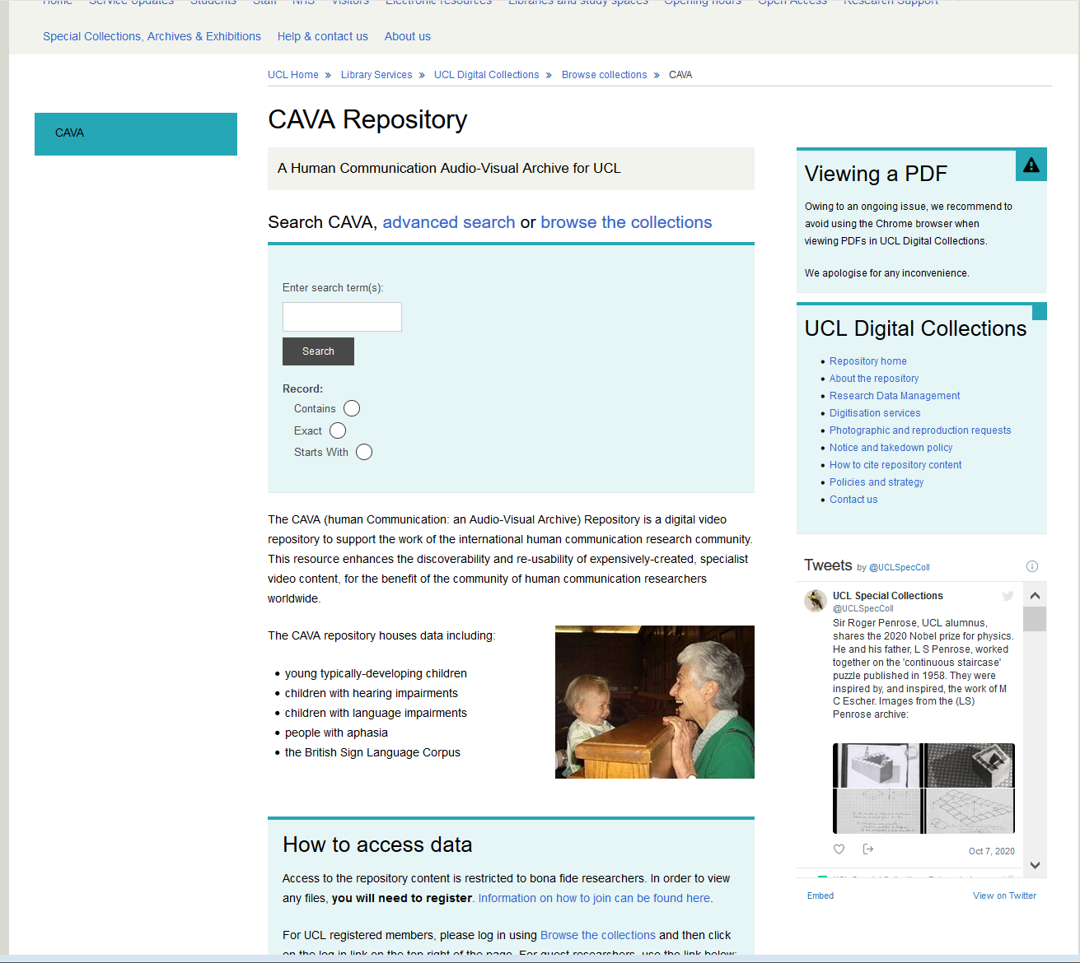
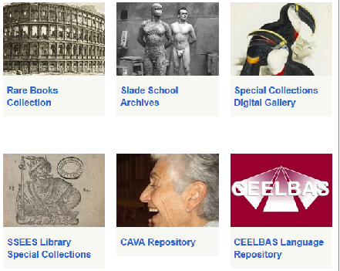
Ten years later – still going

Slide 40
Post-project issues
2010 2020
Sustaining maintenance and growth?
  ongoing costs of access management, storage, licences, support
Continuing deposit by UCL researchers is foreseen
Long term future (possible with UKDA)
  Deposit by non-UCL researchers?
  Exit strategy will be required…
Still functioning!
  Modest level
  Permission system works, does not scale
New data, only as resources permit
Considering migration options
“Worth trying”

Slide 41
Fast Forward 2020 – Remote Access Landscape
My context: social science research data (+)
Many successful infrastructures
  NordMan -Nordic Microdata Access Network
  German RDCs – LIfBi - Leibniz Institute for Educational Pathways
  IDAN – International Data Access Network
  UK Data Service Secure Lab
  GESIS – Secure Data Center
  ICPSR – Virtual Data Enclave
But lots of infrastructures is a bit like lots of metadata standards…more ≠ better

Slide 42
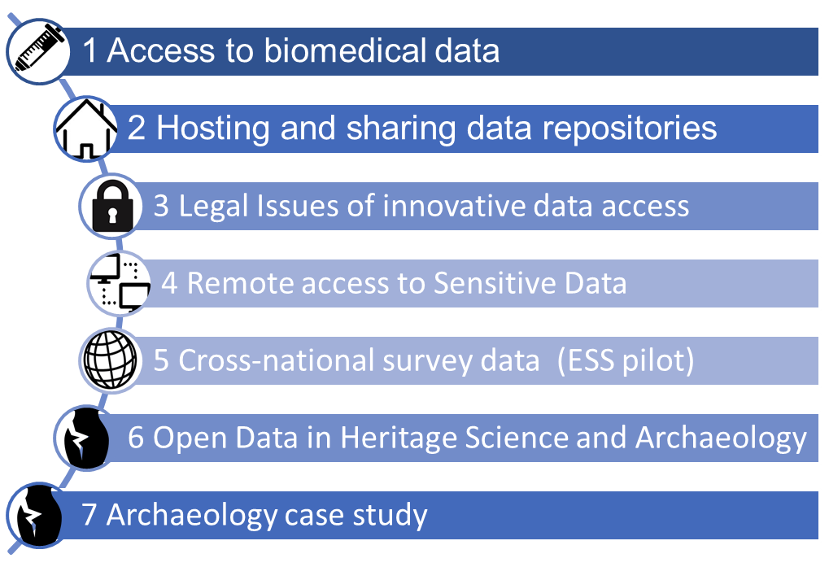
SSHOC WP5: Innovations in Data Access
Goal: to make data access FAIR & intelligently open

Slide 43
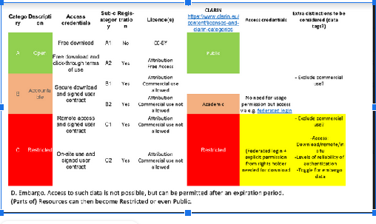
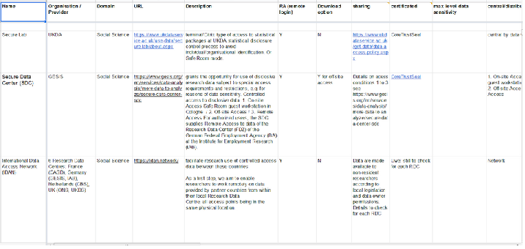
5.4 Remote Access to Sensitive Data
D5.9 Framework for Data Use
  Makes open actual contract in use to enable data access
D5.10 Requirements and Recommendations for Remote Secure Access (RSA) in the Social Sciences and Humanities
  Minimal Access Requirements for Remote Secure Access – specifically including both Social Sciences and Humanities
  Platform Assessment and Recommendations to EOSC for new infrastructure investment for RSA

Slide 44
“Two roads diverged in a wood…”
The CAVA v.2020
  Lots of experience to draw on, more stable tech, but…
  No reliable path to sustainable infrastructure
European Open Science Cloud/SSHOC
  Possible path to sustainable infrastructure
  Stop reinventing Safe Enclaves, Labs, Rooms, Centers
  Demand for services to support Remote Work can only grow (Covid effect)
  But…
  Privacy concerns grown, w/ legal sanctions (GDPR)
  “Ice cream castles in the air” or “illusions”?

Slide 45




Join our community
https://www.sshopencloud.eu
info@sshopencloud.eu
@SSHOpenCloud
/in/sshopencloud

Slide 46


The curation and disclosure
of pathological speech corpora
Katarzyna Klessa

Slide 47
Disclosure and curation of corpora
Legal, research and technical issues play role in the process of disclosure and curation of corpora
The importance of these issues for:
  CDS (Corpora of Disordered Speech)
  especially for CDS created in the past, before the present regulations came into existence: “archival” corpora
legal
research
technical

Slide 48
Licence attribution
Explicit licence attribution is useful even in case of data published without any access restrictions
Users will often expect clear information about licensing, preferably compliant with one of the standard licenses (e.g. those suggested by CLARIN centers)
GDPR - accepted by EU but not necessarily elsewhere
legal

Slide 49
Archival data,
metadata
vs.
new regulations
However:
In the past, recordings were often made based on oral agreements with speakers (no consent form available now)
In case of children (now adults) - the consent usually given by their representatives: parents, guardians or school teachers / directors
Often: no contact with the speakers / representatives at present.
Present regulations not clear with respect to data collected before the present regulations
legal

Slide 50
Data
reusability
interoperability
?
Various perspectives regarding data collection & storage:
  Data re-usability, interoperability perspective: collecting and storing as much (meta)data as possible; data collection is very costly and time-consuming
  The limitations due to GDPR: e.g. it is recommended to collect only the info necessary for a specific purpose
research

Slide 51
Archival data
formats
File formats can be obsolete, unsupported by many of the present data analysis tools, e.g. audio data collected with Kay Elemetrics (CSL, The Computerized Speech Lab proprietary format)
Annotation standards change, currently most formats are XML-based but not only
If allowed to share - data contributors might need help regarding technical issues
technical

Slide 52
How CDS can be found through one organisation and made accessible through another
DELAD
K-Centre for Atypical Speech
TalkBank
Other?
Using various platforms for better visibility

Slide 53
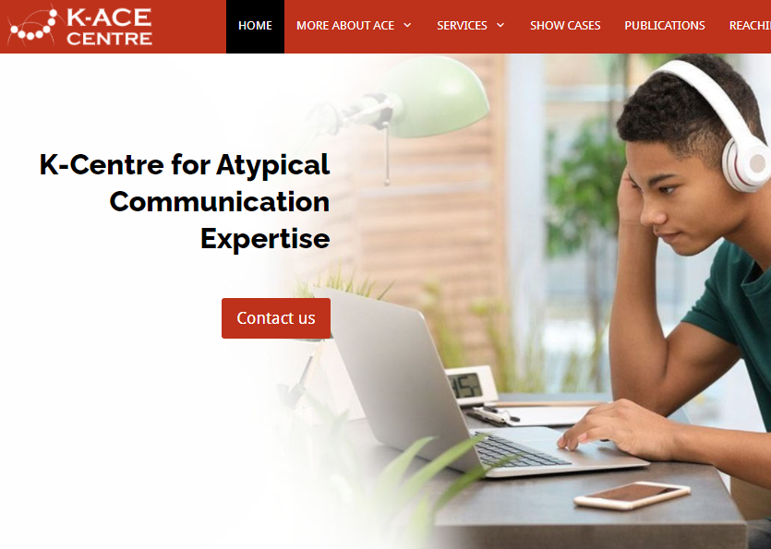
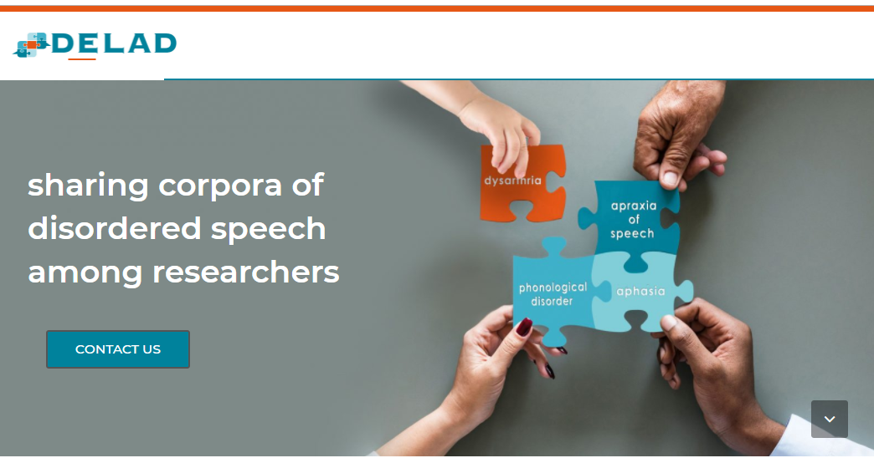
https://delad.net
https://ace.ruhosting.nl/

Slide 54
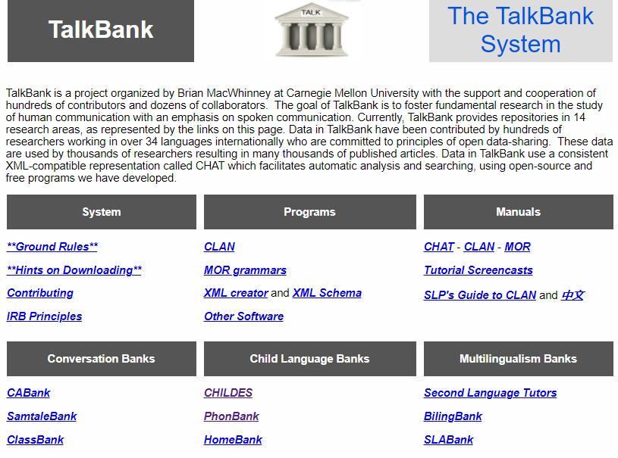
https://talkbank.org/

Slide 55
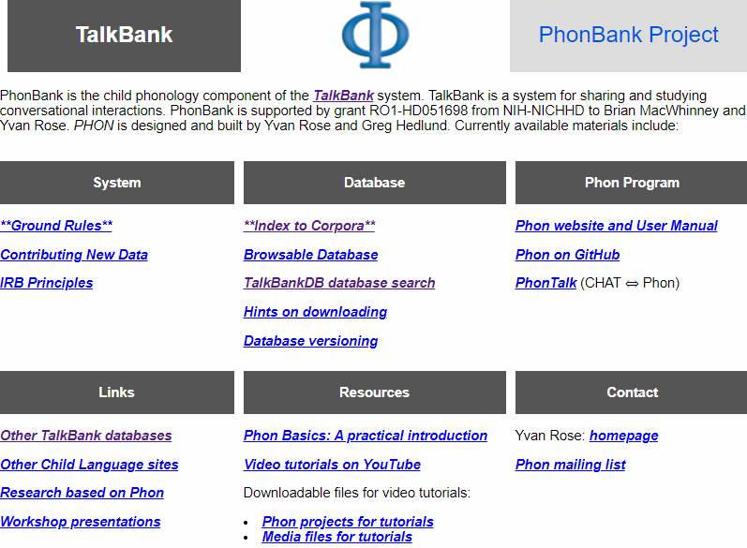
https://phonbank.talkbank.org/

Slide 56
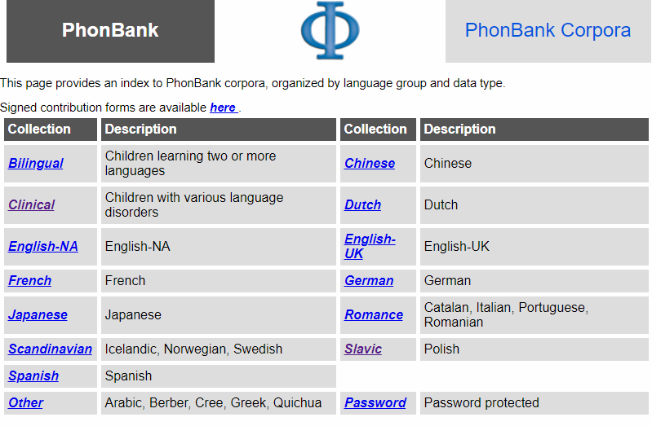
https://phonbank.talkbank.org/access/

Slide 57
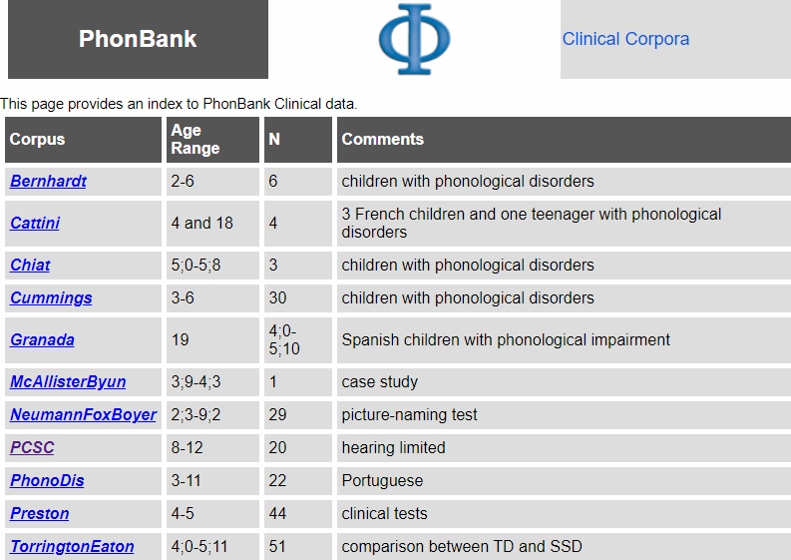
https://phonbank.talkbank.org/access/Clinical/

Slide 58
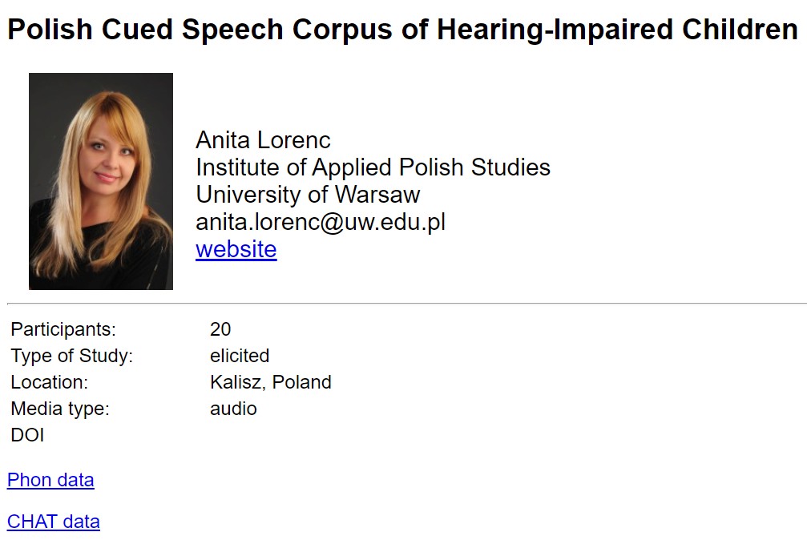
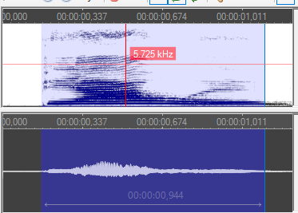
https://phonbank.talkbank.org/access/Clinical/PCSC.html

Slide 59
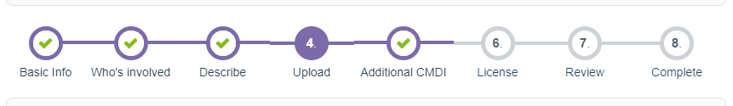
Linking to
local
repositories
?
Polish CLARIN provides an on-line platform supporting deposit and sharing of various types of language corpora
https://clarin-pl.eu/dspace/
The platform is intuitive, basic metadata forms are available, licence agreement type can be selected from a list of defaults or adjusted to the depositor’s needs
It is possible to add links to external websites of the project or data samples
Licence suggestions: https://clarin-pl.eu/dspace/page/licenses

Slide 60

The curation & disclosure of archival corpora
Legal, research and technical issues in dealing with archival corpora
Datasets created in the past can be findable via different platforms thanks to collaboration of partners and technical support from infrastructure representatives
  Access to some parts of the archival corpora must remain restricted because of unsolved legal issues or the character of data (sensitive information)
DELAD initiative - as an integrating platform for potential contributors of disordered speech corpora

Slide 61


Thank you for your attention!
Questions?
Please put them in the chat box.
Slides and a recording will be sent to all registered participants.
Join our community
https://www.sshopencloud.eu
@SSHOpenCloud
info@sshopencloud.eu
/in/sshopencloud

