Slide 1
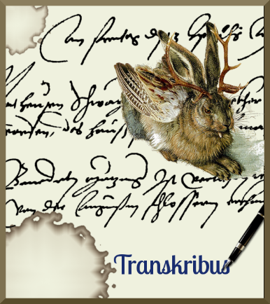


Digi-workshop #3
Transkribus: updates.
By Dr. C.A. (Annemieke) Romein
(Huygens ING)
Digital workshop, 9 October 2020
Noon CEST

Slide 2
Tables and LA
Small regions
How to remove small regions (noise).
Sample sets
Pylaia
Other updates
Small update on P2PaLA
What is Pylaia and does it differ from HTR(+).
Developments in the field of tables/ how to add seperation lines in your LA.
How to create a sample set (to function as a sturdy basis for your models).
How to use it.
Read and Search
Webversion
masking text

Slide 3
Pylaia
In this section you will learn more about Pylaia.

Slide 4
HTR → HTR(+) and Pylaia
Keep in mind HTR stands for Handwriting Text Recognition.
From that, there are different ‘techniques’ that are being used for the recognition. These have (confusingly enough) similar names:
  HTR: original tool with RNN to recognise the handwriting
  HTR+: faster tool. Created by Planet (Germany) and licensed to Transkribus.
    This will be phased out next year, replaced by IDA (which will be faster than HTR+).
  Pylaia: open source tool by the University of Valencia (no license, hence the lower costs).

Slide 5
Pylaia
If you have curved lines (or pages) HTR+ generally works better; but this will improve in pylaia.
Pylaia models cannot be used for Text2Image, you’ll need HTR+.
Pylaia is PyTorch based (aka Machinelearning Library).
Benefits Pylaia: you can adjust more Parameters and the Netstructure can be changed (if you are familiar with machine learning). More can be found on: https://github.com/jpuigcerver/pylaia
Same amount of pages necessary; but preprocessing is important.
You can train Pylaia to fill out abbreviations by using $ as a sign between the abbreviated form and the filled out form. *new sign will come!*
Pylaia can export word-coordinates, which is interesting if you want to be able to show the exact word location in an image/text (e.g. IIIF).

Slide 6
Trainingsbutton
In order to train Pylaia-models you will need – like with HTR+ - ask the Read-Coop team to provide you with the button.
  Info@readcoop.eu
  This is because not everyone is going to be using this.

Slide 7
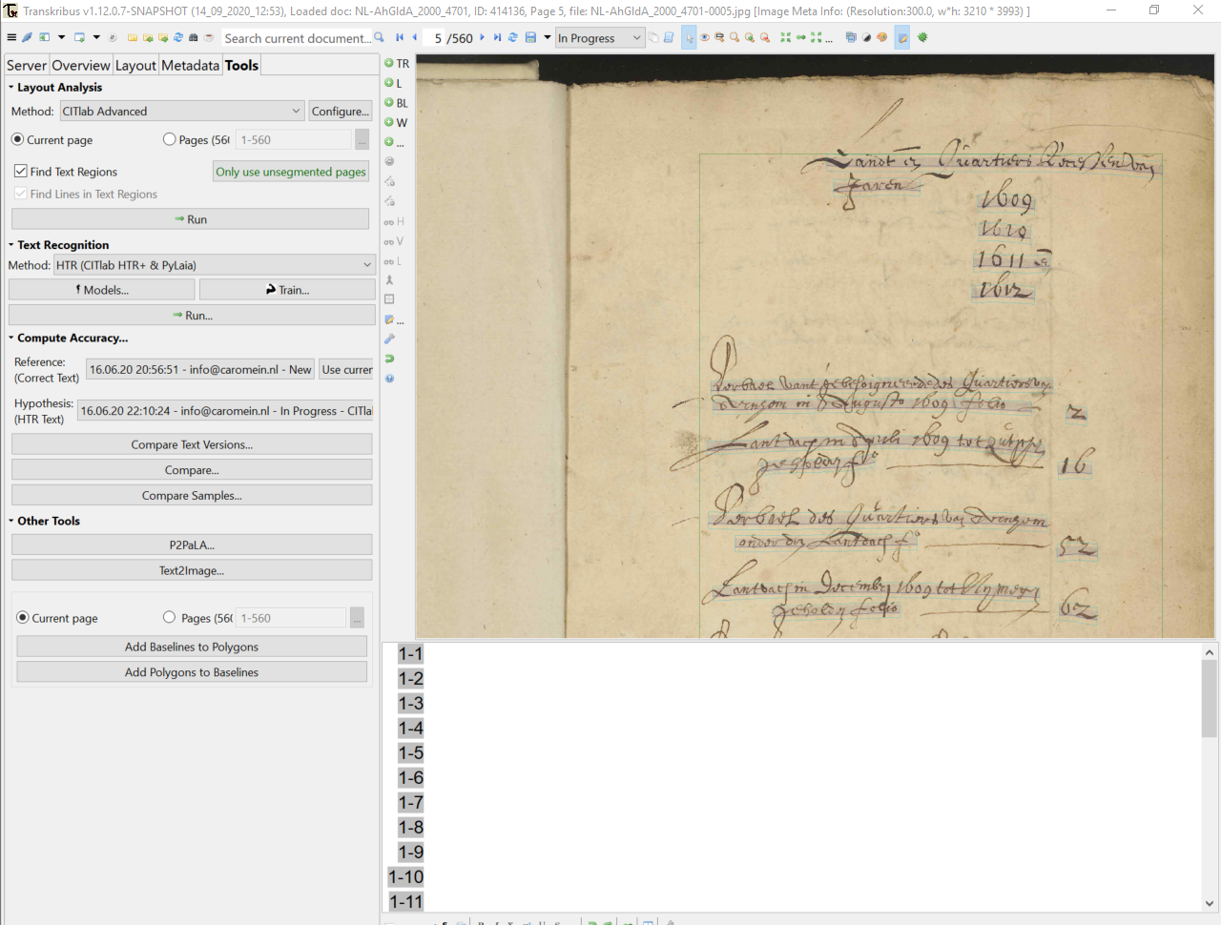

Slide 8
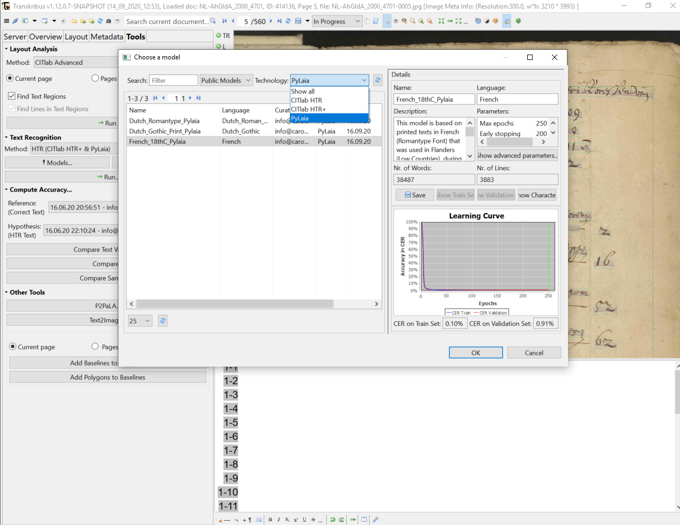

Slide 9
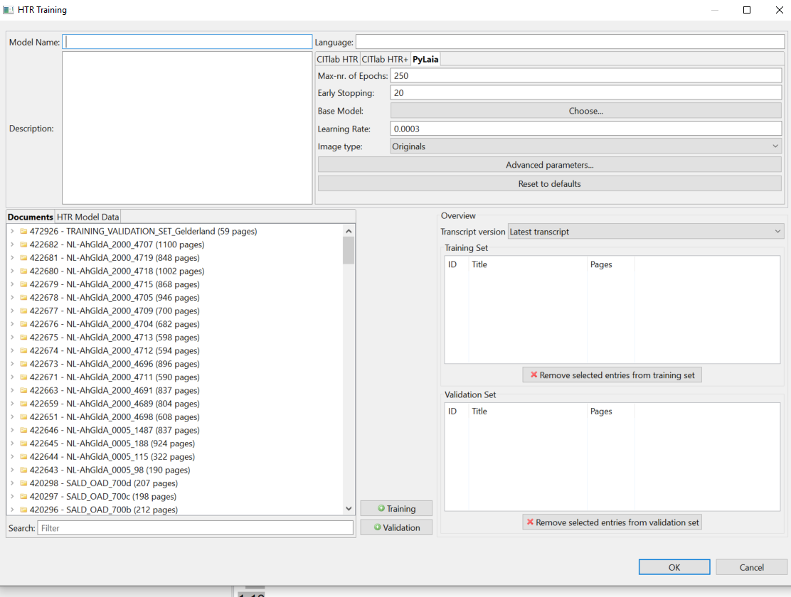

Slide 10
Image type – do you want to have the model work on original or compressed?
  If it takes to long to create, stop the training and use the compressed! (Not that much influence on the result.)

Slide 11
Early stopping & learning rate combined
→ when the improvement on the validationset is too small, the system stops.
(with very small validation sets: make this number a bit higher).
Number of epochs (same as in HTR+)

Slide 12
Learning rate: the worth between each step in the training. If the steps are large, the CER will drop quicker, but is less accurate. Leave it at default if you are not experienced.

Slide 13
Learning rate: the worth between each step in the training. If the steps are large, the CER will drop quicker, but is less accurate. Leave it at default if you are not experienced.

Slide 15
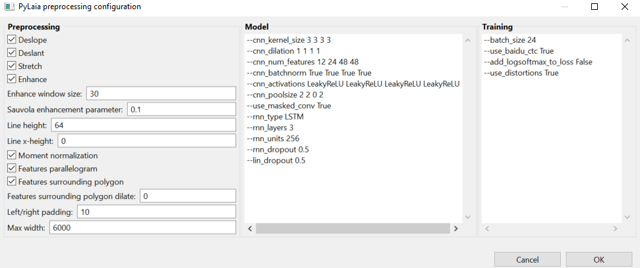
Deslope: ✓ accept a higher variety with the baselines .
Deslant: ✓ necessary for written texts; NOT for printed texts.
Stretch: ✓ if texts are written extremely tight to one another
Enhance: ✓ if there is a lot of ‘noise’ on the page (not with very white pages e.g.)

Slide 16
Enhance window size: the size of the “optimizing tool” that goes over the pages.
Sauvola enhancement parameter: ✗ don’t touch, has to do with special algoritms.

Slide 17
Line height: the height of the text measured in pixels. If it is not high enough, change it to 100.
If you get an ‘out of memory order’ you may change the “batch size” to a lower number. The smaller this number is, the slower the training becomes.
In a next version this will be changed into an automatic batch-size.

Slide 18
Line x-height: this concerns descenders and ascenders. If you chose to fill this one in, the Line-height parameter is ignored.

Slide 19
Moment normalization: ✗ don’t touch (leave the ✓ there)
Features parallelogram: ✗ don’t touch (leave the ✓ there)
Features surrounding polygon: ✗ don’t touch (leave the ✓ there)
Features surrounding polygon dilate: ✗ don’t touch (leave the ✓ there)

Slide 20
Left/ right padding: the number 10 here means ‘10 pixels’ to prevent the risk of cutting a part of the row.
Max width: 6000 is default (pixels). If you have huge pages, you will need to adjust this to a higher number, otherwise you don’t need to touch this.

Slide 21
Model: all the parameters here are meant for people who know their way around with machine learning. It has to do with modifications to the Neural Networks.

Slide 22
Batch size: number of pages that are being processed at once at the GPU (Graphic Processing Unit aka: the core in the server).
Use_distortions: “True” means that the computer will rotate or change the shape and position of the trainingsset to make the model more stable.
  Not necessary for printed and very regularly written texts and really good quality scans. You can then change this statement from ‘True’ by typing ‘False’ there.

Slide 23
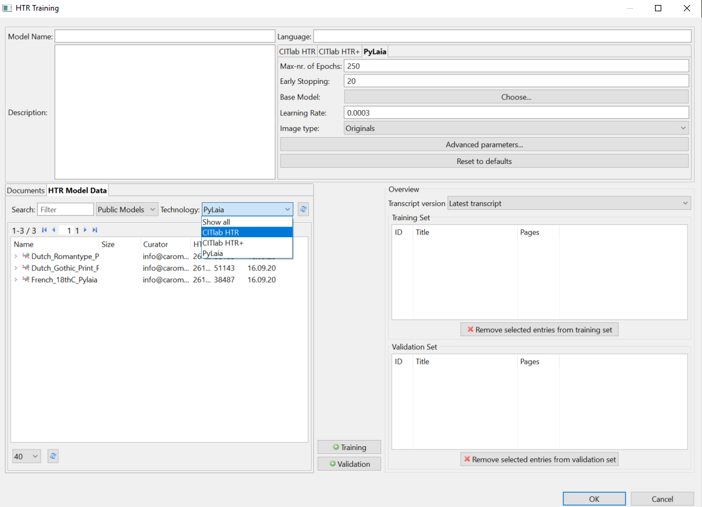
Pylaia only works with Pylaia models as a base (as does HTR+ with HTR+ models)

Slide 24
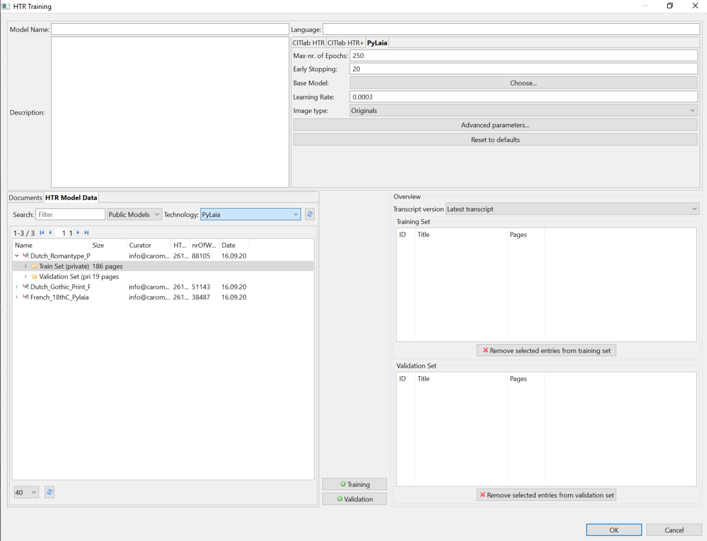

Slide 25
Tables or adjustments of LA with additional lines
There is a lot of improvement regarding tables. It’s easier to draw the lines.
Cells are not yet recognised in P2PaLA but you could opt for columns.
Naverlab Document Understanding will be integrated sometime in the coming months (this focusses on the AI-understanding of the content).

Slide 26
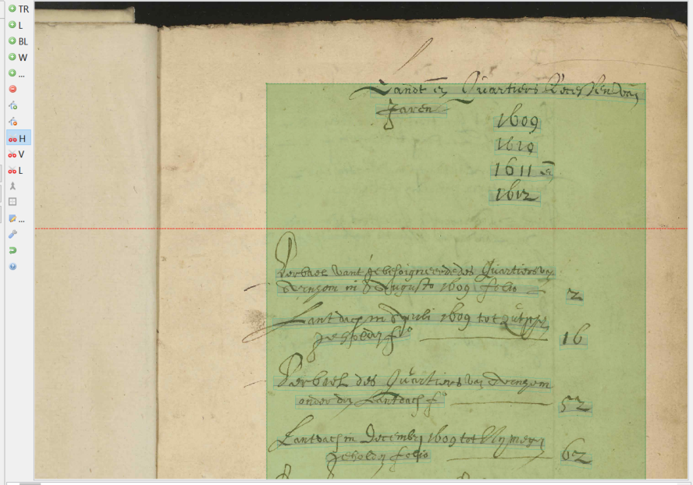

Slide 27
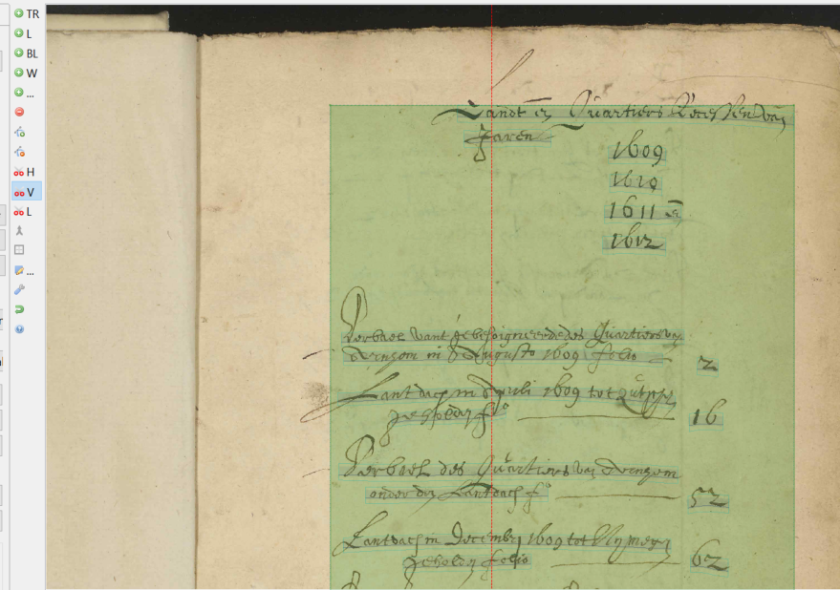

Slide 28
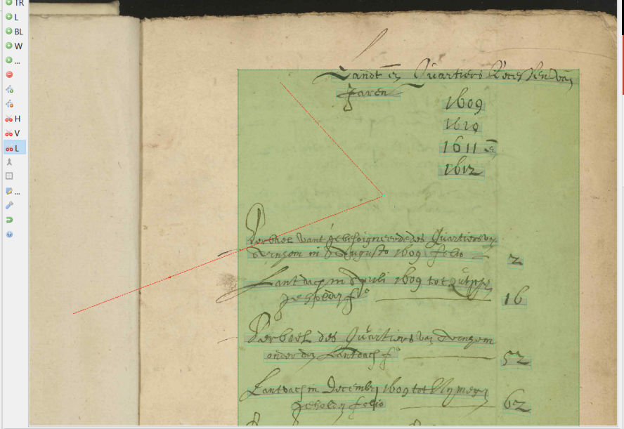

Slide 29
Remove Small regions
If there is a lot of noise on your pages (because of stains or discolourations).

Slide 30
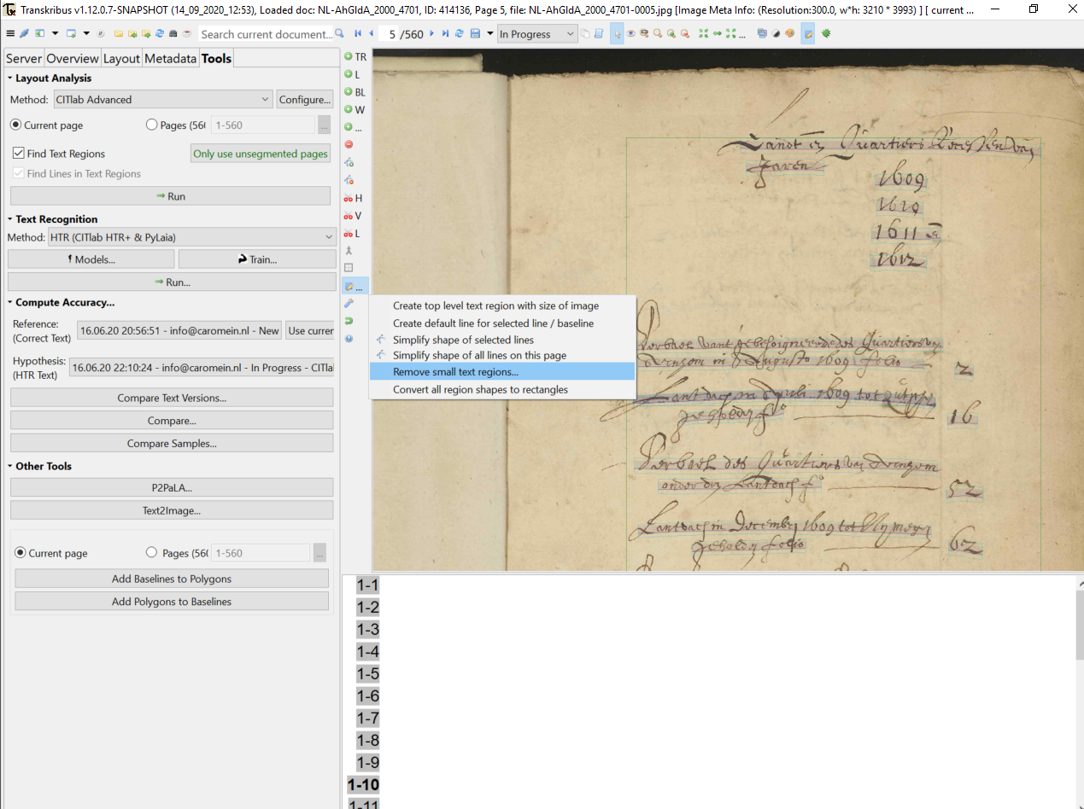

Slide 31
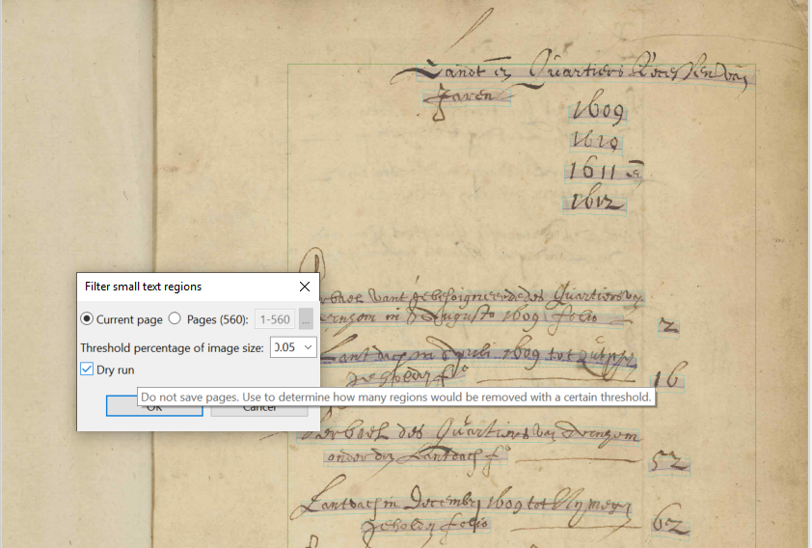

Slide 32
Create a sampleset
Why?
  Because you can create a representative set from a whole collection to transcribe and make that into a useful model for your collection.

Slide 33
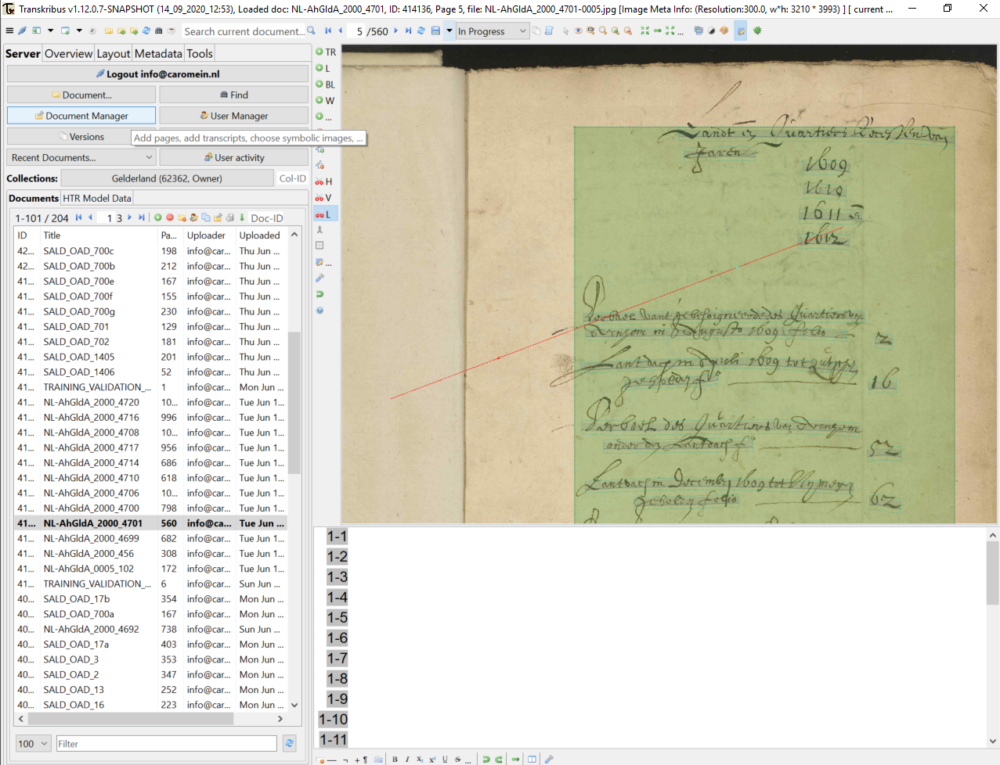

Slide 34
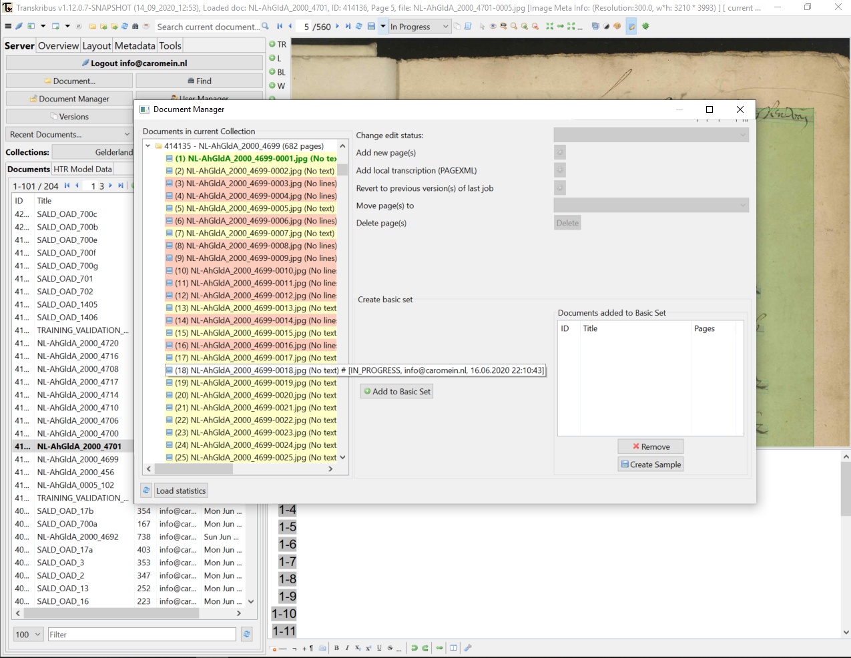

Slide 35
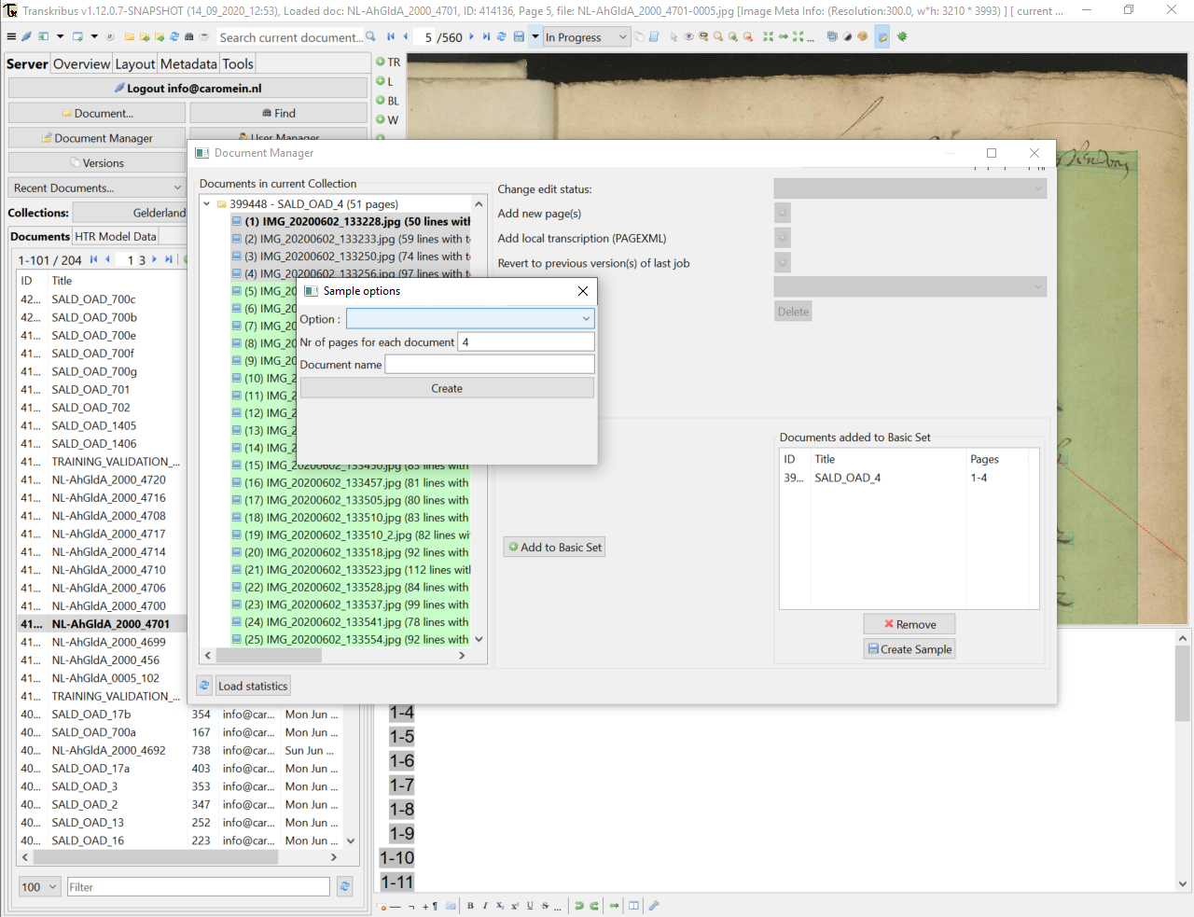

Slide 36
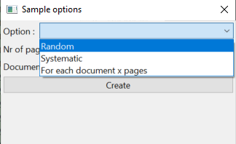

Slide 37
Some other small updates
P2PaLA
Read and Search (kws)
Little bit on the webversion
Masking text

Slide 38
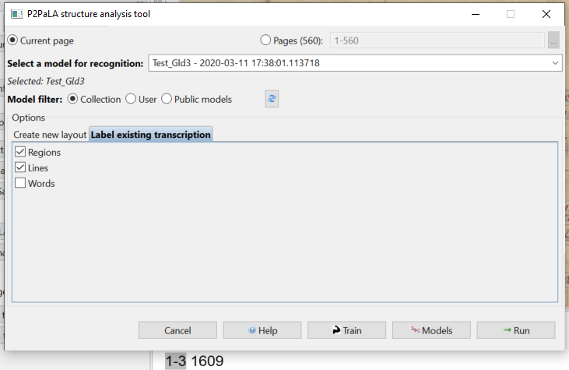
P2PaLA
“Label existing
transcription”
aka: rename the regions
P2PaLA/ text regions
that are labelled can
(in the very near future)
be used to apply a
model just to certain
fields and not on others
if you want. (E.g. useful with multiple languages/translations.)

Slide 39
Read & Search service
Keyword spotting and searching options are available through the Transkribus server (with log in through your own account).
  See KWS in webinar 1 https://youtu.be/5YCfaFNMol4?t=7266
If you have a (small) project and you want to provide the results to a wider audience but you do not want to have to figure out how to host/ create a website and such for all this searchable data… Transkribus is going to offer this as a service. In other words: they can host your data and show it as a searchable website so others (without Transkribus accounts/ access to your collection) would be able to publicly view it.
Works based on IIIF.

Slide 40
Webversion
The rights of someone you shared the folder with will be made the same within the webversion as in the desktop version (expert client). (So a co-owner or editor will be the same in both versions, meaning that they can sign a page off as GT.)
If you need to use special signs: use Unicode. (e.g. Alt133 = é)
Italics and bold are not (yet) possible in the web interface. (Mind you, these are not going to be integrated into a model anyway for the coming time; so ask yourself if you need these to be tagged/ analysed).

Slide 41
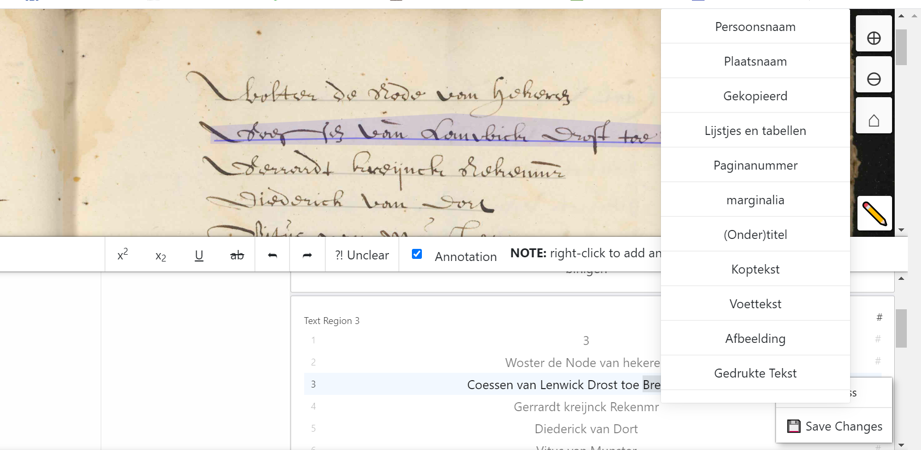

Slide 42
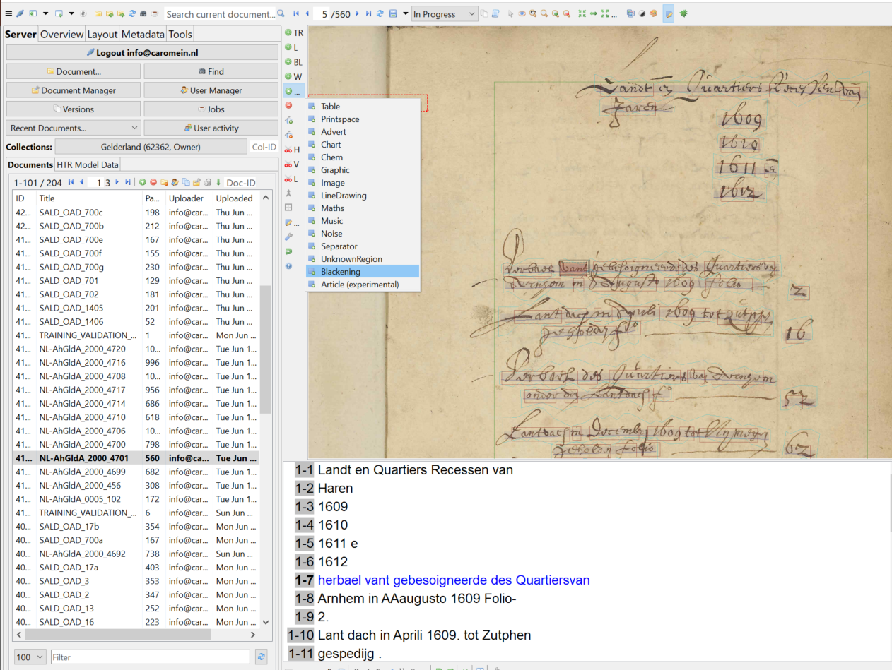
Masking
“blackening”
You then draw
a box over the
text that you
want to hide.
N.B. it’s only
a “layer”, not
in the image.
It will be in pdf
but textual
export contains
the original text

Slide 43


Slide 44
Thank you for your attention!

