Slide 1

FREYA PID Services
DataCite Commons
Webinar – 30 September 2020 15:00 BST/16:00 CEST
Martin Fenner (DataCite)
Richard Hallett (DataCite)
Frances Madden (British Library)

Slide 2
Welcome
Some housekeeping announcements:
Webinar is being recorded and made available via FREYA’s YouTube channel.
Please stay muted during the presentations
Write any questions in the Q&A field
Let us know in the chat if you experience problems

Slide 3
Agenda
Introduction (Frances Madden, British Library)
What is DataCite Commons (Martin Fenner, DataCite)
What is happening next (Richard Hallett, DataCite)
What do you think: Feedback and Q&A (Frances Madden, British Library)

Slide 4












The FREYA project
FREYA helps to build and extend the infrastructure for PIDs as a core component of Open Science
Improved discovery and access of research data
Develop new types of PIDs
Demonstrate disciplinary PID systems
Integrate services with the EOSC

Slide 5
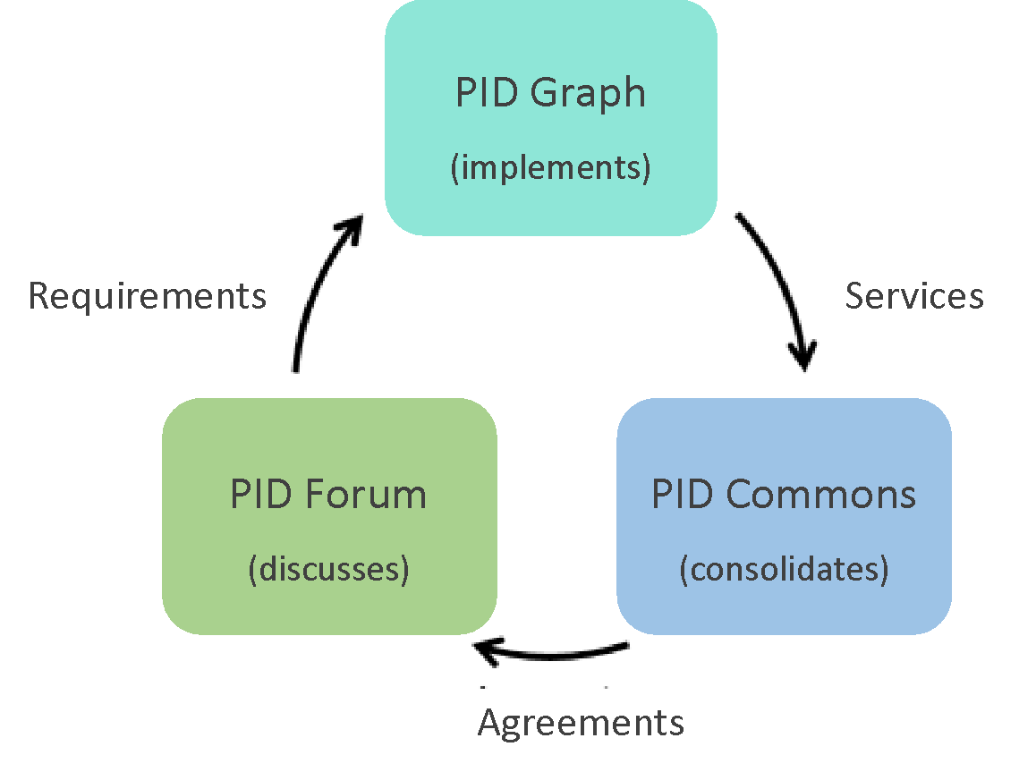

FREYA pillars

Slide 6
FREYA pillars
Today:
Services
supporting PID Graph

Slide 7
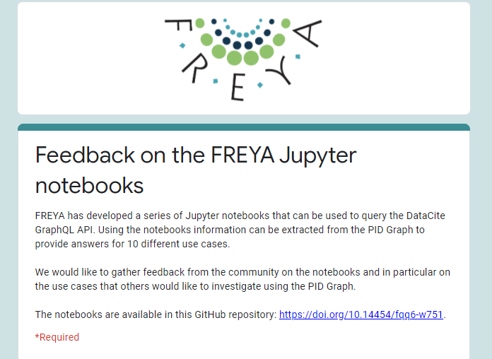
Some final announcements
Please give us feedback on the Jupyter notebooks by 8 October
https://forms.gle/fu5xD862aUUG2h356

Slide 8
Some final announcements
Next webinar A PID Federation – what it could be and what could it do? 14 October, 15:00 CEST
Registration now open - FREYA Final Event, 16-19 November – Realising the European Open Science Cloud
See FREYA website, Twitter feed or pidforum.org for more details

Slide 9
Thank you!

