Slide 1


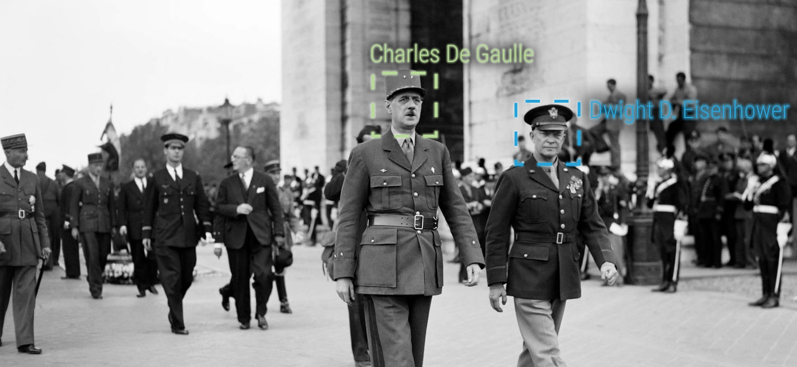
Pasquale Lisena
EURECOM, Sophia Antipolis, France
pasquale.lisena@eurecom.fr
ANTRACT
FaceRec:
an AI-based System for Face Recognition in Video Archives
DataTV2020

Slide 2
How does FaceRec work?
ON TRAINING IMAGES ON VIDEOS
1
CRAWL THE WEB
3
RECOGNISE THE FACES
TRAIN A CLASSIFIER
CLUSTER RECOGNITIONS
4
2

Slide 3
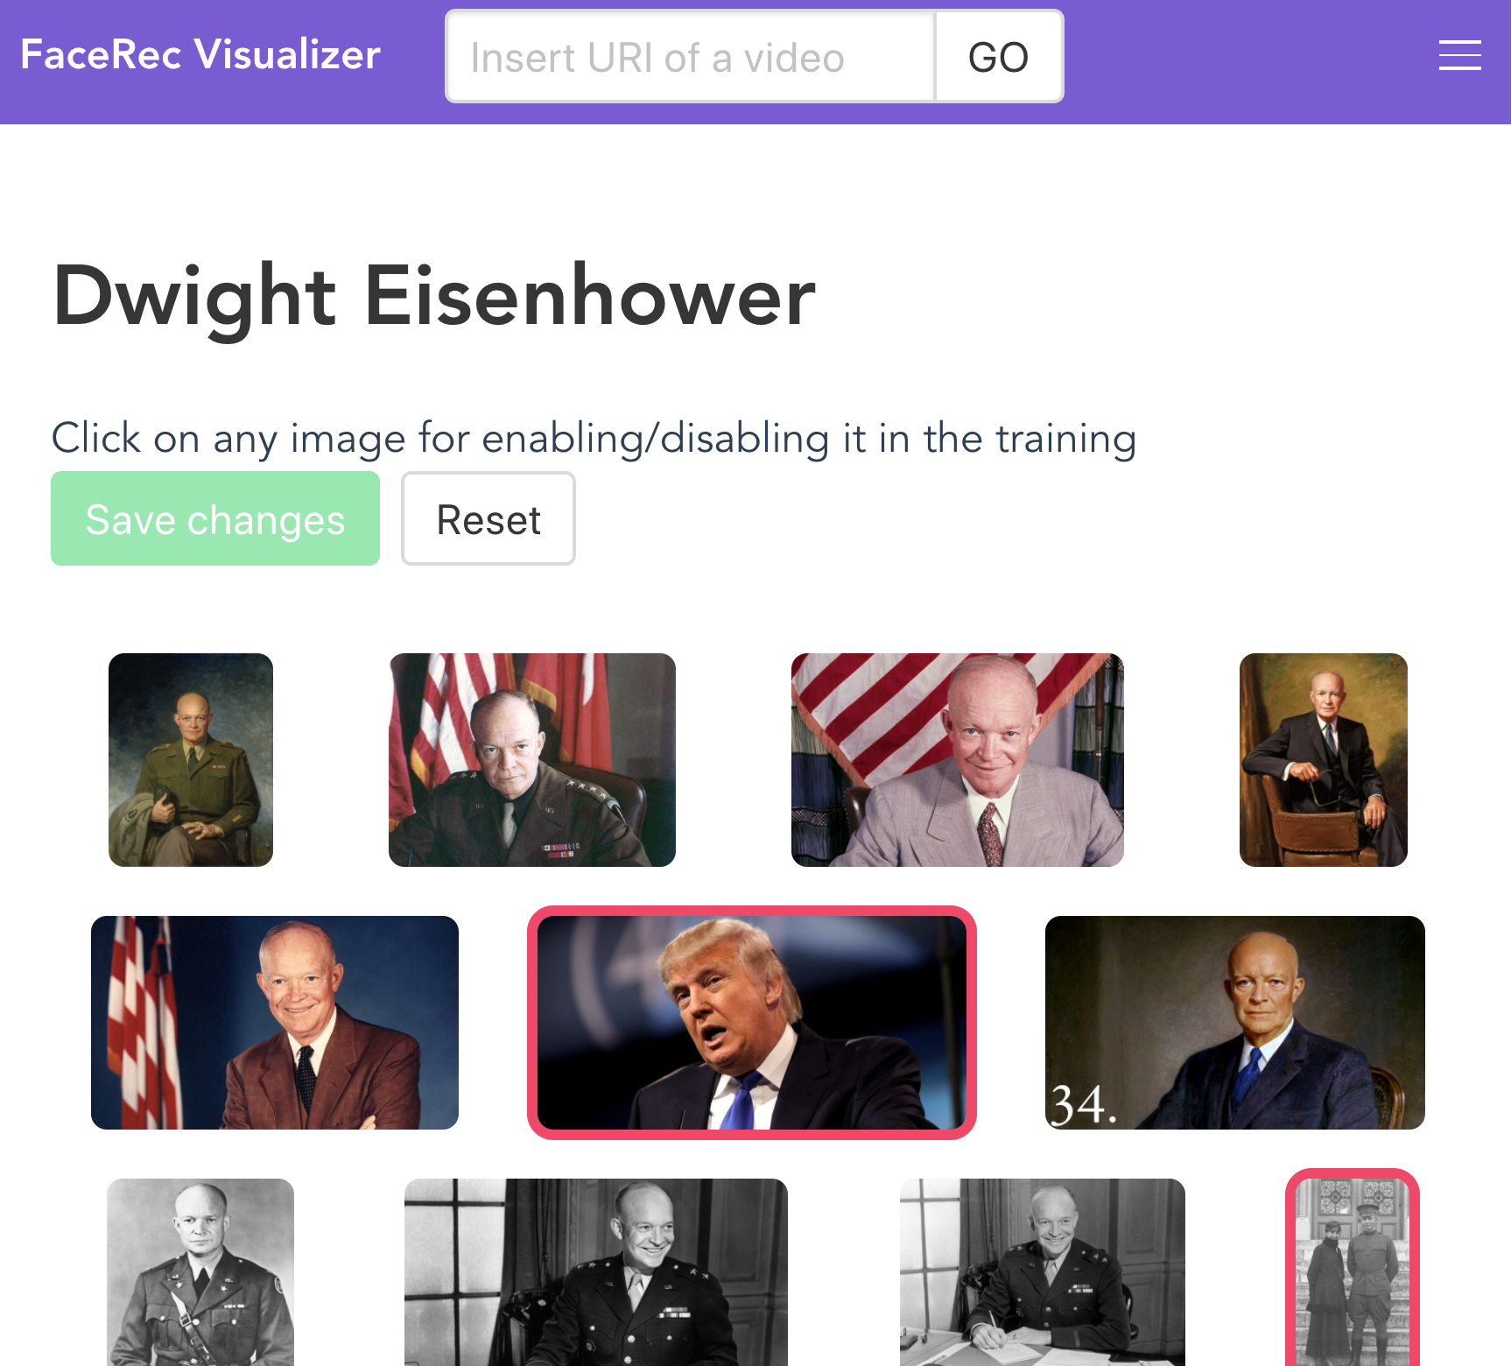
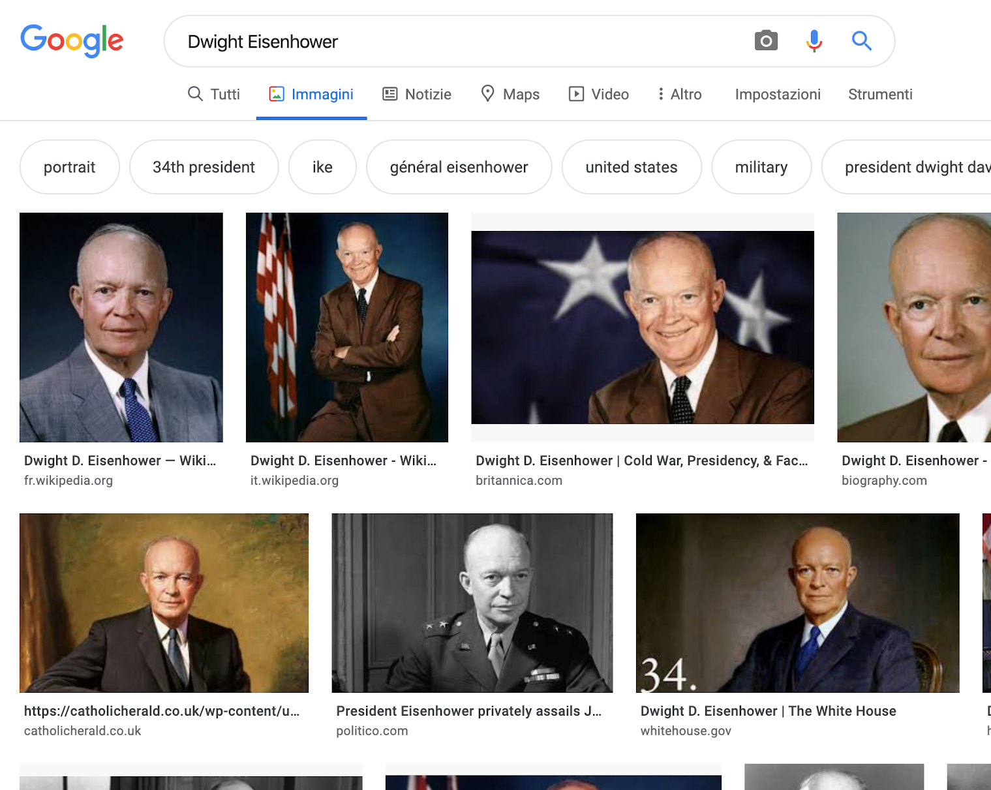
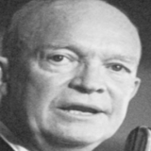
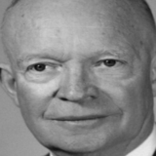
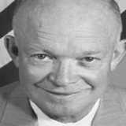
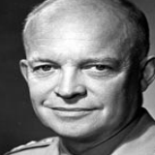
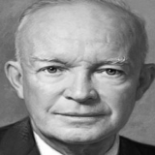
1
CRAWL THE WEB
icrawler
download
mtcnn
face detection and
alignment
https://github.com/hellock/icrawler
https://github.com/ipazc/mtcnn

Slide 4
2
TRAIN A CLASSIFIER
facenet
[-0.24 0.31 0.45 … 0.60]
embedding
SVM
CLASSIFIER
training
combination of N One-vs-All classifiers
Facenet: https://arxiv.org/abs/1503.03832

Slide 5
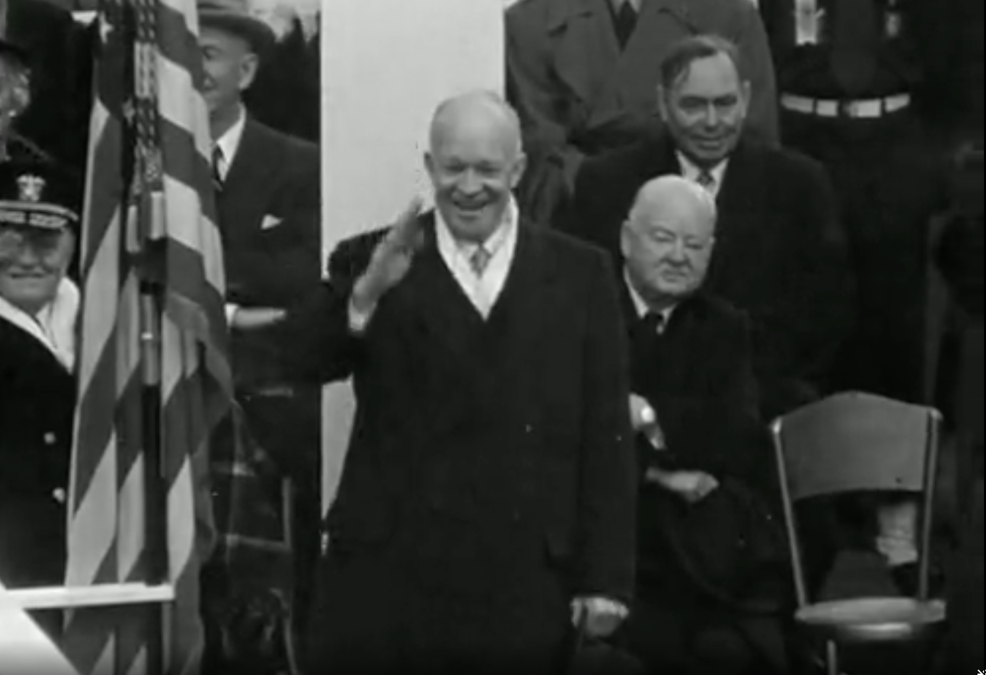
3
RECOGNISE THE FACES
CLASSIFIER
mtcnn
facenet
face detection and
alignment
embedding
SORT
frame
tracking

Slide 6
4
CLUSTER RECOGNITIONS
For each tracking id:
Selection of the most represented prediction (weighted by confidence)
  Discard uncertain trackings
Merge consecutive trackings assigned to the same person
Filter by average confidence
CLASSIFIER
prediction
SORT
tracking id

Slide 7
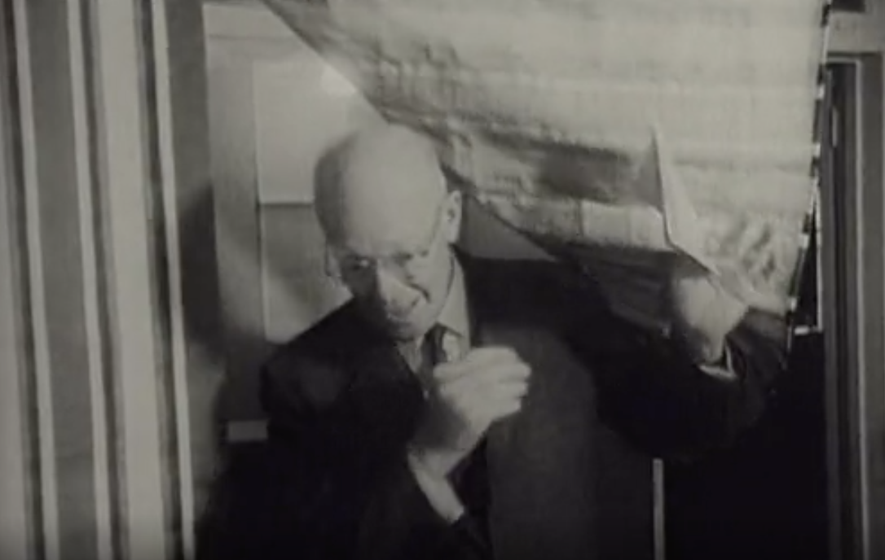
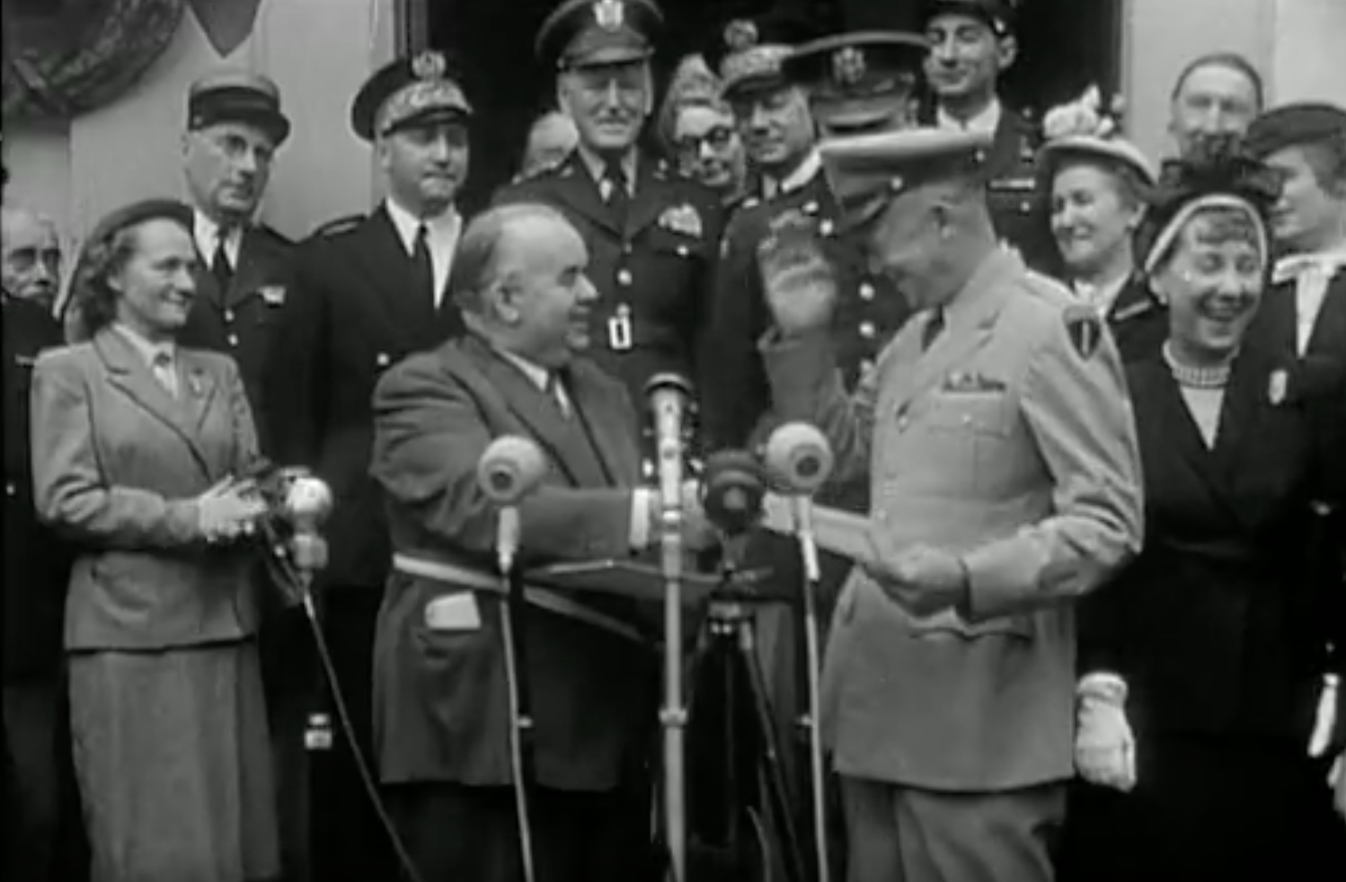
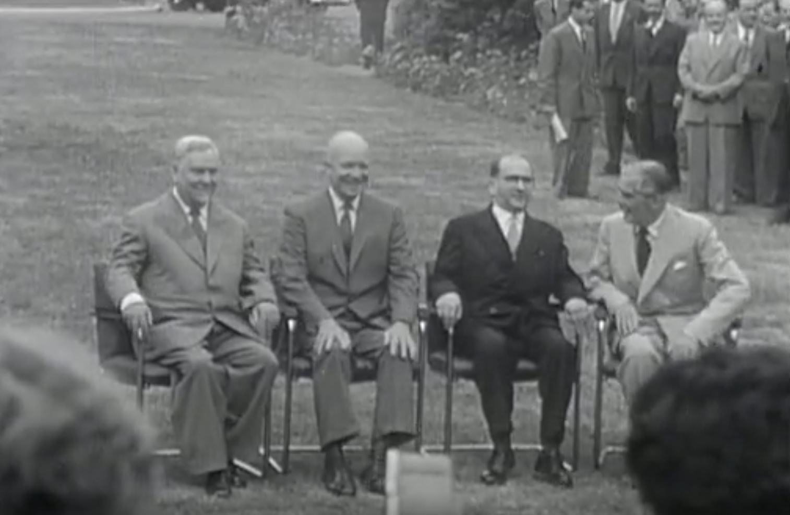
Some results
ANTRACT Ground Truth
Realised in the context of ANTRACT project, with video material from 1950s
200 shots of different length, containing 0, 1 or more among 13 celebrities
Correct matches: 93 (52.54%)
Unpredicted people: 83 (46.89%)
Wrong people: 1 (0.56%)
Common error cases
Glasses or other occlusion
Side of the face
Small resolution

Slide 8
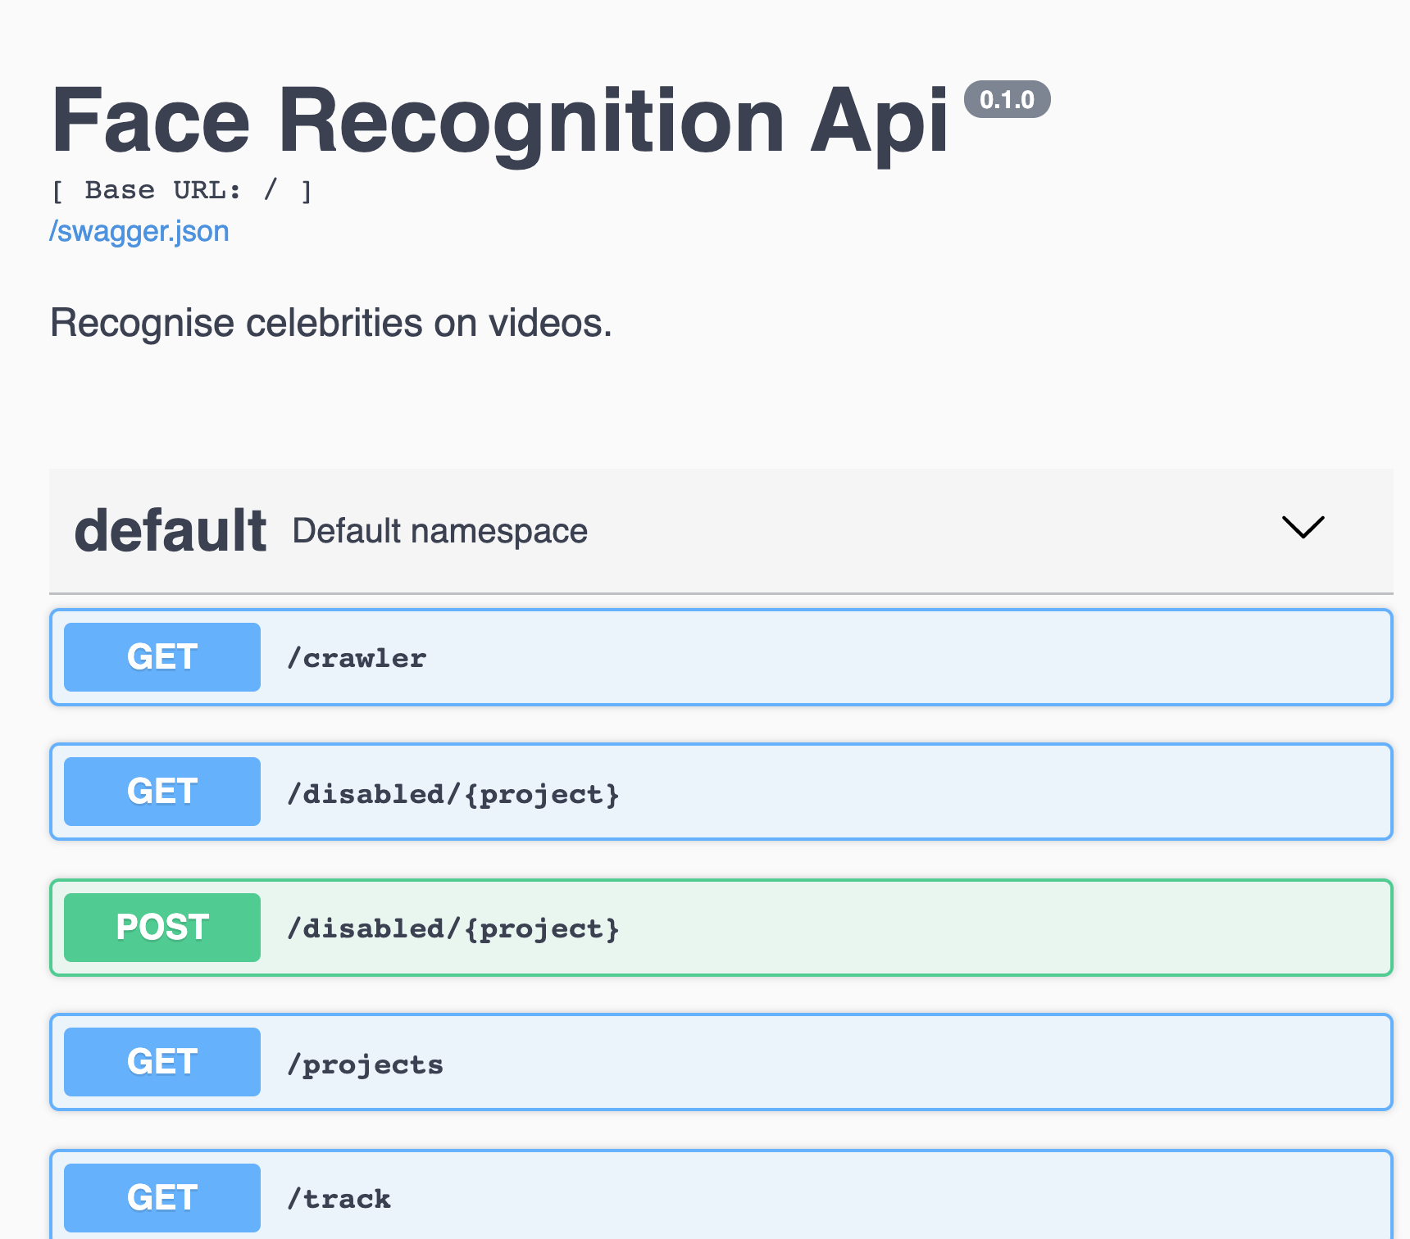
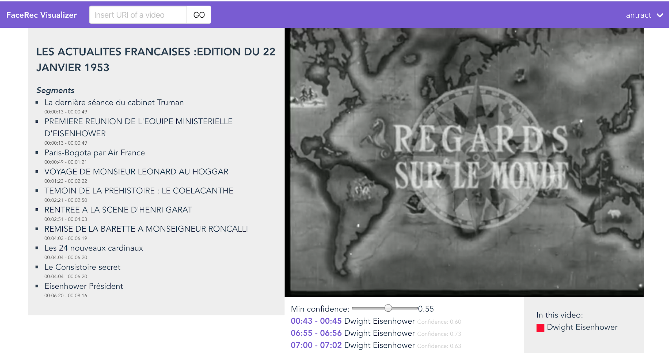

How to interact with Facerec?
http://facerec.eurecom.fr/
http://facerec.eurecom.fr/visualizer/
https://github.com/D2KLab/Face-Celebrity-Recognition

