Slide 1
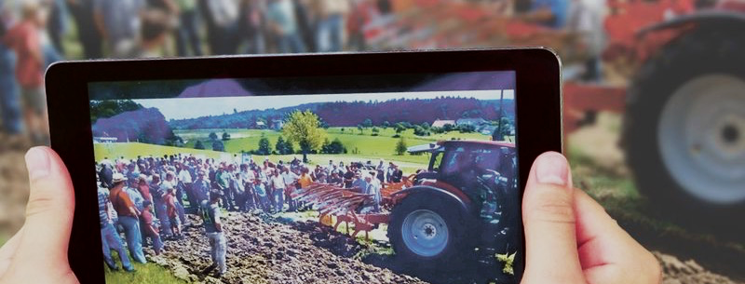



How to produce informative & low-cost videos
thomas.alfoeldi@fibl.org
01.09.2020 14.00–15.30 PM

Slide 2
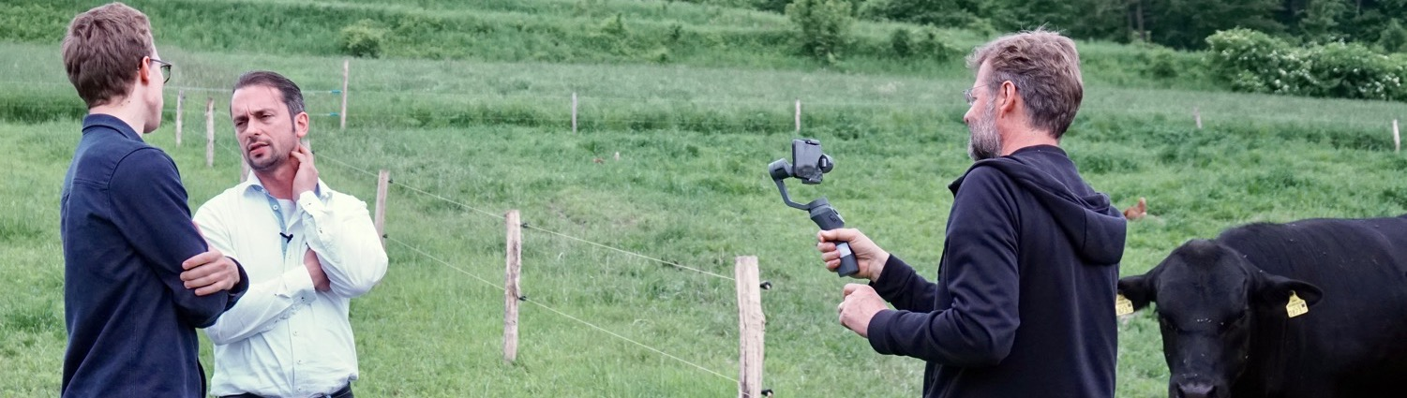


Content
  Intro 5’
  Equipment 15’
  Planning 10’
  Filming 10’
  Editing 10’
Q & A
Your experiences
Photo: Donausoja/Ina Jaeger

Slide 3
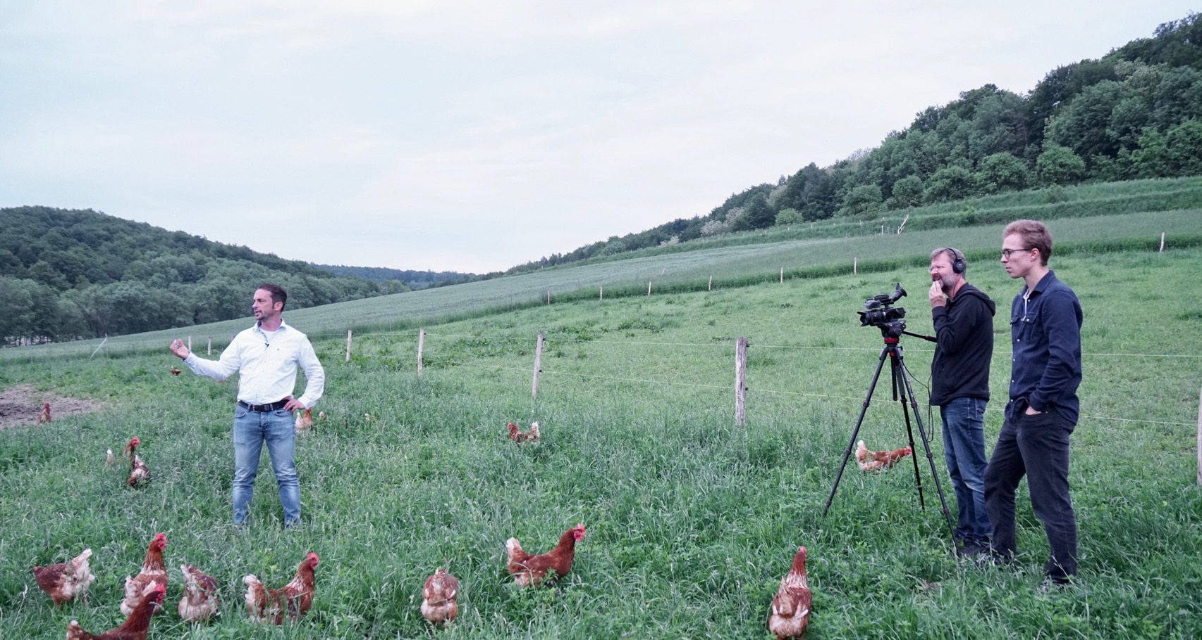
Why to produce your own video?
  Powerful dissemination tool
  Knowledge of stakeholders
  Increasing the reach-out of field-days
  Equipment is good, simple & inexpensive
Photo: Donausoja/Ina Jaeger

Slide 4
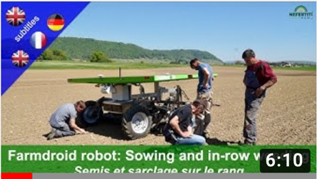
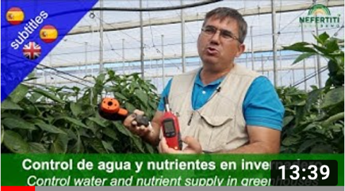


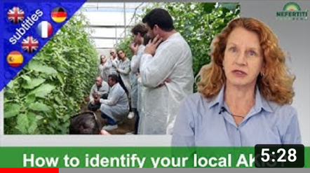
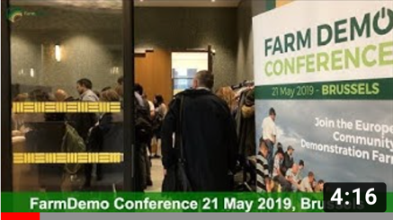
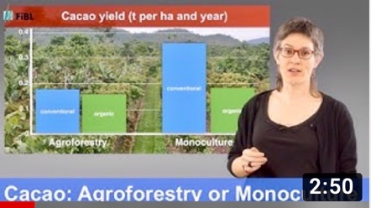

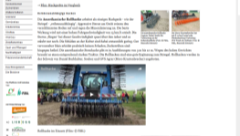
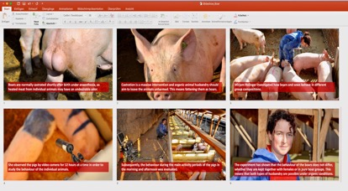

Video applications in agriculture
Machine demo
2) Practice Innovation
3) Tutorial (field)
4) Tutorials (studio)
5) Events
6) Research projects
7) Teaser, Promo
8) Online-texts, webinars
9) Animated PPT

Slide 5
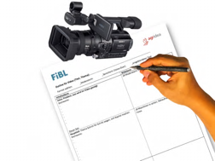
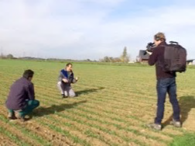
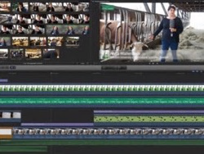
3 steps of each video production
1 Pre-Production:
planning, equipment
2 Production:
shooting
3 Post-Production:
editing/dissemination

Slide 6
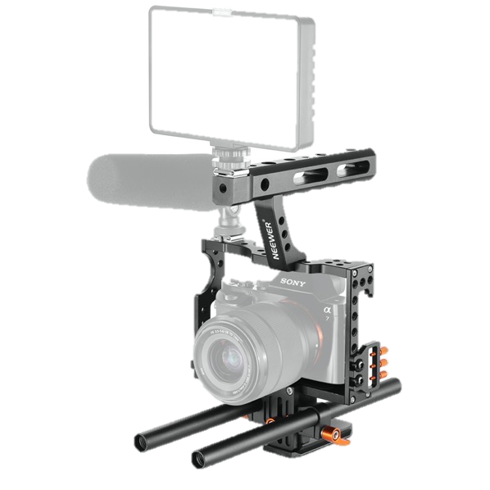
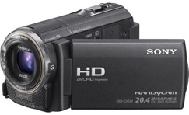
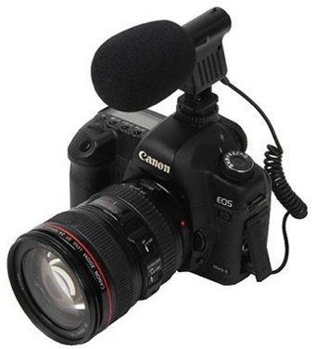
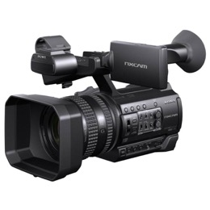
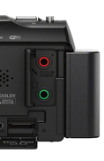
Smartphone, VideoCam or PhotoCam?
Smartphone
VideoCam
From 300 € e.g. Sony HDR-CX625 Full HD
PhotoCam
+ Cheap, always at hand
+ Picture quality
+ Easy to operate
- External mic needed,
- Image control in sunshine
- No zoom
+ Zoom wide/tele
+ Viewfinder for Image control
+ Handling
- Additional costs
Plugs for Mic and headphone!
+ picture quality
- Handling needs exercise
- Picture control

Slide 7
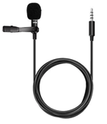

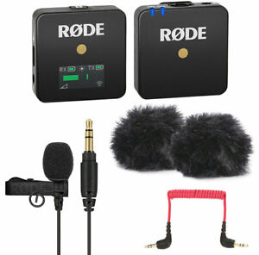
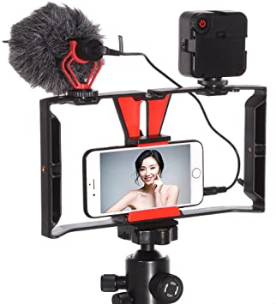
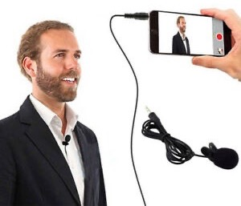
External mic: Crisp sound without wind noise
Lavalier mic
20 Euro
https://www.youtube.com/watch?v=yiWHsfdjHGQ
Shotgun mic
50 Euro
https://www.youtube.com/watch?v=HWL3mZkUnW8
Wireless mic
160 Euro
https://www.youtube.com/watch?v=1uTFm-tu41s

Slide 8
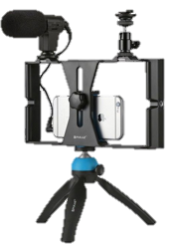
Stabilize your video
Rig
20 Euro
https://www.youtube.com/watch?v=b-eWH-boeXE
Gimbal
150 Euro
https://www.youtube.com/watch?v=AphESb06R8Q
Shoulder rig
50 Euro
https://www.youtube.com/watch?v=yCT9LnpHPJk
Tripod with video head
200 Euro
https://www.youtube.com/watch?v=oFTPxQMdmho

Slide 9
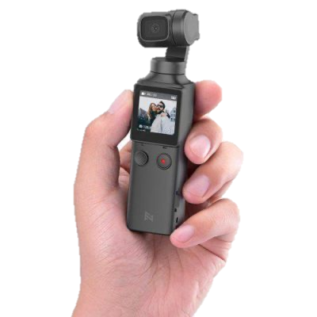
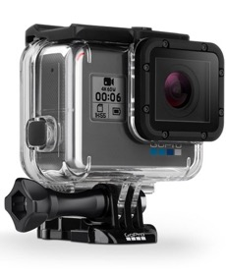
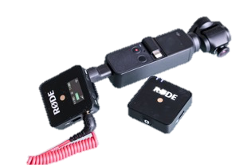
Nice-to-have equipment
Actioncam
e.g. GoPro
Drone
e.g. DJI Mavic air mini
https://dronerush.com/international-drone-laws-16520/
DJI Osmo Pocket
Compact stabilized handheld cam
https://www.techradar.com/reviews/dji-osmo-pocket

Slide 10
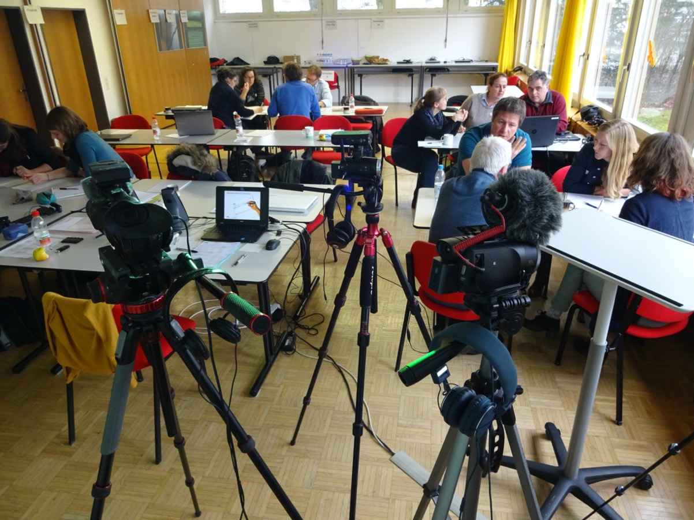
Time for exchange: Equipment
Q & A
Your experiences

Slide 11


Planning and structuring your video
Tell the viewer…
Relevance of the topic
What will he/she learn
Define main key messages and length for each part
Make chapters
Conclusion
Call for action
Intro 30‘‘
Main Part 90‘‘
Outro 30‘‘

Slide 12
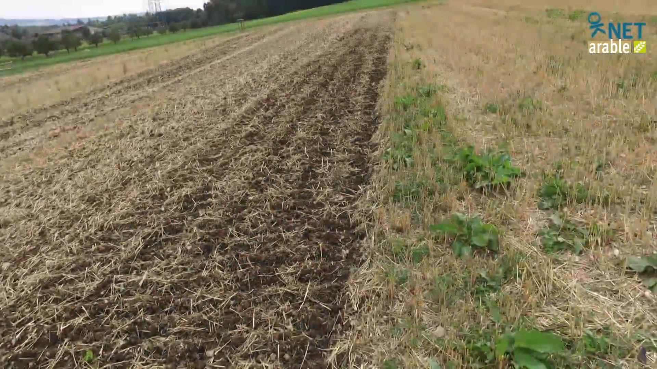
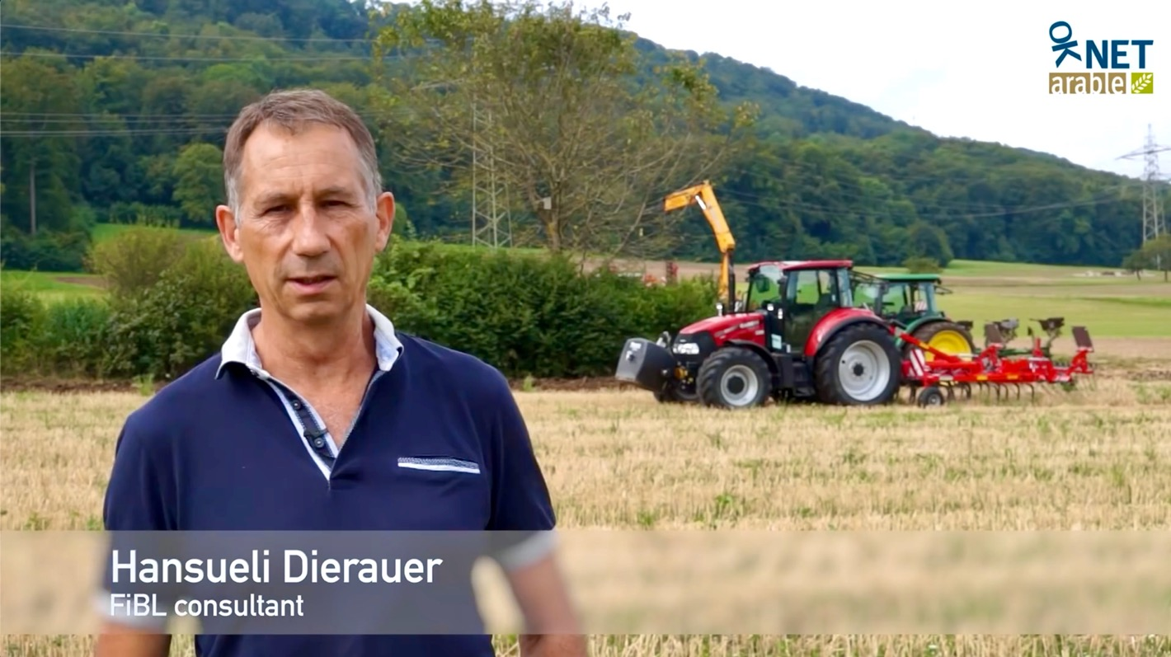
Example: Intro Stubble cultivation
https://www.youtube.com/watch?v=wsK6U8c5Jso
Video 1

Slide 13


Understanding A- and B-roll (footage)
B-Roll
B-Roll
B-Roll
B-Roll
B-Roll
A-Roll
Interview
A-Roll
Interview
A-Roll
Interview
A-Roll
Interview
A-Roll
Interview
Intro
Main part
Outro

Slide 14
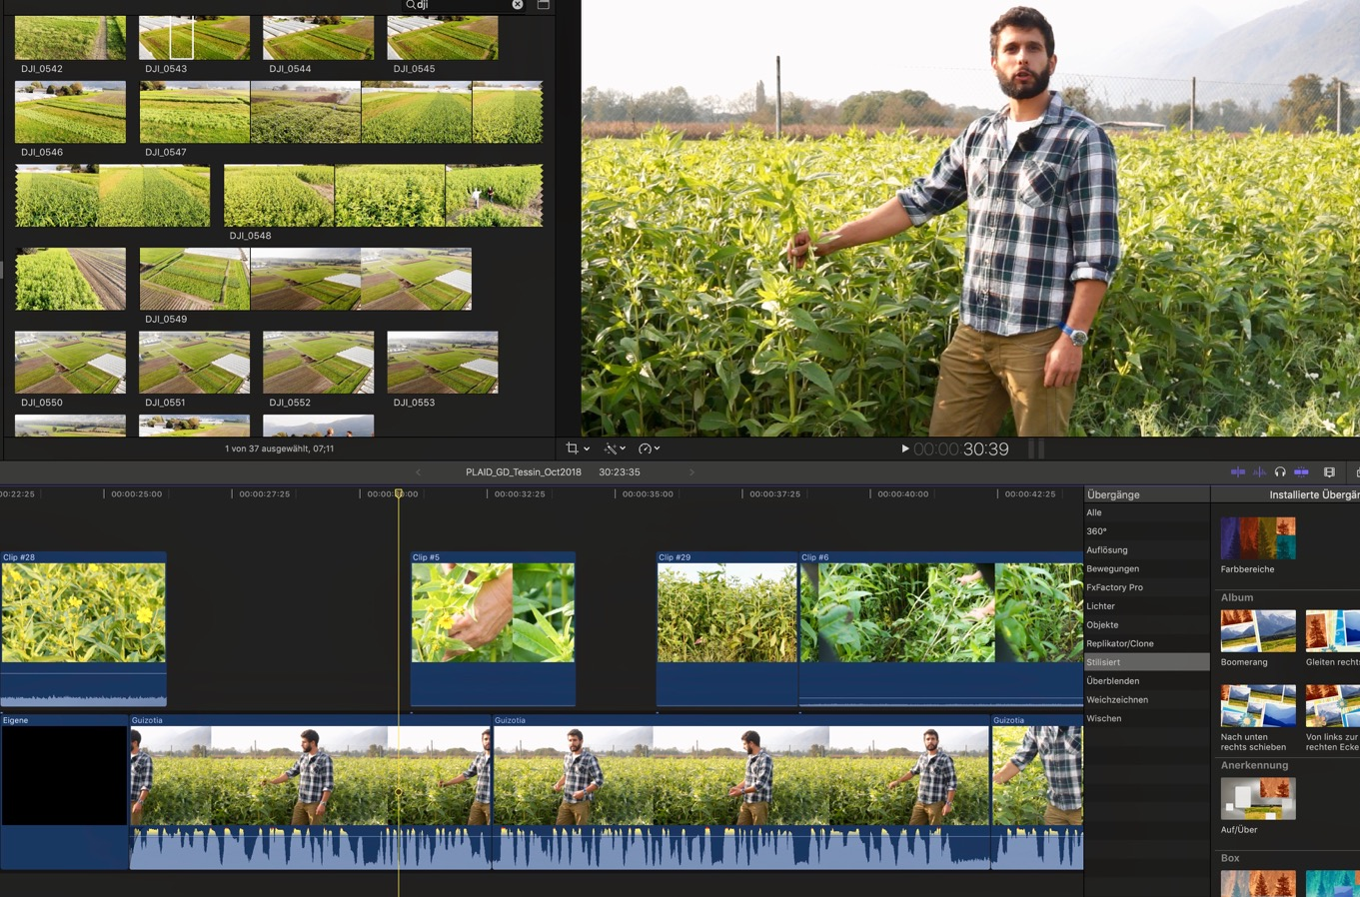
Using A- and B-Roll in the editing program
B-roll
A-roll

Slide 15


Off-speaker or presenter?
Advantages
Disadvantages
suitable person
good planning
no corrections afterwards
editing time consuming
efficient
authentic
Presenter
writing afterwards
precise formulations
Less authentic
writing needs more time
Speaker
Combination: Moderator and off-speaker

Slide 16
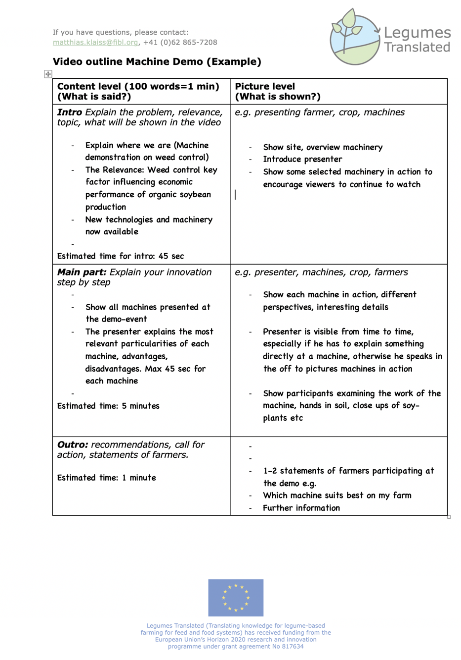
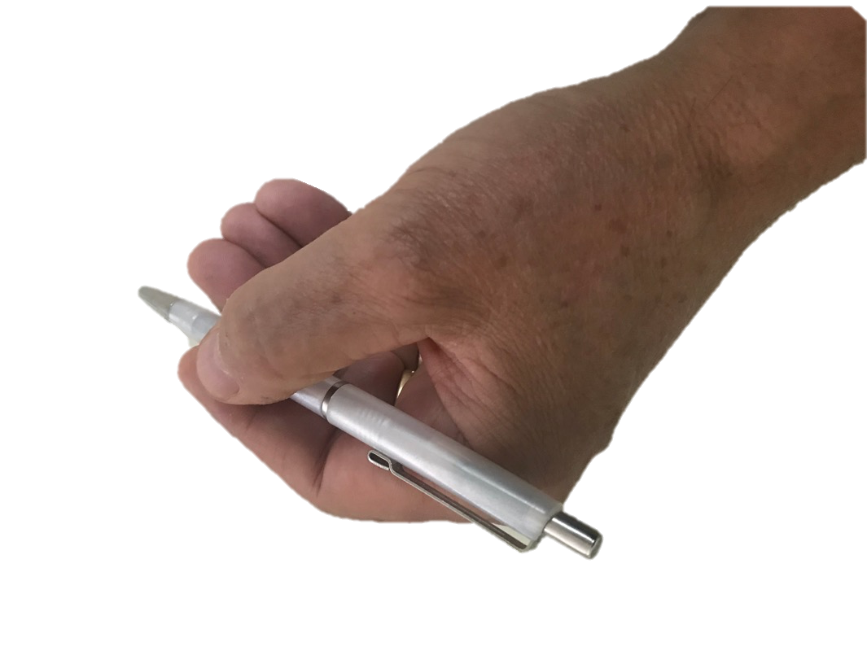
Write an outline
Picture level
See related video under:
https://www.youtube.com/watch?v=eMg4h_eklm0 (French)
https://www.youtube.com/watch?v=dozO8i9zmy4 (German)
https://www.youtube.com/watch?v=tBv_3RIWELc (English)
Content level

Slide 17
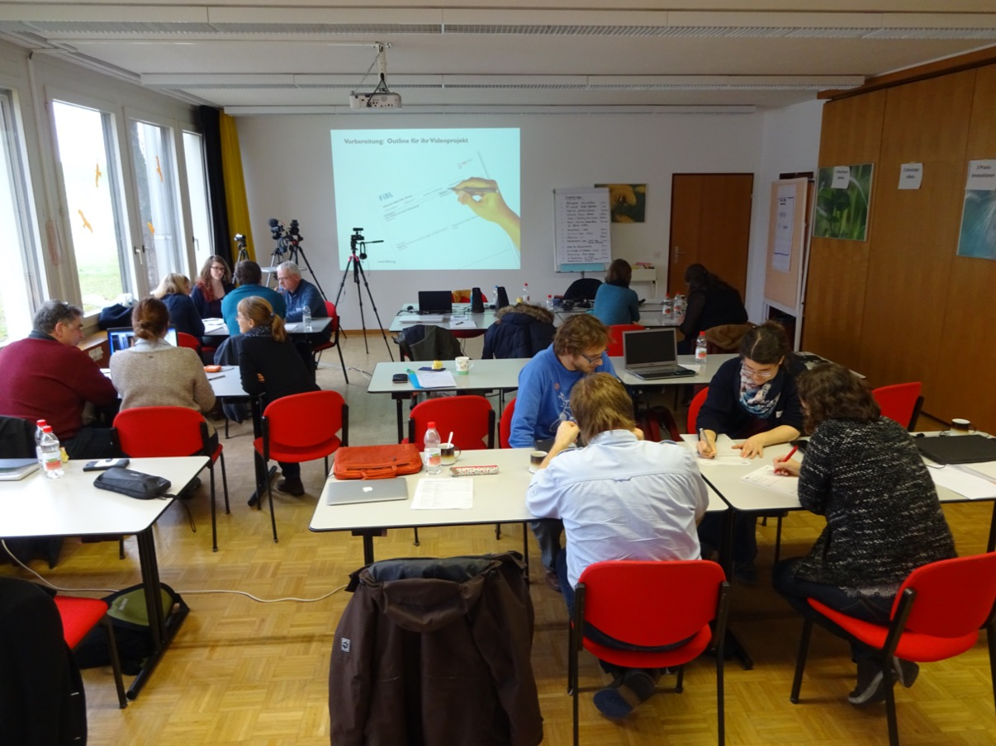
Time for exchange: Planning
Q & A
Your experiences

Slide 18
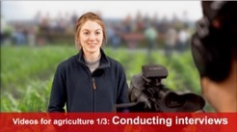

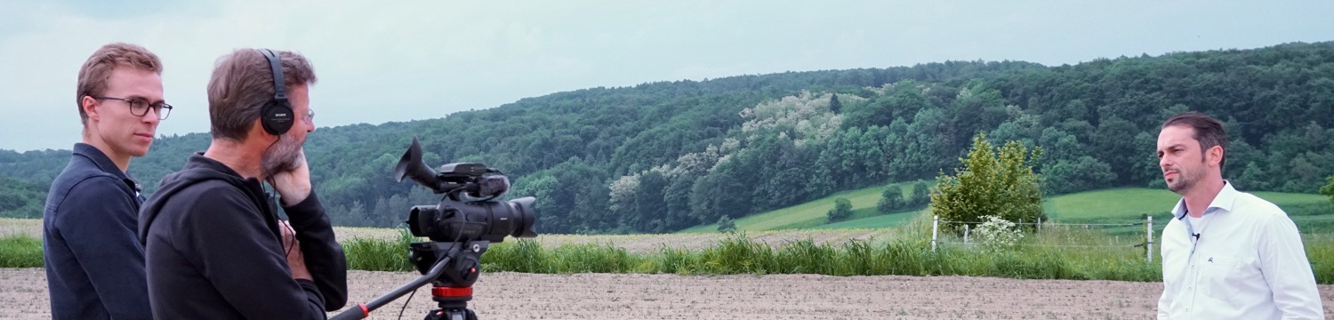
Tipps for interview
  Interviewed person (IP): sitting or standing
  Focus on IP and content -> tripod, camera in auto mode
  Always check sound via headphones
  Let IP speak freely
  Keep eye contact, mute, nod
  Ensure relaxed atmosphere, little interruptions
  Ask follow-up questions, let IP repeat if not focussed enough
Link to tutorial “How to conduct interviews”
Photo: Donausoja/Ina Jaeger

Slide 19
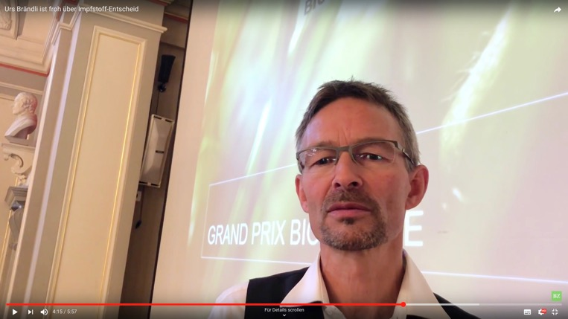
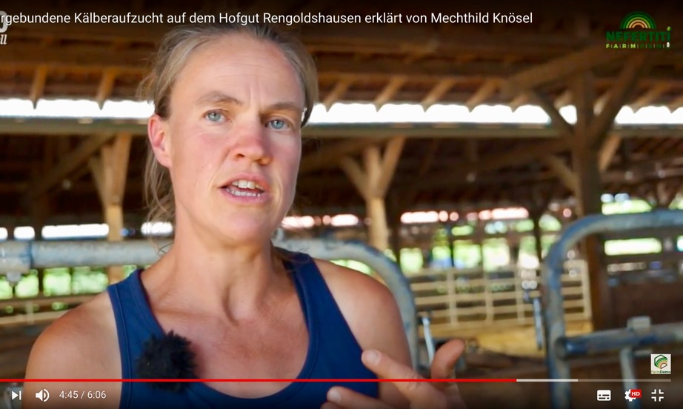
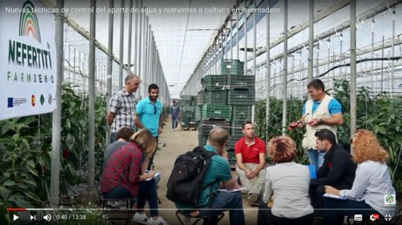
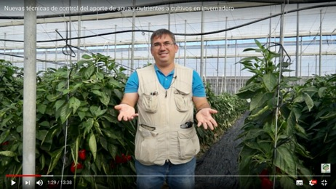
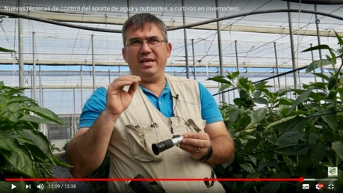
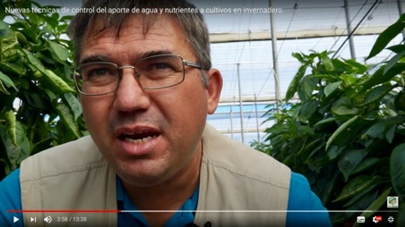
Cadrage, Rule of third
Eye line
ok
Eye line
too low
Long establishing
Medium Long
Shoulder Close Up
Close Up

Slide 20
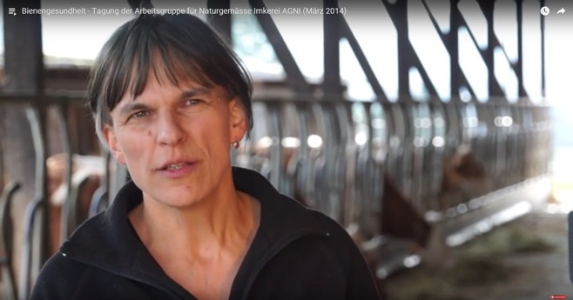
Light at the interview
  Goal: No hard shadows, eyes well lit
  Inside: Face towards light source (window, lamp)
  Outside: If possible in the shade, possibly brighten with a lamp
  If not possible: sun from the side; watch out with baseball caps

Slide 21
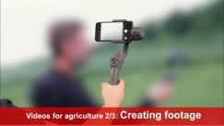

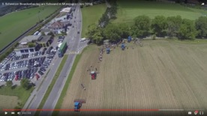
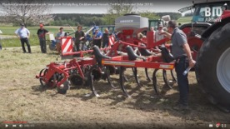
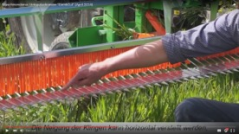
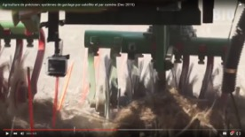
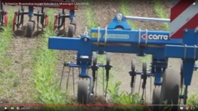
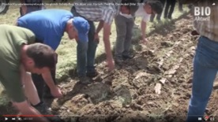

Shooting B-roll/Footage
  Sufficient footage, min 30 sec, no pan, no zoom!
  Various settings: Long, medium shot, close-ups
  Move camera slowly, avoid zooming
Link to tutorial “How to create varied footage”
Long shot, establishing
Medium long shot
Close-ups
Close-ups with Action Cam
Close-ups with Tele
Footage

Slide 22
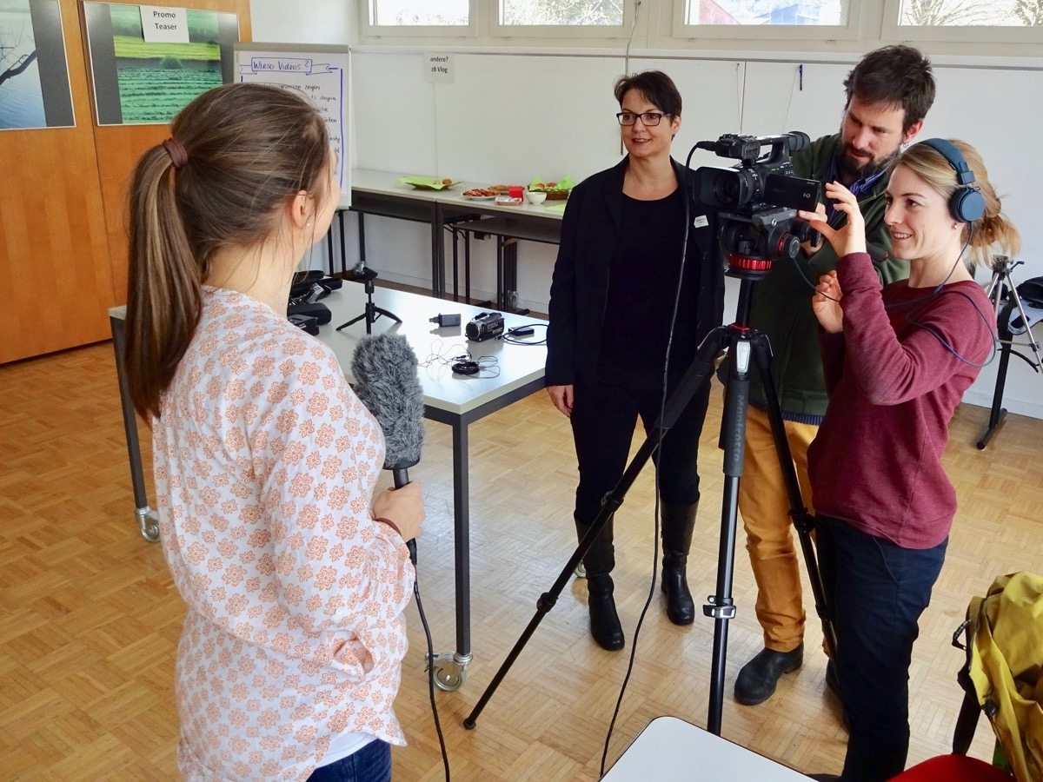
Time for exchange: Filming
Q & A
Your experiences

Slide 23




Editing software
Price
Points
    Android
    FilmoraGo
    KineMaster
    CuteCUT
    iphone
    iMovie
    LumaFusion
    Both
    Adobe Premiere Rush
    Review/Links
    https://www.creativebloq.com/features/6-great-video-editing-apps-for-mobile

Slide 24



Tips for editing
  Decision: On Smartphone or Computer
  Edit voice track first
  Place B-roll pictures over audio track
  Add titles and breaks
  Use effects very sparingly
  Add music
Link to tutorial “How to edit your video”

Slide 25

Ideal length of a video...
  ... does not exist -> As short as possible, as long as necessary
  Ideally 2-3 minutes -> YT-users are quickly lost
  Show rough cut to a friend -> kill your darlings!
  Rule of thumb: 1 min video -> 100 words (650 characters)

Slide 26

Use only license-free music
Audio library in YouTube: free of charge
Other music providers:
https://audiojungle.net ca. USD 20.-
https://www.premiumbeat.com ca. USD 50.-

Slide 27

Time for exchange: Editing
Q & A
Your experiences

Slide 28


Creating an animated Slideshow as video in PPT
Example: https://youtu.be/8kv85NhNdtI
Video 2

Slide 29

Summary & recommendations
Start with a simple topic suitable for visualisation
Prepare outline with key messages
Select a suitable presenter
Use external microphone and tripod
Shoot enough B-roll/footage
Plan approx. 1 day for editing
Disseminate via established channels

Slide 30

Download our video guide
In English, Polish, French, Italian, German, Spanish
https://farmdemo.eu/hub/app/project-outputs

Slide 31


Tutorial style
For more complex content
Good planning of content and visualisation
Green screen technique, lamps not needed
Use beamer, teleprompter app, or cards to remember text

Slide 32


Filming at conferences, project meetings
Overview or selected topics
Footage: Speakers, audiences etc.
Footage: Photos, PPT, videoclips from interviewed partner

Slide 33

How to add subtitles/translations on YouTube

Slide 34

Title, description and tags on YouTube

Slide 35




























Actor Groups
Thank you for your participation
www.legumestranslated.eu
Consortium

