Slide 1
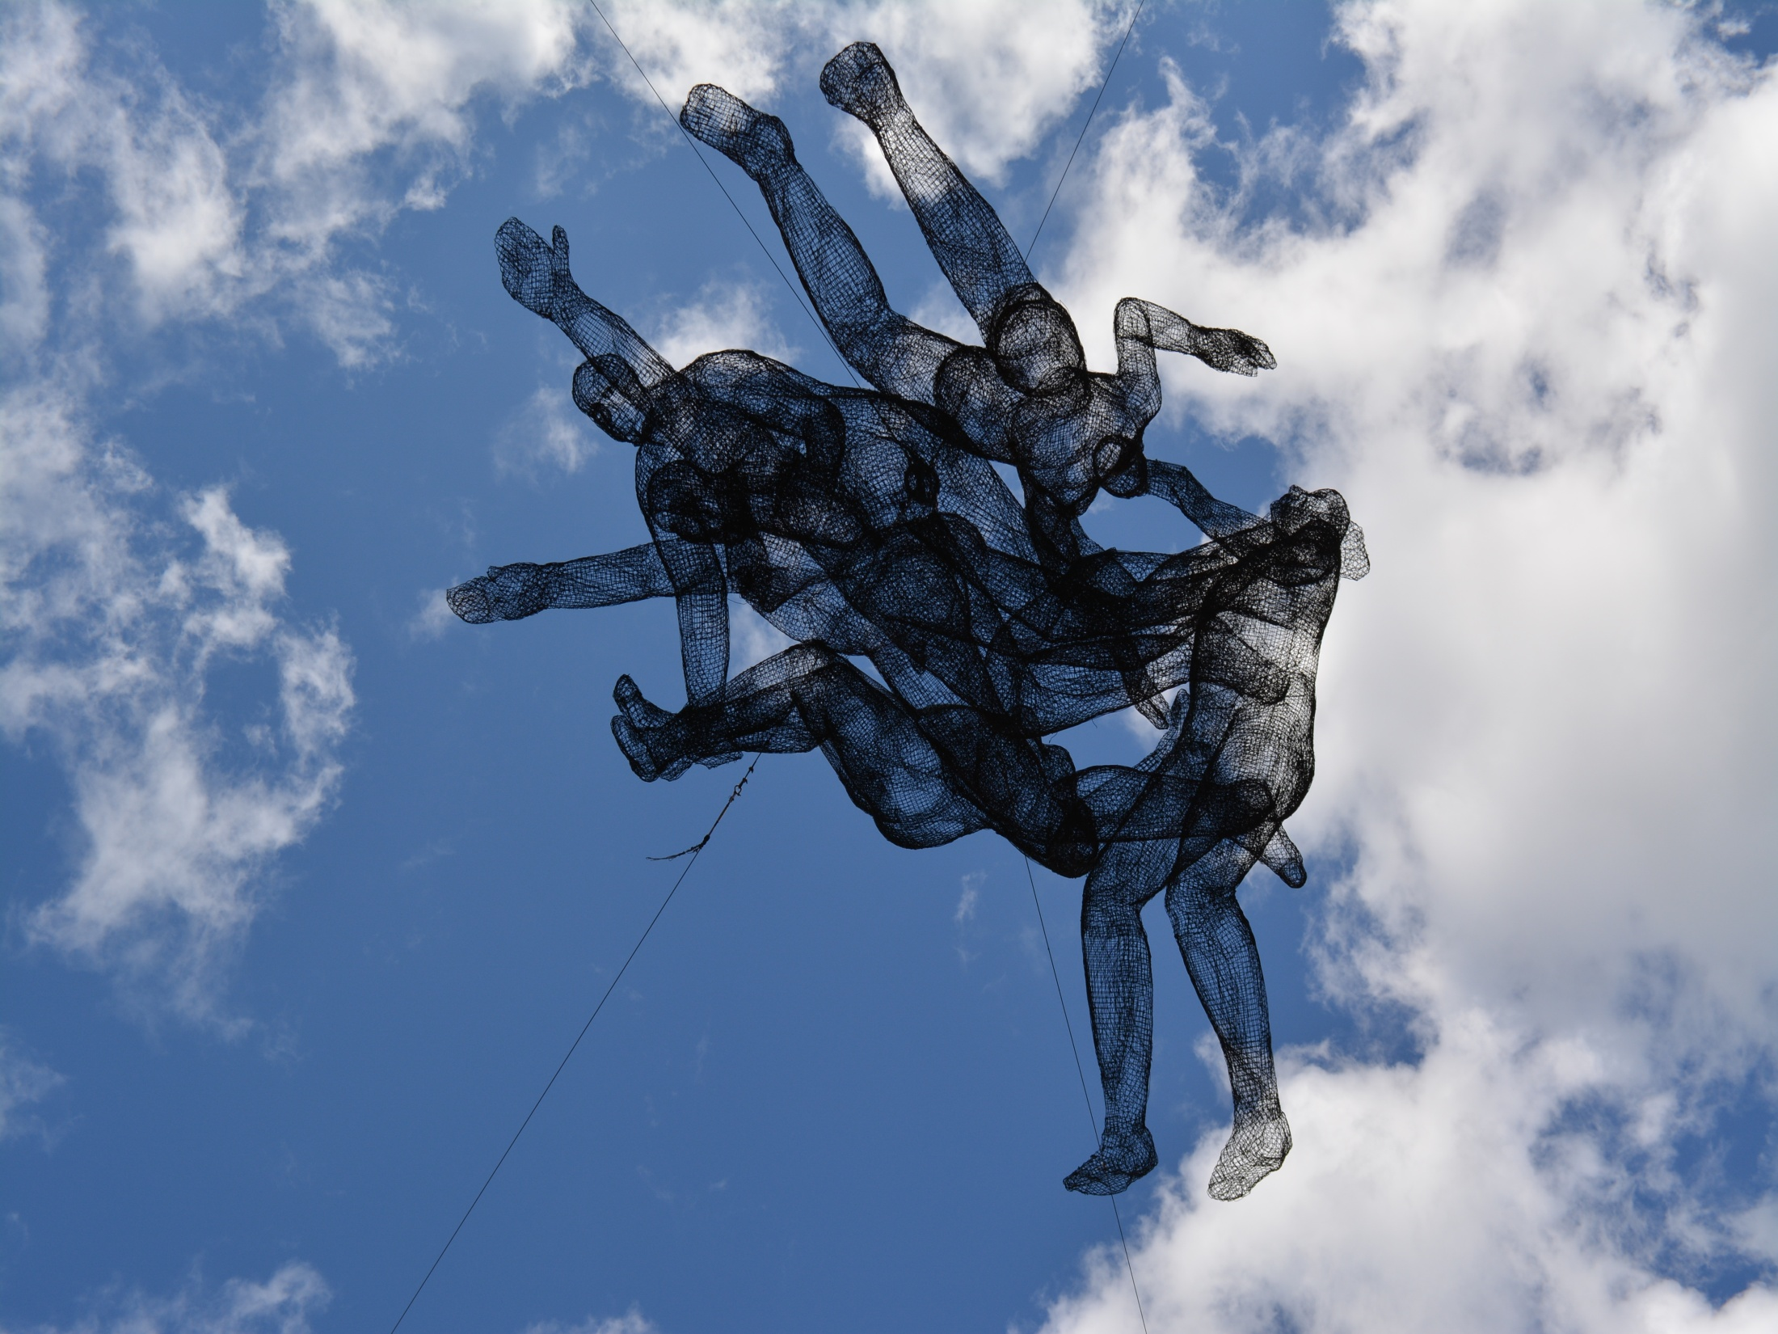
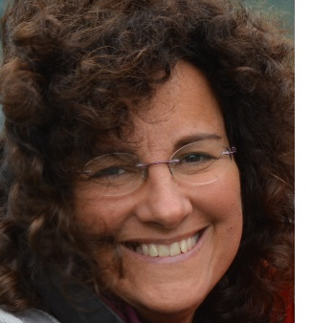
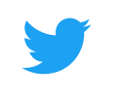
Open Science 3
EUROPE AND OPEN SCIENCE
Elena Giglia
elena.giglia@unito.it
@egiglia
https://doi.org/10.5281/zenodo.4039829
This work is licensed under a Creative Commons Attribution-ShareAlike 4.0 International License. Photos are mine, available for reuse on Flickr, https://www.flickr.com/photos/eg65/albums/

Slide 2
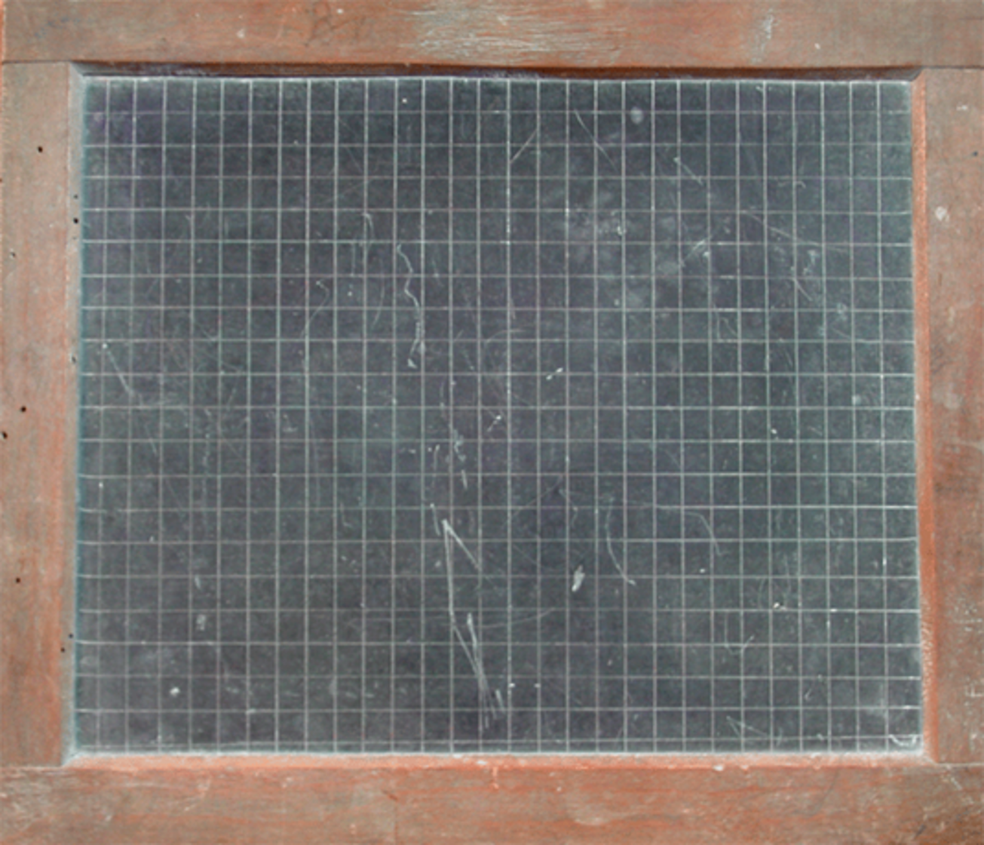
We’ll learn
that Europe is fully supporting Open Science, more than we think/know
everything about the EOSC
Take home messages
EOSC is here to stay: take advantage!

Slide 3

Openness
…new Commissioner
Marjia Gabriel
Let's dare to make Europe open to innovation, open to science and open to the world.
It is my opinion that the future of innovation lies in bringing as many different people, concepts and fields together. The future of research in Europe lies in people like you setting its course as a community, and with those who are different from you.
In my eyes, the future lies in open innovation, because openness fuels innovation.
C. Moedas, The importance of research for the future of Europe, August 31, 2015

Slide 4
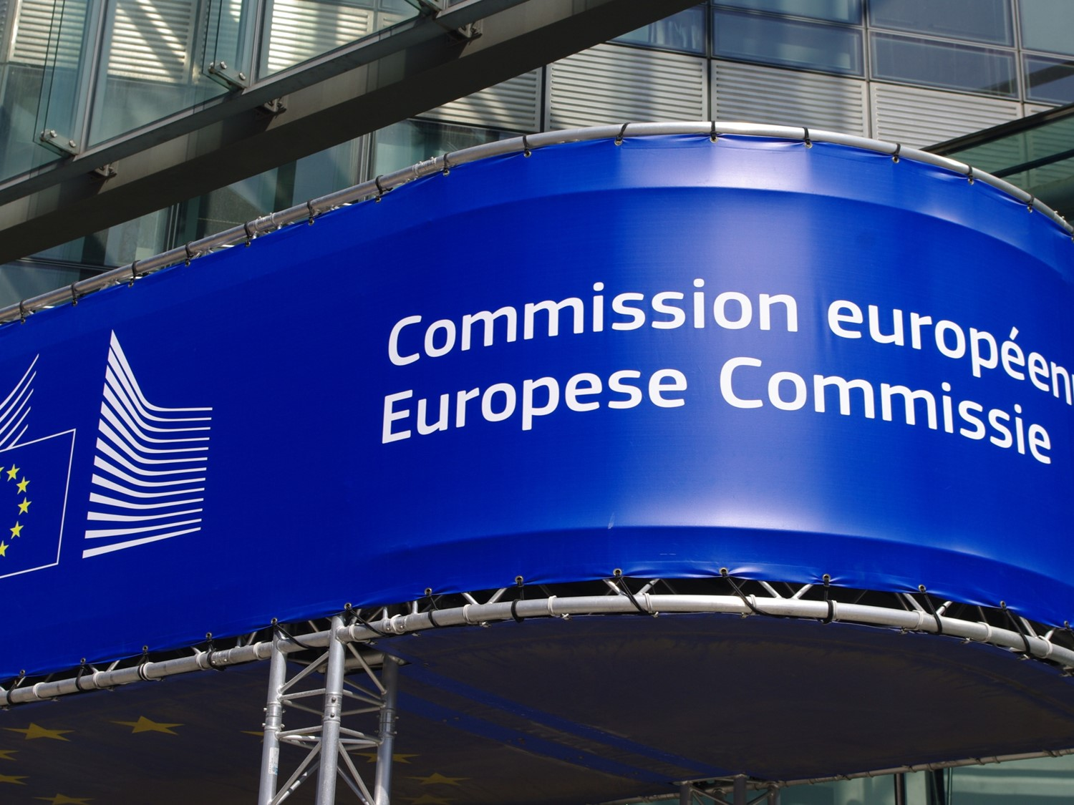

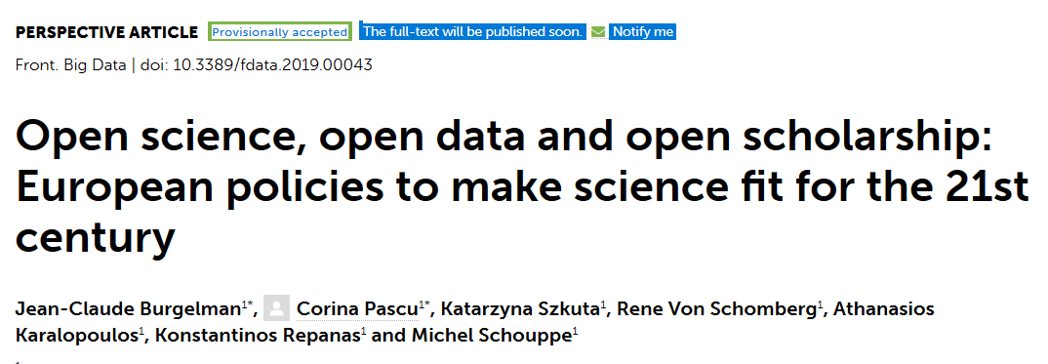


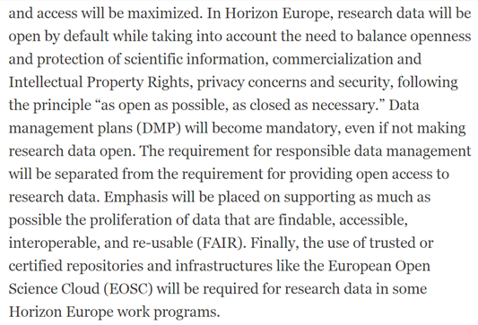
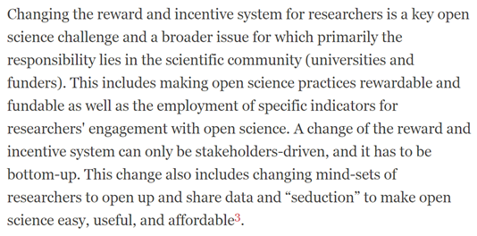

«make science fit for the 21th century»
[Nov.2019]

Slide 5
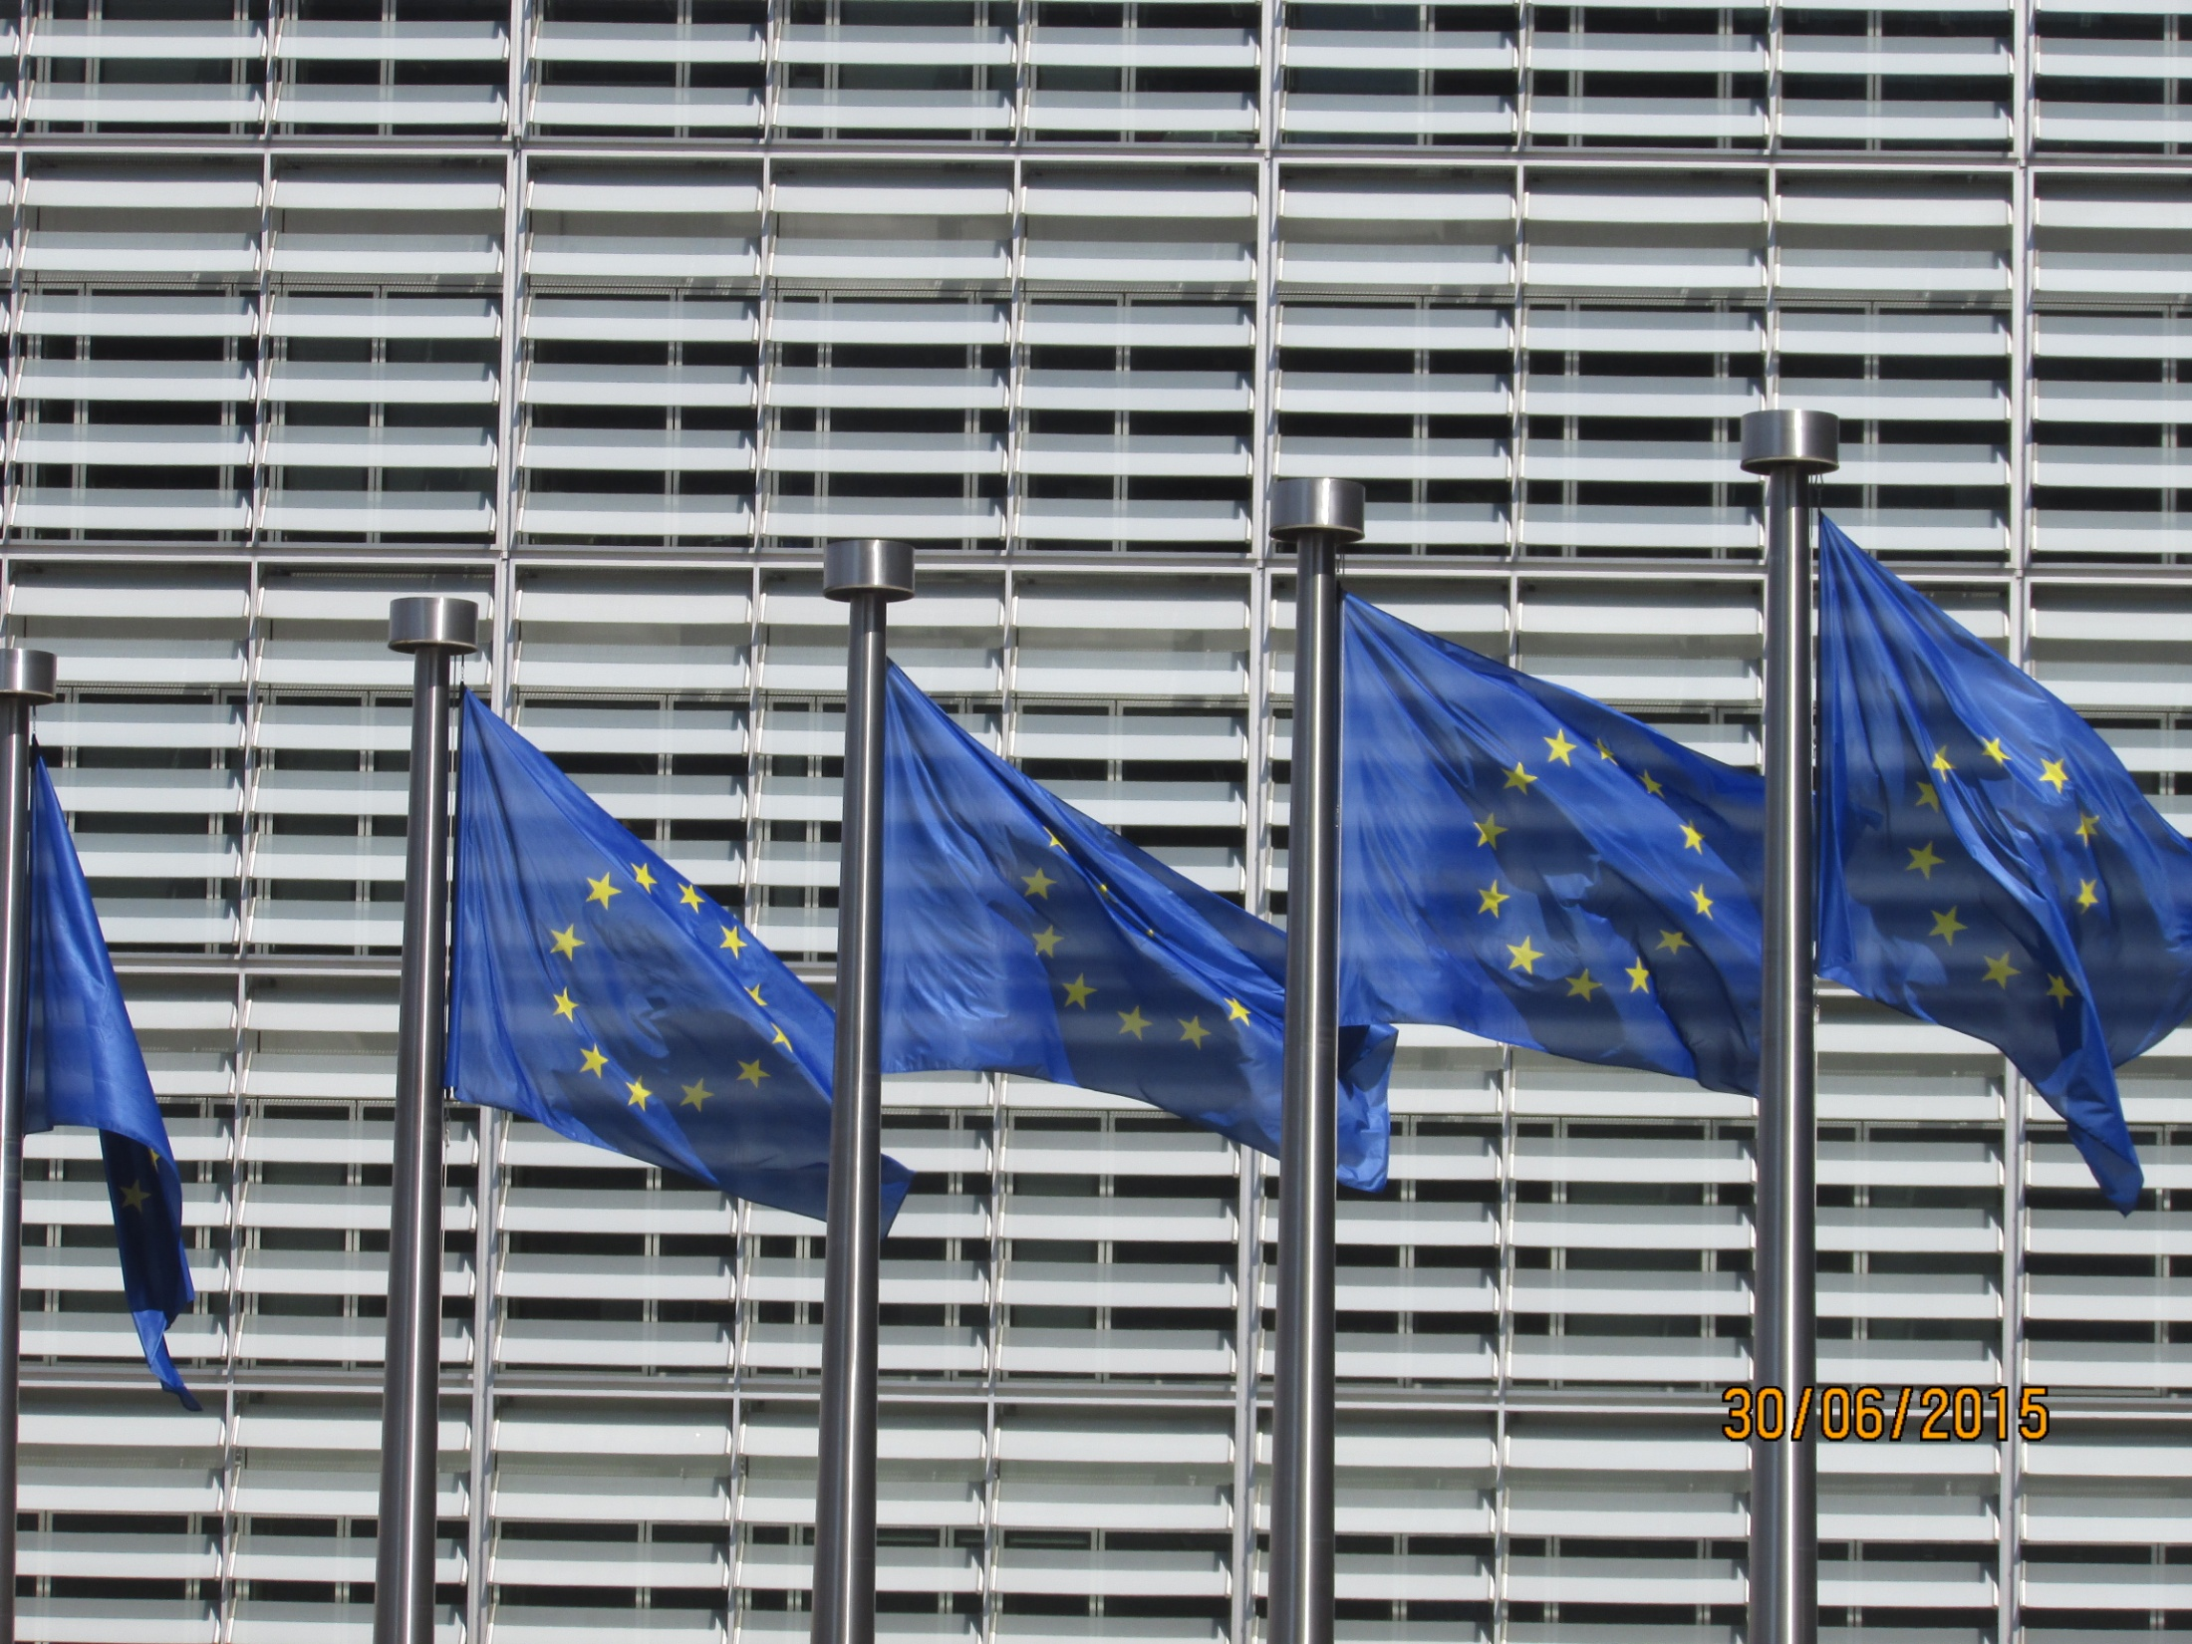
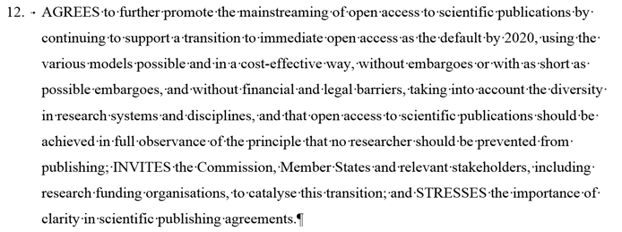
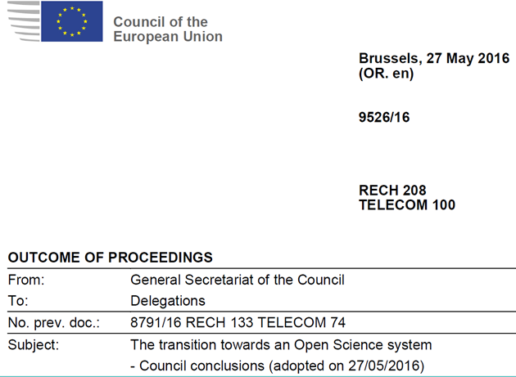
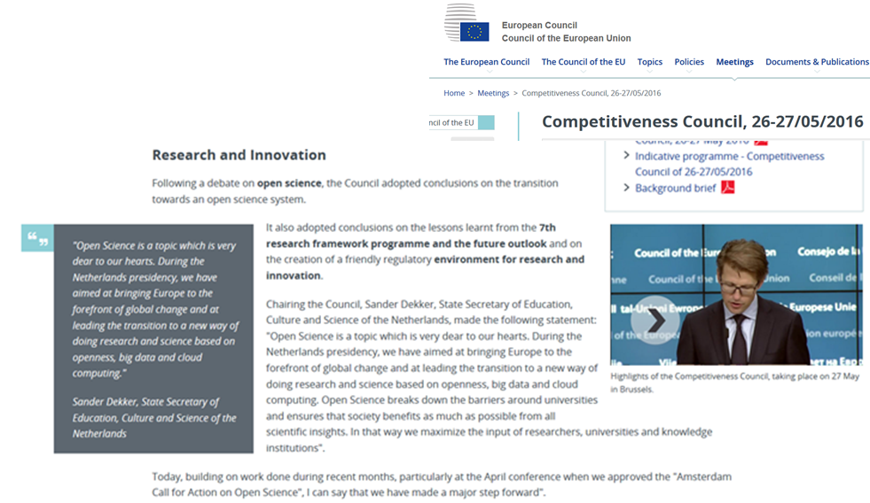
…Open Access by default in 2020…

Slide 6
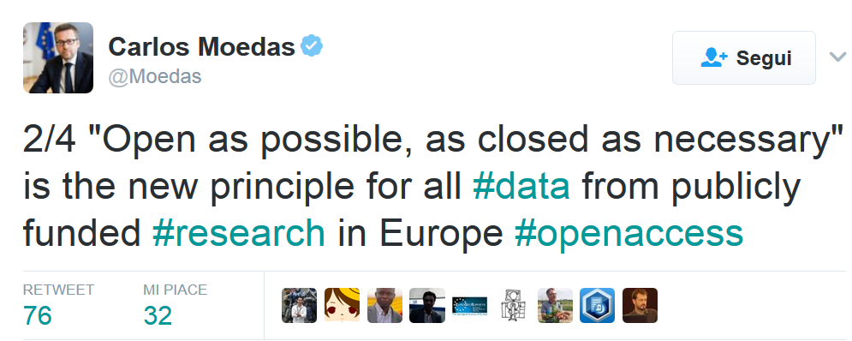
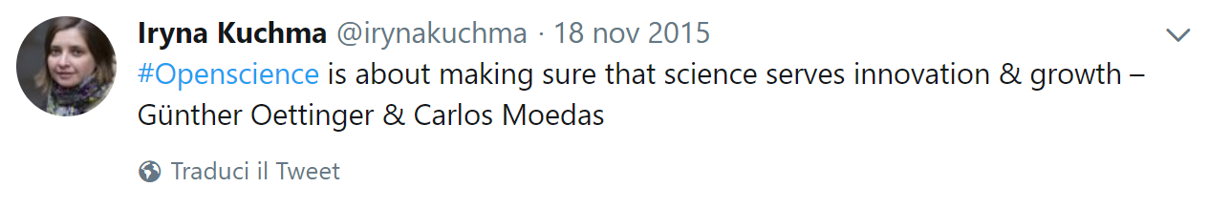
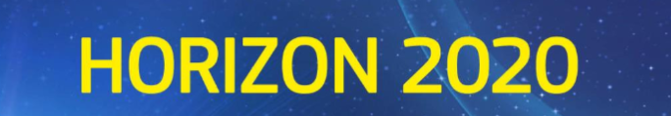
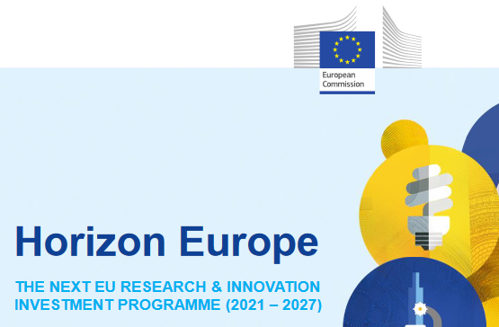
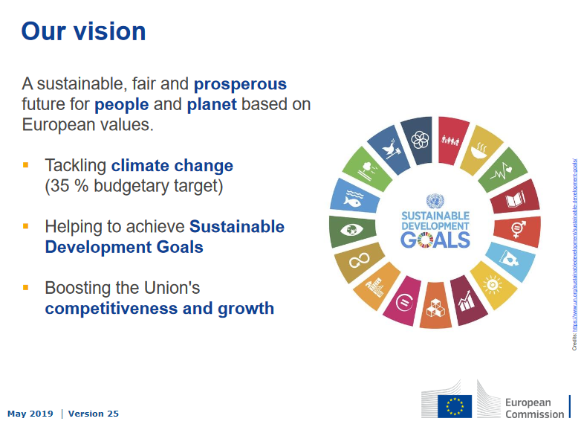
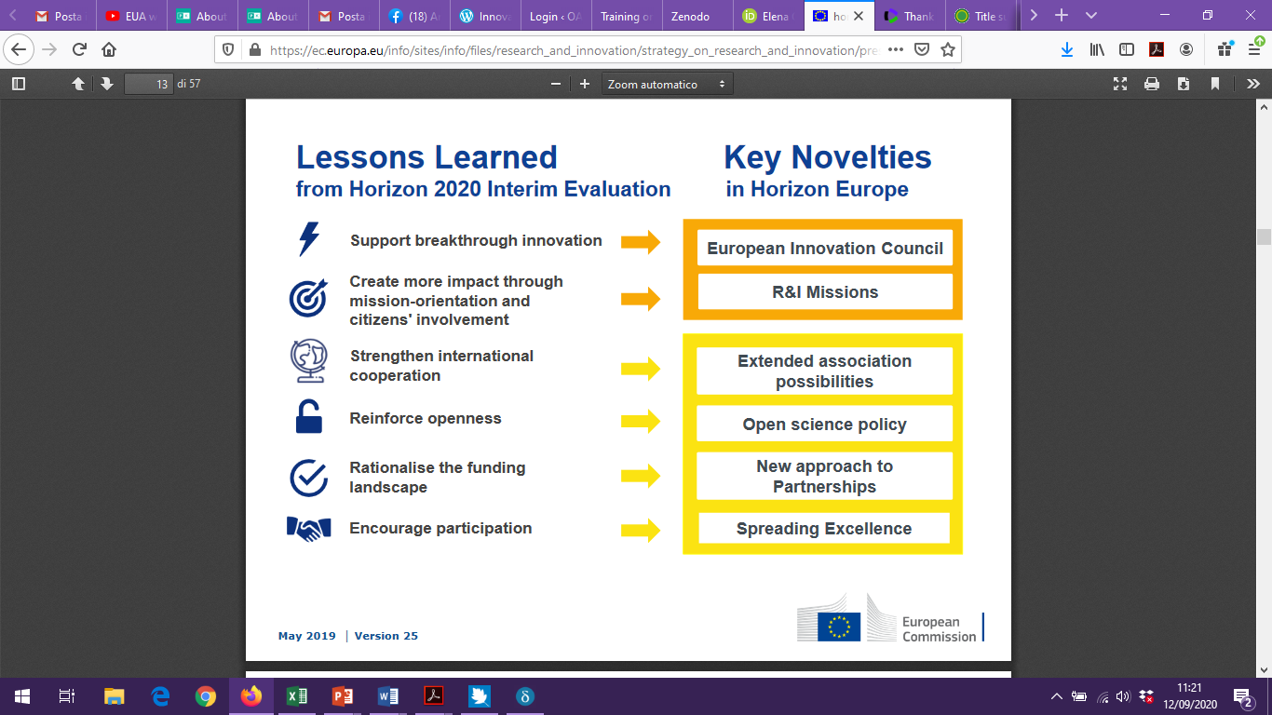
… as Open as possible
HORIZON2020: AS OPEN AS POSSIBLE
HORIZON EUROPE: REINFORCE OPENESS + UNITED NATIONS SUSTAINABLE DEVELOPMENT GOALS
TEXTS AND DATA OPEN BY DEFAULT
(how to)
2019

Slide 7
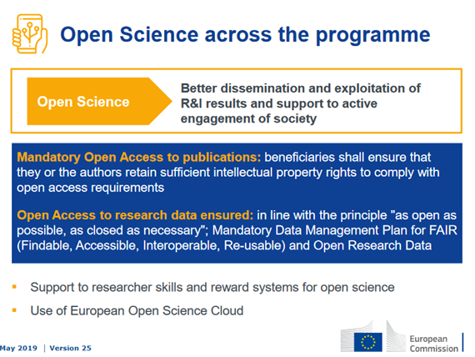
… as Open as possible
HORIZON EUROPE
OPEN BY DEFAULT…
IT’S PUBLICLY FUNDED RESEARCH, SO IT MUST PUBLIC AND OPEN TO ANYONE
GET USED!
Horizon Europe presentation, 2019

Slide 8
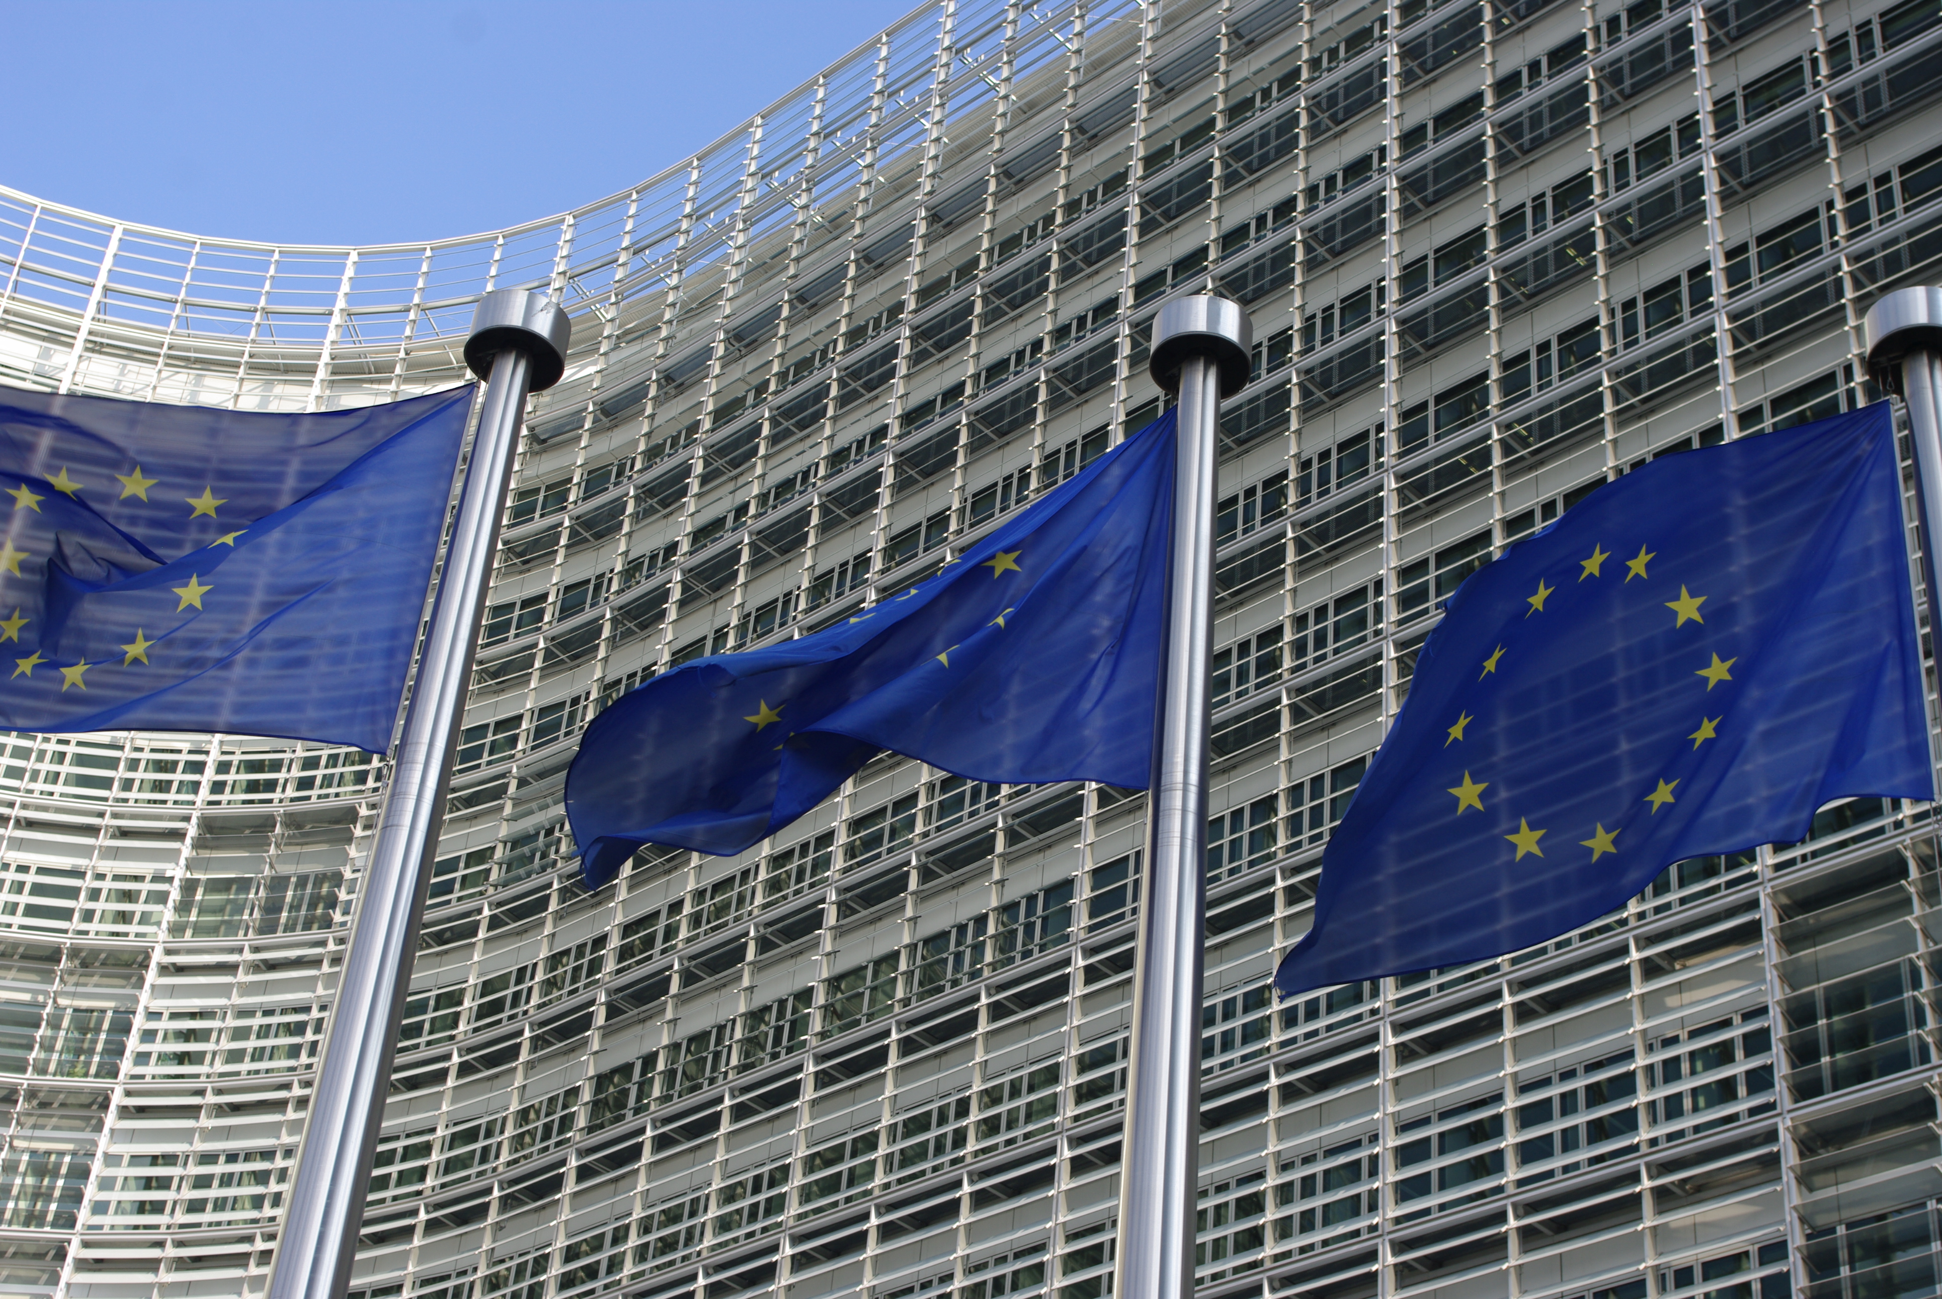
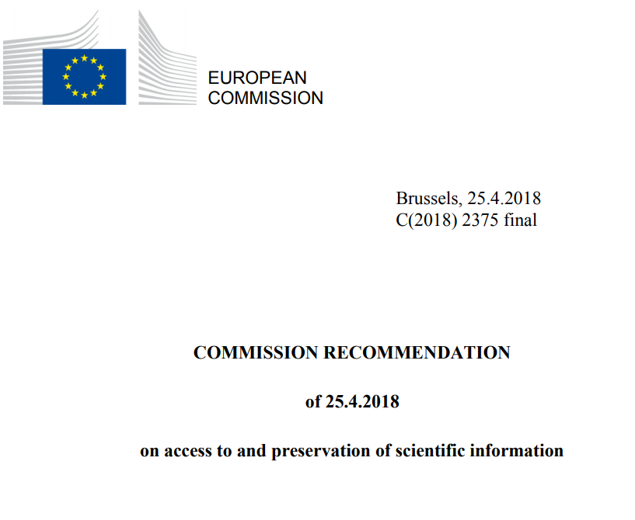
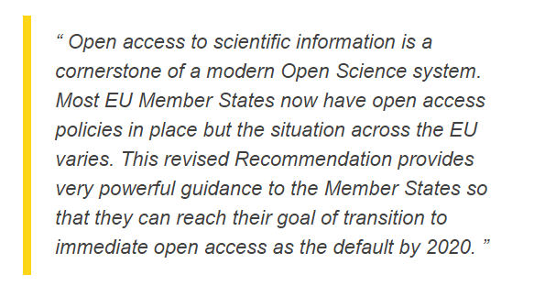
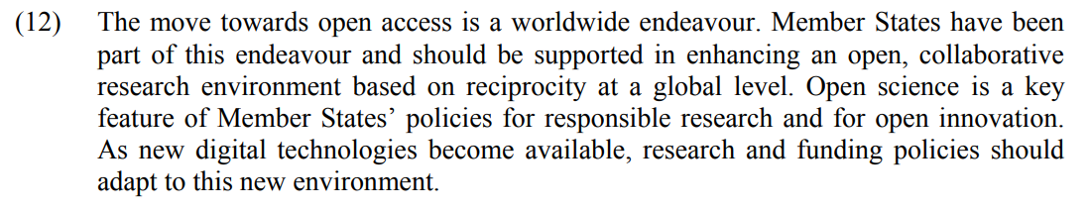
Recommendation on Access (2018)
25 Apr. 2018

Slide 9
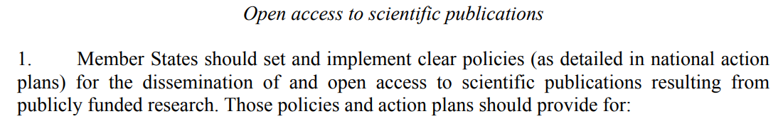
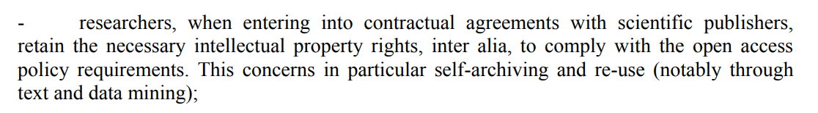
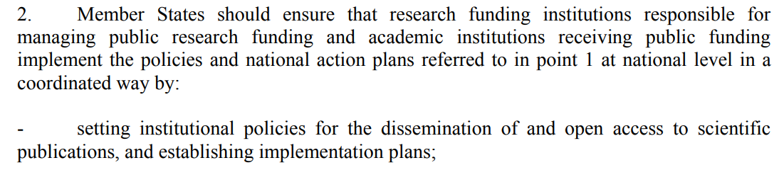
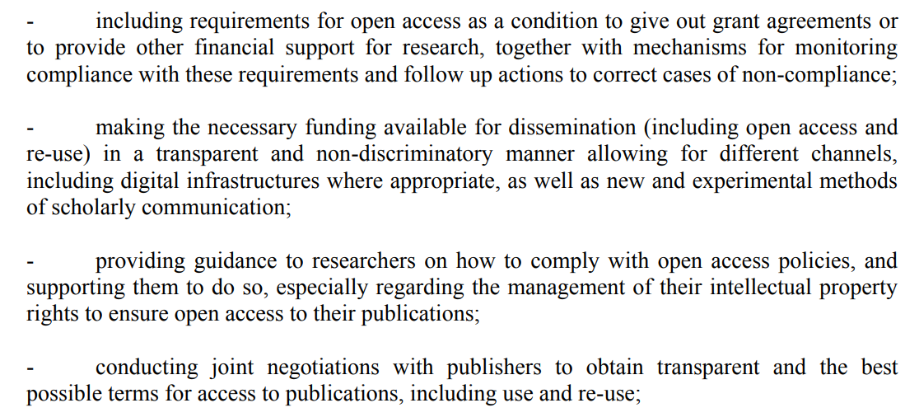
Recommendation on Access (Apr. 25)
Open Access policy (national level)
Keep your rights
Open Access policy (institutional level)
Link to evaluation
Dissemination in different channels
Training and support

Slide 10
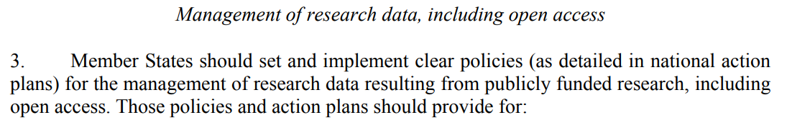
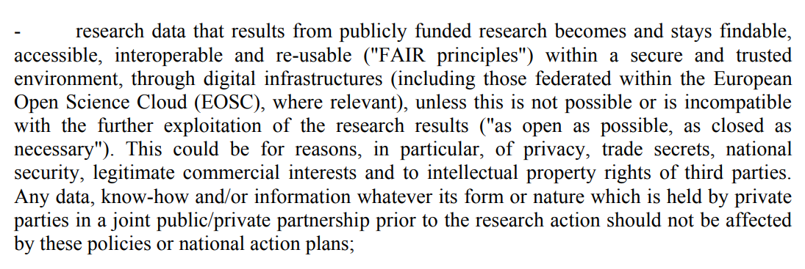
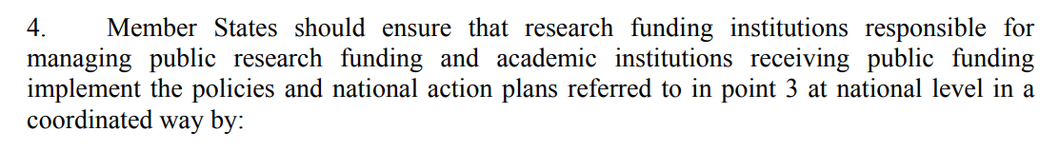
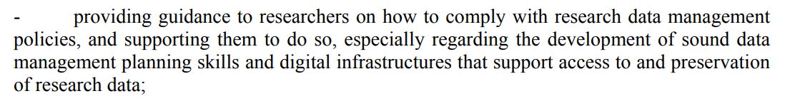
Recommendation on Access (Apr. 25)
Data policy (national level)
FAIR data for EOSC
Data policy (institutional level)
Skills
Infrastructures

Slide 11
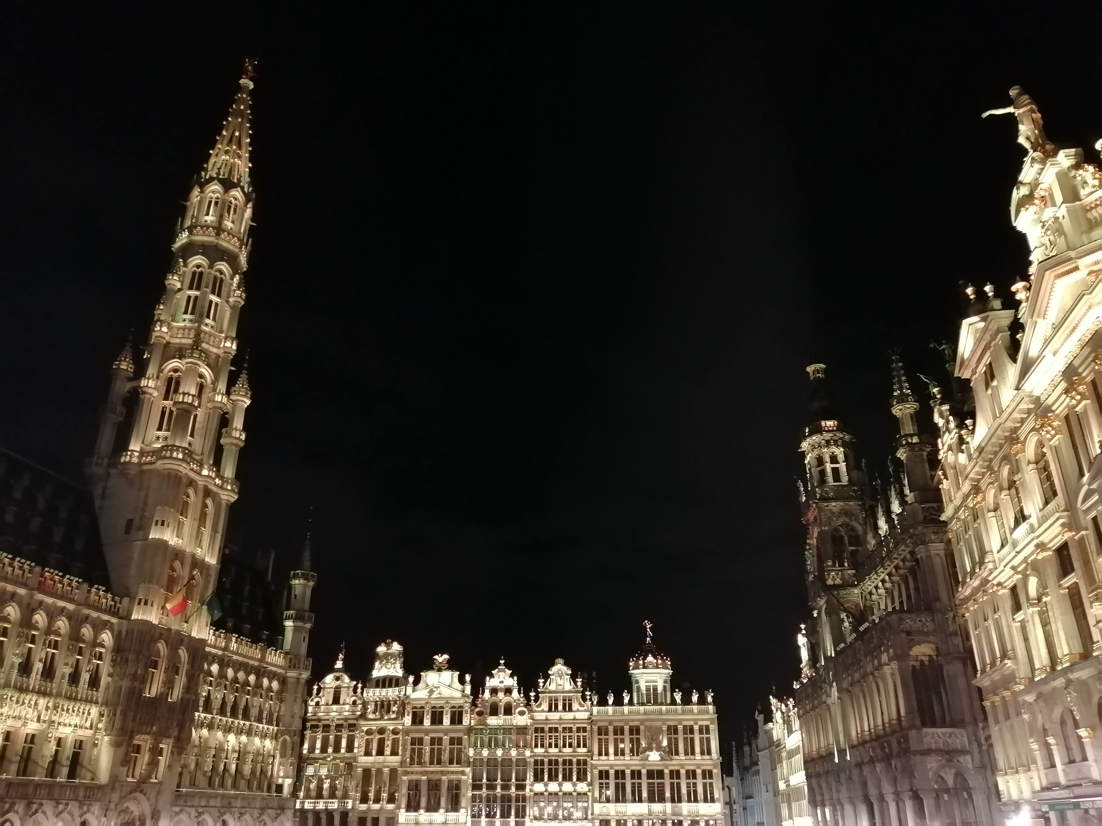
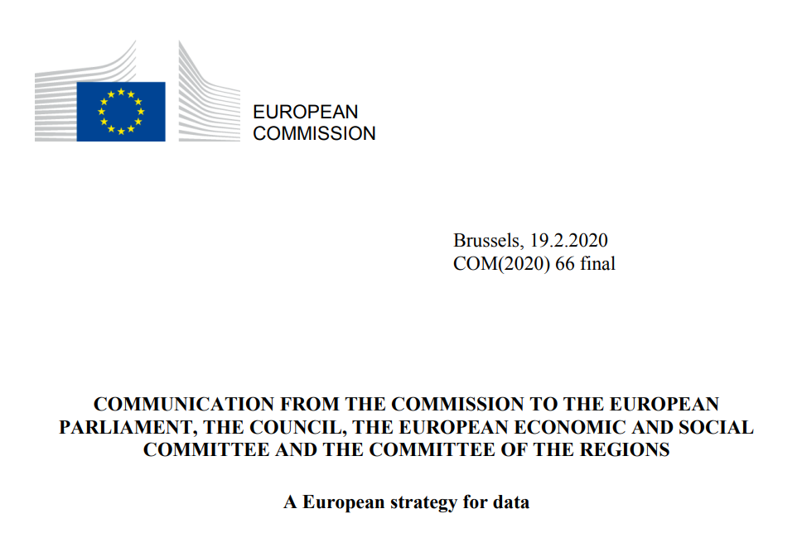
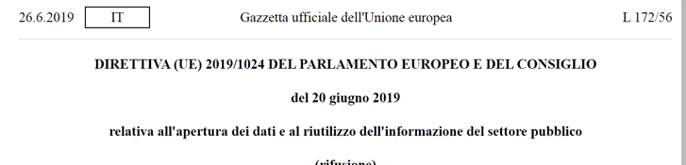

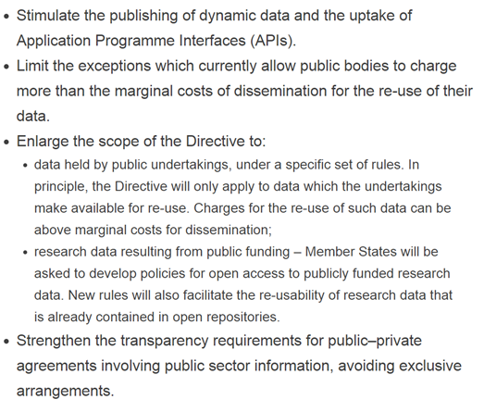
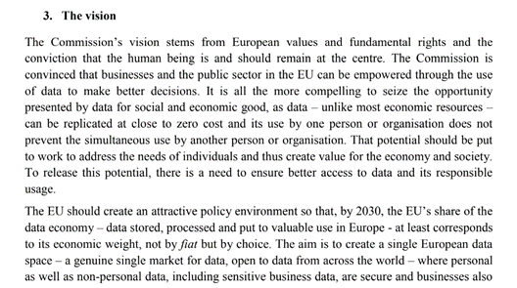
Bruxelles on the move
Open data directive
RESEARCH DATA INCLUDED IN THE PSI DIRECTIVE (NOW «OPEN DATA DIRECTIVE»)
DATA CAN BE REPLICATED AND USED SIMULTANEOUSLY WITHOUT LOOSING VALUE

Slide 12
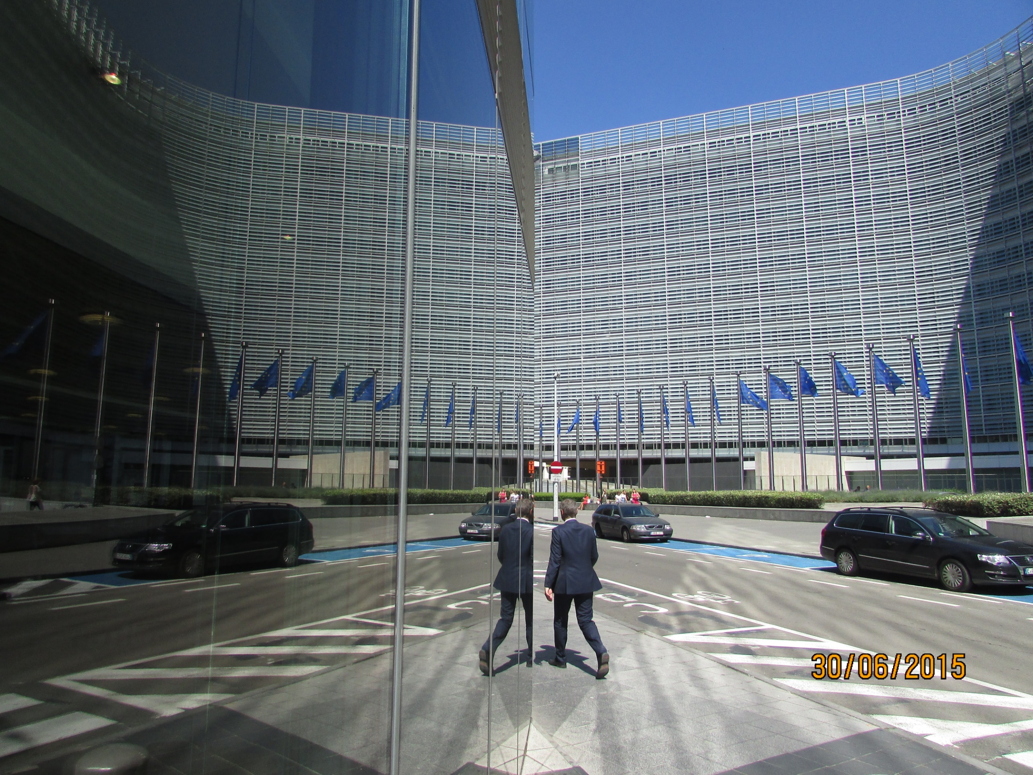
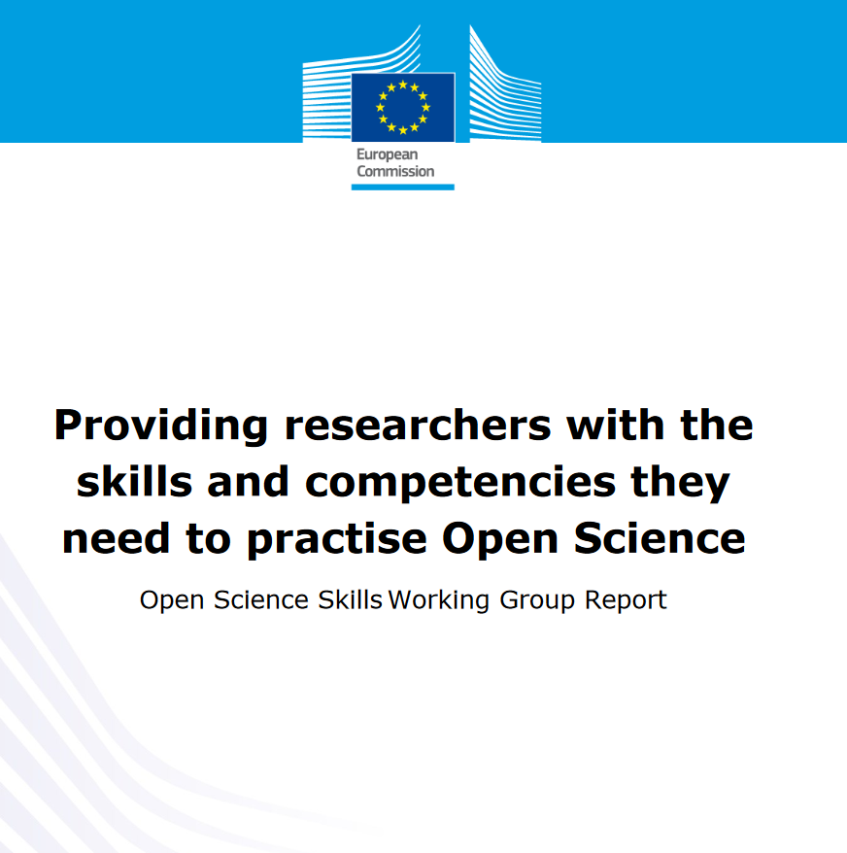
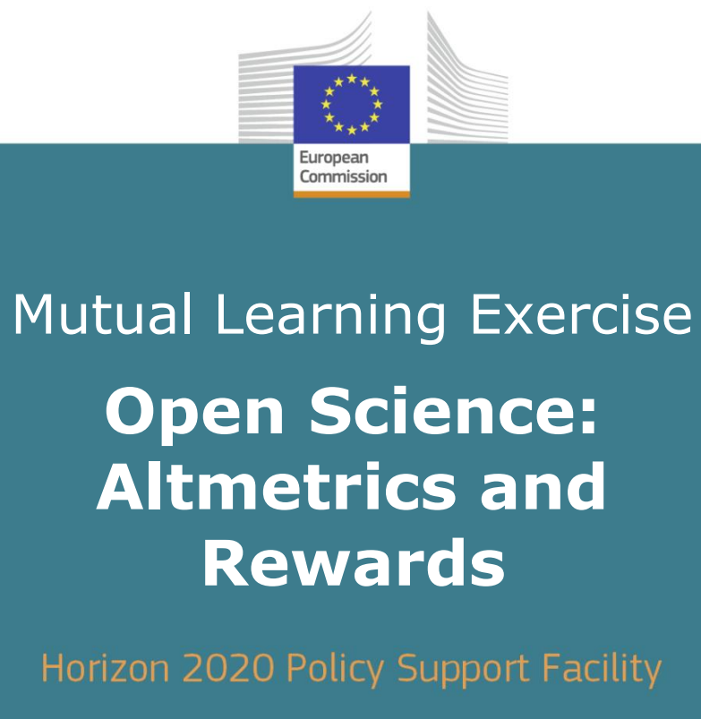

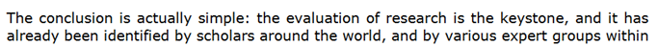
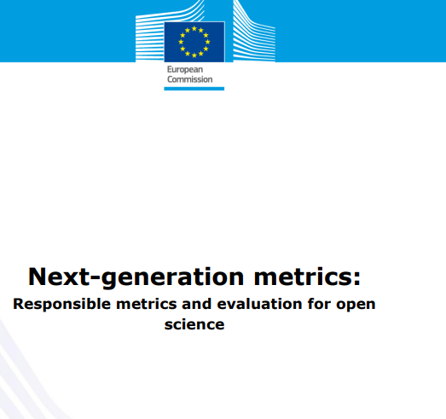
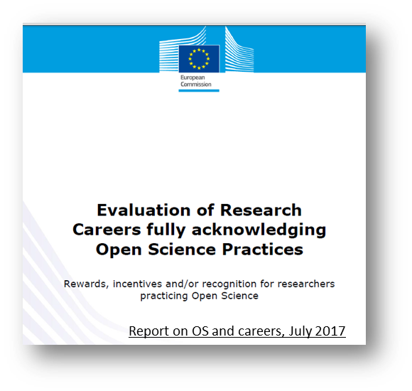
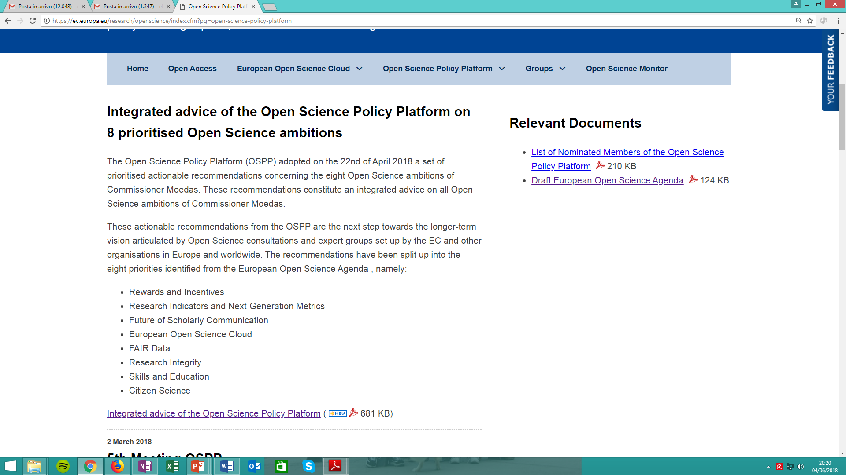
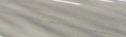

Supporting Open Science
Apr. 25, 2018
Feb.4, 2019
Report, Sept.2017
2017
May 29, 2018

Slide 13
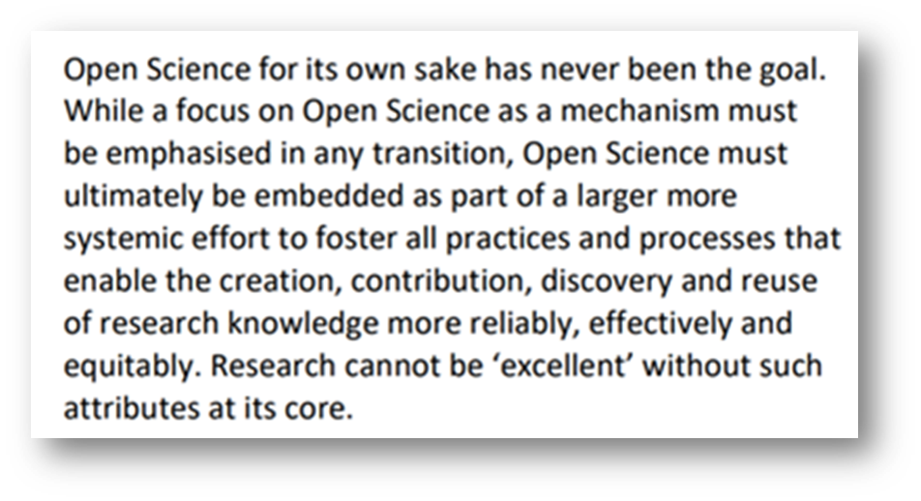
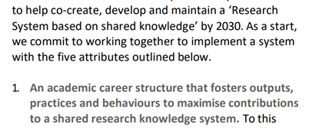

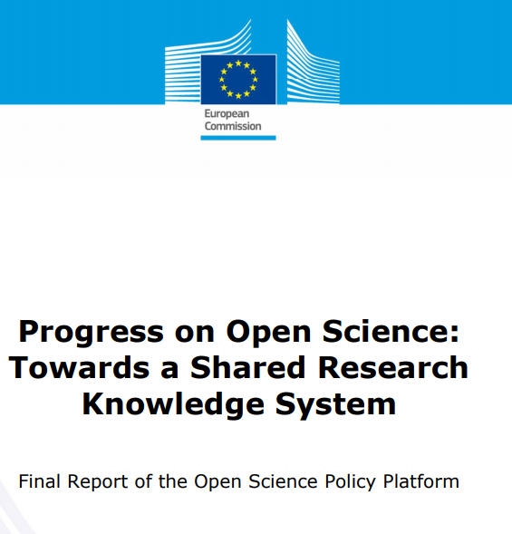

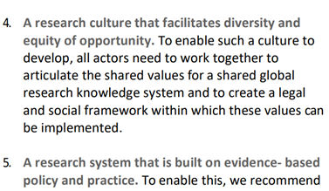
Supporting Open science
June 2020

Slide 14
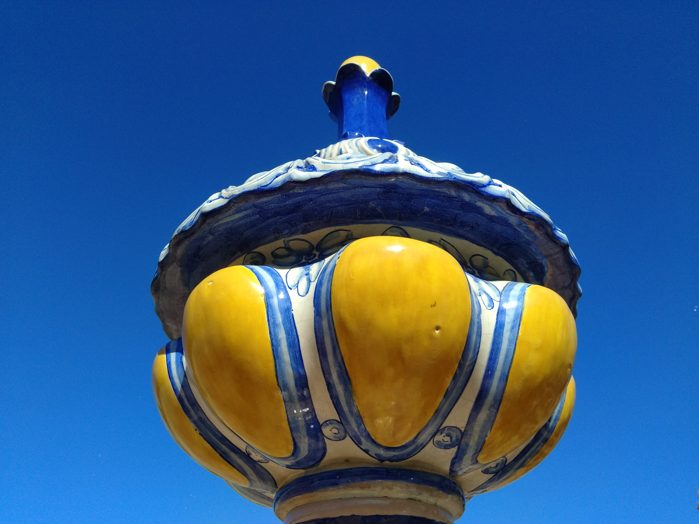
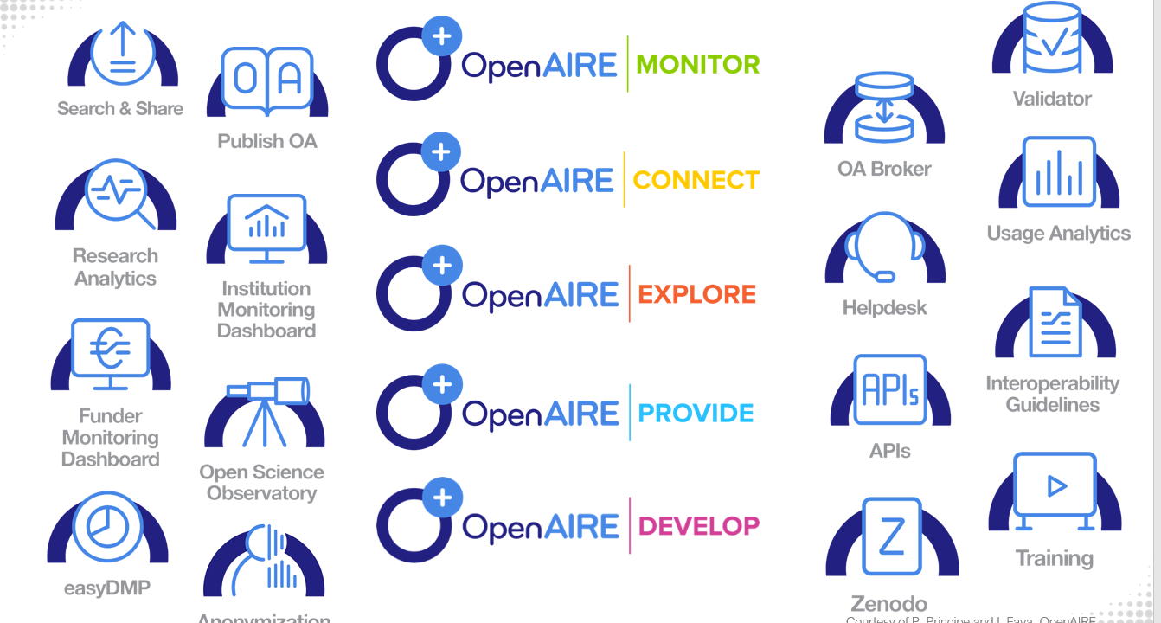



…OpenAIRE
Slides
Emma Lazzeri

Slide 15



[EOSC – what?]
2016
A SUPPORTING ENVRONMENT FOR OPEN SCIENCE AND NOT AN «OPEN CLOUD» FOR SCIENCE

Slide 16



EOSC Declaration
CULTURAL CHANGE: COMMON CULTUR OF DATA STEWARDSHIP
NO DISCIPLINE COUNTRY OR INSTITUTION MUST BE LEFT BEHIND
Oct. 2017

Slide 17

EOSC Declaration
WE NEED 500.000 DATA STEWARDS
A NEW REWARD SYSTEM
FAIR PRINCIPLES TO BE DISCIPLINARY-BASED
Oct. 2017

Slide 18



…and eventually… welcome EOSC!
Vienna, 23 novembre 2018
Vienna, Nov.23, 2018
SEAMLESS ACCESS TO OPEN BY DEFAULT FAIR DATA

Slide 19


EOSC objective tree
EOSC Hub week May 18 2020, C. Stover

Slide 20



EOSC Working Groups
https://www.eoscsecretariat.eu/eosc-working-groups

Slide 21







EOSC timeline
EOSC
2019

Slide 22





EOSC
https://www.eoscsecretariat.eu/
Sept.7 2020
https://www.eoscsecretariat.eu/

Slide 23


EOSC - WHY
https://www.eosc-portal.eu/
85% OF DATA GENERATED BY PUBLIC MONEY IS NEVER USED. THIS IS NOT SUSTAINABLE
Jan. 22, 2020
THIS IS THE EOSC AND WE ARE DOING IT NOW

Slide 24




GO FAIR
https://www.go-fair.org/

Slide 25

[clouds on the Cloud???]

