Slide 1



New capacity control technique for two-phase ejectors in transcritical CO₂ condensing units: Preliminary experimental outcomes
P. Gullo^{1*}, M.R. Kærn¹, M. Birkelund², E.E. Kriezi²
¹ Technical University of Denmark (DTU), Department of Mechanical Engineering
² Danfoss A/S
* parigul@mek.dtu.dk
6th International Conference on Contemporary Problems of Thermal Engineering
CPOTE 2020, 20-24 September 2020, Poland
CPOTE 2020 22/09/2020

Slide 2

Outline
Background
Research motivation
Novel capacity control mechanism
Preliminary experimental outcomes
Conclusions and Future developments

Slide 3


Background
Small-format stores:
average sales area below 280 m² [1] , e.g. grocery and convenience stores
food preservation essential in modern society

Slide 4
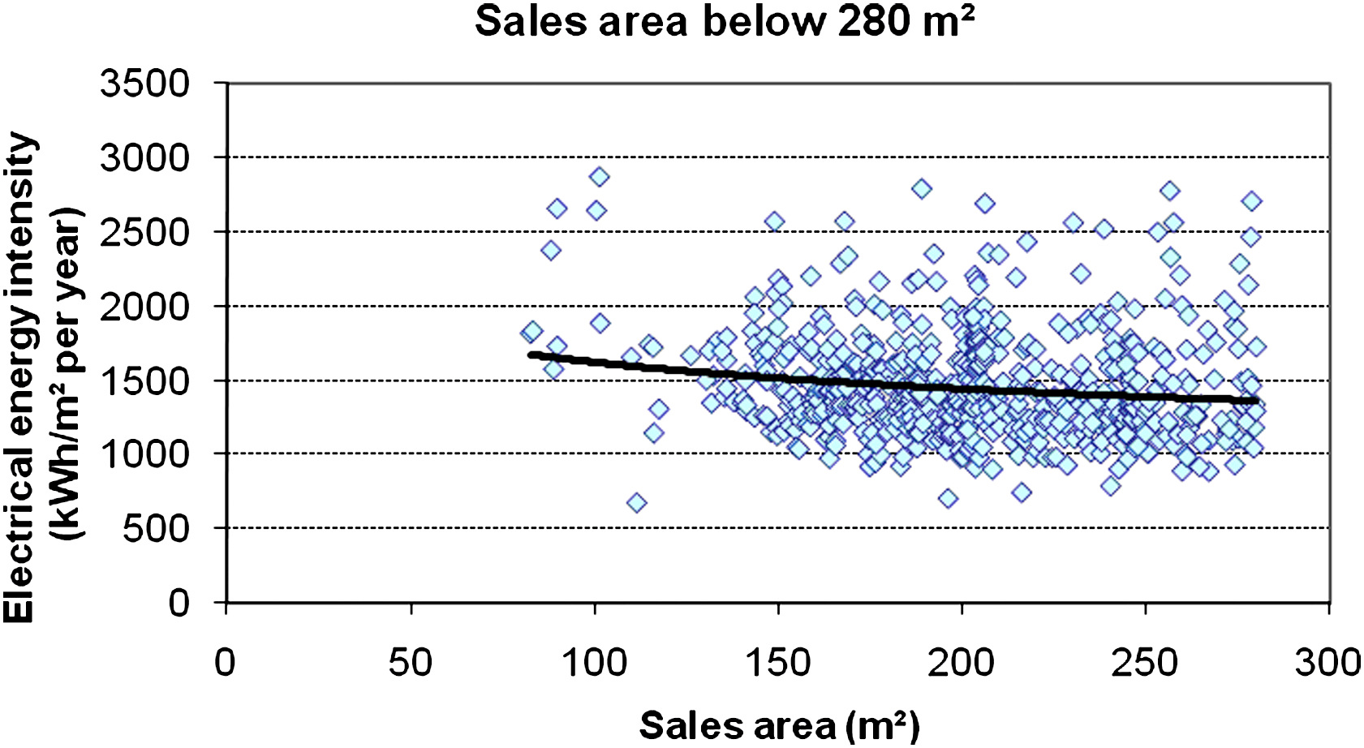
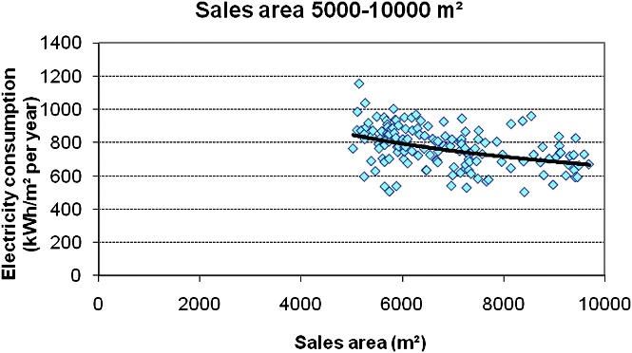
Background(2)
However,…
considerably electricity intensive [1] significant contribution to global warming
30-60% of required electricity is for their refrigeration system (i.e. condensing units) [1]
Need to adopt highly efficient condensing units
Small-format stores [1]
Hypermarkets (Sales area: 5,000÷10,000 m²) [1]

Slide 5
Background(3)
Implementation of EU F-Gas Regulation 517/2014
Similar regulations are being implemented worldwide
Need to adopt highly efficient condensing units relying on low global warming potential (GWP) refrigerants
However, condensing units are easily accessible by the public
Need to adopt highly efficient condensing units relying on low GWP refrigerants possibly non-toxic and non-flammable

Slide 6
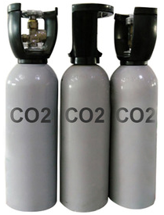
Background(4)
CO₂ as a refrigerant (R744)
Ozone depletion potential (ODP) = 0
Global warming potential (GWP) = 1
Non-toxic
Non-flammable
Inexpensive
Compactness
Low pressure drop
High heat transfer
Great performance in heating mode
…
Eco-friendly and safe refrigerant

Slide 7
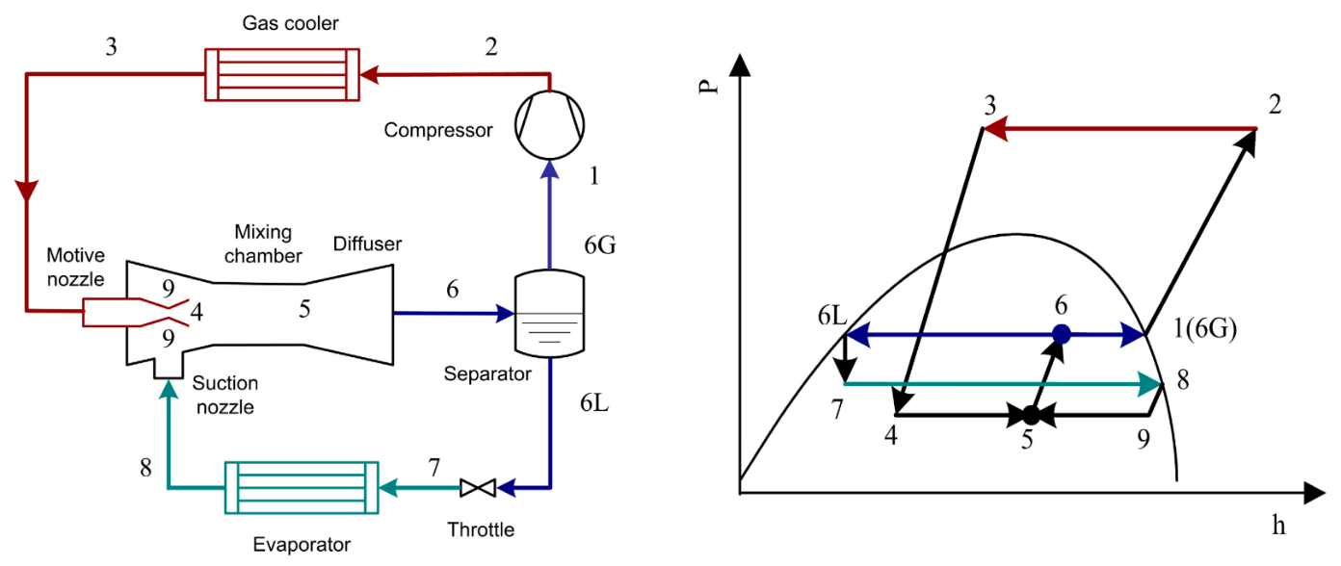
Background(5)
R744 two-phase ejectors for expansion work recovery
Source: [2]
R744 exiting gas cooler is expanded and accelerated through motive nozzle (or primary nozzle)
R744 exiting evaporator is then entrained into suction nozzle (or suction chamber)
Both streams are blended in the mixing section
Part of the remaining kinetic energy of R744 is converted into a pressure increase through the diffuser
Significant pre-compression of R744, i.e. higher compressor suction pressure than standard solution (i.e. without ejector)
COP improvements by up to 30% at DESIGN conditions [3]
Potentially highly efficient condensing units

Slide 8
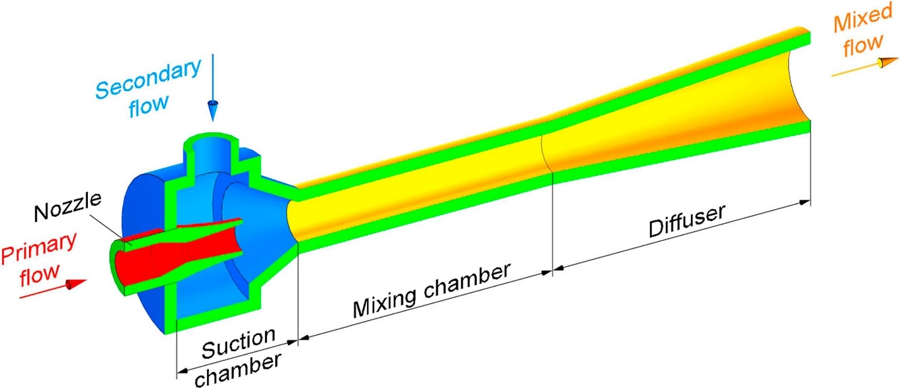
Research motivation: Challenges with ejectors
Ejector-equipped R744 condensing unit performance dramatically penalized at off-design operations [4]
4 ejector characteristic dimensions need to be permanently suited to the operating conditions
Need to effectively control high pressure to maximize COP in R744 condensing units
e.g. -3%÷-17% in COP as P_{gas cooler} = P_{gas cooler,optimal}±5 bar [6]
Source: [5]

Slide 9
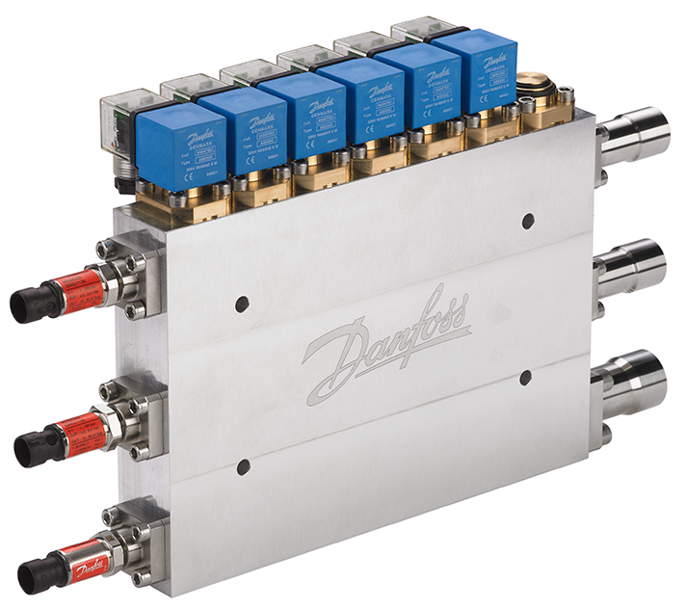
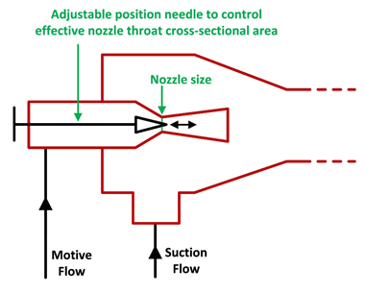
Research motivation: Current status of ejectors
At present, two-phase ejectors cannot be effectively capacity controlled without penalizing ejector and system efficiency in condensing units
Source: [3]
Multi-ejector concept: too complicated [3], expensive [7] and limited by manufacturing size (i.e. not suitable for condensing units)
Adjustable needle: complicated and costly design, more friction losses are incurred, vulnerable to clogging [8]

Slide 10
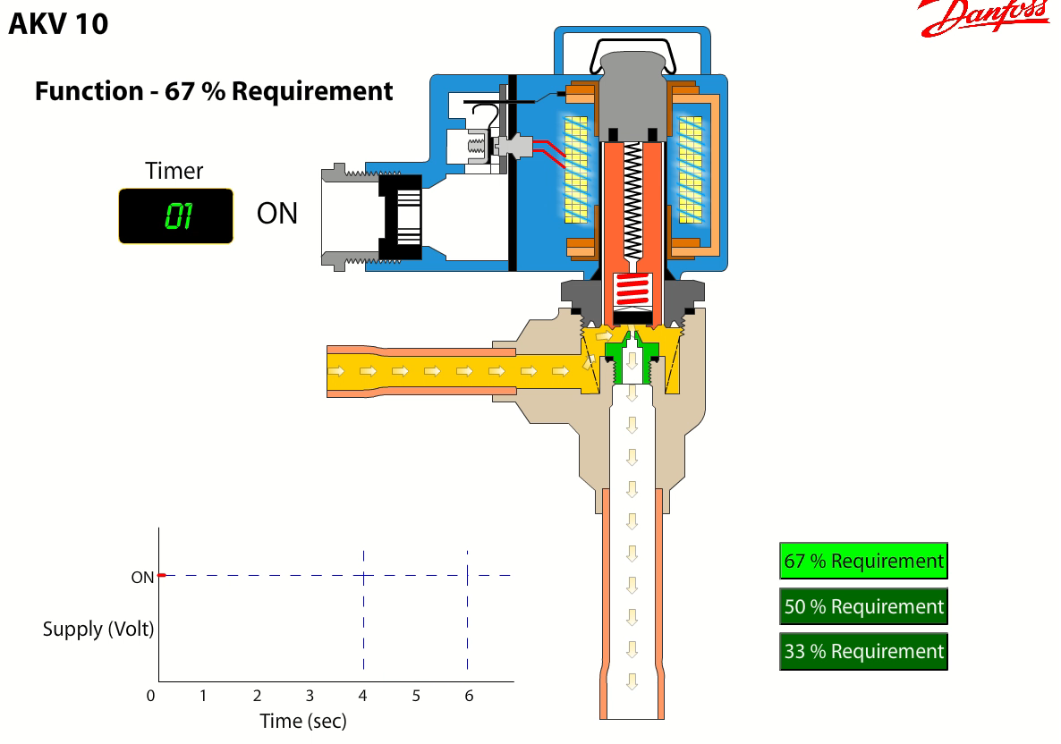
Novel capacity control mechanism: PWM ejector
Novel capacity control methodology based on pulse-width modulation (PWM) of R744 flow through the ejector
Widely used methodology [link] in expansion valves by Danfoss
PWM ejector features:
simplicity and low cost
low vulnerability to clogging
no practical size or application constraints

Slide 11
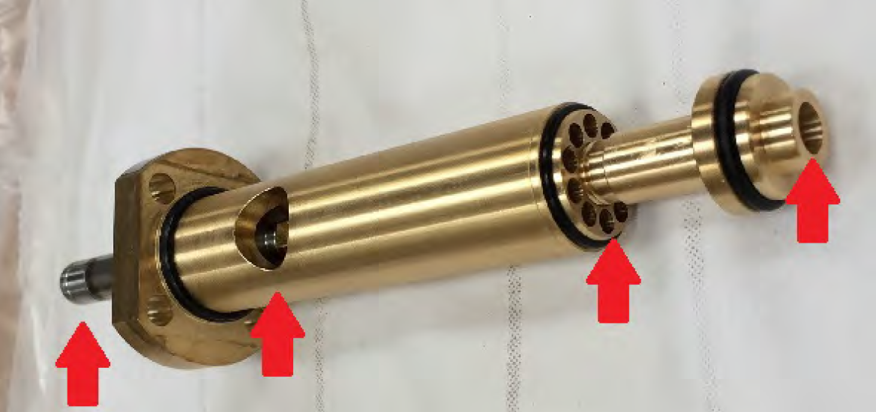

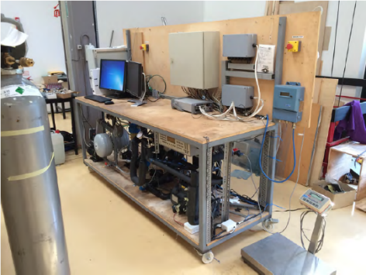
Novel capacity control mechanism: PWM ejector(2)
Motive solenoid valve (MSV) provides the PWM effect similarly to the valve coil pf PWM expansion valves
Suction check valve ensures pressure lift not short-circuited upon closing
Smallest ejector of the multi-ejector block (3 kW low pressure lift ejector)
Outlet of diffuser
Suction flow inlet
Motive flow inlet
Coil

Slide 12
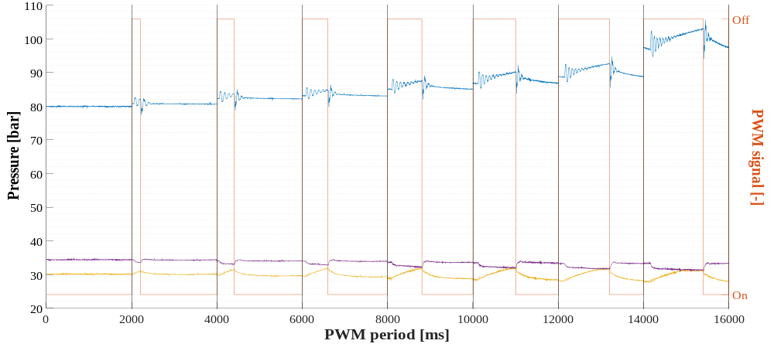
Preliminary experimental outcomes
Operating condition: PWM period = 2 s, 40 Hz, t_{water,in} = 35 °C, t_{evaporator} = -5.5 °C, ΔT_{superheating} = 10 K
Despite the pressure equalization, the compressor still draws R744 from the intermediate pressure rather than from the low one
OD =
100%
OD =
90%
OD =
80%
OD = 70%
OD = 60%
OD = 50%
OD = 40%
OD = 30%
Motive nozzle
Pressure wave
Fluid hammer
Pressure equalization
Diffuser
Suction nozzle
MSV closes for 20% (0,4 s) of PWM period (2,0 s)
MSV opens for 80% (1,6 s) of PWM period (2,0 s)

Slide 13
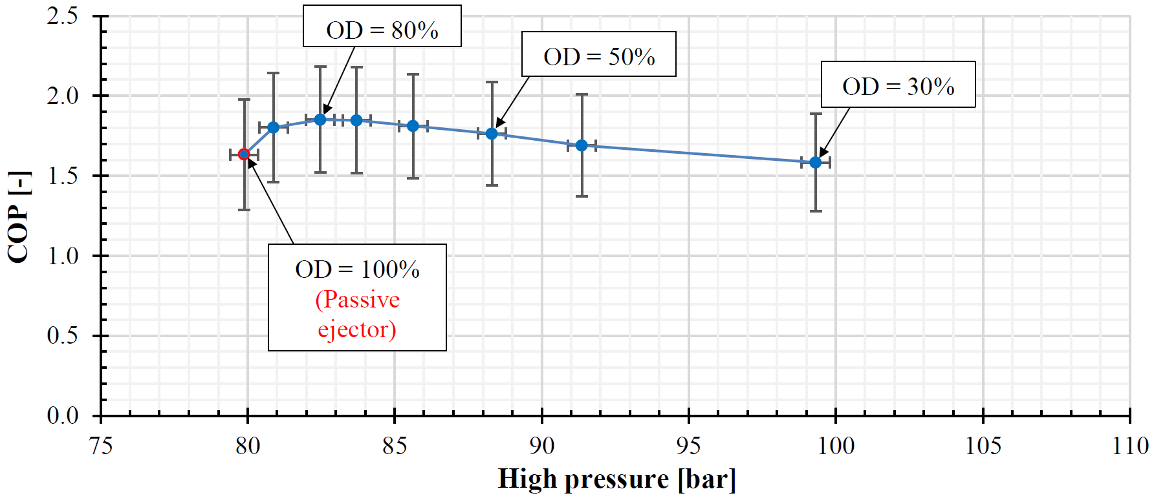
Preliminary experimental outcomes(2)
Operating condition: PWM period = 2 s, 40 Hz, t_{water,in} = 35 °C, t_{evaporator} = -5.5 °C, ΔT_{superheating} = 10 K
Passive ejector = ejector without capacity control technique
PWM ejector is capable of properly controlling the heat rejection pressure and permitting a condensing unit to accomplish the best COP
Low COP values due to the use of an old compressor

Slide 14
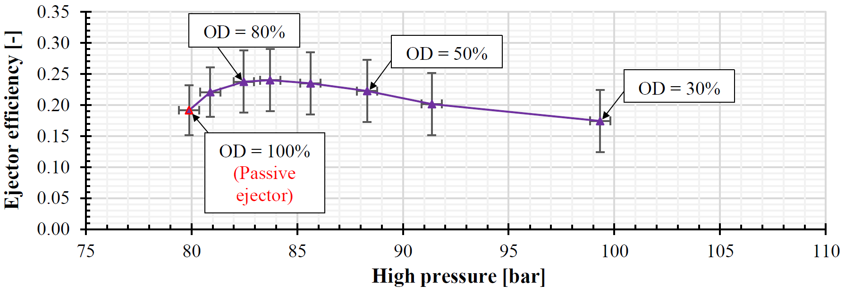
Preliminary experimental outcomes(3)
Operating condition: PWM period = 2 s, 40 Hz, t_{water,in} = 35 °C, t_{evaporator} = -5.5 °C, ΔT_{superheating} = 10 K
Ejector efficiency calculated as suggested in [9]

Slide 15
Preliminary experimental outcomes(4)
Operating condition: PWM period = 2 s, 40 Hz, t_{water,in} = 35 °C, t_{evaporator} = -5.5 °C, ΔT_{superheating} = 10 K
At present adjustable needle ejector offers COP enhancements up to 4% compared to passive ejector [8,9]
PWM ejector has a much more considerable potential than its currently available competitor
Mode | COP [-] | Enhancement [%] | Enhancement [%] | Cooling capacity [kW] | Enhancement [%] | Enhancement [%]
Standard (no ejector) | 1.43 | Taken as baseline | - | 1.41 | Taken as baseline | -
Passive ejector (no active control) | 1.63 | +14.0% | Taken as baseline | 1.60 | +13.5% | Taken as baseline
PWM ejector (at best condition) | 1.85 | +29.4% | +13.5% | 1.88 | +33.3% | +17.5%

Slide 16
Conclusions
Gas cooler pressure can be properly controlled by the PWM ejector
Cooling capacity can be increased by up to about 17%
Solution using PWM ejector offers COP enhancements by 14% compared to system without ejector control, i.e. PWM ejector has a much more considerable potential than its currently available competitors
Solution using PWM ejector offers COP improvements by 29% compared to standard unit (i.e. without ejector)

Slide 17
Future developments
Investigate the influence of the compressor speed and t_{water,gas cooler inlet} on the performance of both PWM ejector and overall system
Study optimal PWM period
Evaluate benefits deriving from use of mufflers having different size
Assess energy advantageous of PWM ejector in air conditioning applications

Slide 18



Dr. Paride Gullo
parigul@mek.dtu.dk
6th International Conference on Contemporary Problems of Thermal Engineering
CPOTE 2020, 20-24 September 2020, Poland
CPOTE 2020 22/09/2020

Slide 19
References
Tassou S.A., Ge Y., Hadawey A., Marriott D.: Energy consumption and conservation in food retailing. Appl Therm Eng Vol. 31 Issue 2-3, Feb. 2011, pp. 147-156.
Zhang Z., Tian L.: Effect of Suction Nozzle Pressure Drop on the Performance of an Ejector-Expansion Transcritical CO₂ Refrigeration Cycle. Entropy Vol. 16 Issue 8, Aug. 2014, pp. 4309-4321.
Elbel S., Lawrence N.: Review of recent developments in advanced ejector technology. Int J Refrig Vol. 62, Feb. 2016, pp. 1-18.
Lawrence N., Elbel S.: Experimental investigation on control methods and strategies for off-design operation of the transcritical R744 two-phase ejector cycle. Int J Refrig Vol. 106, Oct. 2019, pp. 570-582.
Tashtoush B.M., Al-Nimr M.A., Khasawneh M.A.: A comprehensive review of ejector design, performance, and applications. Appl. Energy Vol. 240, Apr. 2019, pp. 138-172.
Lucas C., Koehler J.: Experimental investigation of the COP improvement of a refrigeration cycle by use of an ejector. Int J Refrig Vol. 35 Issue 6, Sep. 2012, pp. 1595-1603.
Madsen K.B., Kriezi E.E.: Financial aspects of ejector solutions in supermarket and smaller industrial systems. Proceedings of the 13th IIR-Gustav Lorentzen Conference on Natural Refrigerants, Jun. 2018.

Slide 20
References(2)
Zhu J., Elbel S.: Experimental investigation into the influence of vortex ejector control on transcritical R744 ejector and cycle performance. Appl Therm Eng Vol. 164, Jan. 2020, pp. 114418.
Elbel S., Hrnjak P.: Experimental validation of a prototype ejector design to reduce throttling losses encountered in transcritical R744 system operate. Int J Refrig Vol. 31 Issue 3, May 2008, pp. 411-422.

