Slide 1
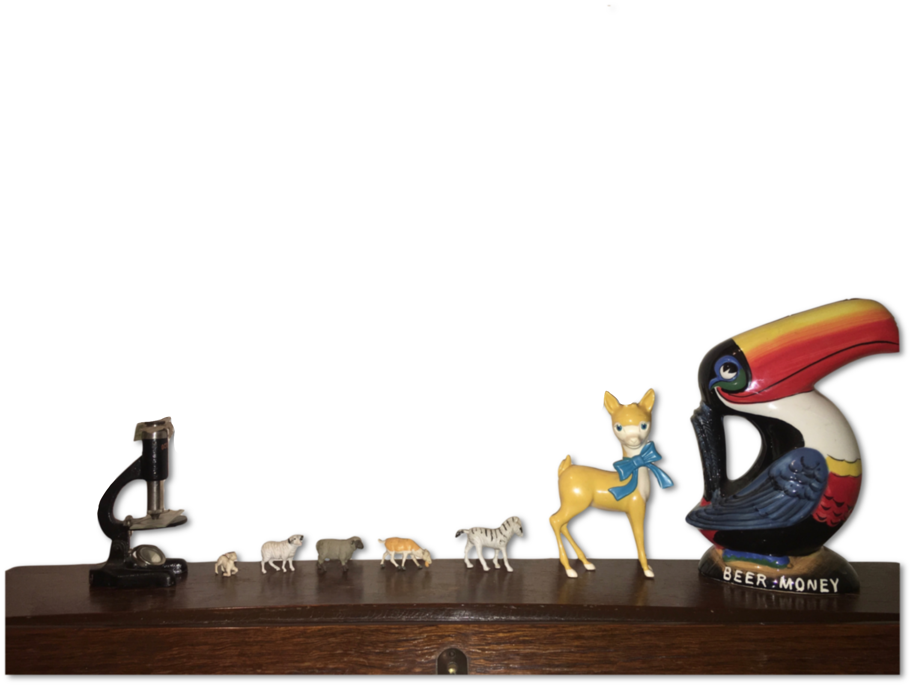



Open Data and Collaboration in Action
cassandra.gouldvanpraag@psych.ox.ac.uk | @cassgvp | Our Networks September 2020 | 10.5281/zenodo.4021622 CC-BY 4.0
1

Slide 2
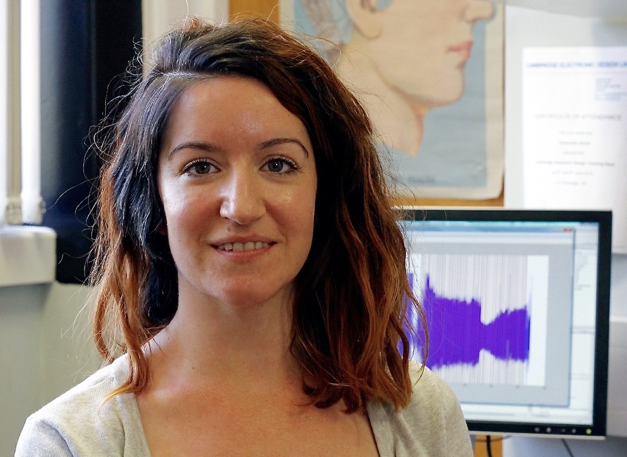
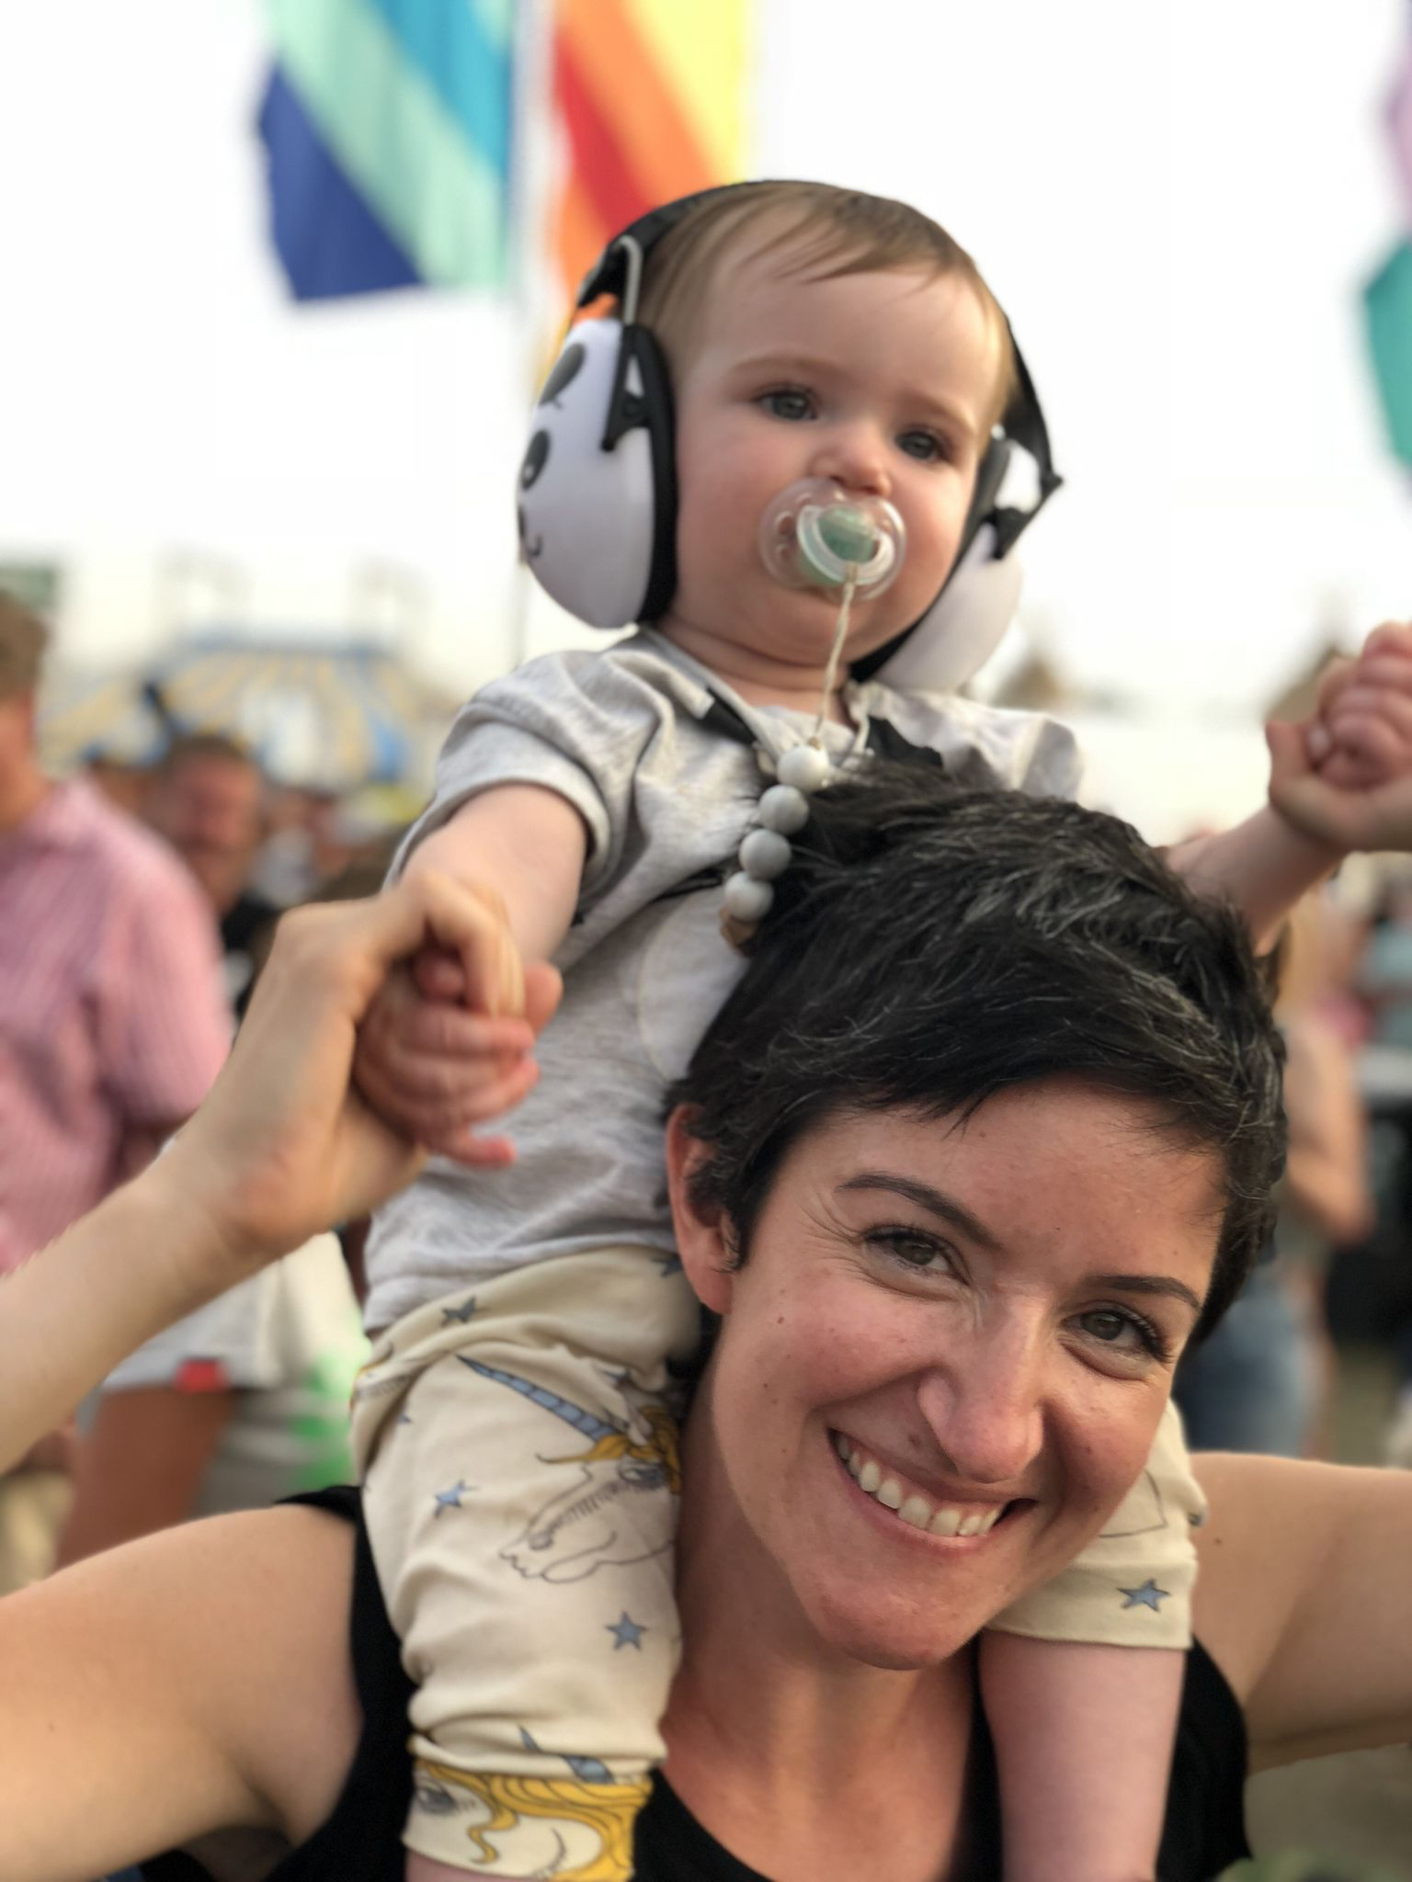
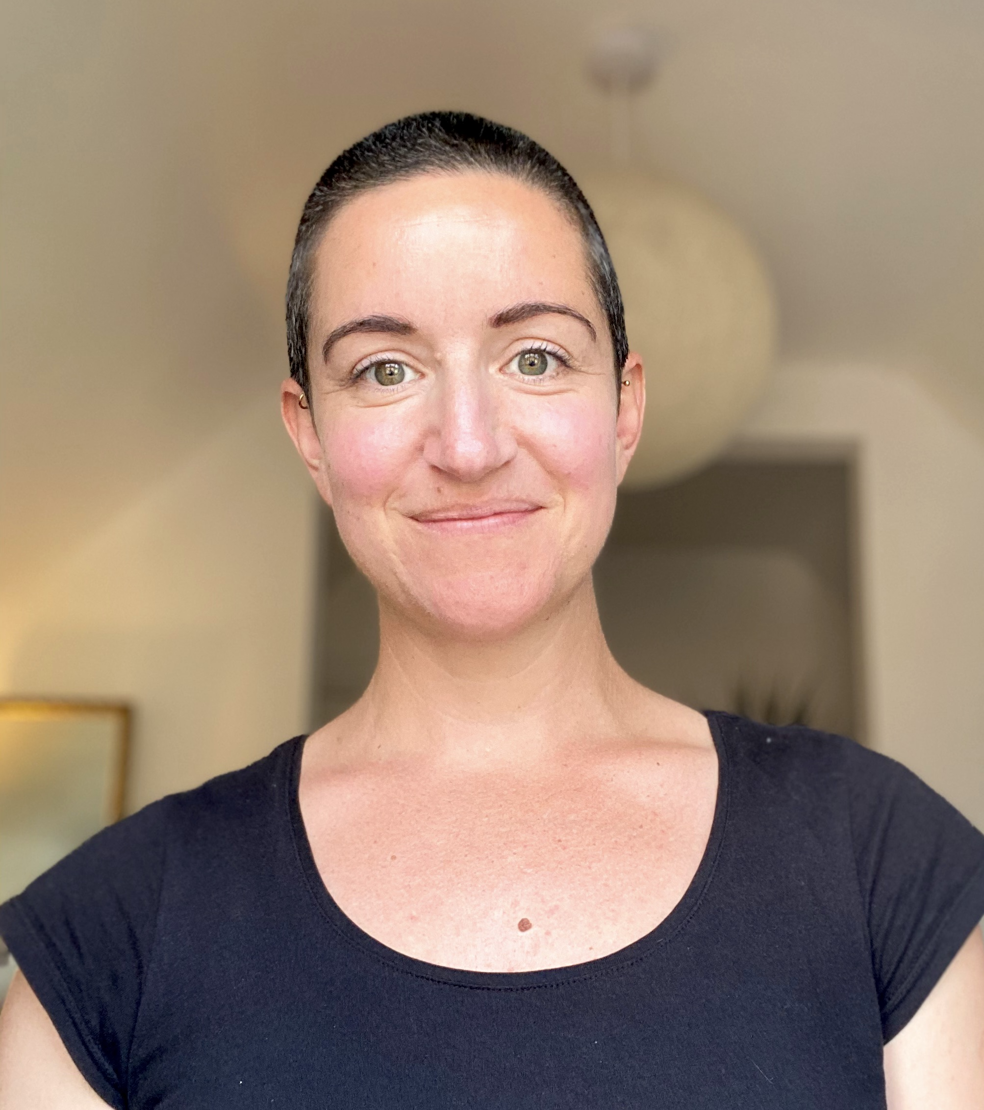
About me
PhD (2010-2014)
  Consciousness and experiences of synaesthsia
Postdocs (2013 - 2020)
  Neuroimaging in Psychiatry
Open Science (2020 – 2022+)
  Community Engagement
  #COVIDHaircut

Slide 3

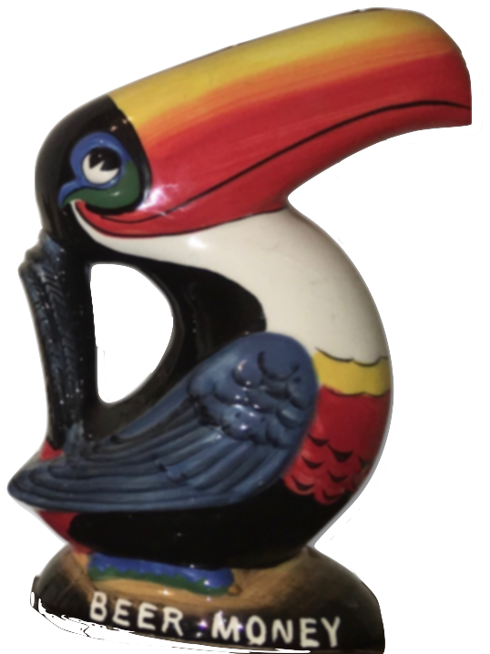
The narrative
Reproducibilty crisis has led to a massive shift in why and how we share data in science.
Data sharing has enabled rapid response to global crises, improved robustness of research and supports Global Agenda for Sustainable Development.
What can we learn from each other to build better open data communities?
What’s going on?

Slide 4
Reproducibilty crisis
“A rule of thumb among biotechnology venture-capitalists is that half of published research cannot be replicated.”
”How science goes wrong” (2013). The Economist
cassandra.gouldvanpraag@psych.ox.ac.uk | @cassgvp | Our Networks September 2020 | 10.5281/zenodo.4021622 CC-BY 4.0

Slide 5
Reproducibilty crisis
“By now, most scientists are familiar with the global and enormously expensive problem of irreproducible biomedical research.”
”Irreproducibility: A $28B Year Problem with some Tangible Solutions” (2015). Genetic Engineering and Biotechnology News

Slide 6
Reproducibilty crisis
Baker (2016) Nature News

Slide 7
Open Science
Young European Research Universities Network (2018)

Slide 8
Open Science
Young European Research Universities Network (2018)

Slide 9

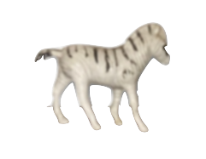
FAIR Data
How to make sure your shared data has value

Slide 10
FAIR Data
Image credit: https://www.openaire.eu/

Slide 11
FAIR Data
Findable: The first step in re(using) data is to find them!
  Metadata, machine readable, indexed
Accessible: How can the data be accessed
  Open and ?free communications protocol, archiving
Interoperable: Integration with other peoples workflows
  - File types and agreed standards of knowledge representation
Reusable: Well described so they can be replicated
  Data usage license

Slide 12

Situated (data) openness
Who is leading the open data agenda?
Who is able to contribute to and benefit from open data?
What barriers are we building into the system?
Notes:
strengthened global solidarity, focussed in particular on the needs of the poorest and most vulnerable and with the participation of all countries, all stakeholders and all people.

Slide 13
Open by design
Open source software
How to manage data collection and transfer within low resource communities
Co-create with global communities to understand challenges
Notes:
Sustainable dev goals: strengthened global solidarity, focussed in particular on the needs of the poorest and most vulnerable and with the participation of all countries, all stakeholders and all people.

Slide 14
Inclusive communities
Build a sense of belonging for members of traditionally excluded groups
Make it easy for people to contribute
Make everyone's voice equally valued
Image credit: http://buddhafieldsoutheast.co.uk

Slide 15

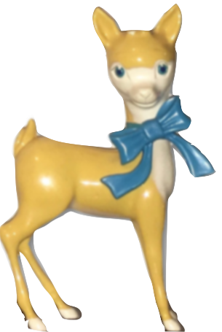
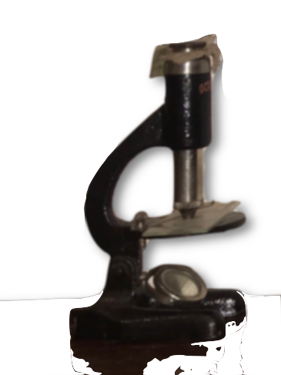

Over to you
Is your data sharing inclusive?
What data is or could be shared in your work?
Are those data FAIR?

Slide 16
Thank you
Sara El-Gebali
Veronika Cheplygina
Kirstie Whitaker
Malvika Sharan
cassandra.gouldvanpraag@psych.ox.ac.uk | @cassgvp | OpenMR Benelux | January 2020 | doi: 10.5281/zenodo.3614070
16

