Slide 1
What Is Web Directory And What Is It For
The presentation was created by the web directory USsiteDir.com

Slide 2
What Is a Web Directory
A web directory is a website or page that contains links to other sites that are categorized. There were no search engines at the beginning of the formation of the Internet and directories were the only source where you could find sites on the topic you need. There are examples when the directory turned into a search engine over time. For example, the former Yahoo search engine was originally a web directory as well as the russian search engine Yandex. As a rule, sites are added to web directories by the owners of these sites; the directories do not scan the Internet.

Slide 3
What Types Of Web Directories Are There
1. There are different types of directories: general and specialized. In general directories, you can place and find a site of any subject, and in specialized directories, you can place and find sites of limited subject matter (for example, it can be medical sites, auto sites, etc.).
2. Also, both types of directories can be world-wide or local. This means that in the global directory you can place and find sites from all over the world, while in the local directory you can place and find only sites from a specific region, country, state or city.

Slide 4
What Types Of Web Directories Are There
3. There is also a division into manually moderated directories and directories with automatic addition. In the first case, after adding a site to the catalog, it is viewed by the moderator, and only after that it gets into this directory (if it complies with the directory rules). In the other case, there is no moderator or algorithm that checks the quality of the site and it gets into the directory immediately.
4. There are also free and paid directories, or with a mixed form of adding (when the site can be added for free, but you need to wait from 2 weeks to 6 months, and for money it will be added within 1-2 days)

Slide 5
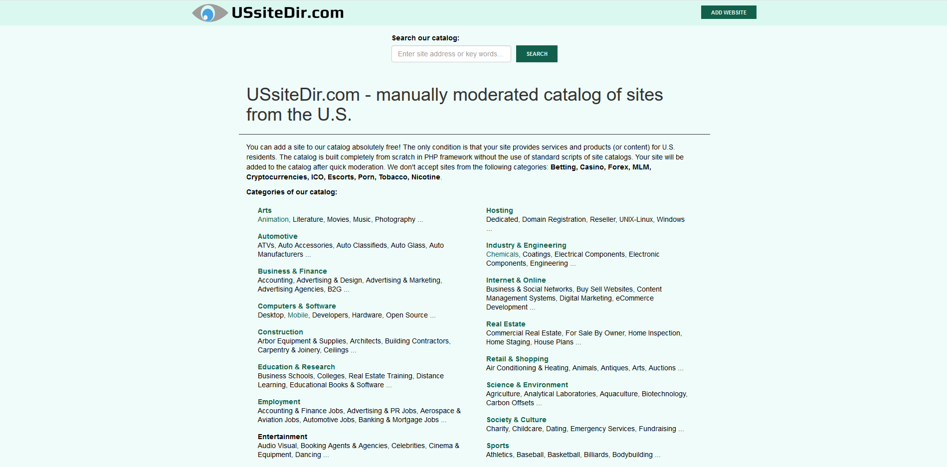
Example Of Web Category
This is how a typical web directory looks like. The image shows the main page of the USsiteDir.com directory

Slide 6
Web Directory vs Search Engine
The main difference between web directories and search engines is that search engines have special bots (crawlers) that automatically add sites to the search engine base. In web categories, all sites are added by users (most often the owners of these sites, or the people who were hired for this). There are no algorithms in directories that allow to scan sites.
The convenience of web categories is that you can search the sites you want by categories sorted by people, not algorithms.
The convenience of search engines is that you can find sites faster just by entering key phrases, but all these results are formed by algorithms and AI, which may not give a very relevant result.

Slide 7
Why Do Site Owners Need Web Directories
1. To attract new users to the site
2. To place links to their site, for better visibility of the site in search engines and better ranking in them.

Slide 8
Why Do People Need Web Directories
1. To find lists of sites of a particular subject, if they need specific categories, and cannot find these lists in a search engine. Because the search engine does not always give relevant results, in contrast to site directories, where all lists are formed by people.
2. Searching local directories can give you more relevant data than a search engine based on your location. The search engine may not always generate a suitable list of local firms, for example.

Slide 9

Thanks for your attention!
You can always add your site to our local web directory which accepts only US sites: USsiteDir.com

