Slide 1




Budgeting for SDGs:
A Data-driven Approach
Daniele Guariso (University of Sussex, ATI)
Omar A. Guerrero (UCL, ATI)
Gonzalo Castañeda (CIDE)

Slide 2
Outline
Introduction
    The 2030 Agenda
    Incorporating SDGs into the Budget Process
    The Aim of the Study
Data Description
    Development Indicators Data
    Government Expenditure Data
    Construction of the Dataset
Analysis and Results
    Predicting Improvements in SDGs Indicators
    Which Expenditure Categories Matter the Most?
Discussion
Conclusion

Slide 3

Introduction : The 2030 Agenda
In 2015 the United Nations adopted the 17 Sustainable Development Goals (SDGs).
Further divided into 169 targets measured through relevant indicators.
Pivotal role of governments.
Spillovers of government programmes.

Slide 4
Introduction : Incorporating SDGs into the Budget Process
Why should we include SDGs into the budget process (Hege et al., 2019)?
    Align budgets with the medium-term objectives of governments.
    Coherence in the allocation of resources within a sustainable framework.
    Coherence with international commitments, increased comparability.
    From the principal-agent perspective: Increased accountability, quantified evaluation of governments’ performance.

Slide 5
Introduction : The Aim of the Study
A flexible, data-driven approach to analyse the relationship between the allocation of public investments and improvement in SDGs indicators.
Two steps:
    Predictive model for the SDGs indicators.
    Identify the most relevant expenditure categories.
Such a framework could complement contextual expertise and assist policymakers when developing national plans to support effective budgeting for SDGs.
Focus on Mexico: Why? Open fiscal data

Slide 6
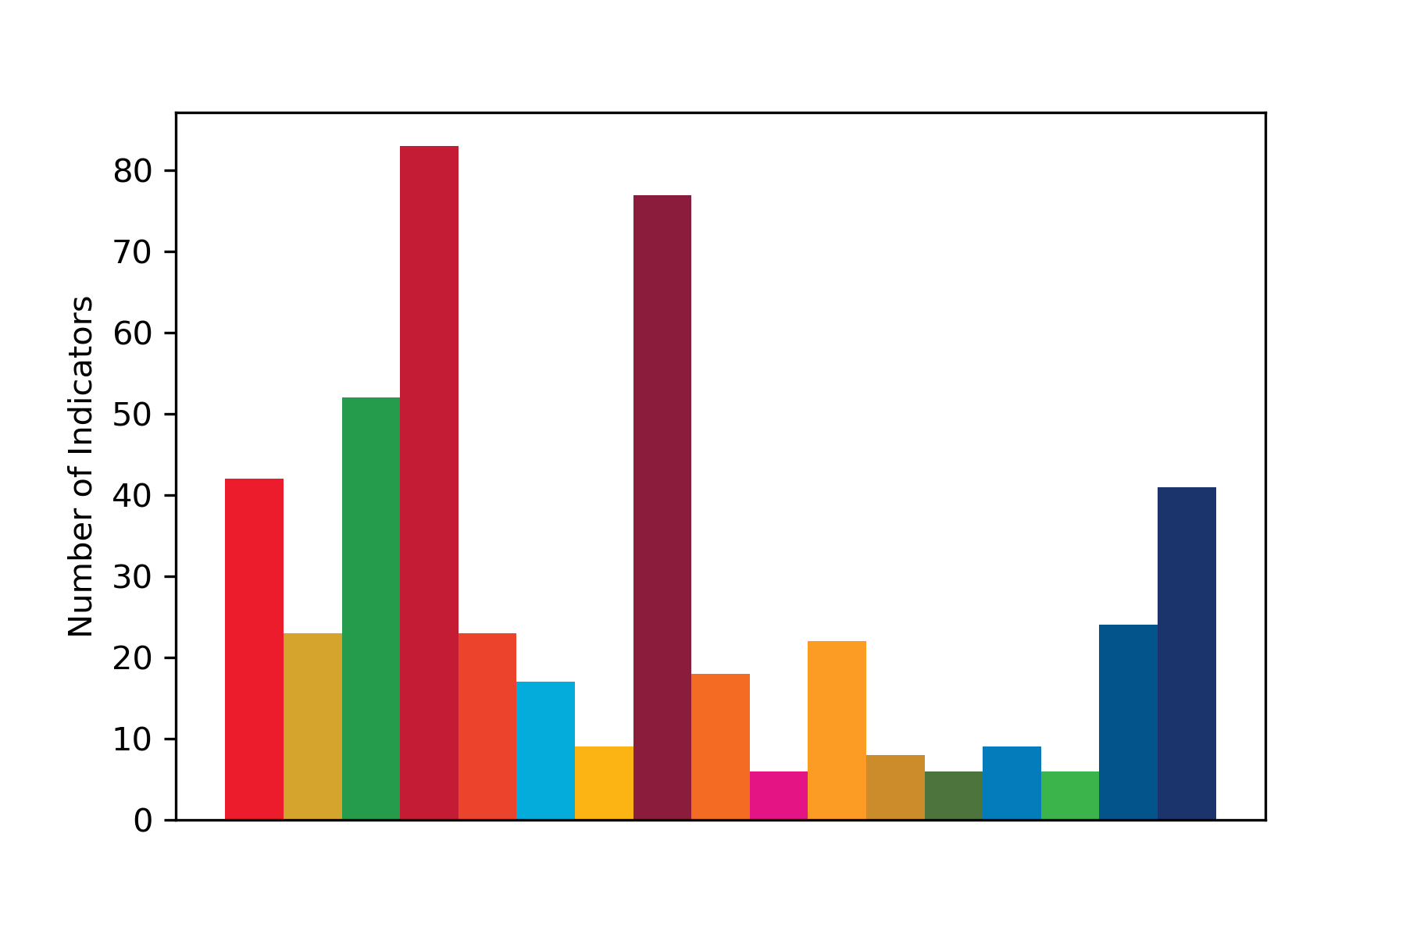
Data Description: Development Indicators Data
456 indicators, spanning the period 2008-2019.
Sources: Mexican National Statistics Institute, World Bank, Sustainable Development Solutions Network.
Diverse in their nature and measurement (e.g., the prison population per 100,000 people (SDG 16), the forest area in square kilometres (SDG 15), …).

Slide 7
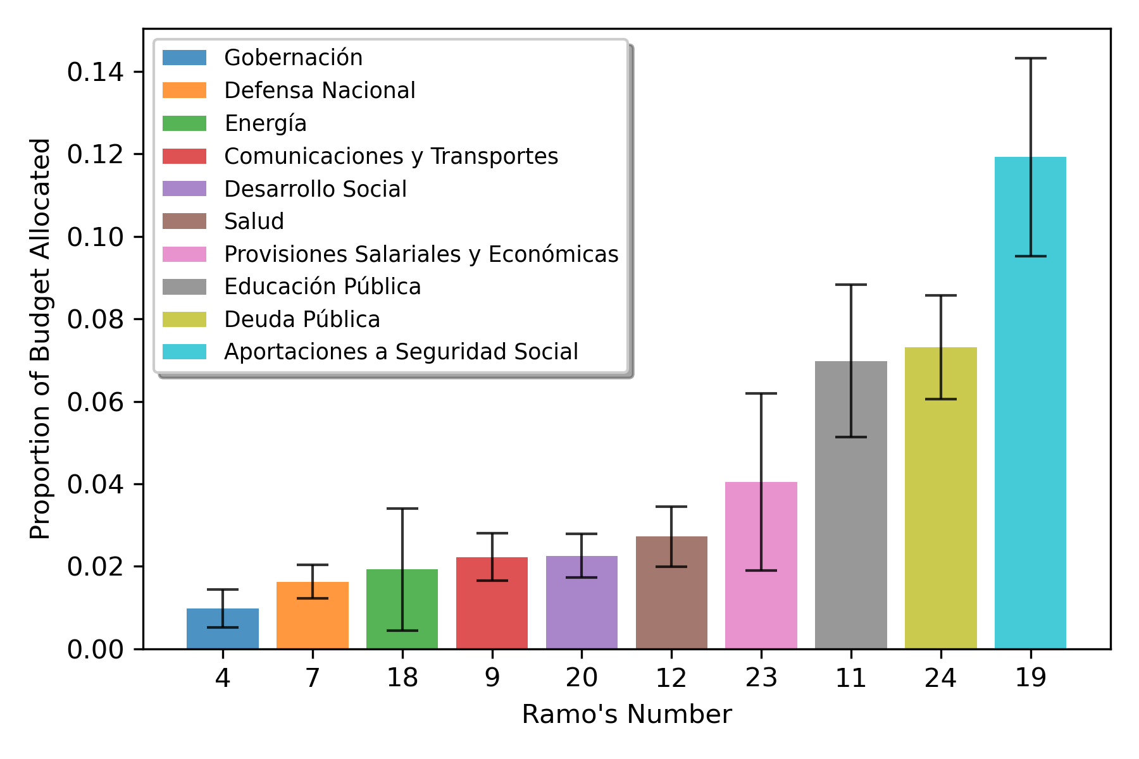
Data Description: Government Expenditure Data
    Data on highly disaggregated government spending coming from the Mexican Treasury and covering the period 2008-2019.
    803 budget programmes (Programas Presupuestarios), characterised by the type of services/products they provide (Modalidad).
    They belong to 41 Ramos, macro-categories of expenditure (i.e., Work and Social Welfare, Public Education…).

Slide 8





Data Description: Construction of the Dataset
$${Ind}_{1,2008}$$
$${Ind}_{1,2009}$$
...
$${Ind}_{1,2019}$$
$${PP}_{1,2008}$$
$${PP}_{2,2008}$$
...
$${PP}_{803,2008}$$
$${PP}_{1,2009}$$
$${PP}_{2,2009}$$
…
$${PP}_{803,2009}$$
…
$${PP}_{1,2019}$$
…
$${PP}_{803,2019}$$
    We combine each development indicator $i$ (${Ind}_{i}$) with every budget programme $j$ (${PP}_{j}$), in every year $t$.
    Hence, we allow for all possible combinations of ${Ind}_{i,t} \text{and} {PP}_{j,t}$, obtaining 1118073 unique observations for the final dataset.
$${Ind}_{2,2008}$$
$${Ind}_{2,2009}$$
…
$${Ind}_{2,2019}$$
…
$${Ind}_{456,2008}$$
$${Ind}_{456,2009}$$
…
$${Ind}_{456,2019}$$

Slide 9

Analysis and Results: Predicting Improvements in SDGs Indicators
Classification task: we want to predict an improvement in the development indicators given their historical trends and changes in public expenditure.
The model:
$${\hat{IncrInd}}_{i,t+1}=f(∆{\ln\left(Ind\right)}_{i,t},∆{\ln\left(Ind\right)}_{i,t−1},∆{\ln\left(Exp\right)}_{j,t},∆{\ln\left(Exp\right)}_{j,t−1},∆{\ln\left(Exp\right)}_{j,t−2},∆{\ln\left(Exp\right)}_{j,t−3},x_{j})$$
${IncrInd}_{i,t+1}$ is a dummy variable that takes the value of 1 if indicator $i$ improves in year $t + 1$.
Relative change of the indicator $i$ in year $t$ ($∆{\ln\left(Ind\right)}_{i,t}$) and one lag of it.
Relative change in the expenditure level for budget programme $j$ in year $t$ ($∆{\ln\left(Exp\right)}_{j,t}$) and three lags of it.
Vector containing binary variables for the individual Ramos ($x_{j}$).

Slide 10
Analysis and Results: Predicting Improvements in SDGs Indicators
We compare three different classifiers:
A Logistic Regression.
A Random Forest as in Breiman (2001).
    The maximum number of random inputs variables considered at each split and the number of trees are optimized through grid search.
A Multilayer Perceptron (MLP) with three hidden layers in which we alternate different activation functions (i.e., PReLU, Softplus, ELU).
    The learning rate of the optimizer, the number of neurons in each hidden layer and the number of epochs are optimized through grid search.
For the Random Forest and the MLP, the hyperparameters are optimized within a nested cross-validation framework (Varma and Simon, 2006).

Slide 11
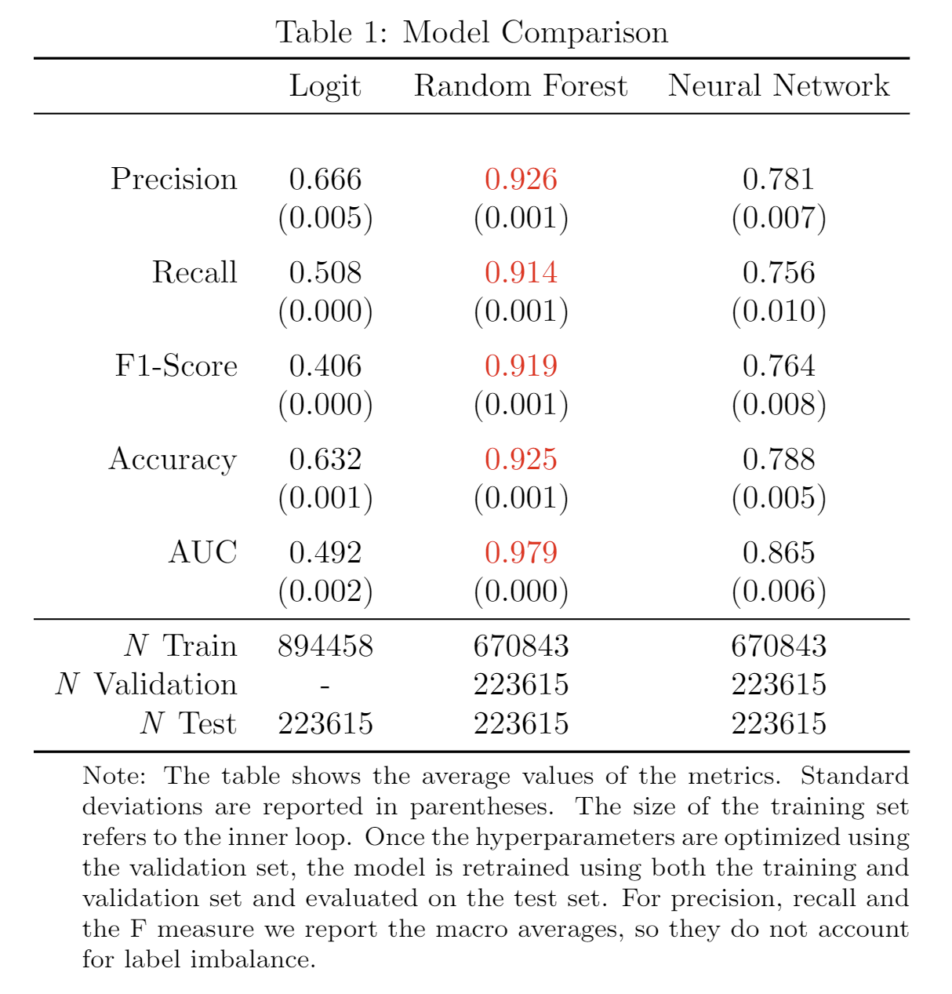
Analysis and Results: Predicting Improvements in SDGs Indicators
The Random Forest obtains the best performance across all metrics considered.
Compared to a more traditional approach (i.e., the Logistic Regression), we observe an increase of 46.4% in the accuracy and 99.0% in the AUC.

Slide 12
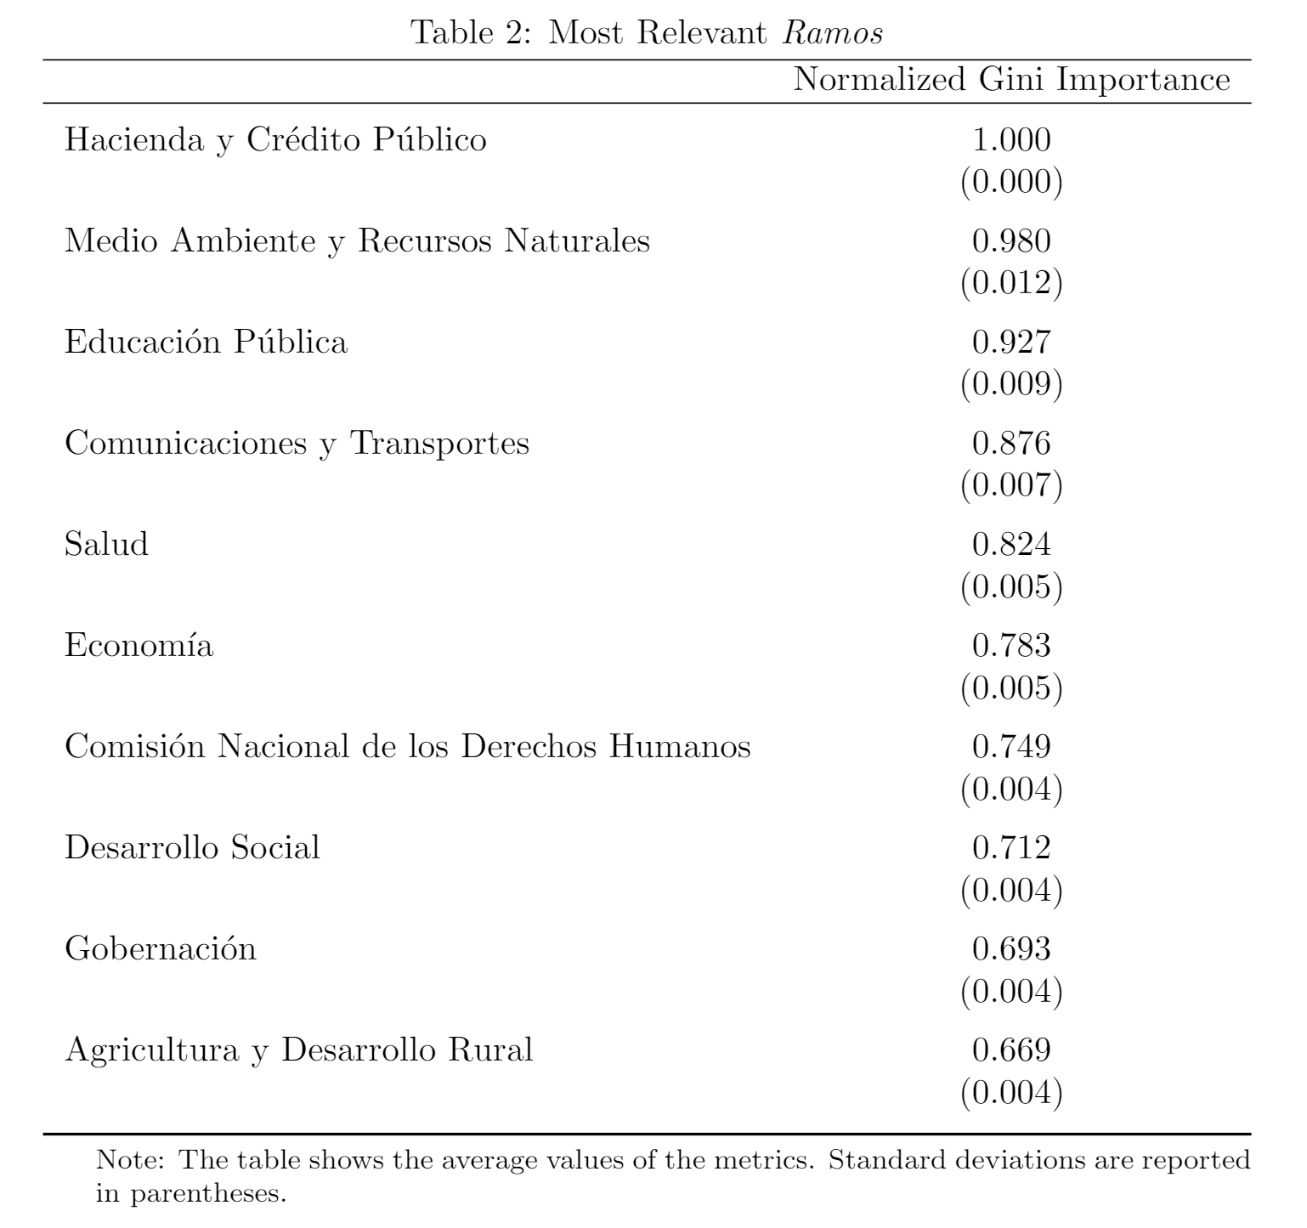
Analysis and Results: Which Expenditure Categories Matter the Most?
We analyse features’ relevance based on their Mean Decrease Impurity (MDI) (Louppe et al. 2013).
We identify the 10 most relevant Ramos to building the predictive model (i.e., those macro-categories of expenditure that are the most important to predict an improvement in the SDGs indicators).

Slide 13
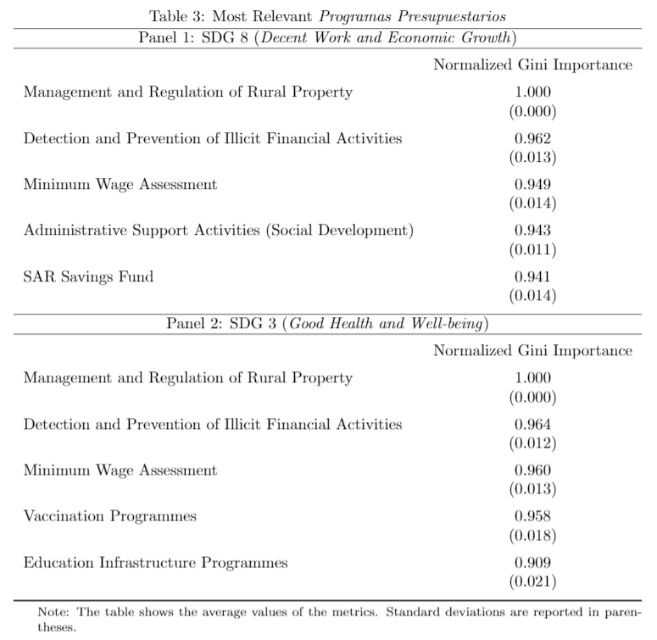
Analysis and Results: Which Expenditure Categories Matter the Most?
We perform the same analysis at the SDG level, replacing the dummies for the Ramos with a full set of binary variables for the individual budget programmes (Programas Presupuestarios).
Same budget programmes might be relevant to different SDGs, suggesting broader impact and spillovers.

Slide 14
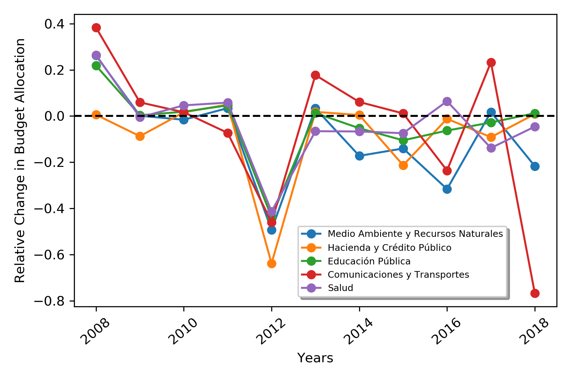
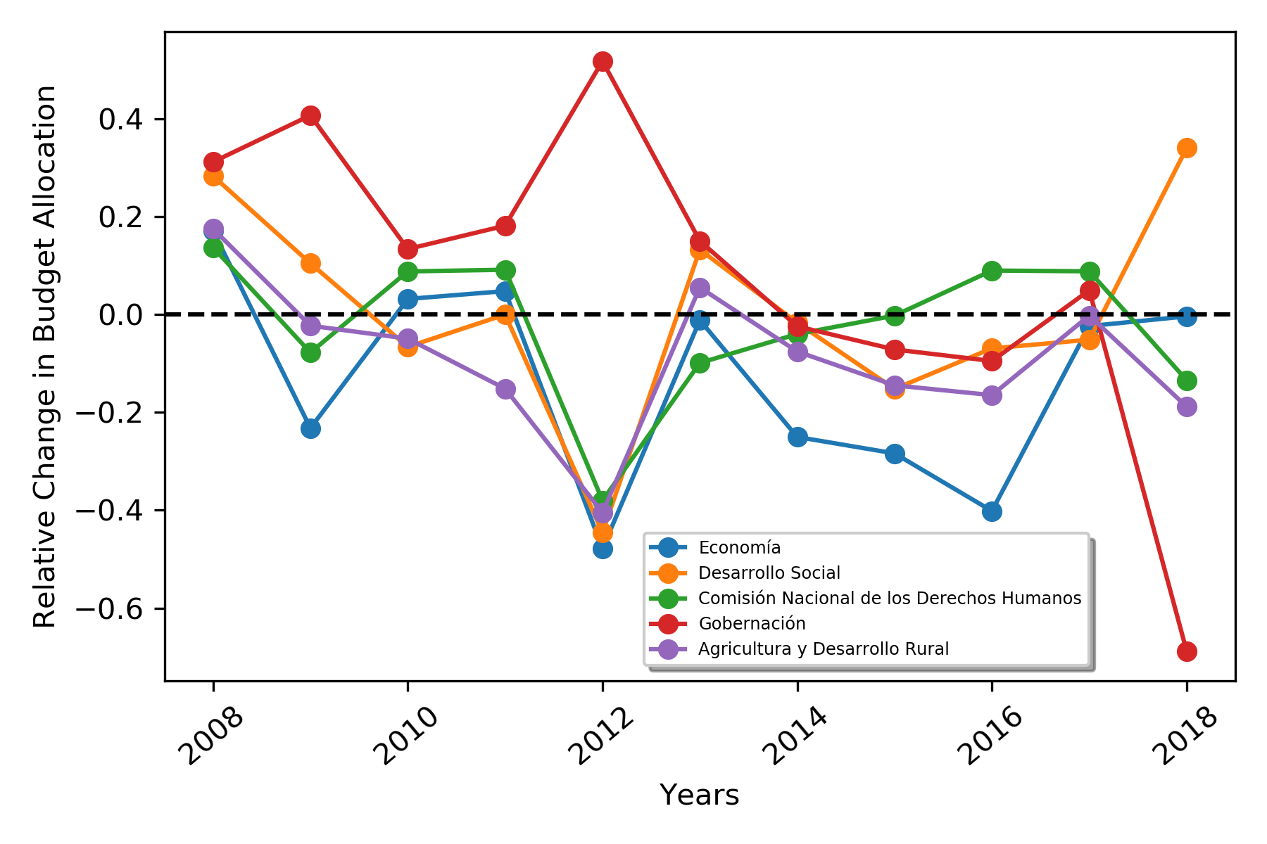
Discussion
Let’s analyse the trend in public expenditure for those Ramos that we identified as the most relevant to the SDGs indicators.

Slide 15
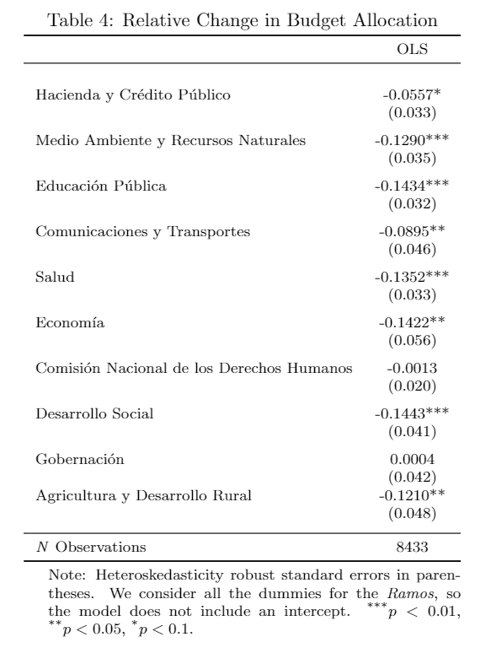
Discussion
On average, systematic disinvestment in those budget programmes that belong to the most relevant Ramos.

Slide 16
Conclusion
Data-driven framework to identify those expenditure categories that are the most relevant to improving the SDGs indicators.
This framework could be useful to help treasuries around the world in making the best use of their resources to achieve the SDGs and thinking about potential spillovers of budget programmes.
Importance of open fiscal data.

