Slide 1
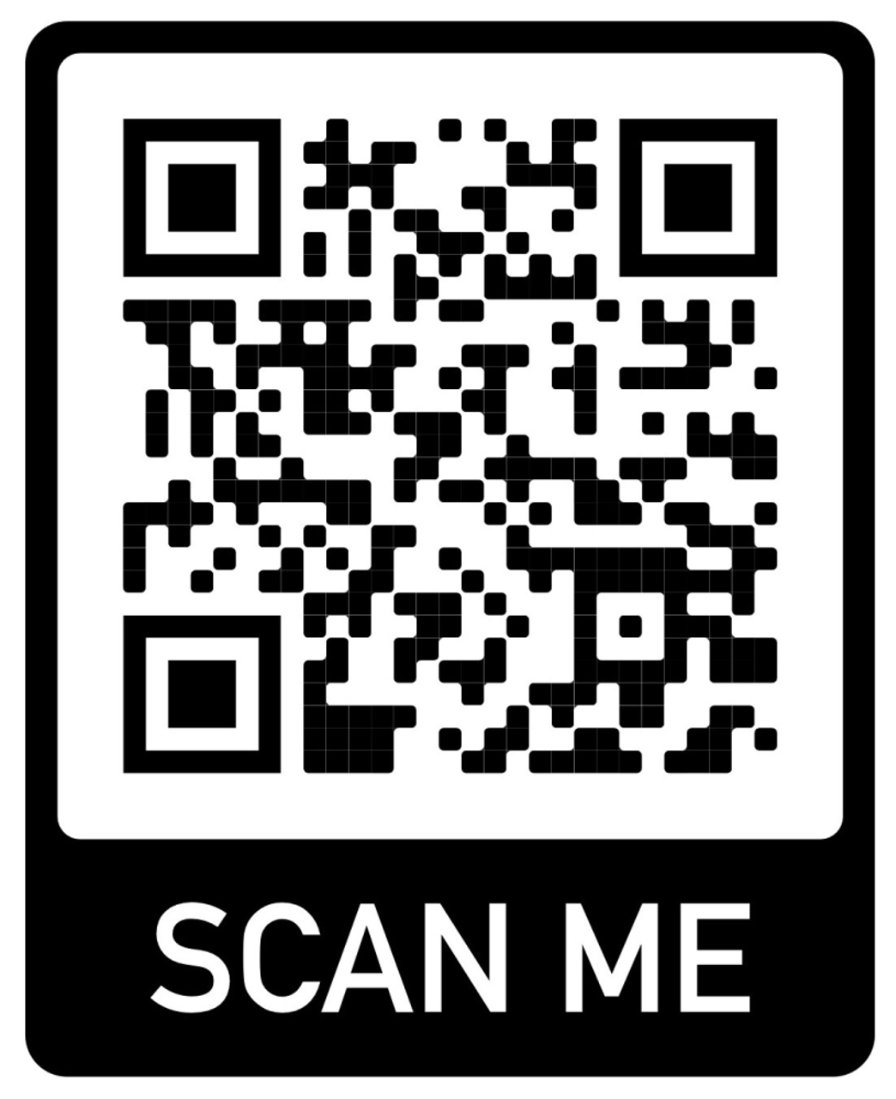
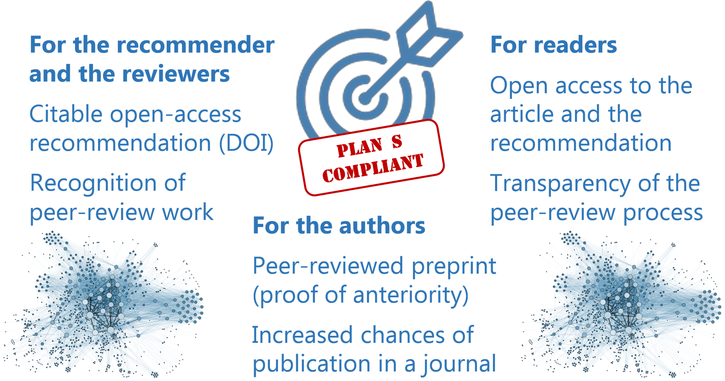
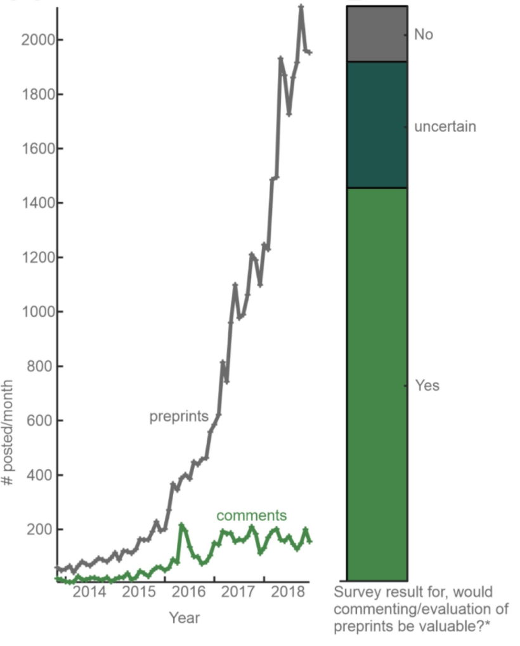
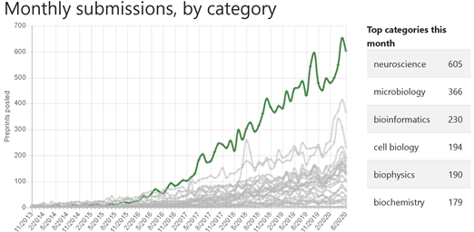





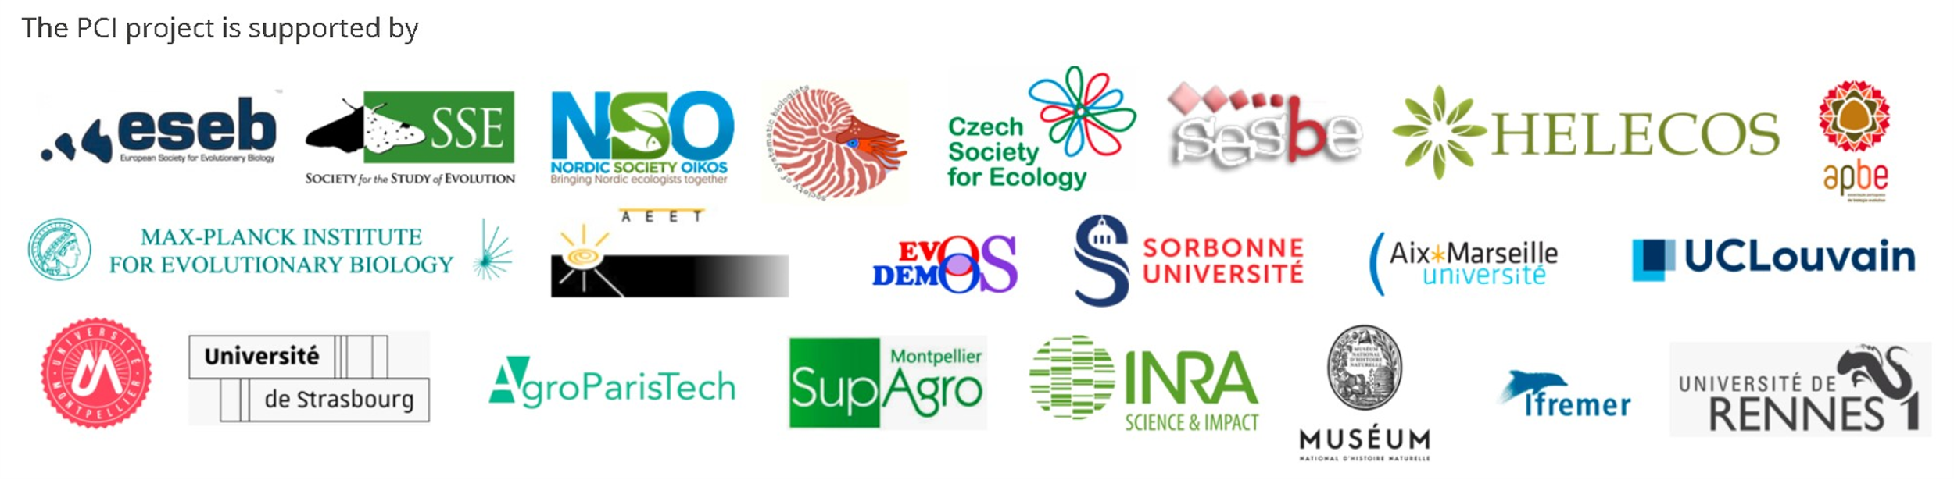





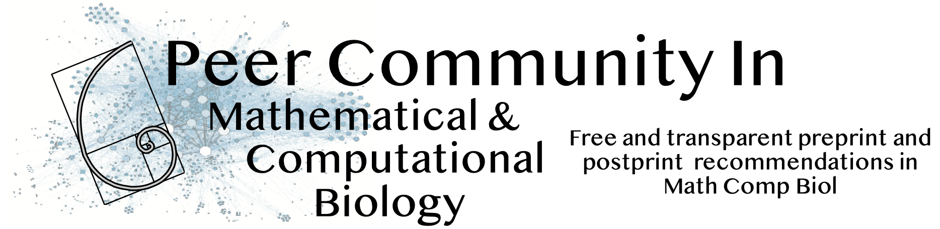

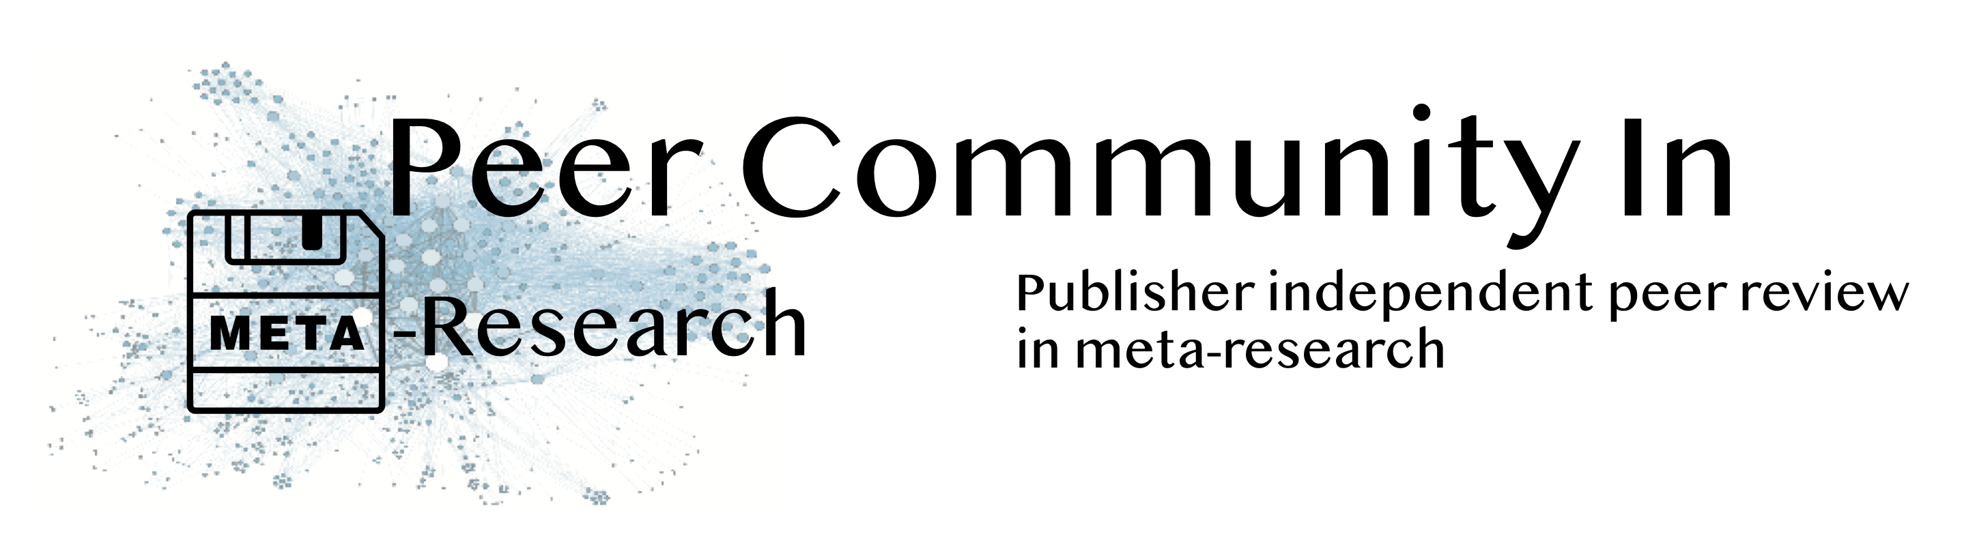

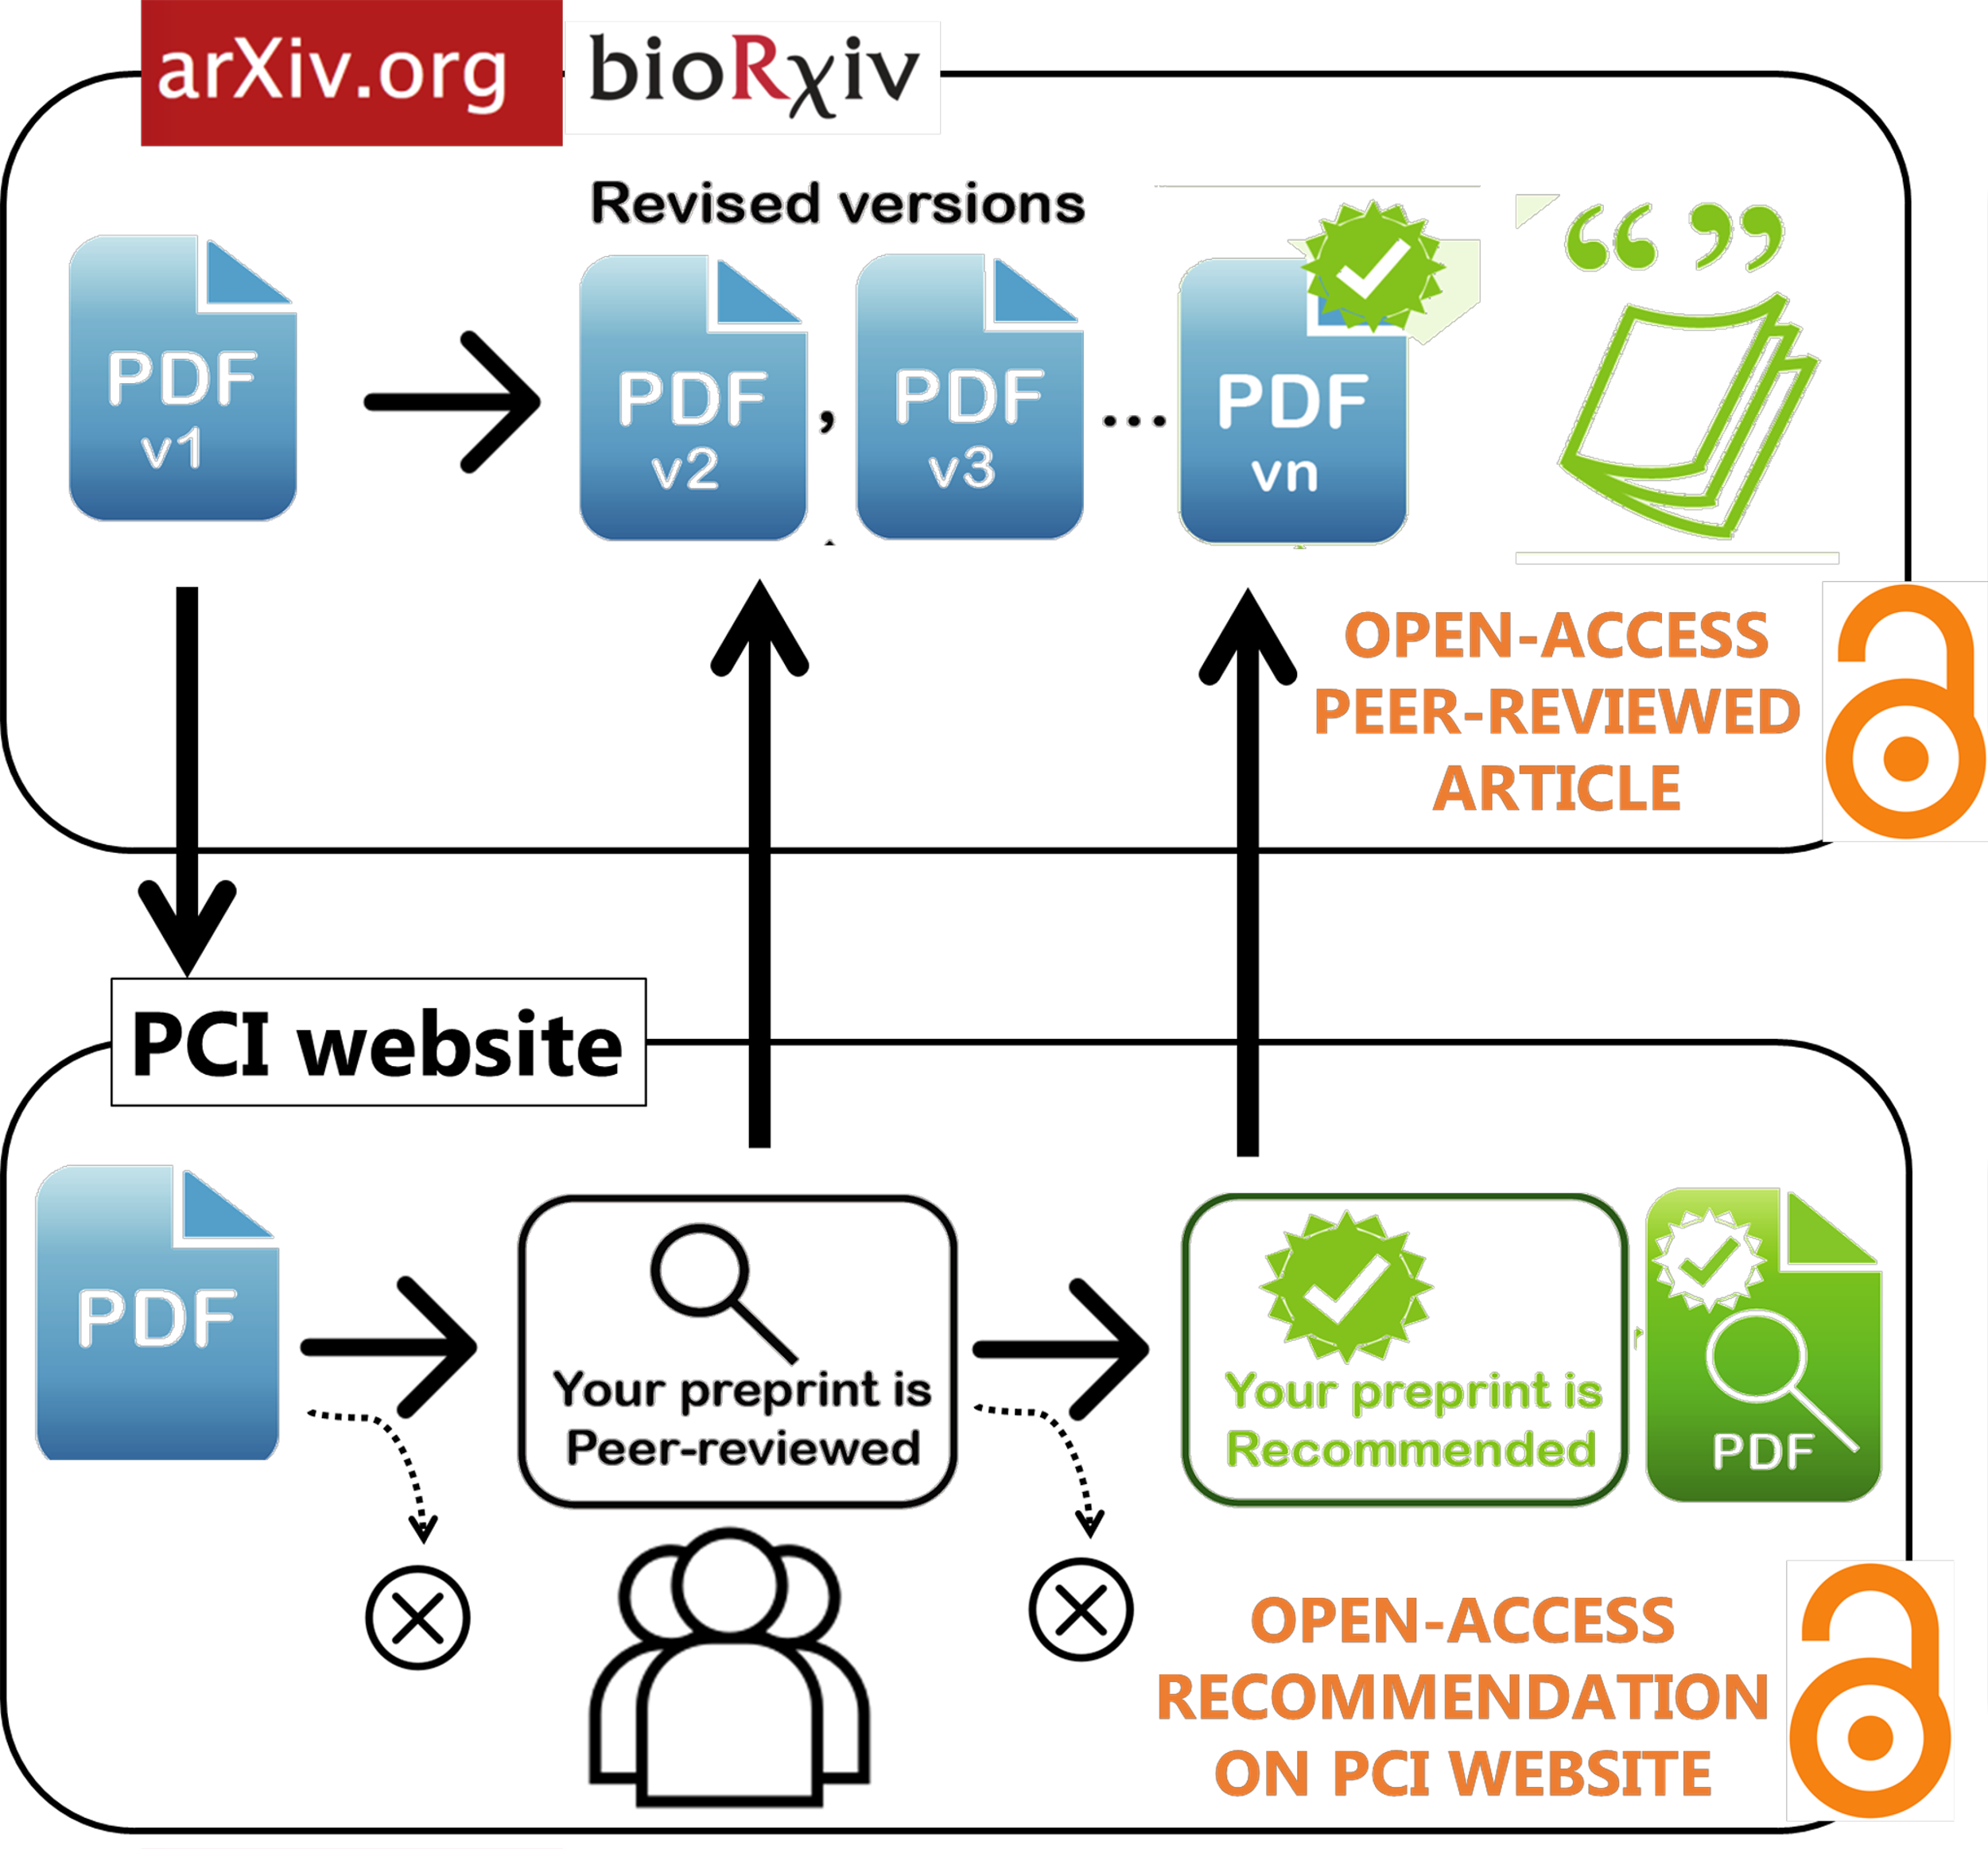

Peer Community In … Circuit Neuroscience
Free and transparent peer-review and recommendation of preprints
Vincent Magloire, Marion Mercier, Mahesh Karnani
C
u
r
r
e
n
t
p
u
b
l
i
c
a
t
i
o
n
s
y
s
t
e
t
m
o
o
e
x
p
e
n
s
i
v
•
too slow
e
•
n
o
t
t
r
a
n
s
p
a
r
e
n
W
H
Y
•
t
?
P
r
e
p
r
i
n
t
f
s
r
e
•
e
•
immediate
•
but not peer-reviewed
S
u
p
p
l
o
y
f
p
r
e
p
r
i
n
t
h
s
a
s
o
u
t
p
a
c
e
e
d
v
a
l
u
a
t
i
o
n
w
h
i
l
d
e
taken from www.rxivist.org
under CC-BY 4.0
e
m
a
n
d
i
s
h
i
g
h
.
N
e
u
r
o
s
c
i
e
n
c
p
e
r
e
p
r
i
n
t
s
a
r
e
t
h
e
b
i
g
g
e
s
a
t
n
d
f
a
s
t
e
s
t
g
r
o
w
i
n
g
c
a
t
e
g
o
r
y
o
n
b
i
o
R
x
i
v
.
C
o
m
m
u
n
i
t
i
e
s
o
f
r
e
s
e
a
r
c
h
e
r
s
p
r
e
p
r
i
n
t
p
s
e
e
r
r
e
v
i
e
w
i
n
•
d
g
e
p
o
s
i
t
e
d
i
n
a
r
c
h
i
v
e
W
H
A
T
s
?
t
h
e
i
p
r
u
b
l
i
s
h
i
n
•
r
g
e
c
o
m
m
e
n
d
a
t
i
o
n
o
n
t
h
P
e
C
I
w
e
b
s
i
t
e
How does it work?
Email: contact@cneuro.peercommunityin.org

