Slide 1





How to write a good scientific paper for publication
Writing Compelling Papers
Umar Ahmad
August 4, 2020
@babasaraki01

Slide 2





Talk content
Scientific Manuscripts:
- Research papers
- Ethical conduct
Preprint servers
  - AfricArxiv
  - bioRxiv
  - medRxiv
  ChemRxiv
Publishers & Standalone journals
- Identifying predatory journals
- Choosing the right journals

Slide 3
Scientific Manuscripts: Research Papers
Umar Ahmad

Slide 4
The writing guide
1) Preparation | Steps | Discussion & Content
 | Concept | Get idea, List experiments/dry lab work, Present to group, Prioritize the experiments, Gather reagents/tools for analyses, Make a timeline for completion, Ask, “Is this experiment or approach necessary and will it answer the questions”?
 | Data collection | Present goals to group, assemble figures as you go, paper quality images, controls, perform similar experiments together, set up meetings, finalise data with the Team and PI.
 | Transition | Decide where to publish, confirm data is sufficient for the journal.

Slide 5
The writing guide…
2) Writing | Steps | Discussion & Content
 | Figures | List key points for figure, determine order, rationale for order and confer with colleagues.
 | Outlines | Choose a title, list sections, theme sentences, and figures. Remember to describe in this order. “Why you did it, How you did it, and What you learned”. Don’t write the section, until the outline is OK by the PI or project leader.
 | Meeting with PI | Technical issues: I) Figures, II) Content, III) Order, IV) Story, V) Spin Management issues: I) Journal, II) Date of the final draft, III) Agreement on responses and submission dates, and IV) Authorship- List authors’ contribution and agree on order.

Slide 6
The writing guide…
2) Writing | Steps | Discussion & Content
 | Writing | Take control, Conform to journal’s requirements, Write in this order: I) Results, II) Methods, III) Discussion, IV) Introduction, V) Abstract. Reduce writing delays by remembering not to write the perfect sentence the very first time. First put down all you wanted to say and then tighten text. Get acceptance of other authors on the authorship order and their critique. Get it read by a few lab mates.
 | Submit to PI | Should be in the final stages (references, number of words, and figures). While waiting to hear from PI, learn on-line submission requirements, assemble a list of potential reviewers, and draft a cover letter. Print check figures and get them ready for online submission.

Slide 7
The writing guide…
3) Post-submission | Steps | Discussion & Content
 | Under review | Perform experiments that you couldn’t include but anticipate reviewers might demand Think of alternate plans (journals with similar style/length, more experiments/analysis, strategy) in case of a rejection.
 | Review | If accepted and revising, have a MS word file of all modifications as you make them for the cover letter to the editor: Be prepared for rapid response; at galley stages, if out of town, leave contact info with someone in the lab as the journal want a quick response.

Slide 8
Who are we writing for?
Scientific community
The journal editors
2 – 3 peer reviewers and (perhaps) 1 biostatistician
Fellow researchers, scientists and clinicians
Your own self

Slide 9

Authorship
Finalise before you begin writing
Read the ICMCJE standard requirements
Ask about your departmental policy and develop a project-based on its
Decide and finalise authorship with supervisor, HOD and research team.

Slide 10
IMRaD format
Title, authors and affiliation etc | 1 page
Introduction | 1 to 2 pages
Materials and Methods | 2 to 4 pages
Results | 2 to 4 pages
Discussion | 2 to 3 pages
Figures and Tables | Maximum of 6
References | 20 – 35 lists

Slide 11
Results
Content :-
Results section should report
  - Your main findings and important ones
  - Point or direct the reader to the data shown in figures and tables
  Include control results
  Place results that answer the question of the paper at the beginning
  Report from most to least import findings
  Interpret the data for the readers
  State purpose, background experiments, approach, results and interpretations
  Used past tense for results but present tense for descriptive papers
Overall: -
The major scientific contribution of your study
Answer the aims directly
It represents the core findings that may be of interest to scientific community
Do not repeat numbers from the tables in the text.
Create scientific table & quality figures figures

Slide 12
Organise the results into segments
Each segments should cover one long paragraph that contains four essential components:
Background of experiment (when needed but optional)
Purpose
Experimental approach
Results
Interpretations of results

Slide 13
Good examples of data interpretation
Wrong
Presenting data without interpretation
Heart rate was 100 beats per minute after digitalis was added (Figure 3)
Correct I
Heart rate increased to 100 beats per minute after digitalis was added (Figure 3)
Correct II
Heart rate increased from 60 to 100 beats per minute after digitalis was added (Figure 3)

Slide 14
Signals for the reader in Results
Purpose/Questions | Experimental approach | Results | Interpretations
To establish if… | ..we did … | We found… | , indicating that…
To determine … | X was subjected to… | We observed … | , consistent with…
Substance X was tested to…. | ..by/using … | We detected … | ' which indicates that…
For the purpose of XYZ… | ABC was performed.. Experiment X showed .. | Our results indicated that… | ' This observation indicates that…
[Hofmann (2010); 274-275 ]

Slide 15
Good examples of data interpretation I
Correct
To examine whether the recombinant Newcastle disease virus (rNDV) AF2240 bearing a transgene of green fluorescence protein (GFP) (rNDV-GFP)(X. Cheng et al., 2016) will persistently infect the established persistent bladder cancer cell lines, both TCCSUPPi vs TCCSUP (control) and EJ28Pi vs EJ28 (control) were re-infected with rNDV-GFP at MOI of 1. Since the recombinant NDV carries an inserted GFP within its genome, it is expected that the persistent cell lines will express the green fluorescence upon viral replication in the cells. At 24 hours post-infection, the cells were monitored for detecting the expression of GFP. As shown in Figure 4.13, control cells (TCCSUP and EJ28) were mostly infected by the rNDV especially the EJ28 cells as demonstrated by the large majority of GFP-expressing cells (top right panel A & B). Conversely, the persistently infected cells (TCCSUPPi and EJ28Pi) showed low level of GFP-expressing cells, indicating that some of the viral persistent cells are either resistant to re-infection by rNDV-GFP or are unable to express the GFP transgene within the 24 hours post infection (Figure 4.13; bottom panels A & B).
[Ahmad et al (2020) unpublished work ]

Slide 16
Common problems in Results
The most common problems in results are
Adding irrelevant information
Missing the components mentioned above
Excessive details of experiments
Inclusion of comparisons with previous studies

Slide 17
Materials & methods
Content & Organization:-
Methods section should cover
  - Materials (buffers, drugs, culture media, apparatus)
  - Subjects (patents, experimental materials, animals, plants etc)
  - Details study design
  Procedure (what, how and why you did something)
  Follow guidelines on ethical conduct
  State what you did that yielded the results section.
  Explain the purpose of each procedure whose function is not clear
  Always read Instructions to Authors of your target journal.
Overall: -
Describe the experimental approach
Reviewer carefully read it to evaluate your scientific claims
Write this part with great care and ensure it is reproducible
Paper get reject if methods section are not carefully written or the study is not design well.

Slide 18
Example of good reporting in methods section
Referring to previous described methods
Plasmids were isolated according to Braun [19]
For numerical calculations involved in this study, we developed at the National Centre for Atmospheric Research [22].
Referring to described methods that were modified
Plasmids were isolated according to Braun [19] with minor modifications. Instead of dissolving DNA pellets in sterile water, pellets were dissolved in buffer A.

Slide 19
Common problems in methods
The most common problems in methods section are
Omission of experimental purpose
Insufficient details
Excessive length
Switching between past tense and present tense
Interchanging between passive and active voice
Passive voice is most preferred when writing method section of a research paper

Slide 20
Discussion
Content :-
Discussion section should report
  - Your key findings by providing answer to the research question
  Summarise and generalise
  Organise in Pyramid structure
Overall: -
The hardest section to define and write
Bad discussion results in paper rejection
Good style and logical presentation is important in discussion

Slide 21
First paragraph
Interpretation based on key findings
Middle paragraphs
Compare and Contrasts to previous studies
Limitations of your study
Unexpected findings
Hypotheses
Last paragraph
Summary/implication

Slide 22
First paragraph | Tell your reader what your key findings were and what they mean. Do not begin Discussion with second Introduction. State the answer based on your findings in opening sentence of the Discussion. Restate the purpose of the study (optional).
Middle paragraphs | Explain how your findings fit into what is known in the field. Tell your readers what you think your results mean and how strongly you believe in them. Organise it from most to least important and explain the science Compare and contrast your results with those found by others
Last paragraph | Analyse the most important results and the significance of your work Summarise and generalise why the contribution of your study is important overall, in your field, outside your field, and for society.

Slide 23
Signals for the Discussion I
Answer | Key findings | Summary | Significance
In this study, we have shown that… | In our experiments… | In summary…
Our study shows that… | We found that… | To summarize our results… | We recommend that X is… Y should be used for ….
In this study, we found that | …..can be attributed to… | In conclusion… Finally… Taken together.. | Our finding will serve to… can be use…
Our findings demonstrate that… | Our data shows that….has been demonstrated by… | We conclude that… | Y indicates that X might …
[Hofmann (2010); 274-275 ]

Slide 24
Signals for the Discussion II
Comparisons | Conflicting Results | Limitations | Unexpected Findings | Proposed hypothesis
…consistent with ..(ref.) Similar to…(ref.) | However, other studies found that… (ref.) | ..was not possible.. | Surprisingly… To our surprise.. | Our results lead to the conclusion that…
…has also been observed by …(ref.) | …is controversial..(ref.) …does not agree with …(ref.) | …could not be measured… …was limited by… | ….was not expected. | From these data we hypothesize that…
X has been demonstrated …(ref.) | …has also been reported…(ref.) | Further observations are needed to.. |  | We proposed the following new principle….

Slide 25
Common problems in & Best ways in Discussions
The most common problems in Discussion are
Not providing the answer/interpretation of your findings in the first paragraph
No concluding paragraph is provided
Inclusion of irrelevant or peripheral information
Repeating results in the Discussion.
Best ways
Interpretation/answer
Key findings
Comparison with previous findings
Comparisons with models of others
Suggested hypothesis
Summary
Significance of the finding/work

Slide 26
The Introduction
Overall: -
Begin with the broadest scope and get progressively narrower but do not review literature
Provide contextual background information for the readers
Tell the reader why you did the study
May contain or repeat some parts of the Abstract
Content & Organization:-
Follow ”funnel” structure by including:
  - Background
  - Unknown/Problem
  - Questions/study aims/purpose
  Experimental approach
  Results /Conclusion/Significance (optionally).

Slide 27
The Introduction…
General Content & structure:-
Background
  - broad and specific background info and previous research in the area under study.
Unknown/Problem
  - Problems of previous work and unknown factors in the research area.
Purpose of the study
- addition made by your research
Experimental approach
- approach taken toward this addition.
Keep it short: -
One to two double-spaced pages (about 250-600 words)
Check the instructions to authors of your target journals to ensure you are within the word limits.
Most research papers are investigative

Slide 28
Example of good Introduction
Broad background | In mammals, the auditory hair cells of the inner ear are the sensory receptors of the auditory system. Two functionally and anatomical distinct types of mammalian auditory hair cells exist; inner and outer har cells. Outer hair cells do not send neural signals to the brain, but they mechanically amplify low-level sound that enters the inner ear [1]. The amplification is powered by an electrically driven motility of their cell bodies [2].
Specific background | The molecular basis of this mechanism is thought to be the motor protein prestin, which is embedded in the lateral membrane of the outer hair cells. Mammalian prestin is an 80kDa, 744 amino acid membrane protein whose function appears to depend on chloride channel signaling [3,4]. Although prestin has been researched
Unknown/Problem | intensively, its molecular function has not been fully established.
[Hofmann (2010); 223-245 ]

Slide 29
Example of good question/study aim
To determine if the triggered cellular processes affect the rRNA structure and folding dynamic in vivo,…
Here we asked how rheumatic fever influences heart rate
In this study, we show that a sequential scheme of phosphorylation and dephosphorylation can generate circadian oscillations.
Here we examine the effects of total carbon concentration on U(VI) adsorption.

Slide 30
In case of a descriptive papers
Expected Content:-
Background
  - background info and previous research in the area.
Discovery statement
  - New discovery made or found in your search.
Experimental approach
- methods taken toward analyzing the new discovery
Description
- description of the new findings or elements.
Implication
- Importance of the findings
New discovery or novel apparatus: -
Describe new findings, unknown disease or a novel apparatus
Slightly different from funnel structure done for investigative paper
The expected elements are differed

Slide 31
Example of discovery statement
We discovered a new toxigenic seragroup, O210, of Vibrio cholerae. O210 can produce cholera toxin (CT) and cause severe symptoms.
Here we describe a novel bacterial protease, Ecpro-3.
We examined the structure of the bacterial ribosome in complex with tetracycline.

Slide 32
Template and common problems in intro
Paragraph 1:
What we know
The most common problems in Introduction are
Overview sentences
Too narrowed background/context
Excessive length
`Missing elements such as; problems, questions, experimental approach.
Paragraph 2:
What we don’t known
Paragraph 3:
Why we did this study
Always report the science not the scientists

Slide 33
Abstract
Overall
Covers all the main information in the paper in a single paragraph
Abstract should interest the reader
Knowing how to write an abstract is one of the most important skills in science.
Do not include or refer figures
No references should be included
General Content
Background
Question/Aim/objectives
Methods (or experimental approach)
Results
Conclusion/implication
Structure or informative abstract (for research papers)

Slide 34
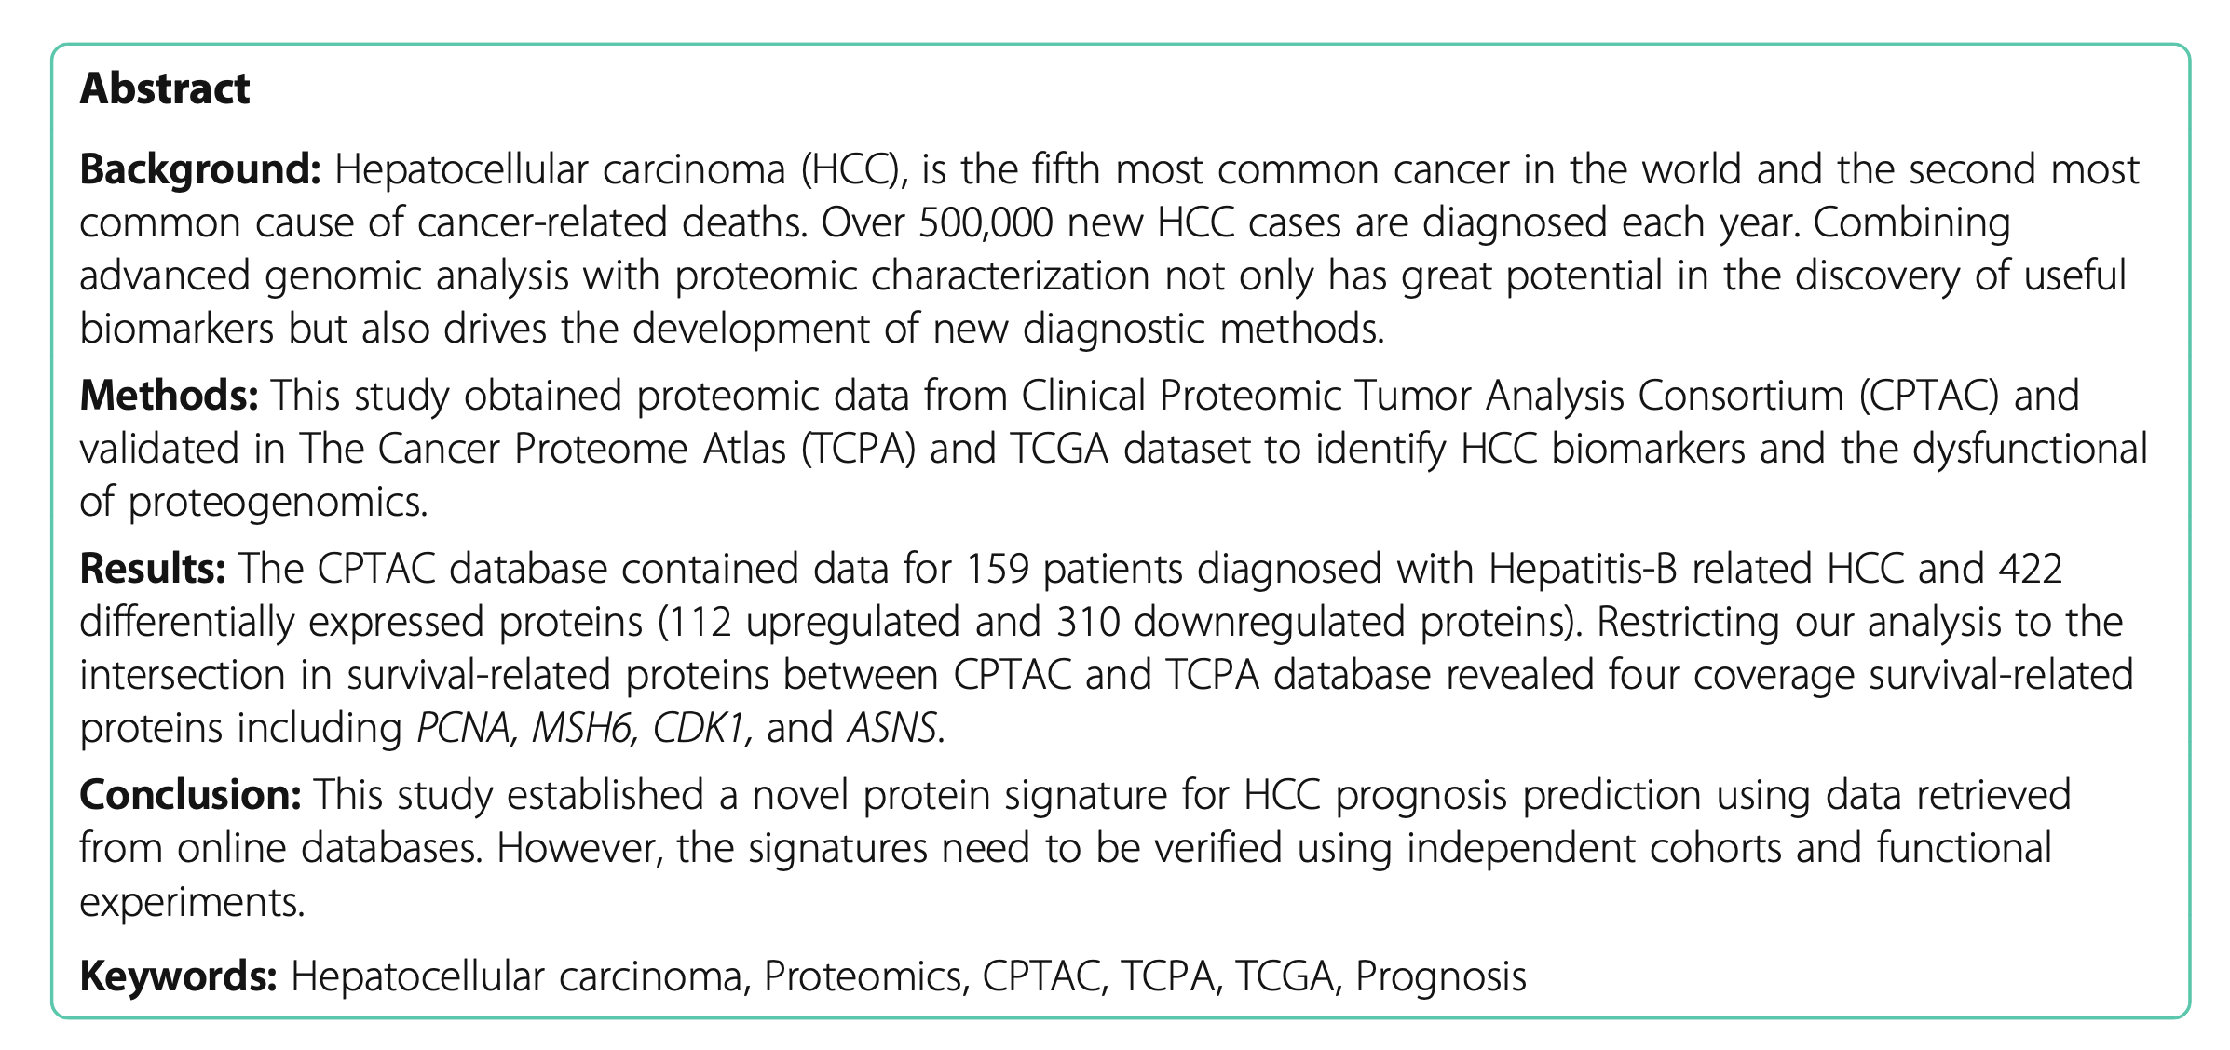
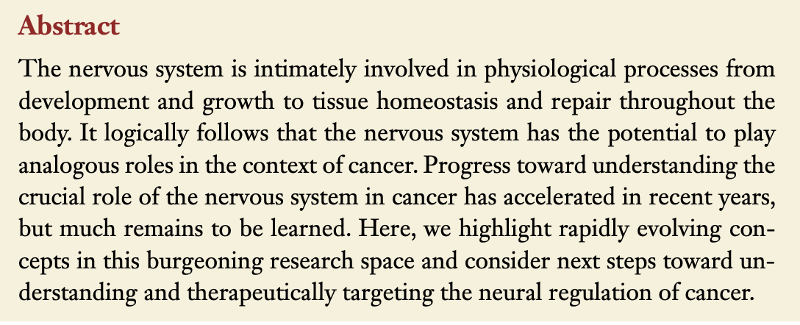
Example of good Abstracts
Structure or informative abstract (for research papers)
Indicative (for review papers)
Gillespie and Monje 2019

Slide 35
Scientific Manuscripts: Ethical Conducts
Umar Ahmad

Slide 36
Follow guidelines on ethical conduct
Ethical, legal and regulatory requirements should carefully be studied
Check each countries or international requirements before reporting your findings
Journal editors required authors to seek for an approval by ethics committee.

Slide 37
Guideline on ethical conduct
Guidelines/Mandate | Source | Purpose | Url (site)
Uniform Requirements for Manuscripts Biomedical Journals | International Committee of Medical Journal Editors (ICMJE) | Statement of ethical principles in the conduct and reporting of research and recommendations relating to specific elements of editing and writing. | http://www.icmje.org
Declaration of Helsinki | The World Medical Association |  | https://www.wma.net/policies-post/wma-declaration-of-helsinki-ethical-principles-for-medical-research-involving-human-subjects/
Guide for the Care and Use of Laboratory Animals | Institute for Laboratory Animal Research of the National Research Council |  | https://www.nap.edu/author/ILAR/division-on-earth-and-life-studies/institute-for-laboratory-animal-research

Slide 38
Preprint servers
Umar Ahmad

Slide 39

Preprints
Benefits
Full draft or complete scientific manuscripts shared publicly online
before they are peer reviewed by the journals.
Publicly free
Exposure
Citations
Credits
Feedback
Notes:
Preprints are complete drafts of scientific manuscripts that are freely shared online prior to peer review by the journals.
We also accept dataset, presentation slides, student reports, conference proceedings, and posters

Slide 40

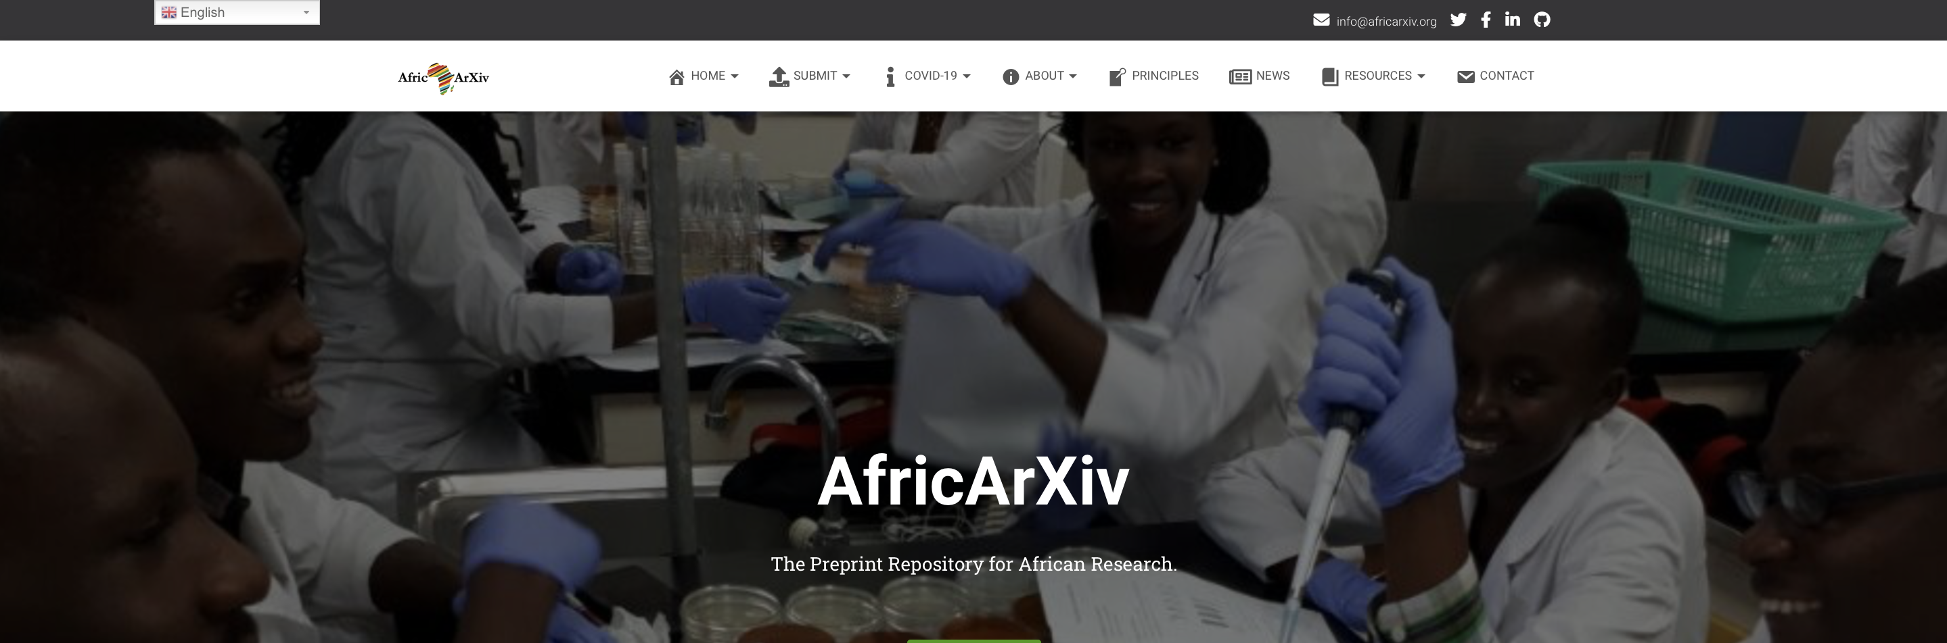

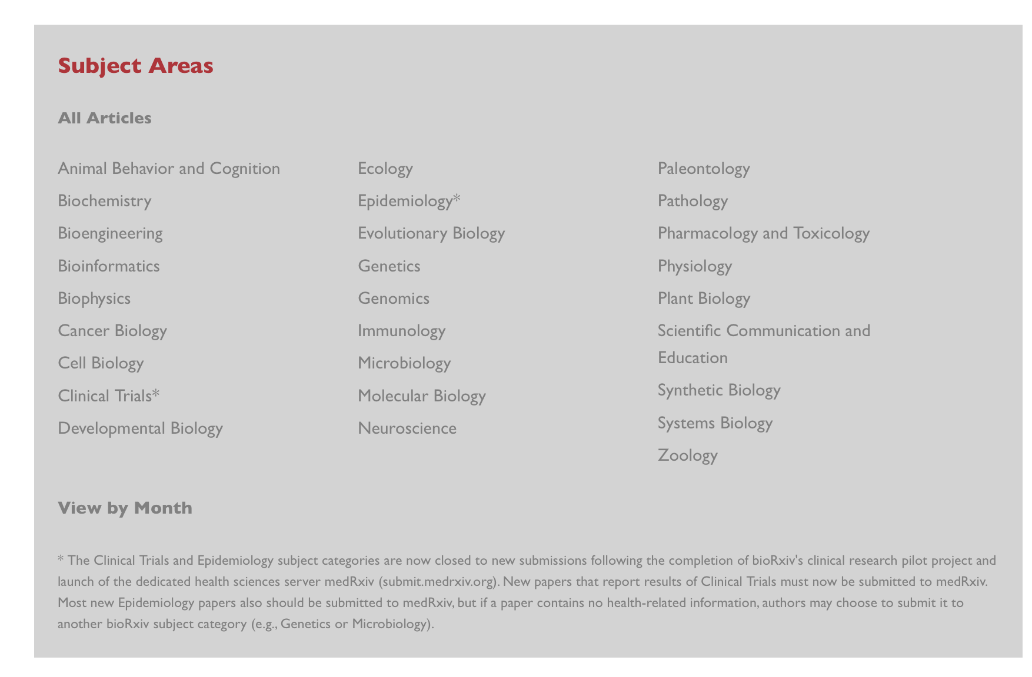

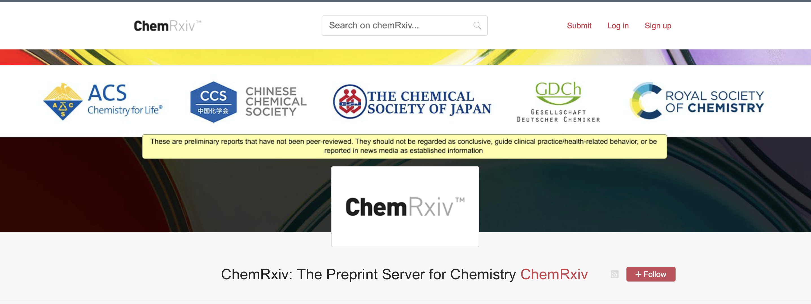


Slide 41

With AfricArxiv, we want to
promote the use of local African languages in science
bridge language barriers
Increase the discoverability of African researches
info.africarxiv.org
Notes:
Most African are either speaking Arabic or French and they speaks more than 2 languages
To increase the discoverability of African researches and showcase African scientists based on their field to the global community of scientists.
We also accept dataset, presentation slides, student reports, conference proceedings, and posters

Slide 42

Our repository partners
info.africarxiv.org/partners/
Notes:
As we are working towards building our own repository that is
owned by the African Science community
hosted on African territory
open source
open access
free for users
-Hosting institution based in Africa for African researchers to deposit and save their research work
-Aim for African research Infrastructure- any scientist in the continent can access what is in the server.
- to ensure accessibility and discoverability for any scientist in the continent

Slide 43

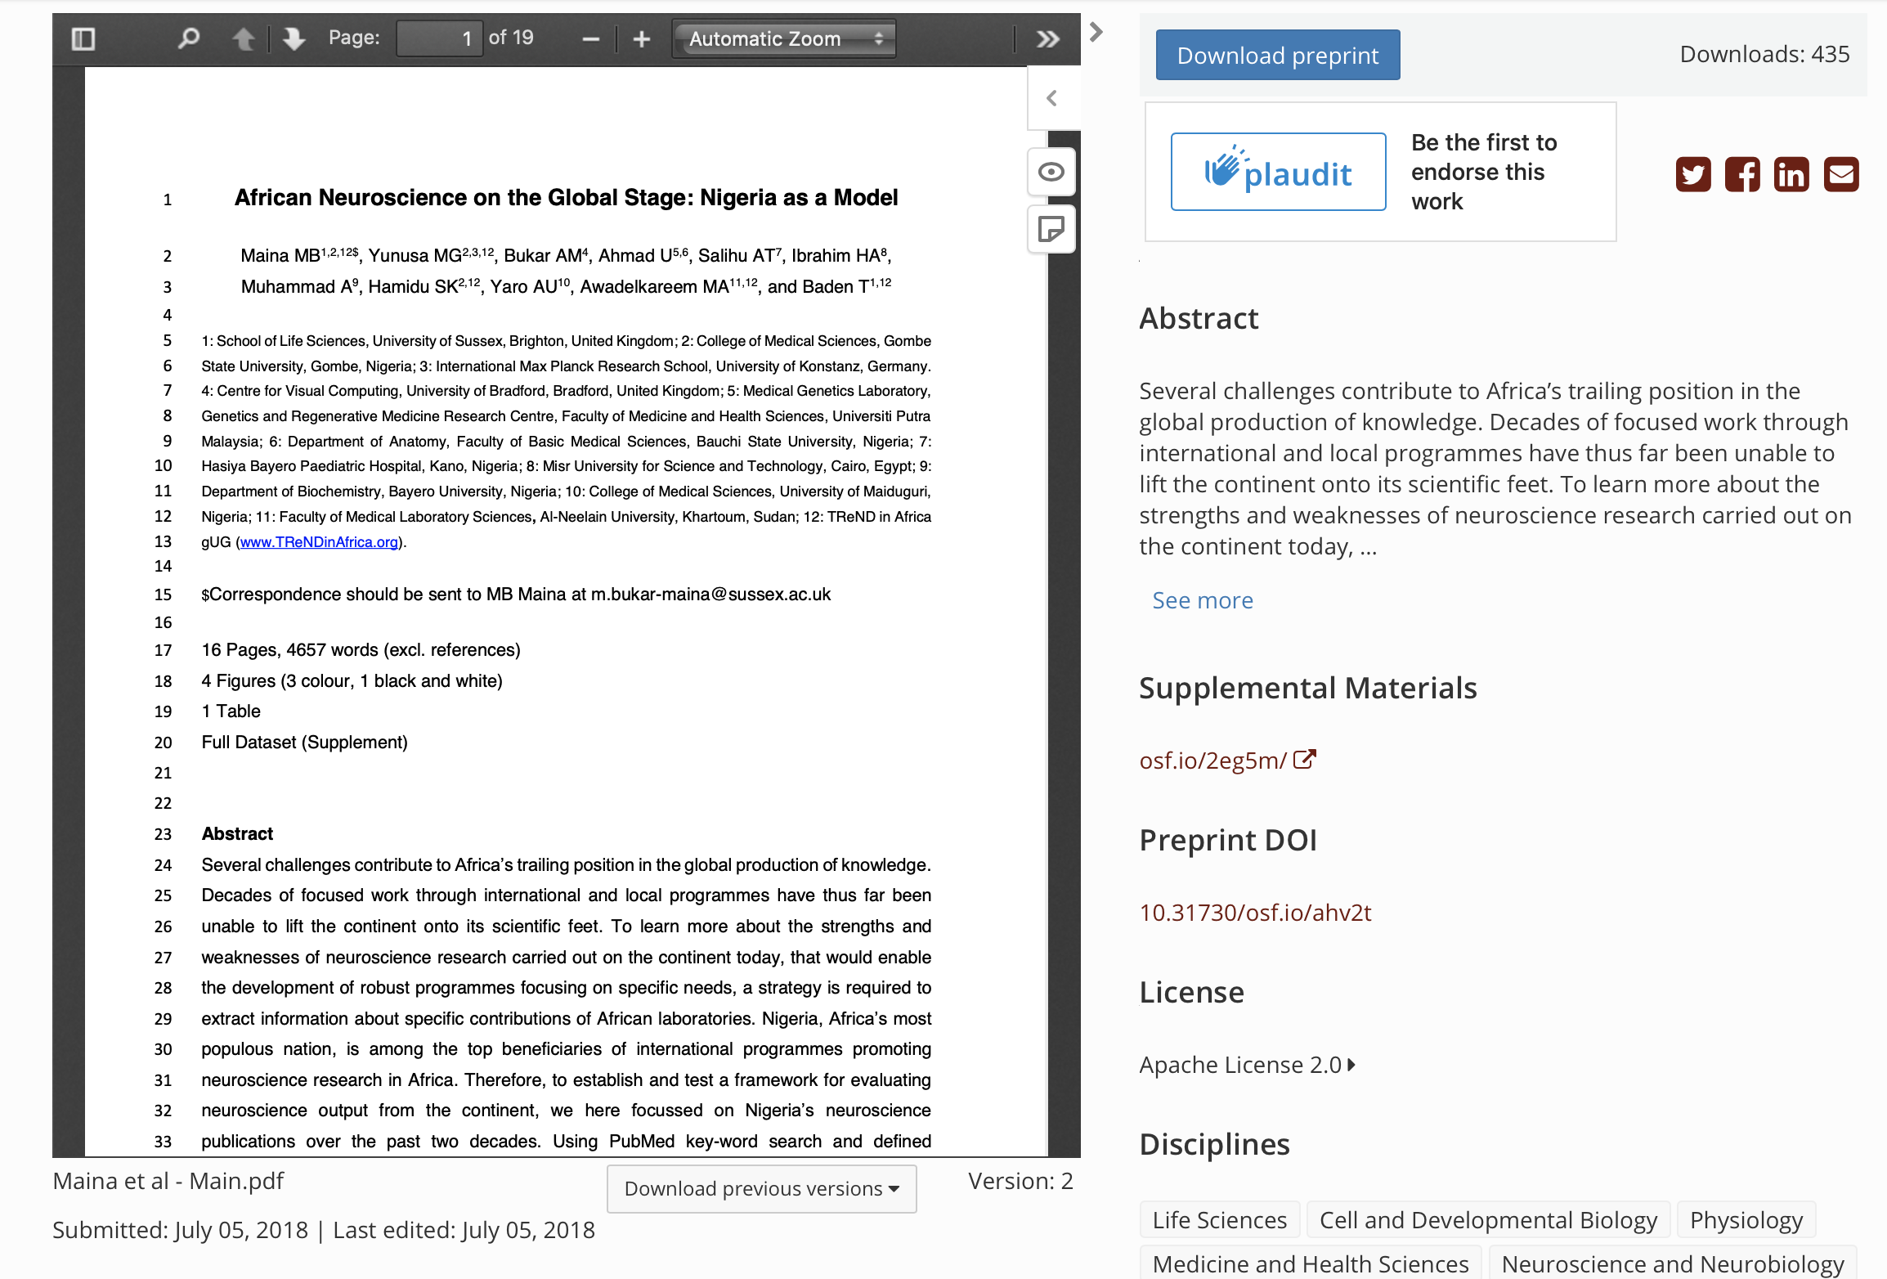
https://osf.io/preprints/africarxiv/ahv2t/
Notes:
How preprint support African scientists discoverability, making their work more visible and download

Slide 44
Choosing the right journals
Umar Ahmad

Slide 45

THINK
Are you submitting your research to a trusted journal or publisher?
Is it the right journal or book for your work?
More research is being published worldwide.
New journals are launched each week.
Stories of publisher malpractice and deception are also on the rise.
It can be challenging to find up-to-date guidance when choosing where to publish.
How can you be sure the journal you are considering is the right journal for your research?

Slide 46

CHECK
Reference this list for your chosen journal to check if it is trusted.
Do you or your colleagues know the journal?
Can you easily identify and contact the publisher?
Is the journal clear about the type of peer review it uses?
Are articles indexed in services that you use?
Is it clear what fees will be charged?
Do you recognise the editorial board?
Is the publisher a member of a recognized industry initiative?
– Do they belong to the Committee on Publication Ethics (COPE) ?
– If the journal is open access, is it listed in the Directory of Open Access
Journals (DOAJ) ?
– If the journal is open access, does the publisher belong to the Open Access
Scholarly Publishers’ Association (OASPA) ?

Slide 47

SUBMIT
If you can answer ‘yes’ to most or all of the questions on the list.
Complete the check list and submit your article only if you are happy you can answer
‘yes’ to most or all of the questions.
You need to be confident your chosen journal will have a suitable profile among your peers to enhance your reputation and your chance of gaining citations.
Publishing in the right journal for your research will raise your professional profile, and help you progress in your career.
Your paper should be indexed or archived and be easily discoverable.
You should expect a professional publishing experience where your work is
reviewed and edited.
Only then should you submit your article.

Slide 48

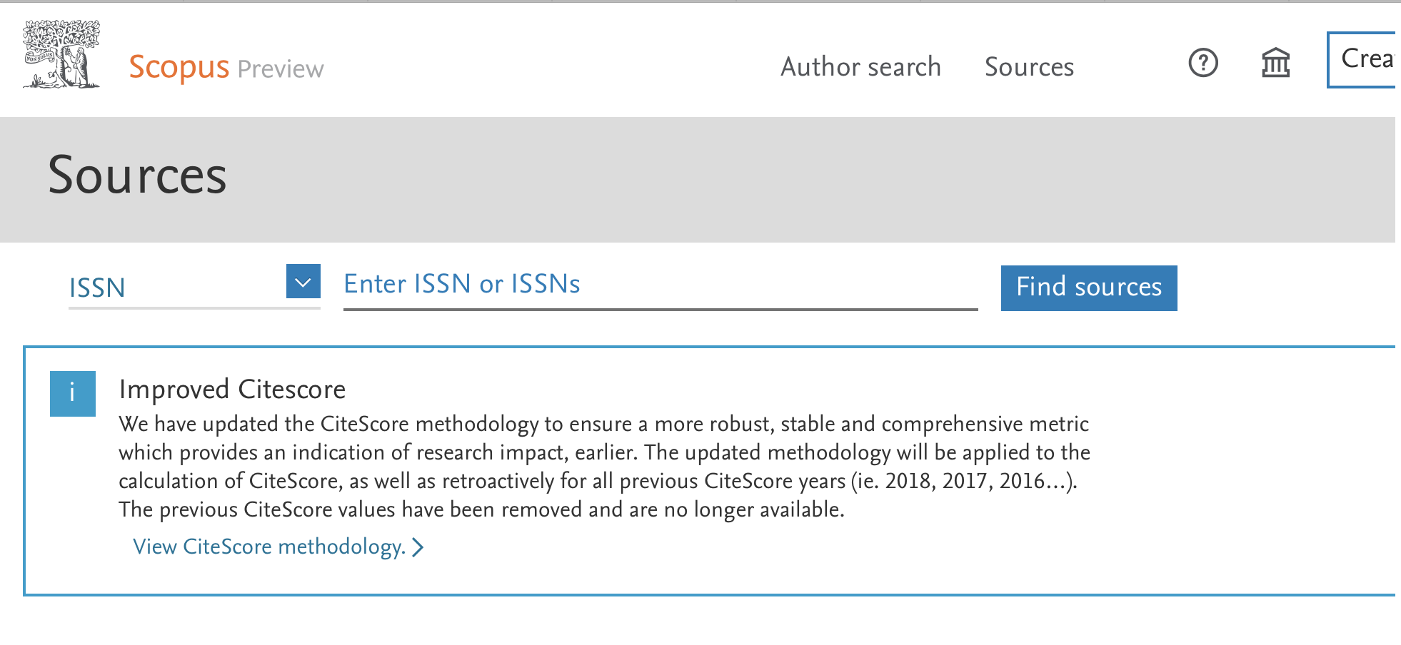
Alternatively
Scopus Index journals link: https://www.scopus.com/sources
ISI journals master list link: https://mjl.clarivate.com/home

Slide 49
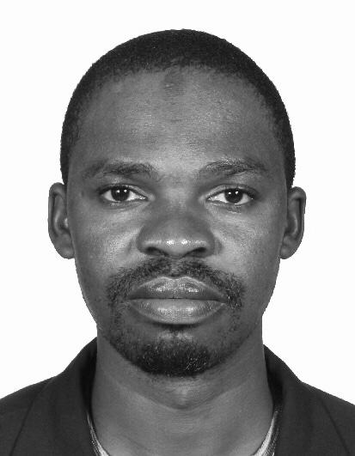

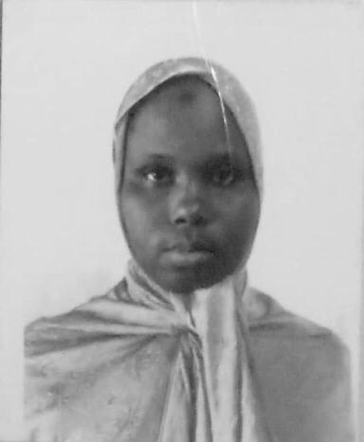

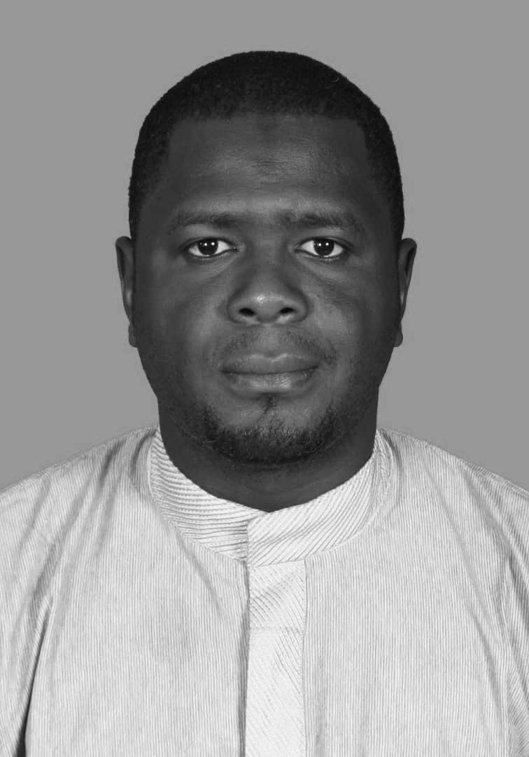

Organizers & Sponsors
Abdussamad Abubakar- co-host
Department of Microbiology
Universiti Putra Malaysia
Buhari Ibrahim – host/moderator
Department of Molecular Imaging
Universiti Putra Malaysia
Balkisu Ibrahim – finance
Department of Economics
Universiti Putra Malaysia
Sani Muhammad – technical
Department of English
Universiti Putra Malaysia
Kabiru Bello Ilela – technical
Department of Politics & Government
Universiti Putra Malaysia

Slide 50

Questions?

