Slide 1

The Turing Way
Reproducible, inclusive, collaborative data science
Kirstie Whitaker
Pronouns: she/her
#DSSGx #TuringWay @turingway @kirstie_j
https://doi.org/10.5281/zenodo.3959179
Notes:
TIMING: 0

Slide 2
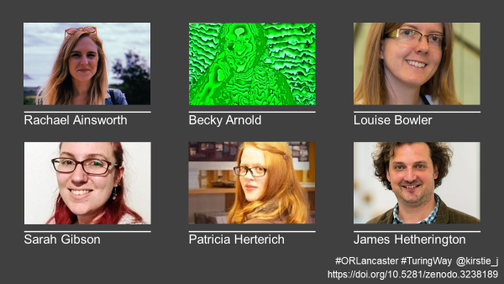
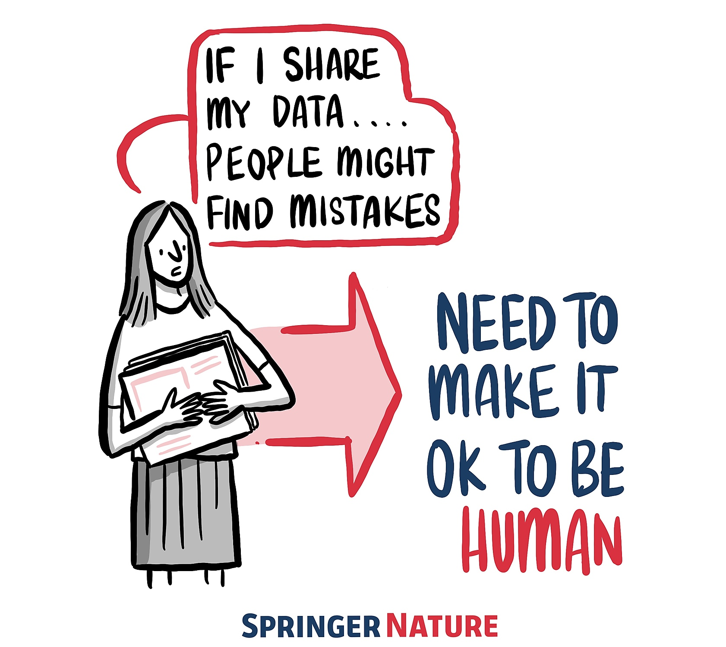
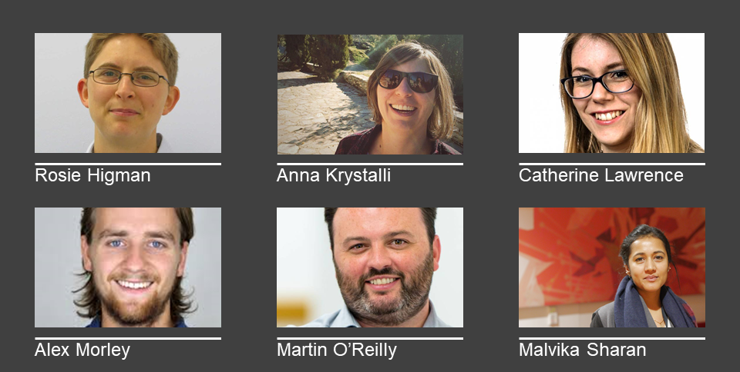
The Turing Way is:
a book
a community
a global collaboration
a whole tonne of work
#DSSGx #TuringWay @turingway @kirstie_j
https://doi.org/10.5281/zenodo.3959179
Notes:
TIMING: 1

Slide 3
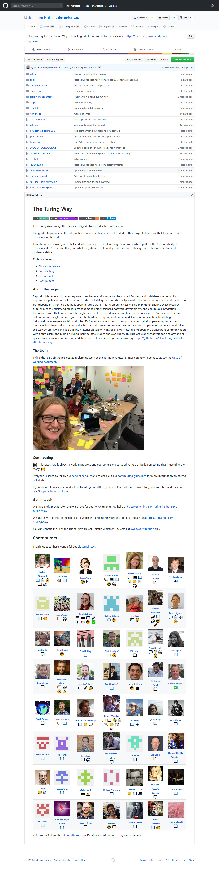
Thank you to all our contributors
#DSSGx #TuringWay @turingway @kirstie_j
https://doi.org/10.5281/zenodo.3959179
https://github.com/alan-turing-institute/the-turing-way#contributors
https://allcontributors.org/docs/en/emoji-key
Notes:
TIMING: 1

Slide 4

An introduction to me
#DSSGx #TuringWay @turingway @kirstie_j
https://doi.org/10.5281/zenodo.3959179
Notes:
TIMING: 1

Slide 5
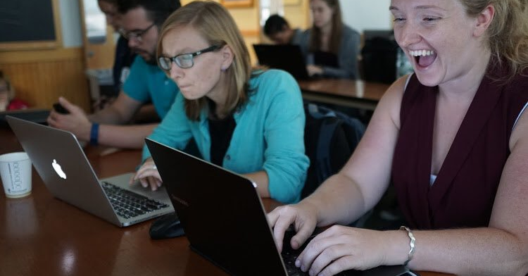
Picture credit: Chris Gorgolewski
#DSSGx #TuringWay @turingway @kirstie_j
https://doi.org/10.5281/zenodo.3959179

Slide 6
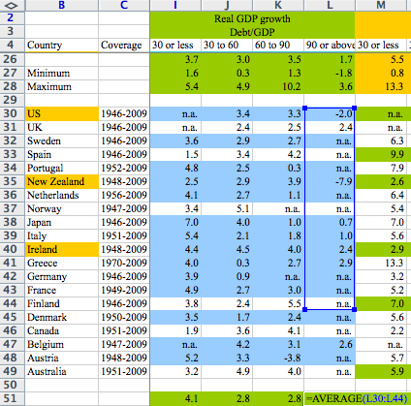
Academic errors have real world effects
#DSSGx #TuringWay @turingway @kirstie_j
https://doi.org/10.5281/zenodo.3959179
https://statmodeling.stat.columbia.edu/2013/04/16/memo-to-reinhart-and-rogoff-i-think-its-best-to-admit-your-errors-and-go-on-from-there
https://www.bbc.co.uk/news/magazine-22223190
Notes:
TIMING: 3

Slide 7
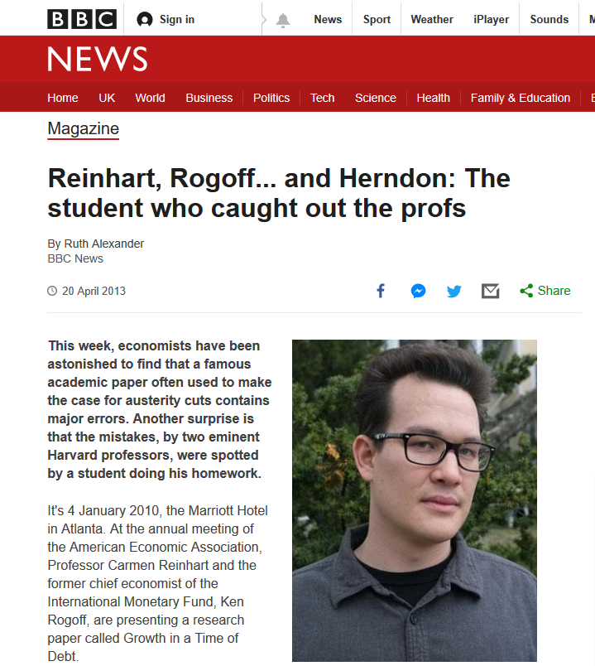
Academic errors have real world effects
#DSSGx #TuringWay @turingway @kirstie_j
https://doi.org/10.5281/zenodo.3959179
https://statmodeling.stat.columbia.edu/2013/04/16/memo-to-reinhart-and-rogoff-i-think-its-best-to-admit-your-errors-and-go-on-from-there
https://www.bbc.co.uk/news/magazine-22223190

Slide 8
The humans are the hardest part of reproducibility
#DSSGx #TuringWay @turingway @kirstie_j
https://doi.org/10.5281/zenodo.3959179

Slide 9
 |  | Data
 |  | Same | Different
Analysis | Same | Reproducible | Replicable
 | Different | Robust | Generalisable
#DSSGx #TuringWay @turingway @kirstie_j
https://doi.org/10.5281/zenodo.3959179
https://the-turing-way.netlify.app/reproducible-research/
overview/overview-definitions.html
Notes:
TIMING: 5

Slide 10
Held to higher standards than others
Is not considered for promotion
Publication bias towards novel findings
Barriers to reproducible research
Requires additional skills
Plead the 5th
Support additional users
Takes time
https://doi.org/10.6084/m9.figshare.5537101
#DSSGx #TuringWay @turingway @kirstie_j
https://doi.org/10.5281/zenodo.3959179
Notes:
TIMING: 6

Slide 11
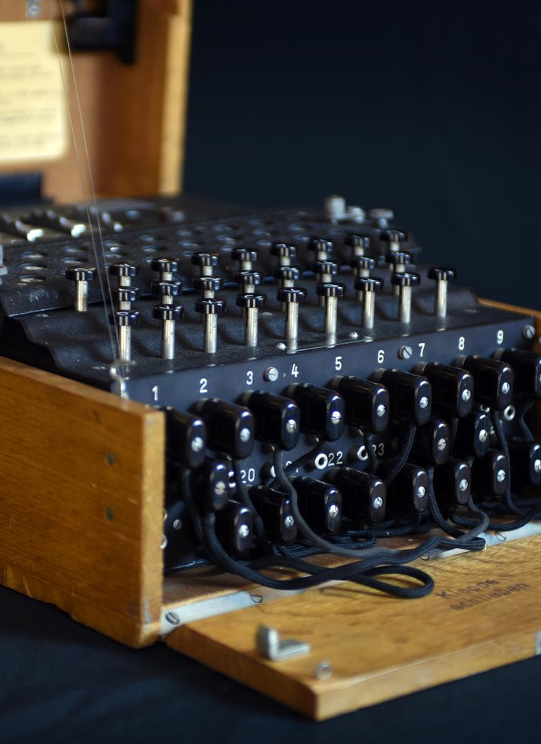
The Turing Institute
https://www.turing.ac.uk/news/enigma-machine-goes-display-alan-turing-institute
#DSSGx #TuringWay @turingway @kirstie_j
https://doi.org/10.5281/zenodo.3959179
Notes:
TIMING: 7

Slide 12
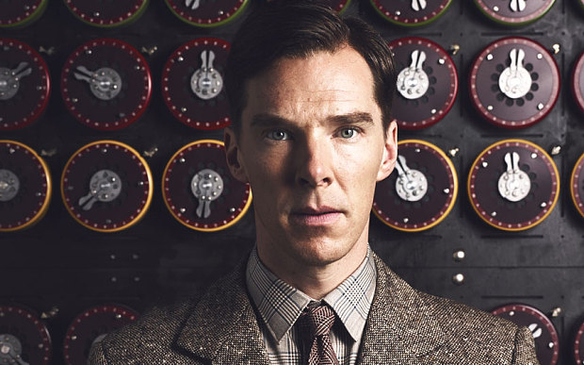
#DSSGx #TuringWay @turingway @kirstie_j
https://doi.org/10.5281/zenodo.3959179
Notes:
TIMING: 3

Slide 13
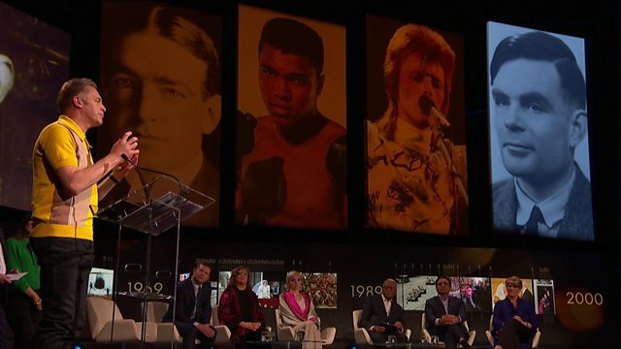
https://www.bbc.co.uk/programmes/p0704h04
#DSSGx #TuringWay @turingway @kirstie_j
https://doi.org/10.5281/zenodo.3959179
Notes:
TIMING: 3

Slide 14
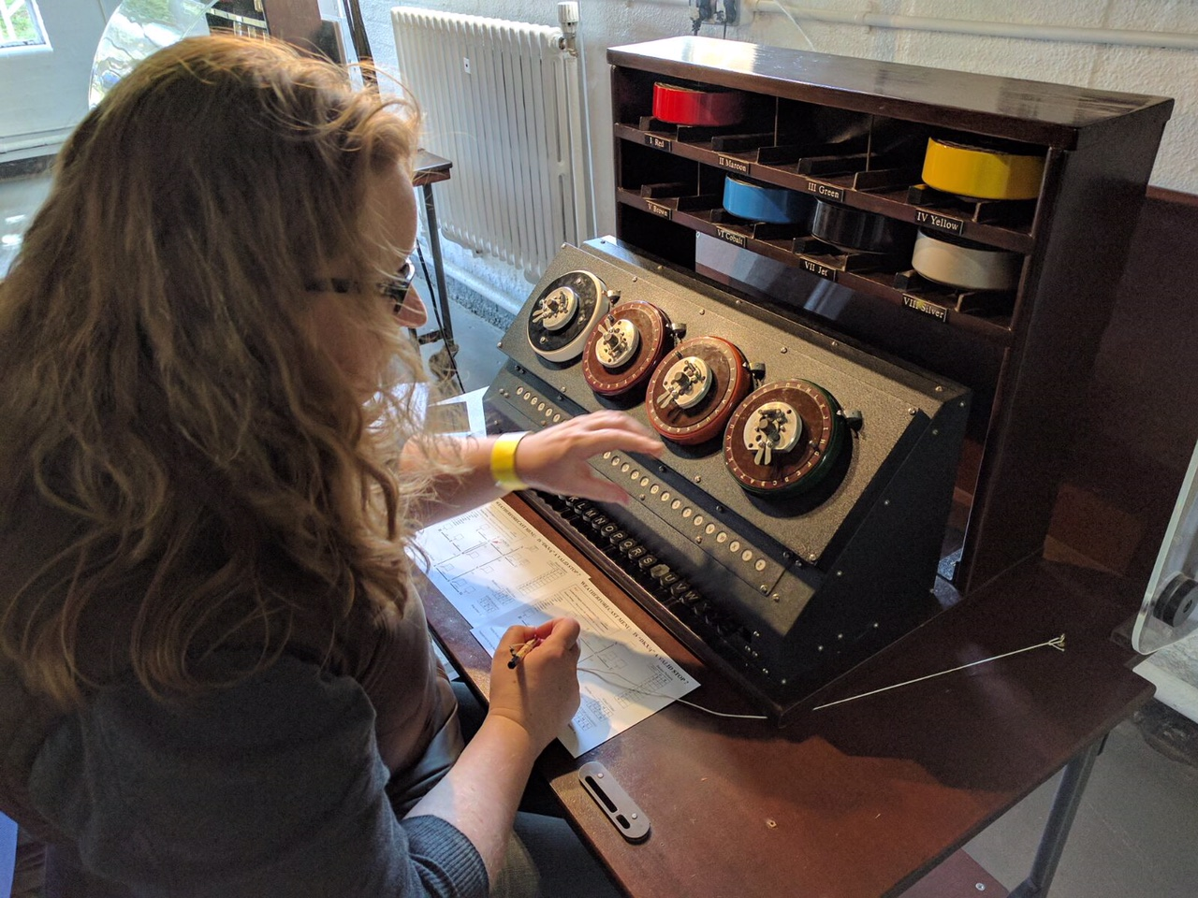
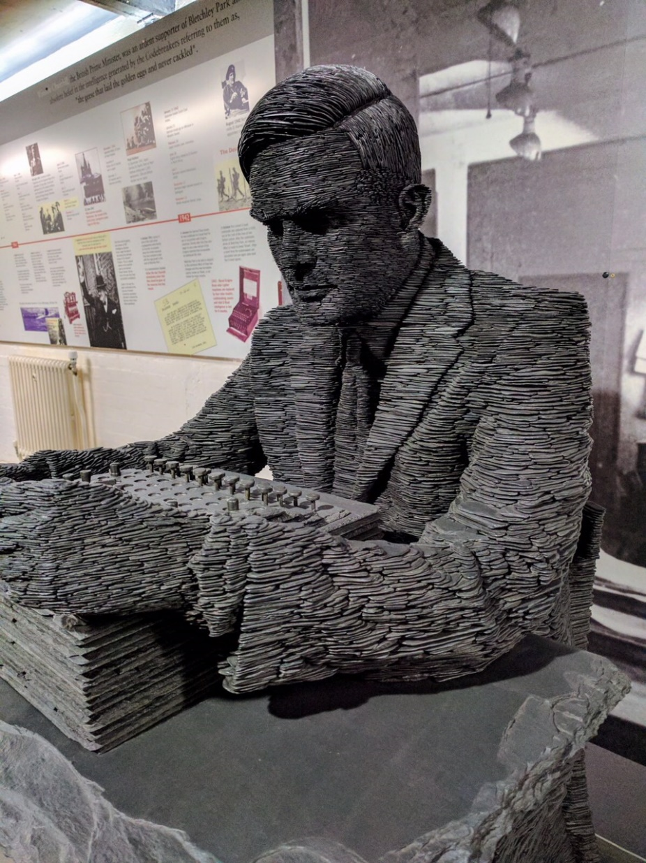
https://bletchleypark.org.uk
#DSSGx #TuringWay @turingway @kirstie_j
https://doi.org/10.5281/zenodo.3959179
Notes:
TIMING: 3

Slide 15
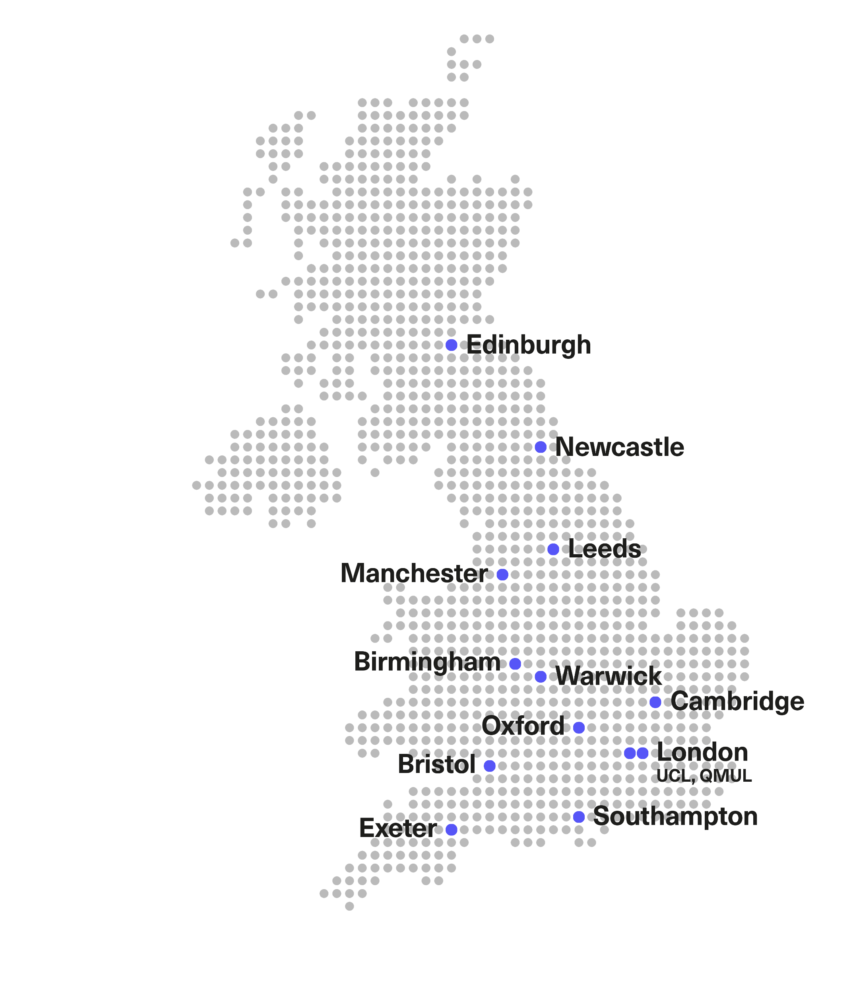













University network
#DSSGx #TuringWay @turingway @kirstie_j
https://doi.org/10.5281/zenodo.3959179
Notes:
TIMING: 3

Slide 16























The Institute’s partners and collaborators
#DSSGx #TuringWay @turingway @kirstie_j
https://doi.org/10.5281/zenodo.3959179
Notes:
TIMING: 3

Slide 17
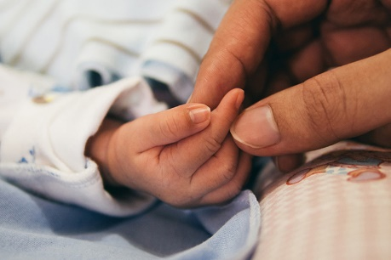


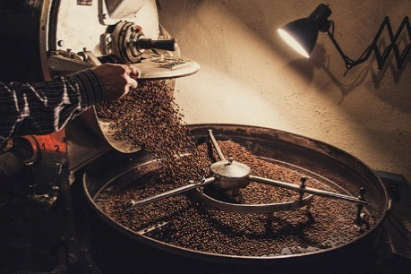


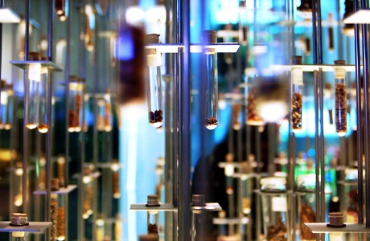
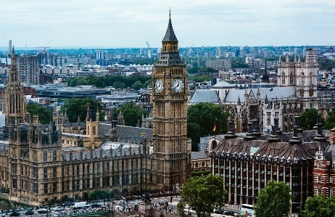
Challenges
Advance data science and artificial intelligence to…
Revolutionise healthcare
Deliver safer, smarter engineering
Manage security in an insecure world
Shine a light on our economy
Make algorithmic
systems fair,
transparent, and ethical
Design computers for
the next generation
of algorithms
Supercharge research
in science and
humanities
Foster government innovation
#DSSGx #TuringWay @turingway @kirstie_j
https://doi.org/10.5281/zenodo.3959179
Notes:
TIMING: 3

Slide 18

Martin O’Reilly
“Make reproducible research too easy not to do.”
https://www.turing.ac.uk/people/researchers/martin-oreilly
#DSSGx #TuringWay @turingway @kirstie_j
https://doi.org/10.5281/zenodo.3959179

Slide 19
Martin O’Reilly
“Make reproducible research too easy not to do.
Do you need a biscuit?”
https://www.turing.ac.uk/people/researchers/martin-oreilly
#DSSGx #TuringWay @turingway @kirstie_j
https://doi.org/10.5281/zenodo.3959179

Slide 20
Martin O’Reilly
“Make reproducible research too easy not to do.
Do you need a biscuit?
If we can’t do it here, we can’t do it at all.”
https://www.turing.ac.uk/people/researchers/martin-oreilly
#DSSGx #TuringWay @turingway @kirstie_j
https://doi.org/10.5281/zenodo.3959179

Slide 21

The Turing Way
#DSSGx #TuringWay @turingway @kirstie_j
https://doi.org/10.5281/zenodo.3959179
Notes:
TIMING: 4

Slide 22
The Turing Way is an open source book project that involves and supports a diverse research community in ensuring that reproducible and ethical data science is accessible and comprehensible for everyone.
#DSSGx #TuringWay @turingway @kirstie_j
https://doi.org/10.5281/zenodo.3959179

Slide 23
The Turing Way is an open source book project that involves and supports a diverse research community in ensuring that reproducible and ethical data science is accessible and comprehensible for everyone.
#DSSGx #TuringWay @turingway @kirstie_j
https://doi.org/10.5281/zenodo.3959179

Slide 24
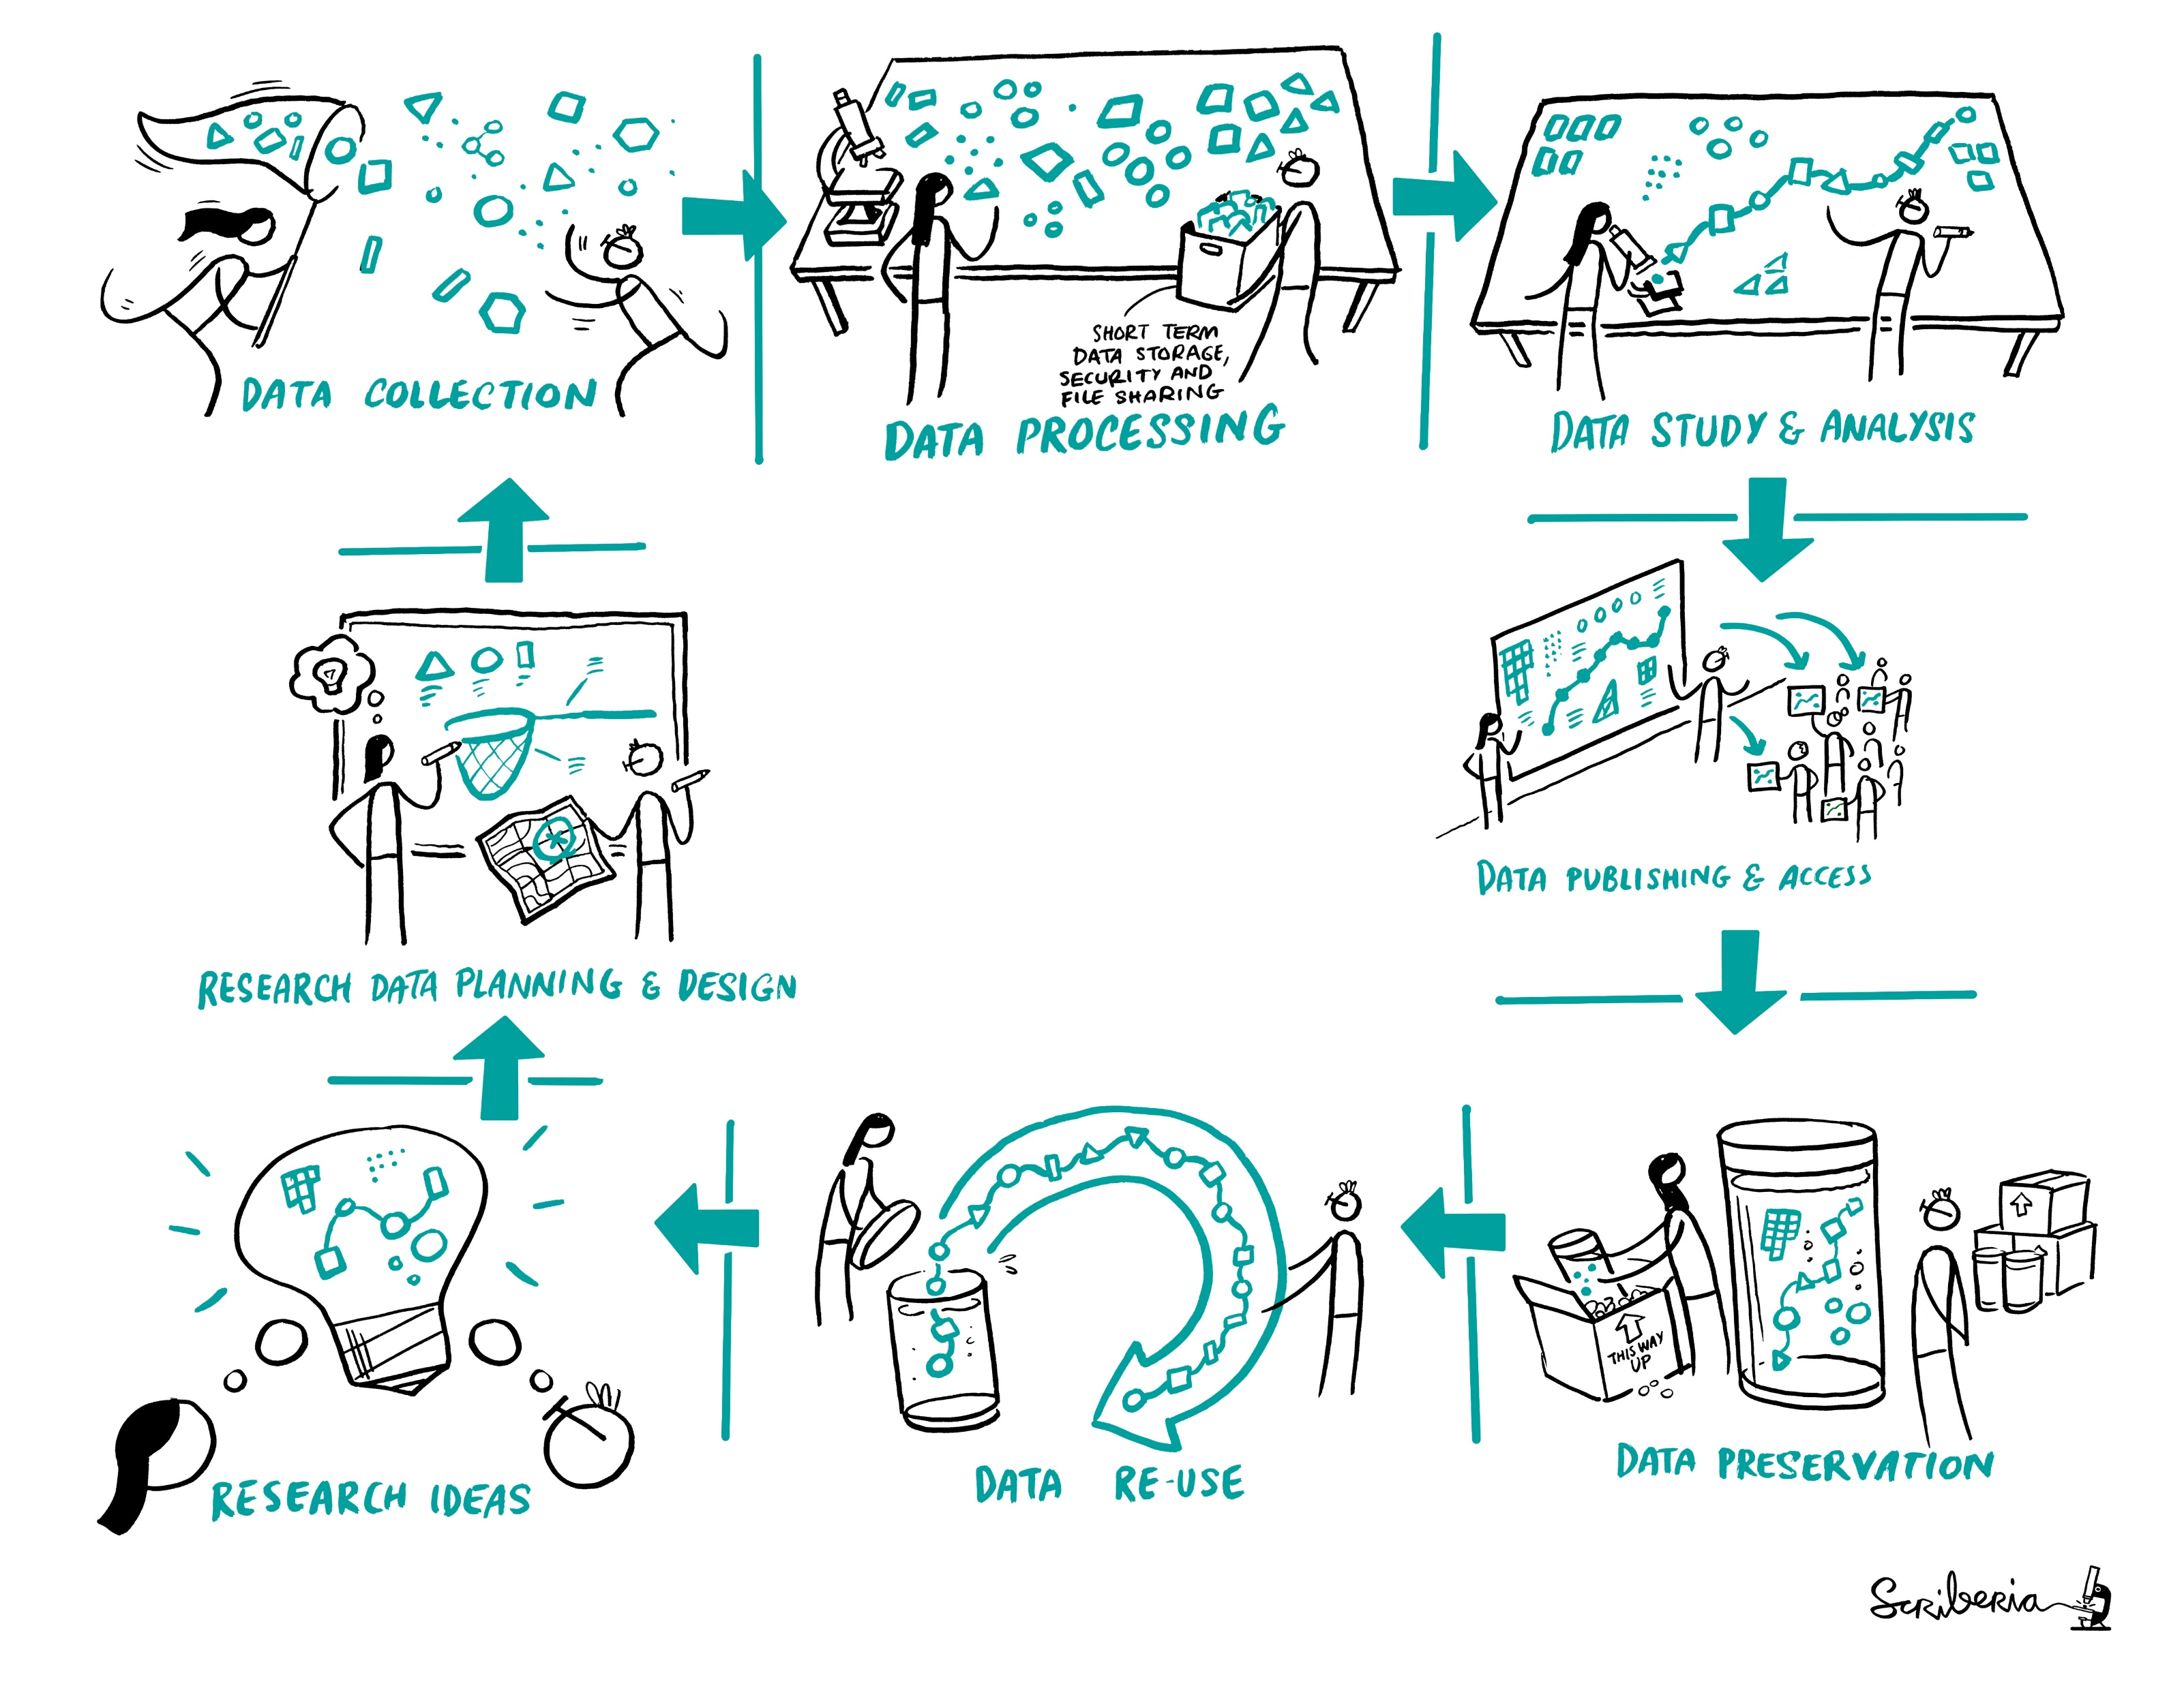
To be fully reproducible we have to cover all the steps of the research cycle
And that is super overwhelming…but we’re here to help
#DSSGx #TuringWay @turingway @kirstie_j
https://doi.org/10.5281/zenodo.3959179
Notes:
TIMING: 4

Slide 25
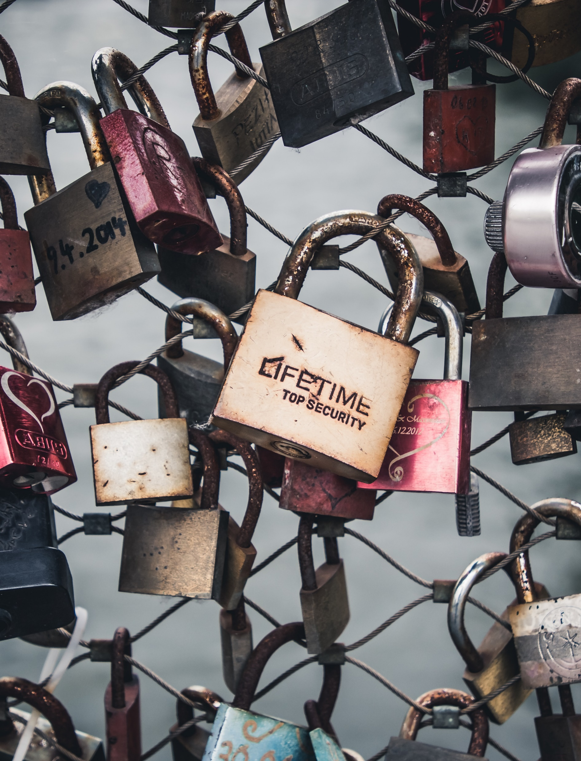
FAIR….but not always open
#DSSGx #TuringWay @turingway @kirstie_j
https://doi.org/10.5281/zenodo.3959179
Notes:
TIMING: 7

Slide 26
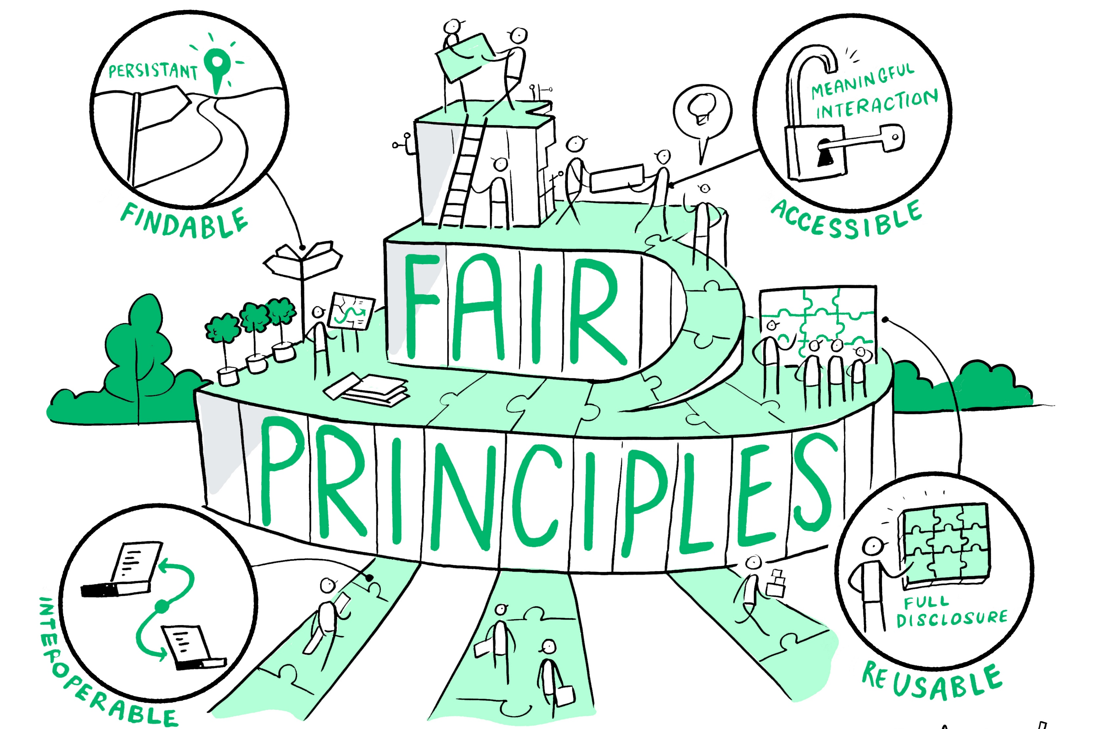
#DSSGx #TuringWay @turingway @kirstie_j
https://doi.org/10.5281/zenodo.3959179
https://the-turing-way.netlify.com/reproducible-research/rdm.html
Wilkinson et al., Sci. Data, 2016. doi: 10.1038/sdata.2016.18
Notes:
TIMING: 6

Slide 27
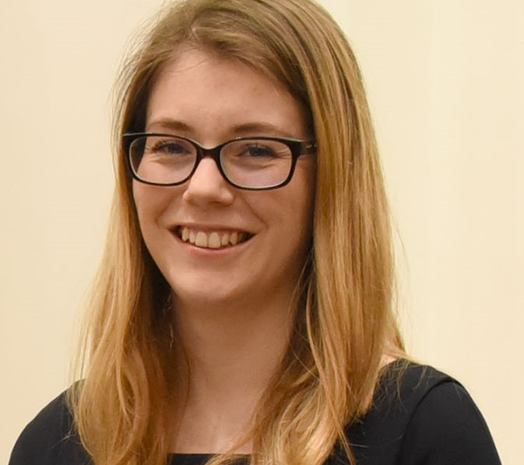
Catherine Lawrence
“We should ensure all our processes for running programmes are FAIR.
Findable (intranet)
Accessible (EDI)
Interoperable across programmes and projects
Reusable (bus factor)”
https://www.turing.ac.uk/people/business-team/catherine-lawrence
#DSSGx #TuringWay @turingway @kirstie_j
https://doi.org/10.5281/zenodo.3959179

Slide 28

Testing for research
#DSSGx #TuringWay @turingway @kirstie_j
https://doi.org/10.5281/zenodo.3959179
Notes:
TIMING: 13

Slide 29
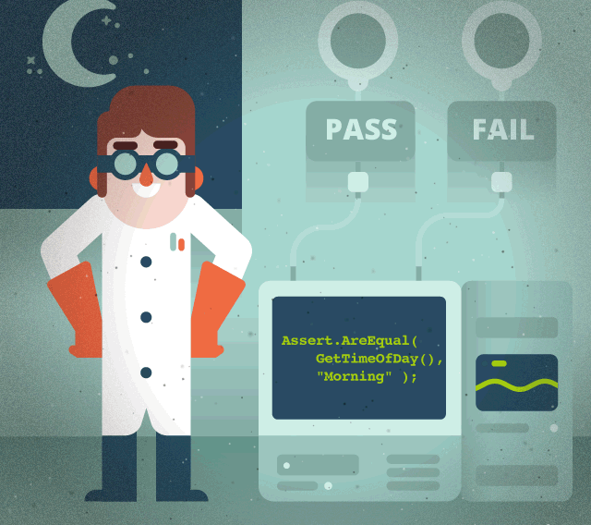
Is your code doing what you think its doing?
#DSSGx #TuringWay @turingway @kirstie_j
https://doi.org/10.5281/zenodo.3959179
https://the-turing-way.netlify.com/reproducible-research/testing.html
https://www.toptal.com/qa/how-to-write-testable-code-and-why-it-matters

Slide 30


Is your code doing what you think its doing?
#DSSGx #TuringWay @turingway @kirstie_j
https://doi.org/10.5281/zenodo.3959179
https://the-turing-way.netlify.com/reproducible-research/testing.html
https://www.toptal.com/qa/how-to-write-testable-code-and-why-it-matters

Slide 31
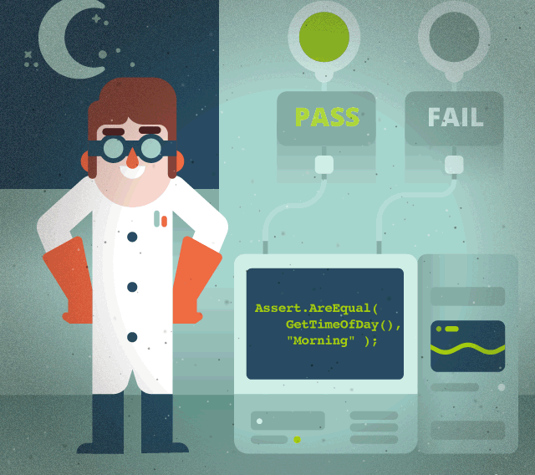
Is your code doing what you think its doing?
Assert.AreEqual(
GetTimeOfDay(),
“Morning” )
#DSSGx #TuringWay @turingway @kirstie_j
https://doi.org/10.5281/zenodo.3959179
https://the-turing-way.netlify.com/reproducible-research/testing.html
https://www.toptal.com/qa/how-to-write-testable-code-and-why-it-matters

Slide 32
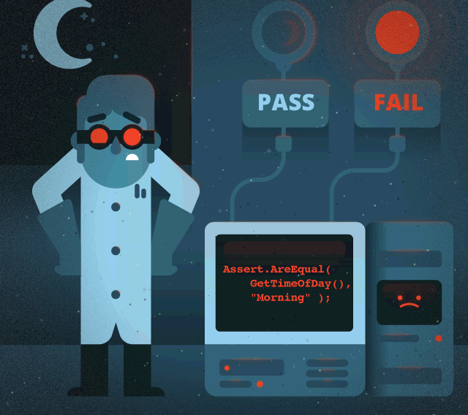
Is your code doing what you think its doing?
Assert.AreEqual(
GetTimeOfDay(),
“Morning” )
#DSSGx #TuringWay @turingway @kirstie_j
https://doi.org/10.5281/zenodo.3959179
https://the-turing-way.netlify.com/reproducible-research/testing.html
https://www.toptal.com/qa/how-to-write-testable-code-and-why-it-matters

Slide 33
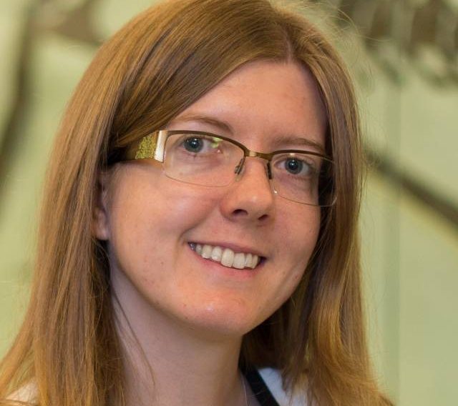
Louise Bowler
“Add a test before you change anything.”
https://www.turing.ac.uk/people/researchers/louise-bowler
#DSSGx #TuringWay @turingway @kirstie_j
https://doi.org/10.5281/zenodo.3959179

Slide 34
Louise Bowler
“Add a test before you change anything.
Particularly if you’re just going to tidy up your code before sharing it.”
https://www.turing.ac.uk/people/researchers/louise-bowler
#DSSGx #TuringWay @turingway @kirstie_j
https://doi.org/10.5281/zenodo.3959179

Slide 35
Continuous Analysis
#DSSGx #TuringWay @turingway @kirstie_j
https://doi.org/10.5281/zenodo.3959179
Notes:
TIMING: 15

Slide 36
Plan and design your experiment
Write down those steps in code
Push to version control and run the analyses
Traditionally done on the cloud, but the important part is that all steps are run every time
Test to see what’s changed
#DSSGx #TuringWay @turingway @kirstie_j
https://doi.org/10.5281/zenodo.3959179
https://the-turing-way.netlify.com/
reproducible-research/ci.html

Slide 37
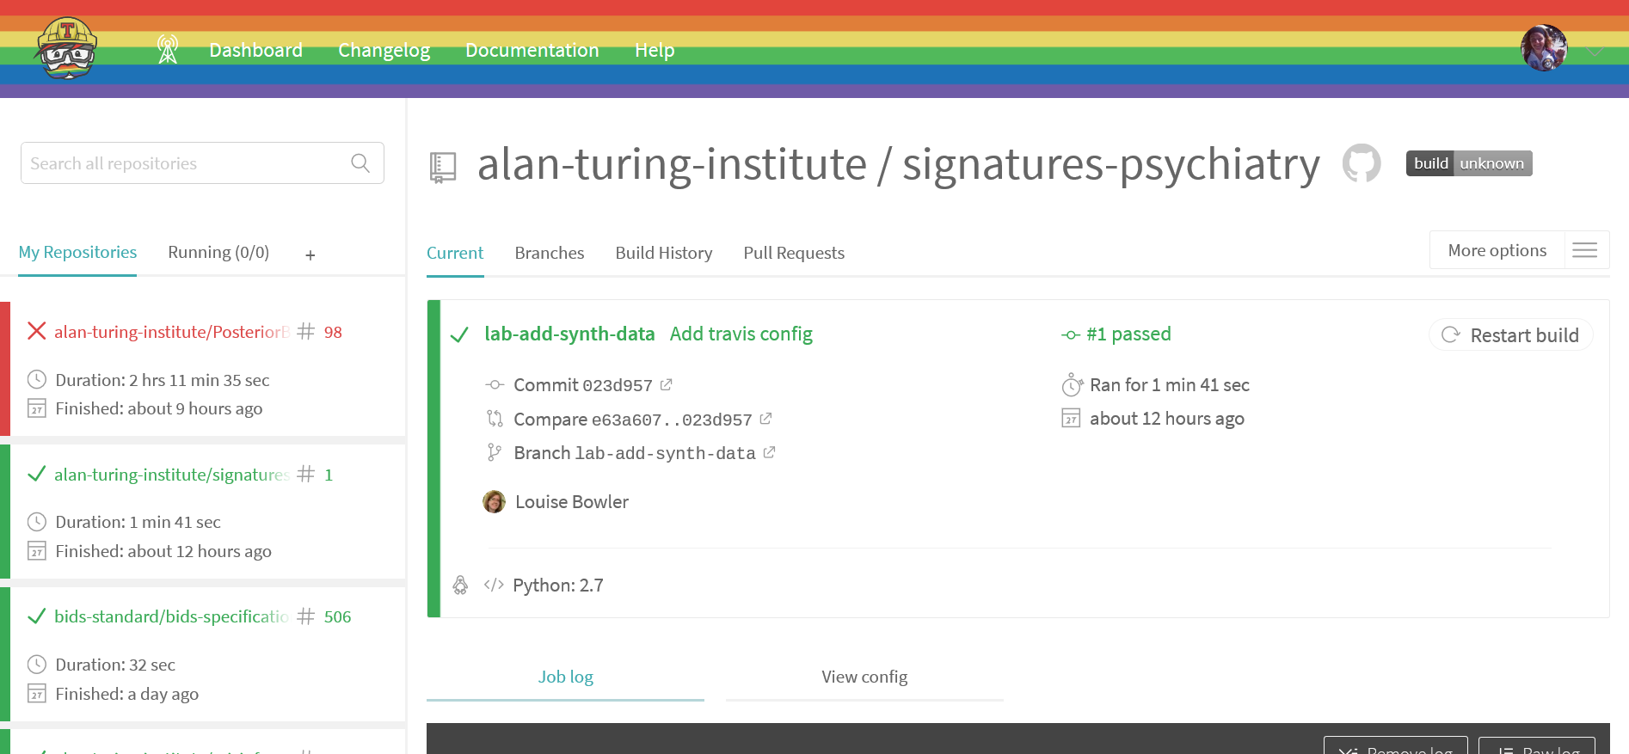
https://github.com/alan-turing-institute/signatures-psychiatry
#DSSGx #TuringWay @turingway @kirstie_j
https://doi.org/10.5281/zenodo.3959179
https://the-turing-way.netlify.com/
reproducible-research/ci.html

Slide 38
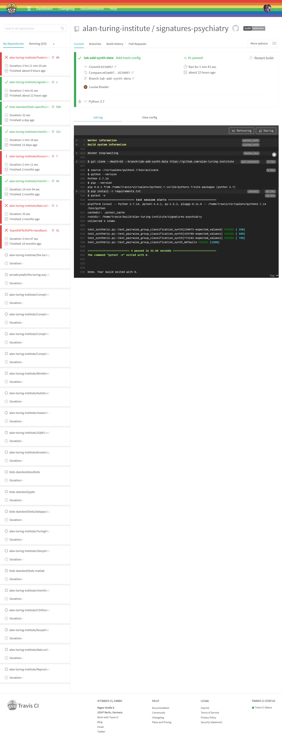
https://github.com/alan-turing-institute/signatures-psychiatry
#DSSGx #TuringWay @turingway @kirstie_j
https://doi.org/10.5281/zenodo.3959179
https://the-turing-way.netlify.com/
reproducible-research/ci.html

Slide 39
https://github.com/alan-turing-institute/signatures-psychiatry
#DSSGx #TuringWay @turingway @kirstie_j
https://doi.org/10.5281/zenodo.3959179
https://the-turing-way.netlify.com/
reproducible-research/ci.html

Slide 40

Run the analysis from start to finish as you work
Many times tests will fail as expected: you’re developing the analysis!
Sometimes tests will fail unexpectedly
CI makes you be explicit about what has changed
#DSSGx #TuringWay @turingway @kirstie_j
https://doi.org/10.5281/zenodo.3959179
https://the-turing-way.netlify.com/
reproducible-research/ci.html

Slide 41
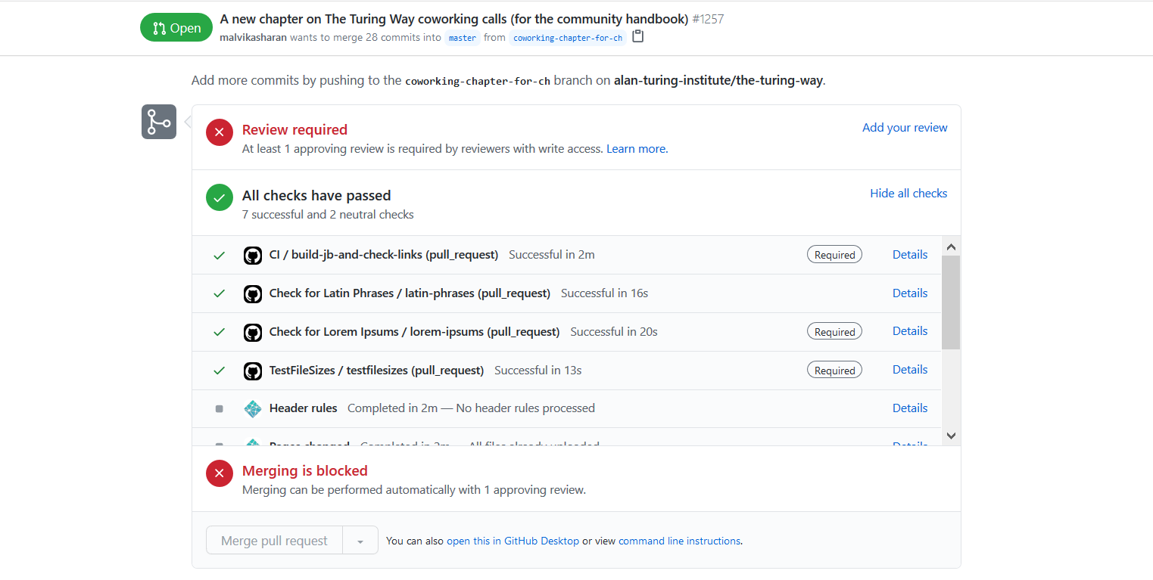
#DSSGx #TuringWay @turingway @kirstie_j
https://doi.org/10.5281/zenodo.3959179
https://insidegovuk.blog.gov.uk/2016/07/20/changes-to-the-style-guide-no-more-eg-and-ie-etc
https://github.com/alan-turing-institute/the-turing-way/pull/1257

Slide 42

Becky Arnold
“There are a lot of things you need to know before you can jump into continuous integration.
Version control is a prerequisite for pretty much everything.”
https://software.ac.uk/about/fellows/becky-arnold
#DSSGx #TuringWay @turingway @kirstie_j
https://doi.org/10.5281/zenodo.3959179

Slide 43
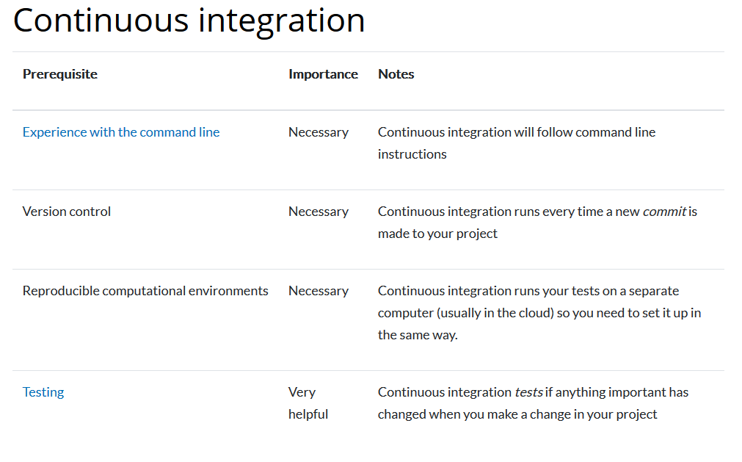
https://the-turing-way.netlify.com/reproducible-research/ci.html
#DSSGx #TuringWay @turingway @kirstie_j
https://doi.org/10.5281/zenodo.3959179

Slide 44

Version control
#DSSGx #TuringWay @turingway @kirstie_j
https://doi.org/10.5281/zenodo.3959179
Notes:
TIMING: 17

Slide 45
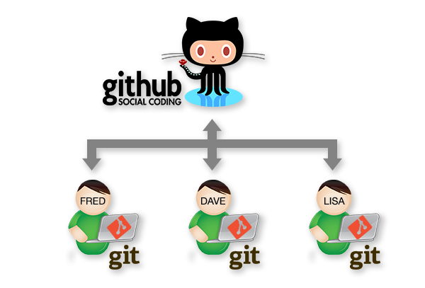
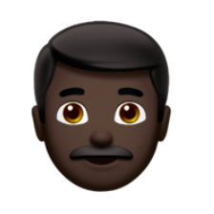
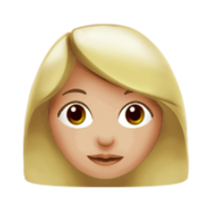

#DSSGx #TuringWay @turingway @kirstie_j
https://doi.org/10.5281/zenodo.3959179
https://the-turing-way.netlify.com/collaboration/github-collaboration.html
https://the-turing-way.netlify.com/reproducible-research/vcs.html

Slide 46
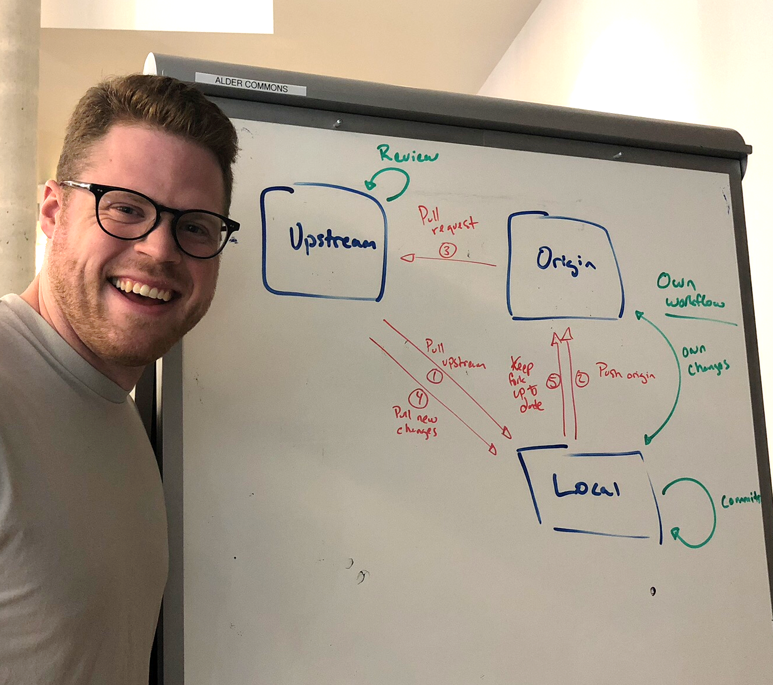
#DSSGx #TuringWay @turingway @kirstie_j
https://doi.org/10.5281/zenodo.3959179
https://the-turing-way.netlify.com/collaboration/github-collaboration.html
https://the-turing-way.netlify.com/reproducible-research/vcs.html
https://neurohackademy.org

Slide 47
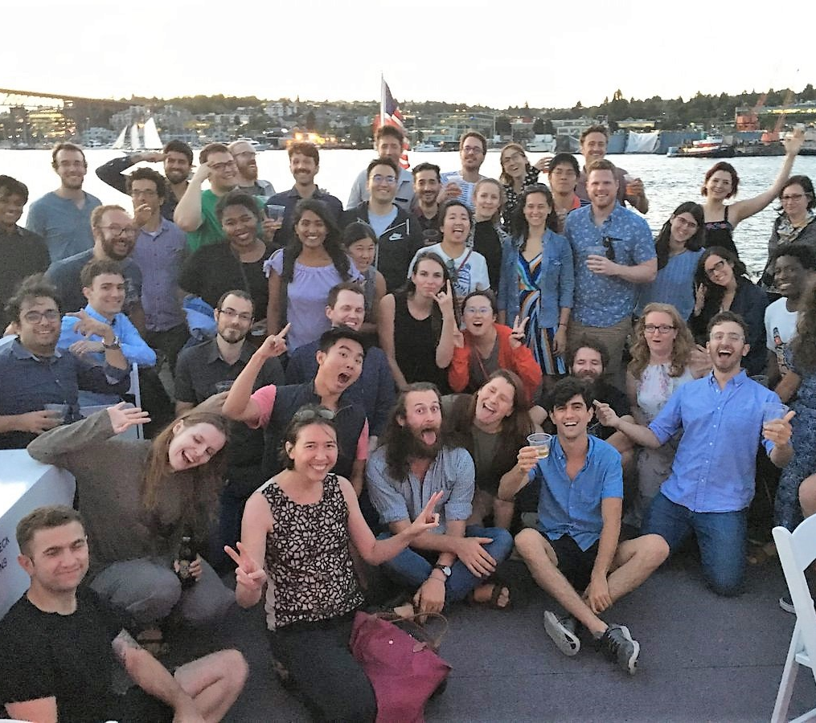
Neurohackademy
“Every hackathon should have a gong that you can ring when you complete your first pull request.”
https://neurohackademy.org
#DSSGx #TuringWay @turingway @kirstie_j
https://doi.org/10.5281/zenodo.3959179

Slide 48
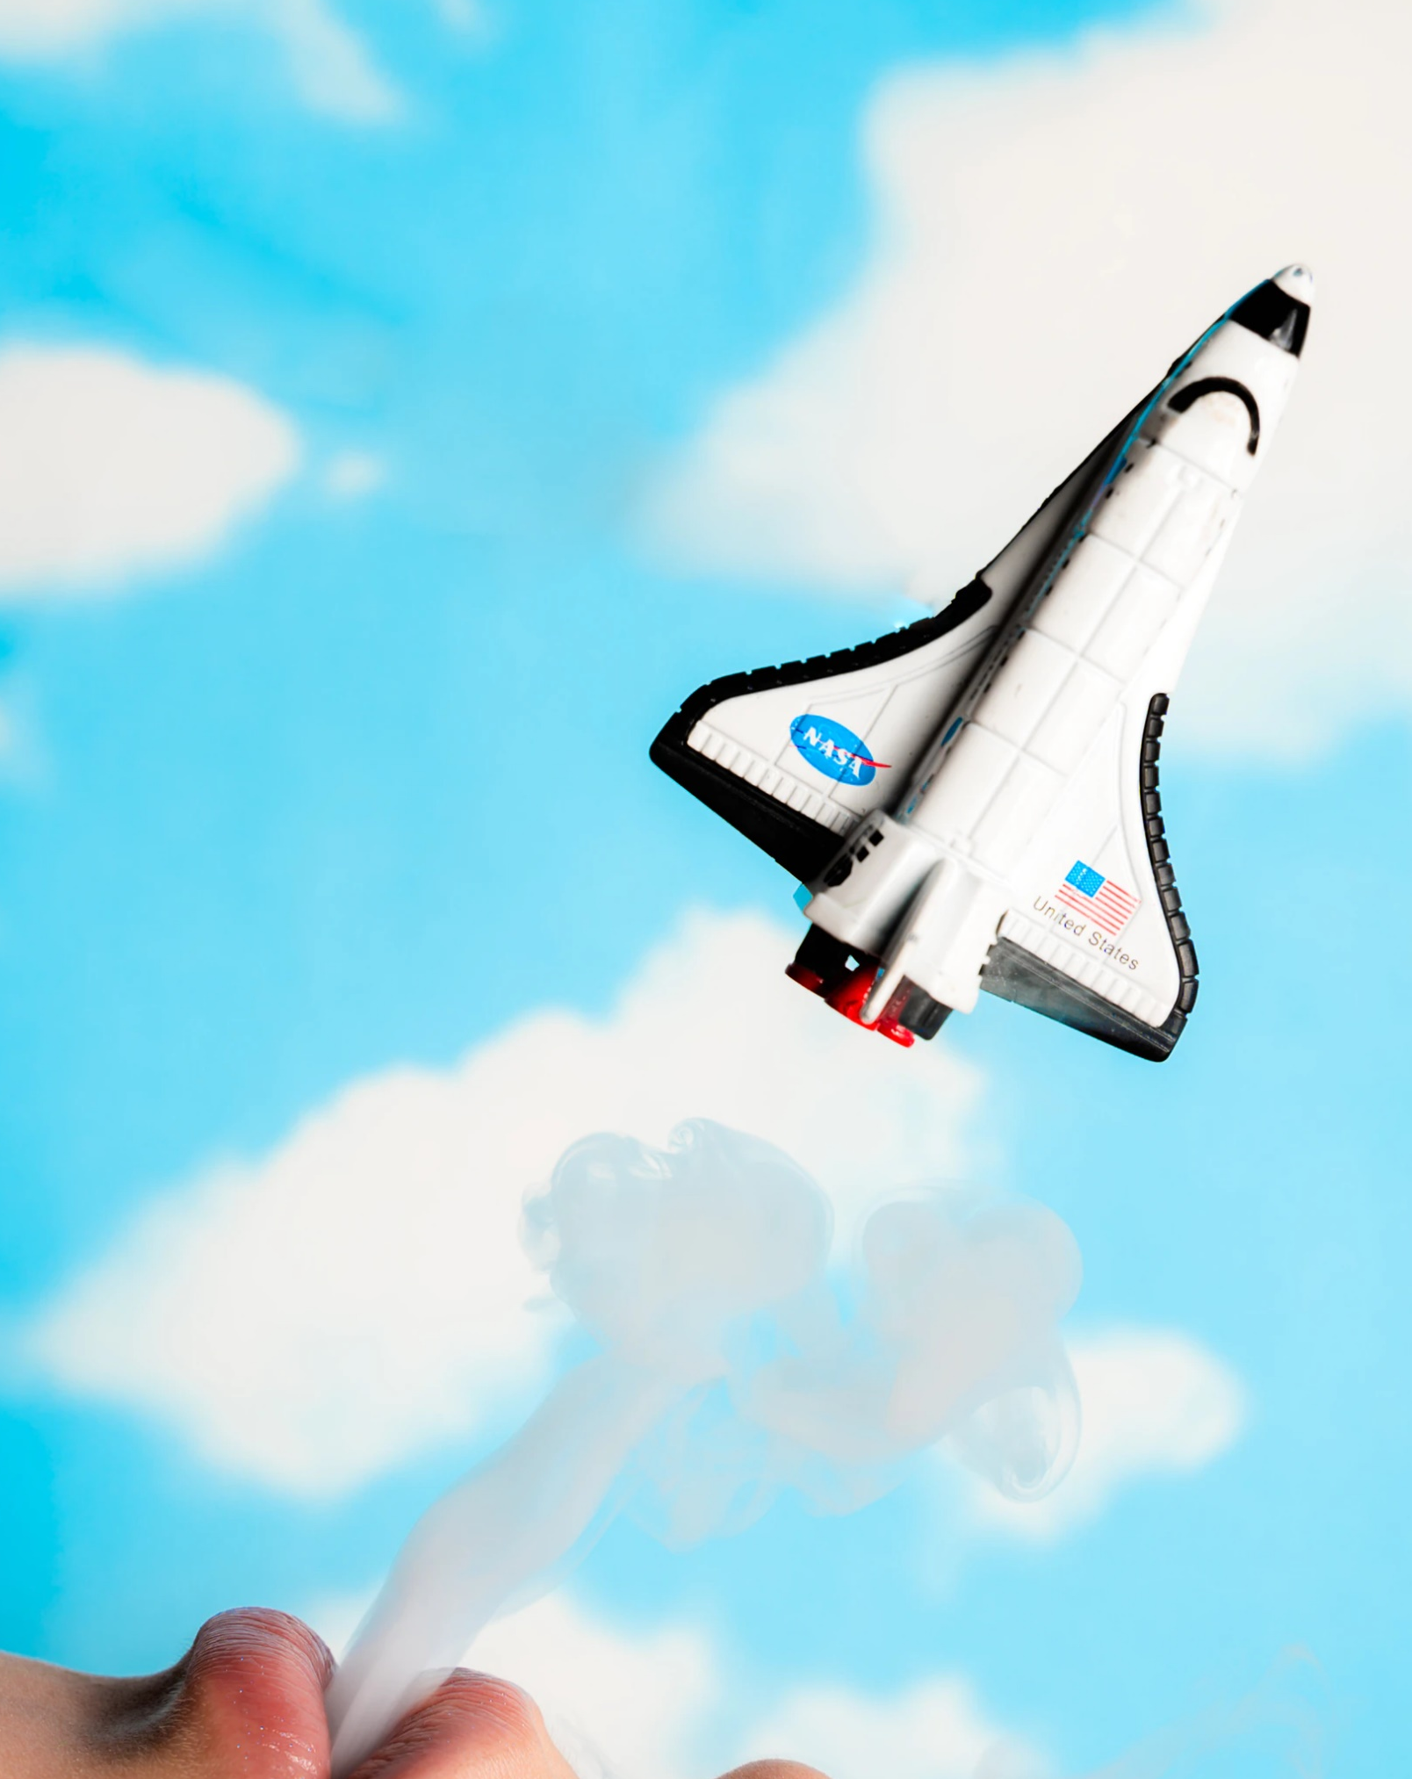
Beyond reproducibility
#DSSGx #TuringWay @turingway @kirstie_j
https://doi.org/10.5281/zenodo.3959179
Notes:
TIMING: 19

Slide 49
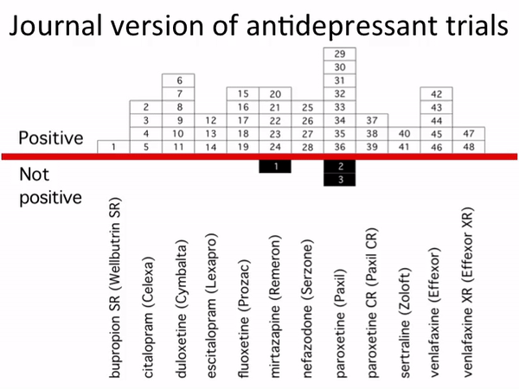
Ethical and transparent research goes beyond reproducibility
#DSSGx #TuringWay @turingway @kirstie_j
https://doi.org/10.5281/zenodo.3959179
https://twitter.com/eturnermd1/status/737436322344927232
https://doi.org/10.6084/m9.figshare.3381379
Notes:
TIMING: 9

Slide 50
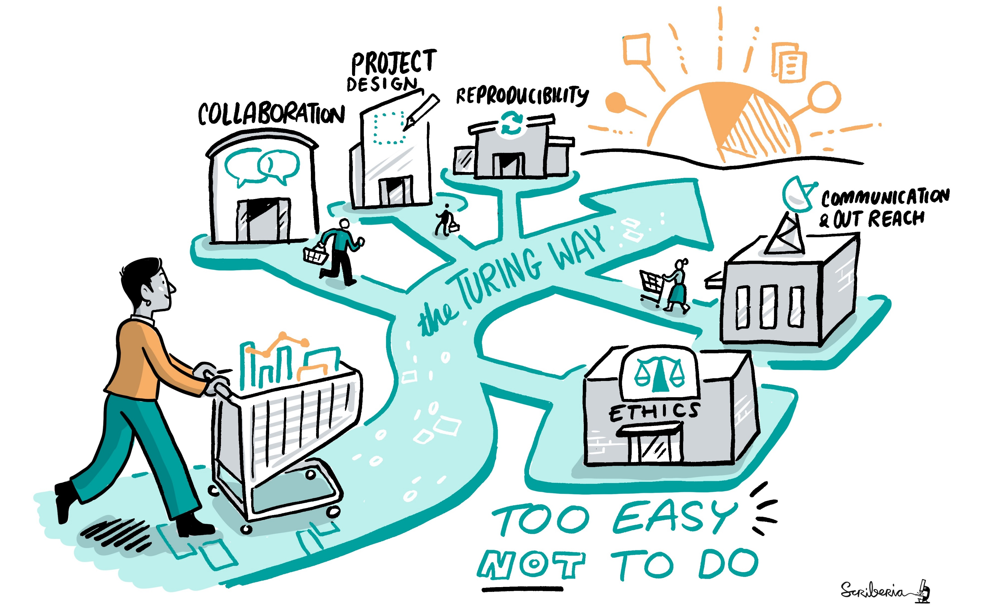
#DSSGx #TuringWay @turingway @kirstie_j
https://doi.org/10.5281/zenodo.3959179
https://doi.org/10.5281/zenodo.3332807

Slide 51
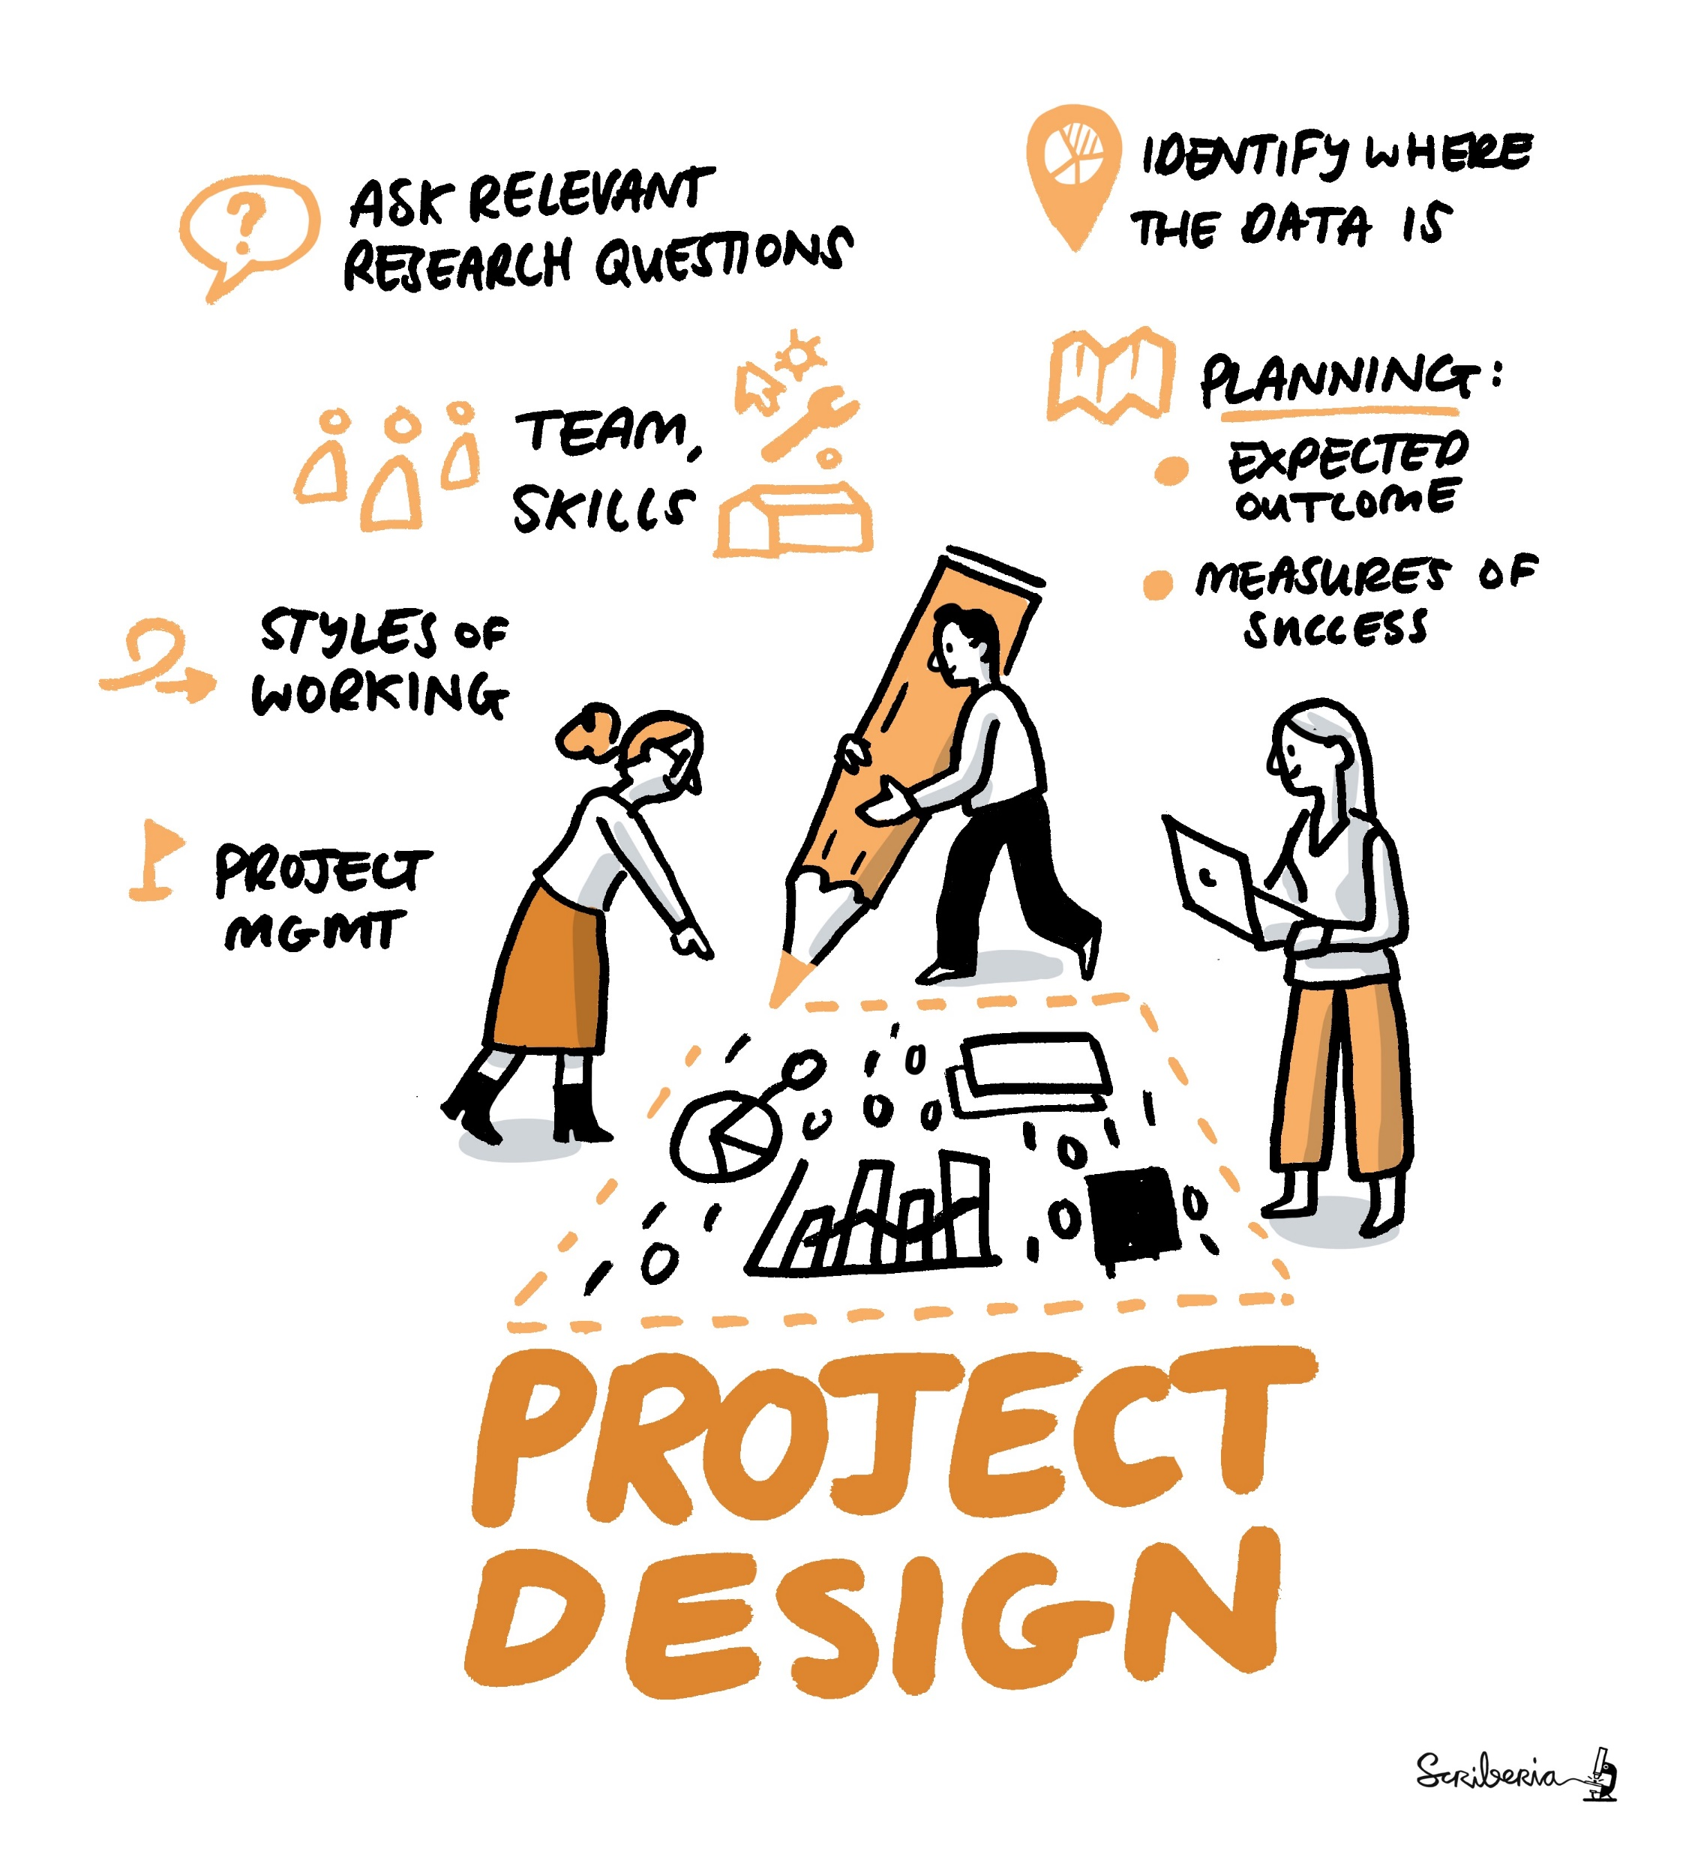
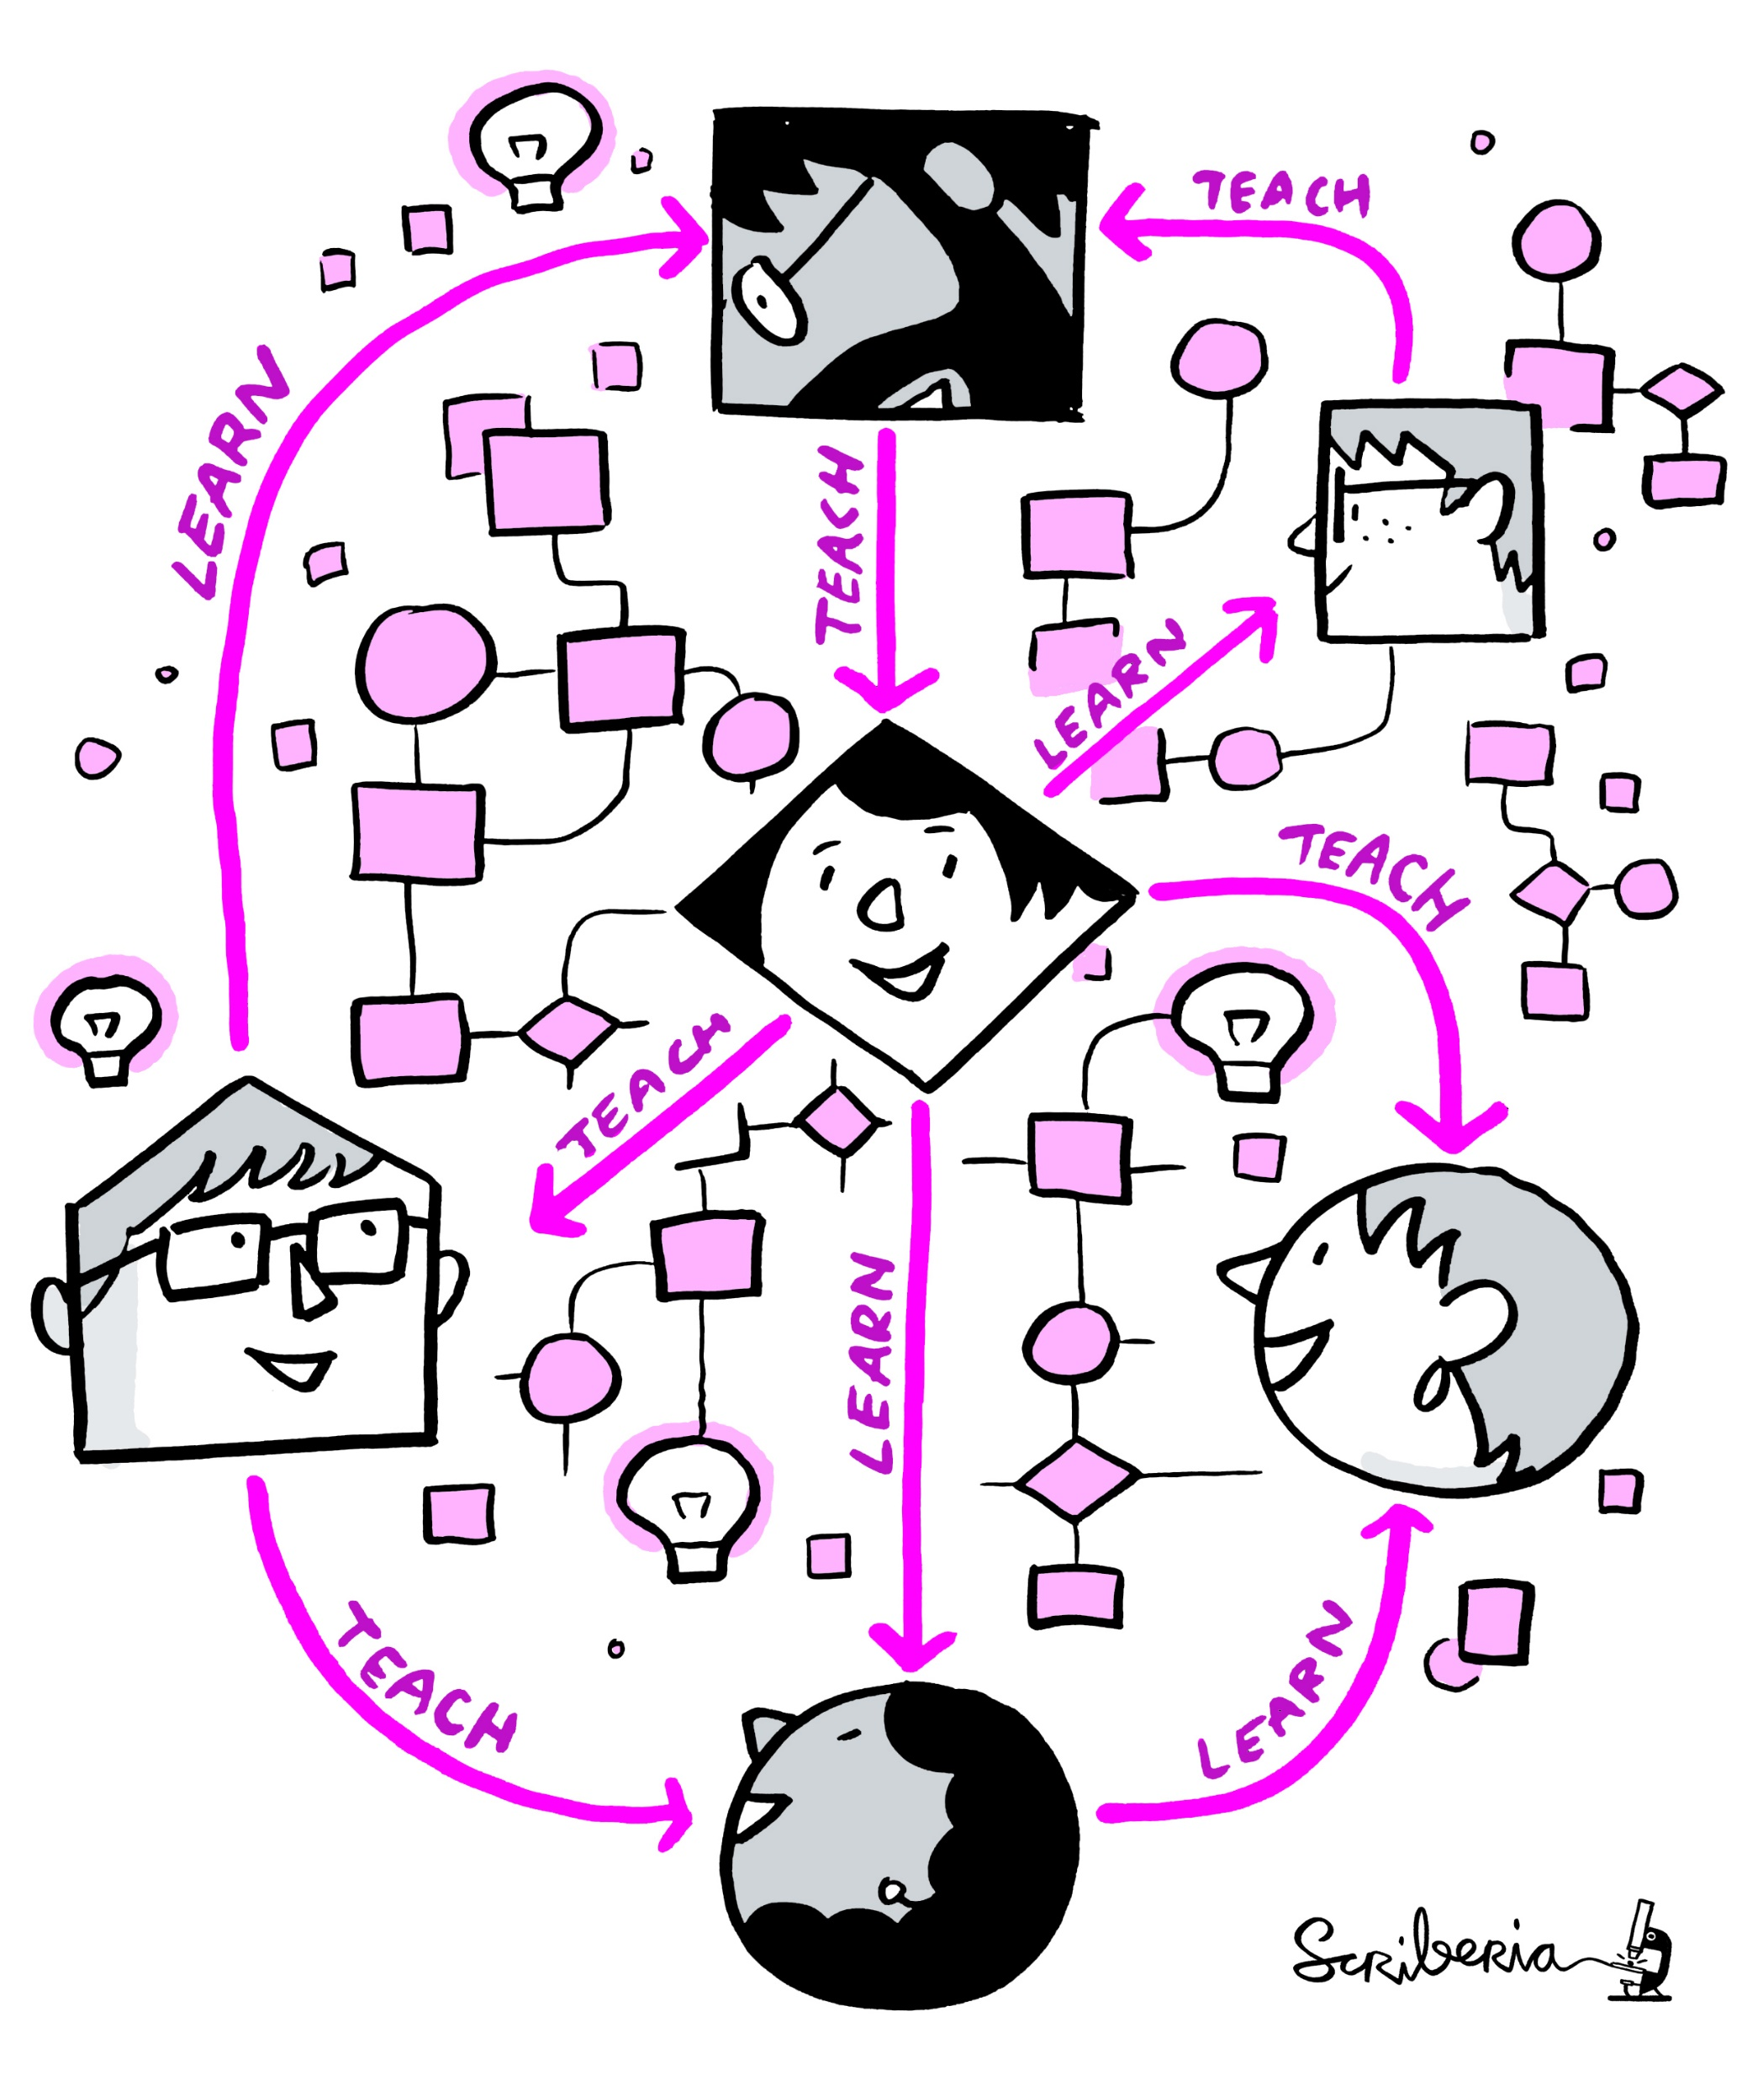
#DSSGx #TuringWay @turingway @kirstie_j
https://doi.org/10.5281/zenodo.3959179
https://the-turing-way.netlify.app/project-design/project-design.html
https://the-turing-way.netlify.app/communication/communication.html

Slide 52
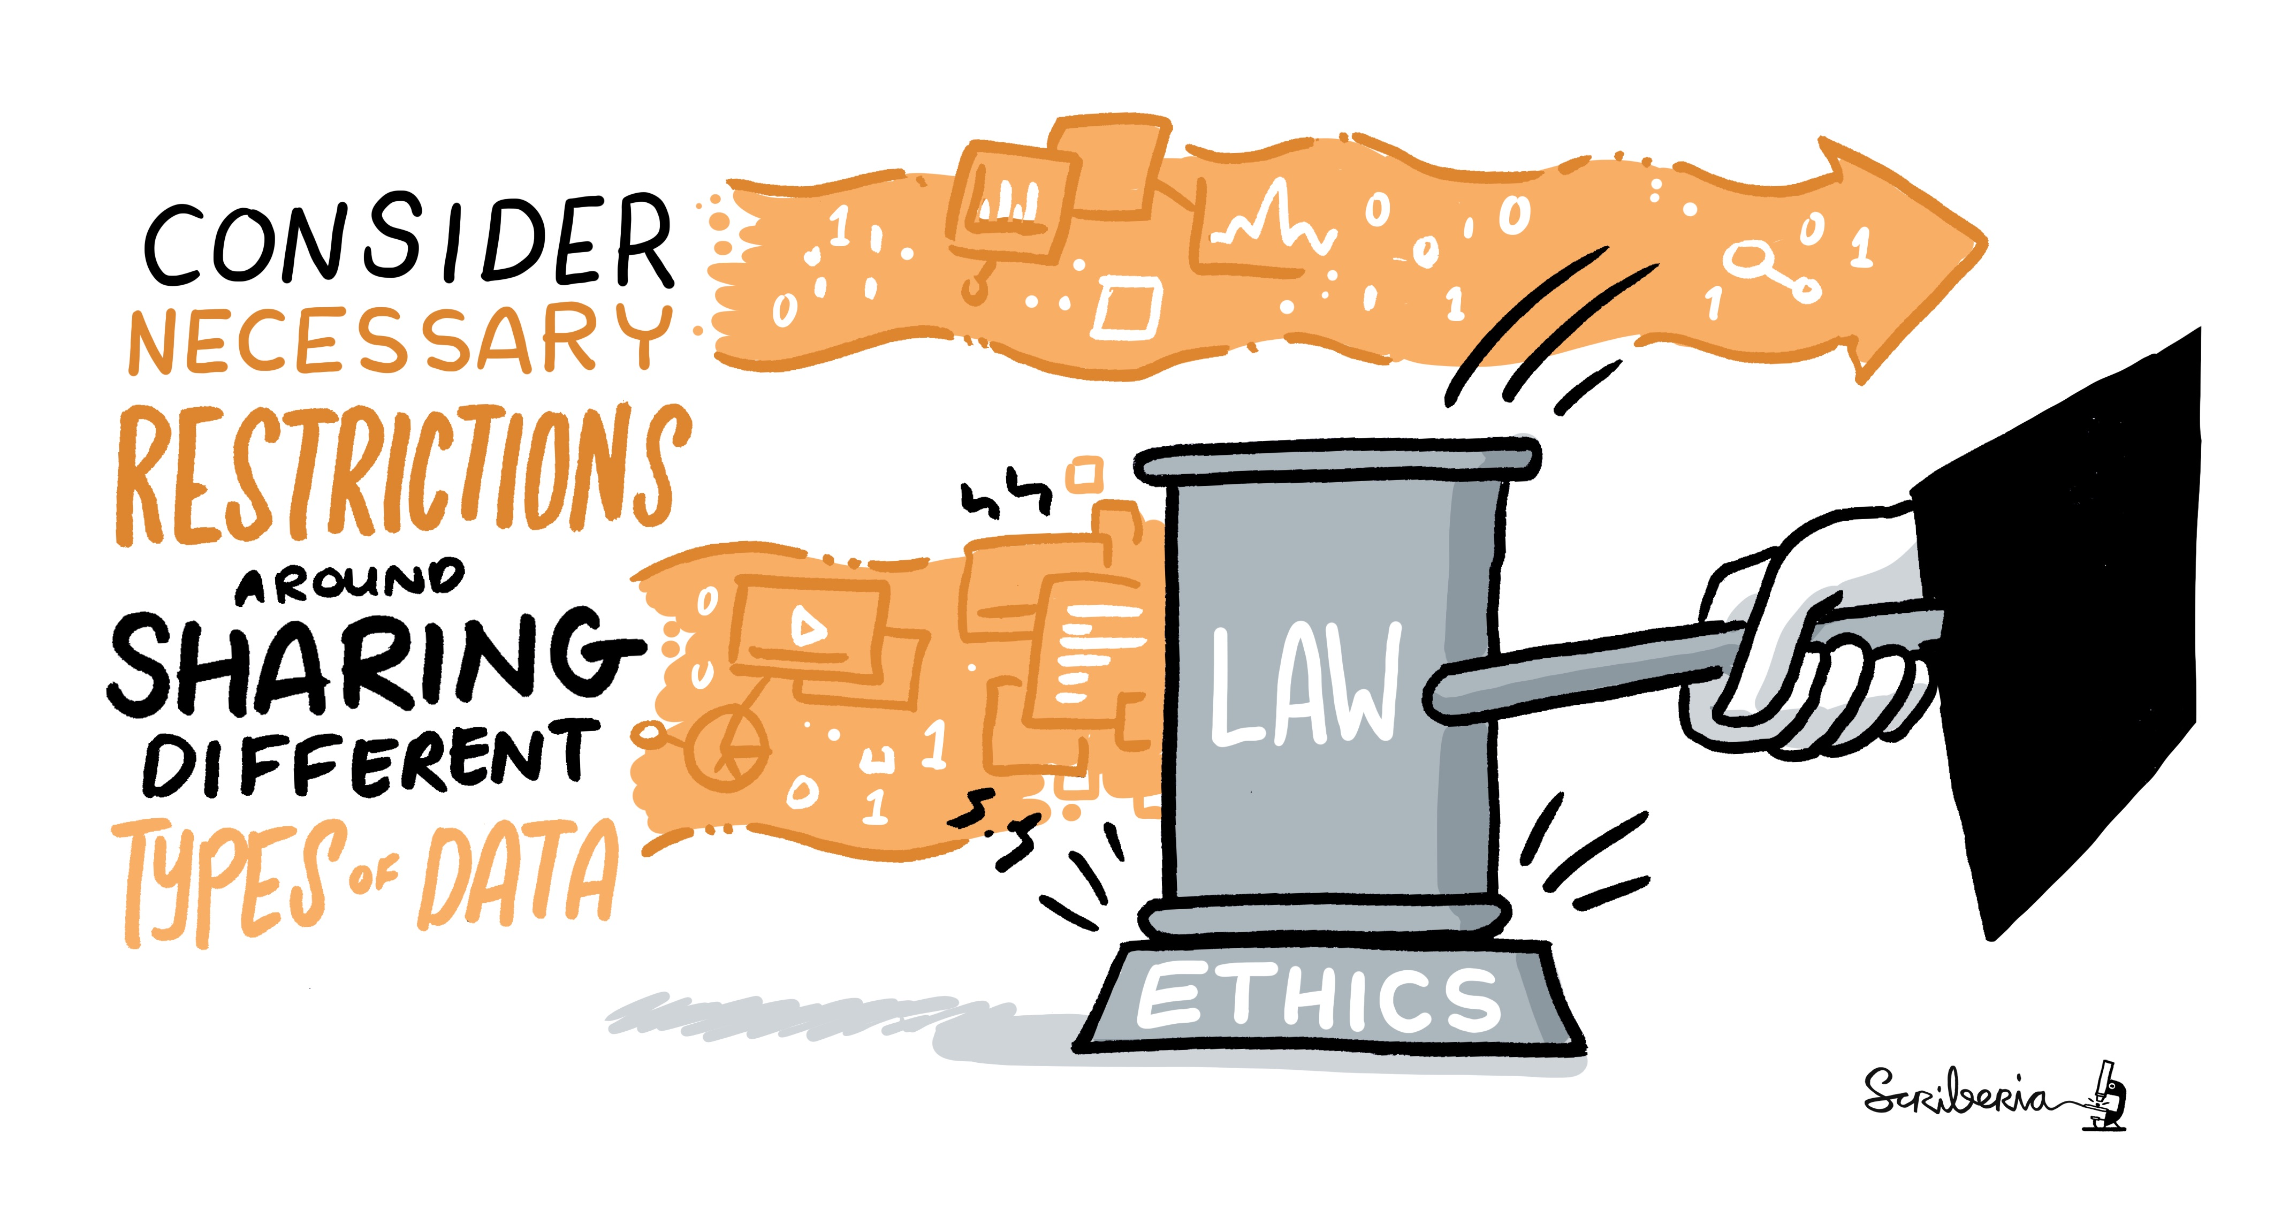
#DSSGx #TuringWay @turingway @kirstie_j
https://doi.org/10.5281/zenodo.3959179
https://the-turing-way.netlify.app/ethical-research/ethical-research.html

Slide 53
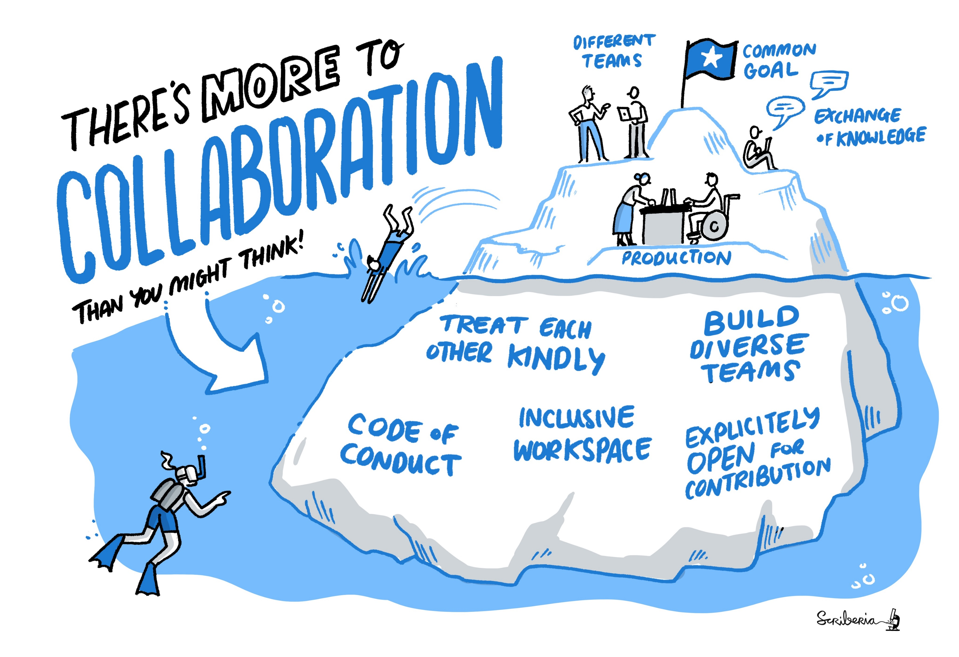
#DSSGx #TuringWay @turingway @kirstie_j
https://doi.org/10.5281/zenodo.3959179
https://the-turing-way.netlify.app/collaboration/collaboration.html

Slide 54
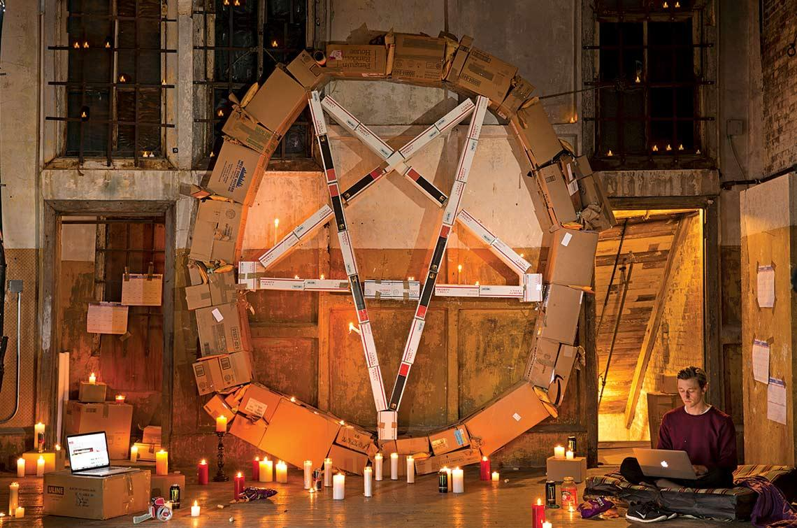
Every project has a culture
Whose work is valued?
Who is glue?
Beware a tyranny of structurelessness
#DSSGx #TuringWay @turingway @kirstie_j
https://doi.org/10.5281/zenodo.3959179
https://noidea.dog/glue
https://www.jofreeman.com/joreen/tyranny.htm
https://www.wired.com/story/silicon-valley-tyranny-of-structurelessness

Slide 55
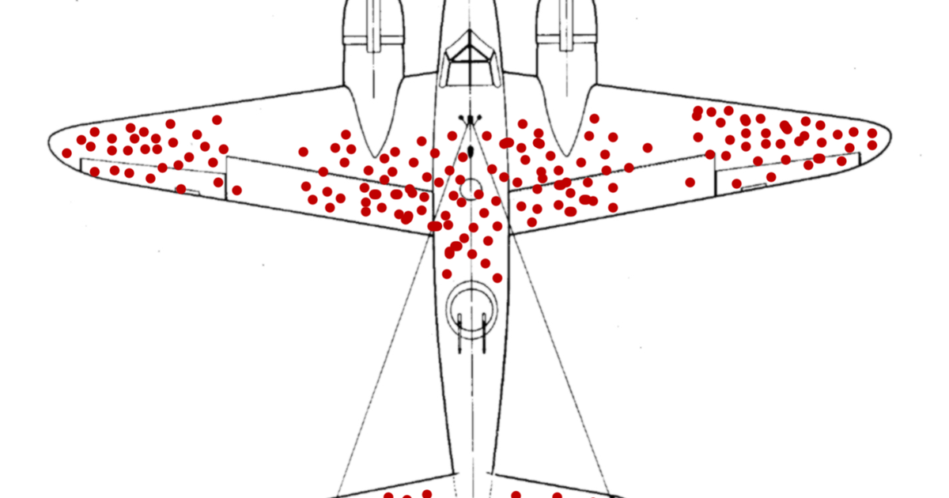
#DSSGx #TuringWay @turingway @kirstie_j
https://doi.org/10.5281/zenodo.3959179
https://medium.com/@penguinpress/an-excerpt-from-how-not-to-be-wrong-by-jordan-ellenberg-664e708cfc3d

Slide 56
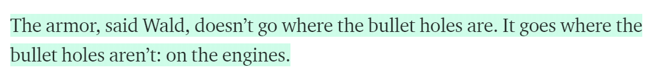
#DSSGx #TuringWay @turingway @kirstie_j
https://doi.org/10.5281/zenodo.3959179
https://medium.com/@penguinpress/an-excerpt-from-how-not-to-be-wrong-by-jordan-ellenberg-664e708cfc3d

Slide 57
Whose voices are missing?
In this room
In your friend group
At open science events
#DSSGx #TuringWay @turingway @kirstie_j
https://doi.org/10.5281/zenodo.3959179

Slide 58
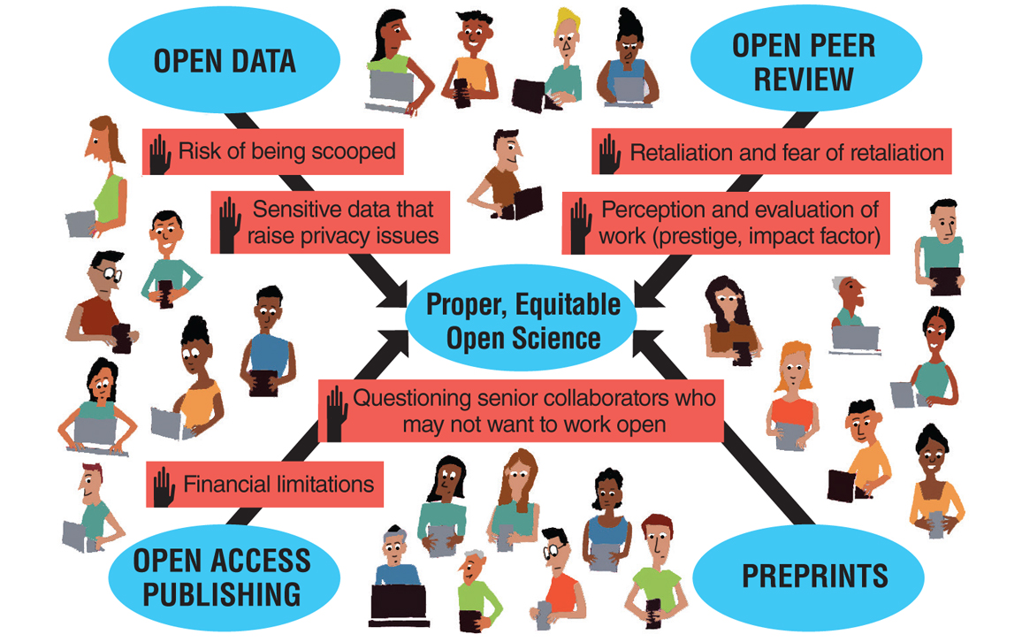
#DSSGx #TuringWay @turingway @kirstie_j
https://doi.org/10.5281/zenodo.3959179
https://www.americanscientist.org/article/
open-science-isnt-always-open-to-all-scientists

Slide 59
Open source tools, practices and systems
#DSSGx #TuringWay @turingway @kirstie_j
https://doi.org/10.5281/zenodo.3959179
Notes:
TIMING: 19

Slide 60
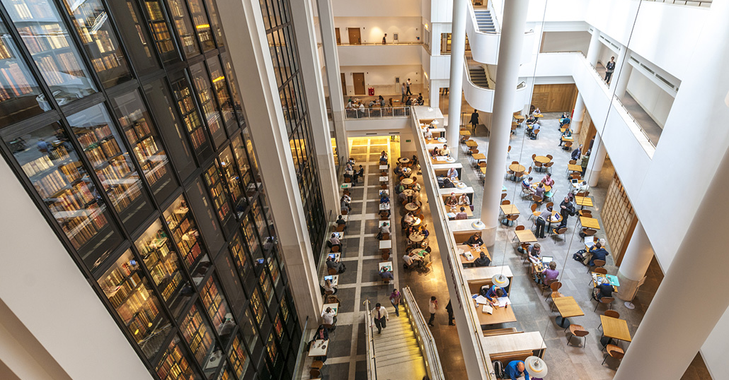
https://www.lifescienceindustrynews.com/people-places/
development-agreement-for-new-london-hub
#DSSGx #TuringWay @turingway @kirstie_j
https://doi.org/10.5281/zenodo.3959179
Notes:
TIMING: 4

Slide 61
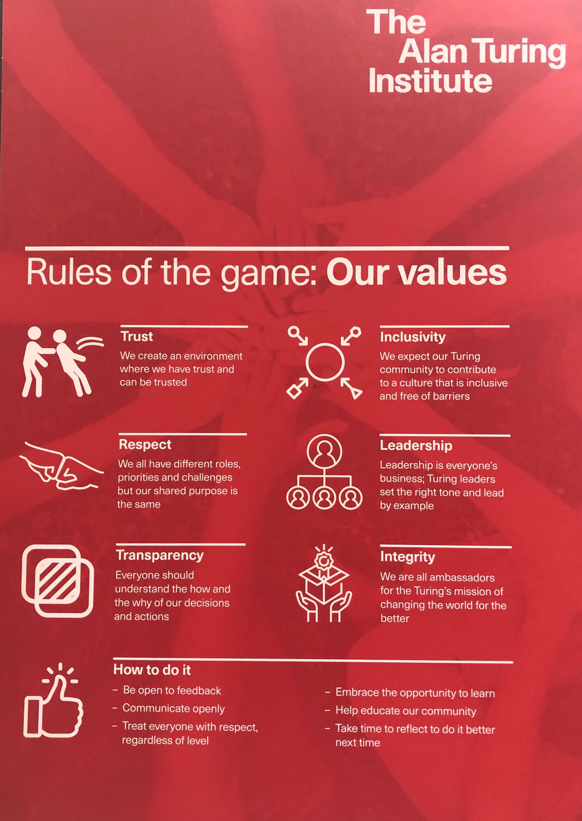
https://www.lifescienceindustrynews.com/people-places/
development-agreement-for-new-london-hub
#DSSGx #TuringWay @turingway @kirstie_j
https://doi.org/10.5281/zenodo.3959179
Notes:
TIMING: 4

Slide 62

Trustworthy systems
Transparent reporting
Inclusive interoperable design
Ethical integrity
Respectful co-creation
Leadership in open research
https://www.turing.ac.uk/research/
research-programmes/tools-practices-and-systems
#DSSGx #TuringWay @turingway @kirstie_j
https://doi.org/10.5281/zenodo.3959179
Notes:
TIMING: 4

Slide 63
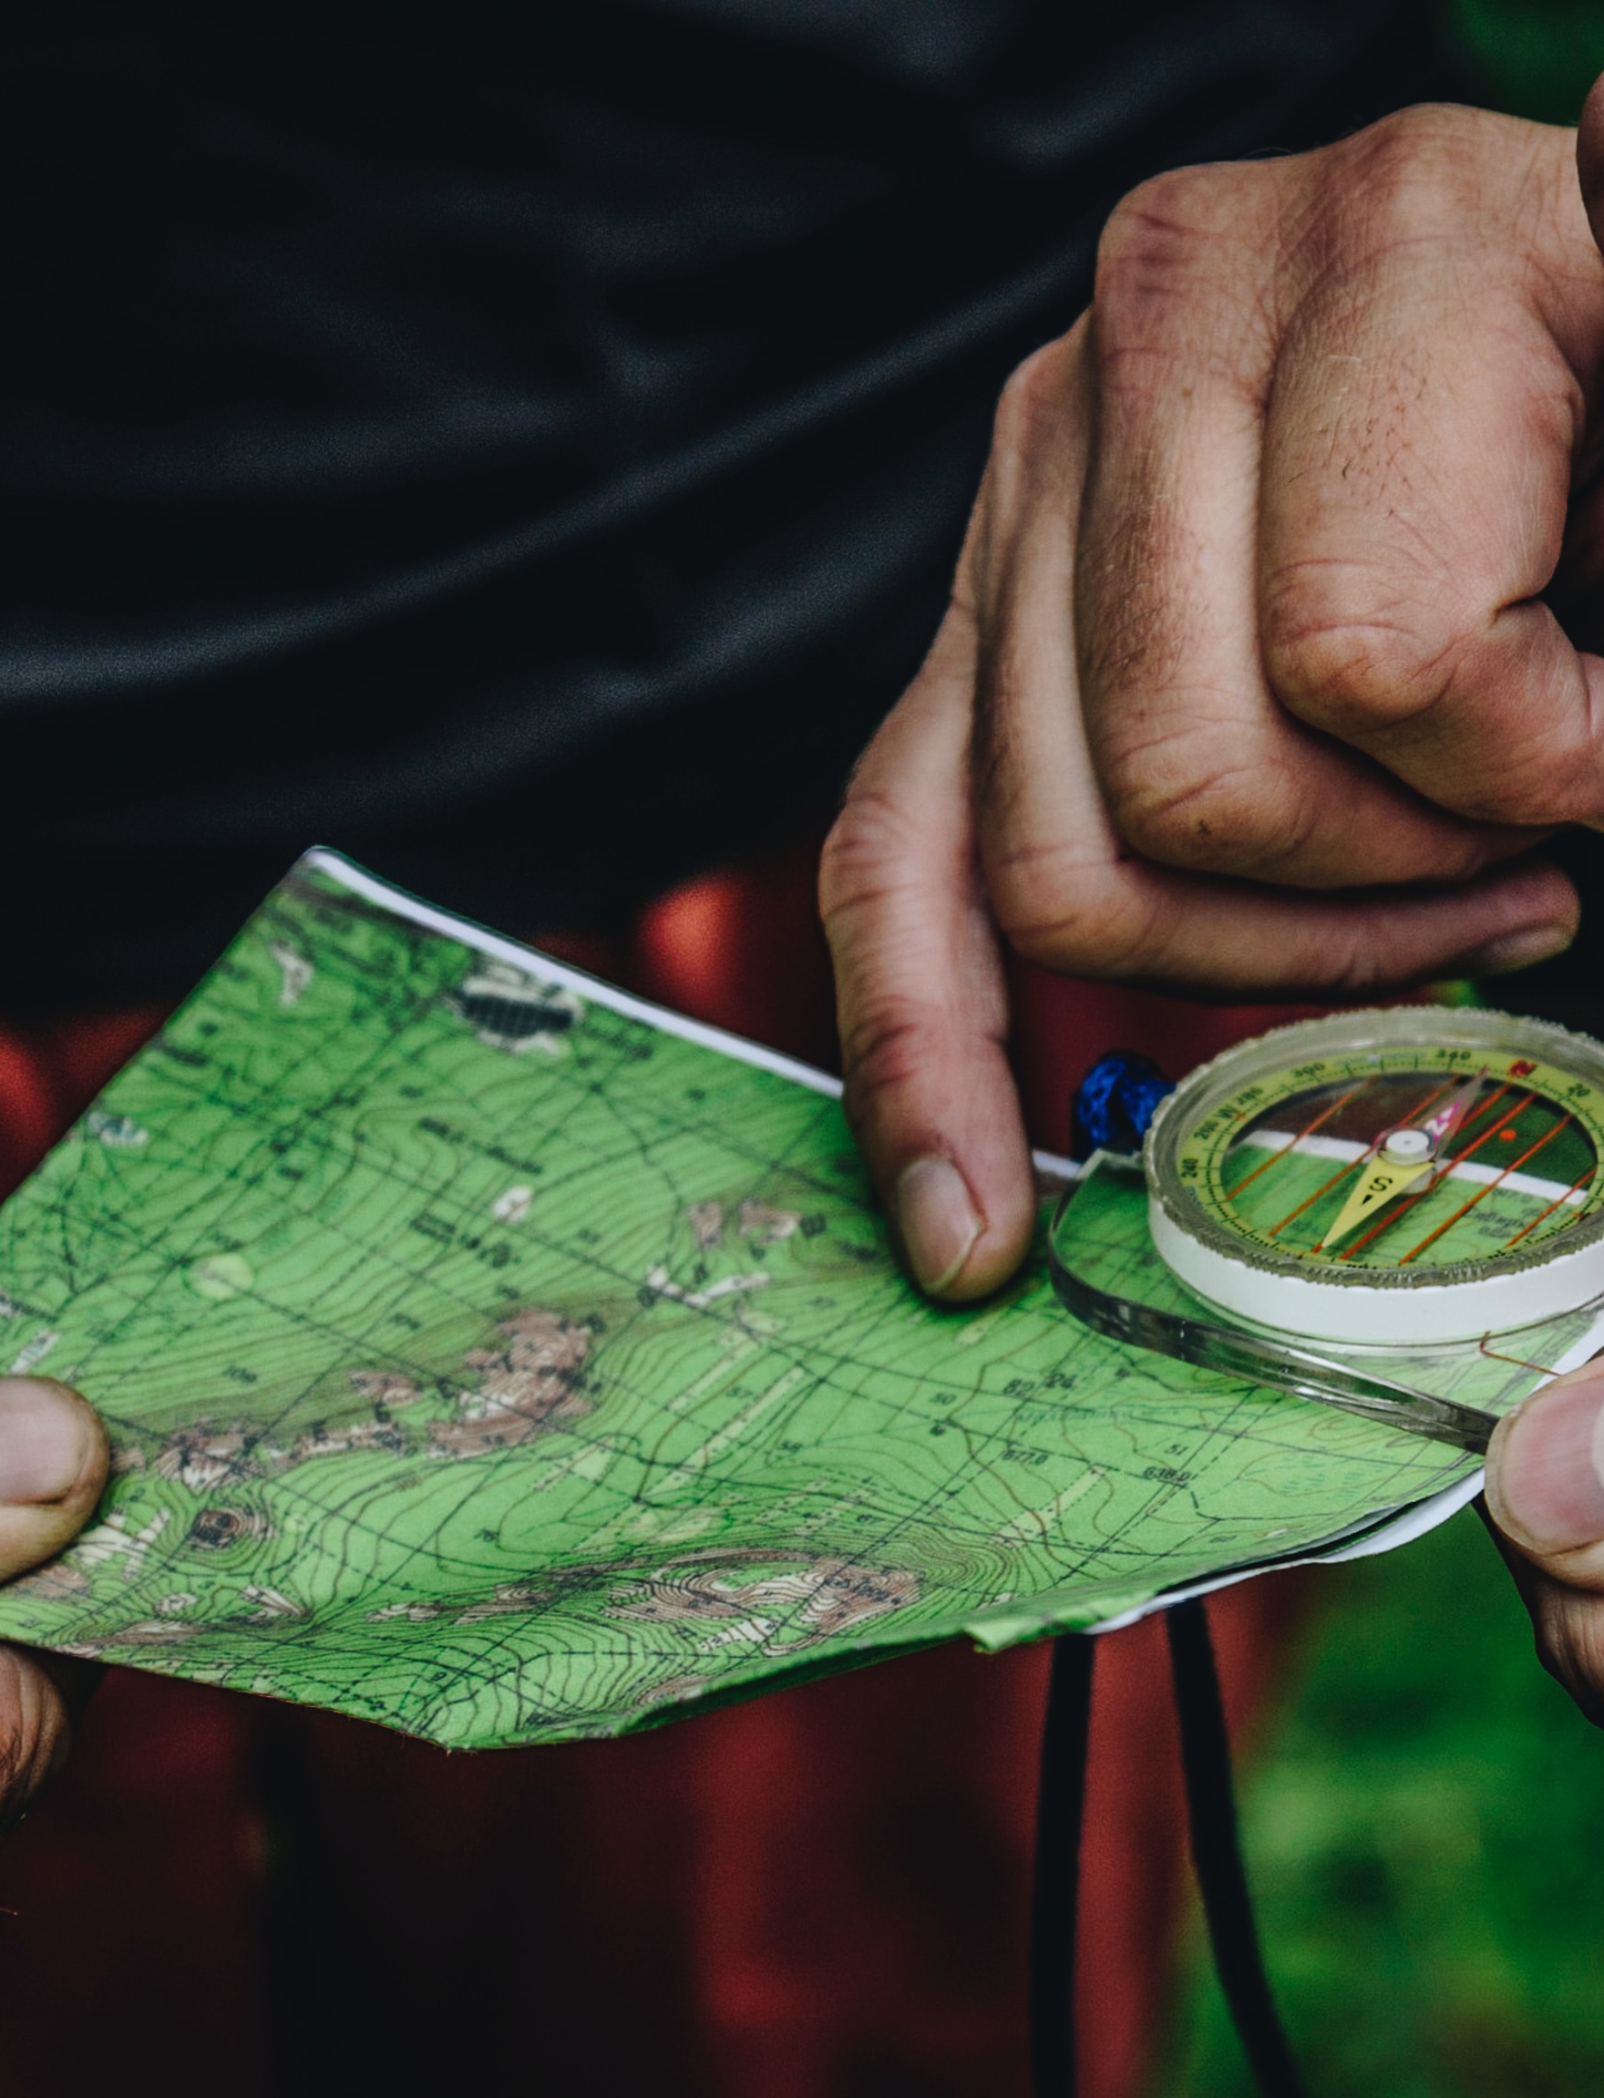
Travelling together
#DSSGx #TuringWay @turingway @kirstie_j
https://doi.org/10.5281/zenodo.3959179
Notes:
TIMING: 14

Slide 64
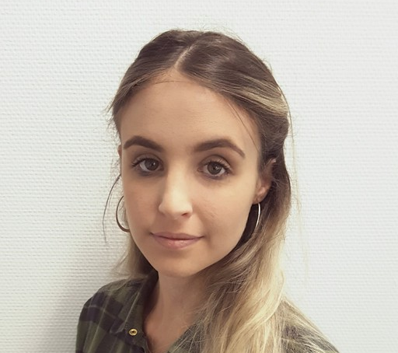
Martina Vilas
The co-working hours are friendly for introverts who might be intimidated working with new people. These personal interactions are also crucial for staying motivated!
https://martinagvilas.github.io
#DSSGx #TuringWay @turingway @kirstie_j
https://doi.org/10.5281/zenodo.3959179

Slide 65
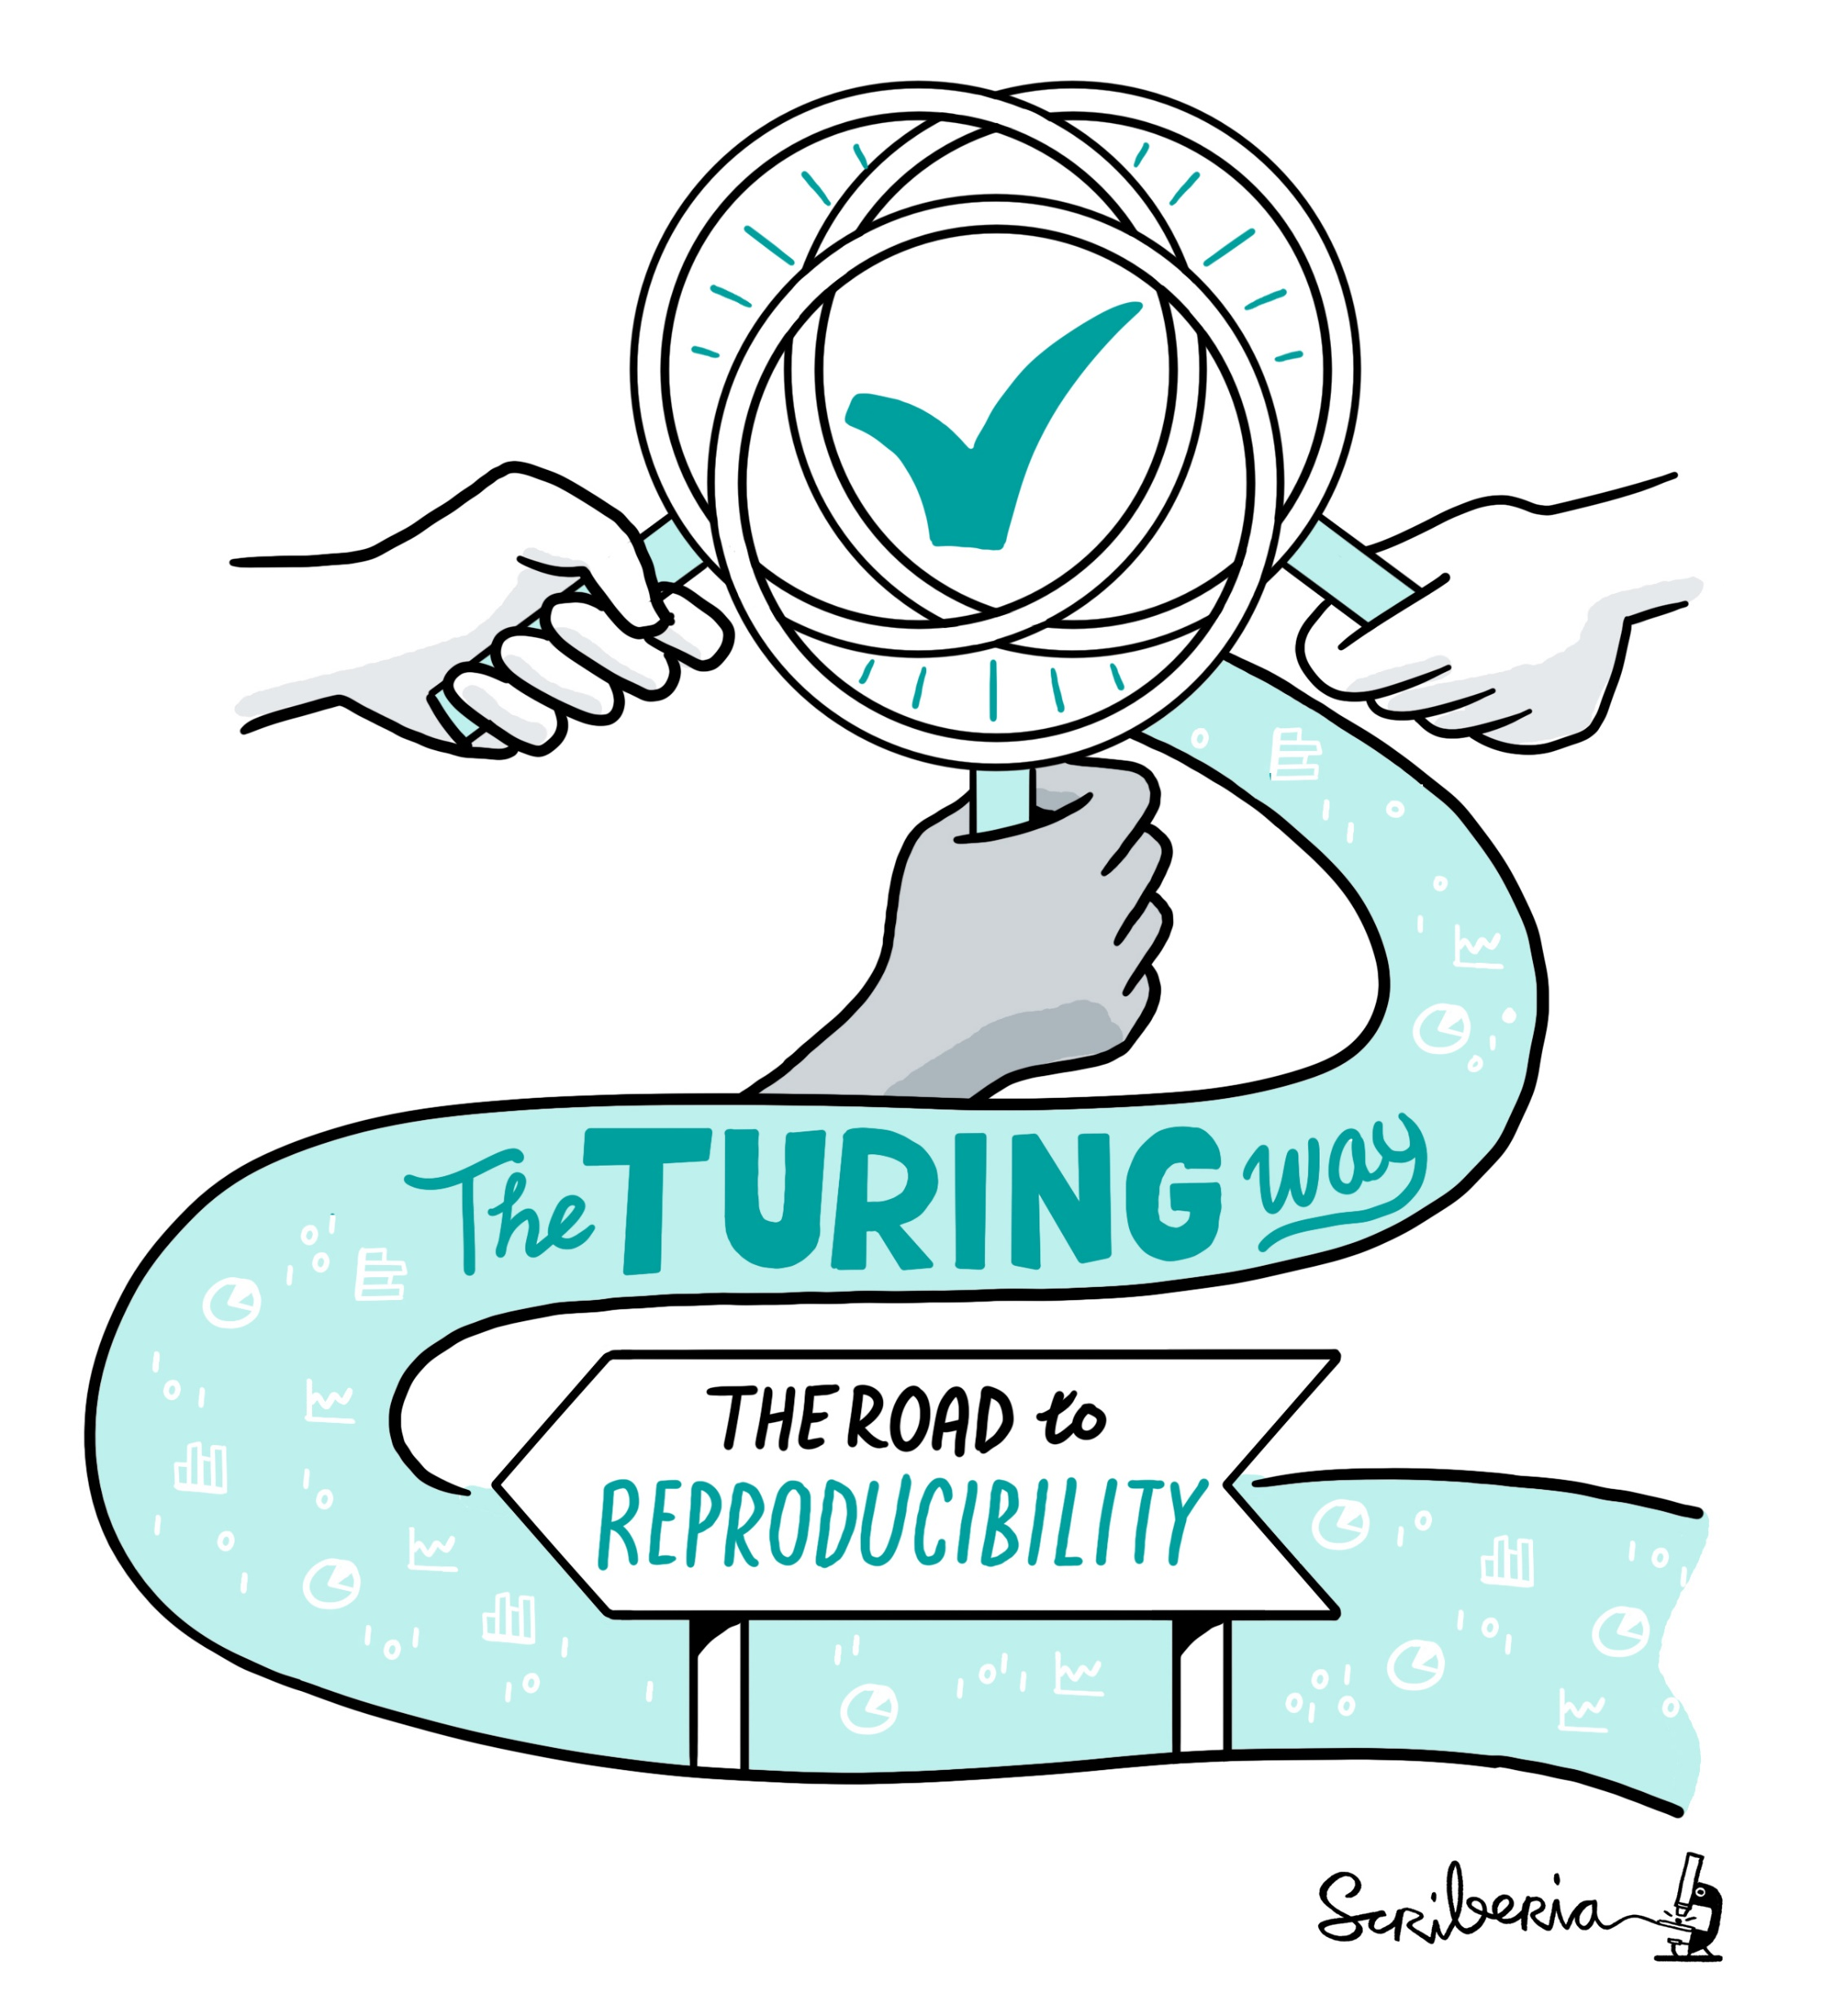
A note on the name
I never thought the name would be approved!
This is not a Turing project (although it has great support from the Institute)
We are creating guidance together, the way is a journey not a set of rules
https://www.turing.ac.uk/research/
impact-stories/changing-culture-data-science
#DSSGx #TuringWay @turingway @kirstie_j
https://doi.org/10.5281/zenodo.3959179
Notes:
TIMING: 14

Slide 66


Your work covers all of these topics!
Reproducibility
Scoping and designing a data science project
Ethics
Communication and visualisation
Collaborative working
https://github.com/
alan-turing-institute/the-turing-way/
blob/master/project_management/
tps-funding-application-20190429.md
#DSSGx #TuringWay @turingway @kirstie_j
https://doi.org/10.5281/zenodo.3959179
Notes:
TIMING: 15

Slide 67
The Turing has convening power and international influence
Tools, practices and systems embed values into research processes.
It is our responsibility to lead the conversation and deliver infrastructure that empowers the data science community.
@kirstie_j
https://doi.org/10.5281/zenodo.3959179
Notes:
TIMING: 13

Slide 68



Thank you
Book: https://the-turing-way.netlify.com
Newsletter: https://tinyletter.com/TuringWay
GitHub: https://github.com/alan-turing-institute/the-turing-way
Chat: https://gitter.im/alan-turing-institute/the-turing-way
Next Collaboration Café: 2 September at 3pm UK, 4pm CEST
This work was supported by The UKRI Strategic Priorities Fund under the EPSRC Grant EP/T001569/1, particularly the "Tools, Practices and Systems" theme within that grant, and by The Alan Turing Institute under the EPSRC grant EP/N510129/1. Unsplash photos by Adolfo Felix,Daniil Silantev, James Pond, Kinson Leung, Mateo Vrbnjak, Toa Heftiba, Thomas Q, Waldemar Brandt. Noun Project icons by Aybige, Luis Prado, Edward Boatman, Becris, Rose Alice Design, Hyemm.work. Original artwork by Scriberia: https://doi.org/10.5281/zenodo.3332807
#DSSGx #TuringWay @turingway @kirstie_j
https://doi.org/10.5281/zenodo.3959179
Notes:
TIMING: 10

