Slide 1
Agile development of the SSH Open Marketplace – User Insights
ICTeSSH 2020
30 June 9.00 -11.00
Moderator: Matej Ďurčo, OEAW/ACDH-CH
SSH Open Marketplace Testers:
Agnieszka Szulińska
Kasia Karpinska
Maurizio Toscano
Vanessa Hannesschläger

Slide 2

Agnieszka Szulińska
The Institute of Literary Research of the Polish Academy of Sciences
  TEI Encoding Supervisor, DH researcher
  Literary Research, Linguistics
  Digital editions, Video games language, scholarly communication in SSH (at OPERAS-P)
  Open Access, FAIR Data
  My ORCID-ID: https://orcid.org/0000-0001-5778-6006
A post-event report will look at the commonalities and areas for collaboration on our journey to EOSC. Tangible result for wide dissemination.

Slide 3
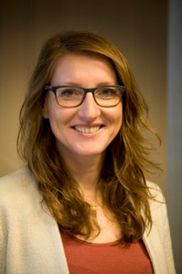
Kasia Karpinska
Erasmus University Rotterdam (the Netherlands)
ODISSEI (Open Data Infrastructure for Social Science and Economic Innovation)
  Researcher, scientific manager at ODISSEI
  Sociology
  Research interests: labour market, migration, family relations,
  social policy
  Research practices: quantitative research, survey data, data
  collection, cross-country comparison.
A post-event report will look at the commonalities and areas for collaboration on our journey to EOSC. Tangible result for wide dissemination.

Slide 4
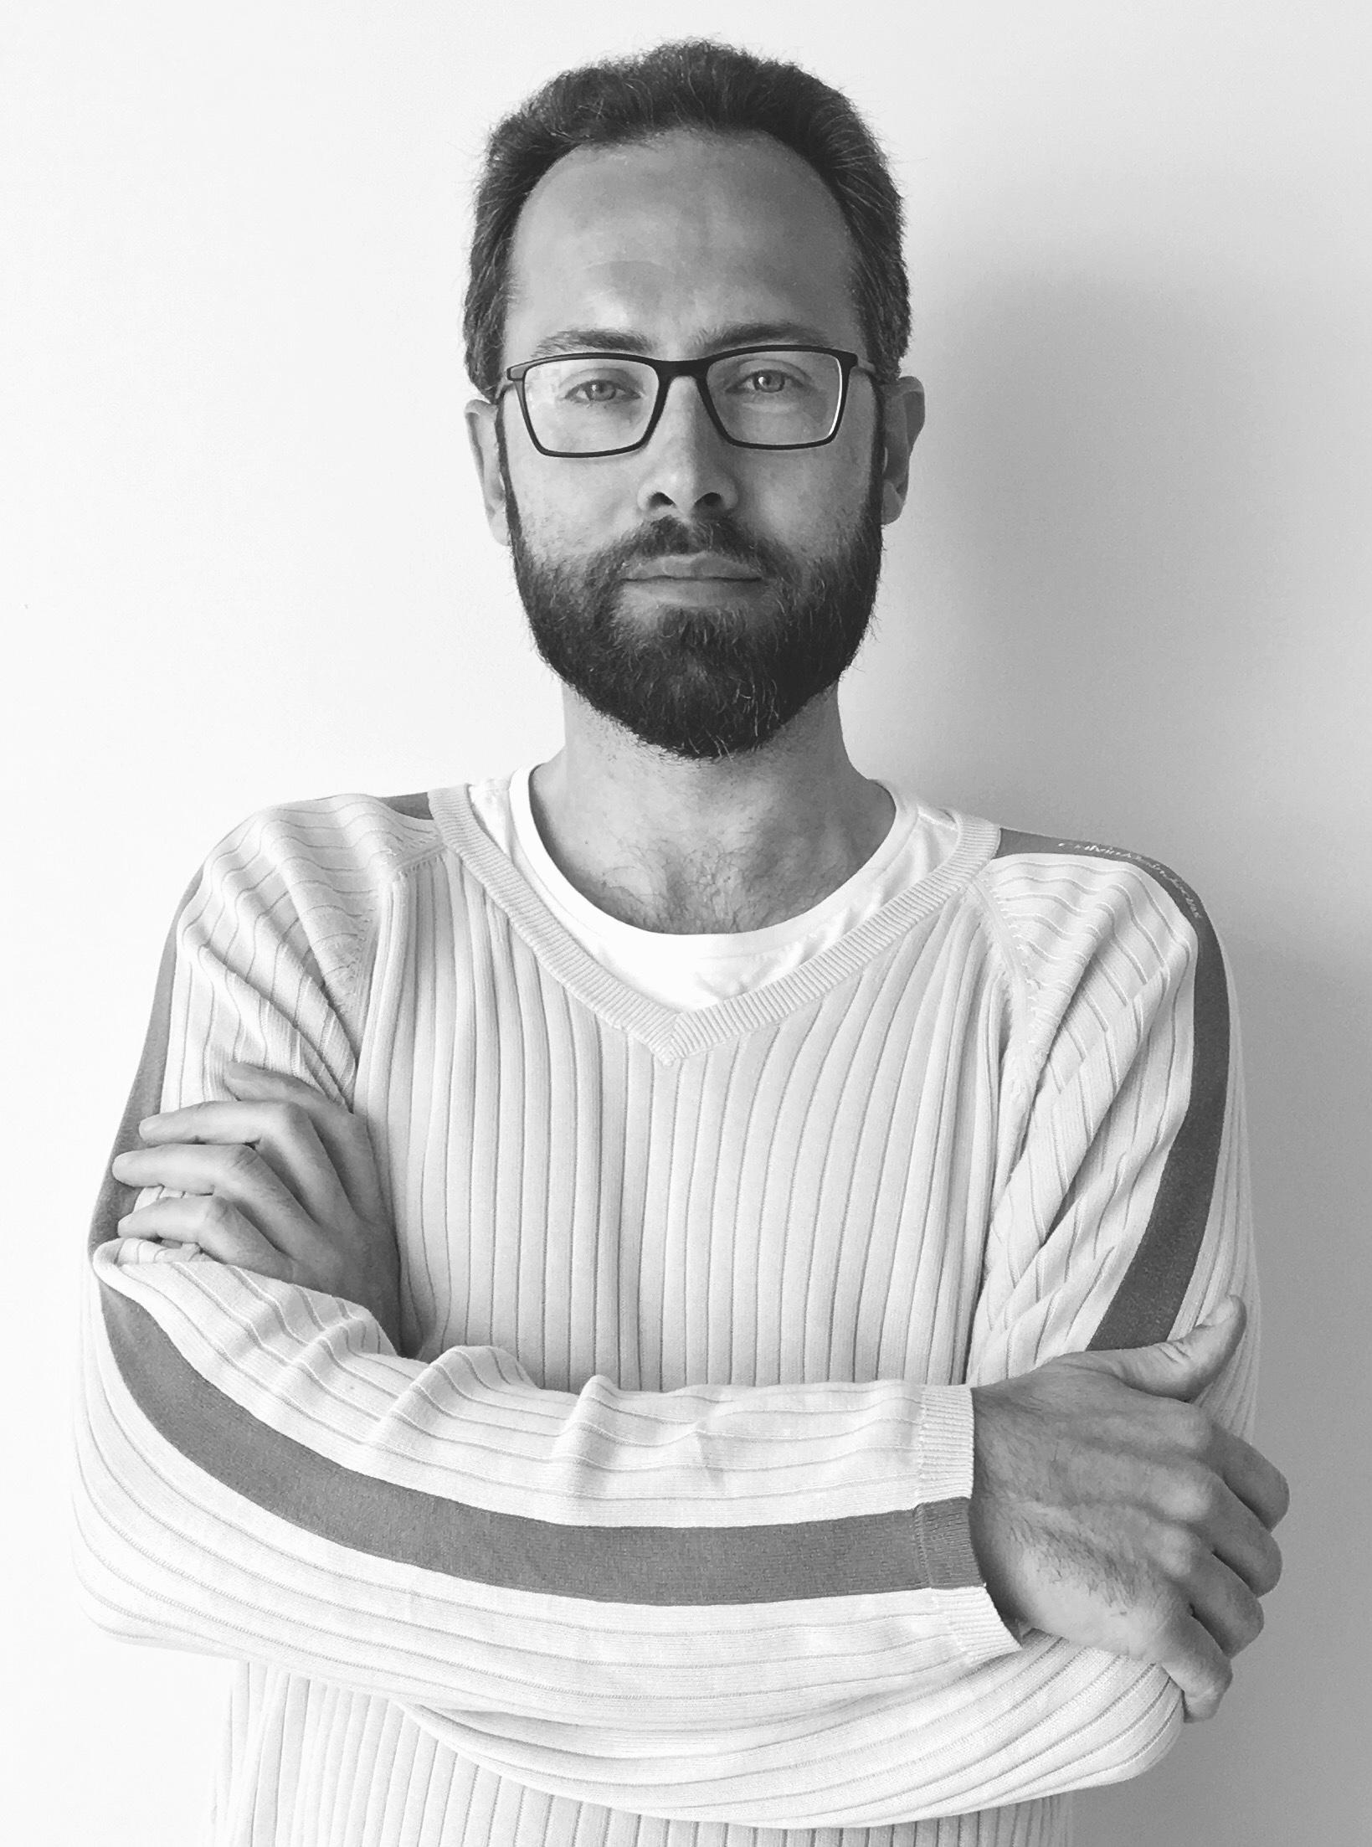








Maurizio Toscano
University of Granada (Spain):
  Digital Humanities researcher
  My research interests include: Digital Public History, Data modelling, Web information systems and GIS
  My research practice involves collaborating with researchers in different departments (History, History of Arts, Archaeology, Cultural Heritage, Architecture, MedialabUGR) and different public and private institutions (UGR, UNED, CSIC, Eachtra Archaeological Projects, local administrations), implementing DH methods and practices in their research.
  I am a member of the Executive Board of the Asociación de Humanidades Digitales Hispánicas.

Slide 5

Vanessa Hannesschläger
Austrian Centre for Digital Humanities & Cultural Heritage,
Austrian Academy of Sciences
  Researcher and research infrastructure member
  German literature studies
  Contemporary Austrian Literature & Austrian Nobel Laureates
  Digital Humanities, Open Science
A post-event report will look at the commonalities and areas for collaboration on our journey to EOSC. Tangible result for wide dissemination.

Slide 6


UX design, navigation and search experience 1
Agnieszka Szulińska
Onet three clicks to get to the content. Nice. Also fast loadings.
Breadcrumb works well for the navigation!
What’s New – if regularly updated – will be great on the Homepage, might be even more highlighted
The Search engine is rather fine with letters from Russian and Polish, no errors or bugs (however, no results yet)
A big plus for adding contrast!
[Safari] version requires changes in CSS probably (to small search engine field, blank image icon etc.)
Information is doubled in some places (activities on the Details page or 3 x about on Homepage)
Fonts (Ubuntu and Open Sans) are too similar to be a pair on one website
Icons are too similar and too detailed, just only colour is not enough for me to diverse them
Keywords sometimes are too general (Textual analysis, Images), sometimes too detailed (Python dictionary) and there should be limit per one item (5 keywords max)
The gallery should be optional

Slide 7
UX design, navigation and search experience
Kasia Karpinska
General impression:
  Clean website
  Main categories are well-defined (distinct, informative)
Remarks:
  Too many keywords
  Some aspects requires finetuning: too small font, pictures not always displayed, some functionalities don’t work (contact, see what’s new)
  Activities doesn’t seem a good label
  Use of operators in the search engine?

Slide 8
UX design, navigation and search experience:
Maurizio Toscano
What I liked:
Clean and uncluttered design
A unified search box
Fast to load on slow connections
Large and distinctive categories: tools, training, workflows and datasets
Accessibility features: font size and contrast
What I missed:
Search box live suggestions
Fixed menu bar during scrolling
A more content rich footer
“back to top” link for long pages
More diversity on the background image, and a larger font
An intro tour for first time users, useful to suggest alternatives to free search

Slide 9
UX design, navigation and search experience:
Maurizio Toscano
Search results page missing features:
  Retain actual search in the search bar
  Switch search results between list and grid (3x3) view
  Filter by Research topic
Search results page useful additions:
  Compare results, using metadata from the details sidebar
  Bookmark favourites resources (for registered users)
  Save a search (for registered users)
  Report an issue: outdated content, wrong classifications, etc.
  Update count between brackets accordingly to selected filters
  Present “browse content” as an alternative to free search, on homepage and if no results found
  At launch, replace “Last added” with a “Recommended” or “Editors’ picks”

Slide 10
UX design, navigation and search experience
Vanessa Hannesschläger
well structured, main elements visible at first glance
easily understandable paratexts, not too long
how to use the search & filter functions is self-explanatory
… a certain uncertainty about what to write in the search field …
too many keywords available
no differentiation between frequently and less frequently used filters
“last added”: maybe useful for future frequent users of the platform, currently serves no real purpose

Slide 11
UX design, navigation and search experience
(Reactions to testers remarks)
Matej Ďurčo
What is already planned in the next stages of development:
  Search autocomplete is a must
  Complex search (search operators) is technically feasible and will be implemented at a later stage, though it is being very seldom used (based on experience from similar projects)
  Personalisation (saved searches, bookmark)
Faceted browsing considered the most intuitive way to explore the dataset, however can be hampered by (bad) data quality
  facet-value proliferation (too many keywords), therefore =>
Curation and editorial work as central elements to improve navigation and search experience
  Last added section
  Images and icons

Slide 12
Content & curation of content
Vanessa Hannesschläger
→ I deliberately did not take a look at the user stories so that I would be a prototypical “uninformed user” who does not know the intentions and expectations of the marketplace makers.
description page per content provides very brief description, picture and link to content
link to content is easily accessible, no lengthy descriptions but direct access
images are too large (e.g. when only a logo is provided → DTA)
language mix might not be ideal for some users (e.g. German description → DTA)

Slide 13
Content & curation of content
Maurizio Toscano
Details sidebar:
  Media and Thumbnail links are useless - Object type is redundant
Missing:
  Tags as links - License type - Difficulty level - Time required (for training)
  Latest release date (for tools) - Provides certification (for training)
Related items:
I would like to see only strong related content on the page of a specific resource, for example:
  Training material specific for the tool I am viewing
  Tools that are alternatives to the tool I am viewing
  Datasets that are suited to be manipulated with the tool I am viewing

Slide 14
Content & curation of content
Maurizio Toscano
Avoid highlighting outdated content:
  LitBlitz, beta Chrome extension, abandoned; TILE, not updated in 9 years; Virtual Lightbox, not updated in 16 years, etc.
  Suggestion: filter out by default outdated/abandoned or experimental software; include a filter or even an option on the user profile
“Last modified on 22 June 2020” is misleading, should be clearer that is referring to the curation and not the item itself
Suggestion: work as a recommender system, not just as a catalogue. On account creation, let users choose what kind of DH researchers they are (new, experienced, advanced), along with their interests (background , research topics, data they work with), and provide personalised content suggestions (i.e. a Netflix for Digital Humanities)

Slide 15
Content & curation of content
Kasia Karpinska
Datasets:
  Hard to visualize the tool (at this point only one dataset)
  No access to variables, only to the general meta data
  What difference between Marketplace and other tools, for instance Google Data Search?
  How will the functionality work with ingestion of the CESSDA Data Catalogue?
    Large database, is current search functionality sufficient?
Other:
  How are the contextual links created, what are the criteria?
  Workflows not used in social sciences, tools and training materials provide a good overview for new users (although can also be found in other search engines)

Slide 16
Content & curation of content 1
Agnieszka Szulińska
I like „contributors” instead of „authors” in details of a particular item.
It would be fan-ta-stic to add examples of using a particular item (tool or datasets) in action!
If the description of an item will be in more than English, then it would be great for multilingualism (like every in English and mother tongue of a project)
It seems like a place for many different initiatives (exact key words, many categories)
Description of particular item seems short and generic, like copy-paste from the project’s page. I'd prefer an original and a little more detailed one, prepared by the SSH Open Marketplace editors.
Not sure about details in alphabetical order.
Not sure if there will be plenty of Workflows to fill plus they appear to be similar to the Training Materials
No option to test Community functionalities yet
Not sure if related items are really related (Oxygen case: https://marketplace.sshopencloud.eu/tools/42) What are criteria for relation?

Slide 17
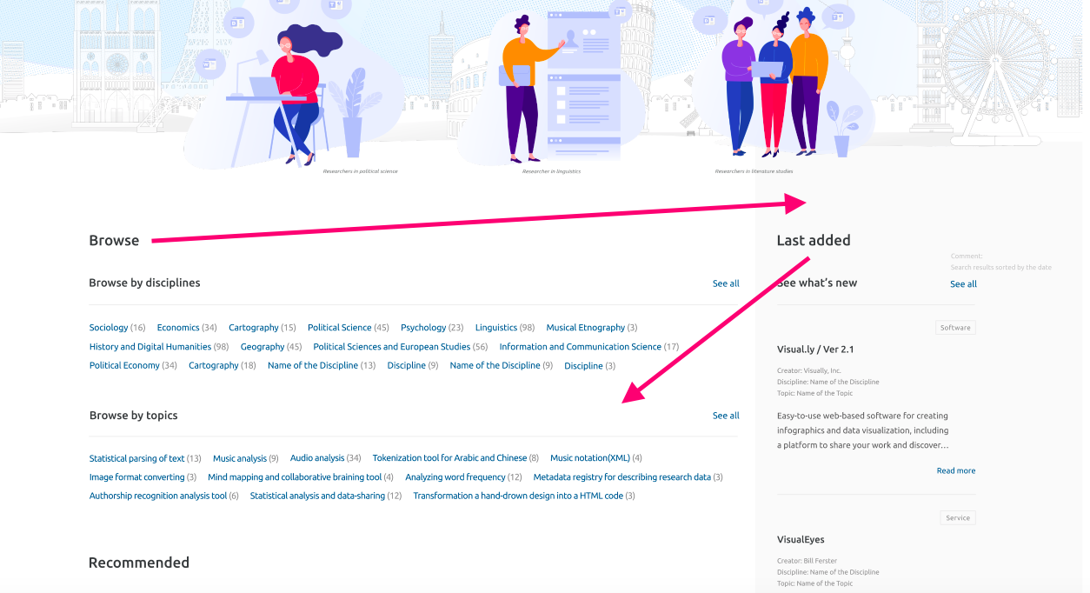
Content & curation of content 2
Agnieszka Szulińska

Slide 18
Content & curation of content
(Reactions to testers remarks)
Matej Ďurčo
Datasets
  No plan to duplicate all the records from big data catalogues (like CESSDA Data Catalogue or CLARIN VLO)
  But the catalogues themselves as items in MP (Discovery Services)
  And manually selected datasets interlinked as samples for tools or used in training materials
Workflows
  aka scenarios, or recipes - Meant to describe sequences of steps to accomplish a task
  Similarity with training materials - yes, but introduced to emphasize the “how” question, which MP is meant to offer answers to

Slide 19
Content & curation of content
(Reactions to testers remarks)
Matej Ďurčo
Relations between items
  Plan to identify semi-automatically, but need to manually curate/prune - quality over quantity
  Relation between tools and datasets also handled by another component being developed in SSHOC: Switchboard
Multilinguality
  Important, but almost impossible to implement
  Massive curation effort, potential usability issues (search)
Categorisation of items considered crucial for discovery
  “Activities” one of the main categorisation dimensions, in the sense of types of research activities, scholarly primitives,
  or research data life cycle

Slide 20
Curation, trust & governance
Kasia Karpinska
Remarks:
  Community effort
  Are there defined KPI’s to monitor usage?
  Is the final aim to make it widely used?
  How the curation criteria will be further defined?
  What are the selection criteria for curators/ moderators?
  More transparency about the contributors and governance structure (limited information is provided now).

Slide 21
Curation, trust & governance
Agnieszka Szulińska
The fact that there is room for testers in the project gains my trust (it’s not a common practice though)
I like the „GitLab documentation” practice, it is very convenient for devs
3 x C (Curation, Community, Contextualisation) is very catchy and tempting
Privacy Policy seems alright (but I am not a lawyer, remember!), I like being plain about which tools collect my data, like Matomo Analytics
Copyright notice about source code!
Cooperation with DARIAH on promoting project also gains my trust
There are no authors or participants listed anywhere by name on the website (without giving any reason why)
„This website collects its content from various sources with different reuse policies.” – I need to check every policy specifically now, maybe there should be information about particular policy with the particular item? Like: can I use the thumbnail of particle tool or not?
Contact is blank now. And it should be linked anywhere it is mentioned.

Slide 22
Curation, trust & governance
Maurizio Toscano
Ensure language consistency
Include an infographic about the relationships among Open Marketplace, EOSC, EOSC Catalogue & Marketplace, the SSHOC Project, DARIAH and other related infrastructures
Publish OMP data model and technologies used
Provide credits for contributors on the website
Include a disclaimer when suggesting commercial software, of not being affiliated or receiving revenues from links
As a user of the community, I expect to be able to suggest new resources, improve metadata, and report issues
Suggestion: include papers, indexing and providing curation and contextualisation to external DH bibliographies

Slide 23
Curation, trust & governance
Vanessa Hannesschläger
funders, project context, implementers are clearly stated
no immediate info (button!) on how I can contribute as a user
Nice-to-haves (wishlist):
immediately visible direct links to EOSC, SSHOC
“last updated” or other indications of when the marketplace platform / content was last updated
comment section for users

Slide 24
Curation, trust & governance
(Reactions to testers remarks)
Matej Ďurčo
Community curation
  Experiences show that it is difficult to motivate people to contribute without direct reward
  How to incentivize contributions
  Glad to see persons interested in contributing
Refine meta-information
  Contributors
  Legal aspects

Slide 25




Join our community!
www.sshopencloud.eu
@SSHOpenCloud
company/sshoc
info@sshopencloud.com

