Slide 1
Agenda
Boost your reproducibility with Binder
13:00 Registration and introductions
13:10 Introduction to the workshop and The Turing Way
13:20 Presentation: Why you need a reproducible computing environment and how Binder can help
14:30 Coffee break
15:00 Code along demo: Zero to Binder, build a Binder resource
16:00 Build your own Binder
16:30 Feedback, group picture and close
#TuringWay @kirstie_j @mybinderteam
https://doi.org/10.5281/zenodo.2598529

Slide 2

Reproducible Computational Environments
Kirstie Whitaker
Pronouns: she/her
#TuringWay @kirstie_j @mybinderteam
https://doi.org/10.5281/zenodo.2598529
Notes:
TIMING: 0

Slide 3

#TuringWay @kirstie_j @mybinderteam
https://doi.org/10.5281/zenodo.2598529
Slide courtesy of Chris Holdraf and the Jupyter Team

Slide 4

Upsetting take home message
Sharing your code and data isn’t enough
#TuringWay @kirstie_j @mybinderteam
https://doi.org/10.5281/zenodo.2598529

Slide 5
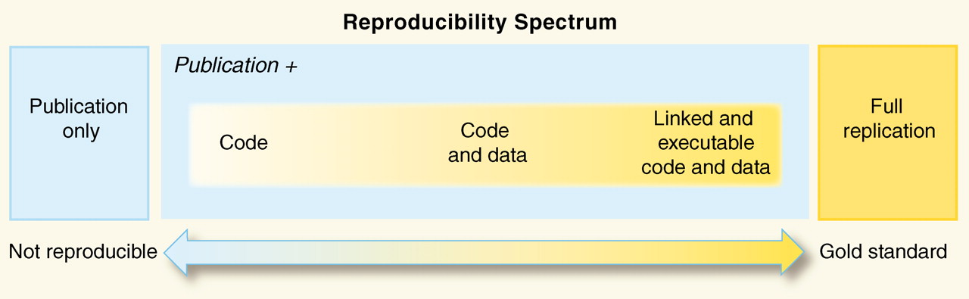
You need the computational environment too
#TuringWay @kirstie_j @mybinderteam
https://doi.org/10.5281/zenodo.2598529
Peng, 2011, doi: 10.1126/science.1213847

Slide 6

You need the computational environment too
#TuringWay @kirstie_j @mybinderteam
https://doi.org/10.5281/zenodo.2598529
Peng, 2011, doi: 10.1126/science.1213847

Slide 7
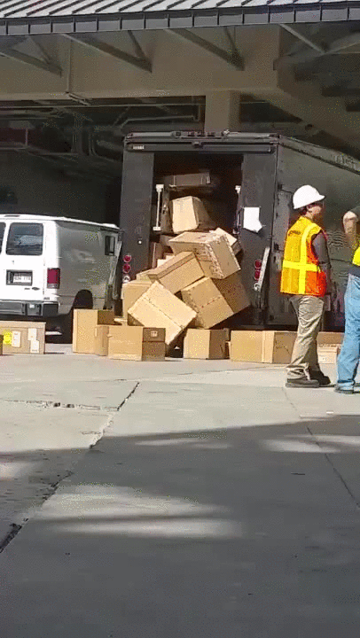
The computational environment includes:
Hardware (GPU, CPU)
Operating system (mac, windows, linux)
Software
    Language version
    Package version(s)
  And all the interactions between the layers
#TuringWay @kirstie_j @mybinderteam
https://doi.org/10.5281/zenodo.2598529
Notes:
TIMING: 5

Slide 8

What is Binder?
#TuringWay @kirstie_j @mybinderteam
https://doi.org/10.5281/zenodo.2598529
Notes:
TIMING: 33

Slide 9
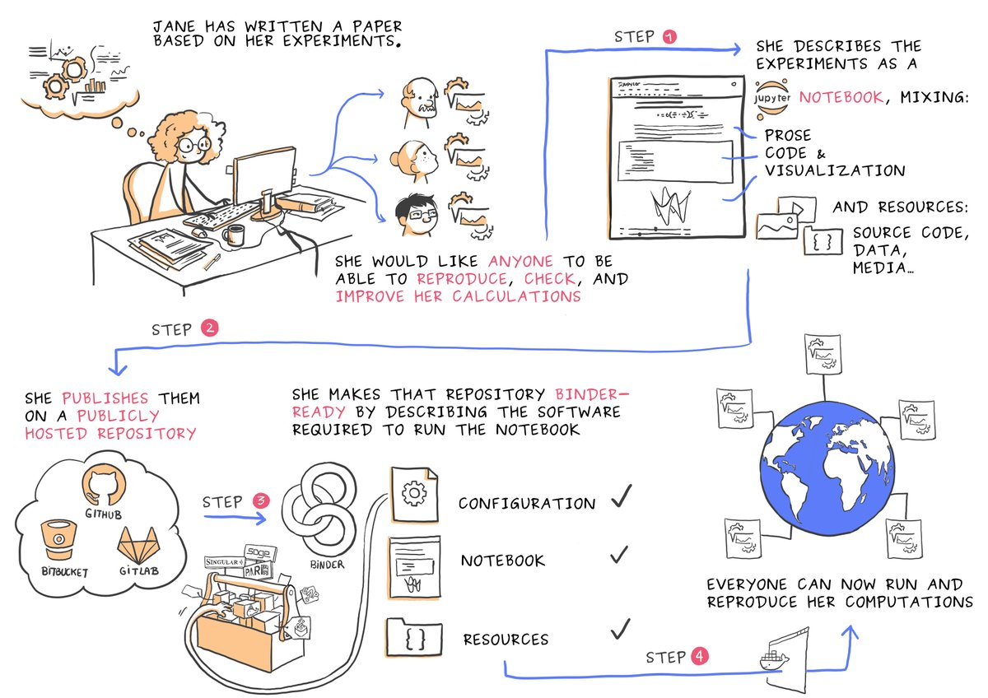
Courtesy of Juliette Taka: https://twitter.com/mybinderteam/status/1082556317842264064
#TuringWay @kirstie_j @mybinderteam
https://doi.org/10.5281/zenodo.2598529

Slide 10

Courtesy of Juliette Taka: https://twitter.com/mybinderteam/status/1082556317842264064
#TuringWay @kirstie_j @mybinderteam
https://doi.org/10.5281/zenodo.2598529

Slide 11
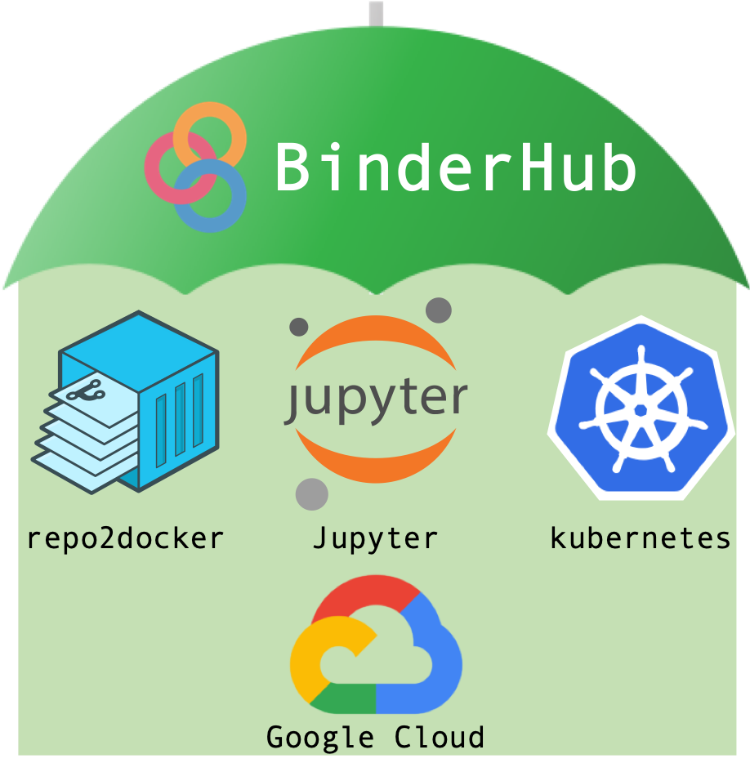
Coordinate cloud computing resources with Kubernetes (k8s)
Make it easy for users to access with a JupyterHub
Set up the environment from your GitHub repository
https://binderhub.readthedocs.io
#TuringWay @kirstie_j @mybinderteam
https://doi.org/10.5281/zenodo.2598529

Slide 12

Sarah Gibson
“It took me a while to feel like I knew enough to contribute to Binder. But the team are always so excited to have my input. Its really motivating to be part of such a welcoming community.”
https://www.turing.ac.uk/people/researchers/sarah-gibson
#TuringWay @kirstie_j @mybinderteam
https://doi.org/10.5281/zenodo.2598529

Slide 13
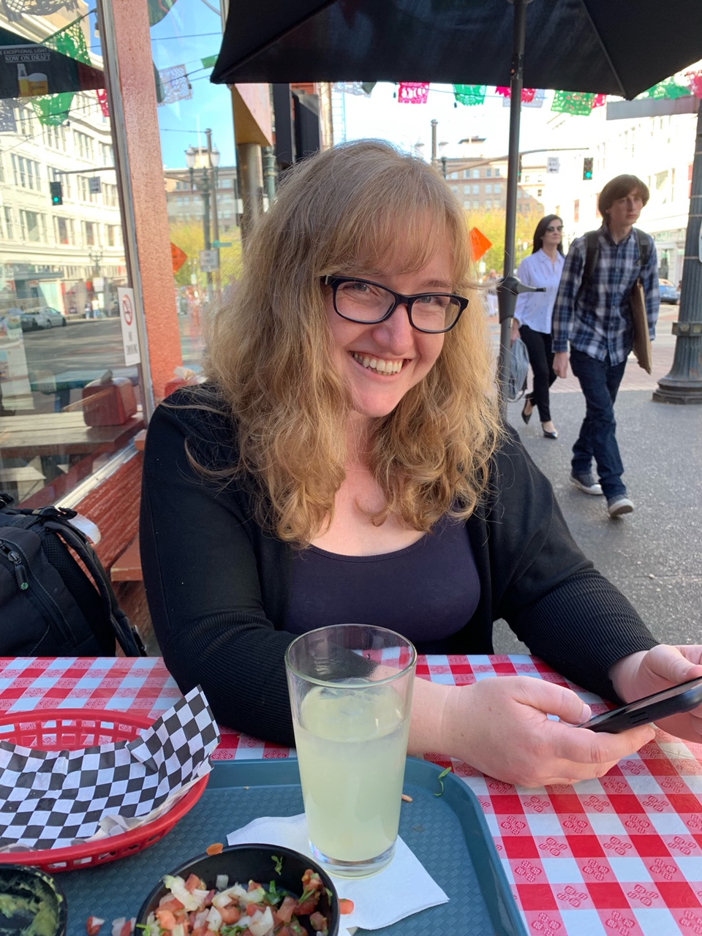
Check analysis on my phone
Share the responsibility with busy PIs
Requires version control, capturing environment and new build for each change
#TuringWay @kirstie_j @mybinderteam
https://doi.org/10.5281/zenodo.2598529

Slide 14
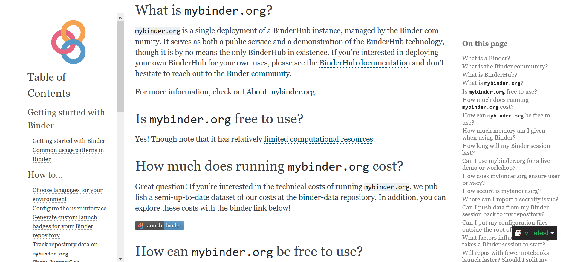
https://mybinder.readthedocs.io/en/latest/faq.html#how-much-does-running-mybinder-org-cost
#TuringWay @kirstie_j @mybinderteam
https://doi.org/10.5281/zenodo.2598529

Slide 15
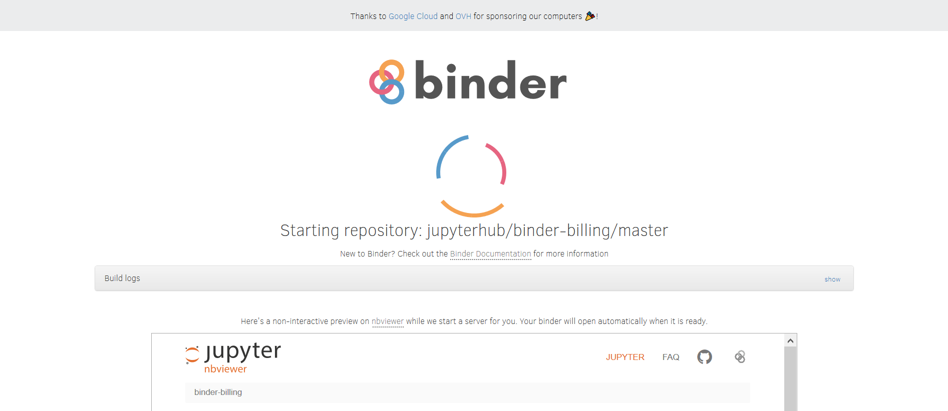
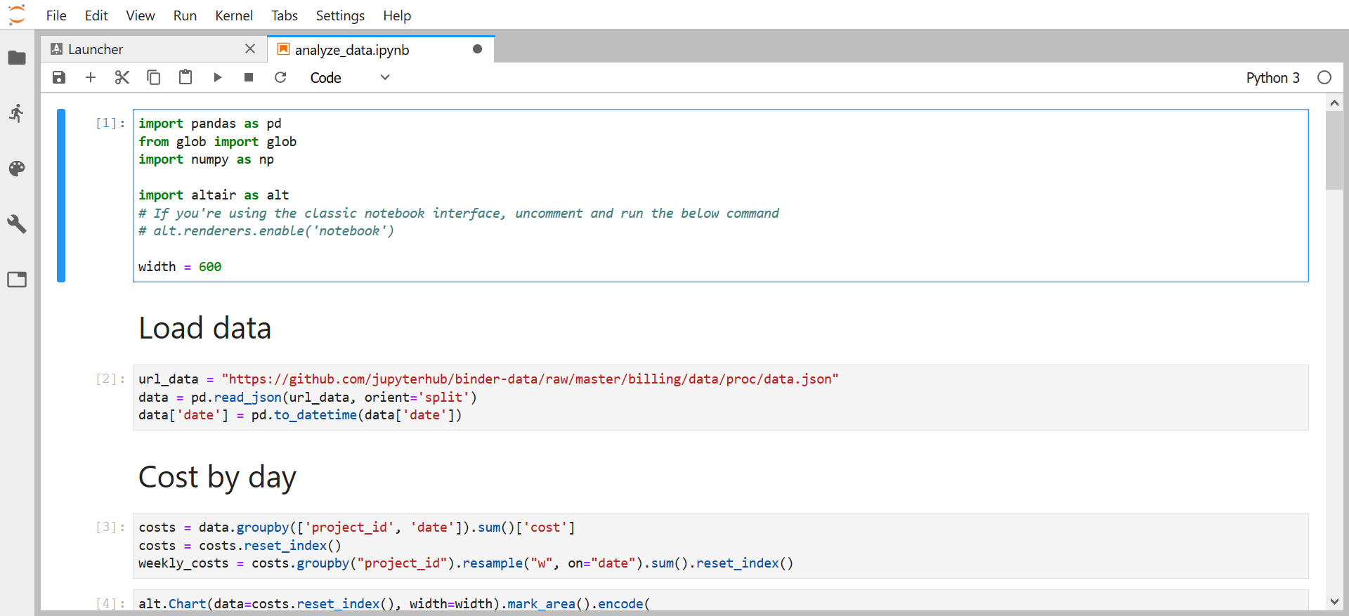
https://mybinder.readthedocs.io/en/latest/faq.html#how-much-does-running-mybinder-org-cost
#TuringWay @kirstie_j @mybinderteam
https://doi.org/10.5281/zenodo.2598529

Slide 16
https://mybinder.readthedocs.io/en/latest/faq.html#how-much-does-running-mybinder-org-cost
#TuringWay @kirstie_j @mybinderteam
https://doi.org/10.5281/zenodo.2598529

Slide 17
https://mybinder.readthedocs.io/en/latest/faq.html#how-much-does-running-mybinder-org-cost
#TuringWay @kirstie_j @mybinderteam
https://doi.org/10.5281/zenodo.2598529

Slide 18
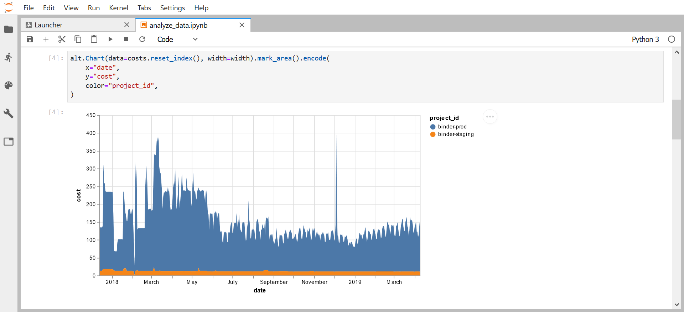
https://mybinder.readthedocs.io/en/latest/faq.html#how-much-does-running-mybinder-org-cost
#TuringWay @kirstie_j @mybinderteam
https://doi.org/10.5281/zenodo.2598529

Slide 19

Gertjan van den Burg
“The fun part of data science is the modelling. Being able to read in information from a csv file should not be the hardest part.”
https://gertjanvandenburg.com
#TuringWay @kirstie_j @mybinderteam
https://doi.org/10.5281/zenodo.2598529

Slide 20
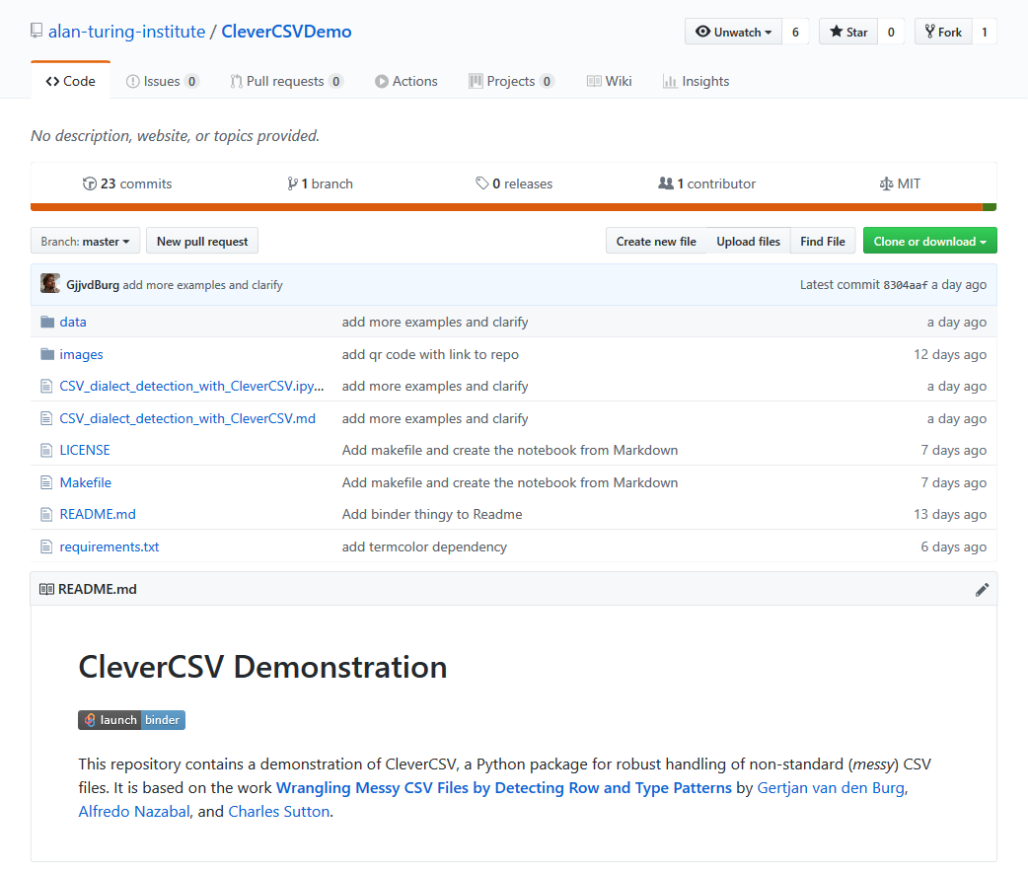
https://github.com/
alan-turing-institute/
CleverCSVDemo
#TuringWay @kirstie_j @mybinderteam
https://doi.org/10.5281/zenodo.2598529

Slide 21

https://github.com/
alan-turing-institute/
CleverCSVDemo
“Wrangling Messy CSV Files by Detecting Row and Type Patterns”
arXiv:1811.11242
#TuringWay @kirstie_j @mybinderteam
https://doi.org/10.5281/zenodo.2598529

Slide 22
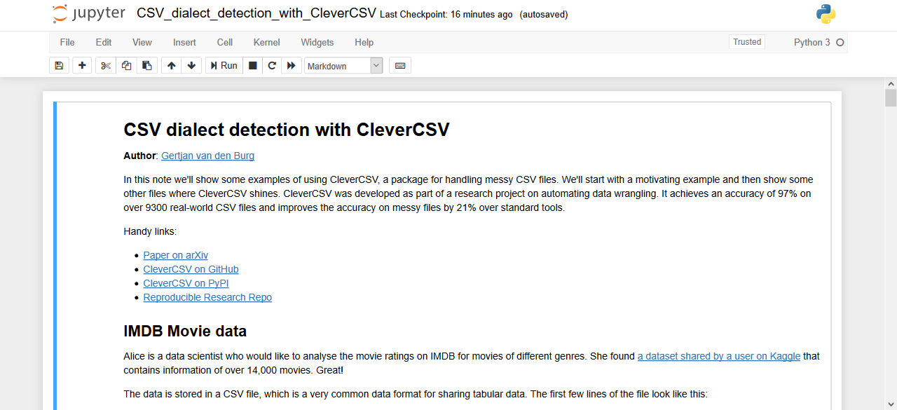
https://github.com/alan-turing-institute/CleverCSVDemo
#TuringWay @kirstie_j @mybinderteam
https://doi.org/10.5281/zenodo.2598529

Slide 23
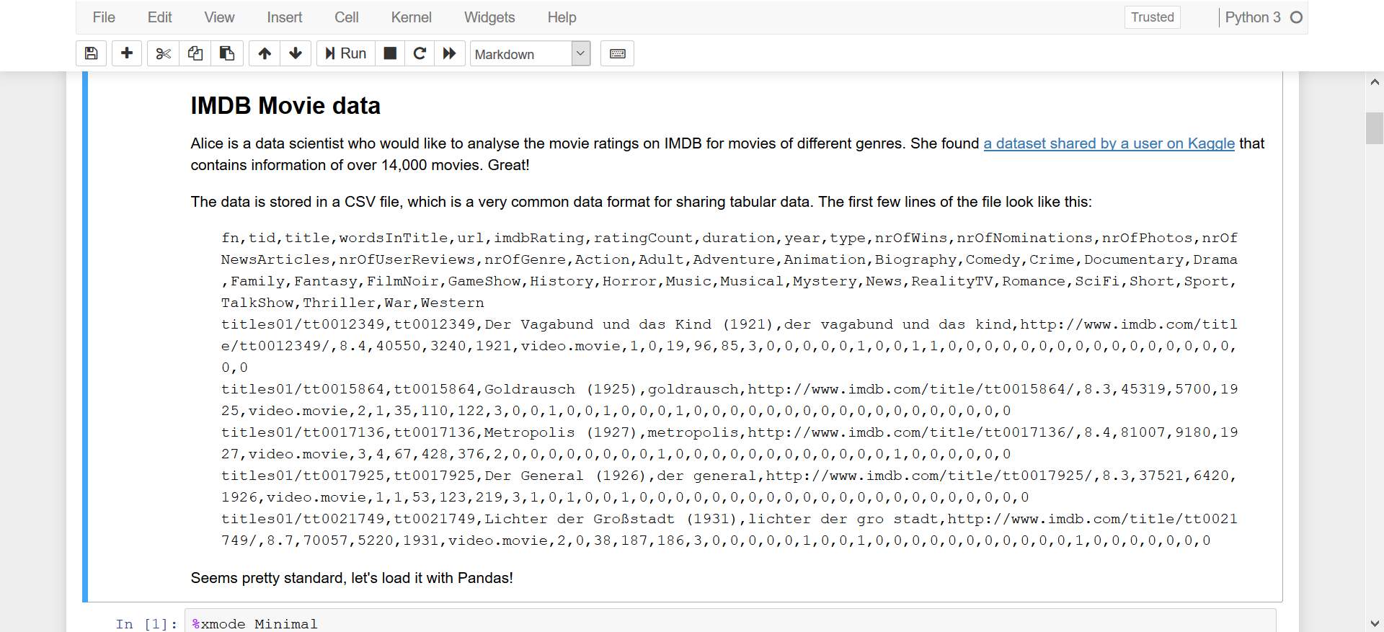
https://github.com/alan-turing-institute/CleverCSVDemo
#TuringWay @kirstie_j @mybinderteam
https://doi.org/10.5281/zenodo.2598529

Slide 24
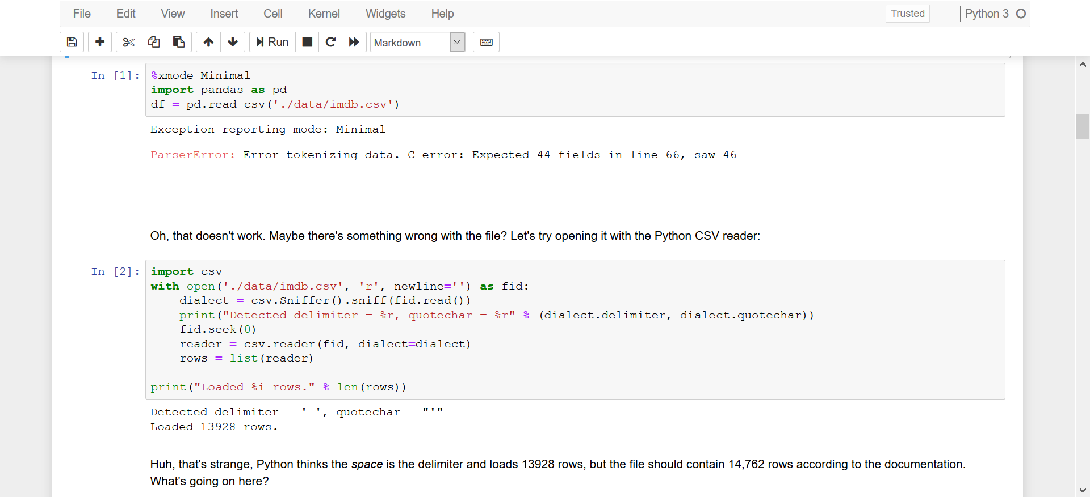
https://github.com/alan-turing-institute/CleverCSVDemo
#TuringWay @kirstie_j @mybinderteam
https://doi.org/10.5281/zenodo.2598529

Slide 25
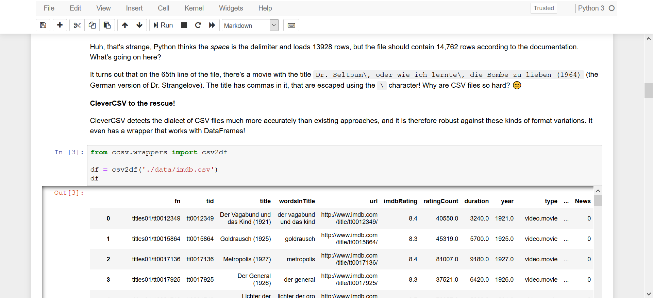
https://github.com/alan-turing-institute/CleverCSVDemo
#TuringWay @kirstie_j @mybinderteam
https://doi.org/10.5281/zenodo.2598529

Slide 26

https://github.com/alan-turing-institute/CleverCSVDemo
#TuringWay @kirstie_j @mybinderteam
https://doi.org/10.5281/zenodo.2598529

Slide 27
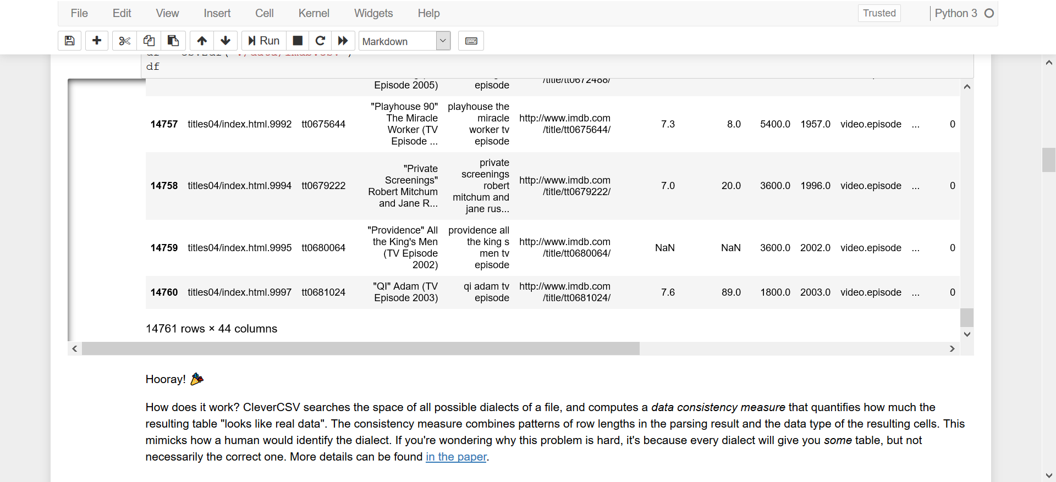
https://github.com/alan-turing-institute/CleverCSVDemo
#TuringWay @kirstie_j @mybinderteam
https://doi.org/10.5281/zenodo.2598529

Slide 28

Defining your computational environment
#TuringWay @kirstie_j @mybinderteam
https://doi.org/10.5281/zenodo.2598529
Notes:
TIMING: 33

Slide 29
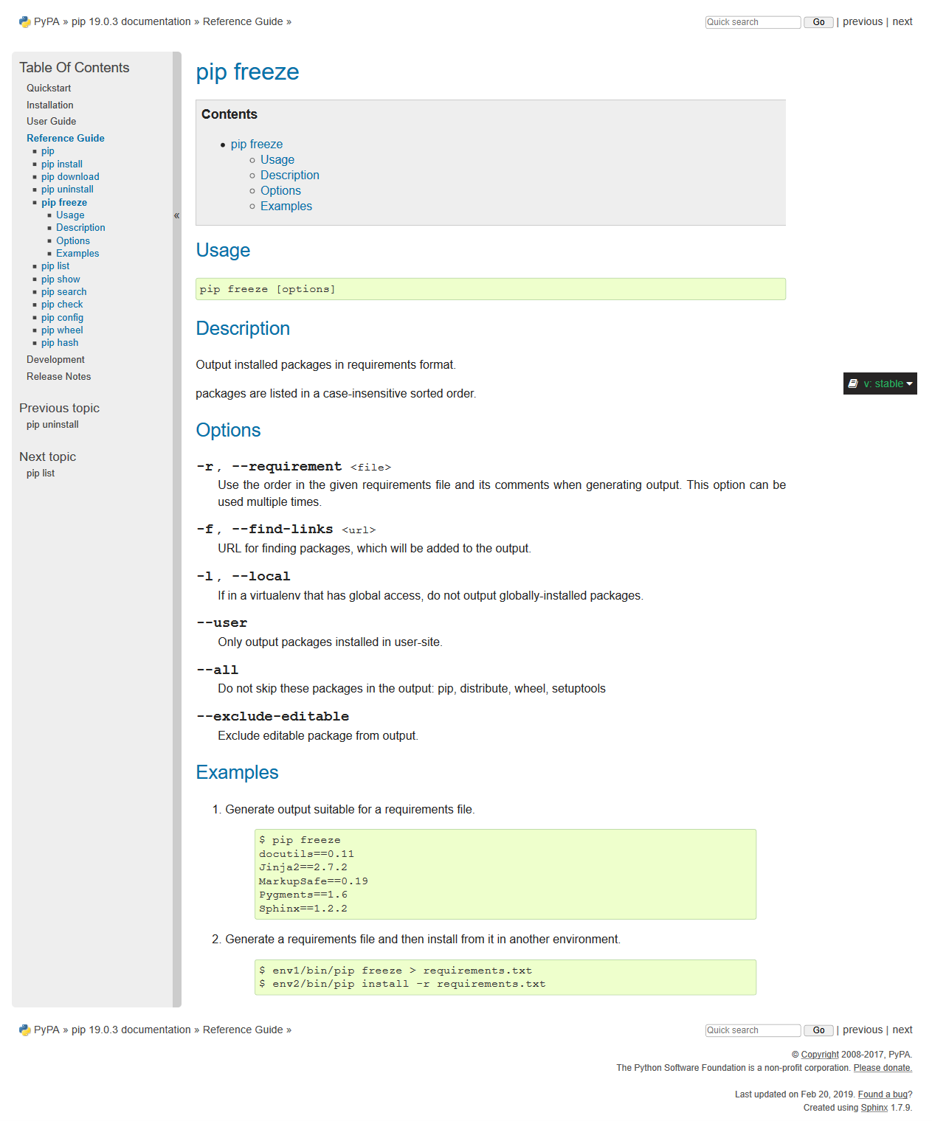
pip freeze
Python Package Index (PyPI)
Pip is a recursive acronym that can stand for either "Pip Installs Packages" or "Pip Installs Python"
#TuringWay @kirstie_j @mybinderteam
https://doi.org/10.5281/zenodo.2598529
https://pip.pypa.io/en/stable/reference/pip_freeze

Slide 30
pip freeze
pip freeze captures the versions of all packages that you’re currently using
Can print to screen or save in a file called requirements.txt
#TuringWay @kirstie_j @mybinderteam
https://doi.org/10.5281/zenodo.2598529
https://pip.pypa.io/en/stable/reference/pip_freeze

Slide 31
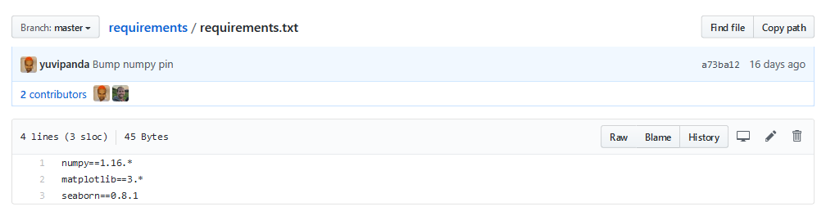
Binder example: requirements.txt
pip freeze
#TuringWay @kirstie_j @mybinderteam
https://doi.org/10.5281/zenodo.2598529
https://github.com/binder-examples/requirements

Slide 32
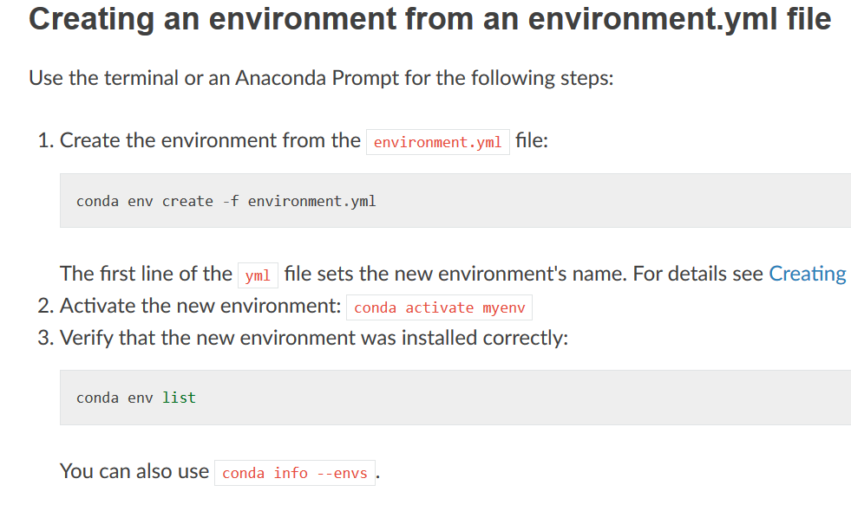
Conda env create
Package manager for multiple languages
Information about installed software saved in file called environment.yml
#TuringWay @kirstie_j @mybinderteam
https://doi.org/10.5281/zenodo.2598529
https://docs.conda.io/projects/conda/en/latest/user-guide/
tasks/manage-environments.html
https://the-turing-way.netlify.com/
reproducible_environments/02/package-management.html

Slide 33
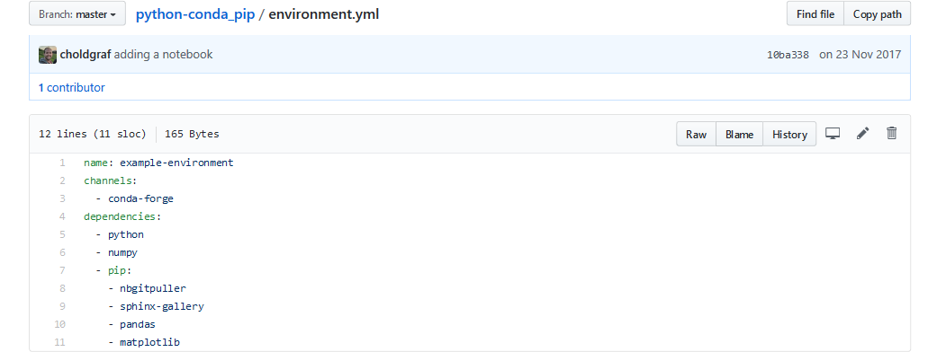
Binder example: environment.yml
pip freeze
#TuringWay @kirstie_j @mybinderteam
https://doi.org/10.5281/zenodo.2598529
https://github.com/binder-examples/python-conda_pip

Slide 34
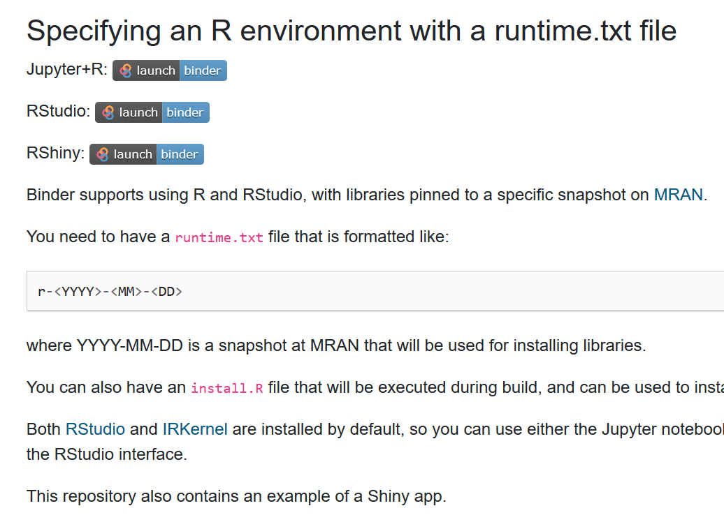
install.R
Binder interface includes Rstudio
install.R contains required packages
runtime.txt sets the version on MRAN
#TuringWay @kirstie_j @mybinderteam
https://doi.org/10.5281/zenodo.2598529
https://mybinder.readthedocs.io/en/latest/sample_repos.html#specifying-an-r-environment-with-a-runtime-txt-file

Slide 35
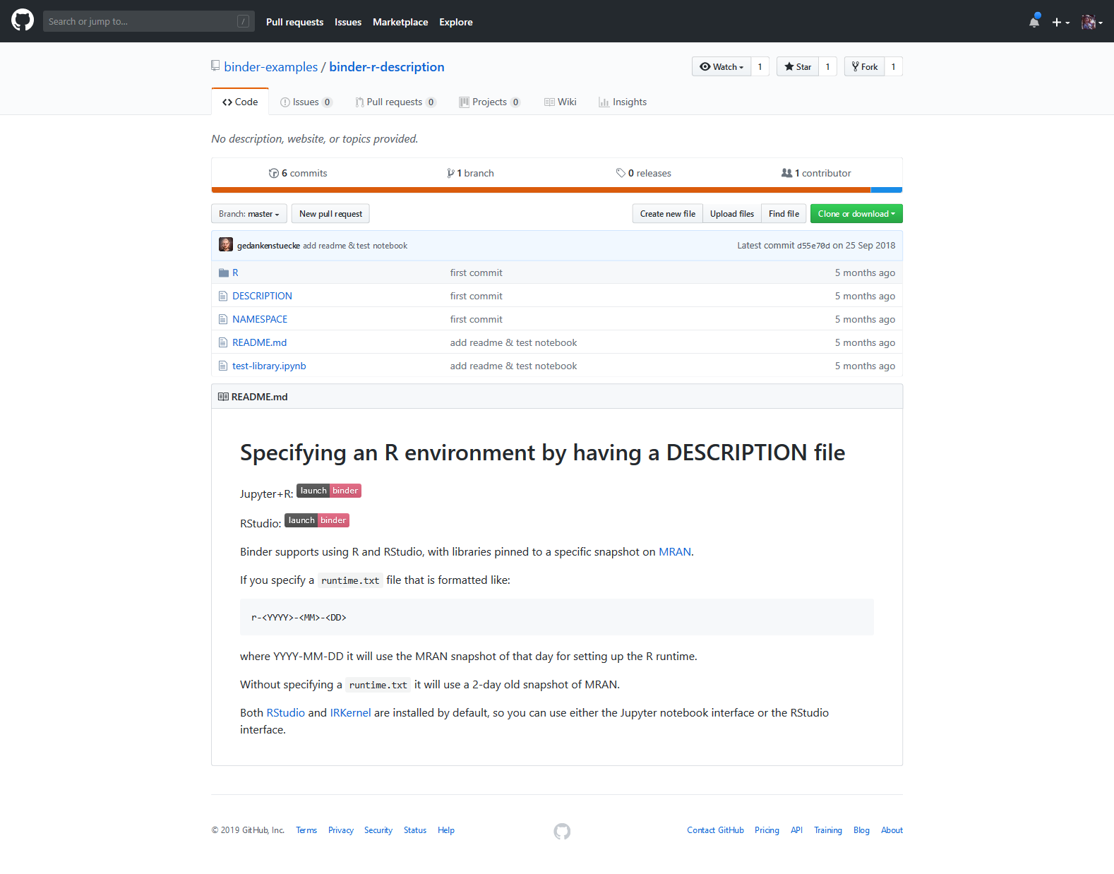
Binder example: install.R
#TuringWay @kirstie_j @mybinderteam
https://doi.org/10.5281/zenodo.2598529
https://github.com/binder-examples/binder-r-description

Slide 36
Binder example: install.R
#TuringWay @kirstie_j @mybinderteam
https://doi.org/10.5281/zenodo.2598529
https://github.com/binder-examples/binder-r-description

Slide 37
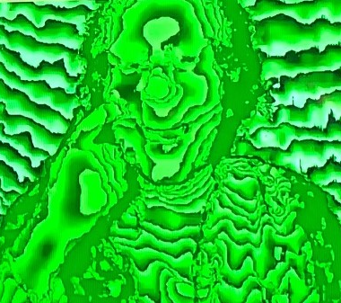
Becky Arnold
“There are a lot of things you need to know before you can jump into continuous integration.
Version control is a prerequisite for pretty much everything.”
https://software.ac.uk/about/fellows/becky-arnold
#TuringWay @kirstie_j @mybinderteam
https://doi.org/10.5281/zenodo.2598529

Slide 38

Distributed and remote version control
#TuringWay @kirstie_j @mybinderteam
https://doi.org/10.5281/zenodo.2598529
Notes:
TIMING: 25

Slide 39
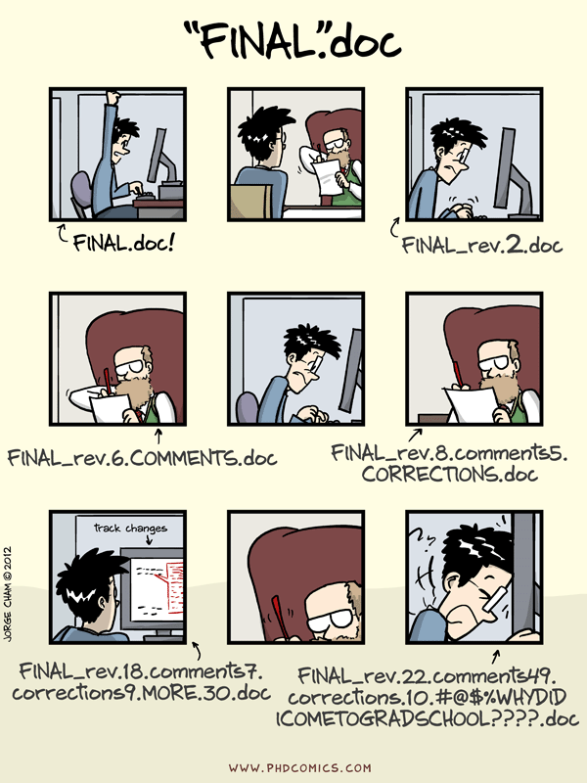
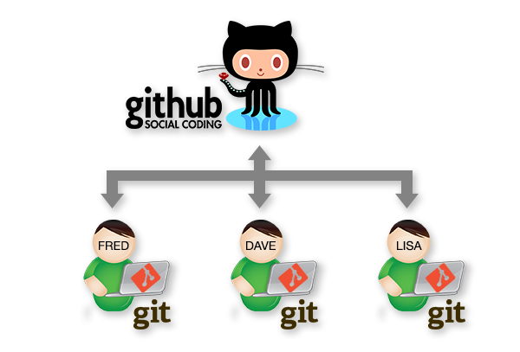
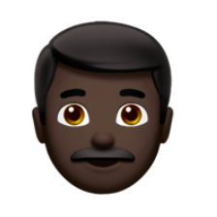
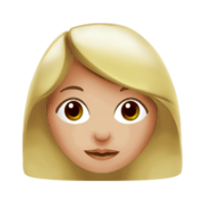

http://phdcomics.com/comics/archive.php?comicid=1531
#TuringWay @kirstie_j @mybinderteam
https://doi.org/10.5281/zenodo.2598529

Slide 40

The cloud is just someone else’s computer
#TuringWay @kirstie_j @mybinderteam
https://doi.org/10.5281/zenodo.2598529

Slide 41
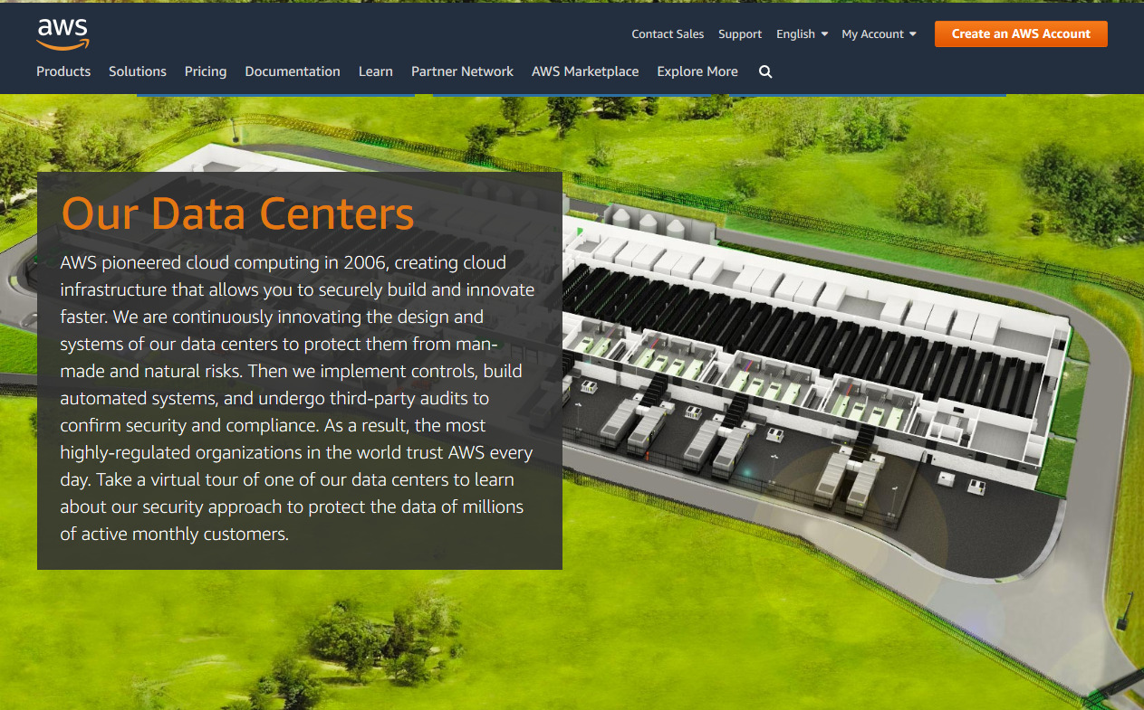
#TuringWay @kirstie_j @mybinderteam
https://doi.org/10.5281/zenodo.2598529
https://aws.amazon.com/compliance/data-center/data-centers

Slide 42
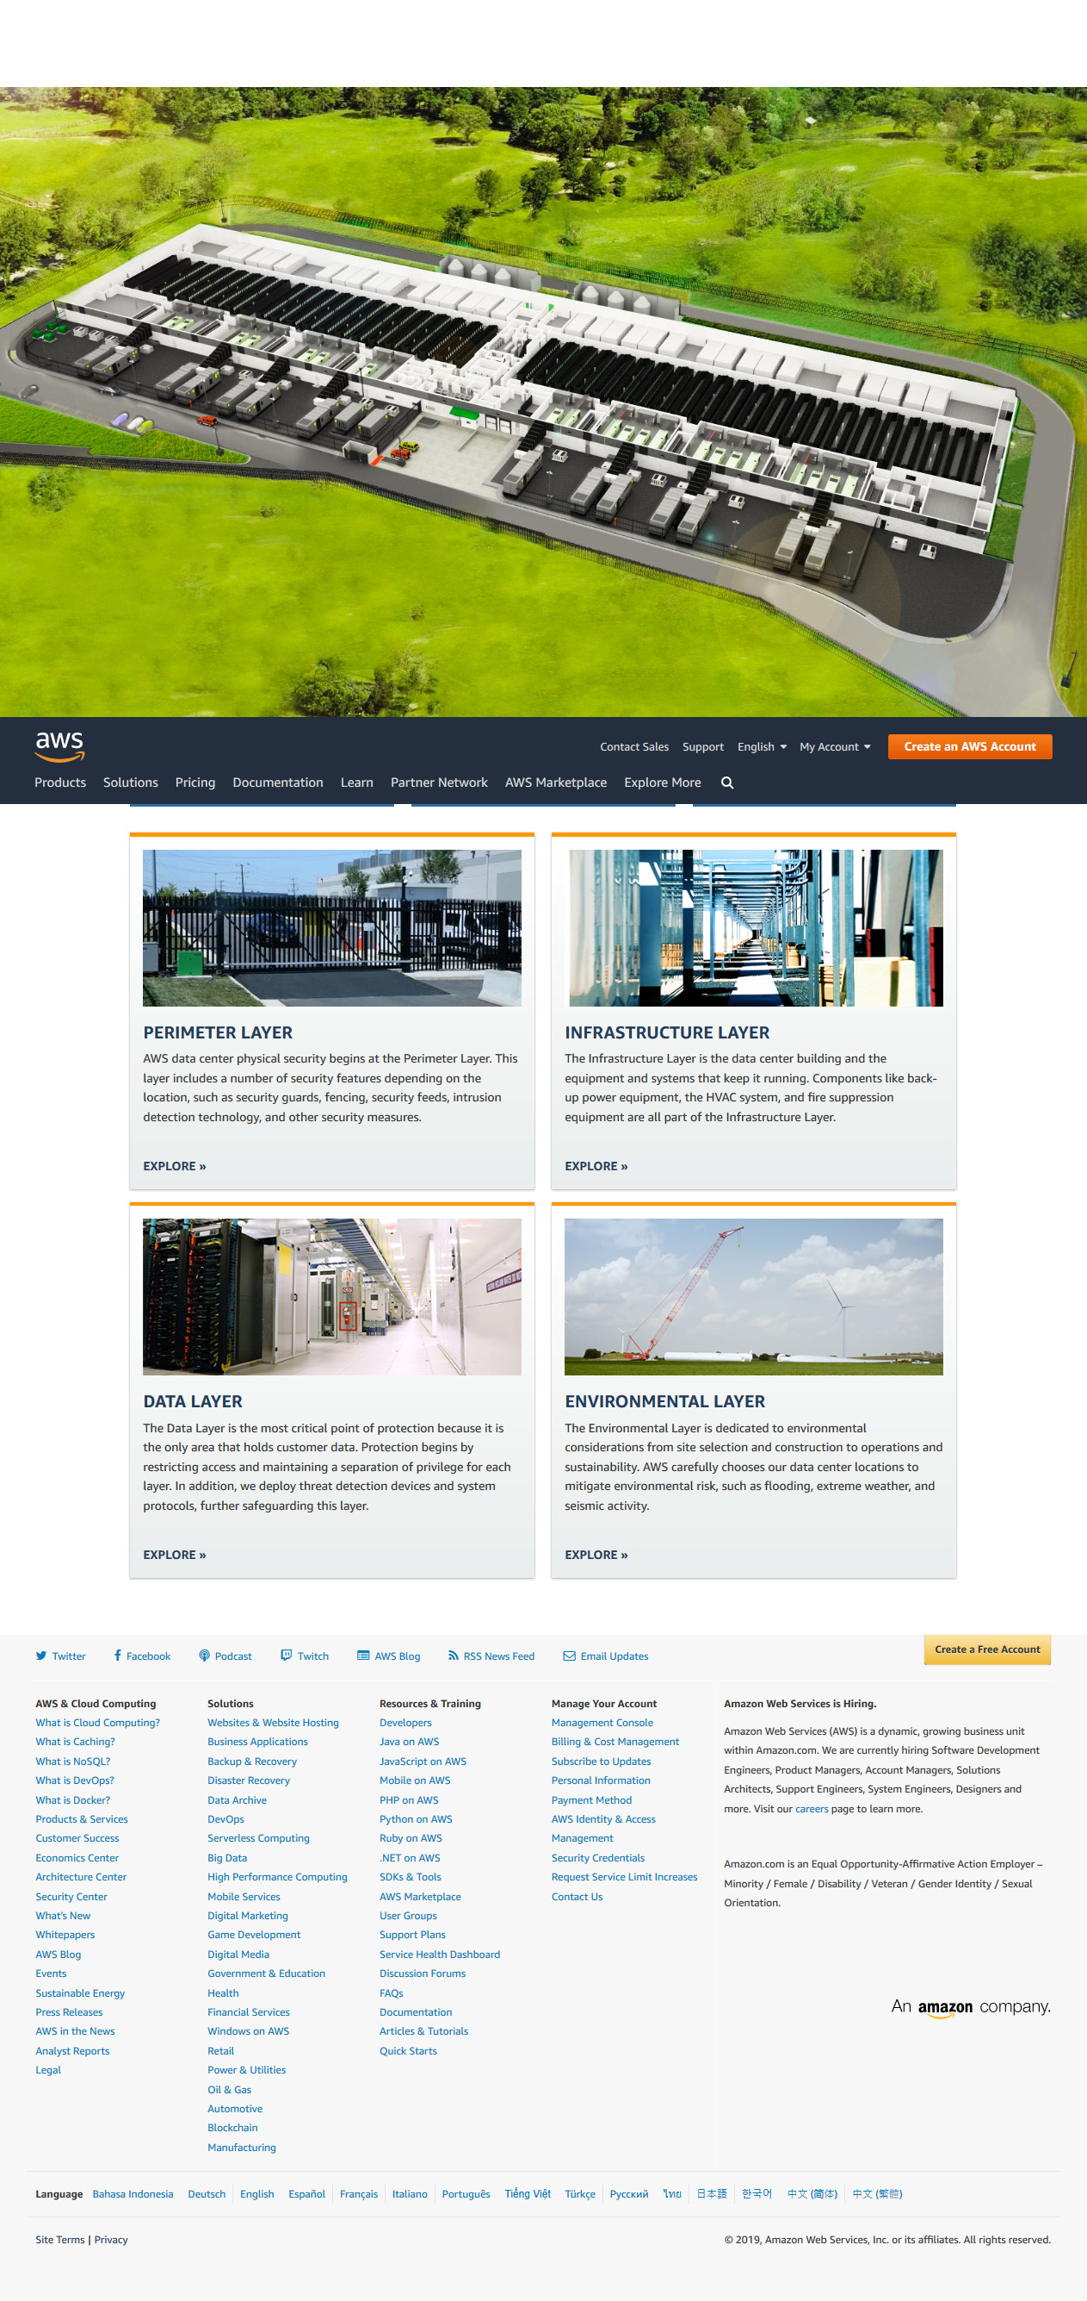
#TuringWay @kirstie_j @mybinderteam
https://doi.org/10.5281/zenodo.2598529
https://aws.amazon.com/compliance/data-center/data-centers

Slide 43
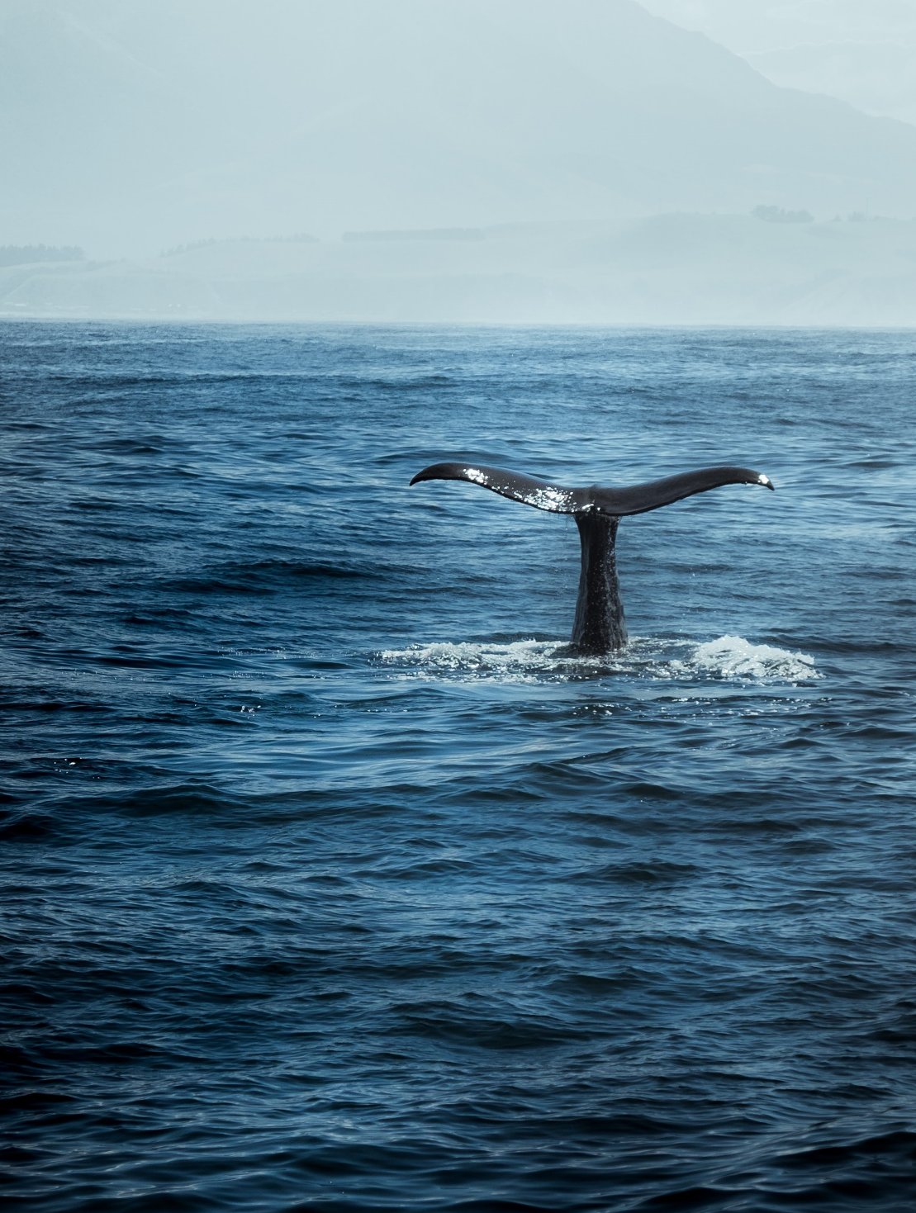
Containers
#TuringWay @kirstie_j @mybinderteam
https://doi.org/10.5281/zenodo.2598529
Notes:
TIMING: 25

Slide 44

Docker
A container that bundles all the infrastructure and software together.
#TuringWay @kirstie_j @mybinderteam
https://doi.org/10.5281/zenodo.2598529
https://mybinder.readthedocs.io/en/latest/sample_repos.html#specifying-an-r-environment-with-a-runtime-txt-file

Slide 45
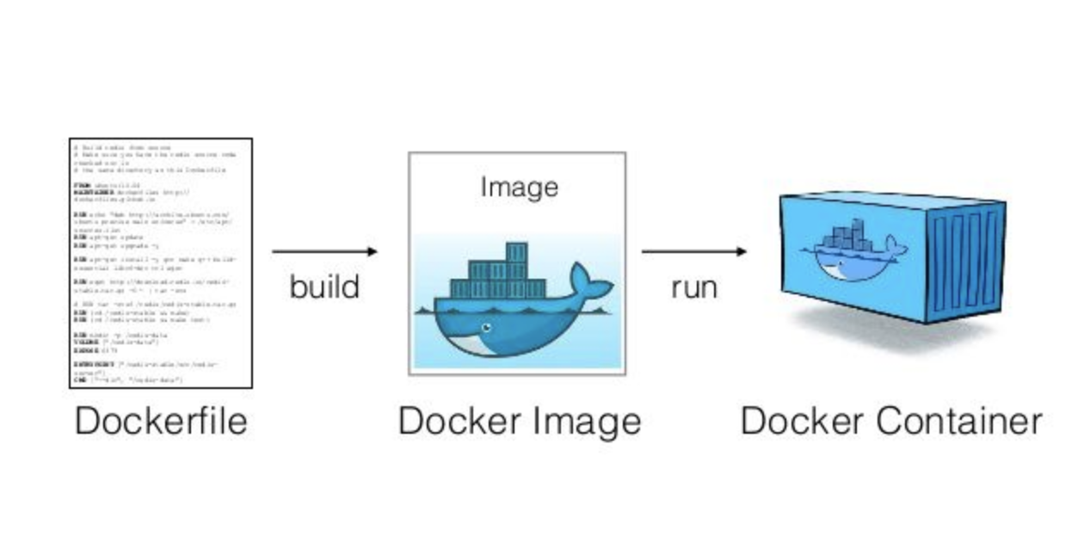
Human and machine readable files
#TuringWay @kirstie_j @mybinderteam
https://doi.org/10.5281/zenodo.2598529

Slide 46
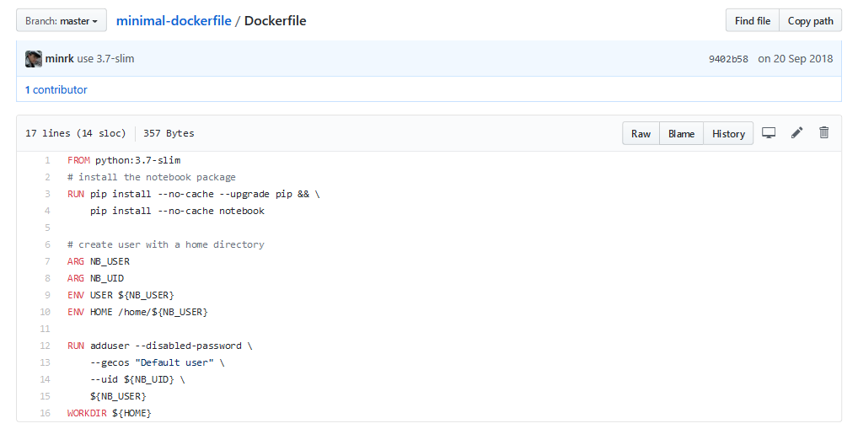
Binder example: docker
#TuringWay @kirstie_j @mybinderteam
https://doi.org/10.5281/zenodo.2598529
https://github.com/binder-examples/binder-r-description

Slide 47
Small group exercise
#TuringWay @kirstie_j @mybinderteam
https://doi.org/10.5281/zenodo.2598529
Notes:
TIMING: 25

Slide 48
Small group exercise
Get into groups of 2-3 and explore these examples
Are there differences between different branches?
Does that give different results?
Did you get what you’d expect?
https://github.com/alan-turing-institute/
the-turing-way/blob/master/
workshops/
boost-research-reproducibility-binder/
paired_examples.md
#TuringWay @kirstie_j @mybinderteam
https://doi.org/10.5281/zenodo.2598529

Slide 49
Zero to Binder
Please open these instructions in your browser
https://github.com/alan-turing-institute/
the-turing-way/blob/master/
workshops/
boost-research-reproducibility-binder/
workshop-presentations/
zero-to-binder.md
#TuringWay @kirstie_j @mybinderteam
https://doi.org/10.5281/zenodo.2598529

Slide 50
Agenda
Boost your reproducibility with Binder
13:00 Registration and introductions
13:10 Introduction to the workshop and The Turing Way
13:20 Presentation: Why you need a reproducible computing environment and how Binder can help
14:30 Coffee break
15:00 Code along demo: Zero to Binder, build a Binder resource
16:00 Build your own Binder
16:30 Feedback, group picture and close
#TuringWay @kirstie_j @mybinderteam
https://doi.org/10.5281/zenodo.2598529

Slide 51

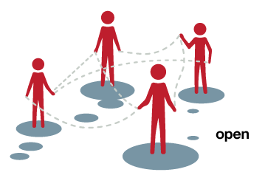
Courtesy of Juliette Taka: https://twitter.com/mybinderteam/status/1082556317842264064
#PyDataLDN #TuringWay @kirstie_j
https://doi.org/10.5281/zenodo.2598529

Slide 52
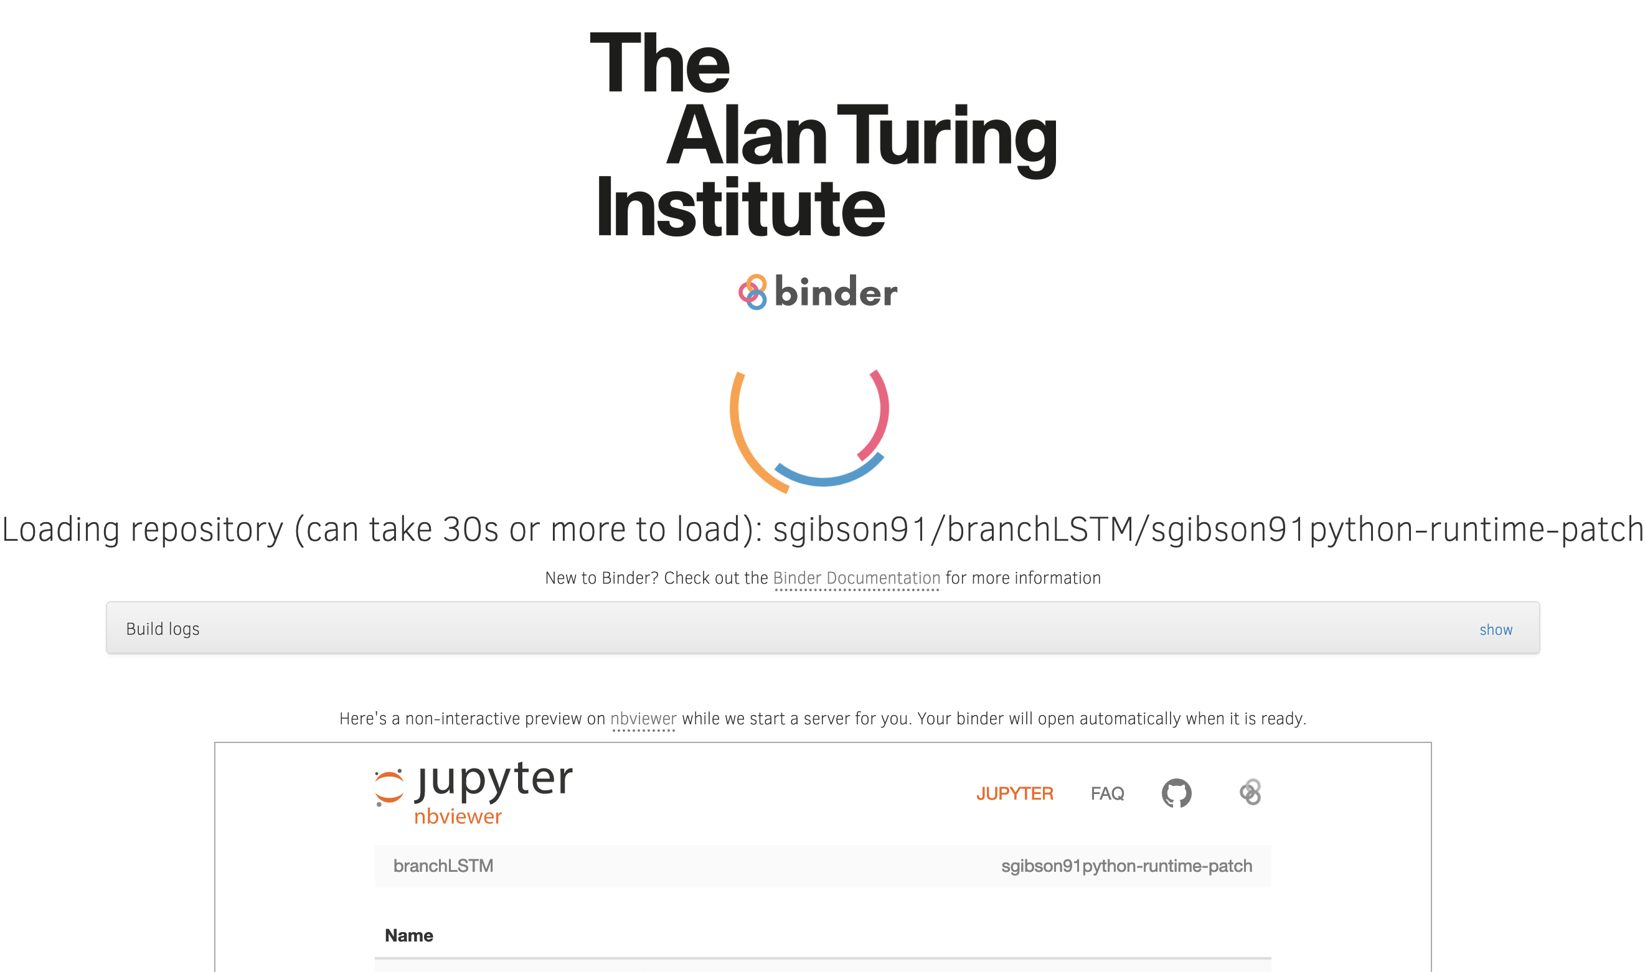
https://github.com/kochkinaelena/branchLSTM (on Turing Way Hub)
#PyDataLDN #TuringWay @kirstie_j
https://doi.org/10.5281/zenodo.2598529

Slide 53
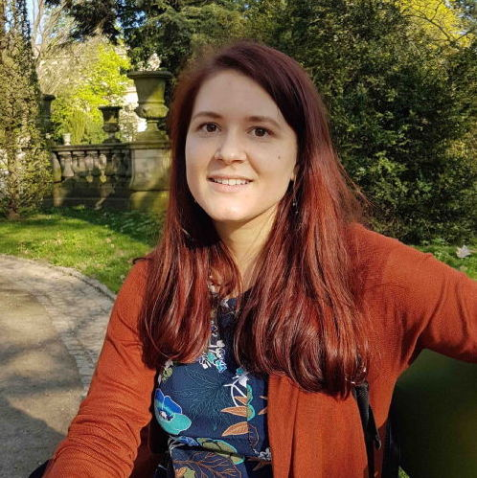
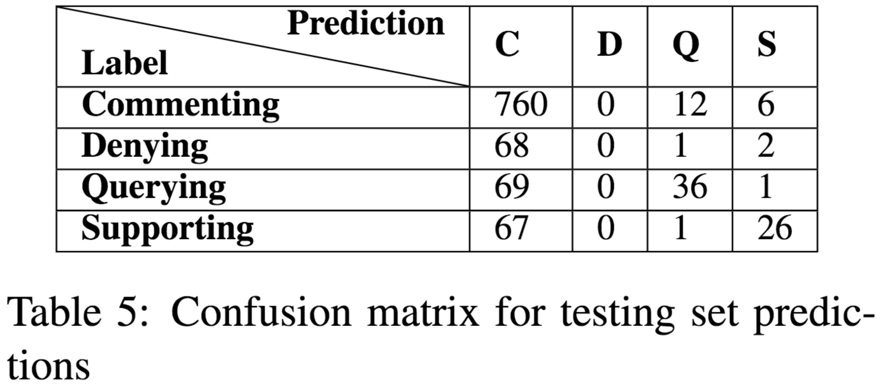
Champion: Elena Kochkina
Turing at SemEval-2017 Task 8: Sequential Approach
to Rumour Stance Classification with Branch-LSTM
Elena Kochkina, Maria Liakata, Isabelle Augenstein
Source tweet
…
…
Support
Deny
Query
Comment
France: 10 people dead after shooting at HQ of satirical weekly newspaper #CharlieHebdo, according to witnesses [link]
SDQC
SDQC
…
SDQC
#PyDataLDN #TuringWay @kirstie_j
https://doi.org/10.5281/zenodo.2598529
https://github.com/kochkinaelena/branchLSTM
https://doi.org/10.18653/v1/S17-2083

Slide 54
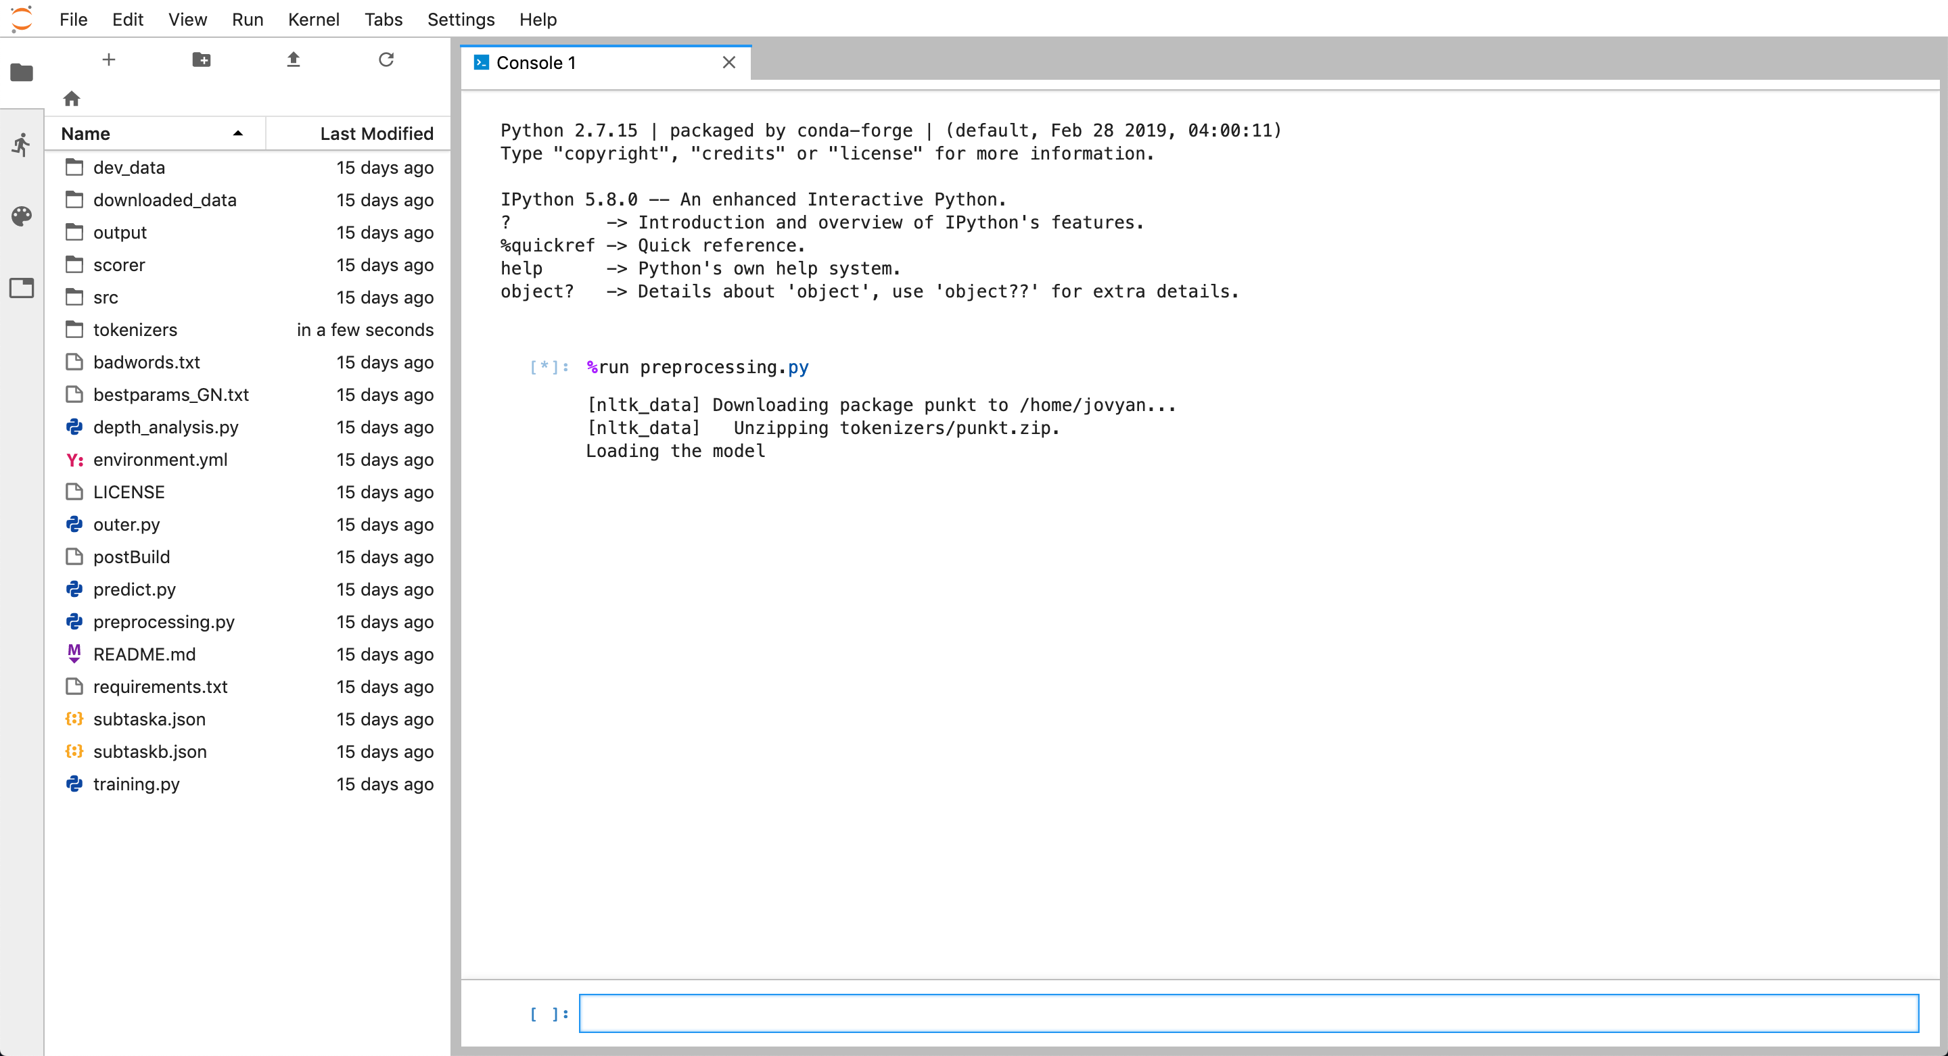
https://github.com/kochkinaelena/branchLSTM (on Turing Way Hub)
#PyDataLDN #TuringWay @kirstie_j
https://doi.org/10.5281/zenodo.2598529

Slide 55
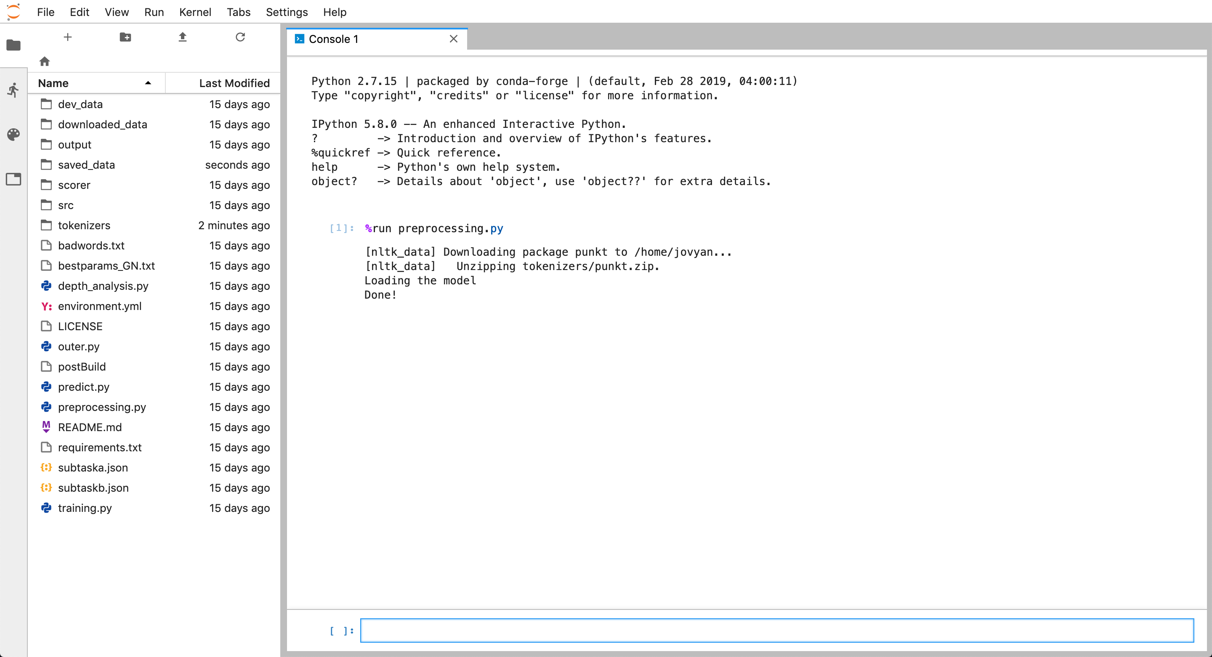
https://github.com/kochkinaelena/branchLSTM (on Turing Way Hub)
#PyDataLDN #TuringWay @kirstie_j
https://doi.org/10.5281/zenodo.2598529

Slide 56
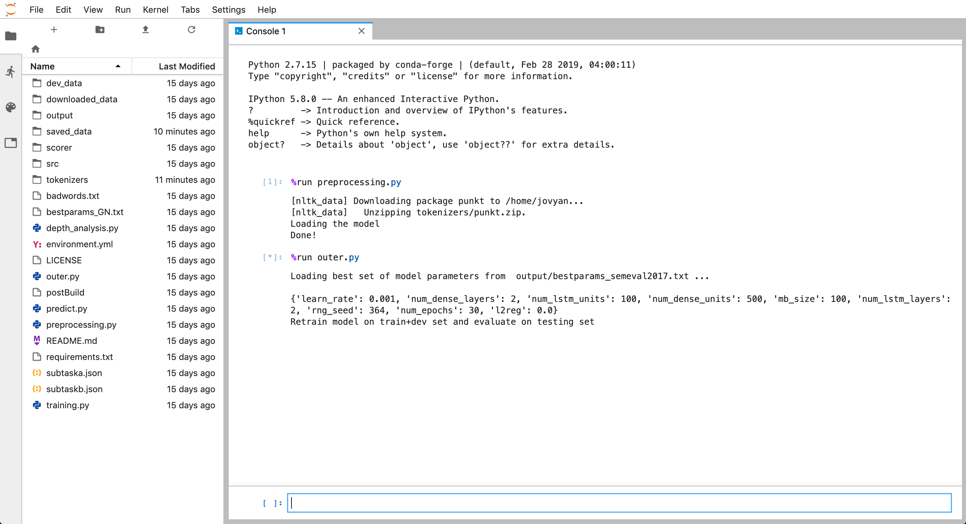
https://github.com/kochkinaelena/branchLSTM (on Turing Way Hub)
#PyDataLDN #TuringWay @kirstie_j
https://doi.org/10.5281/zenodo.2598529

Slide 57
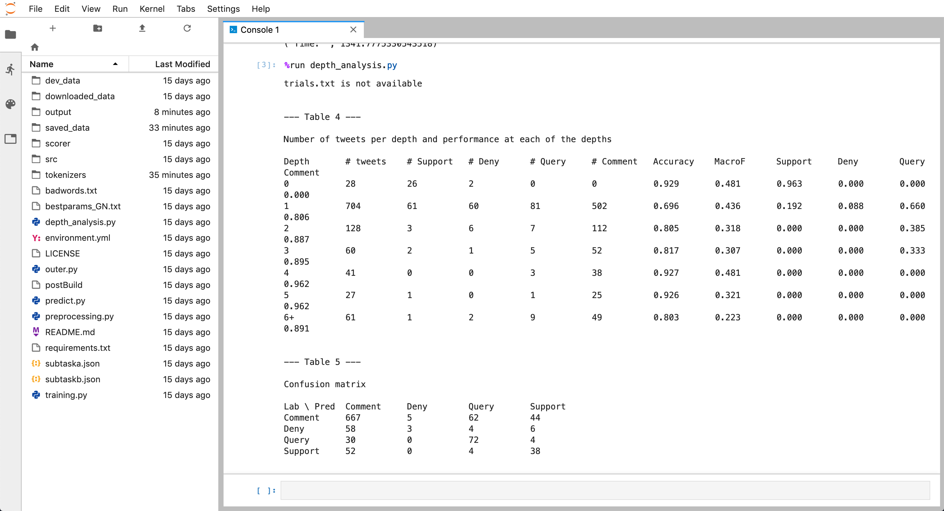
https://github.com/kochkinaelena/branchLSTM (on Turing Way Hub)
#PyDataLDN #TuringWay @kirstie_j
https://doi.org/10.5281/zenodo.2598529

Slide 58
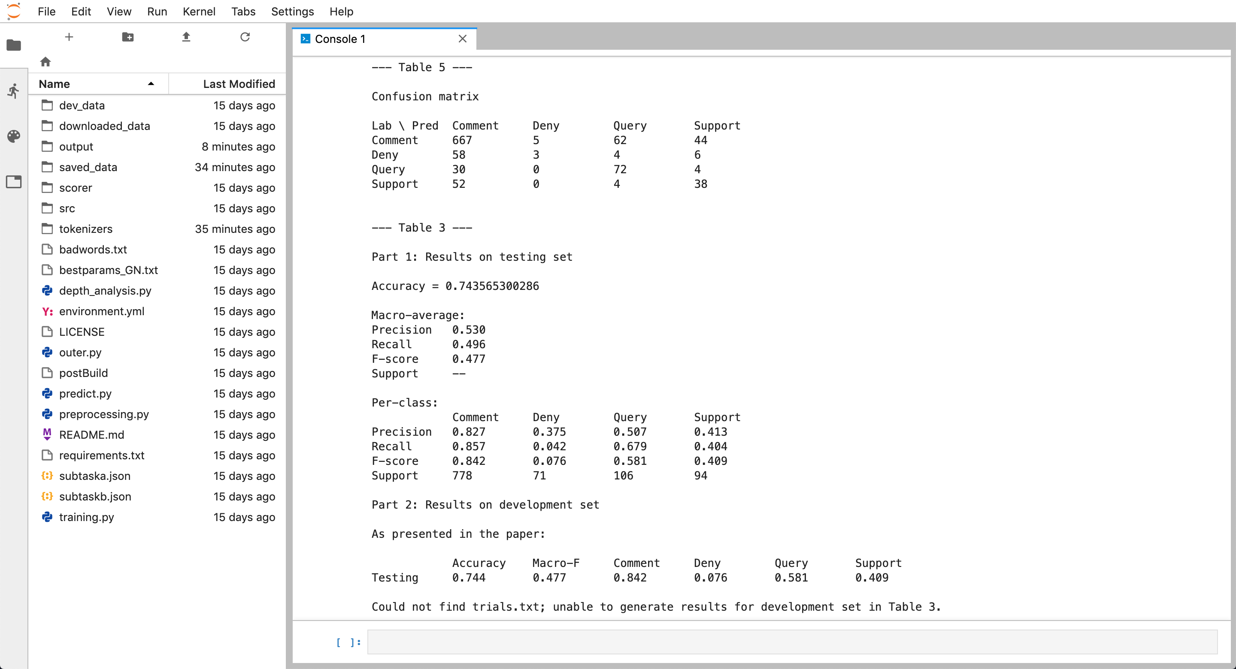
https://github.com/kochkinaelena/branchLSTM (on Turing Way Hub)
#PyDataLDN #TuringWay @kirstie_j
https://doi.org/10.5281/zenodo.2598529

Slide 59
Elena Kochkina
“How would I have known that it would be different on a different machine?! I only have access to the university HPC to run deep learning analyses.”
https://warwick.ac.uk/fac/sci/dcs/people/research/mapmbc
#PyDataLDN #TuringWay @kirstie_j
https://doi.org/10.5281/zenodo.2598529

