Slide 1
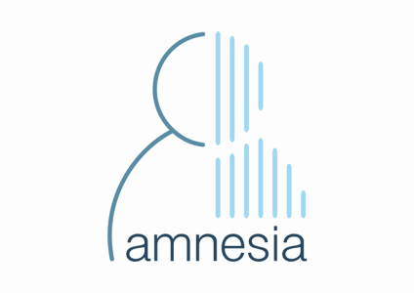

Amnesia
Data anonymization made easy
https://amnesia.openaire.eu
Manolis Terrovitis
mter@imis.athenarc.gr
http://web.imsi.athenarc.gr/~mter/
Research Center Athena, IMSI

Slide 2

Data anonymization?
Data anonymization facilitates the publication of micro data(vs. aggregated macrodata) , e.g., data used in scientific research
Micro data often reveal important private information, e.g., the medical condition of a person
Individuals are afraid to provide their data
Companies are afraid to share data with experts
GDPR makes a strict protection scheme obligatory
The aim of anonymization methods is to allow sharing such data, without compromising the privacy of the users.

Slide 3
Data anonymization and Amnesia
Data anonymization
Removal of direct identifiers, e.g., Names, SSN etc
Removal of infrequent combinations of quasi-identifiers, e.g., unique combinations of birth dates and zipcodes
Infrequent combinations are removed through generalization, e.g., birth date 14/01/1977 becomes **/**/1977
Amnesia is a scalable anonymization tool
It offers several versions of k-anonymity
It allows the user to select and customize possible solutions
It offers graphical tools that allow the user to analyze the anonymized dataset
It is scalable and uses all available CPU cores in the anonymization process

Slide 4
Pseudoanonymization vs Anonymization
PseudoAnonymization
Anonymization
Direct identifiers are replaced by arbitrary ones, which should be kept separately.
“the processing of personal data in such a way that the data can no longer be attributed to a specific data subject without the use of additional information.”
(WG) Pseudonymisation is also addressed to clarify some pitfalls and misconceptions: pseudonymisation is not a method of anonymisation. It merely reduces the linkability of a dataset with the original identity of a data subject, and is accordingly a useful security measure.
Irreversible
No longer personal data

Slide 5
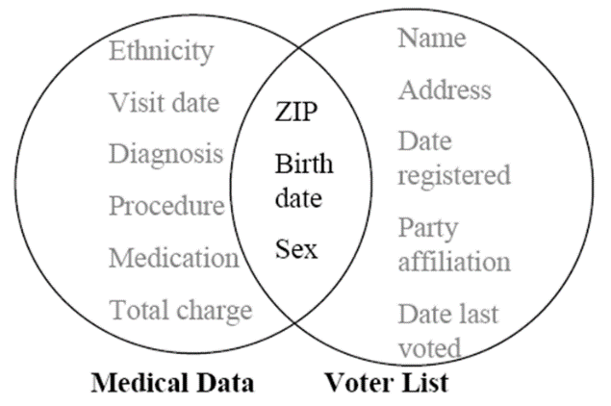
Link attacks

Slide 6
k-anonymity
Each entry becomes indistinguishable from other k-1 entries
  k-anonymity is achieved through suppression and generalization
id | Zipcode | Age | National. | Disease
1 | 13053 | 28 | Russian | Heart Disease
2 | 13068 | 29 | American | Heart Disease
3 | 13068 | 21 | Japanese | Viral Infection
4 | 13053 | 23 | American | Viral Infection
5 | 14853 | 50 | Indian | Cancer
6 | 14853 | 55 | Russian | Heart Disease
7 | 14850 | 47 | American | Viral Infection
8 | 14850 | 49 | American | Viral Infection
9 | 13053 | 31 | American | Cancer
10 | 13053 | 37 | Indian | Cancer
11 | 13068 | 36 | Japanese | Cancer
12 | 13068 | 35 | American | Cancer
id | Zipcode | Age | National. | Disease
1 | 130** | <30 | ∗ | Heart Disease
2 | 130** | <30 | ∗ | Heart Disease
3 | 130** | <30 | ∗ | Viral Infection
4 | 130** | <30 | ∗ | Viral Infection
5 | 1485* | ≥40 | ∗ | Cancer
6 | 1485* | ≥40 | ∗ | Heart Disease
7 | 1485* | ≥40 | ∗ | Viral Infection
8 | 1485* | ≥40 | ∗ | Viral Infection
9 | 130** | 3∗ | ∗ | Cancer
10 | 130** | 3∗ | ∗ | Cancer
11 | 130** | 3∗ | ∗ | Cancer
12 | 130** | 3∗ | ∗ | Cancer

Slide 7
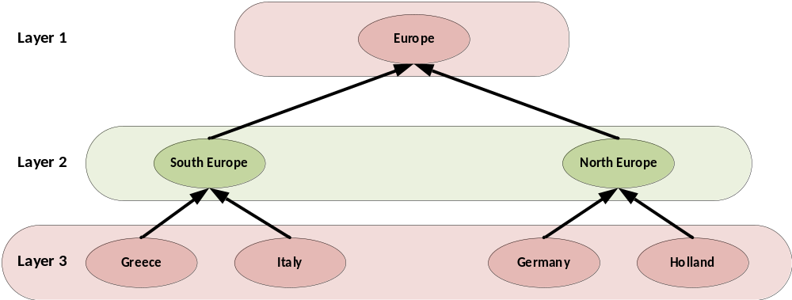
Data transformation – Full domain generalization

Slide 8
Full domain
Age | Place
28 | Greece
33 | Italy
21 | Greece
24 | Greece
37 | Germany
36 | Holland
35 | Greece
Age | Place
[25-35] | Europe
[25-35] | Europe
[20-25] | Europe
[20-25] | Europe
[35-40] | Europe
[35-40] | Europe
[35-40] | Europe

Slide 9
Local Recoding
Age | Place
28 | Greece
33 | Italy
21 | Greece
24 | Greece
37 | Germany
36 | Holland
35 | Greece
Age | Place
[25-35] | South Europe
[25-35] | South Europe
[20-25] | Greece
[20-25] | Greece
[35-40] | Europe
[35-40] | Europe
[35-40] | Europe

Slide 10
Data transformations
Information loss
less more
Local recoding < Global Recoding < Full domain
more less
Complexity

Slide 11
Structural information
We need to anonymize all relevant information about a person, not just a tuple
Information tends to gather over time
Information is linked through semantic properties, it’s schema is irrelevant
Personal data tend to accumulate over time
Research focuses on simple data and complicated guaranties but real world has complex data and requires simple guaranties

Slide 12
Limits of k-anonymity
 | Fruits | Meat | Vegetables | Fish
Vassilis | Χ | Χ
Manolis | Χ | Χ | Χ
Eleni |  |  | Χ
Maria |  | Χ | Χ
Kostas | Χ |  |  | Χ
 | Food
Vassilis | Χ
Manolis | Χ
Eleni | Χ
Maria | Χ
Kostas | Χ
2-anonymous

Slide 13
k^{m}-anonymity
 | Fruits | Meat | Vegetables | Fish
Vassilis | Χ | Χ
Manolis | Χ | Χ | Χ
Eleni |  |  | Χ
Maria |  | Χ | Χ
Kostas | Χ |  |  | Χ
 | Fruits | Meat | Other food
Vassilis | Χ | Χ
Manolis | X | Χ | X
Eleni |  |  | X
Maria |  | Χ | X
Kostas | Χ |  | X
2²-anonymous
Any combination of m items will not appear less than k times

Slide 14
Strengths and Weaknesses
Strengths
Simple to understand
Can be the basis for consent
Close to previous and existing legal definitions
Low information loss
Customizable by non-experts
Weaknesses
Not very strict
Does not take into account sensitive values

Slide 15
Anonymization challenges
Anonymization techniques have not been tested in practice extensively
Mapping the social notion of privacy to technical notions is not easy
Data utility has not been studied extensively in research
Few artificial information loss measures
Data utility is difficult to estimate in practice
Different applications have different needs
No easy to quantify the loss of information

Slide 16
Amensia
Amnesia is a data anonymization tool developed by Research Center Athena
Amnesia is build with Java and Javascript
k-anonymity and k^{m}-anonymity
Tuples and set-values
Visual tools
Estimating data utility
Building hierarchies
Customizing anonymization solutions

Slide 17
Amnesia status
Amnesia is available as a public beta version at
https://amnesia.openaire.eu
On-line version is for demonstration and testing purposes mostly
Sensitive data can be anonymized locally by downloading the application
Security
Scalability
We use it in OpenAIRE and My Health My Data EU projects. We are in process of adjusting it to health data

Slide 18
Next steps
Work on the feedback
Improve user experience
Add support for specific domain data
Fix bugs!
New algorithms
Additional privacy guaranties
More data types
Better scaling capabilities
Disk based solutions
More efficient memory usage

Slide 19

Thank you!
https://amnesia.openaire.eu/

