Slide 1
Want to become
A trainer for Transkribus?
Transkribus User Conference 2020, Innsbruck
Annemieke Romein
(Ghent University/ Erasmus University Rotterdam/ Huygens ING) info@caromein.nl
Stefano Bazzaco
(University of Verona)
stefano.bazzaco.1@gmail.com

Slide 2


Stefano Bazzaco (Progetto Mambrino)
Role: Research fellow in the Dept. of Foreign Languages and Literatures, University of Verona
Matter of study: Renaissance chivalric fiction, at the moment is realizing a Digital Scholarly Edition of Italians translations and adaptations of Spanish “books of chivalry”
Source books features: printed books (Venice, 1530-1580)
•written in italics (Aldo Manuzio’s italic)
•format: octavo (saddlebag books)
•extension: about 450-500 leaves (1000 pages)
Affiliation to Transkribus: Mambrino Project signed a MOU (Memorandum of Understanding) with Transkribus on 2018

Slide 3
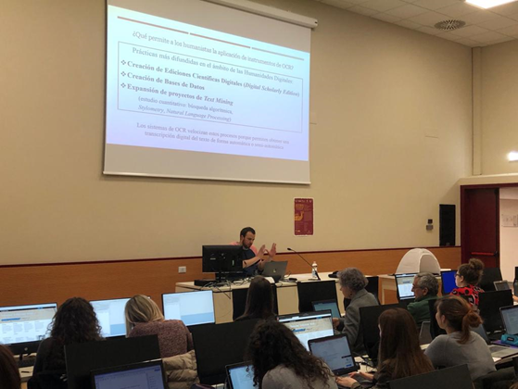
Transkribus workshops: experiences
First workshop: 5th june 2018. «Transcribing. Towards an OCR for old fonts», University of Verona, Italy (with Günter Mühlberger)
Researchers seminars / labs
Students workshops
Phd seminars
Summer/Winter Schools
Lab opening event (Congress)
Counselling
Open Showcase

Slide 4
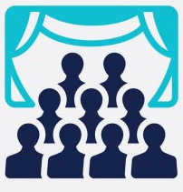
Transkribus workshops: audience
Different types of workshops:
brief presentation of OCR/HTR technologies and Transkribus platform (about 1 Hour)
presentation of OCR/HTR history and technologies; introduction to the use of Transkribus (about 2 hours)
presentation of OCR/HTR history and technologies; extended introduction to Transkribus; Transkribus in practice (also with personal materials from the attendees – about 4/6 hours)
Different audiences:
academic researchers
independent researchers
students

Slide 5
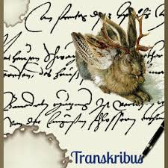
Why using Transkribus? users’ expectations
[ In the Humanities ]
there is a sort of bias towards automatic transcription technologies
(it belongs mostly to the ‘90s when OCR techniques were still raw for historical texts –
automatic transcription is still considered an errorfull operation)
Trainers should “break” with this premature judgement: make clear that Transkribus can be the best solution to improve a humanistic research
(without the need of a technical expertise)

Slide 6
Why using Transkribus? users’ expectations (2)
Researchers and students can make use of Transkribus to:
solve specific transcription issues in their humanities fields;
enhance DH projects (f.e. Distant Reading projects, DSE projects);
sustain and improve the research on automatic transcription itself.
Trainers should put the stress on the main features of Transkribus:
  its clear and simple usage (comfortable user interface)
  its productiveness, mainly with historical and handwritten materials (efficiency)
  the growth of its community (sustainability)

Slide 7
How do I prepare a workshop
1) Introduction. Adjust the first part of the training to the audience expectations (introduction to automatic text transcription, OCR/HTR history and techniques, Transkribus)
2) Transkribus in theory. Spend almost one hour explaining Transkribus usage in theory (image improvement; image segmentation - automatic LA; how to manage collections, documents and users inside the platform; HTR and HTR+; how to use an HTR model)
3) Transkribus in practice. Create a special collection for the workshop (including: different documents in different scripts; various models; in case: use that space also to upload audience materials). Then let the audience to experiment with the platform features.
[4) Closing. Scan Tent showcase]

Slide 8
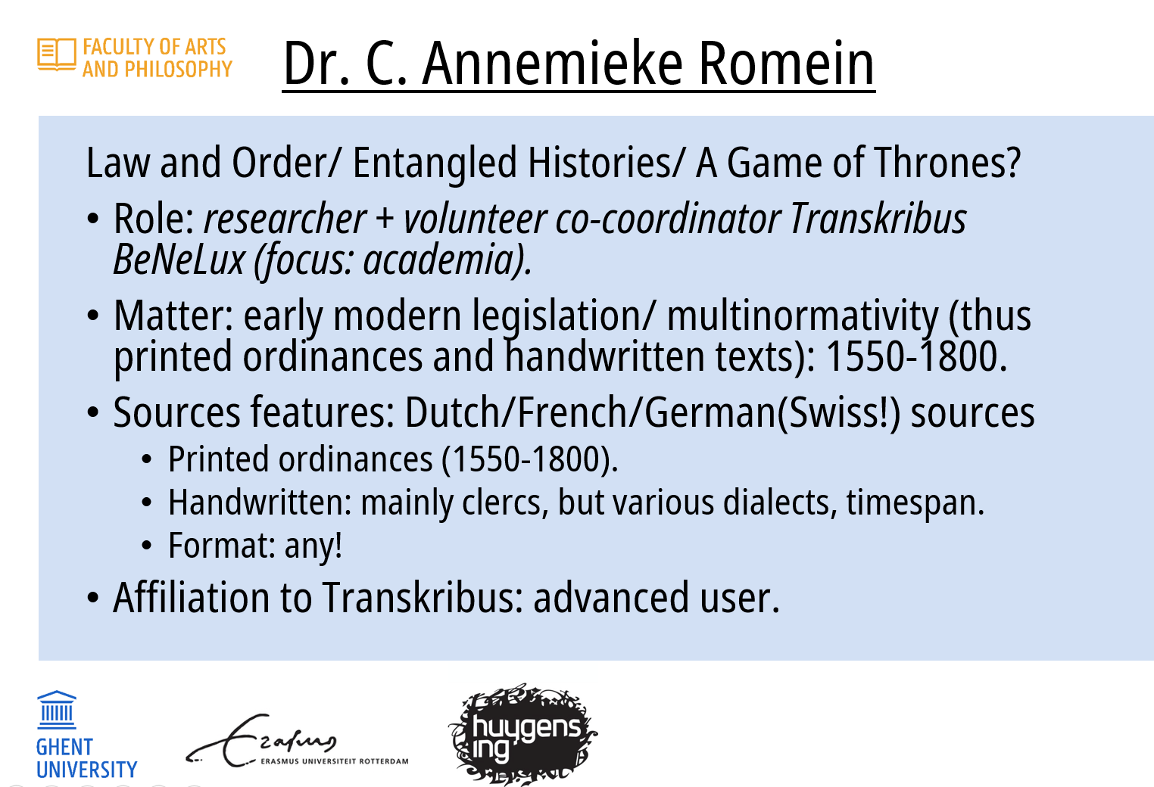
Presenting own projects (Annemieke)
Not associated to Transkribus (no formal contract)

Slide 9
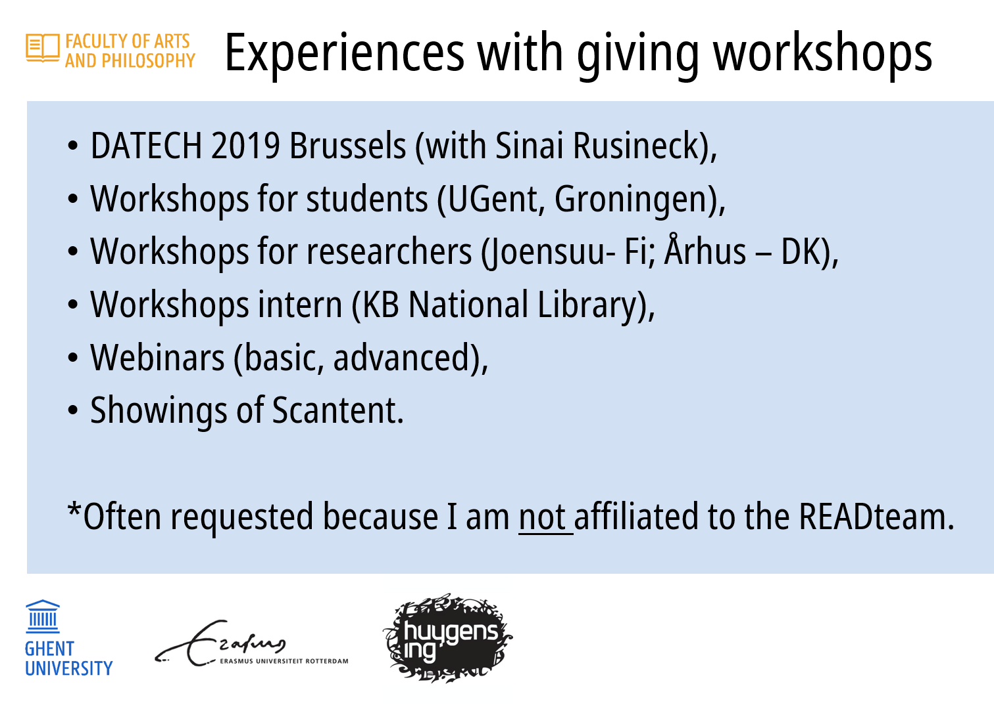

Slide 10
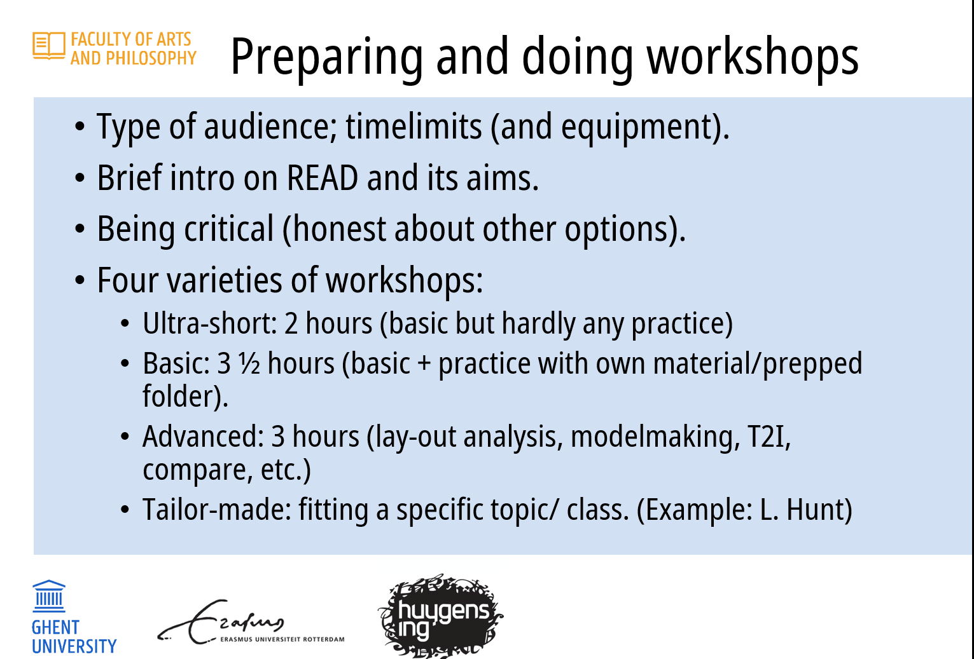

Slide 11
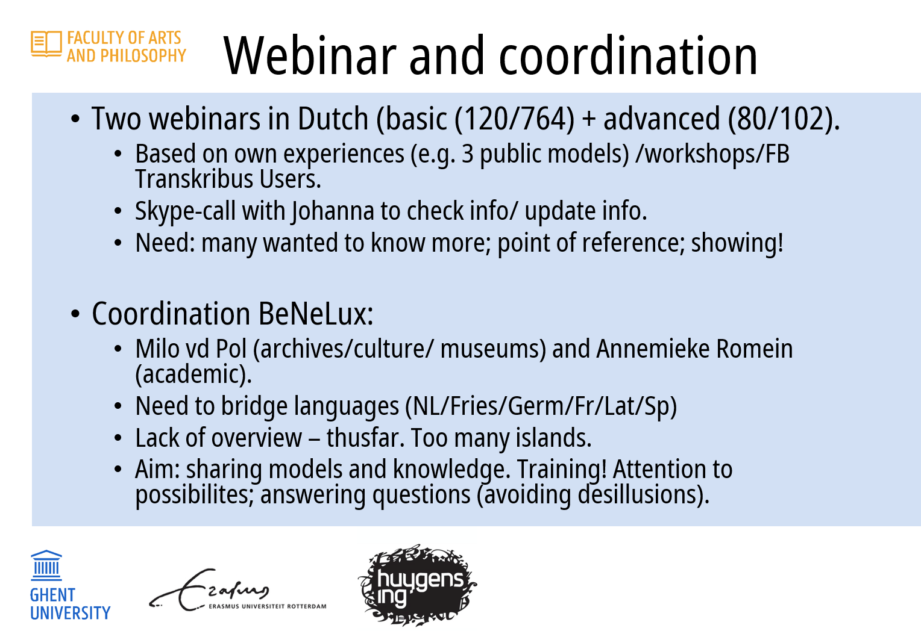

Slide 12
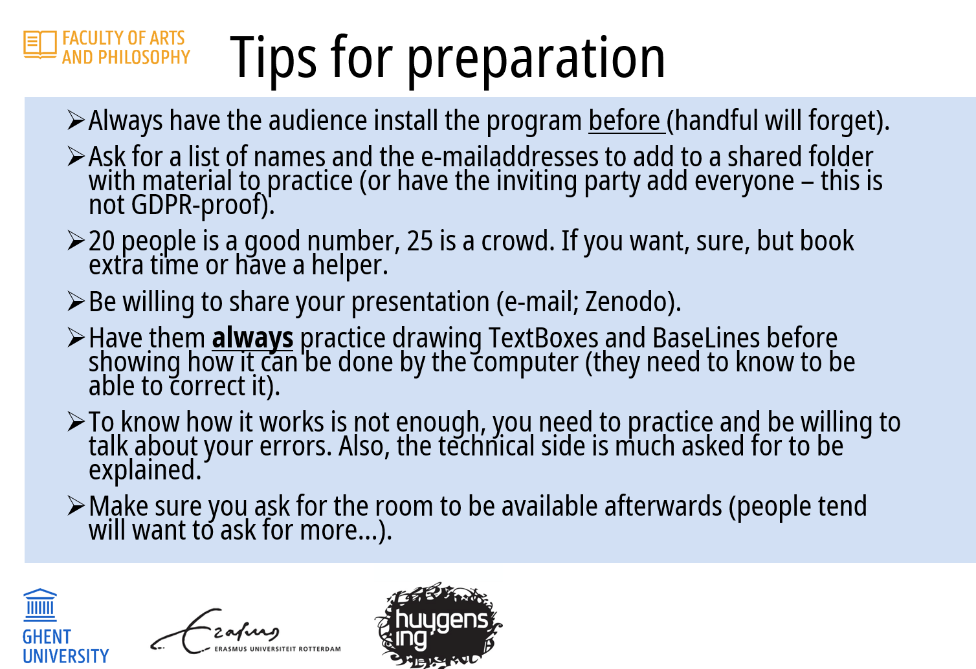

Slide 13
…any suggestion?
Need some infrastructure??
workshops’ slides repository or shared document where links are kept
a faq page or chat, in which people can share their doubts and ask trainers questions about their works on Transkribus
Specific doubts??
for academic researchers: how get advantage of being a trainer?
(f.e. recognized positions, products of the research,...)

