Slide 1
(legislation)
LOD for early modern normative texts
Cooperation between law, history and DH
and other fields of research(?)
C. Annemieke Romein
Date: 05 June 2020

Slide 2
Content
Sources: norms/legislation
Content of the Sources
Where is research being done/ Available Data
Sketching an Ontology

Slide 3
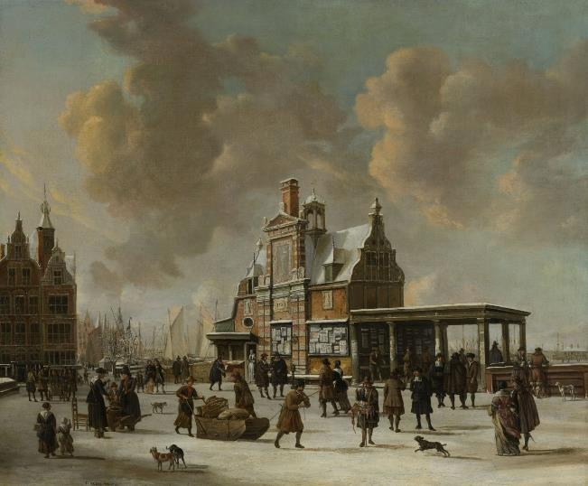
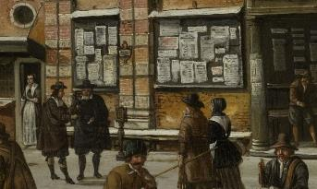

Slide 4
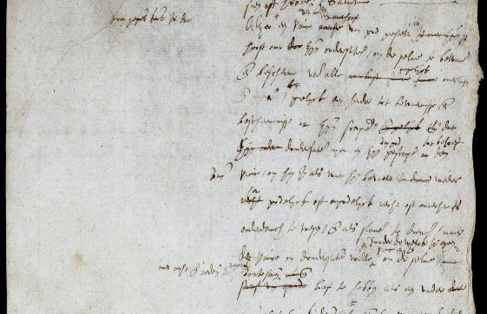
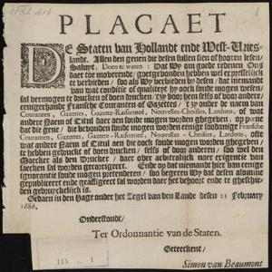
Different appearances
Left: https://library.maastrichtuniversity.nl/collections/databases/digitale-plakkaatzoeker/
Right: Plakkaat van Verlatinghe, pagina 1 (NA)

Slide 5
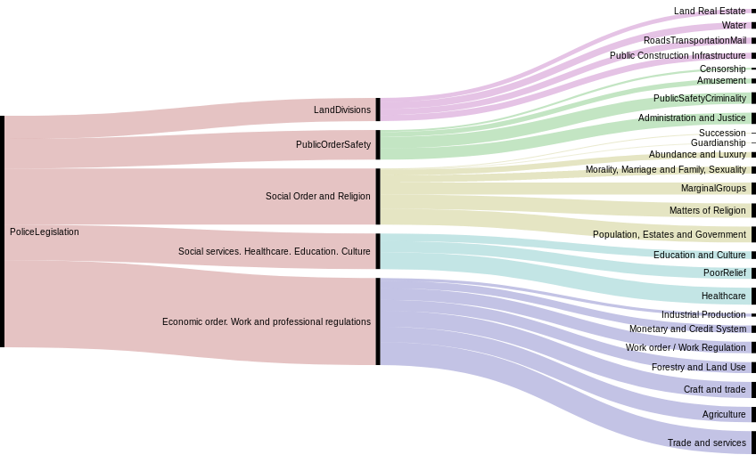
Many topics (± 1800 in total)
The first three levels for the top category 'Police legislation'. Bar width indicates the number
of texts in each category. Through: Alluvial Diagram - https://app.rawgraphs.io/
SKOS: https://doi.org/10.5281/zenodo.3564586

Slide 6
Police-ordinances include much information
Police-ordinances
Jurisdictions
Dates
Institutions
Promulgation/ publication place
Topics
Penalties
Assemblies

Slide 7
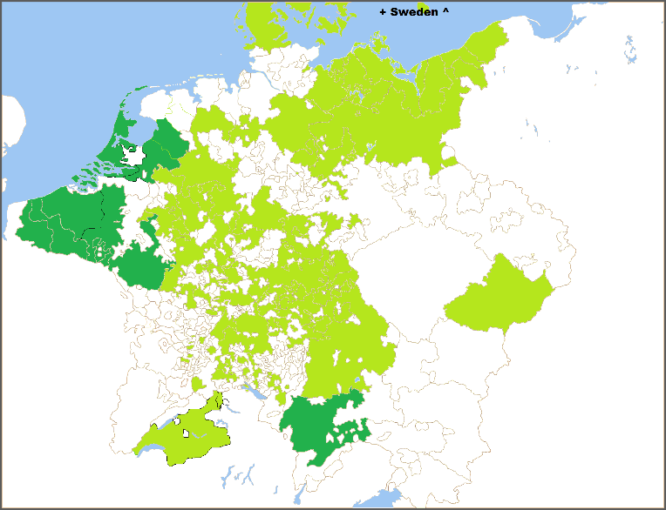
MPIeR Repertorium and other initiatives (dark green), period 1500-1800.

Slide 8
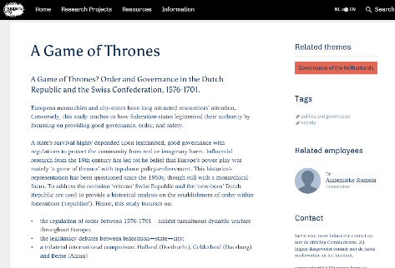
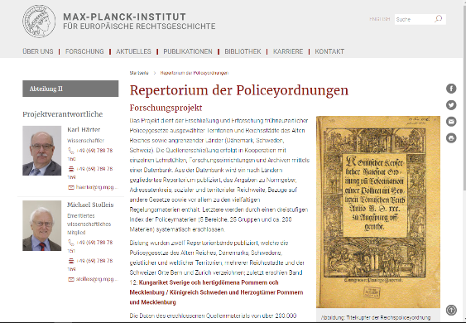
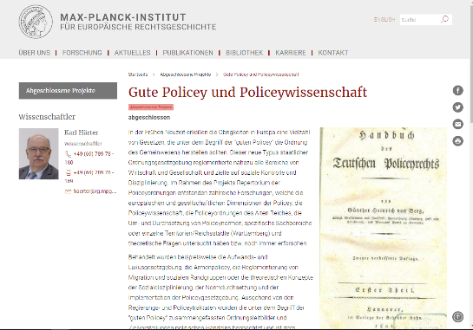
Several projects

Slide 9
Linked Open Data
Aim:
  to connect to existing ontologies.
  to connect the data from the different areas.
  to connect despite of language differences.
  being able to query data based on topic, time, space – and find out if rules were copied/adapted and/ or follow perceived problems.
Ideal:
  Interconnected dataset for the whole of Europe.
  Full-text search (not LOD) ánd query through certain keywords (to filter).
  Set a framework to link requests and lawsuits to.

Slide 10
How to create the LOD(?)
Protégé*
Web-Karma*
Blazegraph*
(*were included in the Oxford LD4DH-course).
(Other suggestions???)

Slide 11
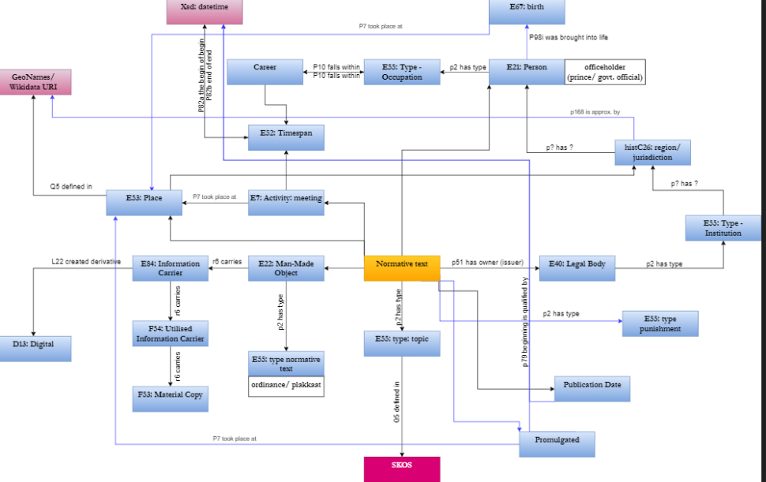
Notes:
https://drive.google.com/file/d/1pxNk_ZK7NBgtfbZrjoZIt6DgYYjhOQbJ/view?usp=sharing

Slide 12
Thank you!
Contact: Annemieke.Romein@Huygens.knaw.nl

