Slide 1
Find the Sign: Signing as Input for Sign Language Dictionary Search Using Pose Estimation
Manolis Fragkiadakis, Victoria Nyst

Slide 2
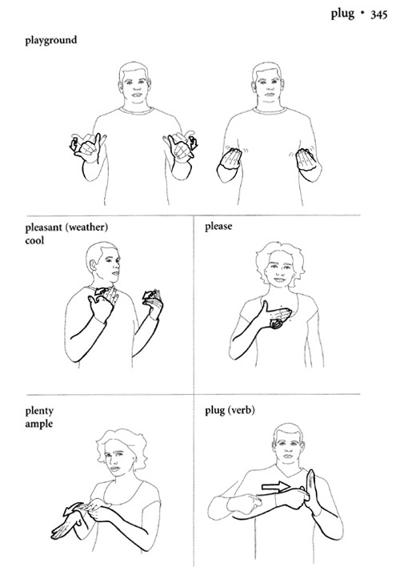
Sign Language Dictionaries
﻿Major source for people who want to learn sign languages, teachers and researchers
Initially paper based
Nowadays: Online
http://gupress.gallaudet.edu/excerpts/GDASLpic3.html

Slide 3
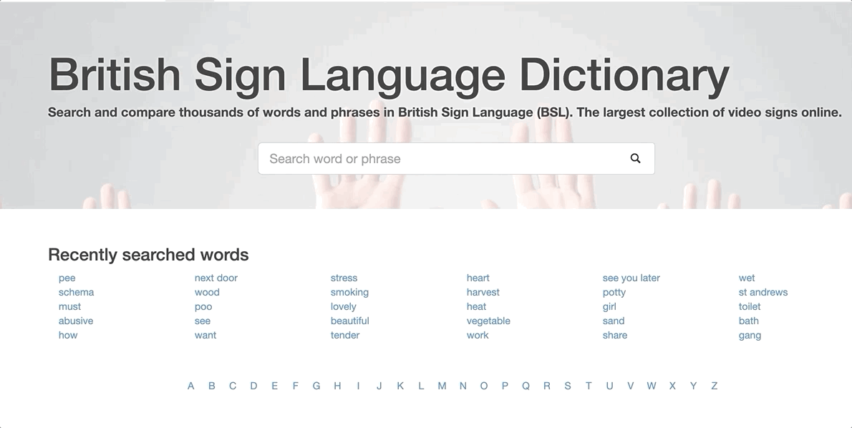
Search Functionality (1/2)
https://www.signbsl.com/

Slide 4
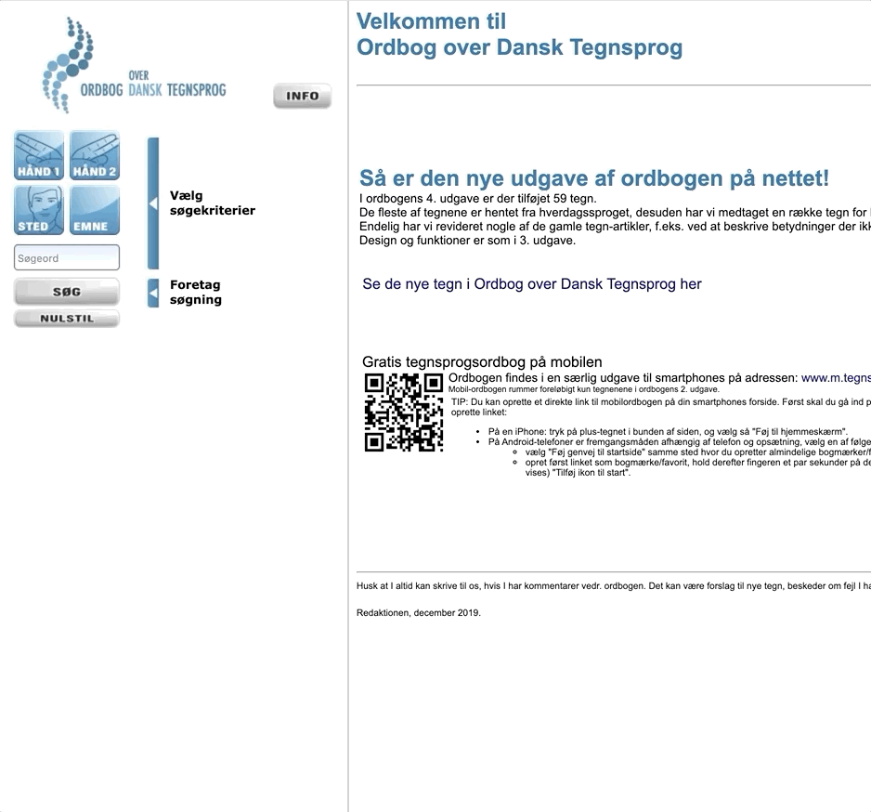
Search Functionality (2/2)
http://www.tegnsprog.dk/

Slide 5
Goals
Create a more user-friendly search functionality
Language neutral
No training required
Not classification but rather a suggestion system

Slide 6
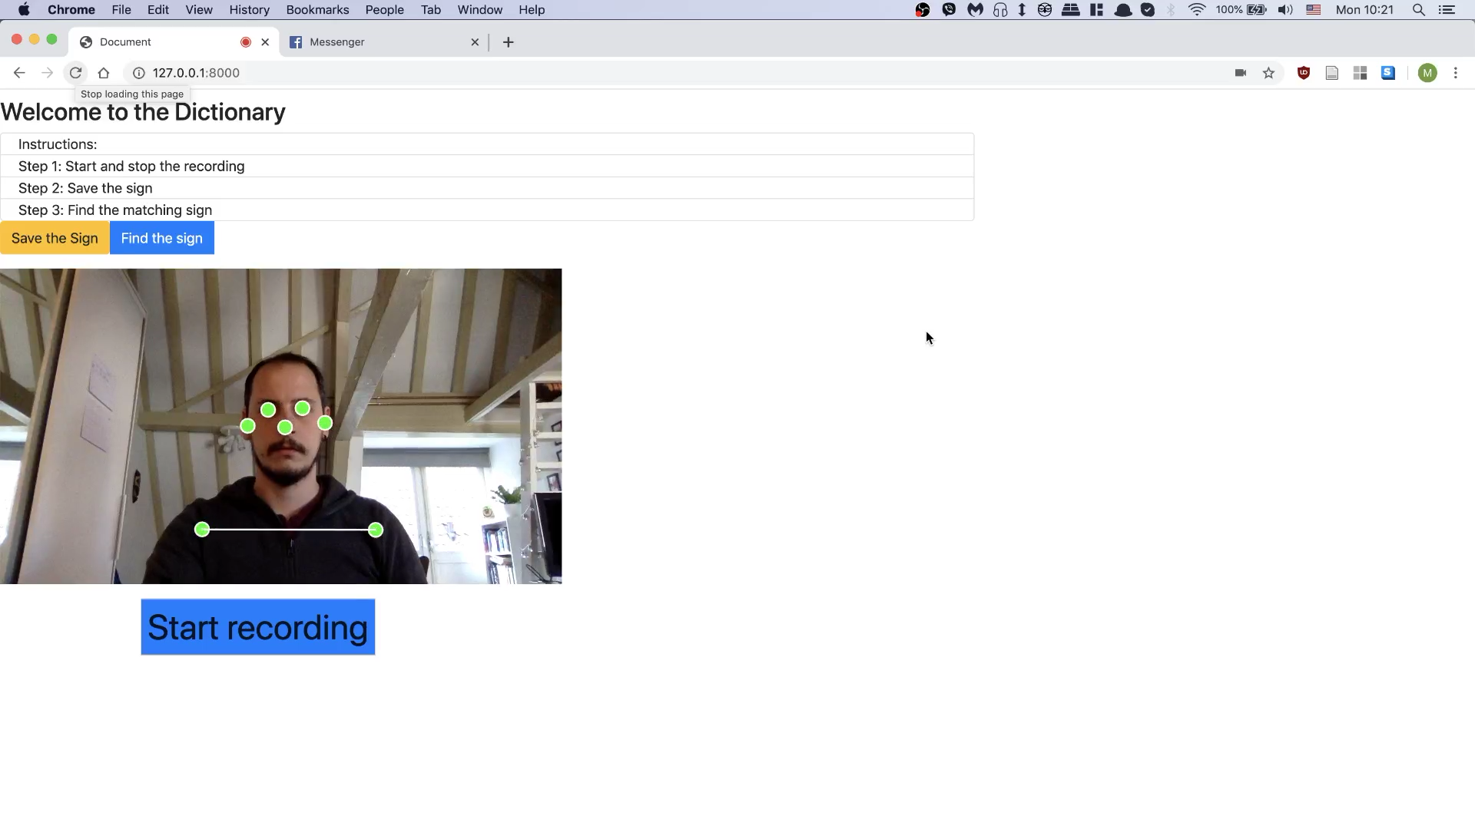
Example

Slide 7
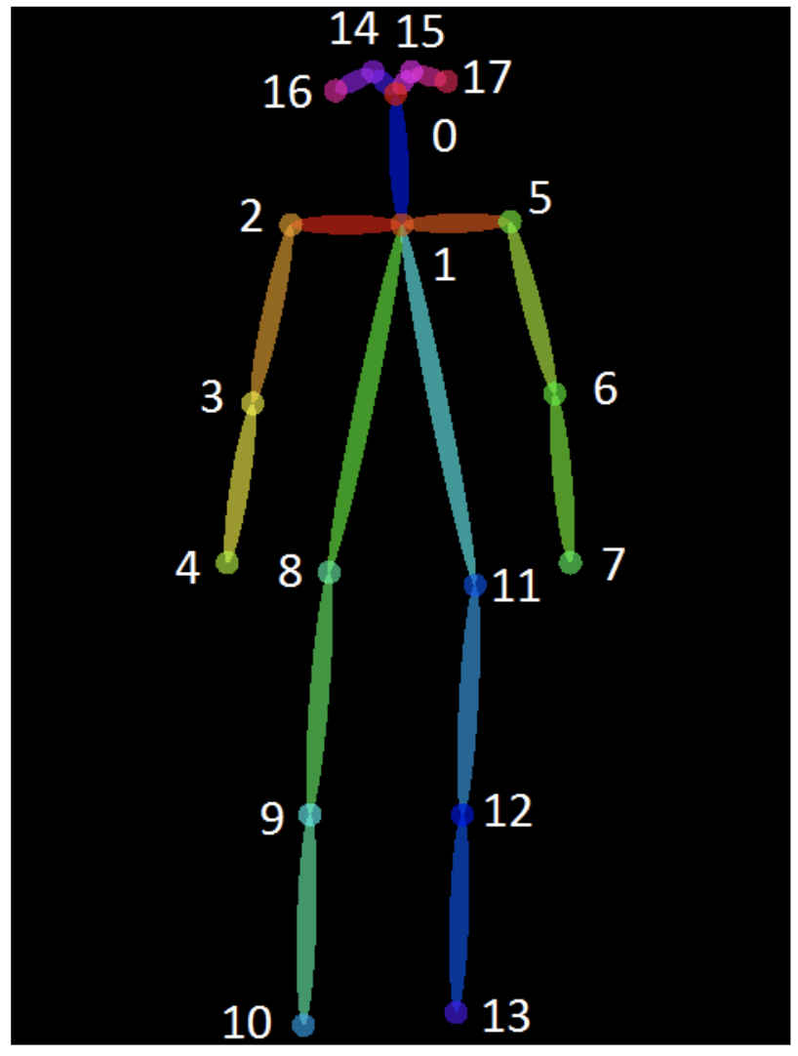
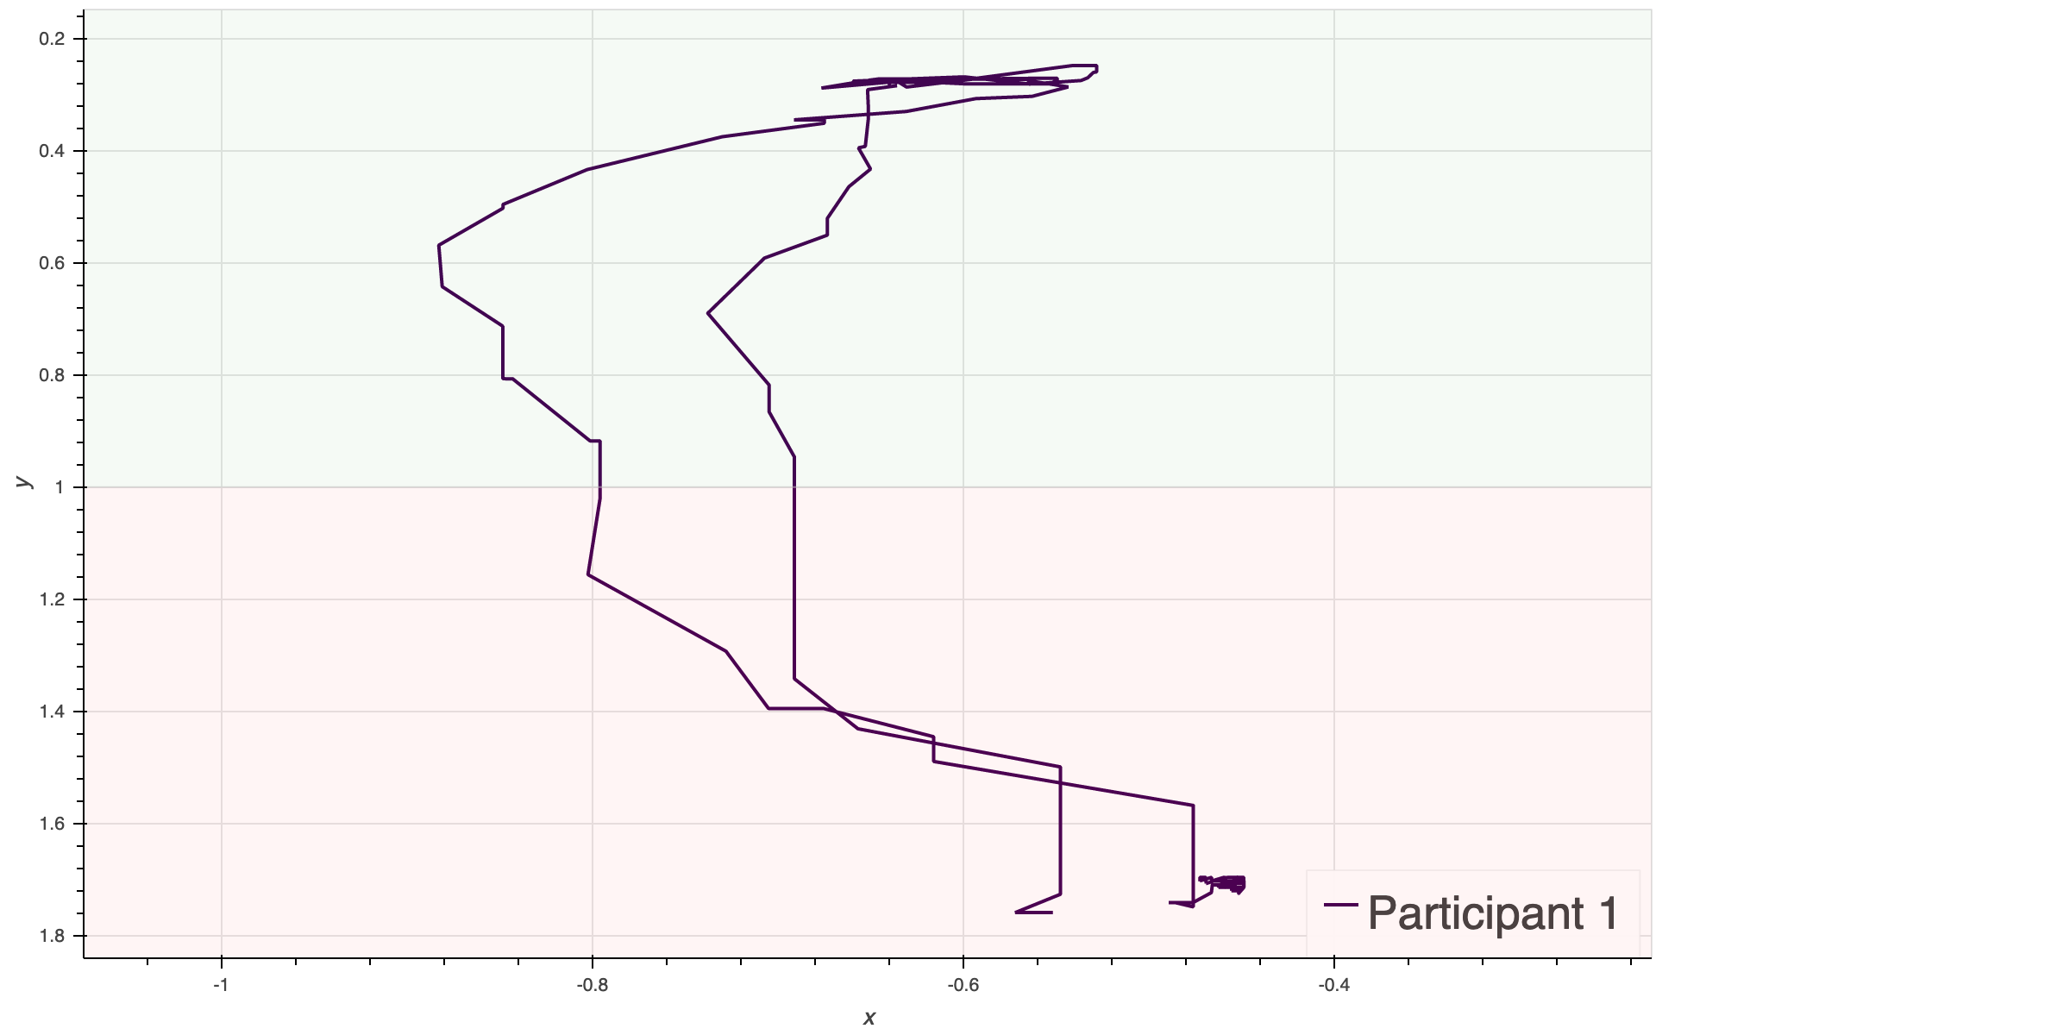

How does it work?
Front end:
PoseNet
https://www.tensorflow.org/lite/models/pose_estimation/overview

Slide 8

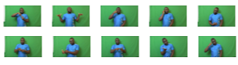

How does it work?
Back end:
OpenPose¹
¹ Cao, Zhe, et al. "OpenPose: realtime multi-person 2D pose estimation using Part Affinity Fields." arXiv preprint arXiv:1812.08008 (2018)

Slide 9
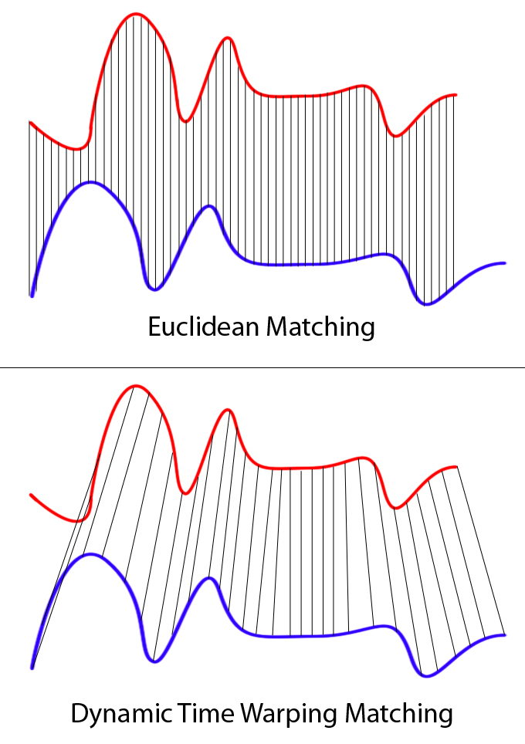
Dynamic Time Warping
This Photo by Unknown Author is licensed under CC BY-SA
Dynamic programming algorithm
Measures similarity between two temporal sequences
Used in speech, gesture and sign language recognition
Requires no training
https://databricks.com/blog/2019/04/30/understanding-dynamic-time-warping.html

Slide 10


Architecture
DTW (python package)

Slide 11
Conclusions
Suggestion tool for sign retrieval in SL dictionaries
﻿Use only of the trajectory of the dominant hand
Needs to be tested with a larger vocabulary
﻿Future application for sign language corpora annotation

Slide 12

Thank you!
Contact: m.fragkiadakis@hum.leidenuniv.nl
adsa

