Slide 1

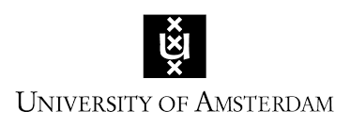
Automatic loan word extraction for early modern Dutch
DH Benelux 2020, June 3rd
Lucas van der Deijl
PhD candidate, University of Amsterdam
l.a.vanderdeijl@uva.nl
www.lucasvanderdeijl.nl

Slide 2
Research question
What is the relationship between early modern language philosophy, linguistic purism and the use of loan words in seventeenth-century Dutch discourse?

Slide 3
Method
What?
  The aim of the method is to partly automate the analysis of foreign (= French and Latin) terminology in early modern Dutch texts.
How?
  The method was designed to extract all loan words from a corpus based on three seventeenth-century loan word dictionaries comprising a lexicon of 10,457 distinct loan words.

Slide 4
Methodological questions
  What is the representativeness of the lexicon?
  What is the coverage of the lexicon?
  What is the method’s accuracy? (Does it work?)
  Why do we need this method?

Slide 5
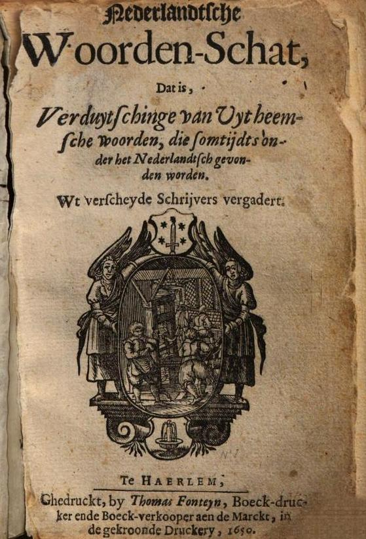
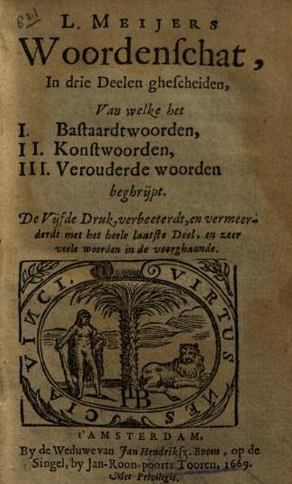
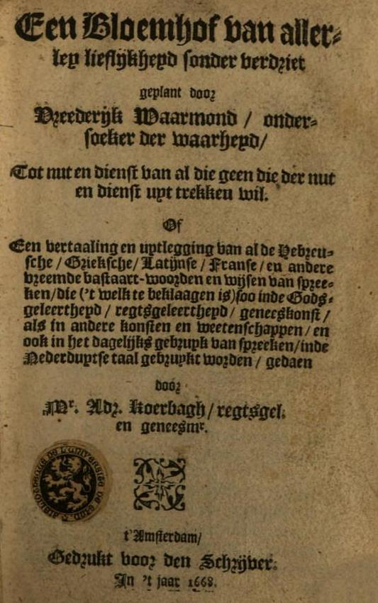
The lexicon: representativeness
10,457 unique lemmas from three loan word dictionaries with a similar definition and categorisation of the notion of ‘loan word’
‘Hofman 1650’ ‘Meijer 1669’ (5th ed.) ‘Koerbagh 1668’

Slide 6
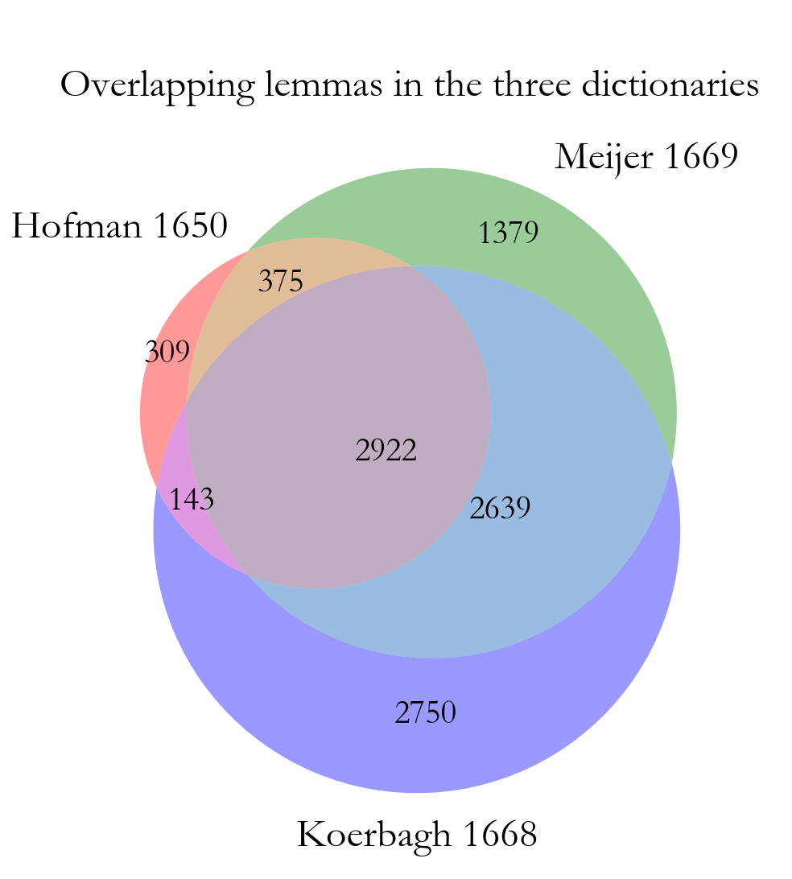
The lexicon: representativeness
The dictionaries overlap significantly because both Meijer and Koerbagh built upon previous lexicographical work

Slide 7
The lexicon: coverage
Documents | Tokens | Loan word tokens | Lemmas | Loan word lemmas | Average percentage of distinct loan word lemmas per text (SD)
207 | 4,879,632 | 37,686 | 208,616 | 1,799 | 1.59% (0.81%)
Relative document frequency by loan word lemma: percentage of the corpus (N = 207 texts printed between 1650-1699) with at least one occurrence

Slide 8
The method: preprocessing
There are two preprocessing steps involved:
Spelling normalisation using normalisation software VARD2 trained on early modern Dutch*
  ‘gehandelt’ → ‘gehandeld’ (‘acted’)
Lemmatisation using POS-tagging software FROG implemented in PICCL (available through CLARIN)**
  ‘gehandeld’ → ‘handelen’ (‘to act’)
  * (Baron & Rayson 2008; Wijckmans & Kisjes 2018)
  ** (Van den Bosch et al. 2007; Reynaert et al. 2015)

Slide 9
The method: accuracy
 | Lexical features |  |  | Recall without pre-processing |  | Recall with spelling normalisation and lemmatisation
 | Tokens | Lemmas | Loan word lemmas* | N (tokens) | Recall | N (tokens) | Recall
Balling, VdDG | 23,221 | 2,530 | 181 | 131 (341) | 0.72 | 149 (402) | 0.82
Balling, NvdDG | 19,816 | 2,268 | 147 | 112 (231) | 0.76 | 120 (271) | 0.82
Blankaart, DBT | 25,817 | 4,014 | 106 | 82 (198) | 0.77 | 82 (235) | 0.77
Blankaart, VvdC | 10,159 | 1,836 | 83 | 60 (86) | 0.72 | 66 (102) | 0.80
Glazemaker, RvhB | 23,949 | 2,146 | 15 | 8 (49) | 0.53 | 13 (85) | 0.87
Glazemaker, LvdZ | 38,690 | 2,451 | 11 | 7 (58) | 0.64 | 10 (74) | 0.91
Mean recall |  |  |  | 0.69 |  | 0.83
* ‘Gold standard’: number of loan word lemmas found with manual annotation

Slide 10
Case study I: Pieter Balling (? – 1664)
Loan words are less frequent in Balling’s Spinoza translations and his own philosophical treatise LodK than in his ‘political’ pamphlets VdDG and NVdDG.

Slide 11
Case study II: Stephan Blankaart (1650 – 1704)
Loan words are significantly less frequent in Blankaart’s Descartes translations than in his (original) medical work (Welch’s t (6.78) = 3.20, p < 0.05), except for the biological handbooks SdR and NH.

Slide 12
Conclusions
  What is the representativeness of the lexicon?
    The lexicon combines three often reprinted, highly related early modern dictionaries.
  What is the coverage of the lexicon?
    Only 1799 of all 10.457 distinct lemmas from the lexicon were used at least once in 207 texts printed between 1650-1699. Most loan words are very sparse (566 were found in only one document).
  What is the method’s accuracy? (Does it work?)
    With the necessary preprocessing, automatic loan word extraction achieves an estimated average recall of 0.83 (= 83% of all loan word types are extracted automatically).
  Why do we need this method?
    It offers a representative, replicable standard for analysing the function of foreign terminology in the history of Dutch language and literature.

Slide 13
Replication and further applications
The formal procedure, documentation and lexicon are accessible through a Jupyter Notebook and made available for further improvement and applications to other corpora:
https://github.com/lucasvanderdeijl/automatic-loan-word-extraction

Slide 14
References
Baron, A. & P. Rayson. (2008). VARD 2: A tool for dealing with spelling variation in historical corpora. Proceedings of the Postgraduate Conference in Corpus Linguistics, Aston University, Birmingham.
Van den Bosch, A., Busser, G.J., Daelemans, W., and Canisius, S. (2007). An efficient memory-based morphosyntactic tagger and parser for Dutch, In F. van Eynde, P. Dirix, I. Schuurman, and V. Vandeghinste (Eds.), Selected Papers of the 17th Computational Linguistics in the Netherlands Meeting, Leuven, Belgium, pp. 99-114.
Hardeveld–Kooi, I. (2000). Lodewijk Meijer (1629-1681) als lexicograaf. Leiden: Dissertation Leiden University.
Leeuwenburgh, B. (2013). Het noodlot van een ketter. Adriaan Koerbagh 1633-1669. Nijmegen: Vantilt.
Reynaert, M., M. van Gompel, K. van der Sloot and A. van den Bosch (2015). PICCL: Philosophical Integrator of Computational and Corpus Libraries. Proceedings of CLARIN Annual Conference 2015, pp. 75-79. Wrocław, Poland.
Salverda de Grave, J.J. (1906), De Franse woorden in het Nederlands. Verhandelingen der Koninklijke akademie van wetenschappen te Amsterdam, afd. Letterkunde. Nieuwe reeks deel VII. Amsterdam.
Sijs, N. van der (2005). Van Dale Groot Leenwoordenboek. De invloed van andere talen op het Nederlands. Utrecht/ Antwerp: Van Dale.
Sijs, N. van der & M. van der Meulen (2002). ‘Tokenaanwezigheid van leenwoorden in Nederlandse kranten 1951-2002’. Forthcoming.
Wijckmans, T. & I. Kisjes (2018), ‘Adapting a Spelling Normalization Tool Designed for English to 17th Century Dutch’. Paper presented at DH 2018.

