Slide 1

Today: Open Science!
Scientists for Future
Lecture Series 2020
AND WHAT IT HAS TO DO WITH YOU,
A SUSTAINABLE WORLD AND our FUTURE
Anne-Sophie Waag, M.Sc. Chair for Education Psychology Mannheim Tuesday, May 19, 2020
This presentation is licensed under CC BY 4.0
Notes:
A warm welcome to this session of the scientists for future lecture series in 2020
My name is Anne-Sophie Waag, I am working at the Chair of Education Psychology in Mannheim
I am very excited that today we’ll together explore the movement of Open Science! …and what it has to do with you, a sustainable world and our future.

Slide 2

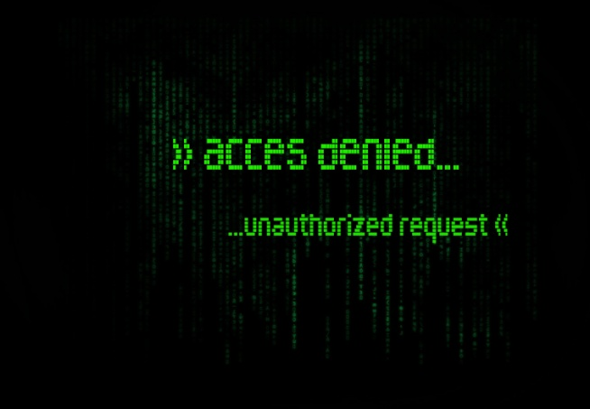
Sources: blogging by Free-Photos from Pixabay; access-denied by solidariat on flickr
Notes:
Do you know this situation?
You’ve just started working on your term paper about – let’s say – the changes in supply and demand of take-away food since the corona outbreak
You’re going to look up the newest empirical studies and then: this! Access denied!

Slide 3

Free access
Sources: laptop by Jan Vašek from Pixabay
Notes:
This is so annoying!
Wouldn’t it be nice to have free access to all research papers?

Slide 4

Free data
Sources: files by Ag Ku from Pixabay
Notes:
…and since we are already there expressing our wishes: Wouldn’t it be nice to have access to other’s research data

Slide 5
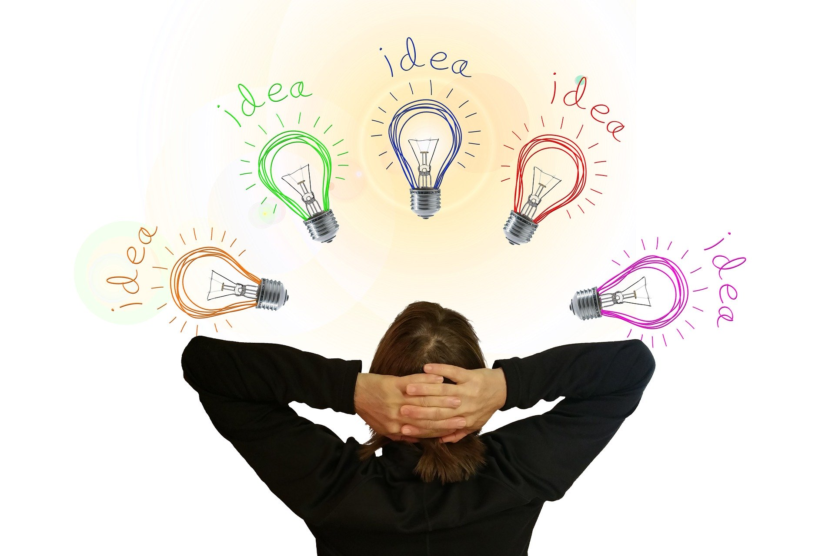
Free Educational Resources
Sources: light-bulb by Gert Altmann from Pixabay
Notes:
…or their presentations, knowledge and thoughts?

Slide 6

Open
Science
Sources: open-science by Kim Holmberg from Pixabay
Notes:
And here Open Science comes into play
Why and how and a lot more will be the topic of today’s talk

Slide 7
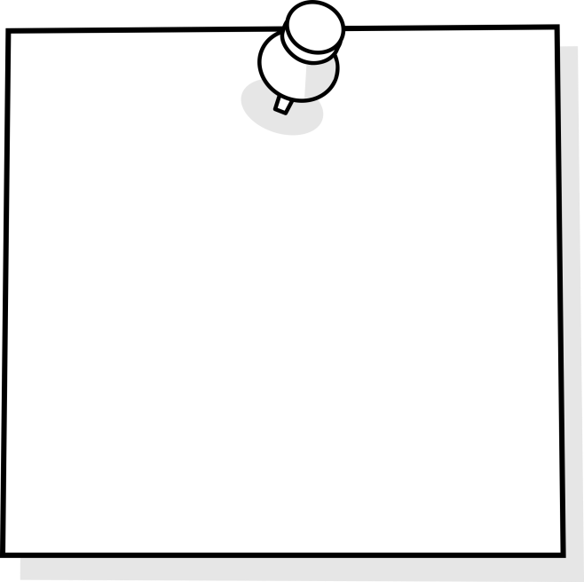
Goals of this talk
Be able to discuss how Open Science and sustainability are interconnected
Be prepared and motivated to start doing Open Science within your next research or educational project
Understand what Open Science has to do with free access to scientific methods, tools, knowledge, data and more
Be glad, that you’ve joined this session!
☺
Notes:
able to understand why Open Science would make your literature research and research in general less annoying - and hence the literature research for everyone, including other scientists, journalists, the community as a whole
prepared (and motivated!) to start doing Open Science in your next research or educational projects: for example when writing your thesis or conducting another research/educational project
Able to explain what Open Science has to do with sustainability: Trust in scientific processes, Collaboration compared to competition, sustainability in the sense of saving of resources, innovation as having the courage to do it the other way and disclose information, thoughts and practices
glad that you’ve joined this session ☺

Slide 8
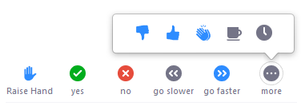
Before we start
I’m quite familiar with OS!
I might have heard about OS, but…
Sources: open-science by Kim Holmberg from Pixabay
Notes:
Bur before we start: Who of you has already heard of “Open Science”?

Slide 9
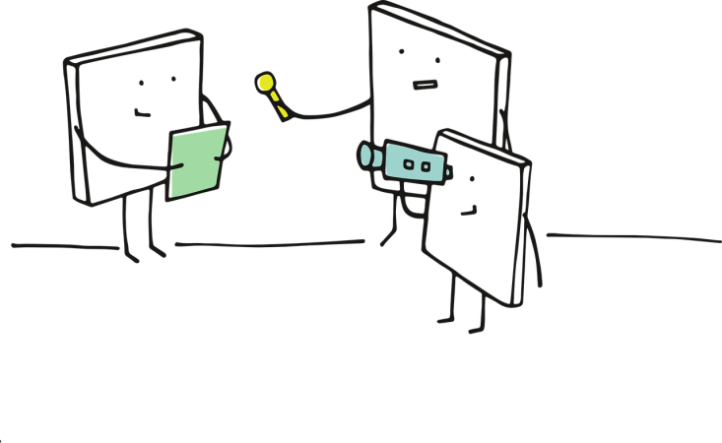
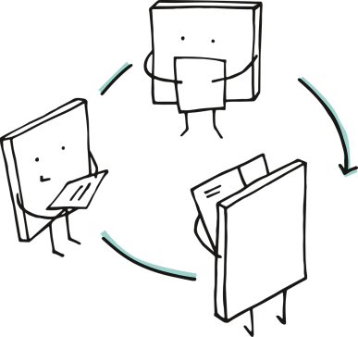
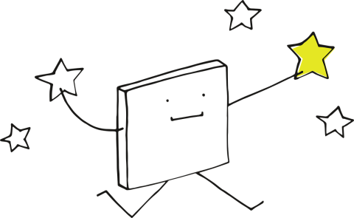

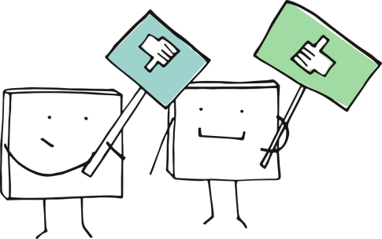
What is science?
Collect
Analyze
Publish
Reanalyze
Criticize
Reuse
DATA
Sources: Molloy (2011). The Open Knowledge Foundation: Open Data Means Better Science. PLoS.Biol.; “Pixelchen Pixel” pictures by Manfred Steger from Pixabay; “Thumbs down” by OpenClipart-Vectors from Pixabay
Notes:
Maybe this seems silly to you, but before we start speaking about open science we should have a quick look on what science actually means.
Science is built on data. Broadly we can say that it is based on the collection, analysis, publication, reanalysis, critique, and reuse of data. Proponents of open science identify a number of barriers that impede or dissuade the broad dissemination of scientific data.
Reanalyze: If you want to reanalyze other’s data, you first of all need those data to run your analyses with them. This is mostly not the case.
Criticize: How can you deeply criticize something you are not able to reanalyze or look at yourself?
Reuse: How can you reuse data or code or analyzing schemes, if they are not available to you?
Publish: When publishing data or paper, they mostly disappear behind a thick pay wall. So if you study in a university or country with less financial possibilities, this means you want have access to all the materials you need
Analyze: We’ll come to this part later again, but a transparent science process involves or a clearly planned analysis of your data (then it’s confirmatory analysis), or a exploratory analysis which is also named that way. What should not happen is, that you have a look at your data and then kind of find the matching hypothesis to those. A key word here is: science crisis.
Collect: When collecting your data you should be aware that it makes a difference, how your population is composed, if you collect your data face to face, via written questionnaires, analogue or digital

Slide 10
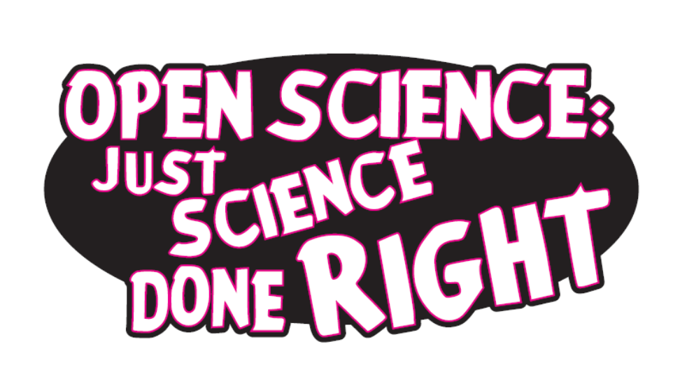
What is open science?
A movement to make scientific research and knowledge
accessible to everyone
more transparent
allowed to be shared
developed through networking
and collaboration
Sources: Sticker - open science just science done right by Imming & Tennant from Zenodo; OpenAIRE, 2018; Wikipedia, 2020
Notes:
Mentimeter: https://www.menti.com/jxf9wri8pn
“Open Science describes an on-going movement in the way research is performed, researchers collaborate, knowledge is shared, and science is organized. It affects the whole research cycle and its stakeholders, enhances science by facilitating more transparency, openness, networking and collaboration.” (OpenAIRE, 2018)
Open science is the movement to make scientific research and its dissemination
accessible to all levels of an inquiring society, amateur or professional
transparent by means that one can retrace which methods were used, how data were analysed, etc.
allowed to be shared (and not only in parts or after a year of publishing it)
developed through collaboration
Openness is an overarching concept or philosophy that is characterized by an emphasis on transparency and collaboration.
That is, openness refers to "accessibility of knowledge, technology and other resources; the transparency of action; the permeability of organisational structures; and the inclusiveness of participation". Openness can be said to be the opposite of closedness, central authority and secrecy. (https://en.wikipedia.org/wiki/Openness)

Slide 11
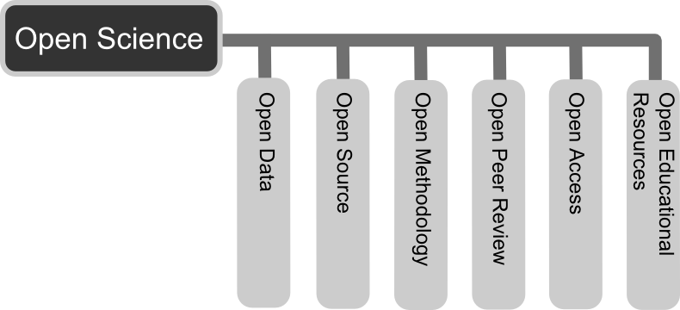
The six Principles of open science
Sources: Die sechs Prinzipien von Open Science by Andreas E. Neuhold, CC BY 3.0; Global Open Educational Resources Logo by Jonathasmello, CC BY 3.0; Open Access Logo, CC0 1.0; Preregistered Logo by COS, CC BY-ND 4.0
Notes:
Open Science opens up scientific processes and products from all levels to everyone. As such it includes Open Access, Open Research Data, Open Methodology, Open Evaluation, Citizen Science. (OpenAIRE, 2018)

Slide 12
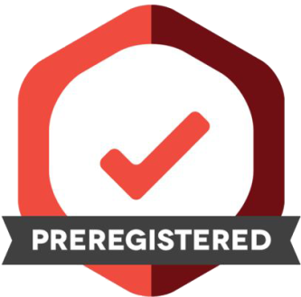
Open Methodology
Sources: Preregistered Logo by COS, CC BY-ND 4.0

Slide 13
What is Open methodology?
Idea
Proposal
(Funding)
Collecting
Analyzing
Publishing
Archiving
Sources: Presentation from Steinhardt, I. (2019). Is Open Science the better Science? Zenodo.

Slide 14
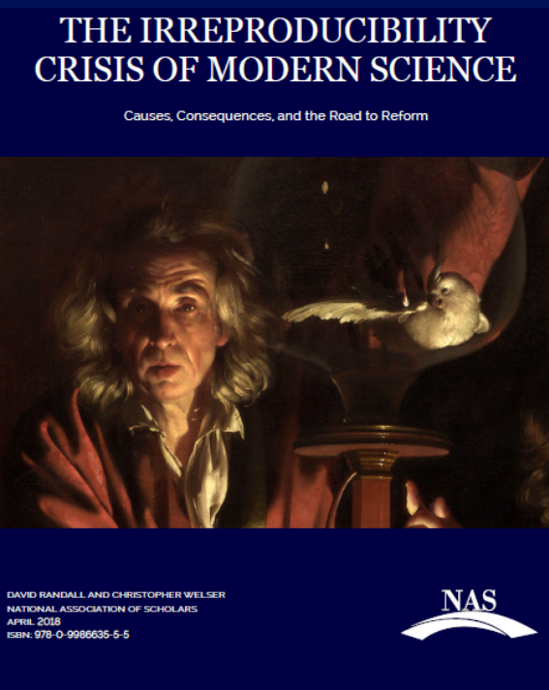
Why Open methodology?
Have you heard of the “Science Crisis”?
“Improper research techniques, lack of accountability, disciplinary and political groupthink, and a scientific culture biased toward producing positive results together have produced a critical state of affairs.” (Randall & Welser, 2018)
Sources: Randall & Welser (2018). The irreproducibility crisis of modern science: causes, consequences, and the road to reform.; Presentation from Steinhardt, I. (2019). Is Open Science the better Science? Zenodo.

Slide 15
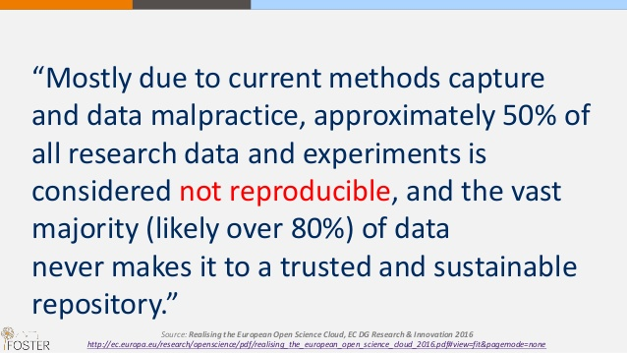
Why Open methodology?
Have you heard of the “Science Crisis”?
Sources: Presentation from Steinhardt, I. (2019). Is Open Science the better Science? Zenodo.

Slide 16
Why Open methodology?
Have you heard of the “Science Crisis”?
“Survival in academia depends on publications in refereed journals. Authors only get their papers accepted if they intellectually prostitute themselves by slavishly following the demands made by anonymous referees who have no property rights to the journals they advise.” (Frey, 2003)
Sources: Presentation from Steinhardt, I. (2019). Is Open Science the better Science? Zenodo. ; Frey, B. S. (2003). Publishing as Prostitution? – Choosing Between One's Own Ideas and Academic Success, Public Choice, 116(1), p. 205-223.

Slide 17
How to Open Methodology
Idea
Proposal
Funding
Collection
Analysis
Publishing
Archive
Sources: Presentation from Steinhardt, I. (2019). Is Open Science the better Science? Zenodo. Preregistered Logo by COS, CC BY-ND 4.0

Slide 18
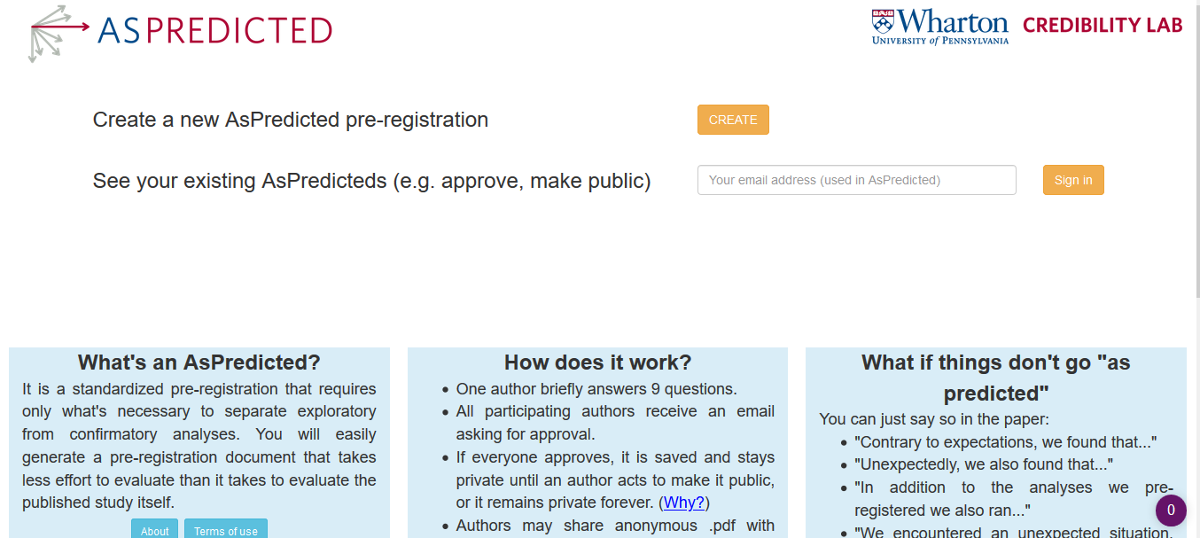
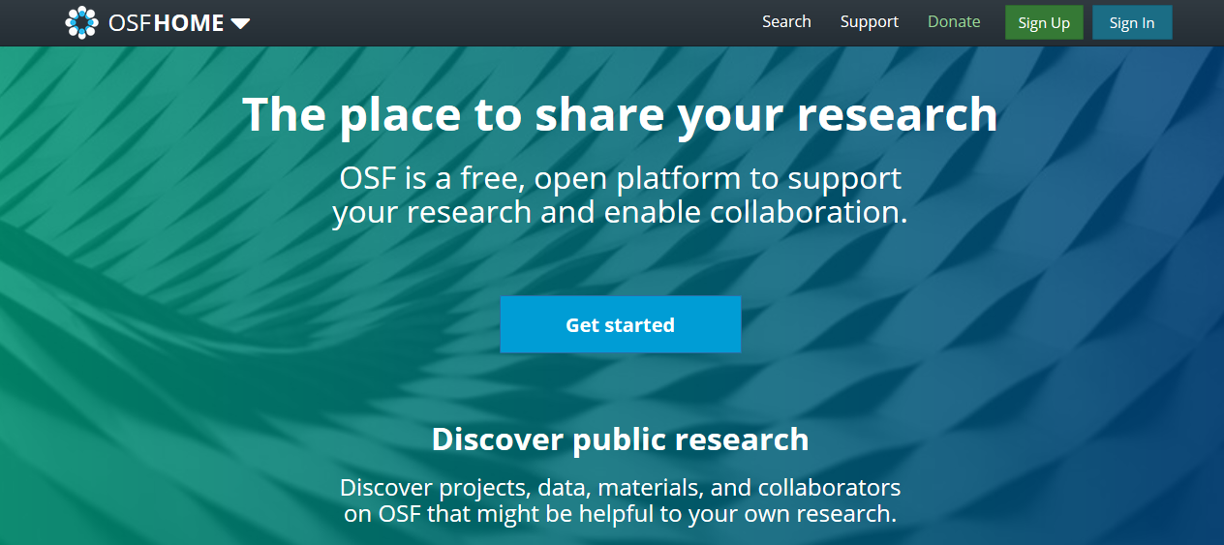
Preregister!
Sources: Preregistered Logo by COS, CC BY-ND 4.0; www.aspredicted.org; www.osf.org

Slide 19
As predicted
Data collection. Have any data been collected for this study already?
Hypothesis. What's the main question being asked or hypothesis being tested in this study?
Dependent variable. Describe the key dependent variable(s) specifying how they will be measured.
Conditions. How many and which conditions will participants be assigned to?
Analyses. Specify exactly which analyses you will conduct to examine the main question/hypothesis.
Outliers and Exclusions. Describe exactly how outliers will be defined and handled.
Sample Size. How many observations will be collected or what will determine sample size?
No need to justify decision, but be precise about exactly how the number will be determined.
Other. Anything else you would like to pre-register?
Name. Give a title for this AsPredicted pre-registration.
Sources: Preregistered Logo by COS, CC BY-ND 4.0; www.aspredicted.org

Slide 20
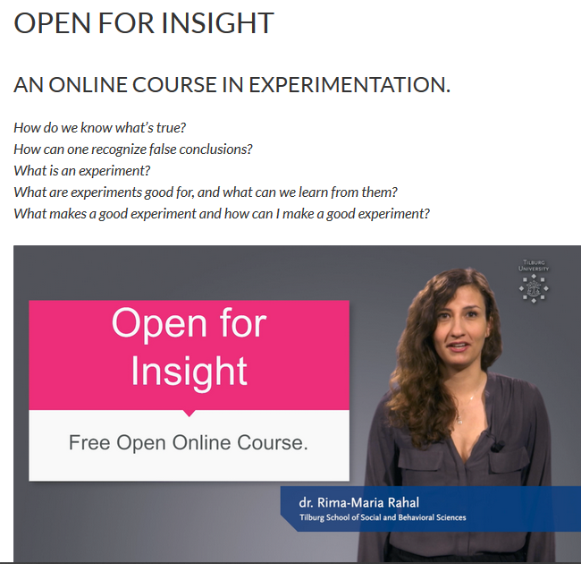
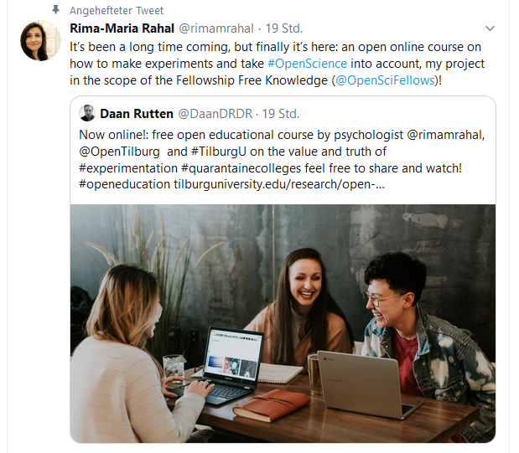
How TO Open Experimentation
Sources: Open for an Insight Courseby Dr. Rima-Maria Rahal available at Tilburg University; Twitterhandle @rimamrahal

Slide 21

Open Access
Sources: Open_Access_logo by PLOS from Wikimedia Commons, CC 0 1.0

Slide 22
What is Open Access?
All scientific articles are…
available online (archives, repositories, journals)
free of charge and other barriers
usable for lawful purpose
free of most copyright and licensing restrictions
and in authors’ control
Sources: Suber (2005). Open Access Overview , CC BY 3.0; Open_Access_logo by PLOS from Wikimedia Commons, CC 0 1.0
Notes:
Here's how the Budapest Open Access Initiative put it: "There are many degrees and kinds of wider and easier access to this literature. By 'open access' to this literature, we mean its free availability on the public internet, permitting any users to read, download, copy, distribute, print, search, or link to the full texts of these articles, crawl them for indexing, pass them as data to software, or use them for any other lawful purpose, without financial, legal, or technical barriers other than those inseparable from gaining access to the internet itself. The only constraint on reproduction and distribution, and the only role for copyright in this domain, should be to give authors control over the integrity of their work and the right to be properly acknowledged and cited."

Slide 23
Why Open access?
Did you also know, that scientists organize the whole peer-review process as well as the editing of their articles in most cases for free?
Did you already think of the fact, that most scientists are paid by the society (in form of taxes) to produce scientific research?
Did you know, that in most cases scientists give away their copyright when handing in a journal article?
Did you further know, that after having published an article, our universities pay lots of money to get access to this same articles again?
And do you also think that’s weird?
Sources: Suber (2003). Not Napster for Science. SPARC Open Access Newsletter; Open_Access_logo by PLOS from Wikimedia Commons, CC 0 1.0
Notes:
Napster Zitat: “The fact that scholars eagerly submit articles to journals that don't pay for them, even journals that demand that authors sign away their copyright, is probably the best-kept secret about academic publishing among non-academics. It's the fact that simultaneously explains the beauty of open access and the mistake of "Napster for science".”

Slide 24
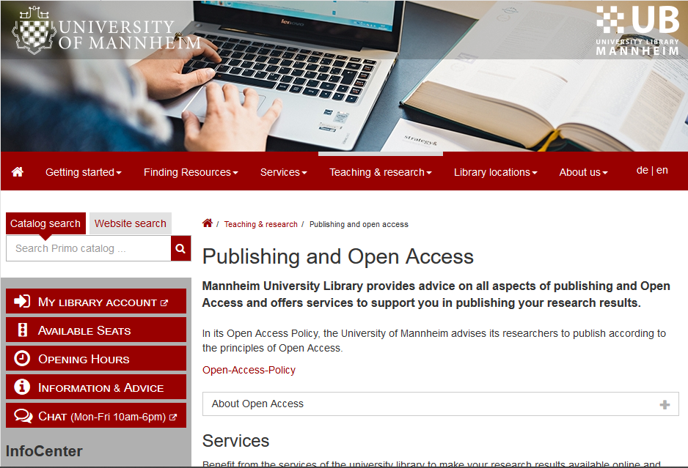
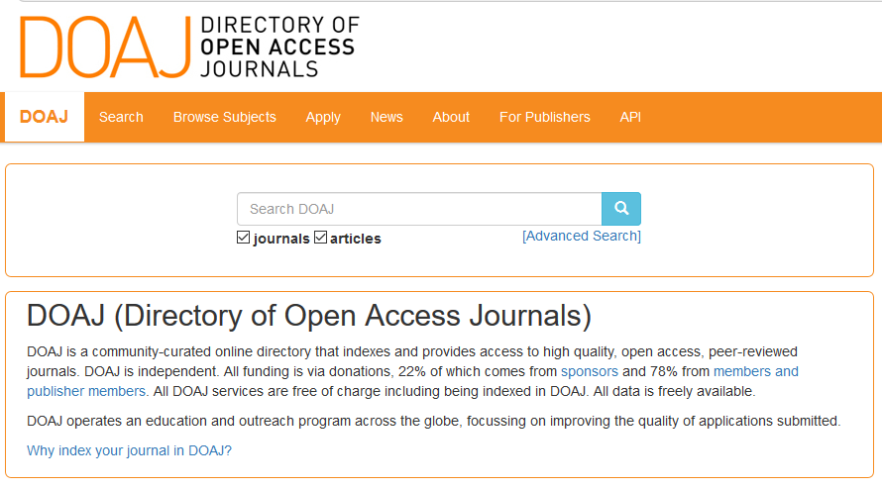
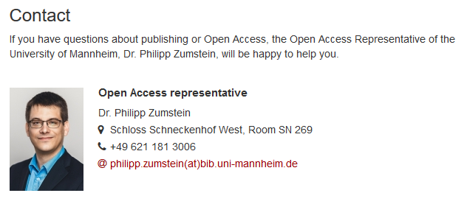
HOW TO OA
Sources: https://doaj.org/; https://www.bib.uni-mannheim.de/en/contact-persons/dr-philipp-zumstein/
Notes:
More and more possibilities to publish open access

Slide 25

Open Educational Resources
Sources: Global Open Educational Resources Logo by Jonathasmello, CC BY 3.0

Slide 26
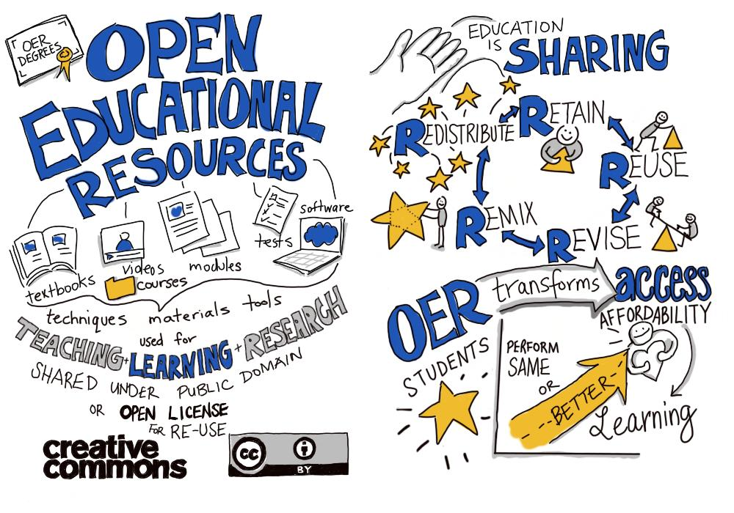
WHAT ARE OER?
Sources: OER is sharing by Giulia Forsythe from flickr; Wiley (2010)
Notes:
Die fünf R von Wiley
Retain - make, own, and control a copy of the resource (e.g., download and keep your own copy)
Revise - edit, adapt, and modify your copy of the resource (e.g., translate into another language)
Remix - combine your original or revised copy of the resource with other existing material to create something new (e.g., make a mashup)
Reuse - use your original, revised, or remixed copy of the resource publicly (e.g., on a website, in a presentation, in a class)
Redistribute - share copies of your original, revised, or remixed copy of the resource with others (e.g., post a copy online or give one to a friend)
OER bedeutet eigentlich OEP (also Open Educational Practices) und damit:
kollaborative Wissenserarbeitung
Möglichkeit zum Wissensaustausch (durch das Internet)
Anpassung an spezifische Lernsituationen und Lernbedürfnisse
Qualität durch OER durch Weiterentwicklung der Inhalte und kontinuierliche Teamarbeit gewährleistet
Lernende können durch Entwicklung und Weiterentwicklung von OER aktivere Rolle im Lernprozess übernehmen
großes transformatives Potential, von dem alle Bildungsbereiche profitieren können

Slide 27
WHY OER?
Efficiency
Quality
Innovation
Participation
Collaboration
Independence
Culture change
…and more!
Sources: Deimann, Neumann & Muuß-Merholz (2015). Whitepaper OER an Hochschulen in Deutschland. Bestandsaufnahme und Potenziale 2015.; Deutsche UNESCO Kommission (2015). Leitfaden OER in der Hochschulbildung.; Global Open Educational Resources Logo by Jonathasmello, CC BY 3.0
Notes:
Es kann auf Bestehendem aufgebaut werden, keine doppelte Arbeit für gleiche Inhalte (gerade in der aktuellen Debatte rund um die Frage nach alternativen Wirtschaftsmodellen – Degrowth=Postwachstum oder Circular Economy=Kreislaufwirtschaft – sehr passend); außerdem aus Steuergeldern finanziertes Material offen
Wiederholte Begutachtung der Materialien kann zu Qualitätssteigerung führen; Bildung von offenen Anwendergemeinschaften zur Unterstützung bei Herstellung und Qualitätsverbesserung und -sicherung von OER
Innovationen finden Beachtung: Entstehung und Verbreitung neuer Bildungsmodelle und Lernkulturen
Einbezug von Studierenden in Auswahl und Anpassung von OER, aktive Beteiligung am Lernprozess, aber auch Chancengleichheit
Zusammenarbeit zwischen Lehrenden und Institutionen universitätsweit, aber auch national und international → damit auch Form der Öffentlichkeitsarbeit für Hochschulen
Unabhängigkeit von „Internetgiganten“ und kommerziellen Einrichtungen (Google, Amazon, Facebook, etc.)
Haltungs- und Einstellungsänderung bezüglich und gegenüber des Lehrens und Lernens auf Seiten ALLER involvierter Akteur*innen, inklusive Verwaltung und Administration aber auch Politik, etc.
„Auch Mayrberger und Hofhues (2013, 66) betonen, dass «offene Bildungspraktiken mit offenen Bildungsressourcen [...] das bisherige Spektrum von Offenheit, Selbstorganisation(-sfähigkeit) und Partizipation der Studierenden und Lehrenden [erweitern]».“ (Bellinger et al., 2018)
OER im Hochschulkontext betrifft häufig wissenschaftliche Literatur. Diese wiederum ist in den meisten Fällen nicht Open Access, sondern hinter einer Paywall. D.h. hier haben wir eine erste größere Überschneidung zu OER und OA. Bezugnehmend auf die neuen Regularien im Urheberrecht (wobei ich auf den wunderbaren Workshop meiner Kollegin Julia Wildgans hinweisen möchte!), kommen wir hier teilweise schon in schwieriges Fahrwasser, da für Lehrzwecke max. 15% eines Werkes oder aber auch Einzelbeiträge zur Verfügung gestellt werden dürfen, eine Weiterverarbeitung o.Ä. ist hier aber nicht zulässig.
OER benötigen Open Educational Practices! Ohne diese bringen die Materialien alleine kaum was!
ALLERDINGS sind viele Definitionen und Beschreibungen von OEP noch sehr normativ und etwas tautologisch; es muss sich erst noch zeigen, was OER tatsächlich im Lehr- und Forschungsalltag verändern, bevor das „Blaue vom Himmel“ gelobt werden kann/sollte
Stichwort: Lebenslanges Lernen

Slide 28
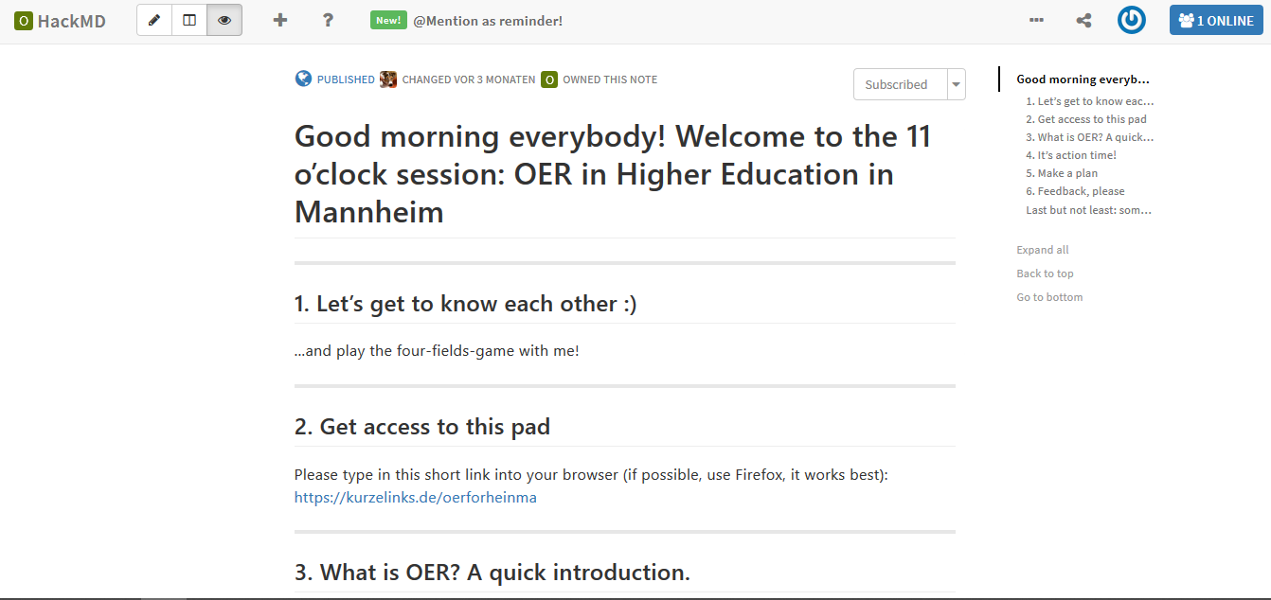
HOW TO OER
Sources: English Version on HackMD via https://hackmd.io/wnBuf1qIQJ2p4s1bohcdSQ ; German Version: on CodiMD: via https://demo.codimd.org/E2XoQ_qzTFmmX4xV8qWRoA#

Slide 29
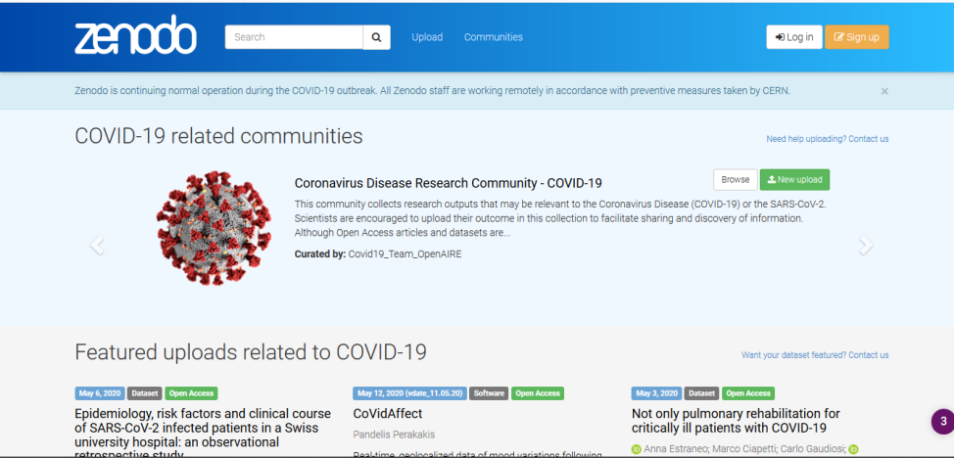
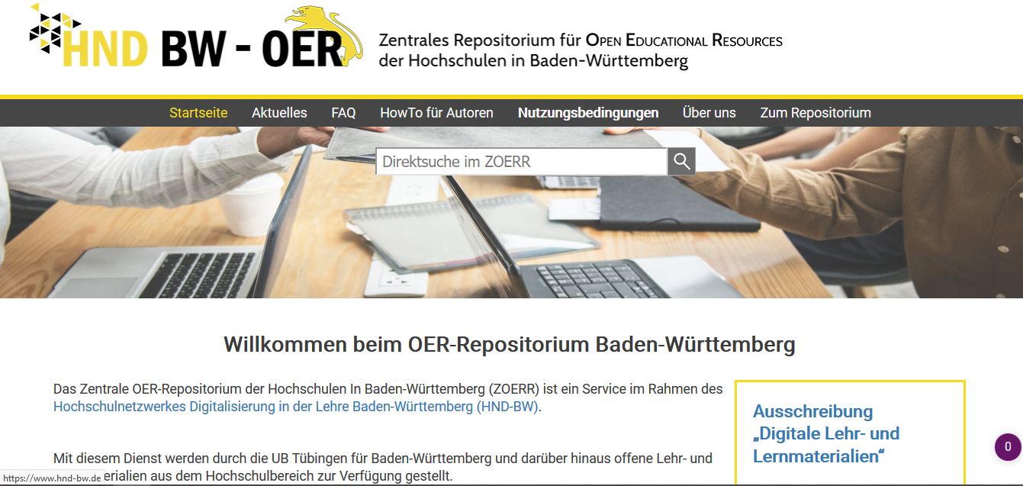
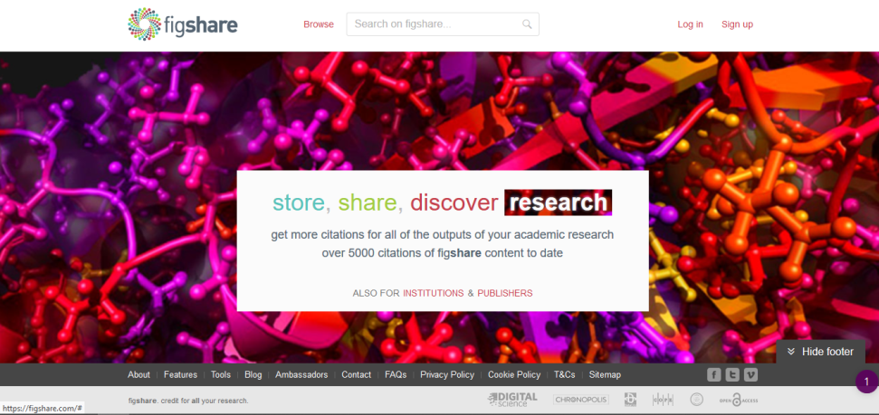
HOW TO OER
Sources: ZOERR via https://www.oerbw.de/, Zenodo via https://zenodo.org/ figshare via https://figshare.com/

Slide 30
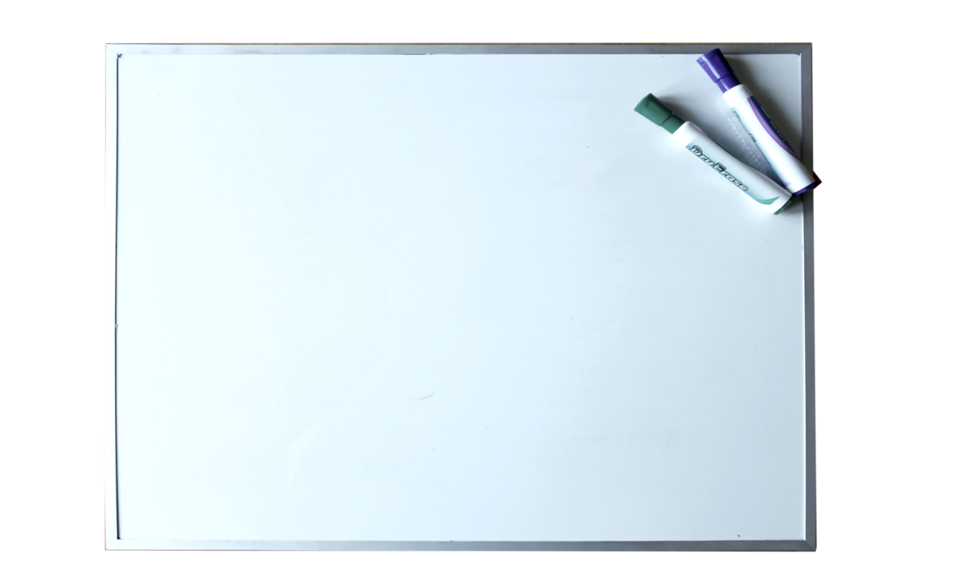
Conclusions so far
Thoughts about
Open Science, or directly on
- Open Methodology,
- Open Access or
- Open Educational Resources?
Sources: whiteboard by mnplatypus from Pixabay
Notes:
Ok, let’s take a quick break here and put it together!
→ Whiteboard

Slide 31
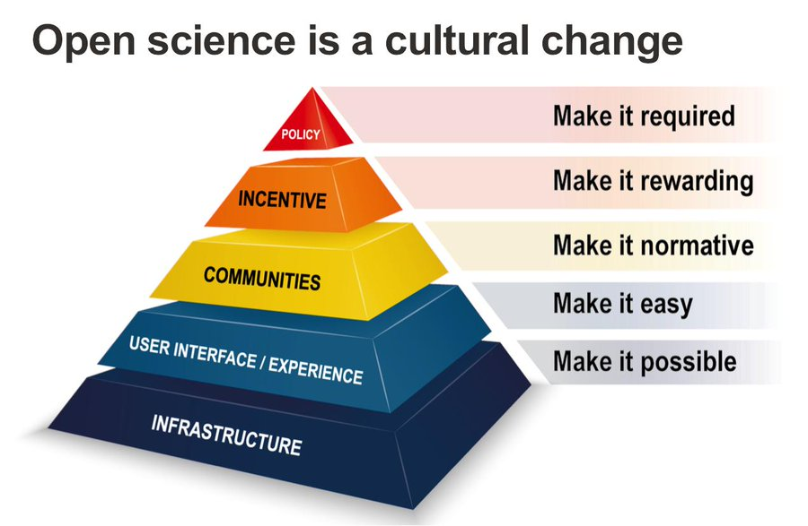
Open science as cultural change!
Sources: Presentation from Steinhardt, I. (2019). Is Open Science the better Science? Zenodo. ; Brian Nosek https://osf.io/r9v3p/ and https://cos.io/blog/strategy-culture-change/

Slide 32
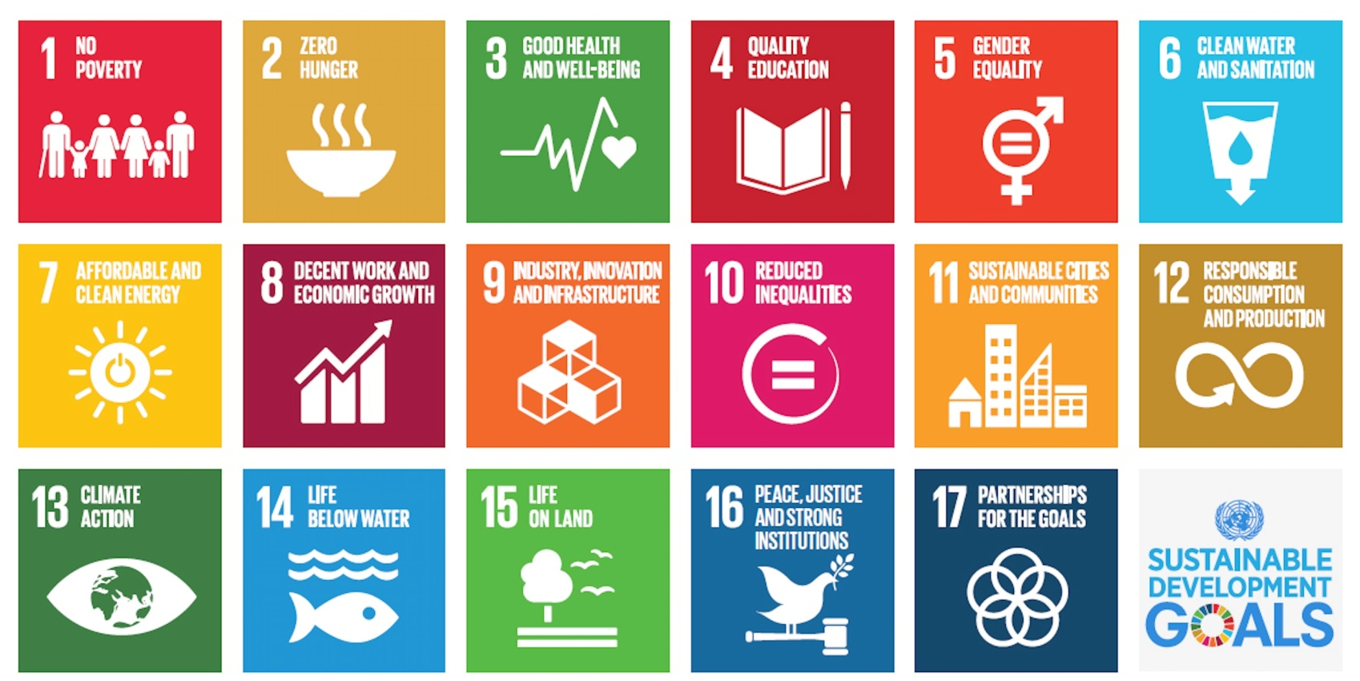
and What about sustainability?
Sources: Von UNDP, Gemeinfrei, https://commons.wikimedia.org/w/index.php?curid=52672594
Notes:
Science can contribute to all of this questions
And Open Science? Open Science can possibly contribute even more
How so?

Slide 33

Open science itself is sustainable
Sources: recycle by Clker-Free-Vector-Images from Pixabay

Slide 34

Sustainability benefits from Os
“By encouraging science to be more connected to societal needs and by promoting equal opportunities for all scientists, policy-makers and citizens), Open Science can be a true game changer in bridging the science, technology and innovation gaps between and within countries and fulfilling the human right to science.”
“In the context of pressing planetary and socio-economic challenges, sustainable and innovative solutions require an efficient, transparent and vibrant scientific effort - not only stemming from the scientific community, but from the whole society. The recent response of the scientific community to the COVID-19 pandemic has demonstrated very well, how open science can accelerate the achievement of scientific solutions for a global challenge.”
Equal opportunities
Connection to societal needs
Building bridges
Accelerate achievements
Scientific effort from the whole society to solve pressing issues
Sources: UNESCO (2019) via https://en.unesco.org/science-sustainable-future/open-science

Slide 35
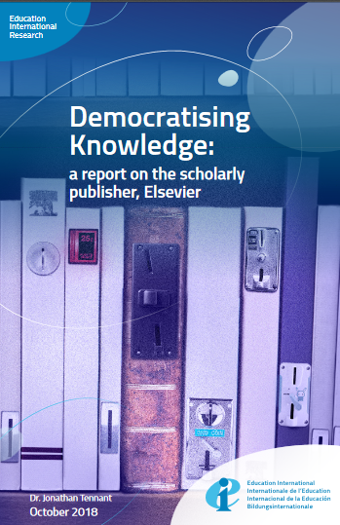
OS Democratizes knowledge
“The effect of this is the continued erosion of the academic journal marketplace, and knowledge discrimination against those who are less financially privileged than all but the wealthiest portion of research institutes. Furthermore, as Elsevier almost entirely publishes only English-language research, this strongly discriminates against indigenous forms of knowledge, research conducted in non-English native speaking countries, and academics who do not speak English fluently as a first language.” (p. 14)
Sources: Tennant, J.(2018). Democratising Knowledge: a report on the scholarly publisher, Elsevier. Zenodo.

Slide 36
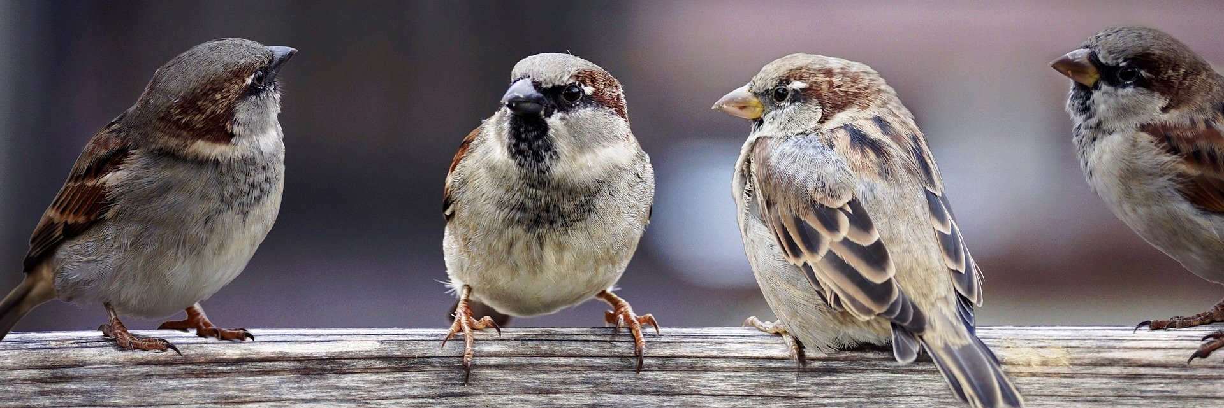
...and probably there’s much more
Sources: Sparrows by Susanne Jutzeler, suju-foto from Pixabay
Notes:
But even if we talk about Open Science this talk is not Open End, so I’d like to come to an end and leave some room for last thoughts and questions

Slide 37
Before we Go ...eh... stay home
What was new to you?
Which information surprised you the most?
What will you tell a fellow student, when being asked about OS (one sentence)?
Did you miss some information? Was there something which remained unclear?
Notes:
Please think about it and write it down in the chat using 1. …, 2. … and 3. …

Slide 38
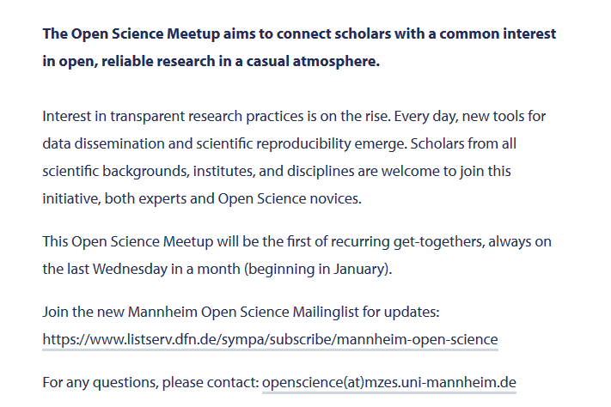
Ad: Open science meetup Mannheim
Sources: https://www.uni-mannheim.de/en/news/mannheim-open-science-meetup0/

Slide 39
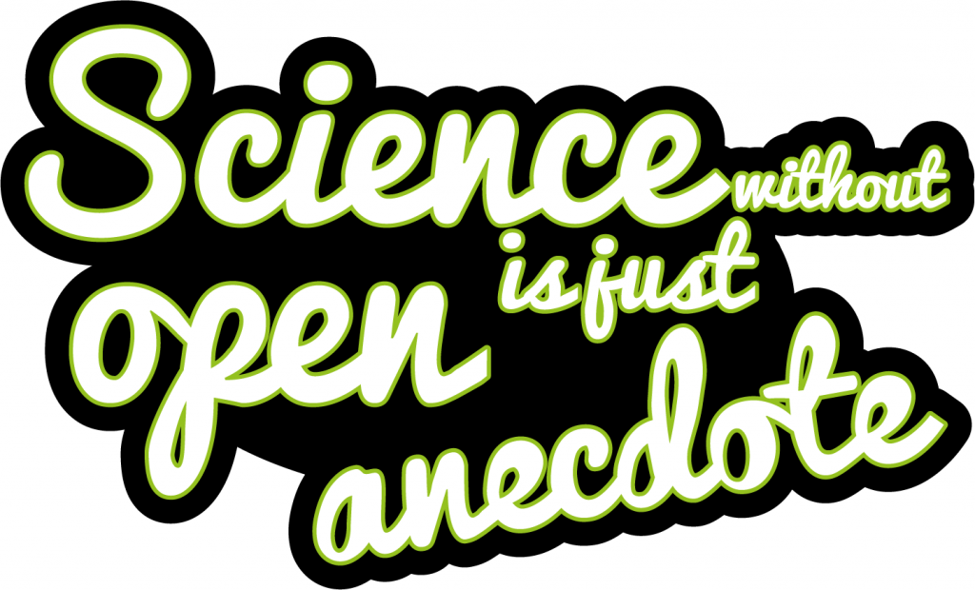
Sources: Sticker - Science without Open is just Anecdote by Imming & Hartgerink (2019) from Zenodo.

Slide 40
Essay question
If you decide for the Open Science Essay, chose one of the two questions.
Discuss, why and how Open Science Practices and Procedures (can) change and innovate
the way we do Scientific Research.
OR
the way we teach and learn in Higher Education.

