Slide 1
Task Force Open Science:
Research Data Management at CESAER Universities
Paula Martinez Lavanchy, TU Delft
Angelina Kraft, TIB, Hannover
STM Webinar, 19 May 2020

Slide 2
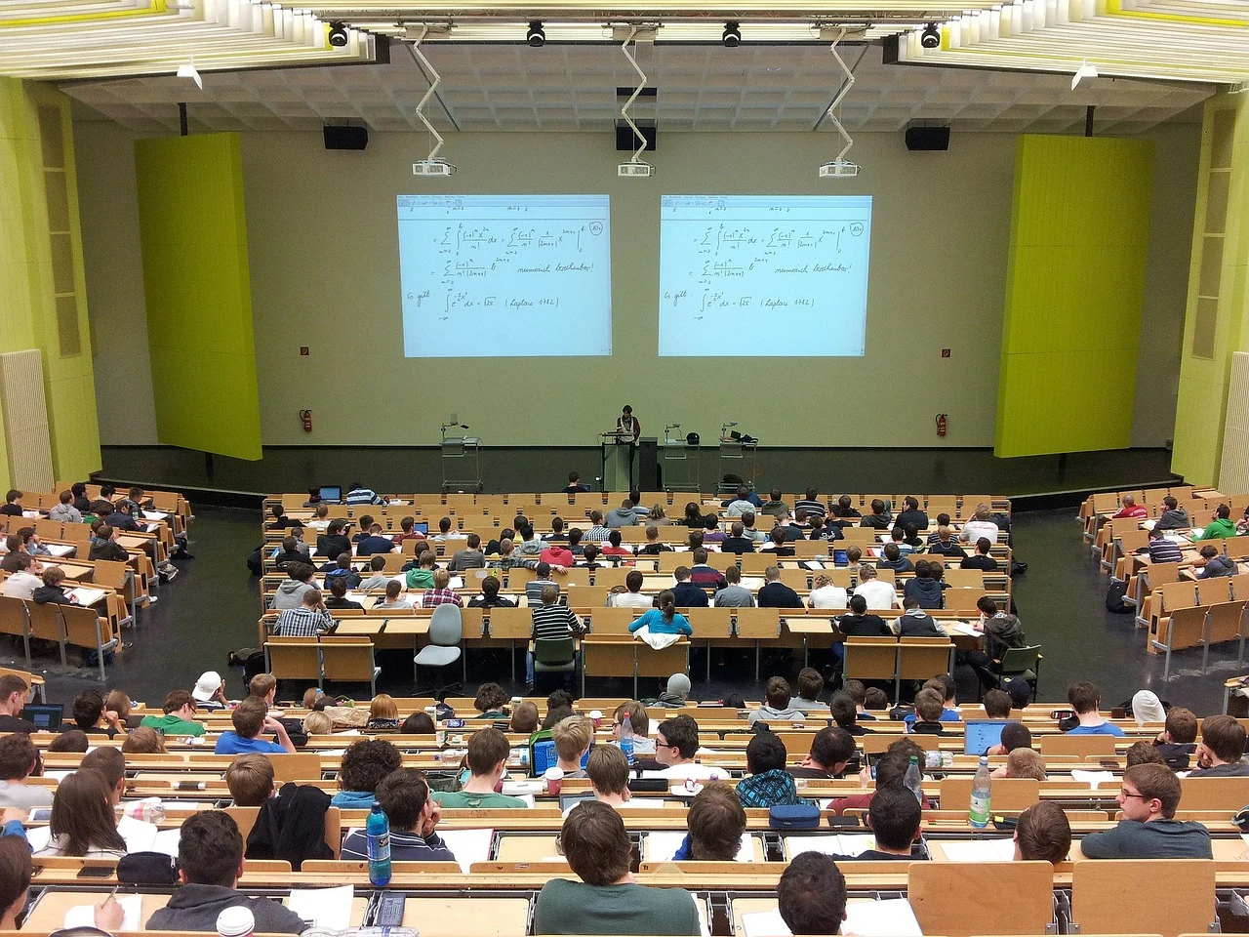
About CESAER
Conference of European Schools for Advanced Engineering Education and Research
CESAER is the strong and united voice of universities of science and technology in Europe
→ over 50 leading S&T Universities
→ members educate over 1 million students & employ over 88,000 academic staff

Slide 3
Task Force Open Science
→ 23 institutions represented
Two subgroups working on:
Research Data Management
Open Access
White Paper: http://doi.org/10.5281/zenodo.3665372

Slide 4

Survey
Aim
To compare RDM activities with a special focus on engineering disciplines and the challenges faced when providing suitable RDM support services, training & infrastructure
Target group
All CESAER member institutions
Persons/team responsible for RDM support and services
One answer per institution

Slide 5

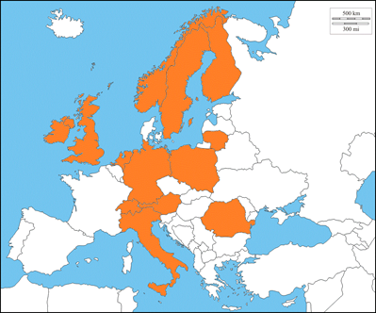
Survey
Structure
Policy & Organization
Infrastructure & Tools
Support services & Training
Responses
21 institutions participated
13 countries represented

Slide 6

Policy & Organization [1]
RDM policies in place in 66.7% of institutions and is work in progress for several
Significant variations in structure but most address the essential issues for RDM: FAIR Data, Reproducibility, Data Preservation, Data Sharing, DMPs, Openness
Policies also clarifies the responsibilities regarding researchers, institutions, faculty, others

Slide 7
Policy & Organization [2]
Challenges
Policies are often generic and the lack of Discipline/Faculty - specific guidelines hinder compliance
Relevant topics for S&T universities such as IPR & data ownership and dealing with Research Software are rarely mentioned
Far too few institutional incentives for researchers to make them comply with research data policies

Slide 8
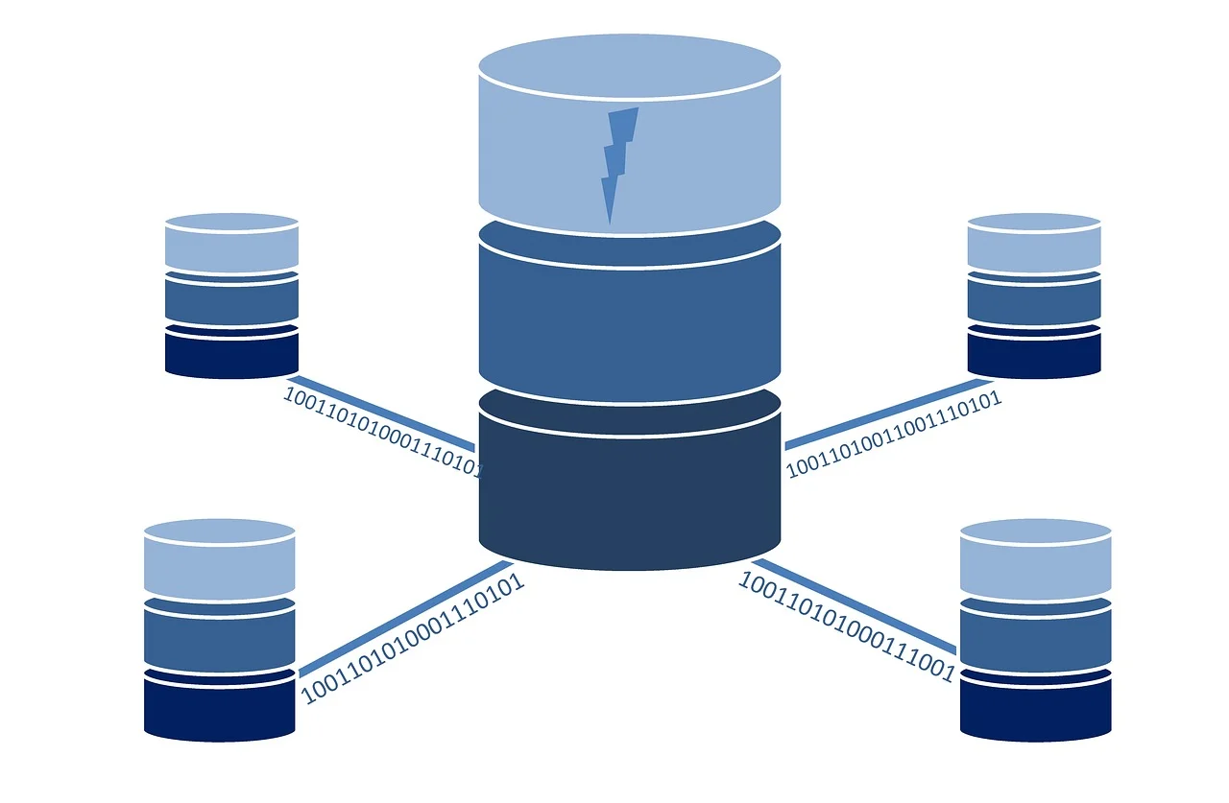
Infrastructure & Tools [1]
An important number of universities offer Data storage (66.7%) and Data repositories/archives (52.4%)
More than half offer RDM tools. For example:
DMP Tools (66.7%)
HPC (61.9%)
Version Control Tools (57.1%)
Less than half also offer:
Jupyter Notebooks (33.3%)
ELNs (28.6%)

Slide 9
Infrastructure & Tools [2]
Challenges
Large size of the data produced/collected within technical/engineering as a main challenge for Storage and Data archiving/publishing
Lack metadata standards/documentation hinder findability and re-use of the data stored and/or preserved
Only few universities providing tools specific for technical/engineering disciplines

Slide 10

Support services & Training [1]
81% have a dedicated team of RDM Support involving more than one administrative office, but mostly Library staff and IT-managers
90% believe that industrial collaboration is ‘relevant’ or ‘very relevant’ for the researchers
81% offer RDM training regularly and only 42.9% offer training tailored to technical/engineering disciplines

Slide 11
Support services & Training [2]
Challenges
Most difficult RDM topics to address are DMPs, Documentation, Legal and Technical issues as well as Software
When collaborating with industry:
Data publication is a major issue in contrast to funder and journals requirements
Archiving research data after the end of a project
RDM workflows are not part of collaboration agreements

Slide 12
Support Services & Training [3]
Challenges
RDM trainings are provided regularly at most universities.
When providing training tailored to technical/engineering disciplines there is a lack of trainers and teaching materials with the needed discipline-specific focus
Lack of interest from researchers

Slide 13

Next steps & Collaborations

Slide 14
What can be the next steps for institutions?
Develop sub-policies and/or specific guidelines for discipline-specific workflows & software
Research Data Management support and IT working together on data storage guidelines that help researchers to determine which data must be stored, for how long and where
Work on establishing disciplines-specific support or communities within the institution, e.g. by embedding data stewards within faculties or research groups

Slide 15
What we should be working on collaboratively?
RDM and FAIR data when collaborating with industry - CESAER TFI + TFOS in 2020
Incentives to motivate & acknowledge researchers complying with RDM best practices - CESAER TFHR + TFOS in 2020
Develop subject-specific trainings materials & course plans considering workflows at S&T universities
Work closely together with research communities and/or relevant global communities on discipline-specific metadata standards & tools for implementing them,
e.g. RDAinEng and RDA metadata group(s)

Slide 16

Contact
Thank you!
Paula Martinez Lavanchy, TU Delft
p.m.martinezlavanchy@tudelft.nl
Angelina Kraft, TIB, Hannover
angelina.kraft@tib.eu
Pictures by pixabay.com, Pixabay Licence, no attribution

