Slide 1
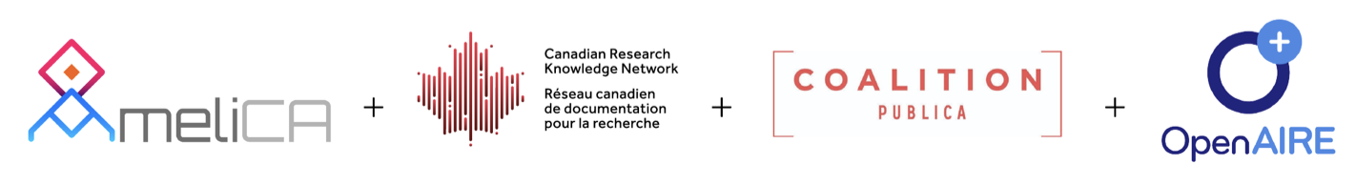
Cooperative Non-APC Publishing Models
Arianna Becerril García

Slide 2
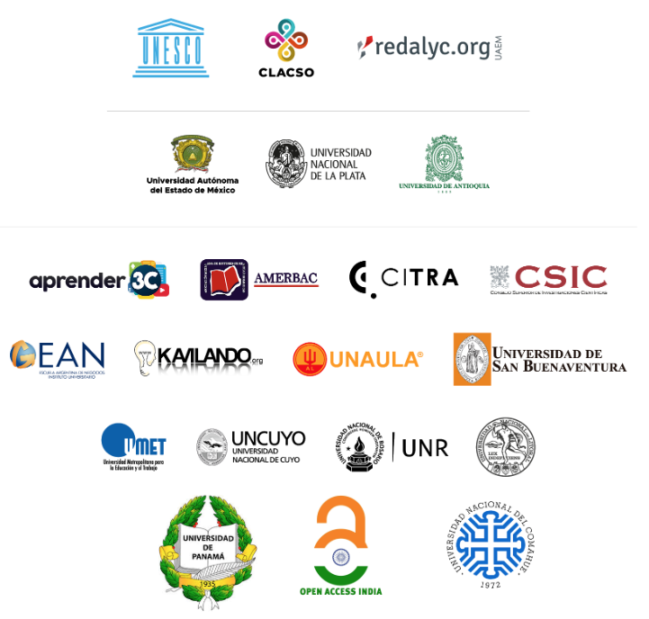

































AmeliCA is a multi-institutional community-driven initiative supported by UNESCO and led by Redalyc and CLACSO aimed to provide a cooperative, sustainable, protected and non-comercial infrastructure for Open Knowledge.
Publisher institutions of participating journals:

Slide 3
A cooperative approach of science as a common and public good
Redalyc and AmeliCA have developed and implemented an infrastructure to sustain non-profit, academy-owned scholarly publishing for more than 1,500 scientific journals, this approach:
  Saves significant costs in journal production in favor of the non-profit publishing sustainability
  Allows to keep journal publishing in hands of the academic, non-profit sector
  Allows native Open Access and Open Data
  Prevents journals from charging APC (author fees)
  Enables bibliodiversity
  Includes AI-aided software that automates XML contents markup and journal output files generation (ePUB, HTML5, PDF, XML)
  Linked Open Data compliant
  Leverages data granularity to enable novel ways of discoverability and knowledge representation

Slide 4
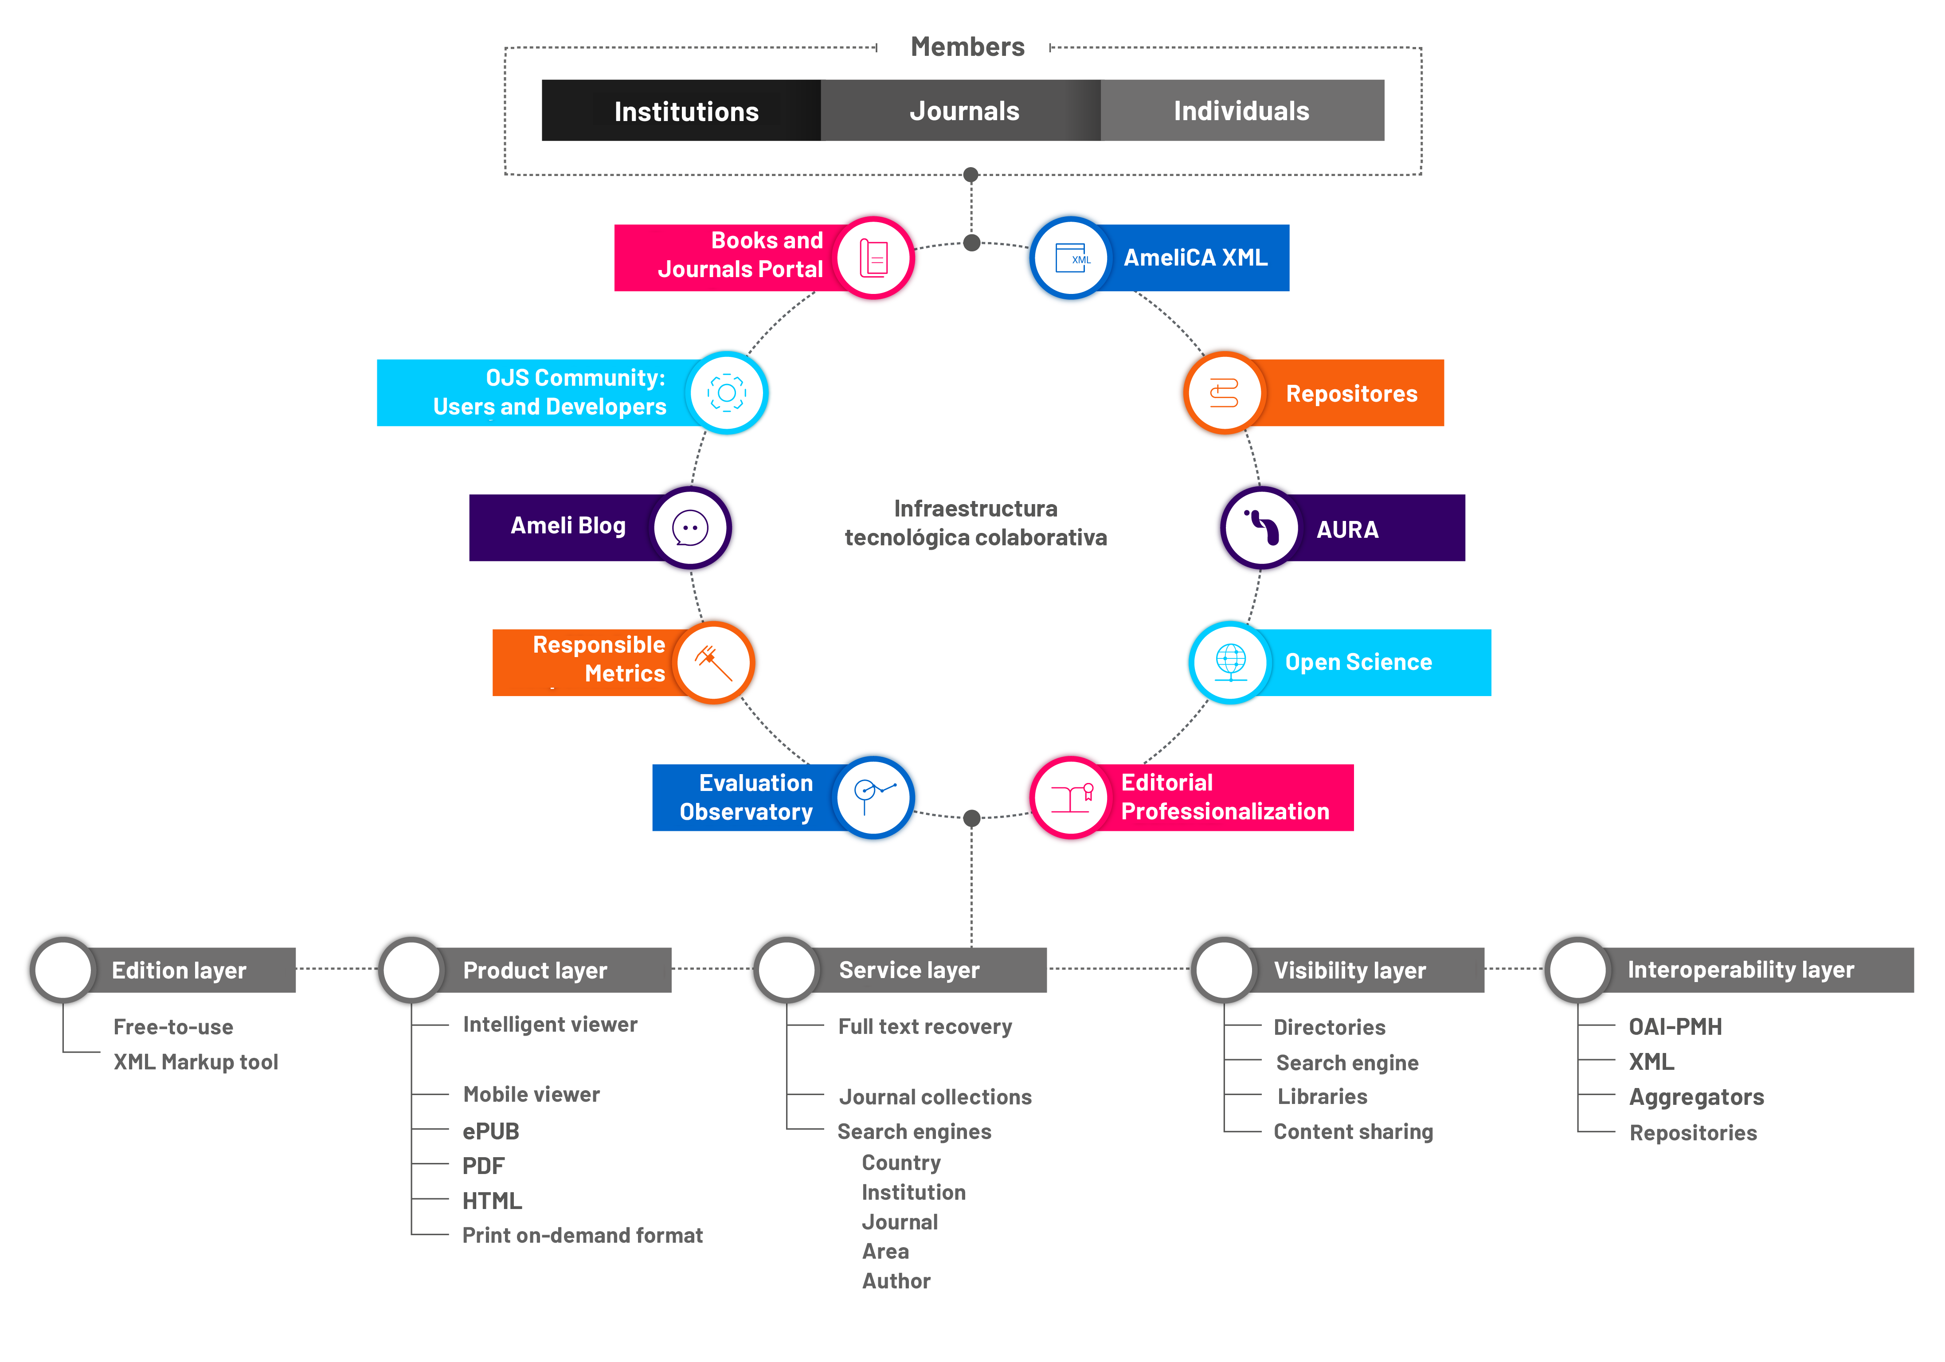
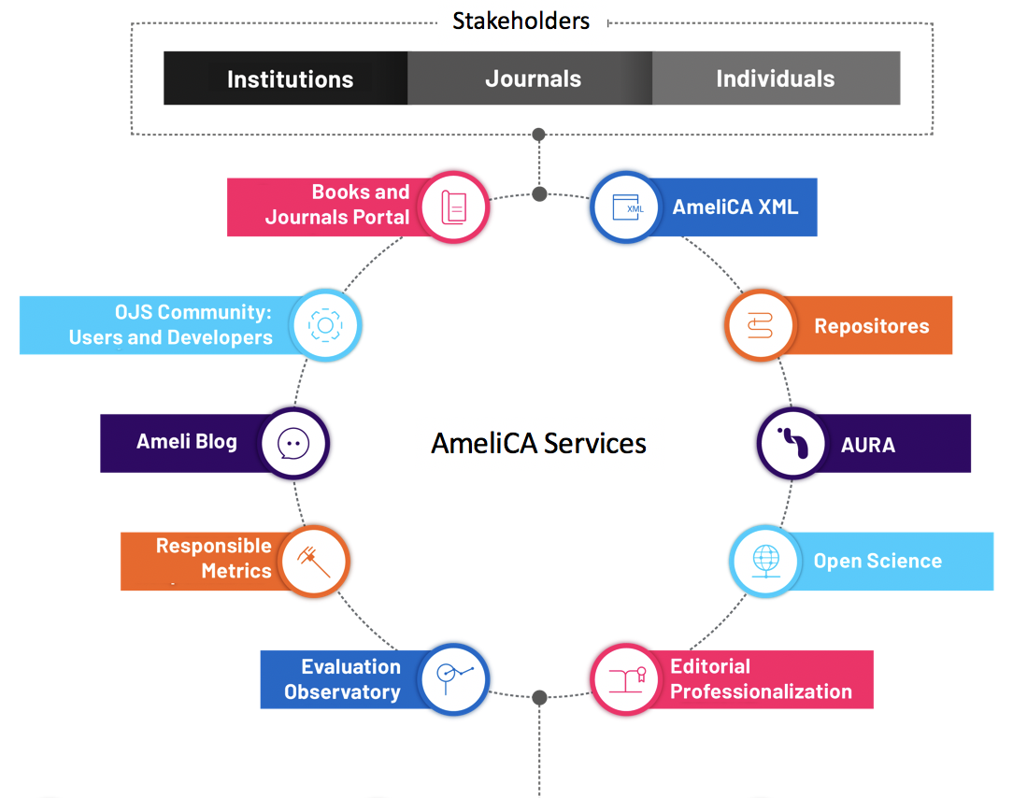
Stakeholders
Cooperation
XML markup
Journal production workflow
Software development
Linked Open Data
AI-aided tools
Hardware
Preservation
Full-text storage and avilability
Trainning
Journal quality criteria
Data quality assurance
Editors & regional operators
Data
Software
Redalyc
Hardware
AmeliCA
Redalyc
AmeliCA Services
Quality Assurance
AmeliCA
Redalyc

Slide 5
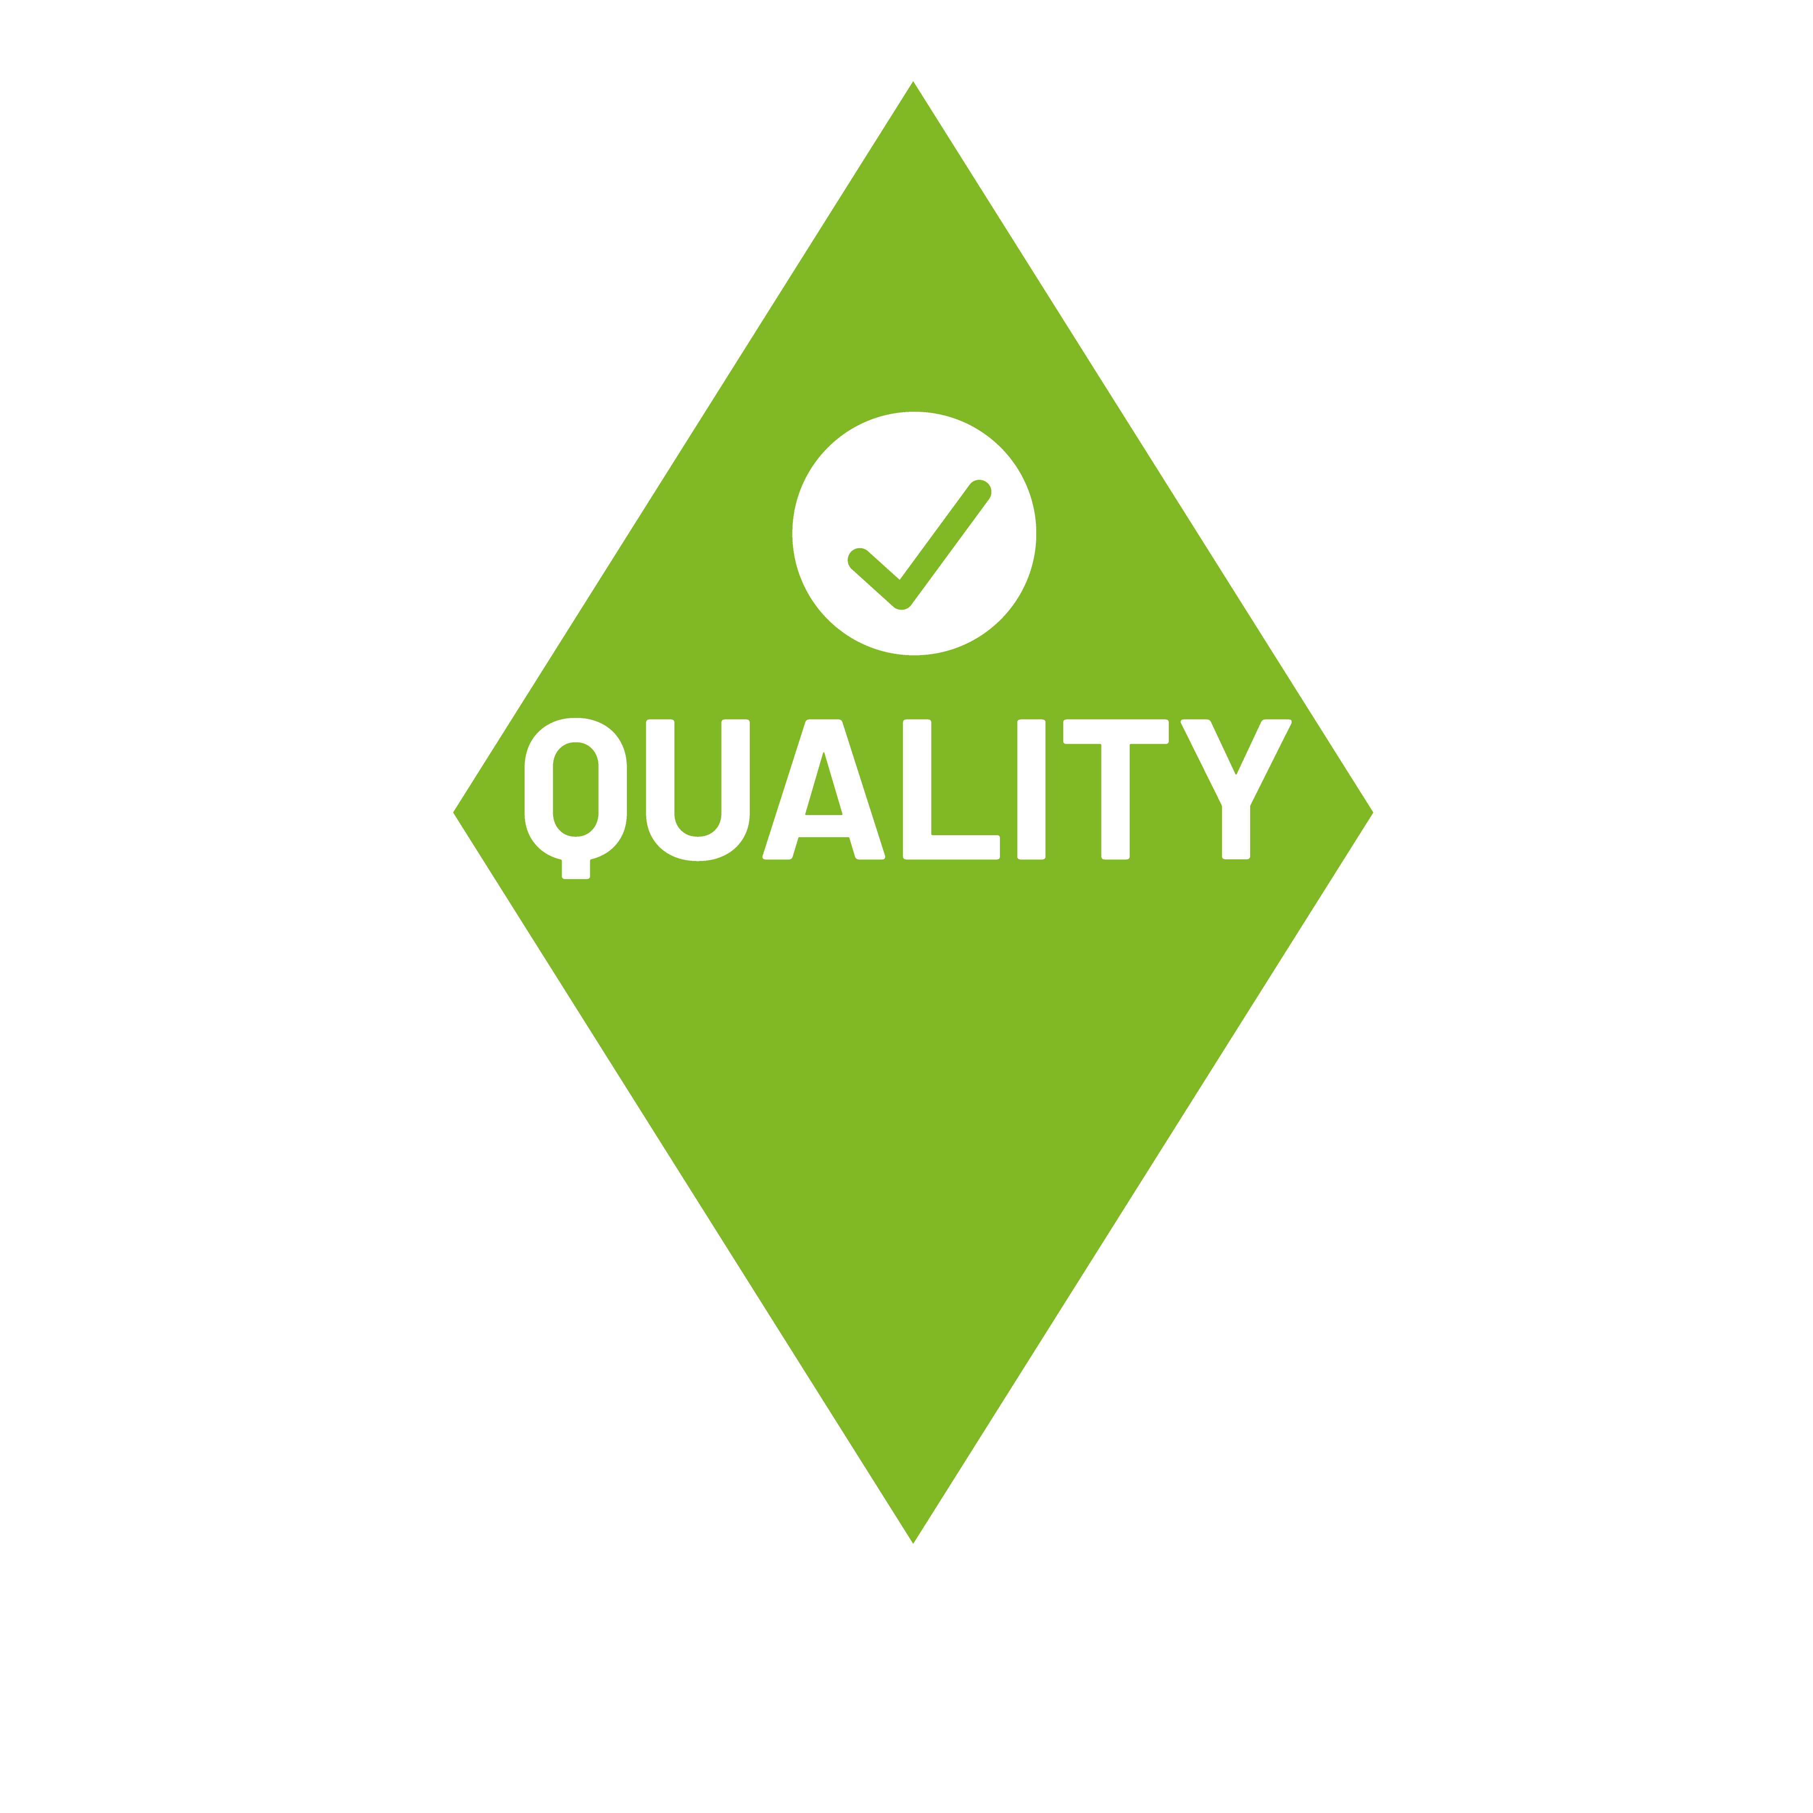



Journals participating in this model have the following:
Peer-review and editorial quality
Open Access policy free of publishing or processing costs (APC)
A vision to overcome the current assessment of science based on the Impact Factor aligned to the Declaration on Research Assessment (DORA)
Digital publishing technology
(XML JATS)

Slide 6
21 participating institutions
31 publisher institutions of participating journals
57 journals online, 130 in process
60.006 full-text articles
869 journal in AURA
656 Redalyc journals retrievable through AmeliCA
2.780 Retrievable books through AmeliCA
207 trained people in AmeliCA XML from 166 journals from 15 countries
342 members in OJS Community

Slide 7


1360
indexed journals
23
countries
644
Publisher institutions
0.7 Million
Full-text articles
11 million
article downloads per month
65.000
Redalyc daily users
1.8 million authors from
10.000 institutions

Slide 8
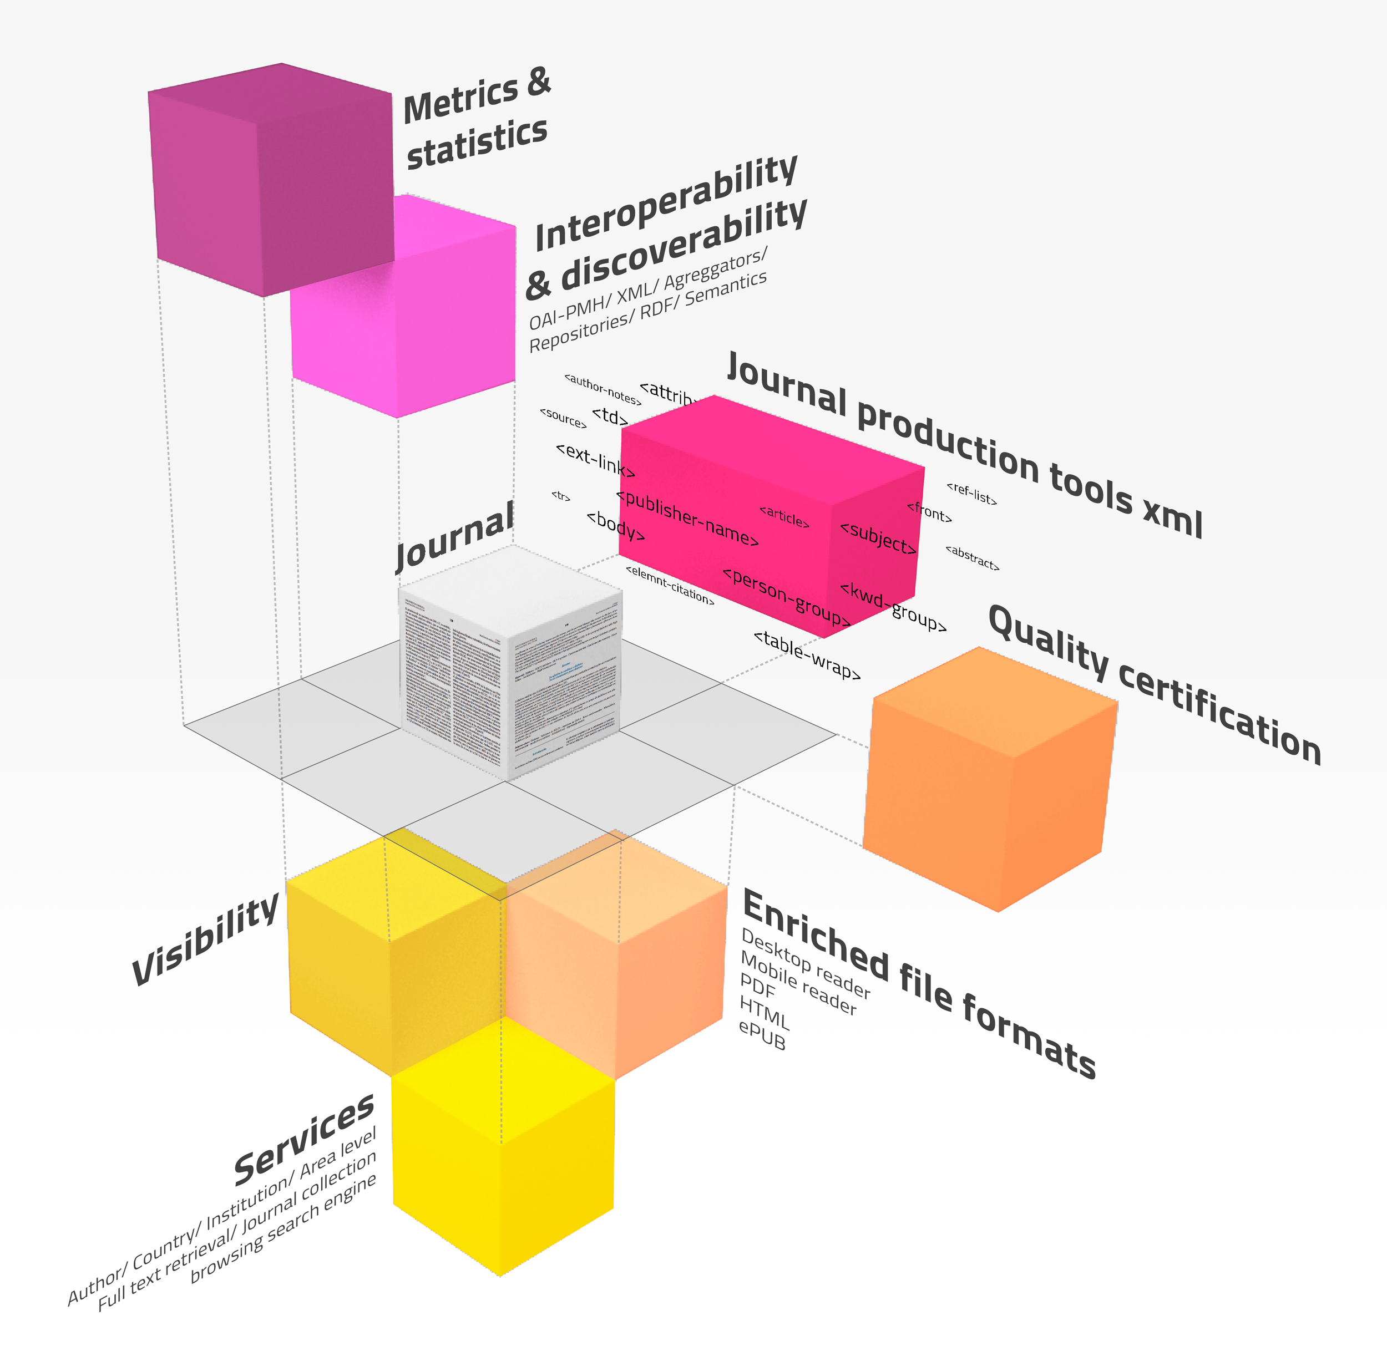
A model for journal visibility, quality improvement, production tools (XML, PDF, HTML, ePUB, desktop & mobile readers)

Slide 9
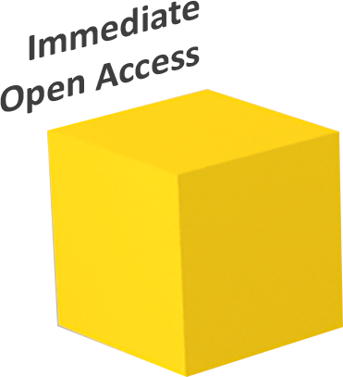
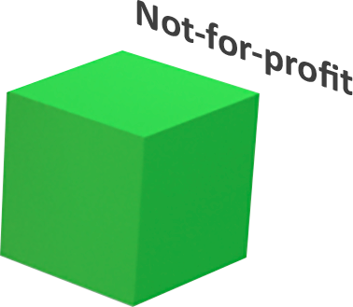
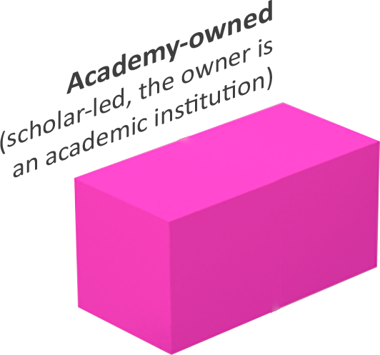

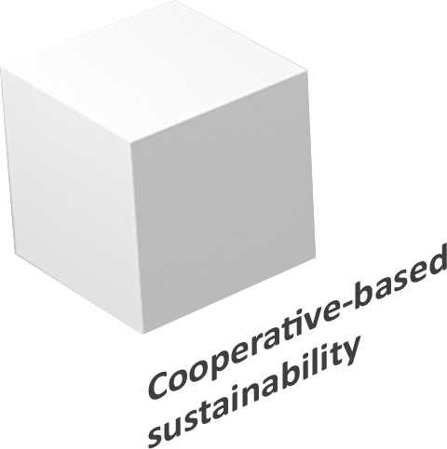
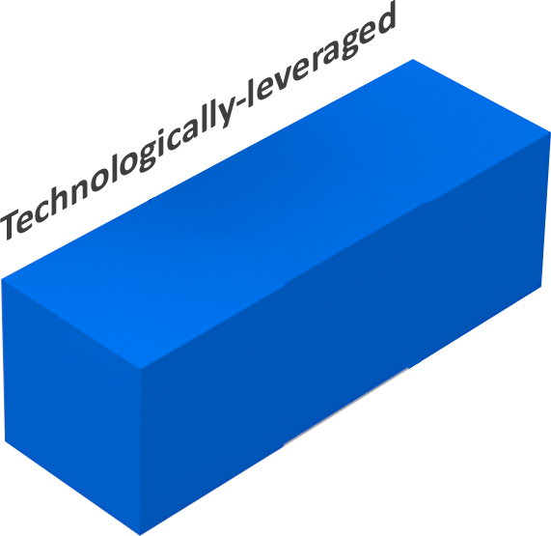
An approach to
science as commons

Slide 10












Traditional Article Processing
Accepted
article
InDesign formation
Electronic version
XML markup
Upload
Printed version
50 - 60 EUR / article
11 - 13 hr / article
Article Processing with Redalyc/AmelicA as infrastructure
Accepted
article
Files automatically generated
XML markup
Printed version
Upload
6 -7 EUR / article
2 - 2.5 hr / article
89%
Cost savings

Slide 11
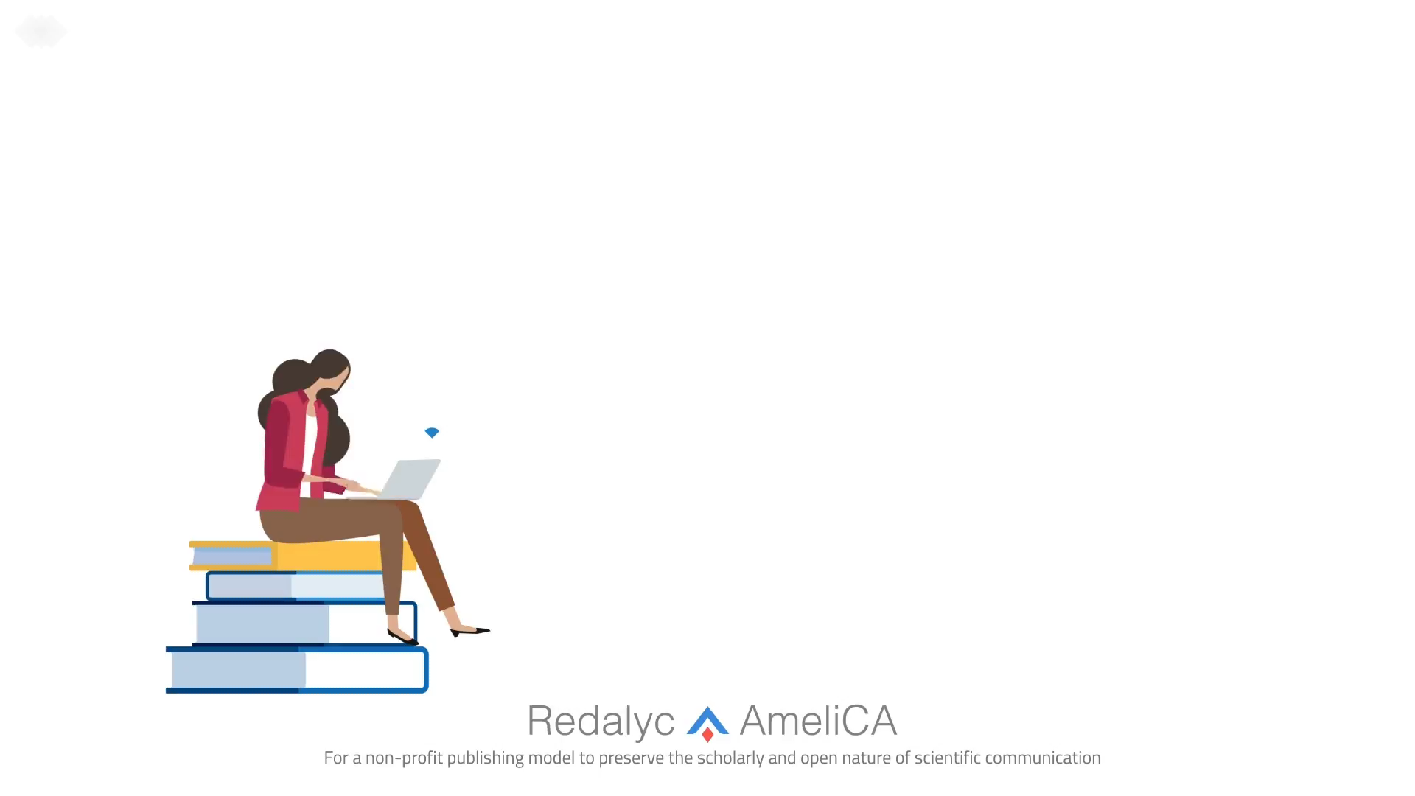

Slide 12
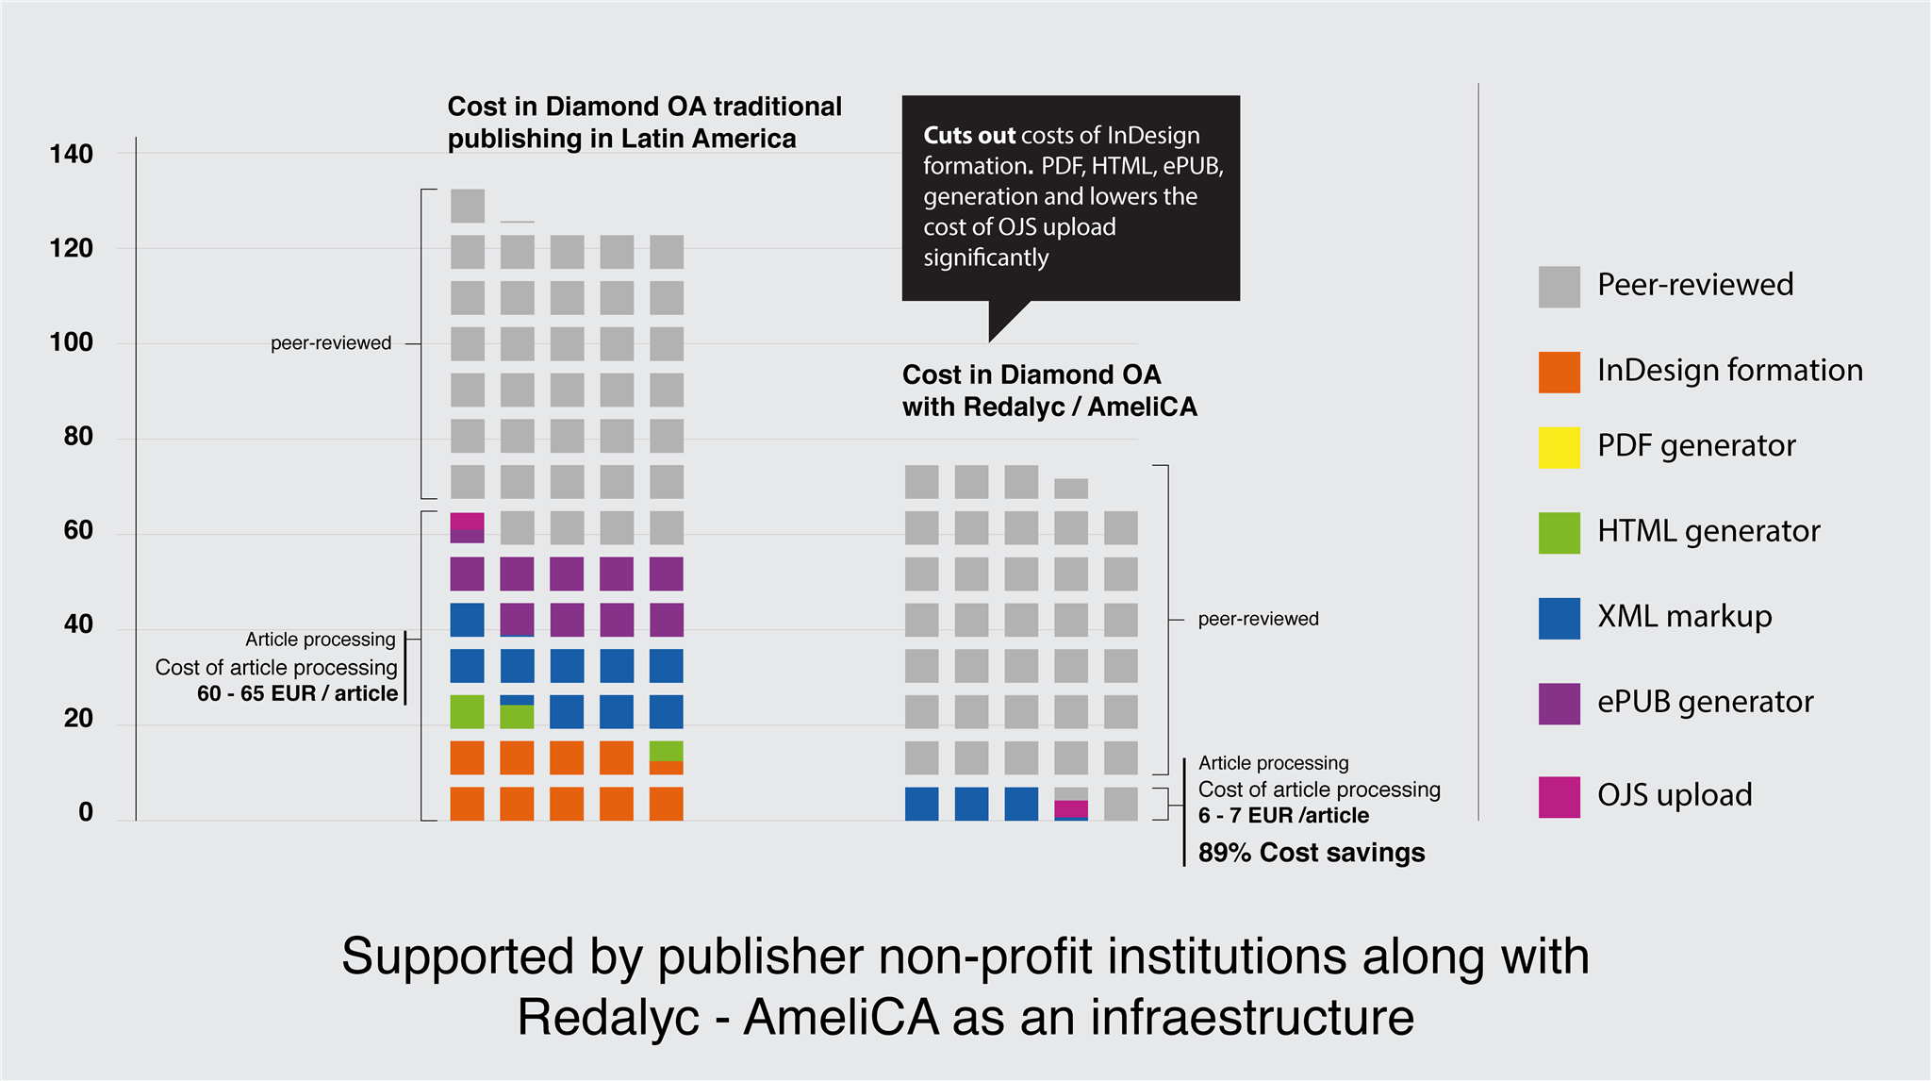

Slide 13
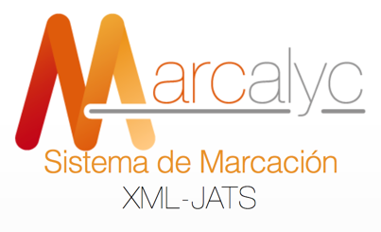
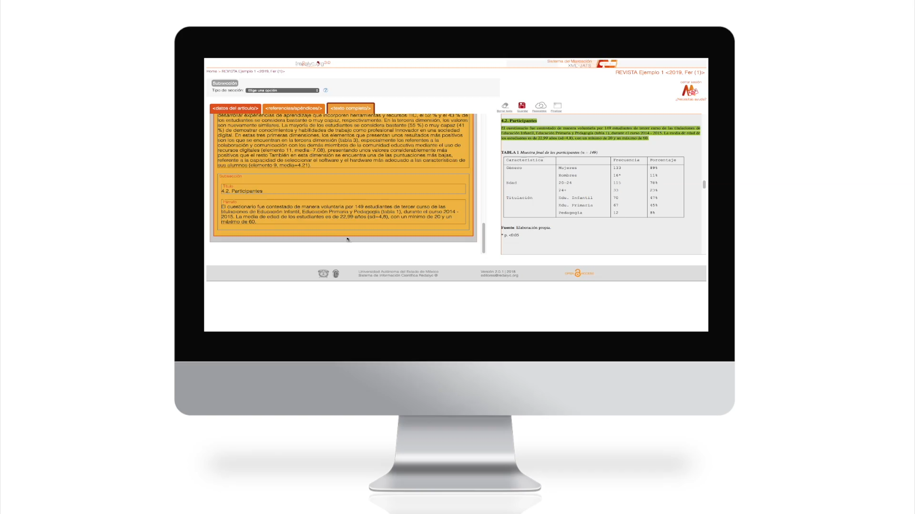

Replicability
necessary condition in science
Mathematical expressions tagging with MathML
XML tagging of tables and data
XML tagging of annexes and supplementary material
Open Data

Slide 14
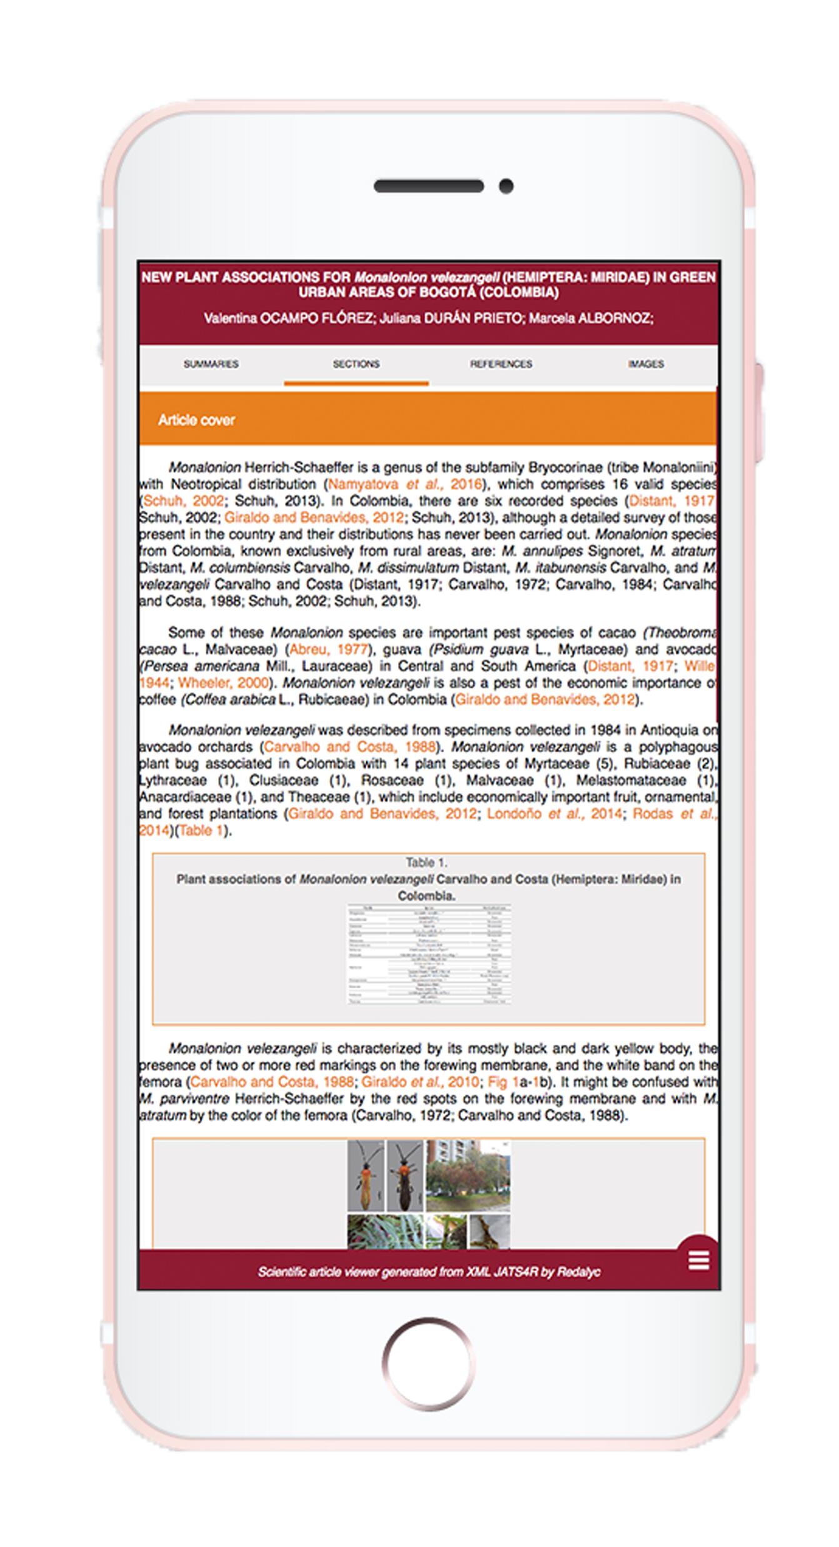
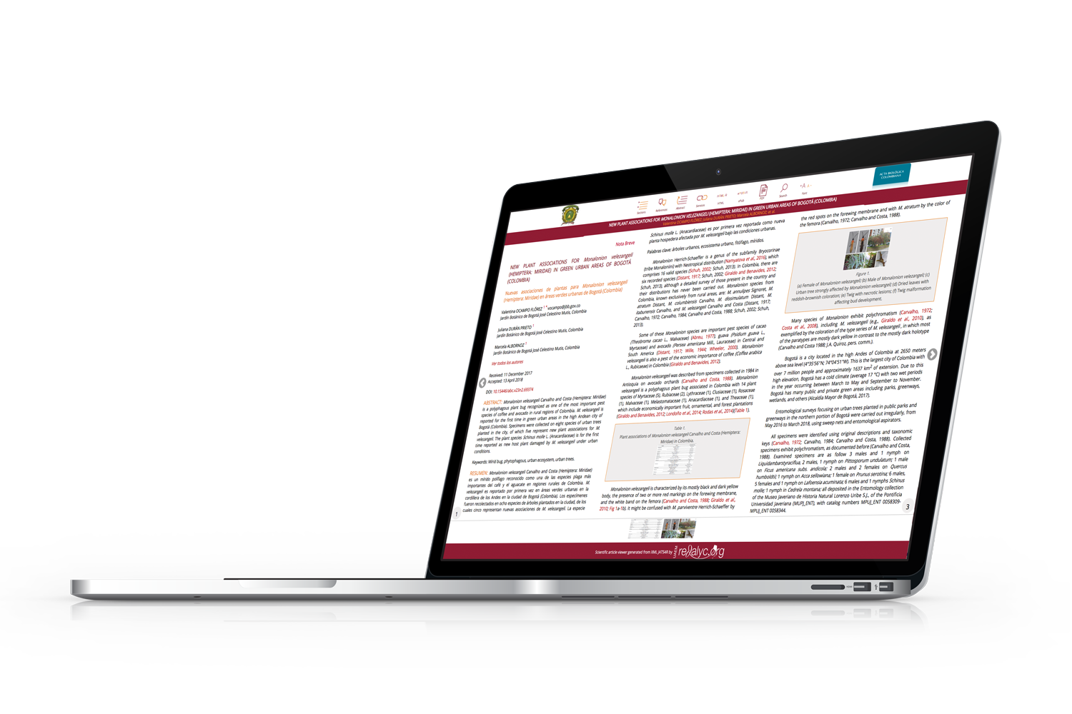
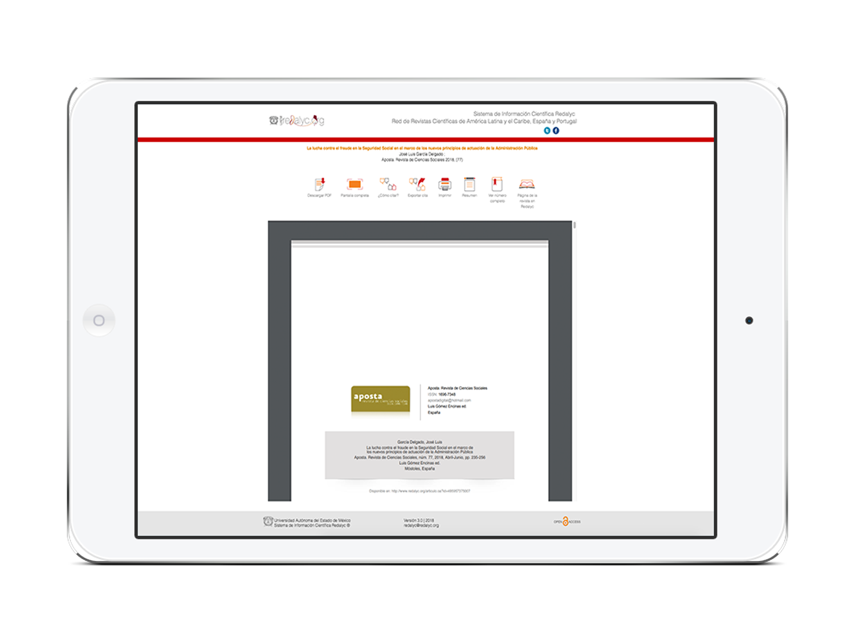
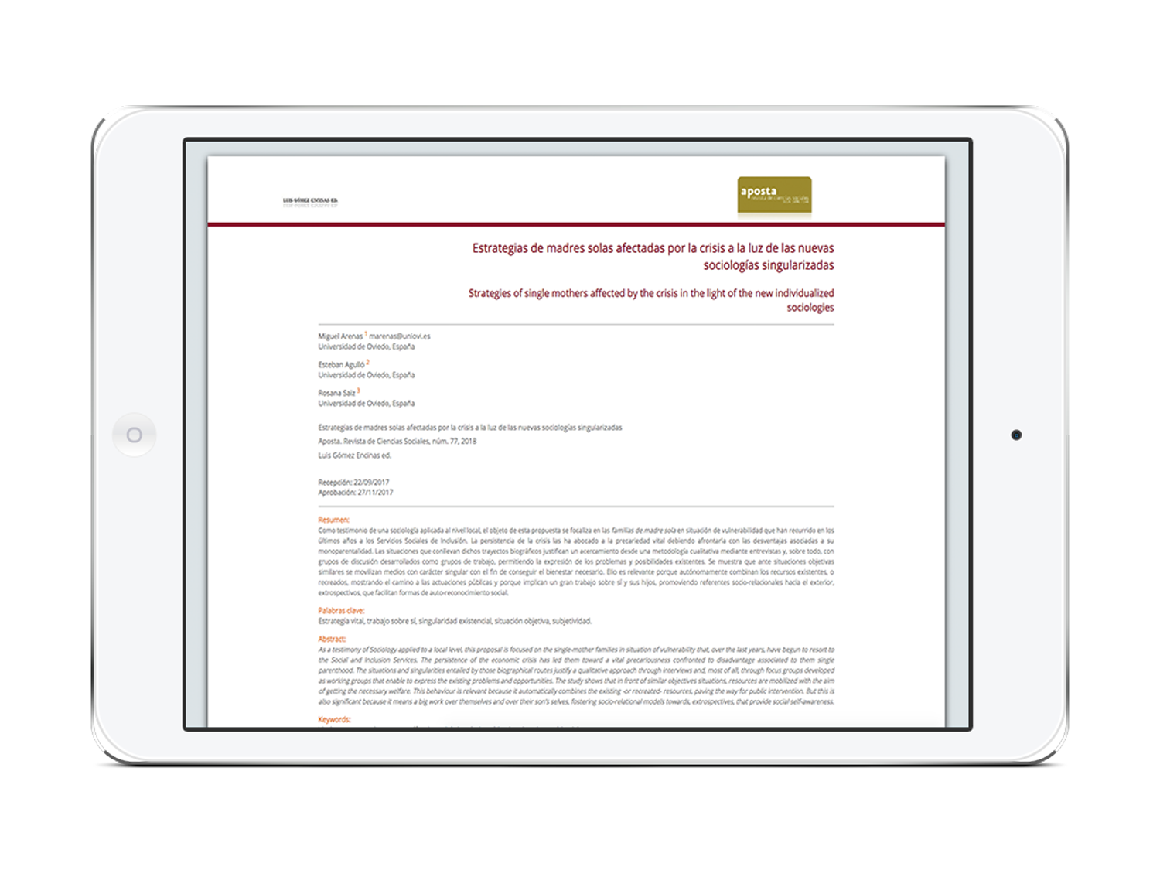
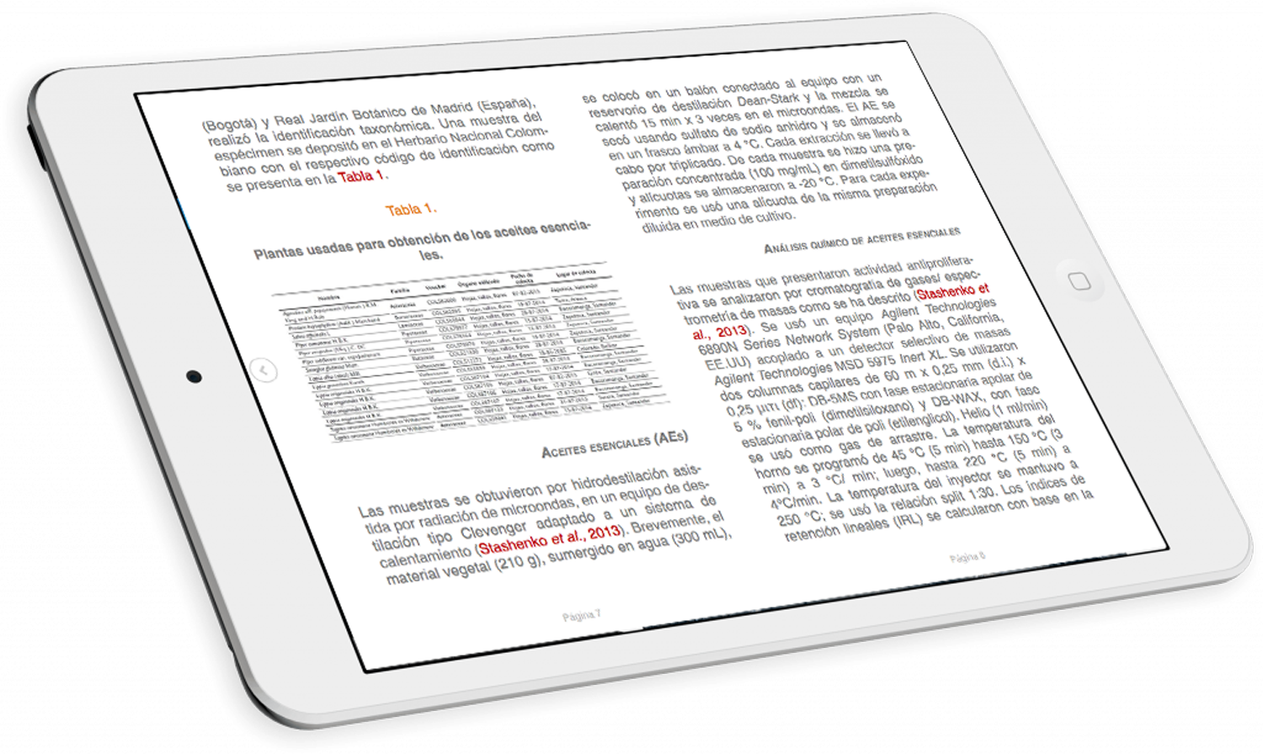
Interactive
article reader
PDF
ePUB
Mobile article
reader
HTML
XML JATS 4R

Slide 15
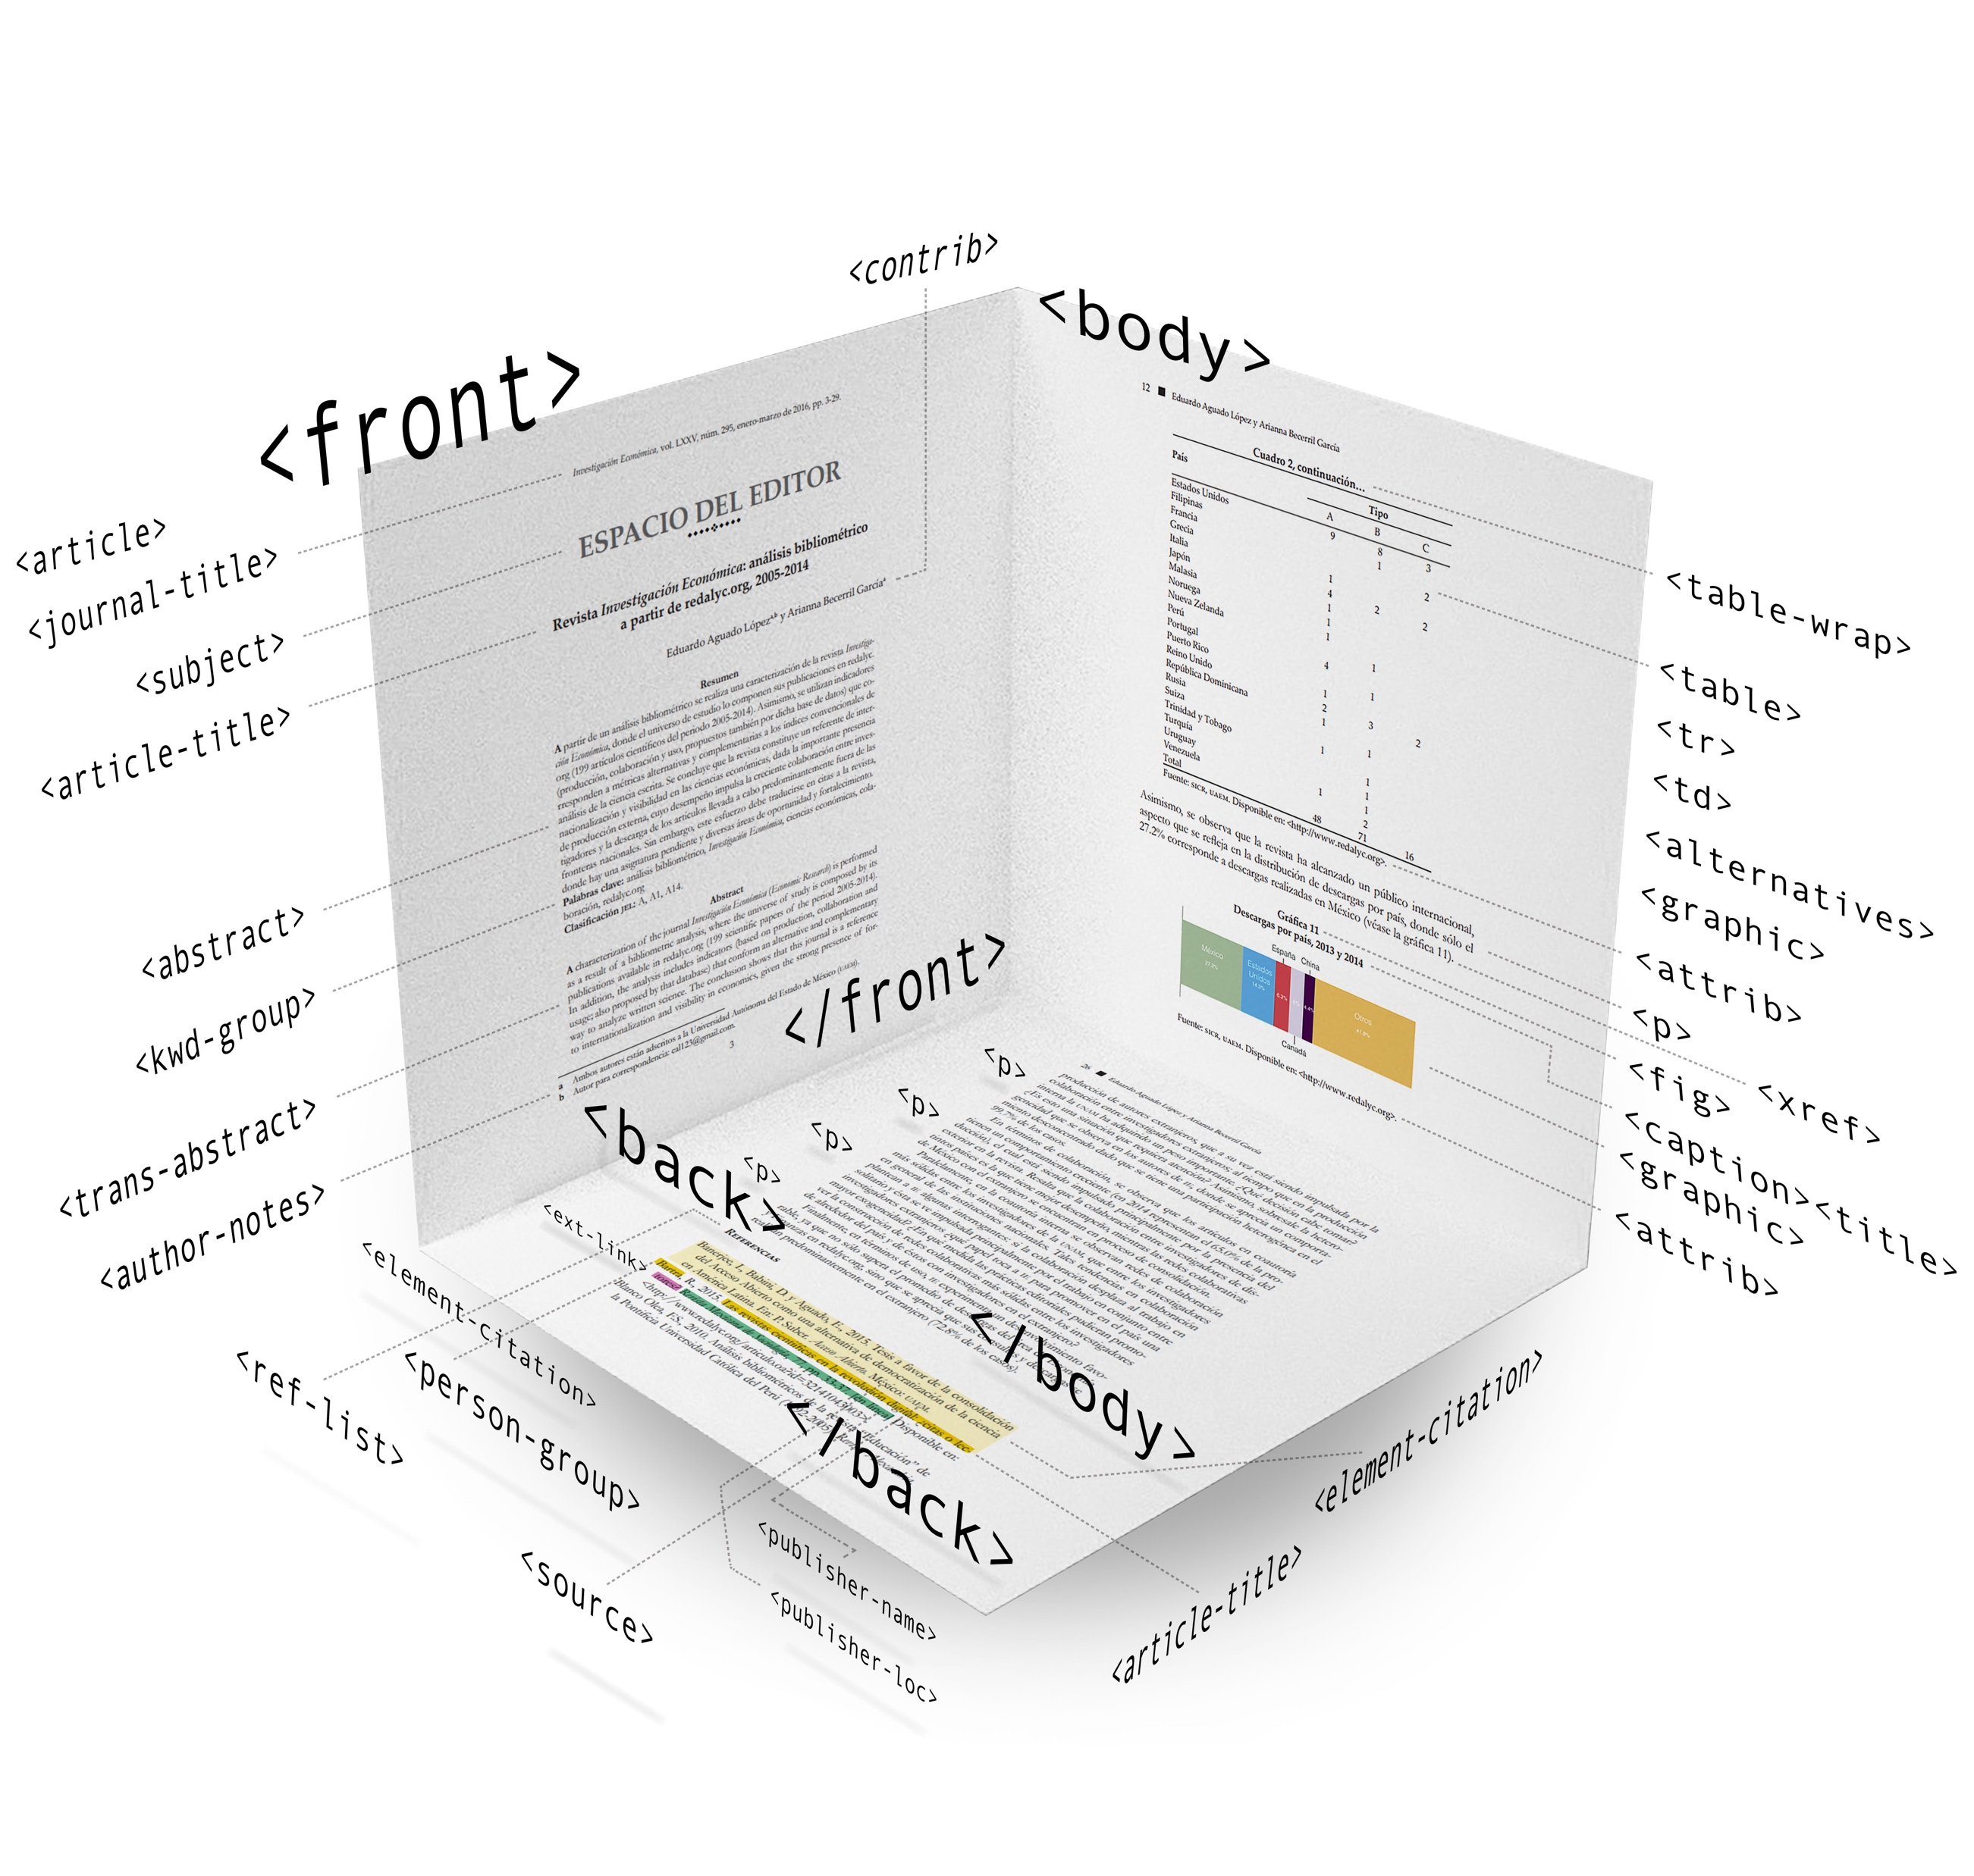
Organic visibility, discoverability and impact of science

Slide 16
The potential of Redalyc/AmeliCA model
Open data
Knowledge Discovery
Semantic web
XML
Linked data
Ubiquity
Artificial Intelligence
Technology
for a participatory and inclusive scholarly communications

Slide 17
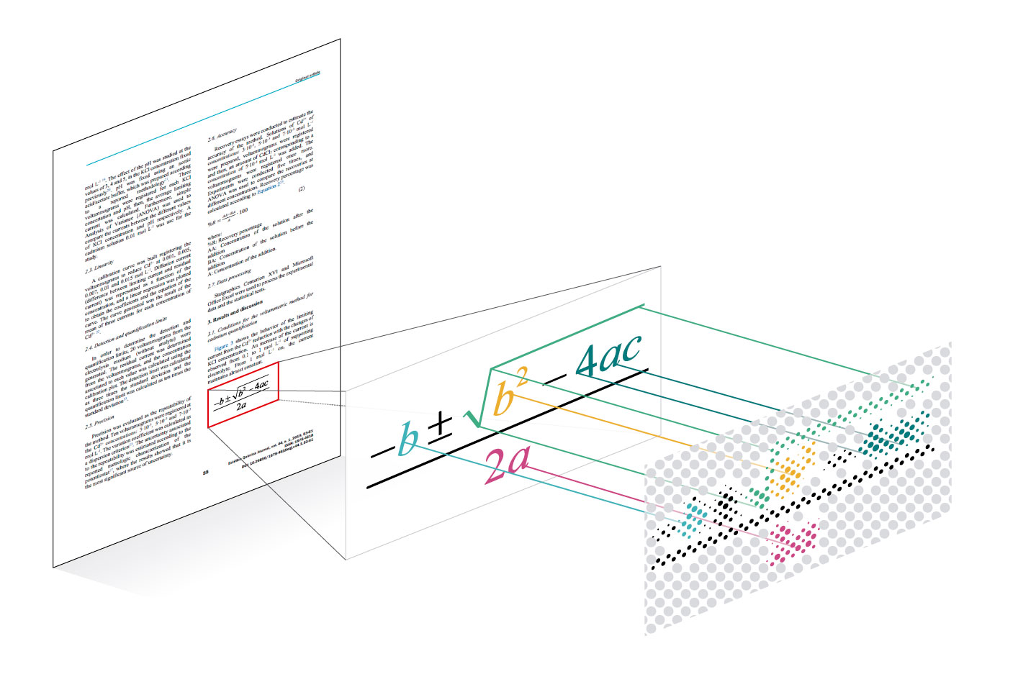
Every single piece of information could be part of a giant graph

Slide 18
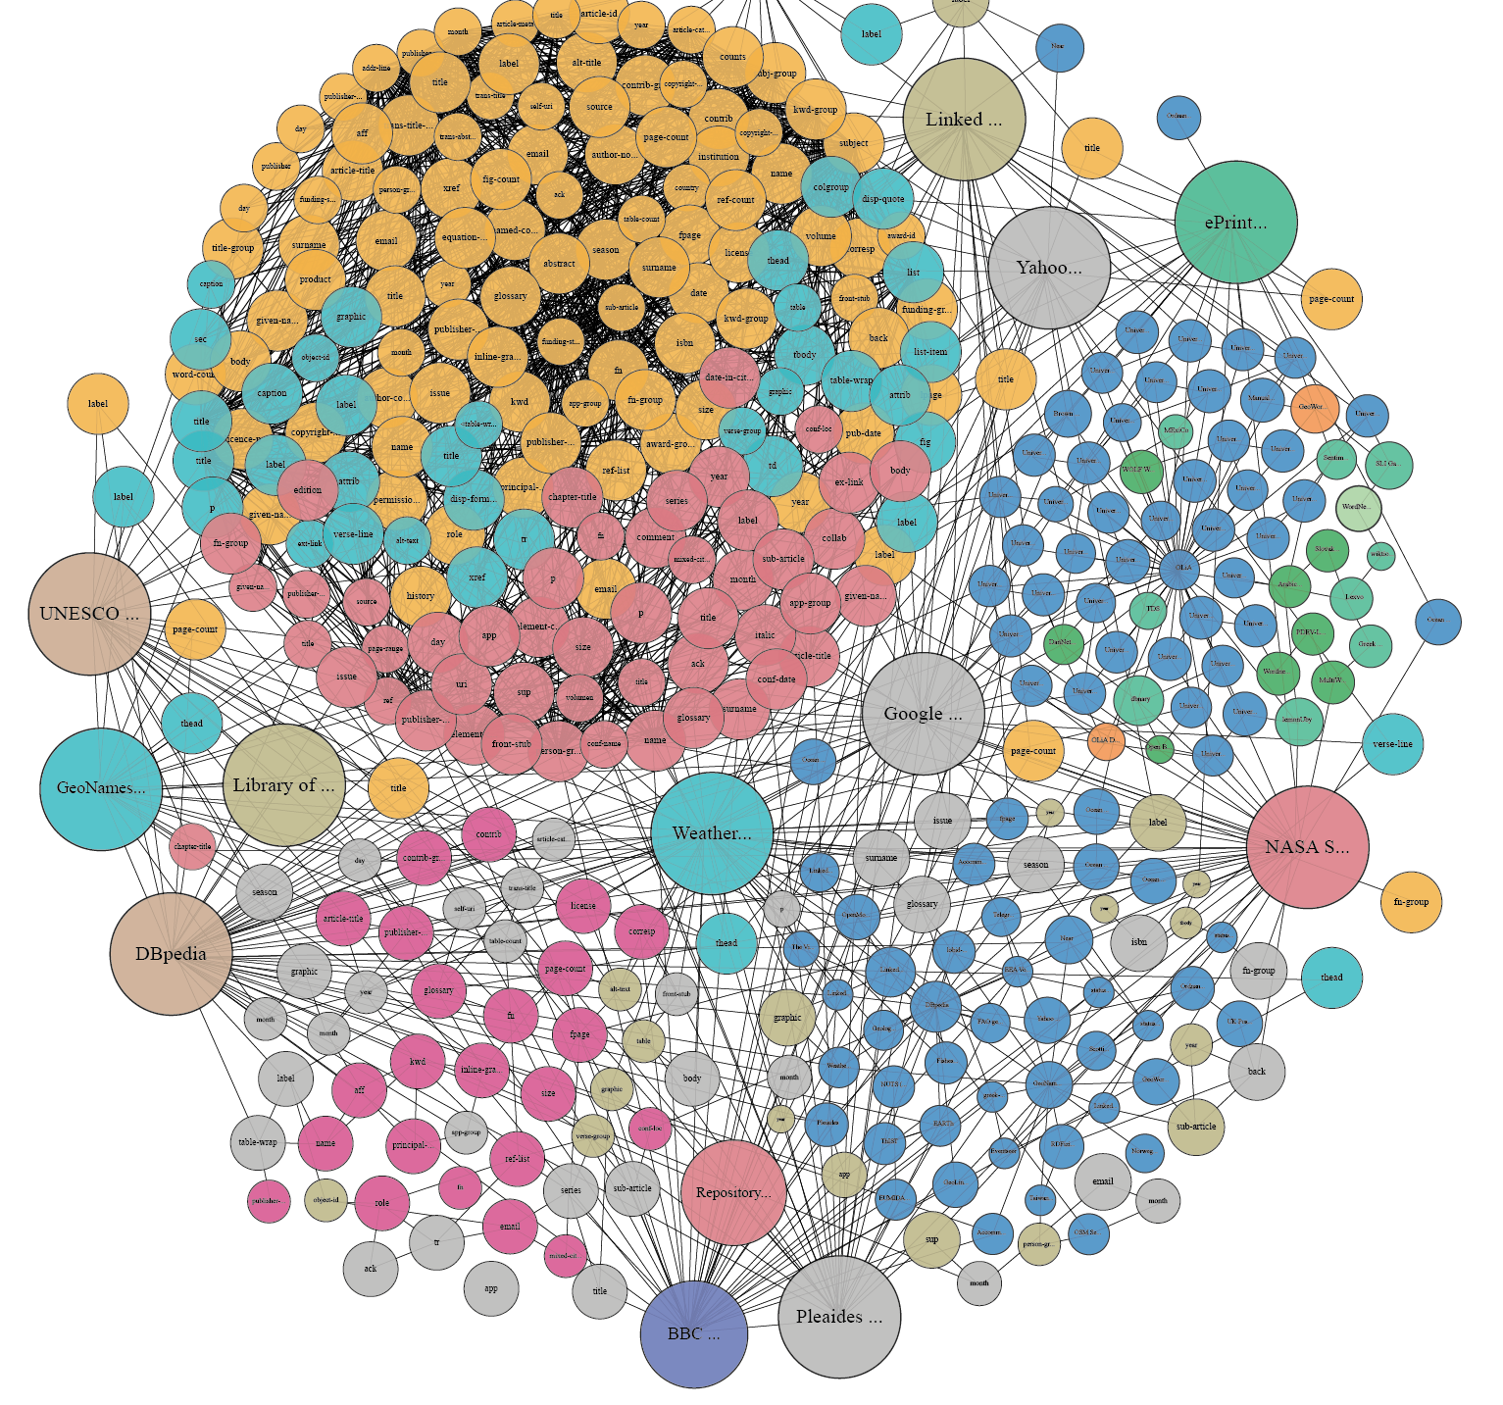
to compose a structure that expresses the inherent knowledge and to be linked to a wider and unrestricted knowledge cloud

Slide 19
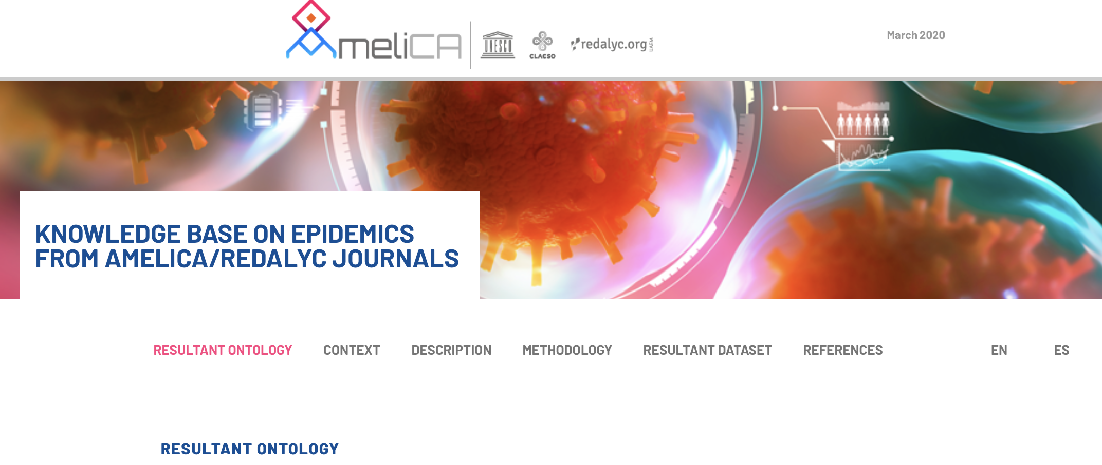
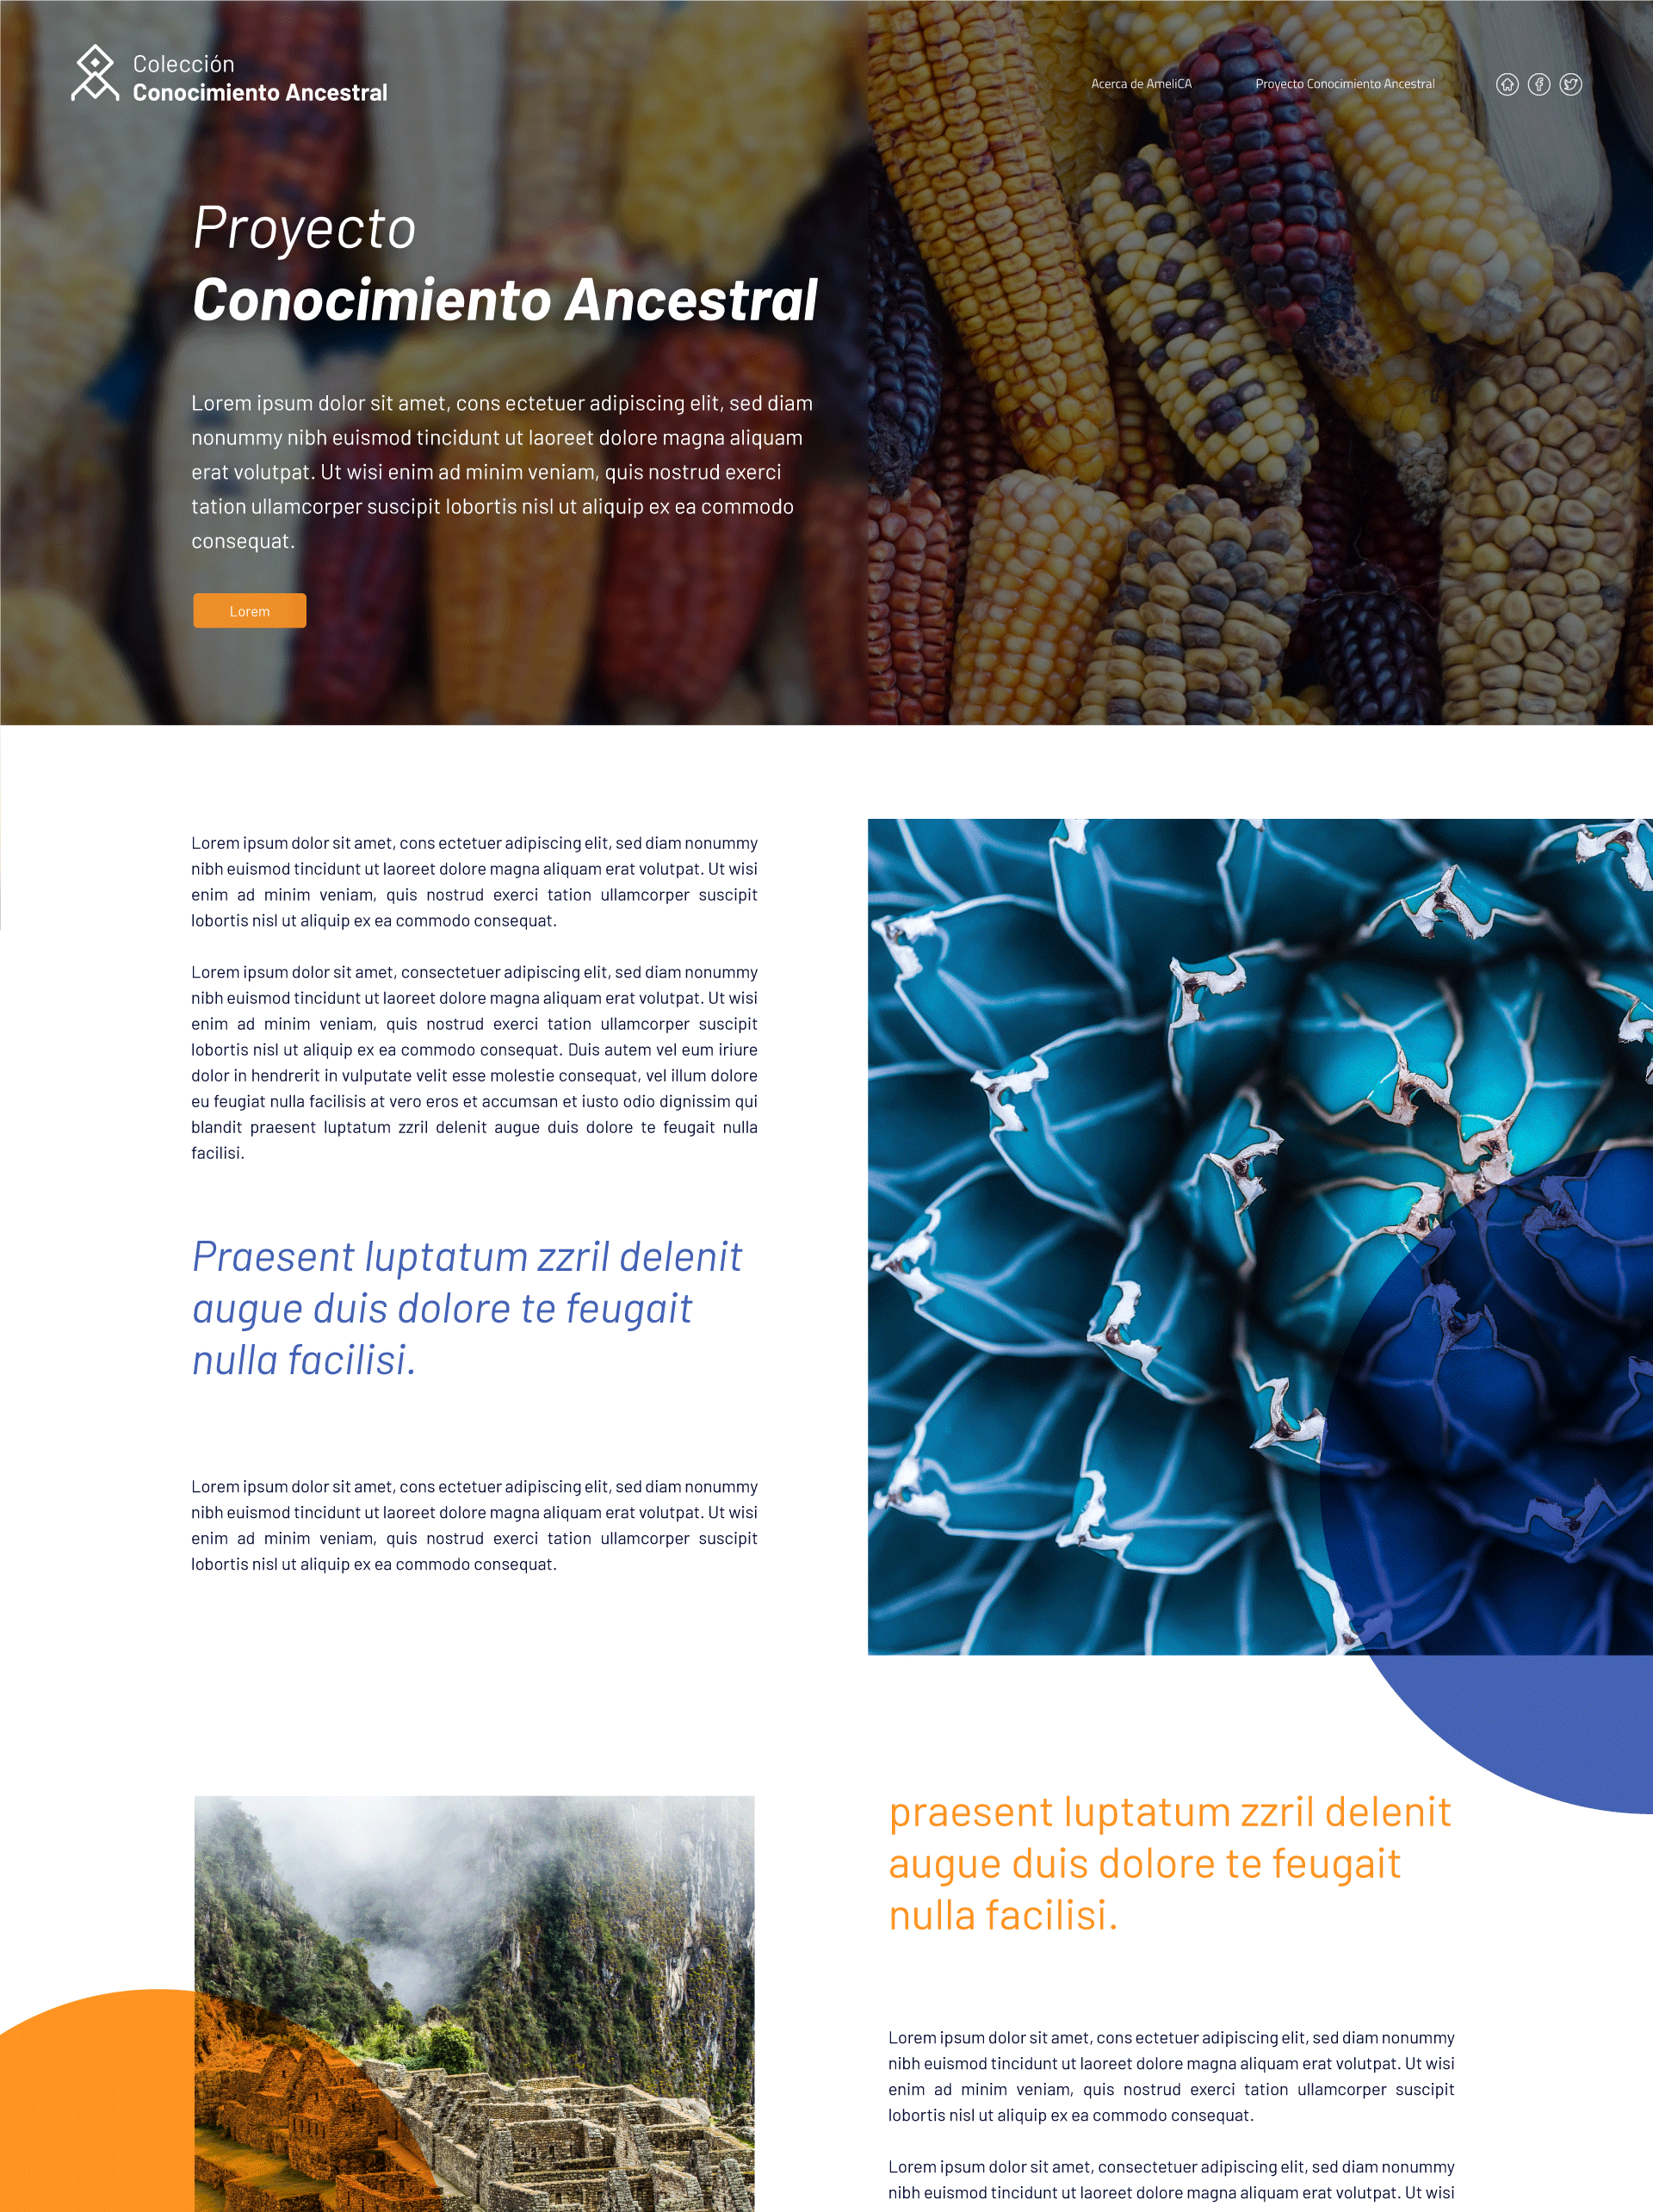
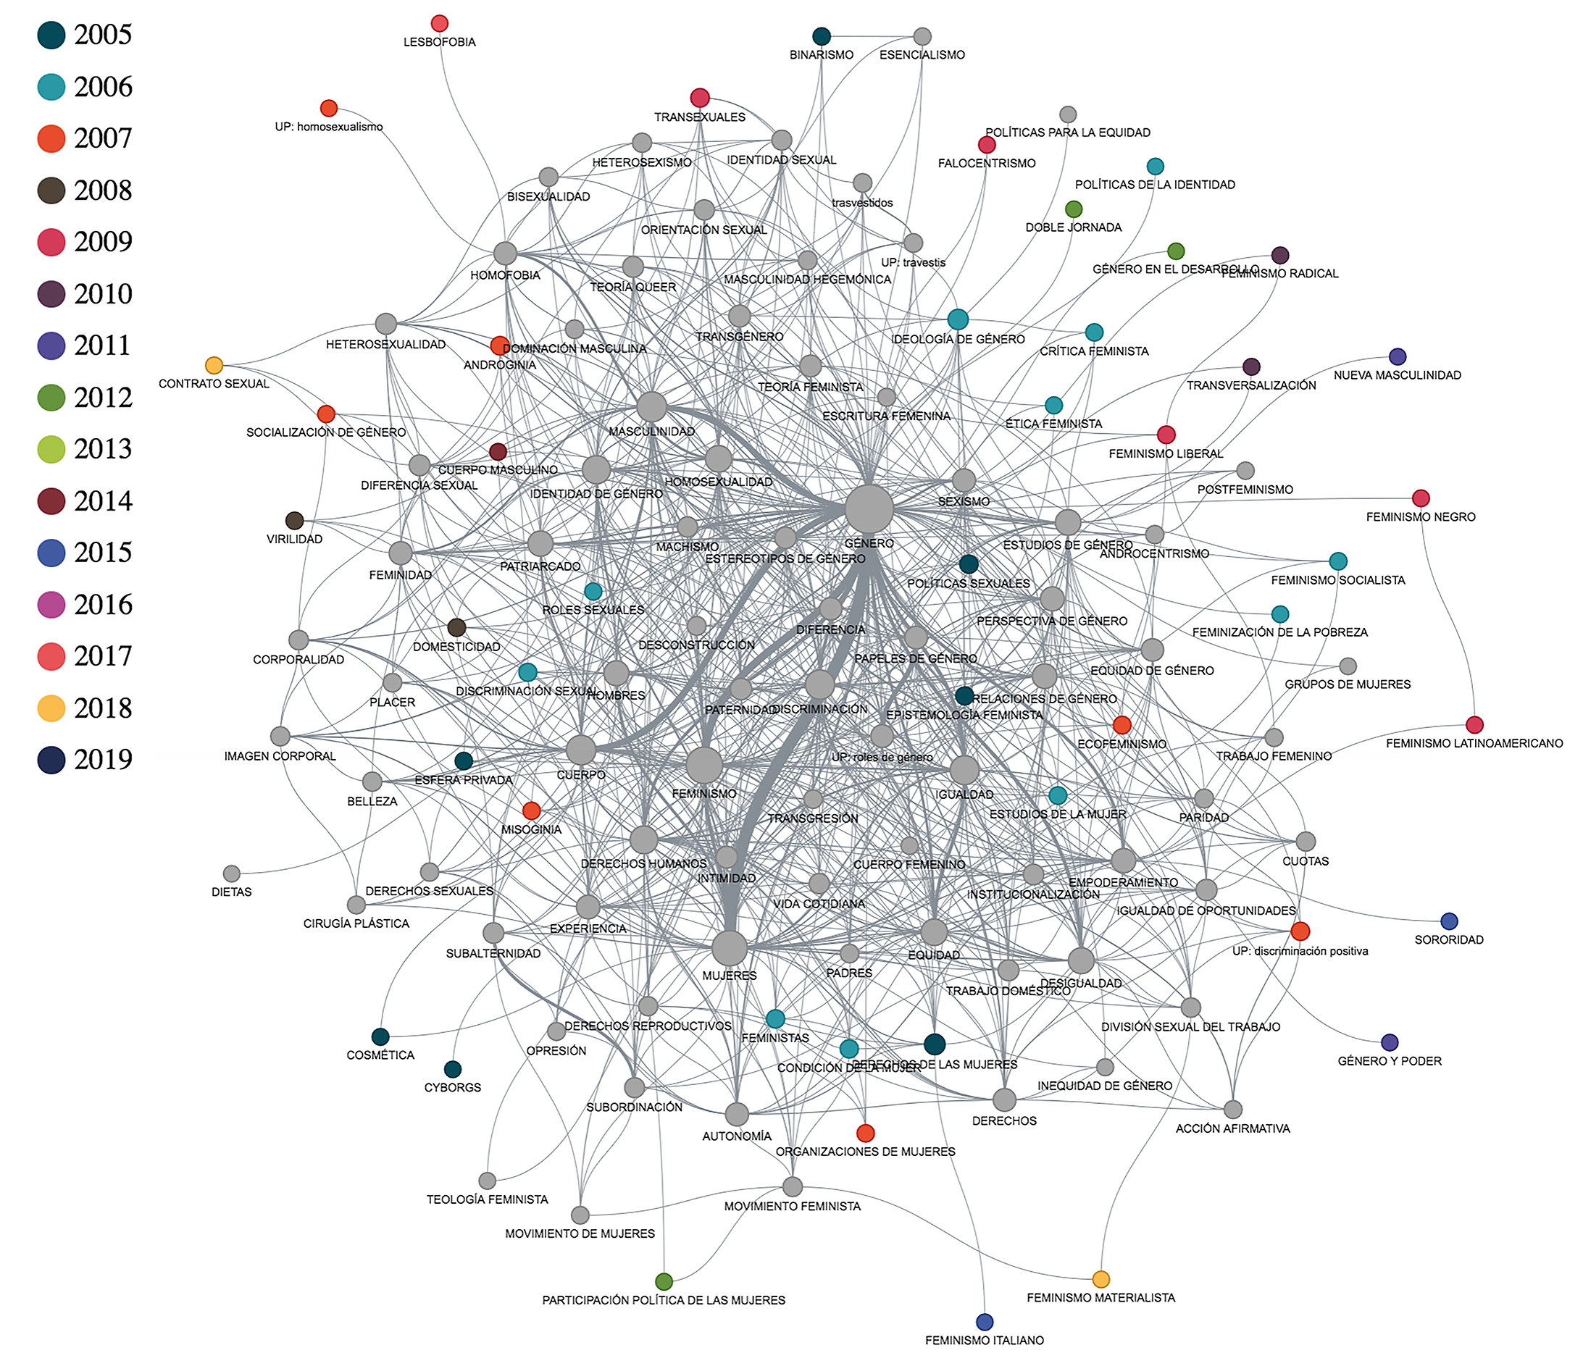
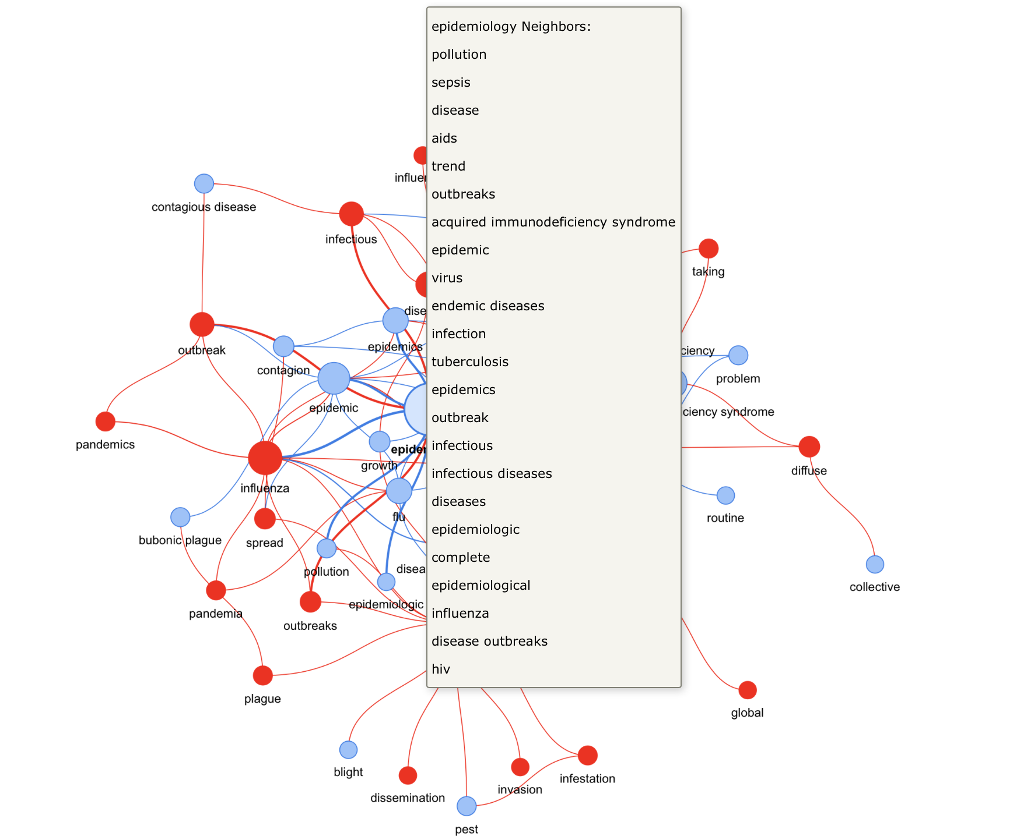
Use cases on Linked Open Data & semantics
COVID-19 – Knowledge base on epidemics
Knowledge base on ancestral knowledge
Knowledge base on genre studies

Slide 20
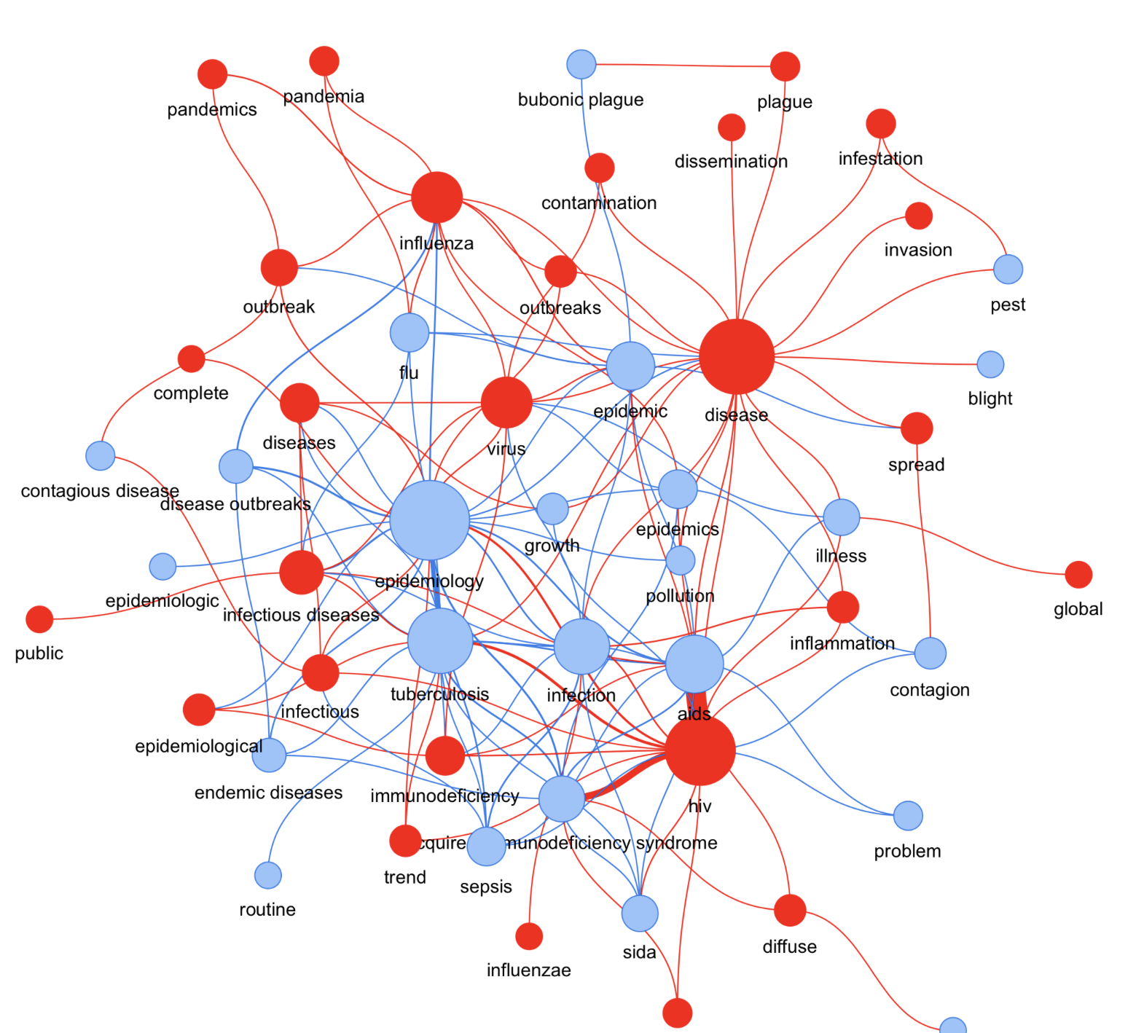
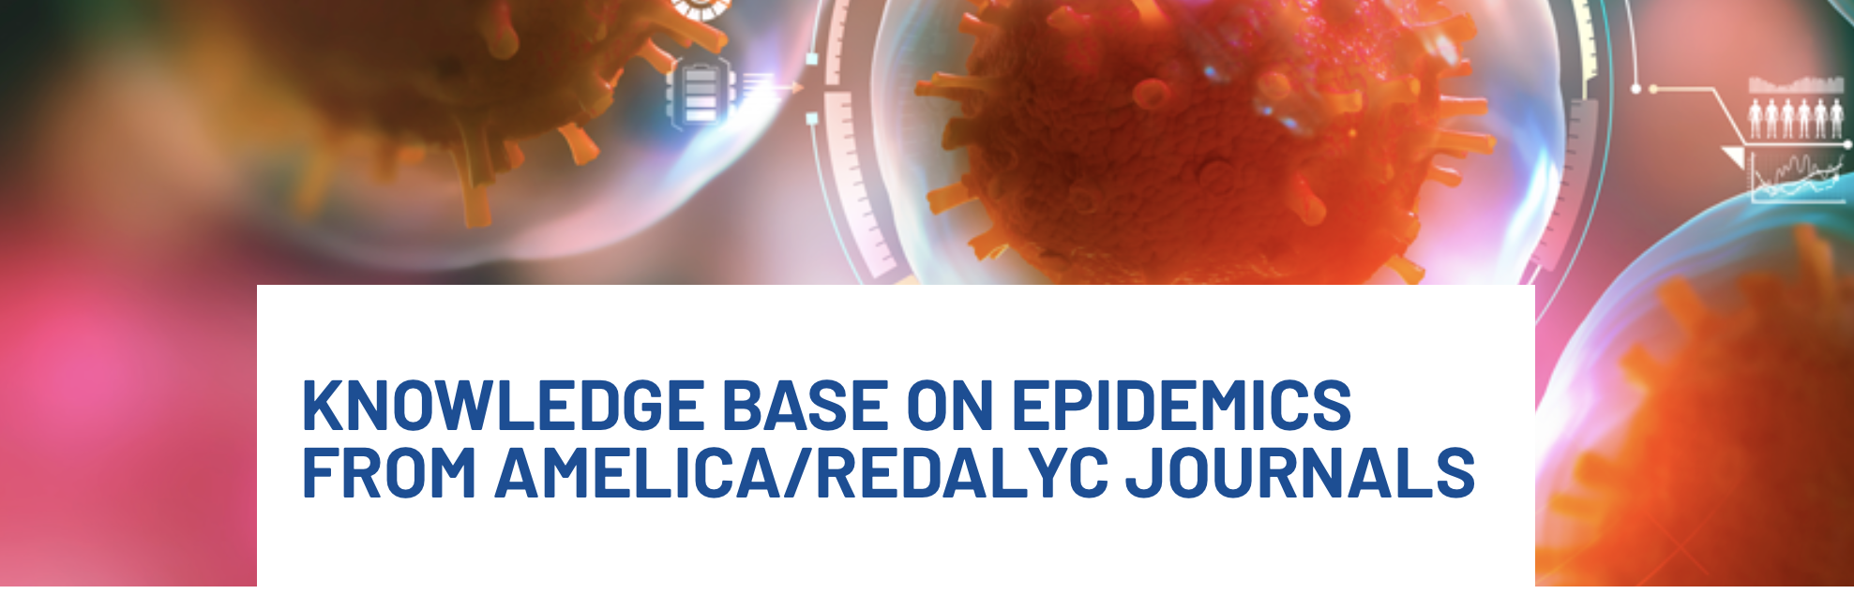
RESULTANT ONTOLOGY
AI-based classification of information
Knowledge representation on Epidemics/Pandemic
Semantic content browser

Slide 21
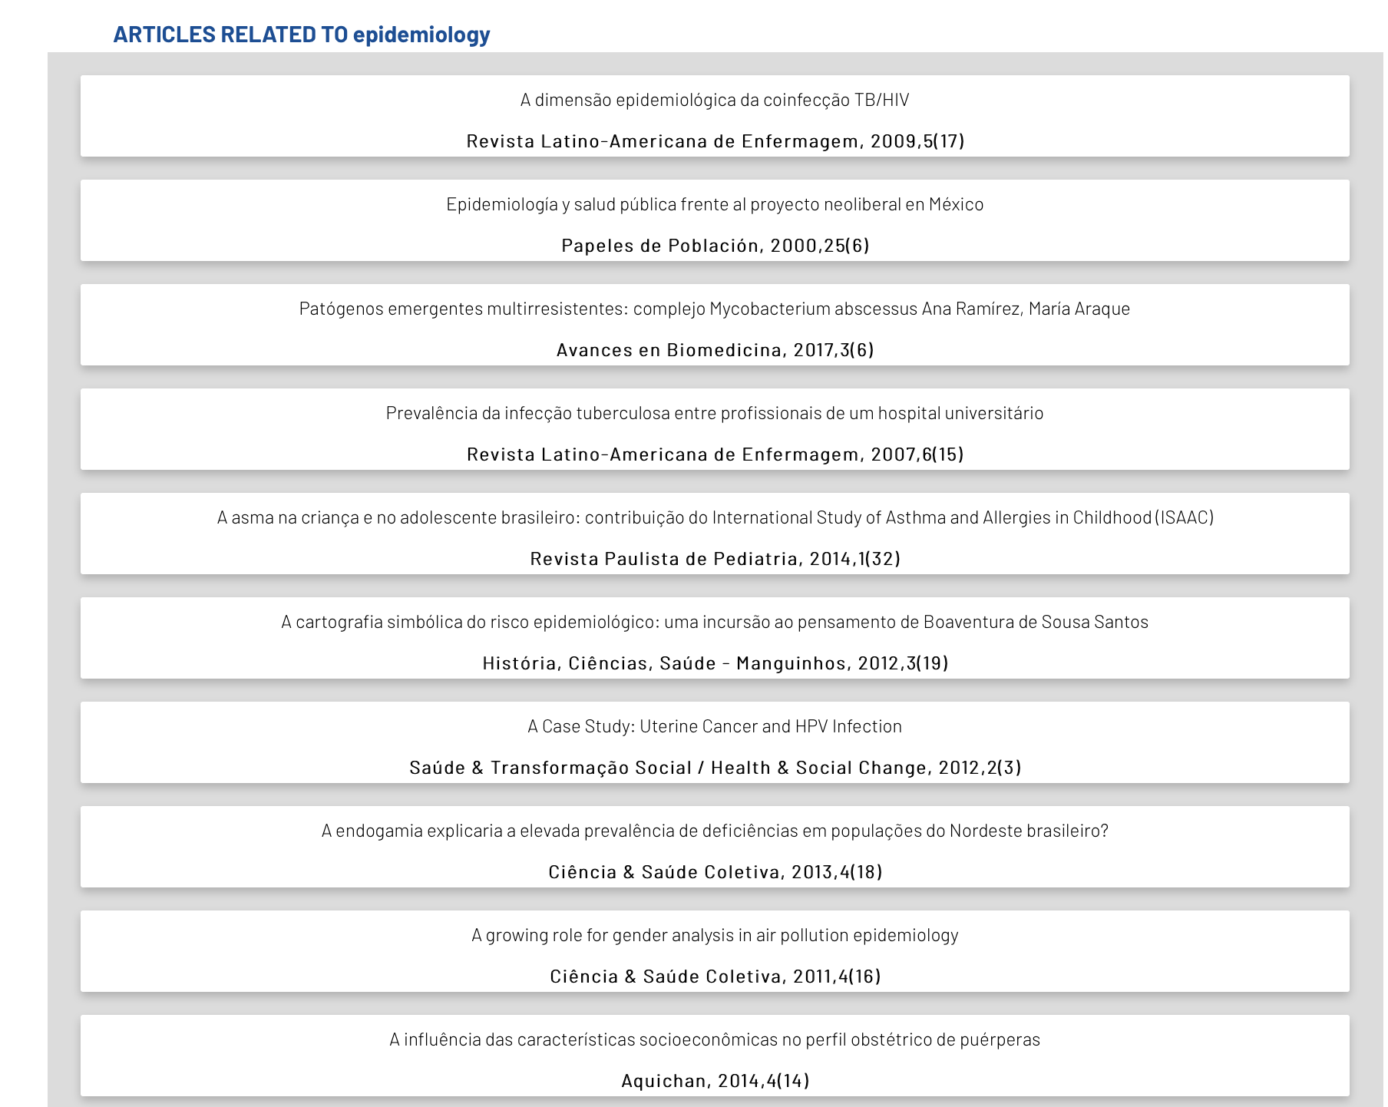

Slide 22
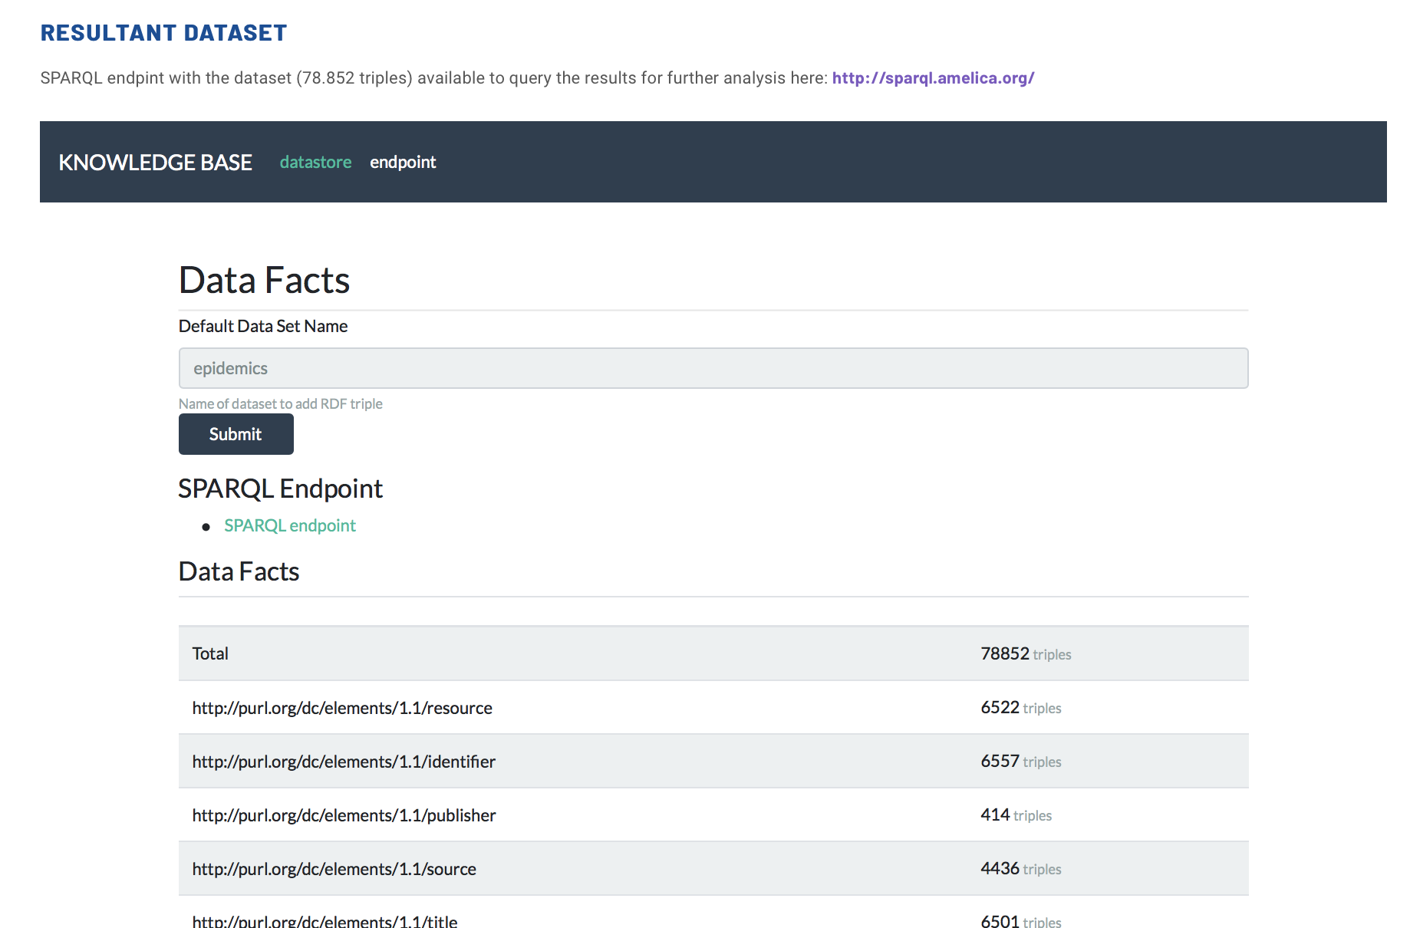

Slide 23
Final thoughts
  Lessons learned from Latin America:
    It is possible to run journal publishing on a not-for-profit basis (non-APC)
    In a cooperative approach everyone gets benefit from everyone’s investment. A distribution of costs among many stakeholders: universities, academic institutions, governments, national science agencies, hospital, funders.
    Journal publishing in hands of the academic sector promotes more inclusive scholarly communications.
  AmeliCA & Redalyc focus their efforts on preserving academy-owned non-commercial publishing
    By leveraging technologies (AI, semantics) to contribute in journal sustainability to prevent the adoption of for-profit business models.
    By developing software and enhancing data to contribute in content’s organic visibility & discoverability in such a way that impact and research assessment are dissociated from commercial databases.

Slide 24

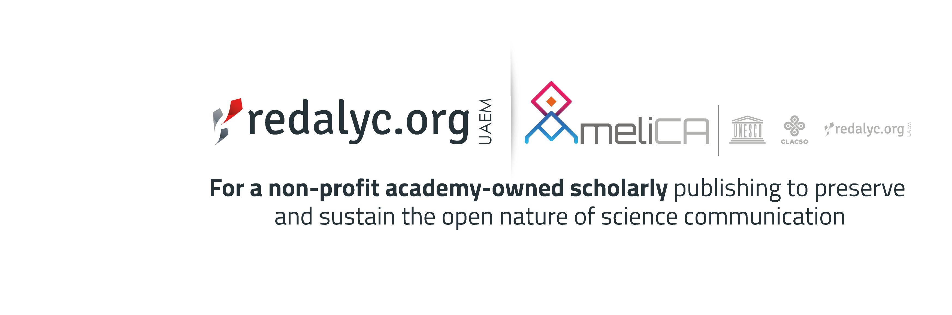

Thank you!
Arianna Becerril- García
arianna.becerril@gmail.com
http://www.redalyc.org/autor.oa?id=25
http://orcid.org/0000-0003-0278-8295
@ariannabec

