Slide 1

Journey of a thousand miles
How HD basic research feeds the clinical trial pipeline

Slide 2
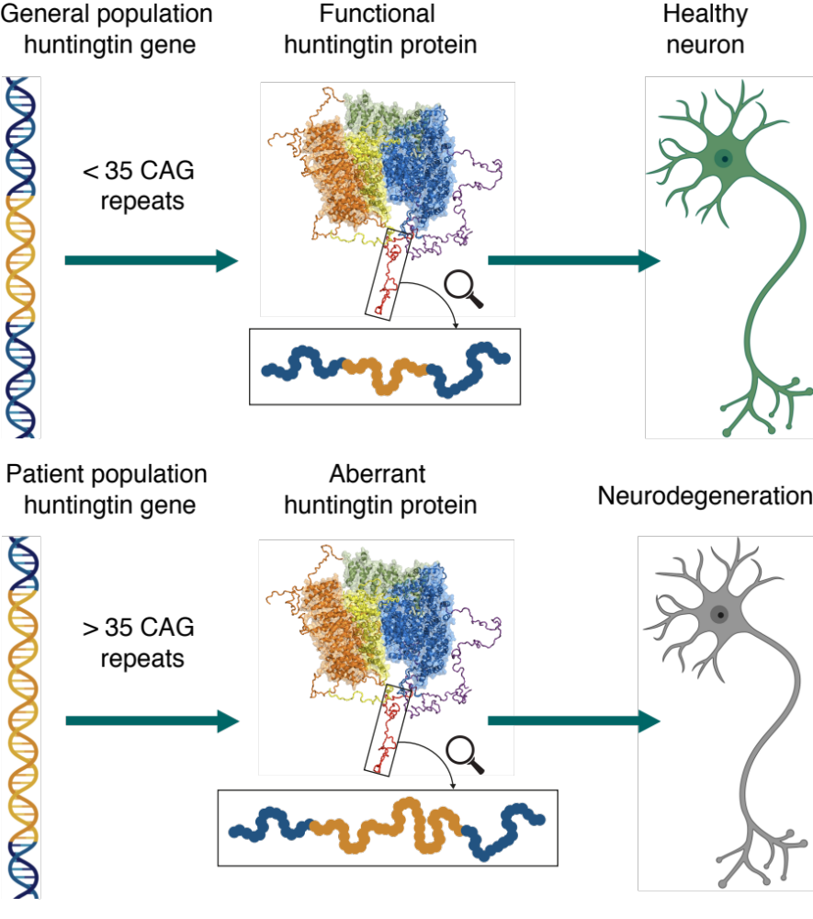




HD gene inheritance
50%
50%

Slide 3

From gene to protein
Huntingtin
protein
DNA
RNA

Slide 4
Unexpanded
huntingtin gene
Normal huntingtin
protein
Healthy nerve cells
Expanded
huntingtin gene
Expanded huntingtin
protein
Huntington’s disease

Slide 5
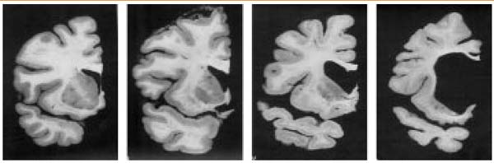
What really causes neurodegeneration?
Expanded huntingtin
protein
Loss of function?
Gain of toxic function?
Why do we care? Just find a treatment!
  Two approaches
Presymptomatic
HD
http://www.buckinstitute.org/site/index.php?option=com_content&task=view&id=41&Itemid=147

Slide 6

Turning off the toxic protein
Expanded huntingtin
protein
DNA
RNA

Slide 7



Multiple approaches to lowering huntingtin
  Antisense oligonucleotides (ASOs)
    Lumbar puncture delivery
    More precise dosing
    Transient (weeks/months)
    Can stop in case of adverse events
  RNAi (gene therapy)
    Intracranial delivery
    Permanent
  Small molecules
    Oral delivery

Slide 8
Clinical trials: recent, current, upcoming
Huntingtin-lowering
IONIS-HTTRx
IONIS-HTTRx OLE
GENERATION-HD1
PRECISION-HD1/2
UniQure gene therapy
PTC small molecule
Observational
Neuroinflammation
LEGATO
Symptom alleviation
SIGNAL
Enroll-HD
HD Clarity
HD Natural History
FIRST-HD and ARC-HD
ExAblate
HART and PRIDE-HD

Slide 9
Working out what the huntingtin protein does is difficult
It’s huge
The huntingtin protein is 7 times larger than the average human protein
It’s very sticky
The huntingtin protein is reported to bind to 100s of different molecules
It’s very pesky
Lot’s of our normal tricks in the lab just don’t work for the huntingtin gene and protein

Slide 10
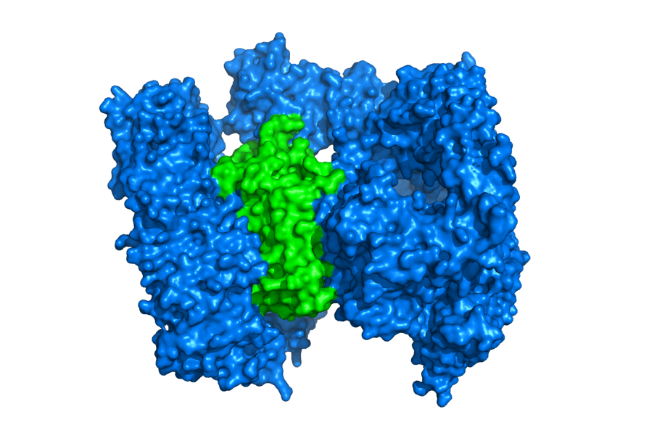
What does the huntingtin protein do?
Huntingtin
protein

Slide 11
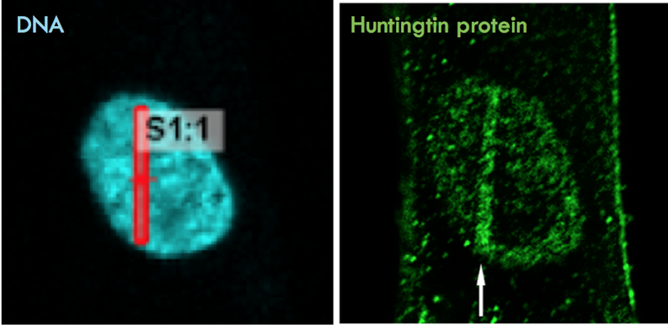



Huntingtin moves to damaged DNA
DNA repair proteins
Huntingtin
protein
High power laser stripe damages DNA

Slide 12


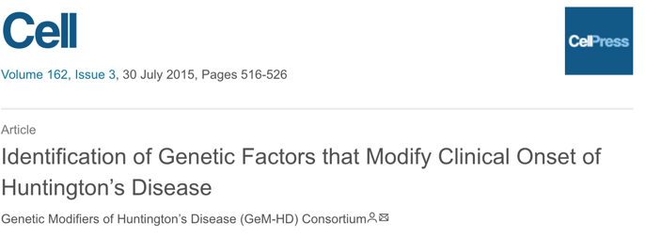
A Major Clue
GENOME WIDE ASSOCIATION STUDY
implicates
“DNA handling and repair mechanisms”
42 CAG repeats
Symptoms early in life
42 CAG repeats
Symptoms late in life
https://en.hdbuzz.net/200
https://en.hdbuzz.net/217

Slide 13
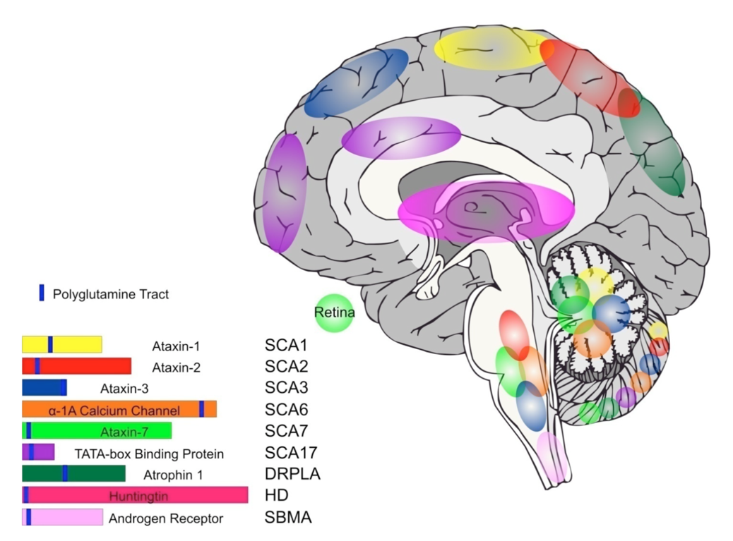
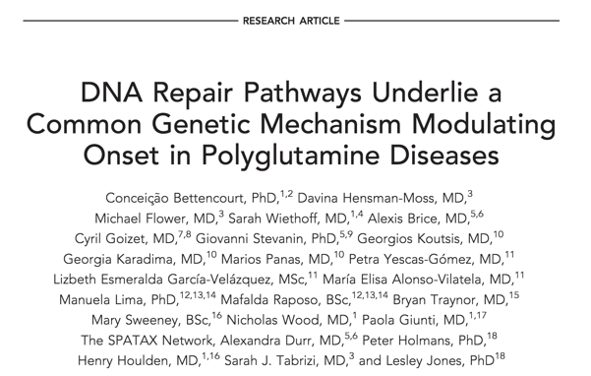

DNA repair and CAG repeat diseases
DNA repair genes are
genetic modifiers for other neurodegenerative diseases caused by CAG expansion
https://en.hdbuzz.net/200
https://en.hdbuzz.net/217

Slide 14

Factor 1: somatic expansion
CAG gene
Most cells
Brain cells
DNA repair gone wrong

Slide 15


Factor 1: somatic expansion
DNA repair genes
acting as
genetic modifiers
by affecting
somatic expansion
Symptoms early in life
Symptoms late in life

Slide 16
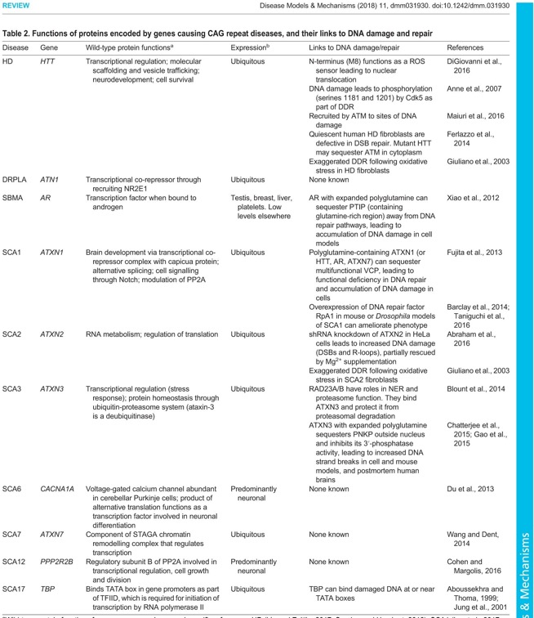
Factor 2: CAG repeat genes are DNA repair genes
https://en.hdbuzz.net/200
https://en.hdbuzz.net/217

Slide 17




Factor 2: CAG repeat genes are DNA repair genes
Faulty DNA repair proteins worsen repair
Efficient DNA repair proteins improve repair
Expanded huntingtin
protein
Expanded huntingtin
protein
DNA repair genes
acting as
genetic modifiers
by affecting the
function of expanded huntingtin
Symptoms early in life
Symptoms late in life
https://en.hdbuzz.net/200
https://en.hdbuzz.net/217

Slide 18
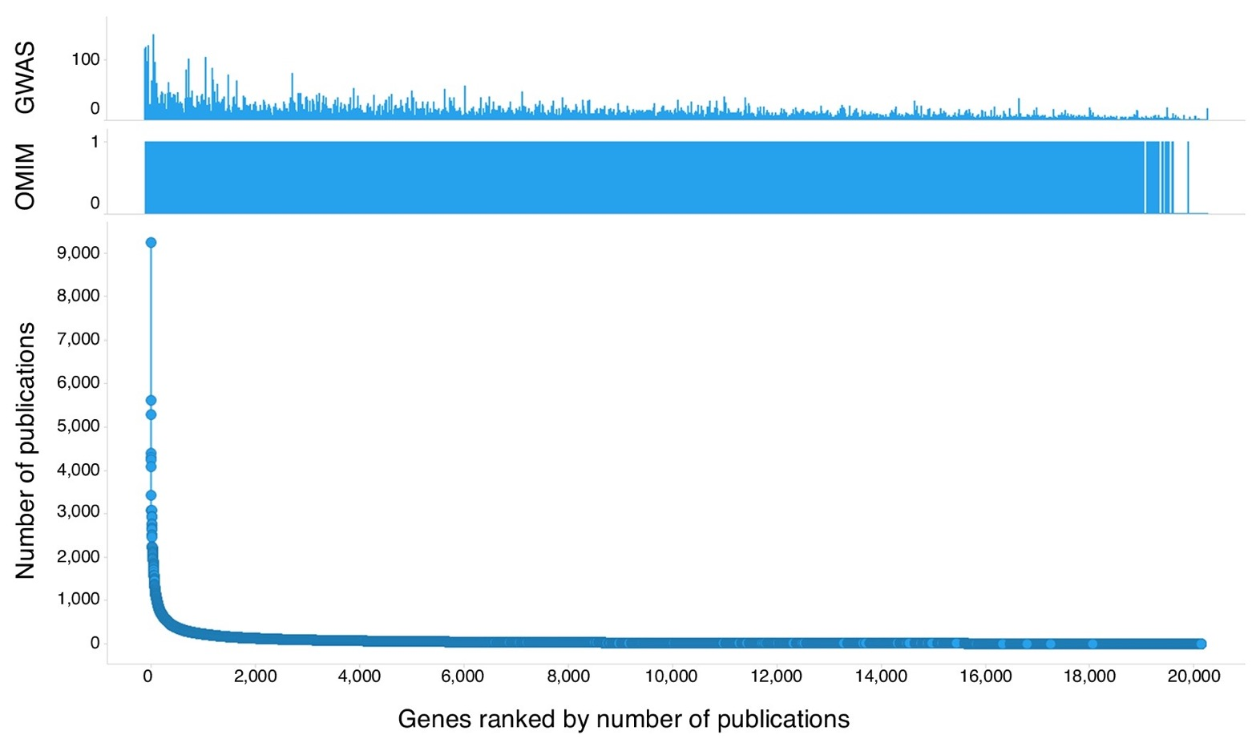
Scientists often look for answers in the same places rather than taking a systematic approach

Slide 19

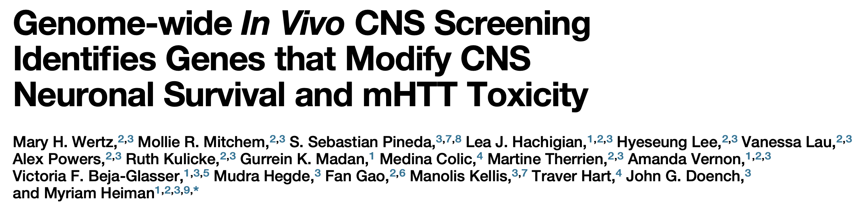
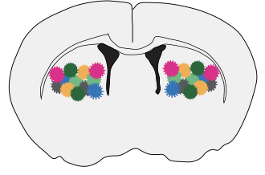
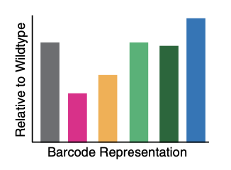

20,000+ genes were systematically investigated in mouse models of HD to see which modified disease progression
Which genes modify HD in mouse models?
https://en.hdbuzz.net/279

Slide 20
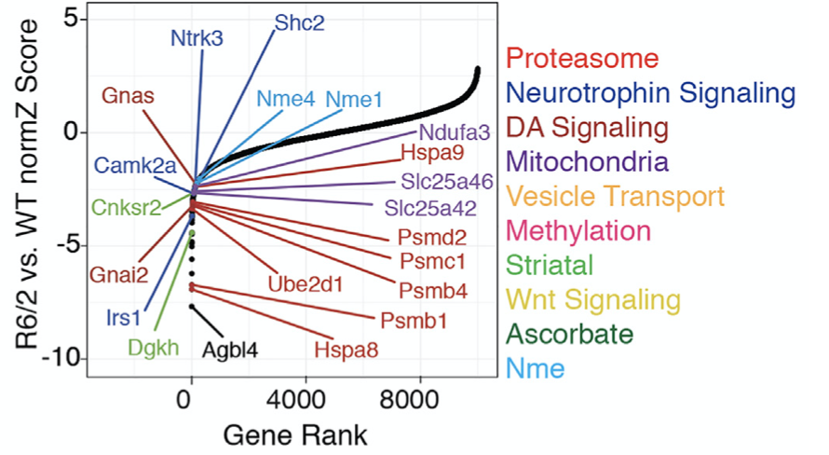

Unbiased approaches turn up new findings
https://en.hdbuzz.net/279

Slide 21

Could targeting the Nme pathway be a new way to lower HTT?
Huntingtin
protein
Huntingtin
protein
Huntingtin
protein
NME1
UBE3A
https://en.hdbuzz.net/279

Slide 22

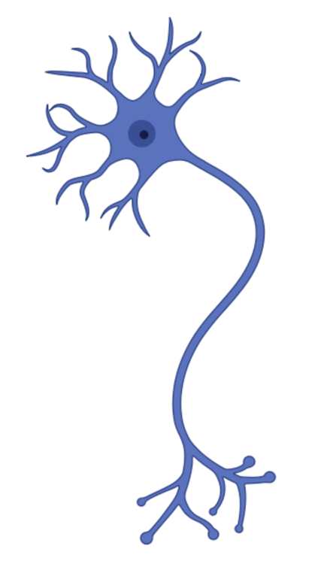
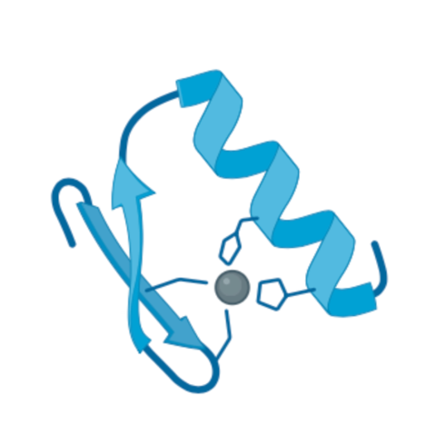

Understanding biology at the molecular level
2 metres
2 m
15 centimetres
0.15 m
20 micrometres
0.00002 m
5 nanometres
0.000000005 m
Notes:
RACHEL
Scale brain neuron to be same size as me (2 m – 100,000 scale factor), the protein molecule would be 0.0005 m or 0.5 mm (same size as the thickness of your finger nails)

Slide 23

Huntingtin
protein
?
Expanded
Unexpanded
Huntingtin
protein
Huntingtin
protein
Spot the difference…
Notes:
What my research is interested in is understanding what the huntingtin protein molecule looks like – how are all the atoms in the protein molecule arranged in 3D space and how are they connected? If we can work out the 3-dimensional structures of protein molecules and see the fine details of their shape, then scientists can begin to understand how they might be working in the cells of our bodies. For the huntingtin protein, the key question scientists have been trying to answer for a long time now is, does the huntingtin protein patients make look different and does this explain why their huntingtin protein works differently?

Slide 24
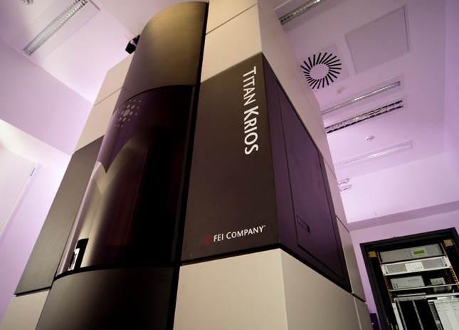
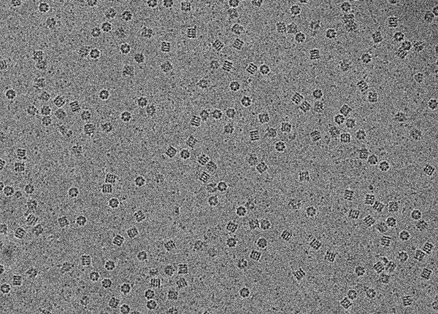
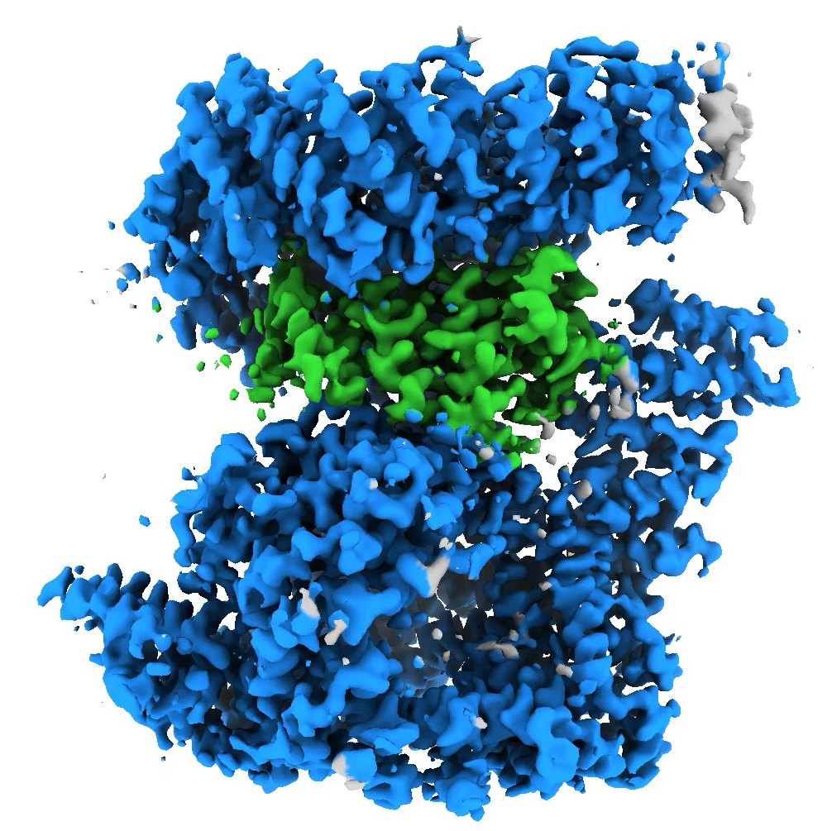
Seeing what molecules look like can give us hints about what they do
Models of the huntingtin protein help us better understand Huntington’s disease
Cutting-edge microscopes can look at protein molecules
These microscopes can see the tiny single molecules of protein which can be used to build models
Notes:
Scientists, including myself are trying to answer these questions, using cutting-edge technology including microscopes which are able to see single molecules of protein. We hope that if we can answer these questions, we might better understand how Huntington’s disease works. We might then be able to design and make new medicines for patients to make their symptoms better or cure them.

Slide 25
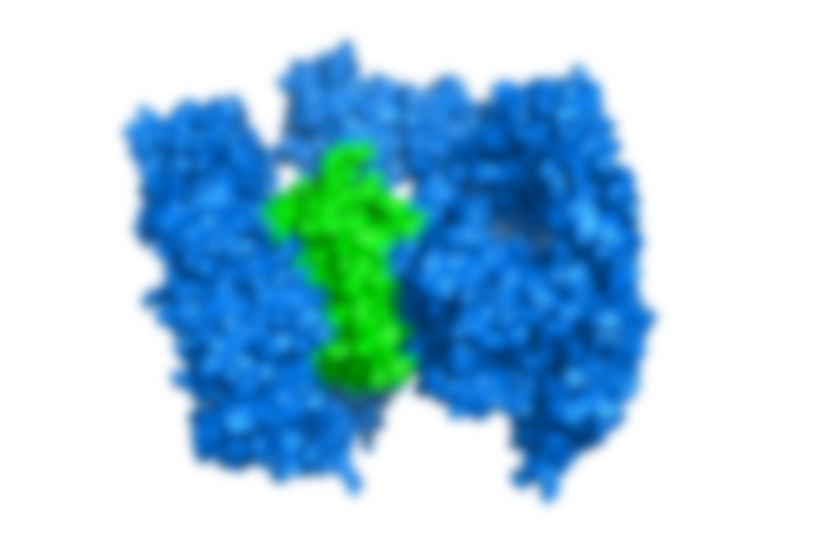

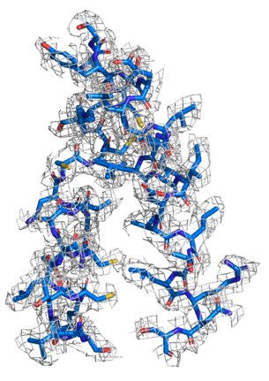
2020
2.6 Å map
2018
4 Å map
But we still don’t fully understand how the expanded and unexpanded huntingtin protein molecules look different…..yet!

Slide 26
Huntingtin
protein
Huntingtin
protein
Huntingtin protein binding molecules could be developed into a number of different tools
PET ligand

Slide 27
Huntingtin
protein
Huntingtin
protein
Garbage Marker
Huntingtin
protein
Huntingtin
protein
Hypothetically……
Huntingtin protein binding molecules can also be used to make huntingtin lowering therapeutics
Proximity-Pharmacology

Slide 28


Could molecular handcuffs lower the protein that causes Huntington's disease?
Huntingtin
protein
Cell Garbage Marker
https://en.hdbuzz.net/276

Slide 29
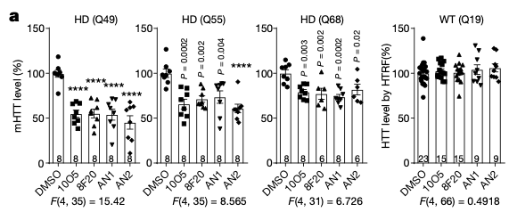
Could molecular handcuffs lower the protein that causes Huntington's disease?
https://en.hdbuzz.net/276

Slide 30
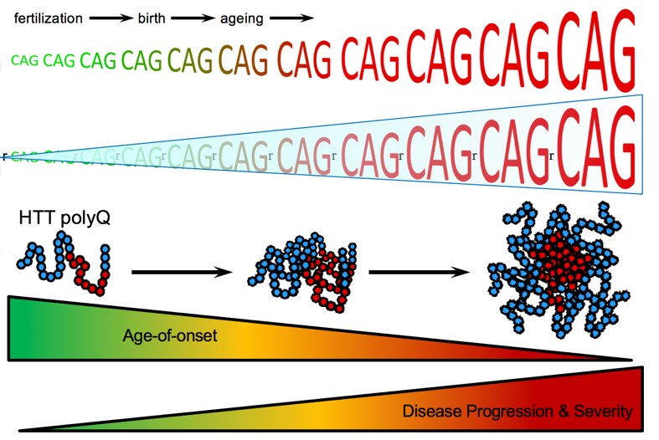
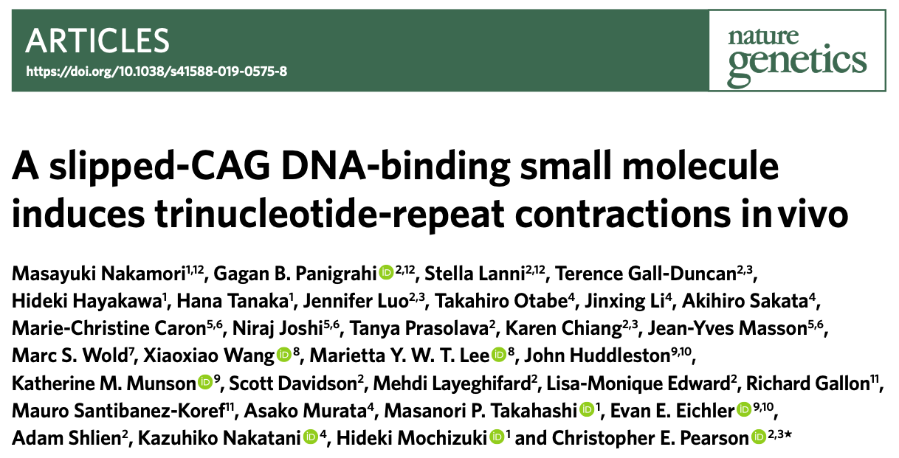
New molecule can reverse the Huntington's disease mutation in lab models
https://en.hdbuzz.net/283

Slide 31
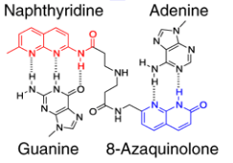
New molecule can reverse the Huntington's disease mutation in lab models
Naphthyridine Azaquinolone (NA)
NA is a small molecule which can change the CAG-repeat length in different lab models of Huntington’s disease
https://en.hdbuzz.net/283

Slide 32
A few HD super scientists
Mahmoud Pouladi
Singapore
Developing cutting edge models to understand disease processes underlying HD
Lesley Jones
UK
Helped identify genetic modifiers by GWAS. Studying DNA repair pathways and how they affect disease onset
Vanessa Wheeler
US
Was on to somatic expansion WAY before everyone else. Studying mechanisms of somatic expansion
Hilal Lashuel
Switzerland
Uses high-tech approaches to study protein misfolding and and it contributes to neurodegenerative diseases

Slide 33
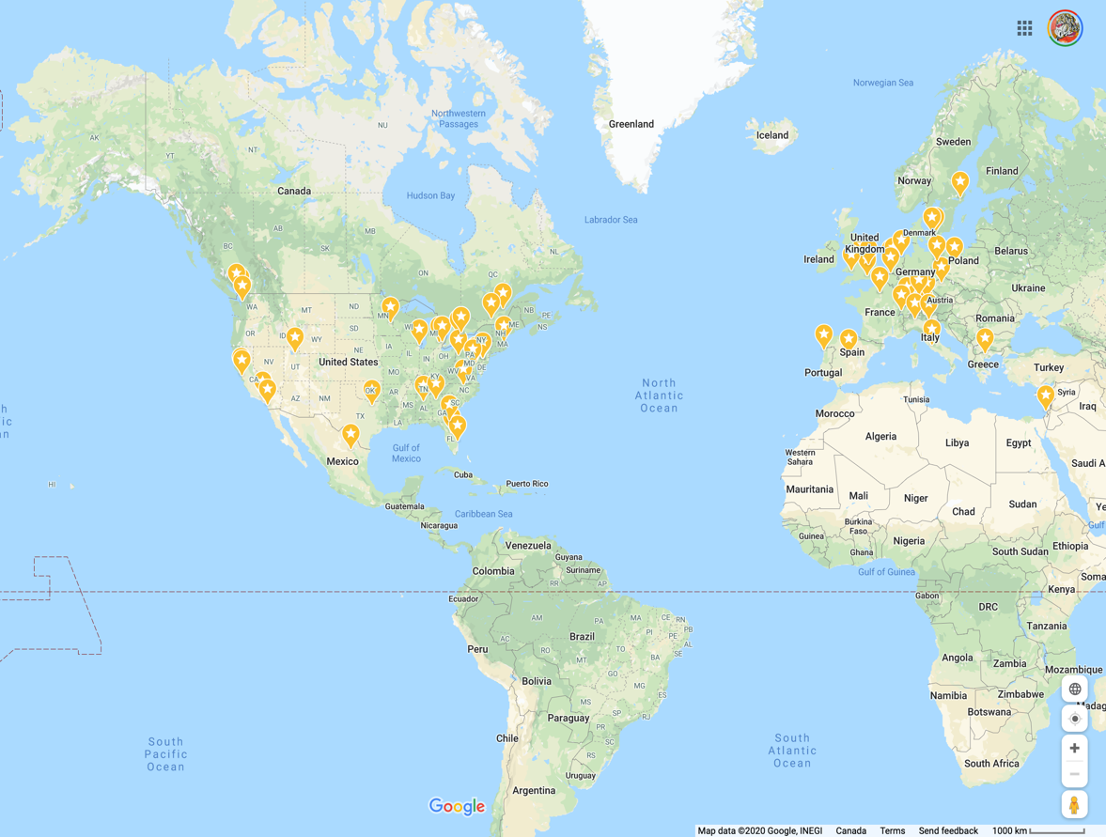

Many HD super scientists!

Slide 34




Stay informed
labscribbles.com
@LabScribbles
raytruantlab.wordpress.com
@tam_maiuri
hdbuzz.net
@HDBuzzFeed
HD Research in plain language
Open Notebooks

Slide 35

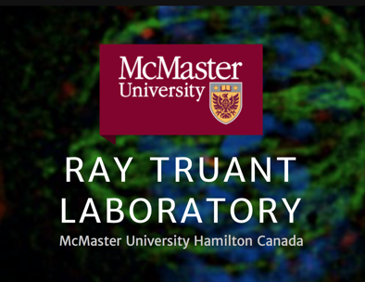
The SGC is a registered charity (number 1097737) that receives funds from AbbVie, Bayer Pharma AG, Boehringer Ingelheim, Canada Foundation for Innovation, Eshelman Institute for Innovation, Genome Canada through Ontario Genomics Institute [OGI-055], Innovative Medicines Initiative (EU/EFPIA) [ULTRA-DD grant no. 115766], Janssen, Merck KGaA, Darmstadt, Germany, MSD, Novartis Pharma AG, Ontario Ministry of Research, Innovation and Science (MRIS), Pfizer, São Paulo Research Foundation-FAPESP, Takeda, and Wellcome.
HD patient and family communities

Slide 36
Thank you!!
Questions?

Slide 37
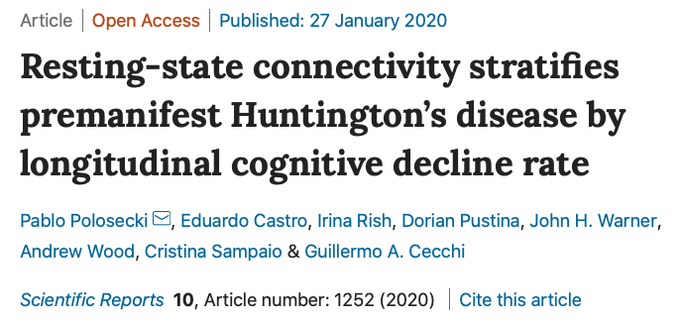
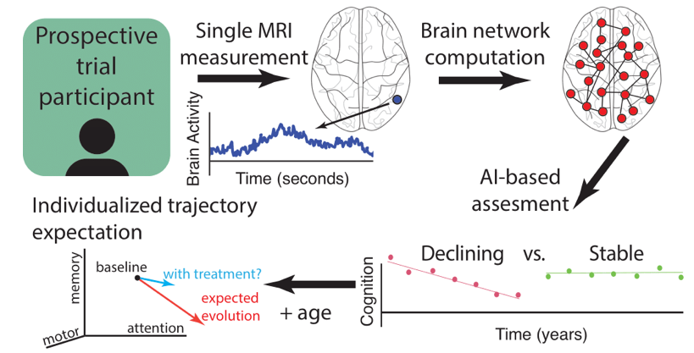

Slide 38
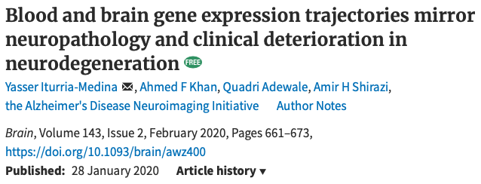
Artificial Intelligence Can ‘See’ Progression of Illnesses Like Huntington’s in Blood Sample

